Slide 1
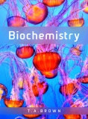
Fig 4.1
Reproduced from: Biochemistry by T.A. Brown, ISBN: 9781907904288 © Scion Publishing Ltd, 2017

Slide 2
Fig 4.2
Reproduced from: Biochemistry by T.A. Brown, ISBN: 9781907904288 © Scion Publishing Ltd, 2017

Slide 3
Fig 4.3
Reproduced from: Biochemistry by T.A. Brown, ISBN: 9781907904288 © Scion Publishing Ltd, 2017

Slide 4
Table 4.1
Reproduced from: Biochemistry by T.A. Brown, ISBN: 9781907904288 © Scion Publishing Ltd, 2017

Slide 5
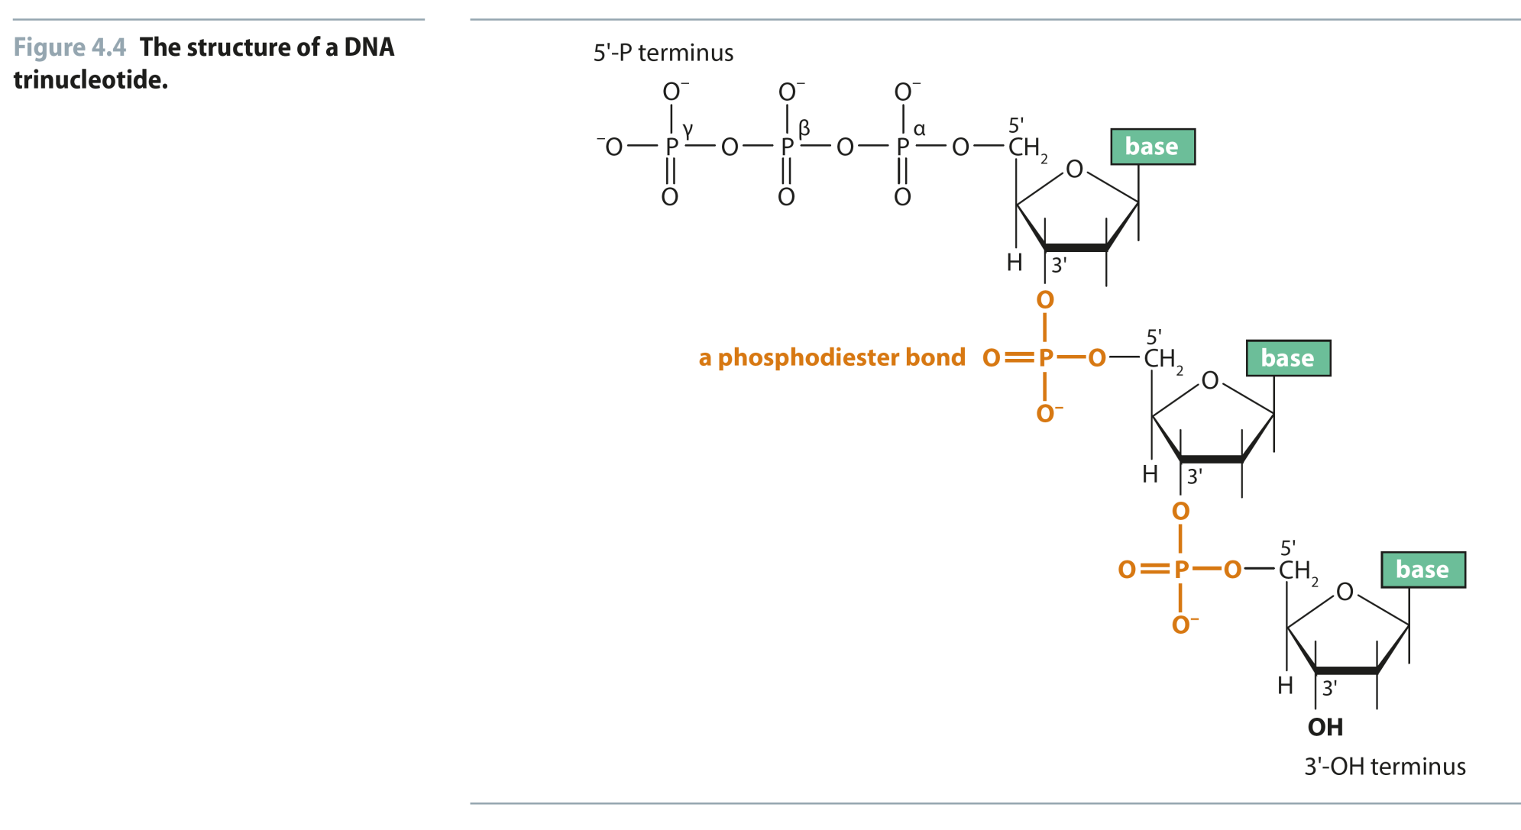
Fig 4.4
Reproduced from: Biochemistry by T.A. Brown, ISBN: 9781907904288 © Scion Publishing Ltd, 2017

Slide 6
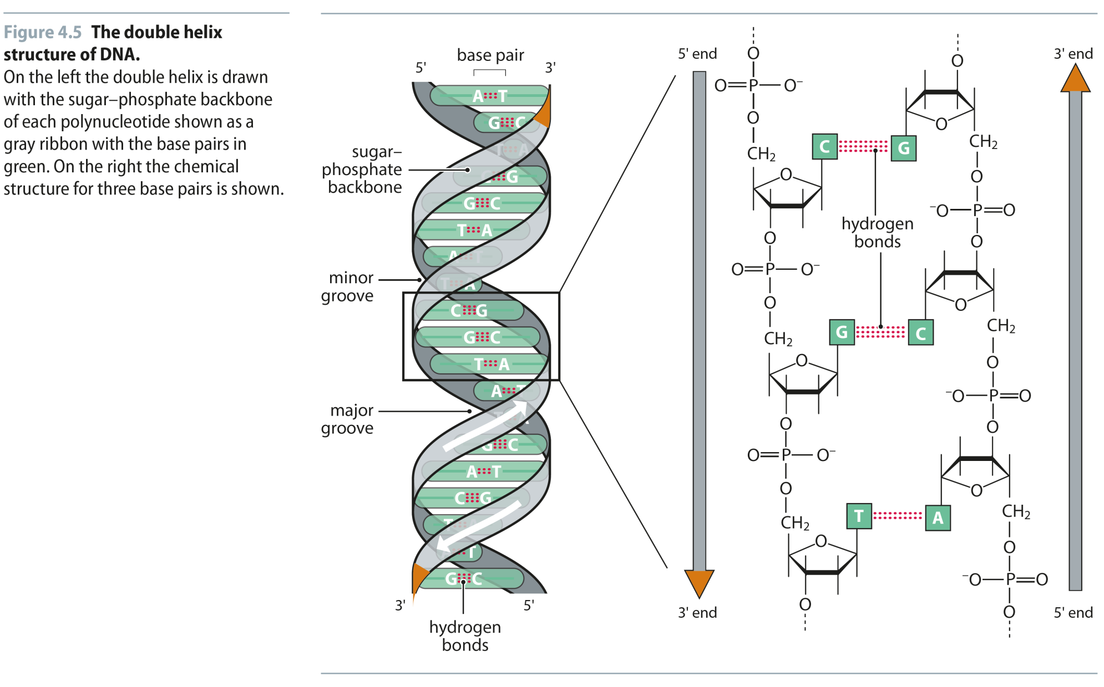
Fig 4.5
Reproduced from: Biochemistry by T.A. Brown, ISBN: 9781907904288 © Scion Publishing Ltd, 2017

Slide 7
Fig 4.6
Reproduced from: Biochemistry by T.A. Brown, ISBN: 9781907904288 © Scion Publishing Ltd, 2017

Slide 8
Fig 4.7
Reproduced from: Biochemistry by T.A. Brown, ISBN: 9781907904288 © Scion Publishing Ltd, 2017

Slide 9
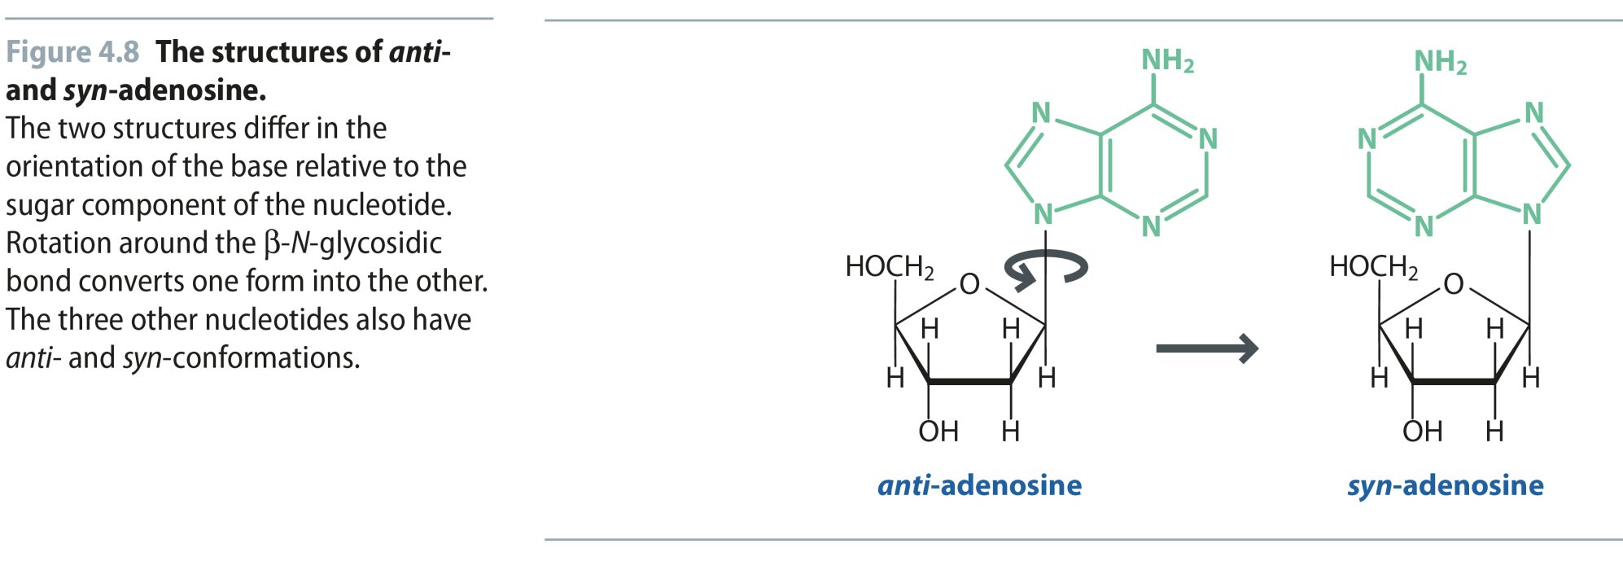
Fig 4.8
Reproduced from: Biochemistry by T.A. Brown, ISBN: 9781907904288 © Scion Publishing Ltd, 2017

Slide 10
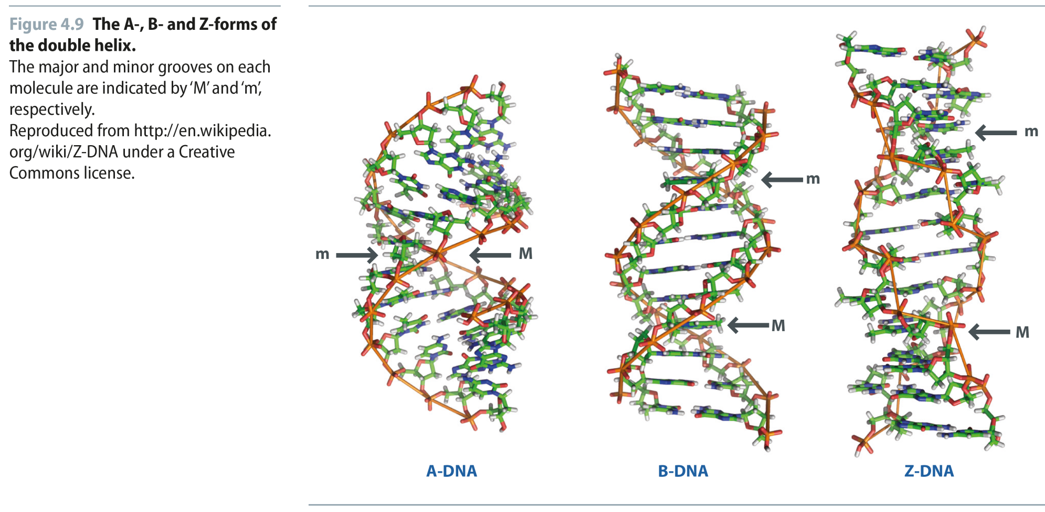
Fig 4.9
Reproduced from: Biochemistry by T.A. Brown, ISBN: 9781907904288 © Scion Publishing Ltd, 2017

Slide 11
Table 4.2
Reproduced from: Biochemistry by T.A. Brown, ISBN: 9781907904288 © Scion Publishing Ltd, 2017

Slide 12
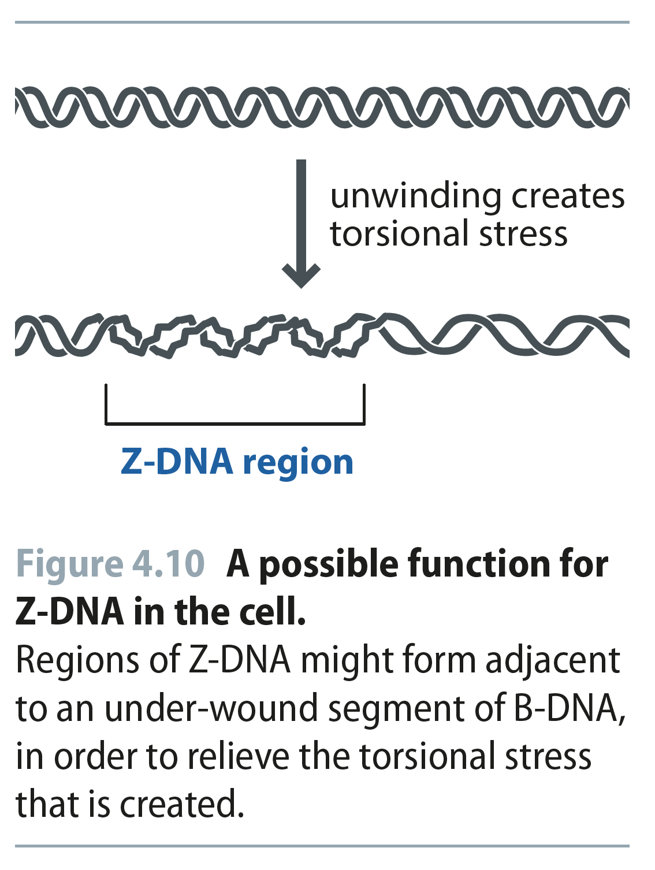
Fig 4.10
Reproduced from: Biochemistry by T.A. Brown, ISBN: 9781907904288 © Scion Publishing Ltd, 2017

Slide 13
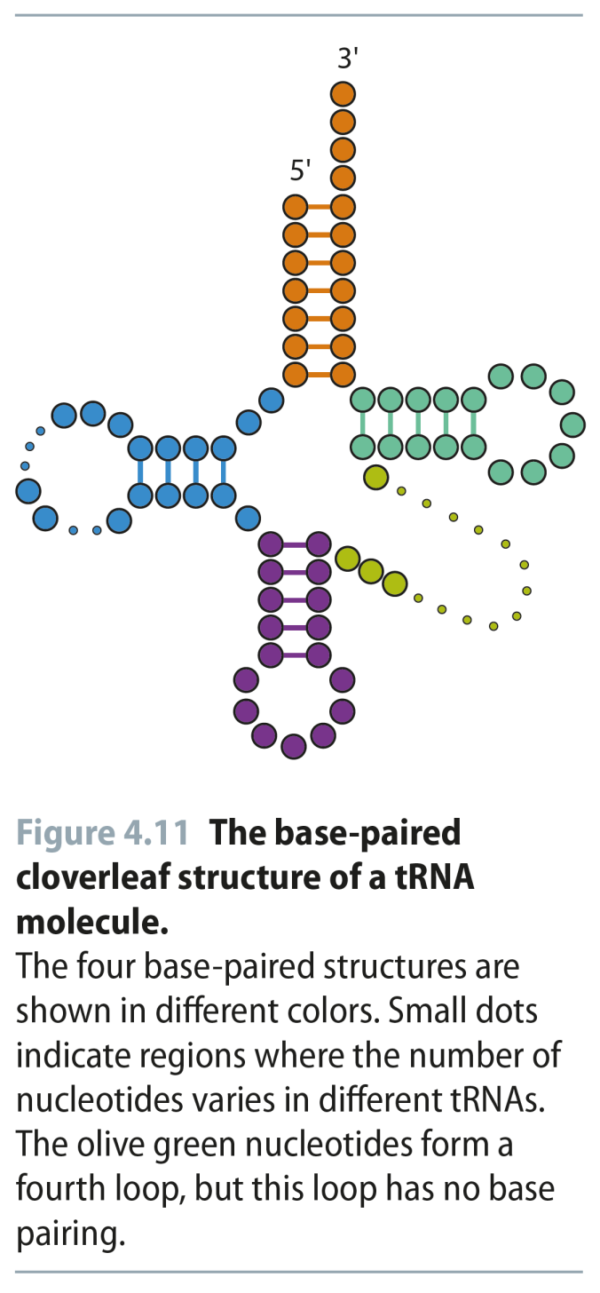
Fig 4.11
Reproduced from: Biochemistry by T.A. Brown, ISBN: 9781907904288 © Scion Publishing Ltd, 2017

Slide 14
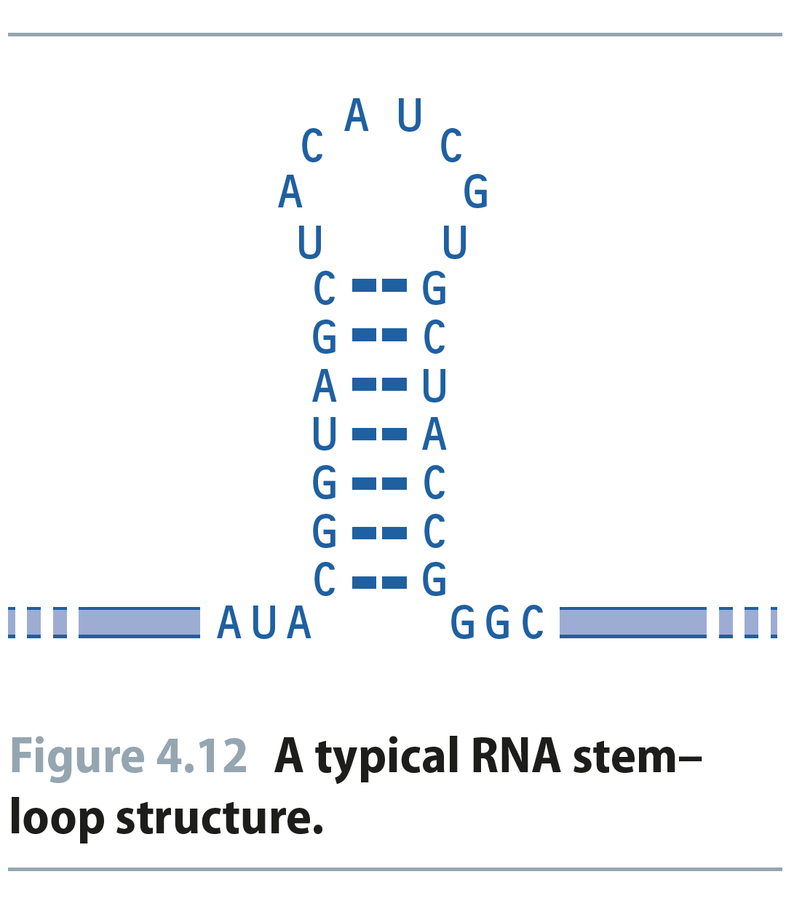
Fig 4.12
Reproduced from: Biochemistry by T.A. Brown, ISBN: 9781907904288 © Scion Publishing Ltd, 2017

Slide 15
Fig 4.13
Reproduced from: Biochemistry by T.A. Brown, ISBN: 9781907904288 © Scion Publishing Ltd, 2017

Slide 16
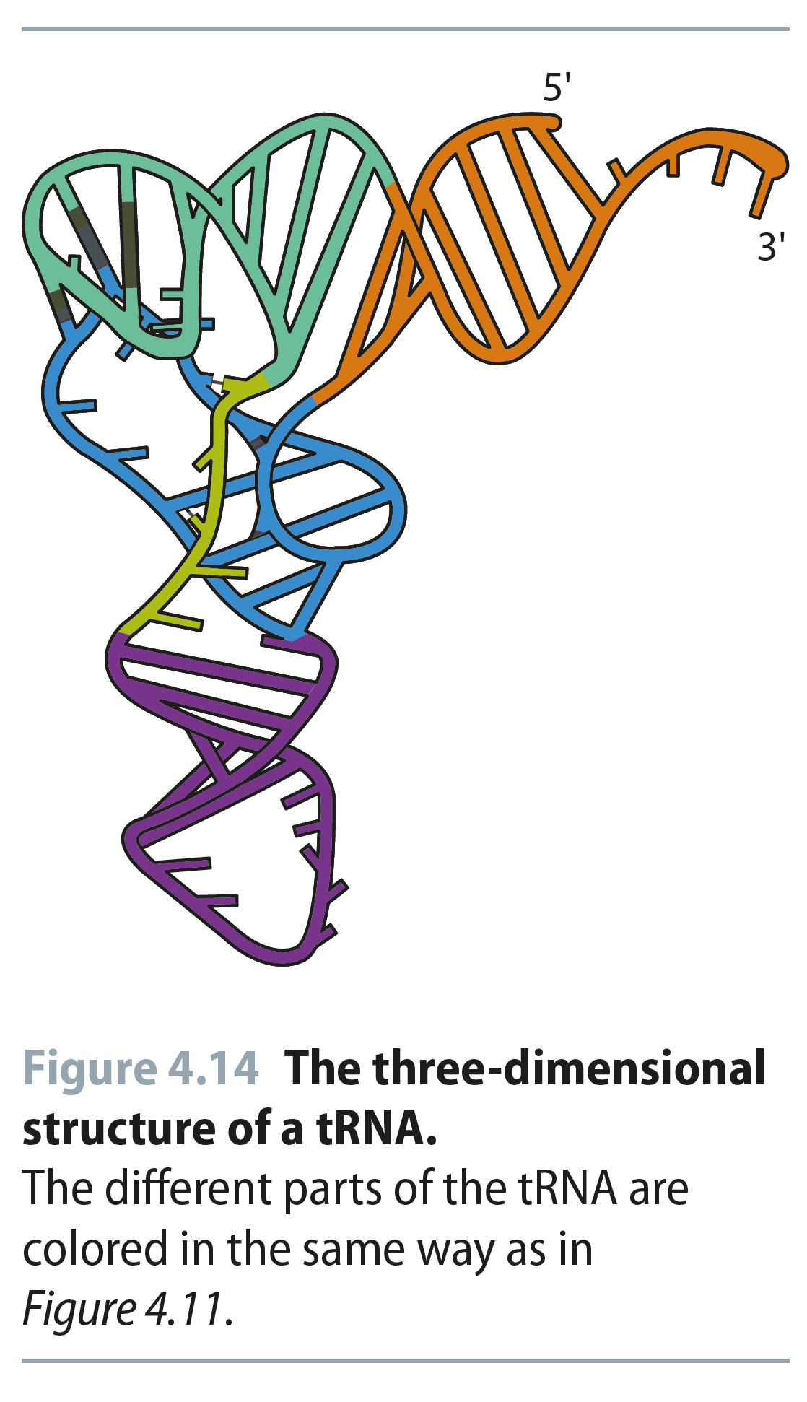
Fig 4.14
Reproduced from: Biochemistry by T.A. Brown, ISBN: 9781907904288 © Scion Publishing Ltd, 2017

Slide 17
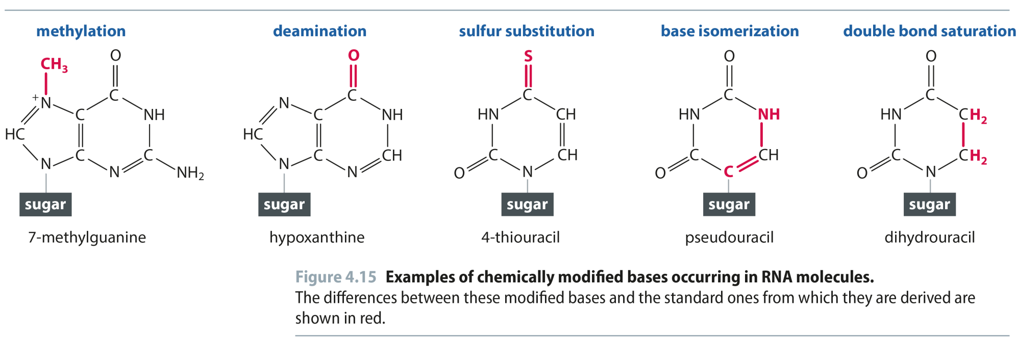
Fig 4.15
Reproduced from: Biochemistry by T.A. Brown, ISBN: 9781907904288 © Scion Publishing Ltd, 2017

Slide 18
Table 4.3
Reproduced from: Biochemistry by T.A. Brown, ISBN: 9781907904288 © Scion Publishing Ltd, 2017

Slide 19
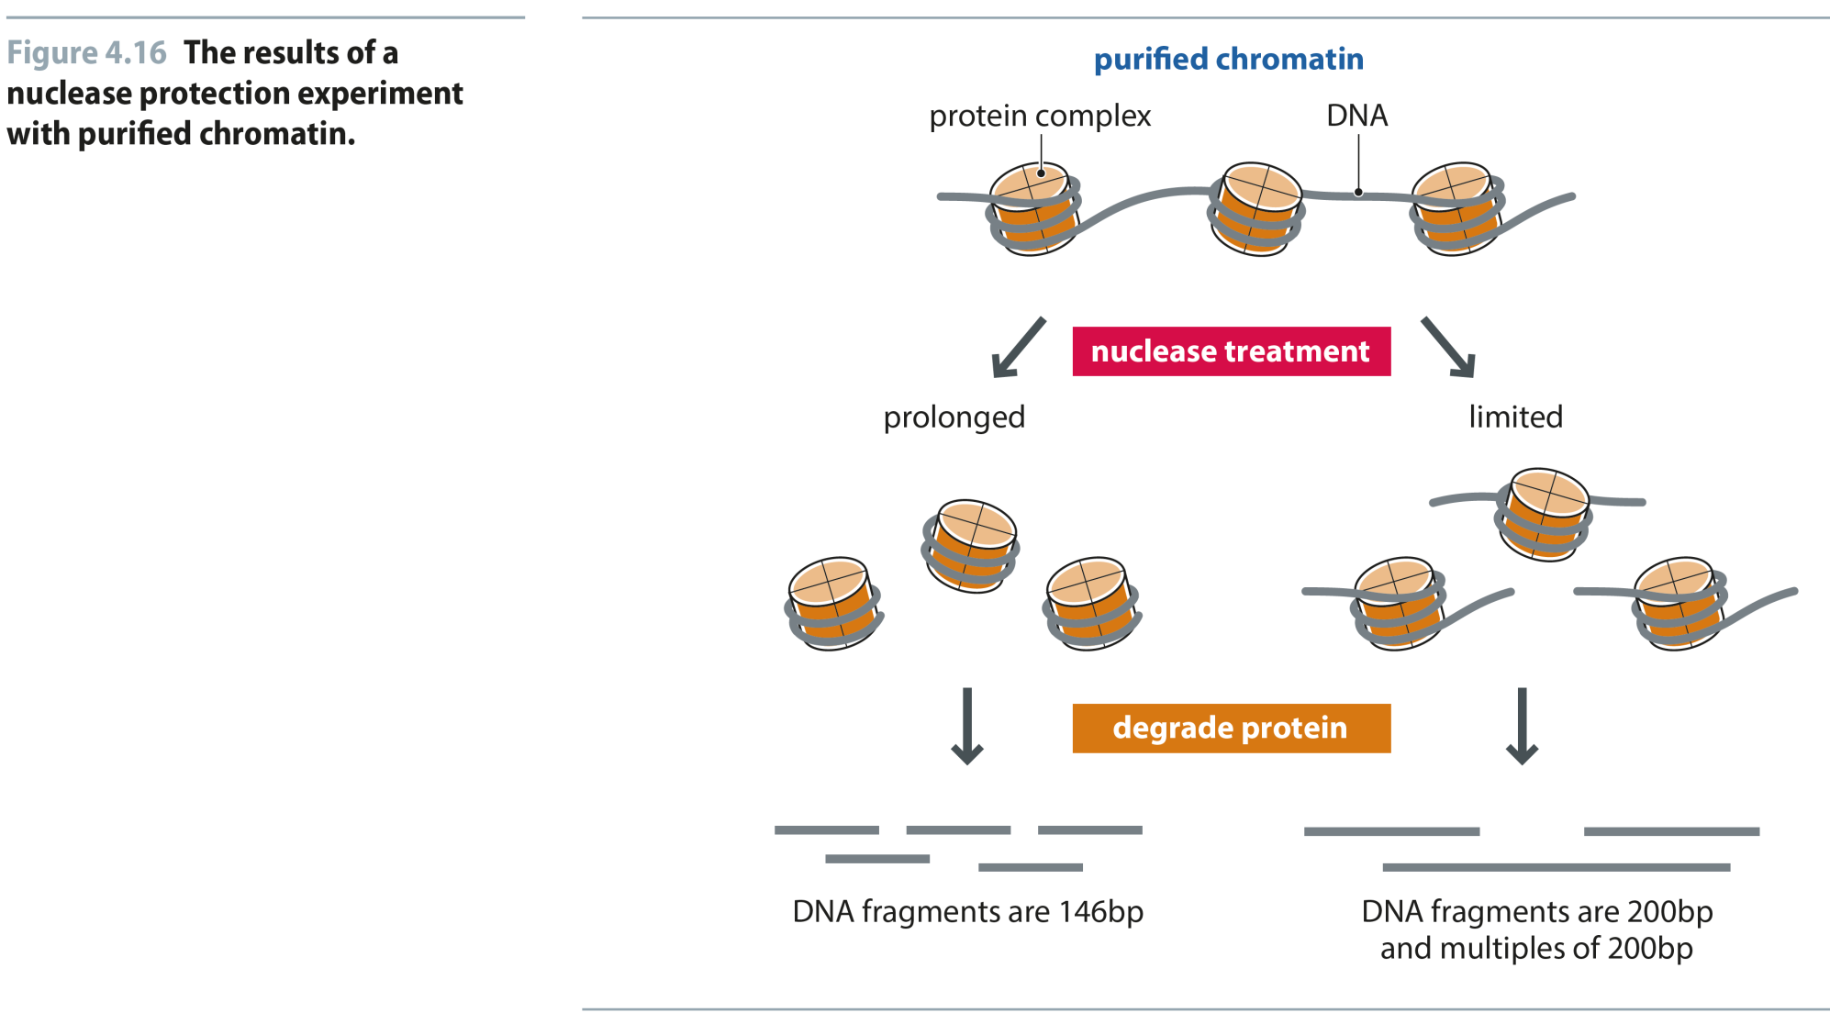
Fig 4.16
Reproduced from: Biochemistry by T.A. Brown, ISBN: 9781907904288 © Scion Publishing Ltd, 2017

Slide 20
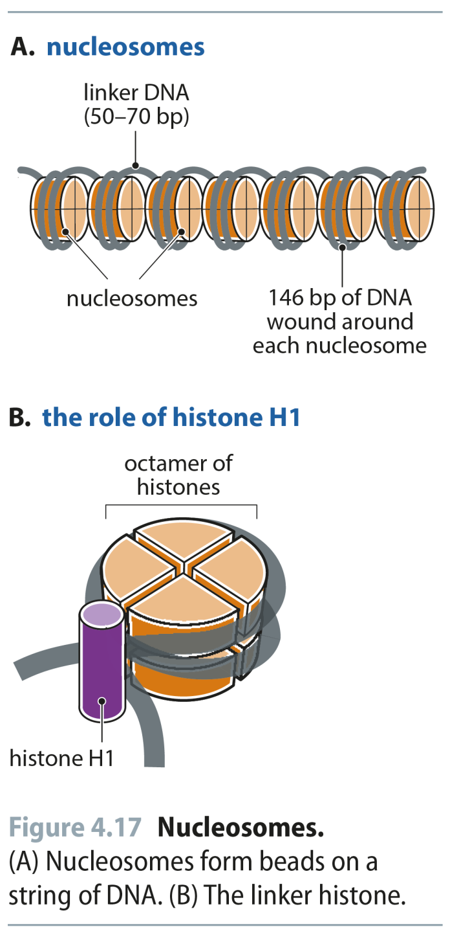
Fig 4.17
Reproduced from: Biochemistry by T.A. Brown, ISBN: 9781907904288 © Scion Publishing Ltd, 2017

Slide 21
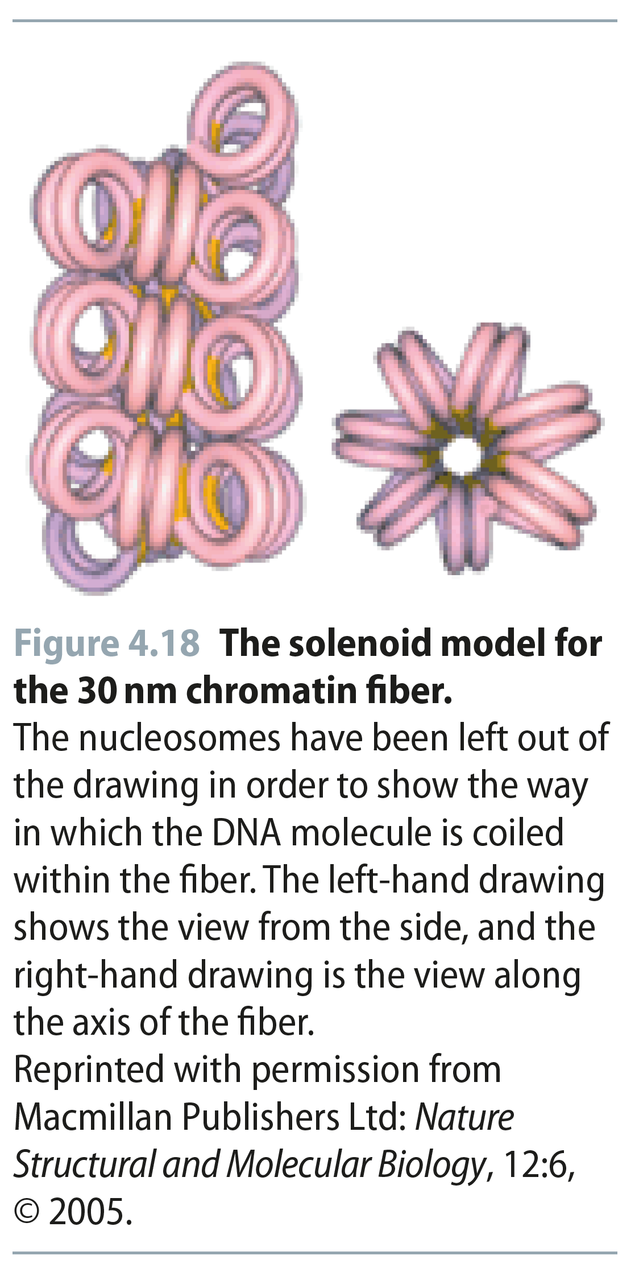
Fig 4.18
Reproduced from: Biochemistry by T.A. Brown, ISBN: 9781907904288 © Scion Publishing Ltd, 2017

Slide 22
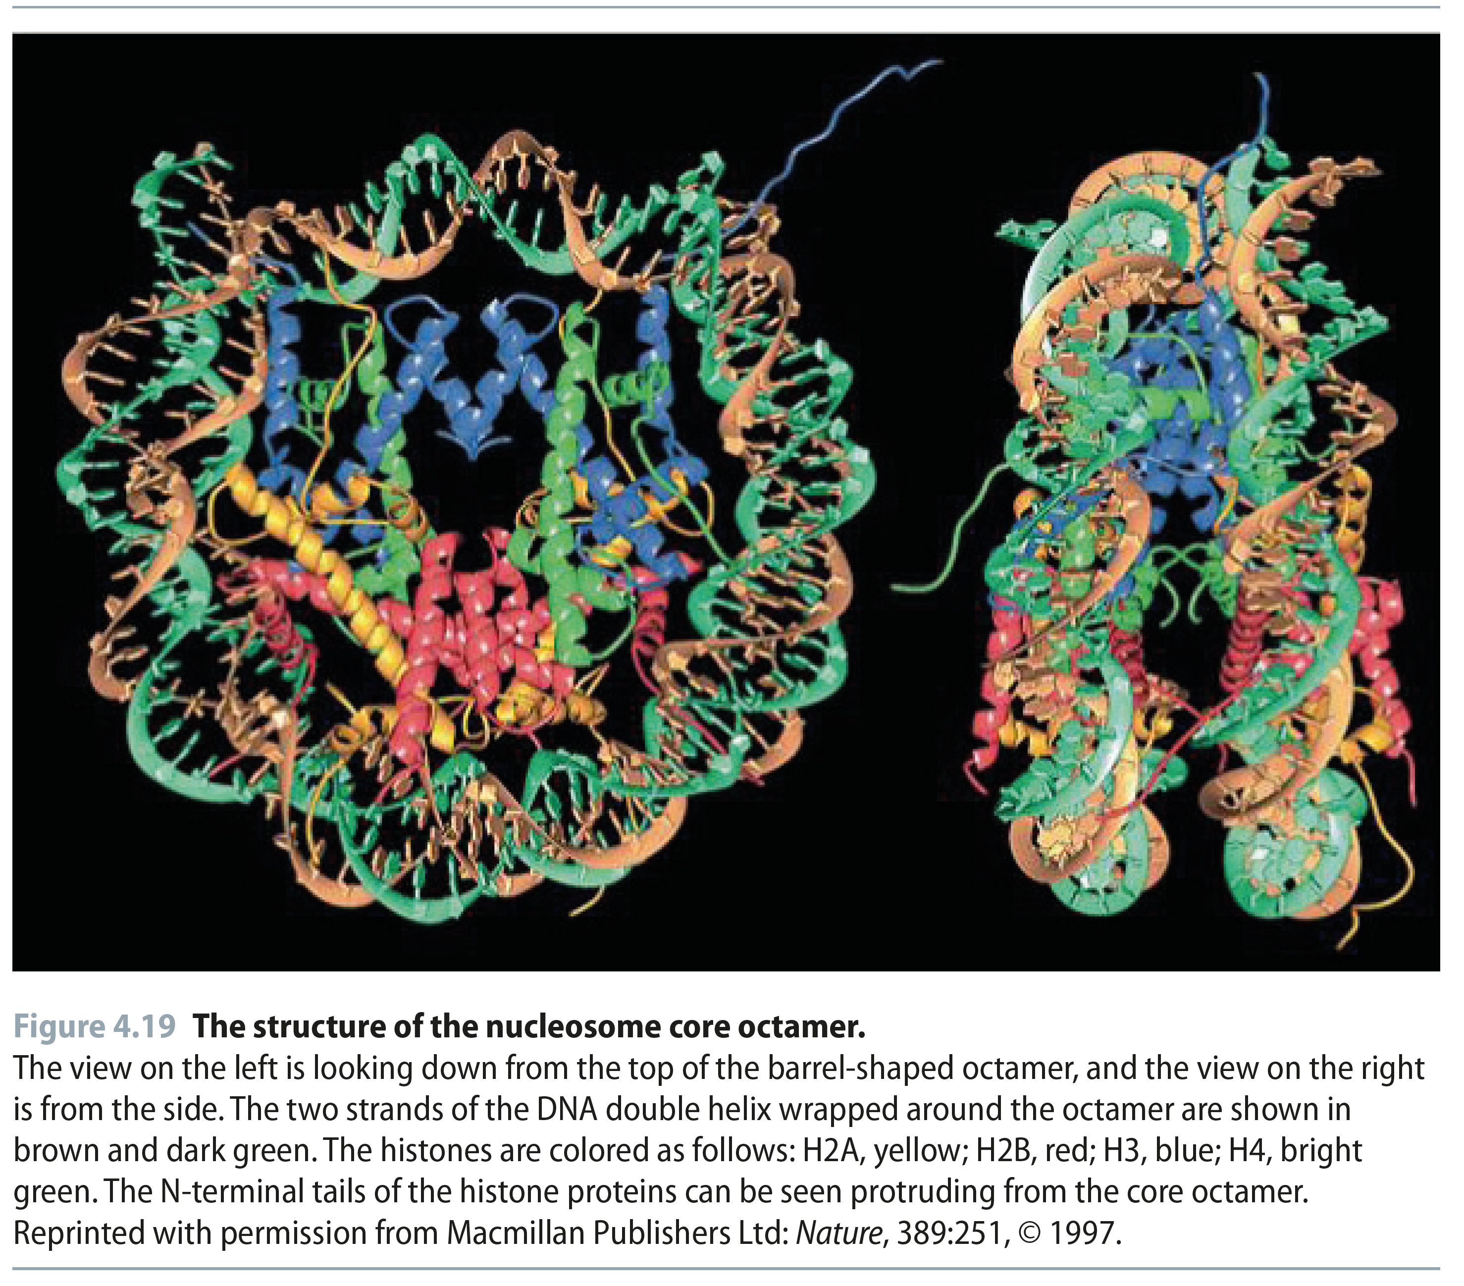
Fig 4.19
Reproduced from: Biochemistry by T.A. Brown, ISBN: 9781907904288 © Scion Publishing Ltd, 2017

Slide 23
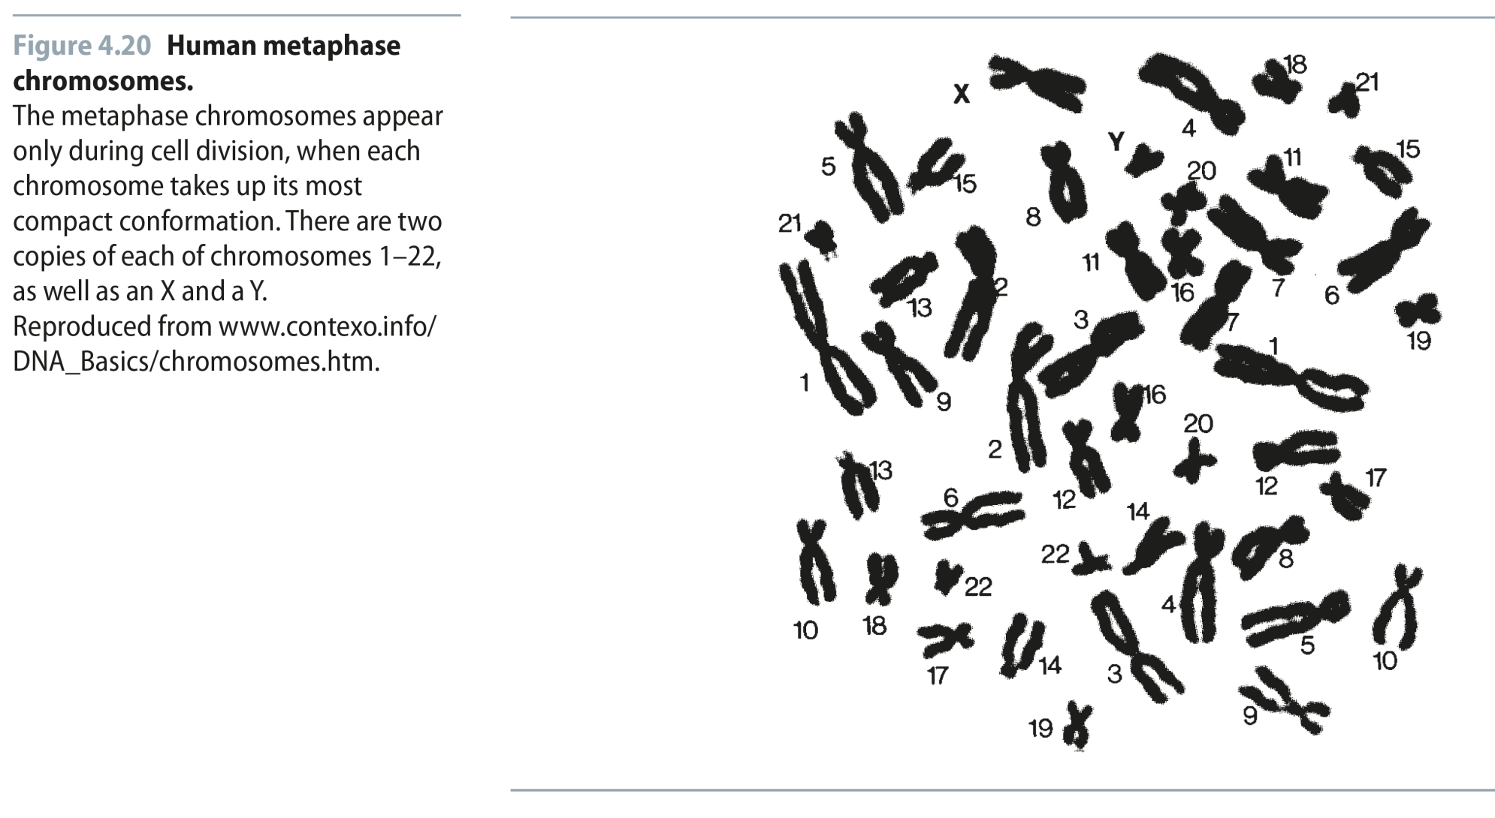
Fig 4.20
Reproduced from: Biochemistry by T.A. Brown, ISBN: 9781907904288 © Scion Publishing Ltd, 2017

