Slide 1
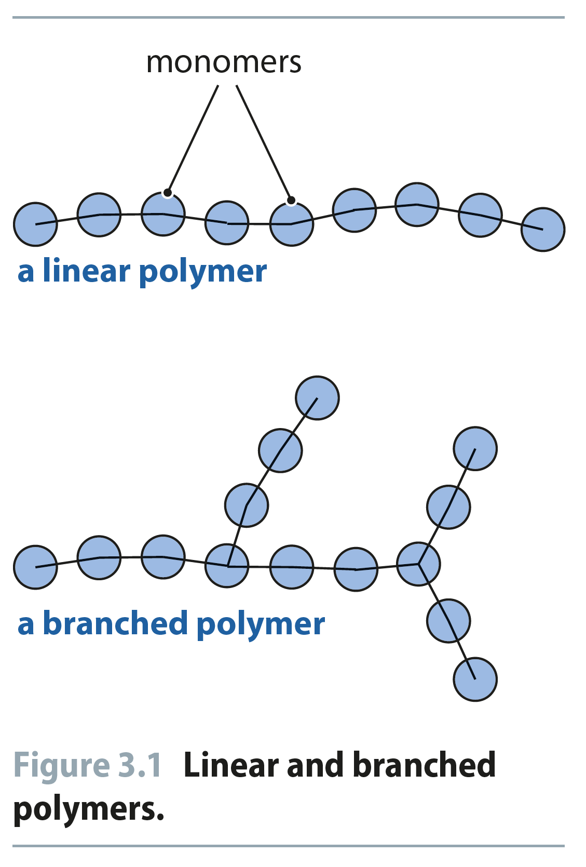
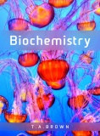
Fig 3.1
Reproduced from: Biochemistry by T.A. Brown, ISBN: 9781907904288 © Scion Publishing Ltd, 2017

Slide 2
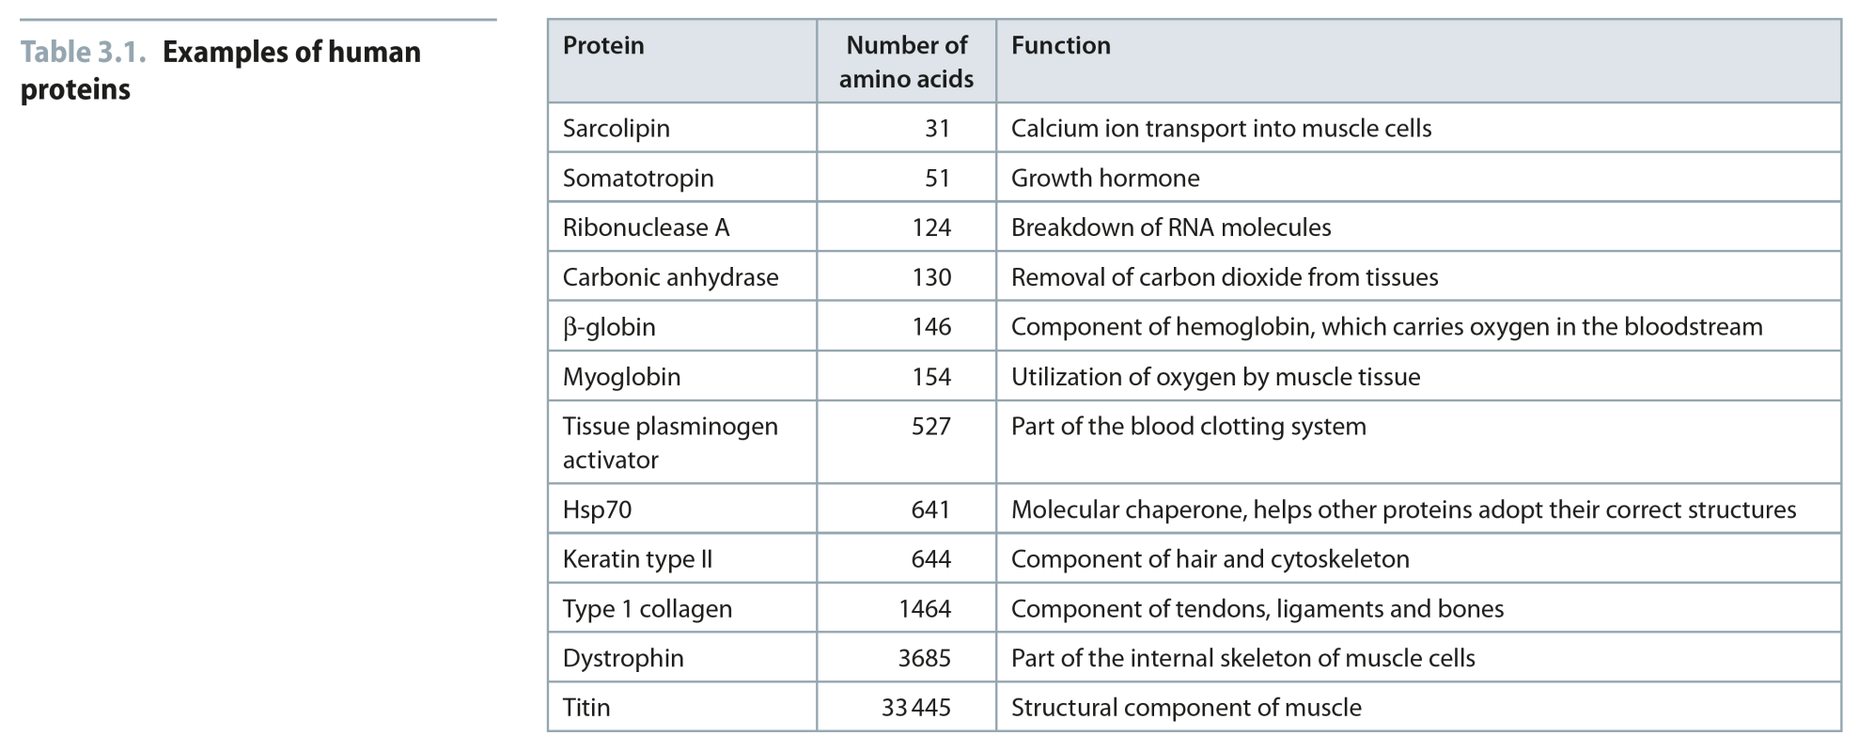
Table 3.1
Reproduced from: Biochemistry by T.A. Brown, ISBN: 9781907904288 © Scion Publishing Ltd, 2017

Slide 3
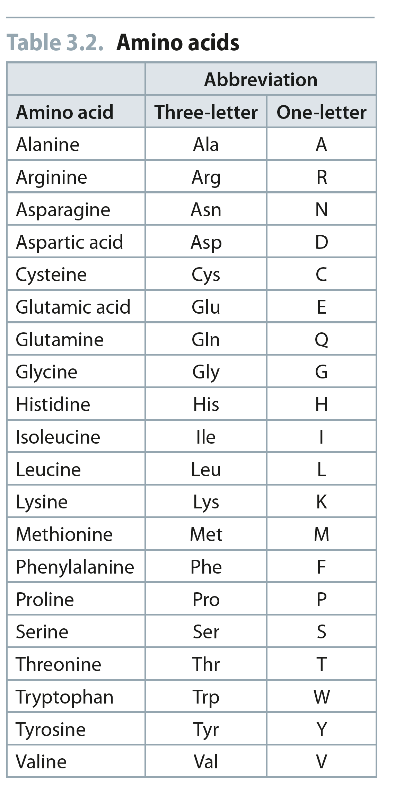
Table 3.2
Reproduced from: Biochemistry by T.A. Brown, ISBN: 9781907904288 © Scion Publishing Ltd, 2017

Slide 4
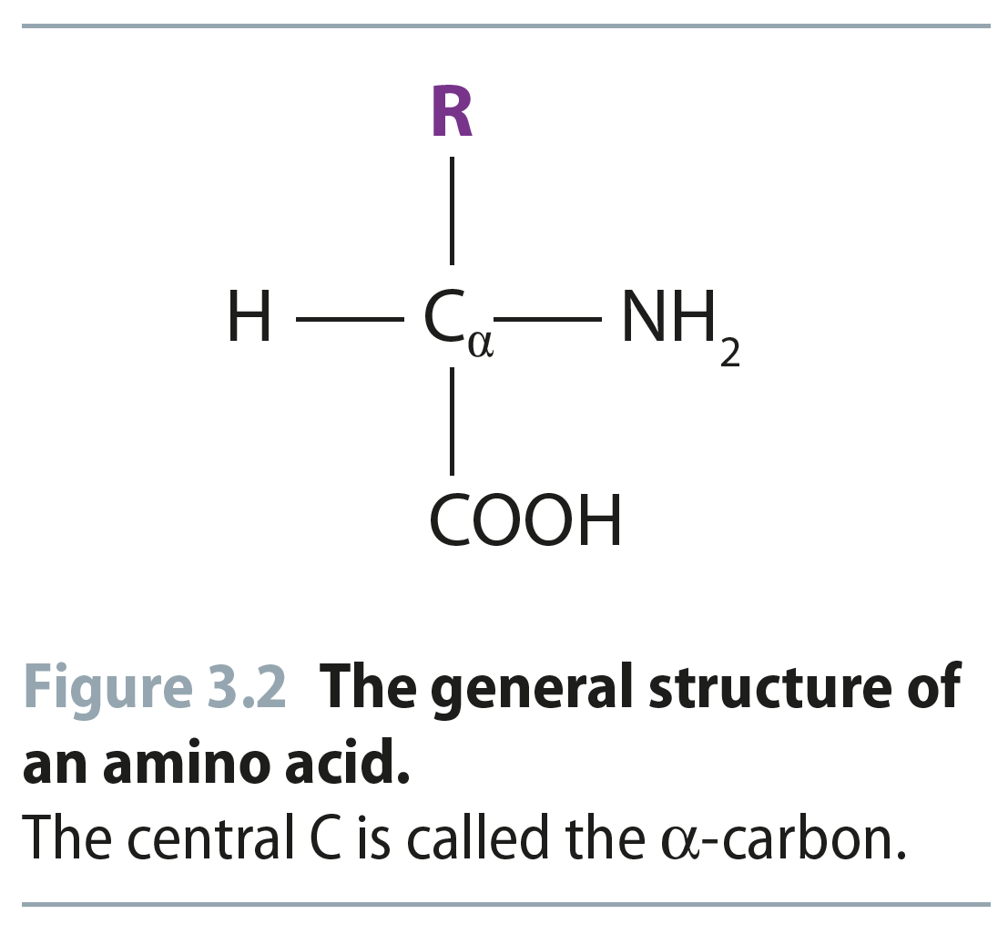
Fig 3.2
Reproduced from: Biochemistry by T.A. Brown, ISBN: 9781907904288 © Scion Publishing Ltd, 2017

Slide 5
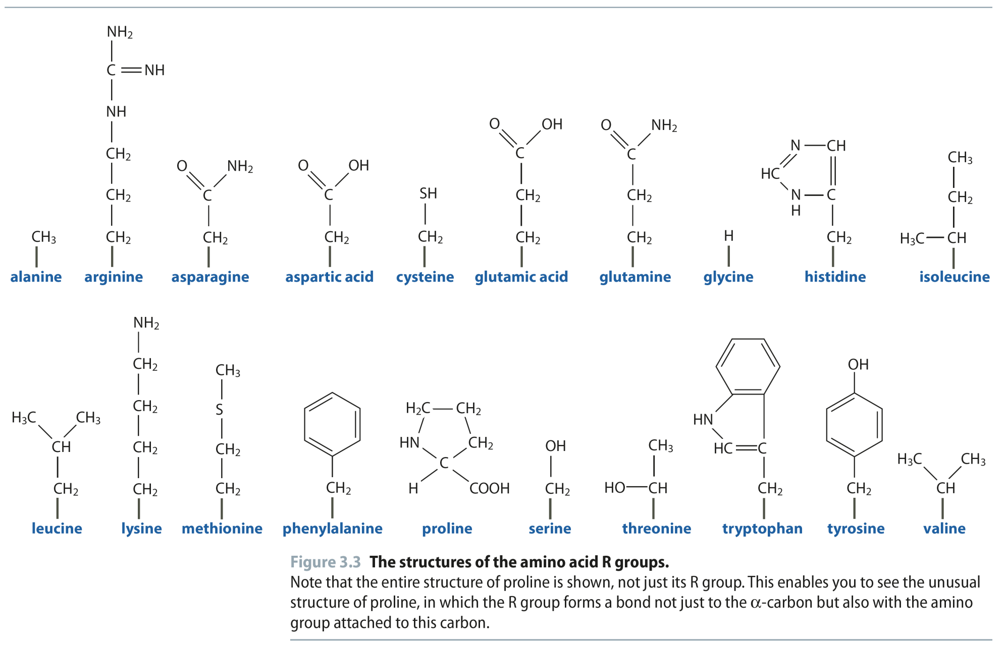
Fig 3.3
Reproduced from: Biochemistry by T.A. Brown, ISBN: 9781907904288 © Scion Publishing Ltd, 2017

Slide 6
Fig 3.4
Reproduced from: Biochemistry by T.A. Brown, ISBN: 9781907904288 © Scion Publishing Ltd, 2017

Slide 7
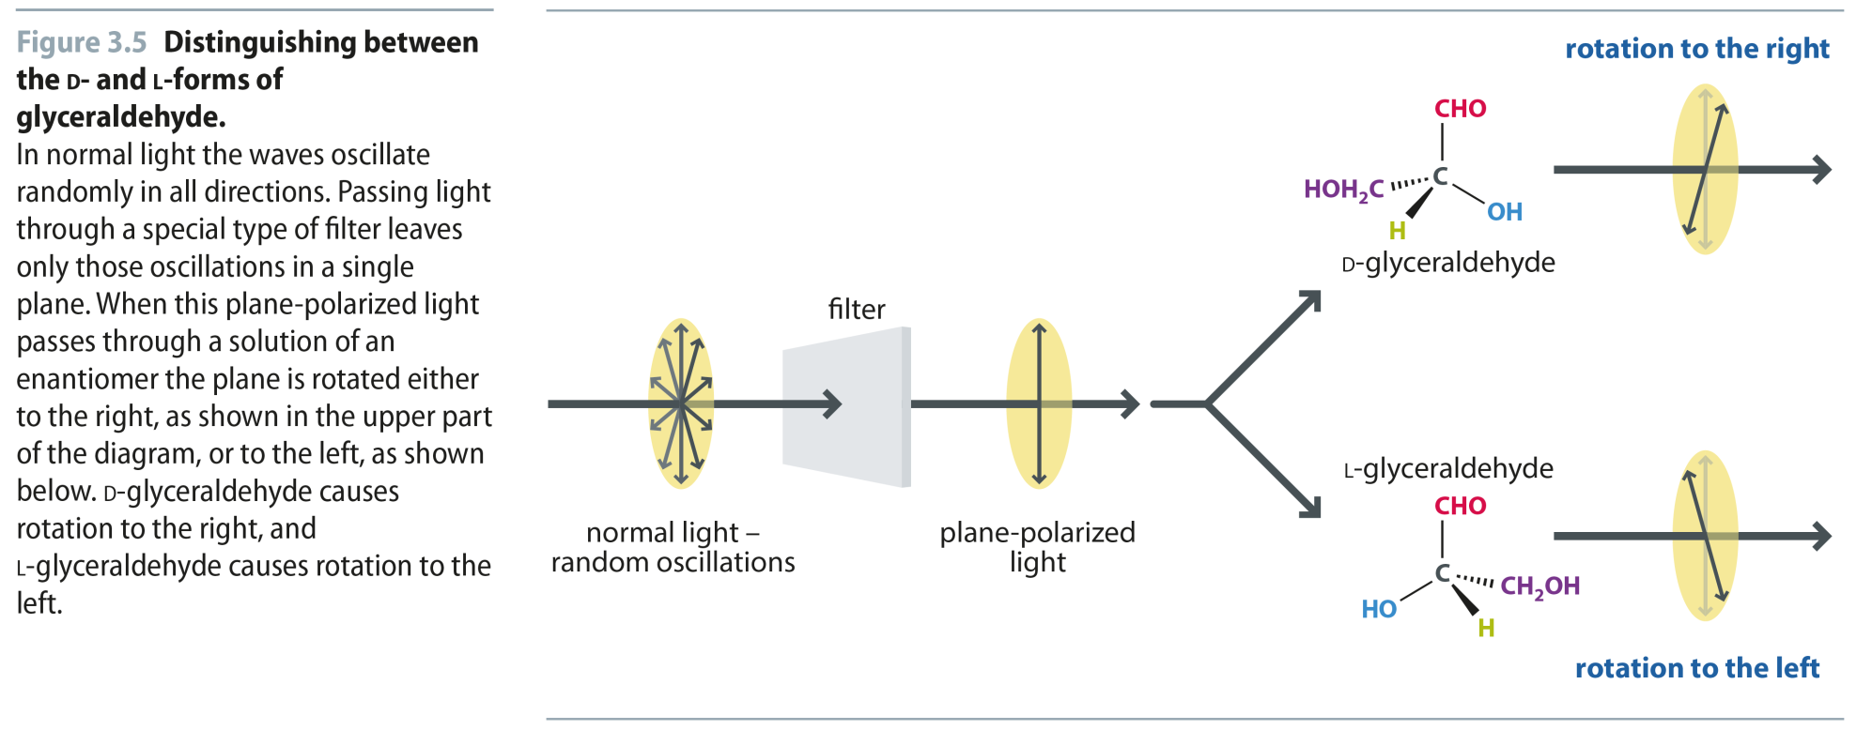
Fig 3.5
Reproduced from: Biochemistry by T.A. Brown, ISBN: 9781907904288 © Scion Publishing Ltd, 2017

Slide 8
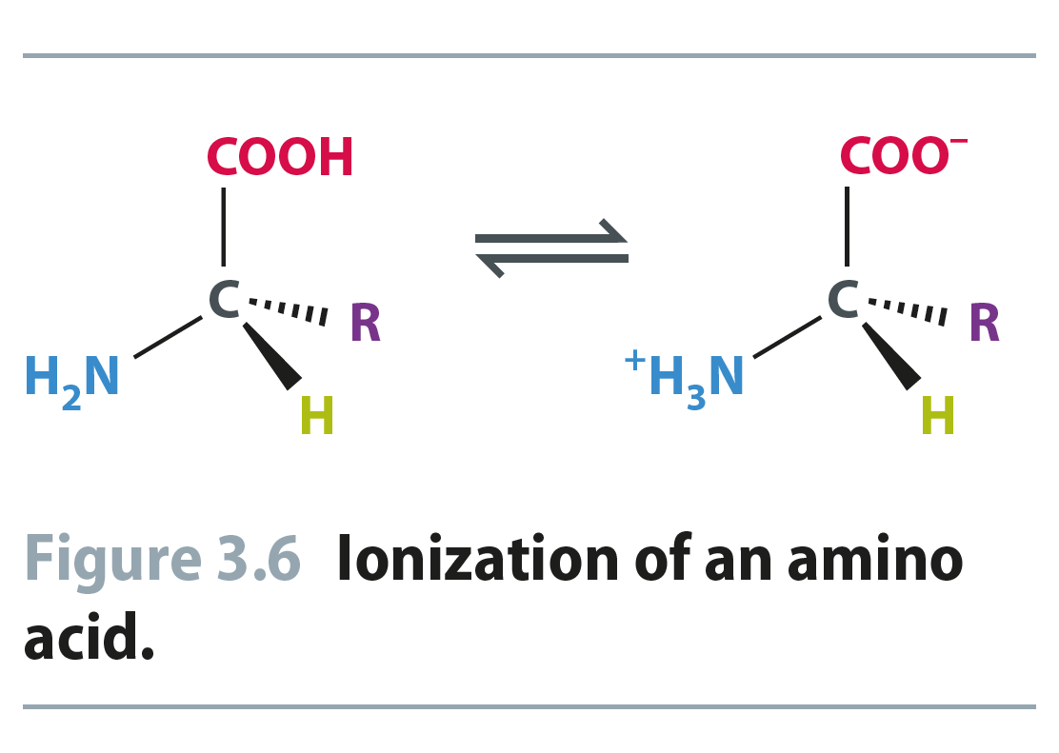
Fig 3.6
Reproduced from: Biochemistry by T.A. Brown, ISBN: 9781907904288 © Scion Publishing Ltd, 2017

Slide 9
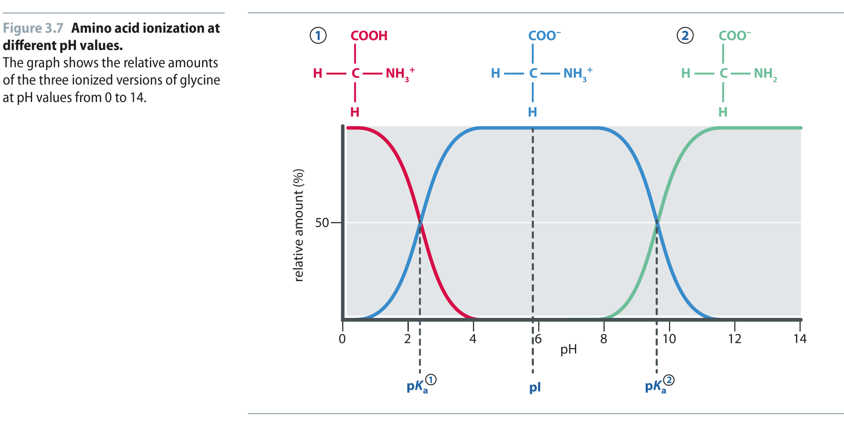
Fig 3.7
Reproduced from: Biochemistry by T.A. Brown, ISBN: 9781907904288 © Scion Publishing Ltd, 2017

Slide 10
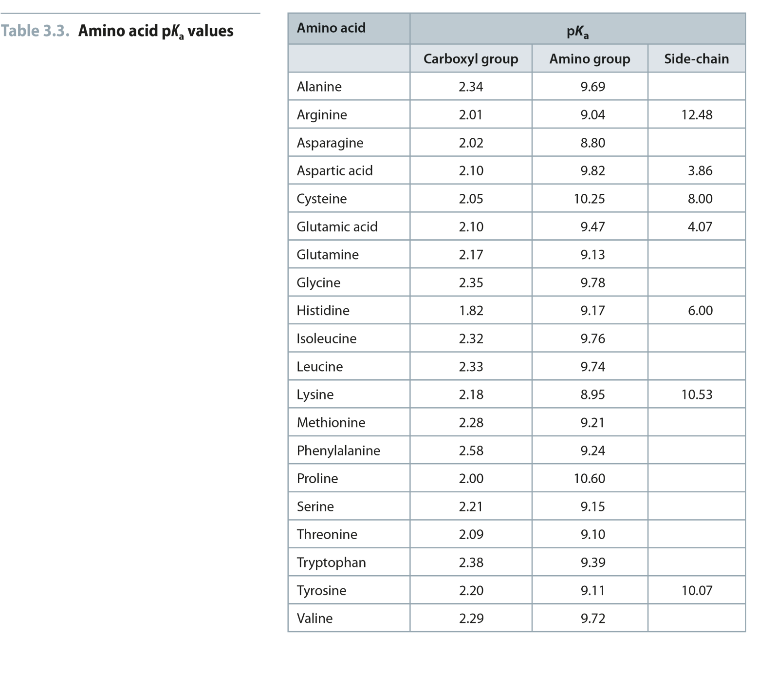
Table 3.3
Reproduced from: Biochemistry by T.A. Brown, ISBN: 9781907904288 © Scion Publishing Ltd, 2017

Slide 11
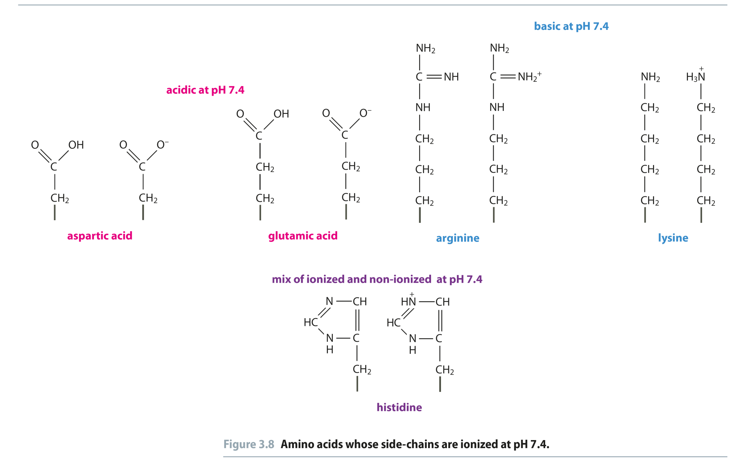
Fig 3.8
Reproduced from: Biochemistry by T.A. Brown, ISBN: 9781907904288 © Scion Publishing Ltd, 2017

Slide 12
Fig 3.9
Reproduced from: Biochemistry by T.A. Brown, ISBN: 9781907904288 © Scion Publishing Ltd, 2017

Slide 13
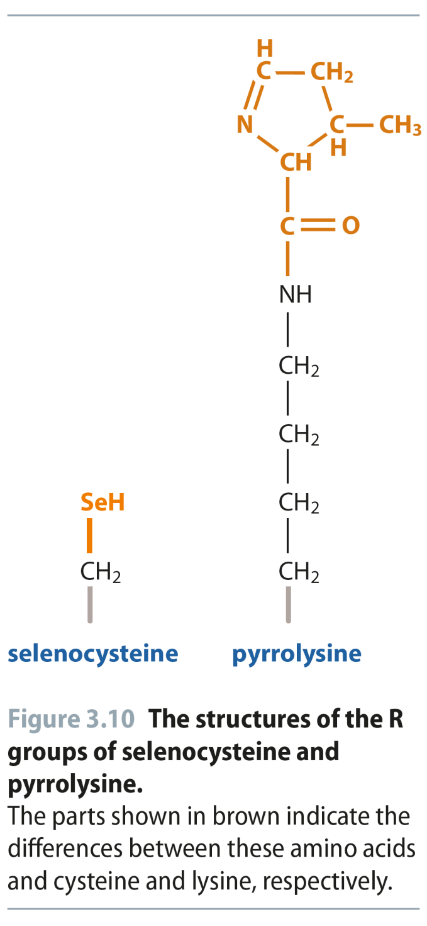
Fig 3.10
Reproduced from: Biochemistry by T.A. Brown, ISBN: 9781907904288 © Scion Publishing Ltd, 2017

Slide 14
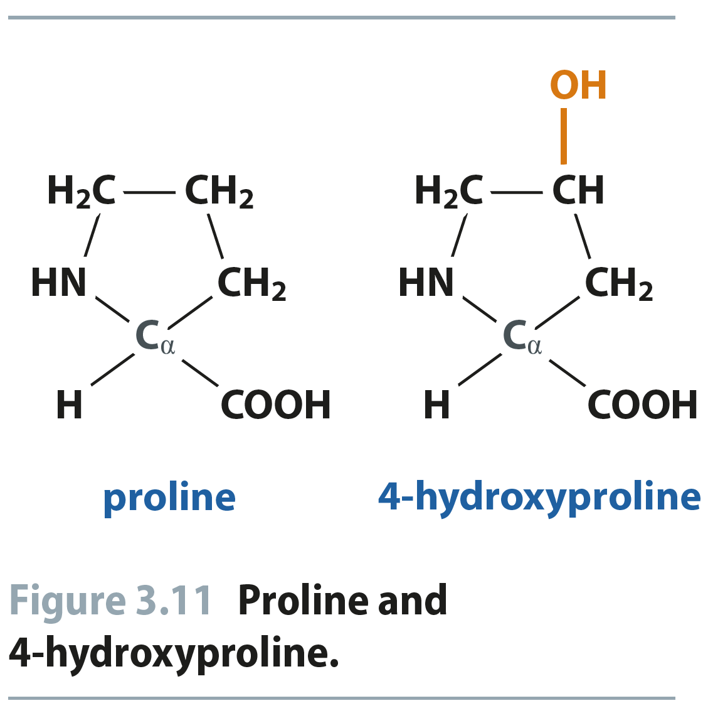
Fig 3.11
Reproduced from: Biochemistry by T.A. Brown, ISBN: 9781907904288 © Scion Publishing Ltd, 2017

Slide 15
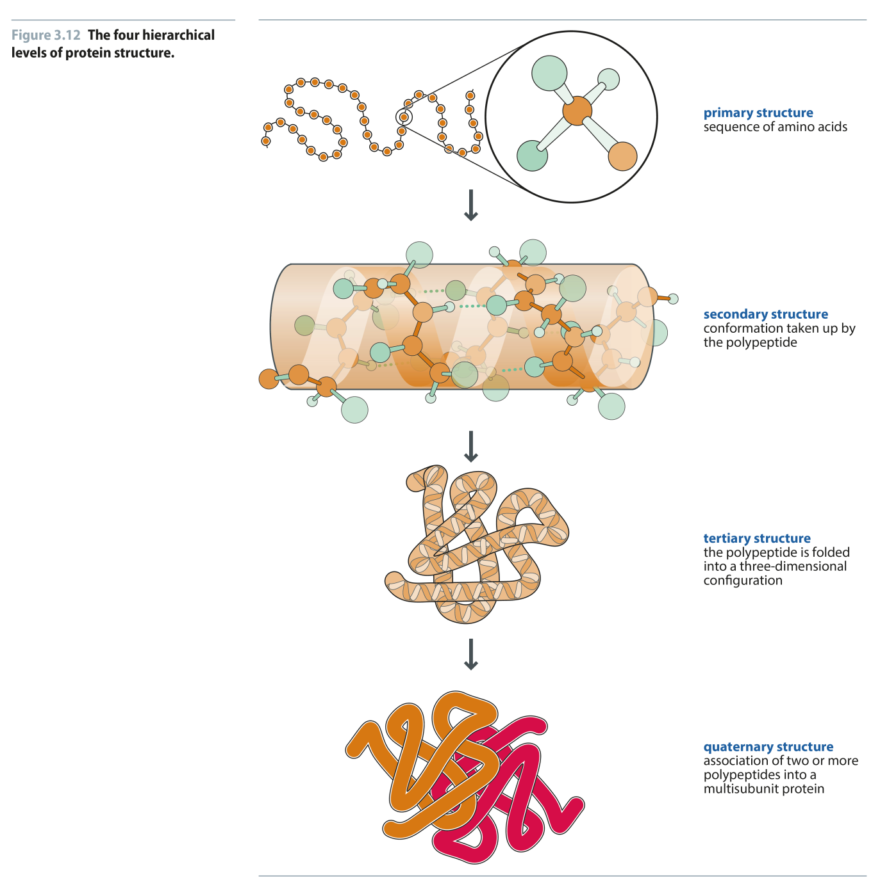
Fig 3.12
Reproduced from: Biochemistry by T.A. Brown, ISBN: 9781907904288 © Scion Publishing Ltd, 2017

Slide 16
Fig 3.13
Reproduced from: Biochemistry by T.A. Brown, ISBN: 9781907904288 © Scion Publishing Ltd, 2017

Slide 17
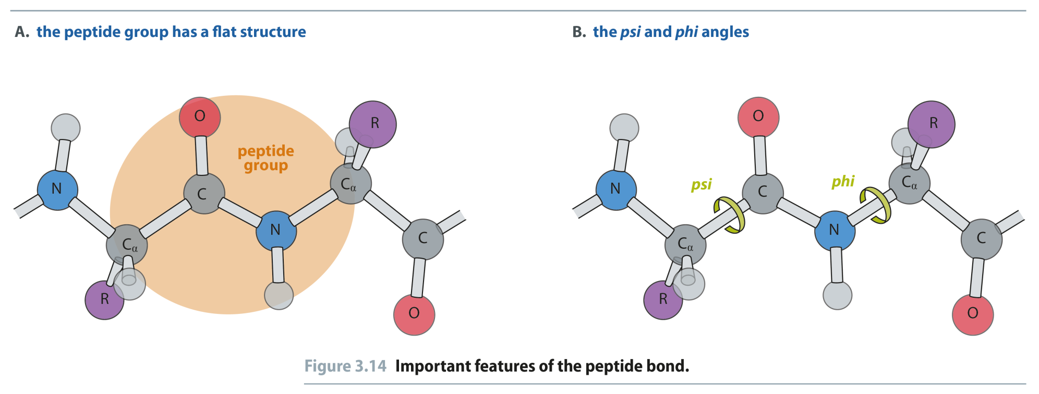
Fig 3.14
Reproduced from: Biochemistry by T.A. Brown, ISBN: 9781907904288 © Scion Publishing Ltd, 2017

Slide 18
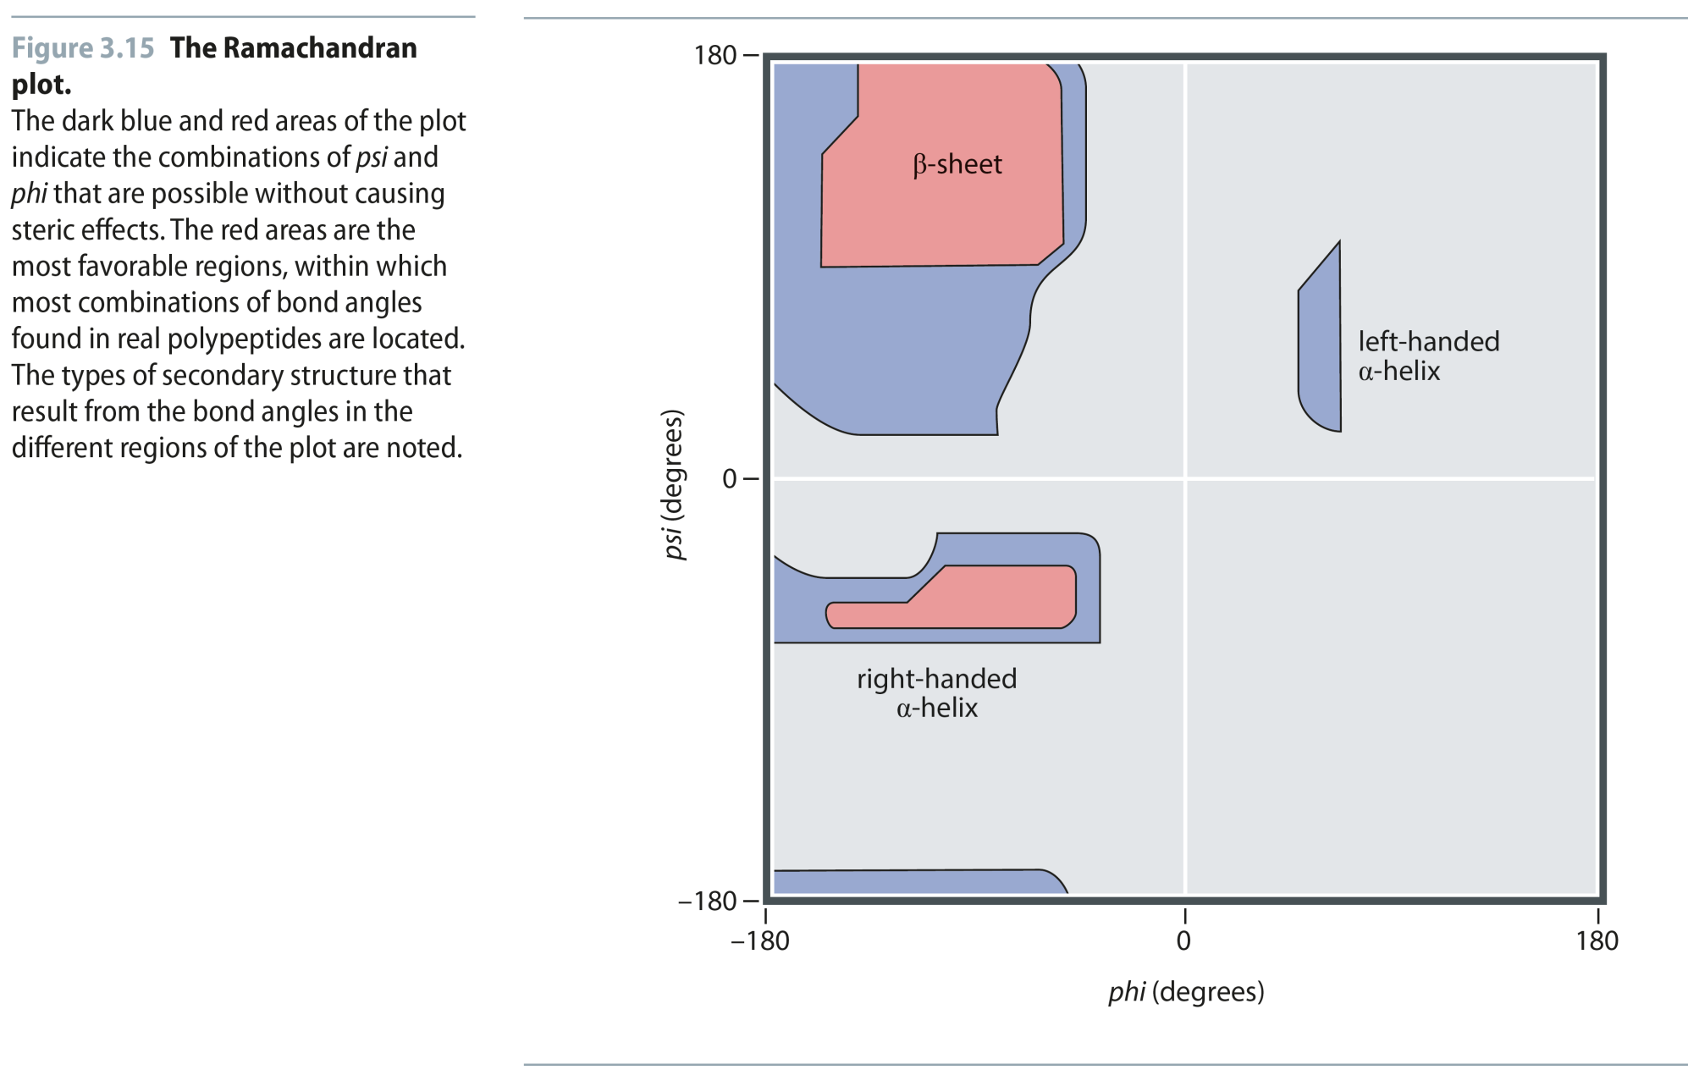
Fig 3.15
Reproduced from: Biochemistry by T.A. Brown, ISBN: 9781907904288 © Scion Publishing Ltd, 2017

Slide 19
Fig 3.16
Reproduced from: Biochemistry by T.A. Brown, ISBN: 9781907904288 © Scion Publishing Ltd, 2017

Slide 20
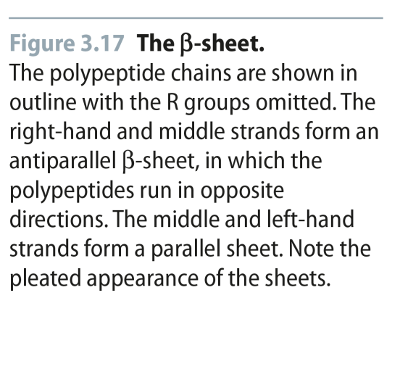
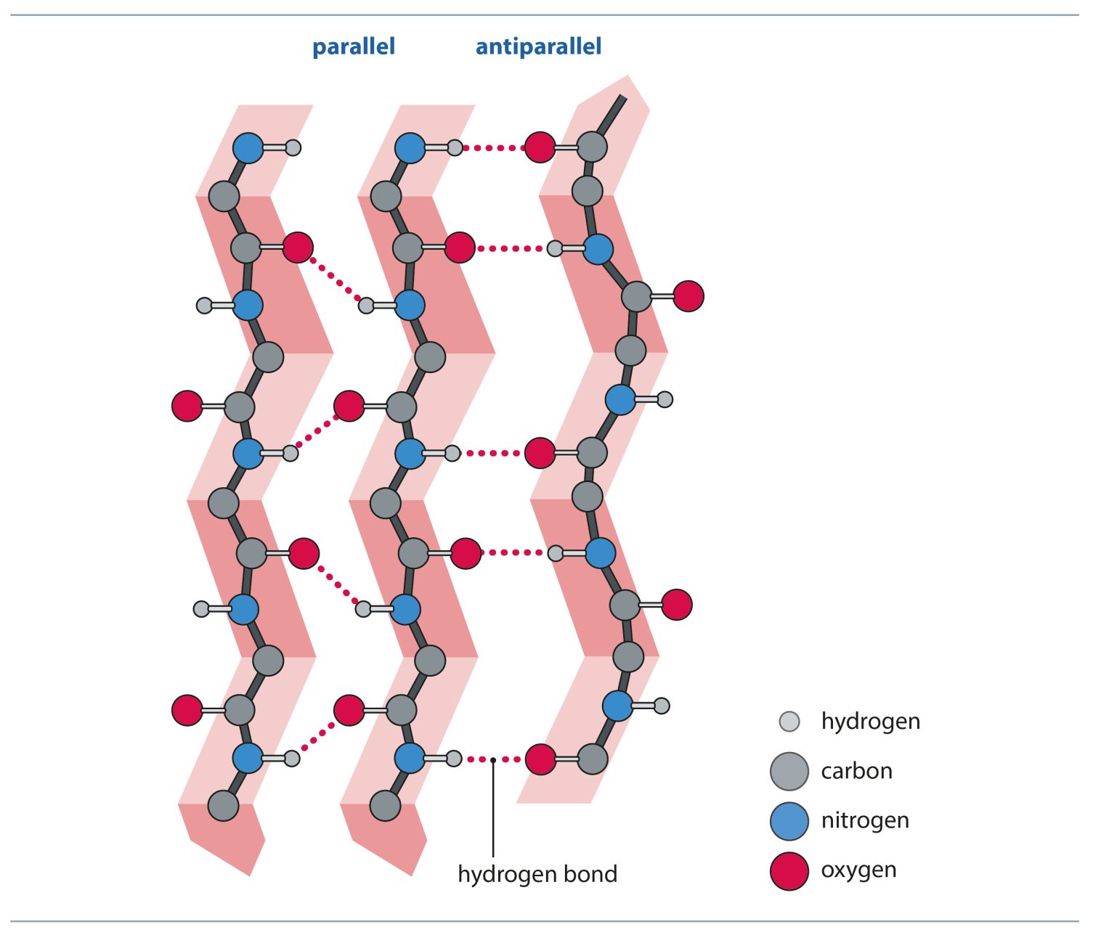
Fig 3.17
Reproduced from: Biochemistry by T.A. Brown, ISBN: 9781907904288 © Scion Publishing Ltd, 2017

Slide 21
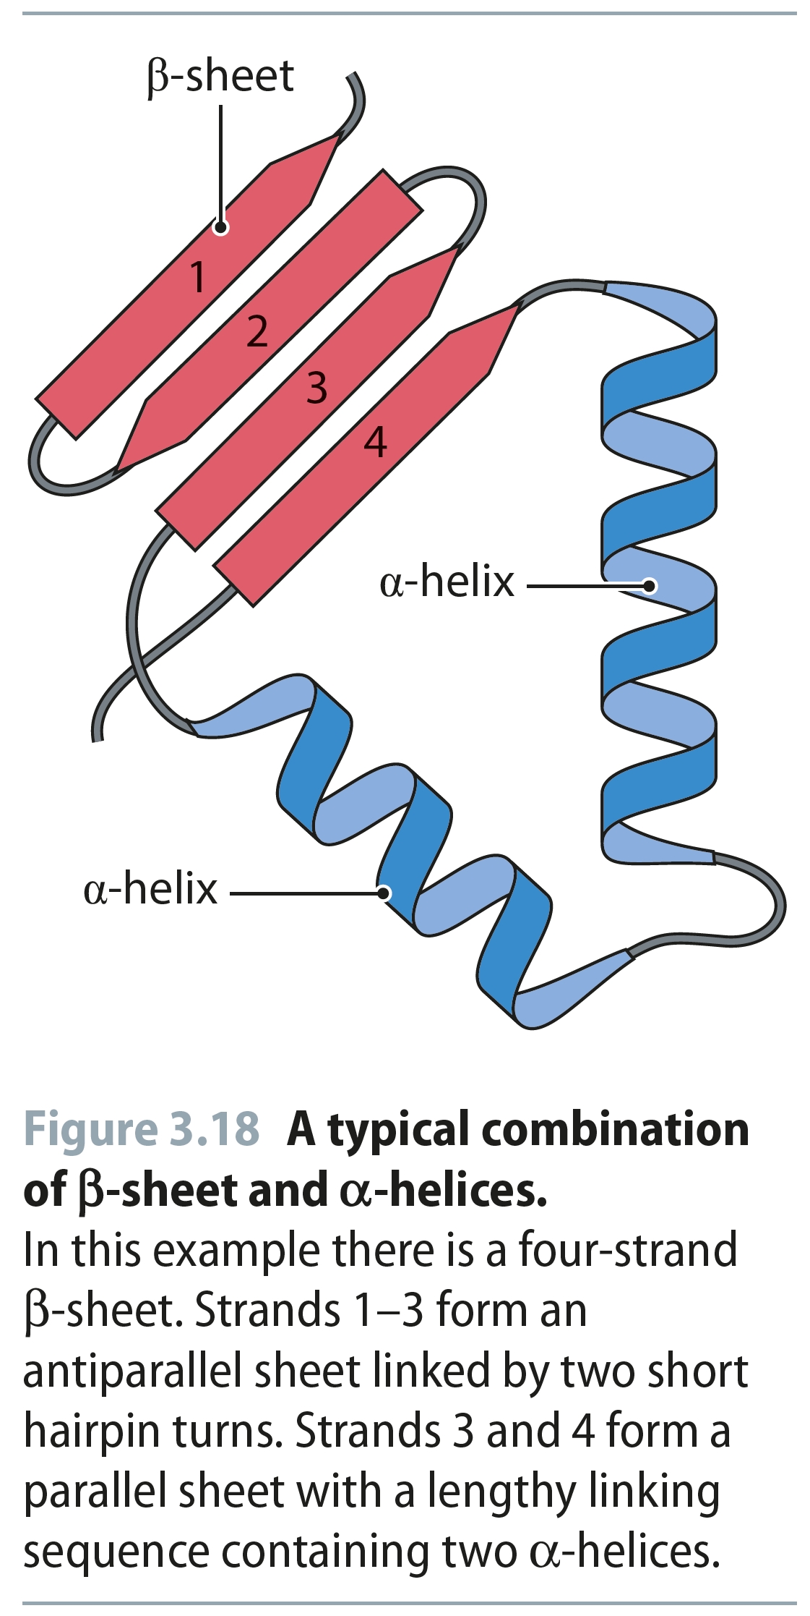
Fig 3.18
Reproduced from: Biochemistry by T.A. Brown, ISBN: 9781907904288 © Scion Publishing Ltd, 2017

Slide 22
Fig 3.19
Reproduced from: Biochemistry by T.A. Brown, ISBN: 9781907904288 © Scion Publishing Ltd, 2017

Slide 23
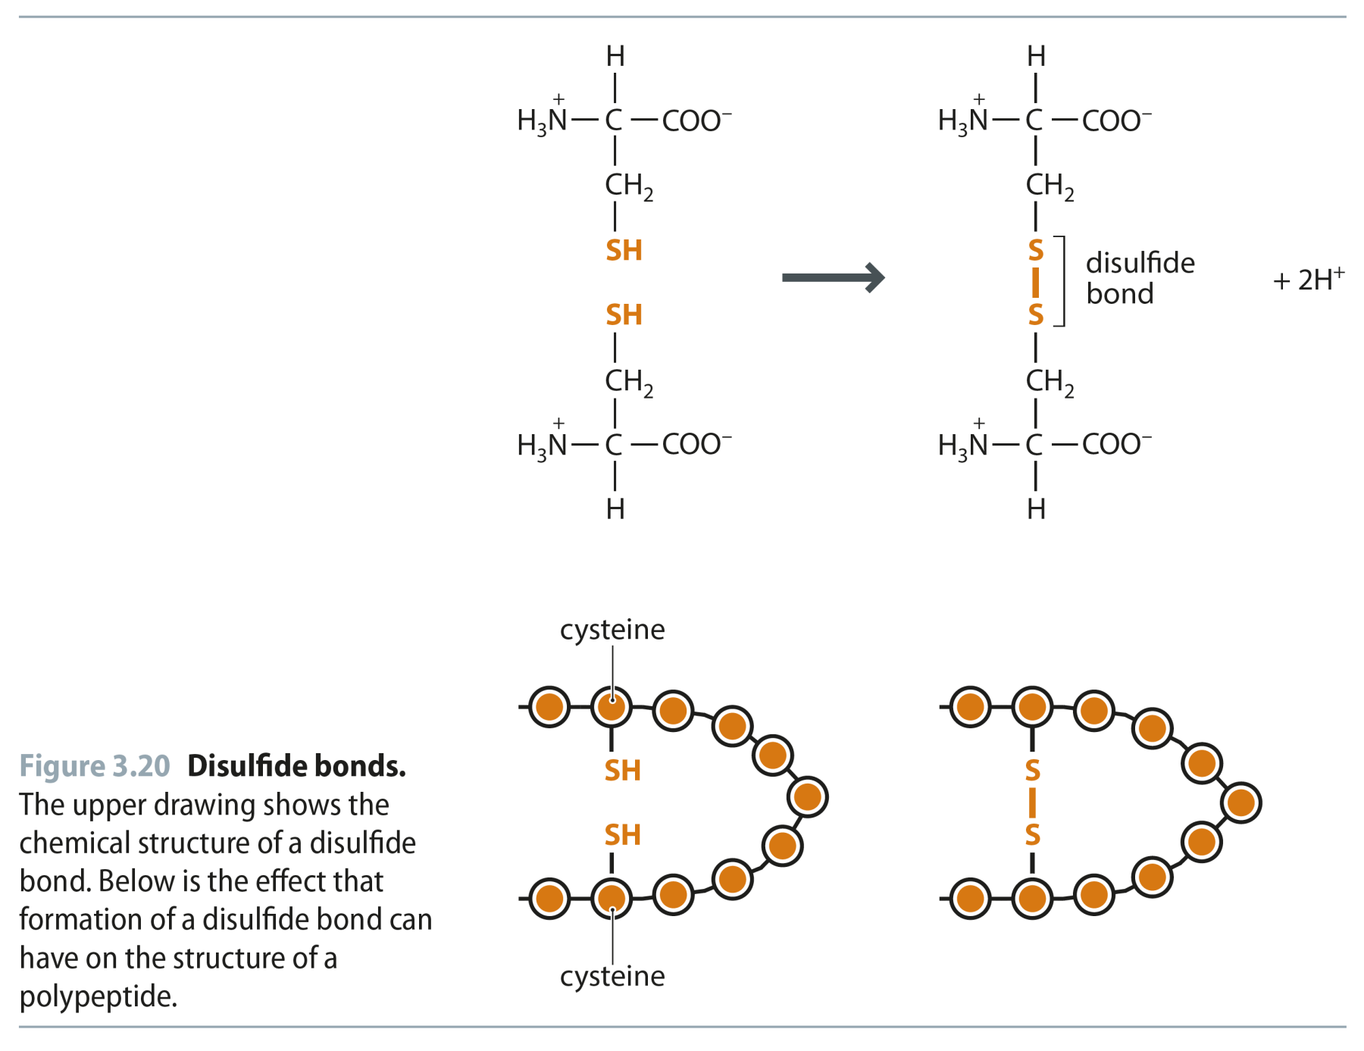
Fig 3.20
Reproduced from: Biochemistry by T.A. Brown, ISBN: 9781907904288 © Scion Publishing Ltd, 2017

Slide 24
Fig 3.21
Reproduced from: Biochemistry by T.A. Brown, ISBN: 9781907904288 © Scion Publishing Ltd, 2017

Slide 25
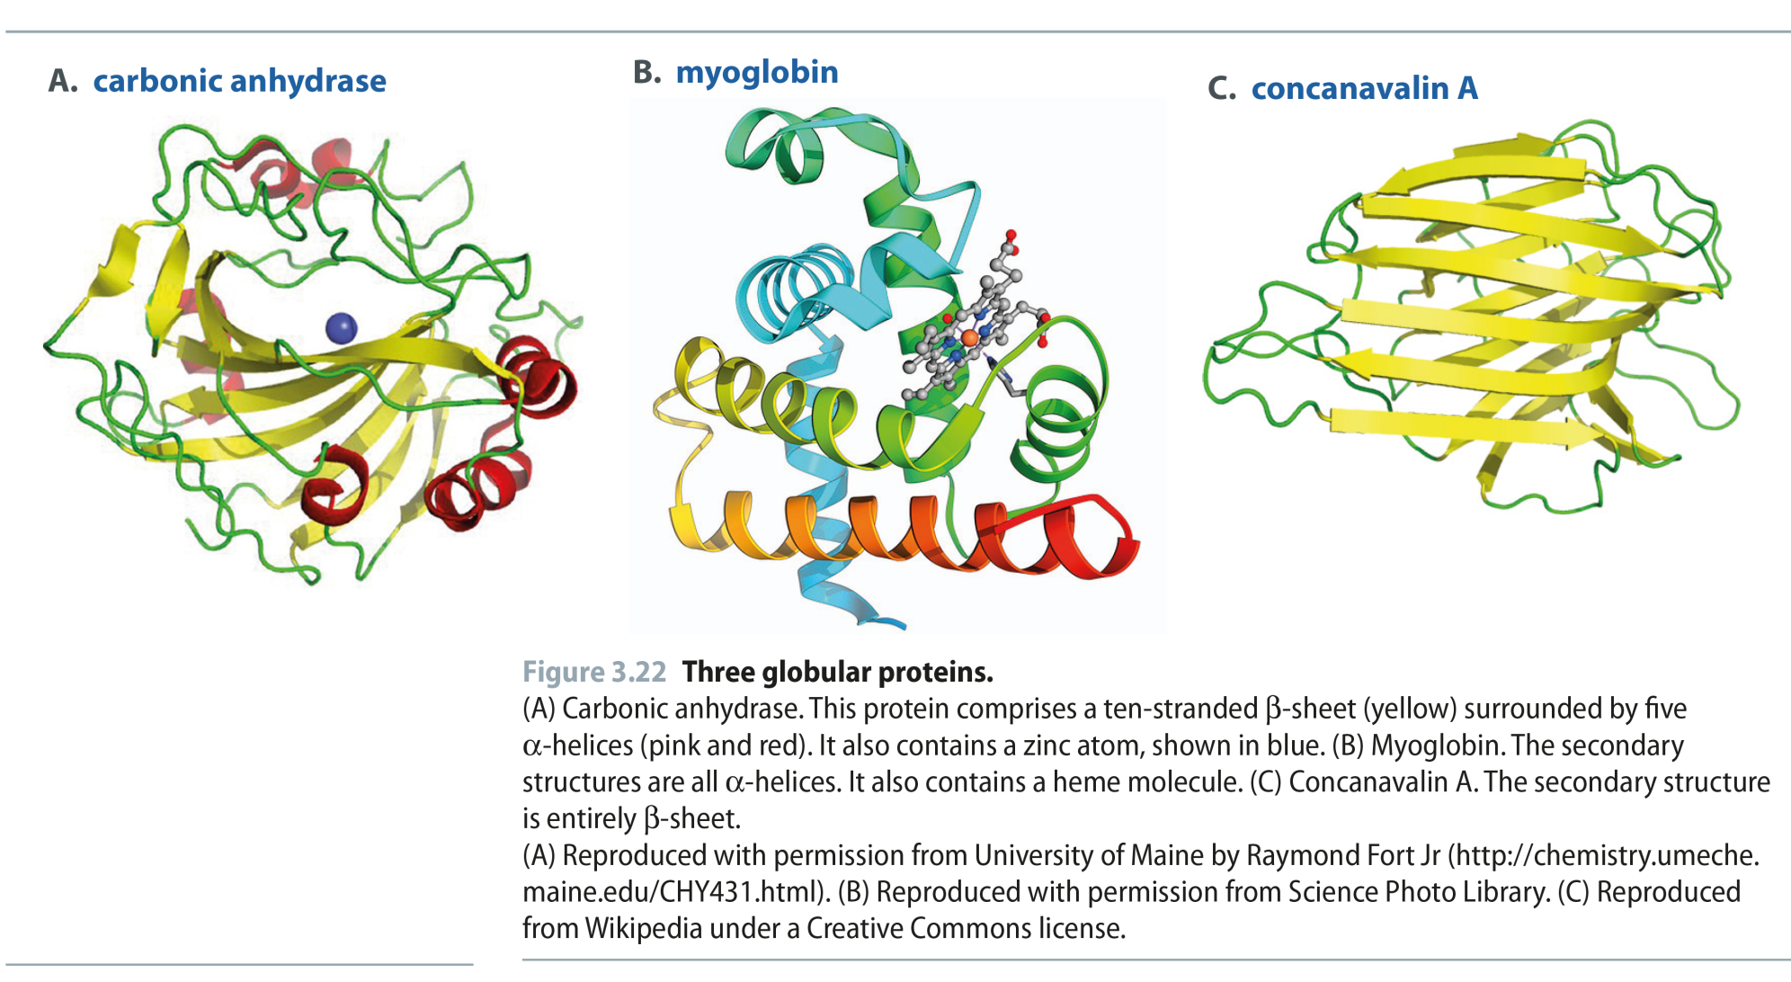
Fig 3.22
Reproduced from: Biochemistry by T.A. Brown, ISBN: 9781907904288 © Scion Publishing Ltd, 2017

Slide 26
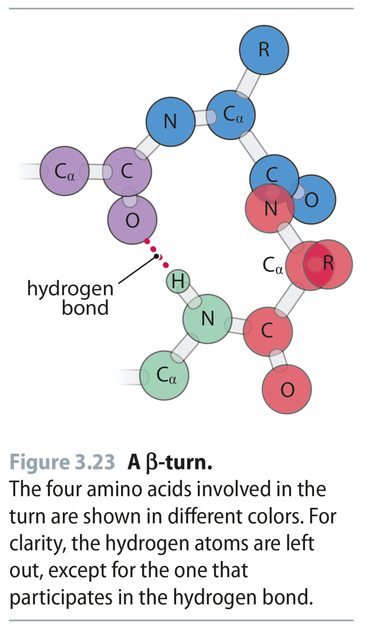
Fig 3.23
Reproduced from: Biochemistry by T.A. Brown, ISBN: 9781907904288 © Scion Publishing Ltd, 2017

Slide 27
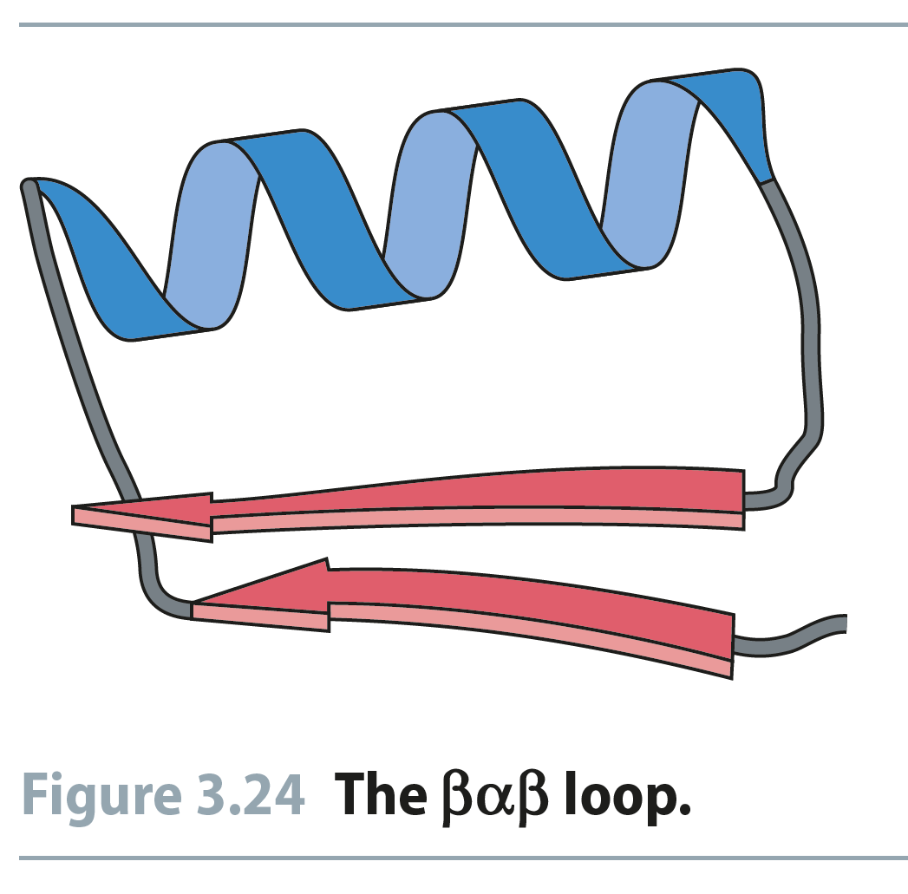
Fig 3.24
Reproduced from: Biochemistry by T.A. Brown, ISBN: 9781907904288 © Scion Publishing Ltd, 2017

Slide 28
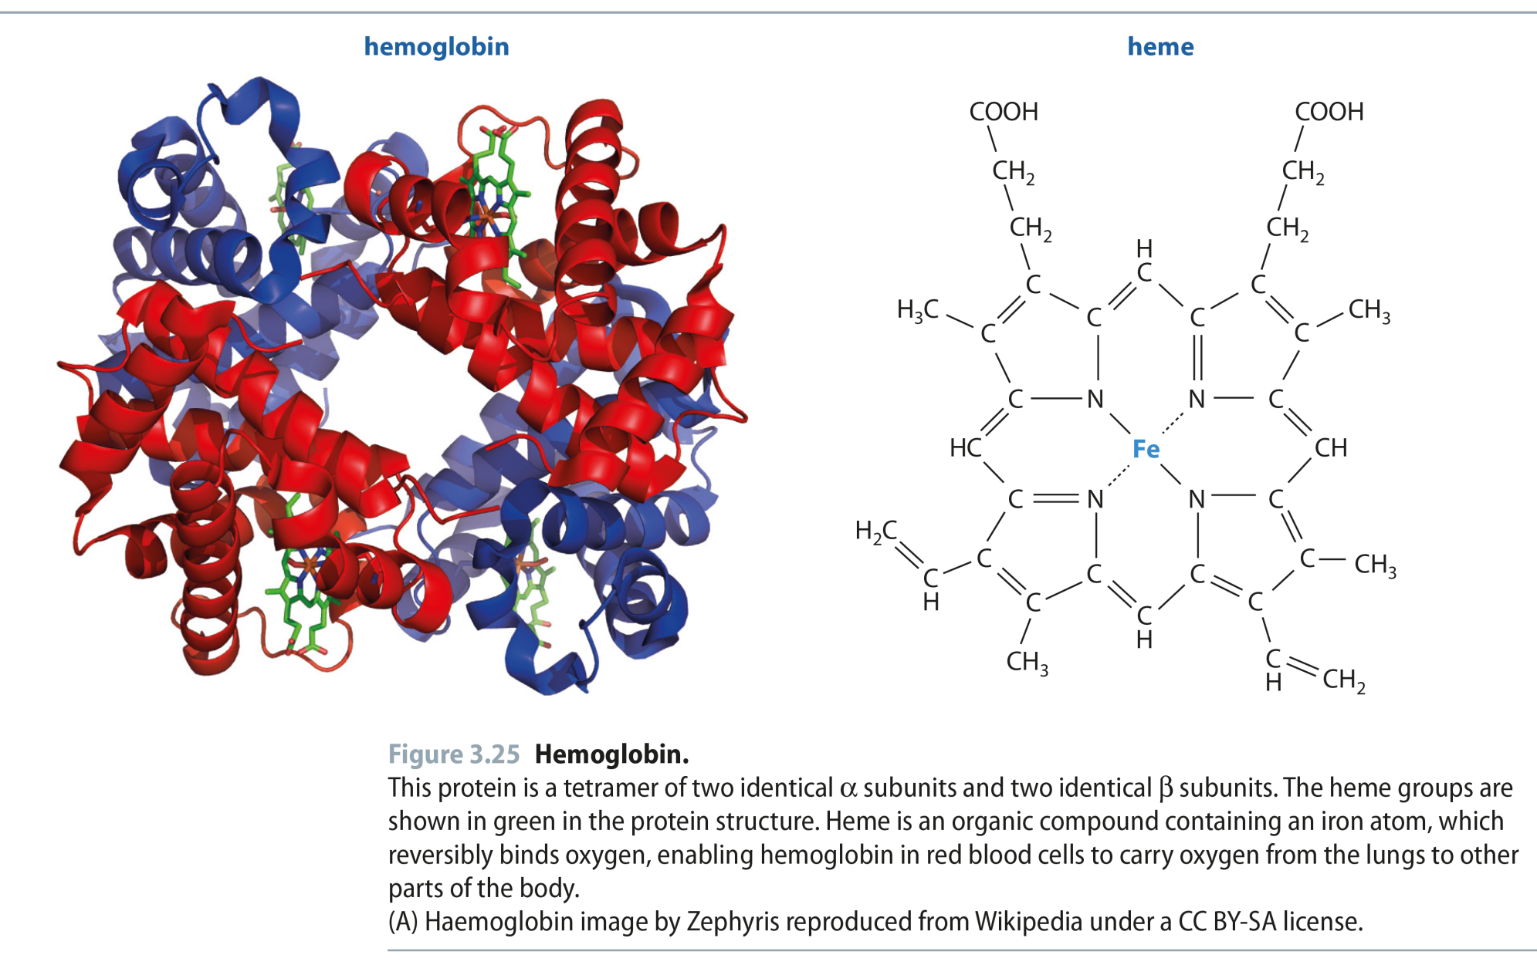
Fig 3.25
Reproduced from: Biochemistry by T.A. Brown, ISBN: 9781907904288 © Scion Publishing Ltd, 2017

Slide 29
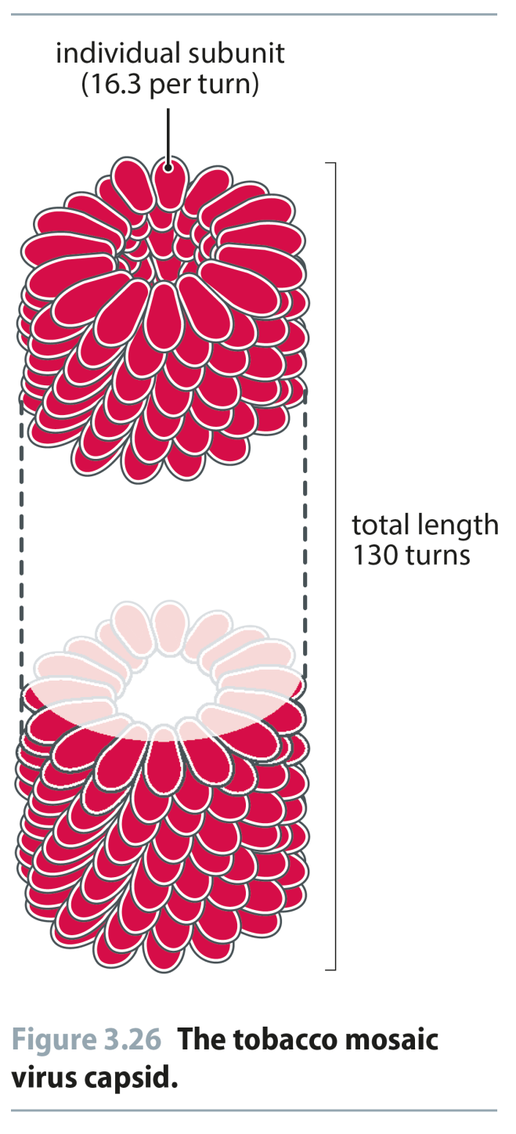
Fig 3.26
Reproduced from: Biochemistry by T.A. Brown, ISBN: 9781907904288 © Scion Publishing Ltd, 2017

Slide 30
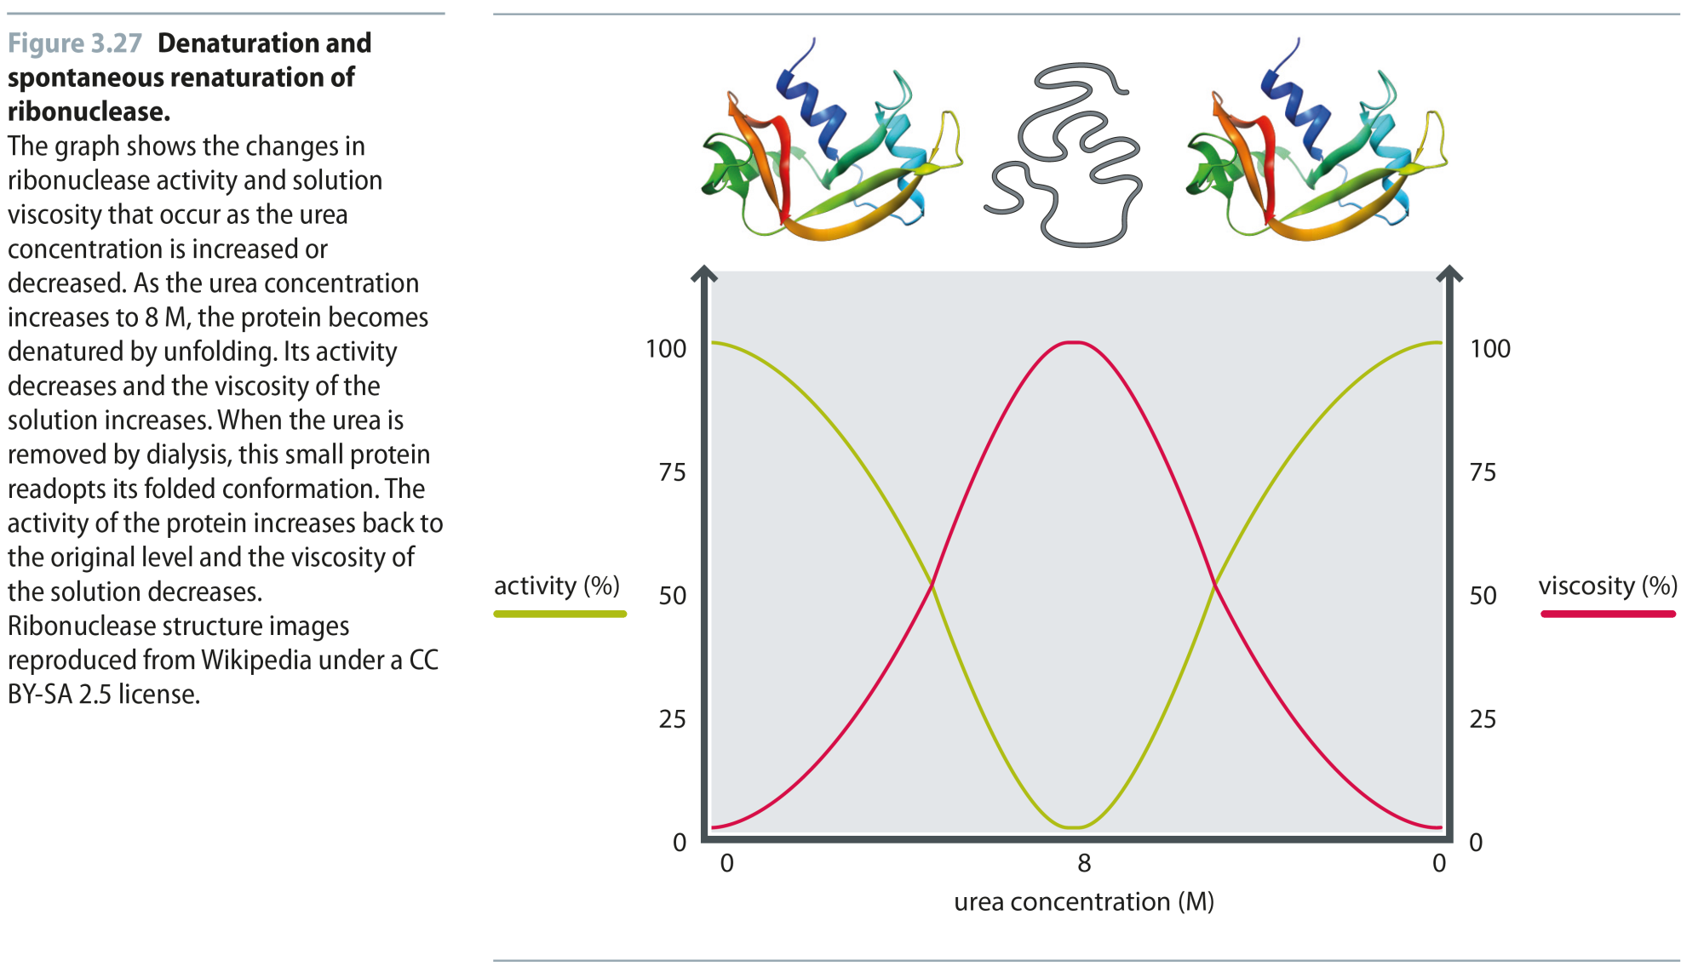
Fig 3.27
Reproduced from: Biochemistry by T.A. Brown, ISBN: 9781907904288 © Scion Publishing Ltd, 2017

Slide 31
Fig 3.28
Reproduced from: Biochemistry by T.A. Brown, ISBN: 9781907904288 © Scion Publishing Ltd, 2017

Slide 32
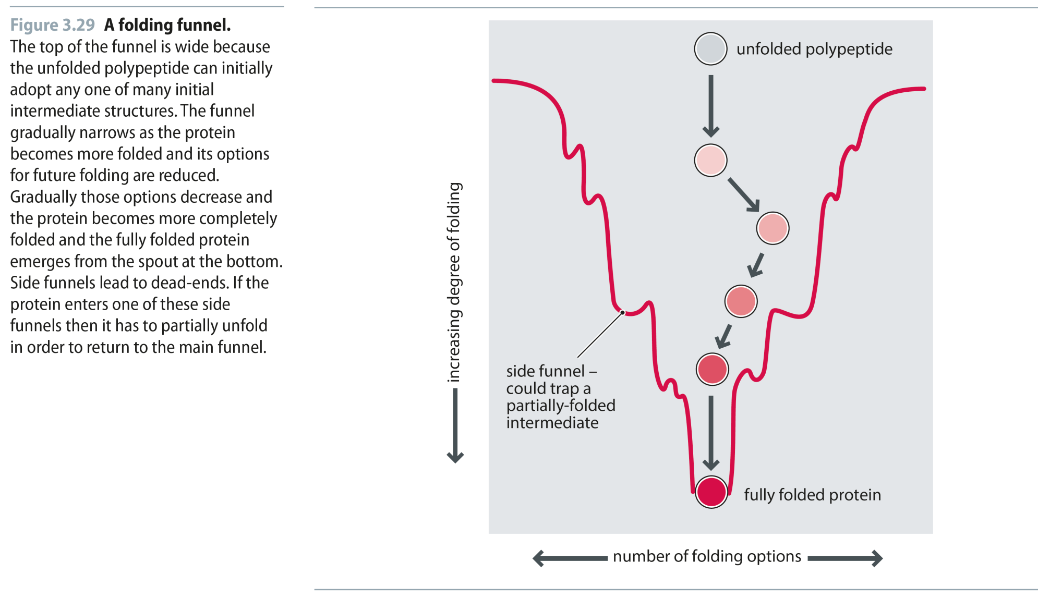
Fig 3.29
Reproduced from: Biochemistry by T.A. Brown, ISBN: 9781907904288 © Scion Publishing Ltd, 2017

Slide 33
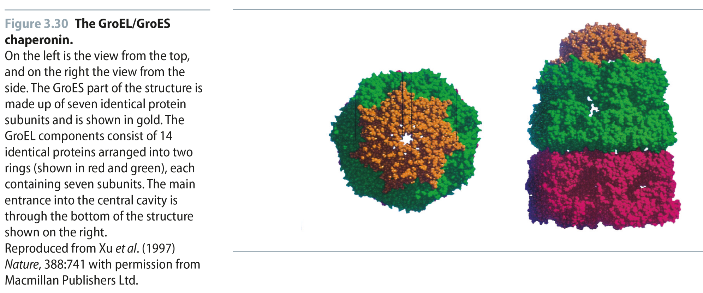
Fig 3.30
Reproduced from: Biochemistry by T.A. Brown, ISBN: 9781907904288 © Scion Publishing Ltd, 2017

