Slide 1
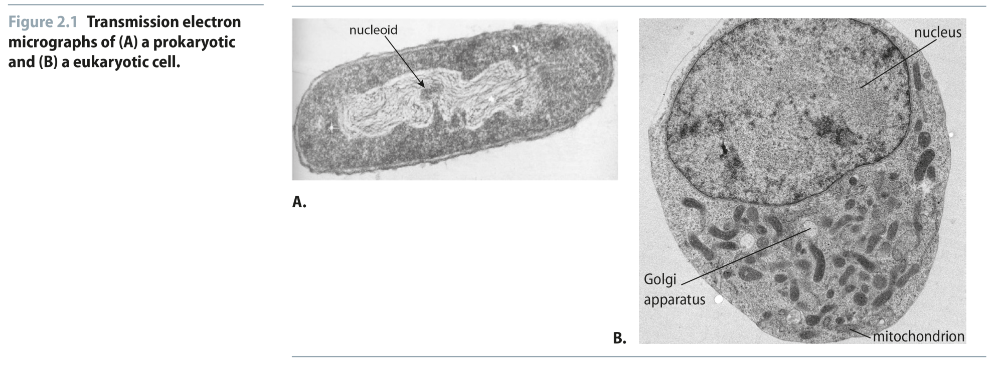
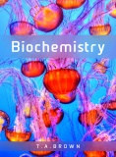
Fig 2.1
Reproduced from: Biochemistry by T.A. Brown, ISBN: 9781907904288 © Scion Publishing Ltd, 2017

Slide 2
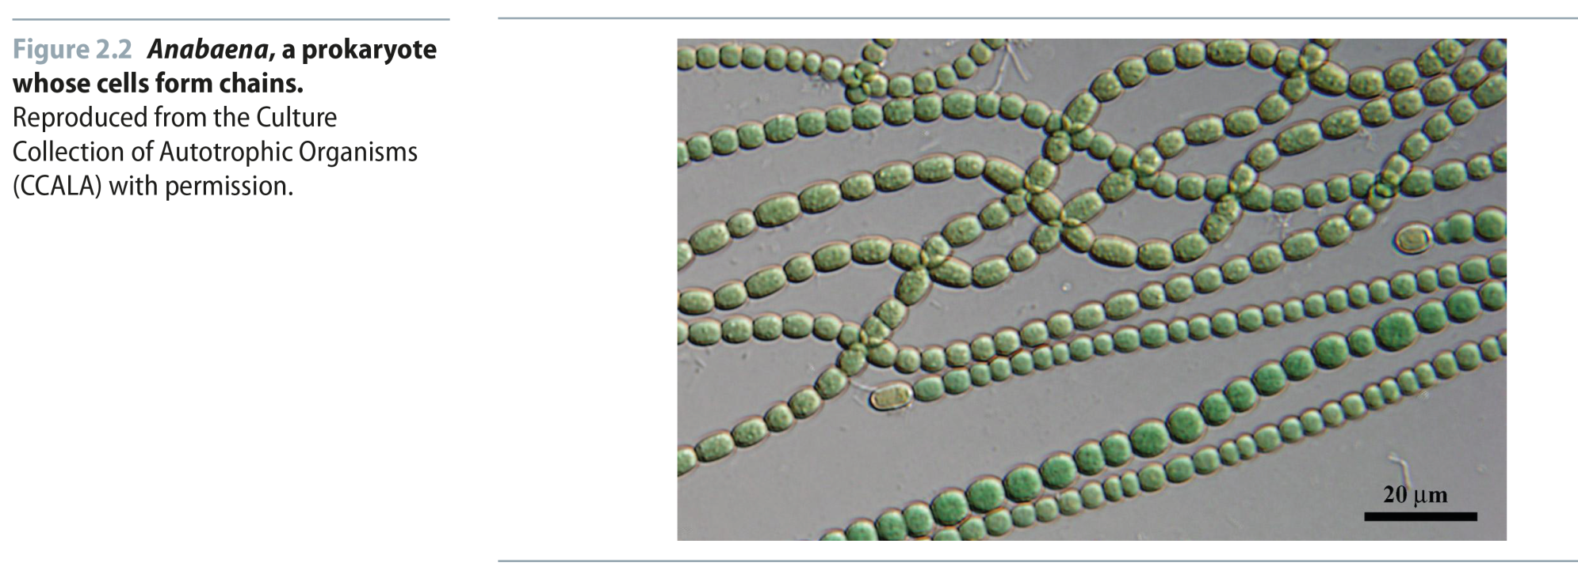
Fig 2.2
Reproduced from: Biochemistry by T.A. Brown, ISBN: 9781907904288 © Scion Publishing Ltd, 2017

Slide 3
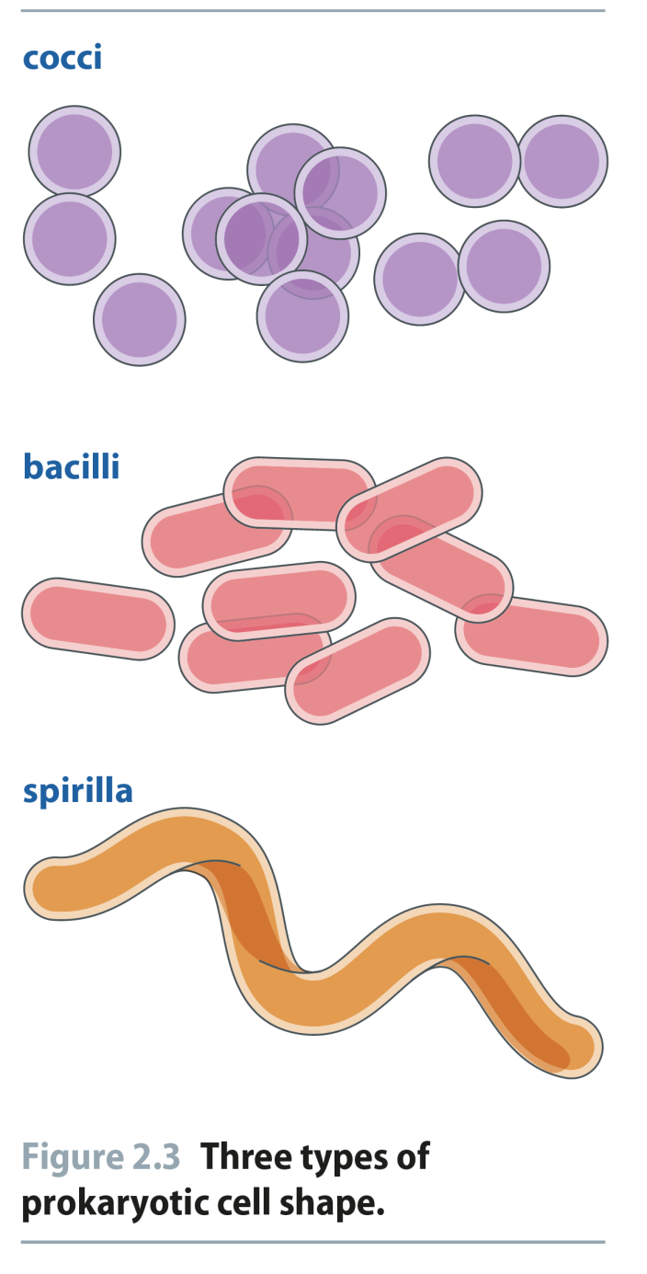
Fig 2.3
Reproduced from: Biochemistry by T.A. Brown, ISBN: 9781907904288 © Scion Publishing Ltd, 2017

Slide 4
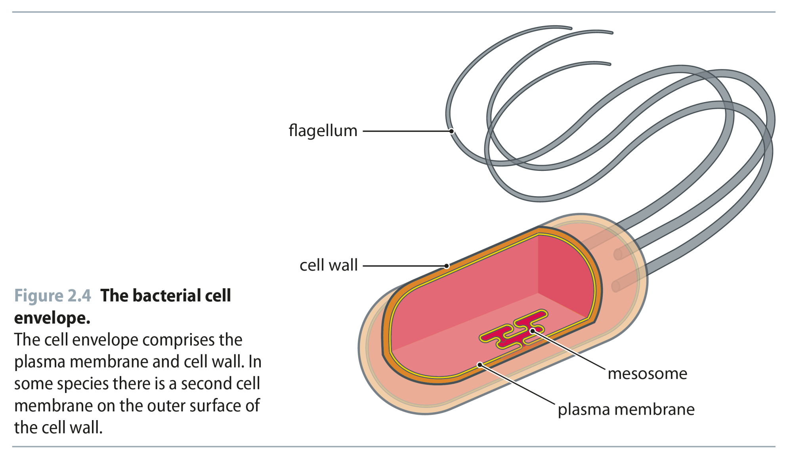
Fig 2.4
Reproduced from: Biochemistry by T.A. Brown, ISBN: 9781907904288 © Scion Publishing Ltd, 2017

Slide 5
Fig 2.5
Reproduced from: Biochemistry by T.A. Brown, ISBN: 9781907904288 © Scion Publishing Ltd, 2017

Slide 6
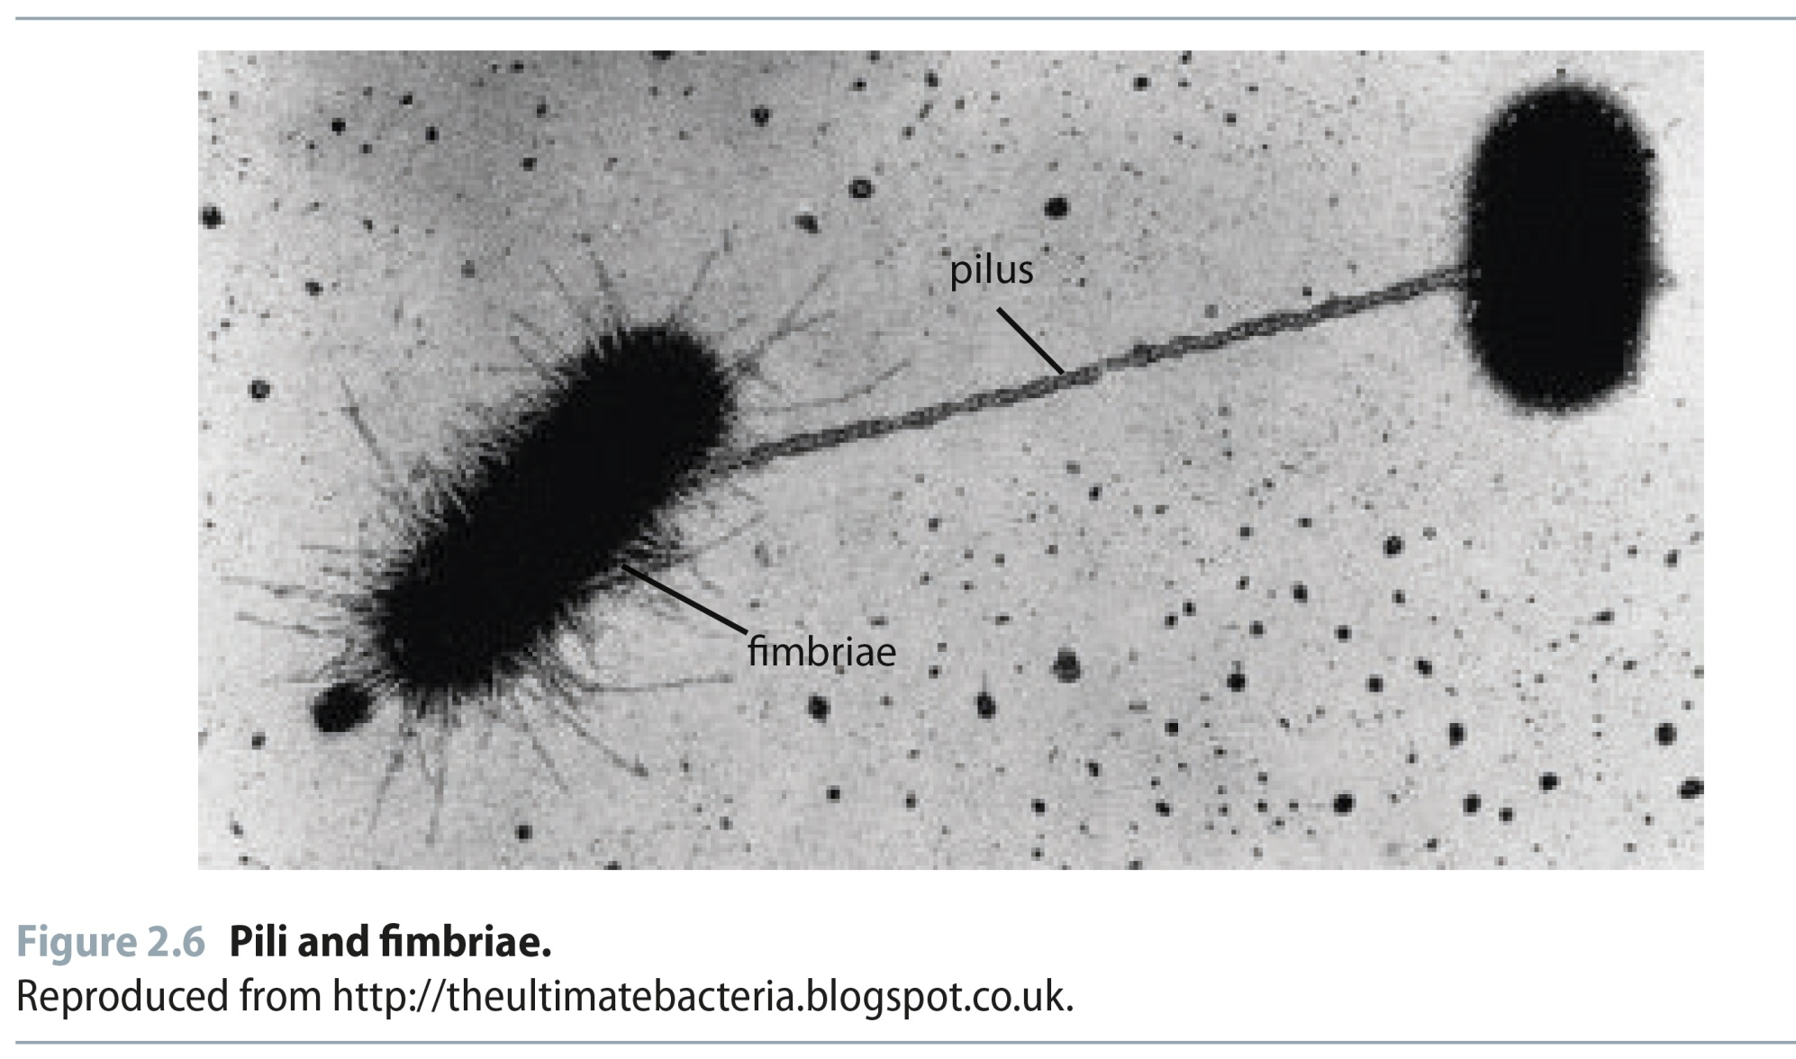
Fig 2.6
Reproduced from: Biochemistry by T.A. Brown, ISBN: 9781907904288 © Scion Publishing Ltd, 2017

Slide 7
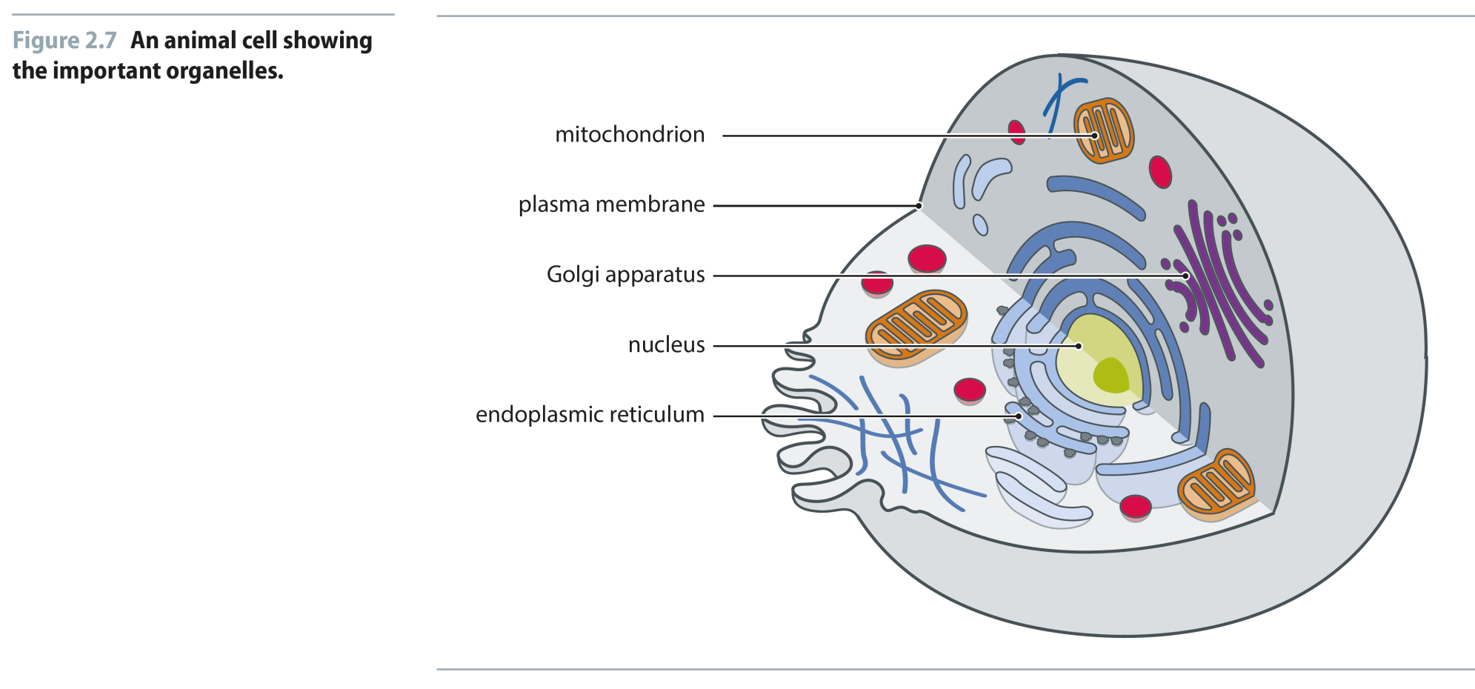
Fig 2.7
Reproduced from: Biochemistry by T.A. Brown, ISBN: 9781907904288 © Scion Publishing Ltd, 2017

Slide 8
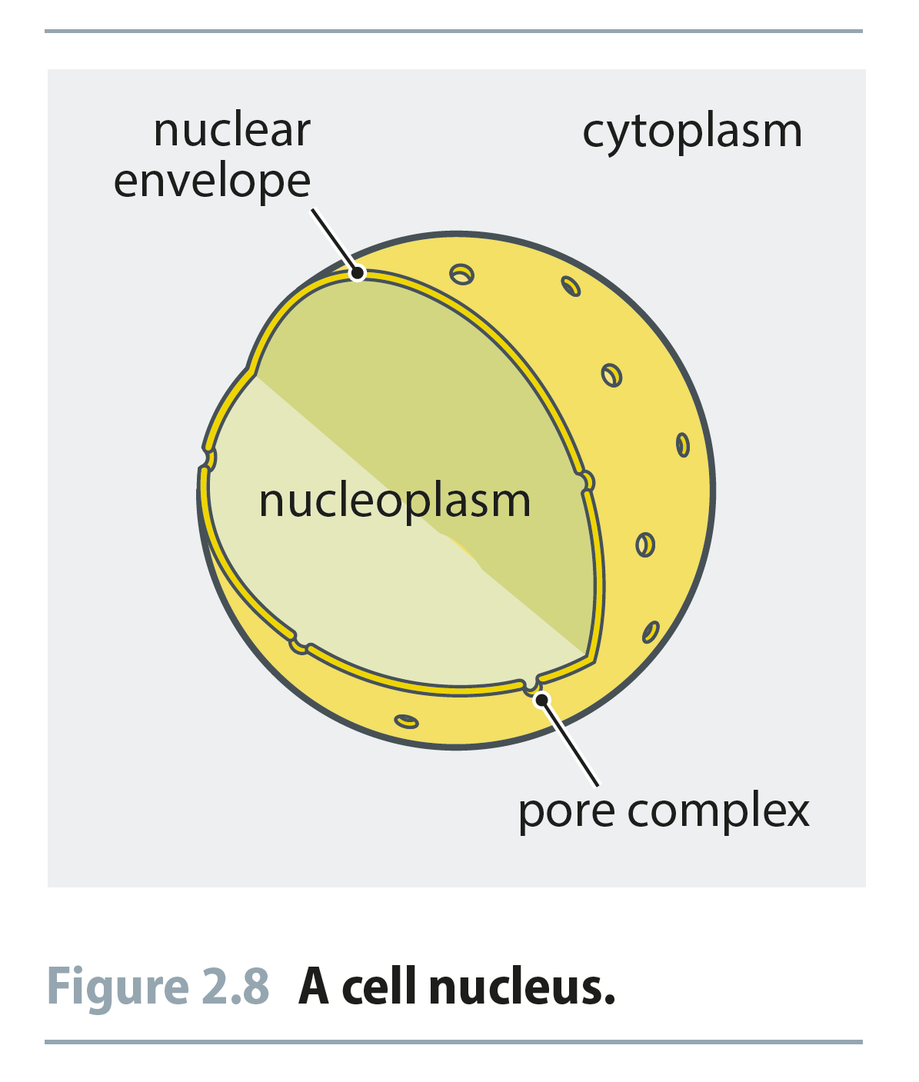
Fig 2.8
Reproduced from: Biochemistry by T.A. Brown, ISBN: 9781907904288 © Scion Publishing Ltd, 2017

Slide 9
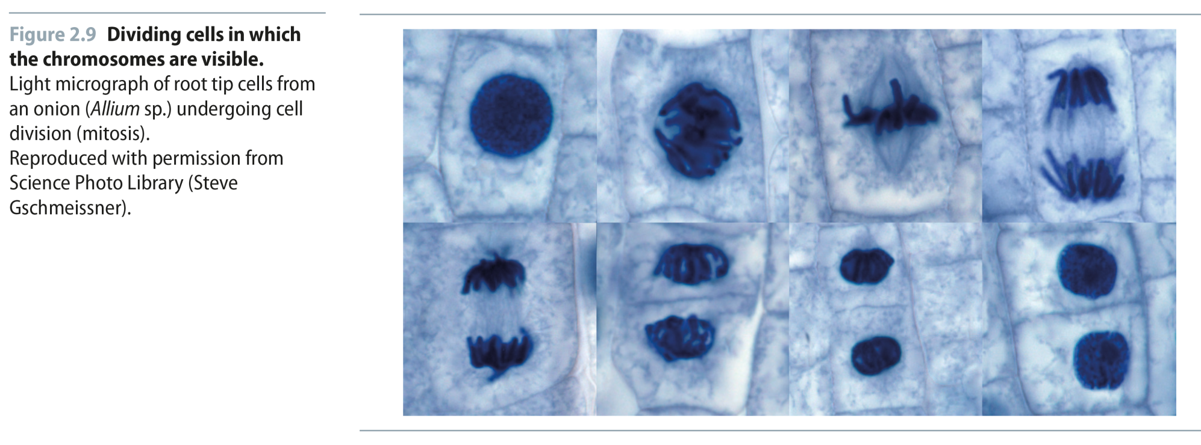
Fig 2.9
Reproduced from: Biochemistry by T.A. Brown, ISBN: 9781907904288 © Scion Publishing Ltd, 2017

Slide 10
Table 2.1
Reproduced from: Biochemistry by T.A. Brown, ISBN: 9781907904288 © Scion Publishing Ltd, 2017

Slide 11
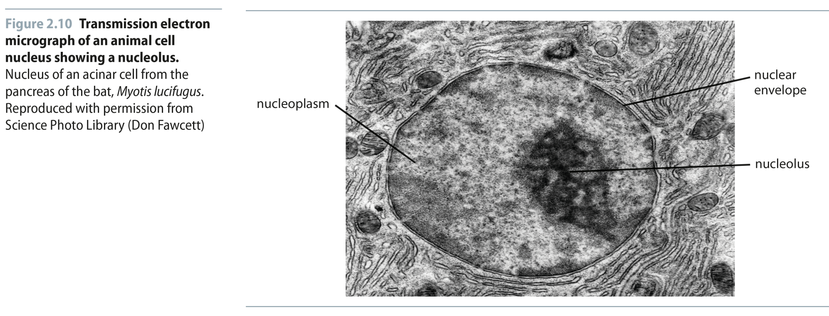
Fig 2.10
Reproduced from: Biochemistry by T.A. Brown, ISBN: 9781907904288 © Scion Publishing Ltd, 2017

Slide 12
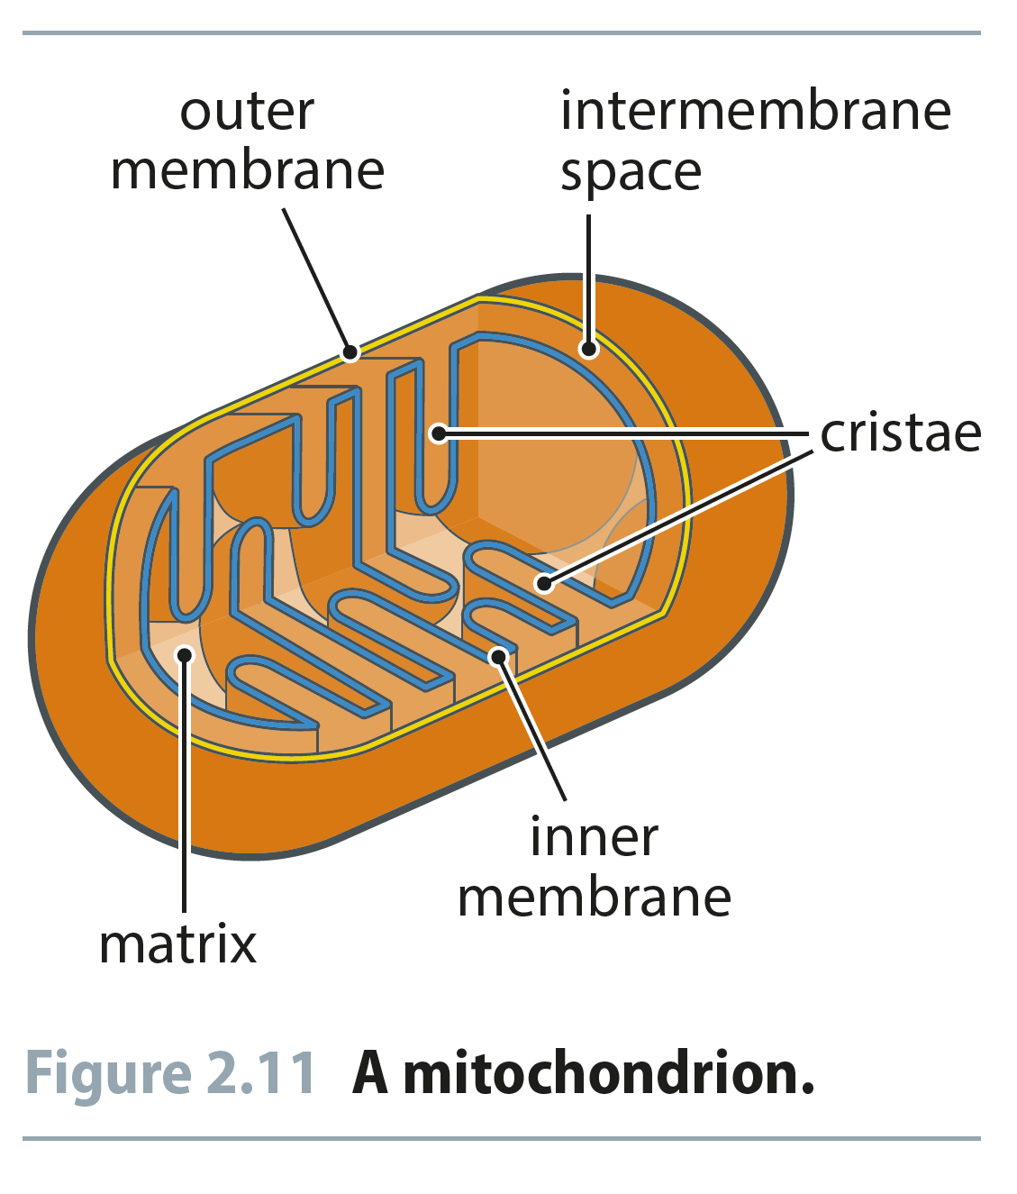
Fig 2.11
Reproduced from: Biochemistry by T.A. Brown, ISBN: 9781907904288 © Scion Publishing Ltd, 2017

Slide 13
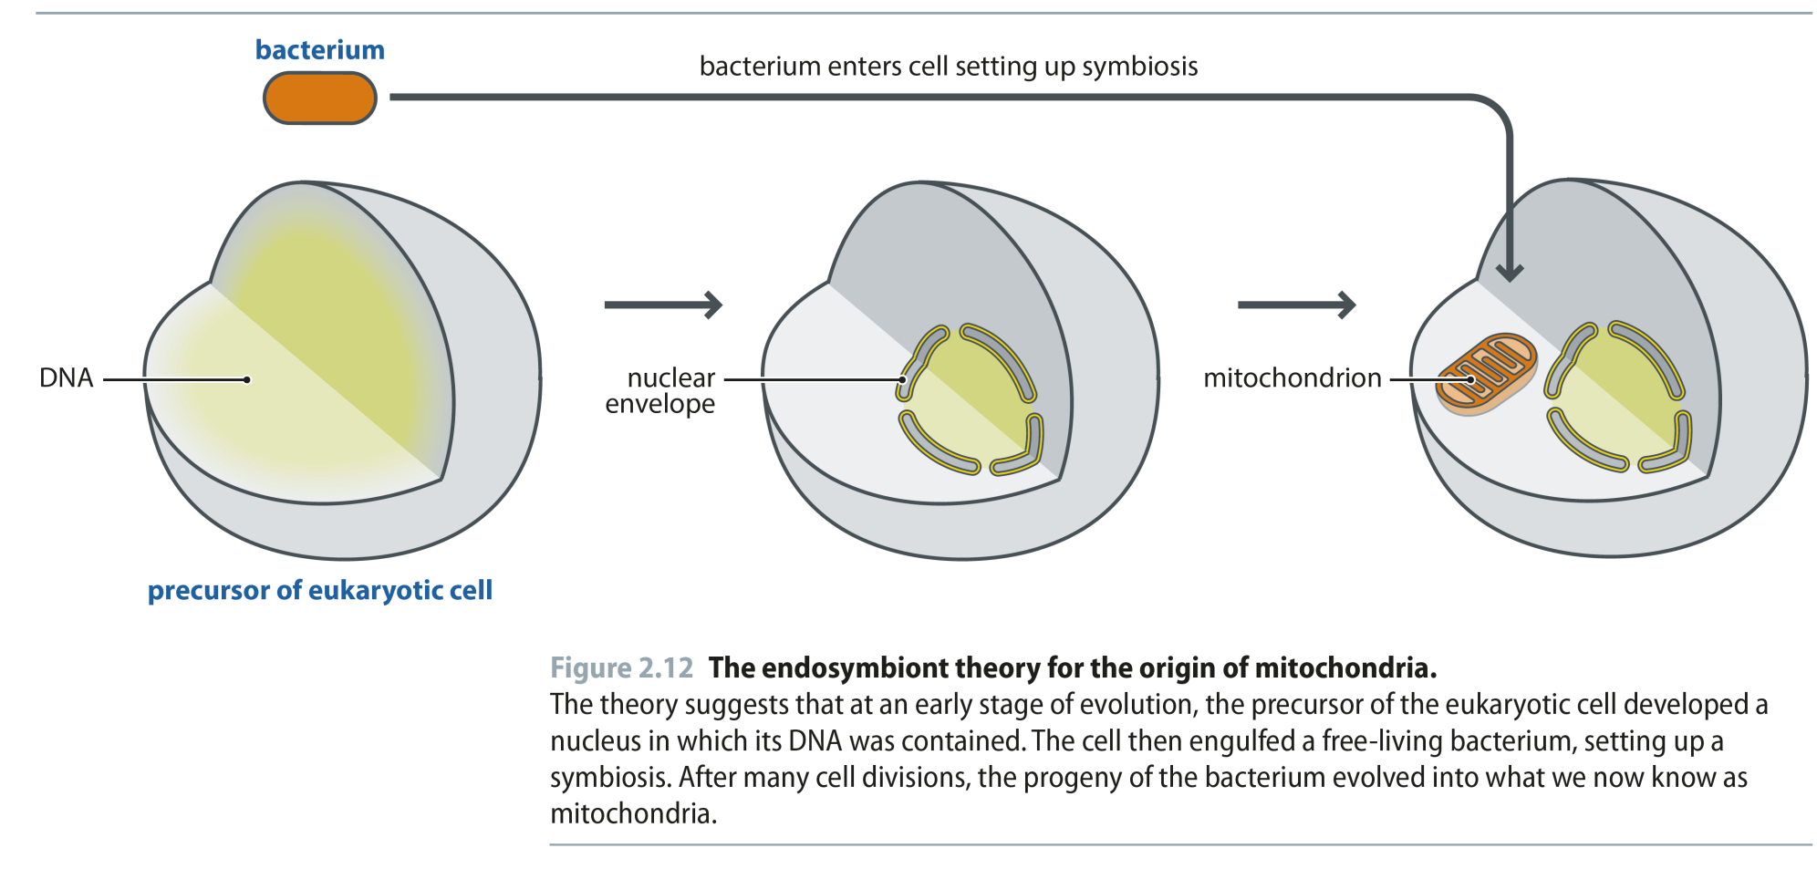
Fig 2.12
Reproduced from: Biochemistry by T.A. Brown, ISBN: 9781907904288 © Scion Publishing Ltd, 2017

Slide 14
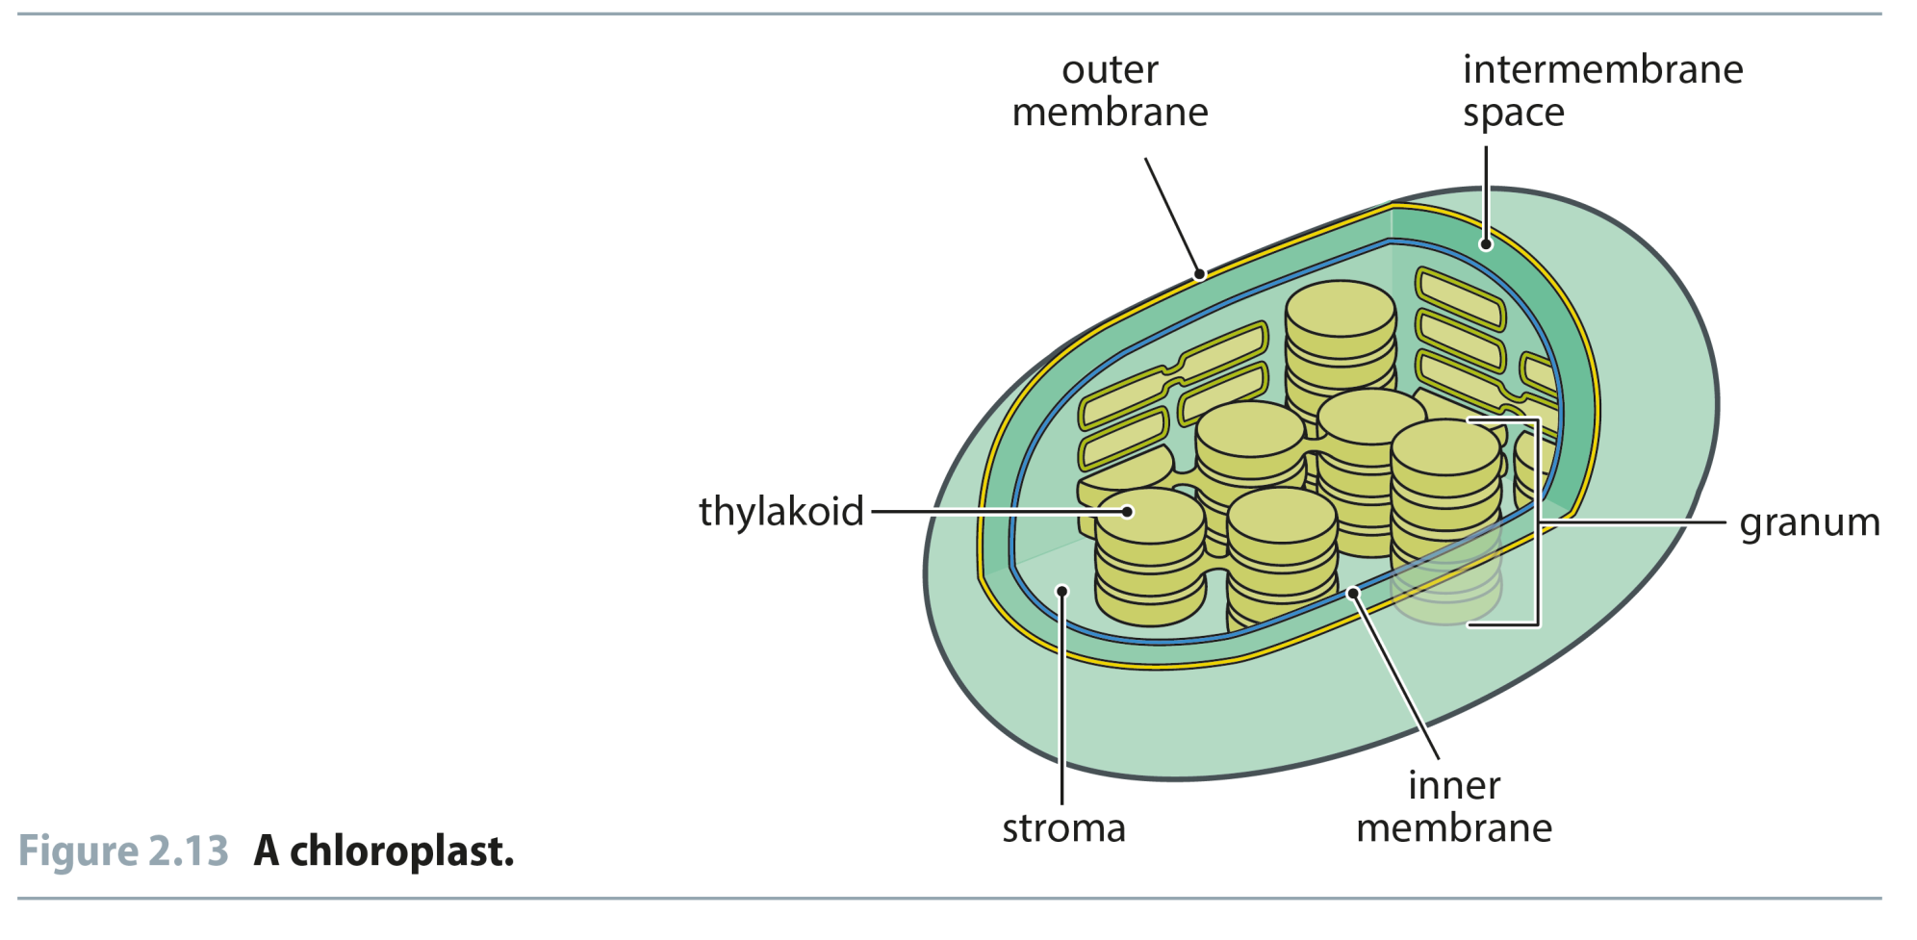
Fig 2.13
Reproduced from: Biochemistry by T.A. Brown, ISBN: 9781907904288 © Scion Publishing Ltd, 2017

Slide 15
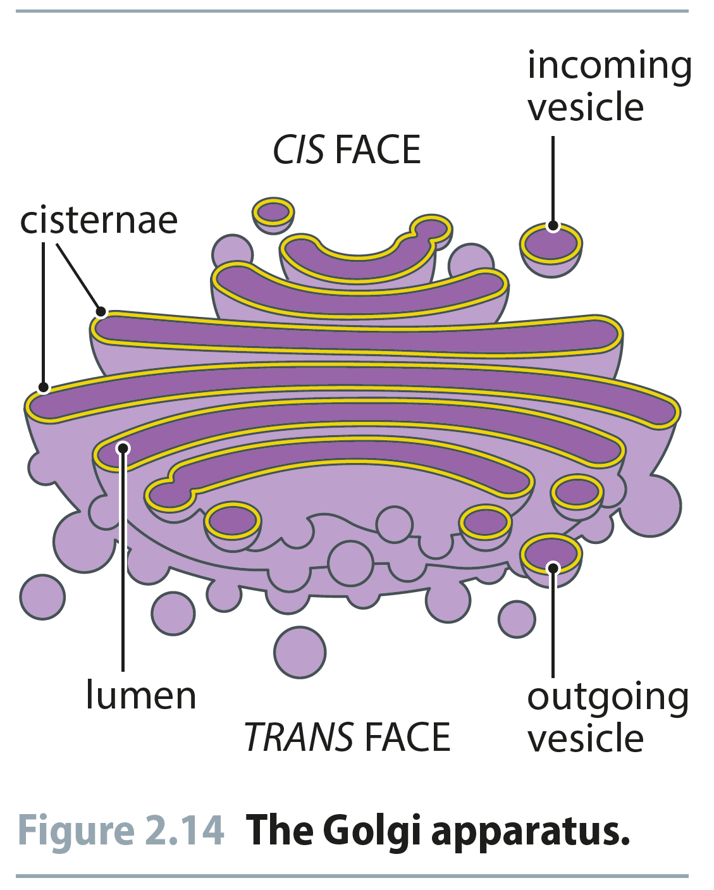
Fig 2.14
Reproduced from: Biochemistry by T.A. Brown, ISBN: 9781907904288 © Scion Publishing Ltd, 2017

Slide 16
Fig 2.15
Reproduced from: Biochemistry by T.A. Brown, ISBN: 9781907904288 © Scion Publishing Ltd, 2017

Slide 17
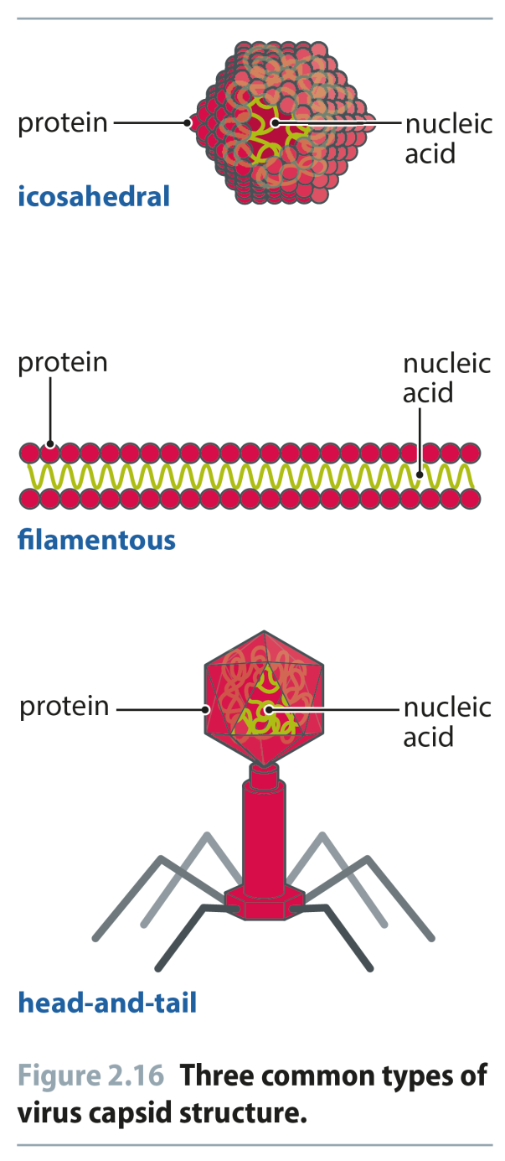
Fig 2.16
Reproduced from: Biochemistry by T.A. Brown, ISBN: 9781907904288 © Scion Publishing Ltd, 2017

Slide 18
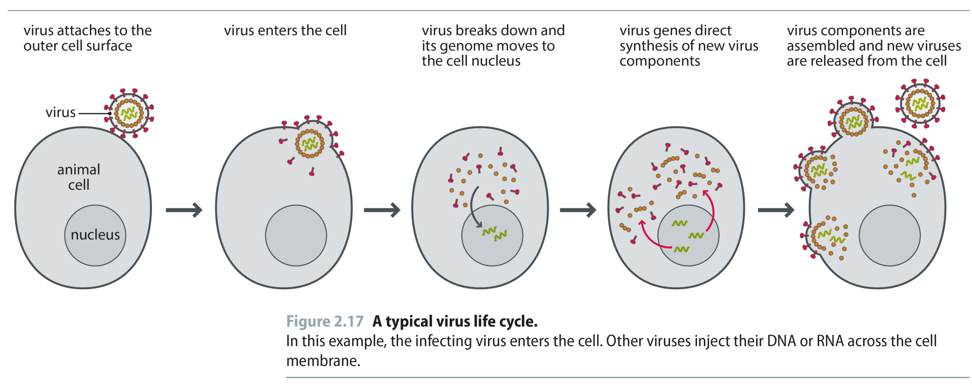
Fig 2.17
Reproduced from: Biochemistry by T.A. Brown, ISBN: 9781907904288 © Scion Publishing Ltd, 2017

Slide 19
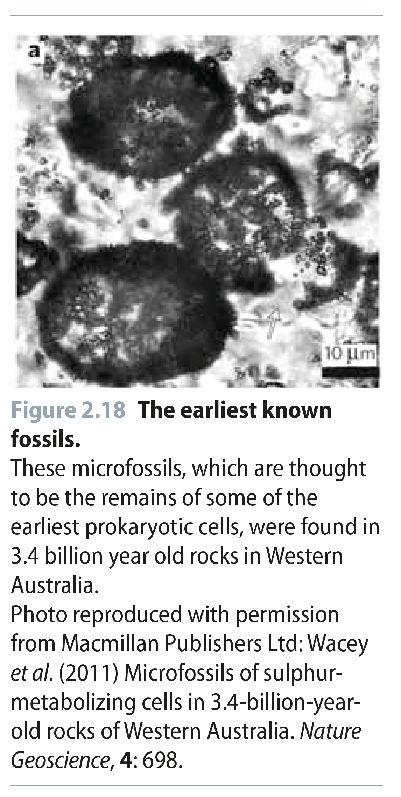
Fig 2.18
Reproduced from: Biochemistry by T.A. Brown, ISBN: 9781907904288 © Scion Publishing Ltd, 2017

Slide 20
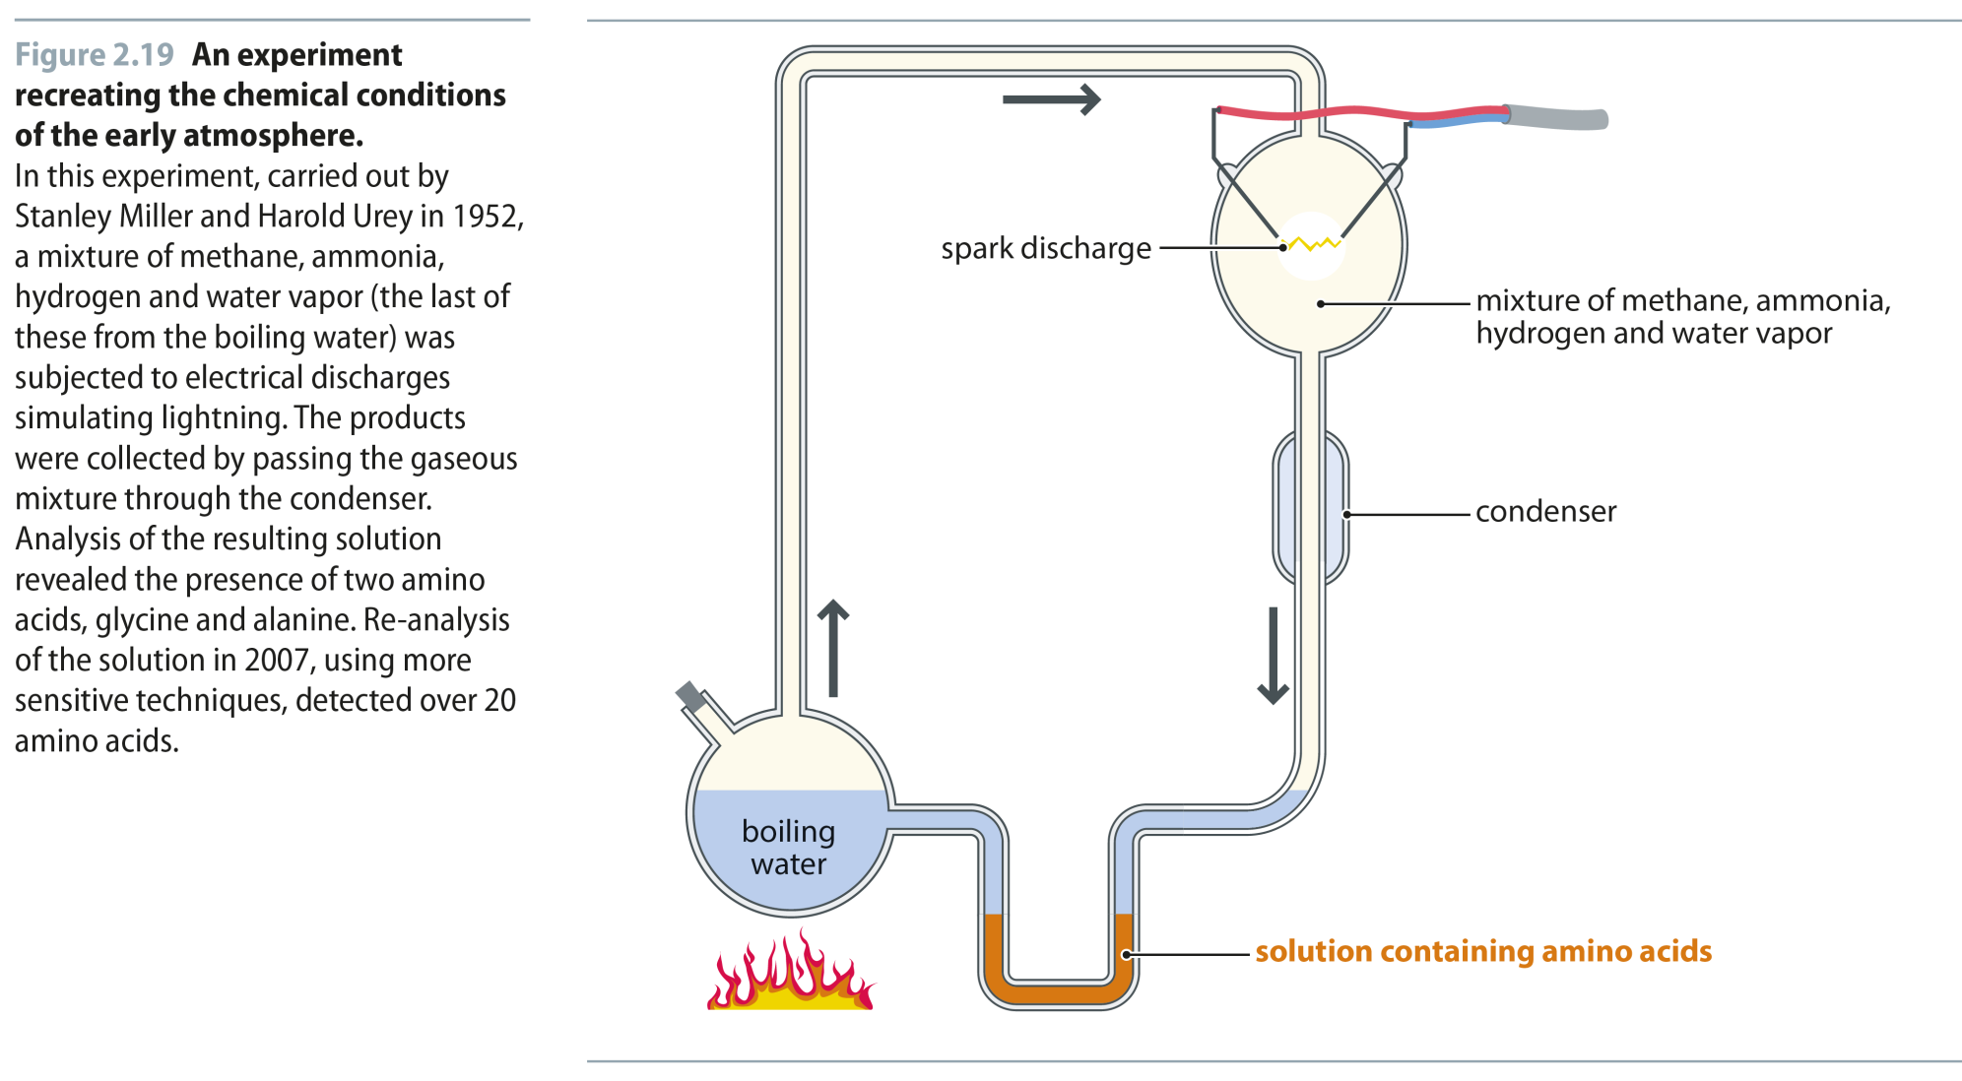
Fig 2.19
Reproduced from: Biochemistry by T.A. Brown, ISBN: 9781907904288 © Scion Publishing Ltd, 2017

Slide 21
Fig 2.20
Reproduced from: Biochemistry by T.A. Brown, ISBN: 9781907904288 © Scion Publishing Ltd, 2017

Slide 22
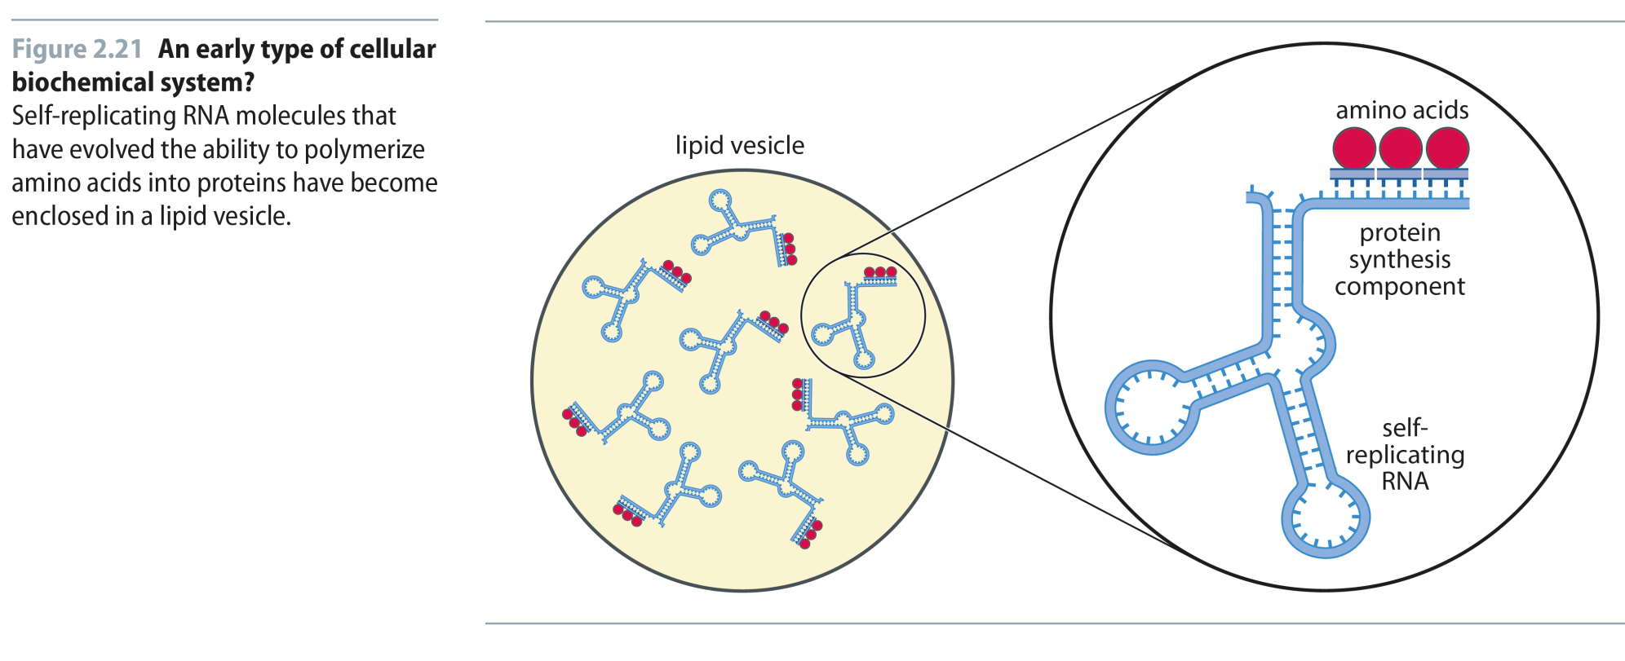
Fig 2.21
Reproduced from: Biochemistry by T.A. Brown, ISBN: 9781907904288 © Scion Publishing Ltd, 2017

Slide 23
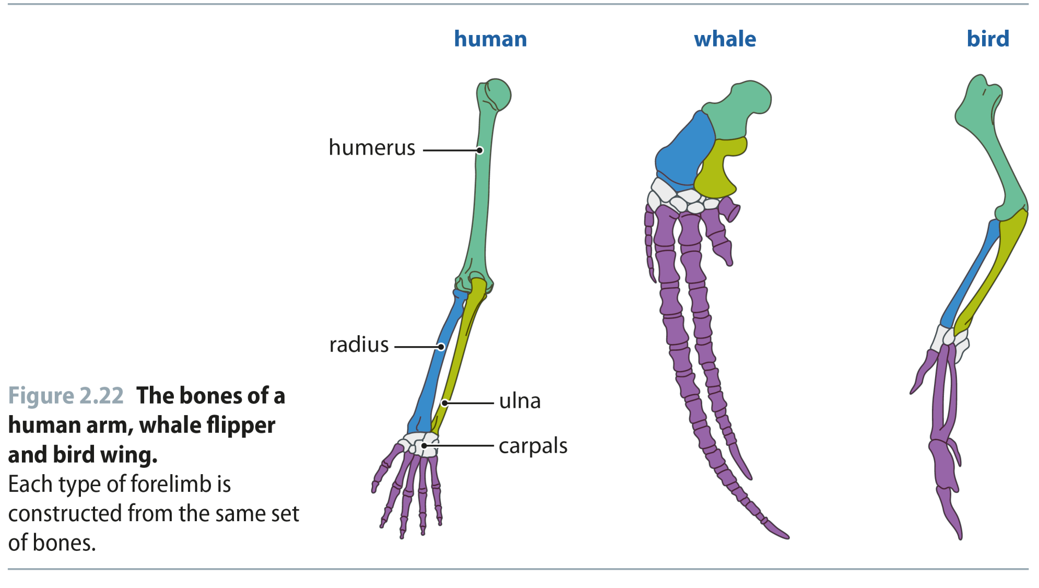
Fig 2.22
Reproduced from: Biochemistry by T.A. Brown, ISBN: 9781907904288 © Scion Publishing Ltd, 2017

Slide 24
Fig 2.23
Reproduced from: Biochemistry by T.A. Brown, ISBN: 9781907904288 © Scion Publishing Ltd, 2017

