Slide 1
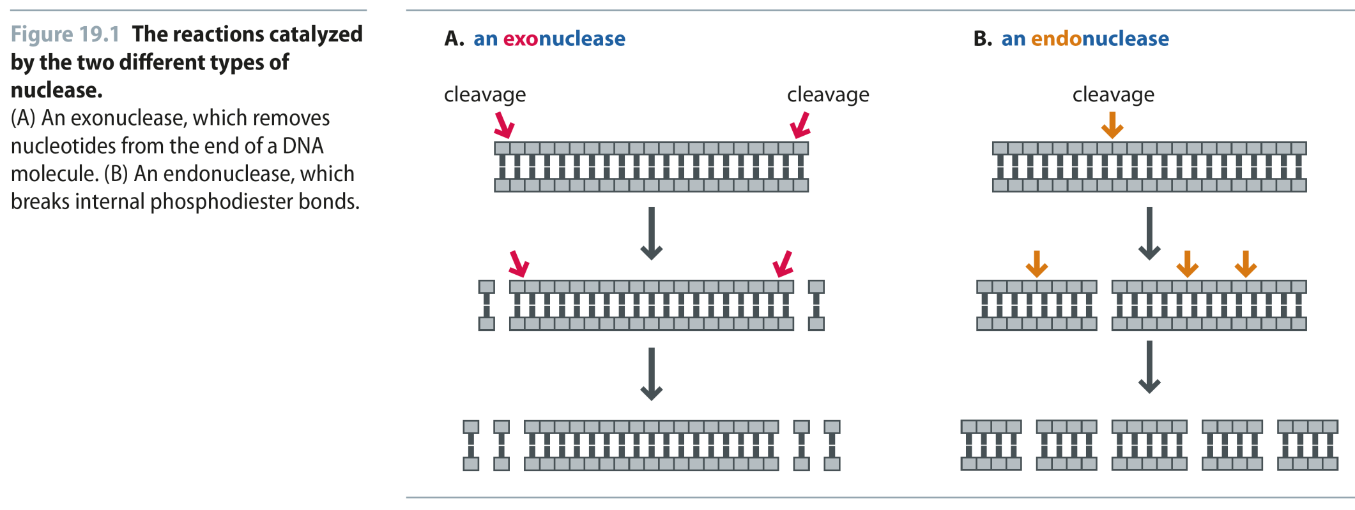
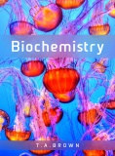
Fig 19.1
Reproduced from: Biochemistry by T.A. Brown, ISBN: 9781907904288 © Scion Publishing Ltd, 2017

Slide 2
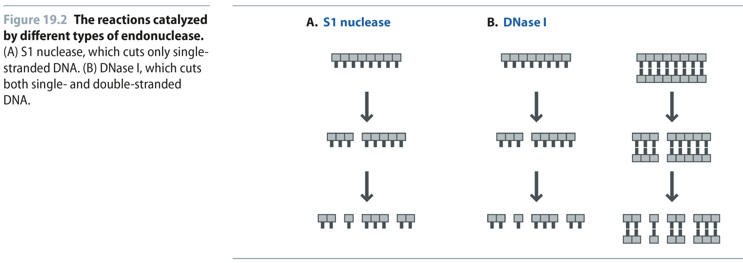
Fig 19.2
Reproduced from: Biochemistry by T.A. Brown, ISBN: 9781907904288 © Scion Publishing Ltd, 2017

Slide 3
Fig 19.3
Reproduced from: Biochemistry by T.A. Brown, ISBN: 9781907904288 © Scion Publishing Ltd, 2017

Slide 4
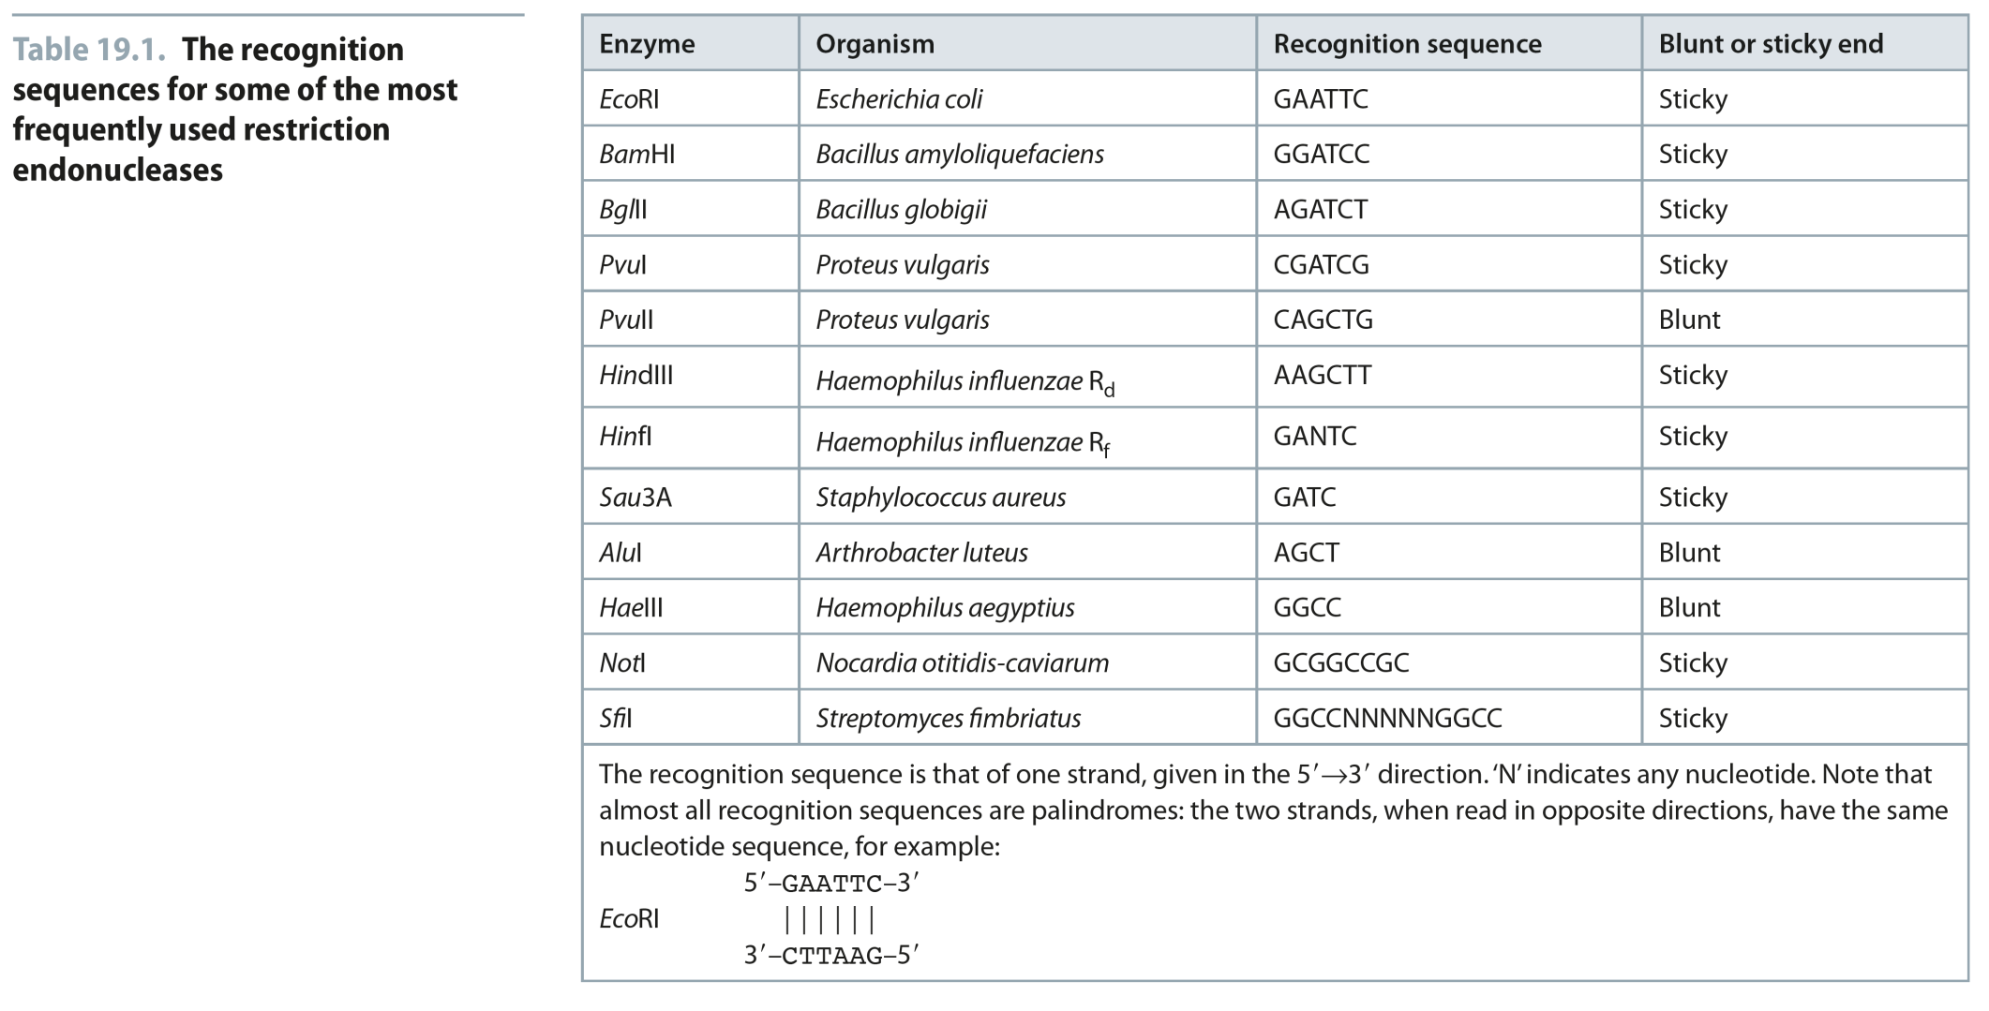
Table 19.1
Reproduced from: Biochemistry by T.A. Brown, ISBN: 9781907904288 © Scion Publishing Ltd, 2017

Slide 5
Fig 19.4
Reproduced from: Biochemistry by T.A. Brown, ISBN: 9781907904288 © Scion Publishing Ltd, 2017

Slide 6
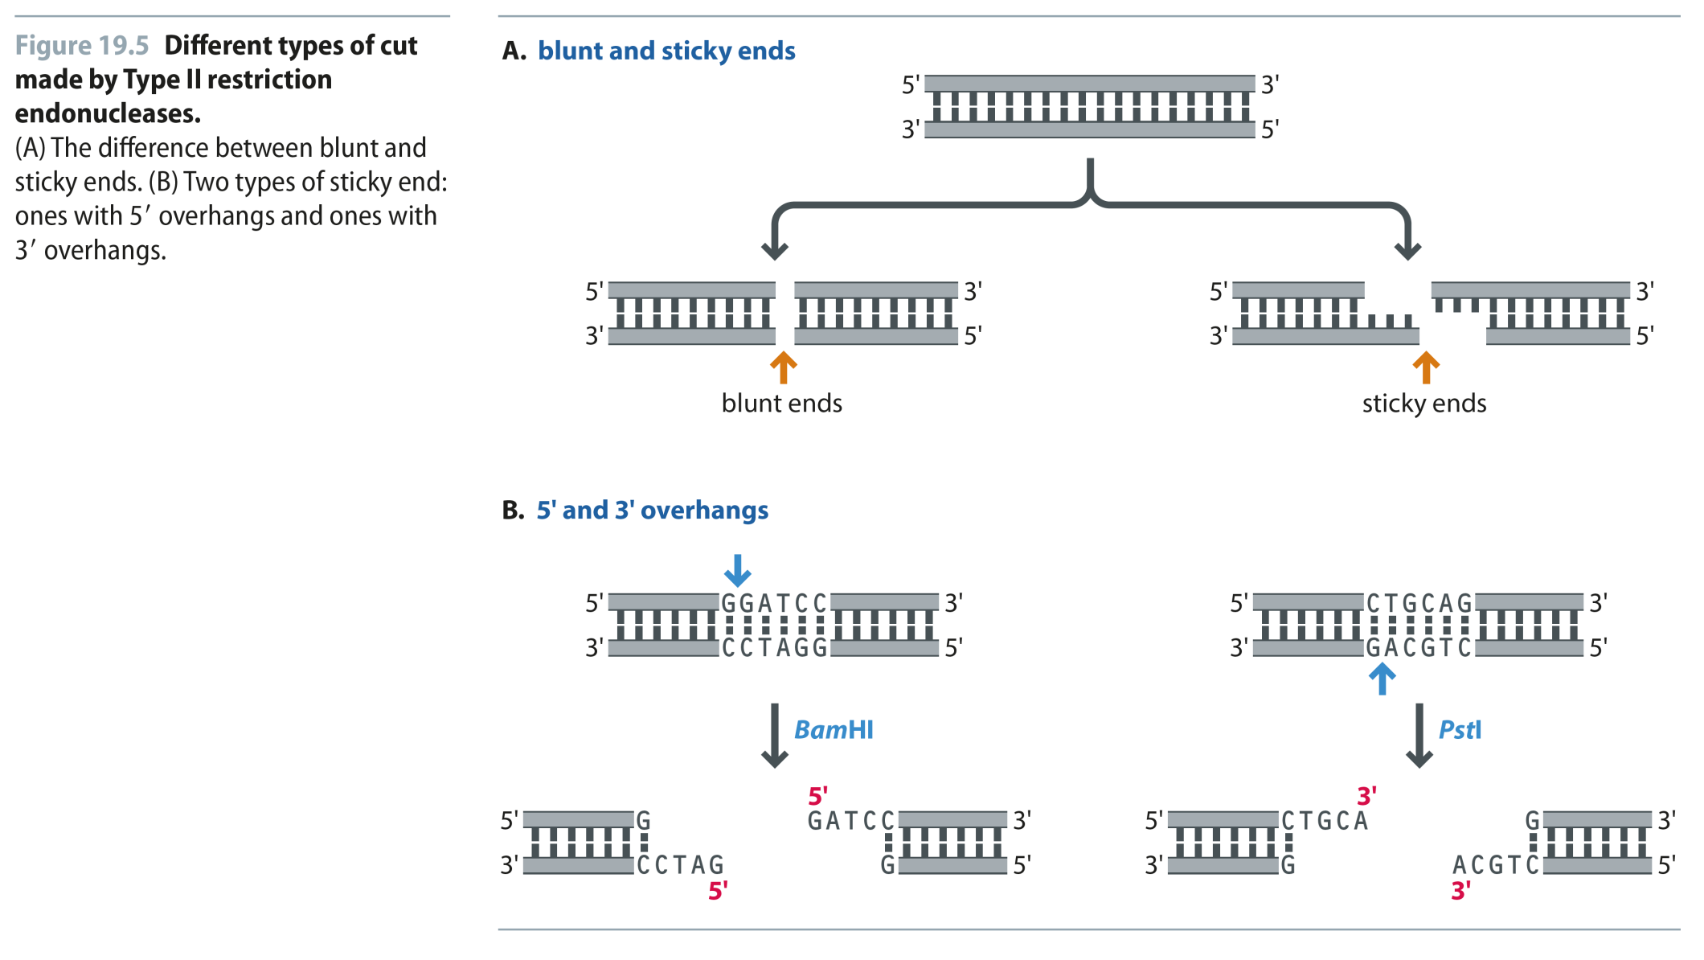
Fig 19.5
Reproduced from: Biochemistry by T.A. Brown, ISBN: 9781907904288 © Scion Publishing Ltd, 2017

Slide 7
Fig 19.6
Reproduced from: Biochemistry by T.A. Brown, ISBN: 9781907904288 © Scion Publishing Ltd, 2017

Slide 8
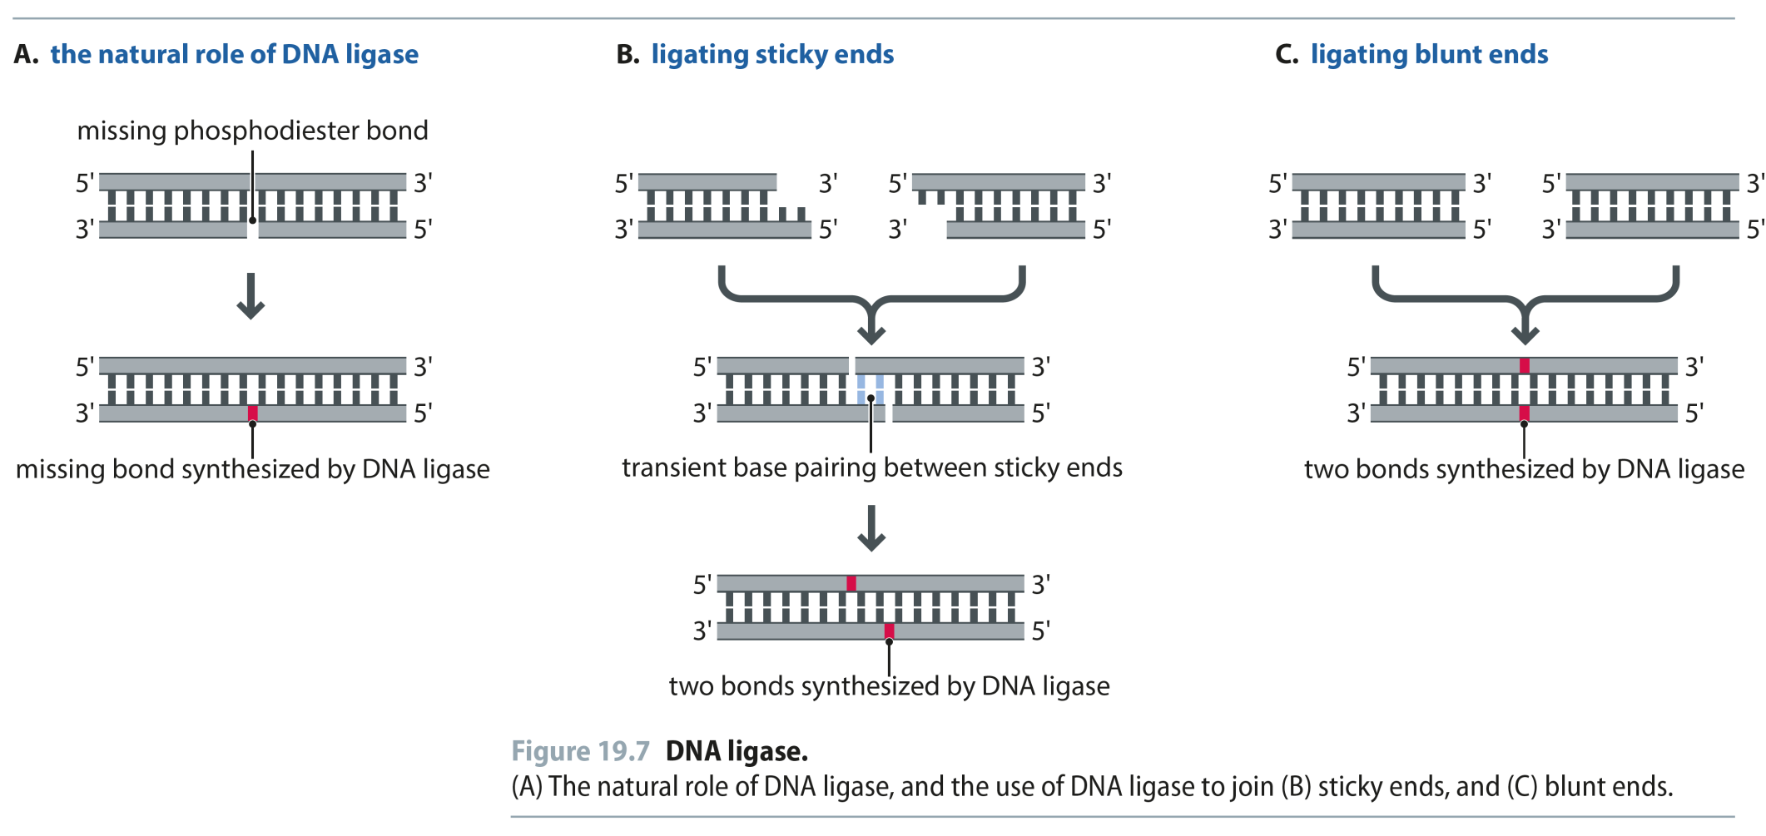
Fig 19.7
Reproduced from: Biochemistry by T.A. Brown, ISBN: 9781907904288 © Scion Publishing Ltd, 2017

Slide 9
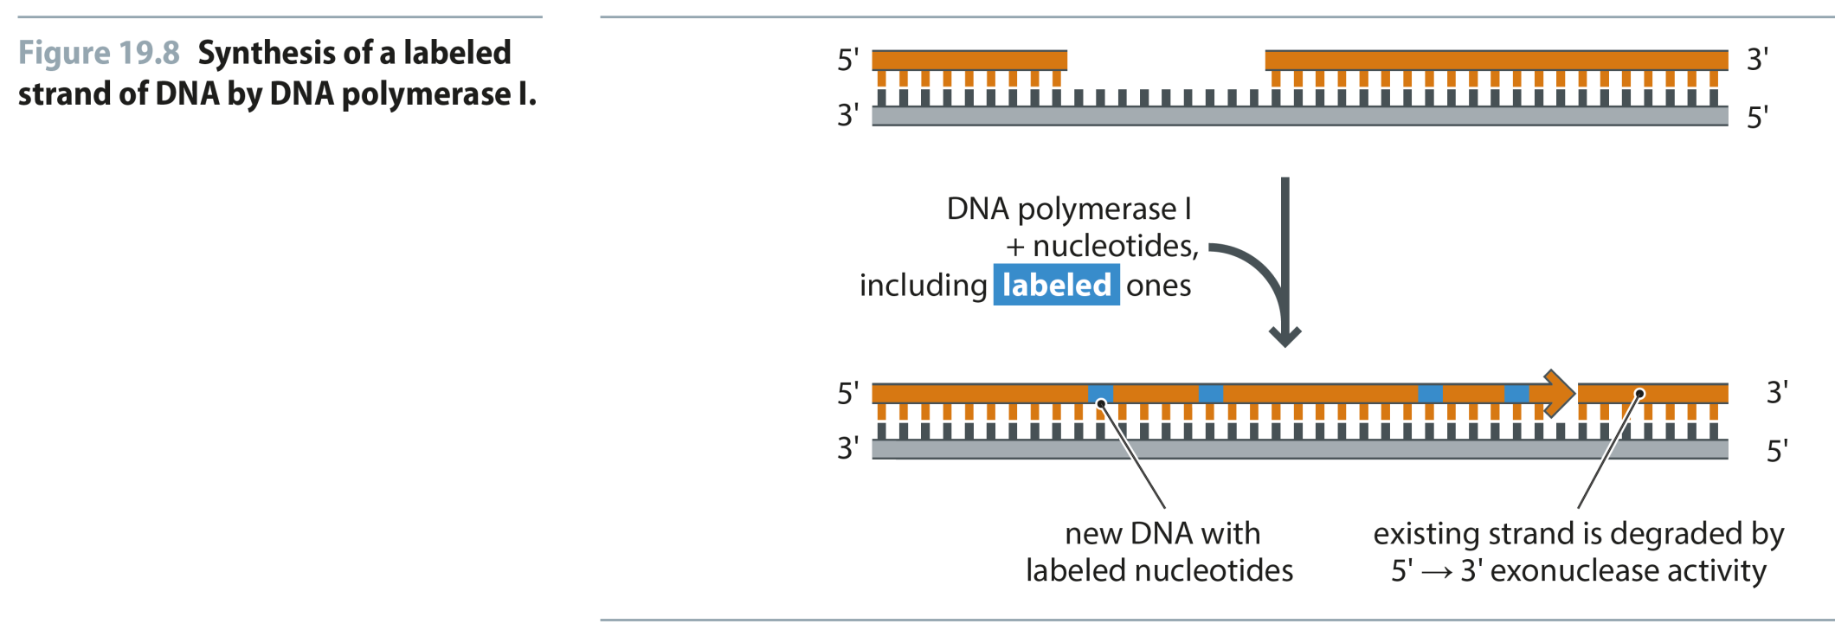
Fig 19.8
Reproduced from: Biochemistry by T.A. Brown, ISBN: 9781907904288 © Scion Publishing Ltd, 2017

Slide 10
Fig 19.9
Reproduced from: Biochemistry by T.A. Brown, ISBN: 9781907904288 © Scion Publishing Ltd, 2017

Slide 11
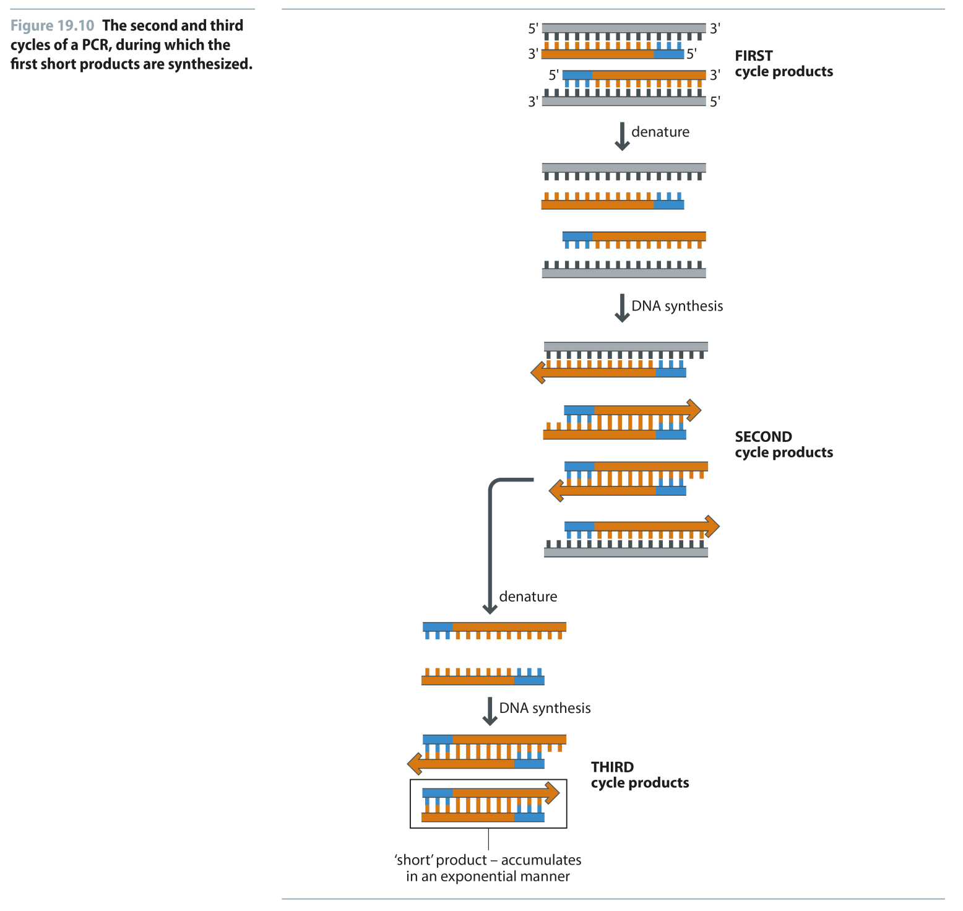
Fig 19.10
Reproduced from: Biochemistry by T.A. Brown, ISBN: 9781907904288 © Scion Publishing Ltd, 2017

Slide 12
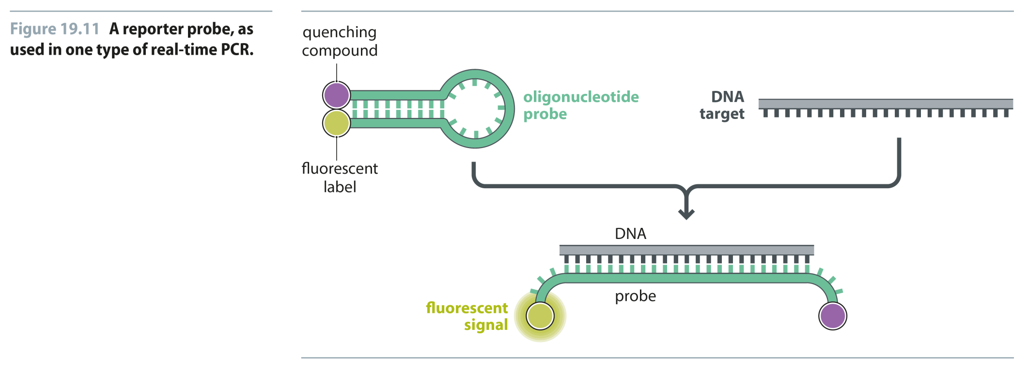
Fig 19.11
Reproduced from: Biochemistry by T.A. Brown, ISBN: 9781907904288 © Scion Publishing Ltd, 2017

Slide 13
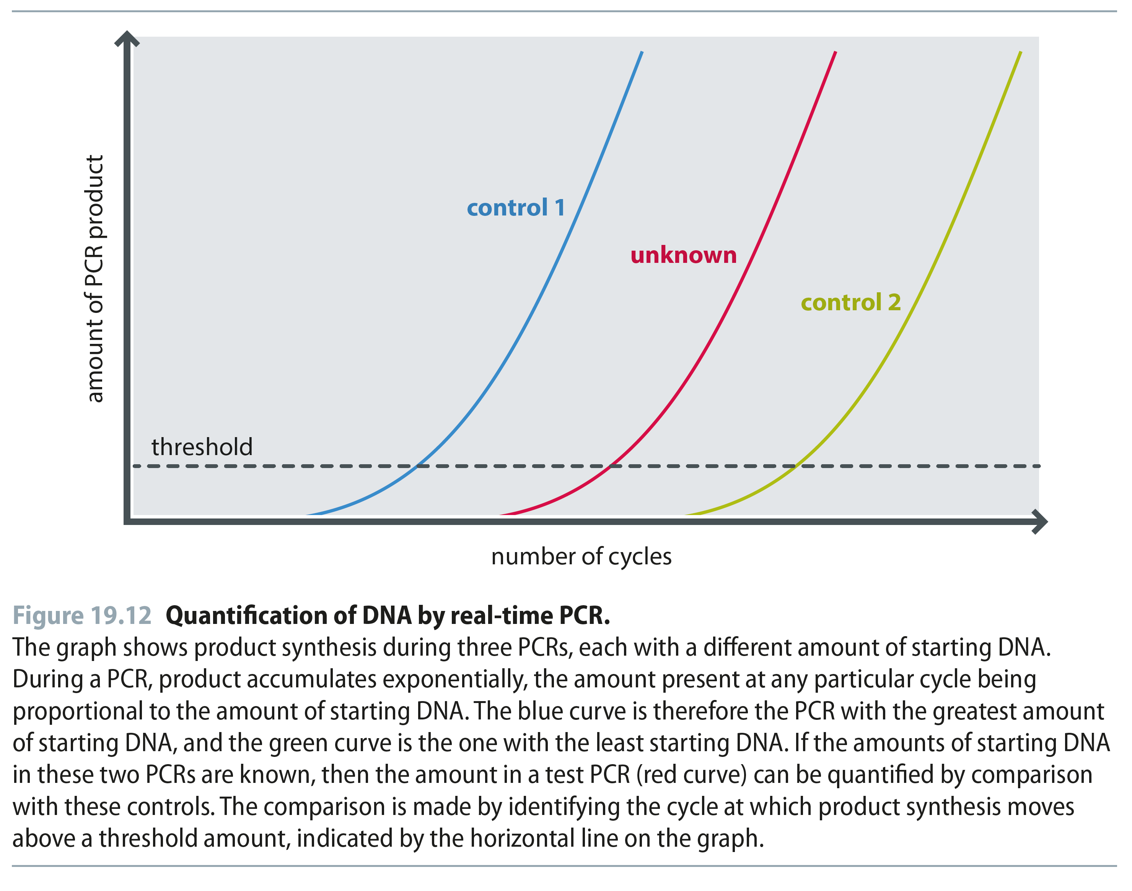
Fig 19.12
Reproduced from: Biochemistry by T.A. Brown, ISBN: 9781907904288 © Scion Publishing Ltd, 2017

Slide 14
Fig 19.13
Reproduced from: Biochemistry by T.A. Brown, ISBN: 9781907904288 © Scion Publishing Ltd, 2017

Slide 15
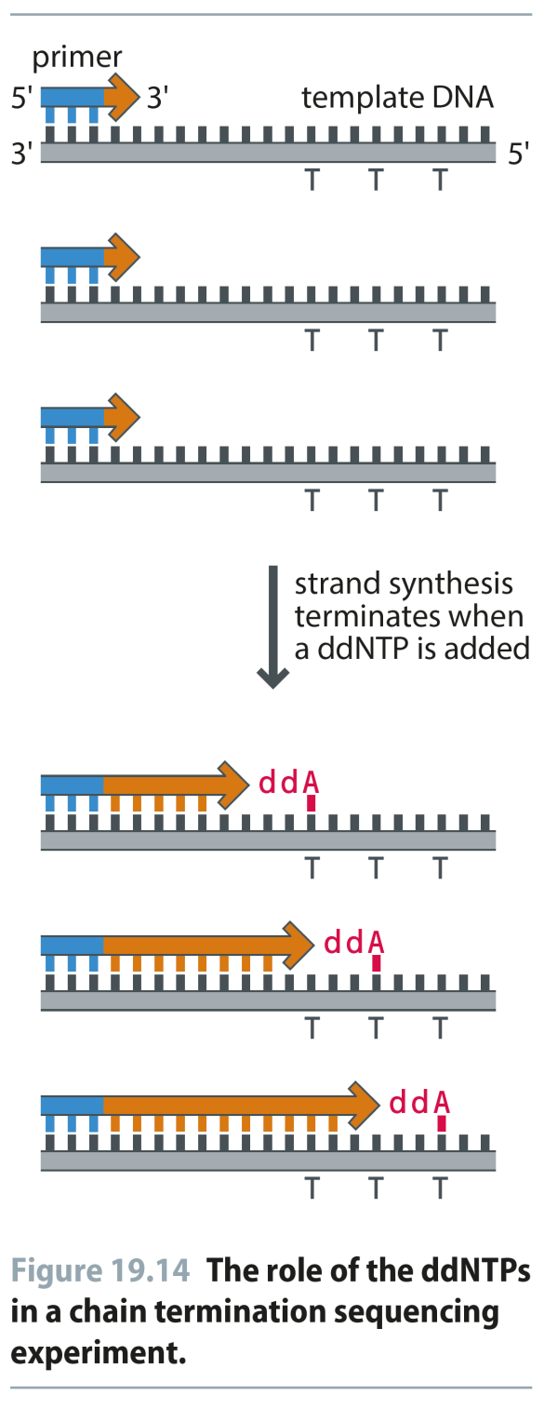
Fig 19.14
Reproduced from: Biochemistry by T.A. Brown, ISBN: 9781907904288 © Scion Publishing Ltd, 2017

Slide 16
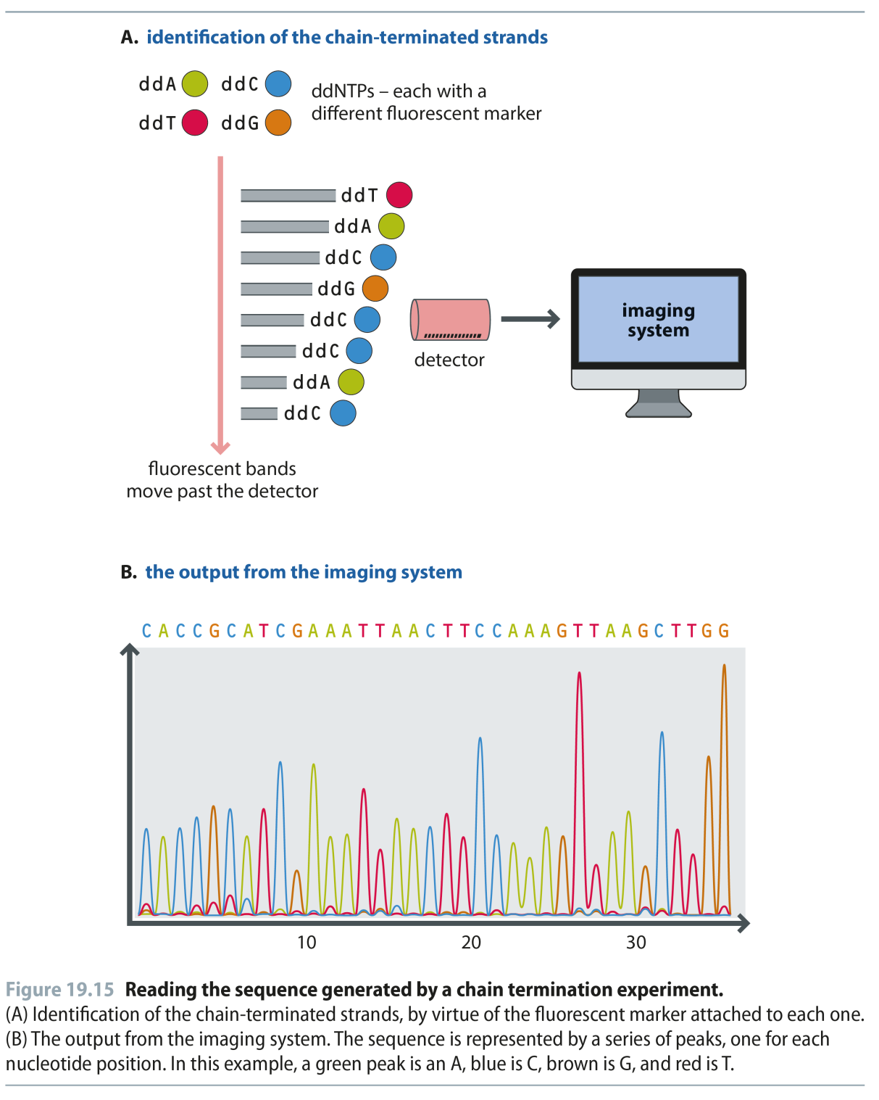
Fig 19.15
Reproduced from: Biochemistry by T.A. Brown, ISBN: 9781907904288 © Scion Publishing Ltd, 2017

Slide 17
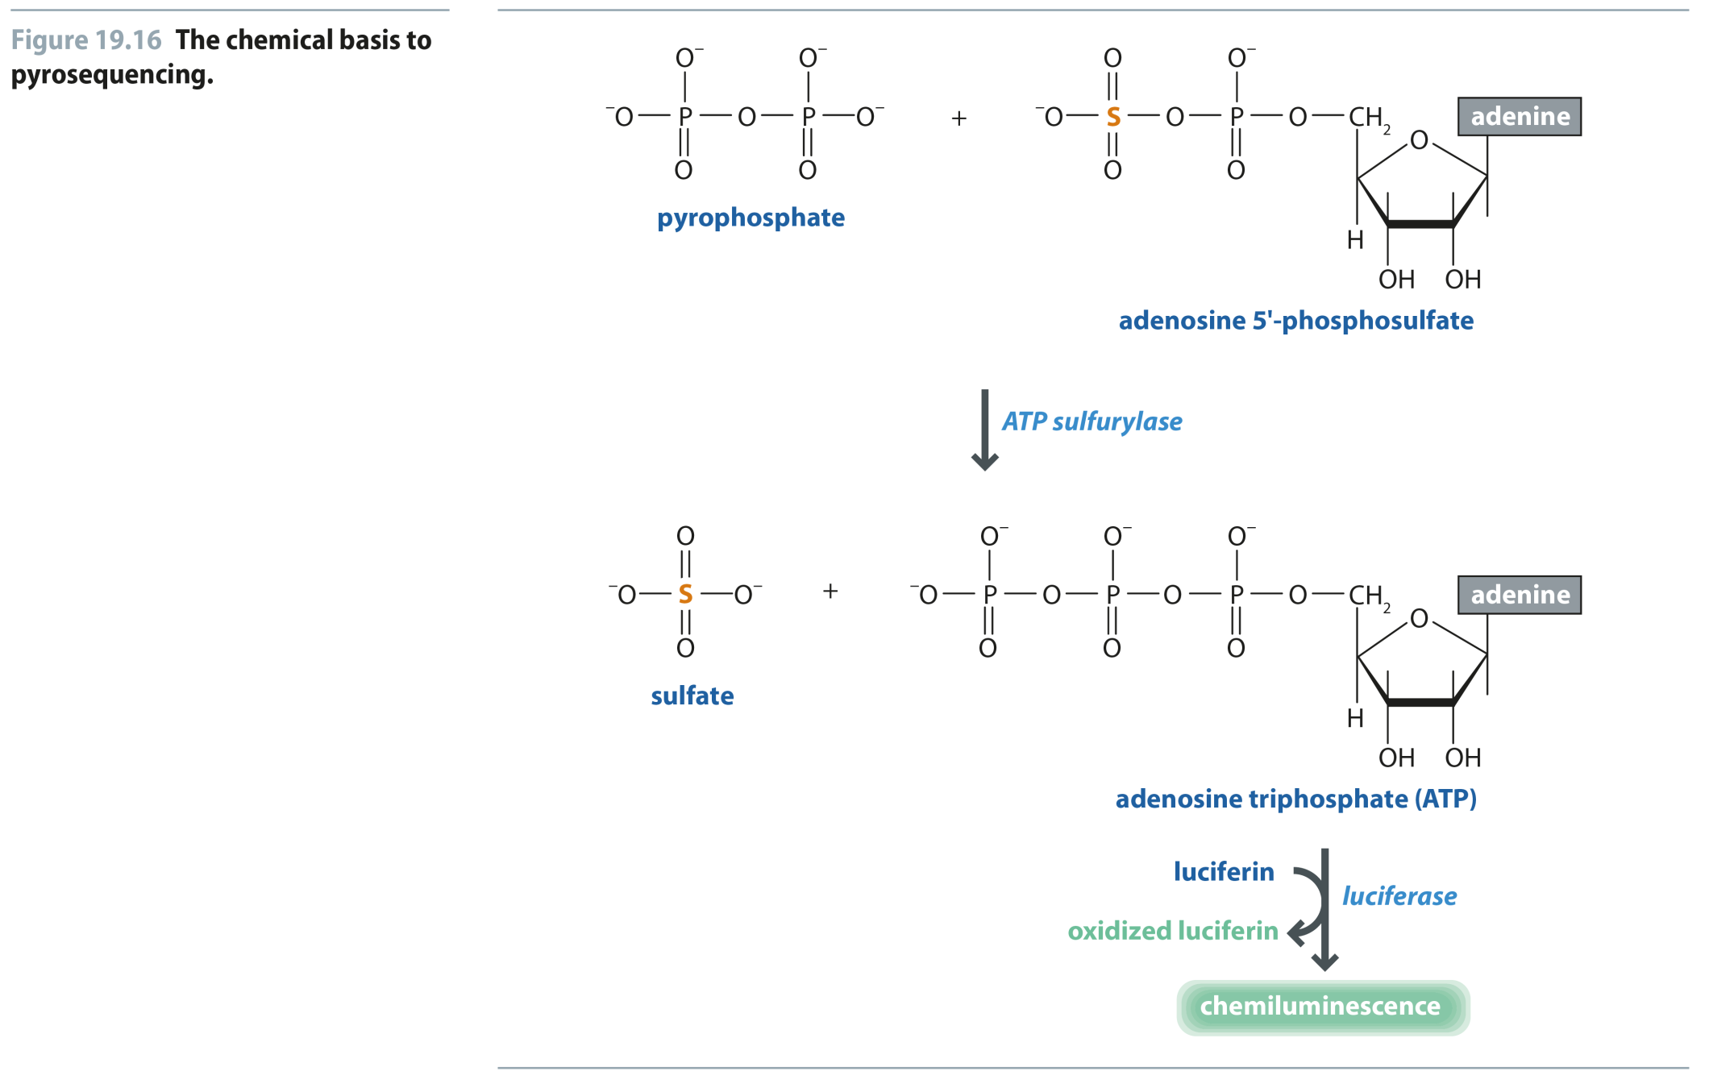
Fig 19.16
Reproduced from: Biochemistry by T.A. Brown, ISBN: 9781907904288 © Scion Publishing Ltd, 2017

Slide 18
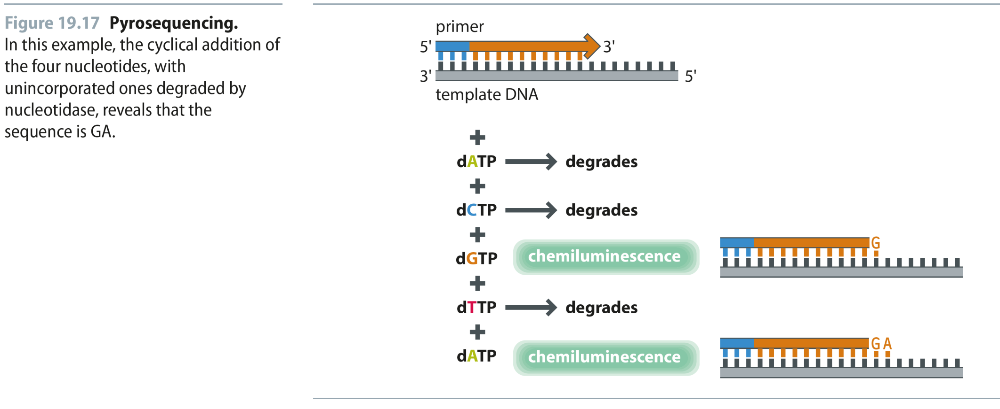
Fig 19.17
Reproduced from: Biochemistry by T.A. Brown, ISBN: 9781907904288 © Scion Publishing Ltd, 2017

Slide 19
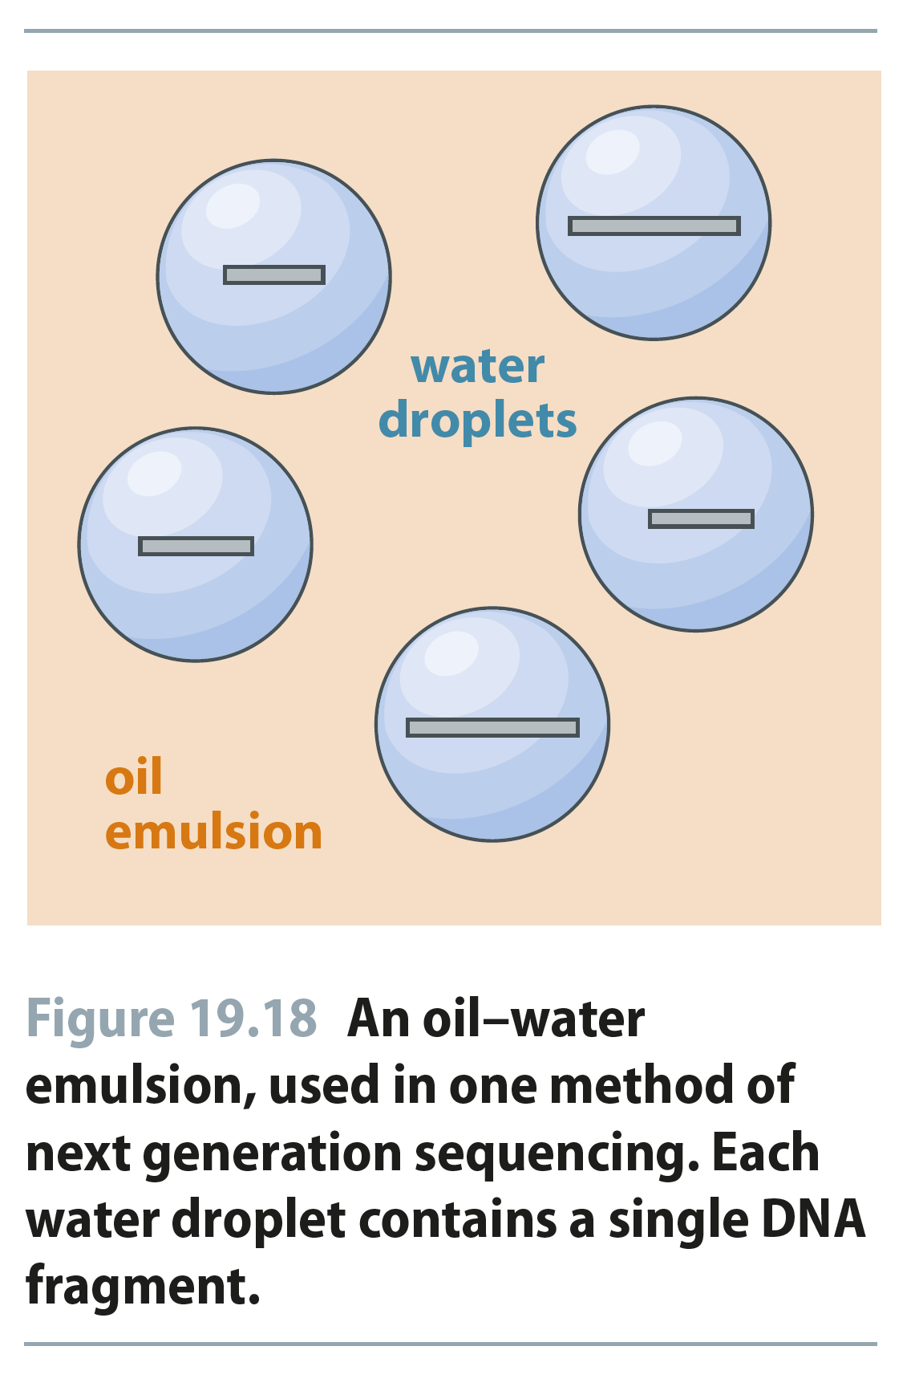
Fig 19.18
Reproduced from: Biochemistry by T.A. Brown, ISBN: 9781907904288 © Scion Publishing Ltd, 2017

Slide 20
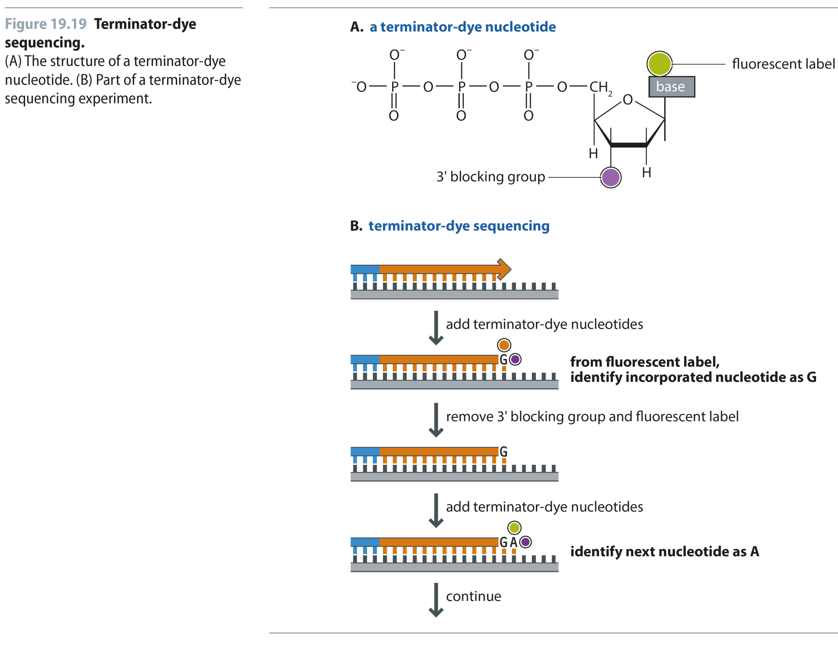
Fig 19.19
Reproduced from: Biochemistry by T.A. Brown, ISBN: 9781907904288 © Scion Publishing Ltd, 2017

Slide 21
Fig 19.20
Reproduced from: Biochemistry by T.A. Brown, ISBN: 9781907904288 © Scion Publishing Ltd, 2017

Slide 22
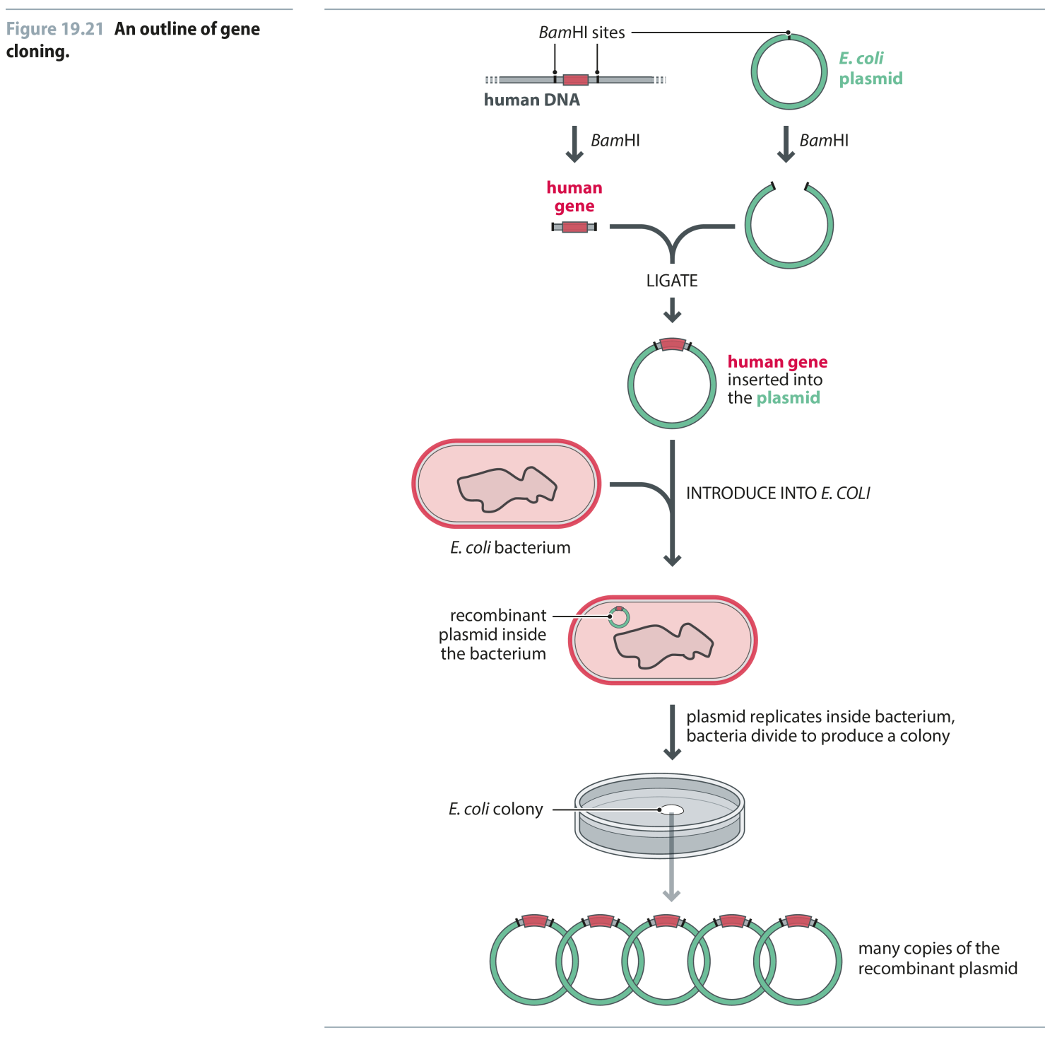
Fig 19.21
Reproduced from: Biochemistry by T.A. Brown, ISBN: 9781907904288 © Scion Publishing Ltd, 2017

Slide 23
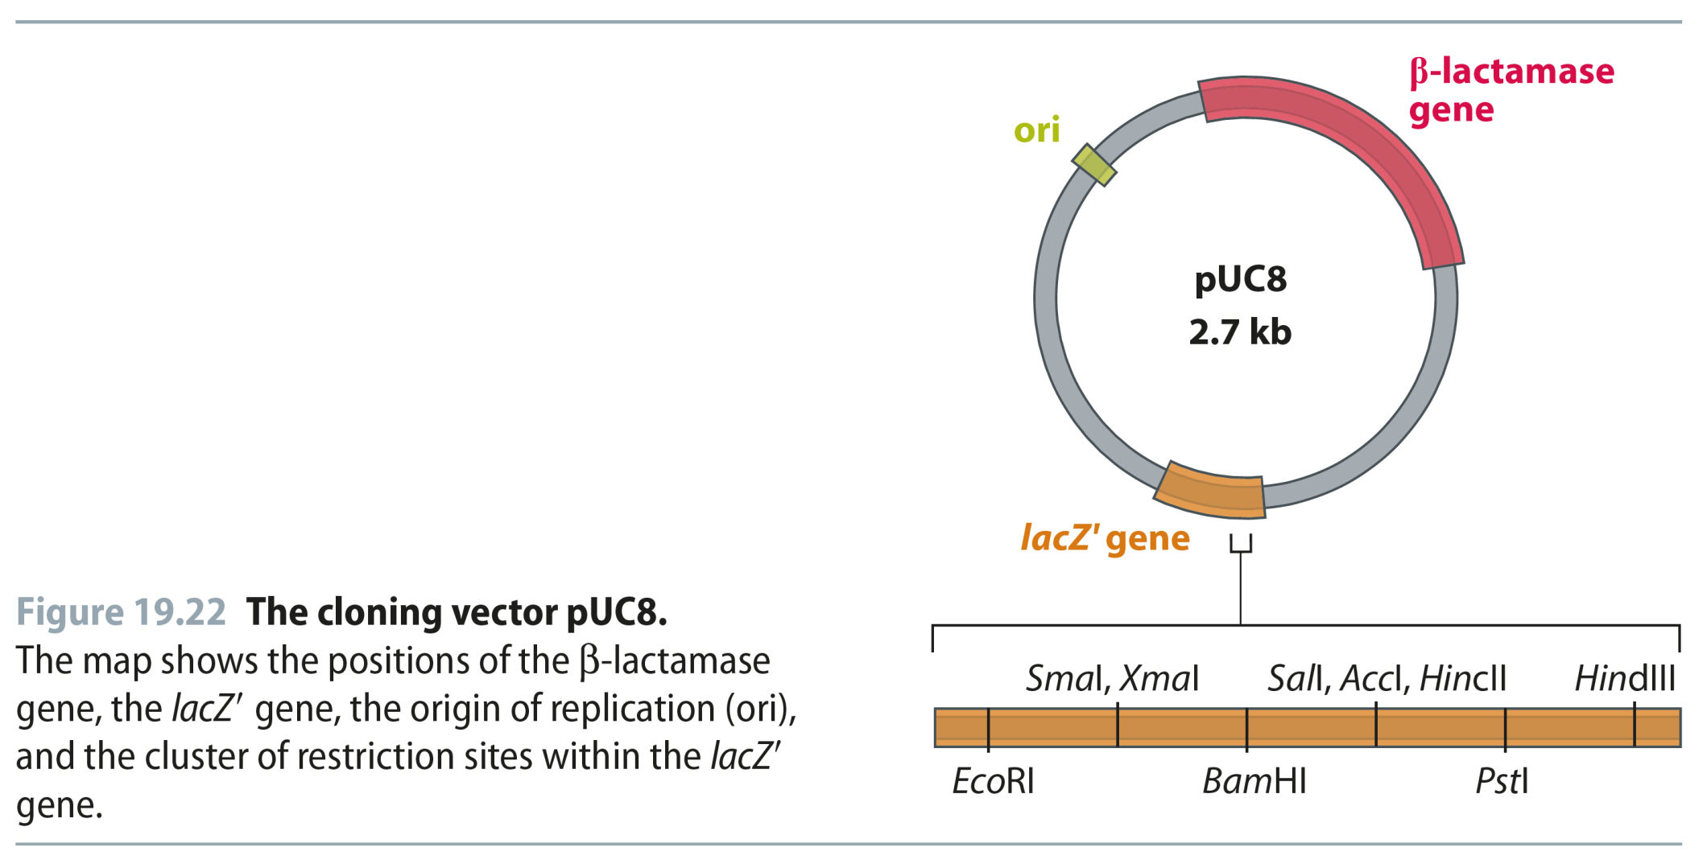
Fig 19.22
Reproduced from: Biochemistry by T.A. Brown, ISBN: 9781907904288 © Scion Publishing Ltd, 2017

Slide 24
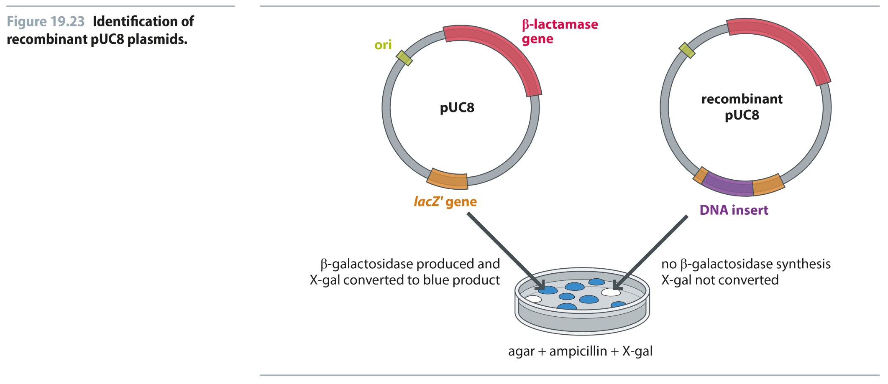
Fig 19.23
Reproduced from: Biochemistry by T.A. Brown, ISBN: 9781907904288 © Scion Publishing Ltd, 2017

Slide 25
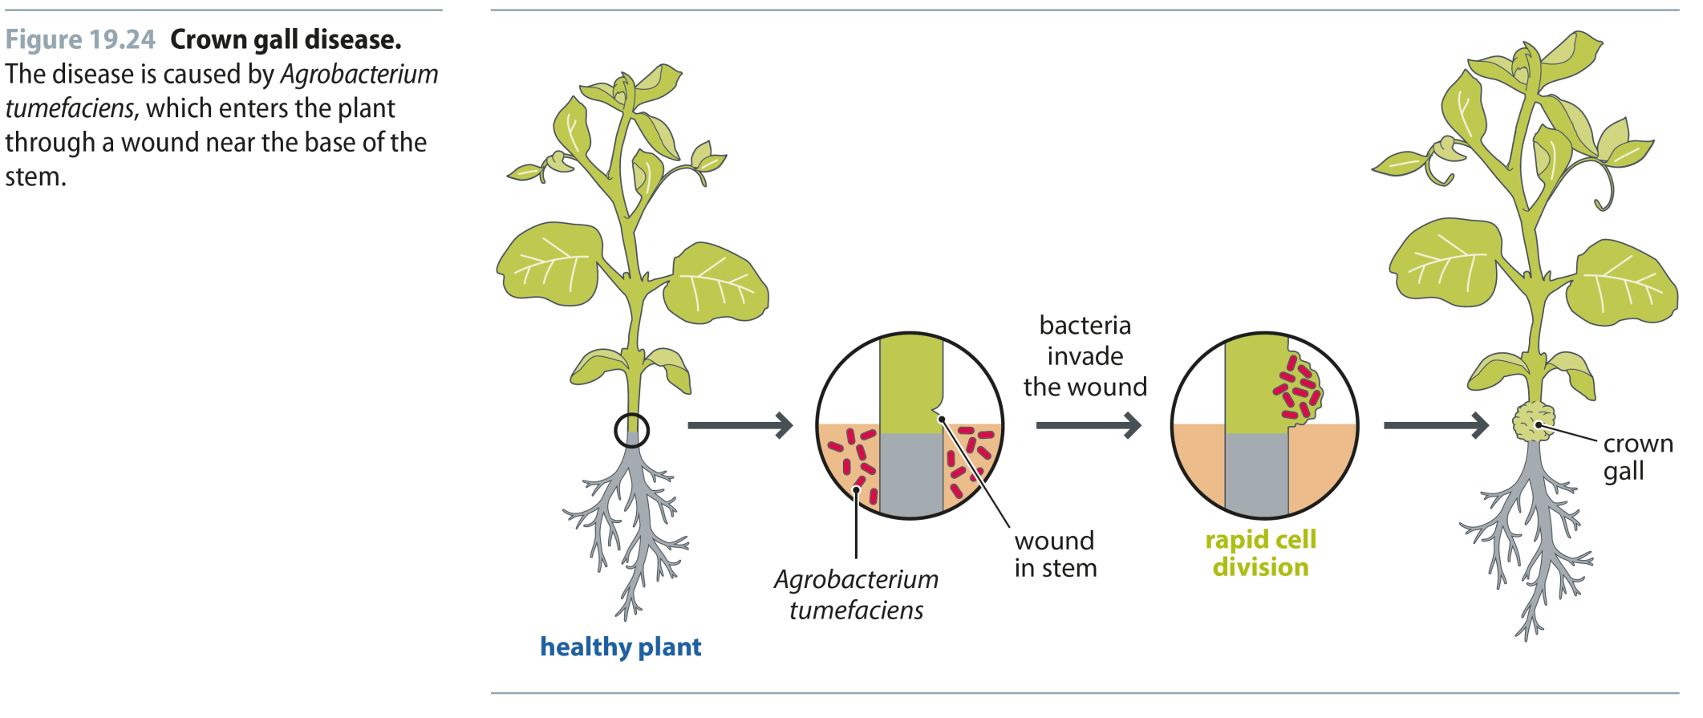
Fig 19.24
Reproduced from: Biochemistry by T.A. Brown, ISBN: 9781907904288 © Scion Publishing Ltd, 2017

Slide 26
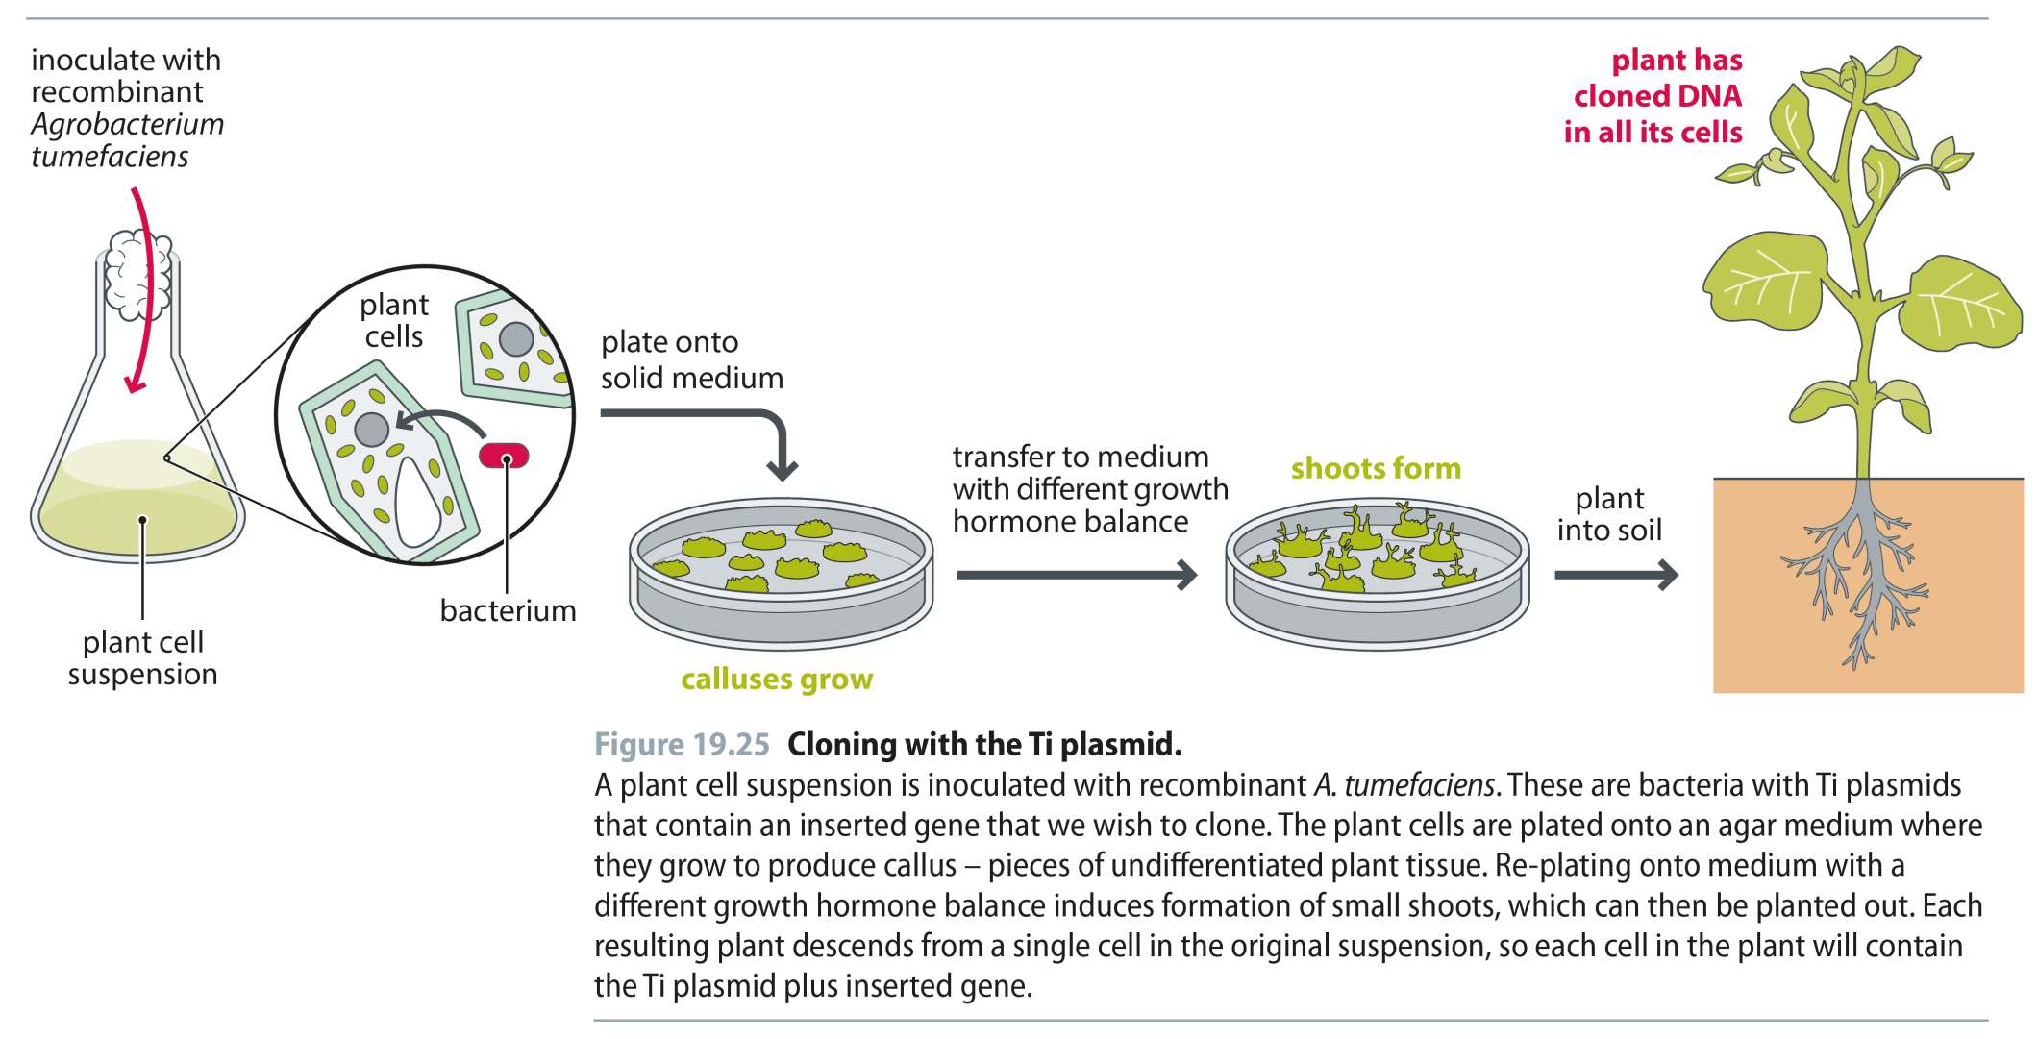
Fig 19.25
Reproduced from: Biochemistry by T.A. Brown, ISBN: 9781907904288 © Scion Publishing Ltd, 2017

Slide 27
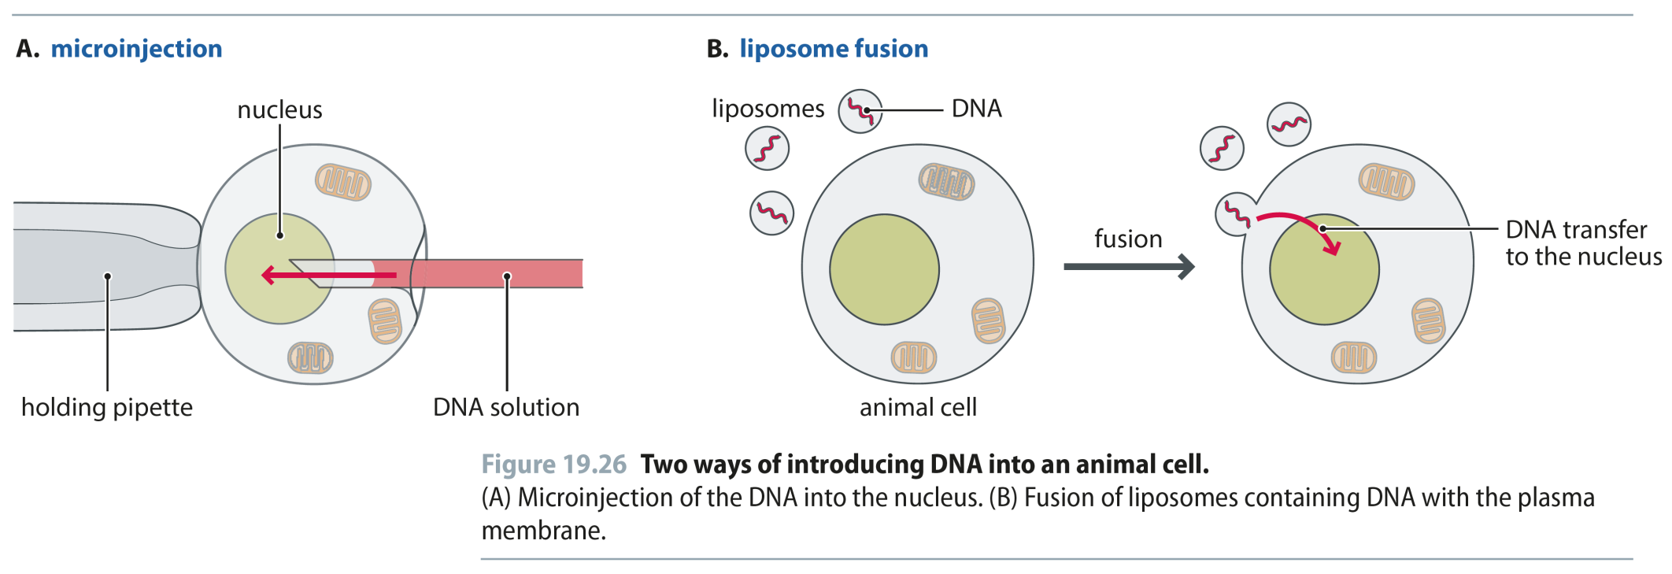
Fig 19.26
Reproduced from: Biochemistry by T.A. Brown, ISBN: 9781907904288 © Scion Publishing Ltd, 2017

Slide 28
Fig 19.27
Reproduced from: Biochemistry by T.A. Brown, ISBN: 9781907904288 © Scion Publishing Ltd, 2017

Slide 29
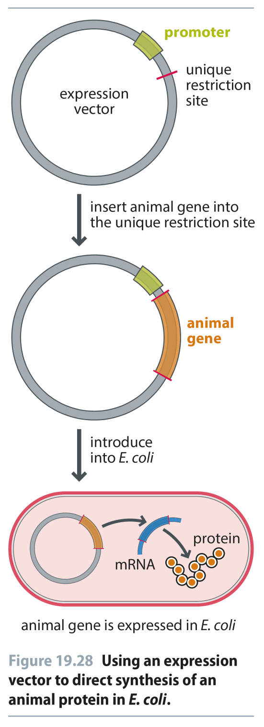
Fig 19.28
Reproduced from: Biochemistry by T.A. Brown, ISBN: 9781907904288 © Scion Publishing Ltd, 2017

Slide 30
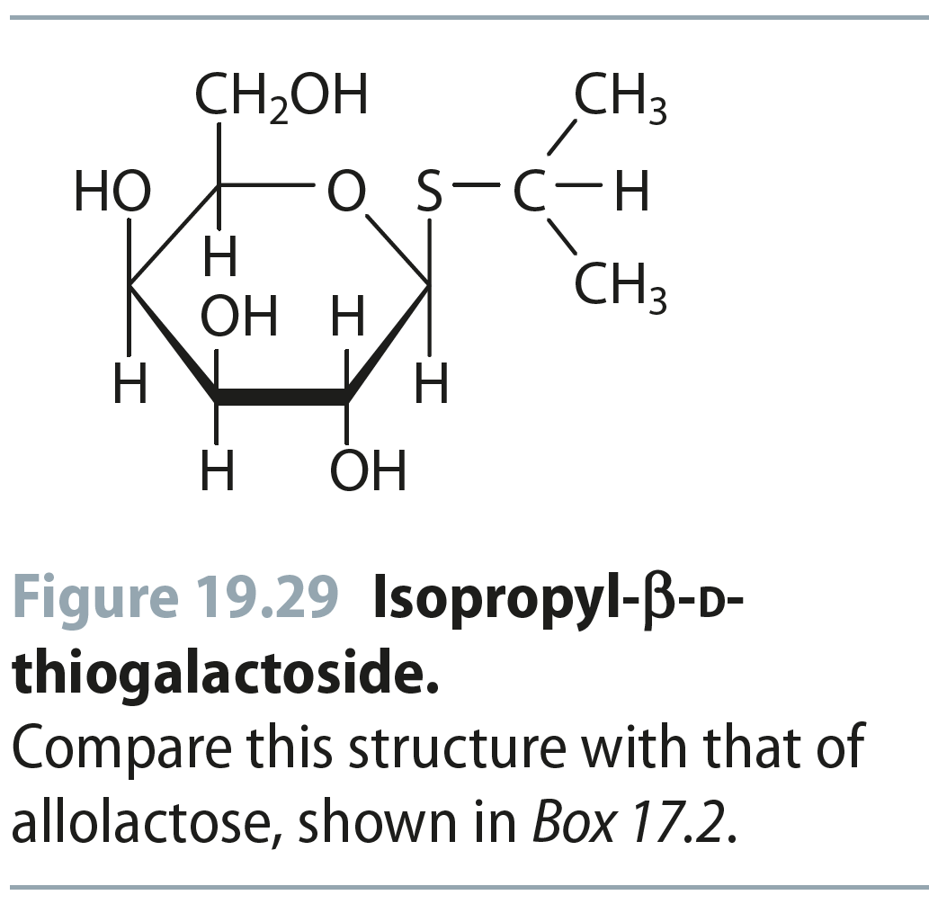
Fig 19.29
Reproduced from: Biochemistry by T.A. Brown, ISBN: 9781907904288 © Scion Publishing Ltd, 2017

Slide 31
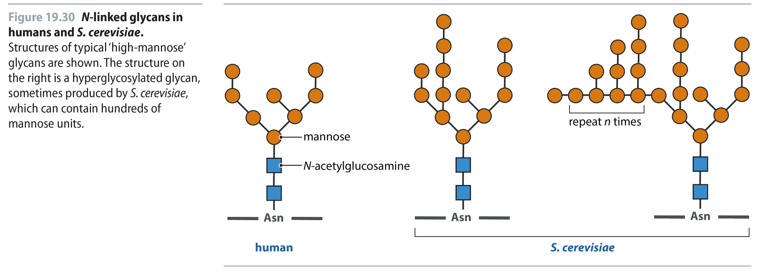
Fig 19.30
Reproduced from: Biochemistry by T.A. Brown, ISBN: 9781907904288 © Scion Publishing Ltd, 2017

