Slide 1
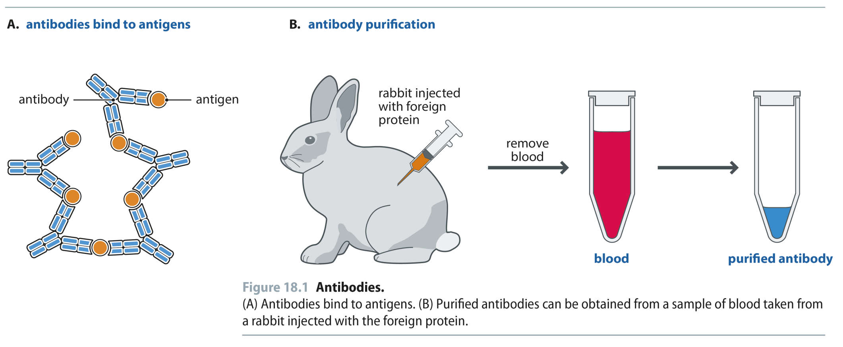
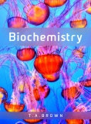
Fig 18.1
Reproduced from: Biochemistry by T.A. Brown, ISBN: 9781907904288 © Scion Publishing Ltd, 2017

Slide 2
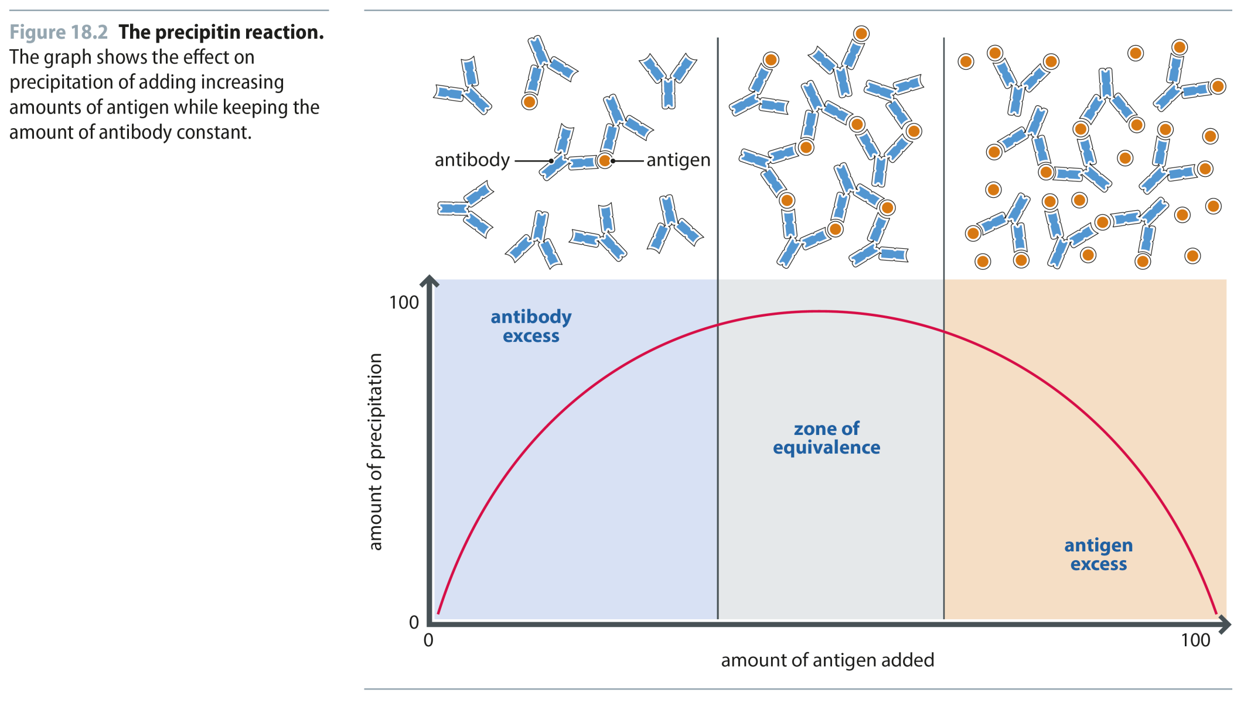
Fig 18.2
Reproduced from: Biochemistry by T.A. Brown, ISBN: 9781907904288 © Scion Publishing Ltd, 2017

Slide 3
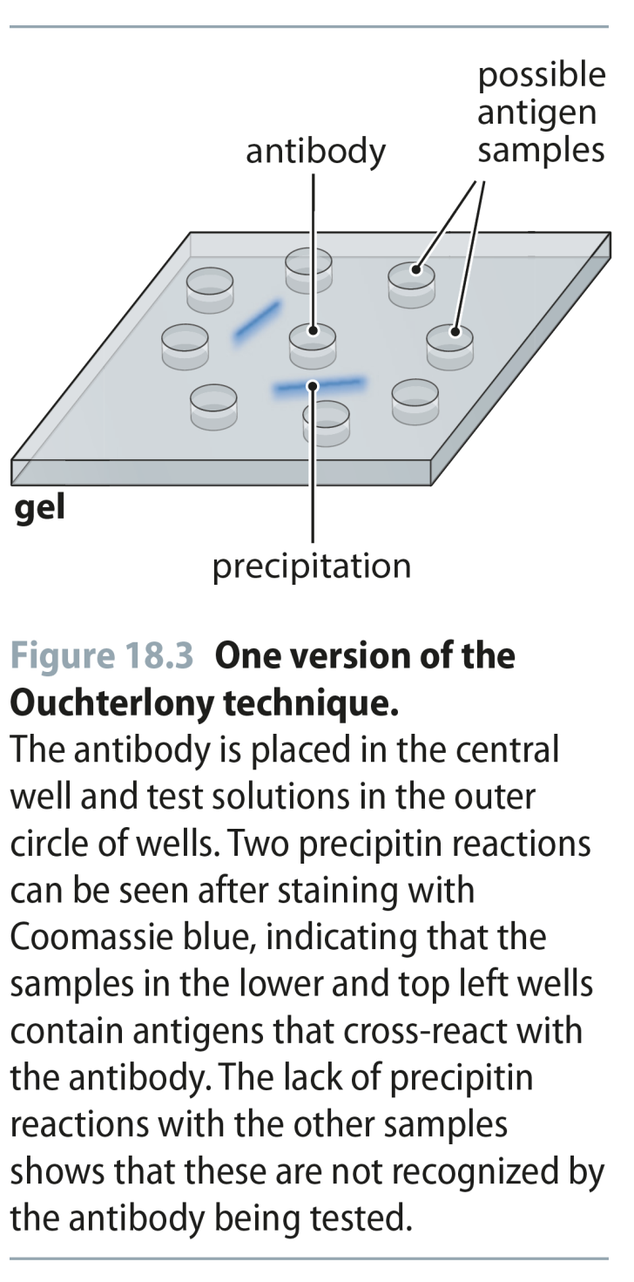
Fig 18.3
Reproduced from: Biochemistry by T.A. Brown, ISBN: 9781907904288 © Scion Publishing Ltd, 2017

Slide 4
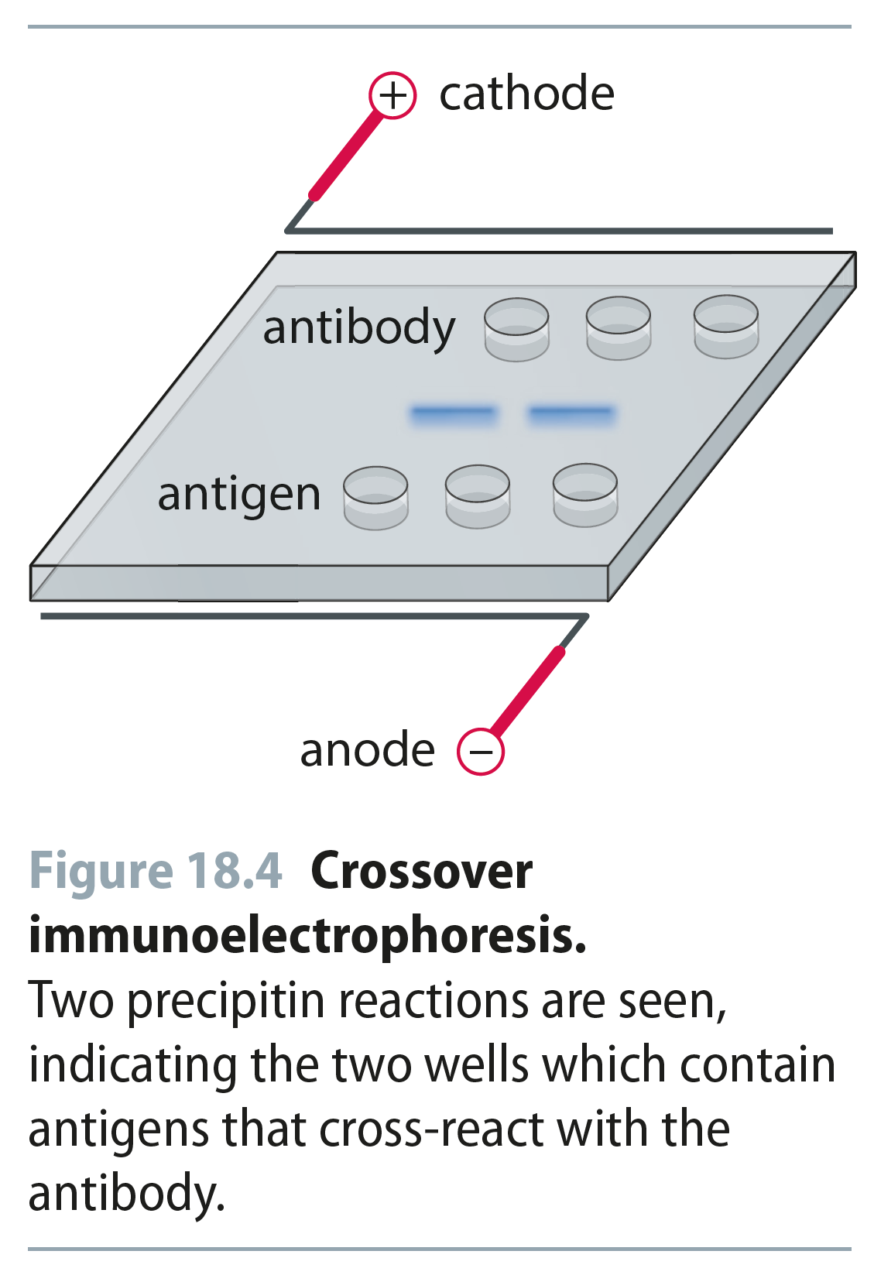
Fig 18.4
Reproduced from: Biochemistry by T.A. Brown, ISBN: 9781907904288 © Scion Publishing Ltd, 2017

Slide 5
Fig 18.5
Reproduced from: Biochemistry by T.A. Brown, ISBN: 9781907904288 © Scion Publishing Ltd, 2017

Slide 6
Fig 18.6
Reproduced from: Biochemistry by T.A. Brown, ISBN: 9781907904288 © Scion Publishing Ltd, 2017

Slide 7
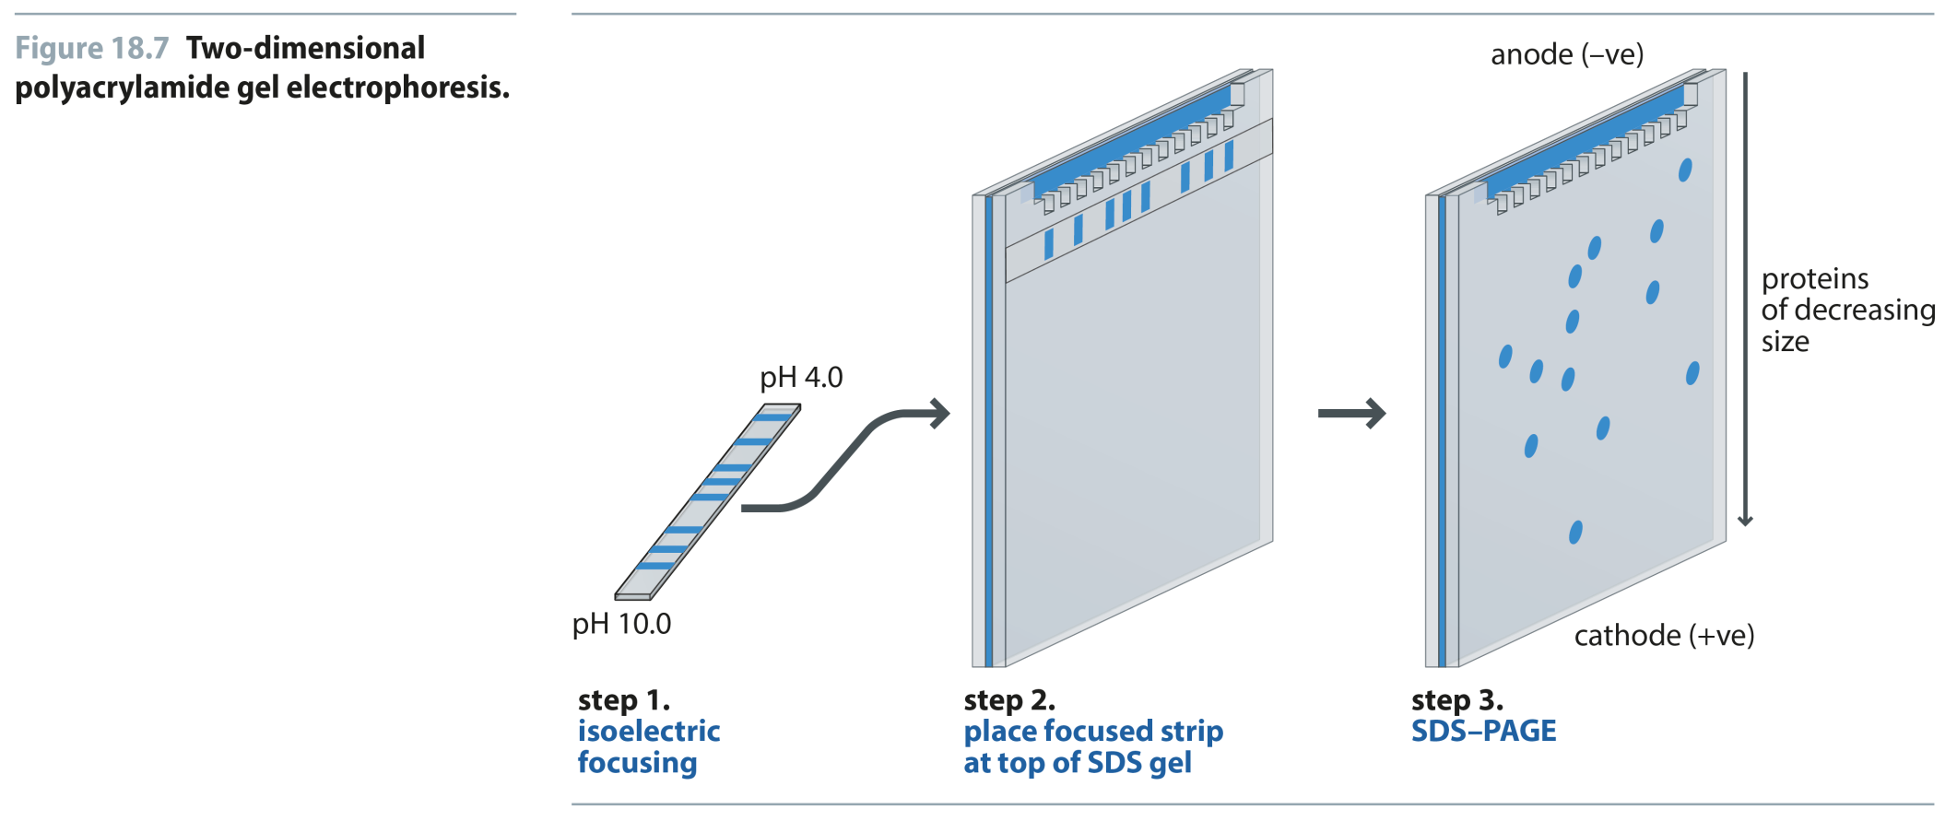
Fig 18.7
Reproduced from: Biochemistry by T.A. Brown, ISBN: 9781907904288 © Scion Publishing Ltd, 2017

Slide 8
Fig 18.8
Reproduced from: Biochemistry by T.A. Brown, ISBN: 9781907904288 © Scion Publishing Ltd, 2017

Slide 9
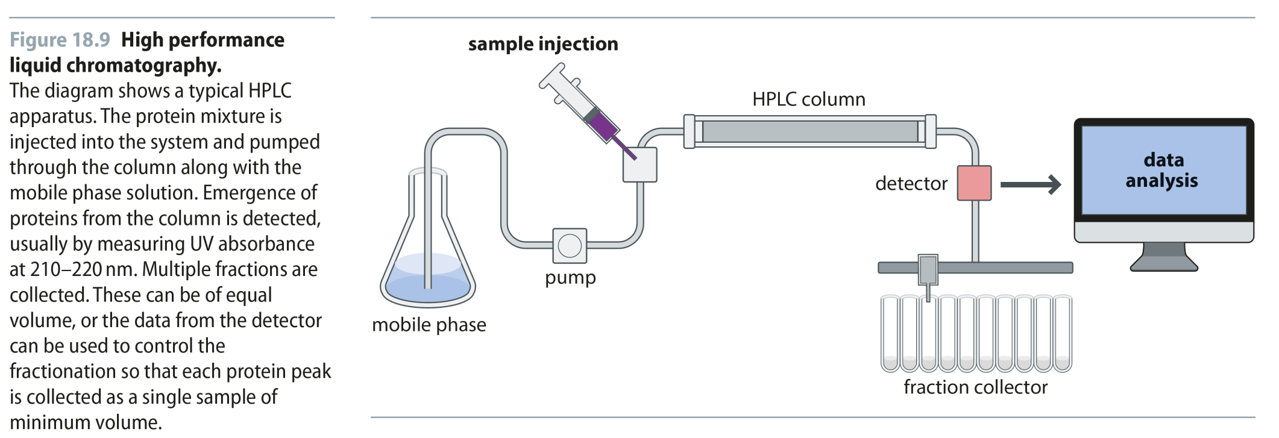
Fig 18.9
Reproduced from: Biochemistry by T.A. Brown, ISBN: 9781907904288 © Scion Publishing Ltd, 2017

Slide 10
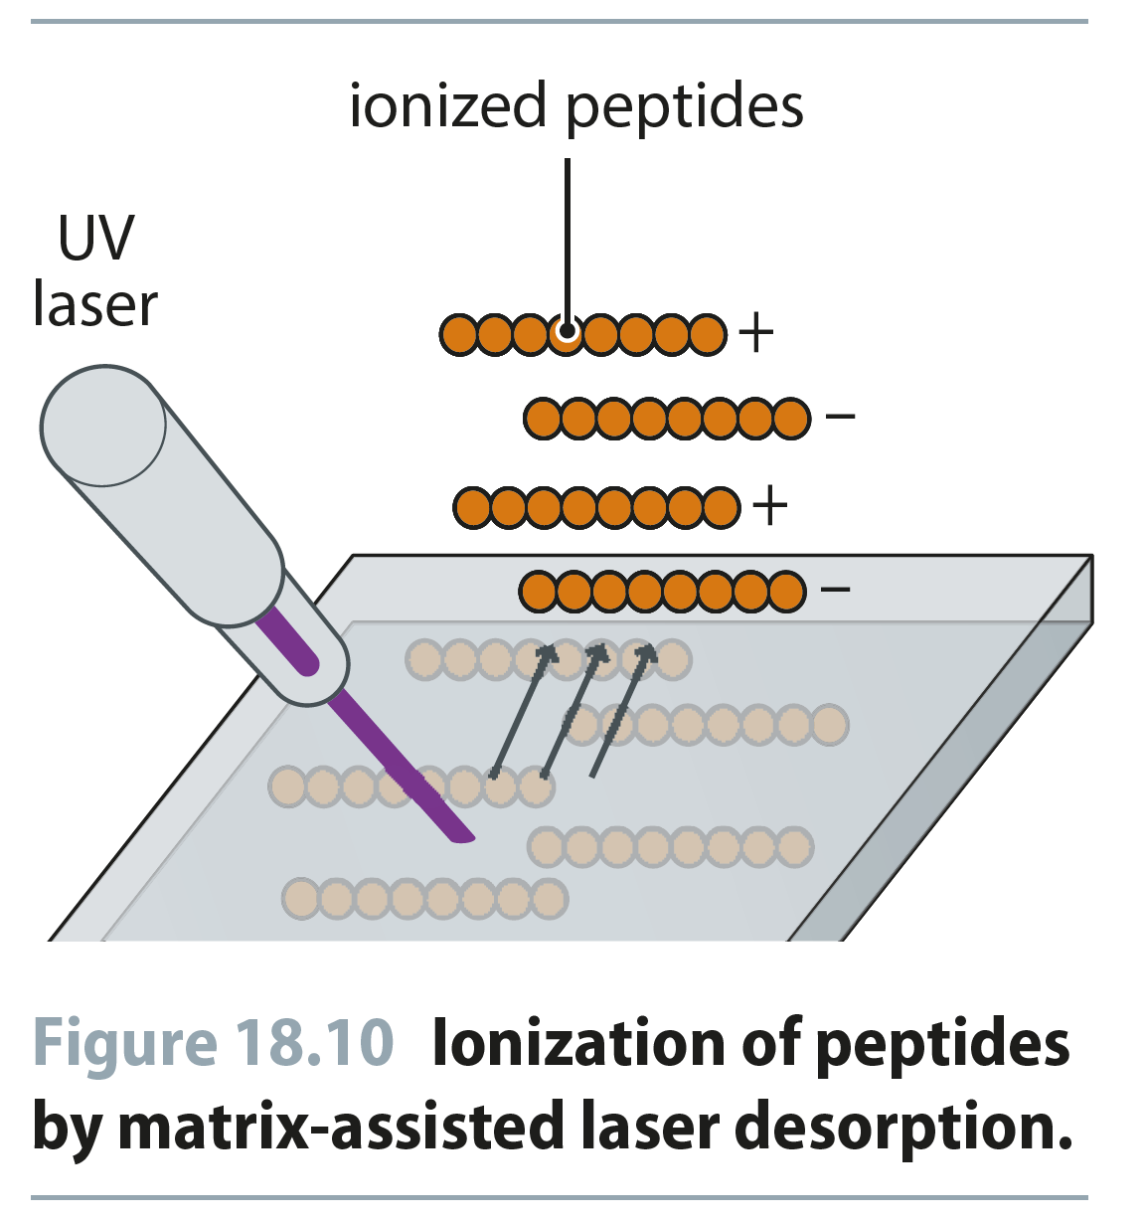
Fig 18.10
Reproduced from: Biochemistry by T.A. Brown, ISBN: 9781907904288 © Scion Publishing Ltd, 2017

Slide 11
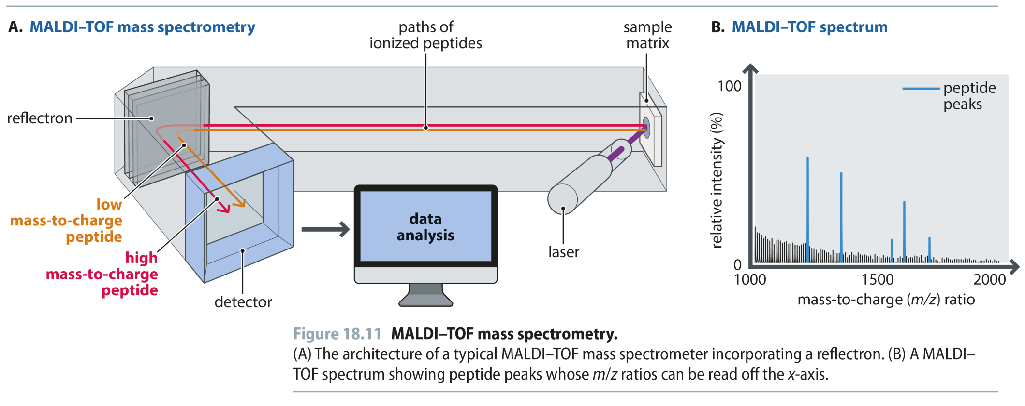
Fig 18.11
Reproduced from: Biochemistry by T.A. Brown, ISBN: 9781907904288 © Scion Publishing Ltd, 2017

Slide 12
Fig 18.12
Reproduced from: Biochemistry by T.A. Brown, ISBN: 9781907904288 © Scion Publishing Ltd, 2017

Slide 13
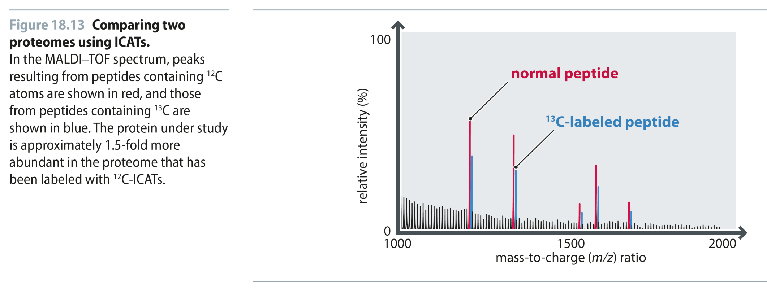
Fig 18.13
Reproduced from: Biochemistry by T.A. Brown, ISBN: 9781907904288 © Scion Publishing Ltd, 2017

Slide 14
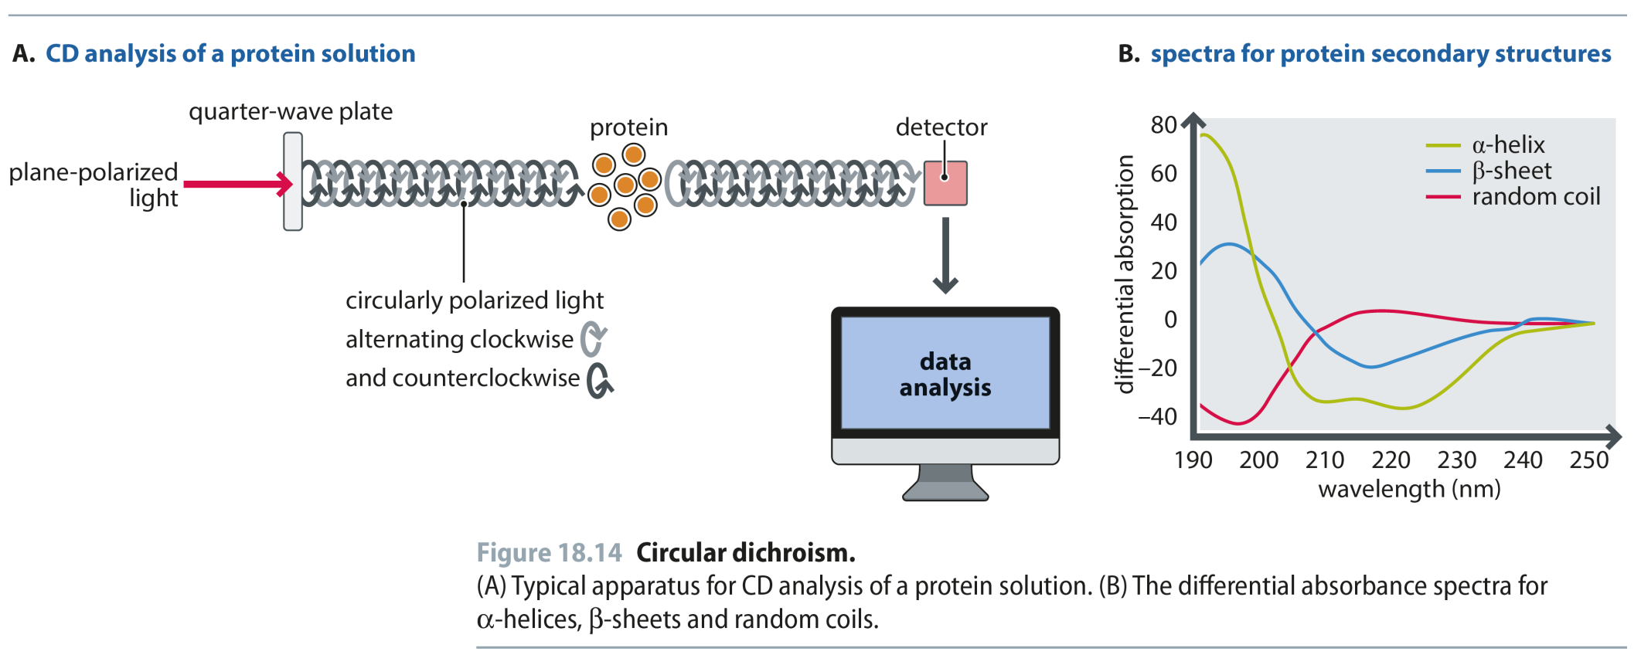
Fig 18.14
Reproduced from: Biochemistry by T.A. Brown, ISBN: 9781907904288 © Scion Publishing Ltd, 2017

Slide 15
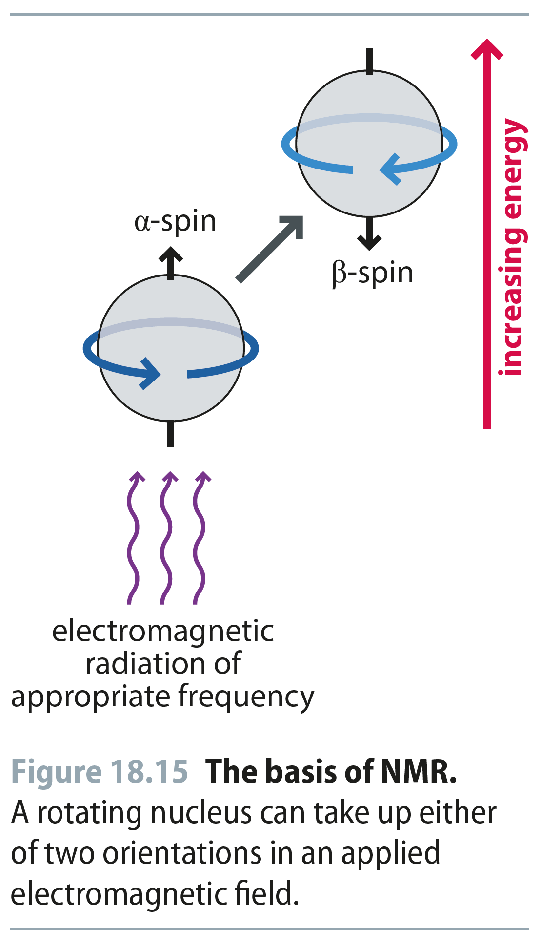
Fig 18.15
Reproduced from: Biochemistry by T.A. Brown, ISBN: 9781907904288 © Scion Publishing Ltd, 2017

Slide 16
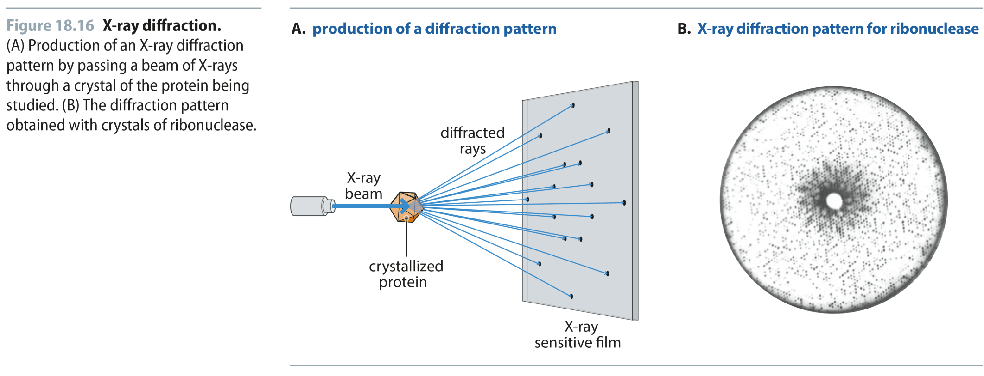
Fig 18.16
Reproduced from: Biochemistry by T.A. Brown, ISBN: 9781907904288 © Scion Publishing Ltd, 2017

Slide 17
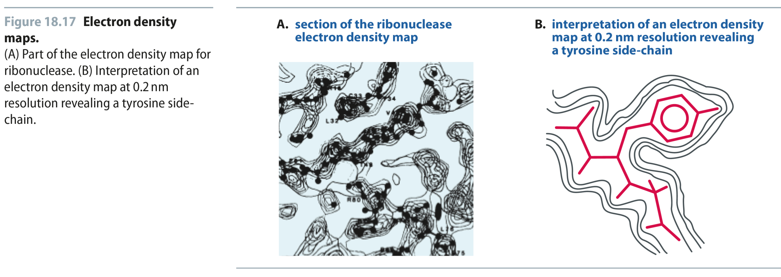
Fig 18.17
Reproduced from: Biochemistry by T.A. Brown, ISBN: 9781907904288 © Scion Publishing Ltd, 2017

Slide 18
Fig 18.18
Reproduced from: Biochemistry by T.A. Brown, ISBN: 9781907904288 © Scion Publishing Ltd, 2017

Slide 19
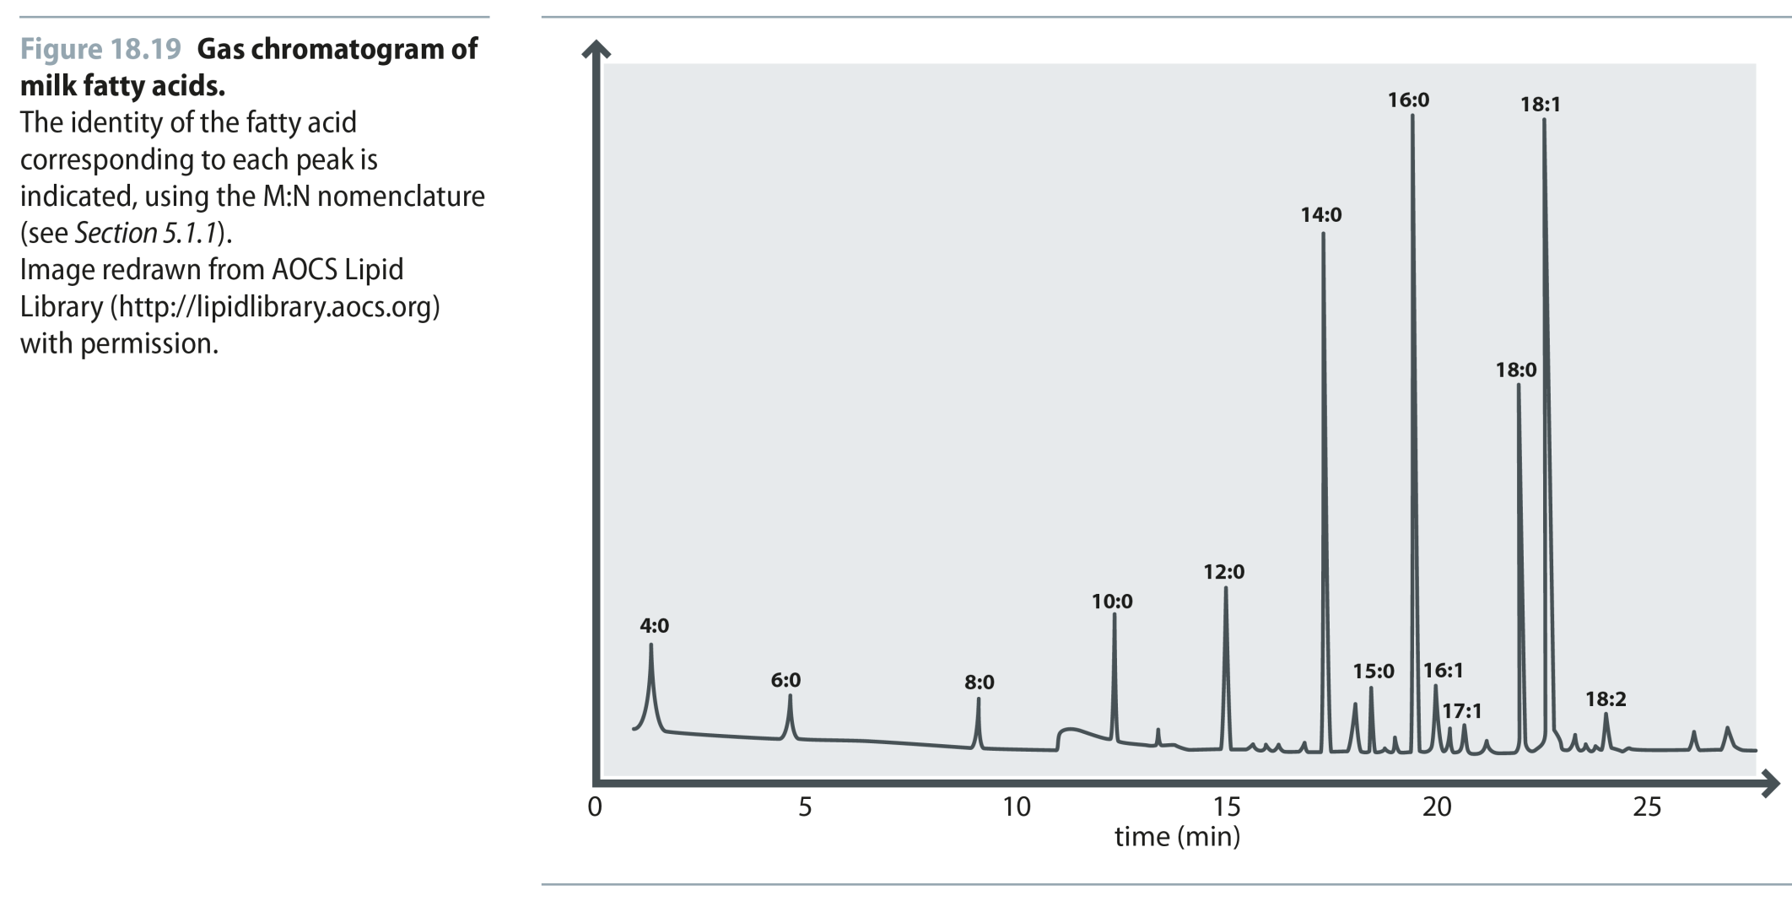
Fig 18.19
Reproduced from: Biochemistry by T.A. Brown, ISBN: 9781907904288 © Scion Publishing Ltd, 2017

Slide 20
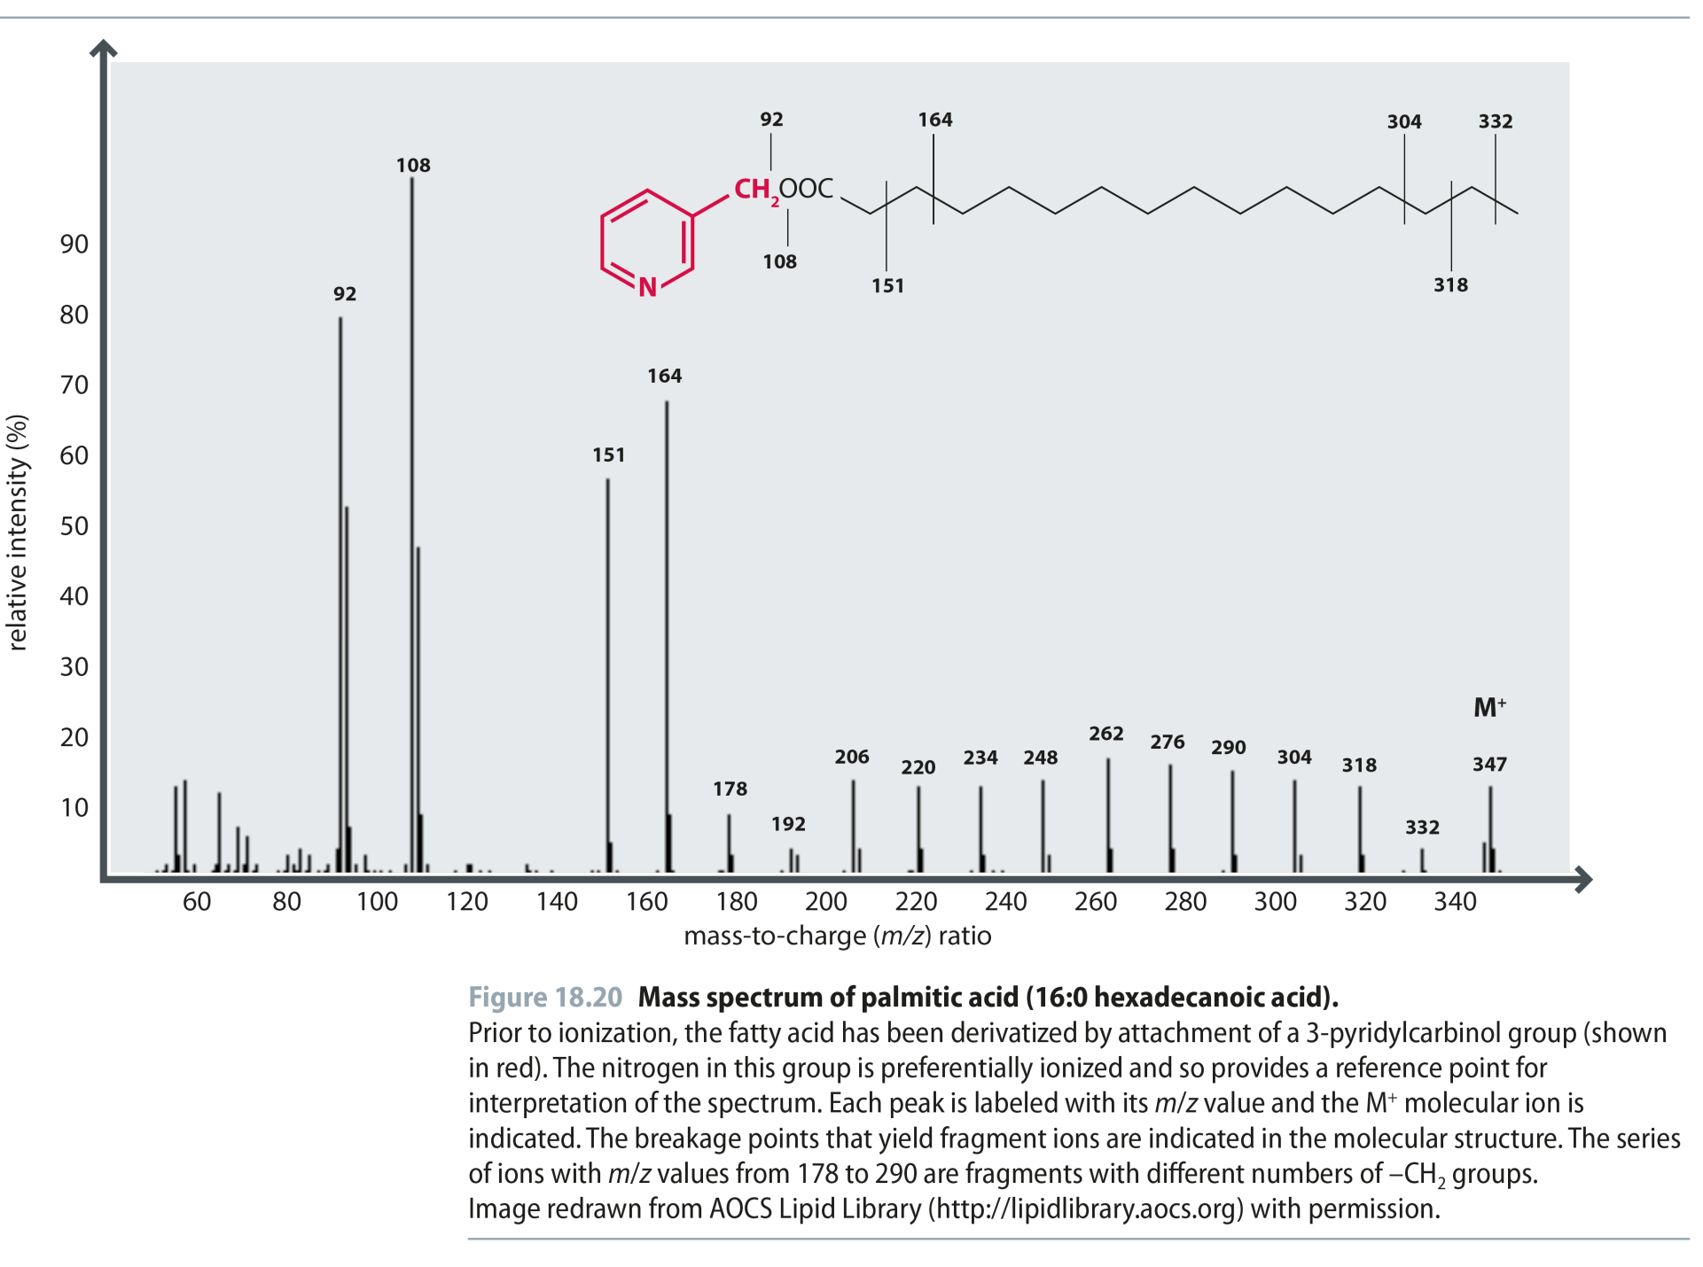
Fig 18.20
Reproduced from: Biochemistry by T.A. Brown, ISBN: 9781907904288 © Scion Publishing Ltd, 2017

Slide 21
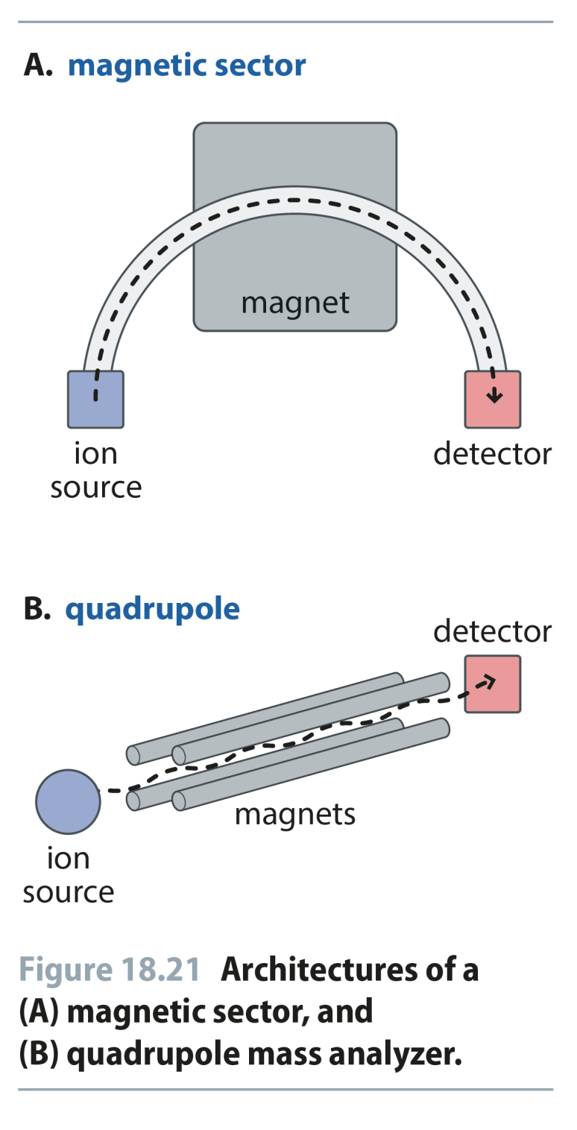
Fig 18.21
Reproduced from: Biochemistry by T.A. Brown, ISBN: 9781907904288 © Scion Publishing Ltd, 2017

Slide 22
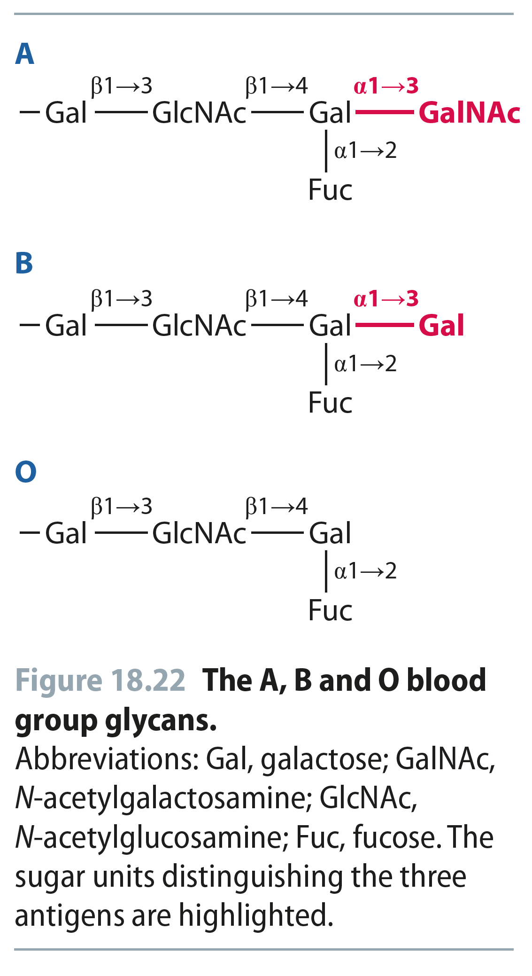
Fig 18.22
Reproduced from: Biochemistry by T.A. Brown, ISBN: 9781907904288 © Scion Publishing Ltd, 2017

