Slide 1
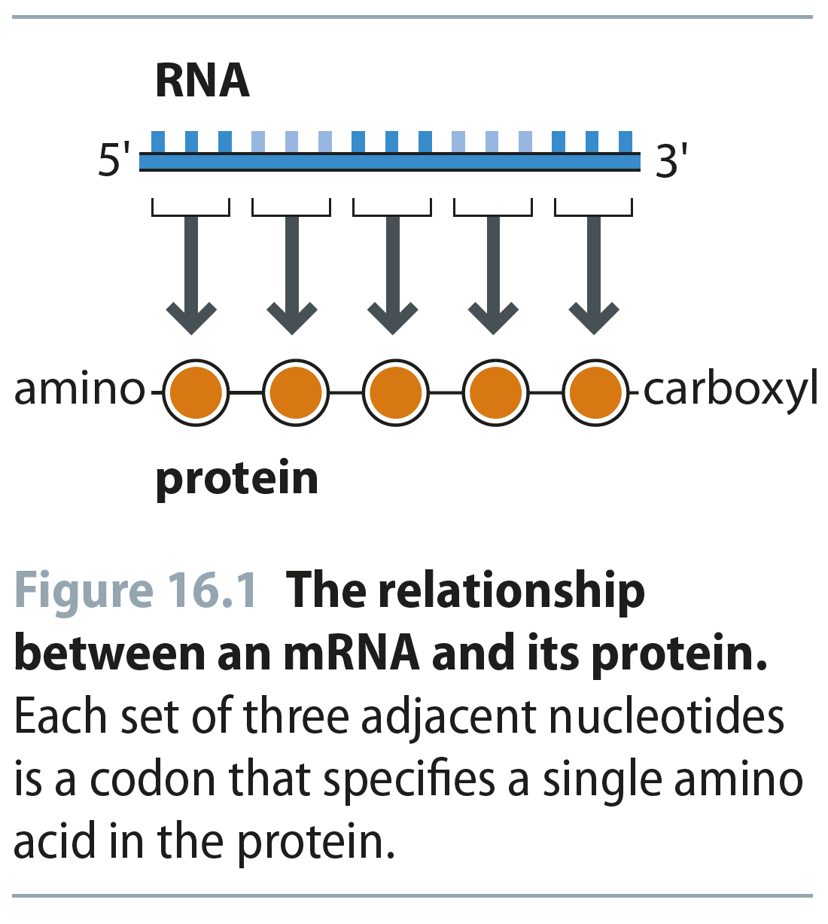
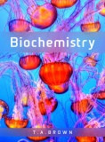
Fig 16.1
Reproduced from: Biochemistry by T.A. Brown, ISBN: 9781907904288 © Scion Publishing Ltd, 2017

Slide 2
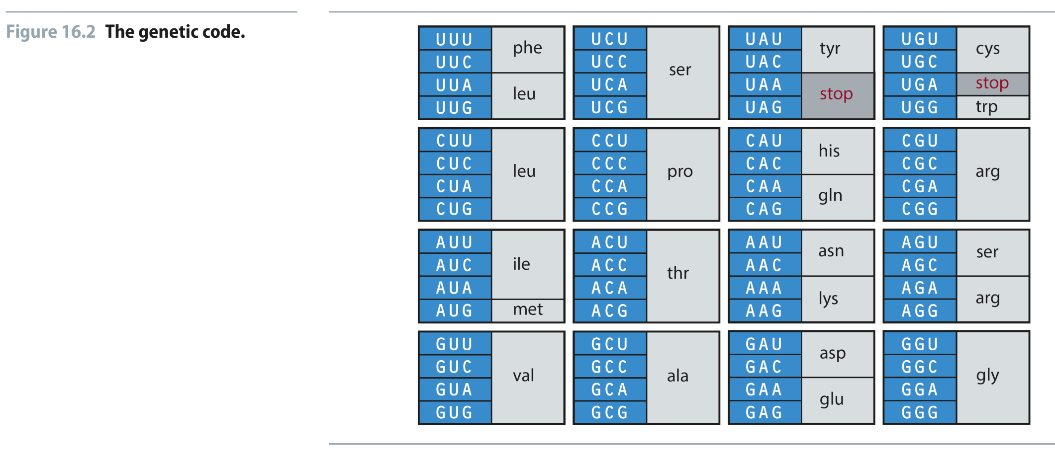
Fig 16.2
Reproduced from: Biochemistry by T.A. Brown, ISBN: 9781907904288 © Scion Publishing Ltd, 2017

Slide 3
Fig 16.3
Reproduced from: Biochemistry by T.A. Brown, ISBN: 9781907904288 © Scion Publishing Ltd, 2017

Slide 4
Table 16.1
Reproduced from: Biochemistry by T.A. Brown, ISBN: 9781907904288 © Scion Publishing Ltd, 2017

Slide 5
Table 16.2
Reproduced from: Biochemistry by T.A. Brown, ISBN: 9781907904288 © Scion Publishing Ltd, 2017

Slide 6
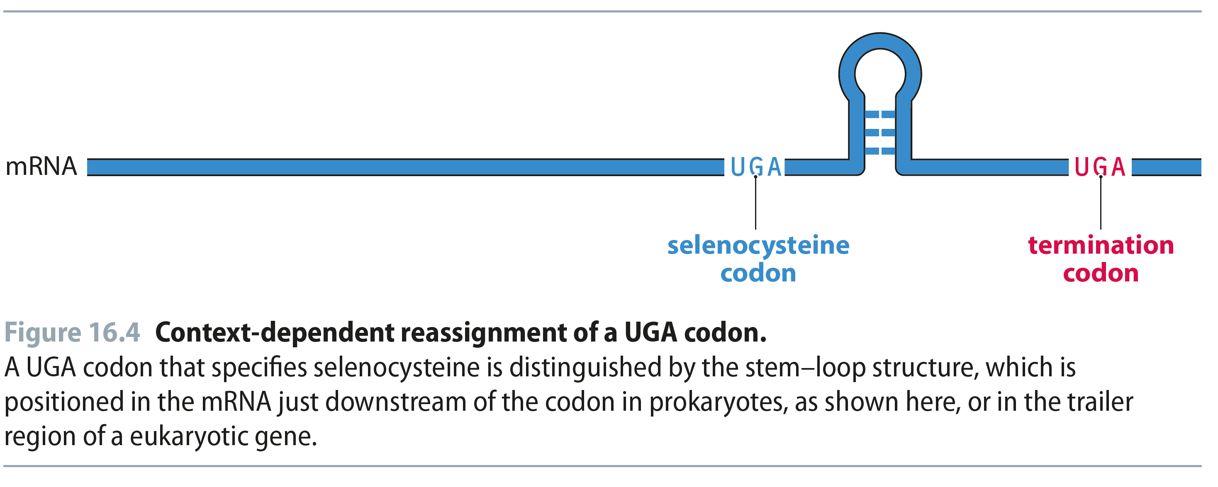
Fig 16.4
Reproduced from: Biochemistry by T.A. Brown, ISBN: 9781907904288 © Scion Publishing Ltd, 2017

Slide 7
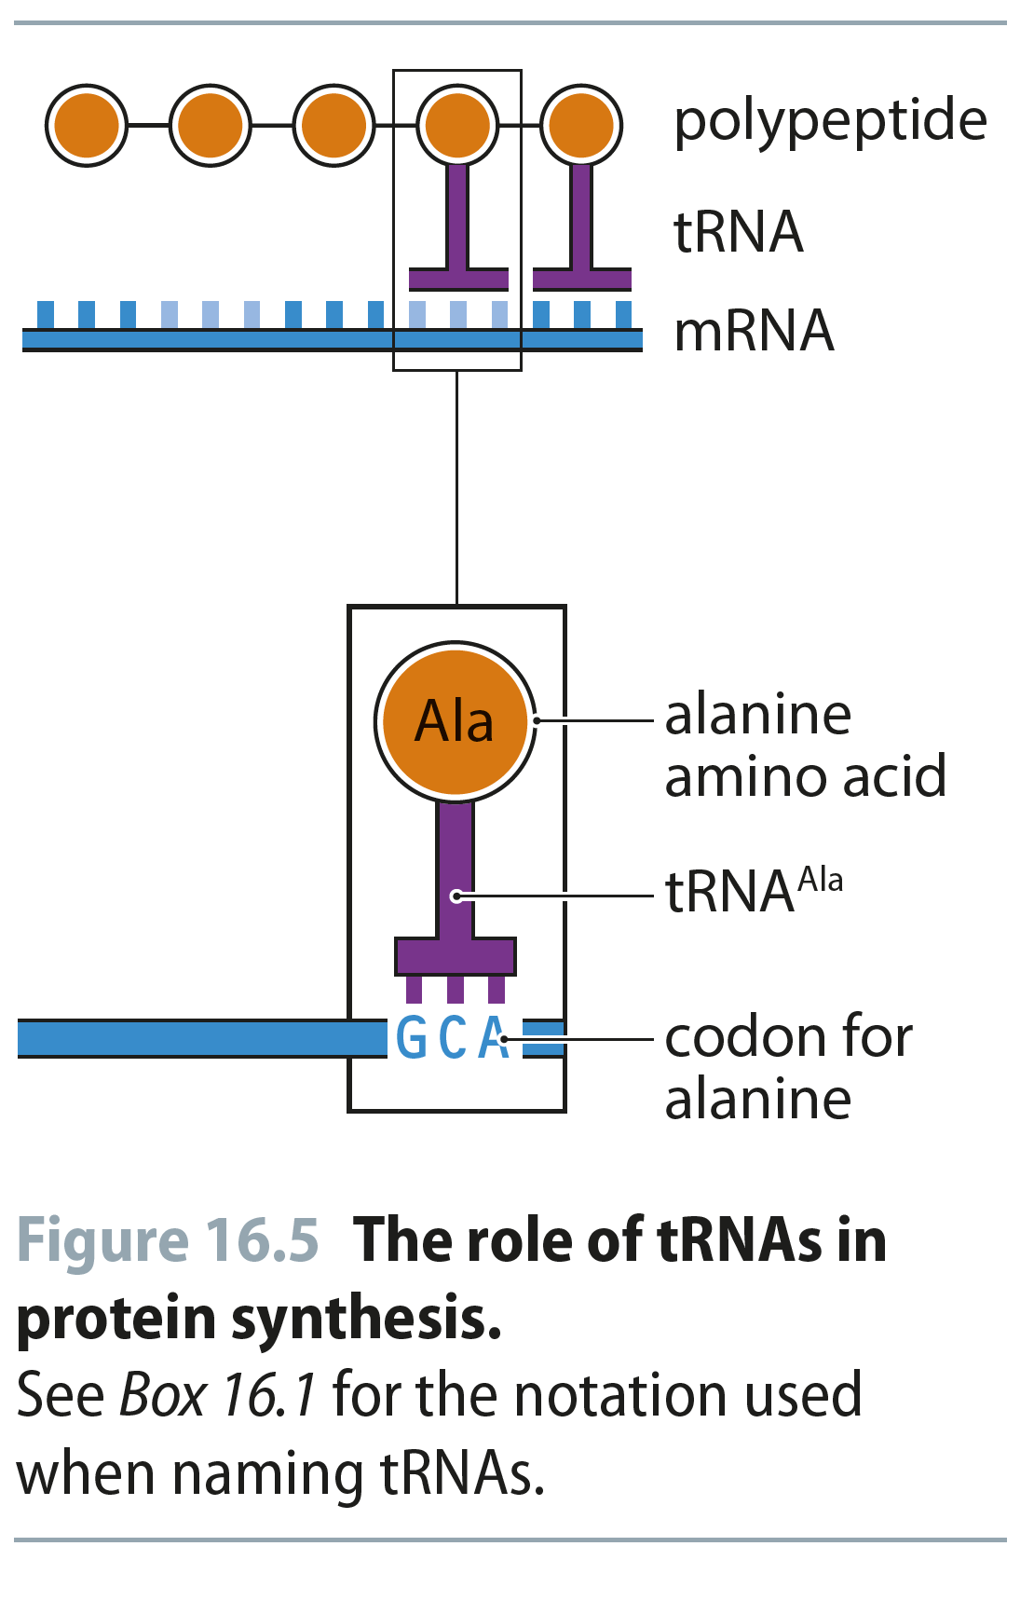
Fig 16.5
Reproduced from: Biochemistry by T.A. Brown, ISBN: 9781907904288 © Scion Publishing Ltd, 2017

Slide 8
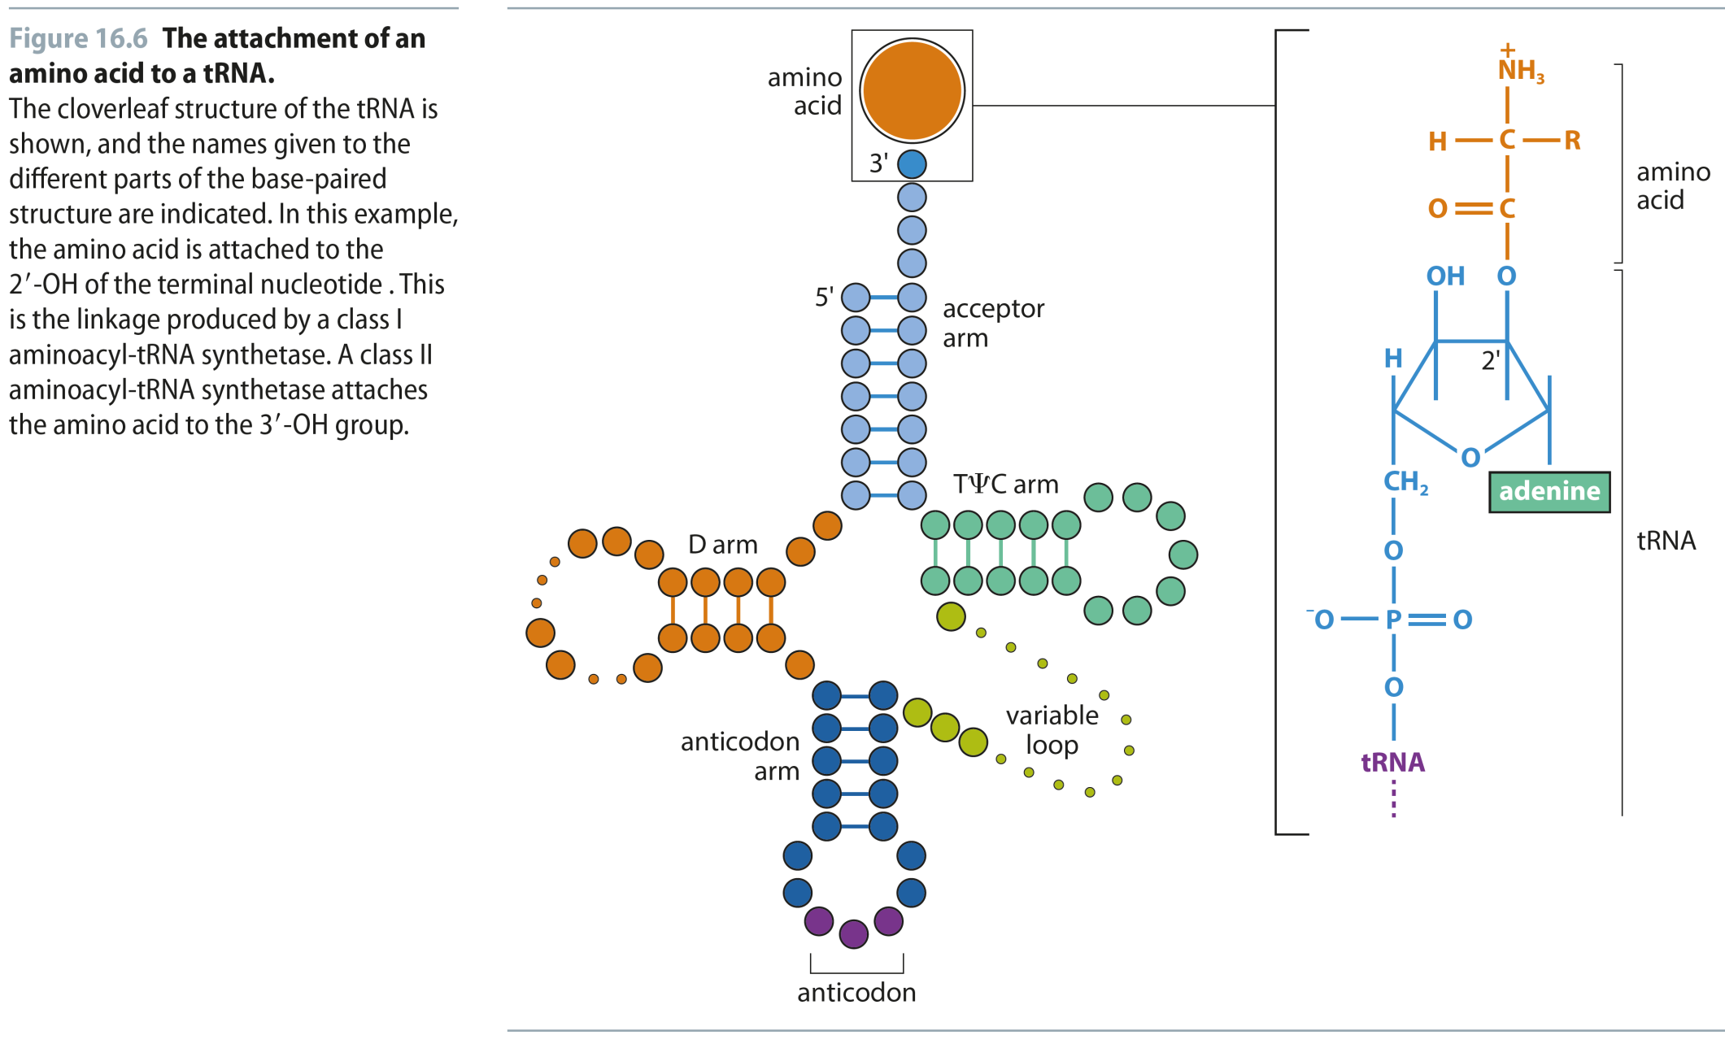
Fig 16.6
Reproduced from: Biochemistry by T.A. Brown, ISBN: 9781907904288 © Scion Publishing Ltd, 2017

Slide 9
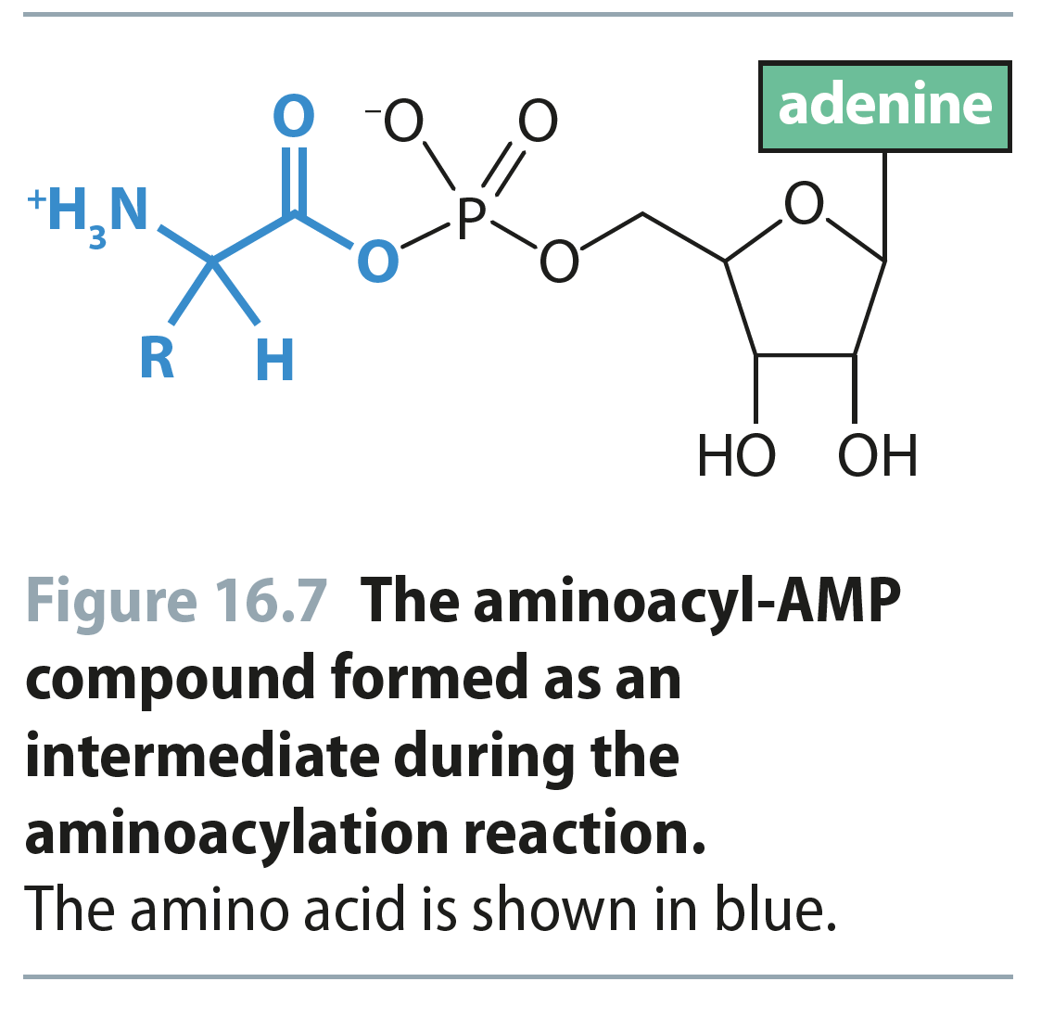
Fig 16.7
Reproduced from: Biochemistry by T.A. Brown, ISBN: 9781907904288 © Scion Publishing Ltd, 2017

Slide 10
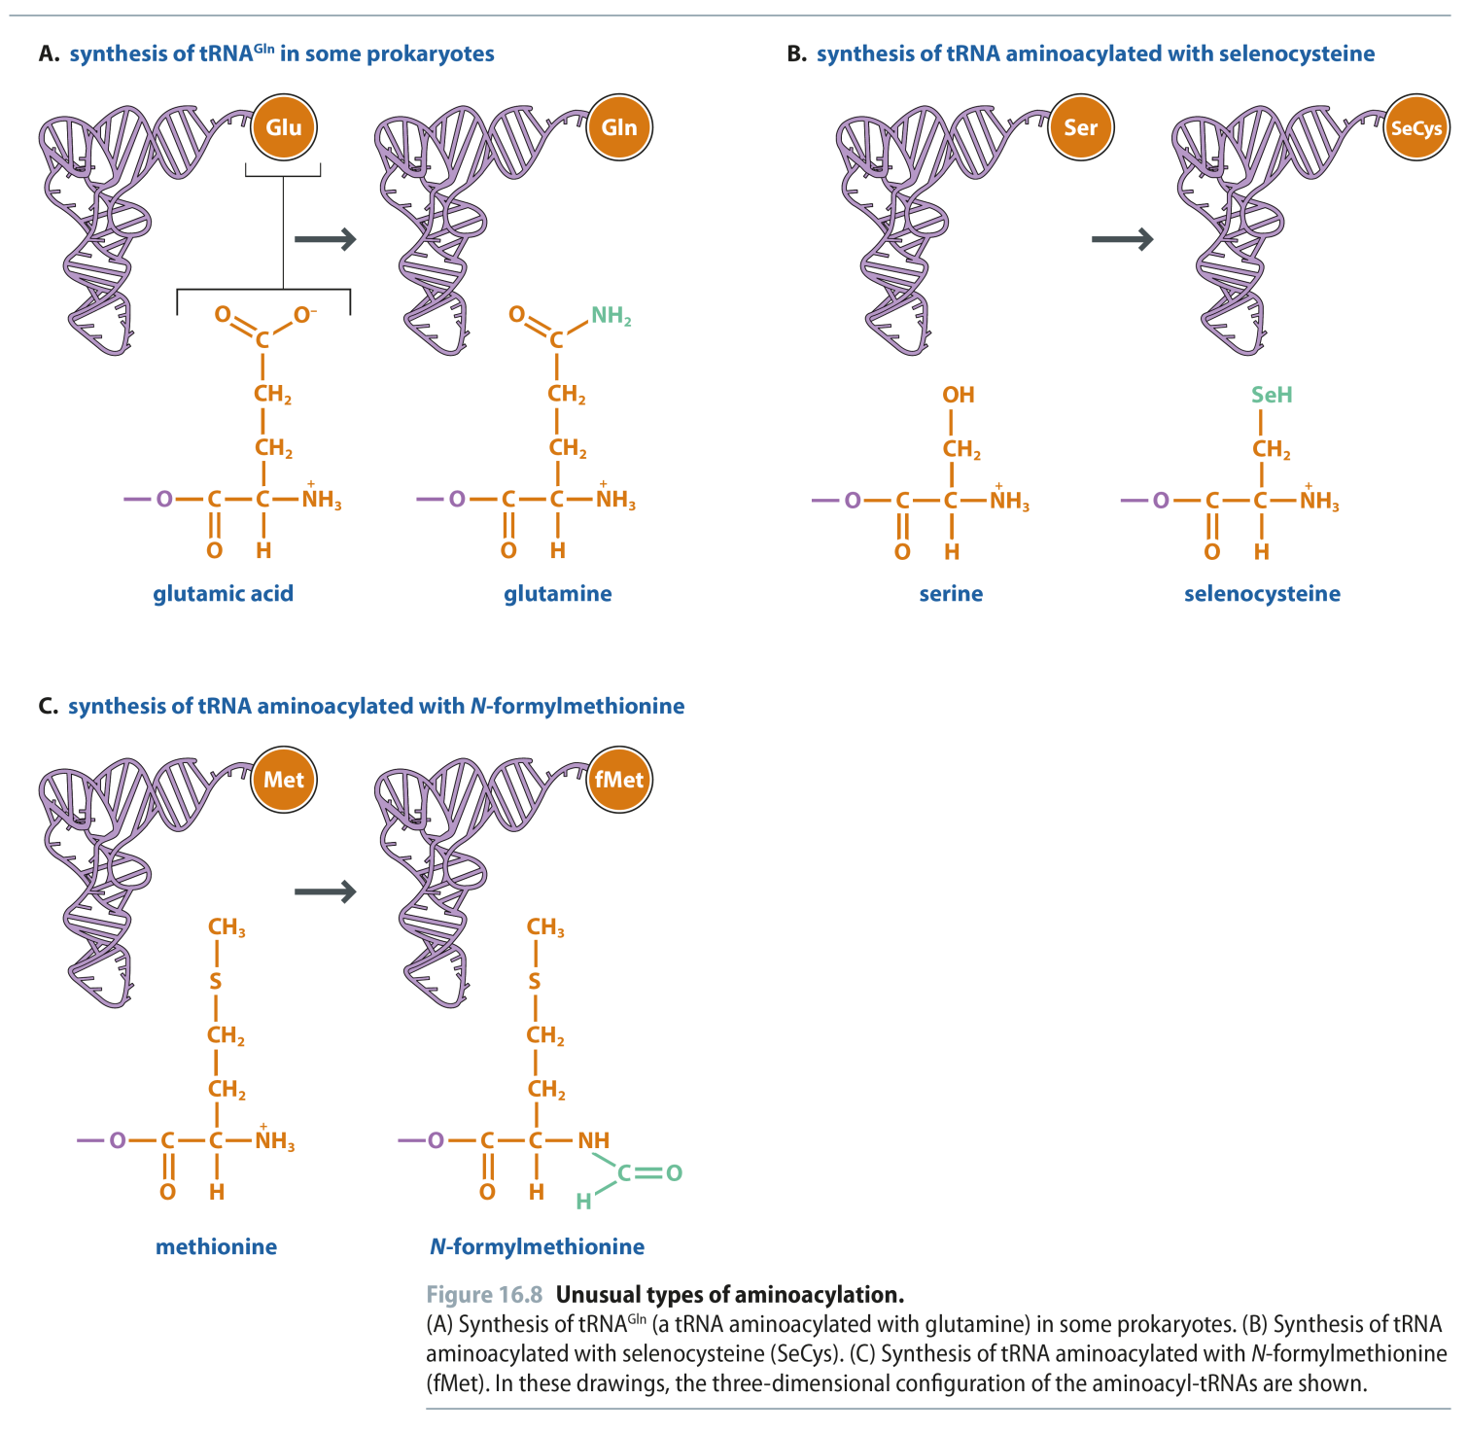
Fig 16.8
Reproduced from: Biochemistry by T.A. Brown, ISBN: 9781907904288 © Scion Publishing Ltd, 2017

Slide 11
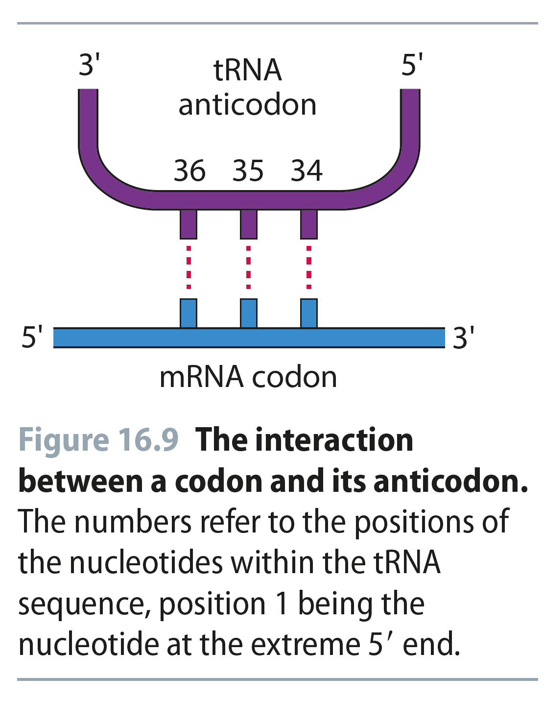
Fig 16.9
Reproduced from: Biochemistry by T.A. Brown, ISBN: 9781907904288 © Scion Publishing Ltd, 2017

Slide 12
Fig 16.10
Reproduced from: Biochemistry by T.A. Brown, ISBN: 9781907904288 © Scion Publishing Ltd, 2017

Slide 13
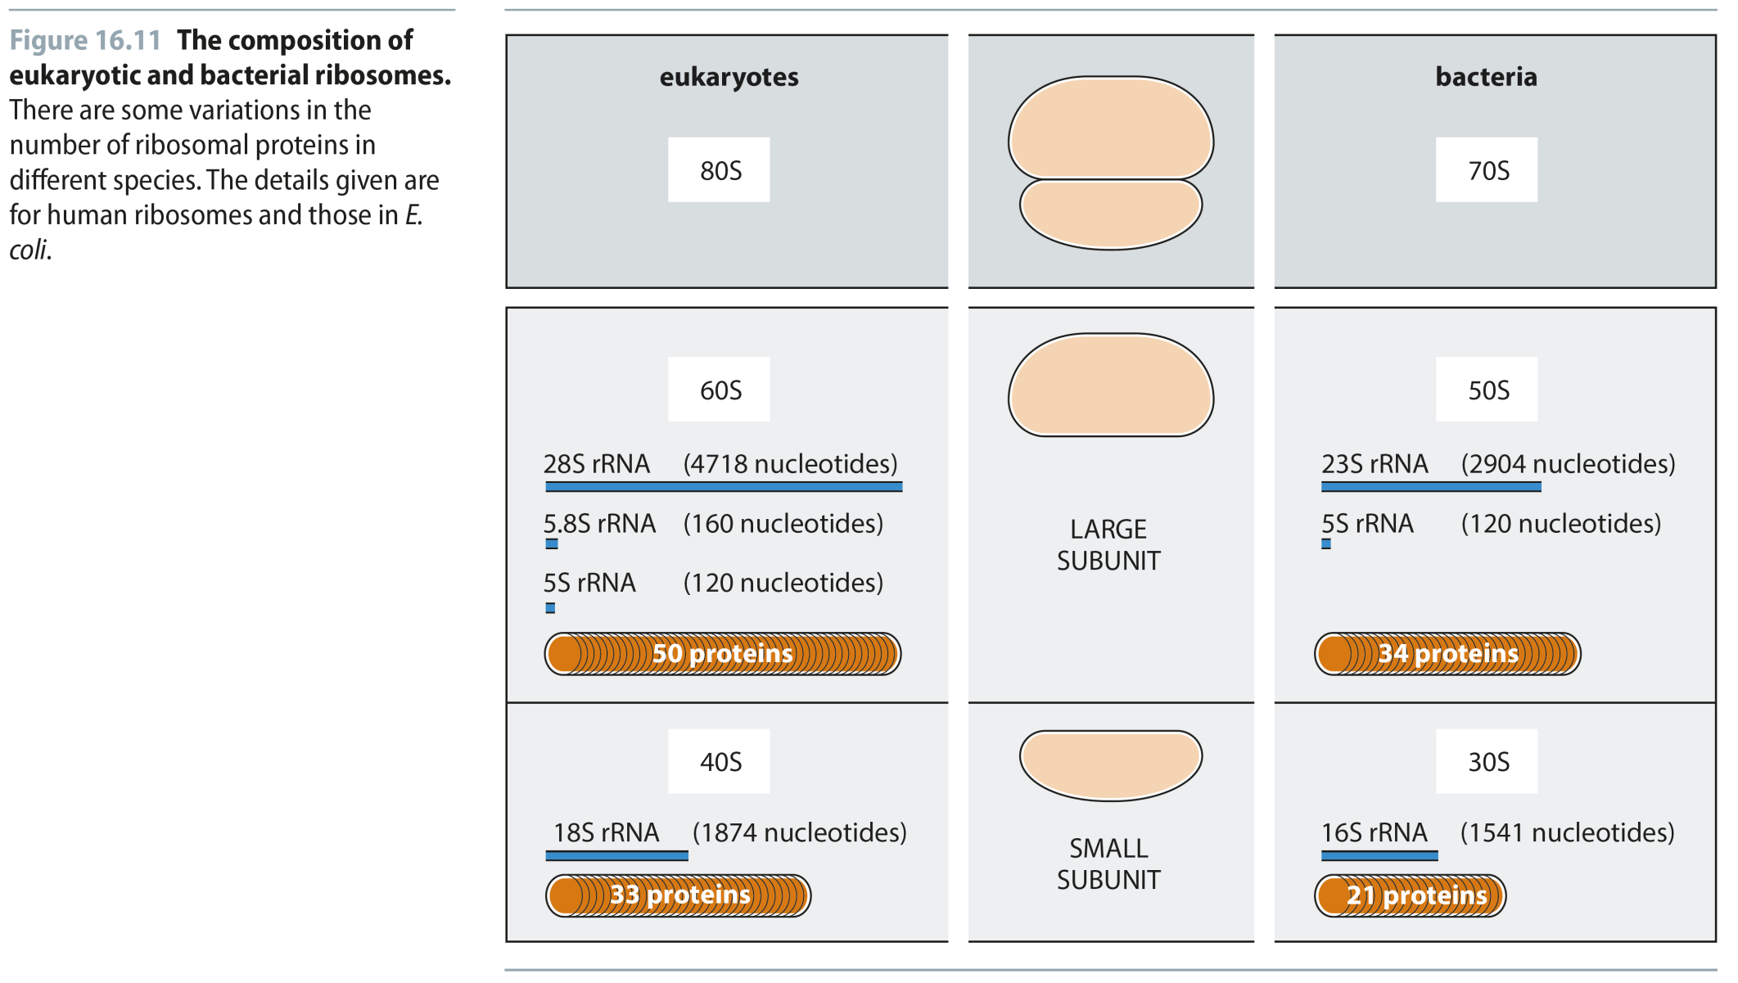
Fig 16.11
Reproduced from: Biochemistry by T.A. Brown, ISBN: 9781907904288 © Scion Publishing Ltd, 2017

Slide 14
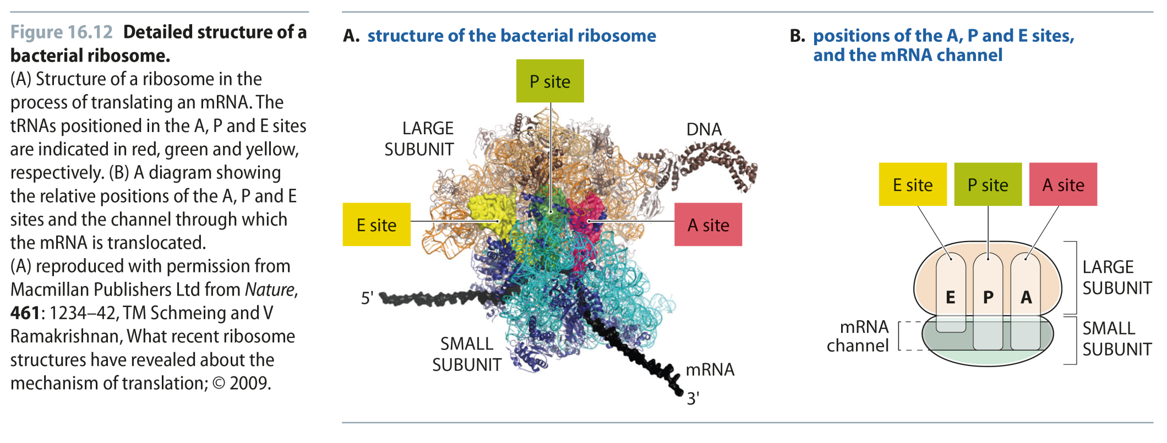
Fig 16.12
Reproduced from: Biochemistry by T.A. Brown, ISBN: 9781907904288 © Scion Publishing Ltd, 2017

Slide 15
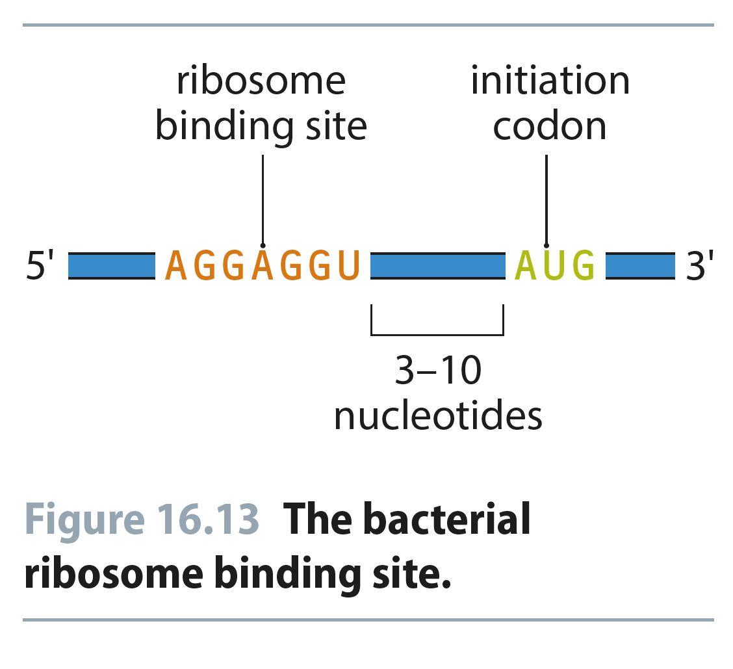
Fig 16.13
Reproduced from: Biochemistry by T.A. Brown, ISBN: 9781907904288 © Scion Publishing Ltd, 2017

Slide 16
Table 16.3
Reproduced from: Biochemistry by T.A. Brown, ISBN: 9781907904288 © Scion Publishing Ltd, 2017

Slide 17
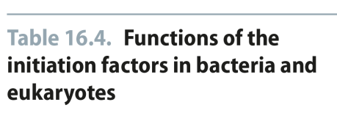
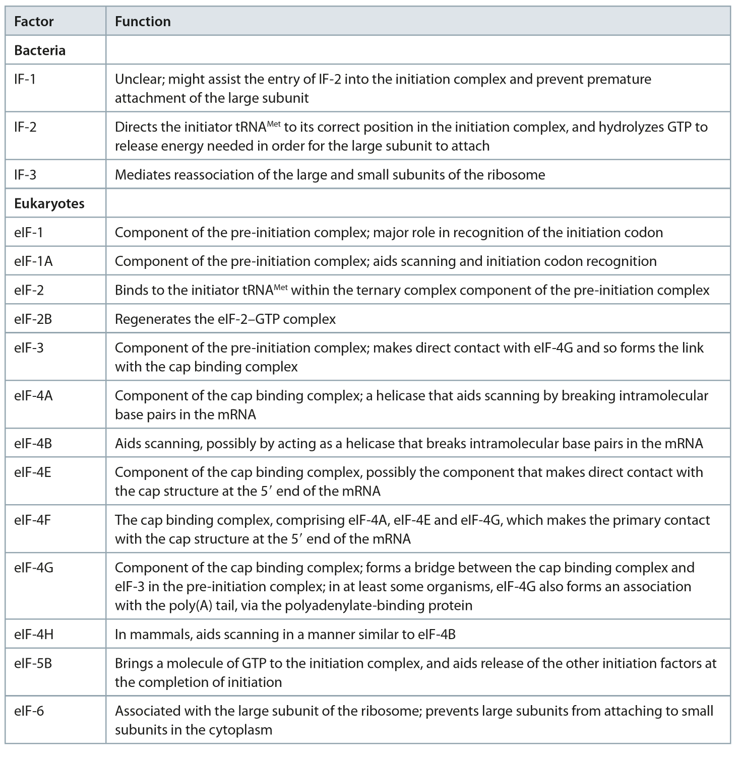
Table 16.4
Reproduced from: Biochemistry by T.A. Brown, ISBN: 9781907904288 © Scion Publishing Ltd, 2017

Slide 18
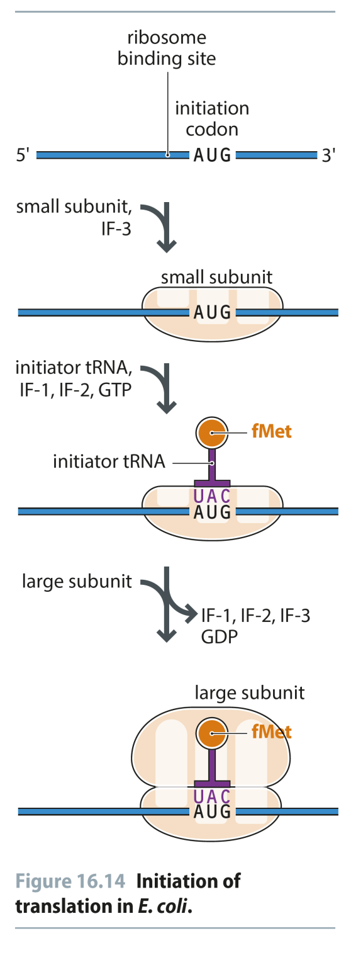
Fig 16.14
Reproduced from: Biochemistry by T.A. Brown, ISBN: 9781907904288 © Scion Publishing Ltd, 2017

Slide 19
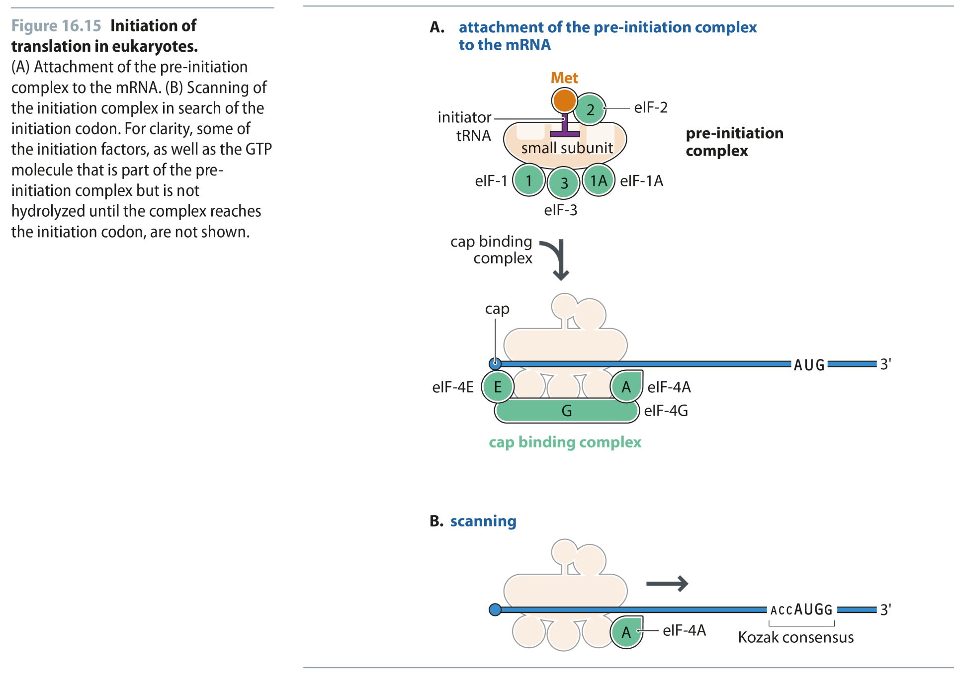
Fig 16.15
Reproduced from: Biochemistry by T.A. Brown, ISBN: 9781907904288 © Scion Publishing Ltd, 2017

Slide 20
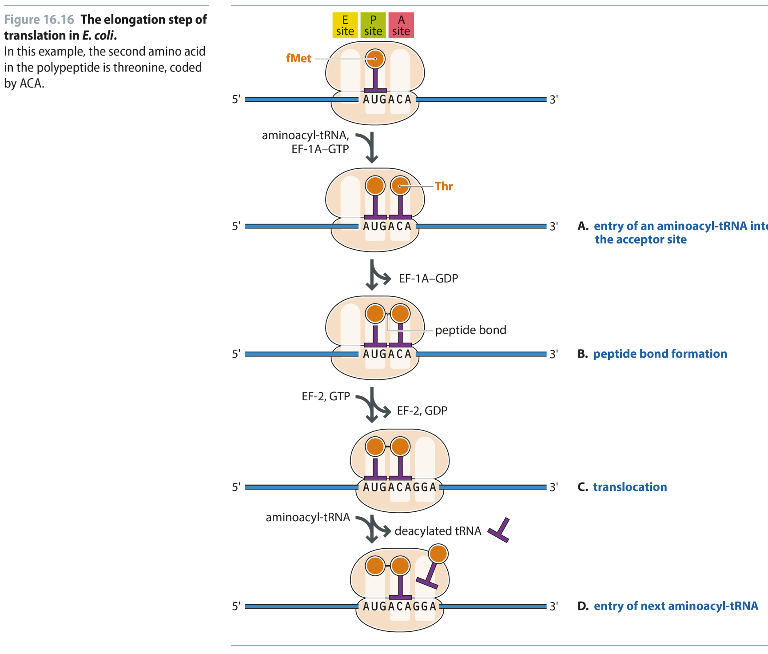
Fig 16.16
Reproduced from: Biochemistry by T.A. Brown, ISBN: 9781907904288 © Scion Publishing Ltd, 2017

Slide 21
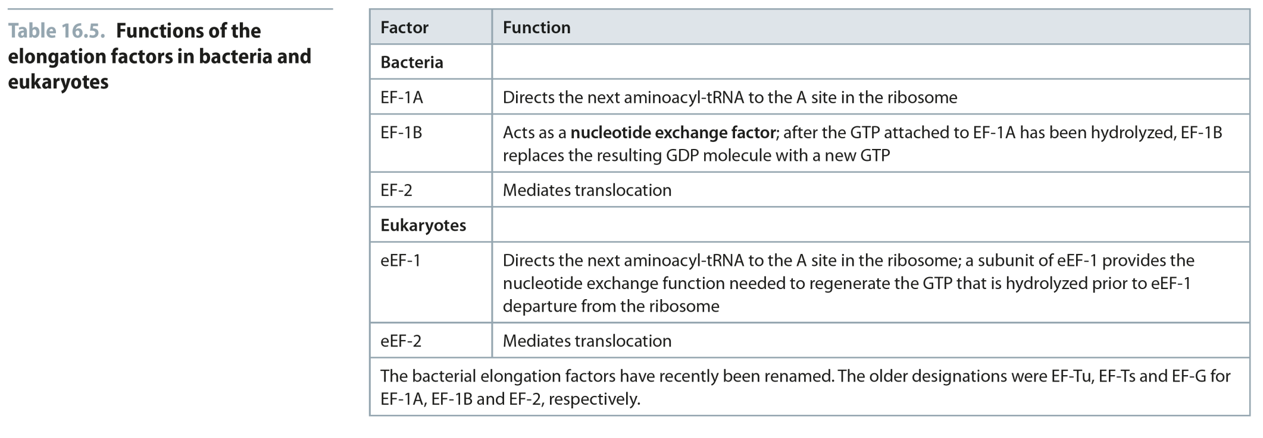
Table 16.5
Reproduced from: Biochemistry by T.A. Brown, ISBN: 9781907904288 © Scion Publishing Ltd, 2017

Slide 22
Fig 16.17
Reproduced from: Biochemistry by T.A. Brown, ISBN: 9781907904288 © Scion Publishing Ltd, 2017

Slide 23
Fig 16.18
Reproduced from: Biochemistry by T.A. Brown, ISBN: 9781907904288 © Scion Publishing Ltd, 2017

Slide 24
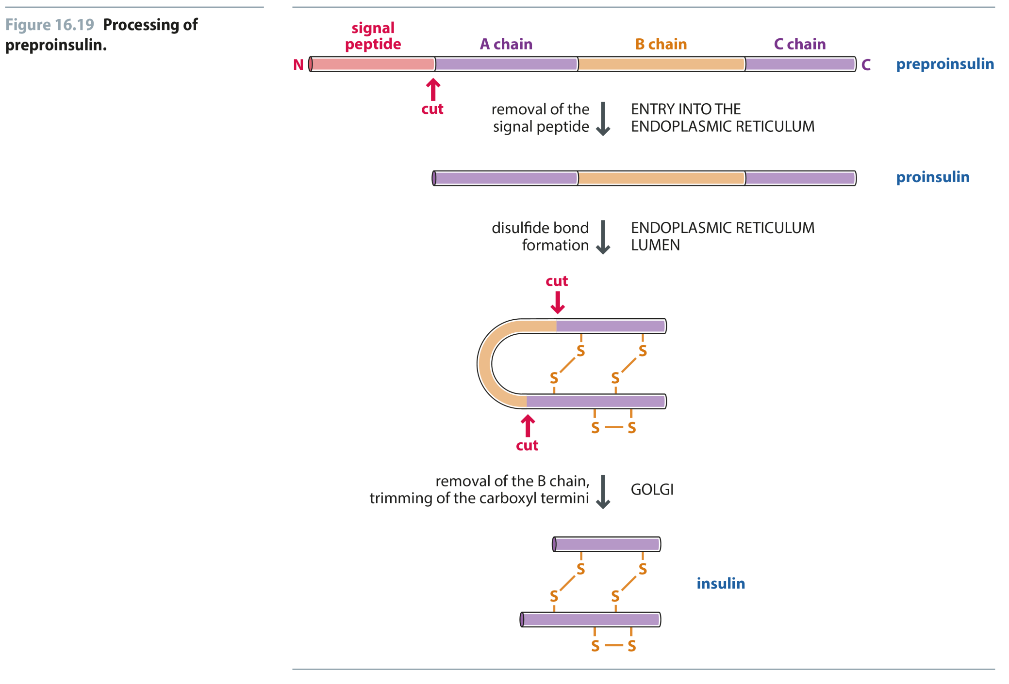
Fig 16.19
Reproduced from: Biochemistry by T.A. Brown, ISBN: 9781907904288 © Scion Publishing Ltd, 2017

Slide 25
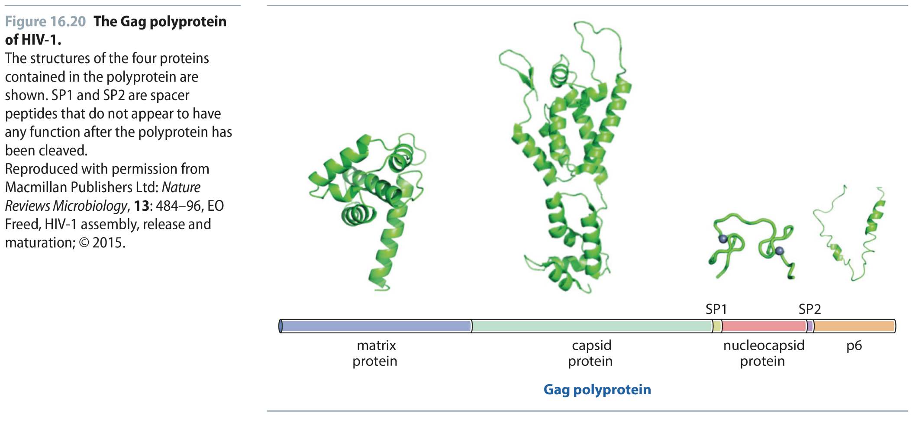
Fig 16.20
Reproduced from: Biochemistry by T.A. Brown, ISBN: 9781907904288 © Scion Publishing Ltd, 2017

Slide 26
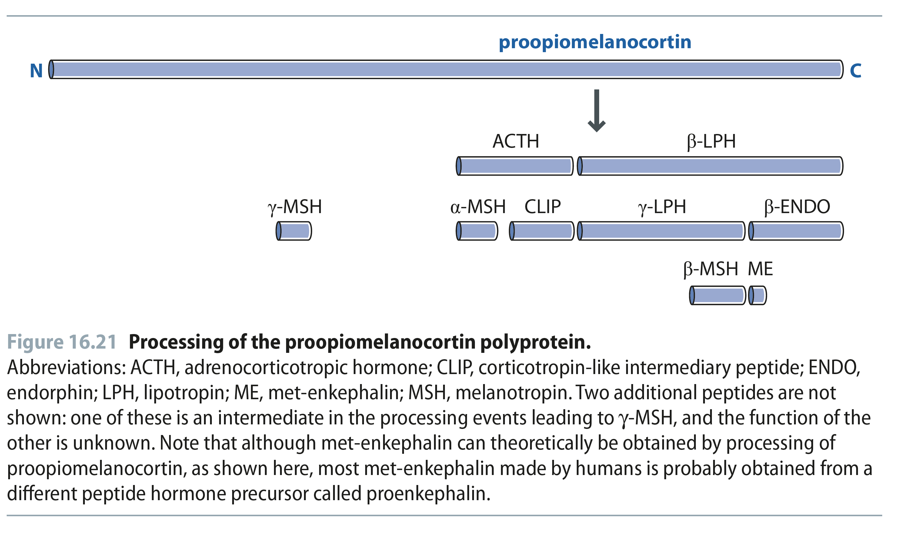
Fig 16.21
Reproduced from: Biochemistry by T.A. Brown, ISBN: 9781907904288 © Scion Publishing Ltd, 2017

Slide 27
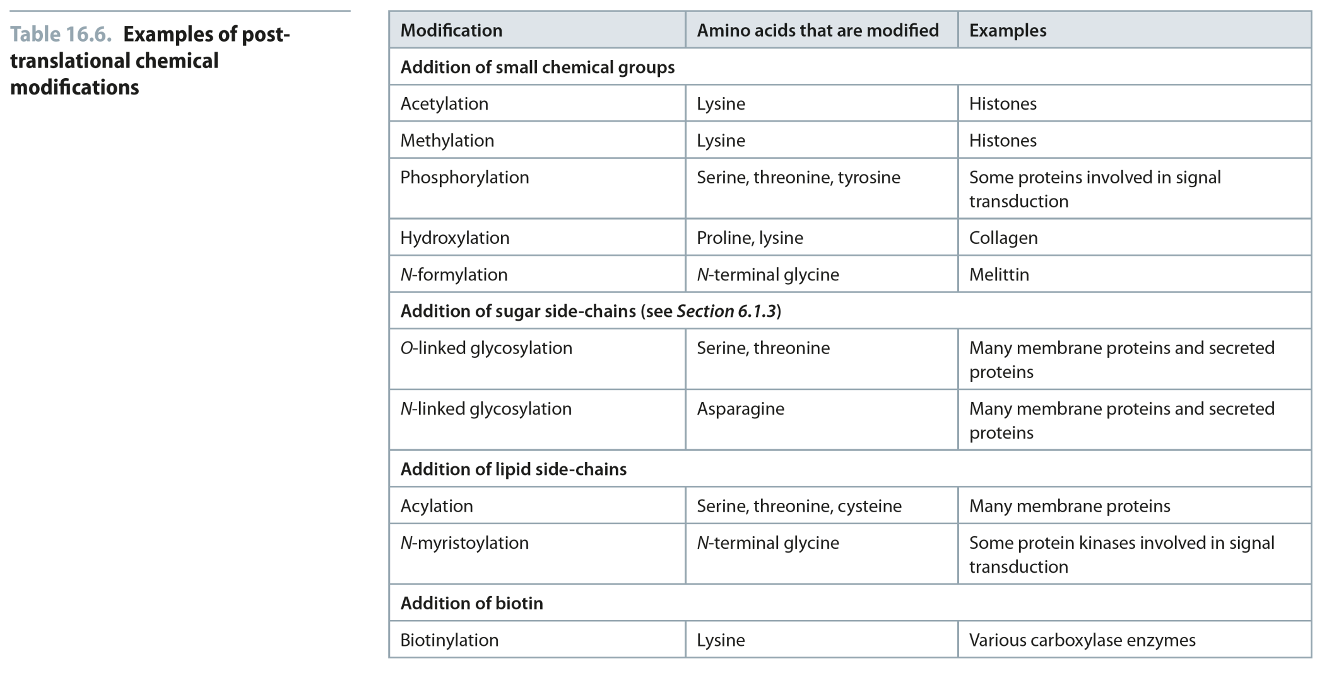
Table 16.6
Reproduced from: Biochemistry by T.A. Brown, ISBN: 9781907904288 © Scion Publishing Ltd, 2017

Slide 28
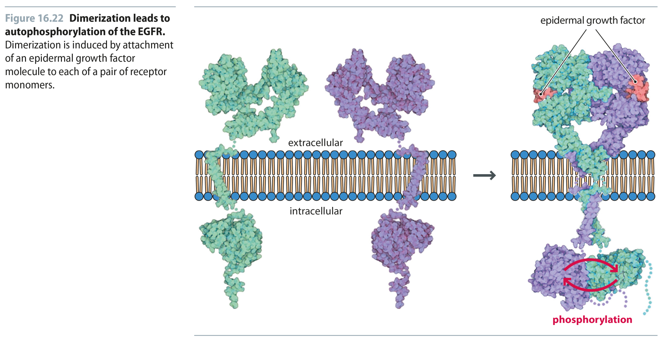
Fig 16.22
Reproduced from: Biochemistry by T.A. Brown, ISBN: 9781907904288 © Scion Publishing Ltd, 2017

Slide 29
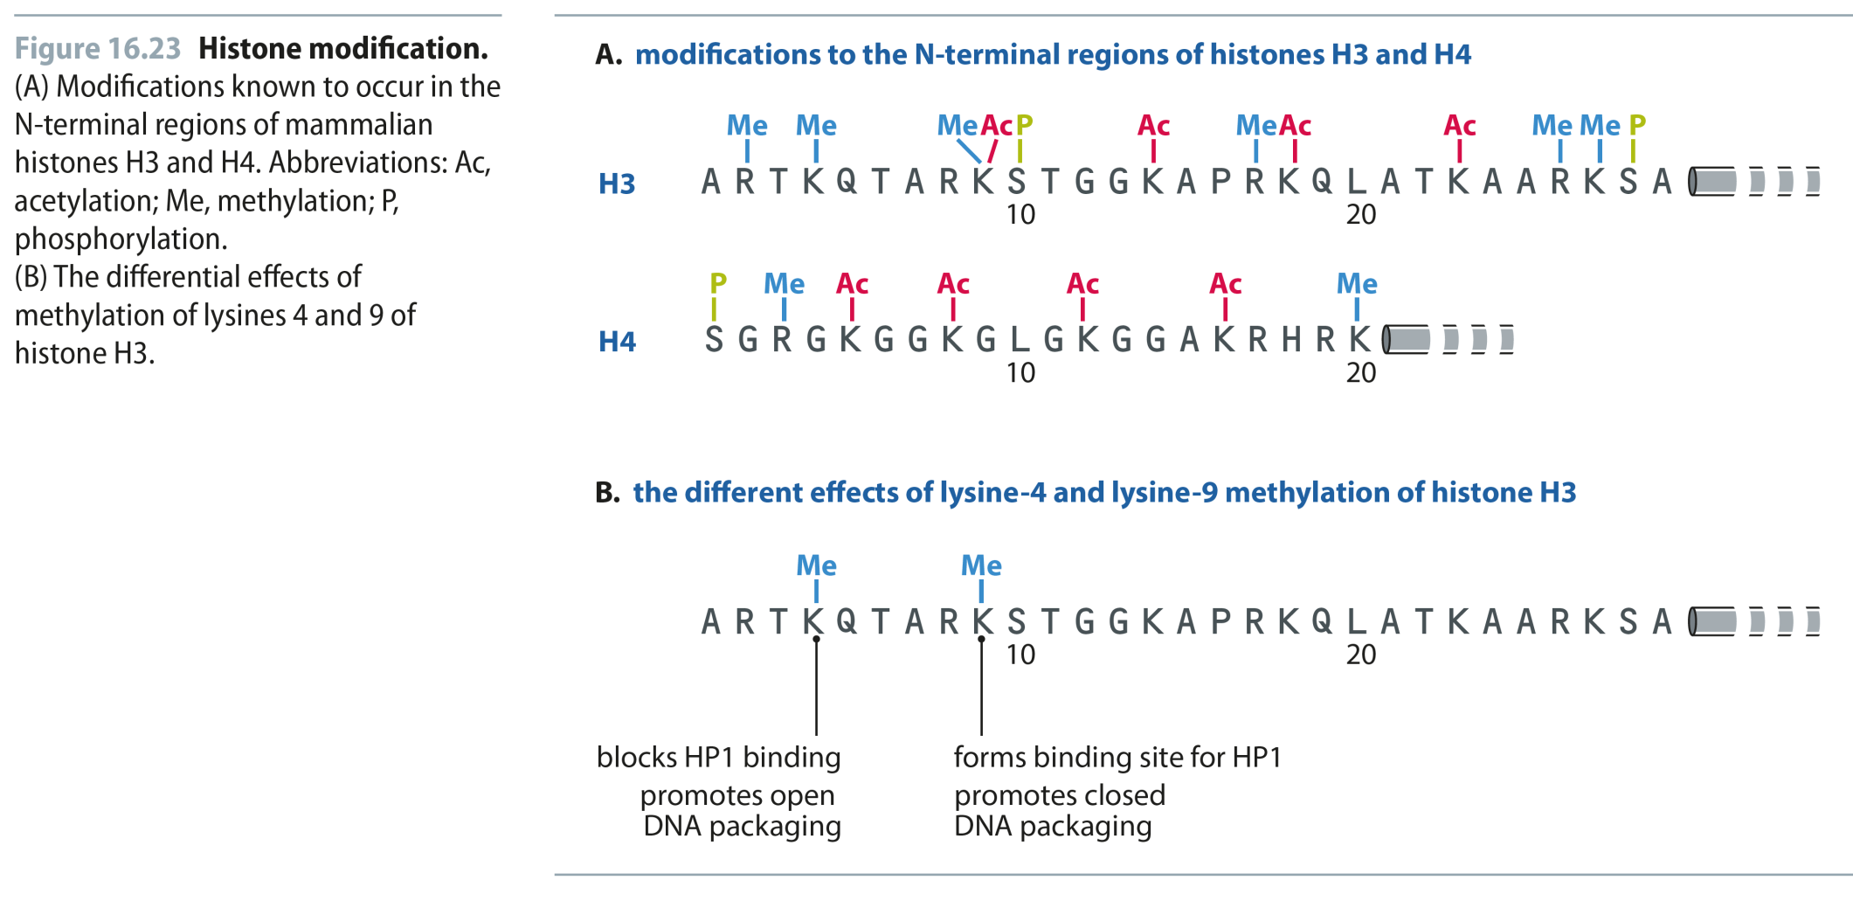
Fig 16.23
Reproduced from: Biochemistry by T.A. Brown, ISBN: 9781907904288 © Scion Publishing Ltd, 2017

Slide 30
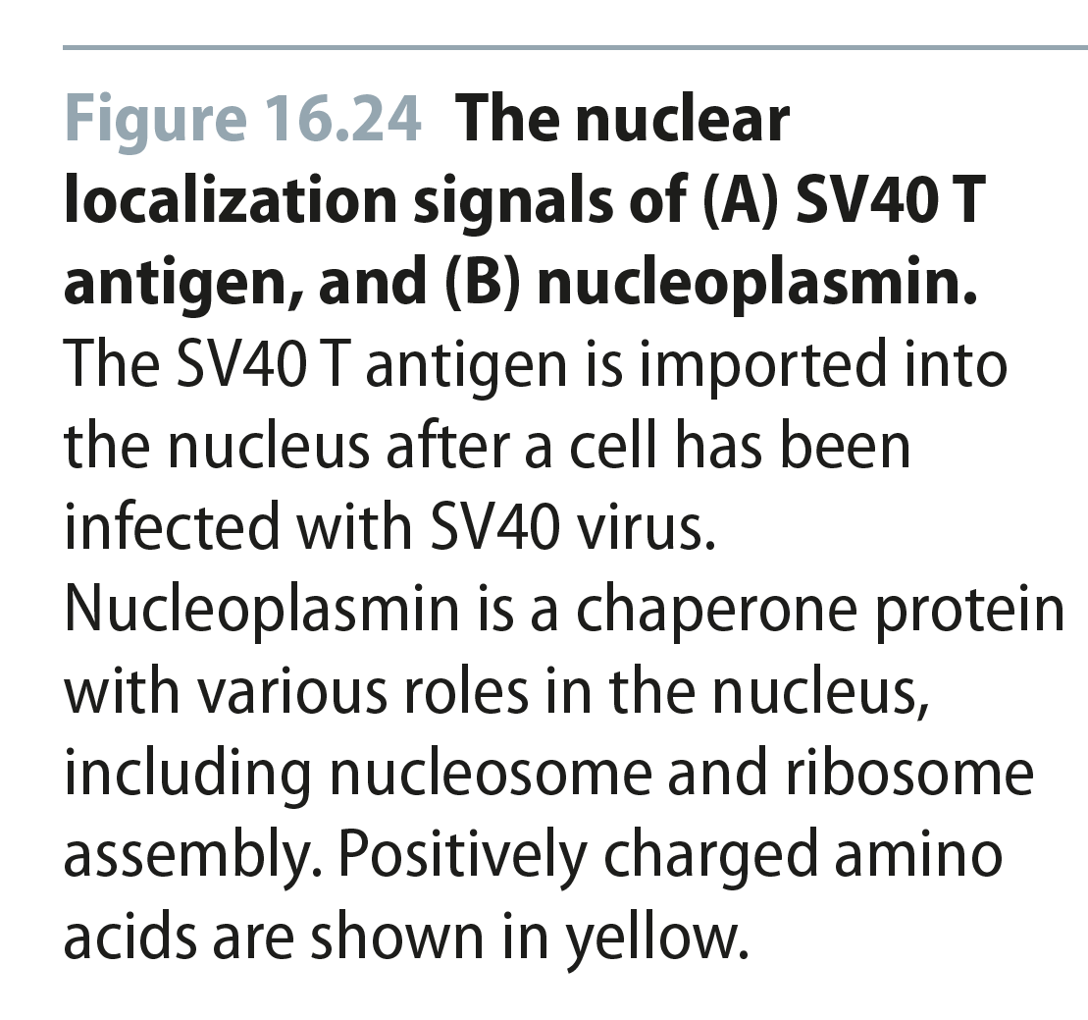
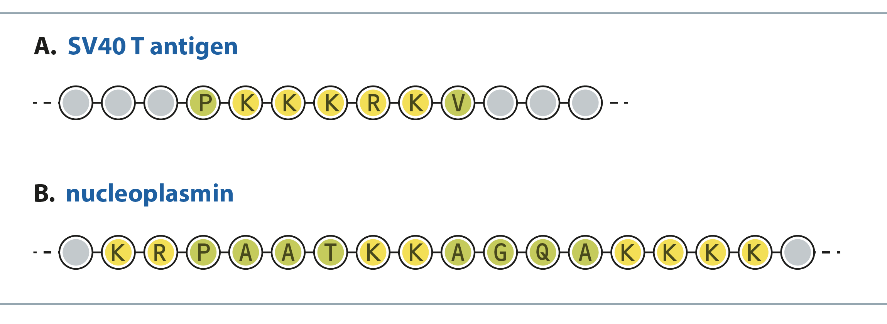
Fig 16.24
Reproduced from: Biochemistry by T.A. Brown, ISBN: 9781907904288 © Scion Publishing Ltd, 2017

Slide 31
Fig 16.25
Reproduced from: Biochemistry by T.A. Brown, ISBN: 9781907904288 © Scion Publishing Ltd, 2017

Slide 32
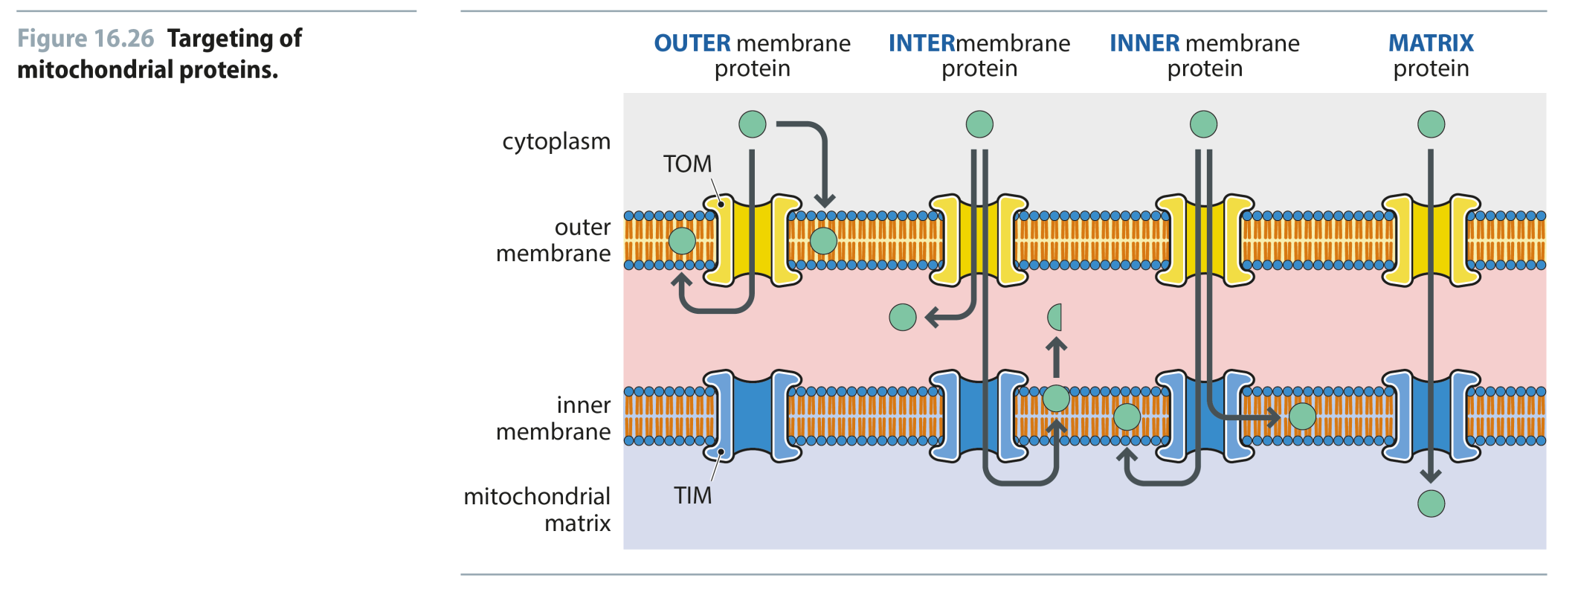
Fig 16.26
Reproduced from: Biochemistry by T.A. Brown, ISBN: 9781907904288 © Scion Publishing Ltd, 2017

Slide 33
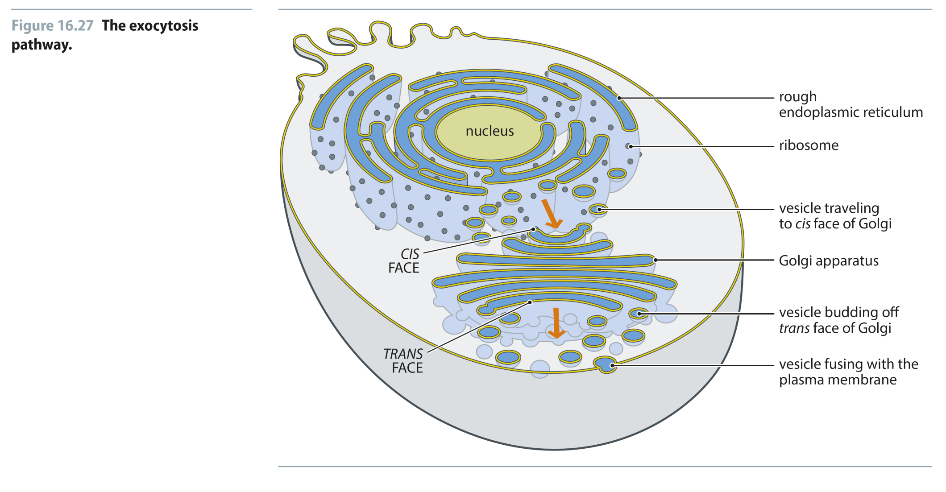
Fig 16.27
Reproduced from: Biochemistry by T.A. Brown, ISBN: 9781907904288 © Scion Publishing Ltd, 2017

Slide 34
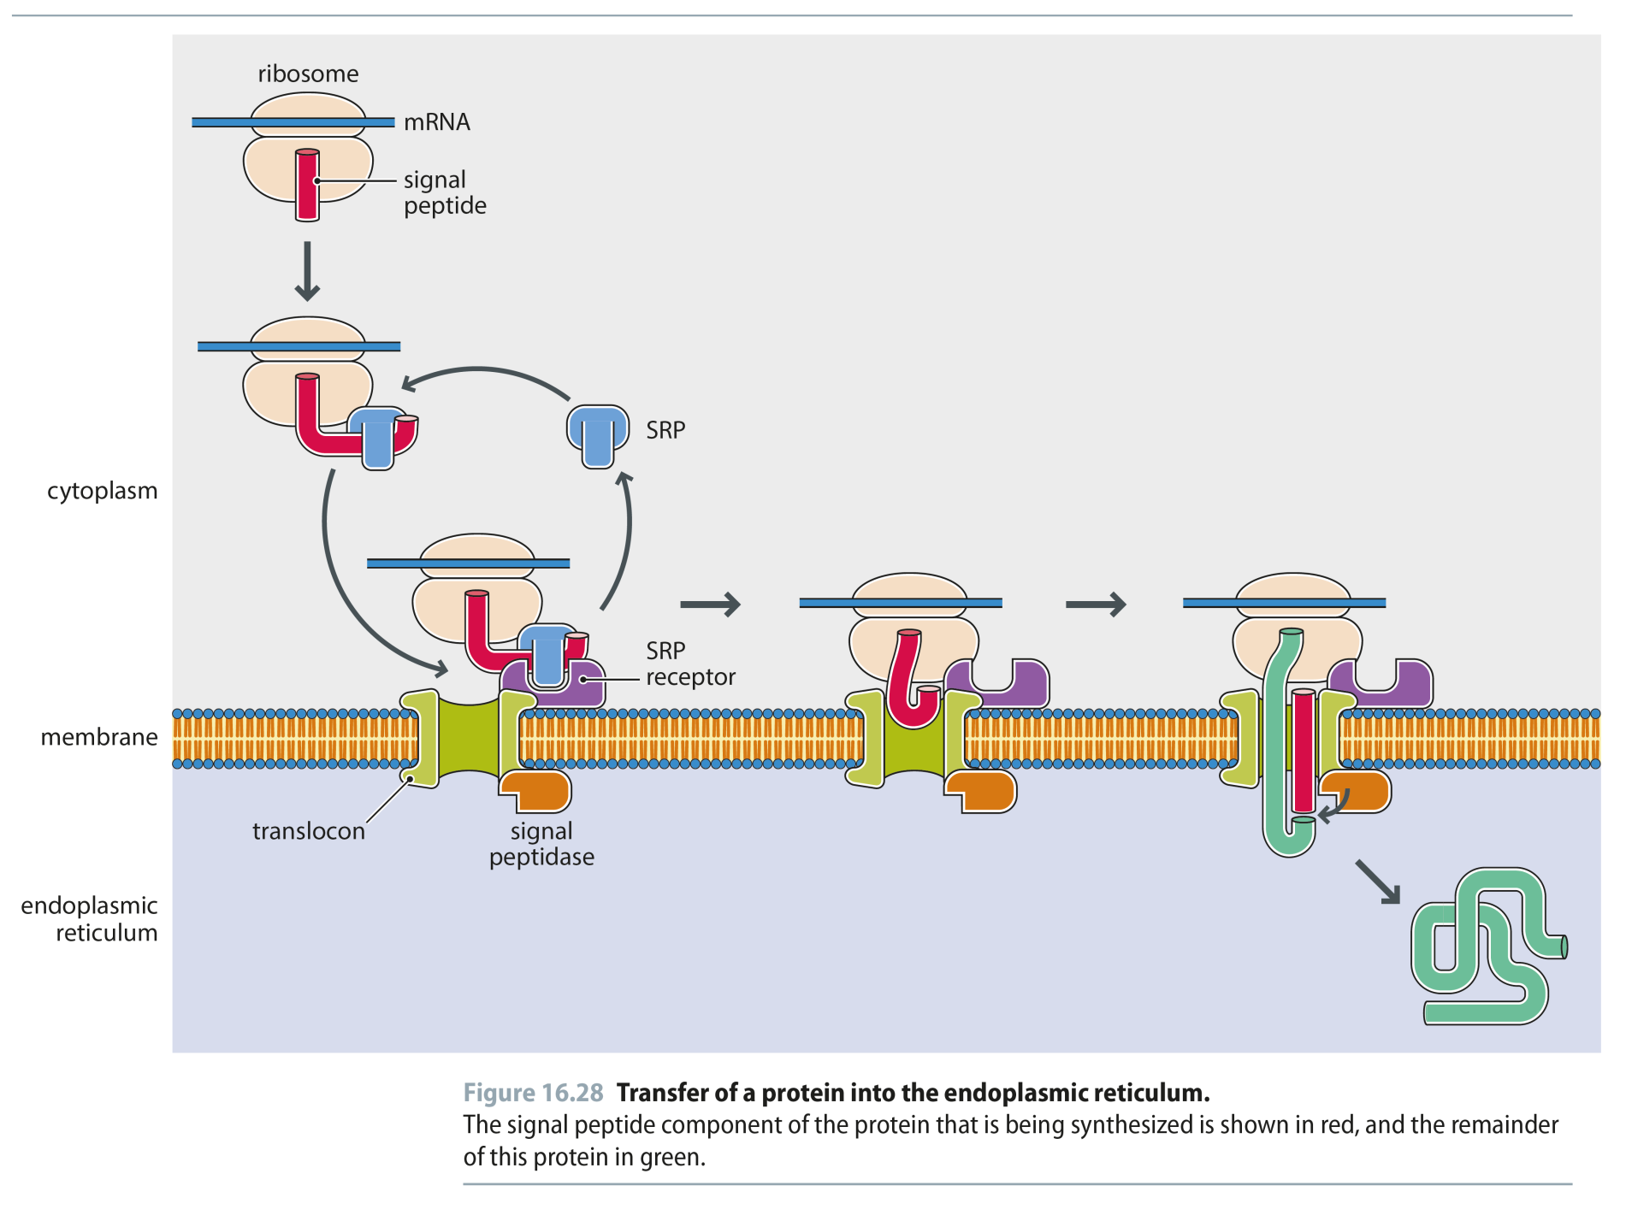
Fig 16.28
Reproduced from: Biochemistry by T.A. Brown, ISBN: 9781907904288 © Scion Publishing Ltd, 2017

Slide 35
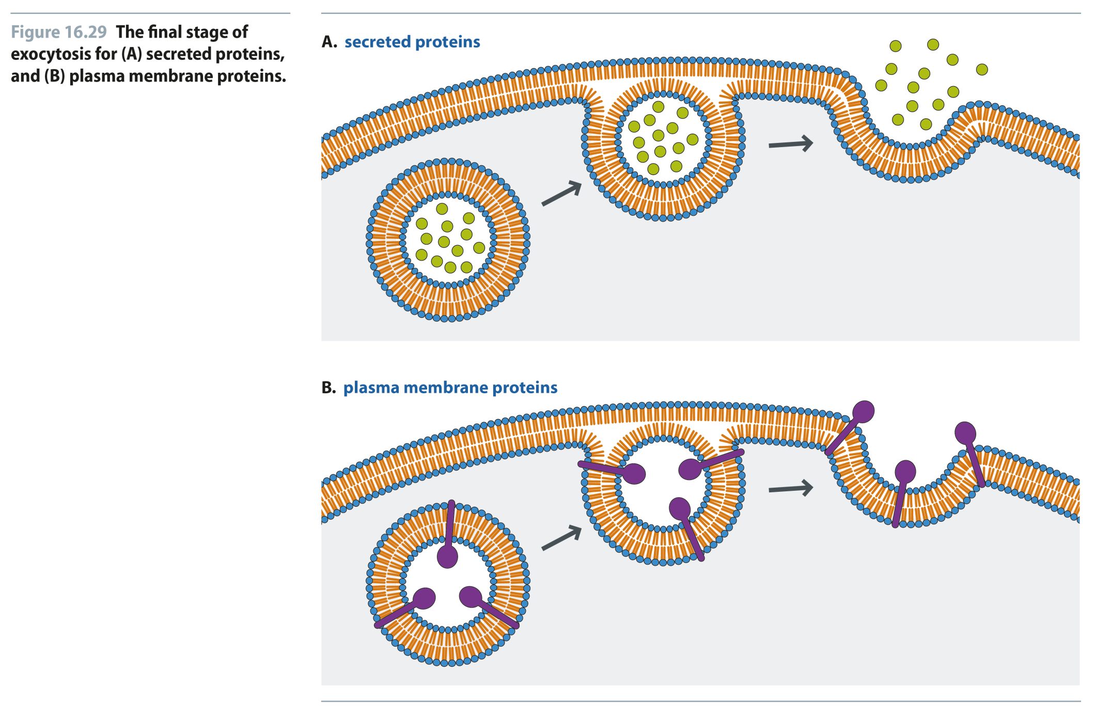
Fig 16.29
Reproduced from: Biochemistry by T.A. Brown, ISBN: 9781907904288 © Scion Publishing Ltd, 2017

Slide 36
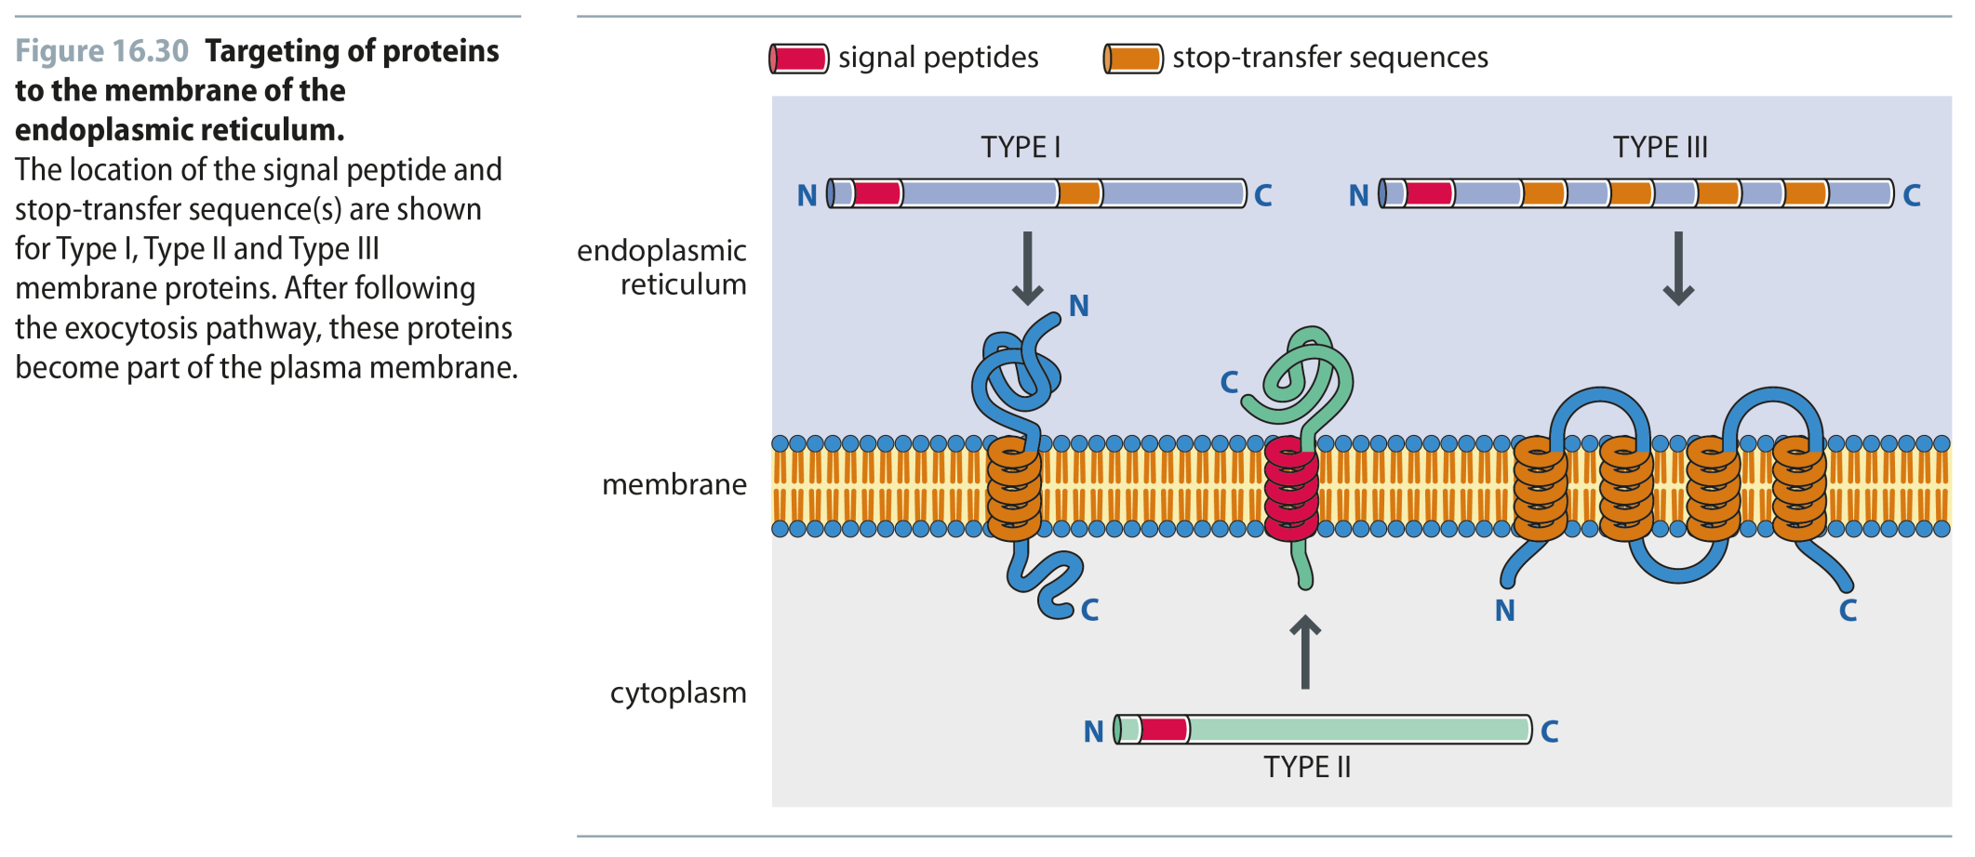
Fig 16.30
Reproduced from: Biochemistry by T.A. Brown, ISBN: 9781907904288 © Scion Publishing Ltd, 2017

Slide 37
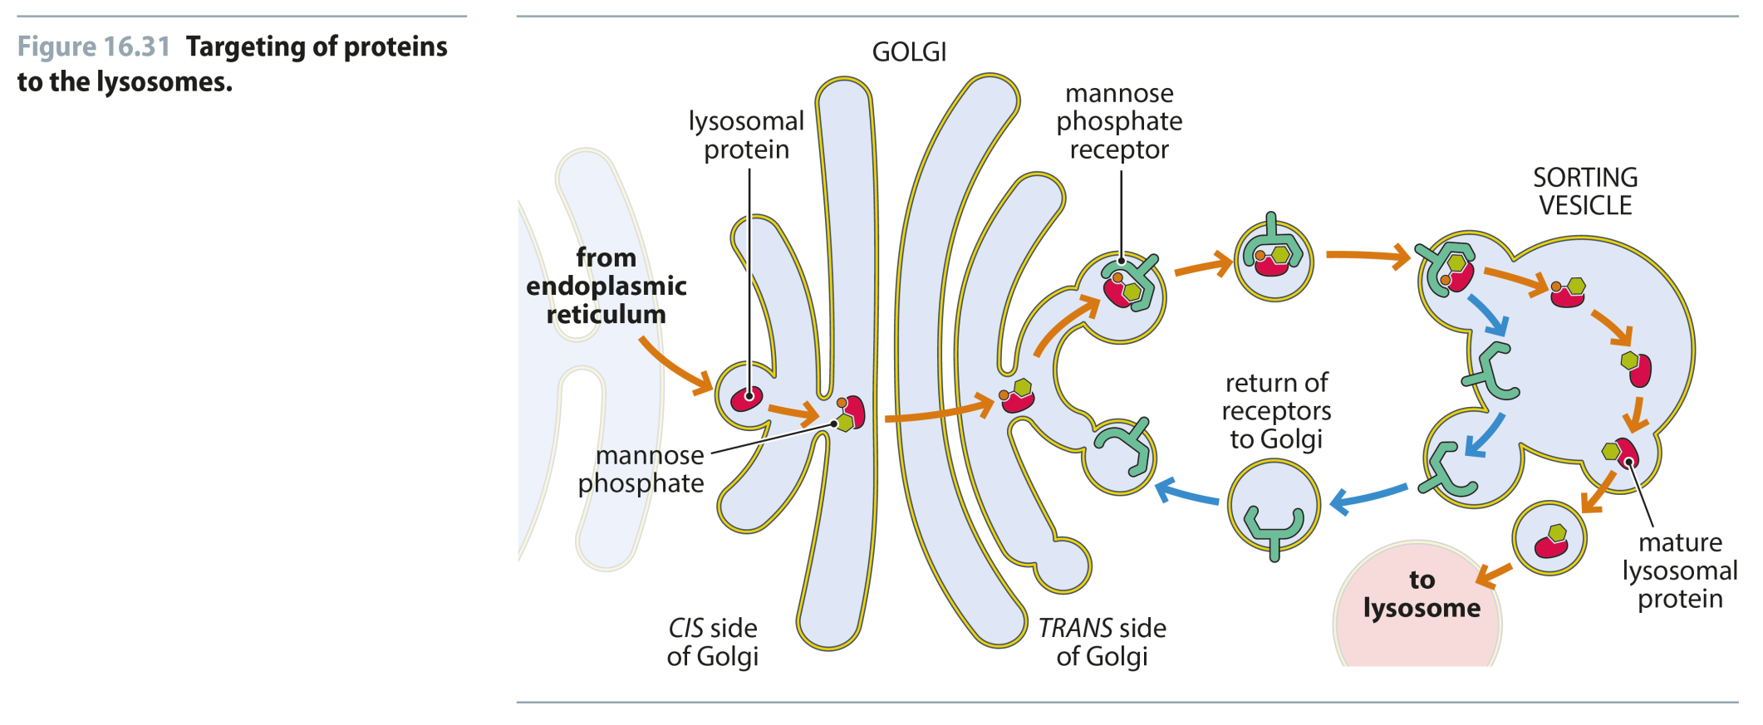
Fig 16.31
Reproduced from: Biochemistry by T.A. Brown, ISBN: 9781907904288 © Scion Publishing Ltd, 2017

