Slide 1
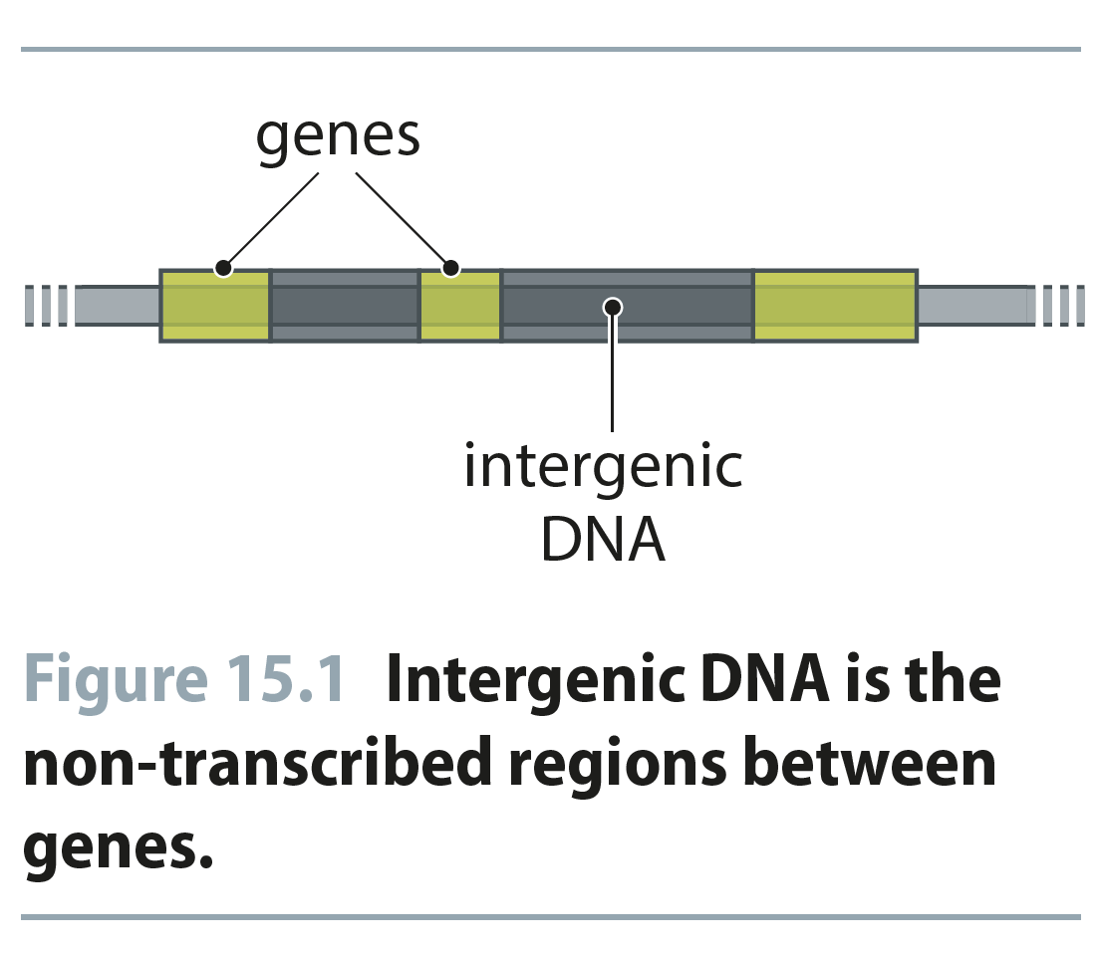
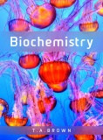
Fig 15.1
Reproduced from: Biochemistry by T.A. Brown, ISBN: 9781907904288 © Scion Publishing Ltd, 2017

Slide 2
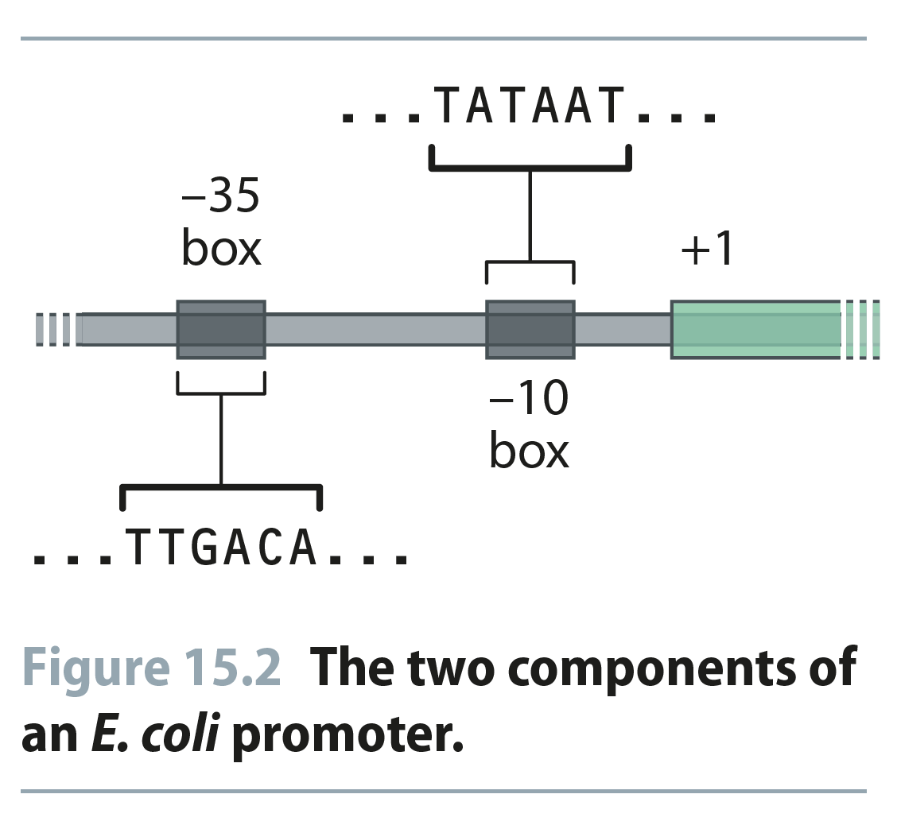
Fig 15.2
Reproduced from: Biochemistry by T.A. Brown, ISBN: 9781907904288 © Scion Publishing Ltd, 2017

Slide 3
Table 15.1
Reproduced from: Biochemistry by T.A. Brown, ISBN: 9781907904288 © Scion Publishing Ltd, 2017

Slide 4
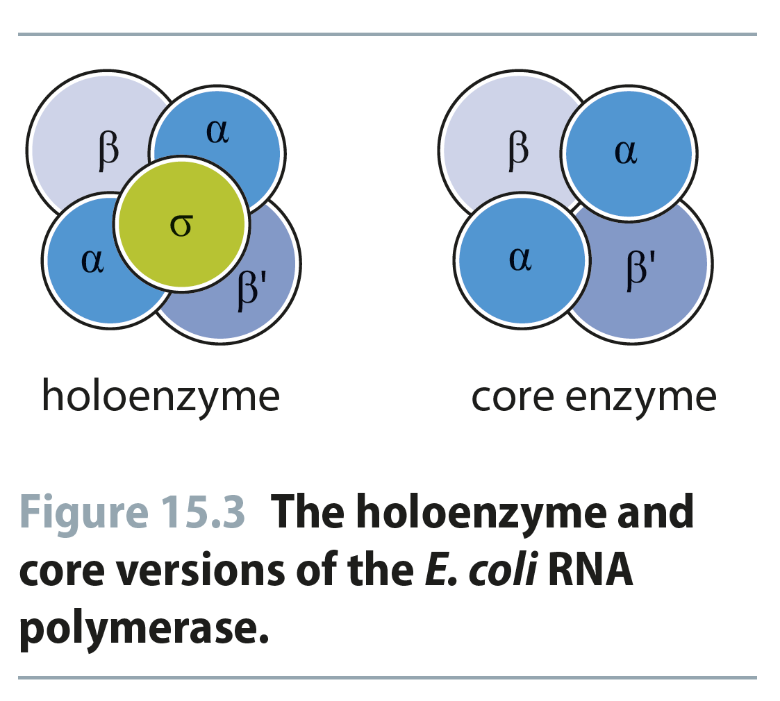
Fig 15.3
Reproduced from: Biochemistry by T.A. Brown, ISBN: 9781907904288 © Scion Publishing Ltd, 2017

Slide 5
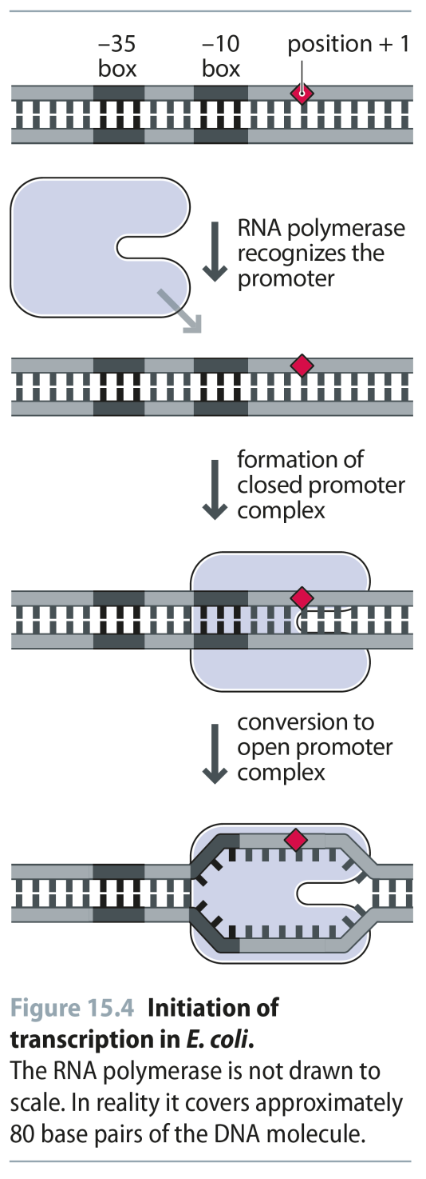
Fig 15.4
Reproduced from: Biochemistry by T.A. Brown, ISBN: 9781907904288 © Scion Publishing Ltd, 2017

Slide 6
Table 15.2
Reproduced from: Biochemistry by T.A. Brown, ISBN: 9781907904288 © Scion Publishing Ltd, 2017

Slide 7
Fig 15.5
Reproduced from: Biochemistry by T.A. Brown, ISBN: 9781907904288 © Scion Publishing Ltd, 2017

Slide 8
Fig 15.6
Reproduced from: Biochemistry by T.A. Brown, ISBN: 9781907904288 © Scion Publishing Ltd, 2017

Slide 9
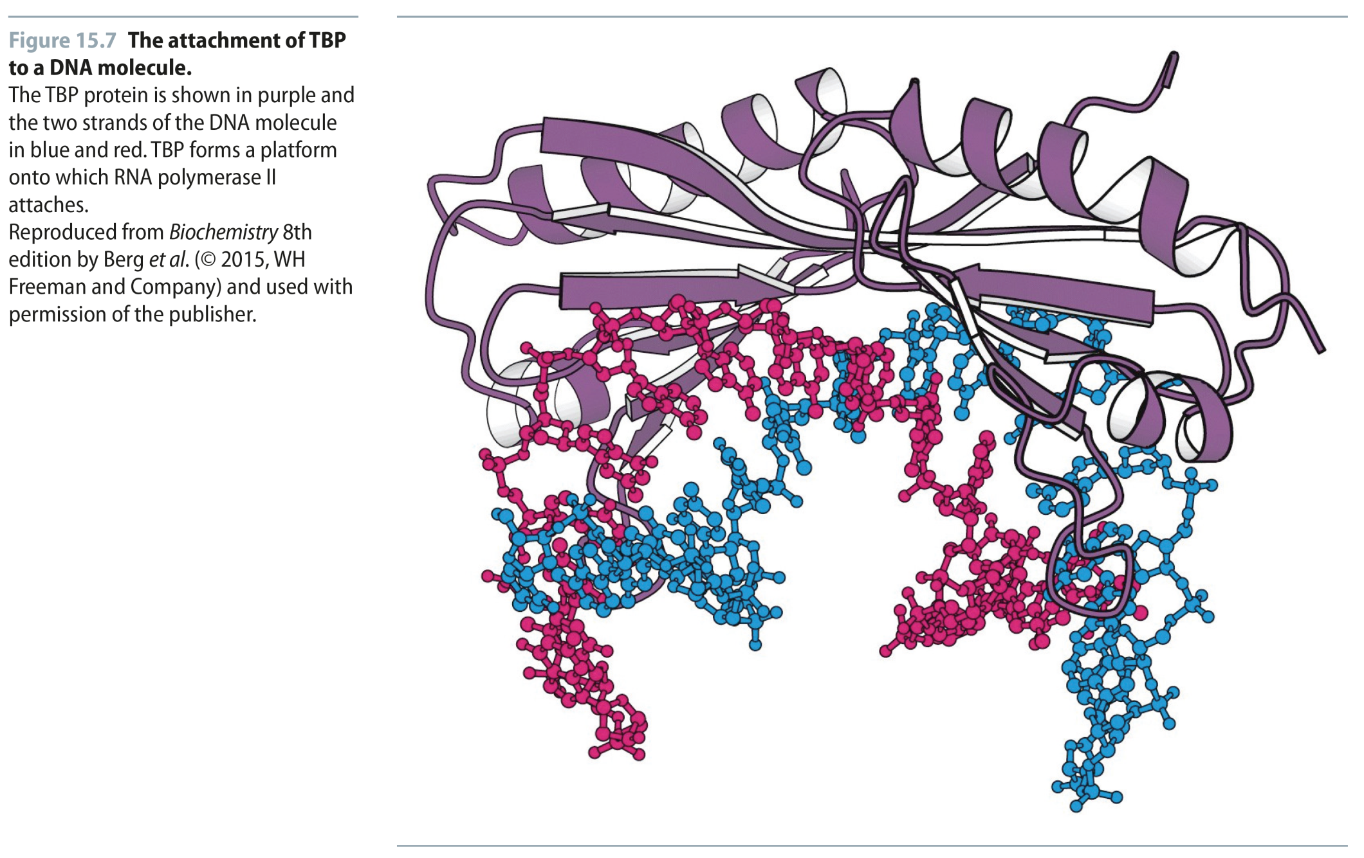
Fig 15.7
Reproduced from: Biochemistry by T.A. Brown, ISBN: 9781907904288 © Scion Publishing Ltd, 2017

Slide 10
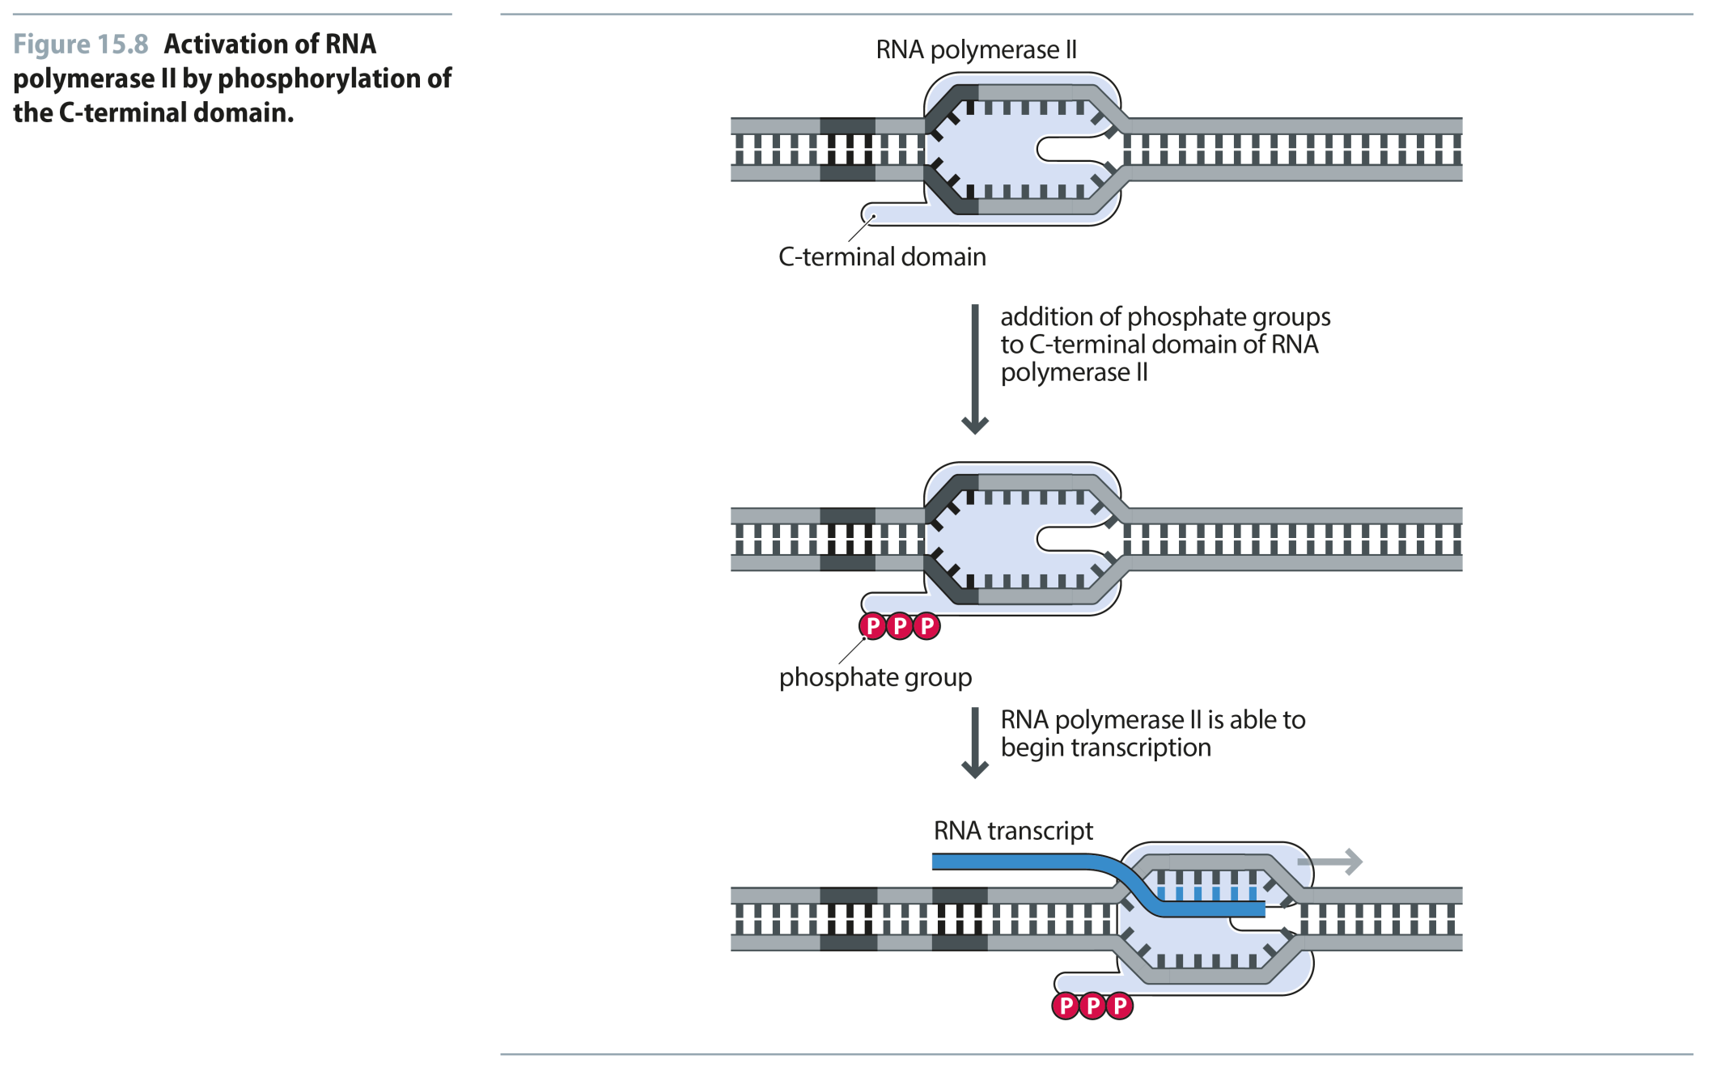
Fig 15.8
Reproduced from: Biochemistry by T.A. Brown, ISBN: 9781907904288 © Scion Publishing Ltd, 2017

Slide 11
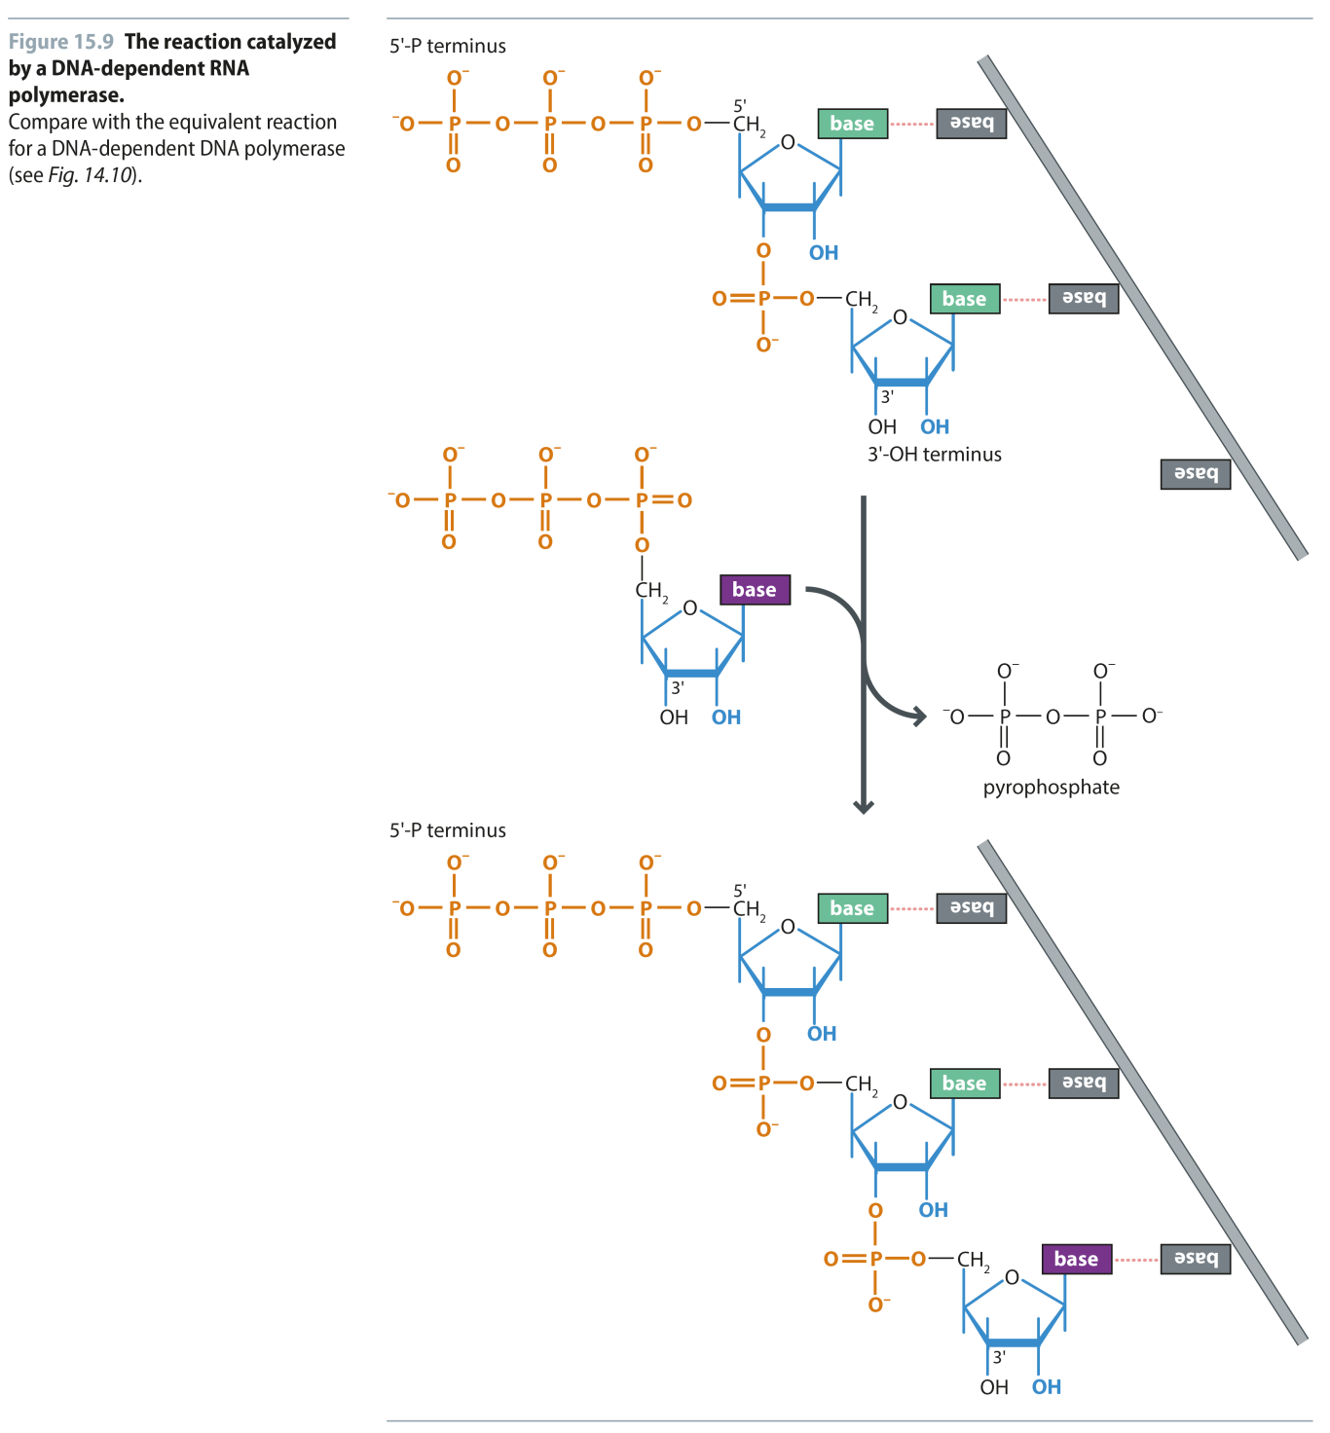
Fig 15.9
Reproduced from: Biochemistry by T.A. Brown, ISBN: 9781907904288 © Scion Publishing Ltd, 2017

Slide 12
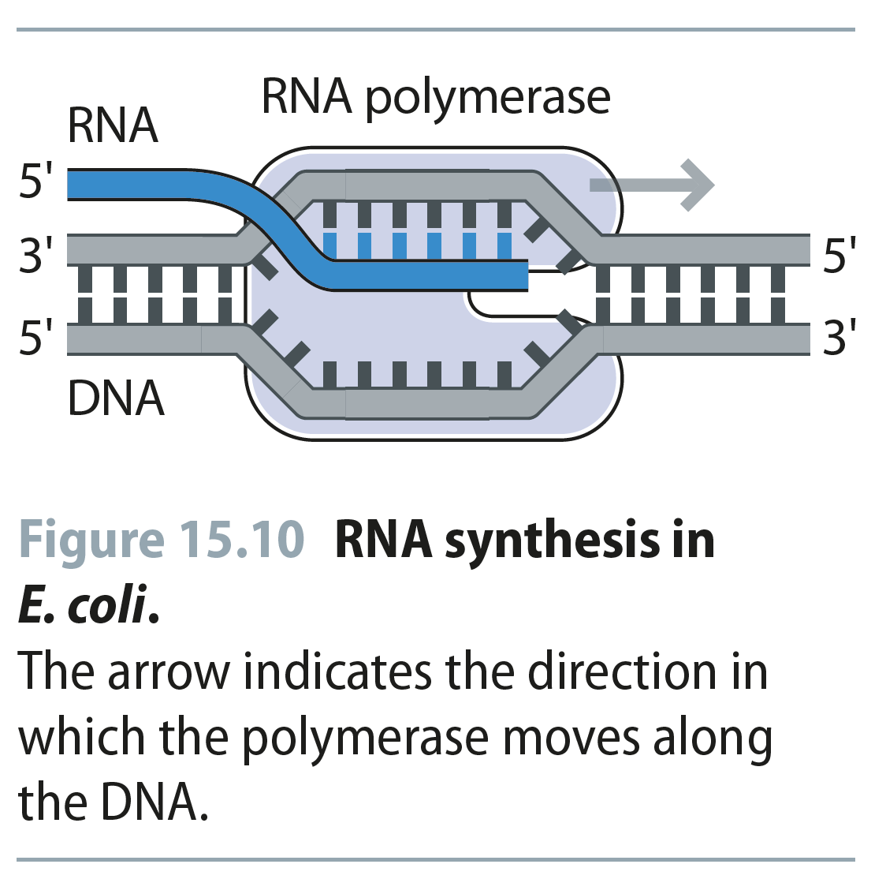
Fig 15.10
Reproduced from: Biochemistry by T.A. Brown, ISBN: 9781907904288 © Scion Publishing Ltd, 2017

Slide 13
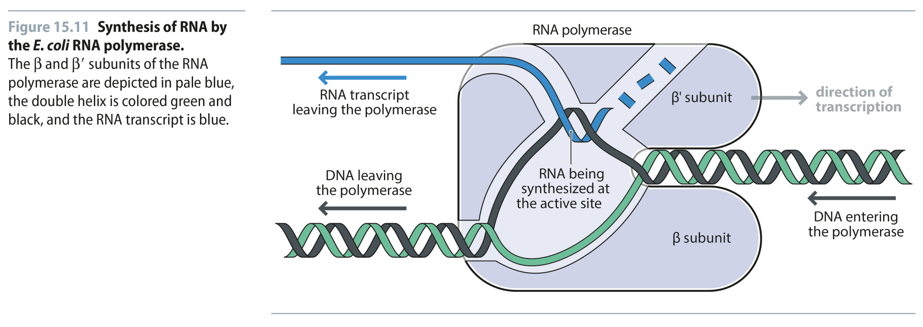
Fig 15.11
Reproduced from: Biochemistry by T.A. Brown, ISBN: 9781907904288 © Scion Publishing Ltd, 2017

Slide 14
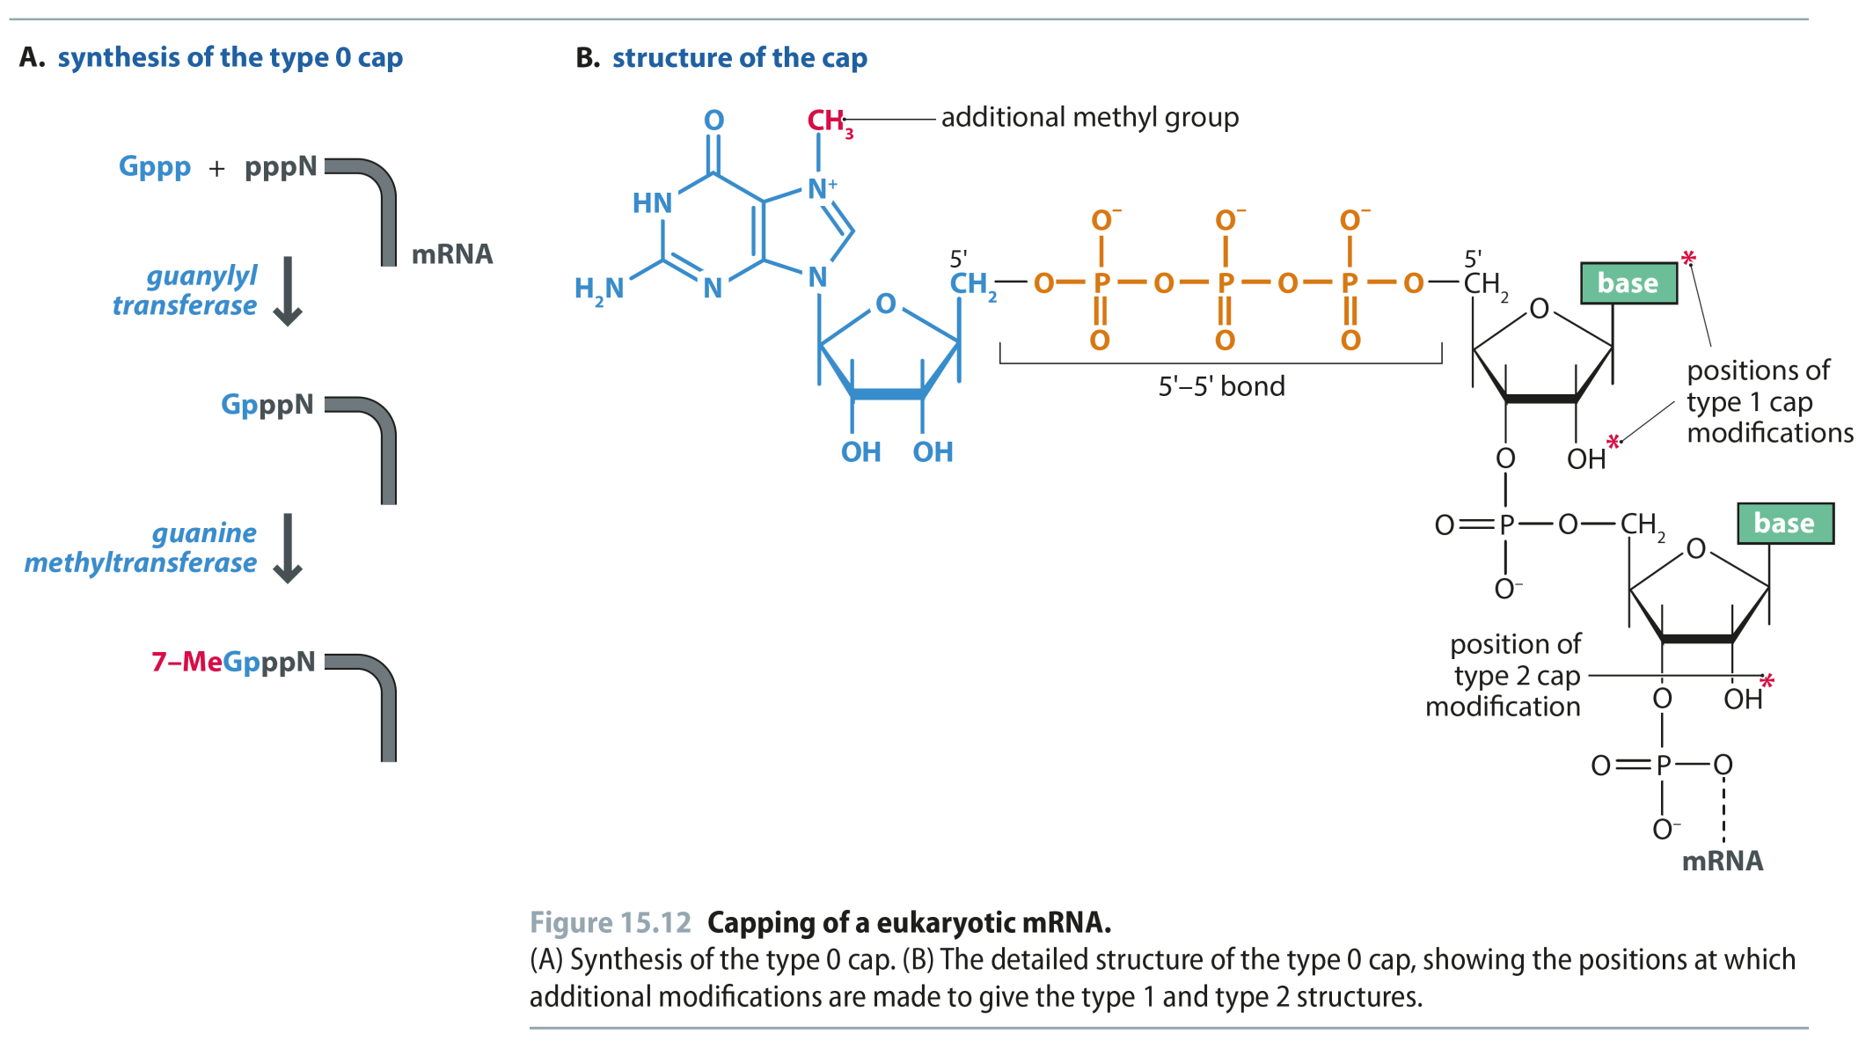
Fig 15.12
Reproduced from: Biochemistry by T.A. Brown, ISBN: 9781907904288 © Scion Publishing Ltd, 2017

Slide 15
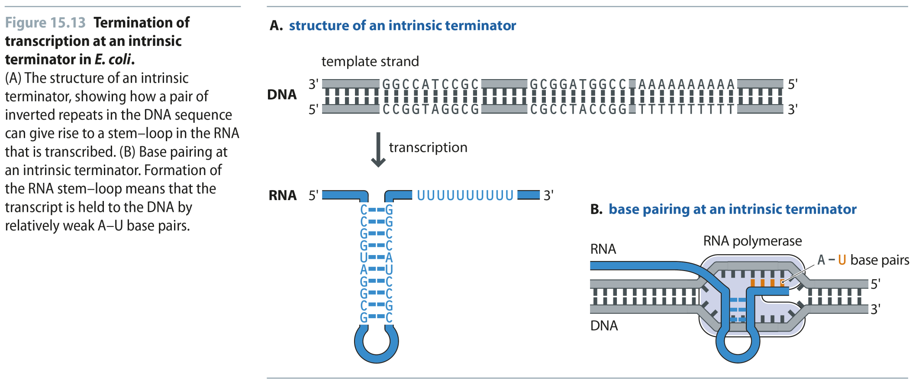
Fig 15.13
Reproduced from: Biochemistry by T.A. Brown, ISBN: 9781907904288 © Scion Publishing Ltd, 2017

Slide 16
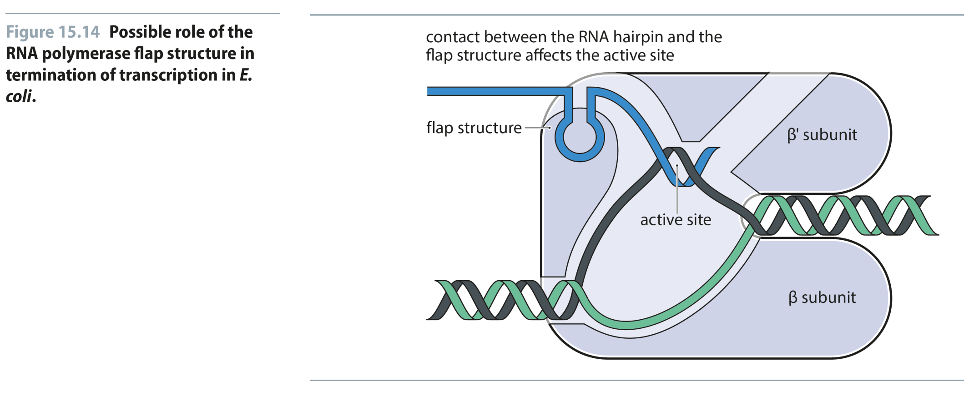
Fig 15.14
Reproduced from: Biochemistry by T.A. Brown, ISBN: 9781907904288 © Scion Publishing Ltd, 2017

Slide 17
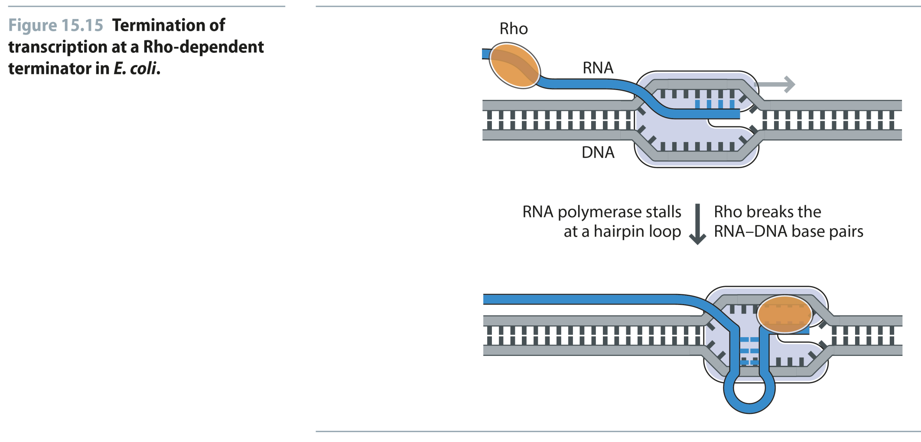
Fig 15.15
Reproduced from: Biochemistry by T.A. Brown, ISBN: 9781907904288 © Scion Publishing Ltd, 2017

Slide 18
Fig 15.16
Reproduced from: Biochemistry by T.A. Brown, ISBN: 9781907904288 © Scion Publishing Ltd, 2017

Slide 19
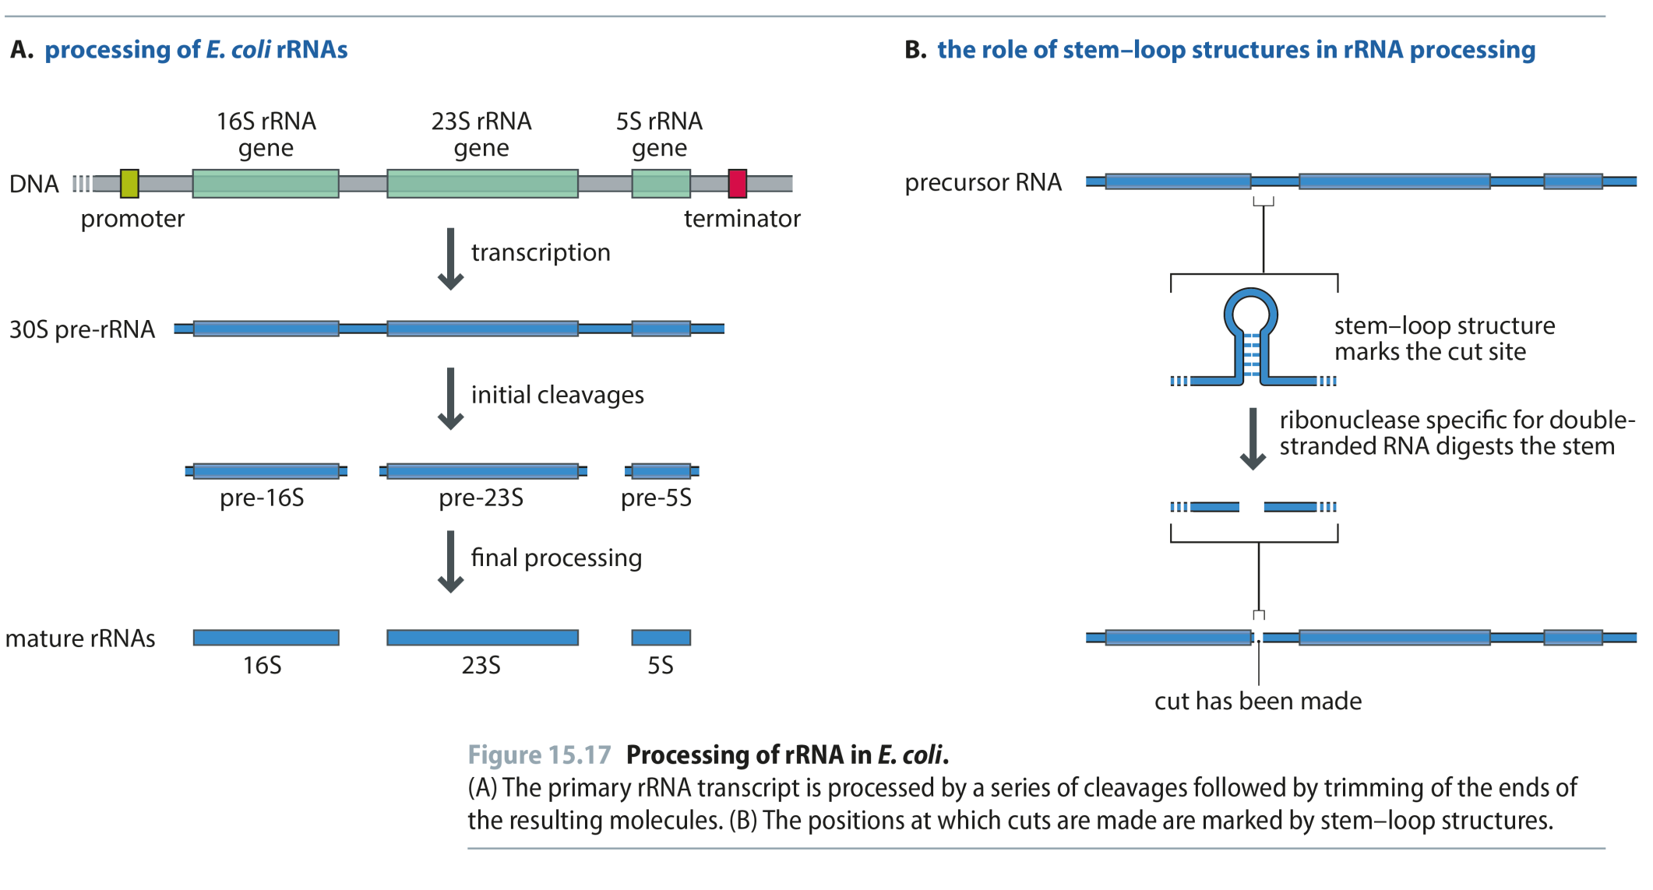
Fig 15.17
Reproduced from: Biochemistry by T.A. Brown, ISBN: 9781907904288 © Scion Publishing Ltd, 2017

Slide 20
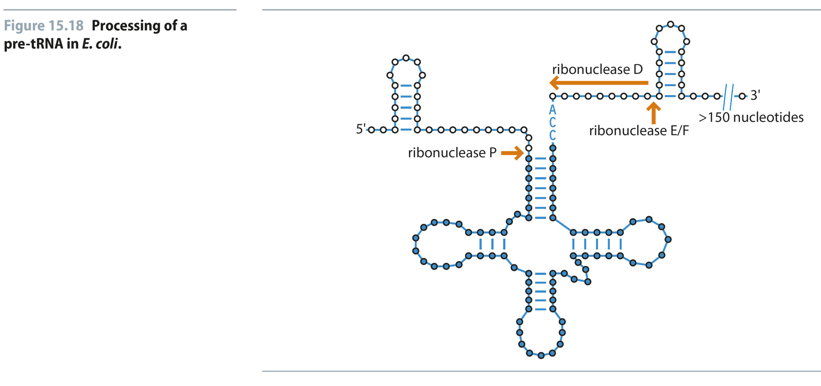
Fig 15.18
Reproduced from: Biochemistry by T.A. Brown, ISBN: 9781907904288 © Scion Publishing Ltd, 2017

Slide 21
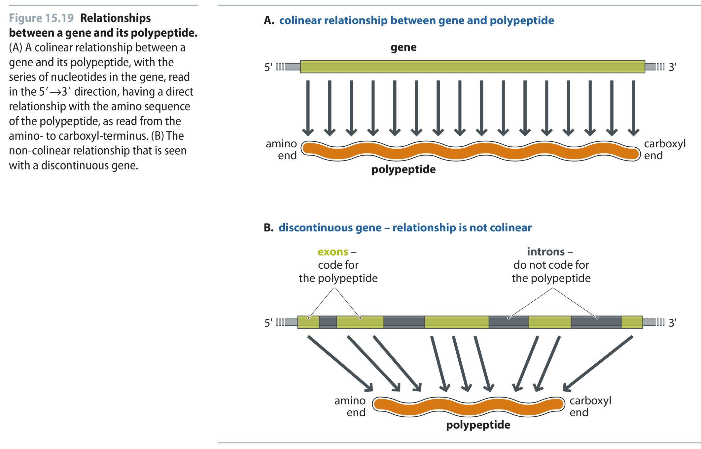
Fig 15.19
Reproduced from: Biochemistry by T.A. Brown, ISBN: 9781907904288 © Scion Publishing Ltd, 2017

Slide 22
Fig 15.20
Reproduced from: Biochemistry by T.A. Brown, ISBN: 9781907904288 © Scion Publishing Ltd, 2017

Slide 23
Fig 15.21
Reproduced from: Biochemistry by T.A. Brown, ISBN: 9781907904288 © Scion Publishing Ltd, 2017

Slide 24
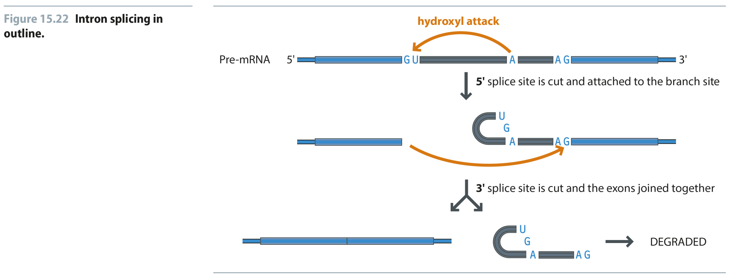
Fig 15.22
Reproduced from: Biochemistry by T.A. Brown, ISBN: 9781907904288 © Scion Publishing Ltd, 2017

Slide 25
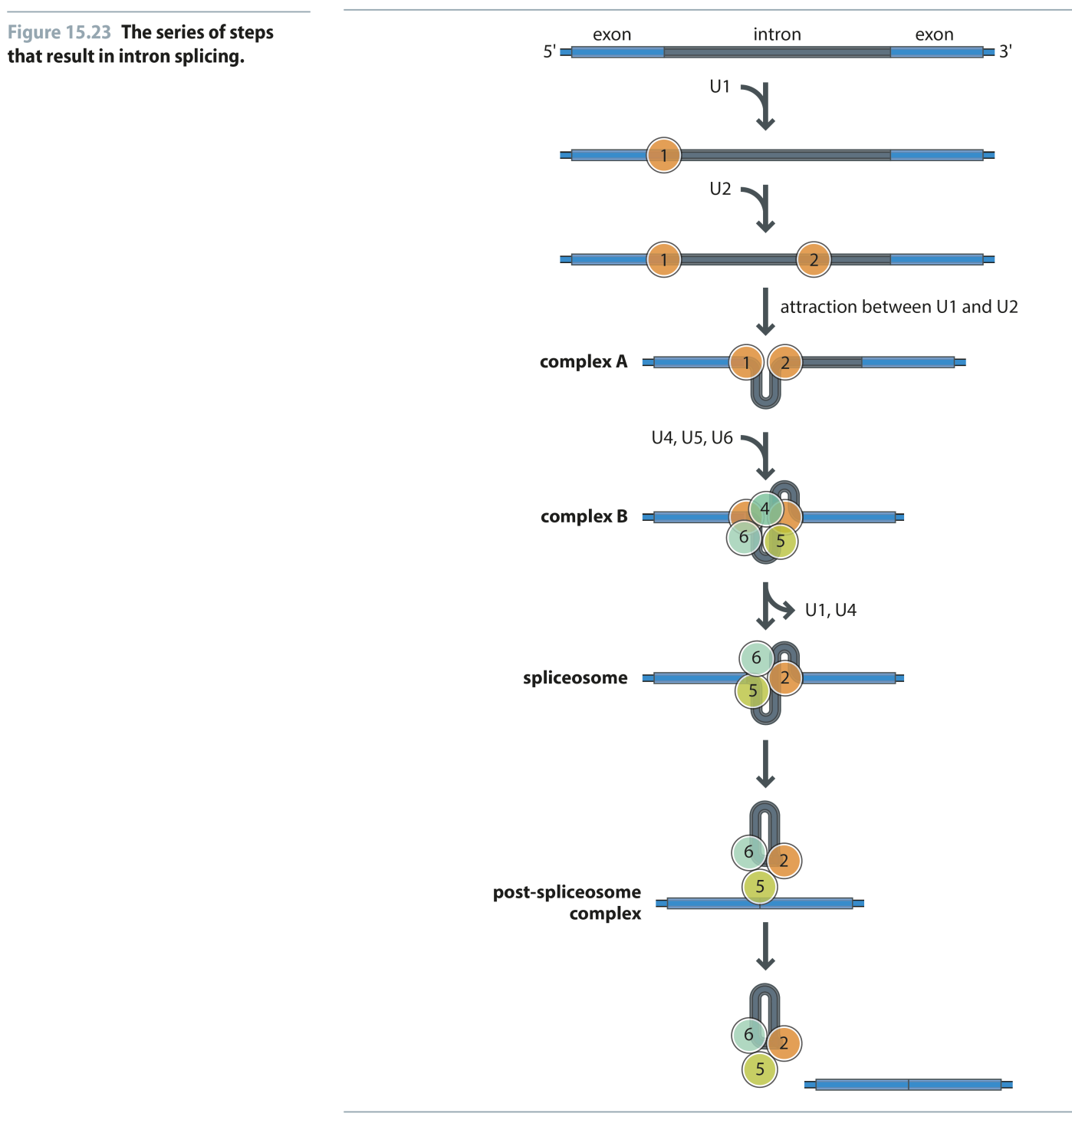
Fig 15.23
Reproduced from: Biochemistry by T.A. Brown, ISBN: 9781907904288 © Scion Publishing Ltd, 2017

Slide 26
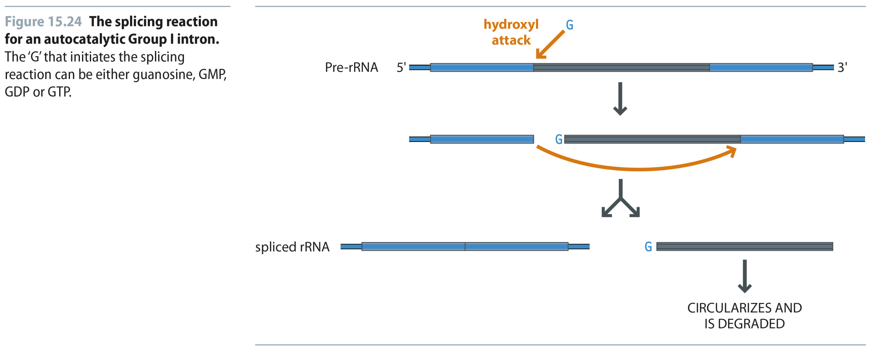
Fig 15.24
Reproduced from: Biochemistry by T.A. Brown, ISBN: 9781907904288 © Scion Publishing Ltd, 2017

Slide 27
Fig 15.25
Reproduced from: Biochemistry by T.A. Brown, ISBN: 9781907904288 © Scion Publishing Ltd, 2017

Slide 28
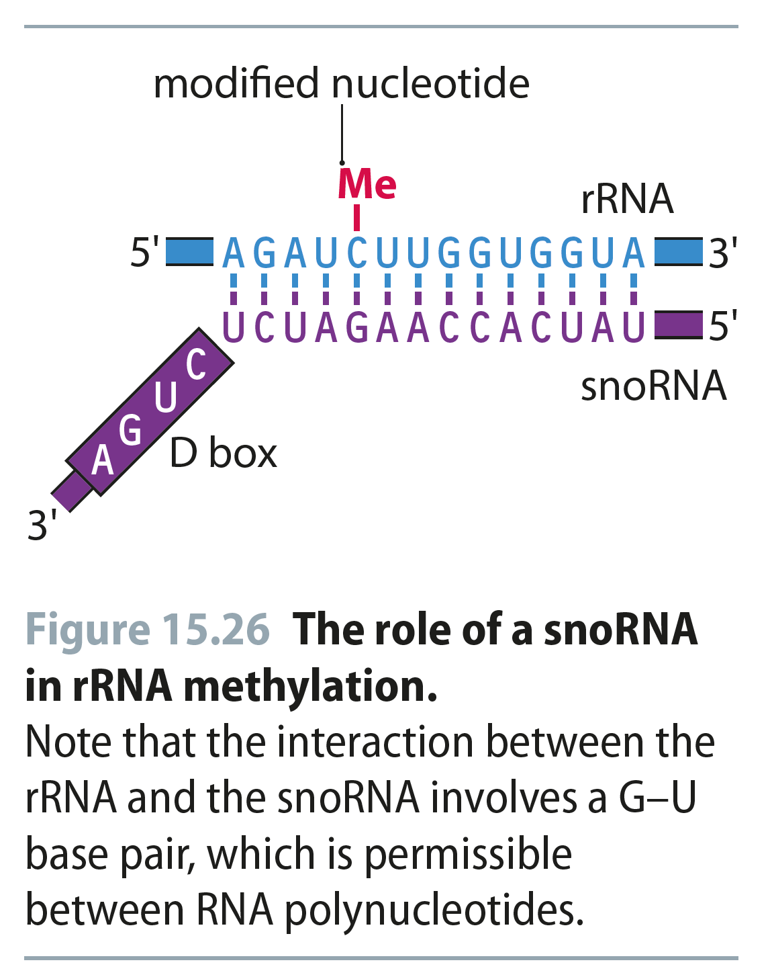
Fig 15.26
Reproduced from: Biochemistry by T.A. Brown, ISBN: 9781907904288 © Scion Publishing Ltd, 2017

