Slide 1
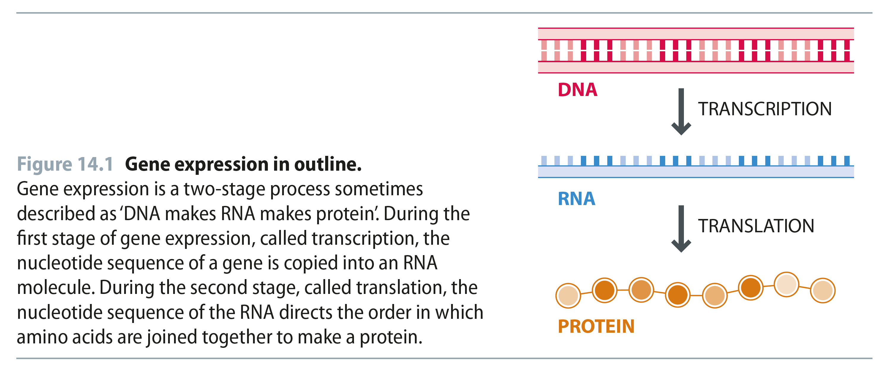
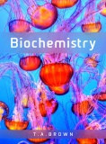
Fig 14.1
Reproduced from: Biochemistry by T.A. Brown, ISBN: 9781907904288 © Scion Publishing Ltd, 2017

Slide 2
Fig 14.2
Reproduced from: Biochemistry by T.A. Brown, ISBN: 9781907904288 © Scion Publishing Ltd, 2017

Slide 3
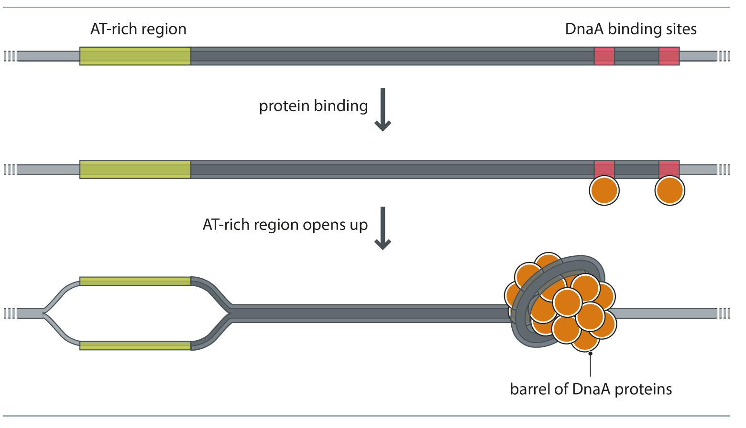
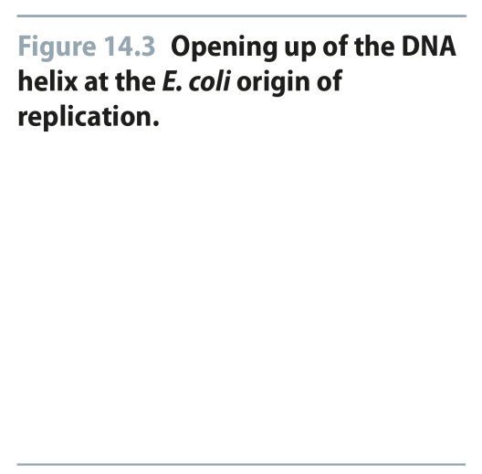
Fig 14.3
Reproduced from: Biochemistry by T.A. Brown, ISBN: 9781907904288 © Scion Publishing Ltd, 2017

Slide 4
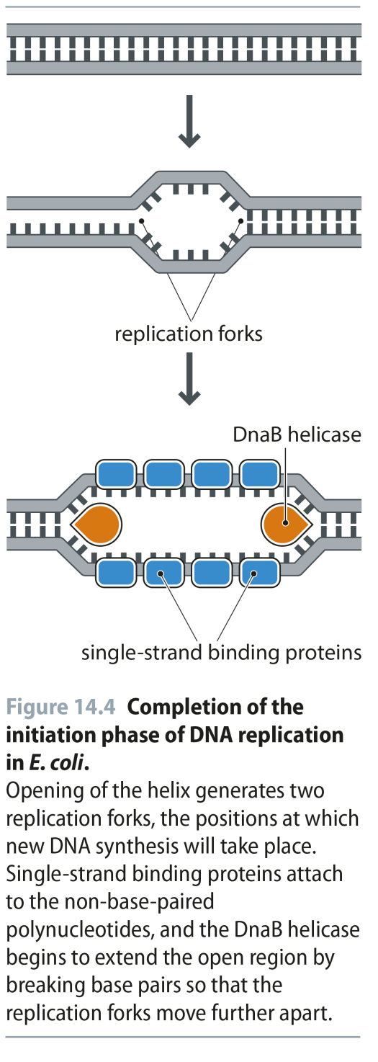
Fig 14.4
Reproduced from: Biochemistry by T.A. Brown, ISBN: 9781907904288 © Scion Publishing Ltd, 2017

Slide 5
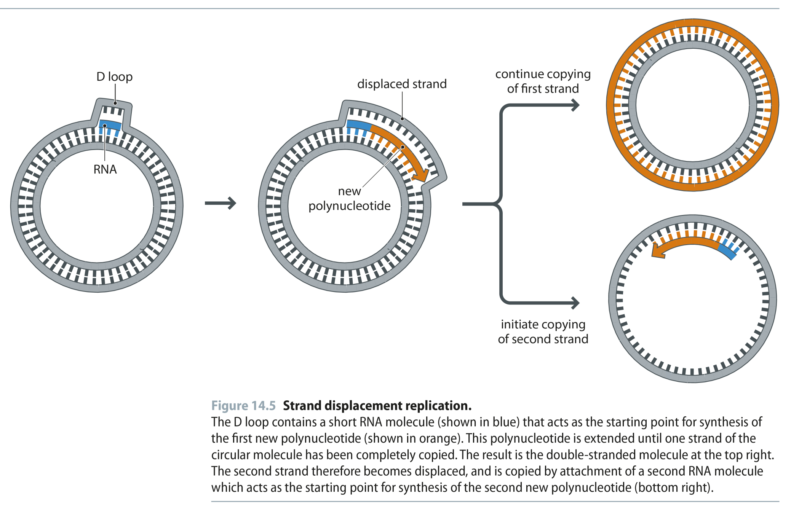
Fig 14.5
Reproduced from: Biochemistry by T.A. Brown, ISBN: 9781907904288 © Scion Publishing Ltd, 2017

Slide 6
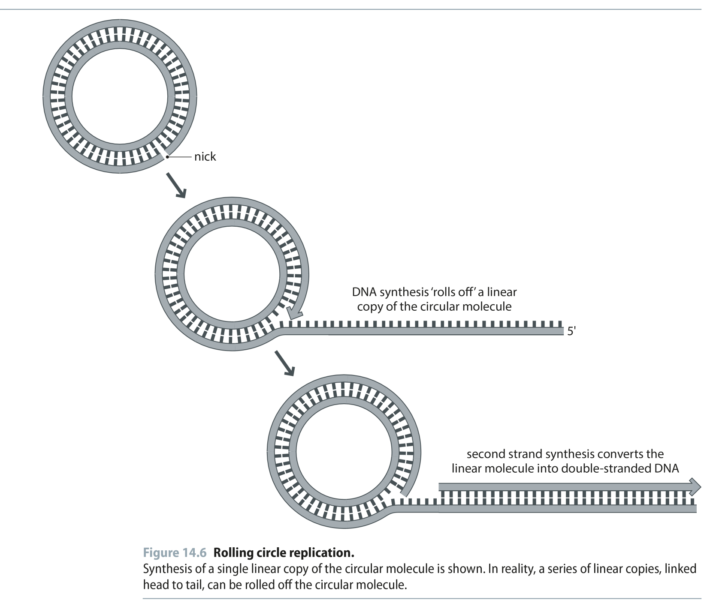
Fig 14.6
Reproduced from: Biochemistry by T.A. Brown, ISBN: 9781907904288 © Scion Publishing Ltd, 2017

Slide 7
Fig 14.7
Reproduced from: Biochemistry by T.A. Brown, ISBN: 9781907904288 © Scion Publishing Ltd, 2017

Slide 8
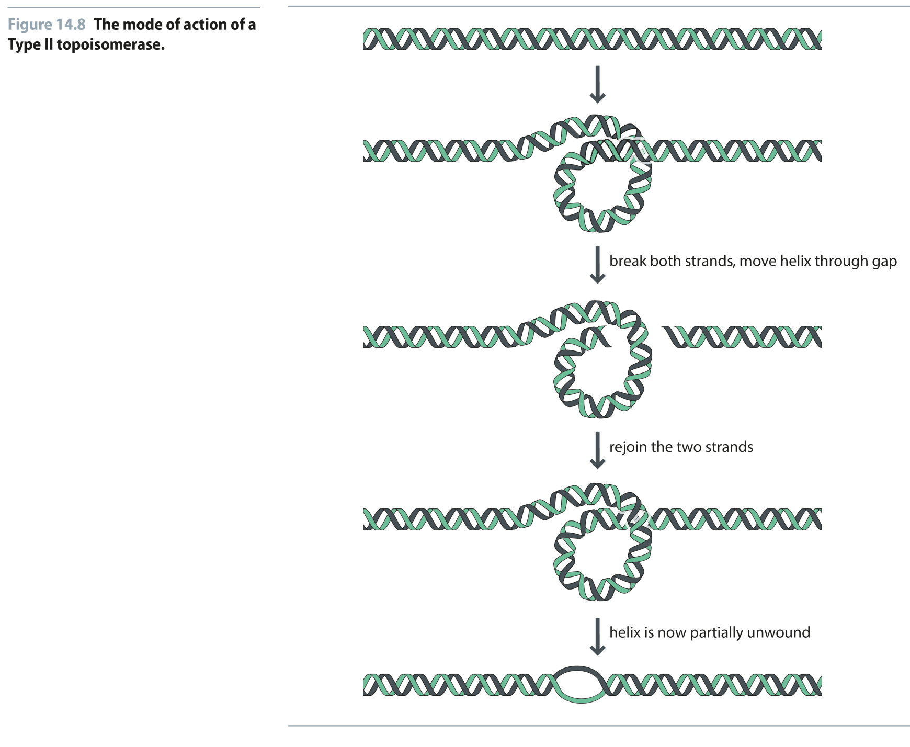
Fig 14.8
Reproduced from: Biochemistry by T.A. Brown, ISBN: 9781907904288 © Scion Publishing Ltd, 2017

Slide 9
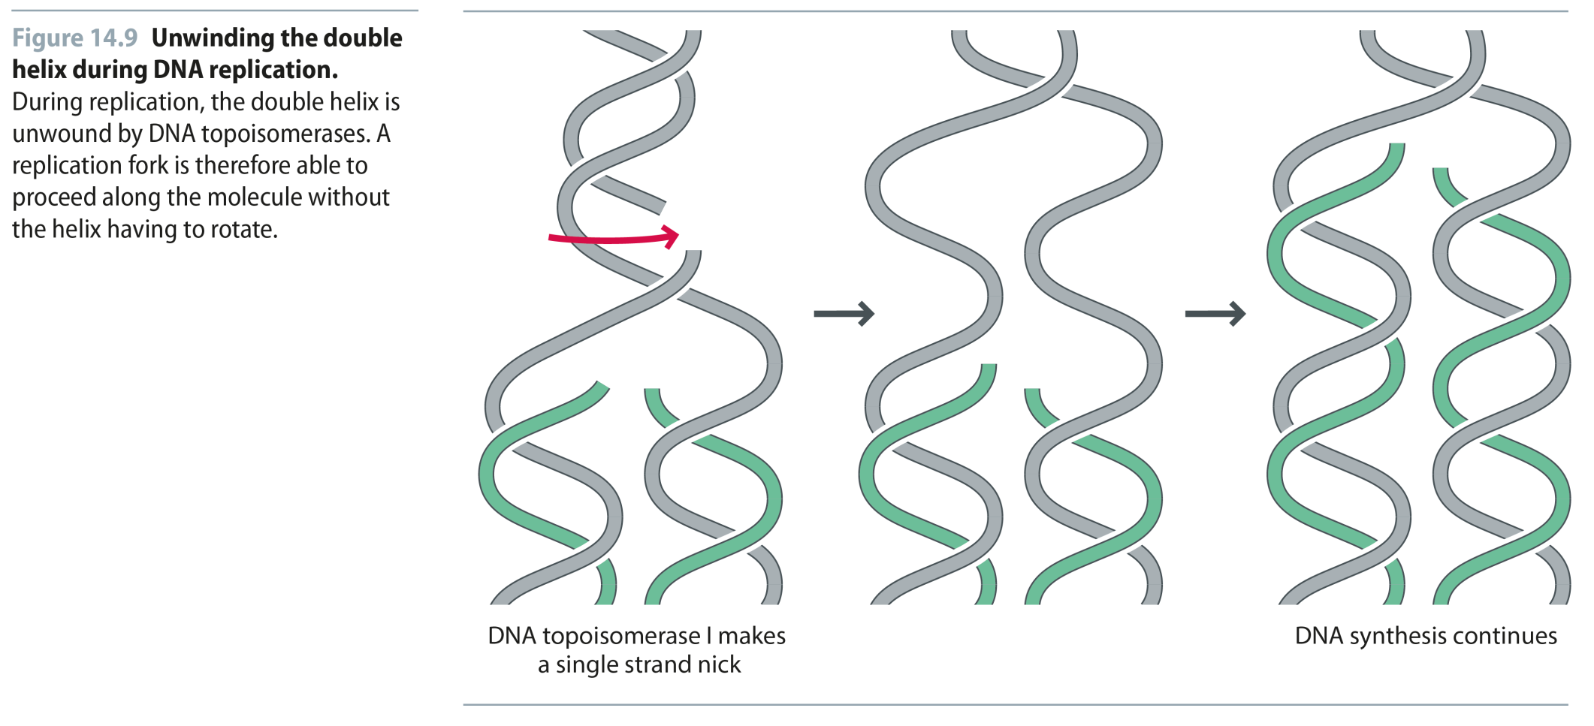
Fig 14.9
Reproduced from: Biochemistry by T.A. Brown, ISBN: 9781907904288 © Scion Publishing Ltd, 2017

Slide 10
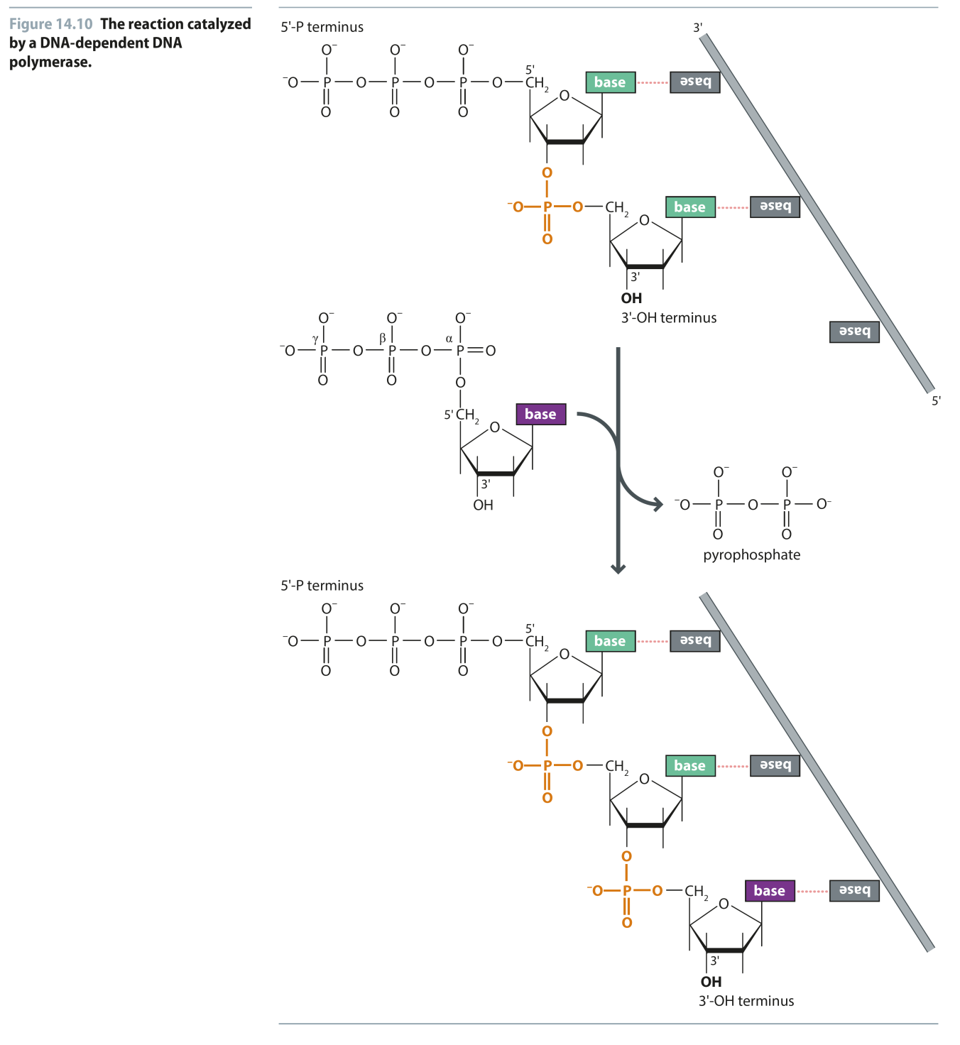
Fig 14.10
Reproduced from: Biochemistry by T.A. Brown, ISBN: 9781907904288 © Scion Publishing Ltd, 2017

Slide 11
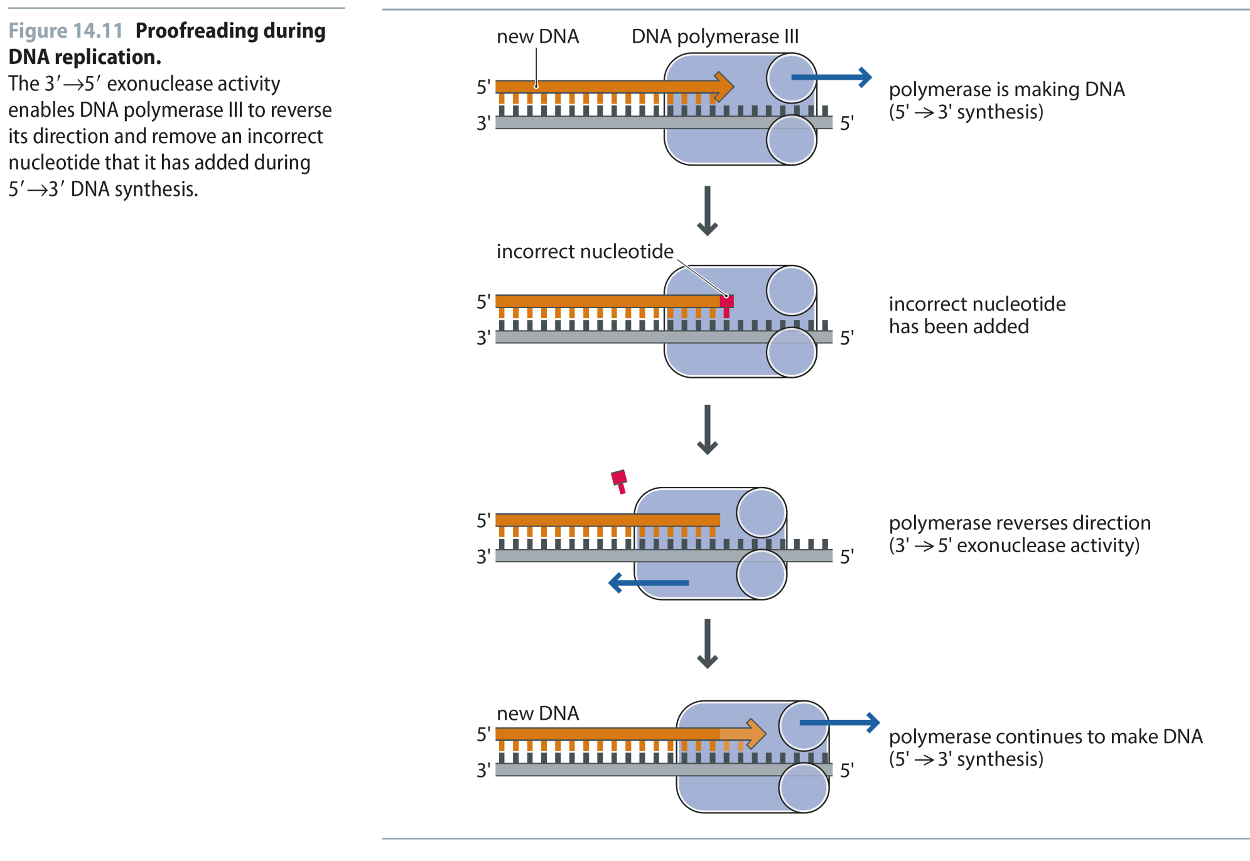
Fig 14.11
Reproduced from: Biochemistry by T.A. Brown, ISBN: 9781907904288 © Scion Publishing Ltd, 2017

Slide 12
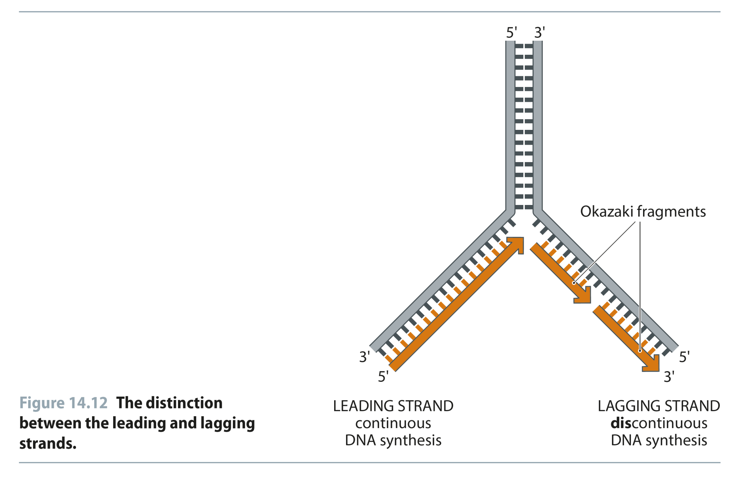
Fig 14.12
Reproduced from: Biochemistry by T.A. Brown, ISBN: 9781907904288 © Scion Publishing Ltd, 2017

Slide 13
Fig 14.13
Reproduced from: Biochemistry by T.A. Brown, ISBN: 9781907904288 © Scion Publishing Ltd, 2017

Slide 14
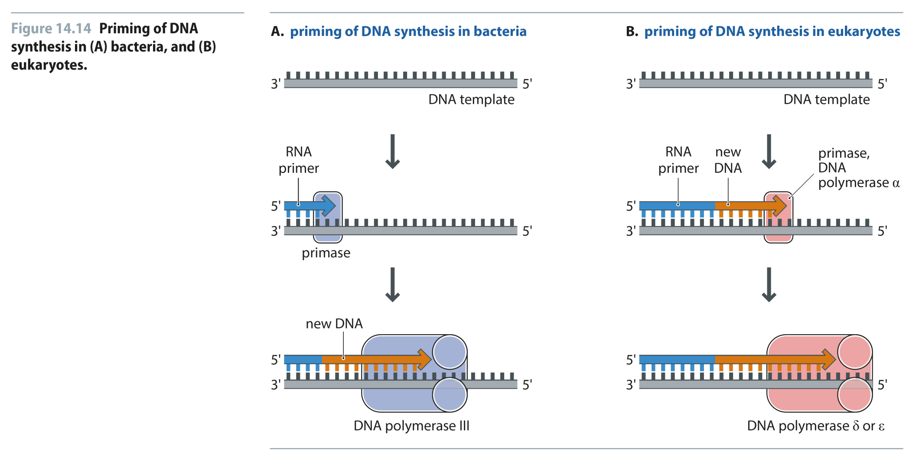
Fig 14.14
Reproduced from: Biochemistry by T.A. Brown, ISBN: 9781907904288 © Scion Publishing Ltd, 2017

Slide 15
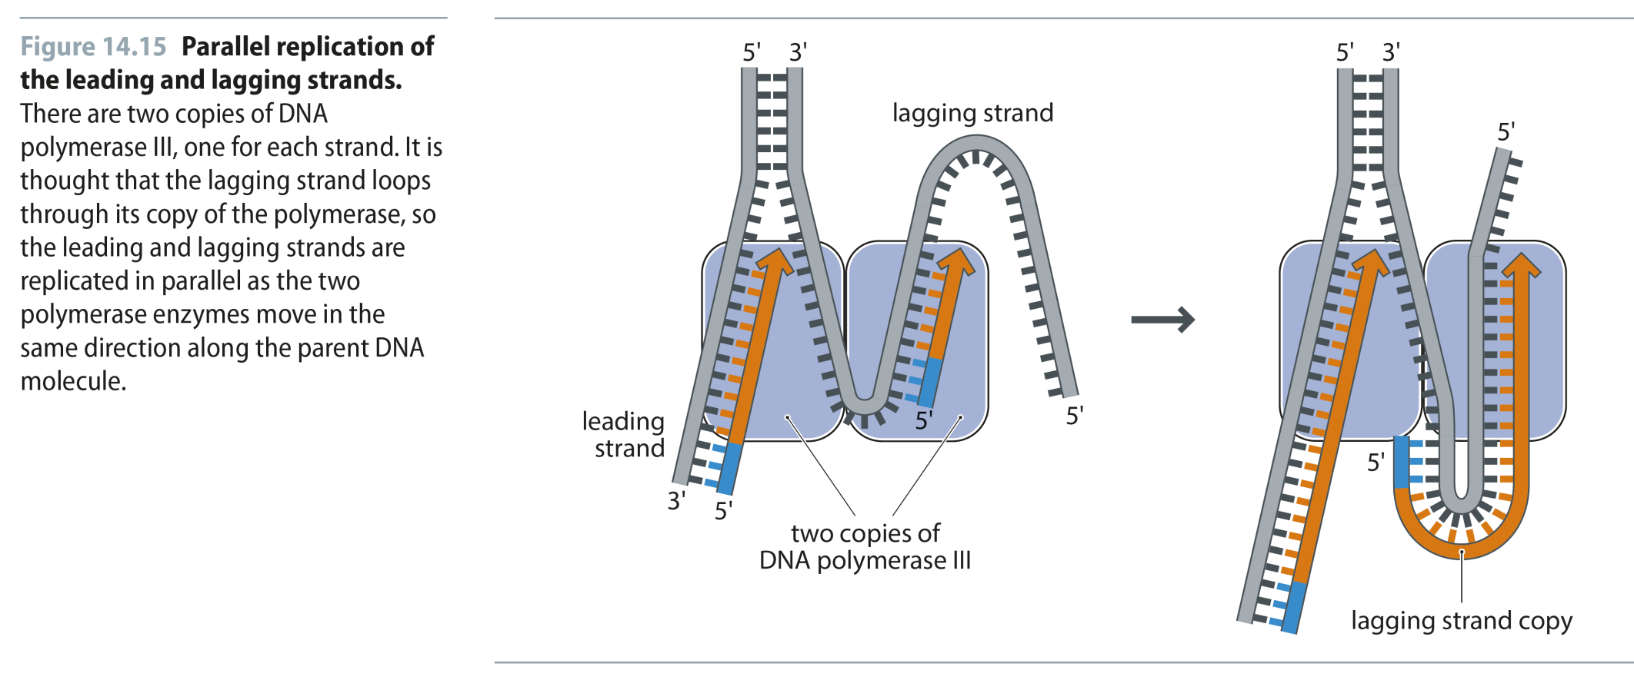
Fig 14.15
Reproduced from: Biochemistry by T.A. Brown, ISBN: 9781907904288 © Scion Publishing Ltd, 2017

Slide 16
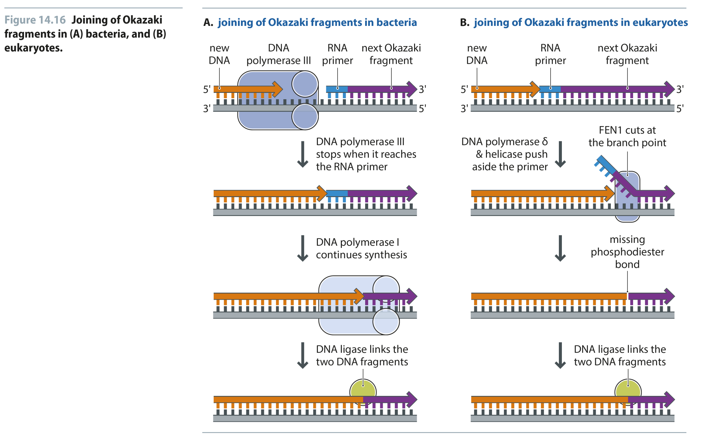
Fig 14.16
Reproduced from: Biochemistry by T.A. Brown, ISBN: 9781907904288 © Scion Publishing Ltd, 2017

Slide 17
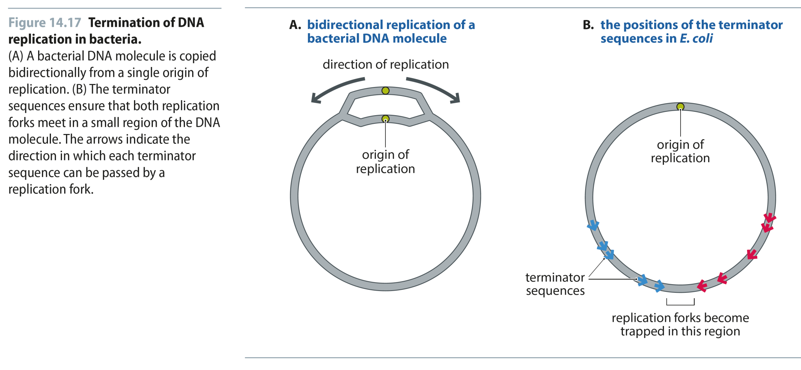
Fig 14.17
Reproduced from: Biochemistry by T.A. Brown, ISBN: 9781907904288 © Scion Publishing Ltd, 2017

Slide 18
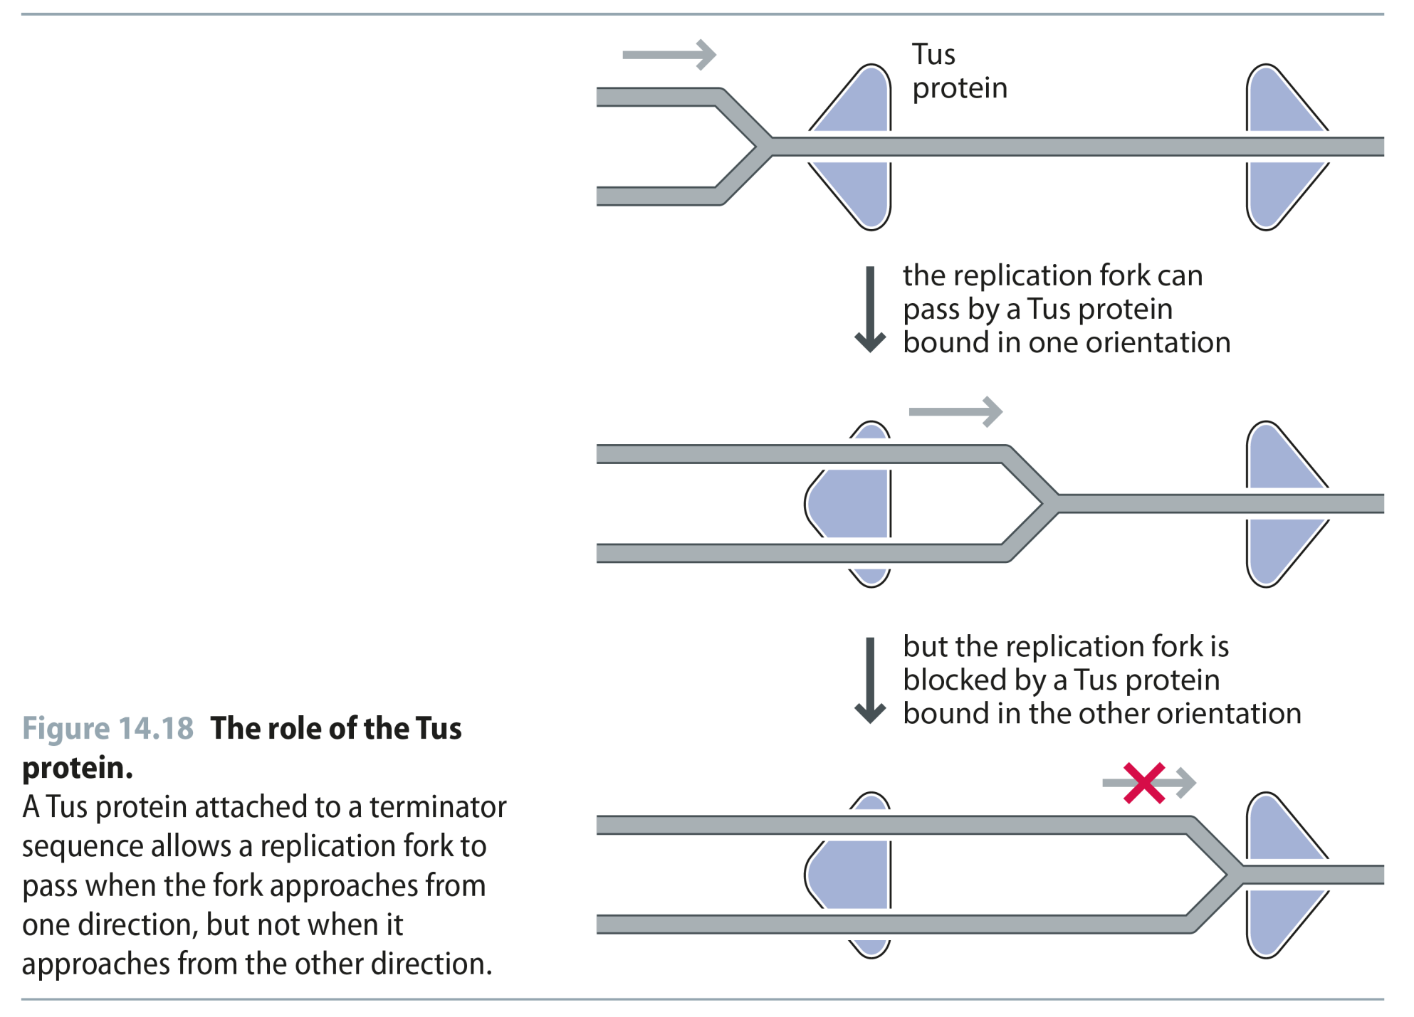
Fig 14.18
Reproduced from: Biochemistry by T.A. Brown, ISBN: 9781907904288 © Scion Publishing Ltd, 2017

Slide 19
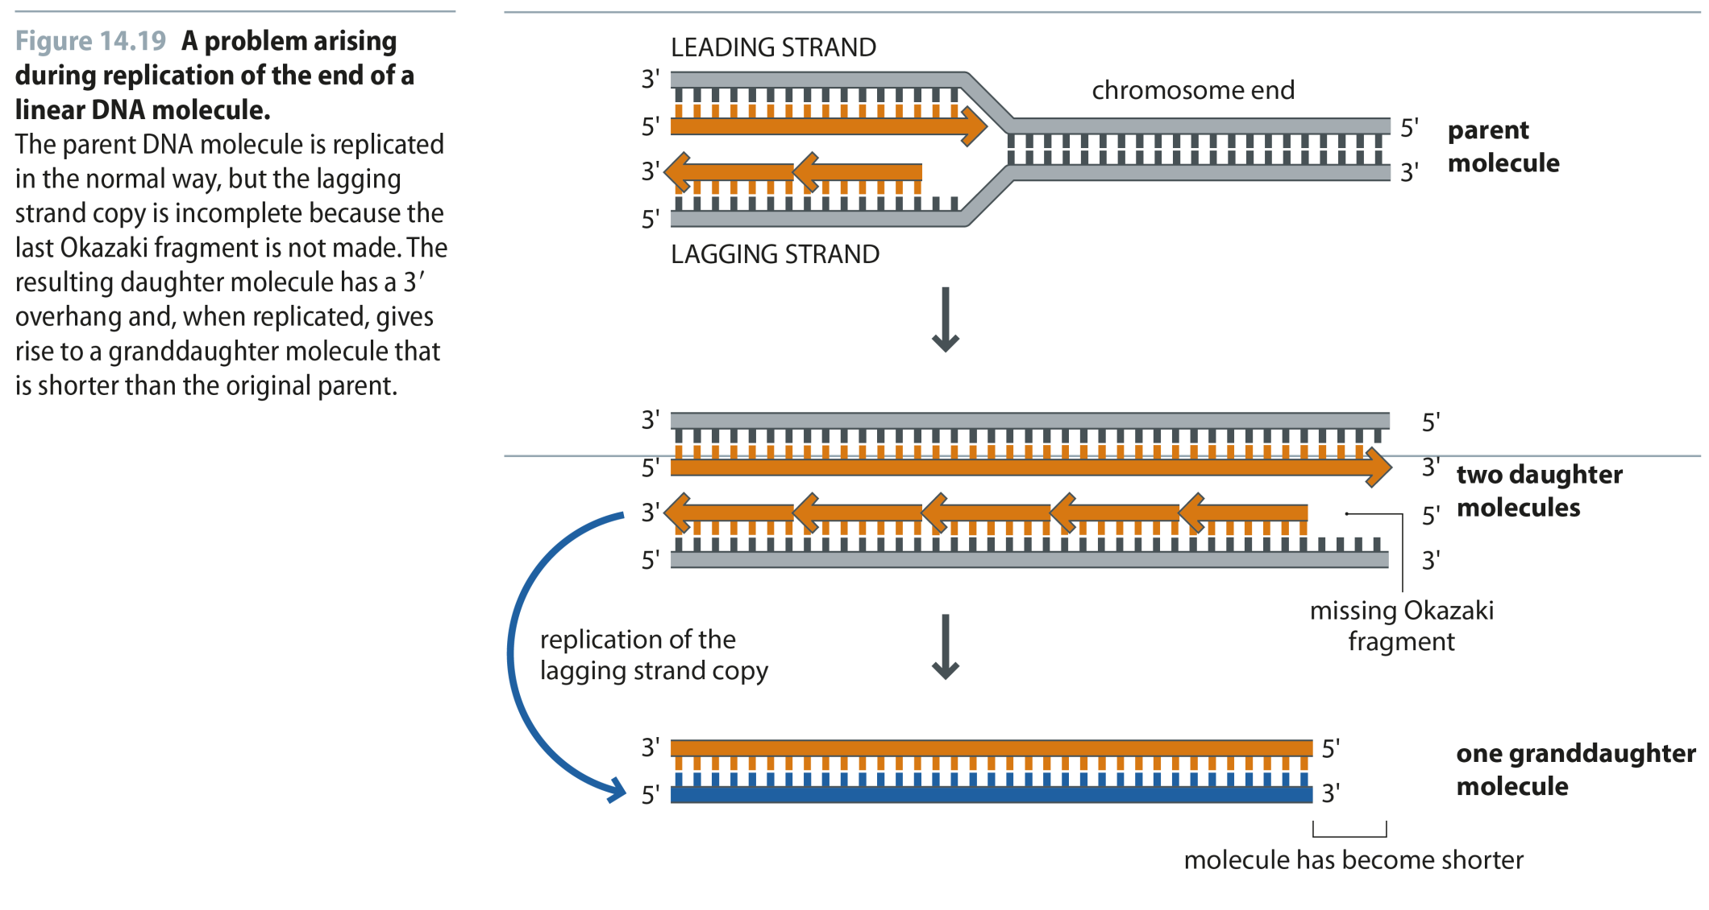
Fig 14.19
Reproduced from: Biochemistry by T.A. Brown, ISBN: 9781907904288 © Scion Publishing Ltd, 2017

Slide 20
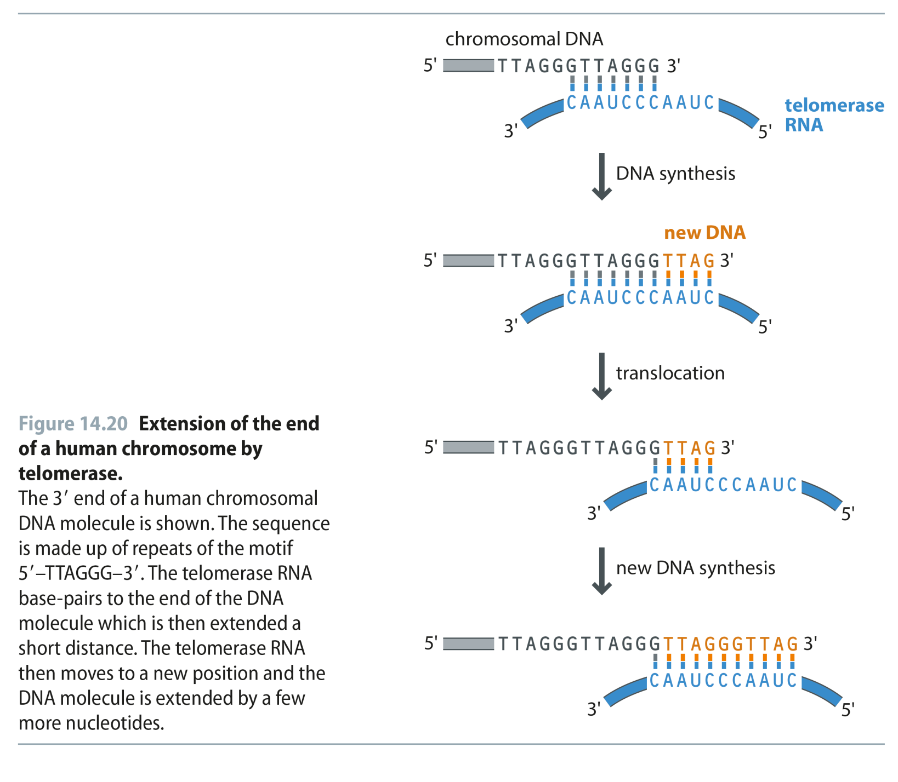
Fig 14.20
Reproduced from: Biochemistry by T.A. Brown, ISBN: 9781907904288 © Scion Publishing Ltd, 2017

Slide 21
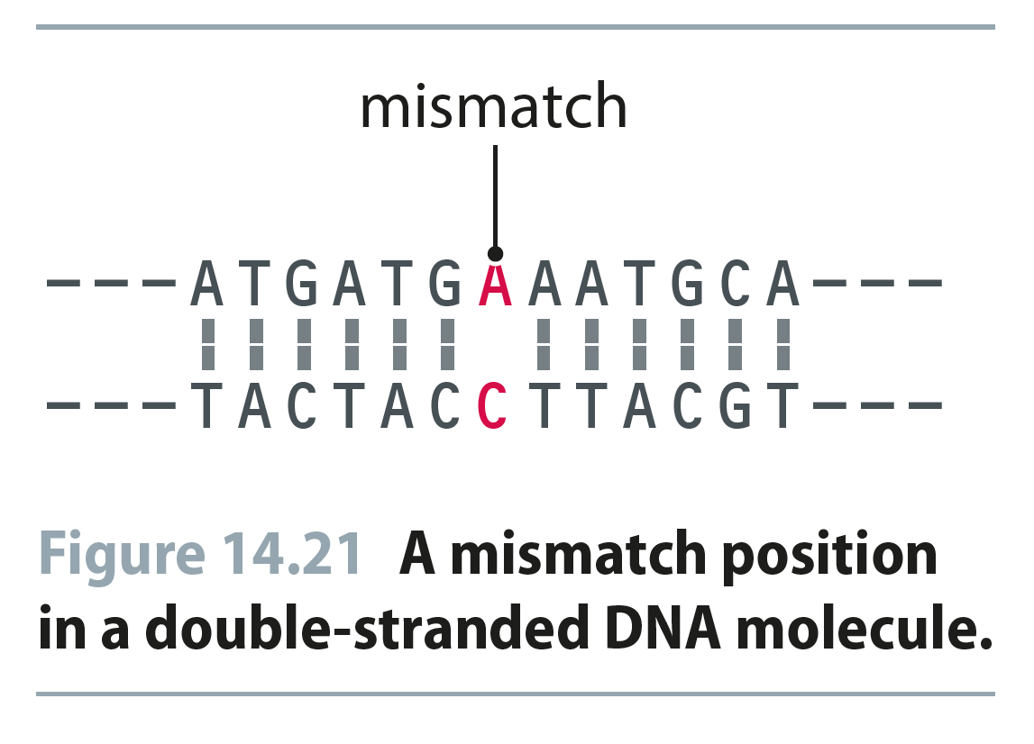
Fig 14.21
Reproduced from: Biochemistry by T.A. Brown, ISBN: 9781907904288 © Scion Publishing Ltd, 2017

Slide 22
Fig 14.22
Reproduced from: Biochemistry by T.A. Brown, ISBN: 9781907904288 © Scion Publishing Ltd, 2017

Slide 23
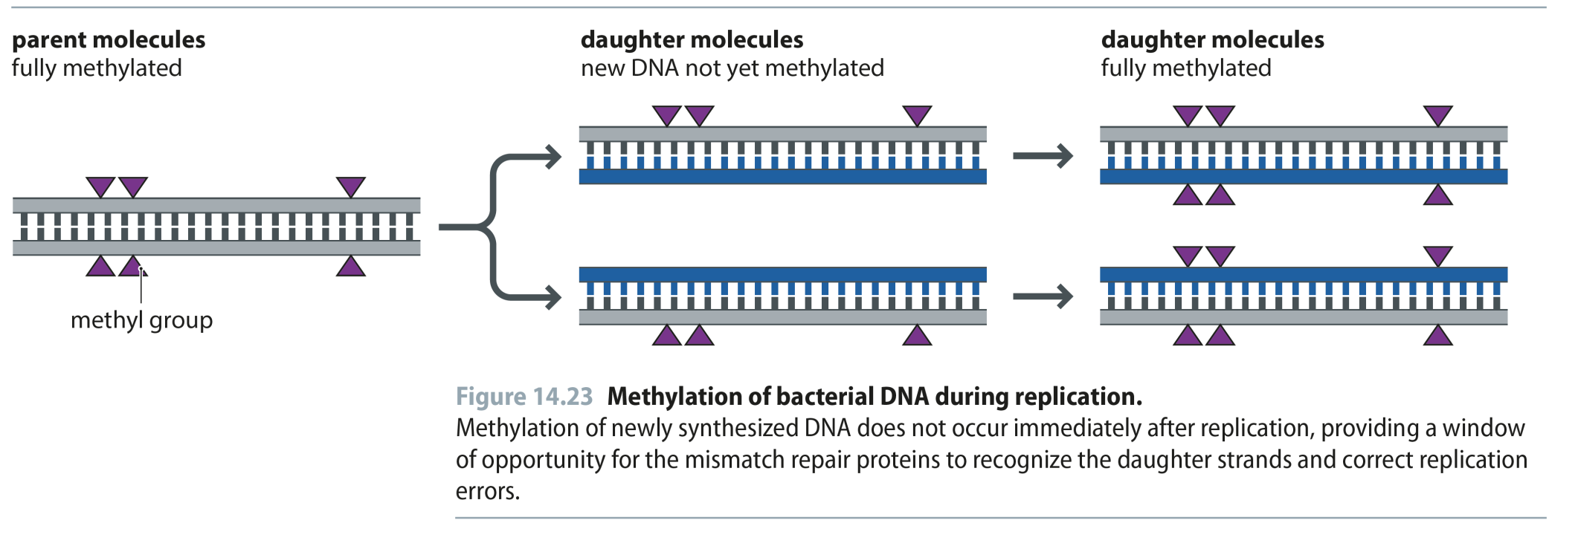
Fig 14.23
Reproduced from: Biochemistry by T.A. Brown, ISBN: 9781907904288 © Scion Publishing Ltd, 2017

Slide 24
Fig 14.24
Reproduced from: Biochemistry by T.A. Brown, ISBN: 9781907904288 © Scion Publishing Ltd, 2017

Slide 25
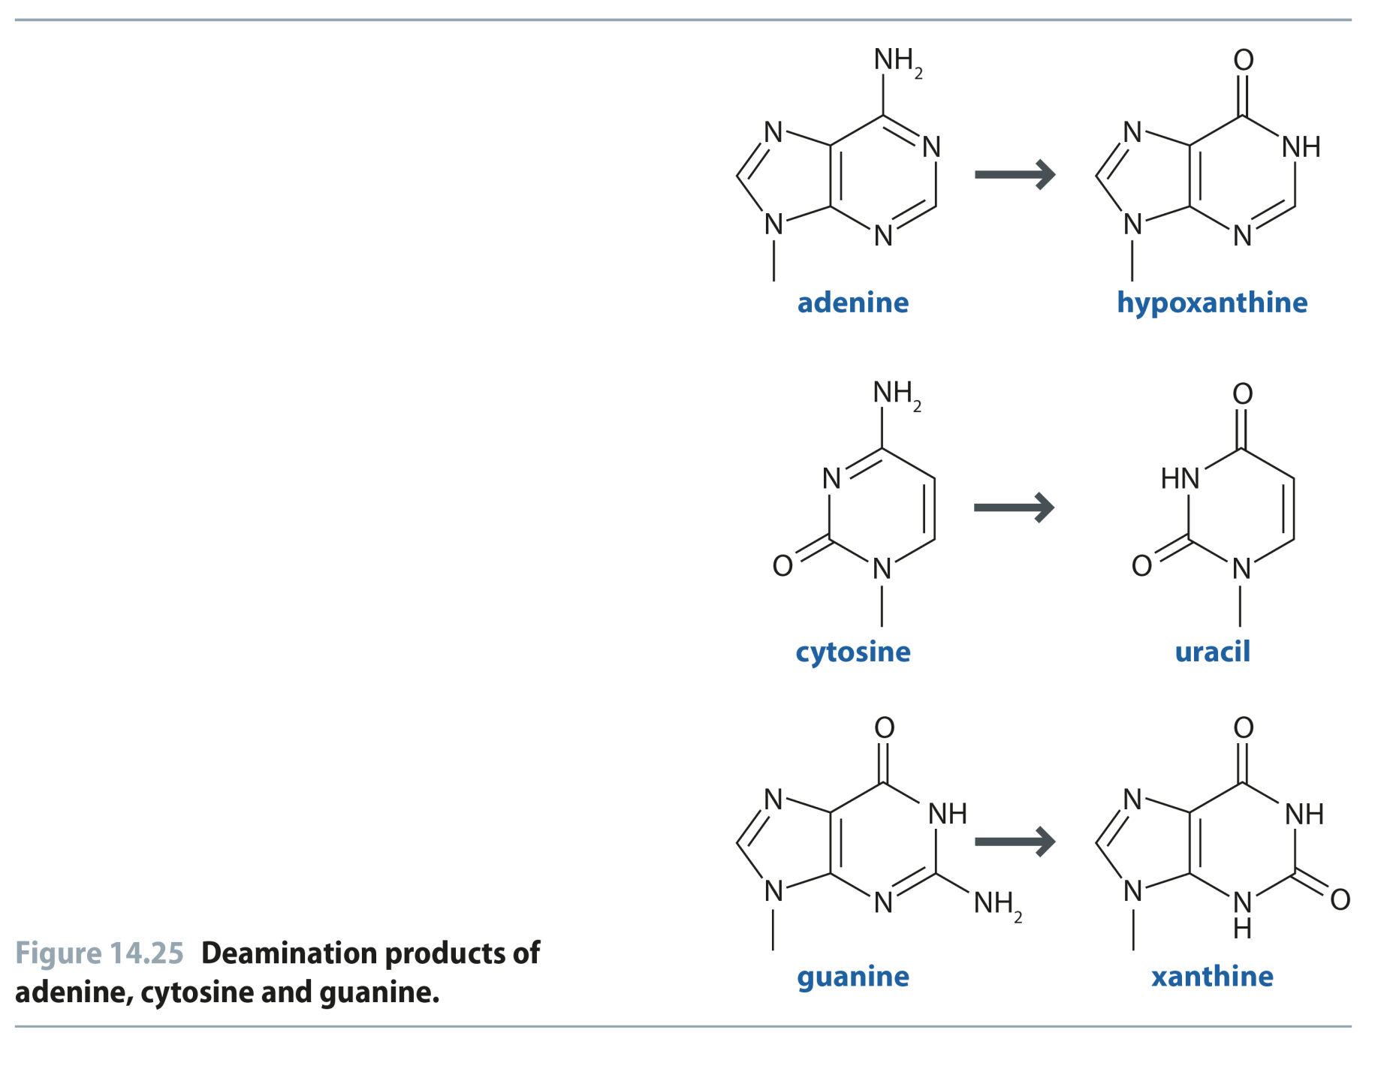
Fig 14.25
Reproduced from: Biochemistry by T.A. Brown, ISBN: 9781907904288 © Scion Publishing Ltd, 2017

Slide 26
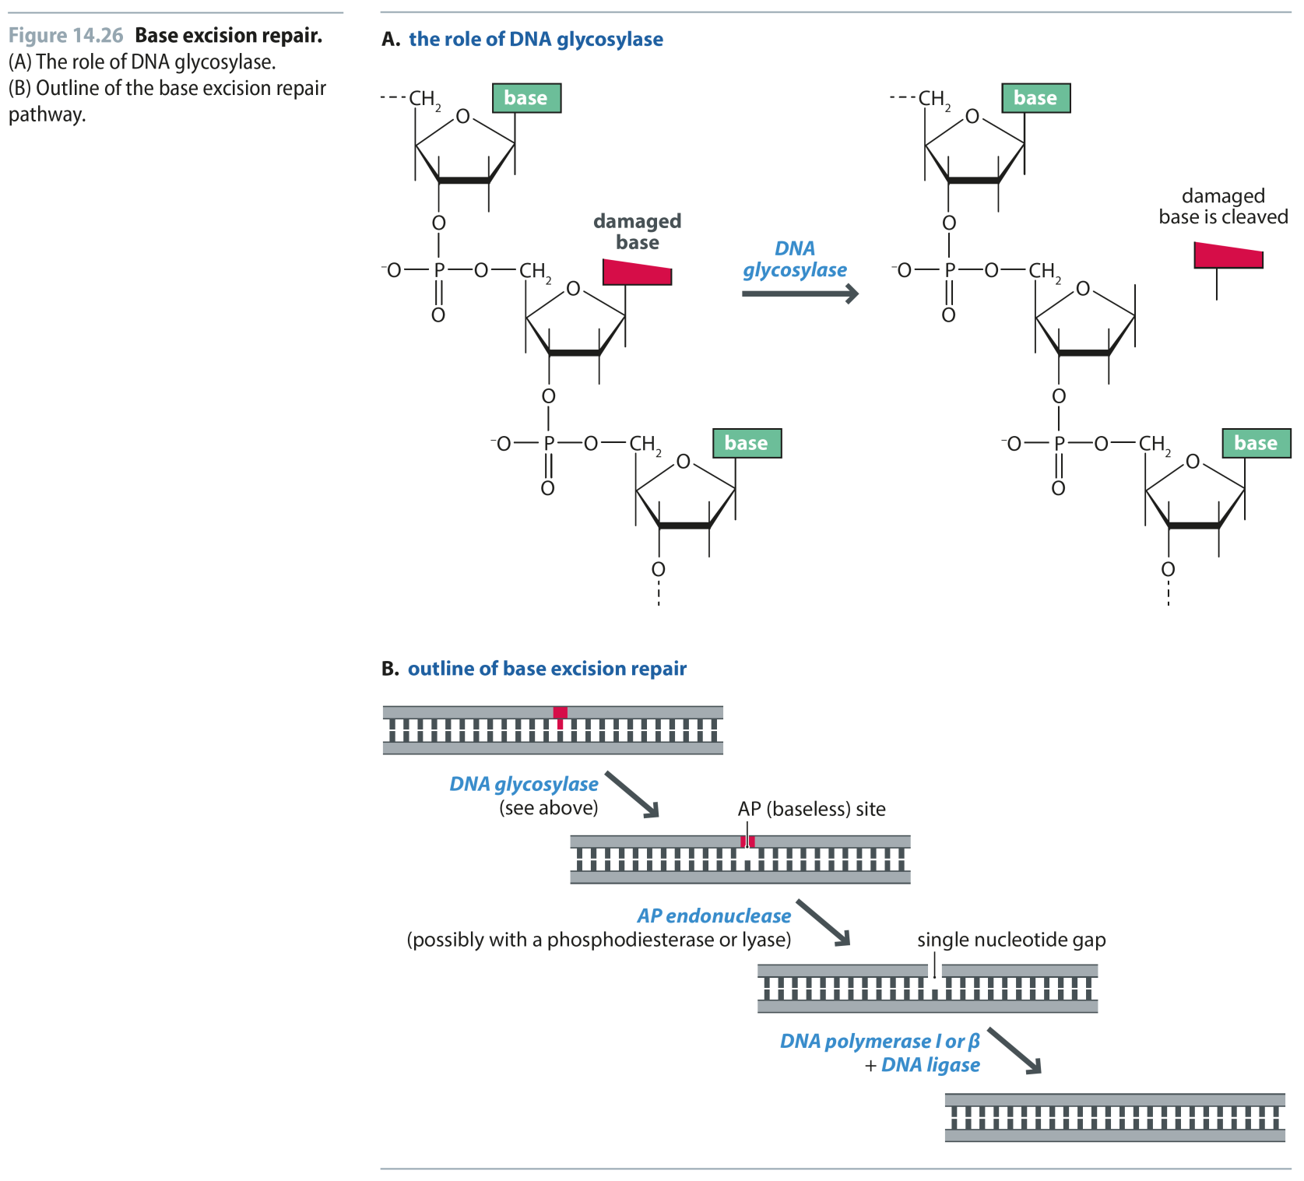
Fig 14.26
Reproduced from: Biochemistry by T.A. Brown, ISBN: 9781907904288 © Scion Publishing Ltd, 2017

Slide 27
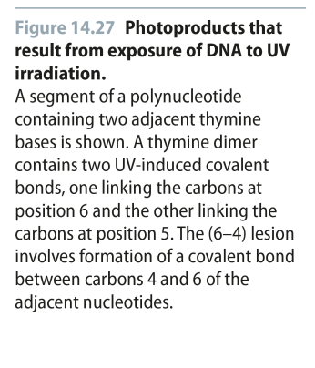
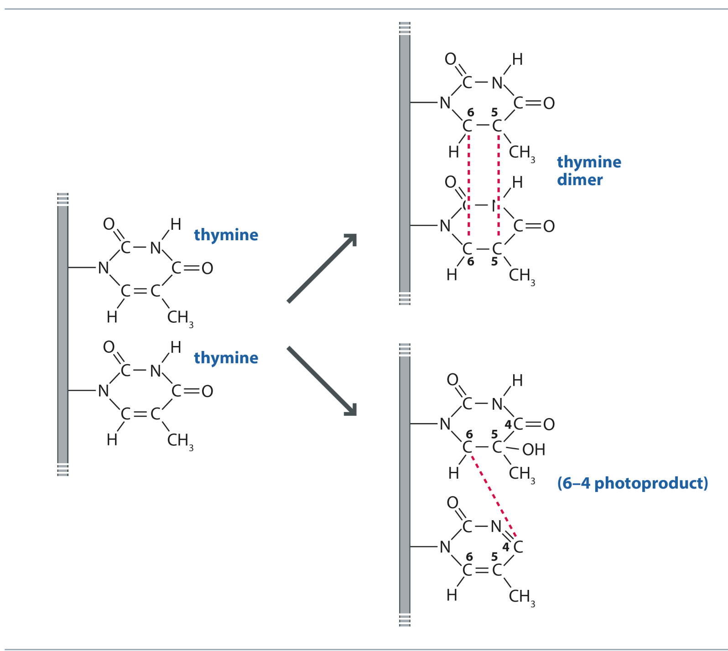
Fig 14.27
Reproduced from: Biochemistry by T.A. Brown, ISBN: 9781907904288 © Scion Publishing Ltd, 2017

Slide 28
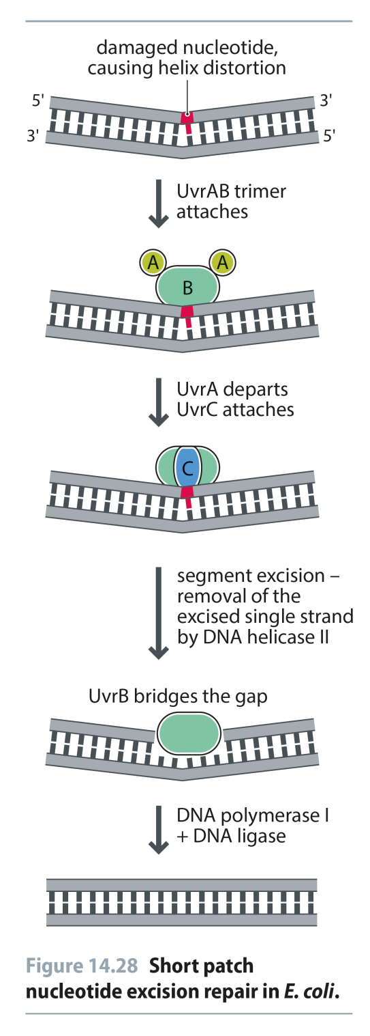
Fig 14.28
Reproduced from: Biochemistry by T.A. Brown, ISBN: 9781907904288 © Scion Publishing Ltd, 2017

Slide 29
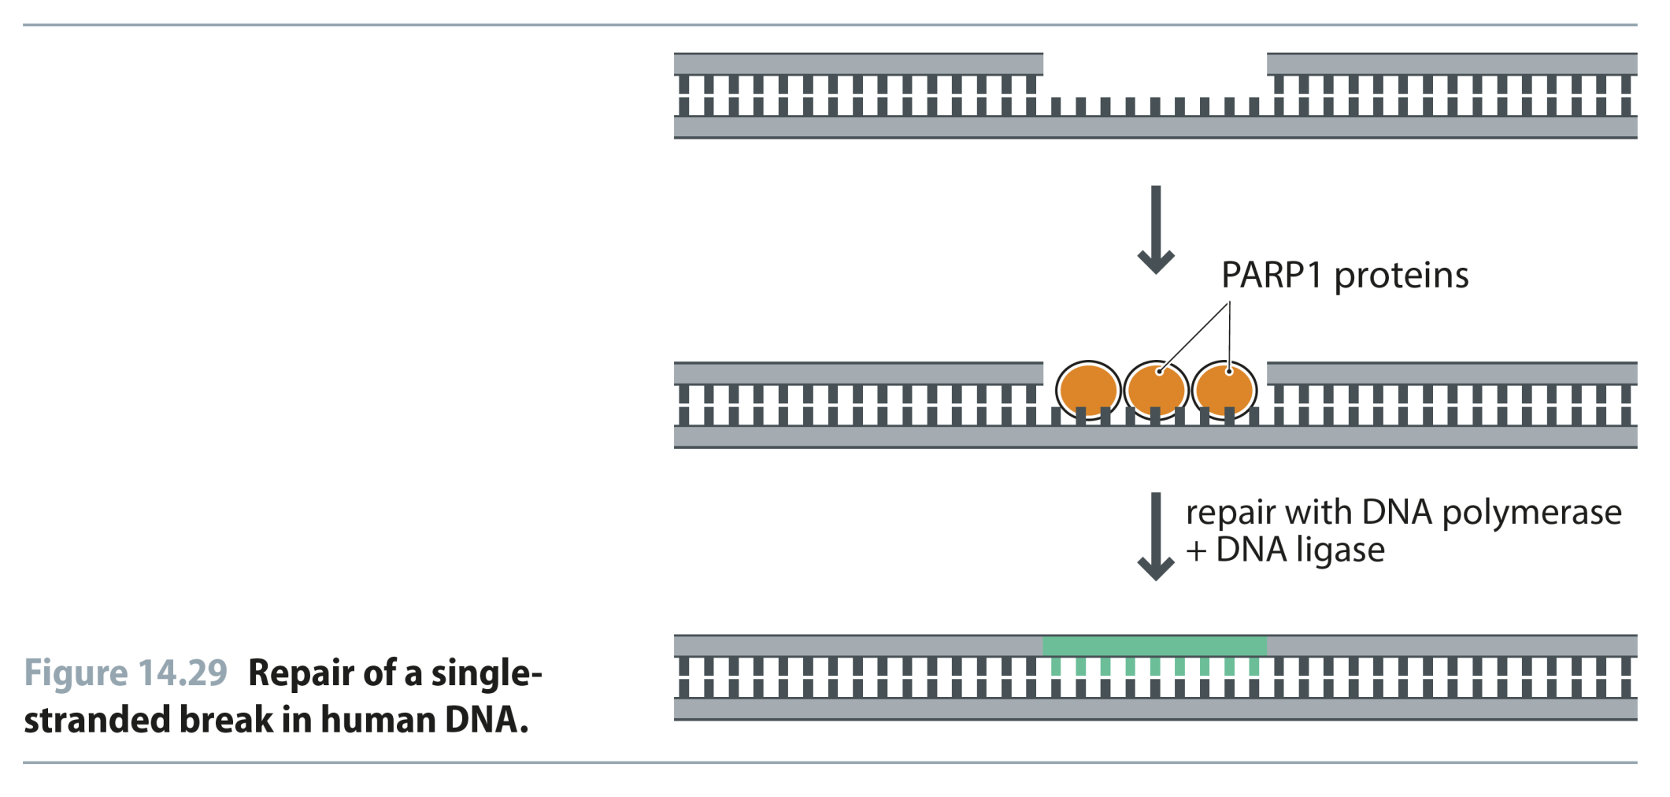
Fig 14.29
Reproduced from: Biochemistry by T.A. Brown, ISBN: 9781907904288 © Scion Publishing Ltd, 2017

Slide 30
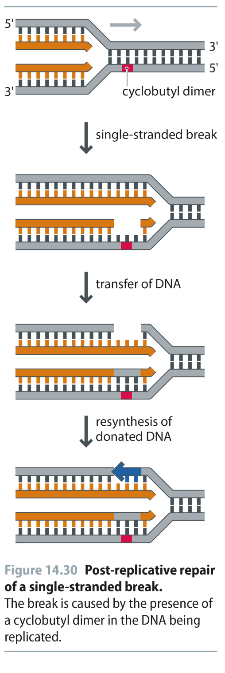
Fig 14.30
Reproduced from: Biochemistry by T.A. Brown, ISBN: 9781907904288 © Scion Publishing Ltd, 2017

