Slide 1
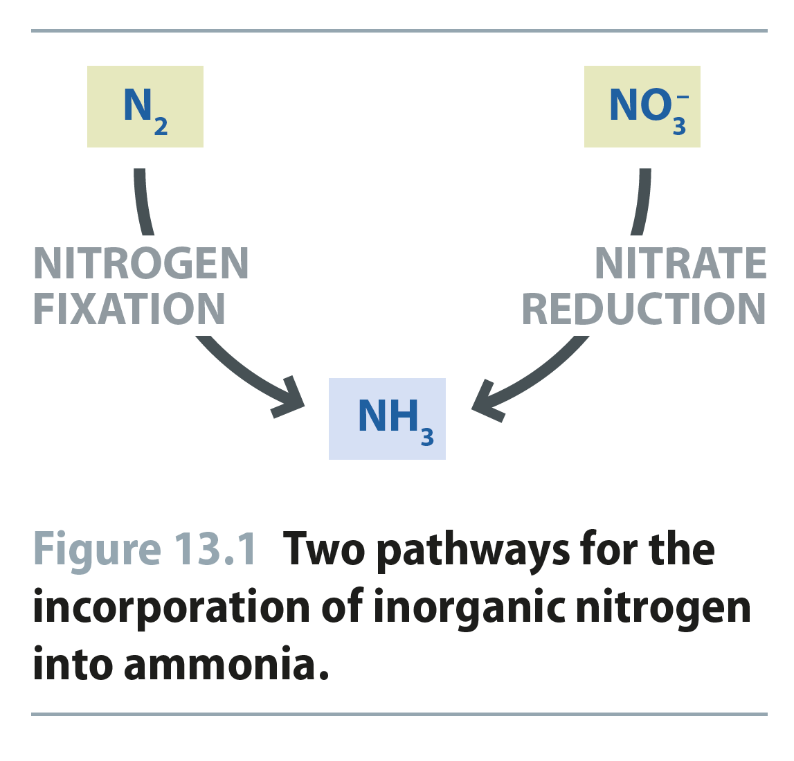
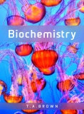
Fig 13.1
Reproduced from: Biochemistry by T.A. Brown, ISBN: 9781907904288 © Scion Publishing Ltd, 2017

Slide 2
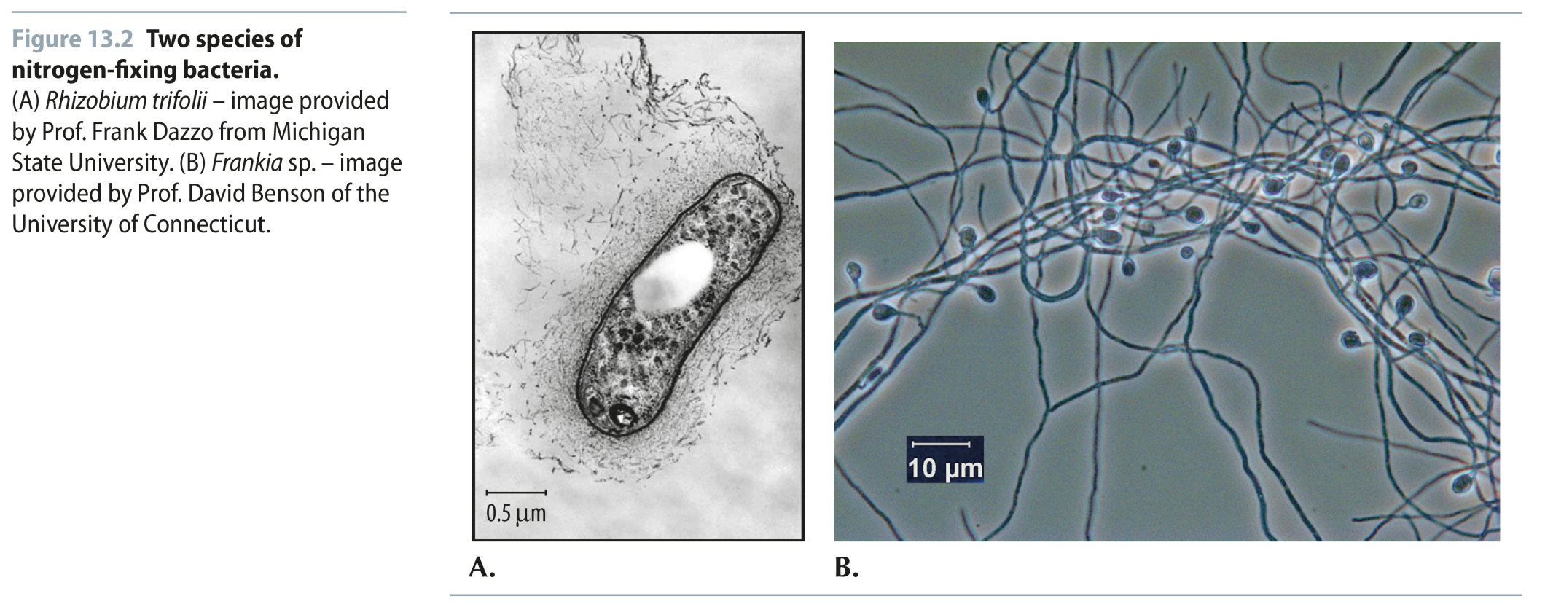
Fig 13.2
Reproduced from: Biochemistry by T.A. Brown, ISBN: 9781907904288 © Scion Publishing Ltd, 2017

Slide 3
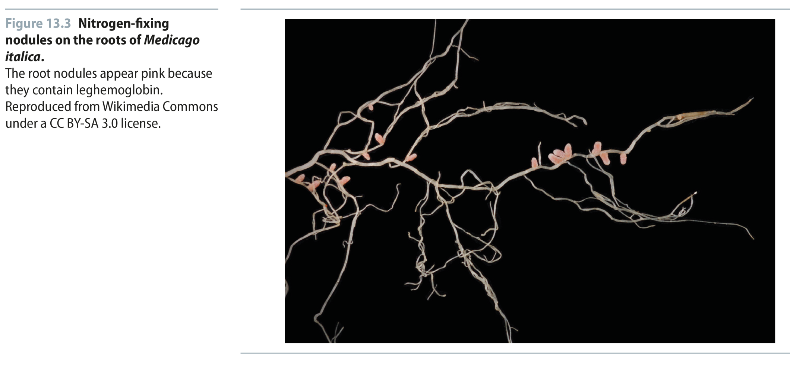
Fig 13.3
Reproduced from: Biochemistry by T.A. Brown, ISBN: 9781907904288 © Scion Publishing Ltd, 2017

Slide 4
Fig 13.4
Reproduced from: Biochemistry by T.A. Brown, ISBN: 9781907904288 © Scion Publishing Ltd, 2017

Slide 5
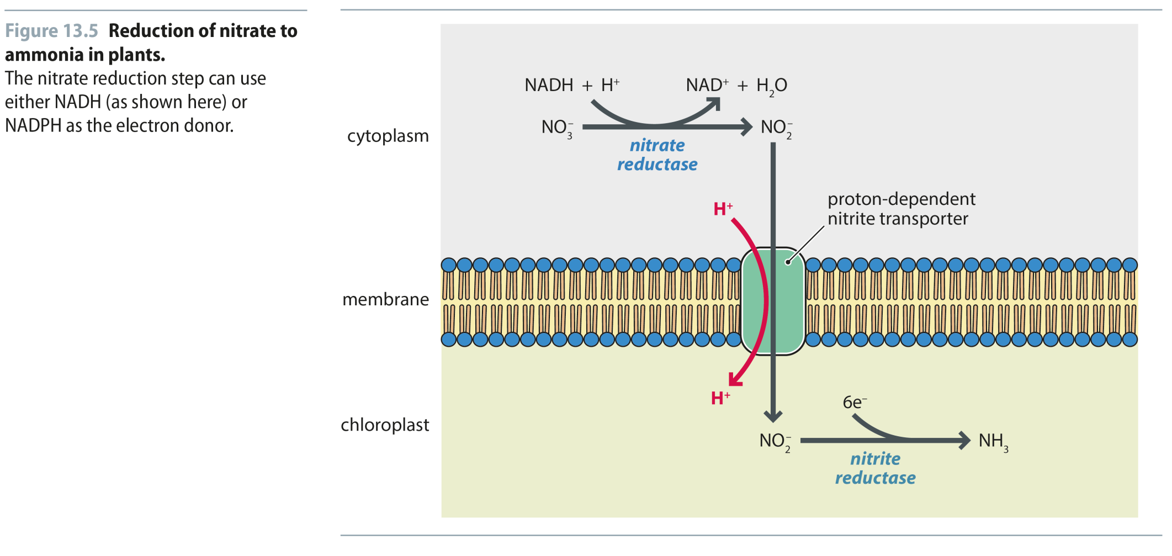
Fig 13.5
Reproduced from: Biochemistry by T.A. Brown, ISBN: 9781907904288 © Scion Publishing Ltd, 2017

Slide 6
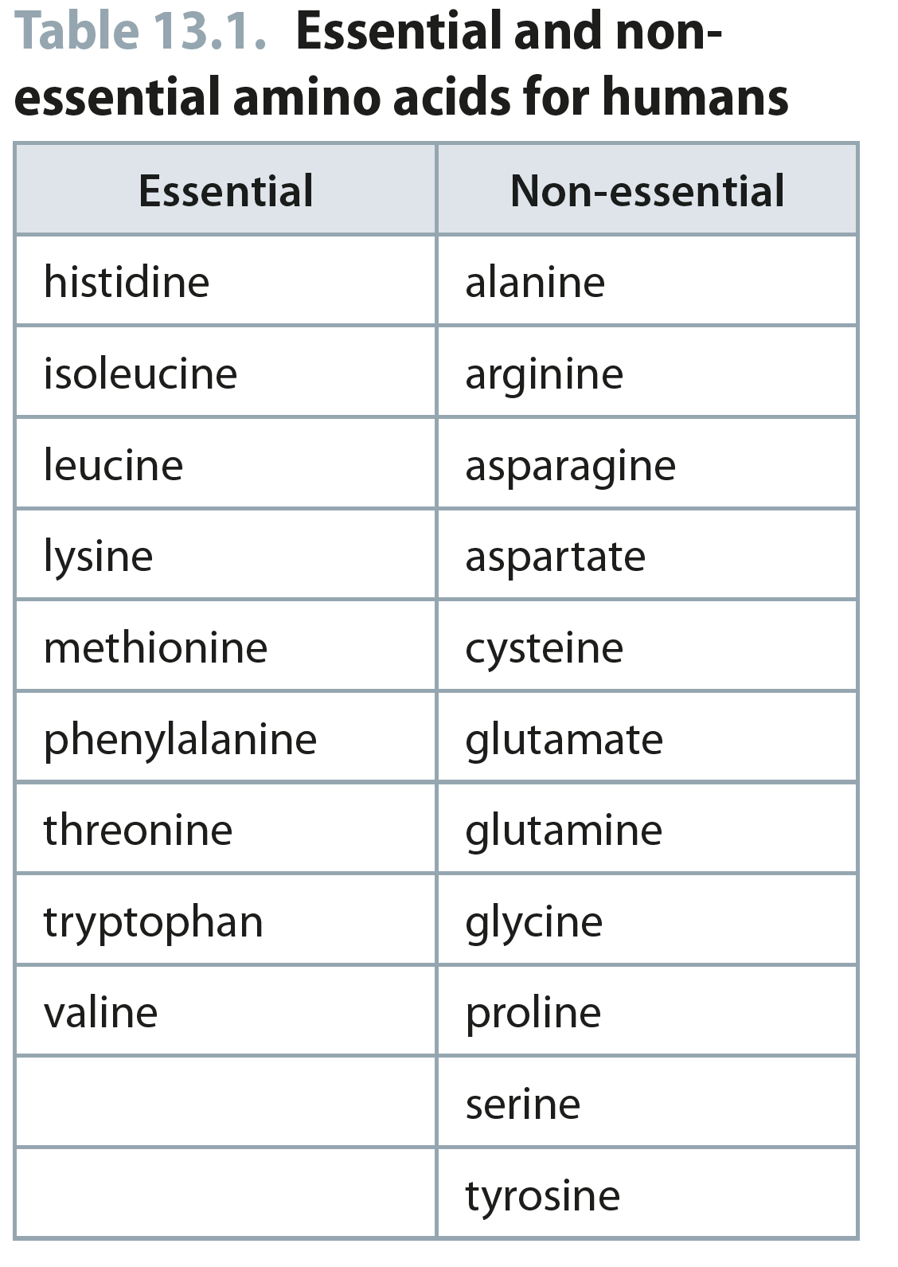
Table 13.1
Reproduced from: Biochemistry by T.A. Brown, ISBN: 9781907904288 © Scion Publishing Ltd, 2017

Slide 7
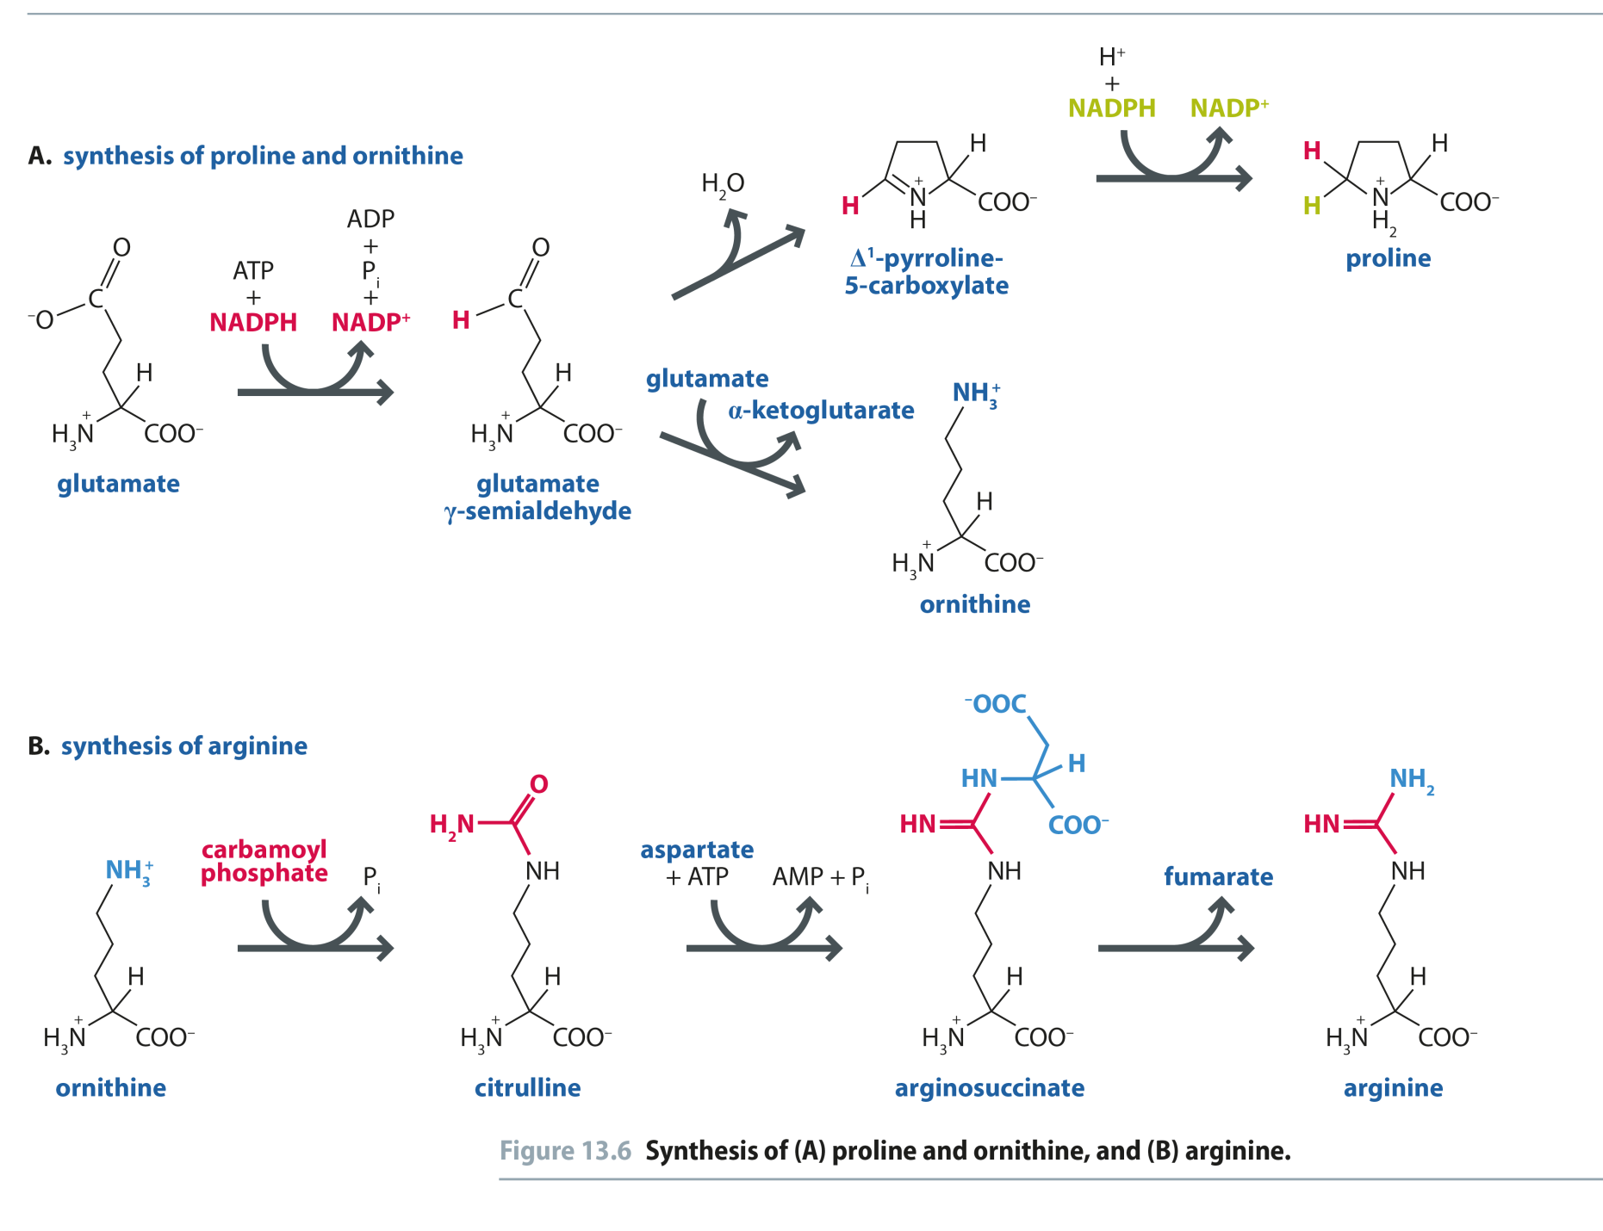
Fig 13.6
Reproduced from: Biochemistry by T.A. Brown, ISBN: 9781907904288 © Scion Publishing Ltd, 2017

Slide 8
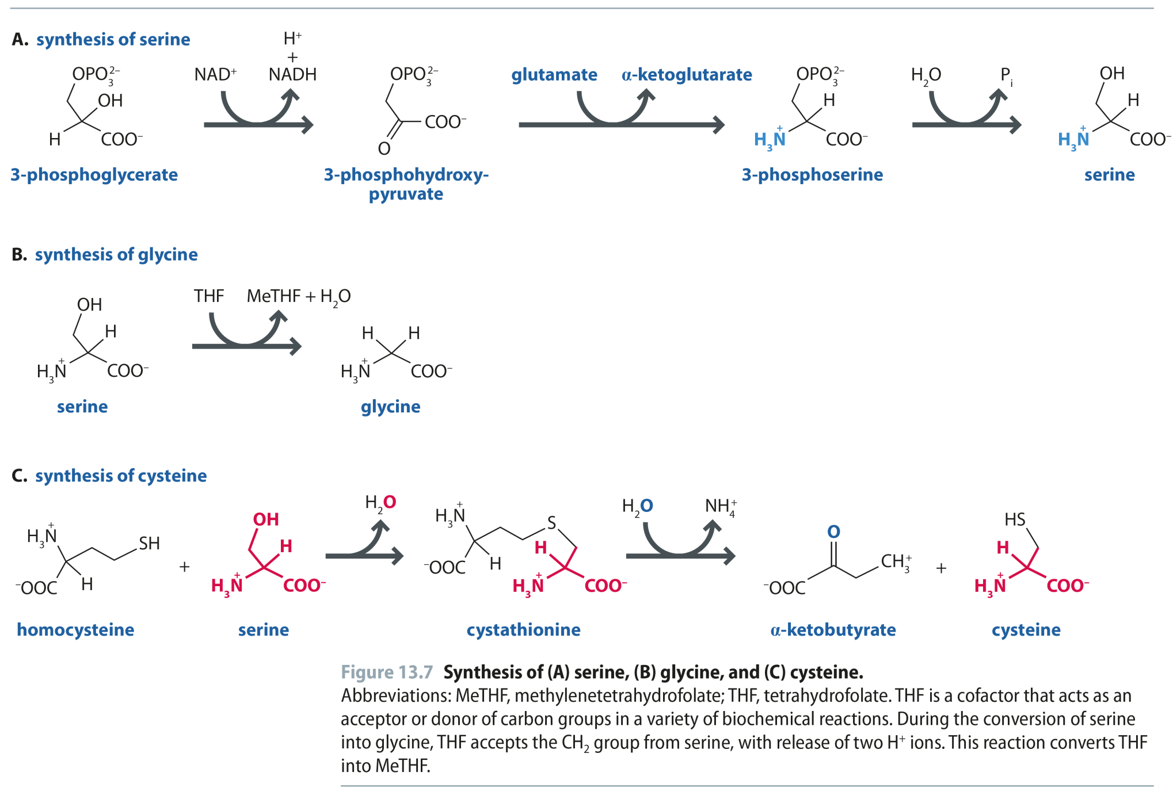
Fig 13.7
Reproduced from: Biochemistry by T.A. Brown, ISBN: 9781907904288 © Scion Publishing Ltd, 2017

Slide 9
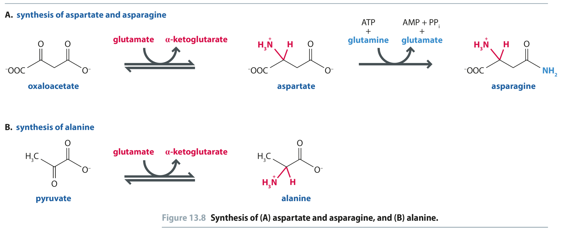
Fig 13.8
Reproduced from: Biochemistry by T.A. Brown, ISBN: 9781907904288 © Scion Publishing Ltd, 2017

Slide 10
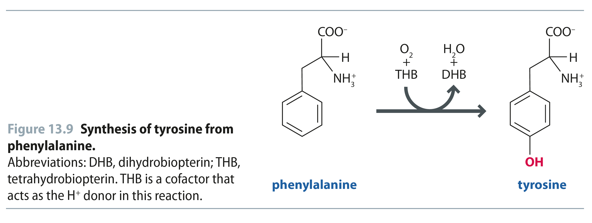
Fig 13.9
Reproduced from: Biochemistry by T.A. Brown, ISBN: 9781907904288 © Scion Publishing Ltd, 2017

Slide 11
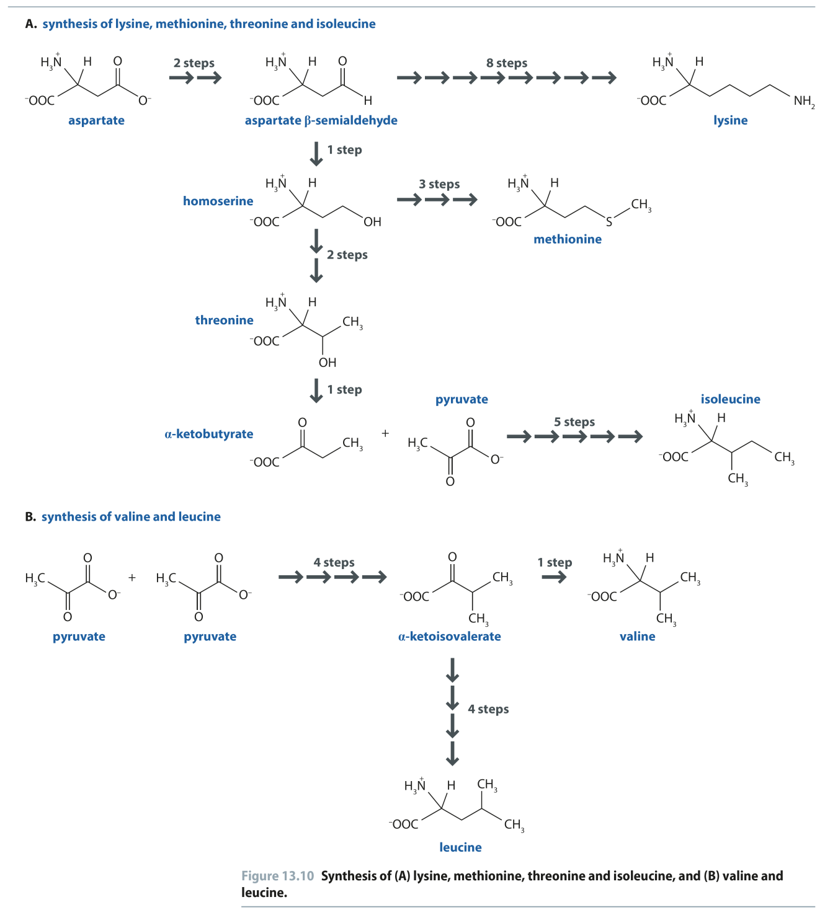
Fig 13.10
Reproduced from: Biochemistry by T.A. Brown, ISBN: 9781907904288 © Scion Publishing Ltd, 2017

Slide 12
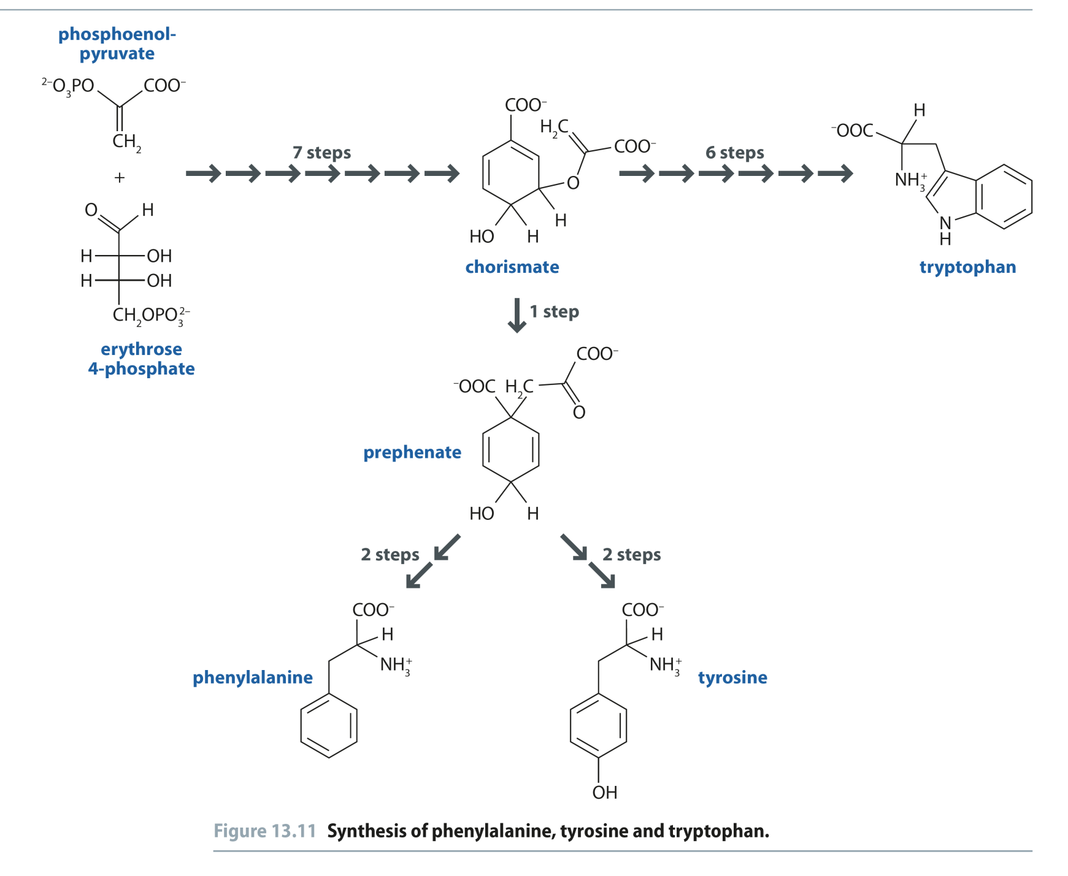
Fig 13.11
Reproduced from: Biochemistry by T.A. Brown, ISBN: 9781907904288 © Scion Publishing Ltd, 2017

Slide 13
Fig 13.12
Reproduced from: Biochemistry by T.A. Brown, ISBN: 9781907904288 © Scion Publishing Ltd, 2017

Slide 14
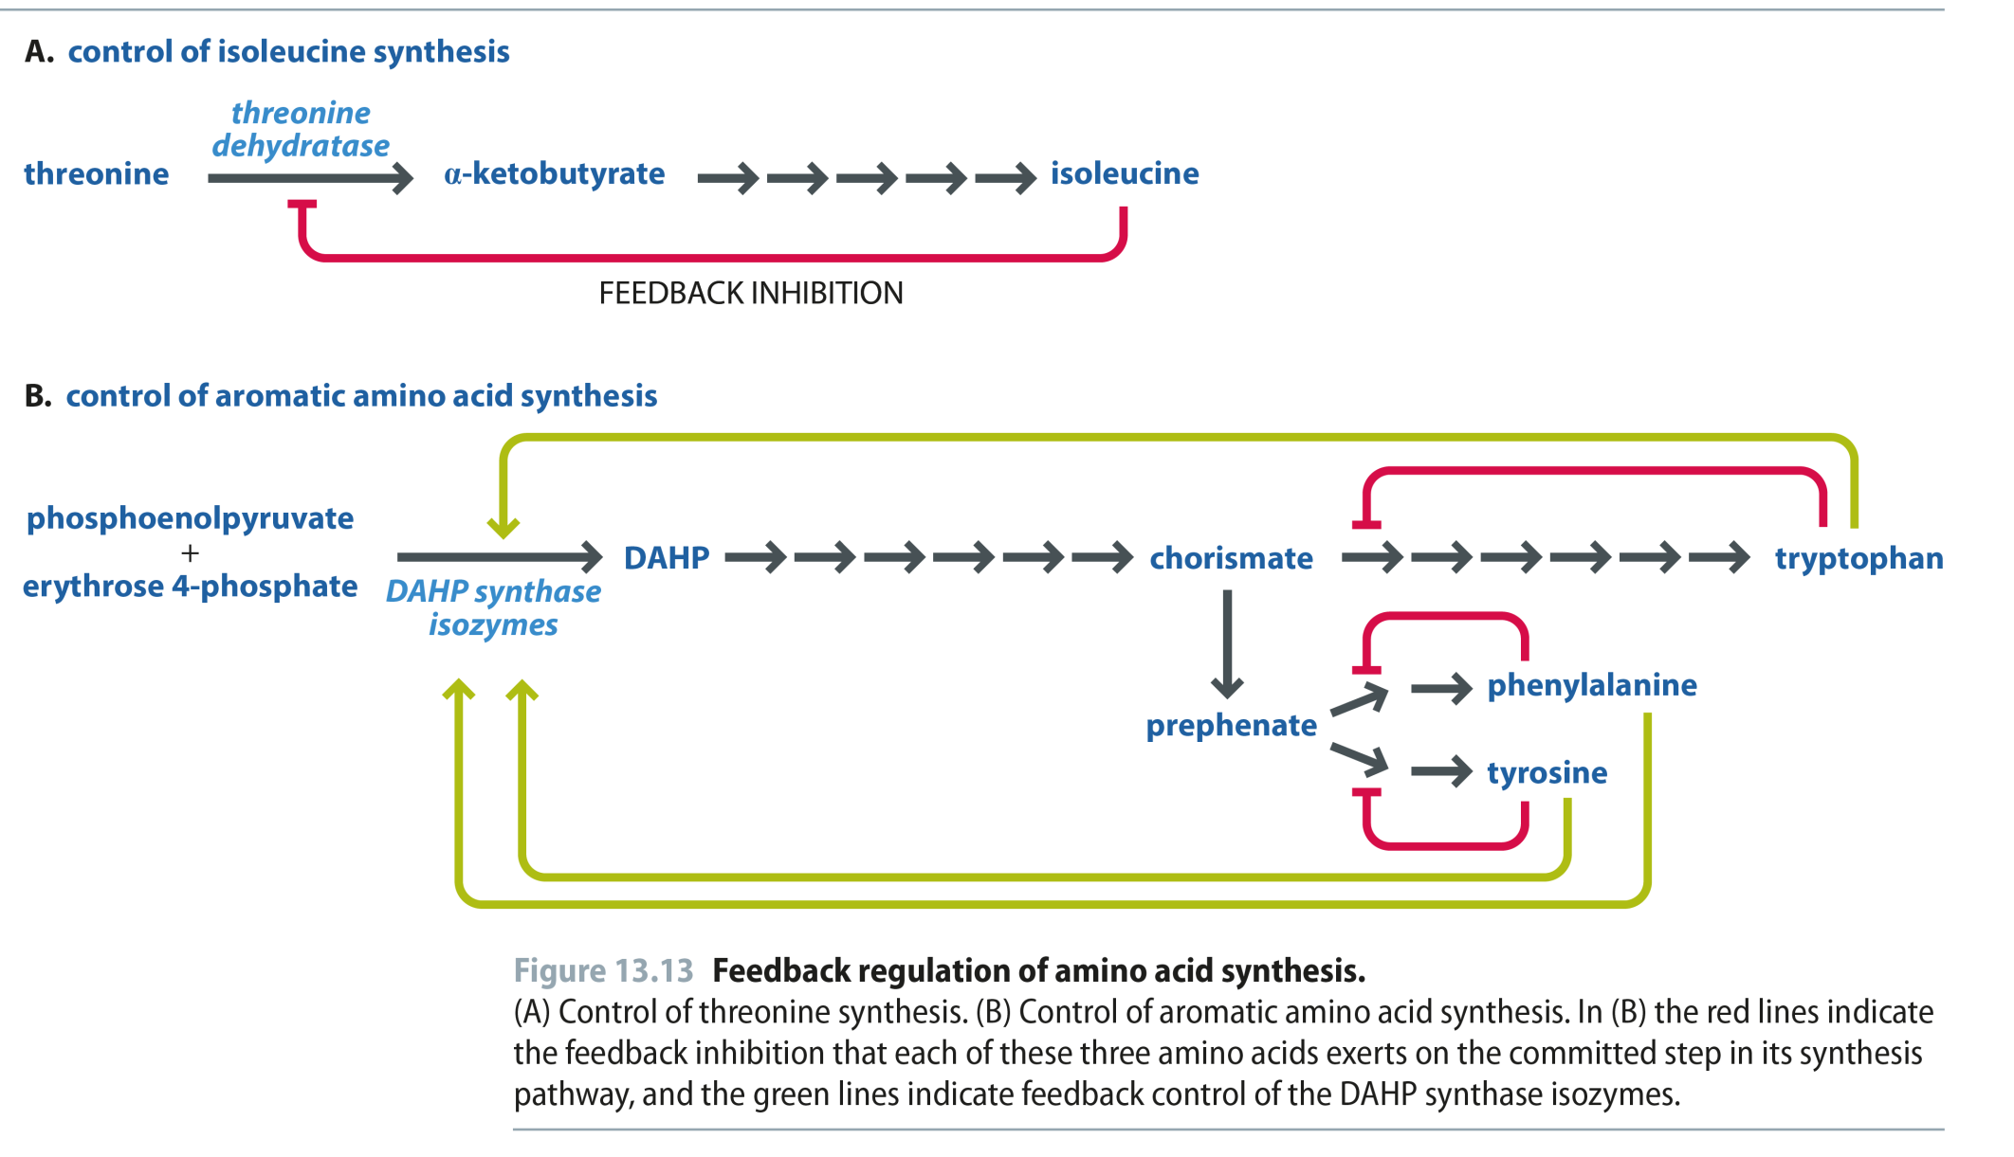
Fig 13.13
Reproduced from: Biochemistry by T.A. Brown, ISBN: 9781907904288 © Scion Publishing Ltd, 2017

Slide 15
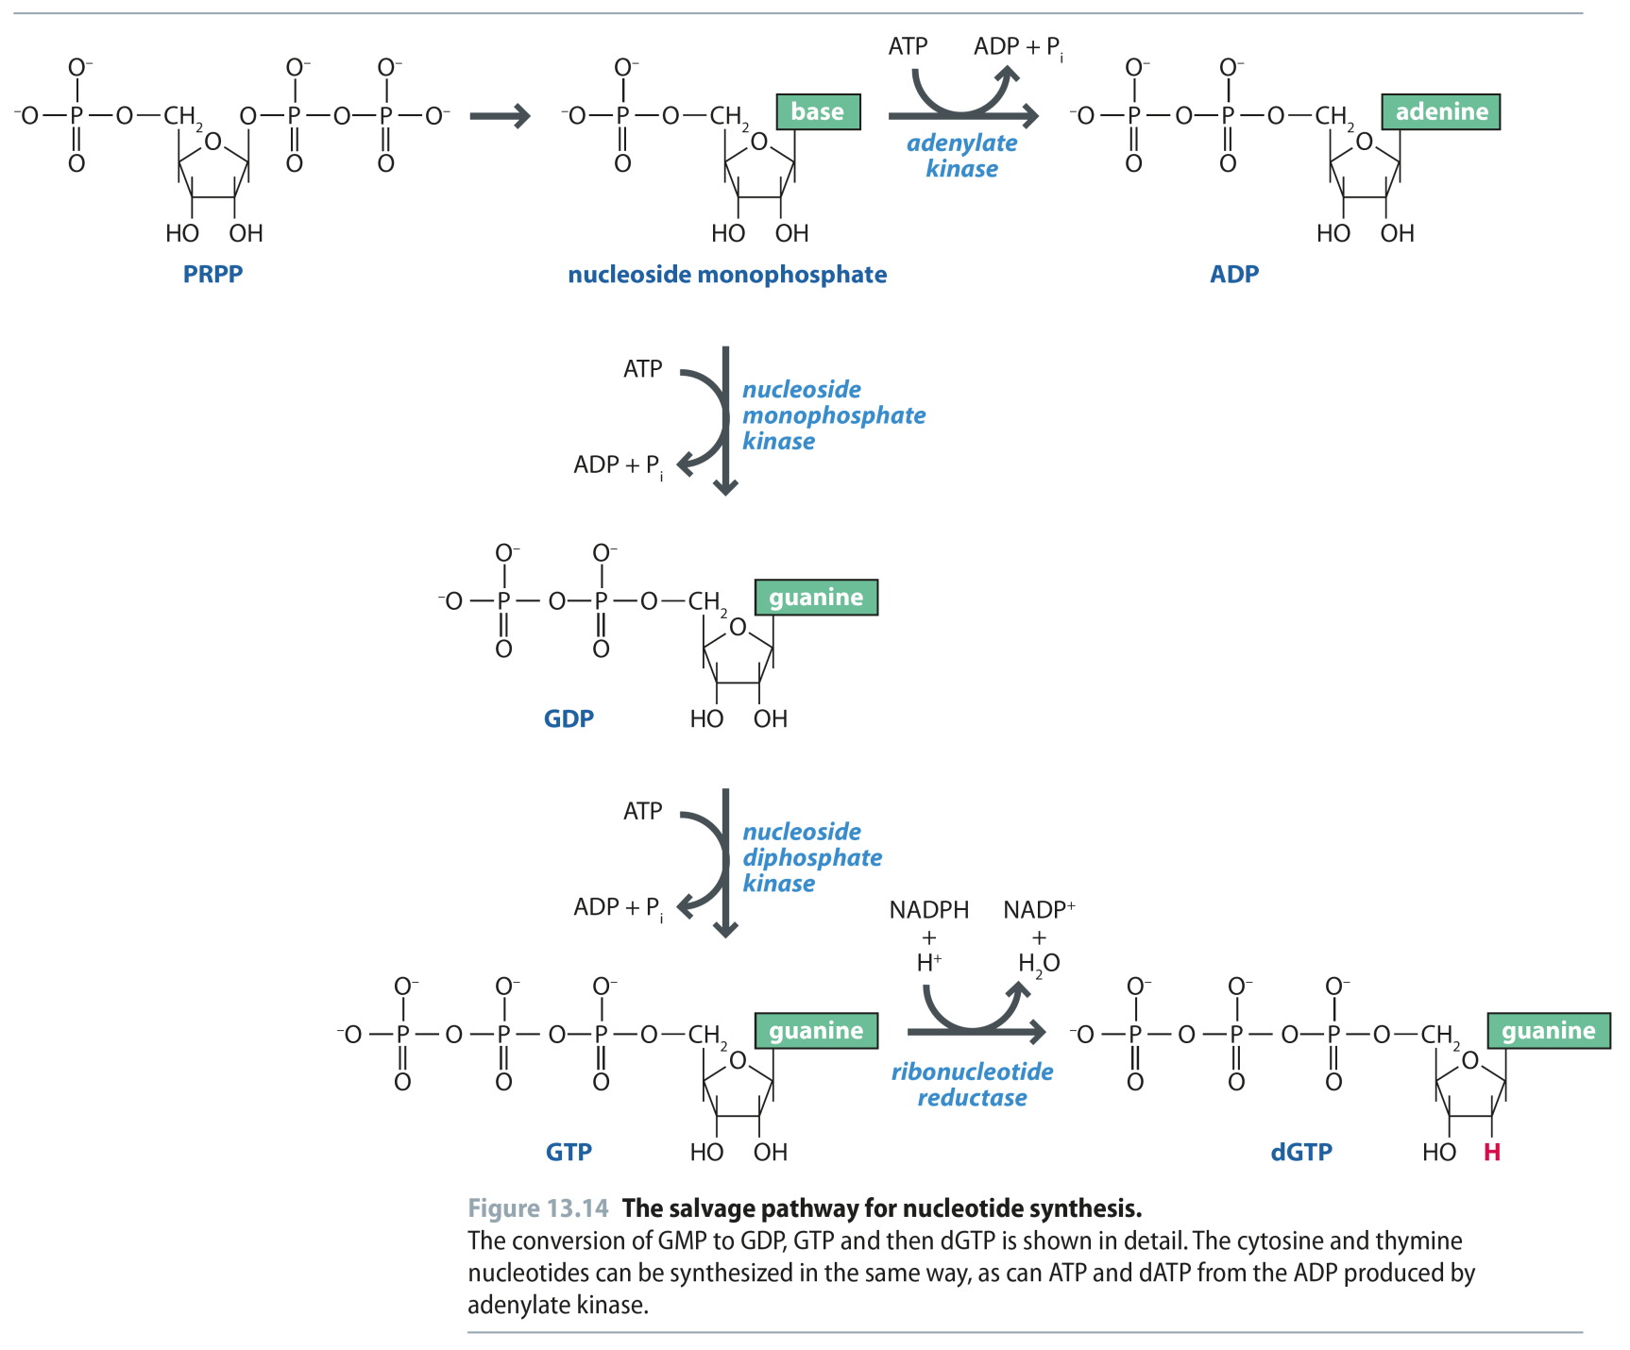
Fig 13.14
Reproduced from: Biochemistry by T.A. Brown, ISBN: 9781907904288 © Scion Publishing Ltd, 2017

Slide 16
Fig 13.15
Reproduced from: Biochemistry by T.A. Brown, ISBN: 9781907904288 © Scion Publishing Ltd, 2017

Slide 17
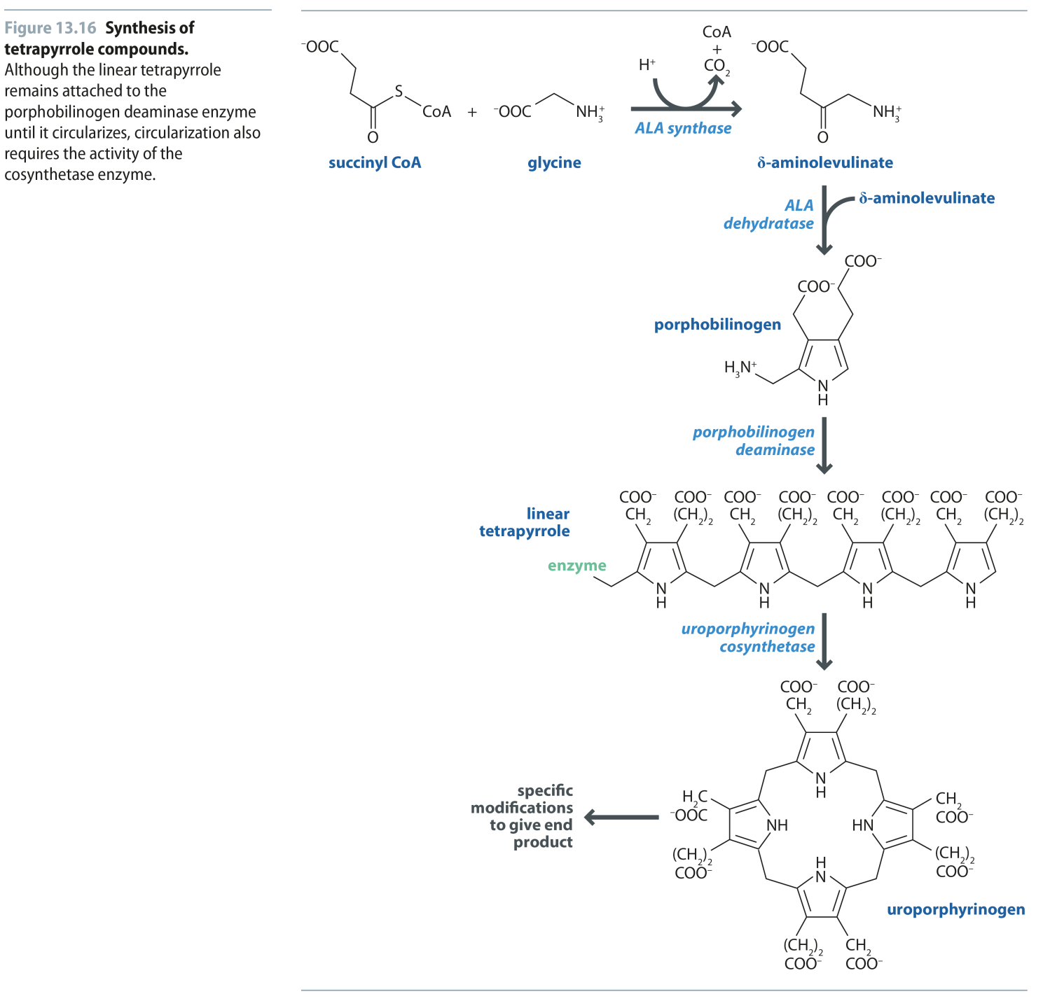
Fig 13.16
Reproduced from: Biochemistry by T.A. Brown, ISBN: 9781907904288 © Scion Publishing Ltd, 2017

Slide 18
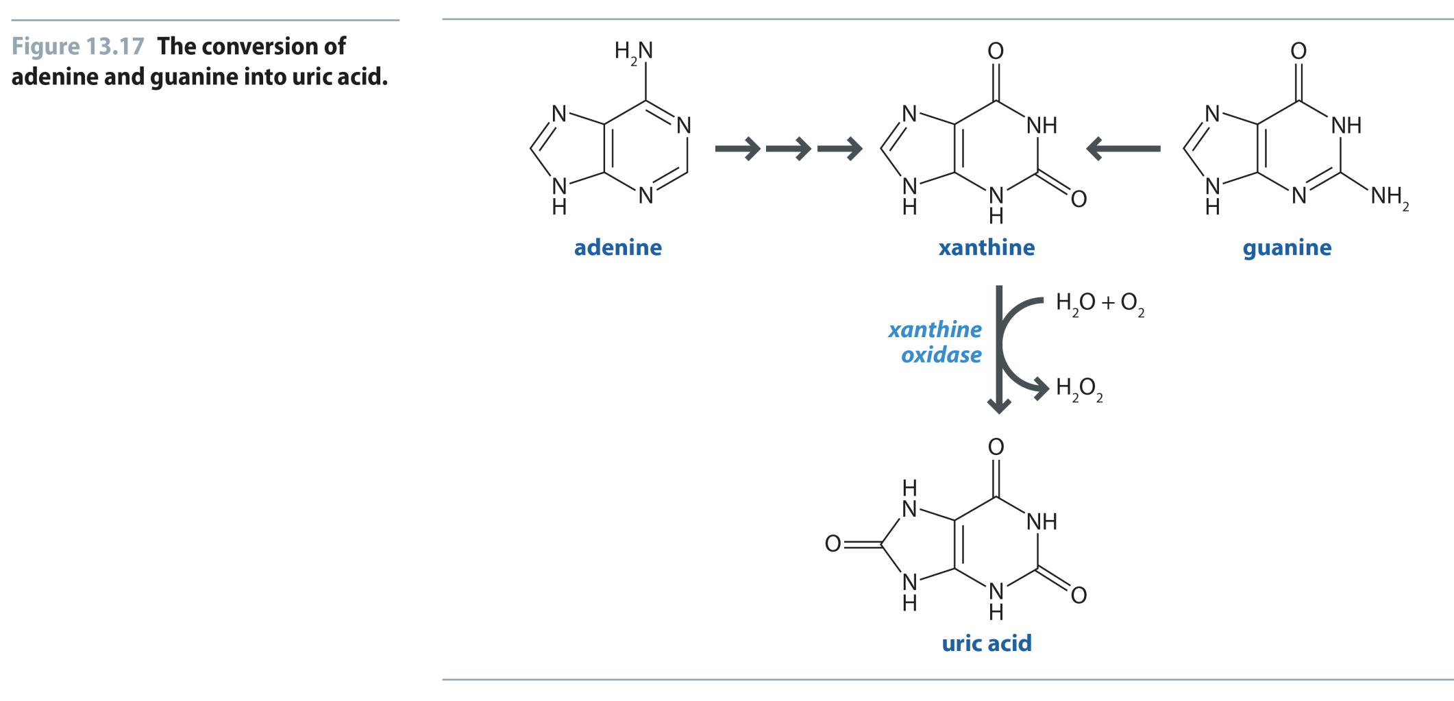
Fig 13.17
Reproduced from: Biochemistry by T.A. Brown, ISBN: 9781907904288 © Scion Publishing Ltd, 2017

Slide 19
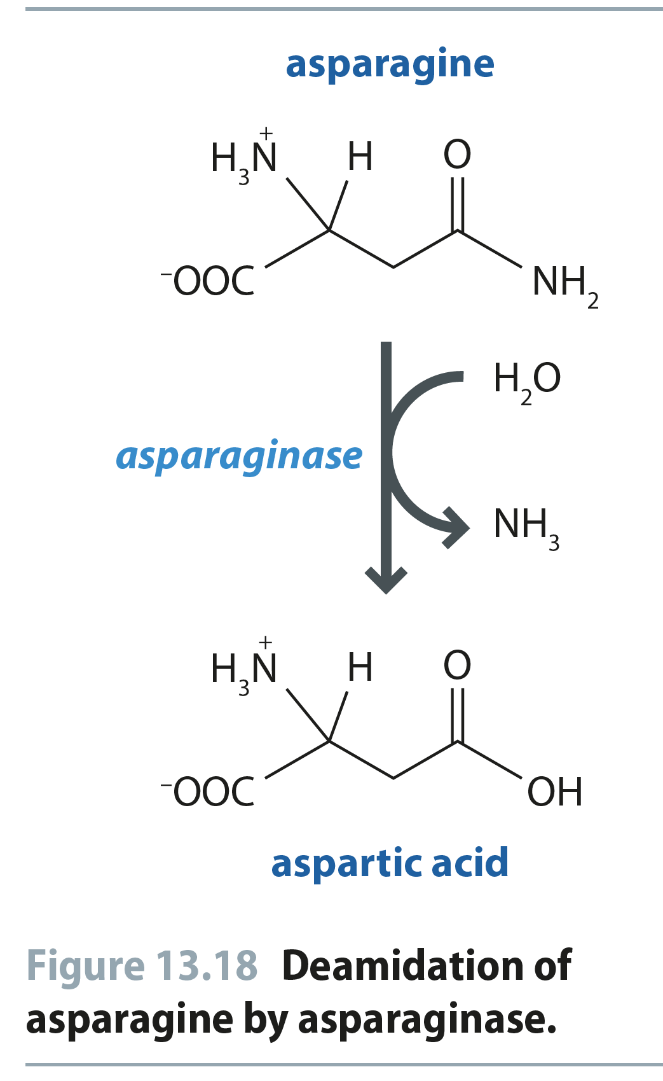
Fig 13.18
Reproduced from: Biochemistry by T.A. Brown, ISBN: 9781907904288 © Scion Publishing Ltd, 2017

Slide 20
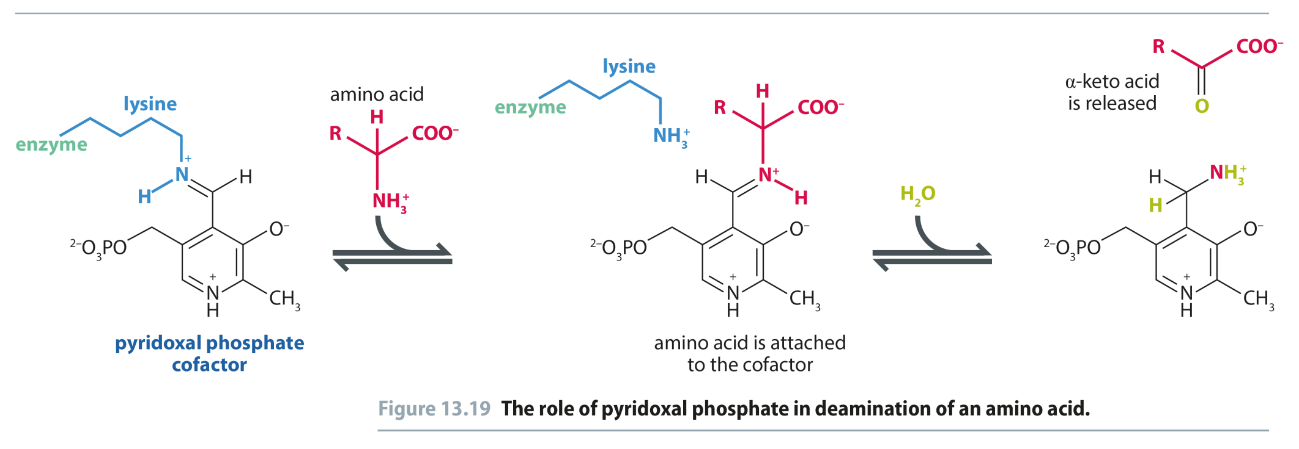
Fig 13.19
Reproduced from: Biochemistry by T.A. Brown, ISBN: 9781907904288 © Scion Publishing Ltd, 2017

Slide 21
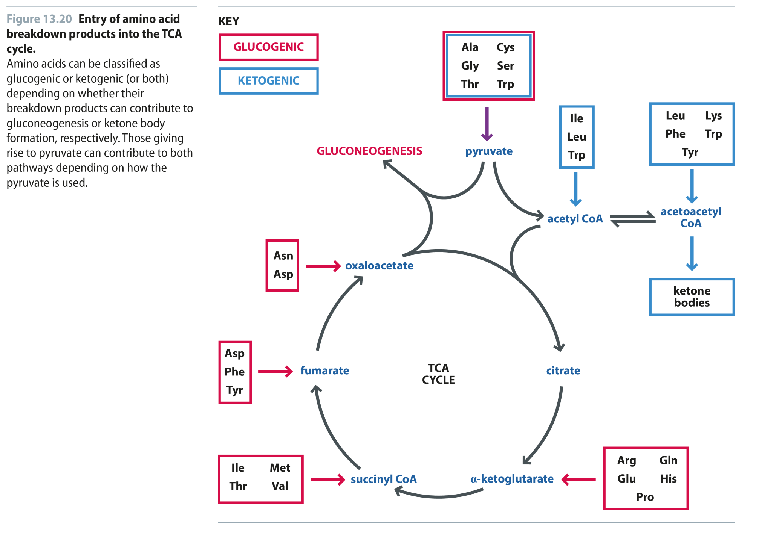
Fig 13.20
Reproduced from: Biochemistry by T.A. Brown, ISBN: 9781907904288 © Scion Publishing Ltd, 2017

Slide 22
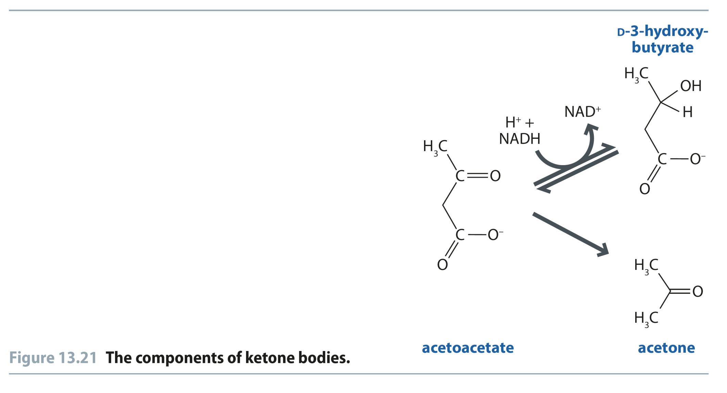
Fig 13.21
Reproduced from: Biochemistry by T.A. Brown, ISBN: 9781907904288 © Scion Publishing Ltd, 2017

Slide 23
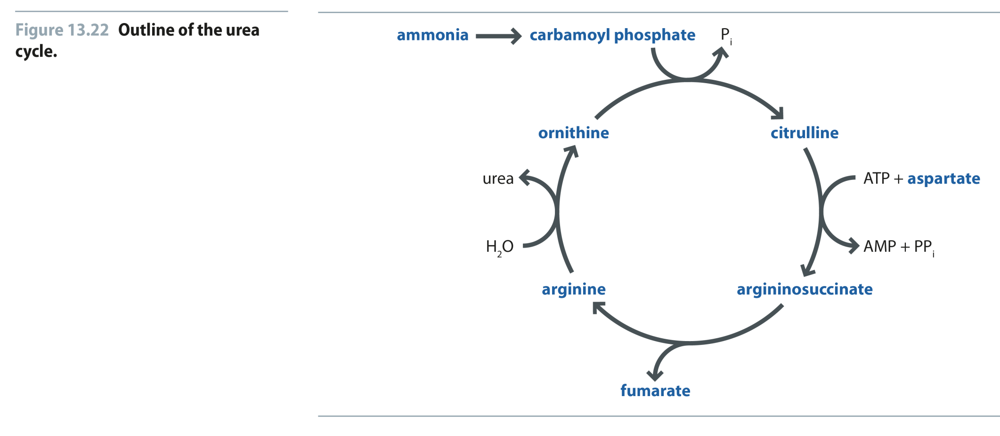
Fig 13.22
Reproduced from: Biochemistry by T.A. Brown, ISBN: 9781907904288 © Scion Publishing Ltd, 2017

Slide 24
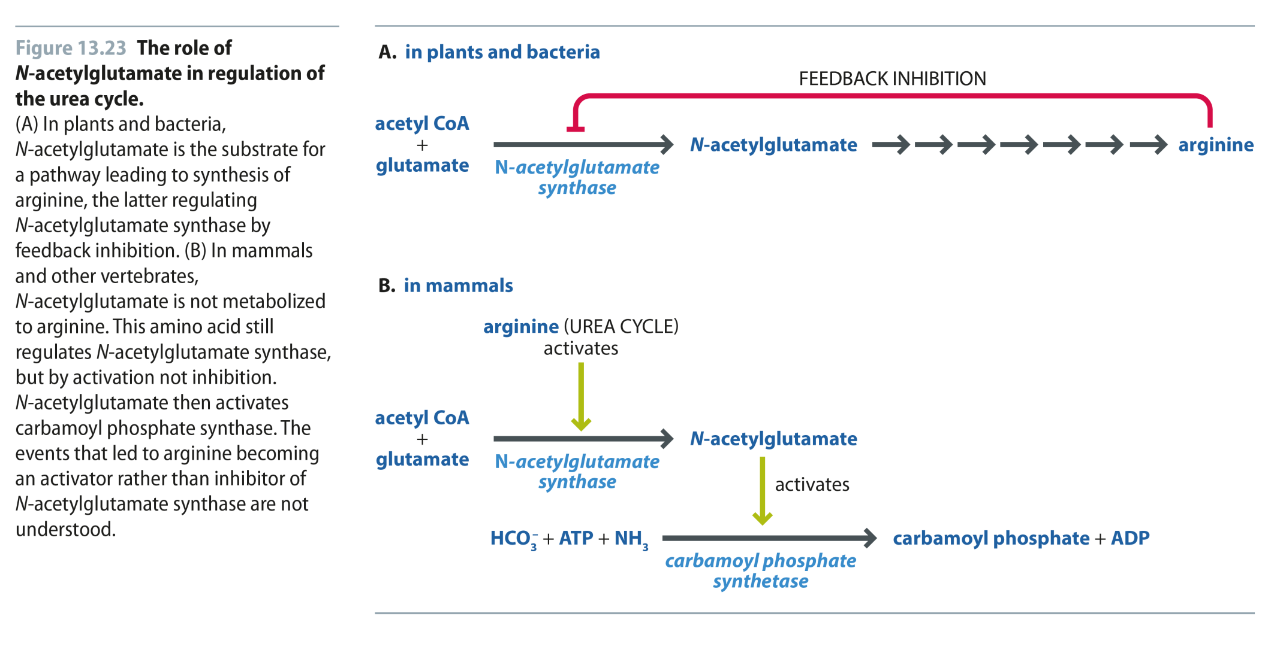
Fig 13.23
Reproduced from: Biochemistry by T.A. Brown, ISBN: 9781907904288 © Scion Publishing Ltd, 2017

Slide 25
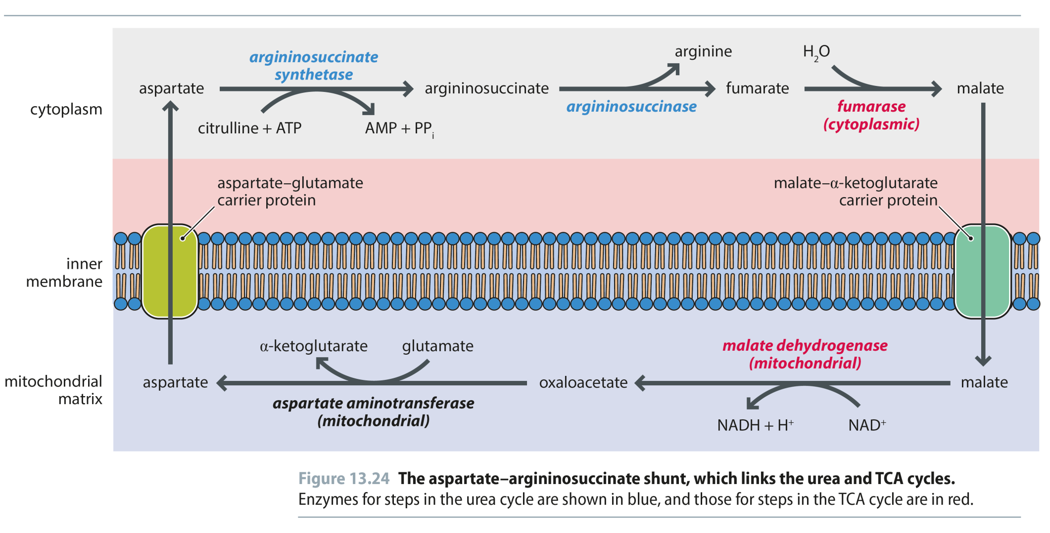
Fig 13.24
Reproduced from: Biochemistry by T.A. Brown, ISBN: 9781907904288 © Scion Publishing Ltd, 2017

