Slide 1
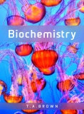
Fig 11.1
Reproduced from: Biochemistry by T.A. Brown, ISBN: 9781907904288 © Scion Publishing Ltd, 2017

Slide 2
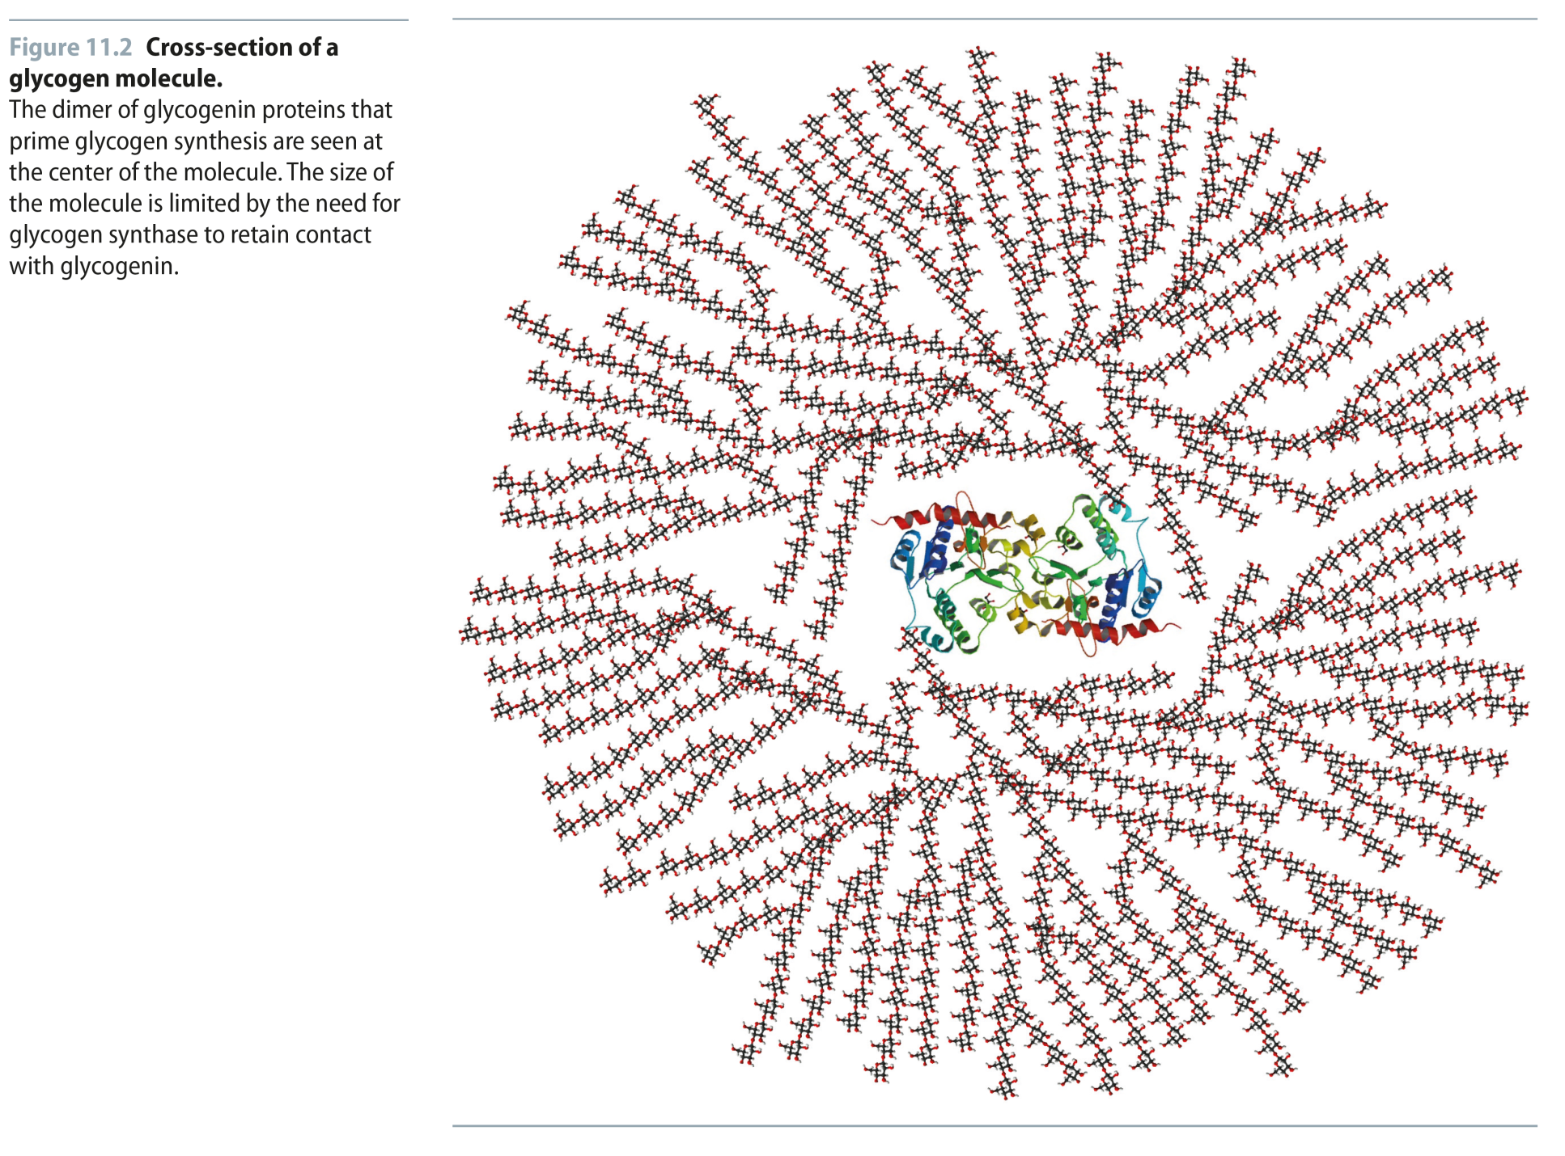
Fig 11.2
Reproduced from: Biochemistry by T.A. Brown, ISBN: 9781907904288 © Scion Publishing Ltd, 2017

Slide 3
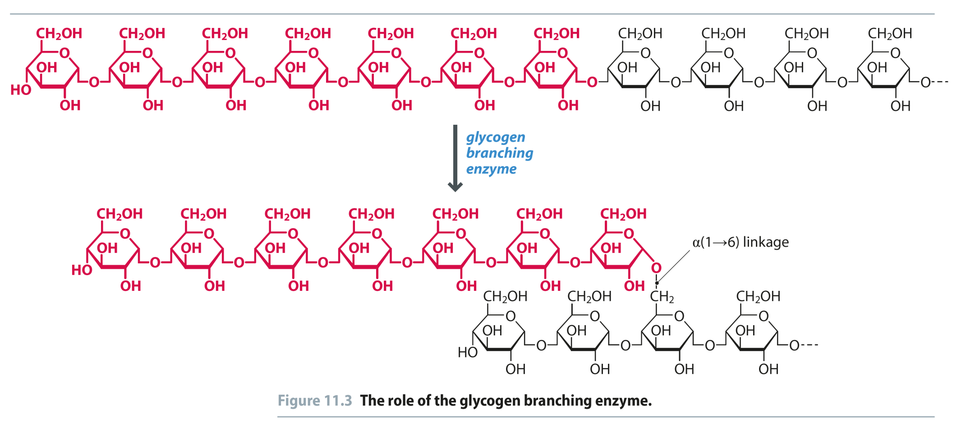
Fig 11.3
Reproduced from: Biochemistry by T.A. Brown, ISBN: 9781907904288 © Scion Publishing Ltd, 2017

Slide 4
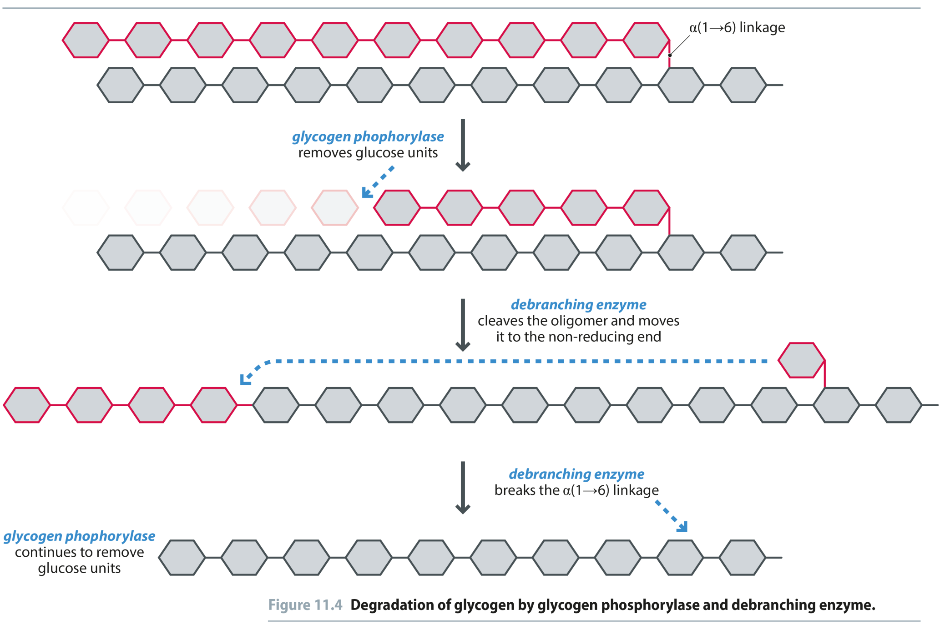
Fig 11.4
Reproduced from: Biochemistry by T.A. Brown, ISBN: 9781907904288 © Scion Publishing Ltd, 2017

Slide 5
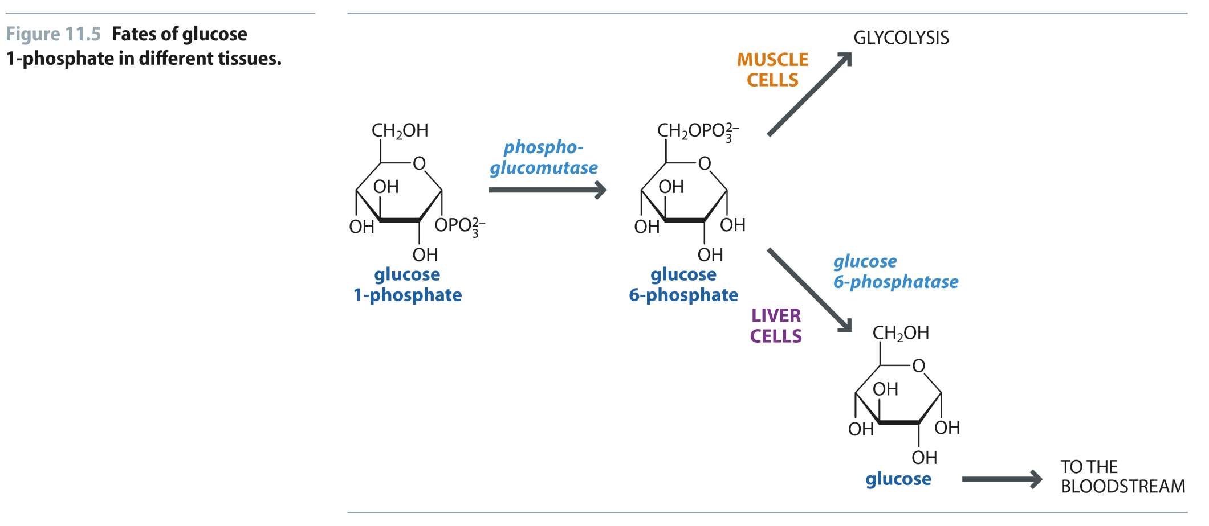
Fig 11.5
Reproduced from: Biochemistry by T.A. Brown, ISBN: 9781907904288 © Scion Publishing Ltd, 2017

Slide 6
Fig 11.6
Reproduced from: Biochemistry by T.A. Brown, ISBN: 9781907904288 © Scion Publishing Ltd, 2017

Slide 7
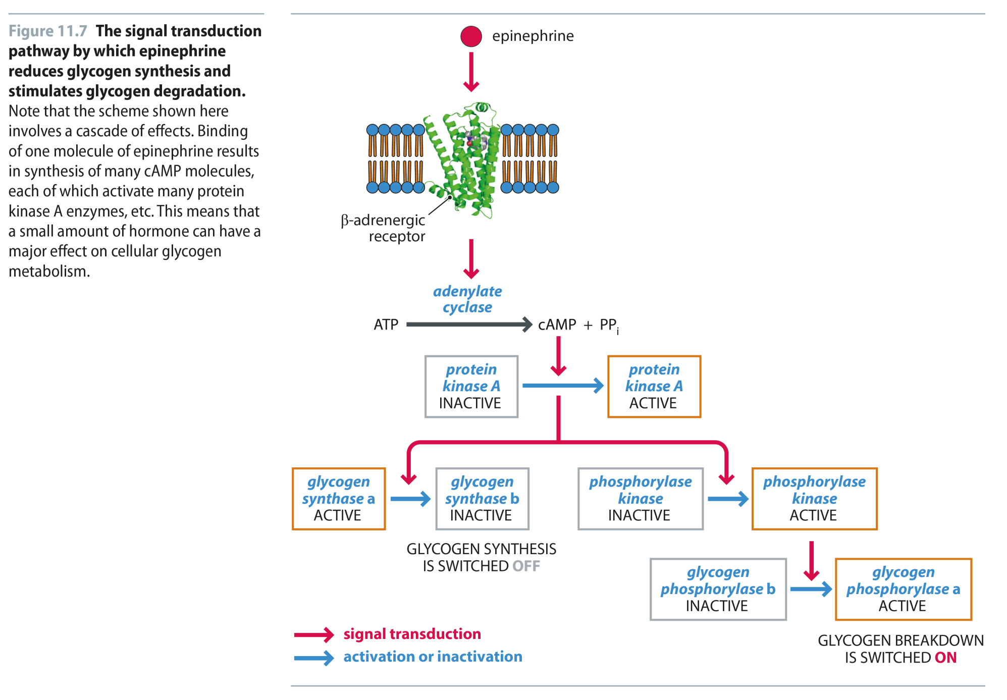
Fig 11.7
Reproduced from: Biochemistry by T.A. Brown, ISBN: 9781907904288 © Scion Publishing Ltd, 2017

Slide 8
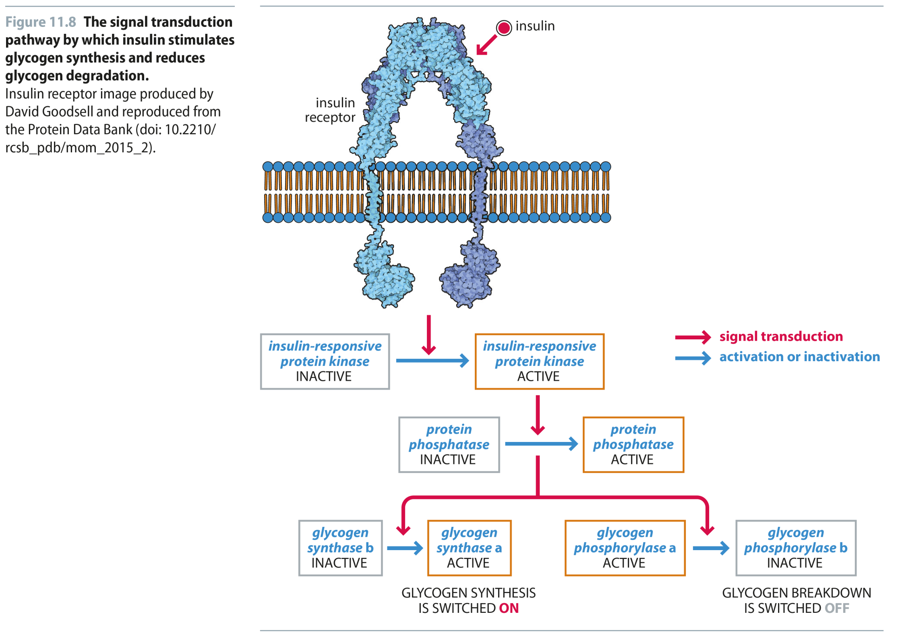
Fig 11.8
Reproduced from: Biochemistry by T.A. Brown, ISBN: 9781907904288 © Scion Publishing Ltd, 2017

Slide 9
Fig 11.9
Reproduced from: Biochemistry by T.A. Brown, ISBN: 9781907904288 © Scion Publishing Ltd, 2017

Slide 10
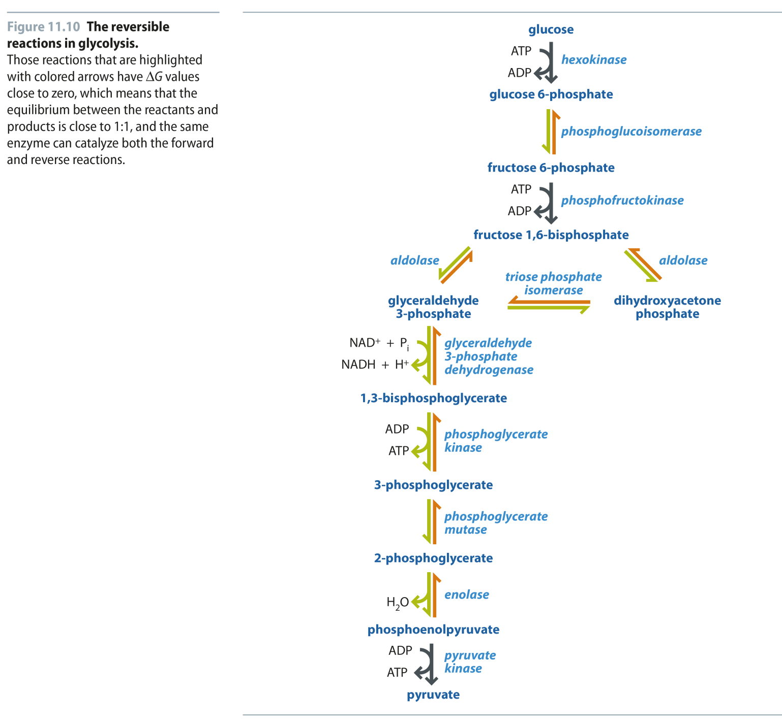
Fig 11.10
Reproduced from: Biochemistry by T.A. Brown, ISBN: 9781907904288 © Scion Publishing Ltd, 2017

Slide 11
Fig 11.11
Reproduced from: Biochemistry by T.A. Brown, ISBN: 9781907904288 © Scion Publishing Ltd, 2017

Slide 12
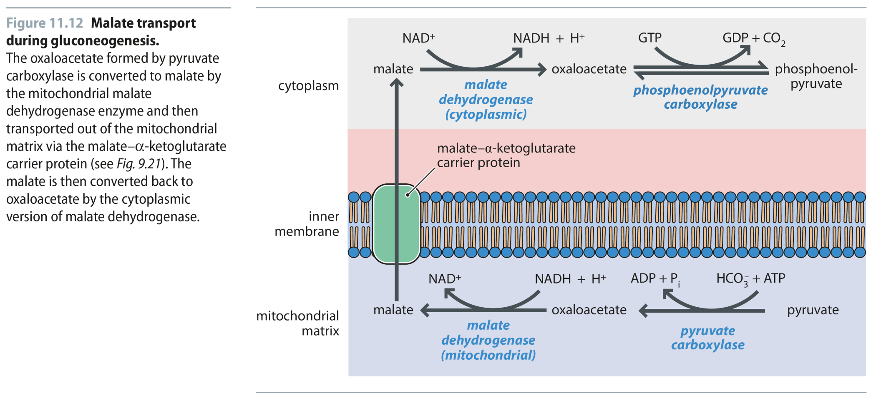
Fig 11.12
Reproduced from: Biochemistry by T.A. Brown, ISBN: 9781907904288 © Scion Publishing Ltd, 2017

Slide 13
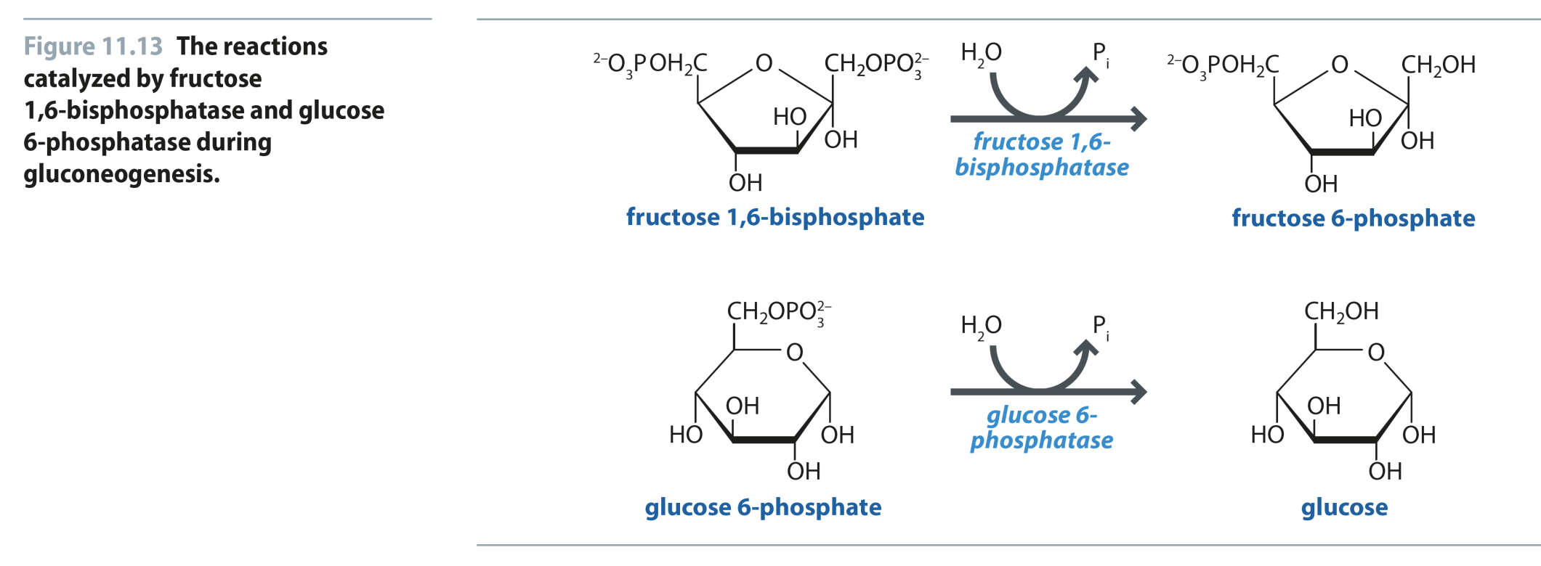
Fig 11.13
Reproduced from: Biochemistry by T.A. Brown, ISBN: 9781907904288 © Scion Publishing Ltd, 2017

Slide 14
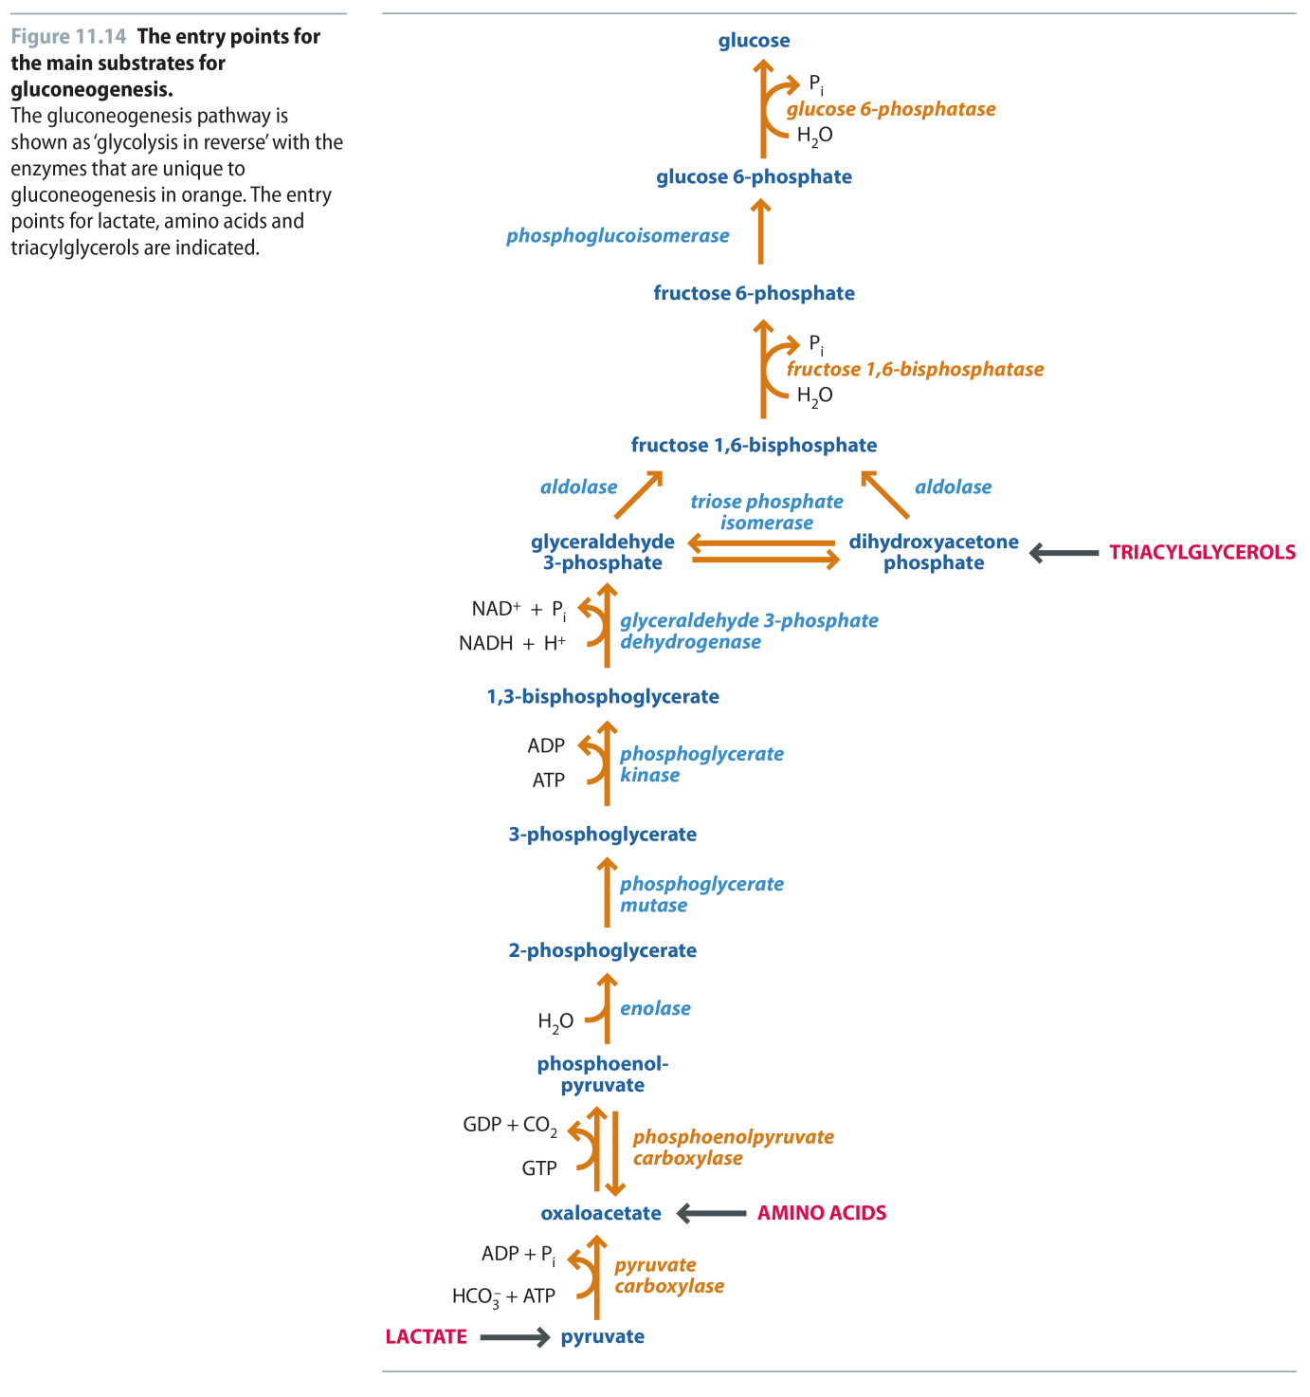
Fig 11.14
Reproduced from: Biochemistry by T.A. Brown, ISBN: 9781907904288 © Scion Publishing Ltd, 2017

Slide 15
Fig 11.15
Reproduced from: Biochemistry by T.A. Brown, ISBN: 9781907904288 © Scion Publishing Ltd, 2017

Slide 16
Fig 11.16
Reproduced from: Biochemistry by T.A. Brown, ISBN: 9781907904288 © Scion Publishing Ltd, 2017

Slide 17
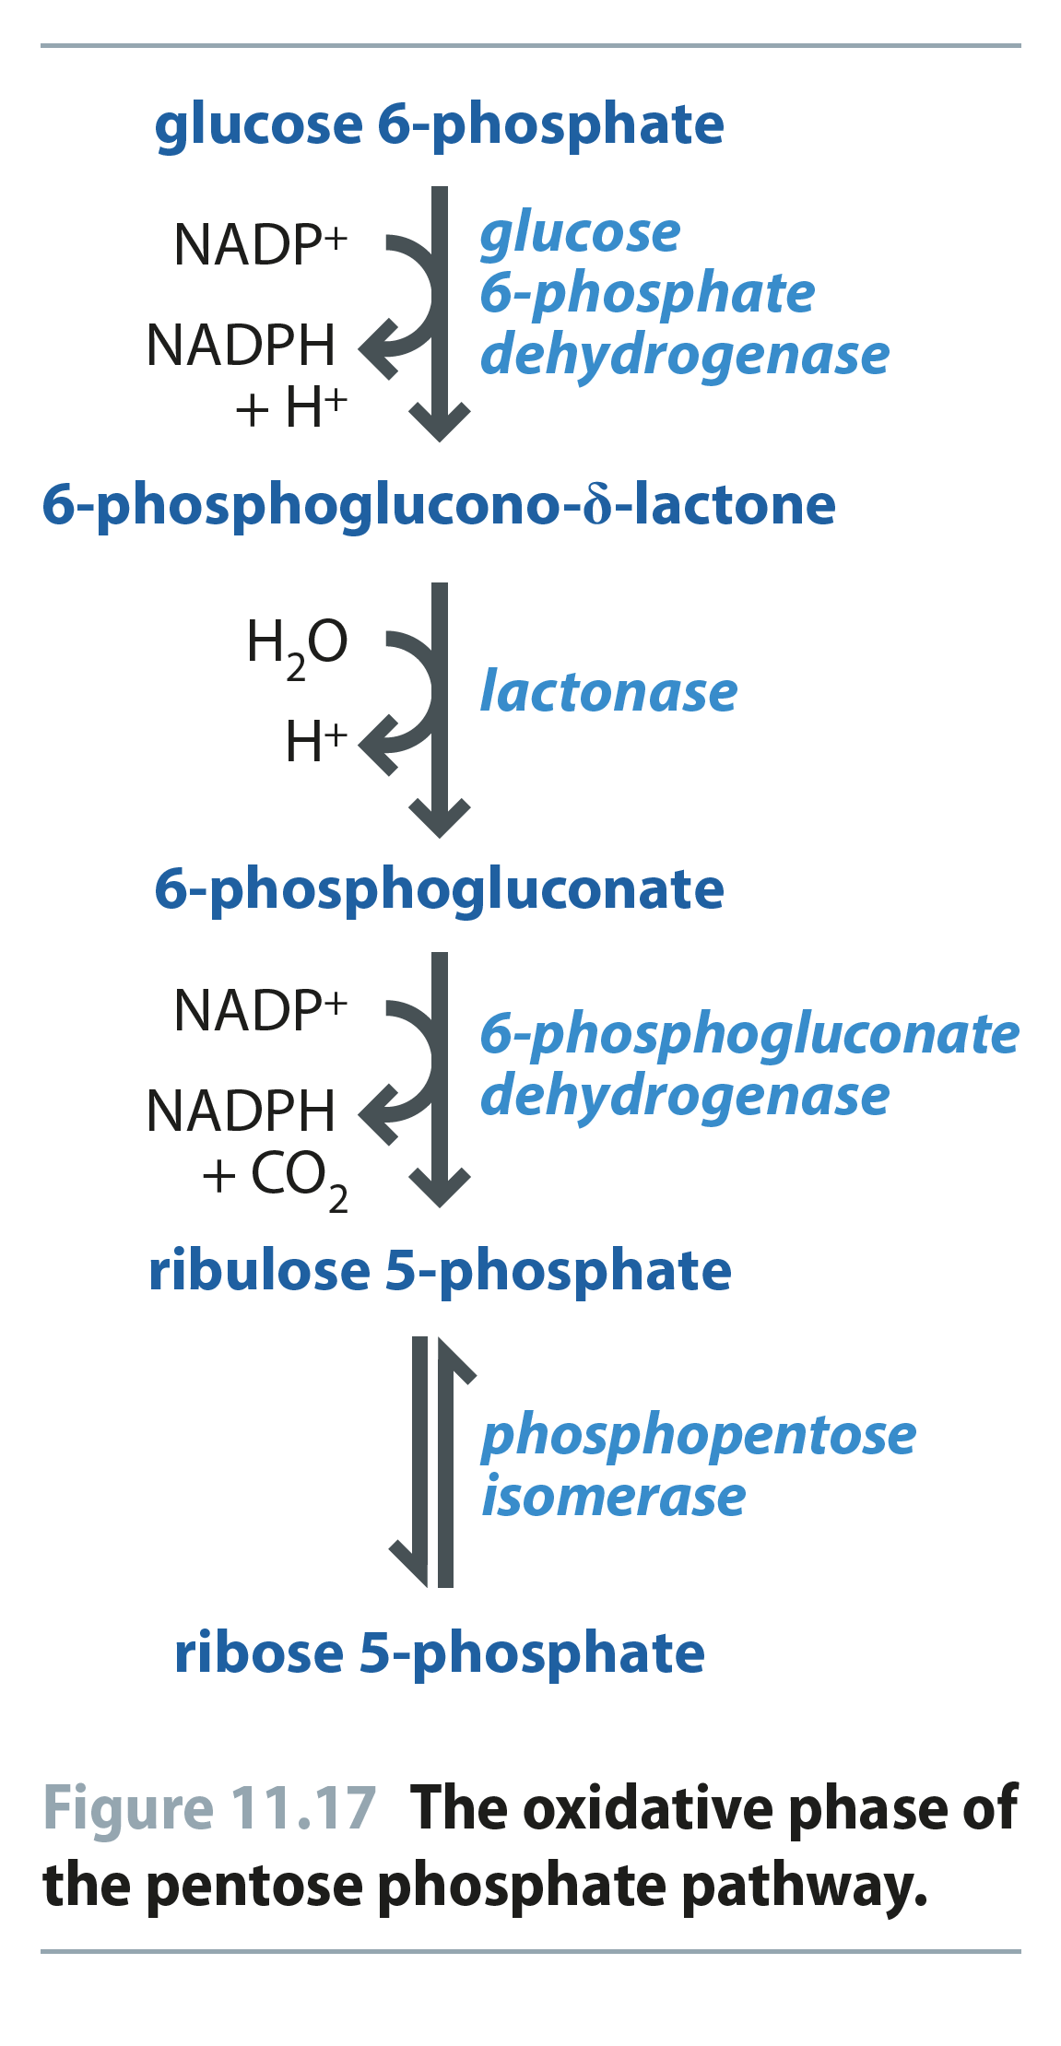
Fig 11.17
Reproduced from: Biochemistry by T.A. Brown, ISBN: 9781907904288 © Scion Publishing Ltd, 2017

Slide 18
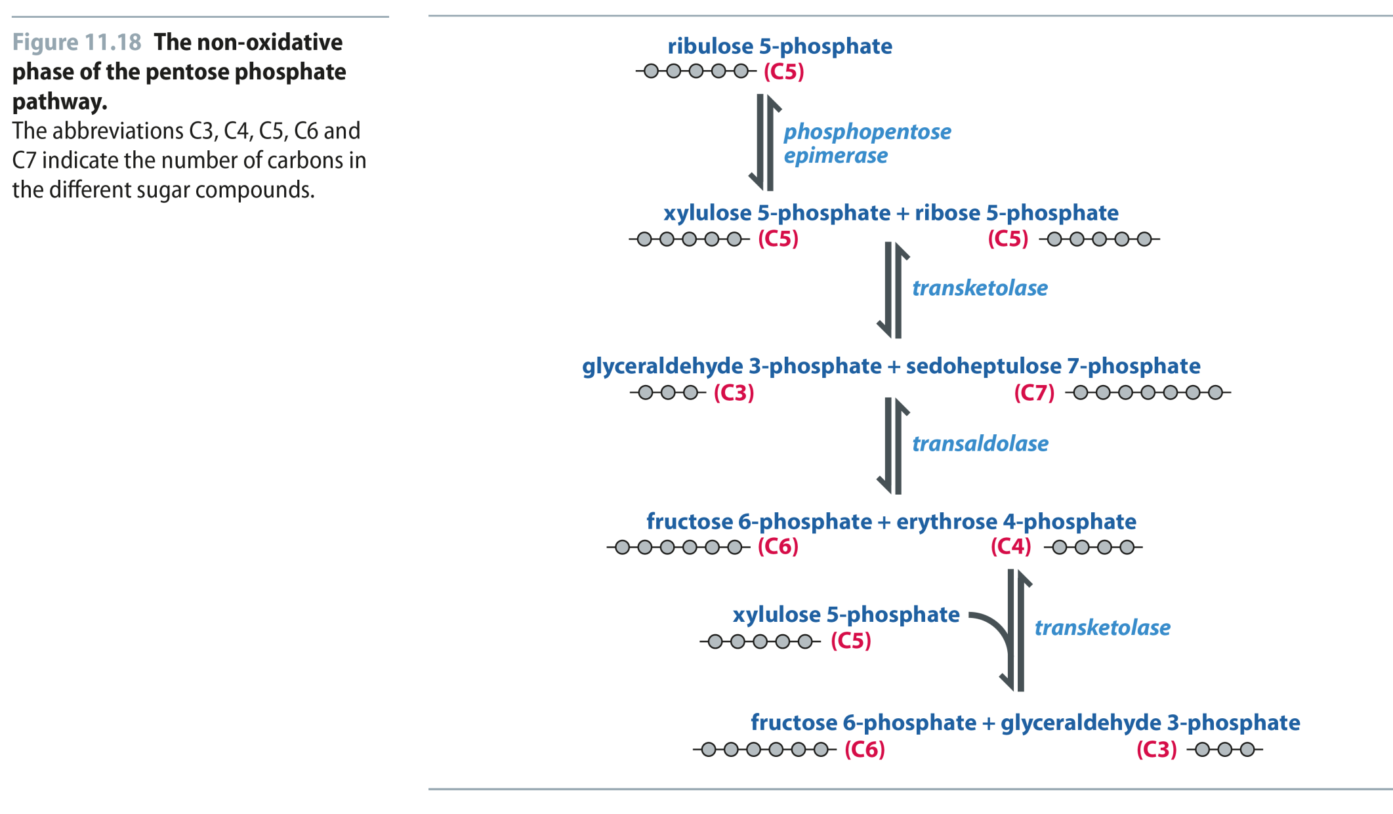
Fig 11.18
Reproduced from: Biochemistry by T.A. Brown, ISBN: 9781907904288 © Scion Publishing Ltd, 2017

