Slide 1
Non-Michaelis-Menton Kinetics
We have looked at the behaviour of monomeric enzymes or non-allosteric enzymes
Allosteric means “Other ______”
Frequently, when we are talking about allosteric proteins, we are talking about proteins with ___________ structure.
The allosteric regulators bind to sites that are not active sites and elicit their effects by causing a Change in Shape of the Catalytic Subunit

Slide 2
Quaternary Structure and Cooperativity
The 4° structure of a protein is the arrangement of discrete subunits or compact, single protein molecules, with distinct tertiary structure
When an Effector molecule binds to one subunit, it may cause a Conformational Change that allows the enzyme to function differently (better or worse) at altered (elevated or depressed) substrate concentrations.
Huh?

Slide 3
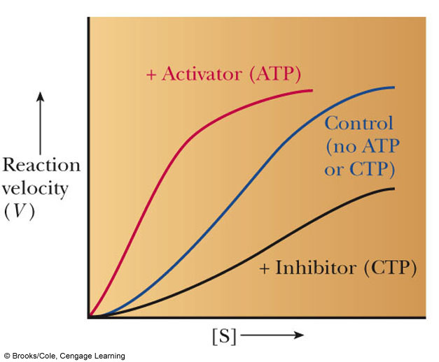
Quaternary Structure and Cooperativity
If the enzyme functions better (K_{M} decreases) as a result of the initial substrate binding events, then Positive Cooperativity is observed
If the enzyme functions worse (V_{M} decreases) then Negative Cooperativity is observed

Slide 4
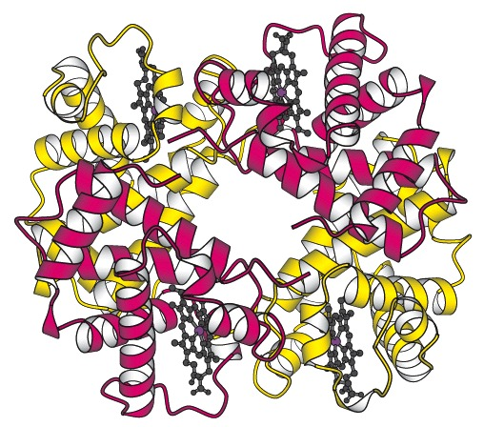
Quaternary Structure
Proteins with quaternary structure are oligomeric (They have multiple subunits)
Subunits do not have to be identical
Oligomeric proteins have the potential to display cooperativity
All cooperative proteins must be oligomeric, but NOT all oligomeric proteins are cooperative.

Slide 5
Quaternary Structure
Quaternary Protein Structure may be disrupted by anything that disrupts non-covalent interactions
pH change
Ionic Strength Change
Addition of a Chaotrope
Temperature change

Slide 6
Feedback Inhibition
One AMAZING benefit to the evolution of allosteric regulation of enzymatic activity is:
You can obtain a much finer level of control of enzymes involved in complicated pathways than you can with simple Michaelis-Menton based inhibition
Feedback Inhibition is an example of this

Slide 7
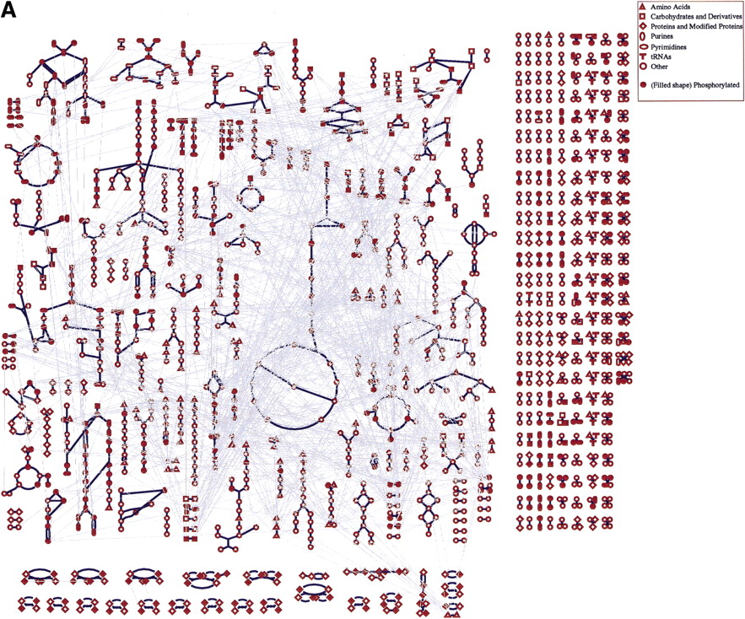
Overview diagram of E. coli metabolism
©2000 by Cold Spring Harbor Laboratory Press
Ouzounis C A, Karp P D Genome Res. 2000;10:568-576
Notes:
Overview diagram of E. colimetabolism. Each node in the diagram represents a single metabolite whose chemical class is encoded by the shape of the node. Each blue line represents a single bioreaction. The white lines connect multiple occurrences of the same metabolite in the diagram. (A) This version of the overview shows all interconnections between occurrences of the same metabolite to communicate the complexity of the interconnections in the metabolic network.

Slide 8
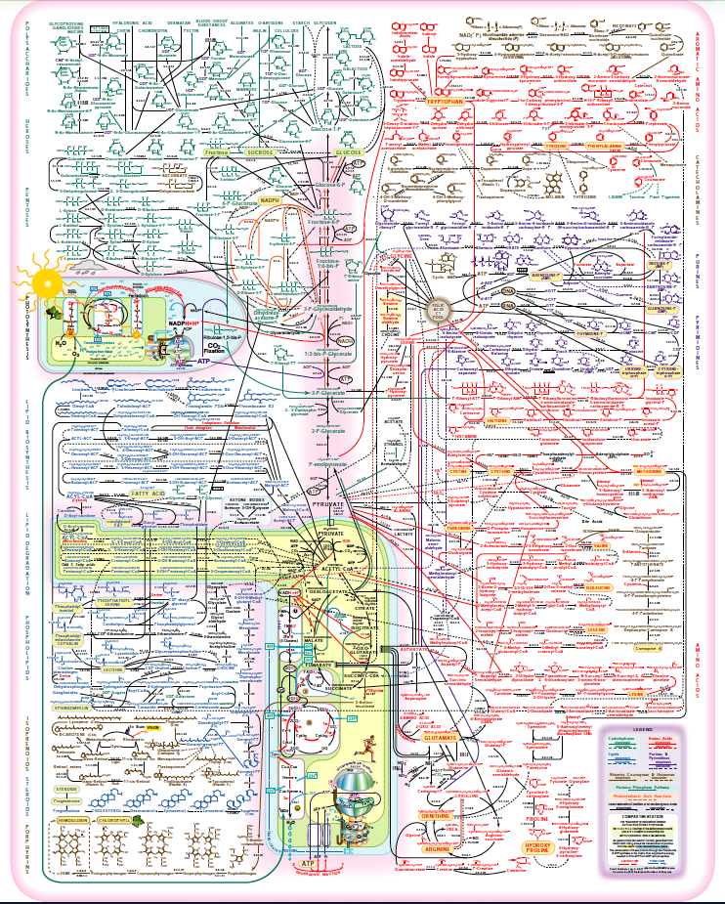
Metabolic Complexity and The Need for Regulation

Slide 9
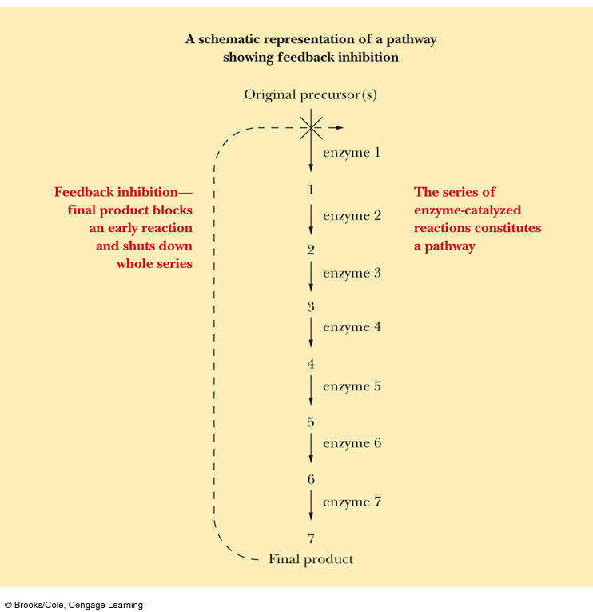
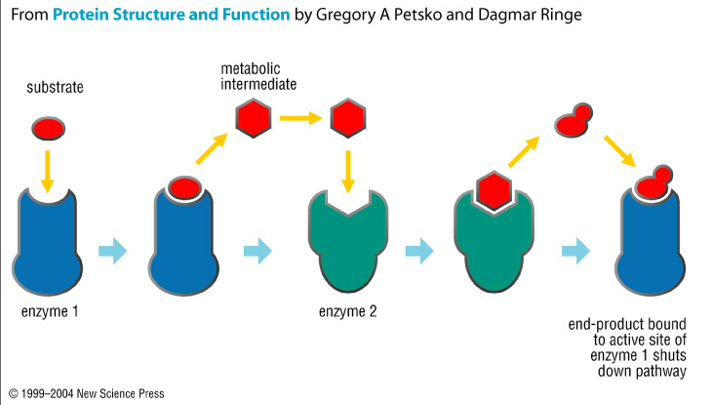
Feedback Inhibition

Slide 10
Feedback Inhibition and Allostery
The presence of allosteric sites on proteins allows the cells to respond much more readily to the ever changing conditions in which they live
Why would this be advantageous?

Slide 11
Phosphorylation
Another means by which enzymes are controlled is by phosphorylation
30% of human proteins are regulated by phosphorylation
Amino acids with hydroxyl groups on their side chains can be phosphorylated
What 3 side chains have hydroxyl groups?

Slide 12
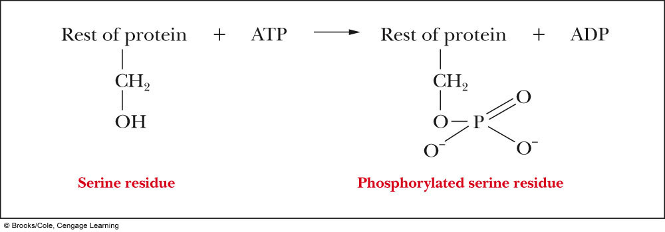
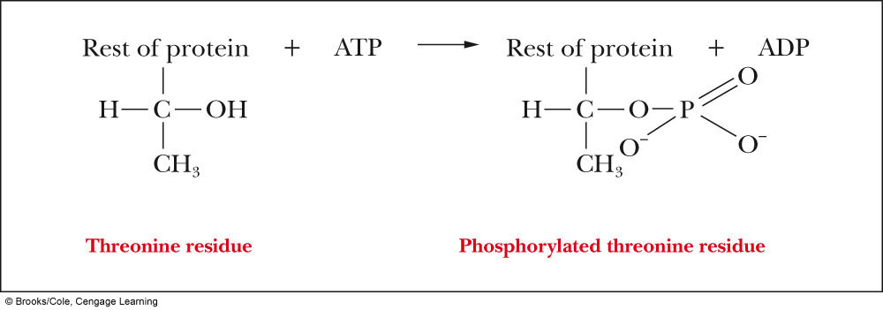
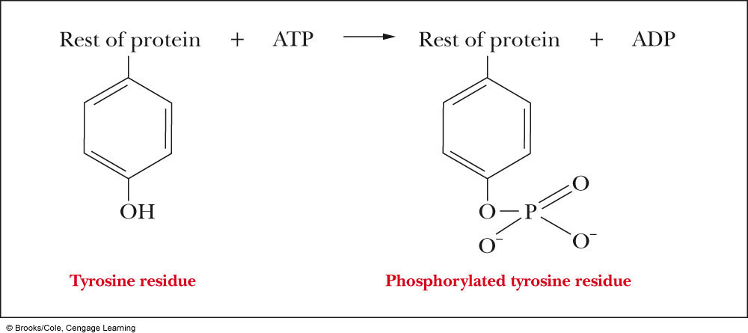
Phosphorylation
Kinases transfer phosphate groups to proteins or other molecules
Phosphatases hydrolyze phosphate esters off of molecules

Slide 13
Phosphate Esters and Conformational Change
The presence of these large, negatively charged phosphoryl groups causes several things to happen to a protein
Site Access / Closure
If a loop is phosphorylated, it may open up, allowing access to a previously hidden (from solution anyways) area of the protein
Active Site, Inhibitor binding site
May disrupt Protein-Protein Interactions
May cause a disordered region of the protein to adopt a coherent tertiary structure

Slide 14
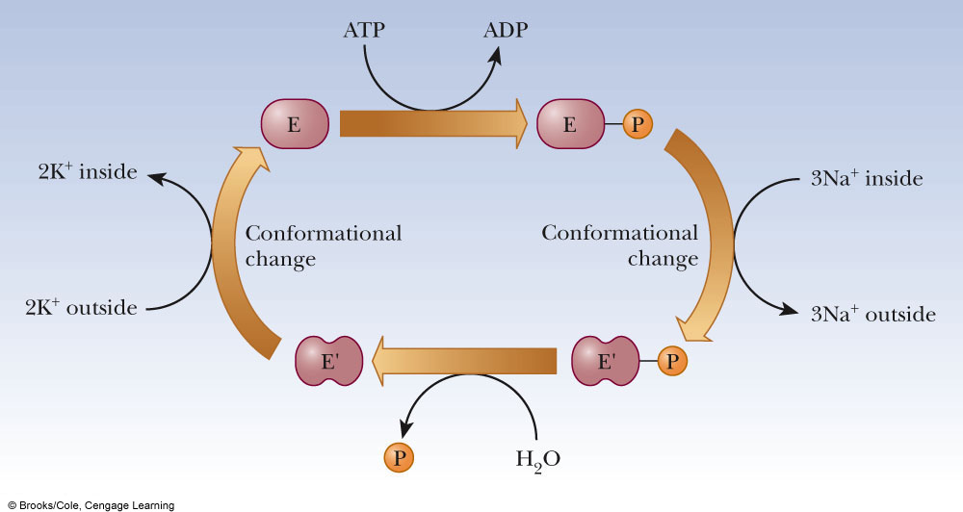
Examples of Phosphorylated Proteins
Na⁺/K⁺ Pump
Responsible for maintaining the balance of ions within the cell
This gradient is needed for Active transport, electrical gradients and signal transduction among other things
The phosphorylated form of the protein allows transport of sodium ions, but the dephosphorylated form only allows transport of potassium ions

Slide 15
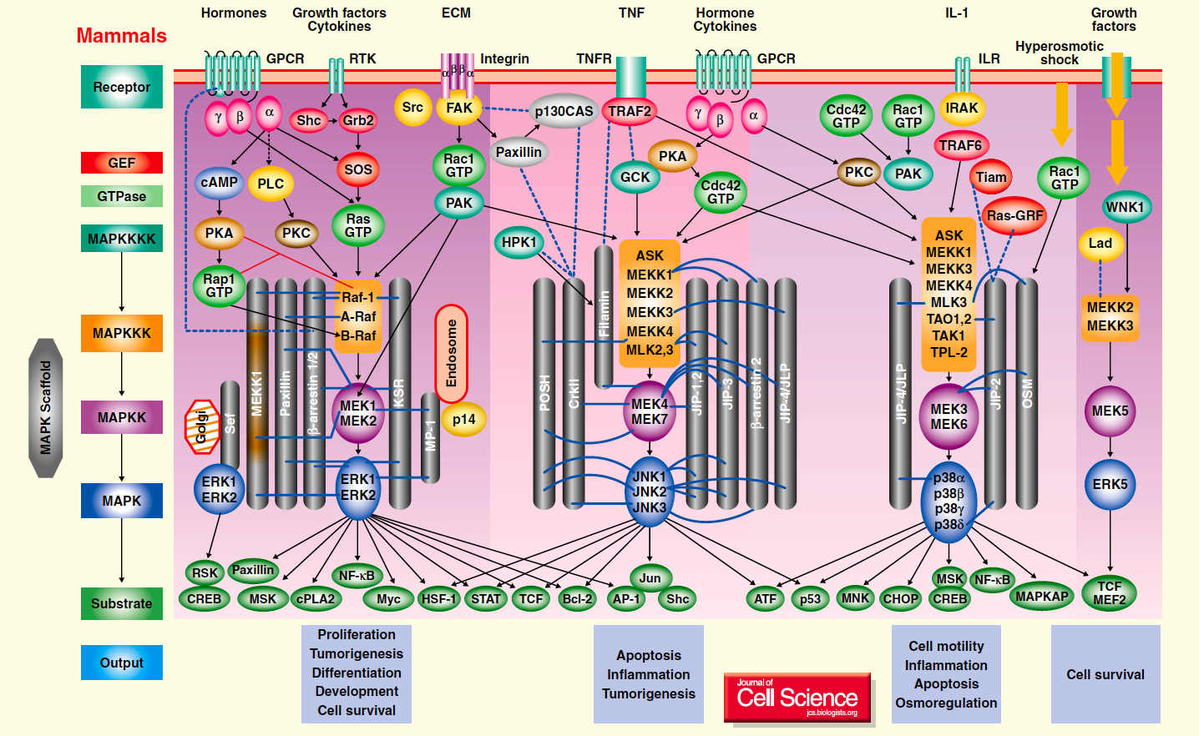
Examples of Phosphorylated Proteins
2. Protein Kinases
Protein Kinases catalyze the transfer of the γ-phosphate group from ATP to a protein
MAP Kinases (Mitogen Activated Protein Kinases) are a perfect example of a protein kinase.
Kinases are critical in the process of signal transduction by which a cell senses a change in the external environment and needs to alter the genes it is expressing to deal with the change

Slide 16
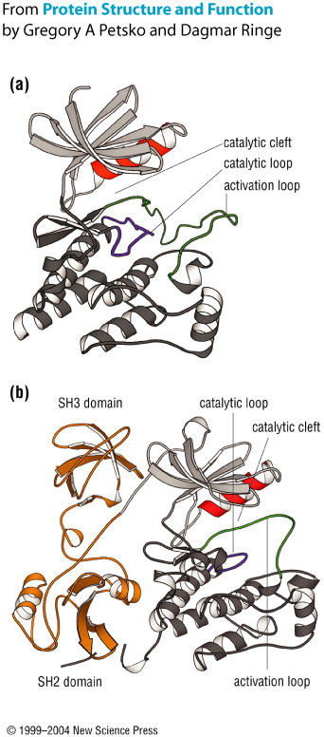
Examples of Phosphorylated Proteins
2. Protein Kinases

Slide 17
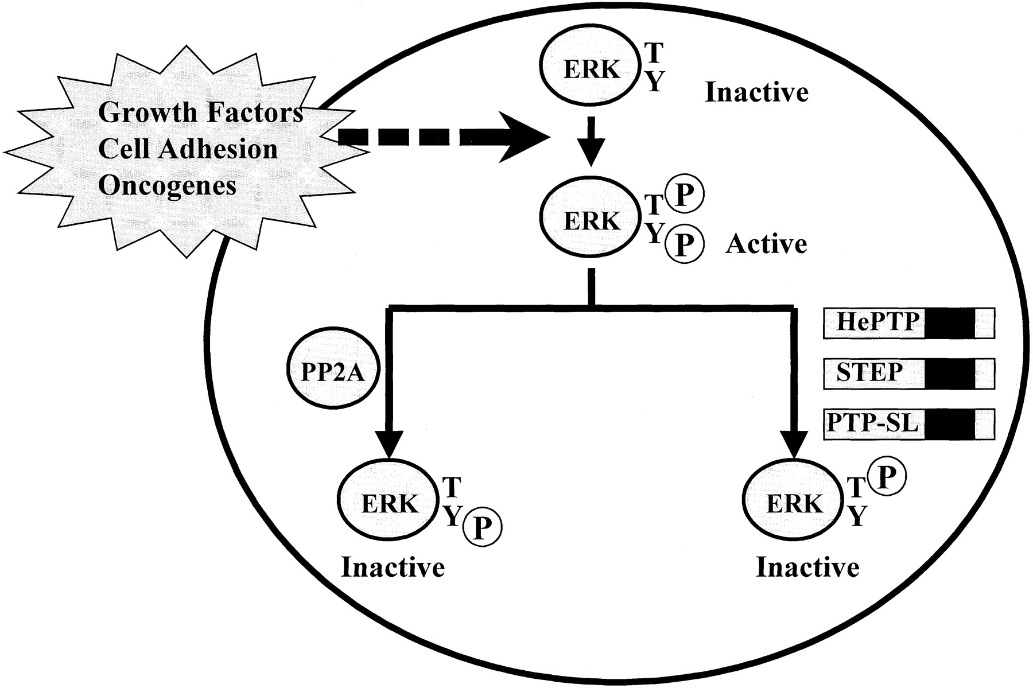
MAP Kinases: ERK
Camps, M, Anton, N. and Arkinstall, S. 2000. FASEB J. 14:6-16.

Slide 18
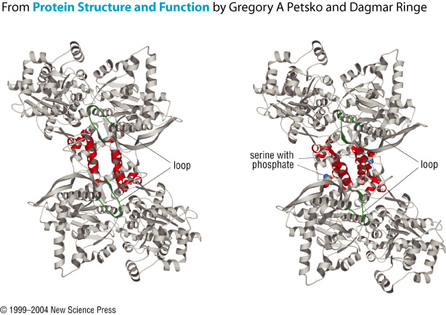
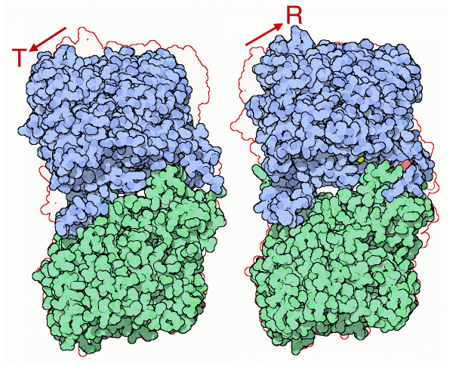
Examples of Phosphorylated Proteins
Glycogen Phosphorylase
Allows the cell to respond to external factors by hydrolyzing stored glycogen, releasing glucose for metabolism
In response to low glucose levels, low ATP levels or hormonal stress, a serine residue is phosphorylated and the resulting change in shape puts the enzyme in an active conformation (R-State)
http://www.rcsb.org/pdb/static.do?p=education_discussion/molecule_of_the_month/pdb24_1.html
Note the opening of the active site after phosphorylation

Slide 19
Phosphorylation
Many enzymes are regulated by phosphorylation
Up to 30% in human cells
Serine, threonine and tyrosine are targets for phosphorylation with the phosphoryl ester forming on the hydroxyl oxygen
Phosphorylation works by causing conformational changes in the tertiary (and/or quaternary) structure of the protein
The phosphate group the forms the ester is from ATP in many cases
Phosphorylation may cause Up or Down-regulation of enzymatic activity

Slide 20
Zymogens
Another level of control of protein function is the production of Zymogens
Zymogens are inactive precursors of enzymes that are irreversibly transformed into active enzymes by cleavage of their primary structure
In other words: Your cells make an enzyme in an inactive form, but cut away a part of it to activate it when it is needed.
Like removing a boat from storage in the Spring.

Slide 21
Examples of Zymogens
Insulin
Chymotrypsin and Trypsin
Fibrinogen
Thrombin

Slide 22
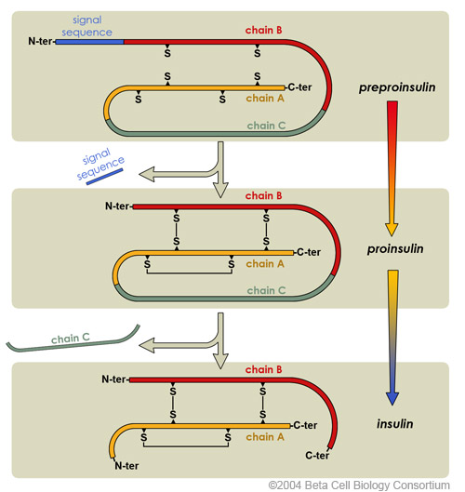
Zymogens: Insulin
Preproinsulin is translated as a 110 amino acid chain. Removal of the signal peptide produces Proinsulin.
Formation of disulfide bonds between the A- & B-chain components, and removal of the intervening C-chain, produces a biologically active Insulin molecule comprising 51 amino acids
http://www.betacell.org/content/articles/articlepanel.php?aid=1&pid=1

Slide 23
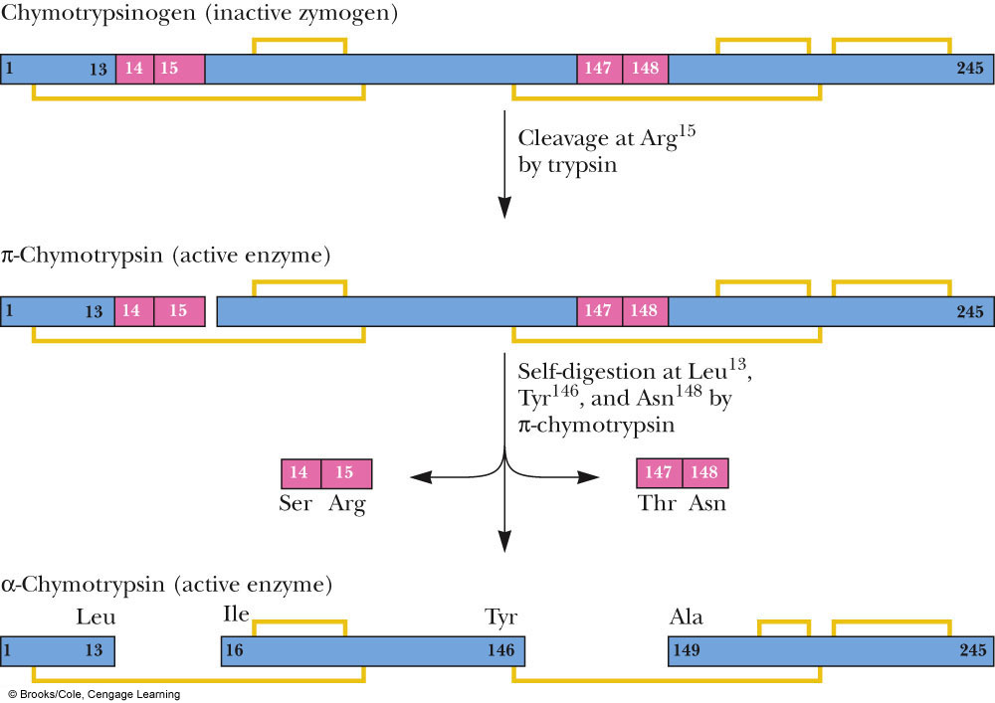
Zymogens: Chymotrypsin

Slide 24
Controlling Enzymatic Activity: Summary
Enzymatic activity can be controlled by a variety of approaches, all of which are different than simple Michaelis-Menton reversible inhibition
Feedback Inhibition
Allows a product from a downstream reaction in a pathway to inhibit and enzyme via allosteric, noncompetitve or uncompetitive means
Phosphorylation
Allows an enzyme to be made and then have its activity up- or downregulated in response to different stimuli
Zymogen production
Allows cells to have proteins ready for immediate action should the become needed

Slide 25
The Active Site
Now that we know the:
Structure of the Amino Acids
Properties of the Amino Acids
Structure of Proteins
Kinetic Theory of Proteins
Regulation of Protein Activity
We are ready to start looking at the active site itself, specific reactions and their mechanisms

