Slide 1
Chapter Eight Lipids and Proteins Are Associated in Biological Membranes

Slide 2
What is a Lipid
Lipids: a heterogeneous class of naturally occurring organic compounds classified together on the basis of common solubility properties
insoluble in water, but soluble in aprotic organic solvents including diethyl ether, chloroform, methylene chloride, and acetone
Amphipathic in nature
Lipids include:
Open Chain forms
fatty acids, triacylglycerols, sphingolipids, phosphoacylglycerols, glycolipids,
lipid-soluble vitamins
prostaglandins, leukotrienes, and thromboxanes
Cyclic forms
cholesterol, steroid hormones, and bile acids

Slide 3
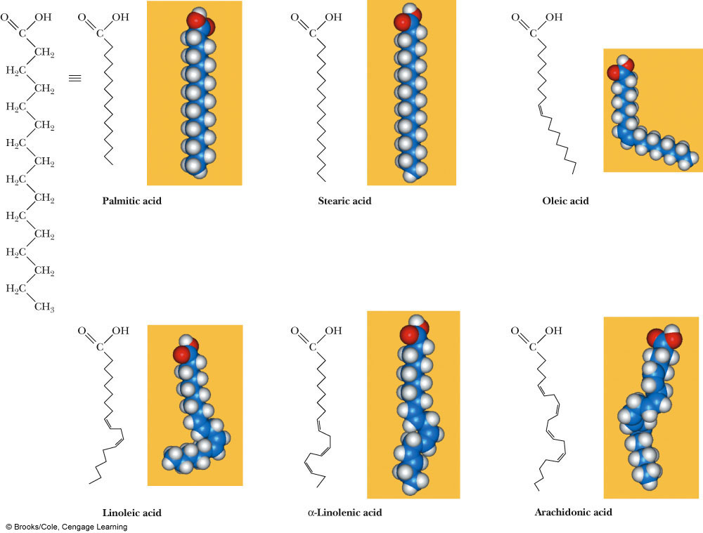
Fatty Acids
Fatty acid: an unbranched-chain carboxylic acid, most commonly of 12 - 20 carbons, derived from hydrolysis of animal fats, vegetable oils, or phosphodiacylglycerols of biological membranes
In the shorthand notation for fatty acids
the number of carbons and the number of double bonds in the chain are shown by two numbers, separated by a colon

Slide 4
Fatty Acids (Cont’d)
Length of fatty acid plays a role in its chemical character
• Usually contain even numbers of carbons (can contain odd, depending on how they are biosynthesized)
• FA that contain C=C, are unsaturated: If contain only C-C bonds, they are saturated

Slide 5
Fatty Acids (Cont’d)
In most unsaturated fatty acids, the cis isomer predominates; the trans isomer is rare
Unsaturated fatty acids have lower melting points than their saturated counterparts; the greater the degree of unsaturation, the lower the melting point
Why is this?

Slide 6
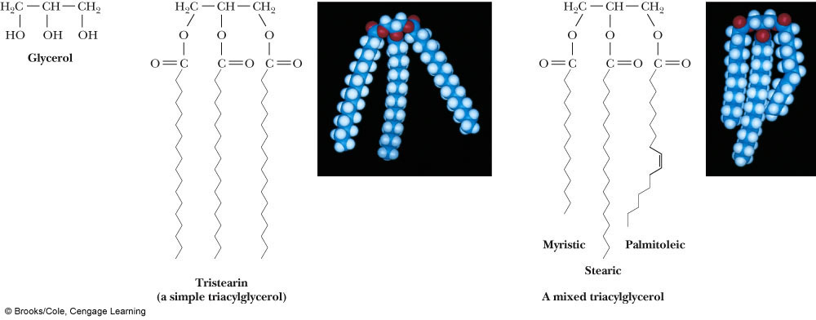
Triacylglycerols
Triacylglycerol (triglyceride): an ester of glycerol with three fatty acids
natural soaps are prepared by boiling triglycerides (animal fats or vegetable oils) with NaOH, in a reaction called saponification (Latin, sapo, soap)

Slide 7
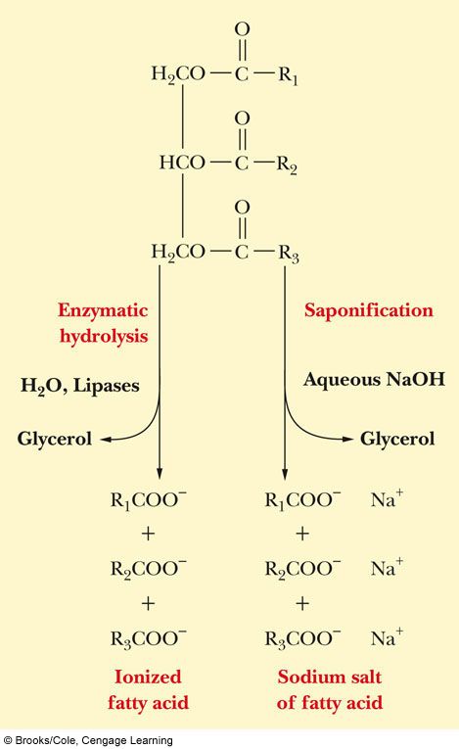
Soaps
Soaps form water-insoluble salts when used in water containing Ca(II), Mg(II), and Fe(III) ions (hard water)
The salt rinses off
Reactions with acids/bases as catalysts
Salts formed by Saponification
Base-catalyzed hydrolysis with salts formed

Slide 8
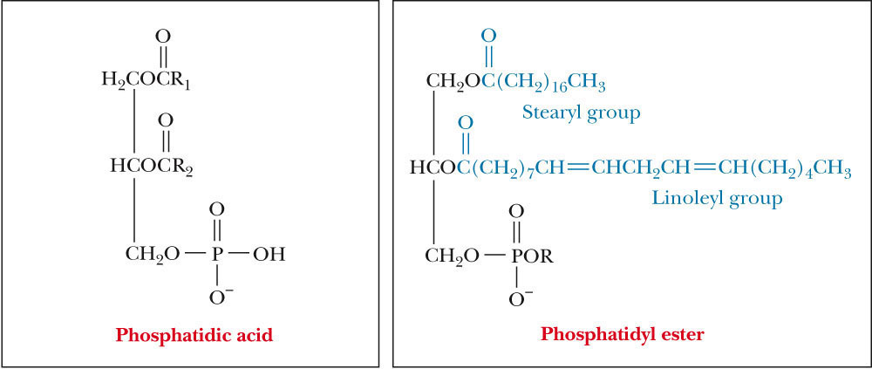
Phosphoacylglycerols (Phospholipids)
When one alcohol group of glycerol is esterified by a phosphoric acid rather than by a carboxylic acid, phosphatidic acid produced
Phosphoacylglycerols (phosphoglycerides) are the second most abundant group of naturally occurring lipids, and they are found in plant and animal membranes

Slide 9
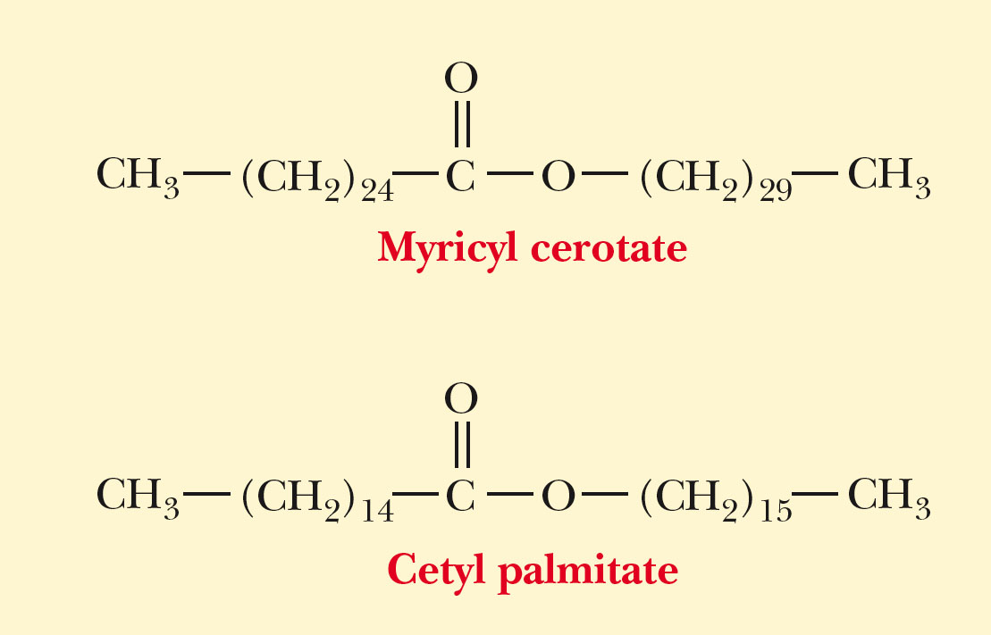
Waxes
A complex mixture of esters of long-chain carboxylic acids and alcohols
Found as protective coatings for plants and animals
Parrafin chains on either side of ester

Slide 10
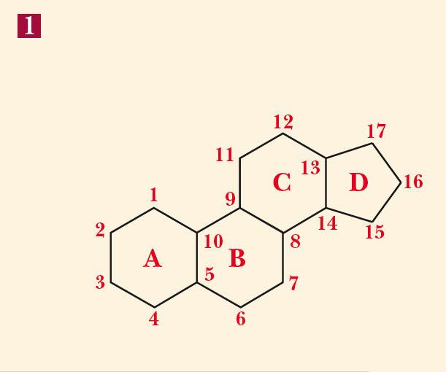
Steroids
Steroids: a group of lipids that have fused-ring structure of 3 six-membered rings, and 1 five-membered ring.

Slide 11
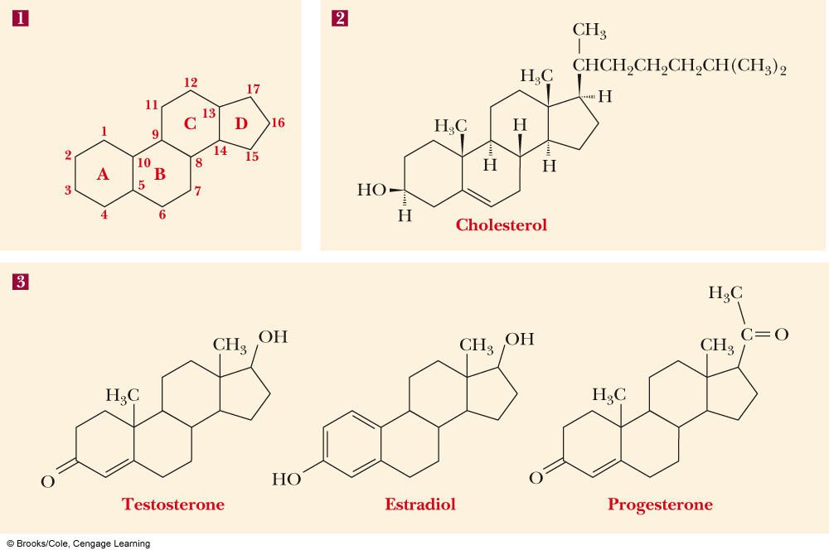
Steroids

Slide 12
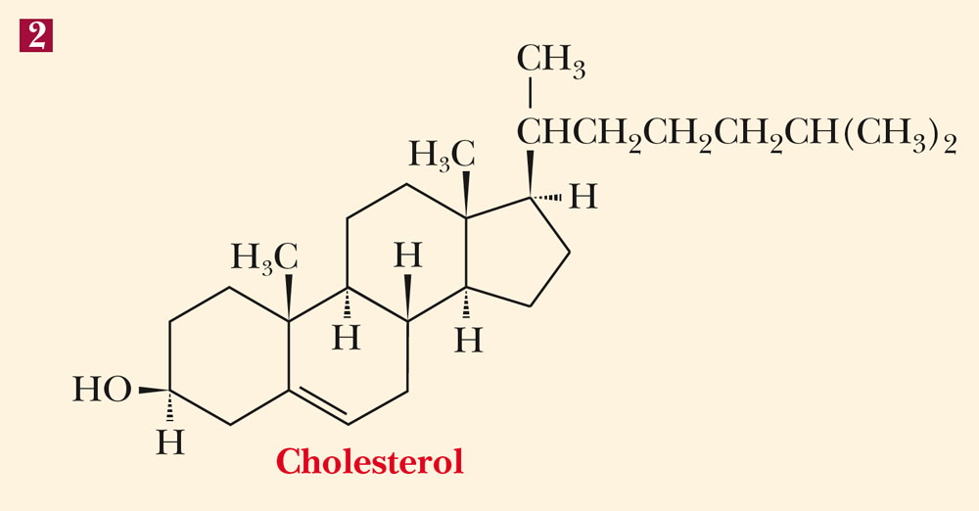
Cholesterol
The steroid of most interest in our discussion of biological membranes is cholesterol

Slide 13
Biological Membranes
Every cell has a cell membrane (plasma membrane)
Eukaryotic cells also have membrane-enclosed organelles (nuclei, mitochondria…etc)
Molecular basis of membrane structure is in lipid component(s):
polar head groups are in contact with the aqueous environment
nonpolar tails are buried within the bilayer
the major force driving the formation of lipid bilayers is hydrophobic interaction
the arrangement of hydrocarbon tails in the interior can be rigid (if rich in saturated fatty acids) or fluid (if rich in unsaturated fatty acids)

Slide 14
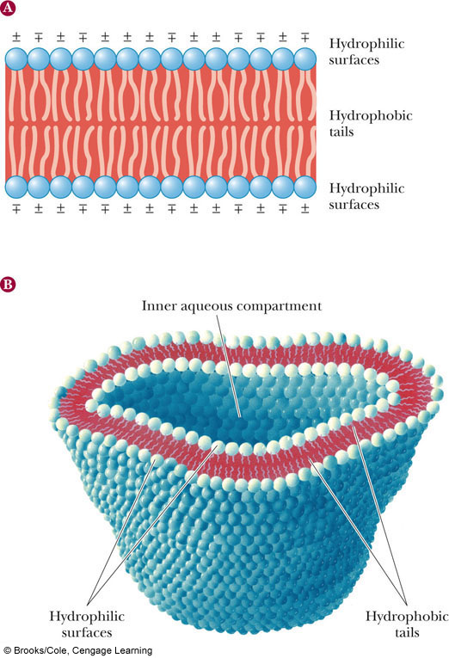
Lipid Bilayers
The polar surface of the bilayer contains charged groups
The hydrophobic tails lie in the interior of the bilayer

Slide 15
Biological Membranes
Plant membranes have a higher percentage of unsaturated fatty acids than animal membranes
The presence of cholesterol is characteristic of animal rather than plant membranes
Animal membranes are less fluid (more rigid) than plant membranes
The membranes of prokaryotes, which contain no appreciable amounts of steroids, are the most fluid

Slide 16
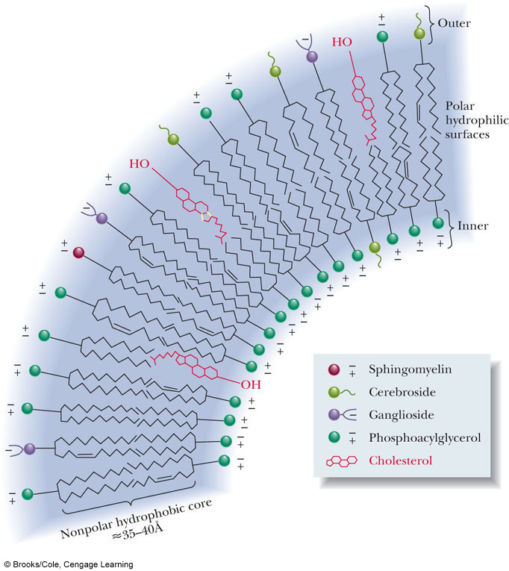
Membrane Layers
Both inner and outer layers of bilayer contain mixtures of lipids
Compositions on inside and outside of lipid bilayer can be different
This is what distinguishes the layers

Slide 17
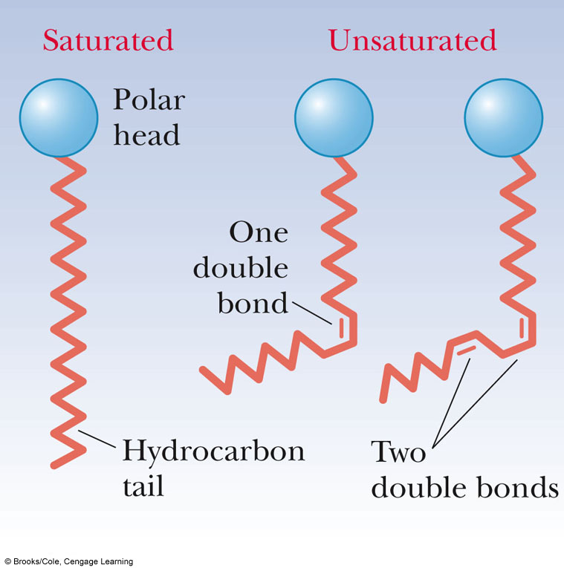
Effect of Double Bonds on the Conformations of Fatty Acids
Kink in hydrocarbon chain
Causes disorder in packing against other chains
This disorder causes greater fluidity in membranes with cis-double bonds vs...... saturated FA chains

Slide 18
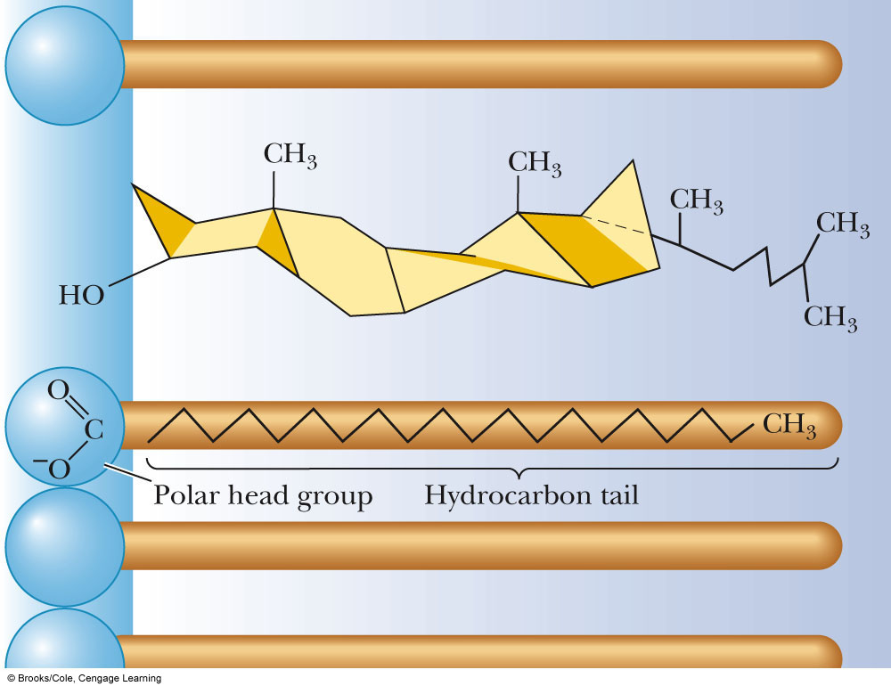
Cholesterol reduces Fluidity
Presence of cholesterol reduces fluidity by stabilizing extended chain conformations of hydrocarbon tails of FA
Due to hydrophobic interactions

Slide 19
Membrane Proteins
Functions: transport substances across membranes; act as receptor sites, and sites of enzyme catalysis
Peripheral proteins (Protein 3 in figure below)
bound by electrostatic interactions
can be removed by raising the ionic strength (Why?)
Integral proteins (Proteins 1, 2 and 4 in figure below)
bound tightly to the interior of the membrane
can be removed by treatment with detergents or ultrasonification
removal generally denatures them (Why?)

Slide 20
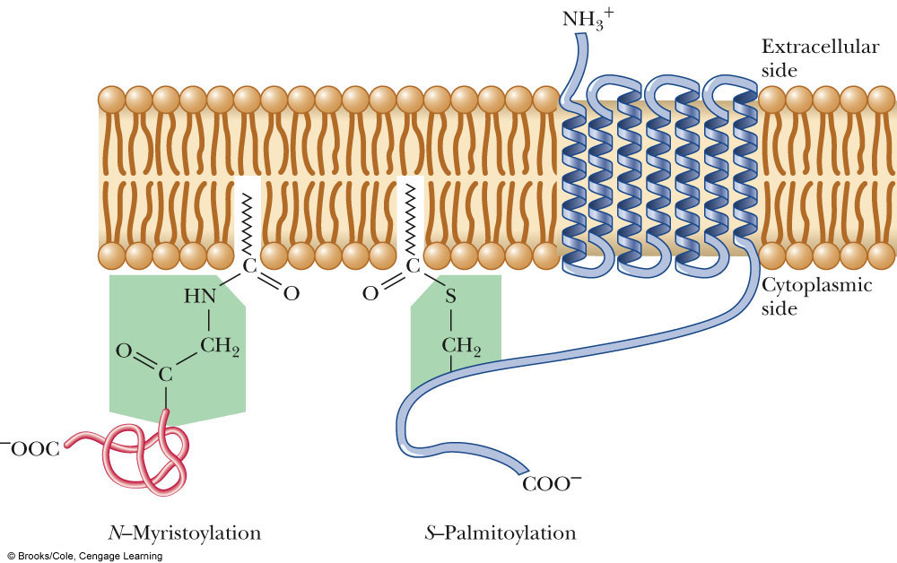
Proteins Can be Anchored to Membranes
N-myristoyl- and S-palmitoyl anchoring motifs
Anchors can be:
N-terminal Gly
Thioester linkage with Cys

Slide 21
Fluid Mosaic Model
Fluid: there is lateral motion of components in the membrane;
proteins, for example, “float” in the membrane and can move along its plane
Mosaic: components in the membrane exist side-by-side as separate entities
the structure is that of a lipid bilayer with proteins, glycolipids, and steroids such as cholesterol embedded in it
no complexes, as for example, lipid-protein complexes, are formed

Slide 22
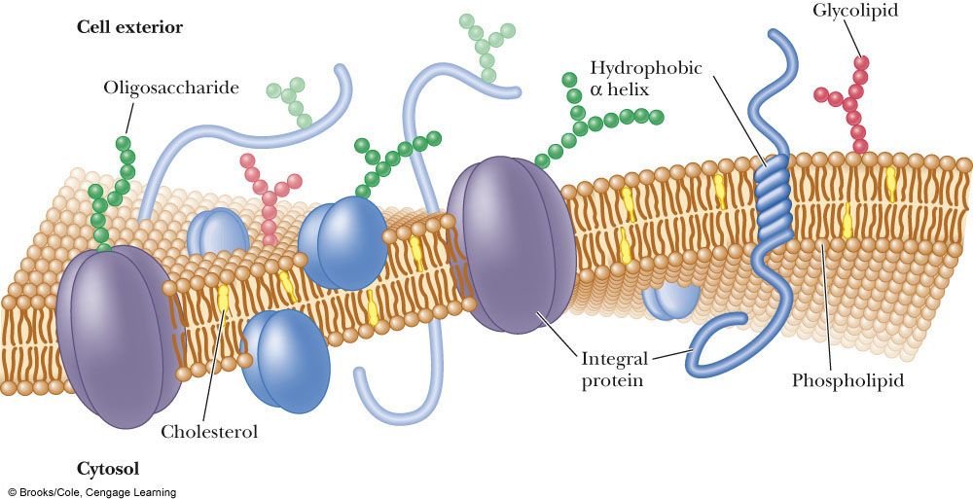
Fluid Mosaic Model of Membrane Structure
What benefits does this model provide to the cell?

Slide 23
Membrane Function: Membrane Transport
Passive transport
driven by a concentration gradient
simple diffusion: a molecule or ion moves through an opening
facilitated diffusion: a molecule or ion is carried across a membrane by a carrier/channel protein
Active transport
a substance is moved AGAINST a concentration gradient
primary active transport: transport is linked to the hydrolysis of ATP or other high-energy molecule; for example, the Na⁺/K⁺ ion pump
secondary active transport: driven by H⁺ gradient

Slide 24
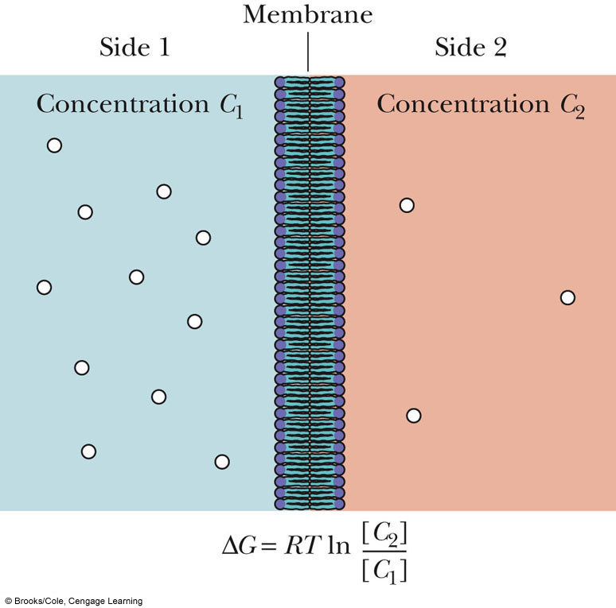
Passive Transport
Passive diffusion of species (uncharged) across membrane dependent on concentration and the presence of carrier protein

Slide 25
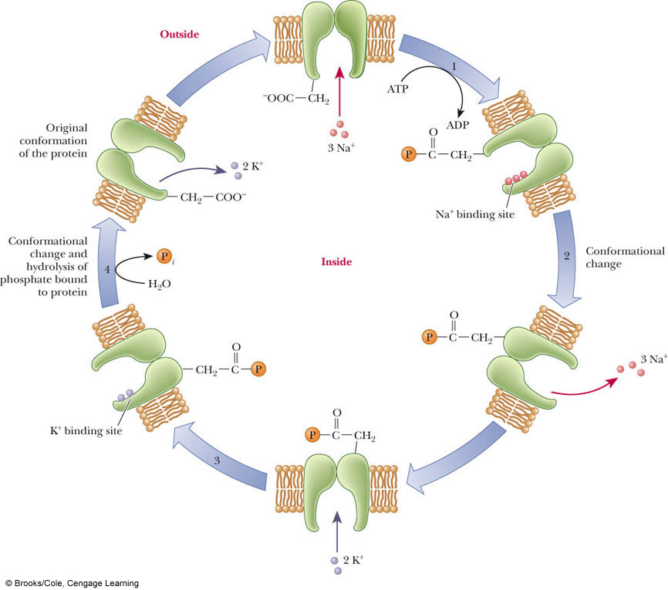
1˚ Active transport
Movement of molecules against a gradient directly linked to hydrolysis of high-energy yielding molecule (e.g. ATP)

Slide 26
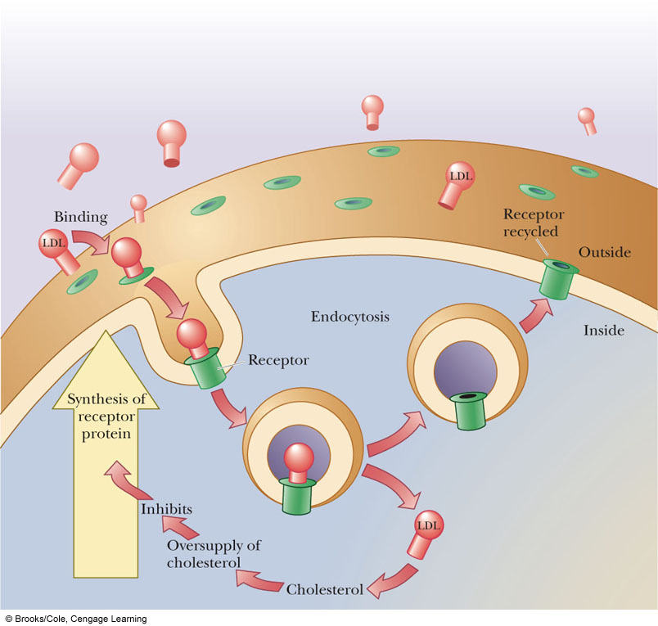
Membrane Receptors
Membrane receptors
generally oligomeric proteins
binding of a biologically active substance to a receptor initiates an action within the cell

