Slide 1
What is a Lipid
Lipids: a heterogeneous class of naturally occurring organic compounds classified together on the basis of common solubility properties
insoluble in water, but soluble in aprotic organic solvents including diethyl ether, chloroform, methylene chloride, and acetone
Amphipathic in nature
Lipids include:
Open Chain forms
fatty acids, triacylglycerols, sphingolipids, phosphoacylglycerols, glycolipids,
lipid-soluble vitamins
prostaglandins, leukotrienes, and thromboxanes
Cyclic forms
cholesterol, steroid hormones, and bile acids

Slide 2
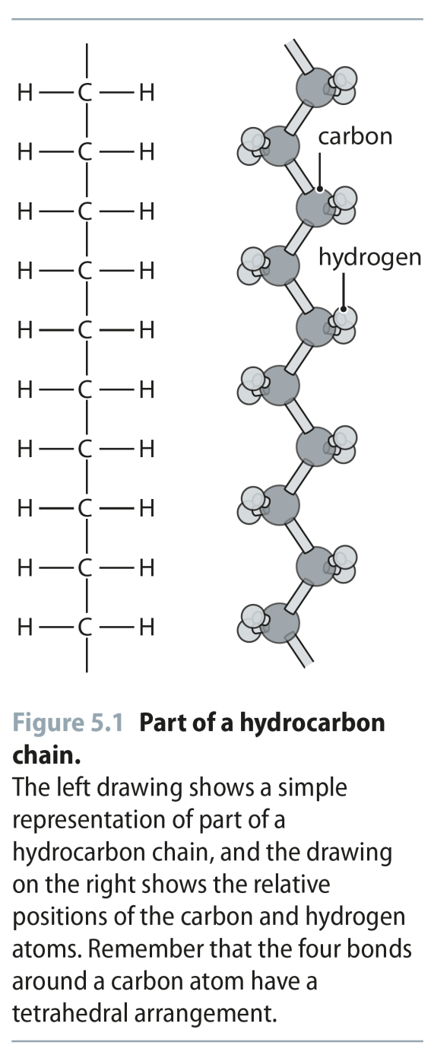
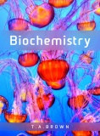
Fig 5.1
Reproduced from: Biochemistry by T.A. Brown, ISBN: 9781907904288 © Scion Publishing Ltd, 2017

Slide 3
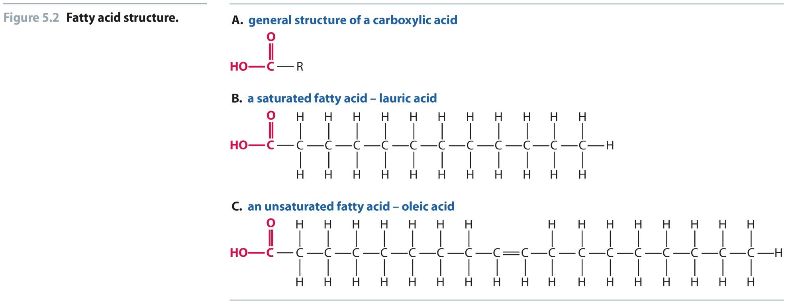
Fig 5.2
Reproduced from: Biochemistry by T.A. Brown, ISBN: 9781907904288 © Scion Publishing Ltd, 2017

Slide 4
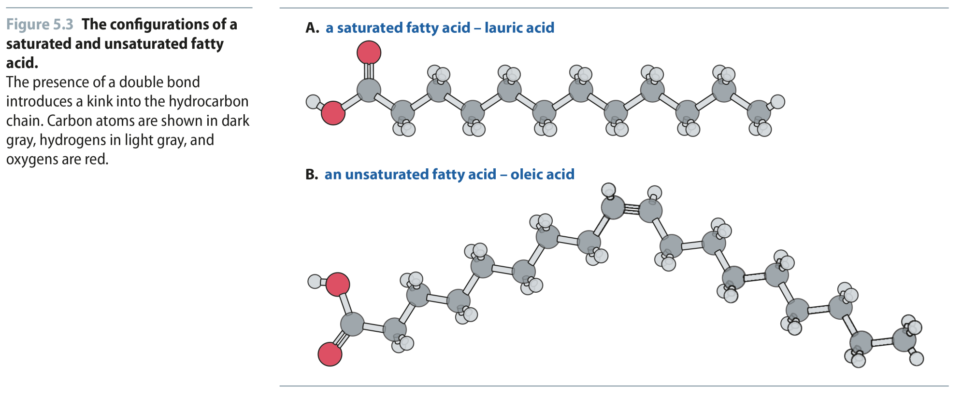
Fig 5.3
Reproduced from: Biochemistry by T.A. Brown, ISBN: 9781907904288 © Scion Publishing Ltd, 2017

Slide 5
Fig 5.4
Reproduced from: Biochemistry by T.A. Brown, ISBN: 9781907904288 © Scion Publishing Ltd, 2017

Slide 6
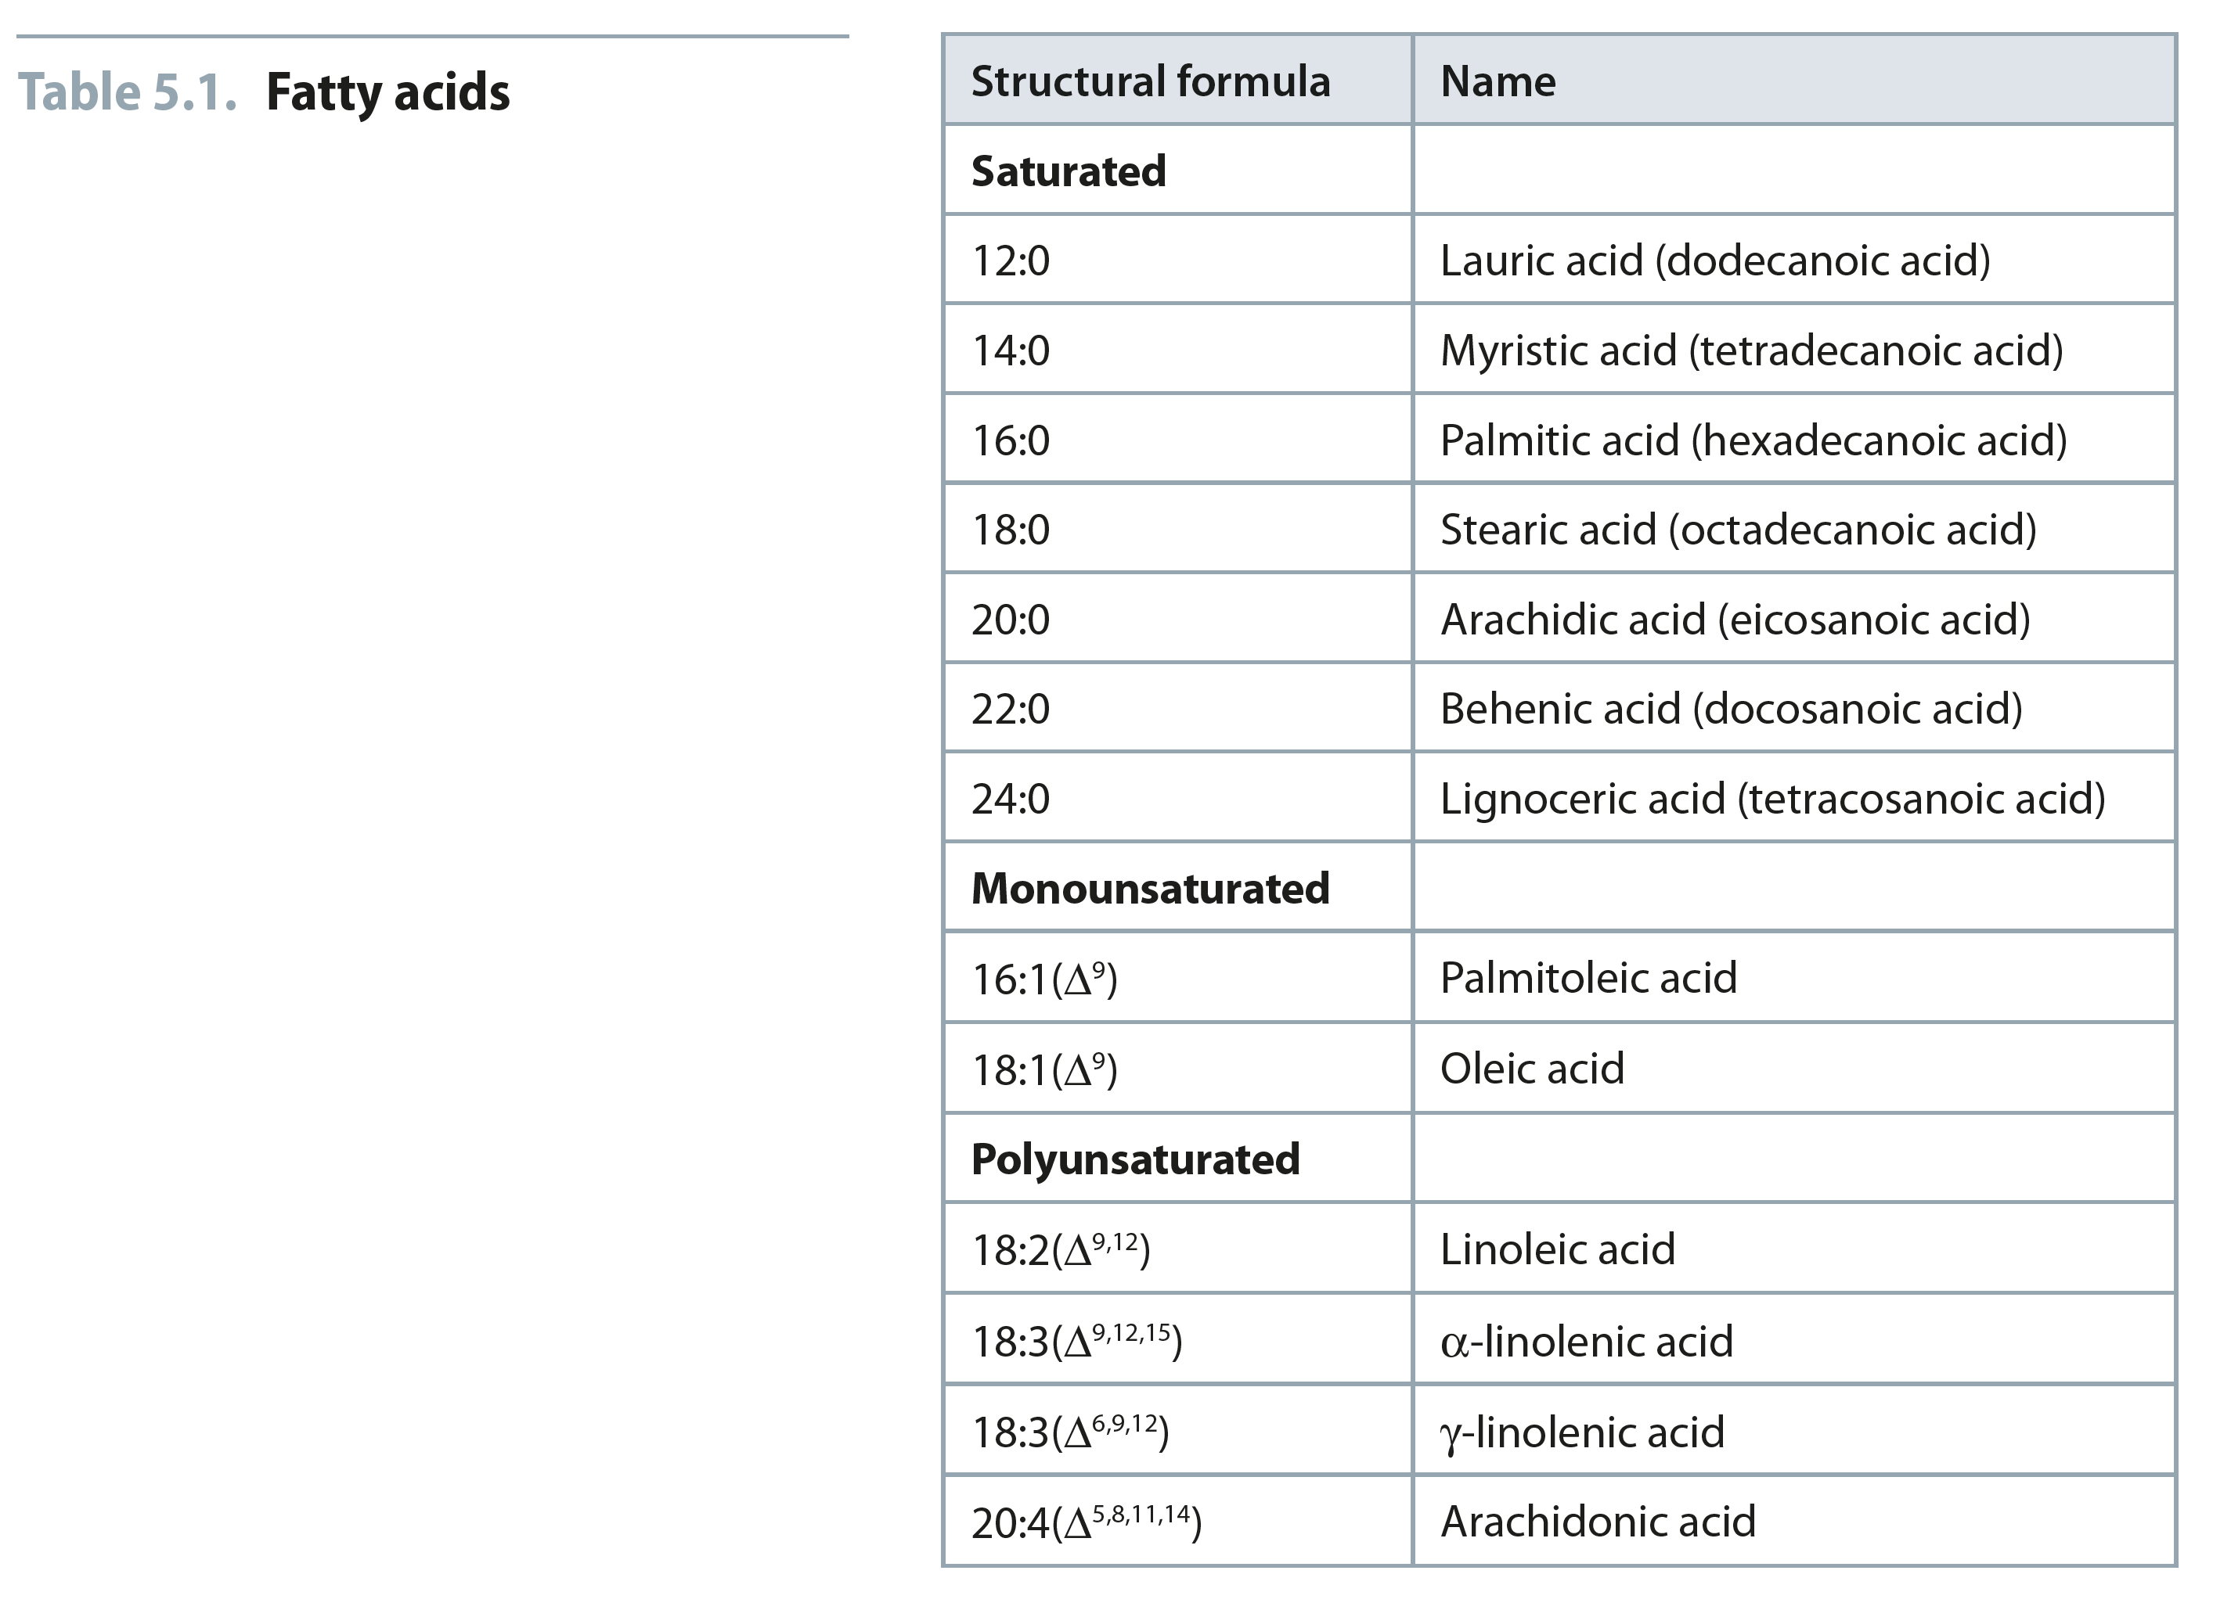
Table 5.1
Reproduced from: Biochemistry by T.A. Brown, ISBN: 9781907904288 © Scion Publishing Ltd, 2017

Slide 7
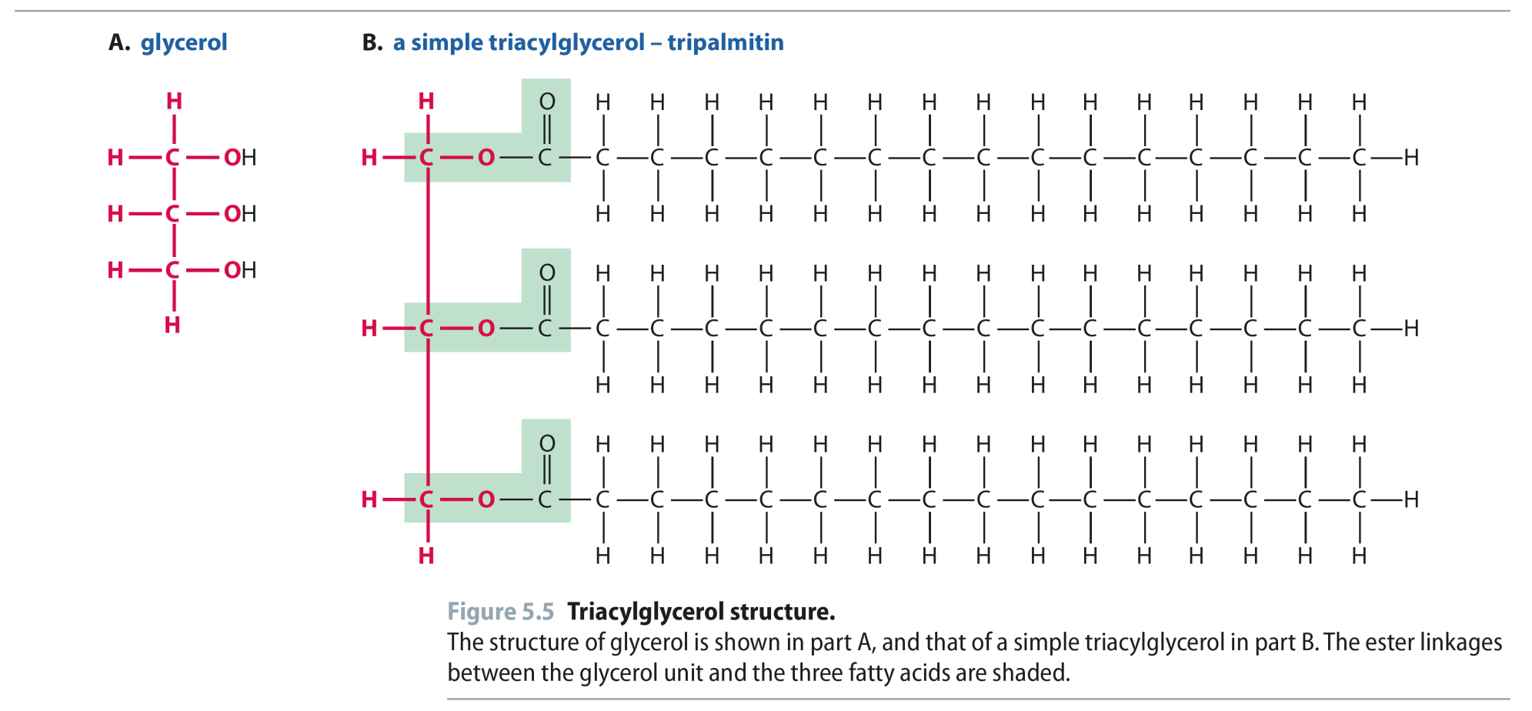
Fig 5.5
Reproduced from: Biochemistry by T.A. Brown, ISBN: 9781907904288 © Scion Publishing Ltd, 2017

Slide 8
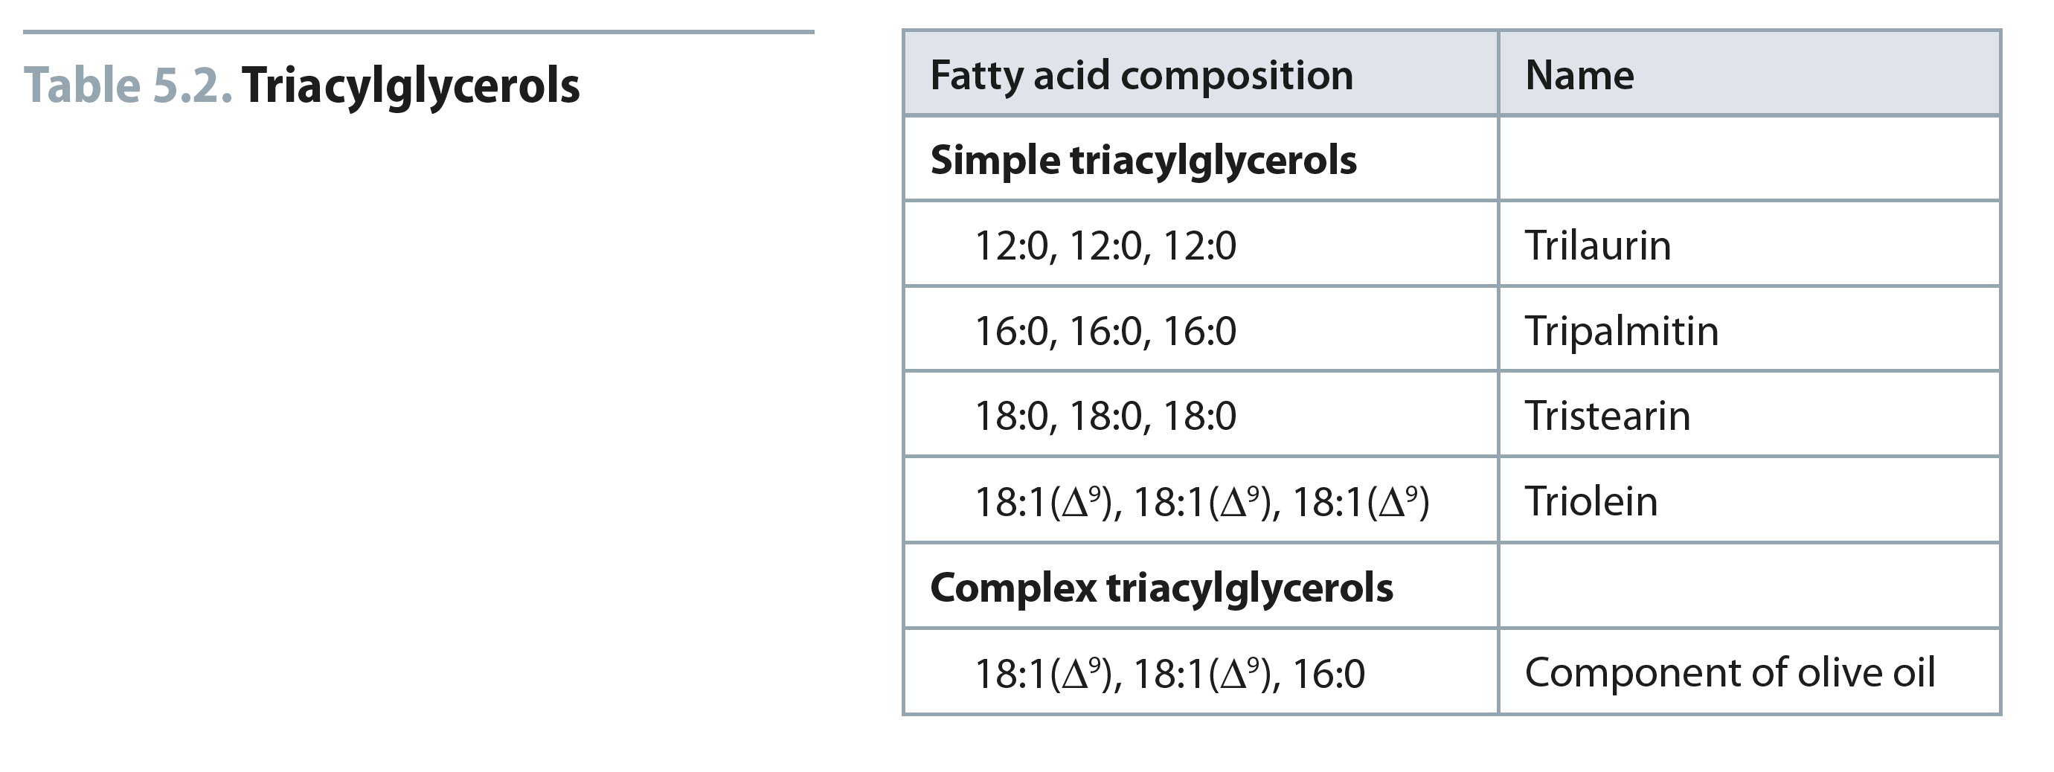
Table 5.2
Reproduced from: Biochemistry by T.A. Brown, ISBN: 9781907904288 © Scion Publishing Ltd, 2017

Slide 9
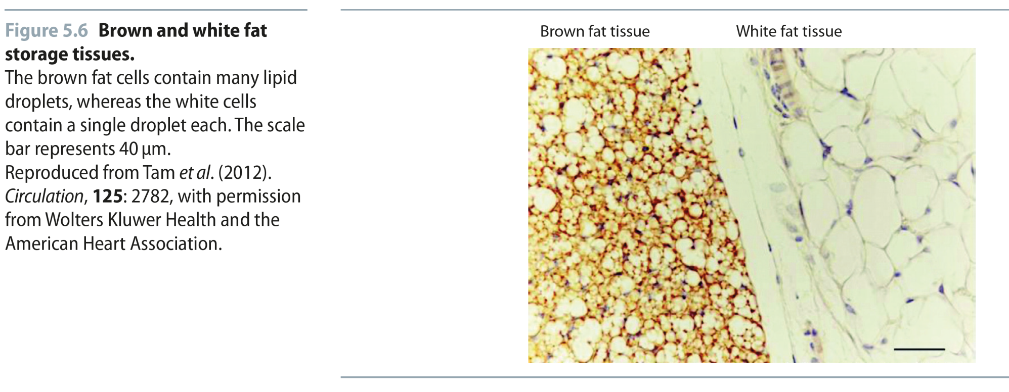
Fig 5.6
Reproduced from: Biochemistry by T.A. Brown, ISBN: 9781907904288 © Scion Publishing Ltd, 2017

Slide 10
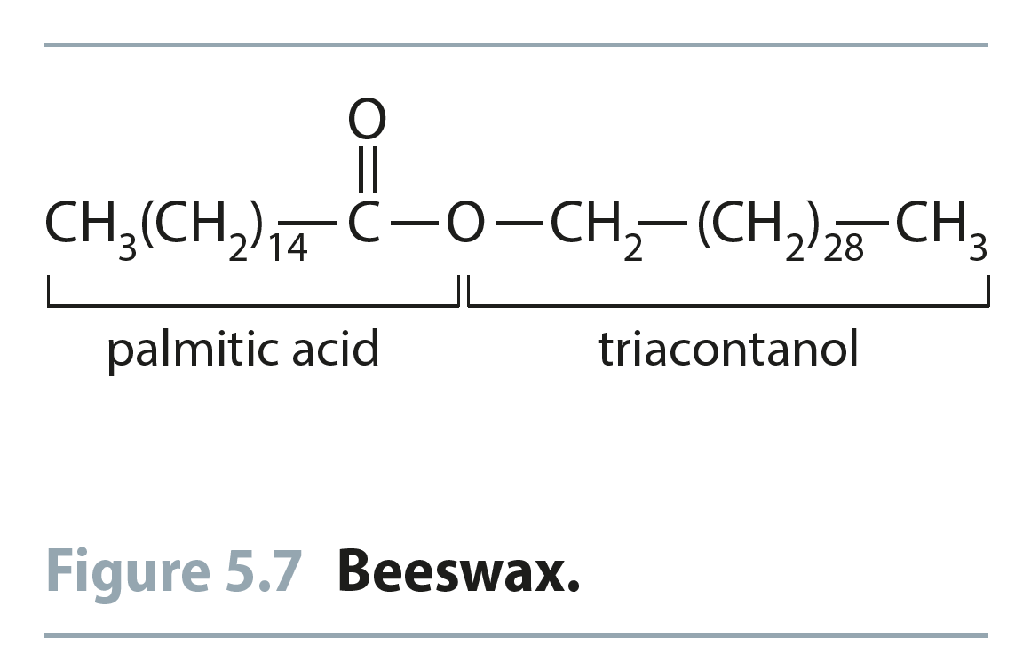
Fig 5.7
Reproduced from: Biochemistry by T.A. Brown, ISBN: 9781907904288 © Scion Publishing Ltd, 2017

Slide 11
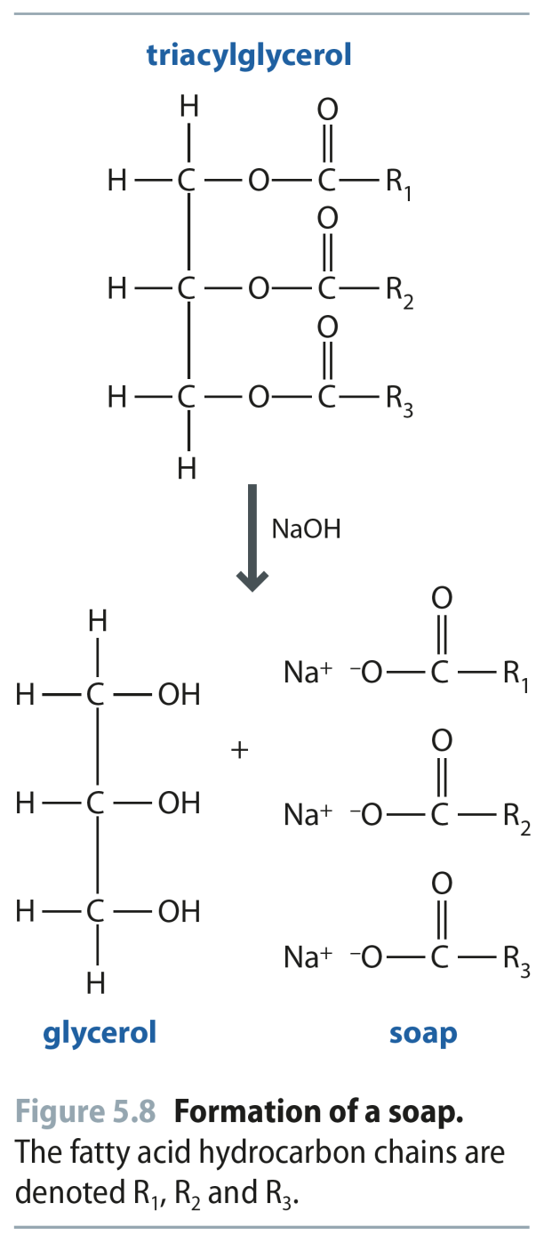
Fig 5.8
Reproduced from: Biochemistry by T.A. Brown, ISBN: 9781907904288 © Scion Publishing Ltd, 2017

Slide 12
Fig 5.9
Reproduced from: Biochemistry by T.A. Brown, ISBN: 9781907904288 © Scion Publishing Ltd, 2017

Slide 13
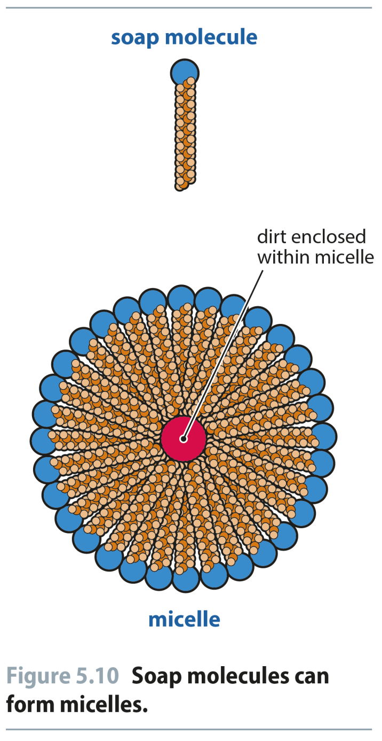
Fig 5.10
Reproduced from: Biochemistry by T.A. Brown, ISBN: 9781907904288 © Scion Publishing Ltd, 2017

Slide 14
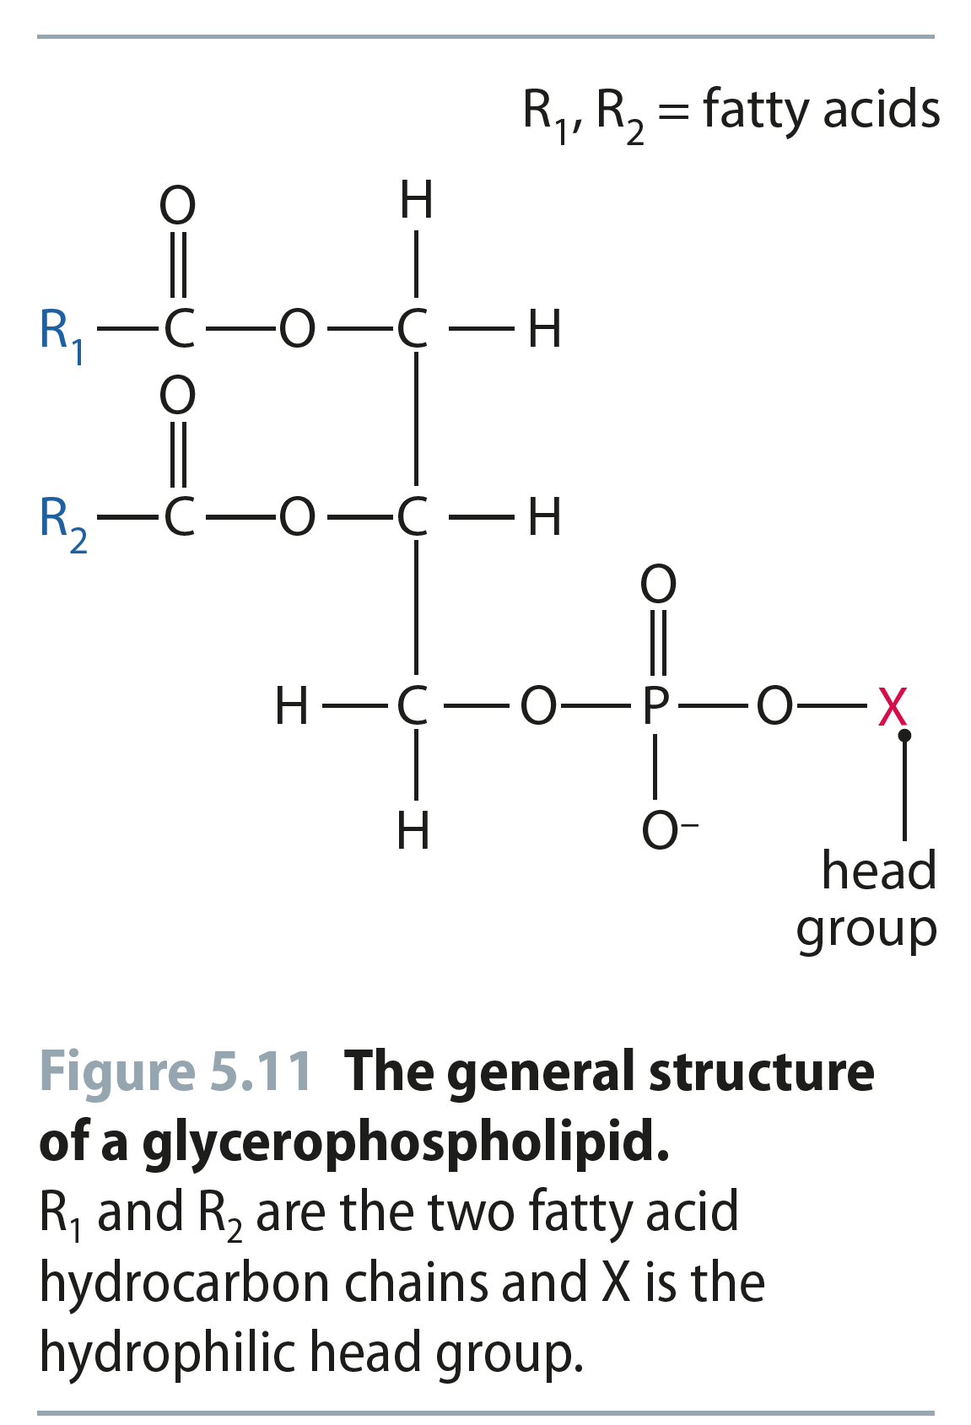
Fig 5.11
Reproduced from: Biochemistry by T.A. Brown, ISBN: 9781907904288 © Scion Publishing Ltd, 2017

Slide 15
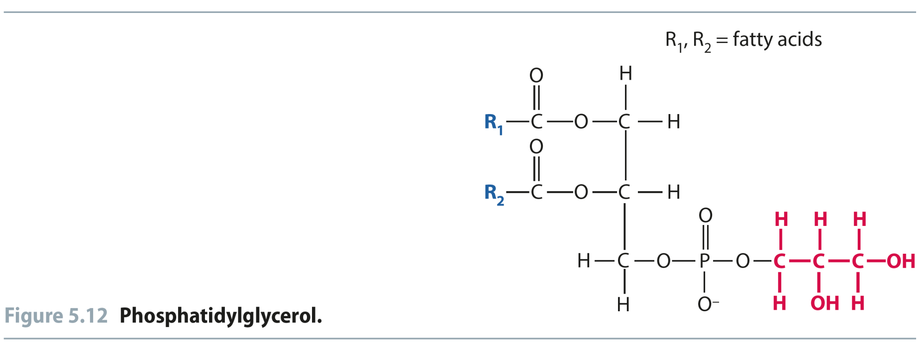
Phosphoacylglycerols (Phospholipids)
When one alcohol group of glycerol is esterified by a phosphoric acid rather than by a carboxylic acid, phosphatidic acid produced
Phosphoacylglycerols (phosphoglycerides) are the second most abundant group of naturally occurring lipids, and they are found in plant and animal membranes

Slide 16
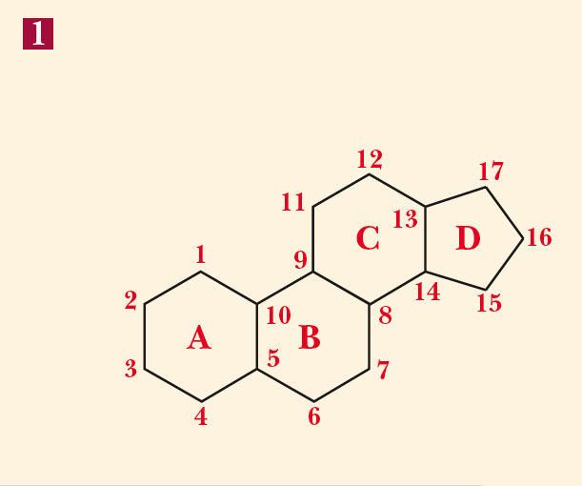
Steroids
Steroids: a group of lipids that have fused-ring structure of 3 six-membered rings, and 1 five-membered ring.

Slide 17
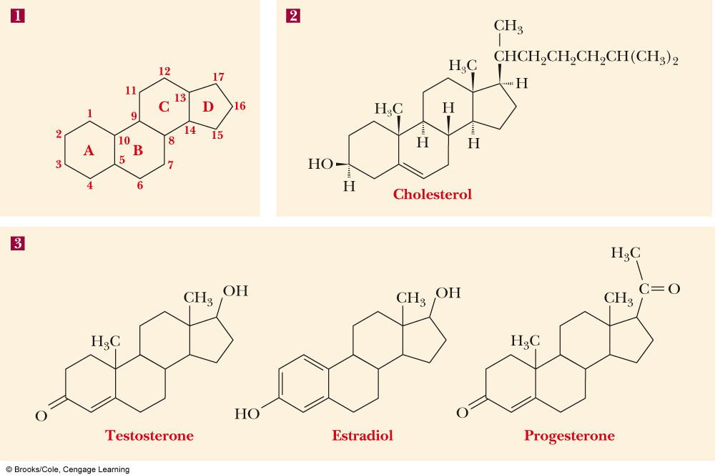
Steroids

Slide 18
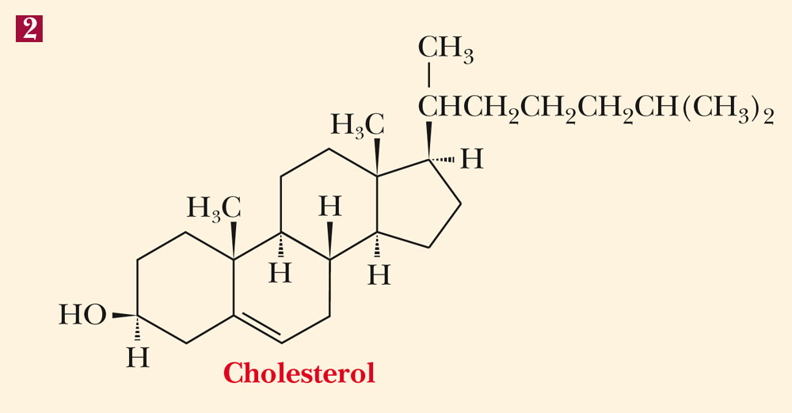
Cholesterol
The steroid of most interest in our discussion of biological membranes is cholesterol

Slide 19
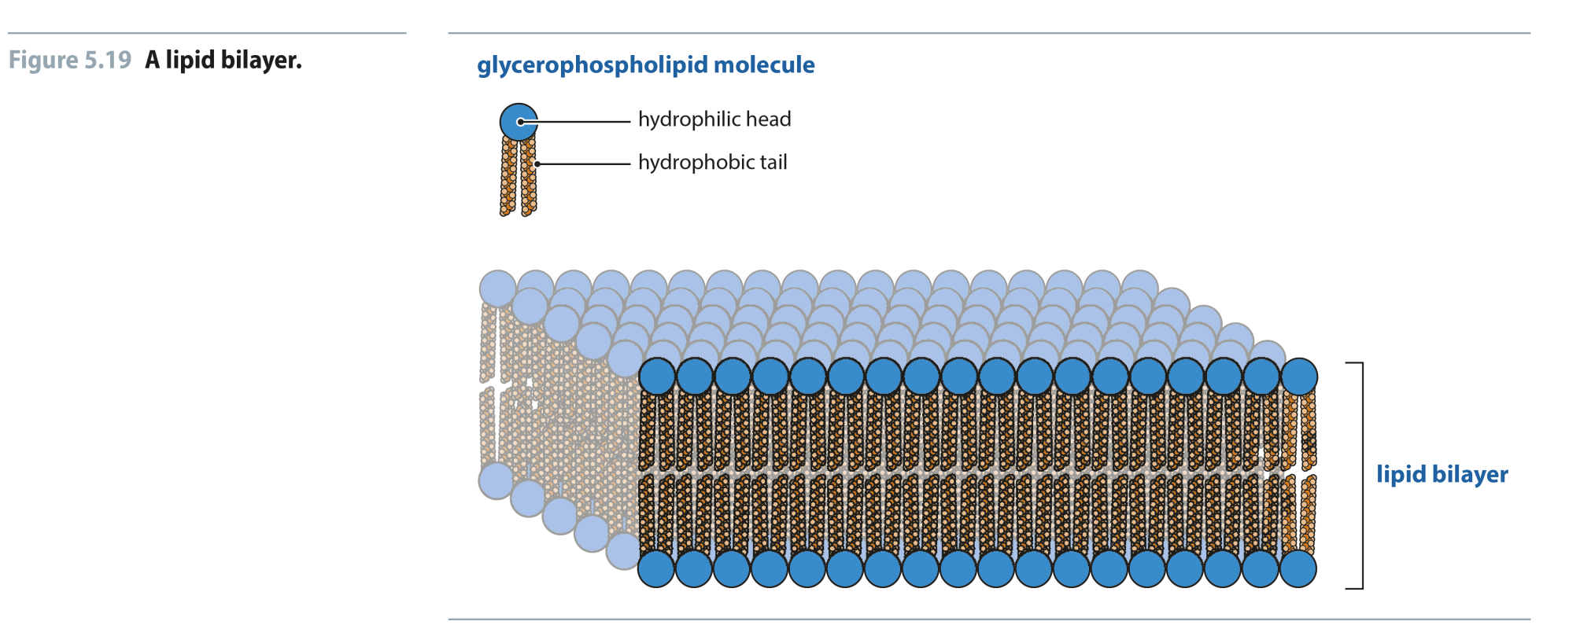
Fig 5.19
Reproduced from: Biochemistry by T.A. Brown, ISBN: 9781907904288 © Scion Publishing Ltd, 2017

Slide 20
Fig 5.20
Reproduced from: Biochemistry by T.A. Brown, ISBN: 9781907904288 © Scion Publishing Ltd, 2017

Slide 21
Biological Membranes
Every cell has a cell membrane (plasma membrane)
Eukaryotic cells also have membrane-enclosed organelles (nuclei, mitochondria…etc)
Molecular basis of membrane structure is in lipid component(s):
polar head groups are in contact with the aqueous environment
nonpolar tails are buried within the bilayer
the major force driving the formation of lipid bilayers is hydrophobic interaction
the arrangement of hydrocarbon tails in the interior can be rigid (if rich in saturated fatty acids) or fluid (if rich in unsaturated fatty acids)

Slide 22
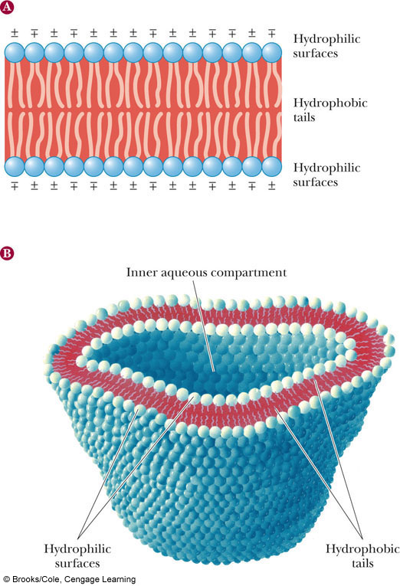
Lipid Bilayers
The polar surface of the bilayer contains charged groups
The hydrophobic tails lie in the interior of the bilayer

Slide 23
Biological Membranes
Plant membranes have a higher percentage of unsaturated fatty acids than animal membranes
The presence of cholesterol is characteristic of animal rather than plant membranes
Animal membranes are less fluid (more rigid) than plant membranes
The membranes of prokaryotes, which contain no appreciable amounts of steroids, are the most fluid

Slide 24
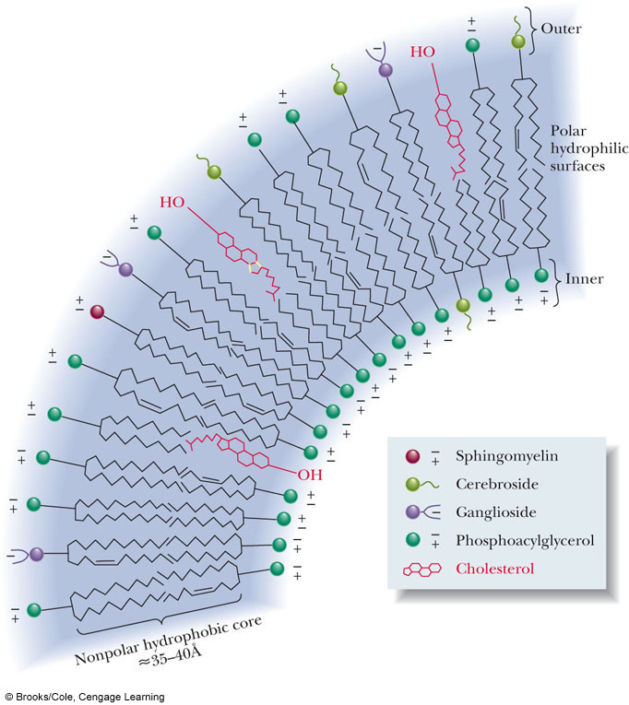
Membrane Layers
Both inner and outer layers of bilayer contain mixtures of lipids
Compositions on inside and outside of lipid bilayer can be different
This is what distinguishes the layers

Slide 25
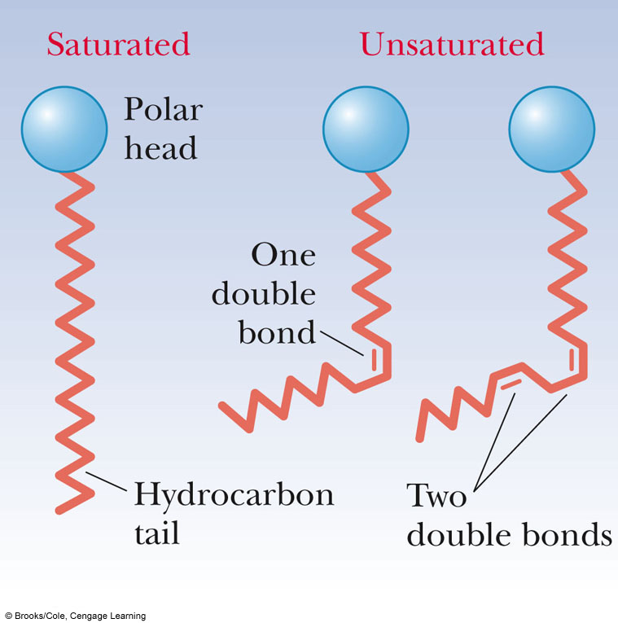
Effect of Double Bonds on the Conformations of Fatty Acids
Kink in hydrocarbon chain
Causes disorder in packing against other chains
This disorder causes greater fluidity in membranes with cis-double bonds vs...... saturated FA chains

Slide 26
Fig 5.22
Reproduced from: Biochemistry by T.A. Brown, ISBN: 9781907904288 © Scion Publishing Ltd, 2017

Slide 27
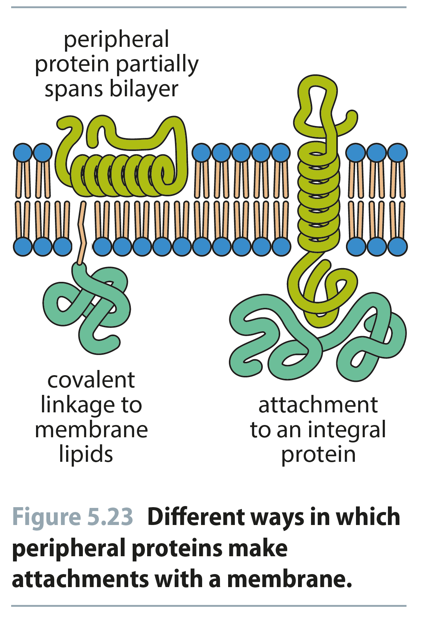
Fig 5.23
Reproduced from: Biochemistry by T.A. Brown, ISBN: 9781907904288 © Scion Publishing Ltd, 2017

Slide 28
Fig 5.24
Reproduced from: Biochemistry by T.A. Brown, ISBN: 9781907904288 © Scion Publishing Ltd, 2017

Slide 29
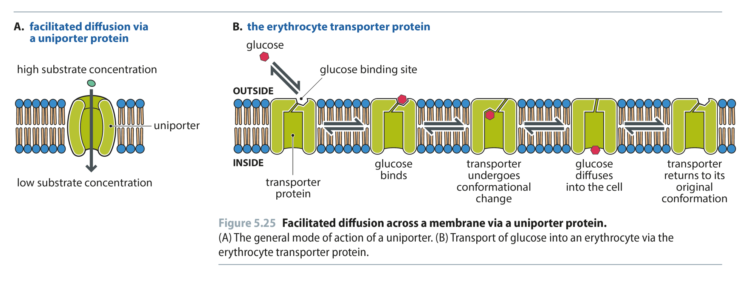
Fig 5.25
Reproduced from: Biochemistry by T.A. Brown, ISBN: 9781907904288 © Scion Publishing Ltd, 2017

Slide 30
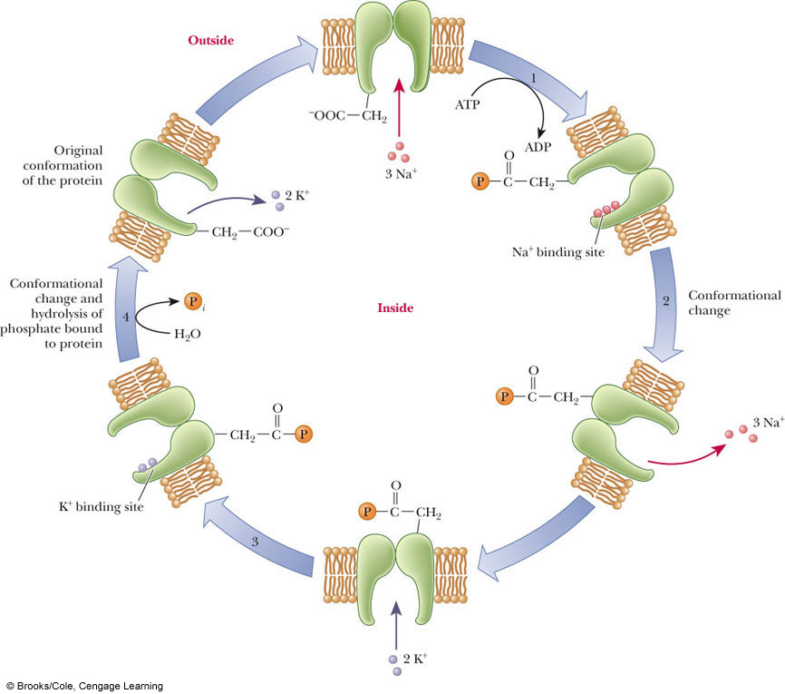
1˚ Active transport
Movement of molecules against a gradient directly linked to hydrolysis of high-energy yielding molecule (e.g. ATP)

Slide 31
Table 5.5
Reproduced from: Biochemistry by T.A. Brown, ISBN: 9781907904288 © Scion Publishing Ltd, 2017

Slide 32
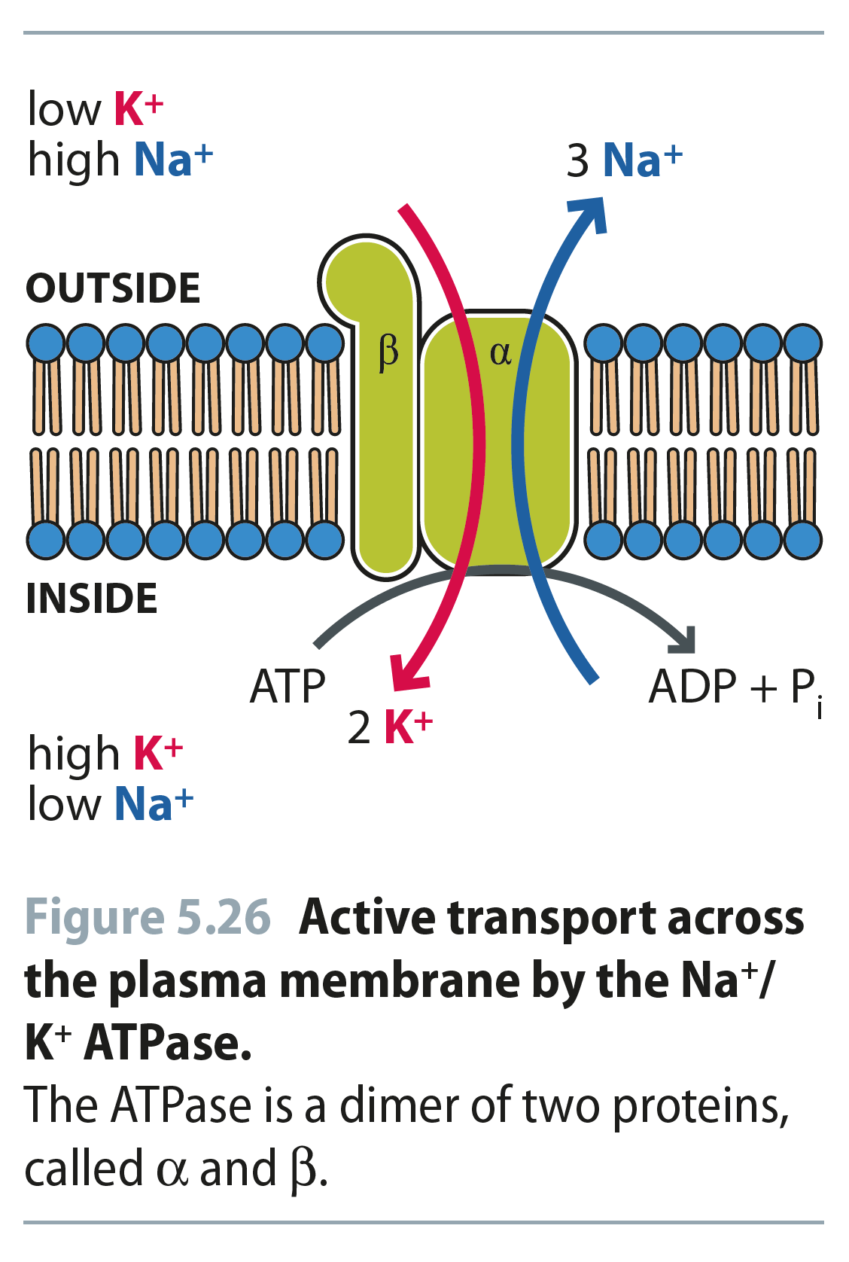
Fig 5.26
Reproduced from: Biochemistry by T.A. Brown, ISBN: 9781907904288 © Scion Publishing Ltd, 2017

Slide 33
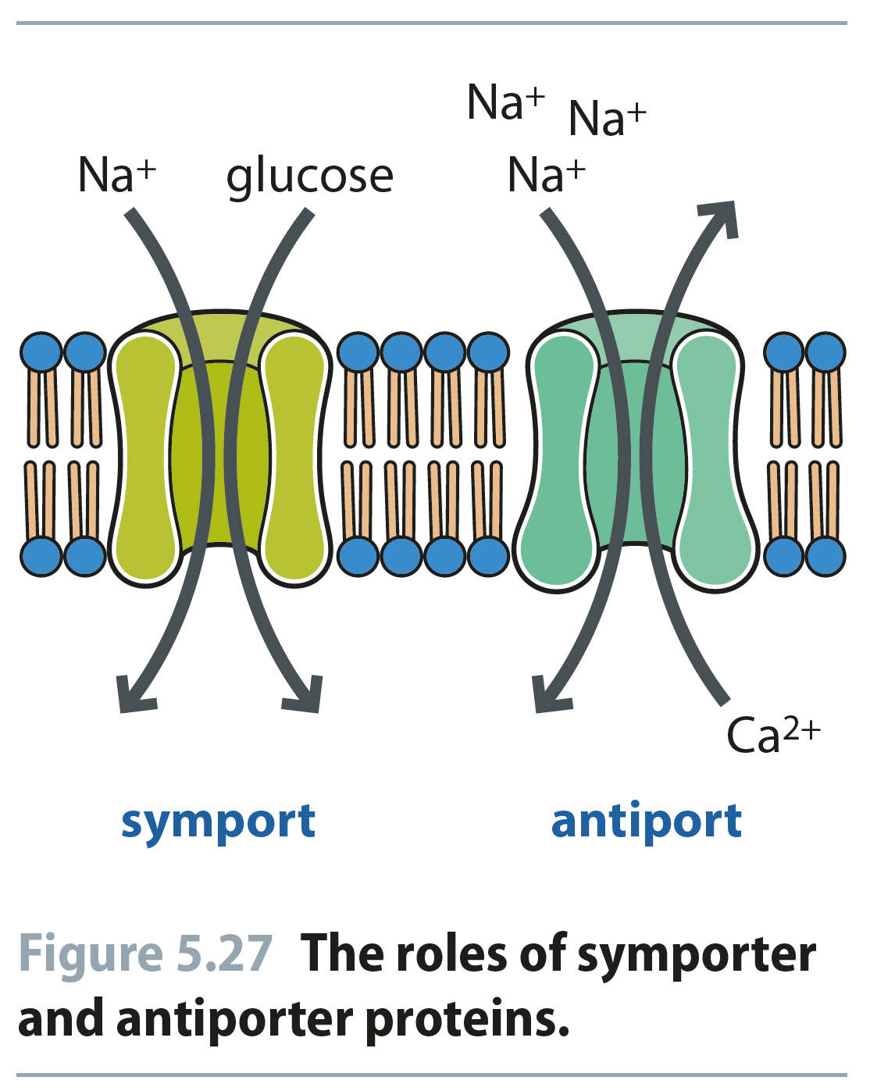
Fig 5.27
Reproduced from: Biochemistry by T.A. Brown, ISBN: 9781907904288 © Scion Publishing Ltd, 2017

