Slide 1
The Michaelis-Menton Model
For non-allosteric enzymes, the most widely used kinetic model is based upon work done by Leonor Michaelis and Maud Menton
For a given enzyme-catalyzed reaction:
Substrate --> Product
k₁
k₂
E
+
S
ES
E
+
P
k₋₁
Note: There is no appreciable back reaction of Product to substrate!

Slide 2
k₁
k₂
E
+
S
ES
E
+
P
k₋₁
k₁ = Rate constant for the Formation of the enzyme/substrate complex
k₋₁ = Rate constant for the Dissociation of the enzyme/substrate complex
k₂ = Rate constant for the formation of product and its release
The enzyme is specifically (or explicitly) described in the mechanism
This means it appears in the rate equation

Slide 3
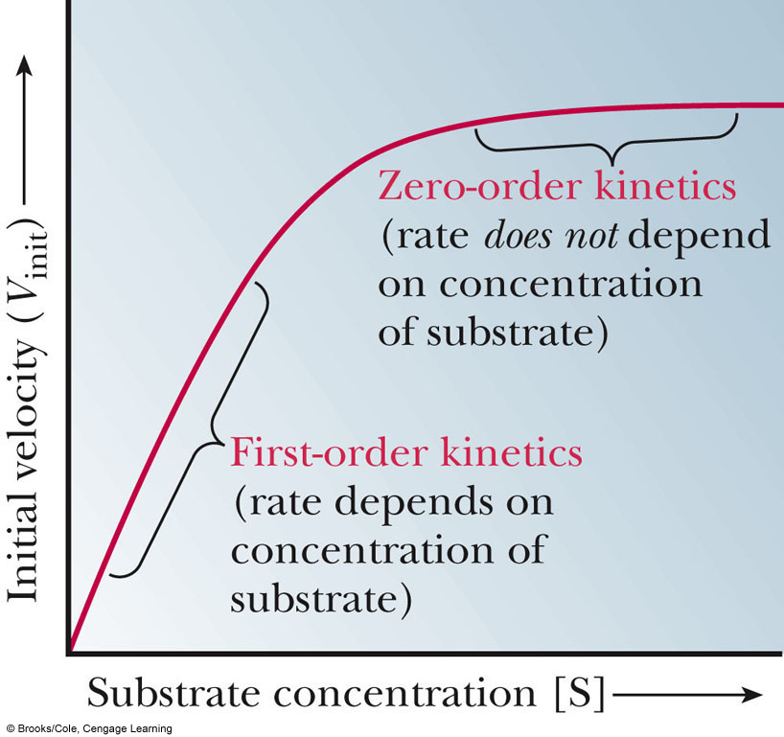
When we carry out an experiment to characterize the kinetics of an enzyme, we do so at several concentrations of substrate
We want to mix the solution and then immediately measure the initial velocity (V₀)
Why?
The [P] is low, so we do not have to be concerned with the back-conversion of product to substrate
We plot V₀ versus the [S]

Slide 4
We can see two distinct portions in the curve:
First Order Kinetics:
Increasing [S] yields an increased V₀
Zero Order Kientics:
The enzyme molecules are saturated with substrate and increasing [S] does not yield an increased V₀
Two useful terms can be extracted from this plot:
V_{m} or V_{max}: The maximum velocity of the enzyme (where do we find it?)
K_{m}: The concentration of substrate that gives (1/2)V_{m}

Slide 5
Deriving K_{m} and the Steady State Assumption
k₁
k₂
E
+
S
ES
E
+
P
k₋₁
In the first step of the reaction, 2 competing processes are taking place.
Rate of Formation of ES:
Rate of Breakdown of ES:
Note: The conversion of ES --> E+P pulls ES out of the pool, so we have to include it in the breakdown rate!

Slide 6
The Steady State Assumption
When we measure the velocity of a reaction, there is no product present in the solution during the initial time periods
This means that E+P --> ES does not occur
We also know that enzymes are very efficient, so during the initial time periods, the lifetime of the ES complex is VERY short
Based upon these two facts, we can assume that within milliseconds (or microseconds or less), the reaction will reach a Steady State in which the rate of ES formation equals the rate of ES breakdown.
This is the Steady State Assumption

Slide 7
K_{m} and the Steady State Assumption
From the steady state assumption
What is [E]? (We know [S] from the experiment?)
At any given moment in the reaction, the amount of free enzyme is:
[E] = [E_{T}] - [ES]
Plug this into the equation:

Slide 8
The Michaelis-Menton Equation
With the Michaelis-Menton equation, we can relate the observed enzymatic velocity at any substrate concentration to the value of V_{m}
This allows us to analyze enzymes and:
Identify differences in enzymatic function between species
Compare the same enzyme from different tissues of the same organism
Analyze the efficiency of newly discovered enzymes
Identify the effect of mutations on enzymatic function

Slide 9
Working with / Thinking about the Michaelis-Menton Equation
If [S] >>> K_{m}, what does V₀ equal?
If [S] = K_{m}, what does V₀ equal?

Slide 10
Working with Real Data to Calculate K_{m} and V_{m}
Using V₀ vs. [S] plots to calculate V_{m} and K_{m} can be difficult and inaccurate because of the asymptotic nature of the plot
Two scientists, Hans Lineweaver and Dean Burk, realized that if you plotted the reciprocal of the Michaelis-Menton equation, you’d get a straight line:
This has the form: y = mx + b

Slide 11
Lineweaver-Burk Plots
This has the form of a linear equation: y = mx + b
If we plot the data as 1/V₀ vs 1/[S]:
The slope = ?
The y-intercept = ? (This occurs when 1/[S] = ?)
The x-intercept = ? (This occurs when 1/V₀ = ?)
This is the common method to analyze non-allosteric Enzymological Data

Slide 12
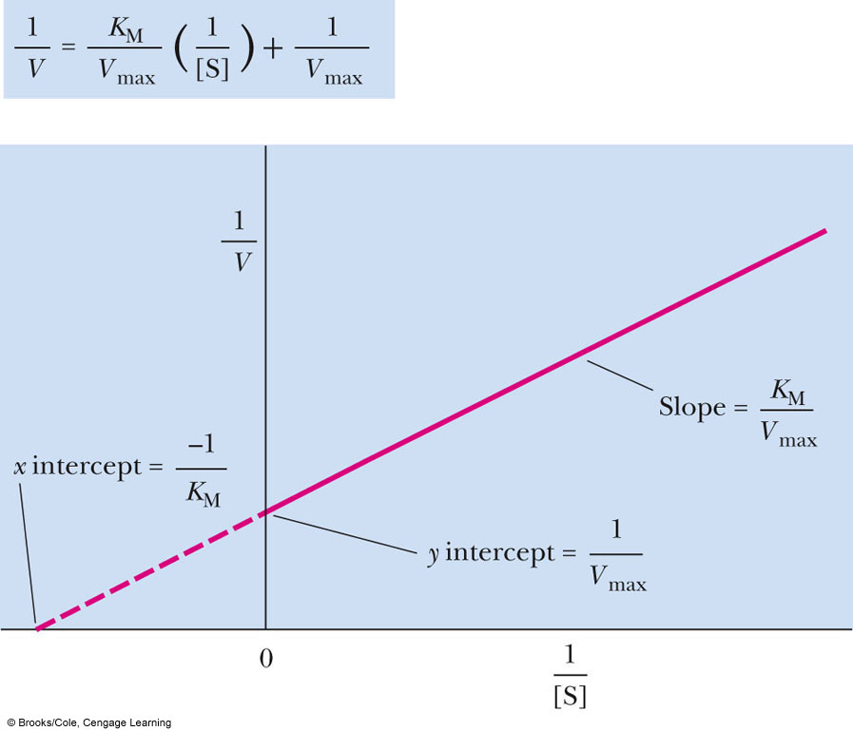

Slide 13
What do K_{m} and V_{m} Really mean?
We know that V₀=V_{m}/2 when [S] = K_{m}
We can use this to say that when [S] = Km, 50% of the active sites of the population of enzymes are occupied
If an enzyme has a low K_{m}, the enzyme achieves maximum efficiency at low [S]
K_{m} is unique for each and every enzyme-substrate pair
Some enzymes catalyze reactions that utilize 2 substrates:
E + A EA + B EAB E + P + Q
There is a unique K_{m} value for A and one for B

Slide 14
Thinking about K_{m}
As long as k₂ << k₋₁ , the Km can be viewed as a measure of the affinity of the enzyme for the substrate
If k₋₁ is high, what does that tell you?
The Km value is also a function of pH and temperature.
Why?

Slide 15
Enzyme Inhibition
An inhibitor of an enzyme slows the V₀ by sequestering enzyme molecules from the reaction pathway
We will be concerned with 3 types of Reversible Inhibitors: Competitive, Noncompetitive and Uncompetitive

Slide 16
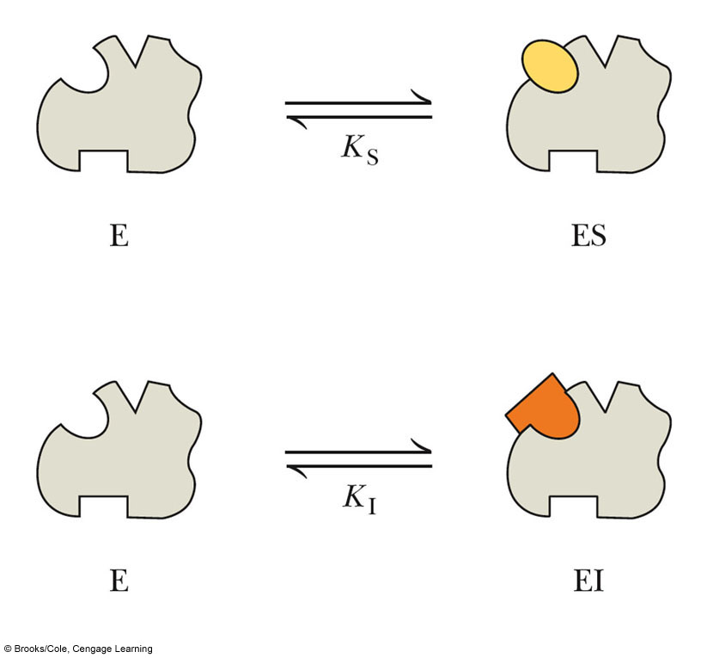
Competitive Inhibition
The simplest kind of inhibition and the easiest to understand:
The Inhibitor COMPETES for the active site with the substrate

Slide 17
Competitve Inhibition
In this process, we can visualize the role of the inhibitor on the reaction pathway as:
EI
I
+
E
+
S
ES
P
We can write a dissociation constant, K_{I} for the EI complex
+
[E][I]
EI
I
E
K
=
I
[EI]

Slide 18
Competitive Inhibition
The removal of a certain fraction of the free enzyme molecules from the reaction pool scales the apparent K_{m} value down
The scaling factor for the K_{m} value in competitive inhibition is called α

Slide 19
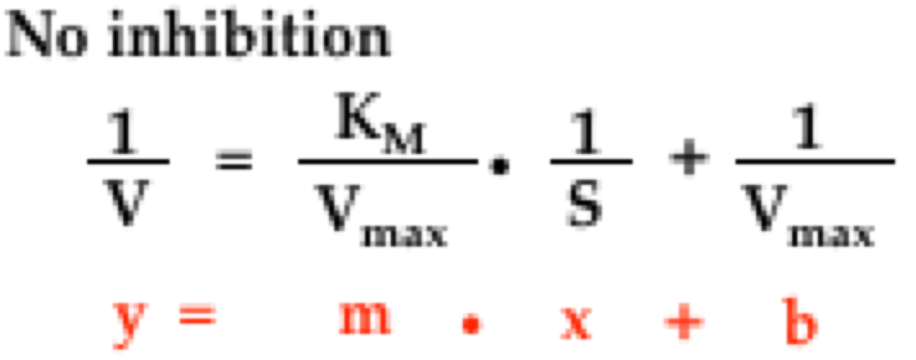
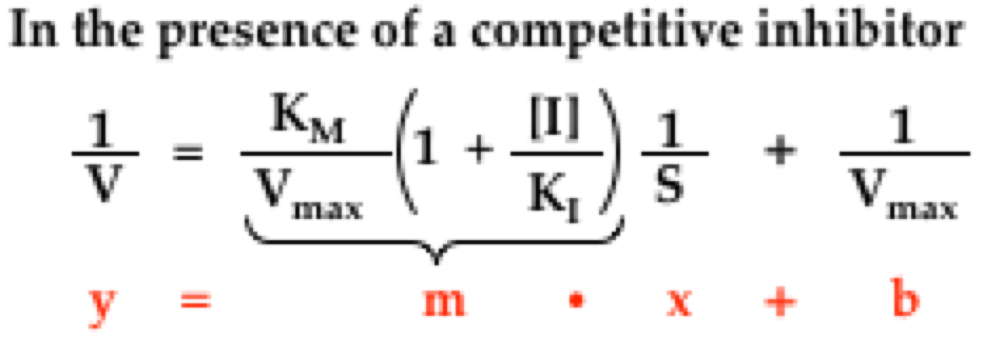
Competitive Inhibition
By plugging αK_{m} into the uninhibited equation, we get the modified Lineweaver-Burk equation for a competitive inhibitor

Slide 20
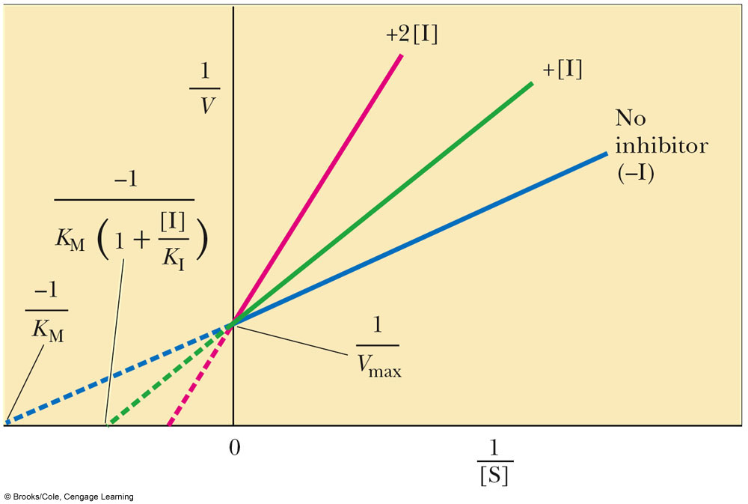
Graphically Evaluating Competitive Inhibition
Note: In a competitively inhibited reaction, the slope term changes, but the y-intercept term doesn’t (V_{max} remains the same)
V_{max} is a measure of V₀ when [S] ≈ ∞
The x-intercept also changes!

Slide 21
Overcoming Competitive Inhibition
By flooding the reaction mixture with substrate, we can overcome Competitive Inhibition
Why?
This is the basis for treating methanol and ethylene glycol poisoning: Give the patient ethanol!
In the liver, the enzyme responsible for oxidizing alcohols is Alcohol Dehydrogenase
The enzyme converts alcohols to aldehydes
Methanol is converted to formaldehyde which can cause blindness or death
By administering ethanol, the methanol outcompeted for the active site of ADH and is instead excreted in the urine

Slide 22
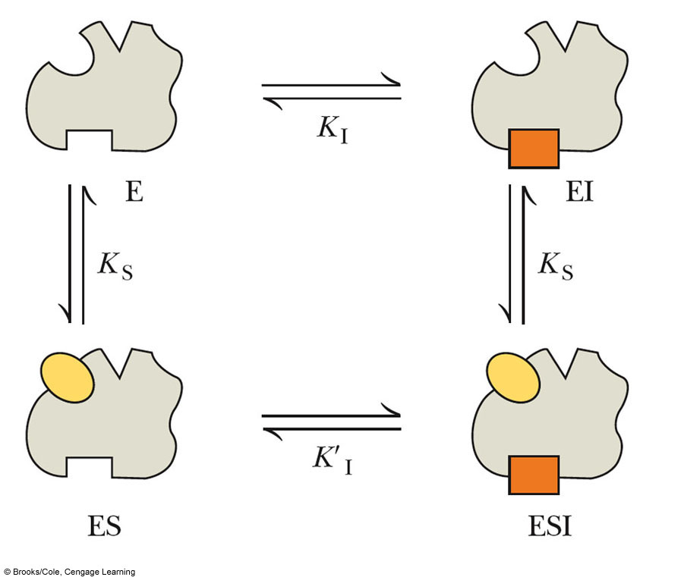
Noncompetitive Inhibition
Also known as mixed inhibition
A noncompetitive can bind to the free enzyme OR the enzyme/substrate complex
Noncompetitive inhibitors bind to sites in enzymes that participate in both substrate binding AND catalysis
Metal ions are frequently noncompetitive inhibitors

Slide 23
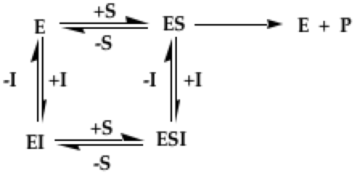
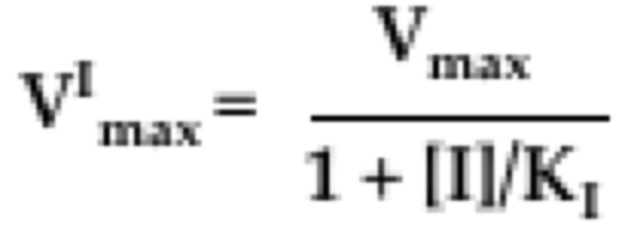
Noncompetitive Inhibition
Several equilibria are involved:
The maximum velocity V_{max} has the form:

Slide 24
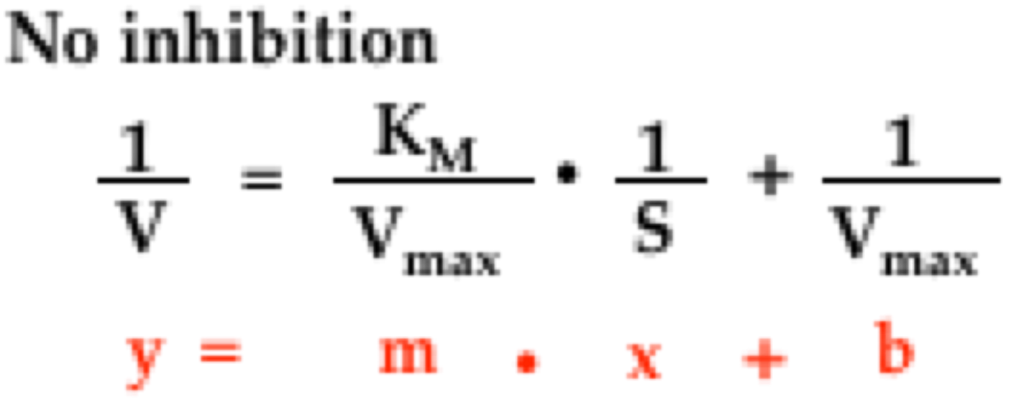
Lineweaver-Burk Plots and Noncompetitive Inhibition
Because the inhibitor does not interfere with the binding of substrate by the enzyme, the apparent K_{m} is unchanged
Increasing [S] won’t overcome Noncompetitive Inhibition

Slide 25
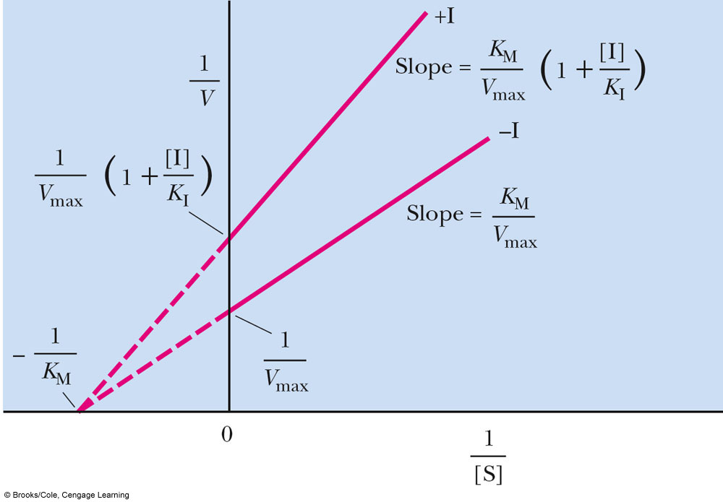
Lineweaver-Burk Plots of Noncompetitive Inhibition

Slide 26
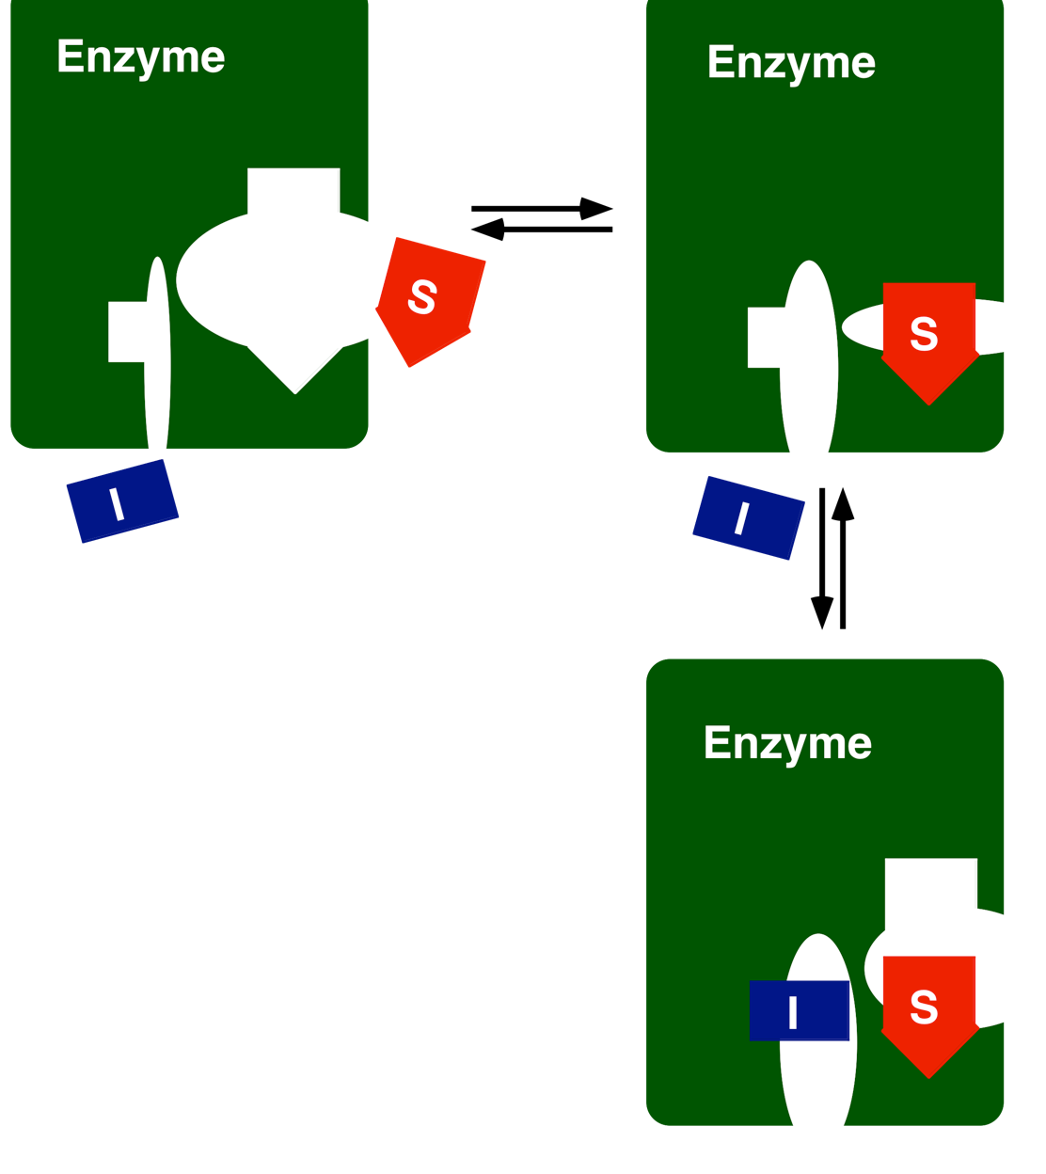
Uncompetitive Inhibition
The binding of an Uncompetitive inhibitor completely distorts active site rendering the enzyme catalytically inactive
In Uncompetitive inhibition, the inhibitor affects the catalytic function of the enzyme BUT NOT substrate binding

Slide 27
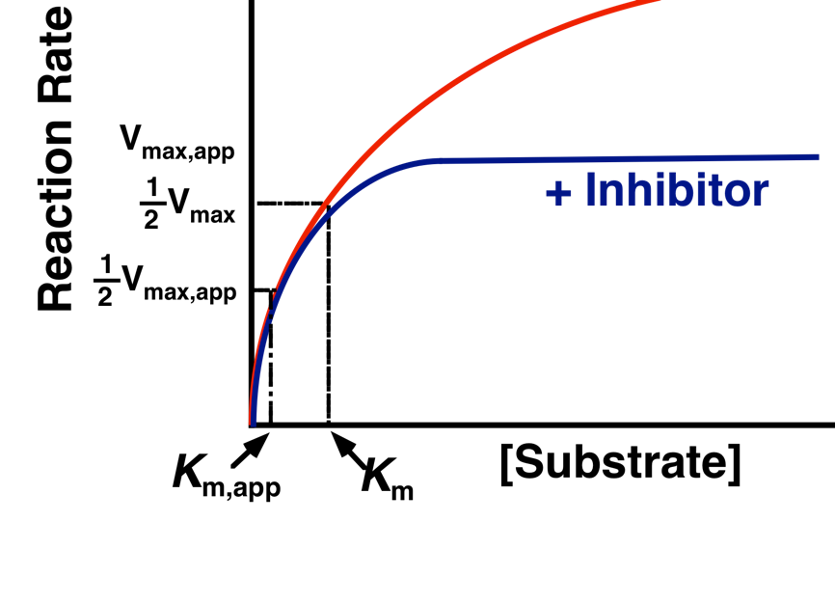
Uncompetitive Inhibition

Slide 28
Uncompetitive Inhibition
Both K_{m} and V_{m} change BUT the slope doesn’t!

Slide 29
Summary of Enzyme Inhibition

Slide 30
How Do We Measure Enzymatic Rates?
Perhaps the easiest way is to use Spectrophotometry
Certain electronic configurations of molecules allow them to absorb radiation in the UV, Visible or Infrared spectra
Proteins typically absorb UV radiation at 260 nm
DNA absorbs UV radiation at 280 nm
Aromatic rings typically absorb UV radiation at 310nm
Colored dyes absorb Visible radiation at the wavelength corresponding to their color
For example, certain copper dyes (Blue dyes) absorb at 595 nm

Slide 31
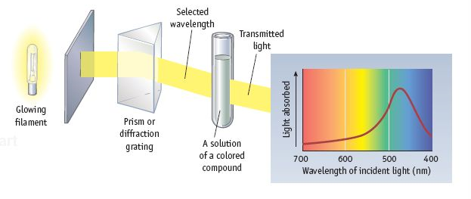
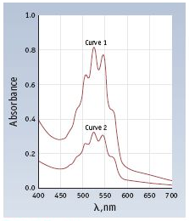
Spectrophotometry: A Vital Method of Analysis
Many solutions of compounds will absorb light at a specific wavelength(s)
This phenomenon is a function of the unique arrangement of electrons in the compound
Most compounds have a set of wavelengths at which they absorb maximally. This set of wavelengths is a kind of “fingerprint” of the compound

Slide 32
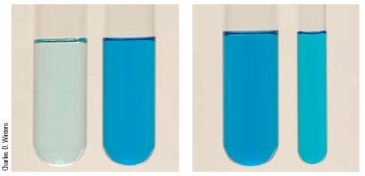
The Beer-Lambert Law
Let’s think about this for a bit…
If we increase the distance the light travels through the solution, the amount of light absorbed should increase. This distance is called the PATHLENGTH
Same concentrations, different pathlength
Different concentrations, same pathlength

Slide 33
The Beer-Lambert Law
We can summarize the depndence of Absorbance on pathlength AND sample concentration with the Beer-Lambert law
This shows that there is a linear relationship between the sample’s absorbance and concentration for a given pathlength. VERY USEFUL!

Slide 34
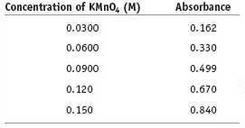
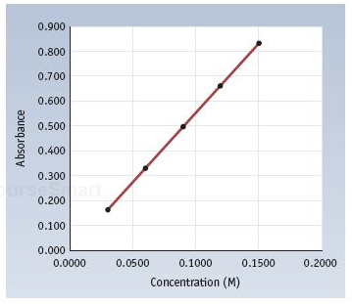
How do we use the Beer-Lambert Law?
Standard Curve for KMnO₄
A=y-axis
l = 1 cm
C = x-axis
ε = slope
We know that the Absorbance = ? When the KMnO₄ = 0M
A=εlC

