Slide 2
The Overall Pathway of Glycolysis
Glycolysis is also called the
Embden-Meyerhof Pathway
Essentially all cells carry out glycolysis.
Glycolysis consists of ten reactions which are essentially the same in all cells. These are divided into two phases.
The first phase converts glucose to two G-3-P and is the energy requiring phase.
The second phase generates two pyruvates and is the energy producing phase.
Products of glycolysis are pyruvate, ATP and NADH.
There are three major fates for pyruvate.

Slide 3
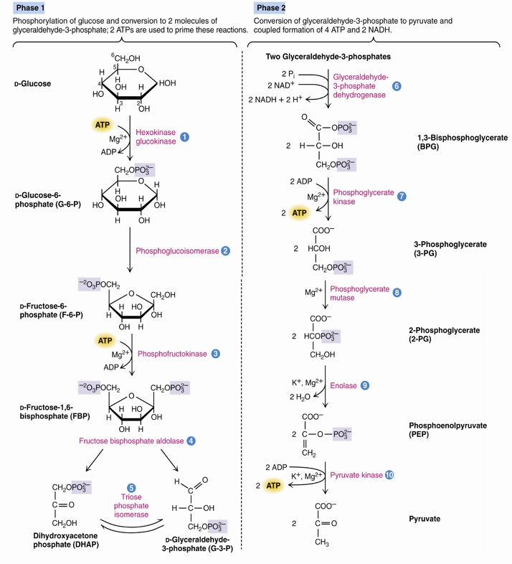
2 Molecules of ATP are consumed in the first 5 reactions
4 Molecules of ATP and 2 molecules of NADH are generated in the second 5 reactions
ATP hydrolyzing reactions are control points (There are 4 of them)

Slide 4
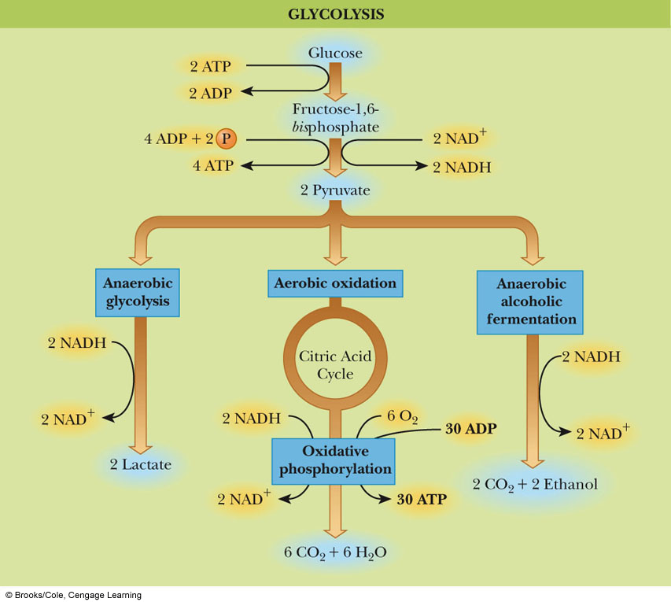
Fates of Pyruvate From Glycolysis

Slide 5
The Reactions of Glycolysis
Phosphorylation of glucose to give glucose-6-phosphate
Isomerization of glucose-6-phosphate to give fructose-6-phosphate
Phosphorylation of fructose-6-phosphate to yield fructose-1,6-bisphosphate
Cleavage of fructose-1,6,-bisphosphate to give glyceraldehyde-3-phosphate and dihyroxyacetone phosphate
Isomerization of dihyroxyacetone phosphate to give glyceraldehyde-3-phosphate

Slide 6
The Reactions of Glycolysis (Cont’d)
Oxidation of glyceraldehyde-3-phosphate to give 1,3-bisphosphoglycerate
Transfer of a phosphate group from 1,3-bisphosphoglycerate to ADP to give 3-phosphoglycerate
Isomerization of 3-phosphoglycerate to give 2-phosphoglycerate
Dehydration of 2-phosphoglycerate to give phosphoenolpyruvate
Transfer of a phosphate group from phosphoenolpyruvate to ADP to give pyruvate

Slide 7
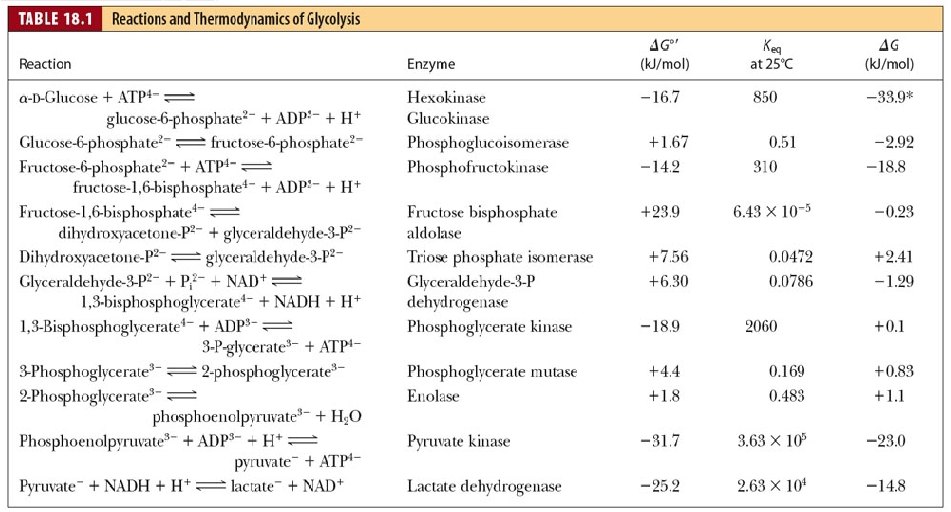
Thermodynamics of Glycolysis
The ΔG value in the right column is the free energy change within the cell, taking the equilibrium concentrations of reactants and products into account

Slide 8
Why Are Coupled Reactions Important in Glycolysis?
Coupled reactions involving ATP hydrolysis are used to drive the glycolytic pathway. (1st Phase)
Some of the individual reactions have very low free energy values (or even slightly positive ones!)
Coupled reactions convert some, but not all of the metabolic energy of glucose into ATP. (2nd Phase)
Under cellular conditions, approximately 5% of the energy of glucose is released in glycolysis.

Slide 9
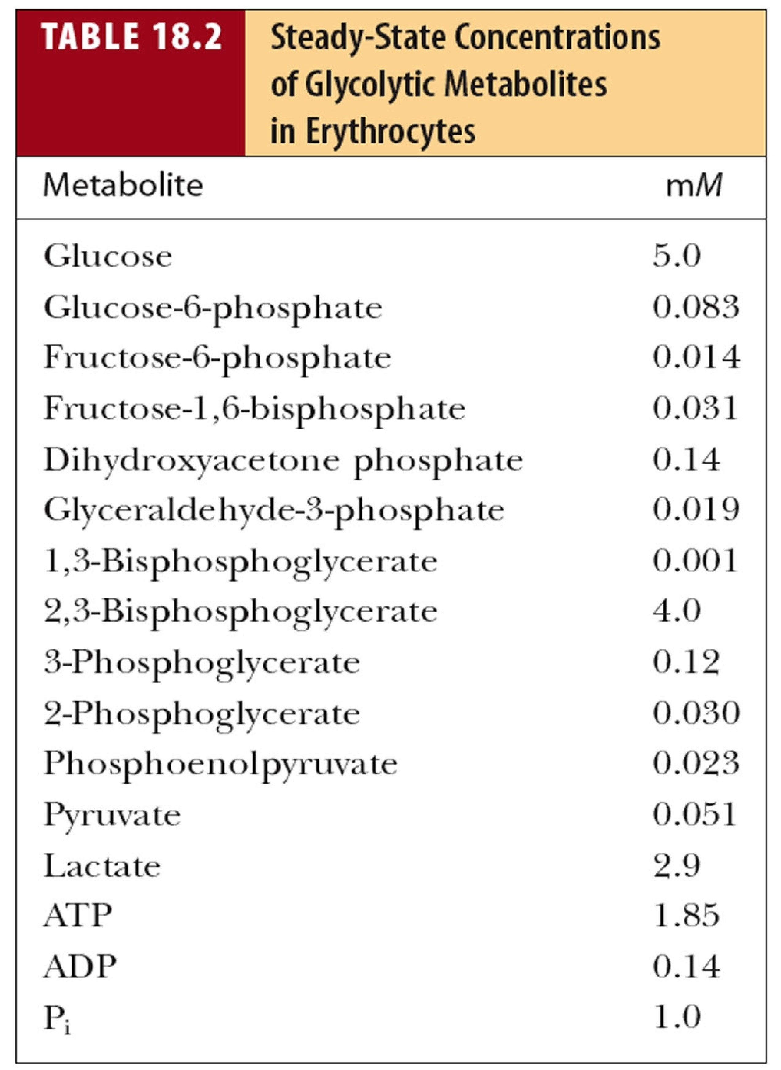
Thermodynamics of Glycolysis
These steady-state concentrations are used to obtain the cellular values of ΔG found in the previous slide.

Slide 10
Thermodynamics of Glycolysis
Glucose + ATP <==> Glucose-6-P + ADP
ΔG = ΔG^{o’} + RT ln K_{eq}
ΔG = ΔG^{o’} + RT ln [G-6-P][ADP]/ [Glucose][ATP]
(0.083x10⁻³)(0.83x10⁻³)
ΔG = -16700 J/mol + RT ln ------------------------------
(5x10⁻³)(1.85x10⁻³)
ΔG = -16700 J/mol + 2577 J/mol (ln (1.256x10⁻³))
= -16700 J/mol + 2577 J/mol (-6.68)
= -16700 J/mol – 17213 J/mol = -33910 J/mol

Slide 11
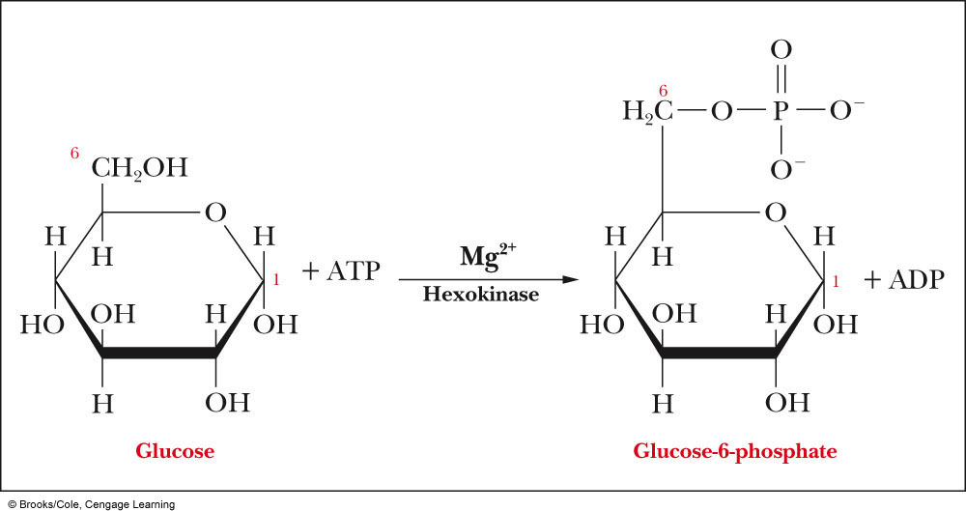
Reaction 1: Hexokinase
In step 1 of glycolysis, glucose is phosphorylated to give glucose-6-phosphate
The reaction is endergonic, as it is driven by the free energy of hydrolysis of ATP

Slide 12
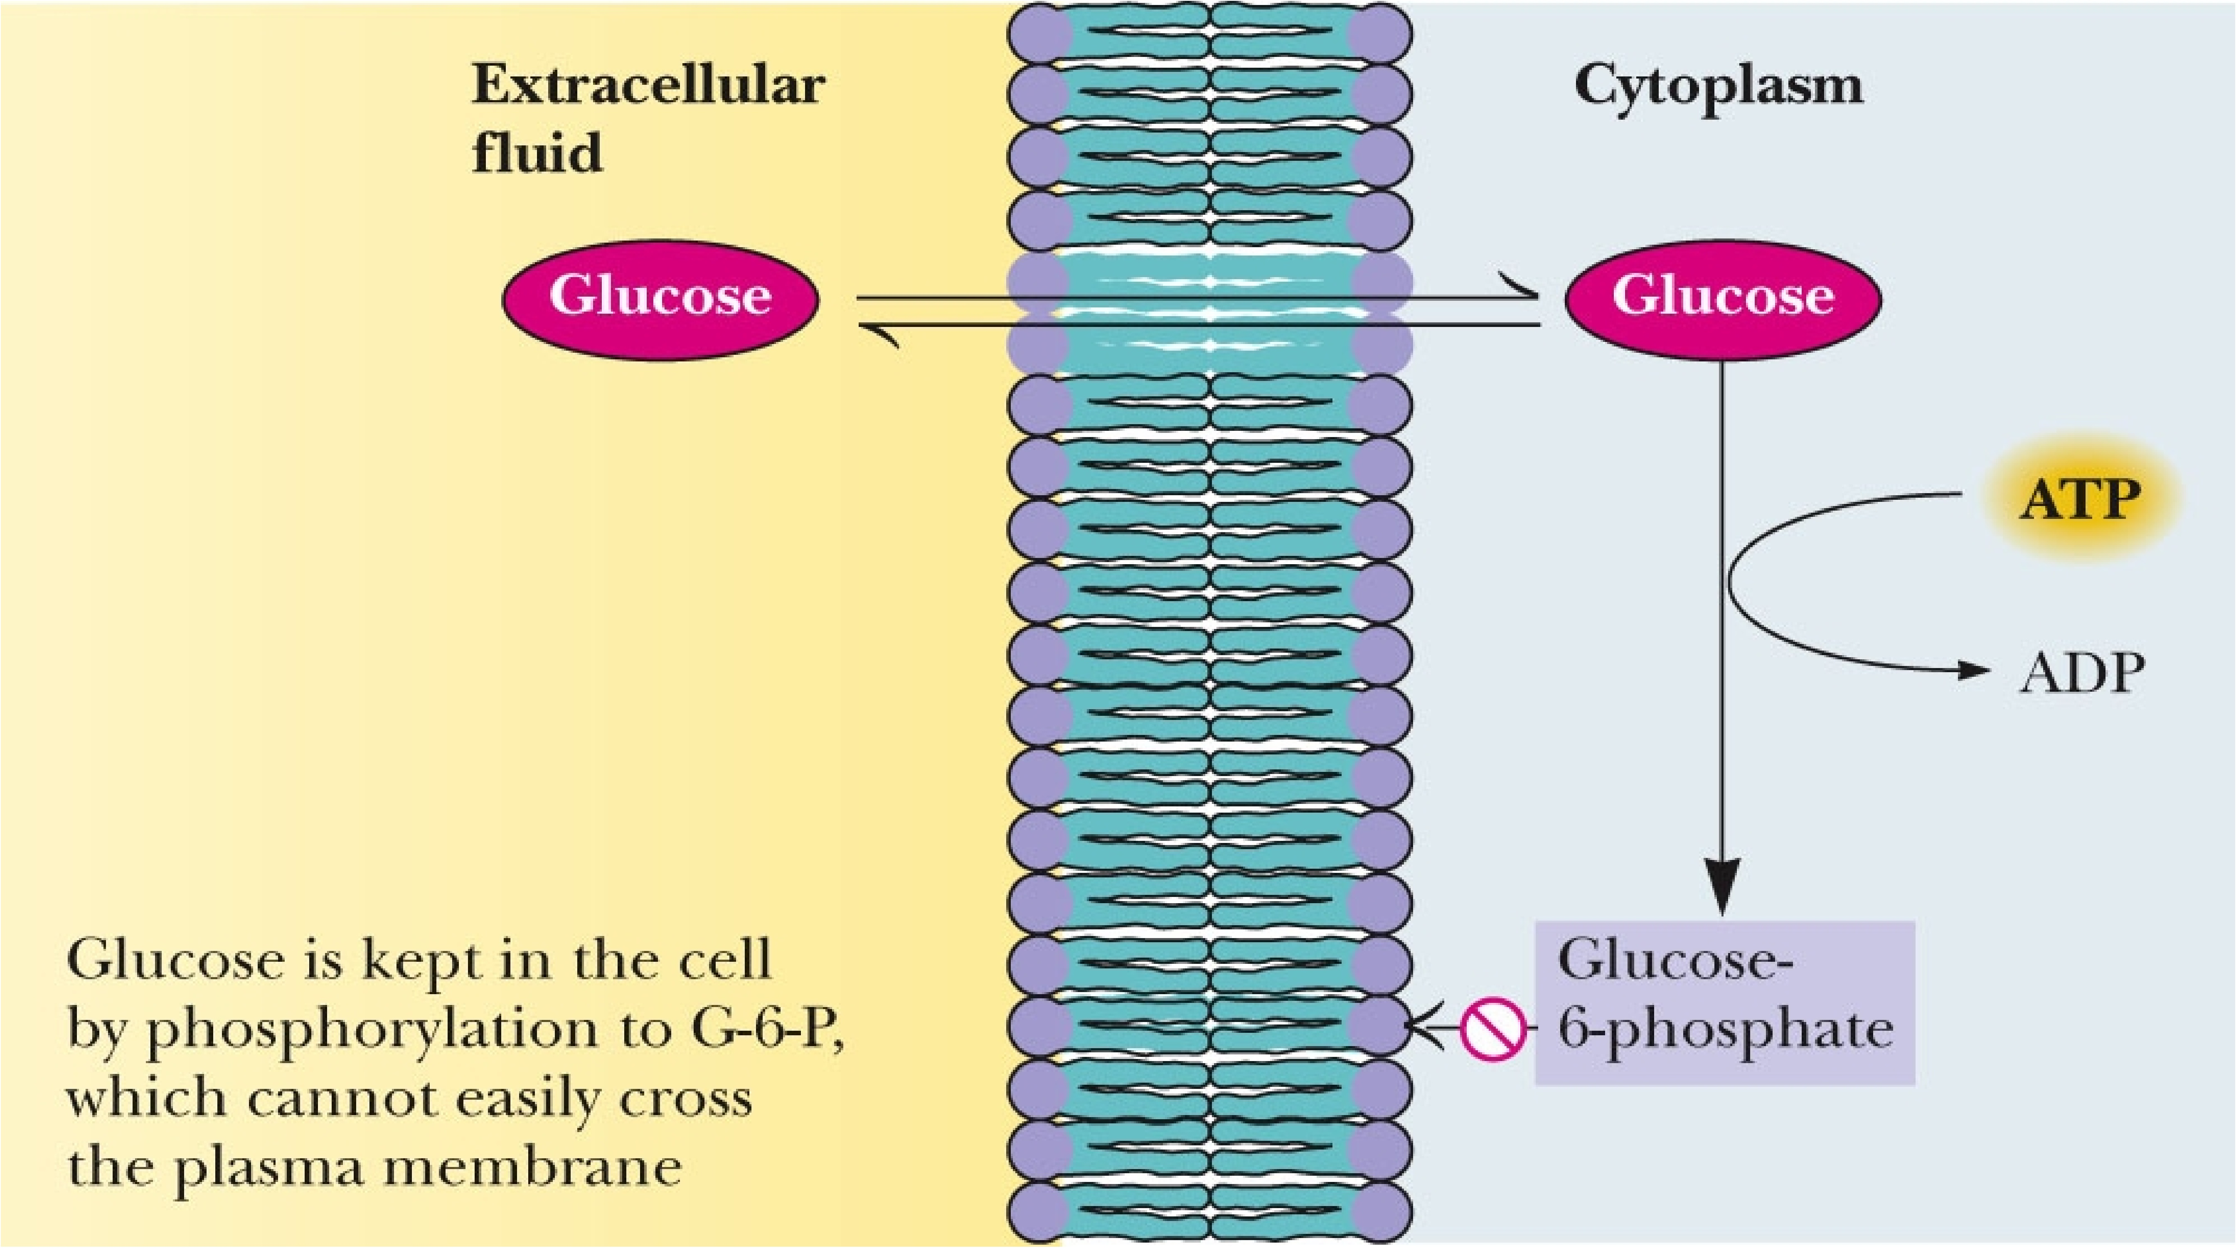
Phosphorylation keeps G6P in the Cell
Why is this?

Slide 13
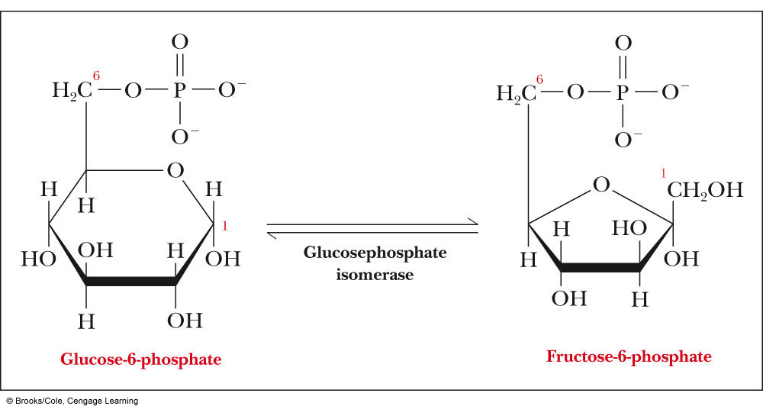
Reaction 2: Glucose Phosphate Isomerase
The second step is the isomerization of glucose-6-phosphate to fructose-6-phosphate
The C-1 aldehyde of glucose-6-phosphate is reduced to a hydroxyl group
The C-2 hydroxyl group is oxidized to give the ketone group of fructose-6-phosphate
There is no net redox reaction
Enzyme catalyzing this reaction is also called Phosphoglucoisomerase

Slide 14
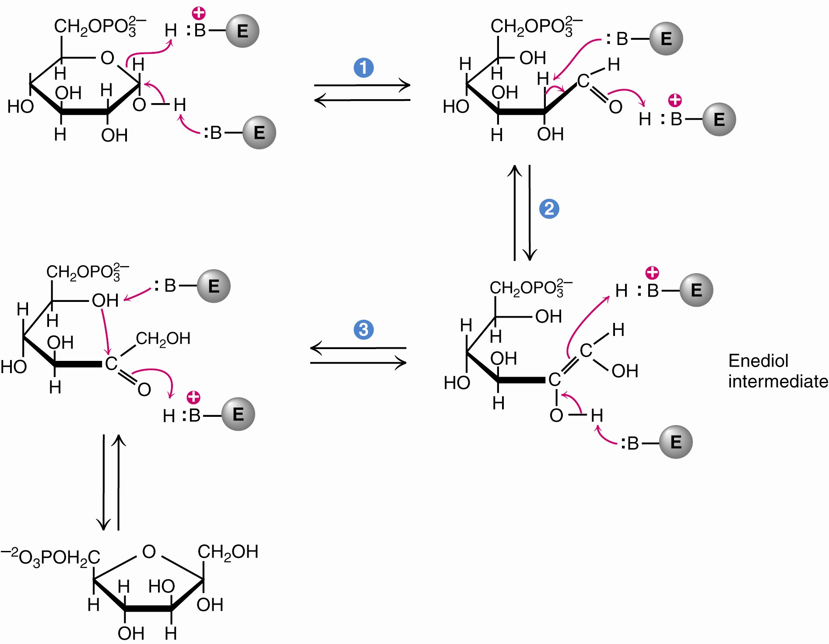
A Mechanism for Phosphoglucoisomerase
The phosphoglucoisomerase mechanism involves: Opening of the pyranose ring (step 1)
Proton abstraction leading to enediol formation (step 2)
Proton addition to the double bond, followed by ring closure (step 3)

Slide 15
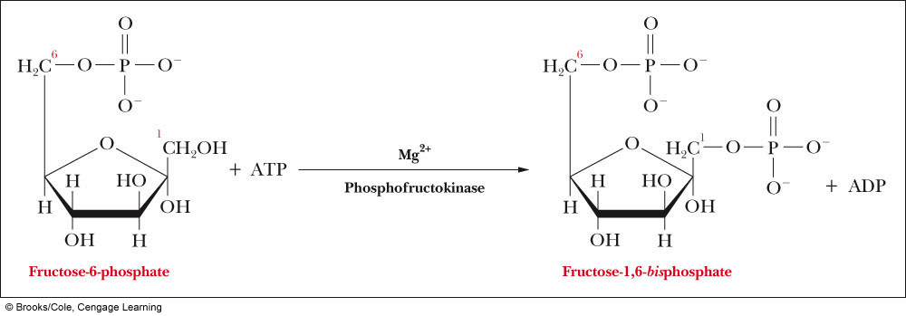
Reaction 3: Phosphofructokinase
Fructose-6-phosphate is then phosphorylated again to generate fructose-1,6-bisphosphate
This is the second reaction to be coupled to ATP hydrolysis

Slide 16
Phosphofructokinase is a Key Regulatory Enzyme in glycolysis
Phosphofructokinase (PFK):
Exists as a tetramer and subject to allosteric feedback
The tetramer is composed of L and M subunits
M₄, M₃L, M₂L₂, ML₃, and L₄ all exist. Combinations of these subunits are called isozymes
Muscles are rich in M₄; the liver is rich in L₄
ATP is an allosteric effector; high levels inhibit the enzyme, low levels activate it
Fructose-1,6-bisphosphate is also an allosteric effector

Slide 17
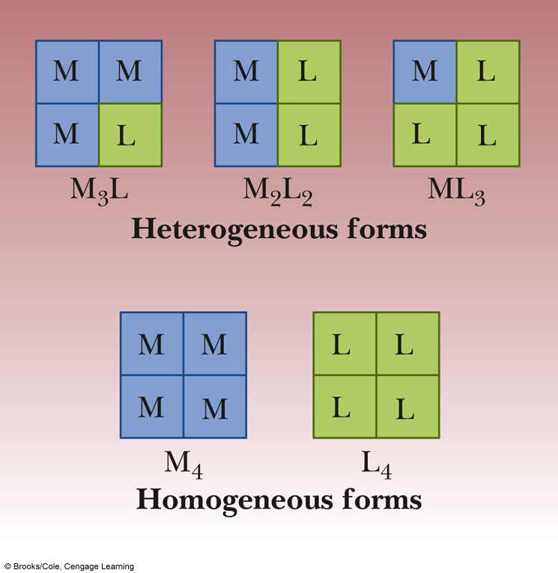
PFK can exist in Many Isozyme Forms

Slide 18
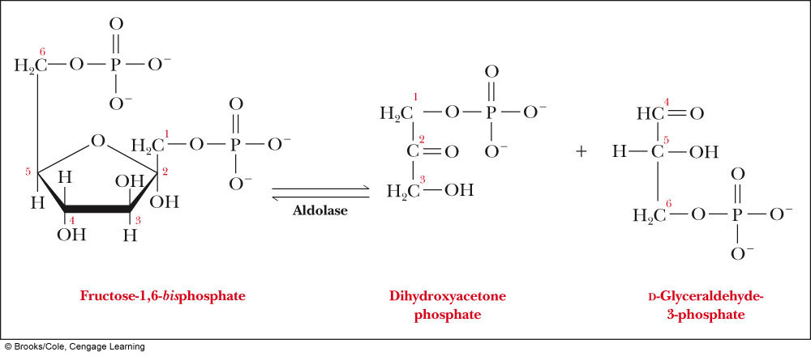
Reaction 4: Aldolase
Fructose-1,6-bisphosphate is split into two 3-carbon fragments
Reaction catalyzed by the enzyme Aldolase
Side chains of an essential Lys and Asp play key roles in catalysis

Slide 19
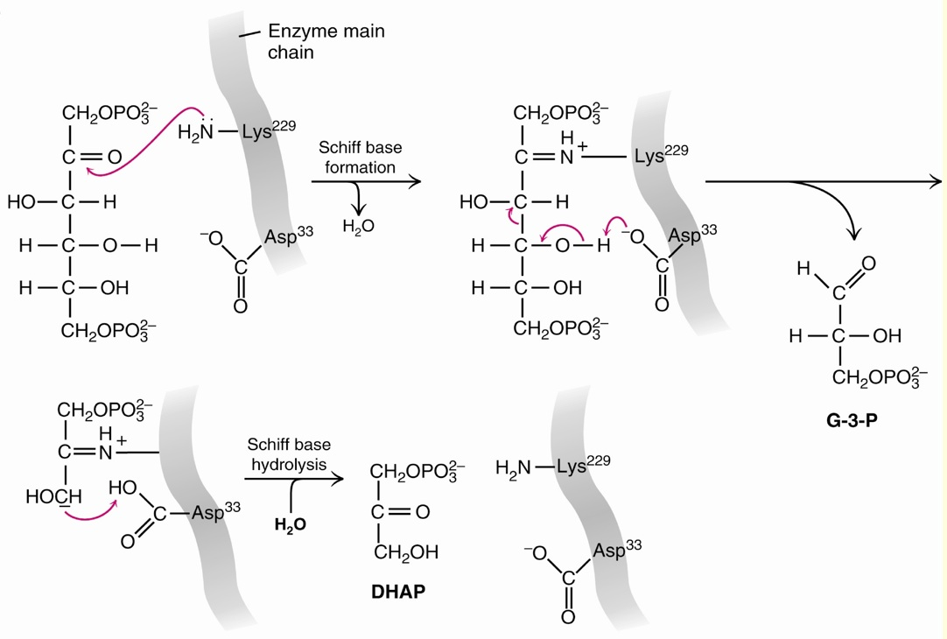
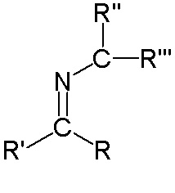
Aldolase Reaction Mechanism
Schiff Base

Slide 20
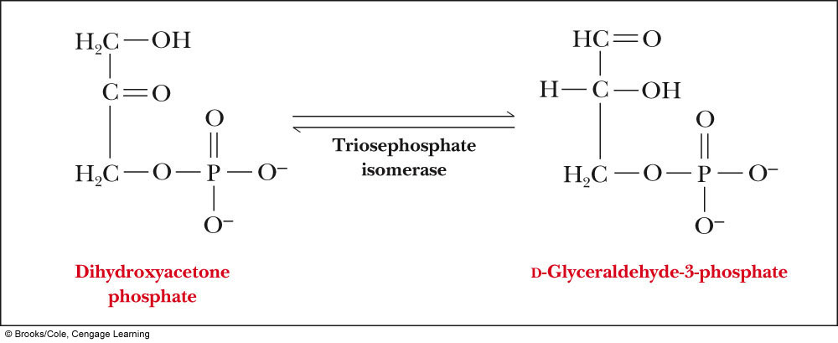
Rxn 5: Triose Phosphate Isomerase
In step 5, dihydroxyacetone phosphate (DHAP) is converted to glyceraldehyde-3-phosphate
These compounds are trioses
This reaction has small +ΔG (0.58kcal/mol⁻¹)
Remember that glycolysis has several reactions that have very negative ΔG values, and drive other reactions to completion, so that the overall process is negative

Slide 21
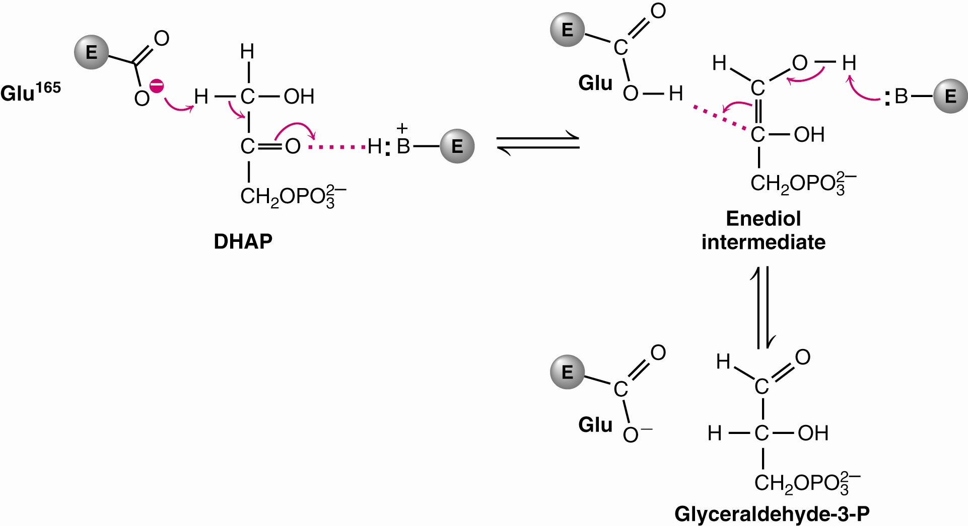
Triose Phosphate Isomerase Reaction Mechanism

Slide 22
Summary
In the first stages of glycolysis, glucose is converted to two molecules of glyceraldehyde-3-phosphate
The key intermediate in this series of reactions is fructose-1,6-bisphosphate. The enzyme that catalyzes this reaction, phosphofructokinase, is subject to allosteric control

Slide 23
The Second Phase of Glycolysis
Metabolic energy of glucose produces 4 ATP.
Net ATP yield for glycolysis is two ATP.
Why?
The second phase of glycolysis involves two very high energy phosphate intermediates:
1,3-bisphosphoglycerate.
Phosphoenolpyruvate.

Slide 24
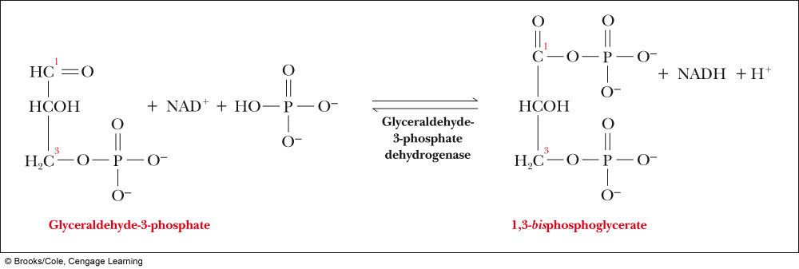
Reaction 6: Glyceraldehyde 3-Phosphate Dehydrogenase
The first reaction that begins the conversion to pyruvate involves the oxidation of glyceraldehyde-3-phosphate to 1,3-bisphosphoglycerate
This reaction involves addition of a phosphate group, as well as an electron transfer
The oxidizing agent, NAD⁺, is reduced to NADH

Slide 25
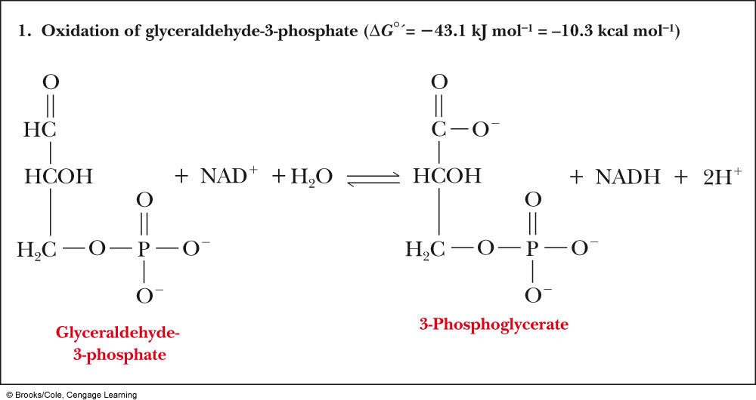
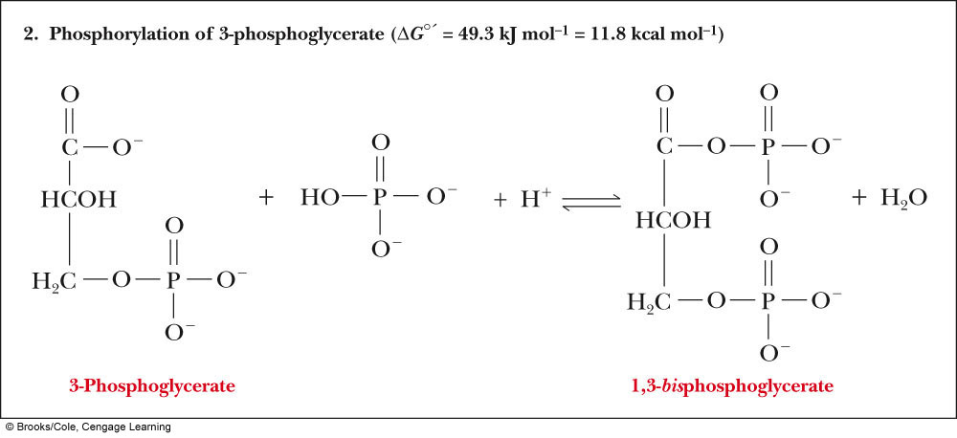
Oxidation and Phosphorylation Reaction

Slide 26
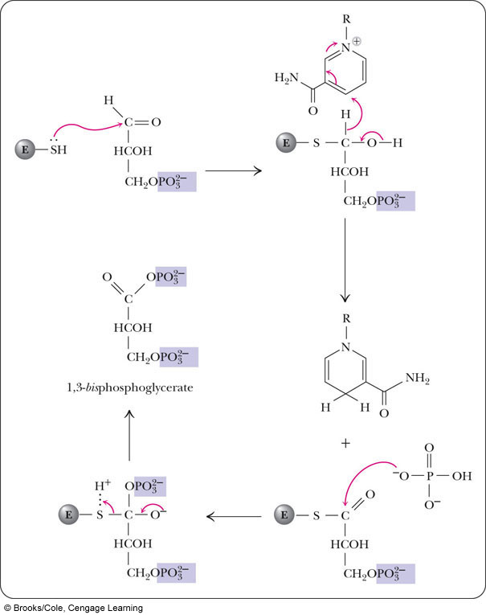
A Cysteine has Active Role in Action of Glyceraldehyde-3-phosphate Dehydrogenase
Nicotinamide ring of NAD⁺
H⁺

Slide 27
Reaction 7: Phosphoglycerate Kinase
1,3-bisphosphoglycerate is converted to 3-phosphoglycerate by Phosphoglycerate Kinase.
This step involves another reaction in which ATP is produced by phosphorylation of ADP
1,3-bisphosphoglycerate transfers a phosphate group to ADP. This is known as substrate-level phosphorylation
Reaction is catalyzed by phosphoglycerate kinase
This reaction is the sum of the endergonic phosphorylation of ADP and the exergonic hydrolysis of the mixed phosphate anhydride

Slide 28
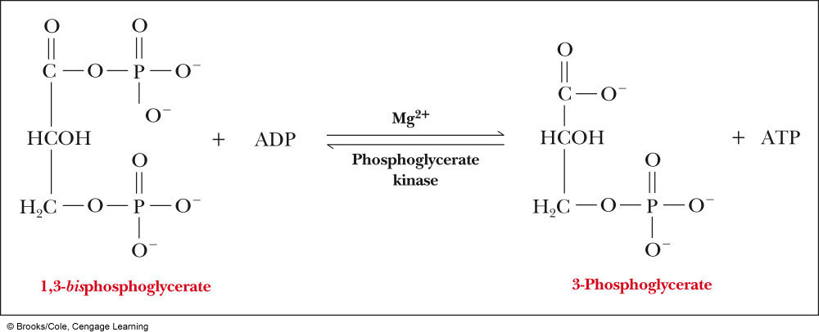
Reaction 7: Phosphoglycerate Kinase
This reaction “pays off” the ATP debt created by the priming reactions in the first phase.

Slide 29
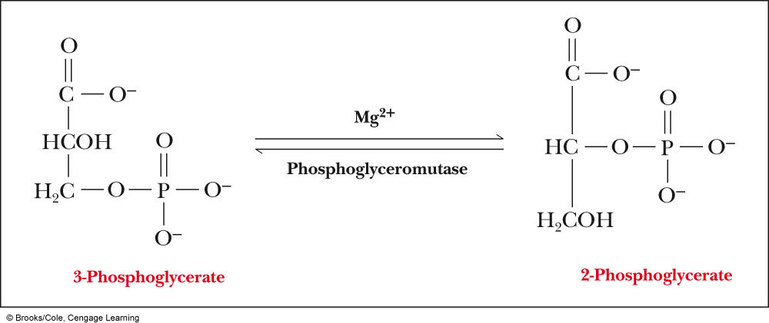
Rxn 8: Phosphoglycerate Mutase
The next step involves the isomerization of 3-phosphoglycerate to 2-phosphoglycerate
A “mutase” catalyzes migration of a functional group within a substrate.

Slide 30
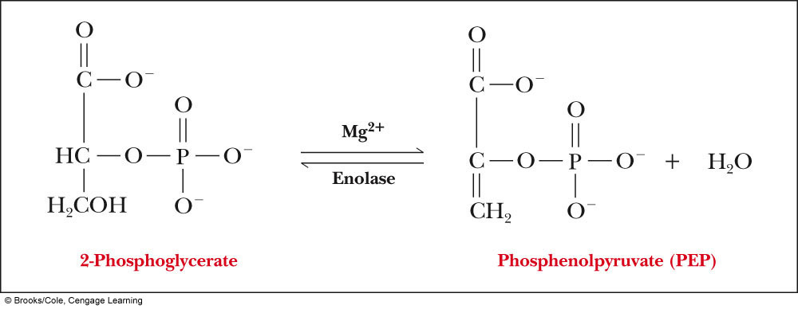
Reaction 9: Enolase
Next, 2-phosphoglycerate loses one molecule of water, producing phosphenolpyruvate
Enolase catalyzes the reaction and requires a Mg²⁺ cofactor
Phosphoenolpyruvate contains a high energy bond

Slide 31
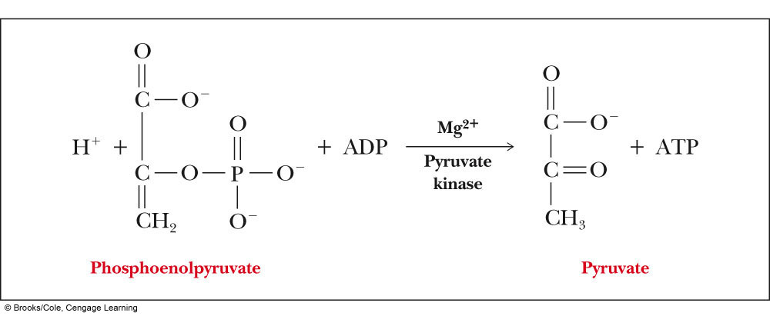
Reaction 10: Pyruvate Kinase
Phosphenolpyruvate (PEP) transfers its phosphate group to ADP, producing ATP and pyruvate
ΔG of hydrolysis of PEP is more than that of ATP
(-61.9kJ mol⁻¹ vs. -30.5kJ mol⁻¹)
Reaction is catalyzed by pyruvate kinase

Slide 32
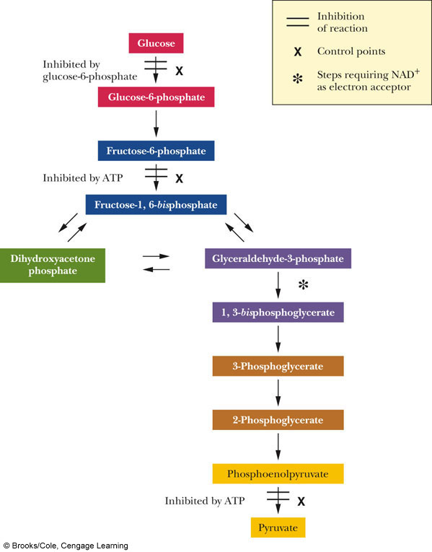
Control Points in Glycolysis
• Three reactions exhibit particularly large decreases in free energy; the enzymes that catalyze these reactions are sites of allosteric control
Hexokinase
Phosphofructokinase
Pyruvate kinase

Slide 33
Summary
In the final stages of glycolysis, two molecules of pyruvate are produced for each molecule of glucose that entered the pathway
These reactions involve electron transfer, and the net production of two ATP for each glucose
There are three control points in the glycolytic pathway

Slide 34
What Are the Metabolic Fates of NADH and Pyruvate Produced in Glycolysis?
NADH can be recycled via aerobic or anaerobic pathways
NADH is energy - two possible fates:
In aerobic conditions (O₂ is available), NADH is re-oxidized in the electron transport pathway, making ATP in oxidative phosphorylation.
In anaerobic conditions, NADH is re-oxidized by lactate dehydrogenase (LDH) or alcohol dehydrogense either of which provide NAD⁺ for more glycolysis.

Slide 35
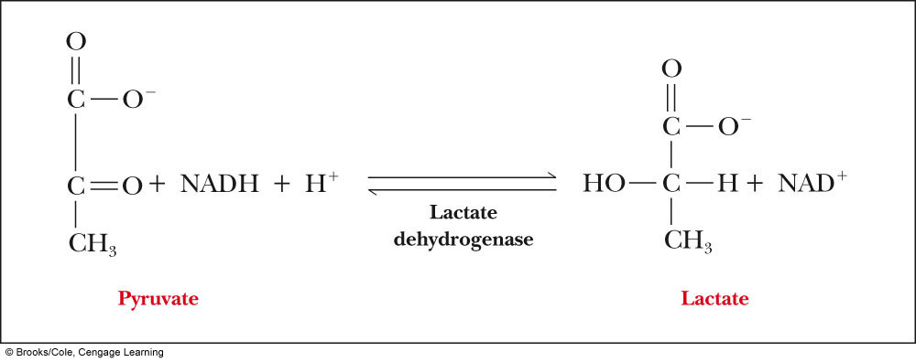
Anaerobic Metabolism of Pyruvate
Under anaerobic conditions, the most important pathway for the regeneration of NAD⁺ is reduction of pyruvate to lactate
Lactate dehydrogenase (LDH) is a tetrameric isoenzyme consisting of H and M subunits; H₄ predominates in heart muscle, and M₄ in skeletal muscle

Slide 36
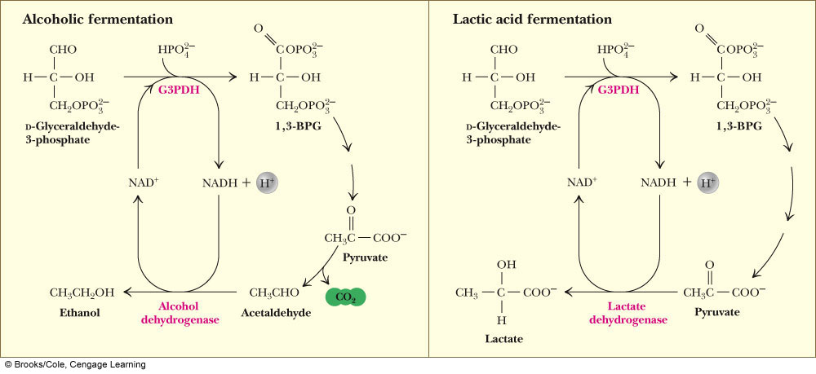
NAD⁺ Needs to be Recycled to Prevent Decrease in Oxidation Reactions
Pyruvate reduction to ethanol in yeast provides a means for regenerating NAD⁺ consumed in the glyceraldehyde-3-P dehydrogenase reaction. (b) In oxygen-depleted muscle, NAD⁺ is regenerated in the lactate dehydrogenase reaction.

Slide 37
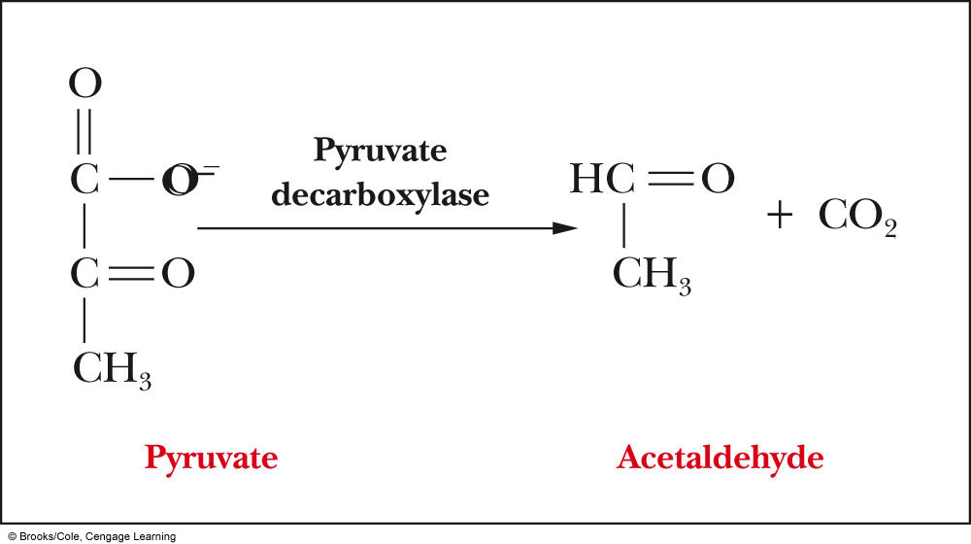
Alcoholic Fermentation
Two reactions lead to the production of ethanol:
Decarboxylation of pyruvate to acetaldehyde
Reduction of acetaldehyde to ethanol
• Pyruvate decarboxylase is the enzyme that catalyzes
the first reaction
• This enzyme require Mg²⁺ and the cofactor, thiamine
pyrophosphate (TPP)
• Alcohol dehydrogenase catalyzes the conversion of
acetaldehyde to ethanol

Slide 38
Summary
Pyruvate is converted to lactate in anaerobic tissues, such as actively metabolizing muscle. NAD⁺ is recycled in the process

