Slide 1
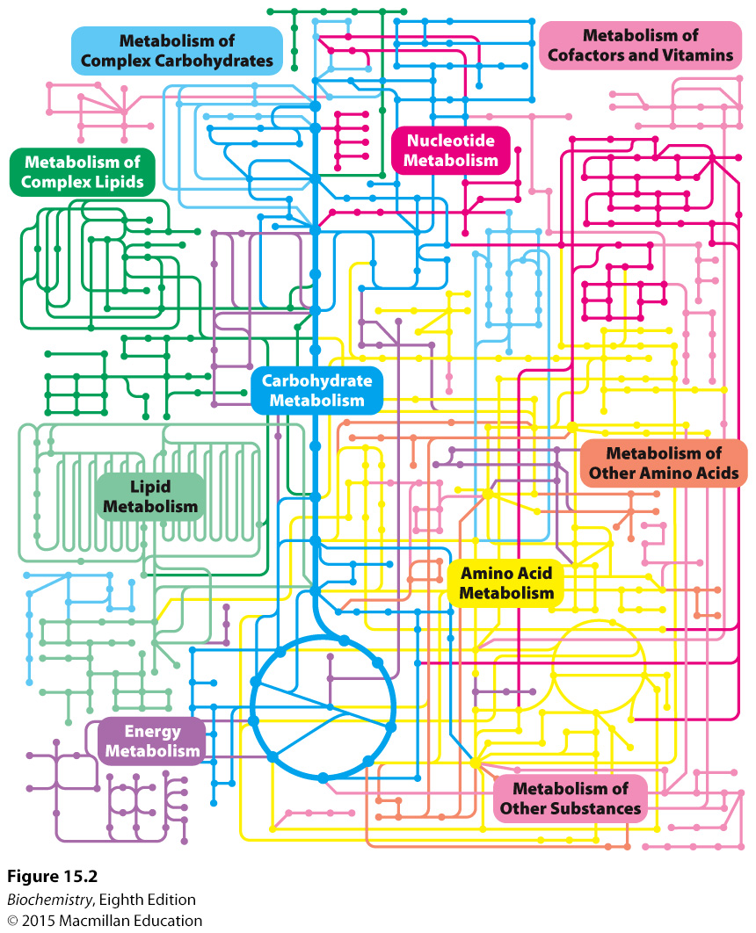

Slide 2
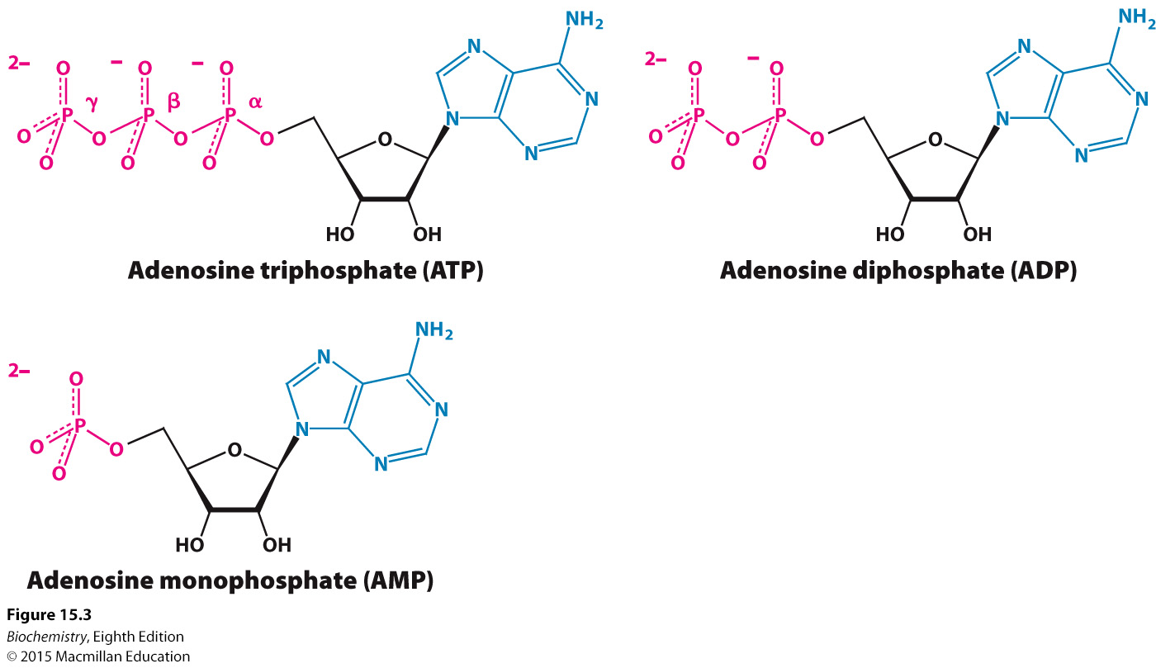
Adenosine phosphates can exist in three forms: AMP, ADP and ATP

Slide 3
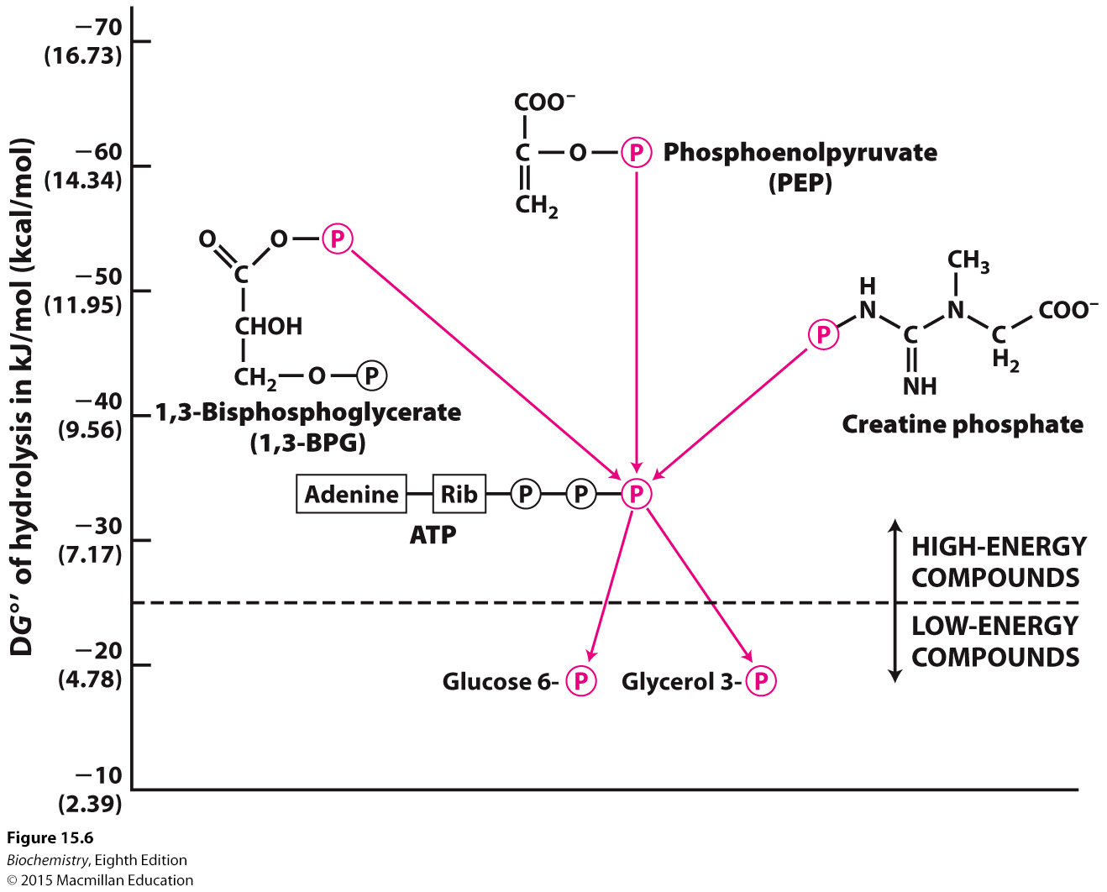

Slide 4
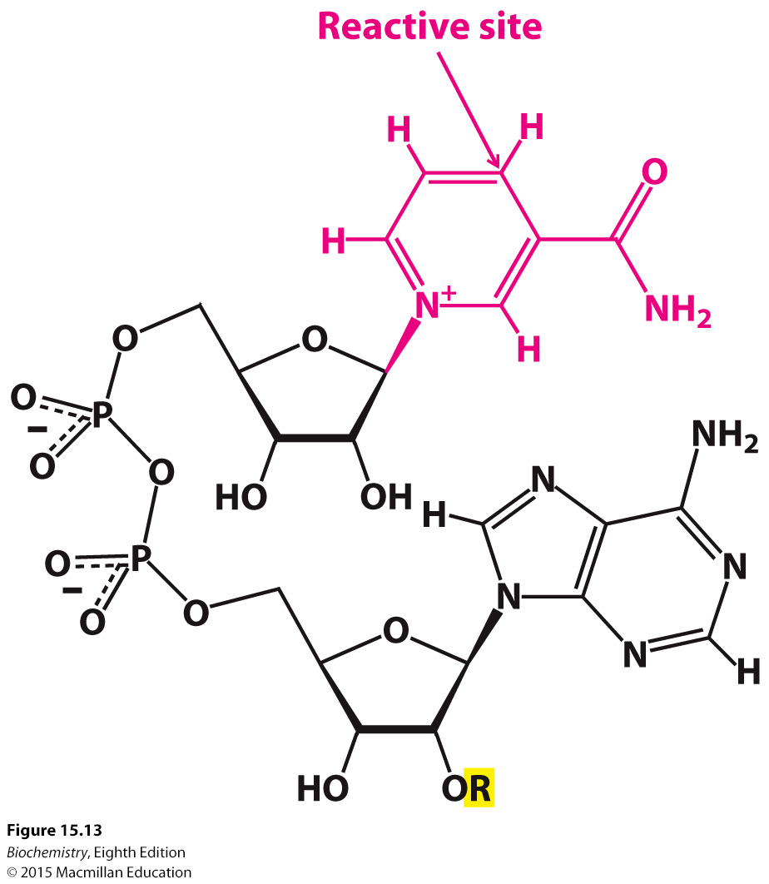

Slide 5
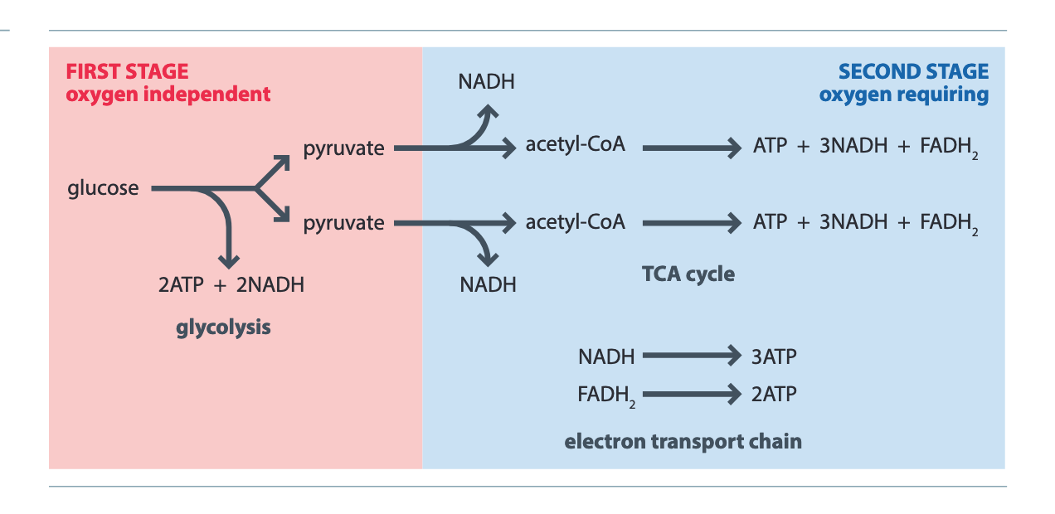

Slide 6
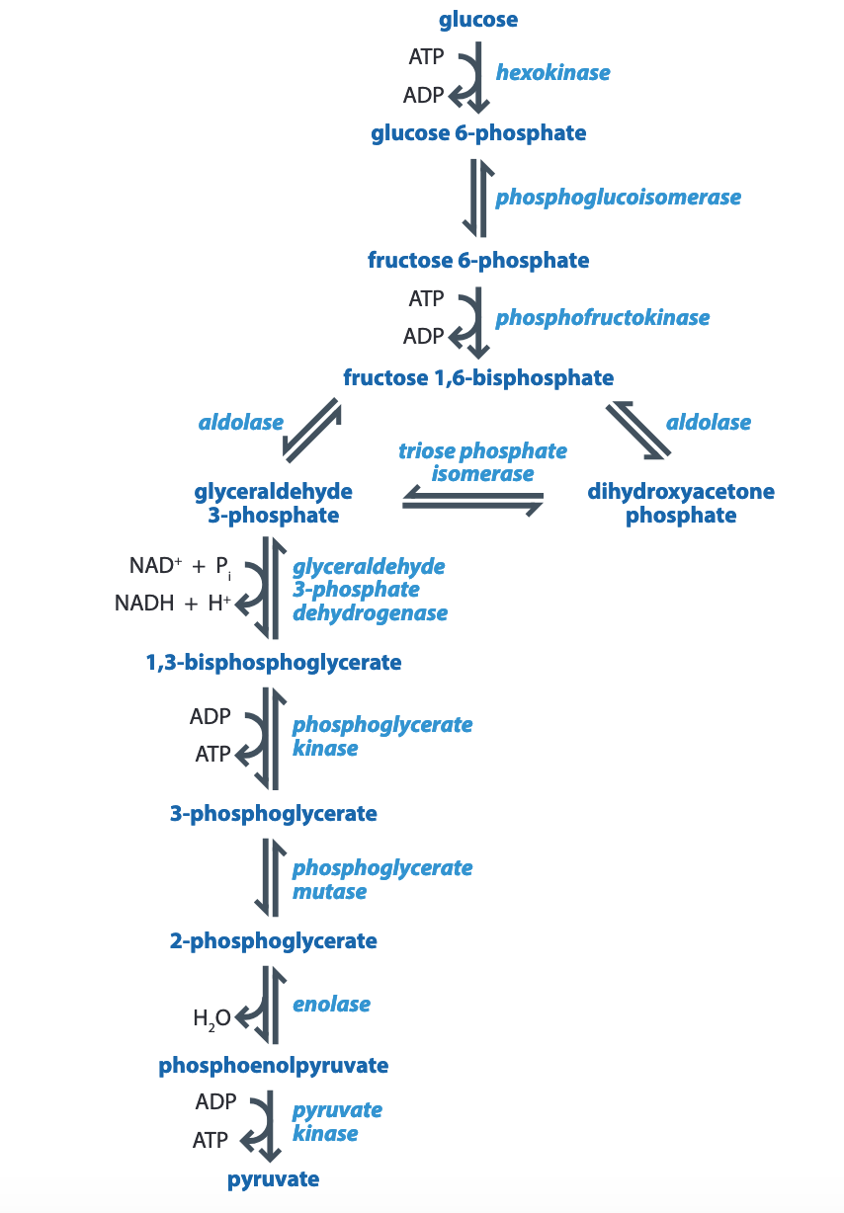

Slide 7
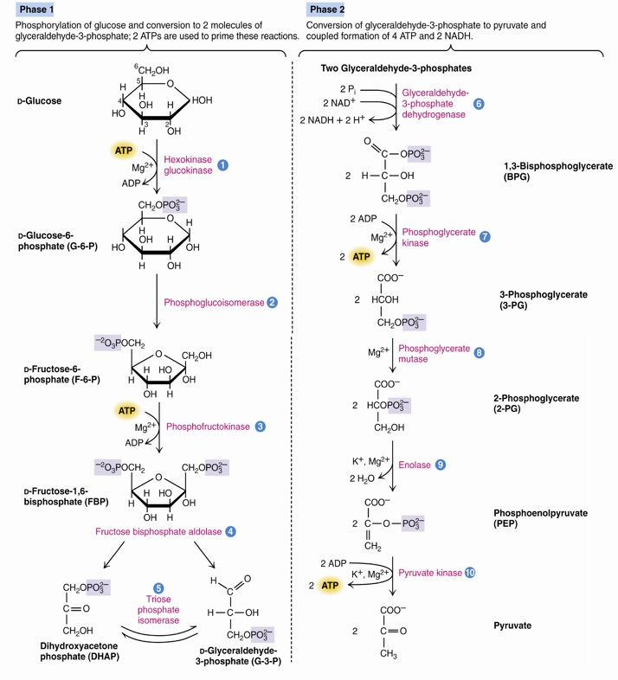
2 Molecules of ATP are consumed in the first 5 reactions
4 Molecules of ATP and 2 molecules of NADH are generated in the second 5 reactions
ATP hydrolyzing reactions are control points (There are 4 of them)

Slide 8
Reactions of Glycolysis
Phosphorylation of glucose to give glucose-6-phosphate
Isomerization of glucose-6-phosphate to give fructose-6-phosphate
Phosphorylation of fructose-6-phosphate to yield fructose-1,6-bisphosphate
Cleavage of fructose-1,6,-bisphosphate to give glyceraldehyde-3-phosphate and dihydroxyacetone phosphate
Isomerization of dihydroxyacetone phosphate to give glyceraldehyde-3-phosphate

Slide 9
Reactions of Glycolysis
Oxidation of glyceraldehyde-3-phosphate to give 1,3-bisphosphoglycerate
Transfer of a phosphate group from 1,3-bisphosphoglycerate to ADP to give 3-phosphoglycerate
Isomerization of 3-phosphoglycerate to give 2-phosphoglycerate
Dehydration of 2-phosphoglycerate to give phosphoenolpyruvate
Transfer of a phosphate group from phosphoenolpyruvate to ADP to give pyruvate

Slide 10
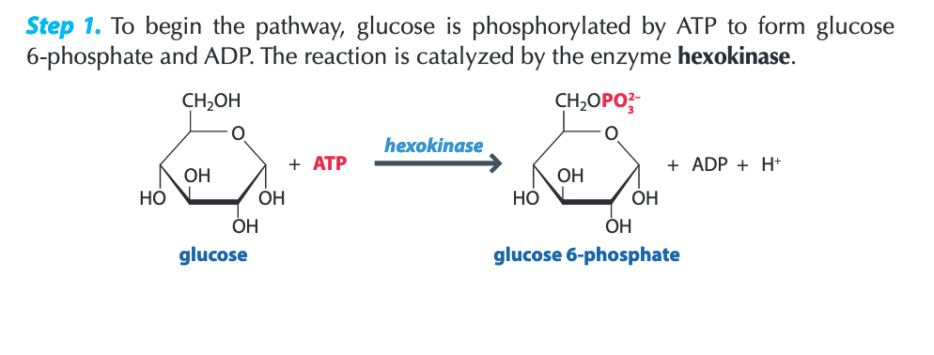
Reactions of Glycolysis
First Step: Hexokinase catalyzed reaction

Slide 11
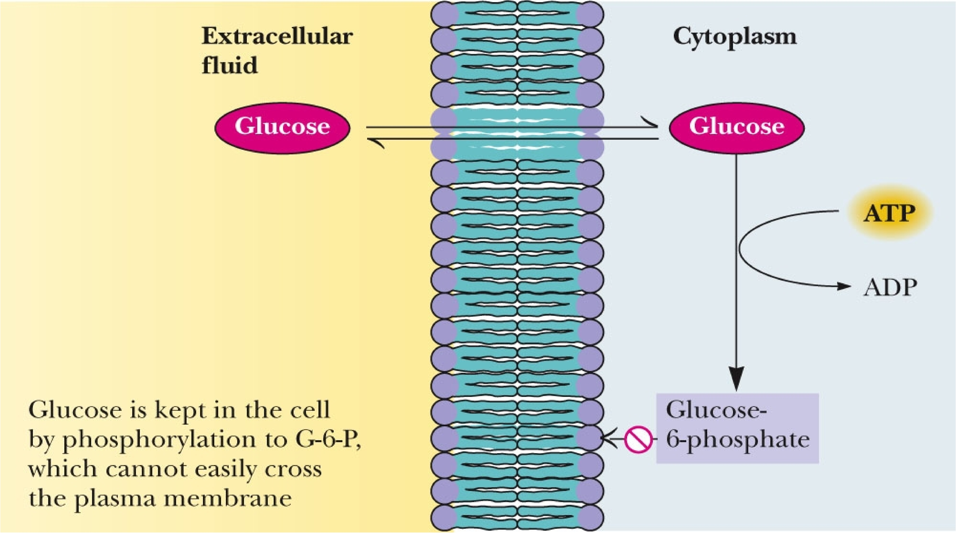
Why is this? What is the permeability of the membrane to ions?

Slide 12
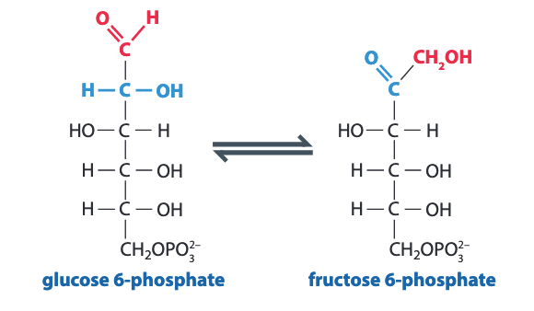
Reactions of Glycolysis
Second Step: Phosphoglucoisomerase
We are converting an aldose to a ketose, why?

Slide 13
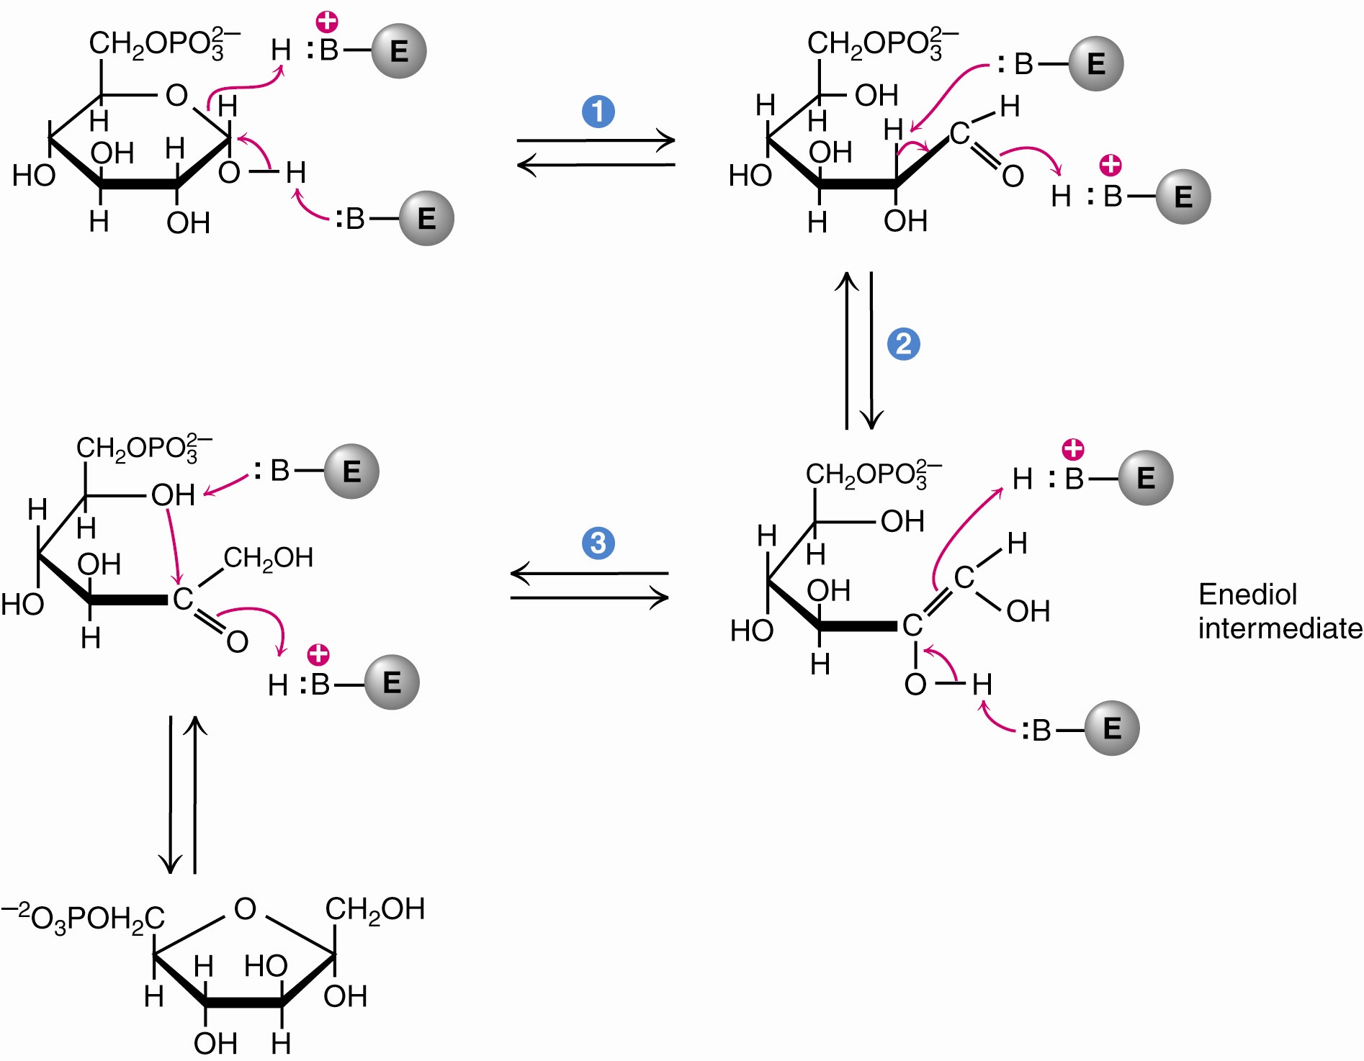
Reactions of Glycolysis
Second Step: Phosphoglucoisomerase
The phosphoglucoisomerase mechanism involves:
Opening of the pyranose ring (step 1)
Proton abstraction leading to enediol formation (step 2)
Proton addition to the double bond, followed by ring closure (step 3)

Slide 14
Reactions of Glycolysis
Third Step: Phosphofructokinase

Slide 15
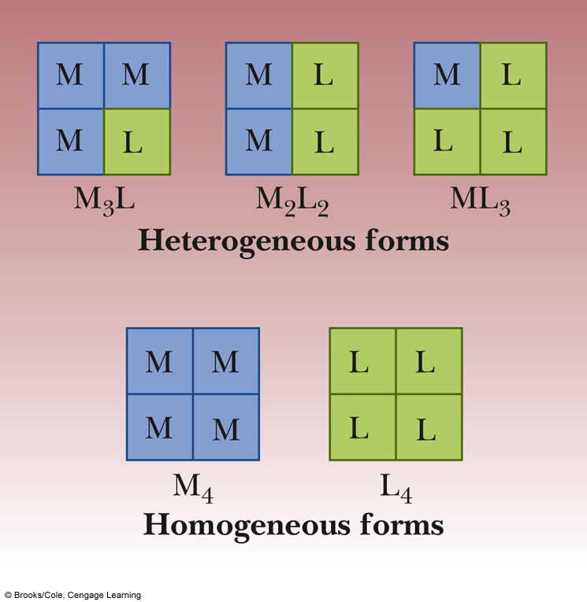
Phosphofructokinase is a Key Regulatory Enzyme in glycolysis
Phosphofructokinase (PFK):
Exists as a tetramer and subject to allosteric feedback
The tetramer is composed of L and M subunits
M₄, M₃L, M₂L₂, ML₃, and L₄ all exist. Combinations of these subunits are called isozymes
Muscles are rich in M₄; the liver is rich in L₄
ATP is an allosteric effector; high levels inhibit the enzyme, low levels activate it
Fructose-1,6-bisphosphate is also an allosteric effector

Slide 16
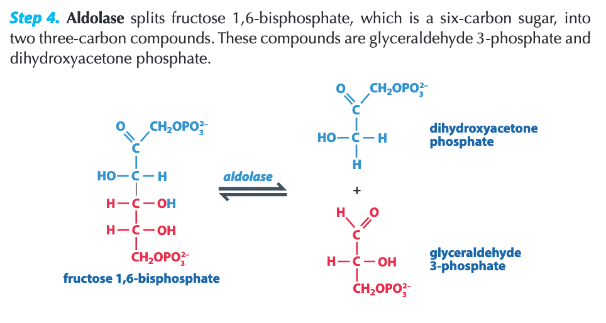
Reactions of Glycolysis
Fourth Step: Aldolase

Slide 17
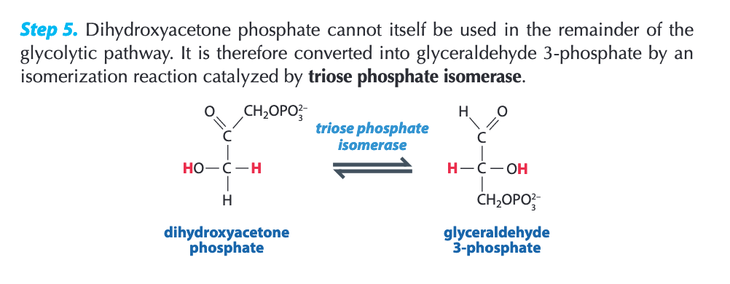
Reactions of Glycolysis
Fifth Step: Triose Phosphate Isomerase

Slide 18
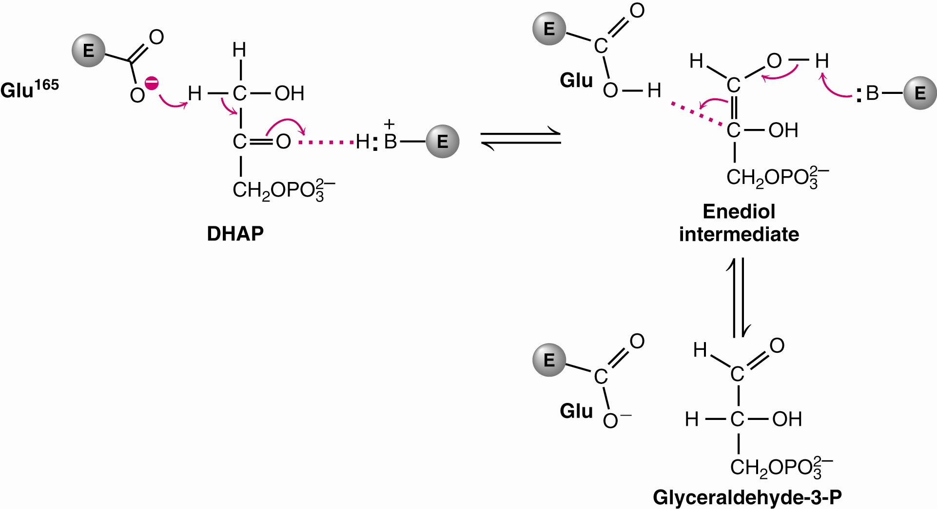
Reactions of Glycolysis
Fifth Step: Triose Phosphate Isomerase Mechanism

Slide 19
Reactions of Glycolysis
Halfway Summary:
In the first stages of glycolysis, glucose is converted to two molecules of glyceraldehyde-3-phosphate
The key intermediate in this series of reactions is fructose-1,6-bisphosphate. The enzyme that catalyzes this reaction, phosphofructokinase, is subject to allosteric control

Slide 20
The Second Phase of Glycolysis
Metabolic energy of glucose produces 4 ATP.
Net ATP yield for glycolysis is two ATP.
Why?
The second phase of glycolysis involves two very high energy phosphate intermediates:
1,3-bisphosphoglycerate.
Phosphoenolpyruvate.

Slide 21
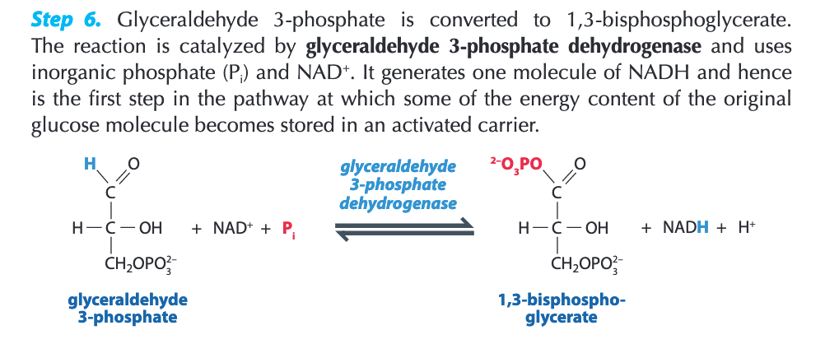
Reactions of Glycolysis
Sixth Step: Glyceraldehyde-3-Phosphate Dehydrogenase

Slide 22
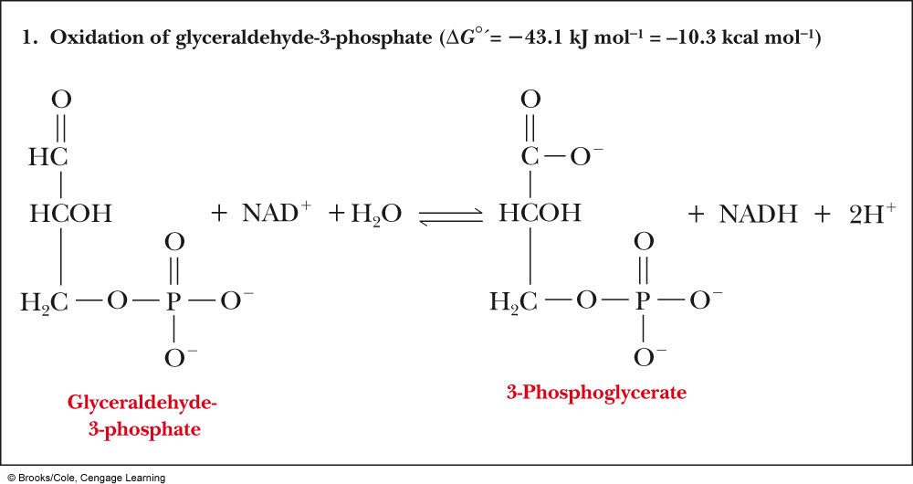
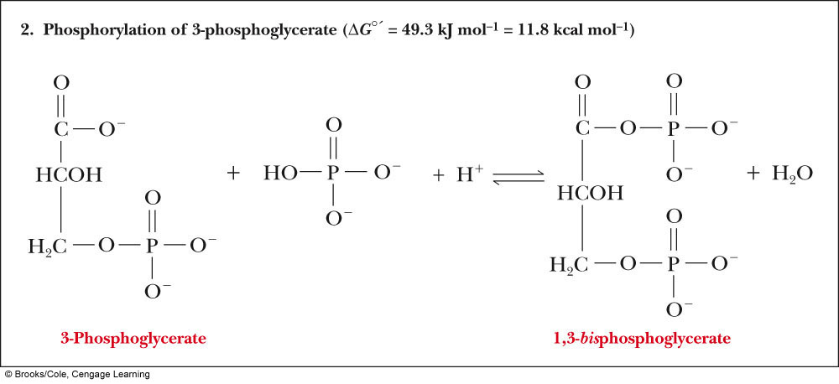
Reactions of Glycolysis
Sixth Step: Glyceraldehyde-3-Phosphate Dehydrogenase
Same Enzyme, 2 parts to overall reaction

Slide 23
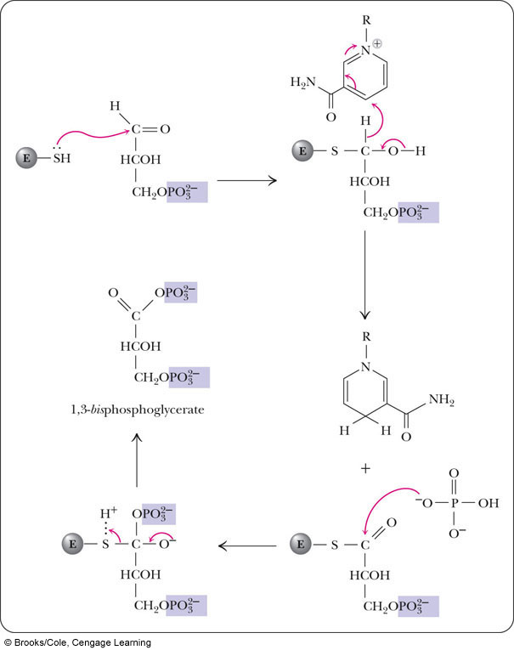
Reactions of Glycolysis
Sixth Step: Glyceraldehyde-3-Phosphate Dehydrogenase
Nicotinamide ring of NAD⁺

Slide 24
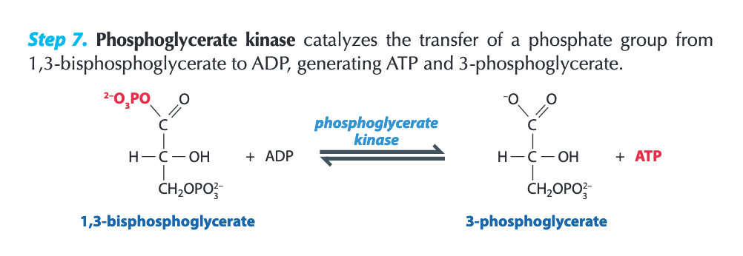
Reactions of Glycolysis
Seventh Step: Phosphoglycerate kinase (PGK)

Slide 25
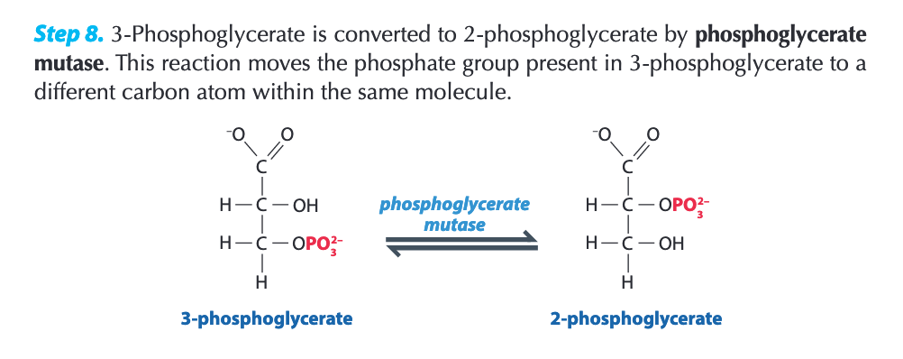
Reactions of Glycolysis
Eighth Step: Phosphoglycerate mutase

Slide 26
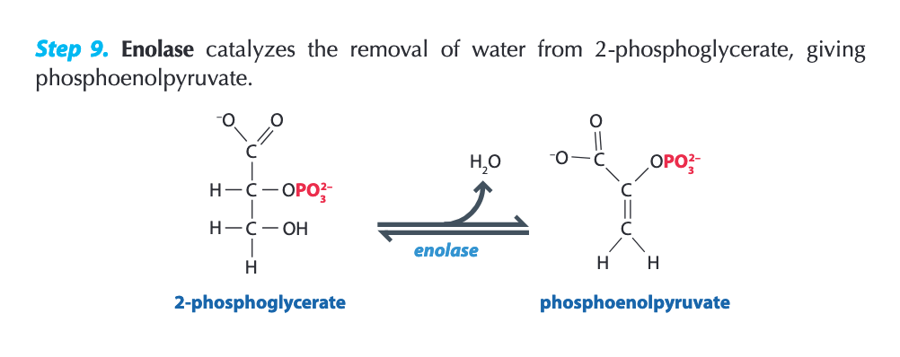
Reactions of Glycolysis
Ninth Step: Enolase

Slide 27
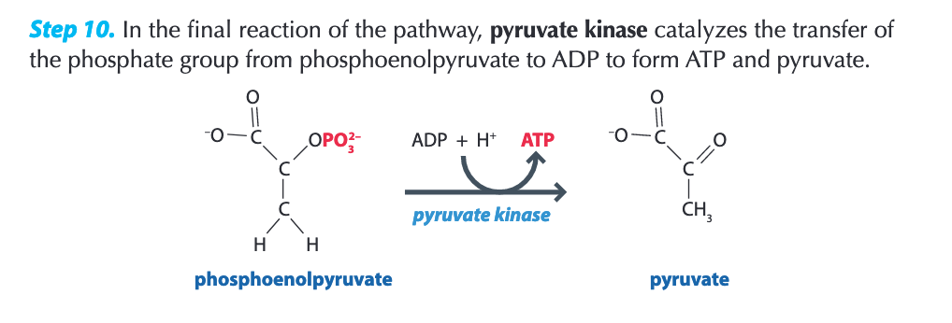
Reactions of Glycolysis
Tenth Step: Pyruvate kinase

Slide 28
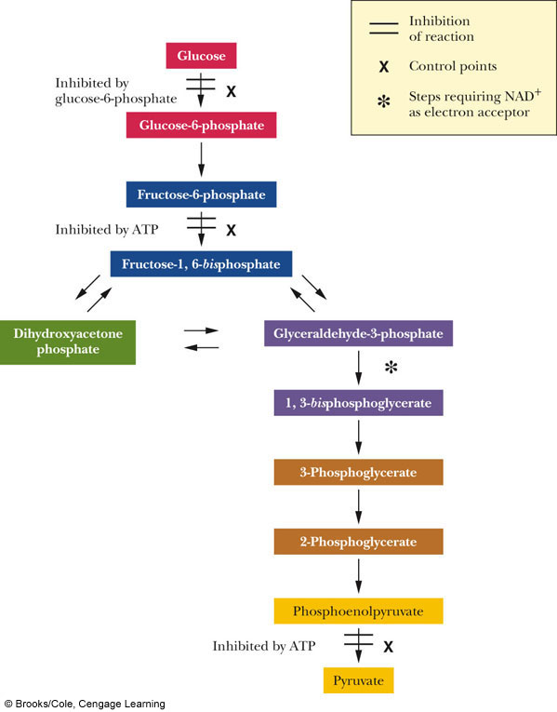
Control Points in Glycolysis
• Three reactions exhibit particularly large decreases in free energy; the enzymes that catalyze these reactions are sites of allosteric control
Hexokinase
Phosphofructokinase
Pyruvate kinase

Slide 29
Summary
In the final stages of glycolysis, two molecules of pyruvate are produced for each molecule of glucose that entered the pathway
These reactions involve electron transfer, and the net production of two ATP for each glucose
There are three control points in the glycolytic pathway

