Slide 1
Carbohydrates
Carbohydrate: a polyhydroxyaldehyde or polyhydroxyketone, or a substance that gives these compounds on hydrolysis
Monosaccharide: a carbohydrate that cannot be hydrolyzed to a simpler carbohydrate
Building blocks of all carbohydrates
They have the general formula C_{n}H_{2n}O_{n}, where n varies from 3 to 8
Aldose: a monosaccharide containing an aldehyde group
Ketose: a monosaccharide containing a ketone group

Slide 2
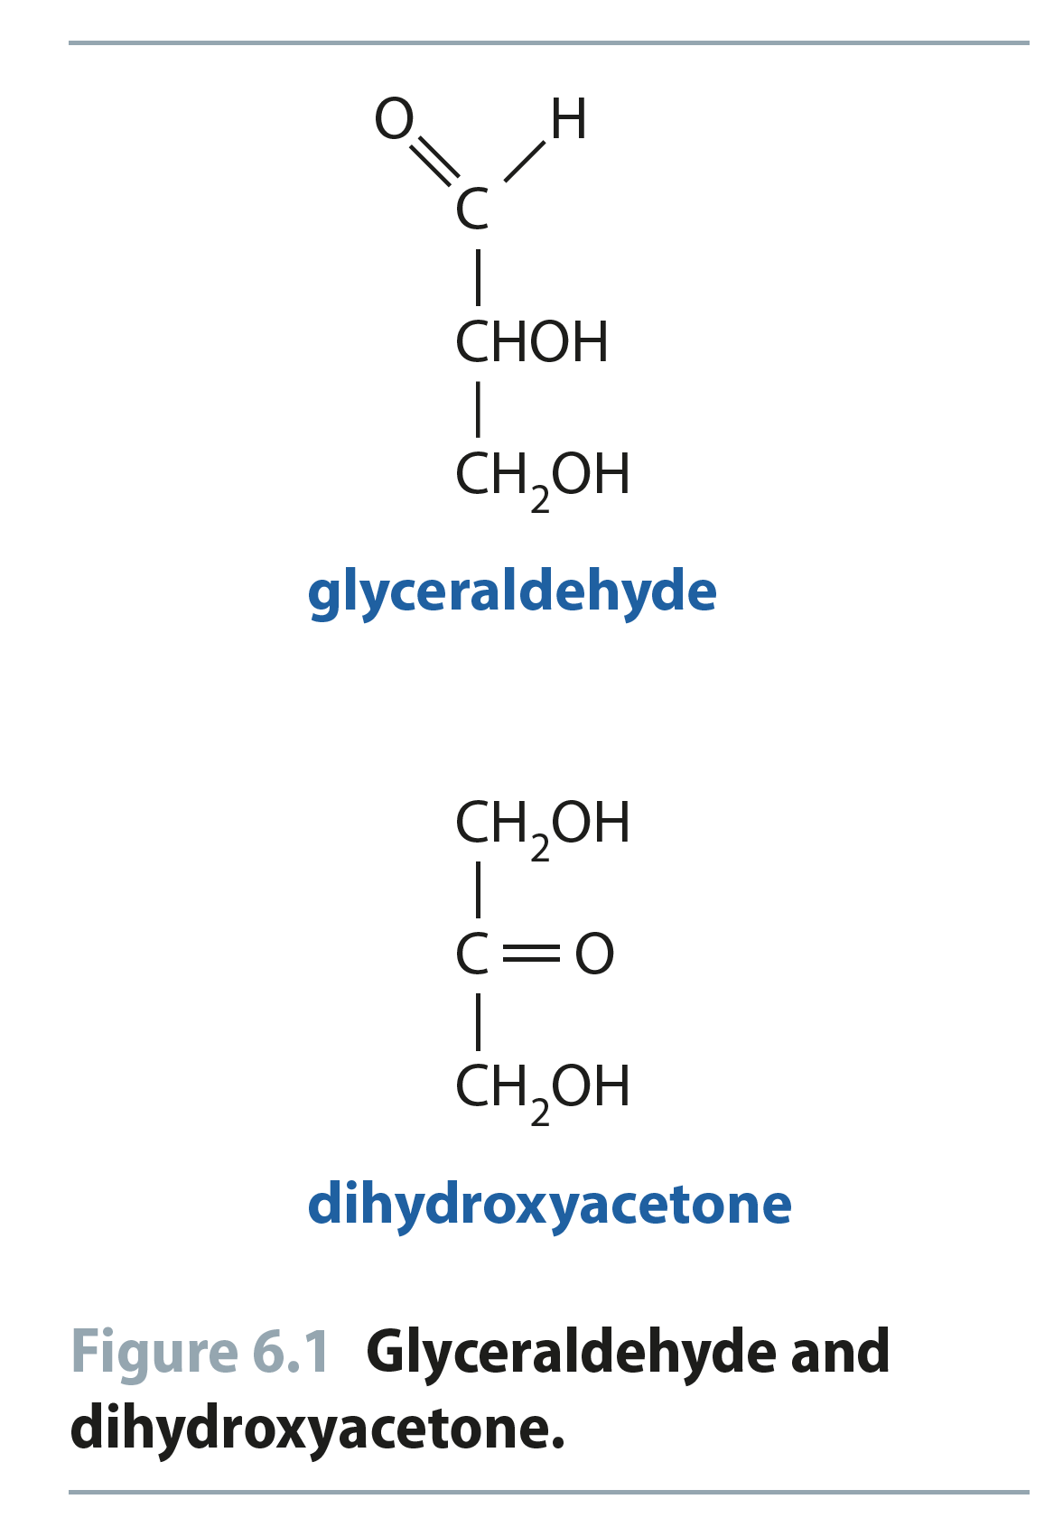
Fig 6.1
Reproduced from: Biochemistry by T.A. Brown, ISBN: 9781907904288 © Scion Publishing Ltd, 2017

Slide 3
D,L Monosaccharides
According to the conventions proposed by Fischer
D-monosaccharide: a monosaccharide that, when written as a Fischer projection, has the -OH on its penultimate carbon on the right
L-monosaccharide: a monosaccharide that, when written as a Fischer projection, has the -OH on its penultimate carbon on the left

Slide 4
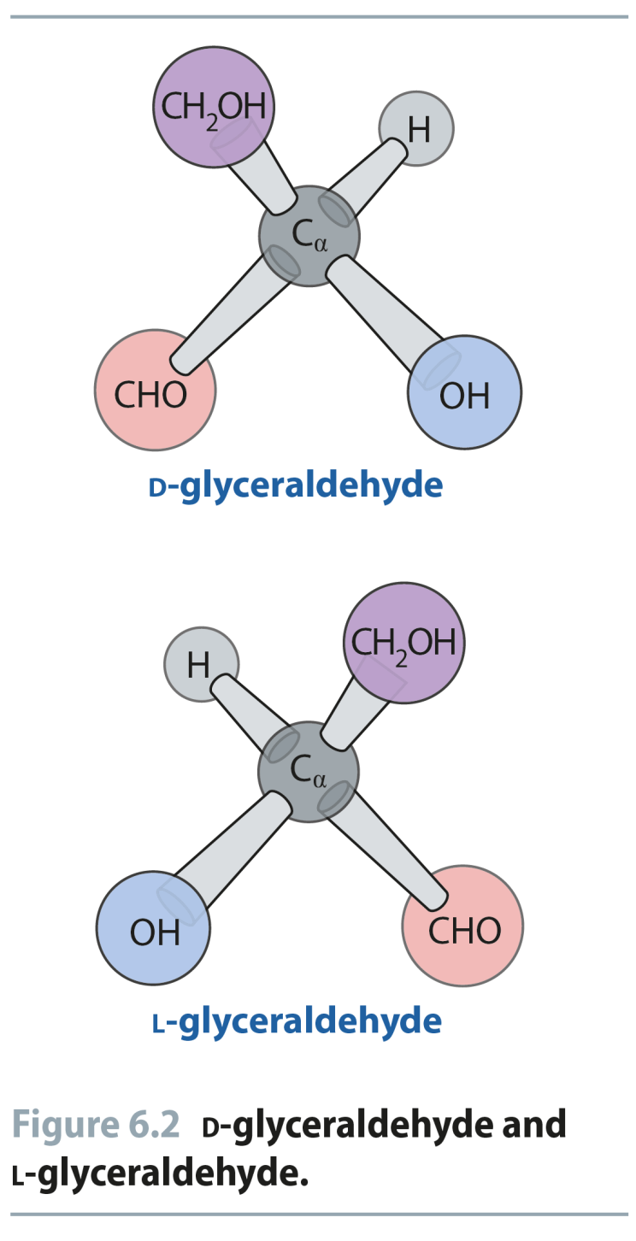
Fig 6.2
Reproduced from: Biochemistry by T.A. Brown, ISBN: 9781907904288 © Scion Publishing Ltd, 2017

Slide 5
Fig 6.3
Reproduced from: Biochemistry by T.A. Brown, ISBN: 9781907904288 © Scion Publishing Ltd, 2017

Slide 6
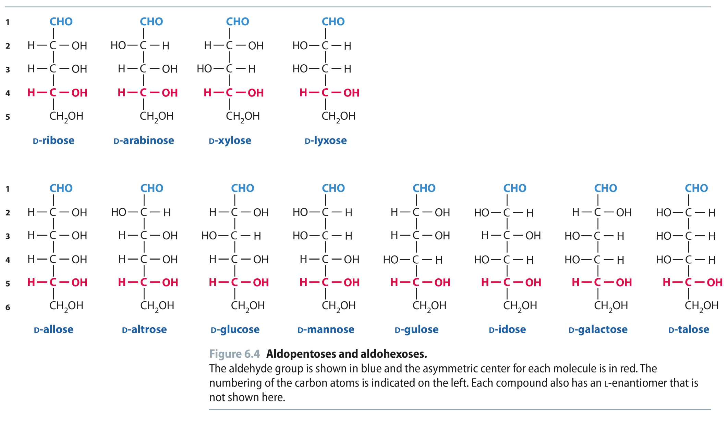
Fig 6.4
Reproduced from: Biochemistry by T.A. Brown, ISBN: 9781907904288 © Scion Publishing Ltd, 2017

Slide 7
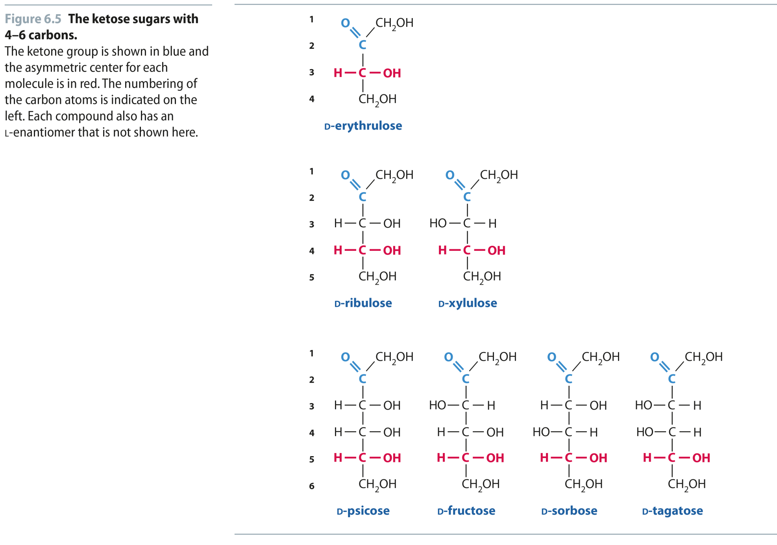
Fig 6.5
Reproduced from: Biochemistry by T.A. Brown, ISBN: 9781907904288 © Scion Publishing Ltd, 2017

Slide 8
What Happens if a Sugar Forms a Cyclic Molecule?
Cyclization of sugars takes place due to interaction between functional groups on distant carbons, C1 to C5, to make a cyclic hemiacetal
Cyclization using C2 to C5 results in hemiketal formation.
In both cases, the carbonyl carbon is new chiral center and becomes an anomeric carbon

Slide 9
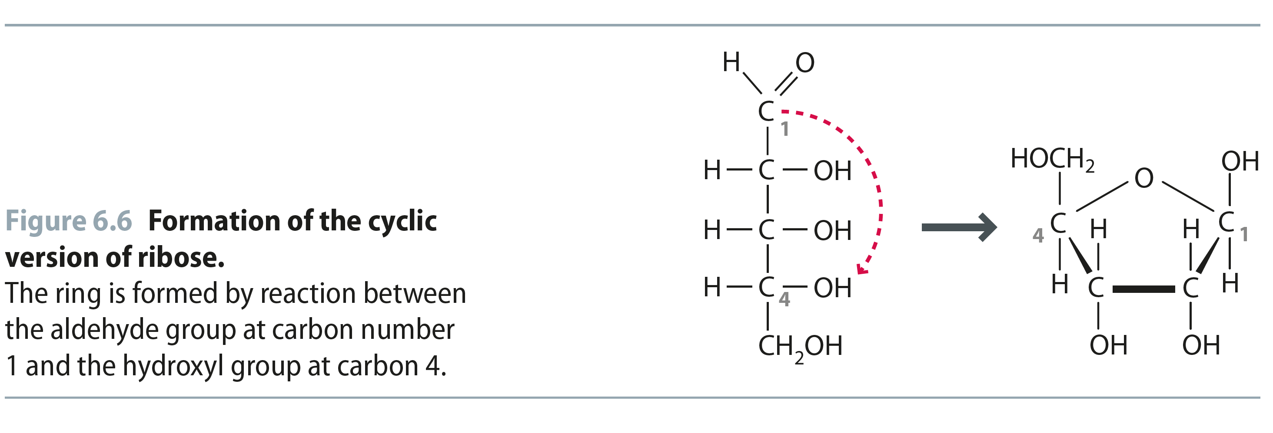
Fig 6.6
Reproduced from: Biochemistry by T.A. Brown, ISBN: 9781907904288 © Scion Publishing Ltd, 2017

Slide 10
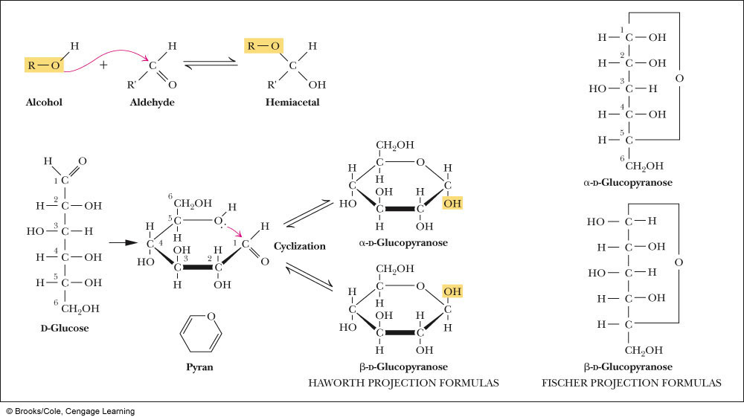
Formation of a Cyclic Hemiacetal

Slide 11
Cyclic Structure
Monosaccharides have -OH and C=O groups in the same molecule and exist almost entirely as five- and six-membered cyclic hemiacetals
anomeric carbon: the new stereocenter resulting from cyclic hemiacetal formation
anomers: carbohydrates that differ in configuration only at their anomeric carbons
For example: alpha- and beta-D-glucose are anomers

Slide 12
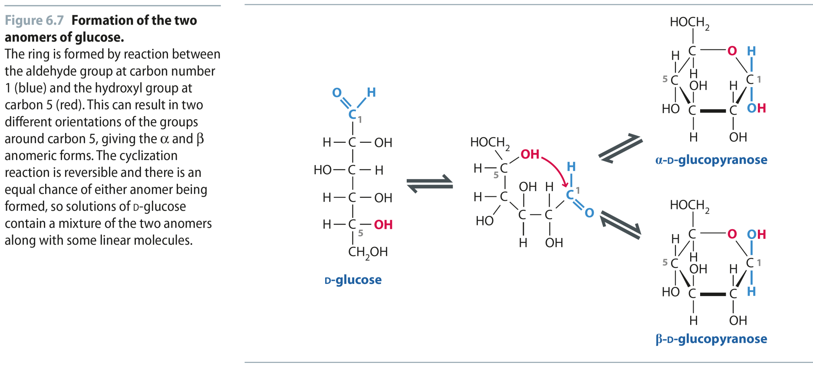
Fig 6.7
Reproduced from: Biochemistry by T.A. Brown, ISBN: 9781907904288 © Scion Publishing Ltd, 2017

Slide 13
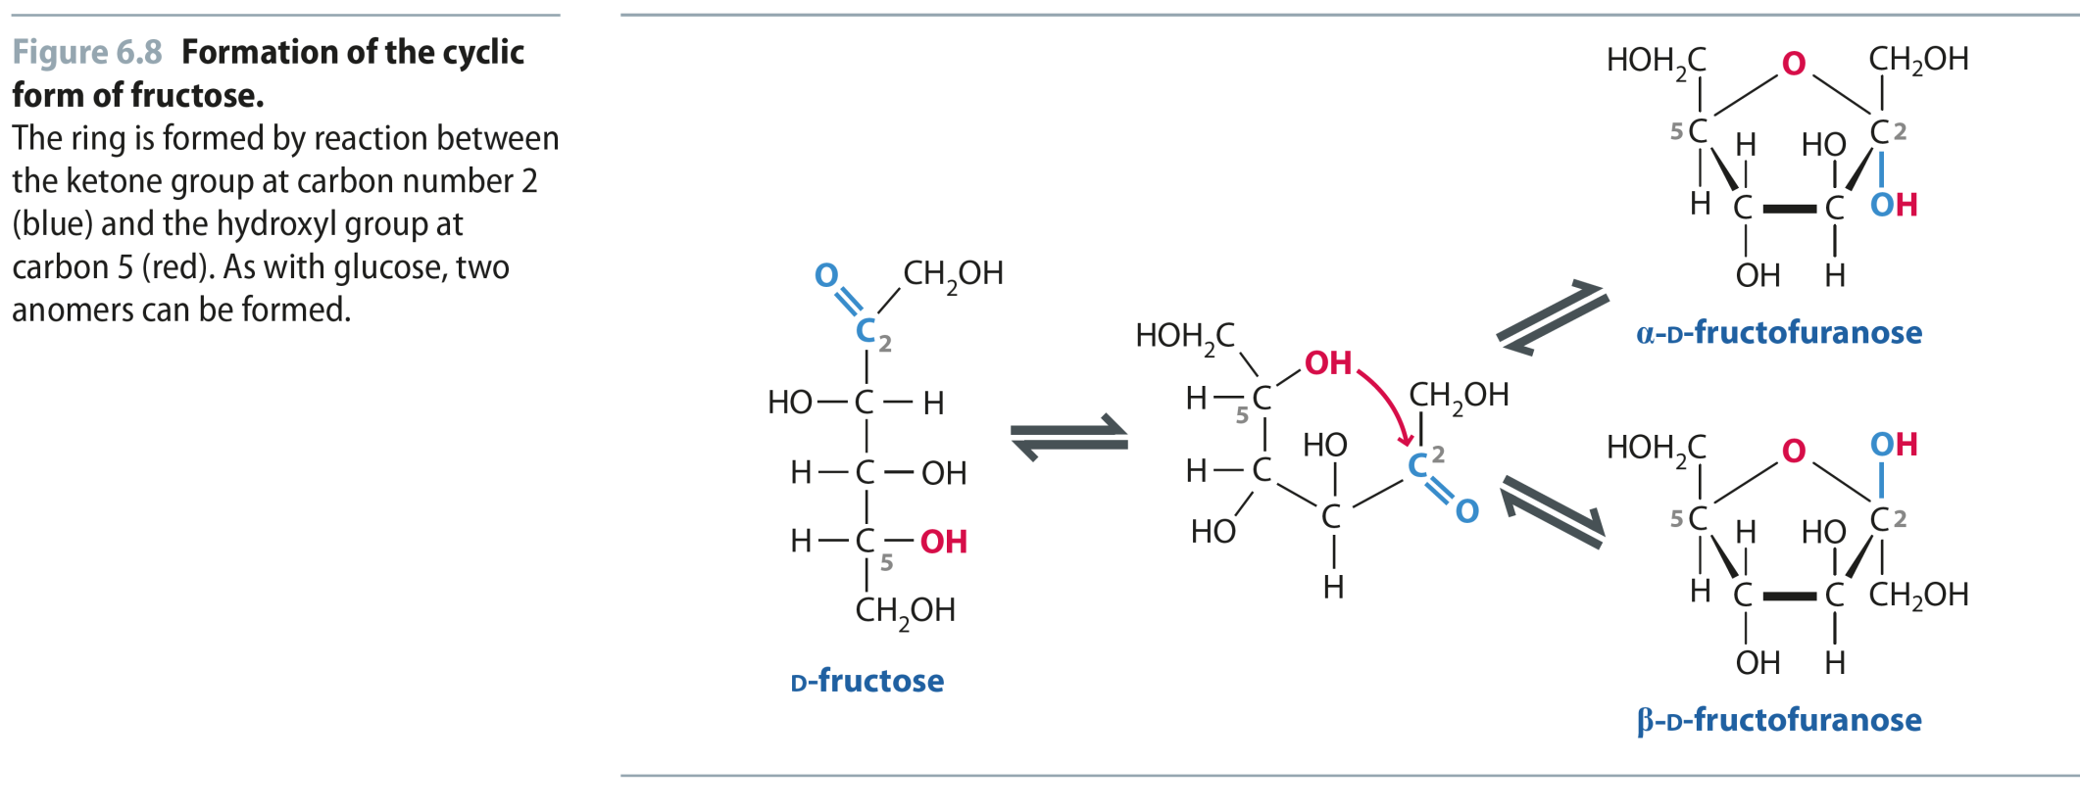
Fig 6.8
Reproduced from: Biochemistry by T.A. Brown, ISBN: 9781907904288 © Scion Publishing Ltd, 2017

Slide 14
Haworth Projections (Cont’d)
A six-membered hemiacetal ring is shown by the infix -pyran- (pyranose)
A five-membered hemiacetal ring is shown by the infix -furan- (furanose)
Five-membered rings are so close to being planar that Haworth projections are adequate to represent furanoses
For pyranoses, the six-membered ring is more accurately represented as a strain-free chair conformation

Slide 15
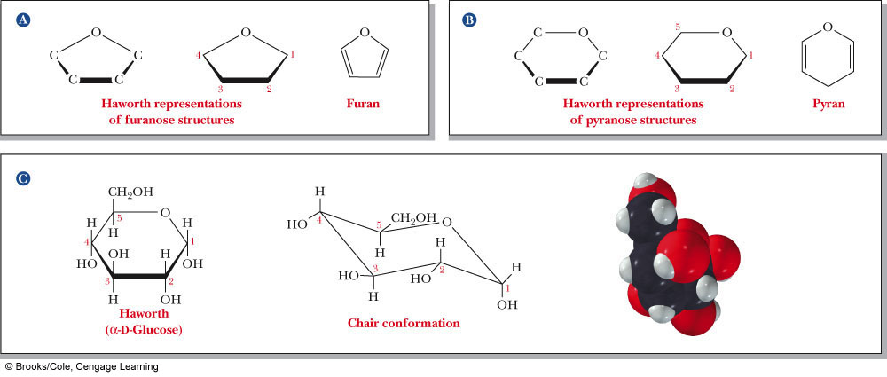
Haworth Projections (Cont’d)

Slide 16
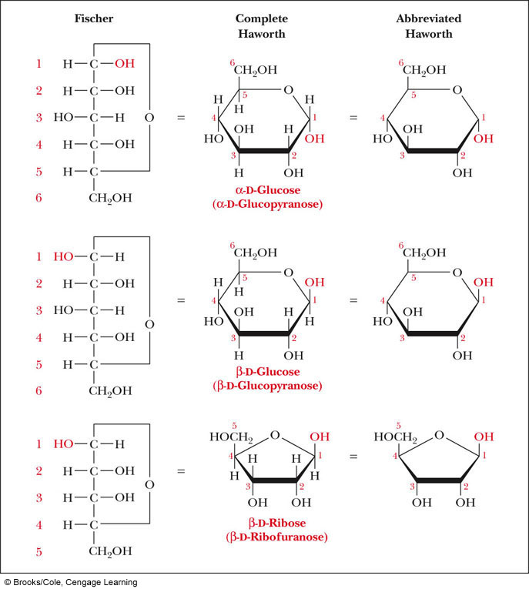
Comparison of the Fischer and Haworth Representations
Groups on the Right Side of the Fischer Representation are drawn as DOWN in the Haworth Projection
DDUDU Rule!

Slide 17
Glycosidic Bond Formation
Glycoside: a carbohydrate in which the -OH of the anomeric carbon is replaced by -OR
those derived from furanoses are furanosides; those derived from pyranoses are pyranosides
glycosidic bond: the bond from the anomeric carbon to the -OR group
This is the basis for the formation polysaccharides/oligosaccharides

Slide 18
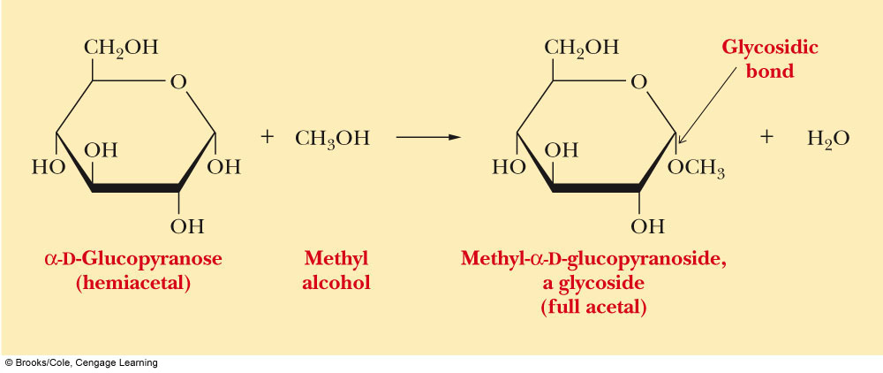
Glycosidic Bond Formation (Cont’d)

Slide 19
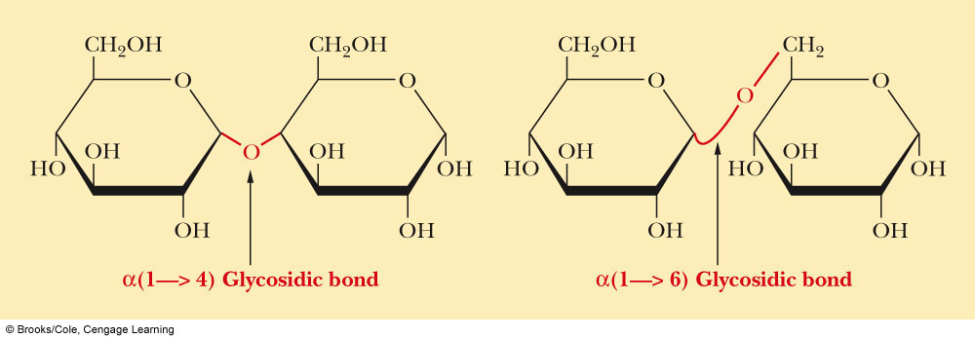
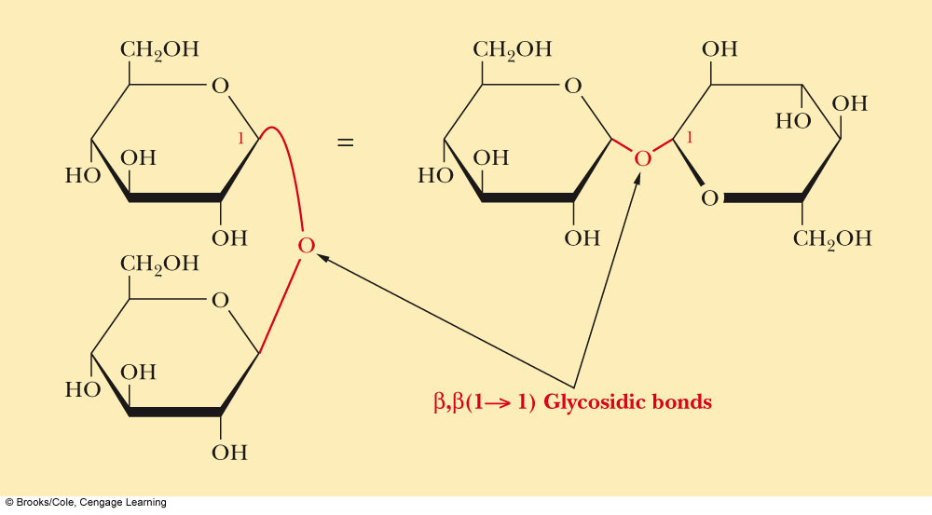
Two Different Disaccharides of α-D-Glucose
Glycosidic linkages can take various forms; the anomeric carbon of one sugar to any of the -OH groups of another sugar to form an α- or β-glycosidic linkage
Different linkages, different properties

Slide 20
Disaccharides
Sucrose
Table sugar; obtained from the juice of sugar cane and sugar beet
One unit of D-glucose and one unit of D-fructose joined by an α-1,2-glycosidic bond
Lactose
Made up of D-galactose and one unit of D-glucose joined by a β-1,4-glycosidic bond
Galactose is a C-4 epimer of glucose
Maltose
Two units of D-glucose joined by an α-1,4-glycosidic bond
Formed from the hydrolysis of starch
Differs from cellobiose by the conformation of the glycosidic linkage

Slide 21
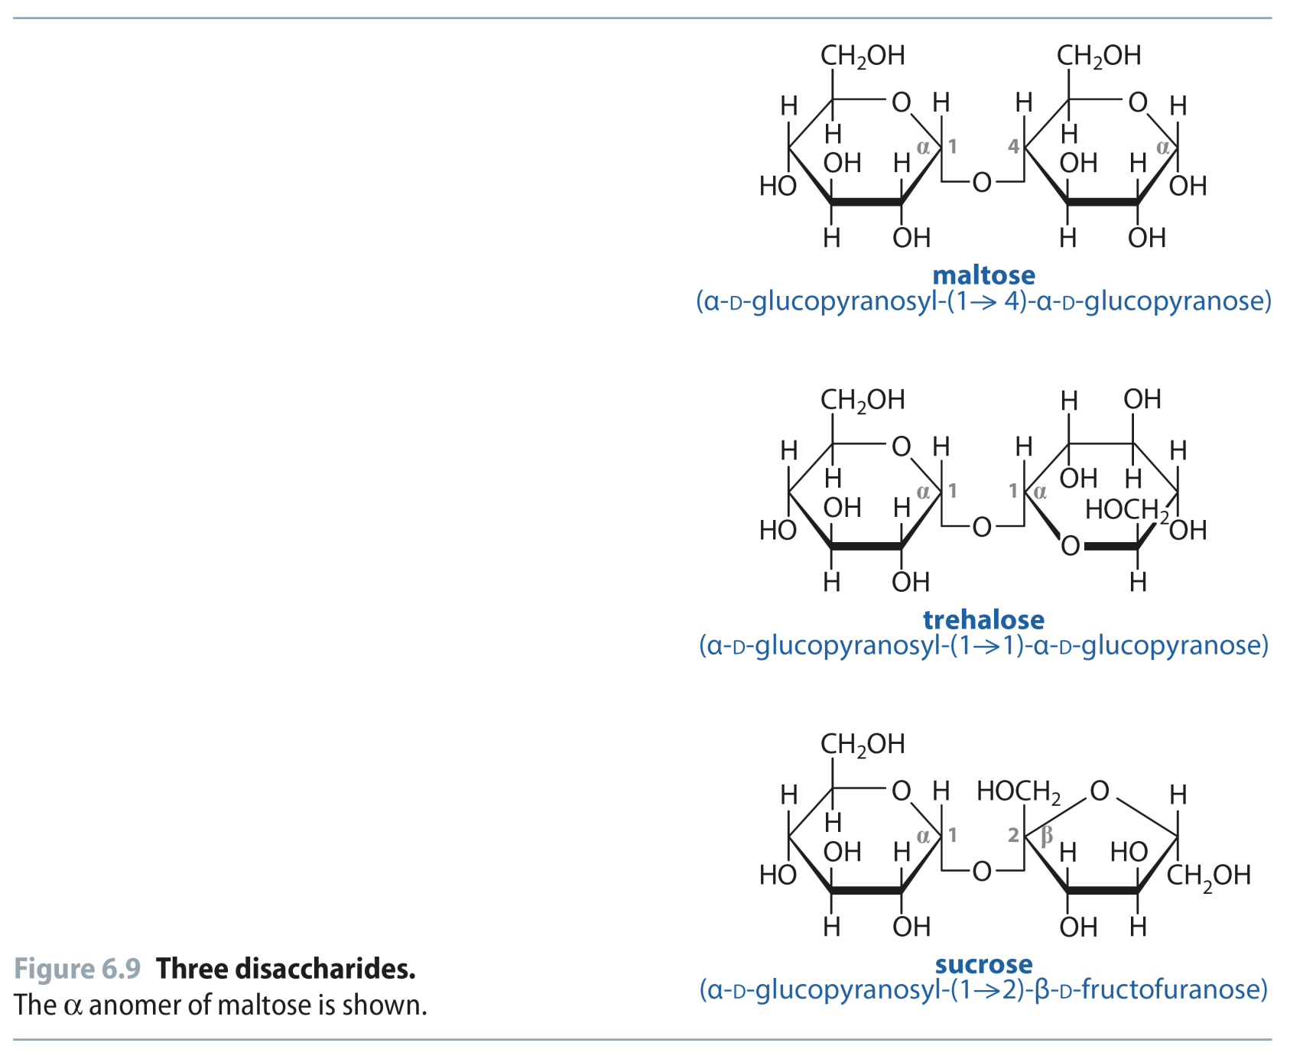
Fig 6.9
Reproduced from: Biochemistry by T.A. Brown, ISBN: 9781907904288 © Scion Publishing Ltd, 2017

Slide 22
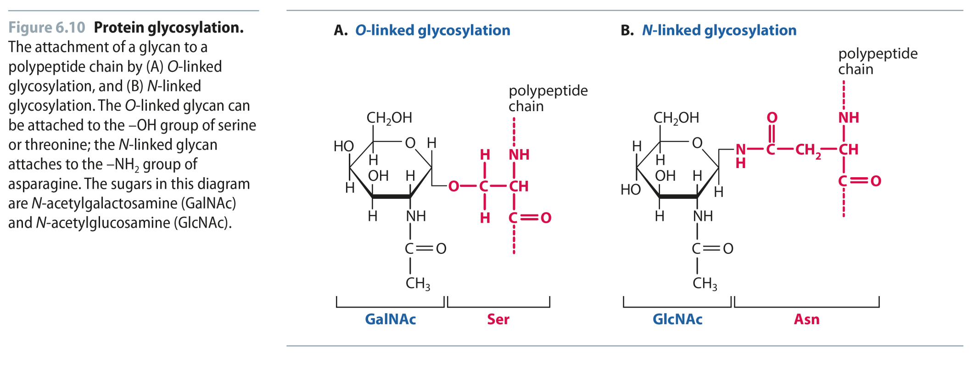
Fig 6.10
Or
Thr
Reproduced from: Biochemistry by T.A. Brown, ISBN: 9781907904288 © Scion Publishing Ltd, 2017

Slide 23
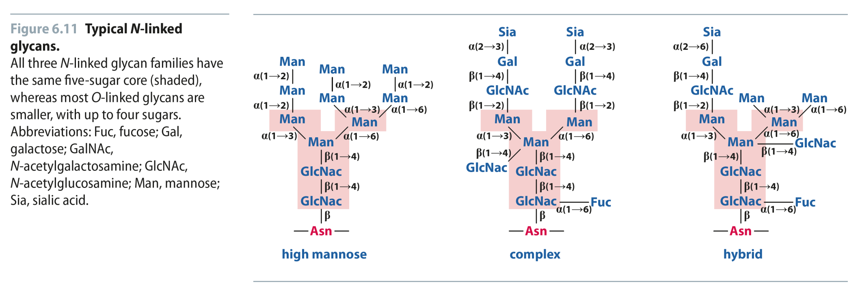
Fig 6.11
Reproduced from: Biochemistry by T.A. Brown, ISBN: 9781907904288 © Scion Publishing Ltd, 2017

Slide 24
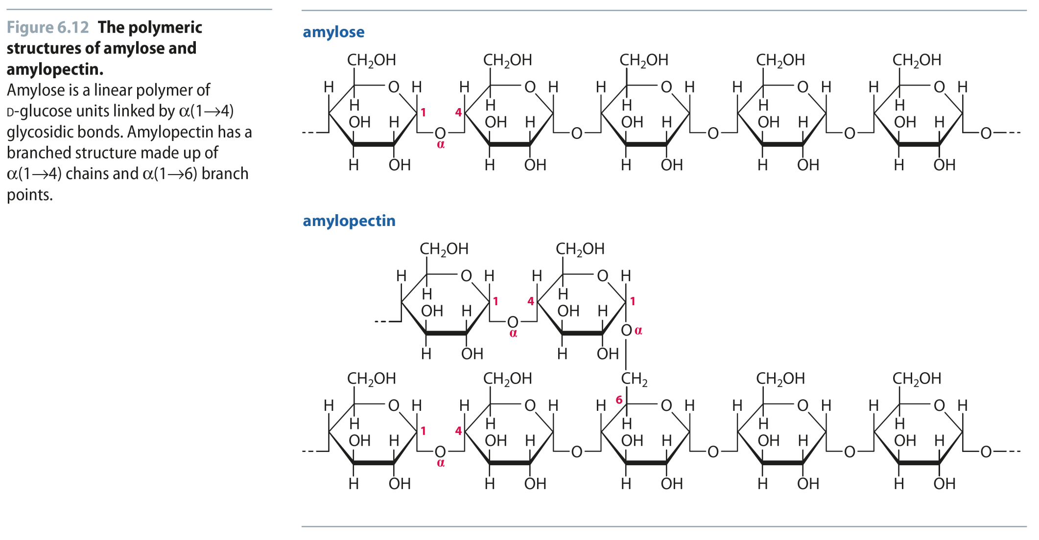
Fig 6.12
Reproduced from: Biochemistry by T.A. Brown, ISBN: 9781907904288 © Scion Publishing Ltd, 2017

Slide 25
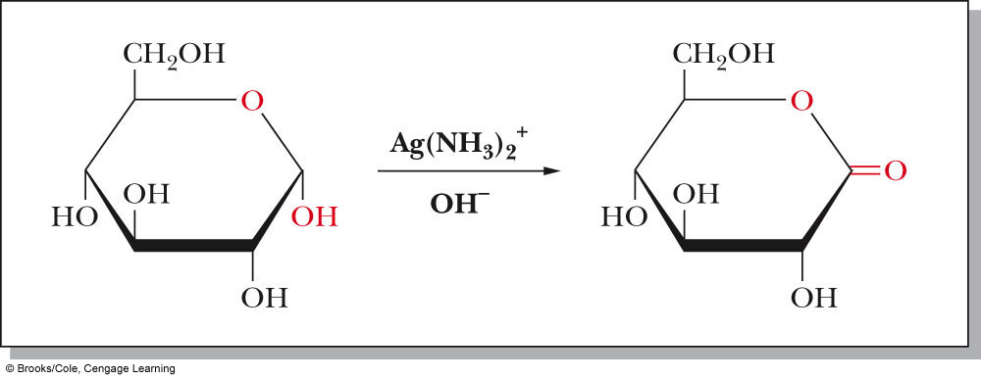
Reaction of Monosaccharides
Reducing sugar: one that reduces an oxidizing agent
Oxidation of a cyclic hemiacetal form gives a lactone
When the oxidizing agent is Tollens solution, silver precipitates as a silver mirror
If anomeric carbons are involved in glycosidic linkage, there will be a negative Tollens reagent test
If another anomeric carbon is not bonded and is free, there will be a positive Tollens reagent test

Slide 26
Fig 6.13
Reproduced from: Biochemistry by T.A. Brown, ISBN: 9781907904288 © Scion Publishing Ltd, 2017

Slide 27
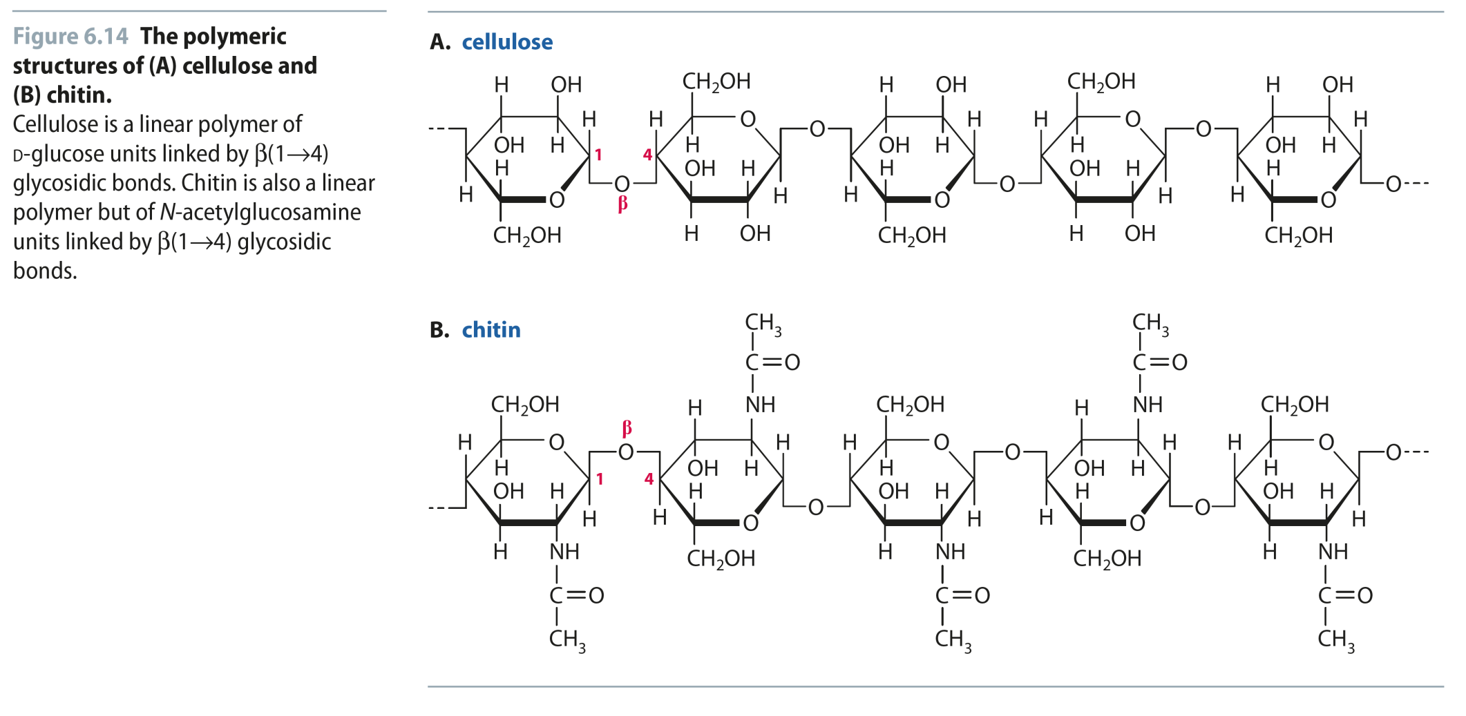
Fig 6.14
Reproduced from: Biochemistry by T.A. Brown, ISBN: 9781907904288 © Scion Publishing Ltd, 2017

Slide 28
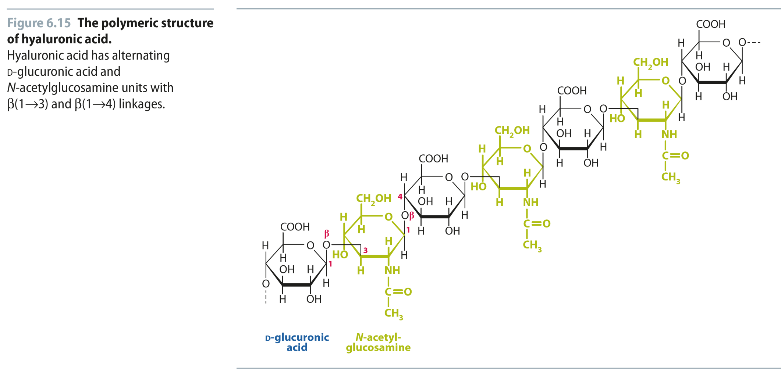
Fig 6.15
Reproduced from: Biochemistry by T.A. Brown, ISBN: 9781907904288 © Scion Publishing Ltd, 2017

Slide 29
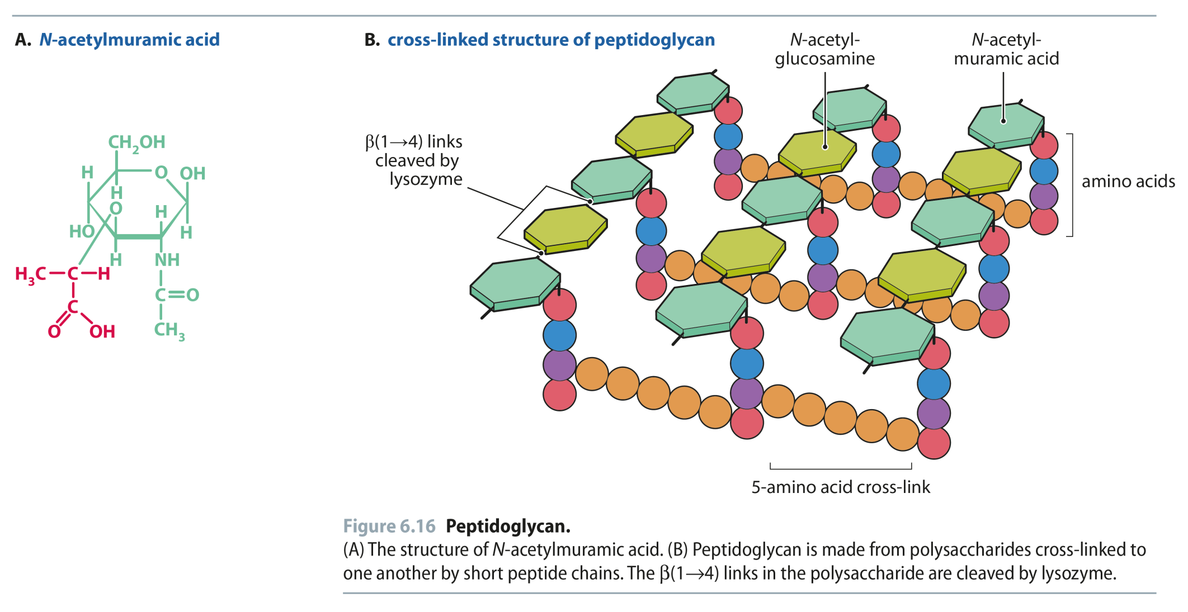
Fig 6.16
Reproduced from: Biochemistry by T.A. Brown, ISBN: 9781907904288 © Scion Publishing Ltd, 2017

Slide 30
Chicken Egg White Lysozyme
Enzyme responsible for degrading bacterial cell walls
Hydrolyzes the glycosidic linkage between NAM and NAG

Slide 31
Chicken Egg White Lysozyme
Binding Site
Substrate fits in groove in enzyme

