Slide 1
Hydrocarbons
Hydrocarbons are compounds consisting of only carbon and hydrogen
Aromatic Hydrocarbons: Contain a benzene ring
Aliphatic Hydrocarbons: No benzene ring; usually a chain
Some molecules have both

Slide 2
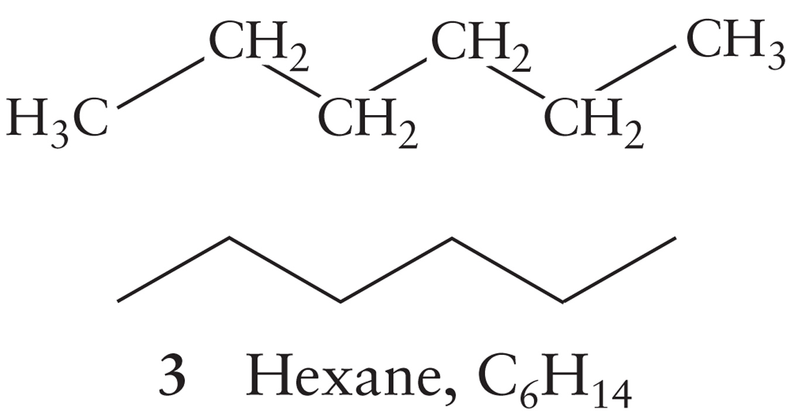
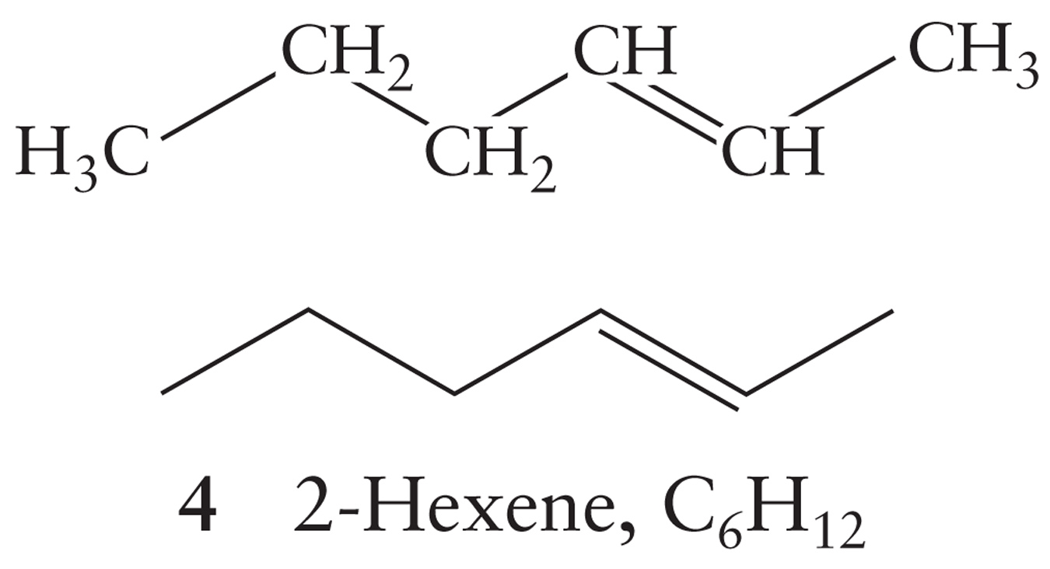
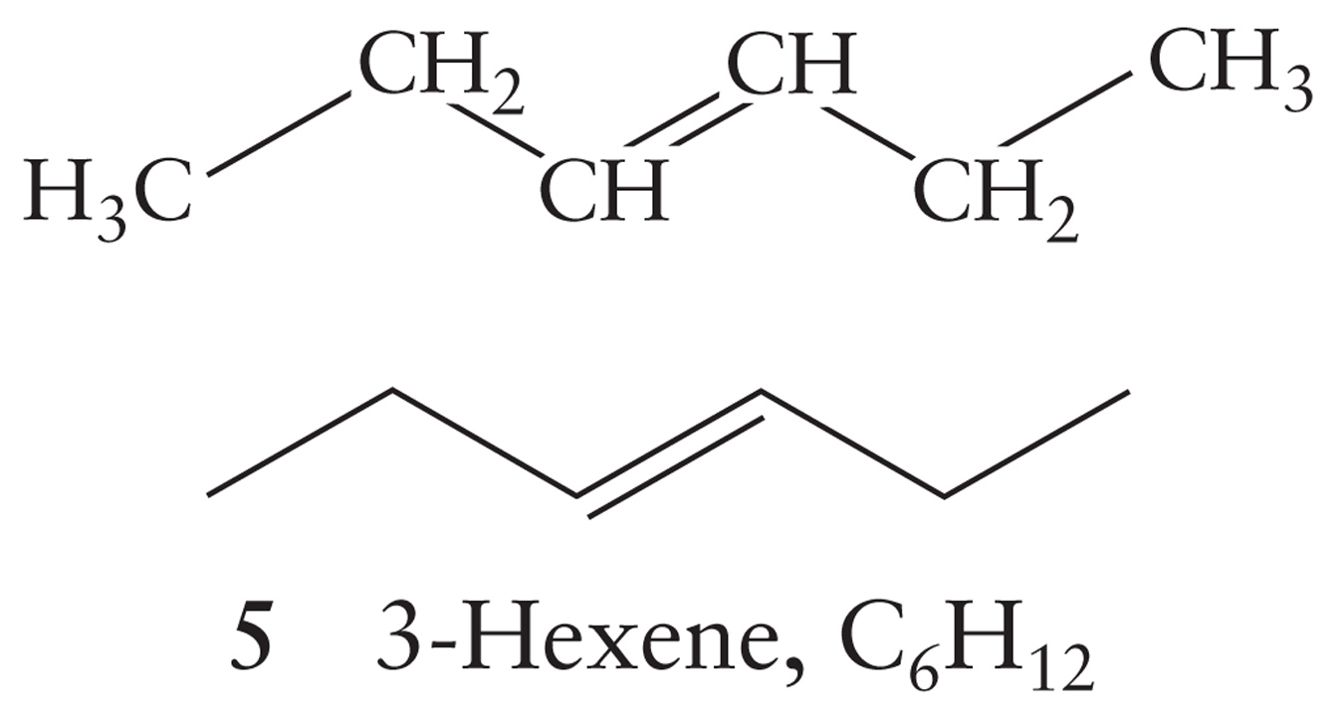
Aliphatic Hydrocarbons
Because we’re talking about chains and carbon will have 4 bonds, we need to define some terms
Saturated Hydrocarbons: No multiple carbon-carbon bonds
The carbons are saturated with hydrogens
Unsaturated Hydrocarbons: One or more multiple carbon-carbon bonds exist

Slide 3
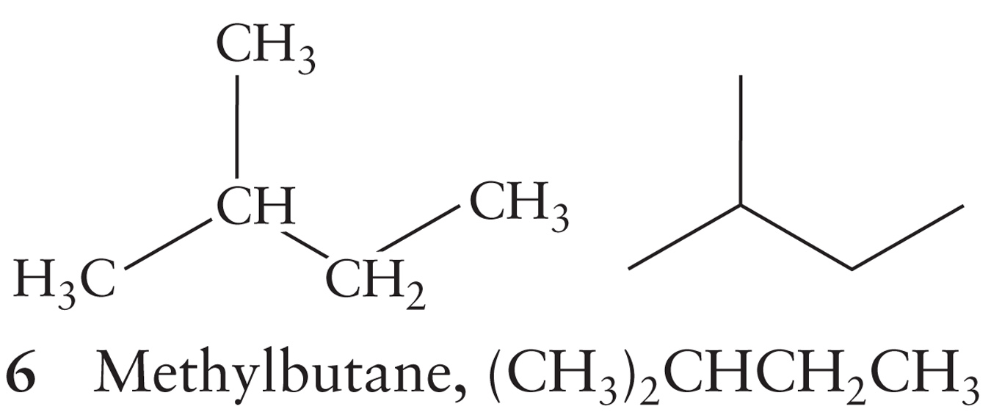
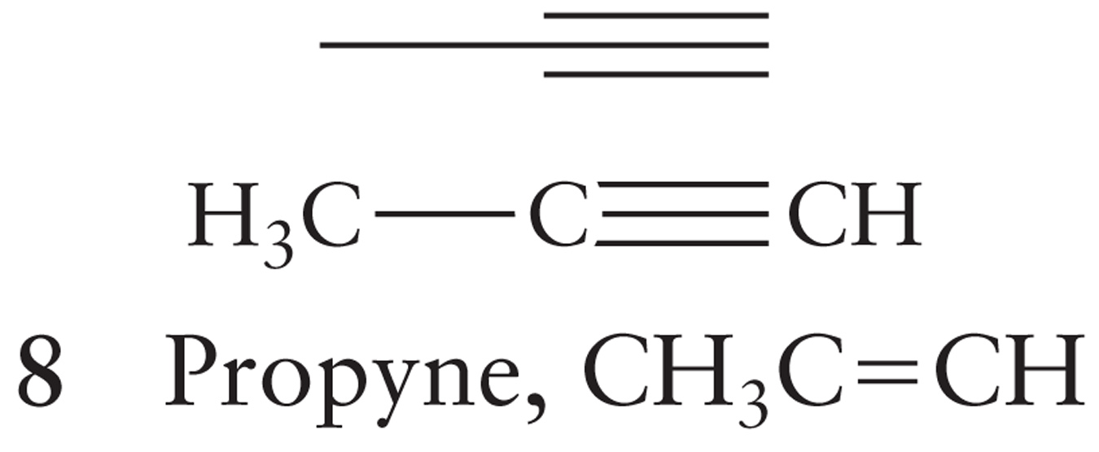
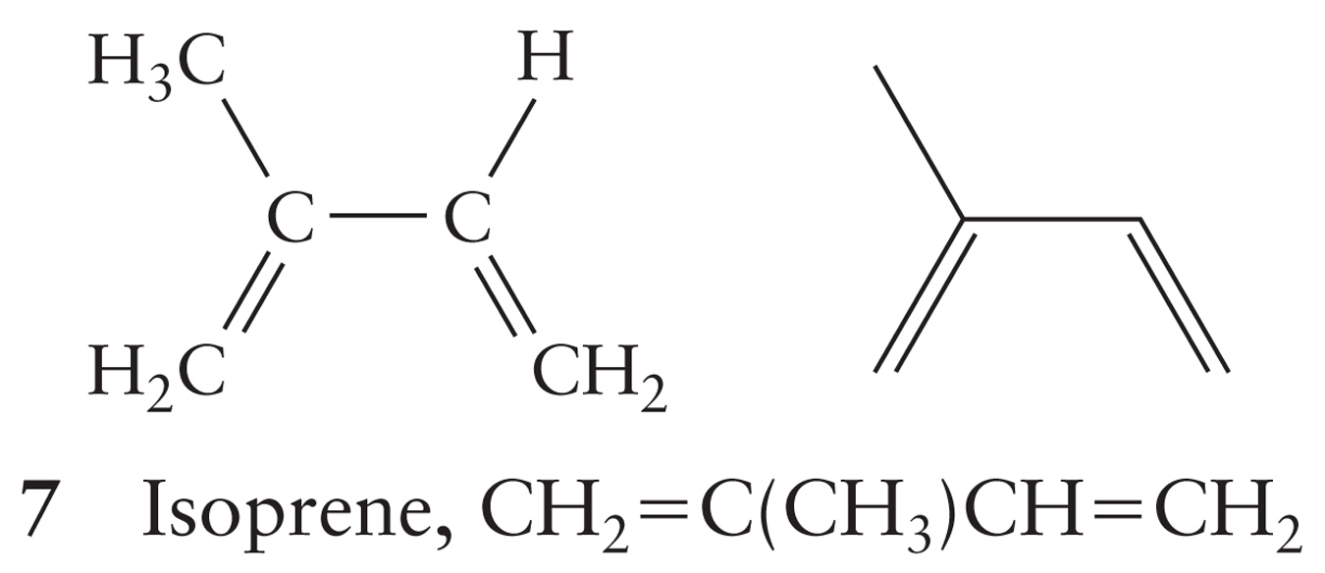
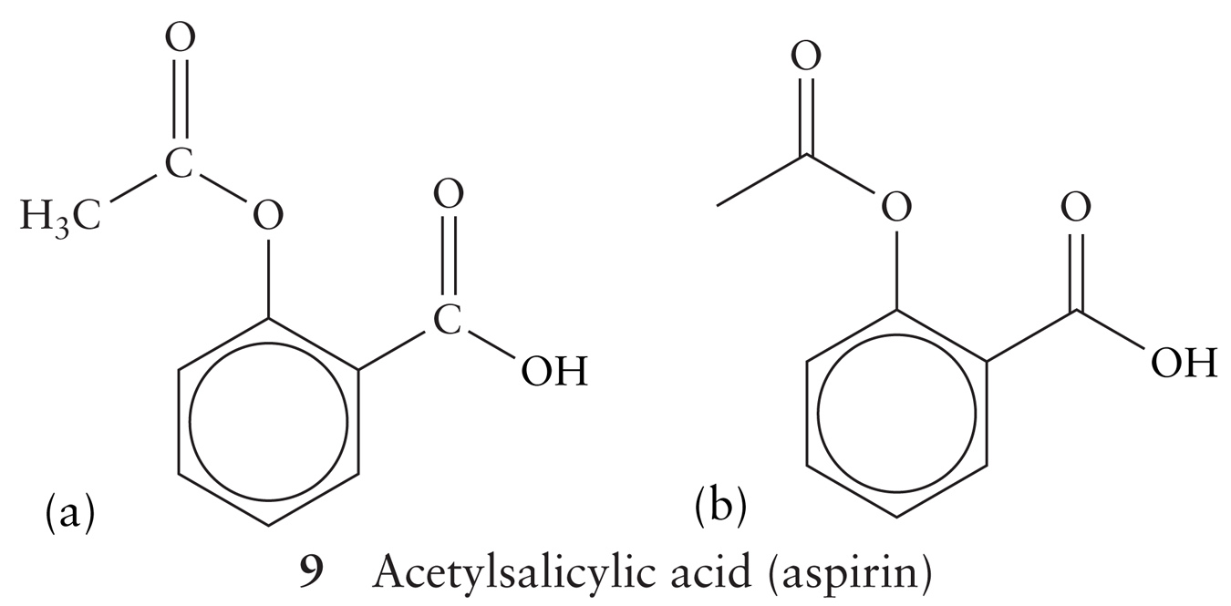
Dealing with Organic Formulas and Structures
Condensed Structural Formula: Shows how the atoms are grouped together
Line Structure: Represents the chain as a zig-zag line

Slide 4
Aliphatic Hydrocarbons
Alkanes: Saturated hydrocarbons (all single bonds)
Alkenes: Unsaturated hydrocarbons with carbon-carbon double bond(s)
Alkynes: Unsaturated hydrocarbons with carbon-carbon triple bond(s)

Slide 5
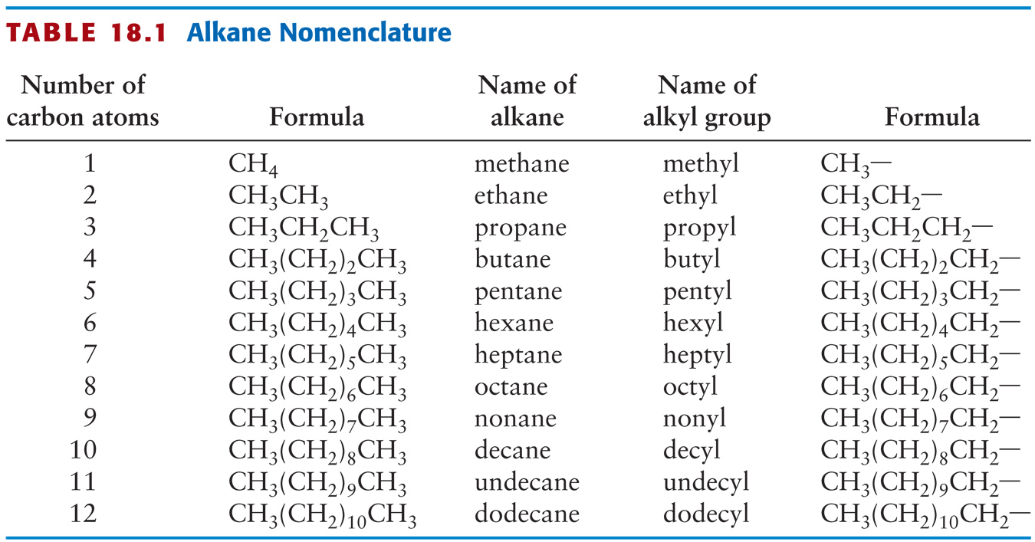
Naming Hydrocarbons
These are the base names

Slide 6
Naming Hydrocarbons: Rules
Alkanes end with _____. Alkenes end with _____. Alkynes end with _____
Branched chain hydrocarbons are based on the longest continuous carbon chain in the molecule
When you have substituents, the carbons in the longest chain are numbered consecutively starting at the end that gives the lower number to the substituent
The prefixes di-, tri-, tetra-, penta-, hexa-, … indicate how many of each substituent are in the molecule
For alkenes and alkynes, number the molecule such that the lowest numbered carbon has the multiple bond

Slide 7
Isomers
Two types: Structural isomers and Stereoisomers
Structural Isomers: Same atoms, different binding arrangements.
A-B-C or C-A-B
Let’s look at Butane and Methylpropane as an example


Slide 8
Isomers: Stereoisomers
Stereoisomers: The molecules are connected the same, but are arranged differently in space.
There are 2 primary types of stereoisomers:
Geometrical Isomers: The atoms on either side of a bond are arranged differently
Optical Isomers: The molecules are each other’s non-superimposable mirror image

Slide 9
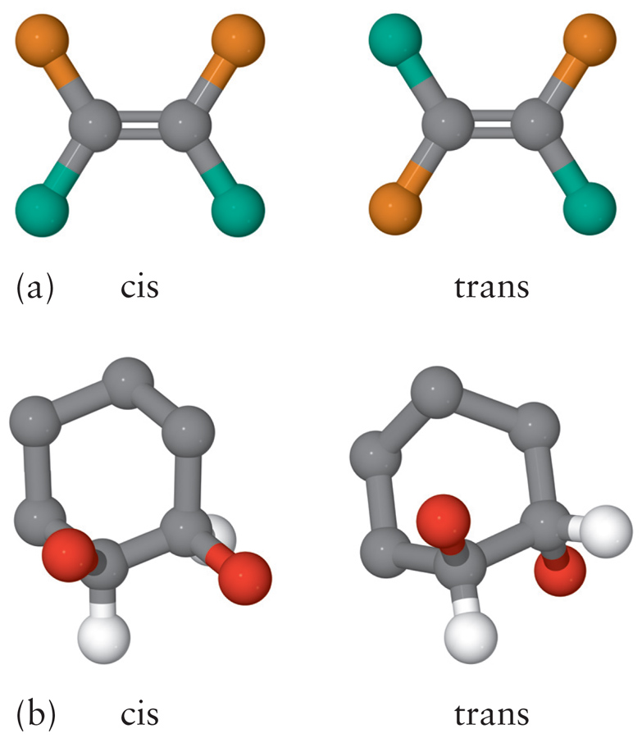
Geometrical Isomers
A clear dividing plane gives the molecule a top half and a bottom half.
If the arrangement of atoms is the same on either side of this plane, the molecule is the cis- isomer
If the arrangement is different, the molecule is the trans- isomer

Slide 10
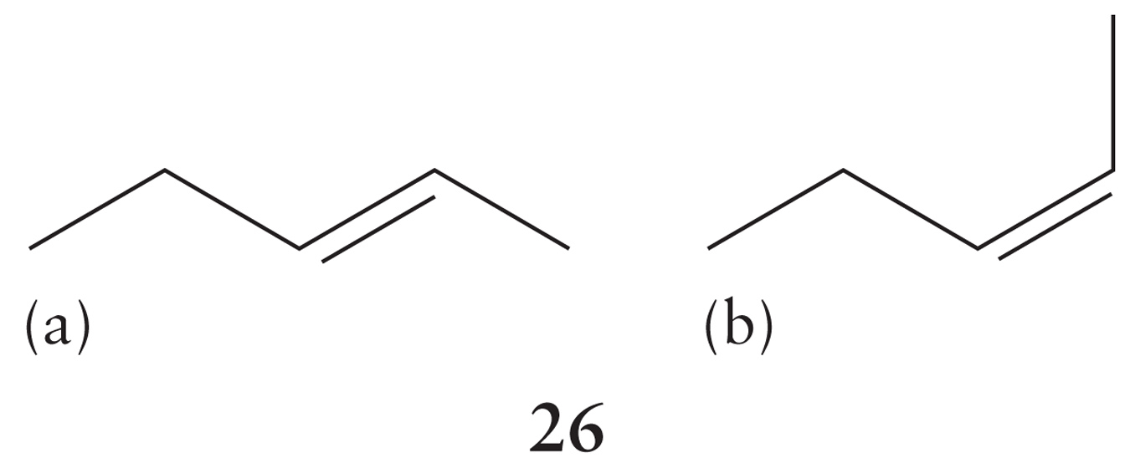
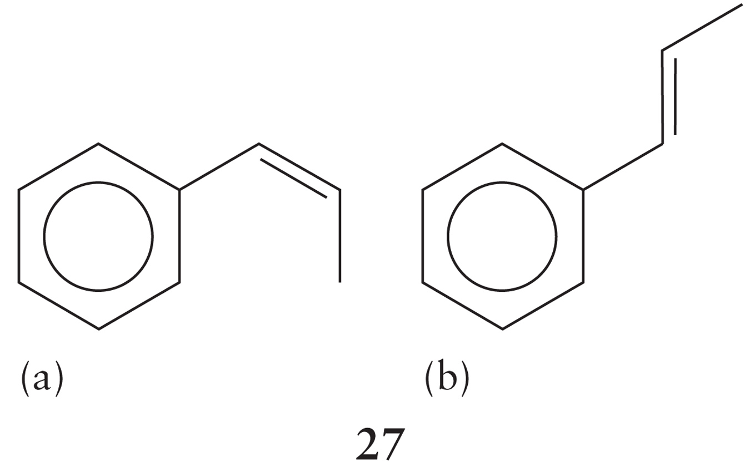
Geometrical Isomers
Are these molecules cis- or trans- ?

Slide 11
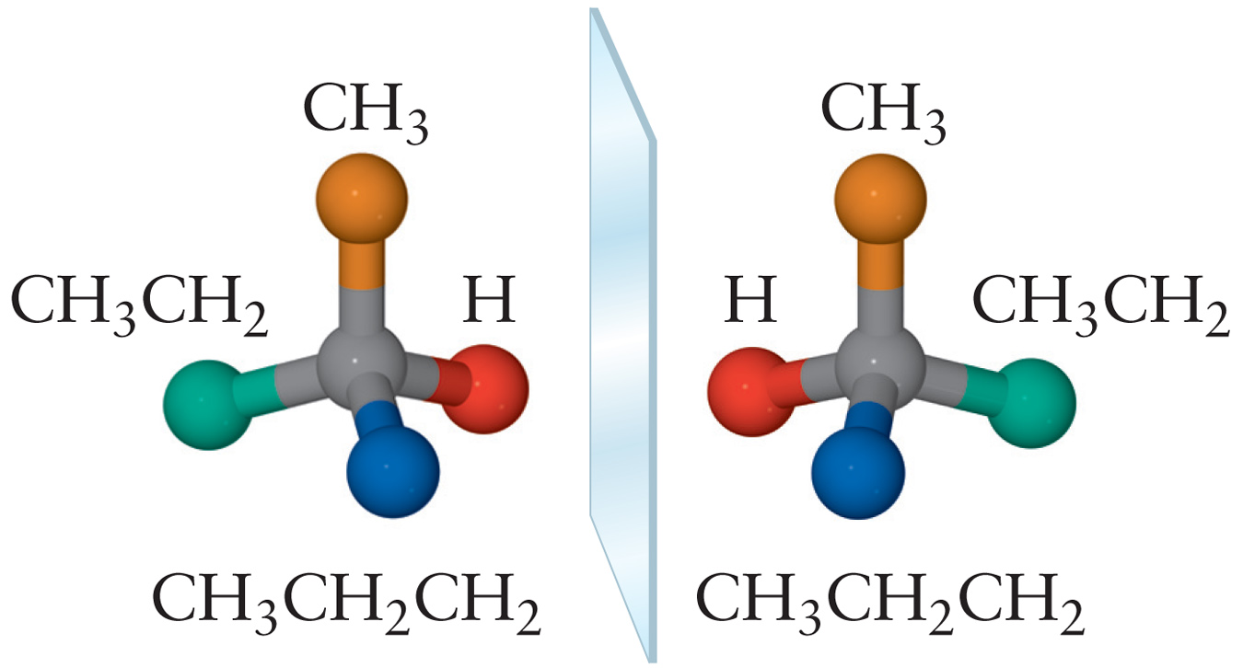
Optical Isomers
Go ahead and mentally rotate the molecules
Do the Blue and Red spheres line up?
It’s the same as trying to superimpose your left and right hands

Slide 12
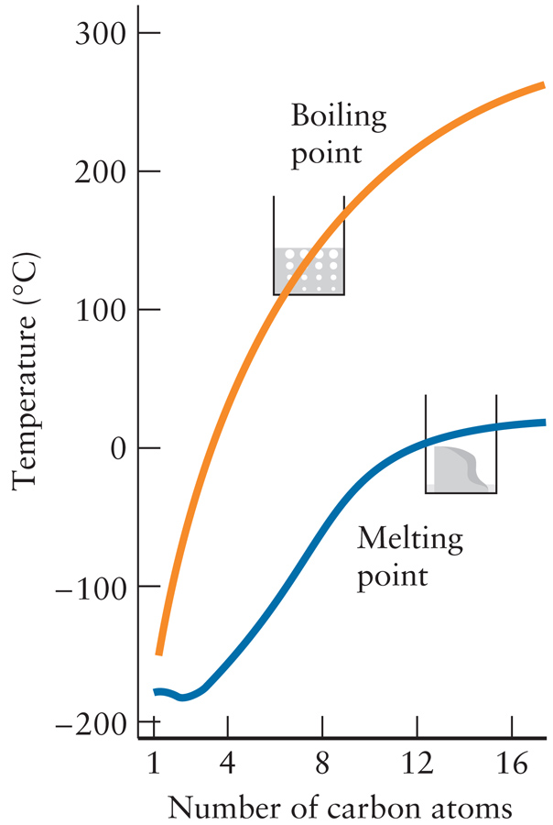
Properties of Alkanes
Hydrocarbons are nonpolar
The only intermolecular force between adjacent hydrocarbons is the London Force
Methane through Butane are gases at room temperature

Slide 13
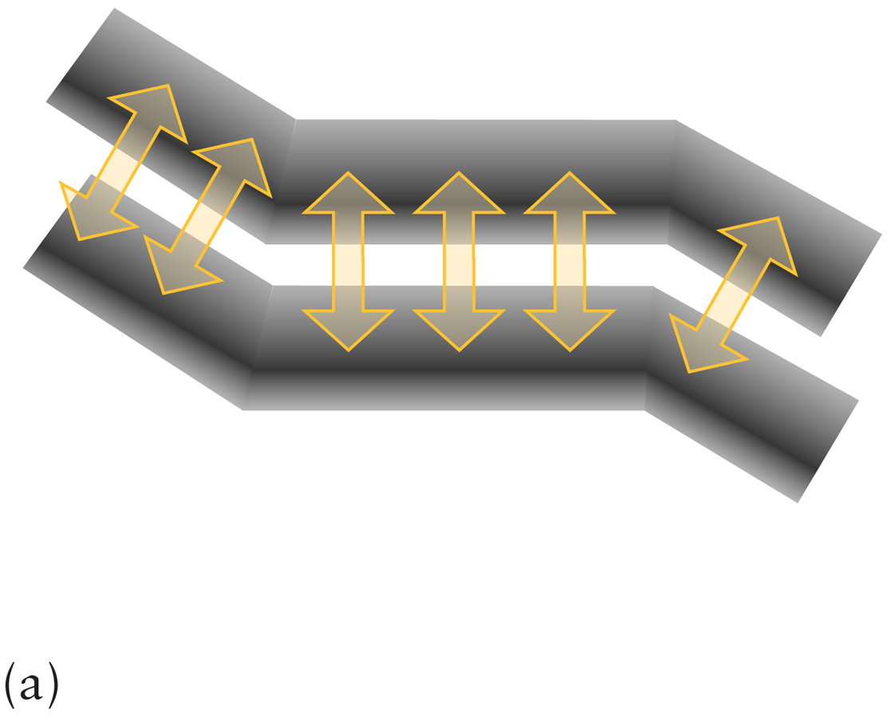
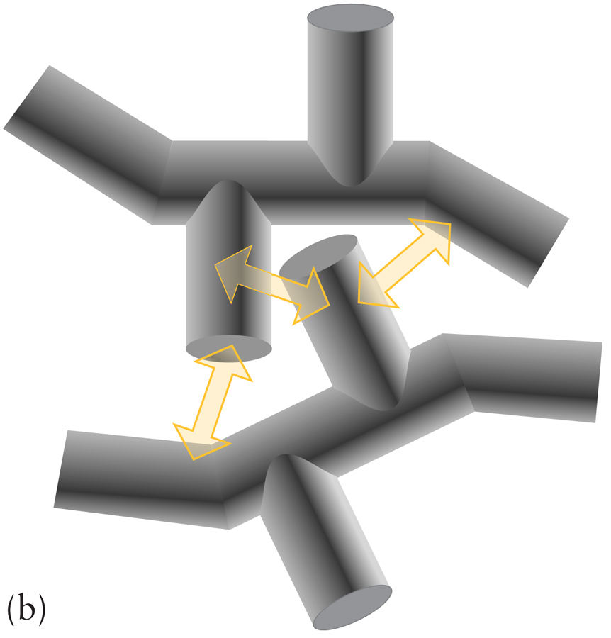
Properties of Alkanes
Long chain hydrocarbons have higher melting points than branched chains with the same number of carbons
Fatty acids in cell membranes take advantage of this to make themselves more fluid

Slide 14
Properties of Alkanes
Parrafins are what alkanes were once called and you’ll sometimes hear the term used today
Means “Little Affinity”
They got this name because they do not react with:
Strong Acids
Strong Bases
Oxidizing Agents
Why?
The bond enthalpies of the C-C and C-H bonds are so high
Alkanes WILL undergo 2 types of reactions:
Combustion
Substitution: Some atom (say a halide) replaces a hydrogen on the hydrocarbon

Slide 15
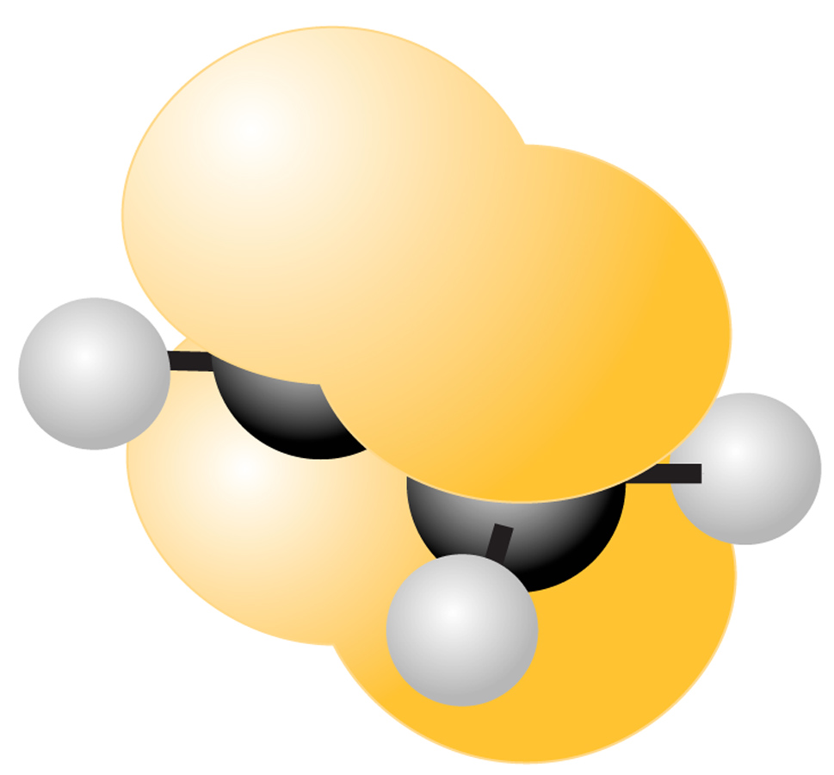
Properties of Alkenes
The C-C double bond is more reactive than a single C-C bond
The electron density is more exposed above and below the plane of the molecule
The atoms can’t spin around the sigma bond
The double bond prevents molecules from packing as tightly
Lower melting points than similar alkanes

Slide 16
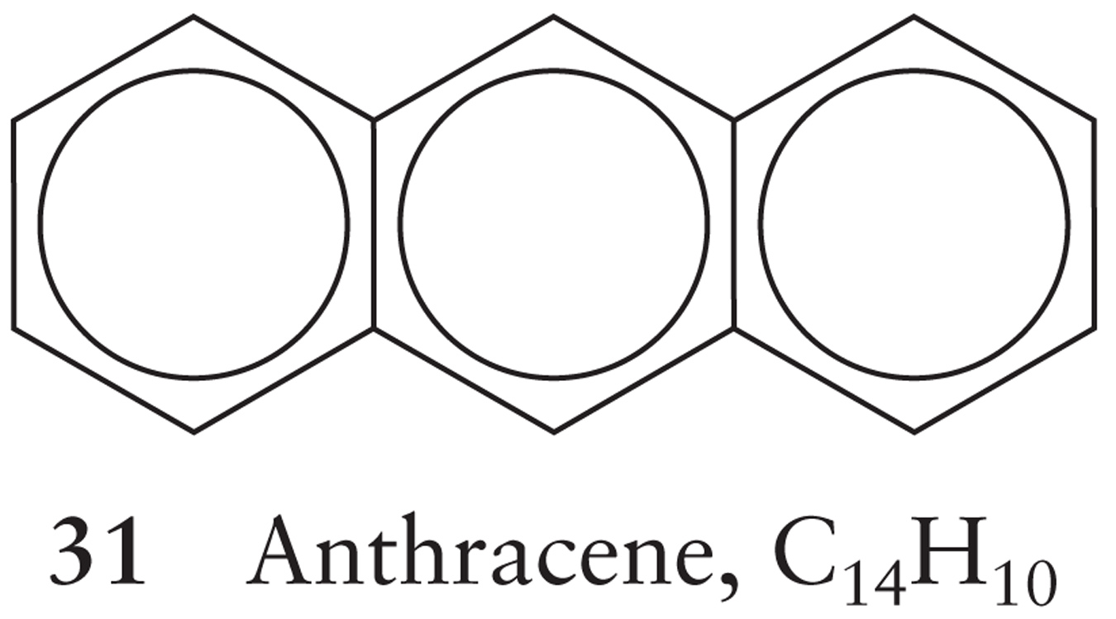
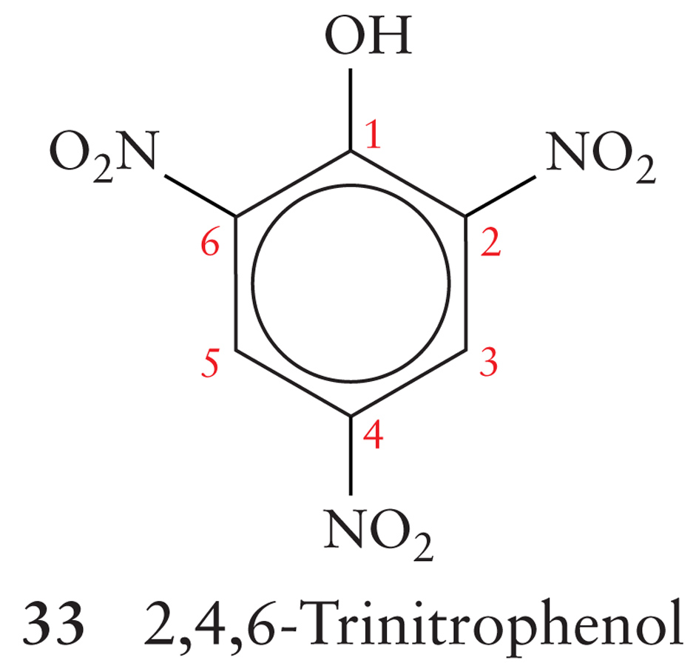
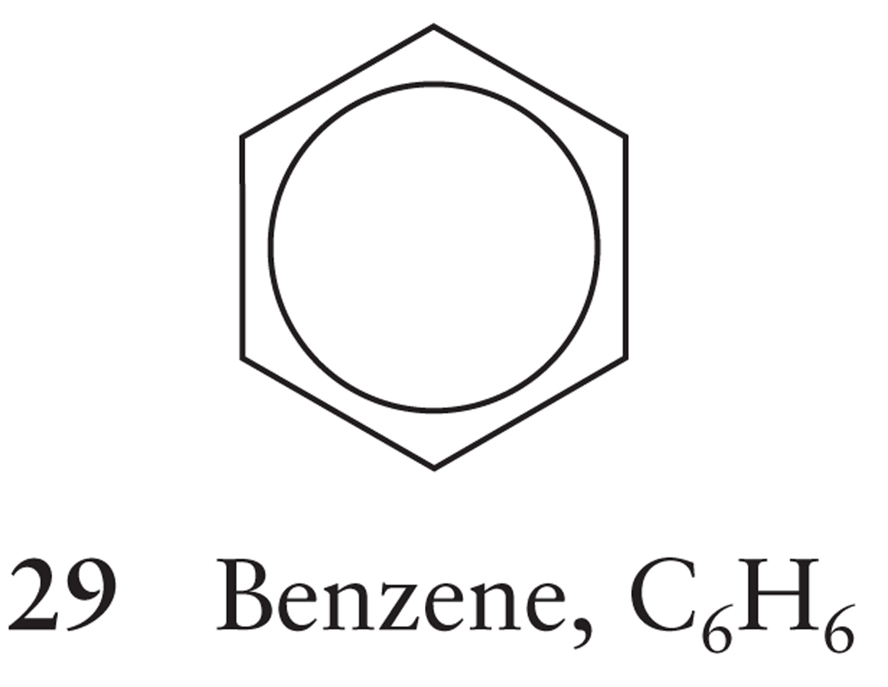
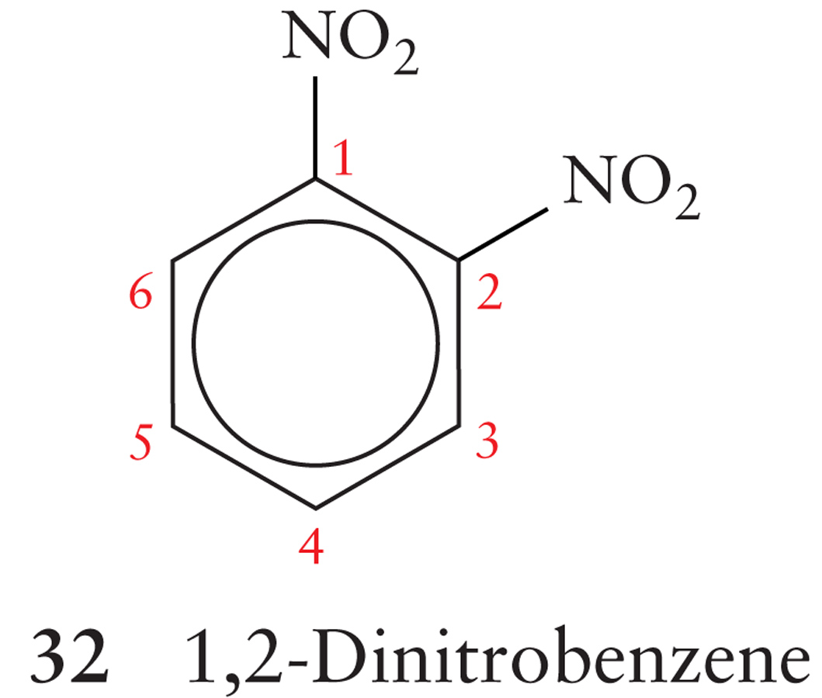
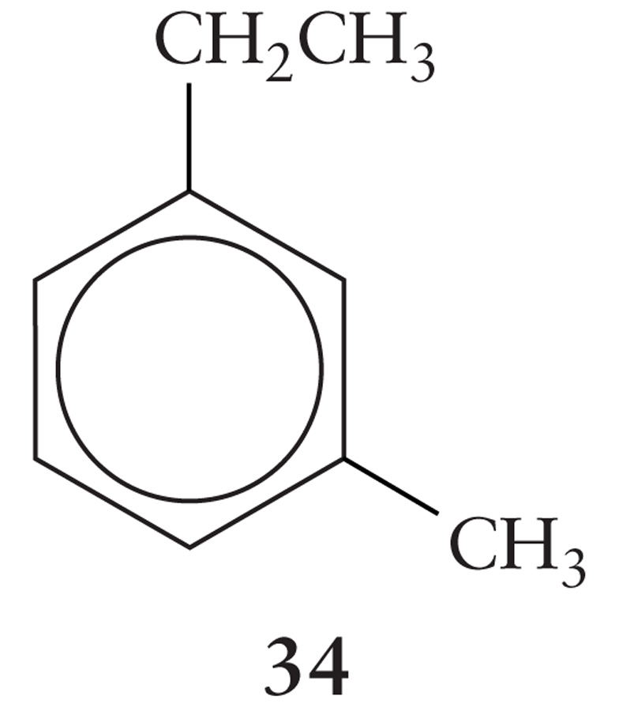
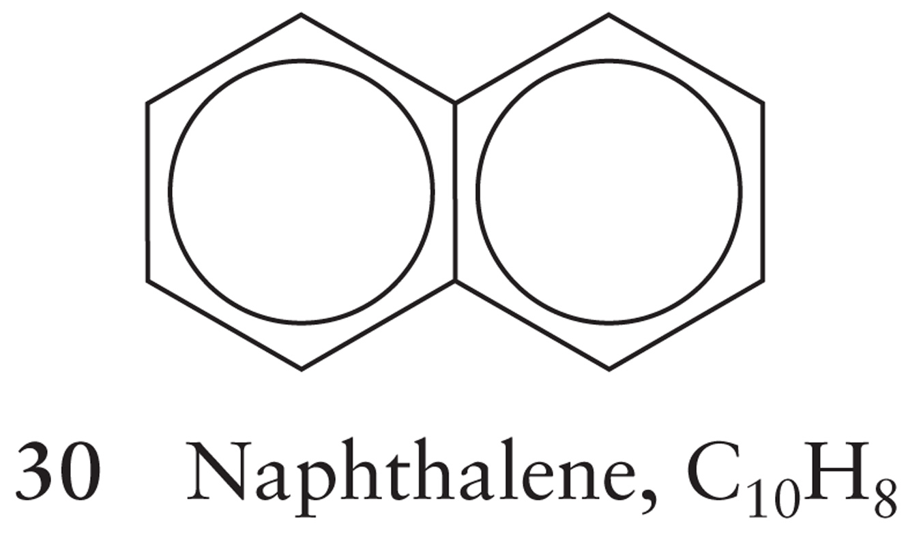
Aromatic Compounds
Aromatic compounds are structurally based on the benzene ring
They are called Arenes
Aromatic alkene
Typically responsible for odors

Slide 17
Nomenclature of Arenes
We’ll start with benzene, C₆H₆
When benzene is a substituent, it is called a phenyl- group
We can use the number based system for naming the linear hydrocarbons
Or
We can use an older system to describe the position of 2 substituents relative to each other

Slide 18
Nomenclature of Arenes
The positions of the benzene ring have unique names when dealing with 2 or more substituents
Ortho: Substituents are at positions 1 and 2
Meta: Substituents are at positions 1 and 3
Para: Substituents are at positions 1 and 4
Examples Dr. Hurlbert?

Slide 19
Organic Chemistry II

Slide 20
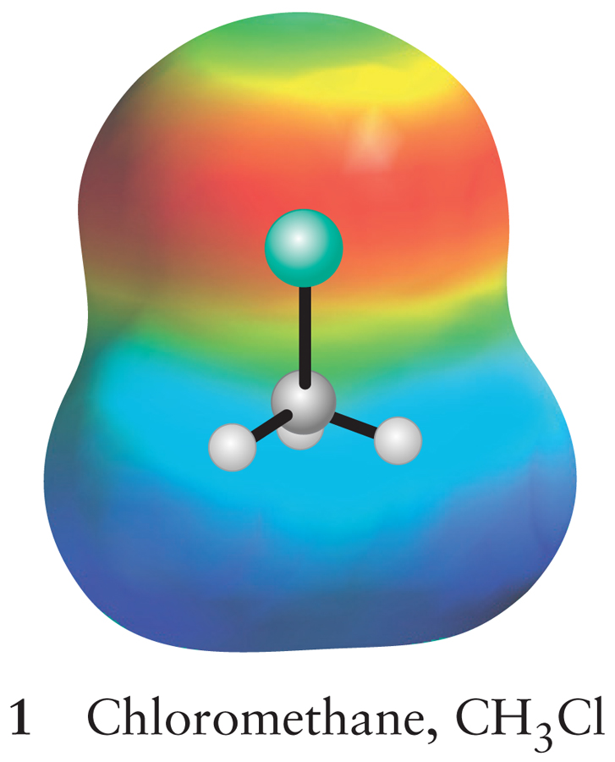
Haloalkanes
A Haloalkane is an alkane that has had one of the hydrogens removed and replaced by a halogen atom
Also called Alkyl halides
Properties:
Polar molecules
Other molecules with electron rich atoms (like oxygen) may attack the electron deficient carbon

Slide 21
Alcohols
When we put a hydroxyl substituent (-OH) onto an organic compound, we form an alcohol
As long as that organic compound isn’t benzene or the carbon isn’t a carbonyl carbon
Alcohols are named by adding the –ol suffix to the base name


Slide 22
Alcohols
Alcohols are liquids at room temperature
This is due to the hydrogen bonding capabilities given to them by the hydroxyl group
Low molecular mass alcohols (methanol, ethanol, propanol) are soluble in water
Butanol and higher mass alcohols aren’t
Why?

Slide 23
Ethers
Who has heard of ethers before?
Used to be used as anaesthetics
Ethers have the formula R-O-R
Where ‘R’ is an alkyl group
The R’s don’t have to be the same
We can think of ethers as the next progression in moving from water to ethanol to ETHERS
H-O-H → CH₃CH₂-O-H → CH₃CH₂-O-CH₂CH₃

Slide 24
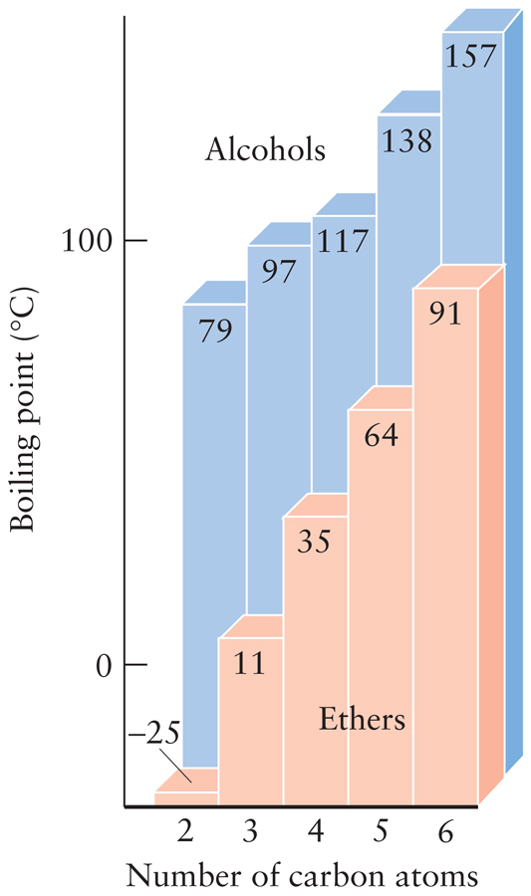
Ethers
Do not form hydrogen bonds. Why?

Slide 25
Ethers
Are not very reactive
Not very polar
Flammable!!
Over time, will form peroxides that will explode at the slightest energy input

Slide 26
Phenols
A Phenol is a compounds with a hydroxyl group attached to an aromatic ring
Unlike non-aromatic alcohols, phenols are weak acids, WHY? (Dr. H will draw something here)
Putting something in the way of the ring and the alcohol oxygen prevents the alcohol proton from becoming acidic

Slide 27
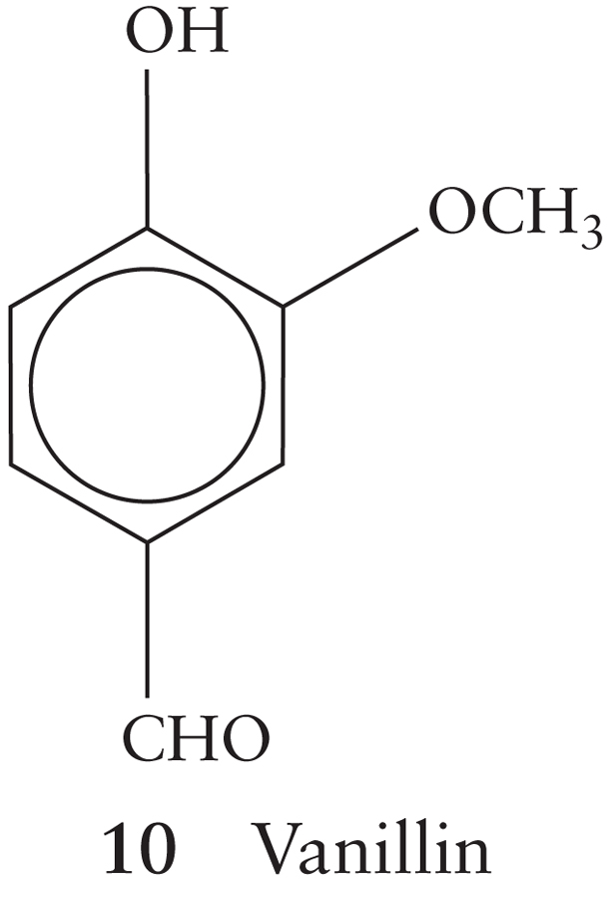
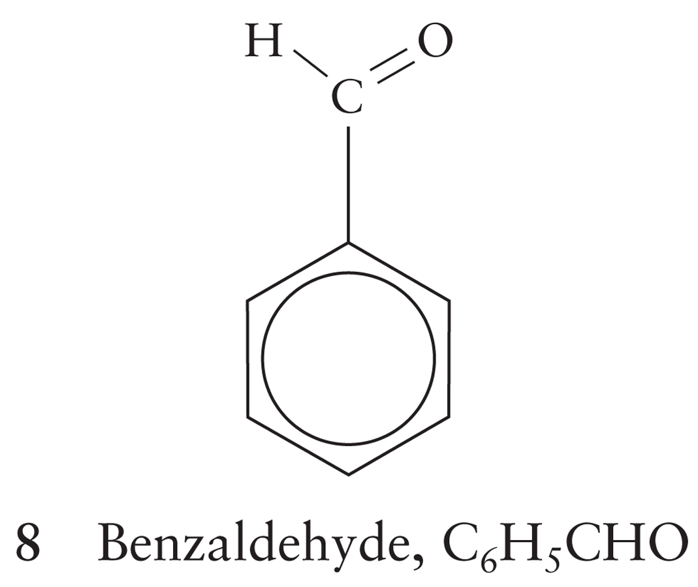
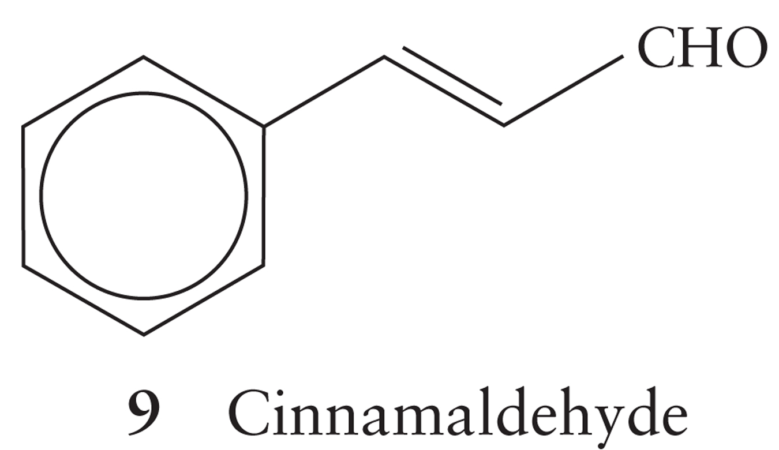
Aldehydes, Ketones, Carboxylic Acids and Amides
The carbonyl group >C=O is one of the most biologically important chemical entities in Organic Chemistry

Slide 28
Aldehydes, Ketones, Carboxylic Acids and Amides
Four families of compounds contain the carbonyl group:

Slide 29
We replace the –e ending of compounds with –al for aldehydes
We know that aldehyde has to be at the end of the molecule.
Why?
Aldehydes are found in many oils and natural extrcts

Slide 30
We replace the –e ending with -one
The simplest Ketone.
Why?

Slide 31
Carboxylic Acid
Weak Acids
They have an acidic proton because of the electron withdrawing effect of the carbonyl oxygen and resonance stabilization of the resultant carboxylate anion

Slide 32
Carboxylic Acids
Named by replacing the –e with –oic acid

Slide 33
From Alcohols to Acids
Progressively Oxidizing (adding Oxygen) the alcohol allows us to go from an alcohol to a carboxylic acid

Slide 34
Amides
An Amide is a compound containing an amine bound to a carboxyl group
An Amide
A peptide bond is an example of an amide

Slide 35
Note:
When drawing organic structures, keep in mind the hybridization of the carbons
Alkanes have sp³ hybridized carbons
Geometry?
Carbonyl carbons have sp² hybridized carbons
Geometry?

Slide 36
Esters
The fatty acids in our bodies are examples of esters
Esters are formed from the condensation of a carboxylic acid and an alcohol

Slide 37
Amines
Amine
Methylamine
1° Amine
Dimethylamine
2° Amine
Trimethylamine
3° Amine
Amines are compounds derived from ammonia
Amines tend to be associated with strong, often unpleasant odors
Putrescine NH₂(CH₂)₄NH₂
Cadaverine NH2(CH₂)₅NH₂

Slide 38
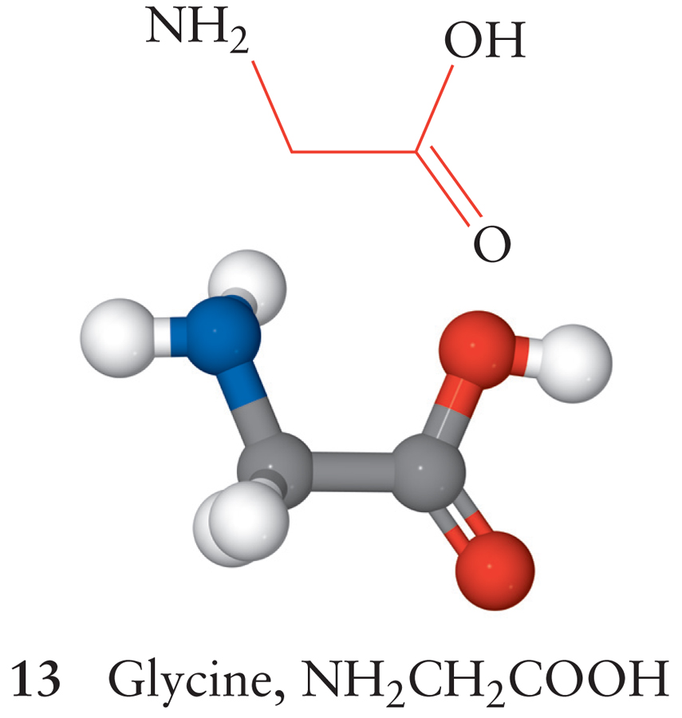
Amino Acids
The building blocks of proteins are amino acids
Amino Acids have an amino group and a carboxylic acid on them
When the ribosome forms a protein from amino acids, it does so in a condensation reaction that forms an amide

