Slide 1
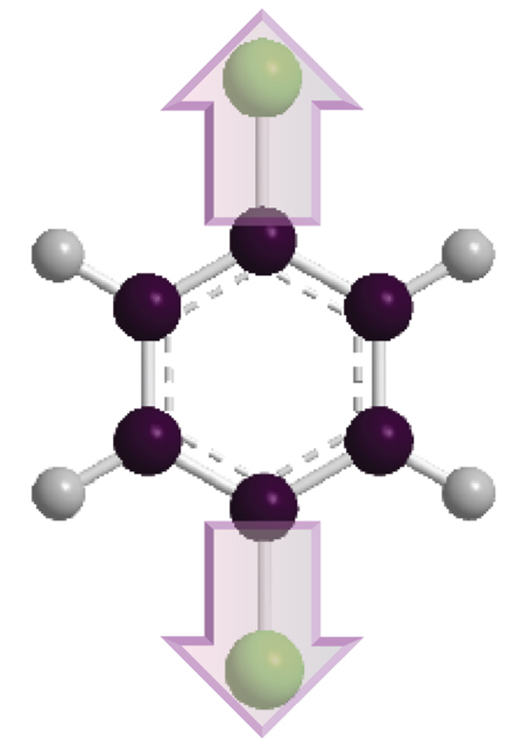
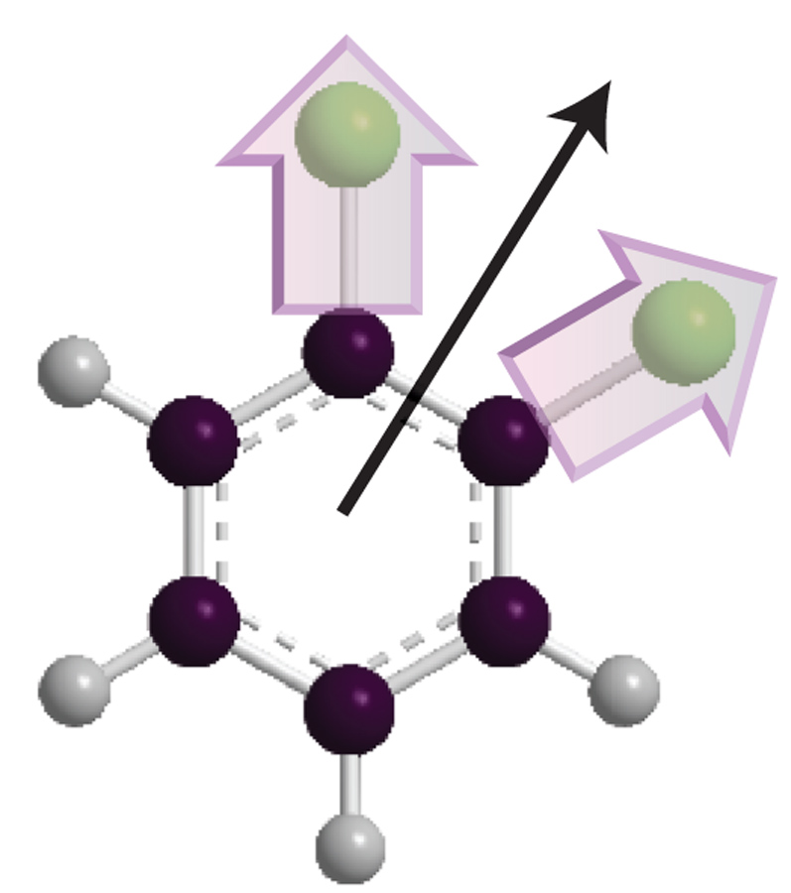
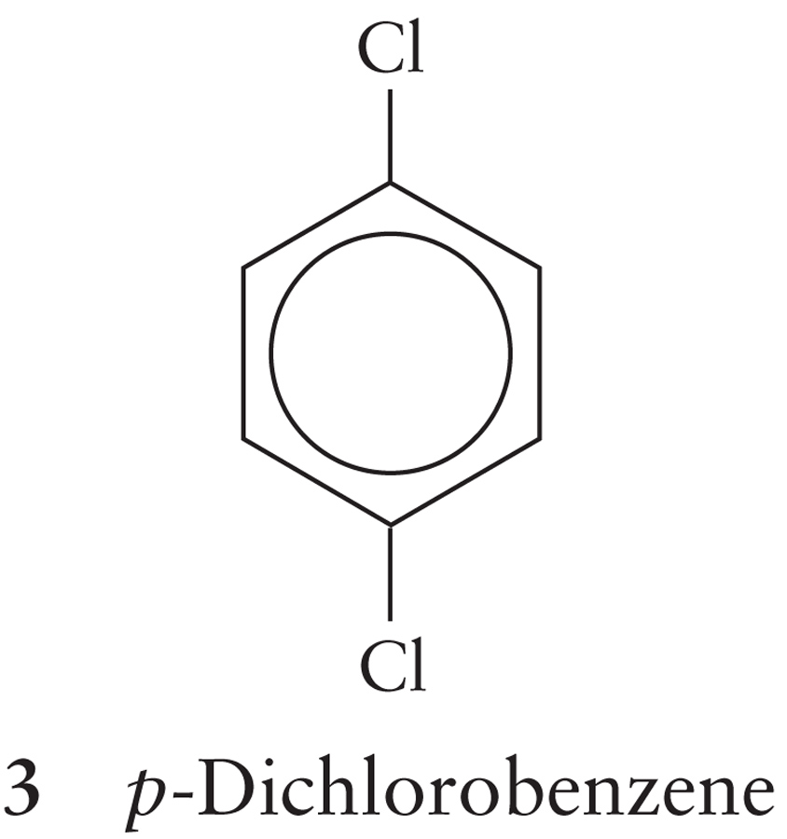
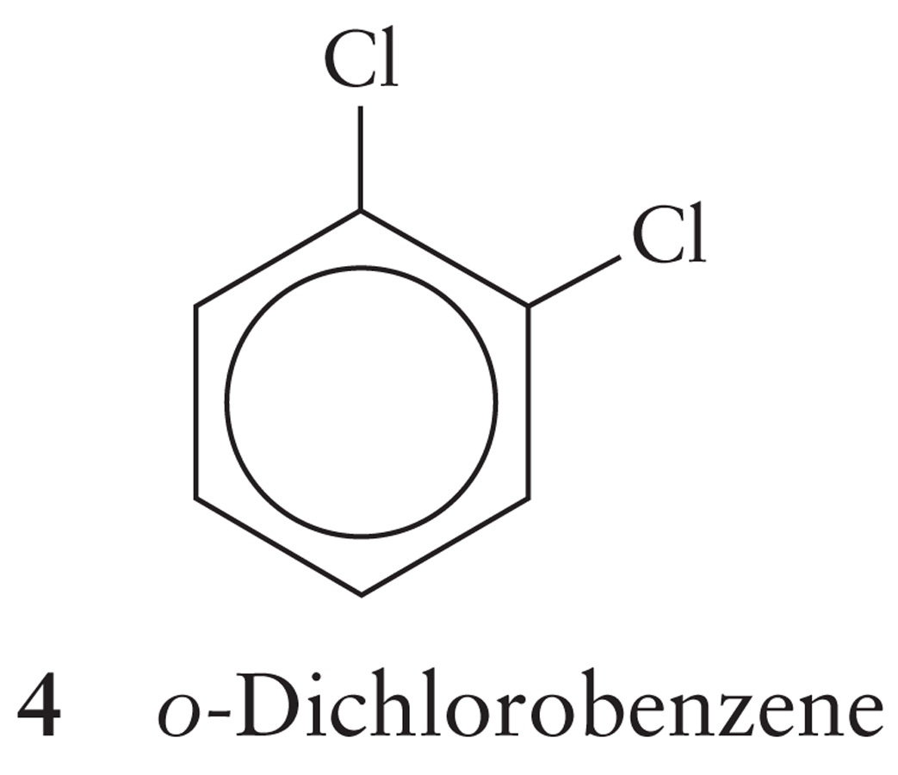
Which molecule has the higher boiling point:
p-dichlorobenzene and o-dichlorobenzene
Dipole moment for the molecules?

Slide 2
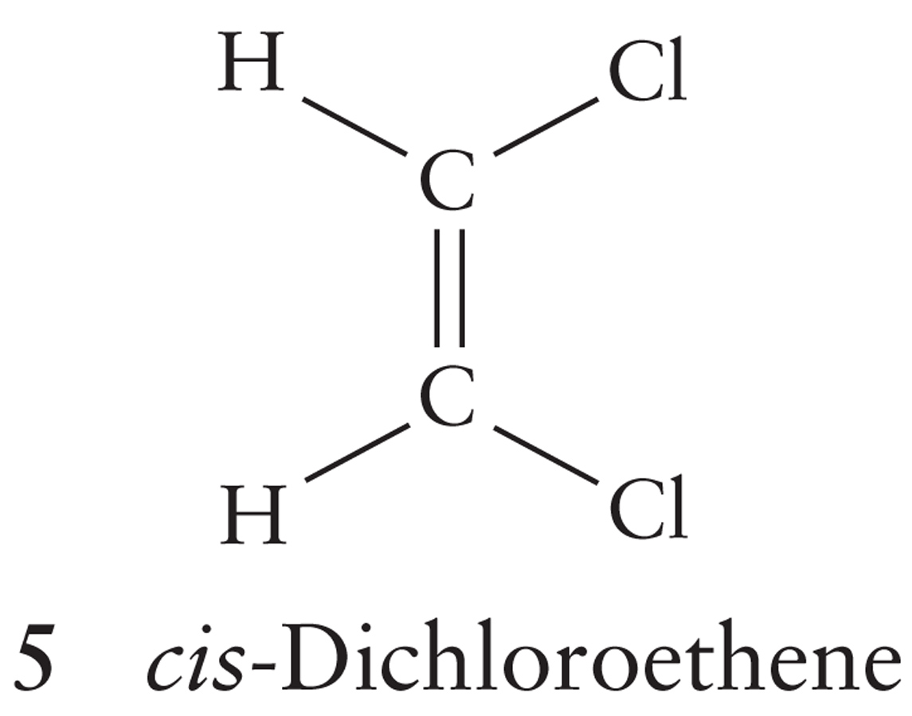
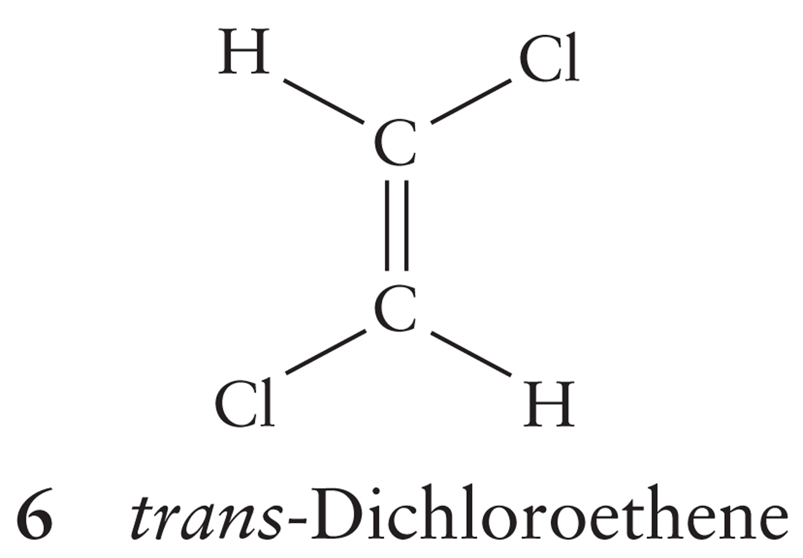
Which molecule has the higher boiling point:
cis-dichloroethene or trans-dichloroethene?
Notes:
Cis-dichloroethane has the higher boiling point due to the dipole moment resulting dipole-dipole interactions holding the molecules into the liquid phase.

Slide 3
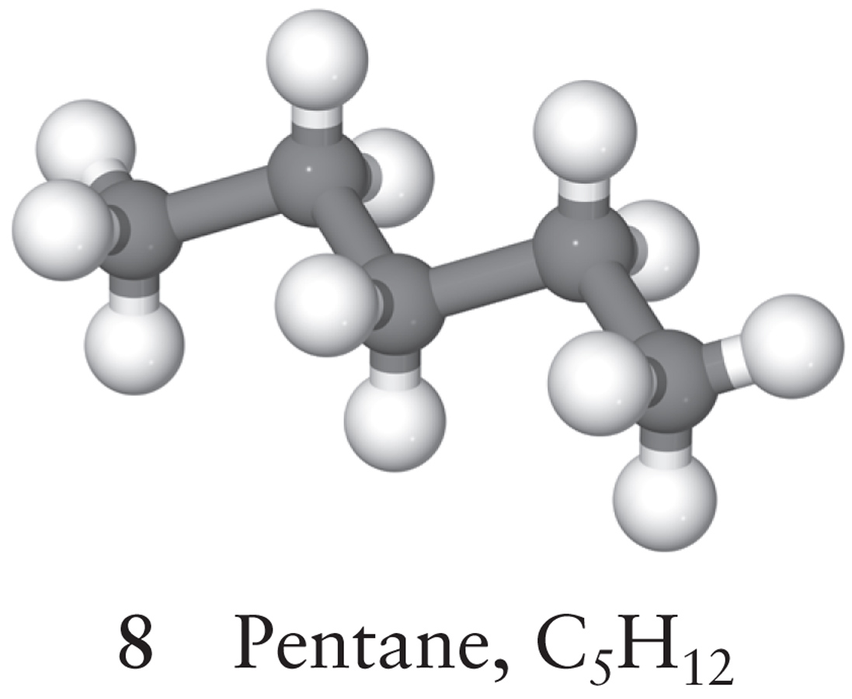
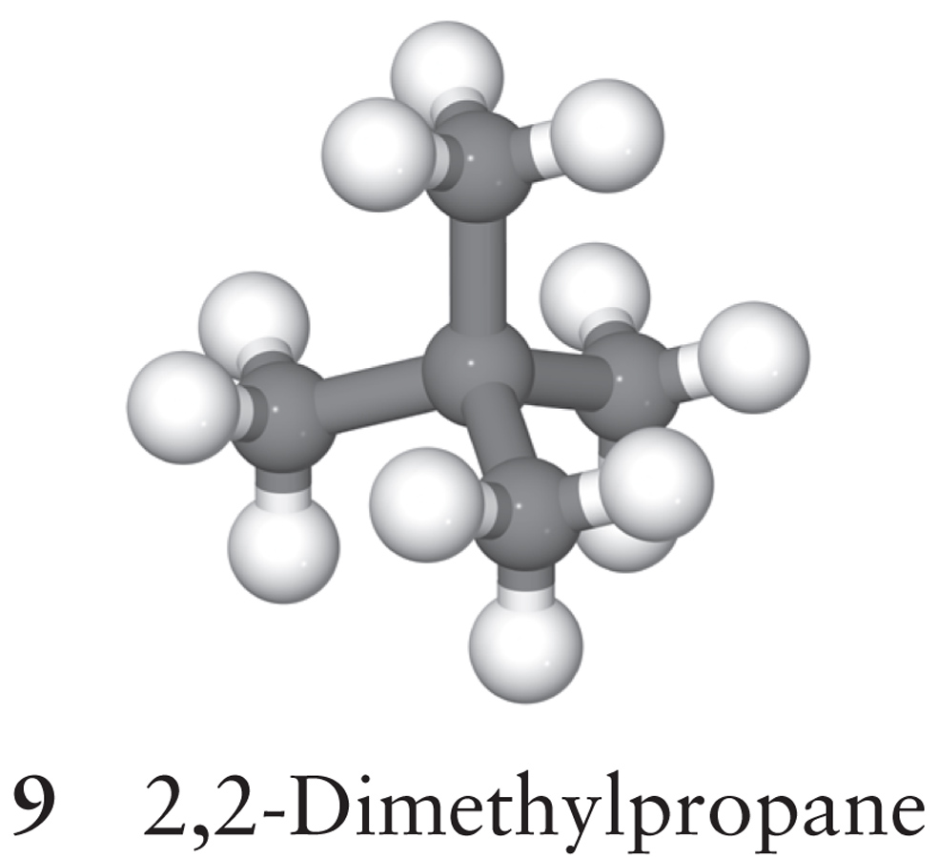
London Forces and Molecular Shape
Because the London Force energy drops off VERY sharply as a function of distance, molecular shape is a major contributor to London Force energy
Which has the higher boiling point?
Notes:
The branched molecule has a lower boiling point due to worse packing than the linear molecule.

Slide 4
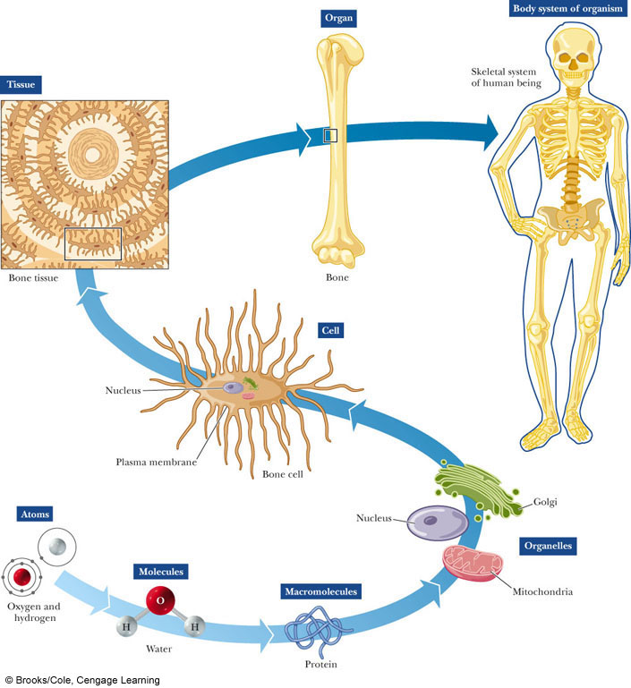
Thinking about Biology Chemically
All living organisms use energy
Energy comes from chemical reactions
The energy stored in chemical bonds is harnessed by proteins to catalyze other reactions

Slide 5
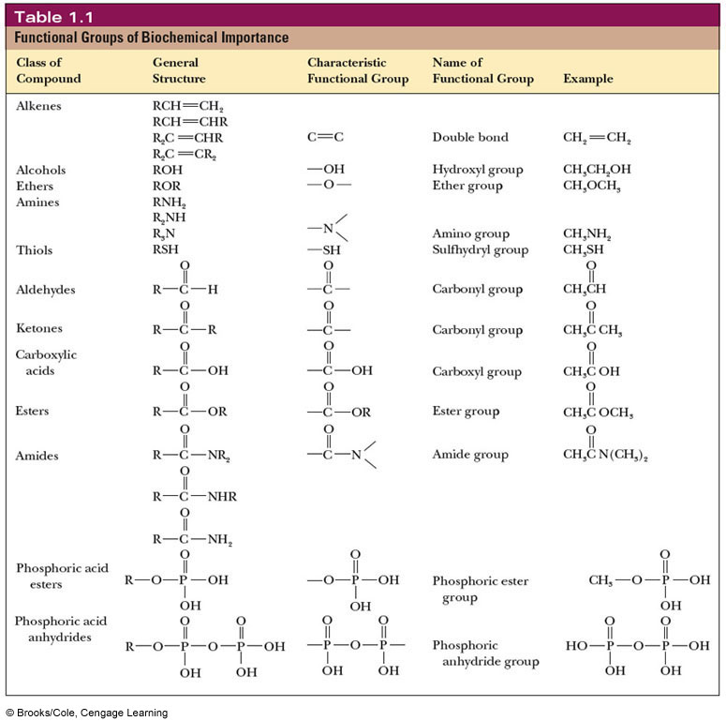
Functional Groups of Biologically Active Molecules
All the chemistry of life is performed using these chemical entities
We’ll go over these in MUCH greater detail in the next lecture

Slide 6
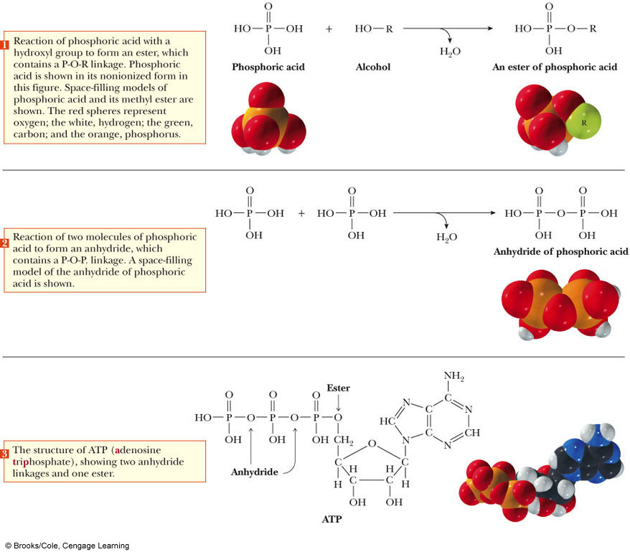
ATP: The Energy Currency of the Cell

Slide 7
Formation of Biomolecules
How did the vast array of biologically active molecules come to be?
Initially, it is thought that only NH₃, H₂S, CO, CO₂, CH₄, N₂, H₂ and H₂O were present on the early Earth
However, the planet was volcanically active (heat and pressure) and there was significant electrical activity in the atmosphere

Slide 8
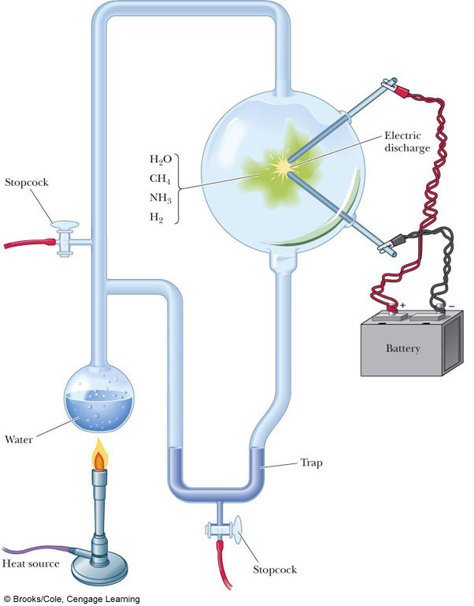
The Miller-Urey Experiment
Formaldehyde and hydrogen cyanide are usually formed, BUT, after prolonged reaction, so are AMINO ACIDS
The experiment can be taken a step further and be performed with simple amino acids as starting material.
Protein like molecules are formed

Slide 9
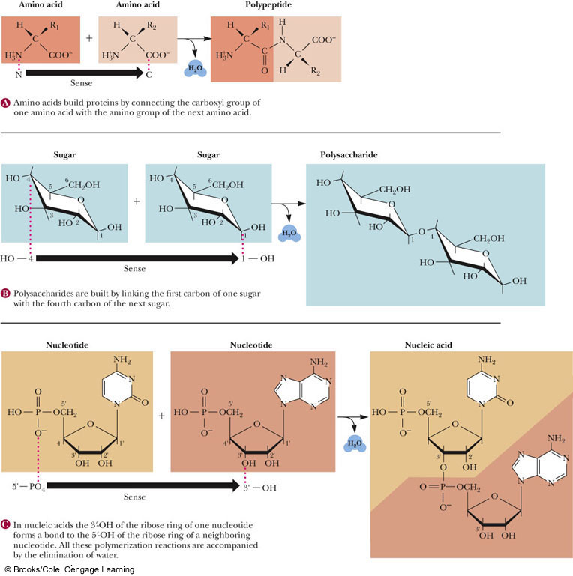
Biological Polymers and Directionality
Biological Polymers have a specific direction to them based upon their sequence
Proteins: Amino terminus to Carboxy terminus
Nucleic Acids: From 5’ to 3’
Carbohydrates: From nonreducing terminus to reducing terminus

Slide 10
Types of Cells
The different biologically active molecules and polymers arrange themselvs to form cells
The formation of a lipid bilayer is instrumental in this!
We can distinguish between types of cells based upon the presence of organelles, especially the nucleus
Prokaryotic do not have a nucleus or other organelles but Eukaryotic cells do
Organelles are specialized compartments that allow unique reactions to occur within them

Slide 11
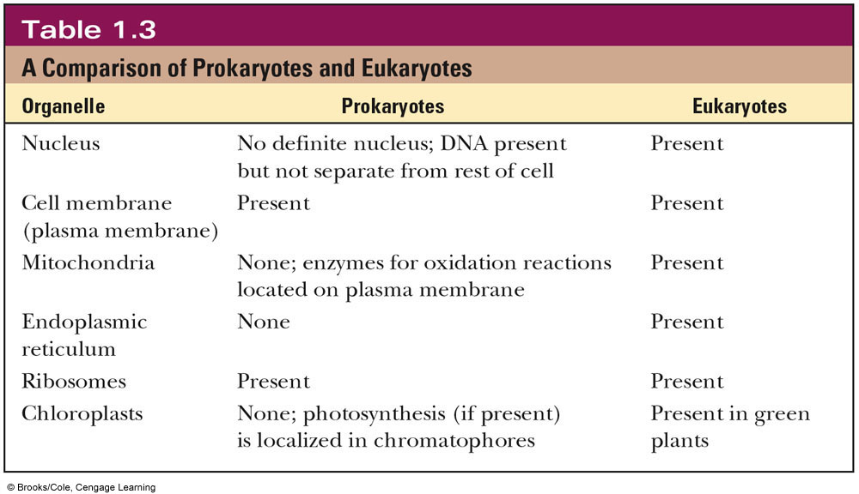
Types of Cells

Slide 12
Types of Cells

Slide 13
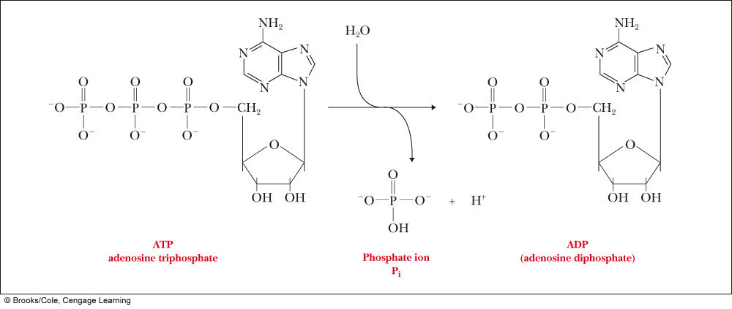
Section 1.9: Biochemical Energetics
All cells need energy to catalyze the reactions of life
ATP (Adenosine triphosphate) is the energy currency of the cell
The gamma phosphate is hydrolyzed off
This is an example of a high-energy bond

Slide 14
Thermodynamics
Let’s review some topics we covered in CHEM105:
Spontaneous Reaction: A reaction that occurs without outside intervention
May be very fast or slow
Free Energy: G, is a measure of the capacity of a system to do thermodynamic work
Only ΔG can be measured
Enthalpy: H, is a measure of the heat stored in a chemical bond
Entropy: S, is a measure of the disorder of a system
ΔG = ΔH - TΔS

Slide 15
Think About It…
If all systems in the universe tend towards disorder, how can cells exist in the first place?

Slide 16
Biochemical Thermodynamics
The Free Energy of a system decreases in a spontaneous reaction
ΔG < 0
This is also called an Exergonic reaction
2. A system at equilibrium has no Free Energy Change at All
ΔG=0
3. In a nonspontaneous reaction, energy must be input into the system
ΔG>0
This is also called an Endergonic reaction

Slide 17
Acids, bases and pH
We talked about strong acids and bases last lecture in our discussion of Electrolytes
A strong acid completely dissociates in solution
HA --> H⁺ + A⁻
pH = -log [H⁺] or pH = -log [H₃O⁺]
For a strong acid, the pH will equal the -log[H⁺]
Remember: Some acids are polyprotic (H₂SO₄, H₃PO₄)

Slide 18
Acids, Bases and pH
For strong bases, we need to remember that ph and pOH are related:
pH + pOH = 14
Take the negative log of the [OH⁻] and subtract it from 14 to determine the pH

Slide 19
Acids, Bases and pH
Weak acids (and bases) pose a new problem: The fact that they do not completely dissociate in solution
They exist in an equilibrium between the acid and conjugate base
HA (aq) + H₂O (l) --> H₃O⁺ (aq) + A⁻ (aq)

Slide 20
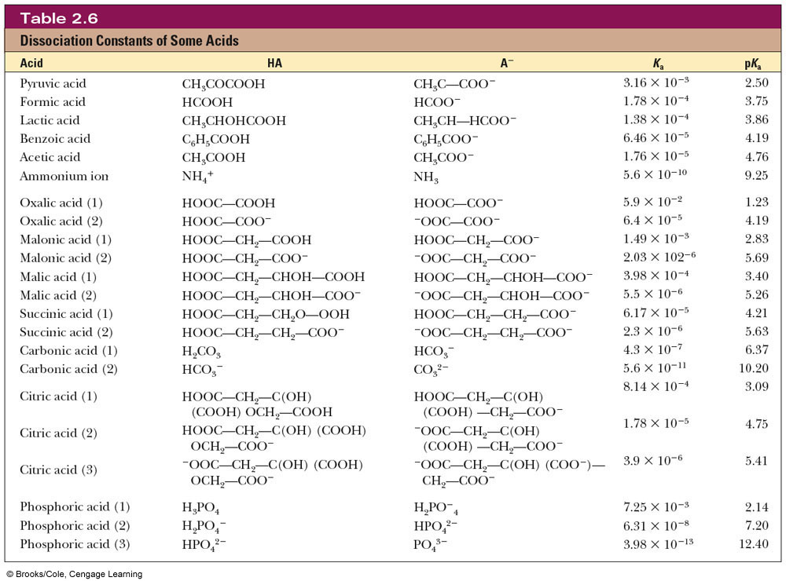
Common Biochemical Acids

Slide 21
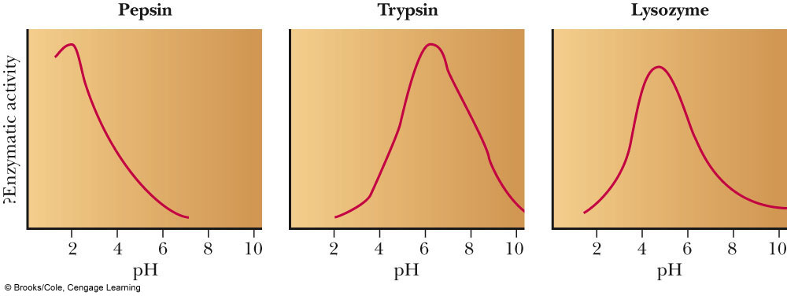
Henderson-Hasselbach Equation
Enzymes have very specific pH ranges in which they will function

Slide 22
Henderson-Hasselbach Equation

Slide 23
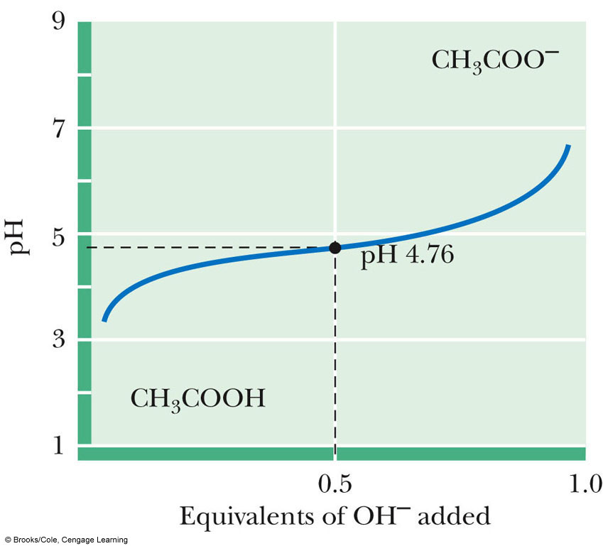
Titration Curves
When we mix an acid and a base together in small increments and then measure the pH, we can make a Titration Curve
HA (aq) + OH⁻ (aq)  H₂O (l) + A⁻ (aq)
The equivalence or endpoint (EP) is the point in the titration at which all of the acid molecules have reacted with base
Halfway to the EP: [HA]=[A⁻]
The pH at this point is the pKa. Why?
At the EP: [A⁻] = Initial [HA]


