Slide 2
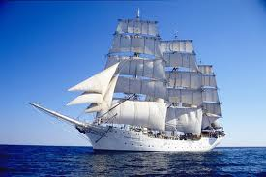
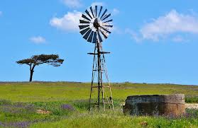
History of Wind Power
Earliest use of wind power goes back to the development of sailing ships. Larger vessels built in the 19th century could extract as much as 10000 hp.
Stationary wind machines were later brought into practice.
pumping water
grain grinding
From the 1890’s on, windmills have been used mainly for the generation of electricity.

Slide 3
What Causes The Wind To Blow?
Wind is another form of indirect solar energy. Uneven heating of the earth’s atmosphere creates a temperature gradient, which causes a pressure gradient. Huge masses of air flow from high pressure regions to low pressure regions.
Hot, light, low pressure air
axis of rotation
Cold, dense, high pressure air

Slide 4
Basics of Wind Power
As with hydropower, the kinetic energy of the moving air can be converted to mechanical energy by spinning a turbine.
Wind power is dependent on:
Amount of air (kg)
Velocity of air (m/s)
Volume of air (m³)
For average conditions, the theoretical maximum power available via wind per unit of sweep area (which can never be fully converted into work):
where $\overline{V}$ is the velocity of air.
$$Wind Power \left(\frac{kW}{m^{2}}\right)=0.0006 {\overline{V}}^{3}$$

Slide 5
Basics of Wind Power
Simply stated, a wind turbine is the opposite of a fan.
Instead of using electricity to make wind, wind turbines use wind to make electricity. The wind turns the blades, which connects to a generator and makes electricity.
Modern wind turbines fall into two basic groups; the horizontal-axis variety, like the traditional farm windmills used for pumping water, and the vertical-axis design. Most large modern wind turbines are horizontal-axis turbines.

Slide 6
Importance of Tower Height
Since the wind power is proportional to the cube of the wind speed, the most important aspect of maximizing wind-to-electric conversion is to get into high wind-speed regions. Turbulence is also detrimental to turbine blades and drastically decreases wind velocity.
Windmills must be very tall to be efficient. Commercial towers are 100 ft high on average
Turbulance Bubble
2H
Height
Wind
direction
H
velocity
2H
20 H

Slide 7
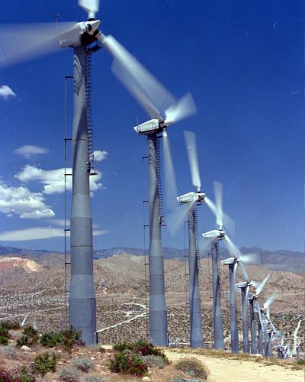

Slide 8
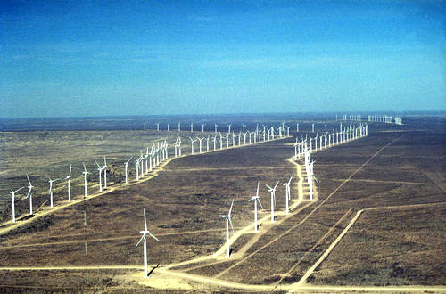

Slide 9
Components of a Wind Turbine
A wind-electric system is much more than just the wind generator and tower.
Also required are transmission wiring, electronic controls, batteries if storage or backup is desired, an inverter for household AC or grid-interconnect, as well as metering, overcurrent protection, and other standard electrical components.

Slide 10
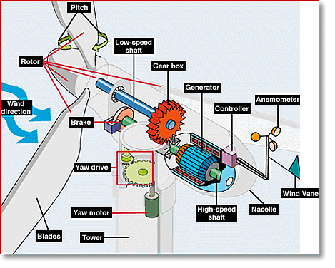

Slide 11
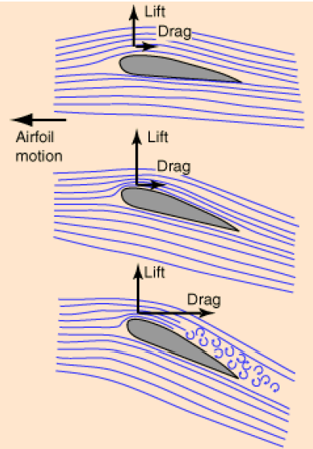
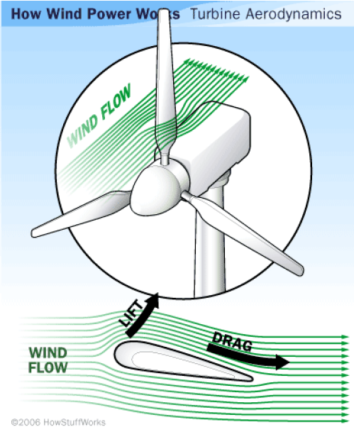
Mechanical Limitation of Wind Turbine Technology
Windmills have limited efficiency because the structure itself impedes the flow of air. A wind turbine can extract, at most, only 59% of the theoretical maximum wind power.

Slide 12
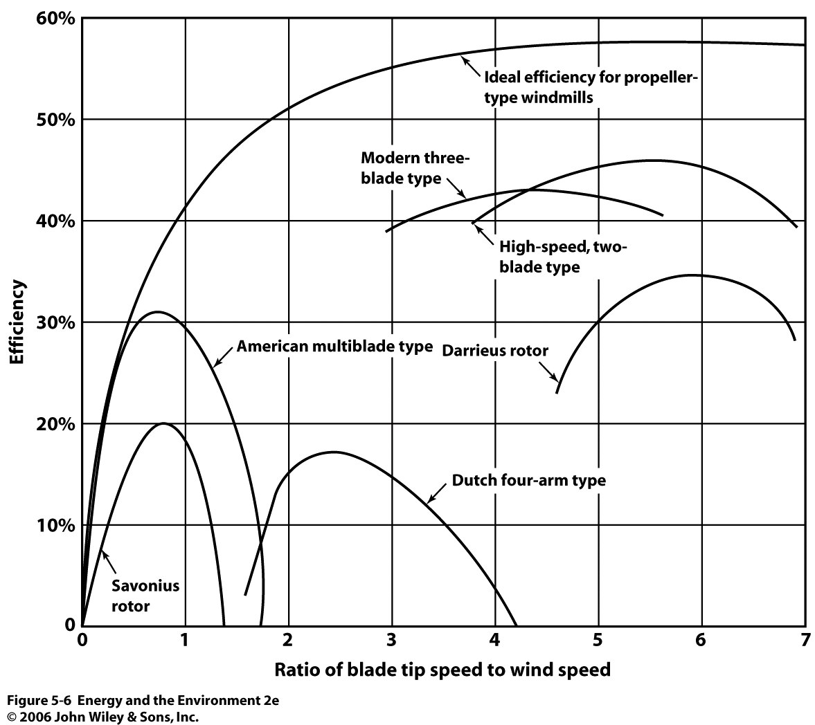

Slide 13
Example
Calculate the electric power produced per square meter of windmill disk area for a modern three-blade type wind turbine which a blade tip is rotating at a speed of 40 mph in wind speeds of 10 mph?
Obtain necessary values from the diagram on the previous slide.
$\frac{{\overline{V}}_{blade}}{{\overline{V}}_{wind}}=4 ; η=42\%$
3
3
3
$$P= .0006 x \left(\frac{10 mi}{hr}\right)x \left(\frac{1609 m}{mi}\right)x \left(\frac{hr}{3600 s}\right)x 0. 59 x 0.42=0.013 \frac{kW}{m^{2}}=130 \frac{W}{m^{2}}$$

Slide 14
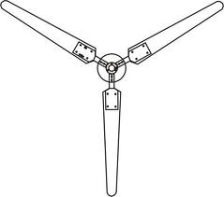
Example
Assuming this wind speed (10 mph) to be the average through the year, the annual energy output would be?
$$\frac{0.013 kW}{m^{2}}x\frac{8760 hr}{yr}=113.8 \frac{kWh}{m^{2}•yr}$$
18 ft
Calculate the energy output of this turbine if the blades are each 18 ft long?
The blade length represents the radius of the sweep circle. The sweep area is then πr²
2
$$113.8 \frac{kWh}{m^{2}•yr}x (π)(9 ft)^{2} x \left(\frac{0.3048 m}{ft}\right)=2689 \frac{kWh}{yr}$$
One of these units would not be enough to power the average home (11, 351 kWh/yr)

Slide 15
Coastal Winds
A more localized effect occurs in coastal regions.
During the day, the sun’s rays beam down, heating the sand and water. Sand heats much fast than water, so the air over the sand is warmer than that over the water. The hotter air, being lighter, rises and creates a void. This creates a pressure gradient
The high pressure air over the water flows inland to fill the air void (onshore breeze).

Slide 16
Coastal Winds
At night, the sand cools faster than the water. This means that the air over the water stays warmer. Now, the pressure gradient has switched.
Higher pressure air over the sand flows outward to the water. This is called an offshore breeze. This wind pattern is very reliable.

Slide 17
On/Offshore Wind Farms
Coastal winds are a vast source of American energy that is close to major population centers and corresponds to periods of high power demand
The 28 coastal and Great Lakes states use 78% of the nation's electricity.
Strong and constant ocean winds correspond to periods of high power demand.
Specifically, on hot days ocean breezes often blow more strongly, which also corresponds to high energy demand.
Powerful wind farms exist both on and offshore to utilize these winds. Offshore wind farms cost 3 times more than onshore wind farms.

Slide 18
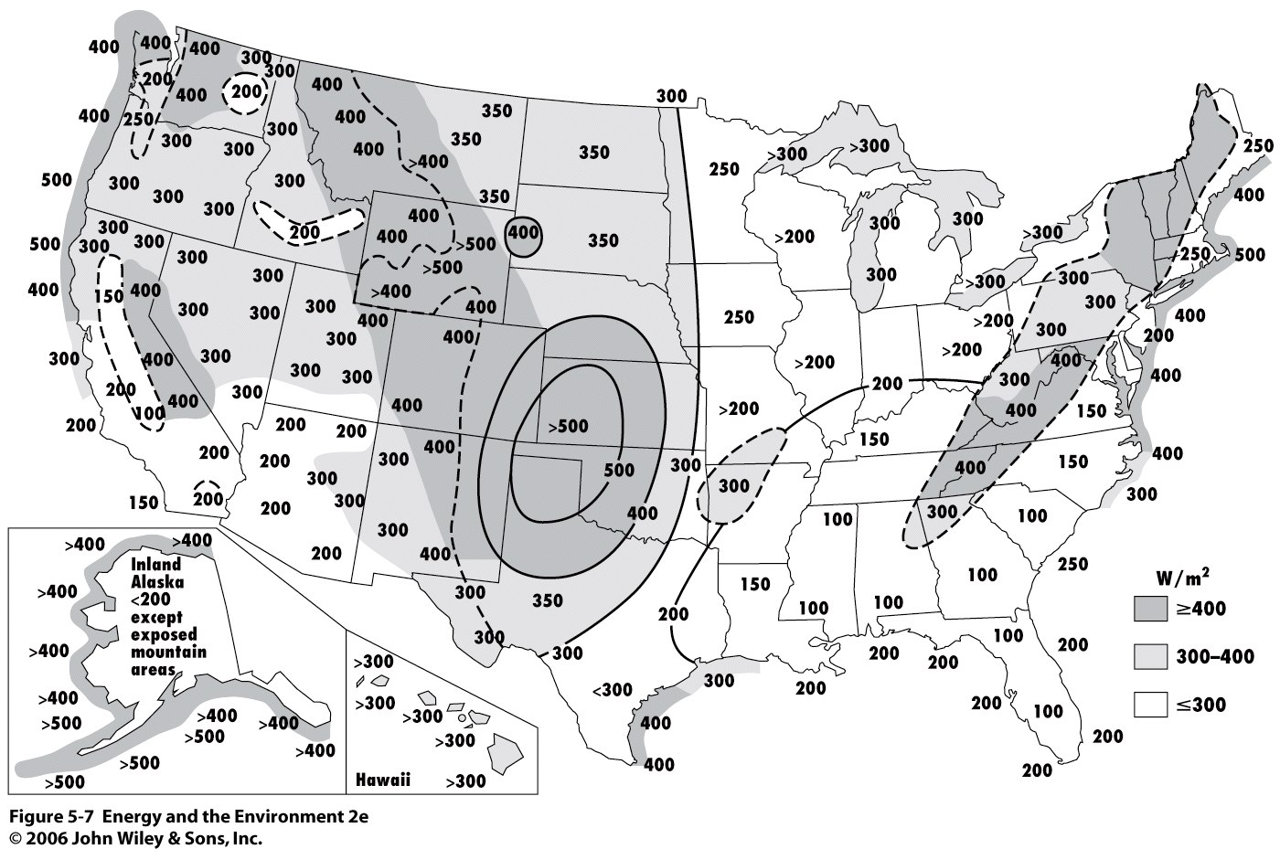
Distribution of Wind Power Intensity

Slide 19
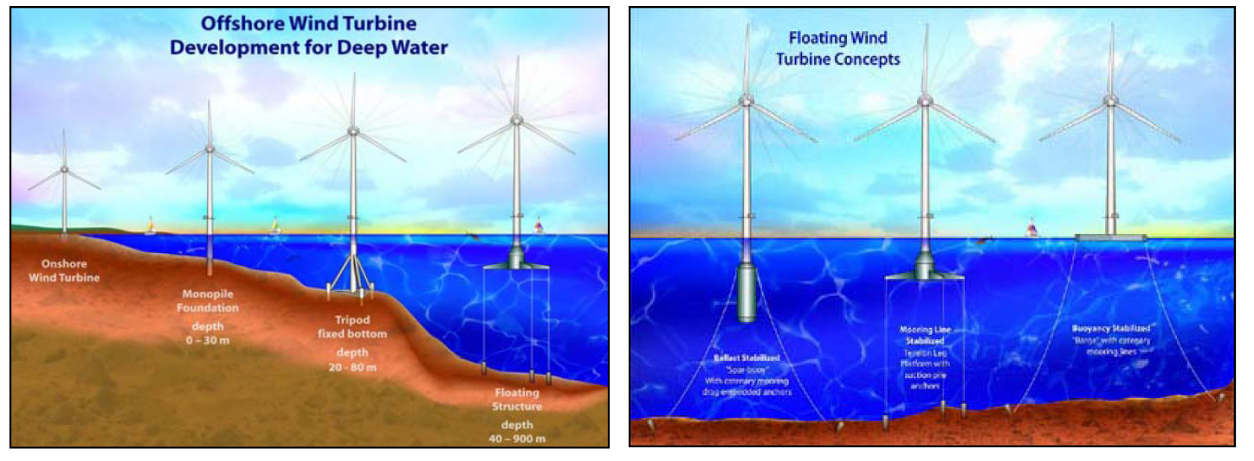

Slide 21
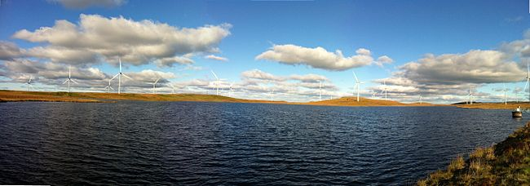

Slide 22
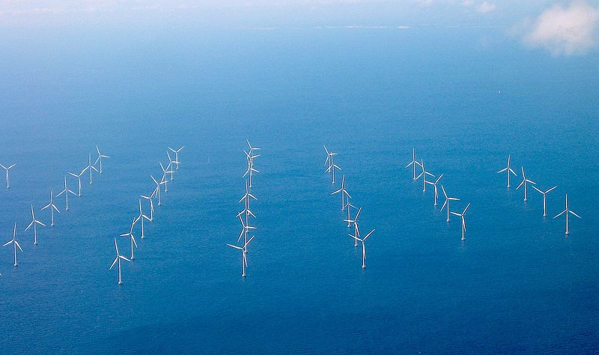

Slide 23
Expanding Use Of Wind Power
World wind generation capacity more than quadrupled between 2000 and 2006, doubling about every three years.
The US is the world’s 2nd leading producer of wind power, generating 60000 MW annually (21.2% of the world’s total)
Nine states now get 10% or more of their power from wind, with Iowa getting more than 20%. California is on course to get more than a third of its supply from wind by 2020, and a recent Department of Energy study predicted wind could supply 20% of the nation's supply by 2030.

Slide 24
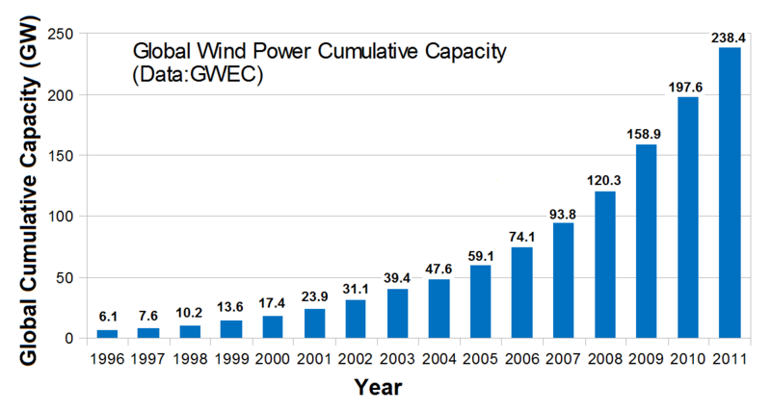

Slide 25
Advantages
Wind can blow day or night, sunny or cloudy, which gives it a clear advantage over direct solar conversion
Winds are strong during the coldest and darkest parts of winter when vast amounts of energy are needed
Offshore winds are also strong during hotter months, another peak demand period
There remains a massive untapped resource of wind power.
No fuel = No emission = No price fluctuations
Wind power is domestically produced.

Slide 26
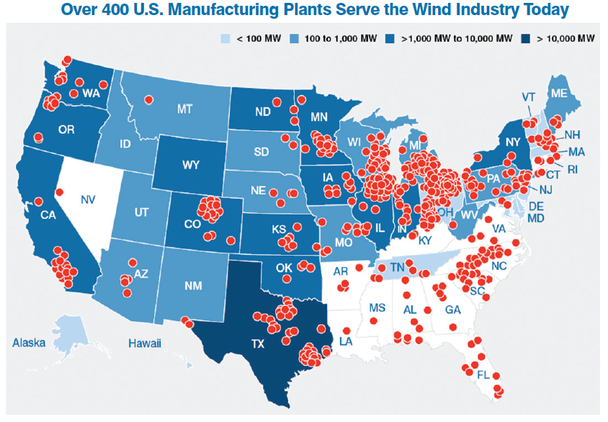

Slide 27
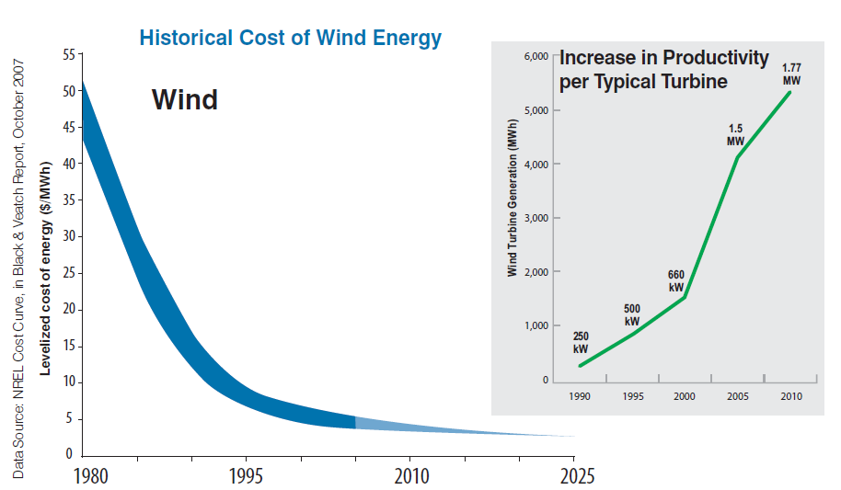
Advantages of Wind
Utility costs are dropping as performance improves.

Slide 28
Disadvantages of Wind Power
The wind is not constant. Wind speeds are also highly variable, changing by the minute.
Because of this, wind farms may operate at as little as 20% of rated capacity
The continuous rise and drop in power output make harnessing wind power difficult, and may potentially cause blackouts across the grid
Wind, therefore, can never be a primary source of energy, but can certainly act as a nice supplement to more sustainable forms (nuclear, fossil fuel, hydro)
The start up costs are high, as is the cost to the tax payer, despite claims of low utility cost
land, transmission lines, maintenance, service contracts, subsidies ($1.5 B per year)

Slide 29
Disadvantages of Wind Power
Wind turbines kill lots of birds and bats. These are predatory species. When predators die, pests accumulate. Bad things can happen.
Wind farms take up a lot of space, with moderate energy outputs.
The Alta Wind Farm (Ca) is the largest US wind farm in the world at 9000 acres. It produces 2680 GWh annually. (Cost: $1.85 B + subsidies)
Catawba nuclear station is 391 acres (4% the size of Alta) and produces 18814 GWh of energy annually (702% more energy) (Cost: $6.5 B)

Slide 30
Disadvantages of Wind Power
Real Estate Considerations:
Noise. Wind turbines are very loud
Aesthetics. Some countries have banned wind turbines because they feel that they detract from the beauty of the countryside.
Wind turbines create electromagnetic interference, affecting TV, radio, radar, and cellular signals.

