Slide 1
Solar Energy (Scientific Perspective)
Dr. Harris
Phys 105
3/18/13

Slide 2
Solar As A Renewable Energy Source
The most attractive source of energy is solar.
The benefits of solar energy:
free
clean
unlimited
can be used in remote areas where the economics do not allow extension of the grid

Slide 3
Light Energy
Energy from the sun come in the form of photons (electromagnetic radiation).
As previously discussed, different types of radiation are distinguished by the wavelengths of the photons (shorter wavelength = higher energy)
The Earth receives three types of radiation from the sun: Ultraviolet (UV), Visible, and Infrared (IR)

Slide 4
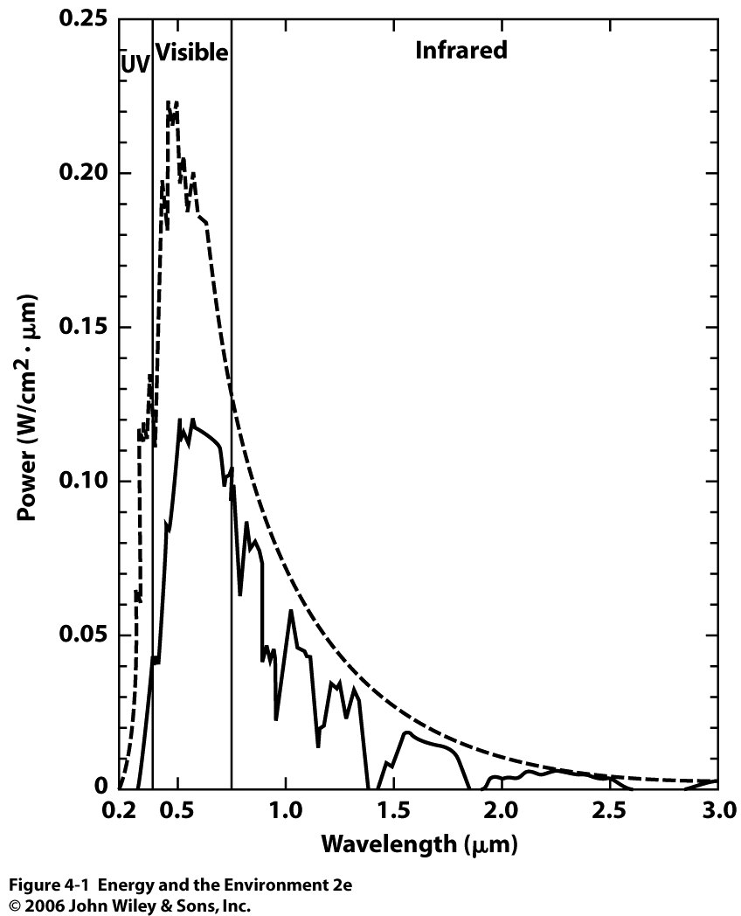
Solar Spectrum
Figure to the left shows the intensity (power per unit area) of solar radiation as a function of wavelength.
About 5% of the sun’s intensity is UV, 50% visible, and 45% IR.
Intensity above the atmosphere
Intensity at surface

Slide 5
Earth’s Revolution and Rotation
23º tilt
Variations in solar intensity between different times of day, as well as with changing seasons, weather, etc. make solar energy complicated

Slide 6
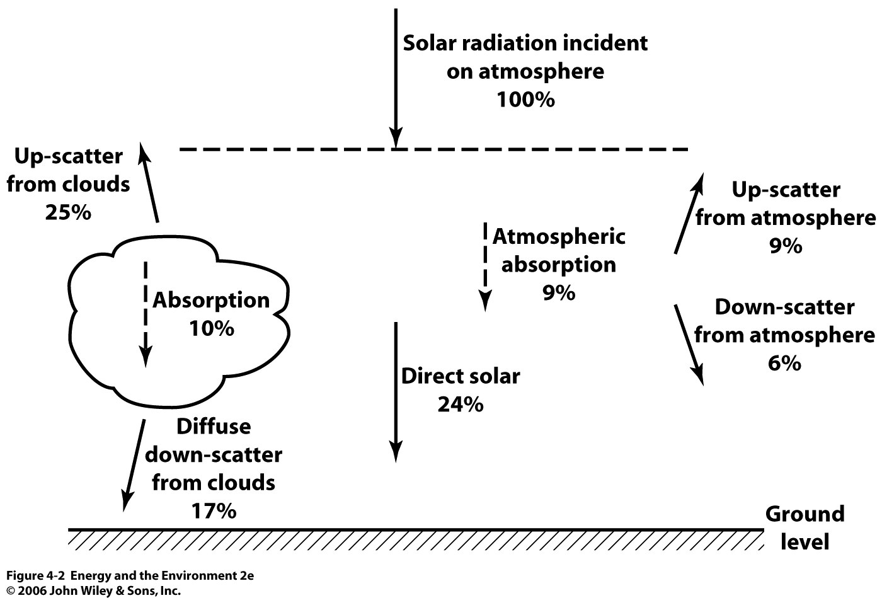
Solar Irradiance
As shown in the solar spectrum, not all of the solar energy incident on the upper atmosphere reaches the surface
Substantial amounts are absorbed (i.e. ozone, photoionizations, photodissociations, gases) and scattered
47% of the solar energy incident on atmosphere reaches the surface

Slide 7
Solar Constant
The intensity of solar energy at the top of the atmosphere on the side of the Earth directly facing the sun is expressed value known as the solar constant
The value of the solar constant is $2 \frac{cal}{min•cm^{2}}$
remember: cal = 4.184 J
One side of the Earth is always dark, and the sun’s intensity is low at the poles
Based on this, the average intensity across a horizontal area of the surface is assumed to be one-fourth the solar constant, $0.50\frac{cal}{min•{cm}^{2}}$

Slide 8
Solar Intensity
Using the values from the last two slides, let’s calculate the average solar power intensity at the Earth’s surface in Watts per square meter
$$\frac{0.5 cal}{min•{cm}^{2}} x \frac{min}{60 sec} x \frac{4.184 J}{cal} x \frac{(100 cm)^{2}}{(1 m)^{2}} x \frac{1 W}{\left(\frac{1 J}{sec}\right)} x 0.47=164\frac{W}{m^{2}}$$
The value calculated above is the average for an entire 24-hour period. If you average only over the sunniest 8 hours of the day, the value is closer to 600 $\frac{W}{m^{2}}$.
These values vary with location. Such values are also called insolation values.

Slide 9
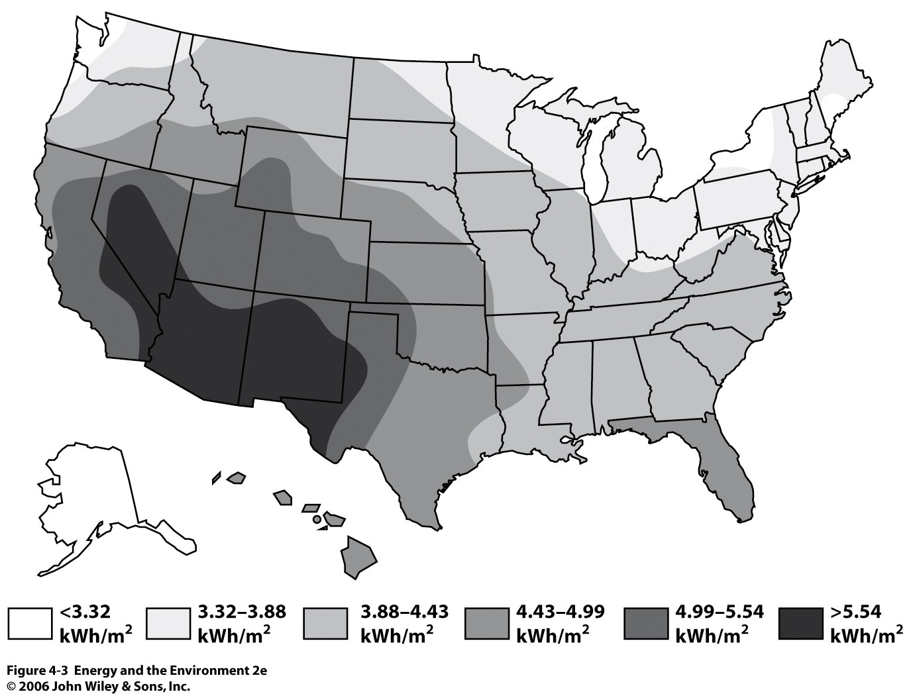
Insolation Values Across the U.S.

Slide 10
Something to Consider
The U.S. has an area of 3.615 million square miles. The total solar energy that strikes the U.S during one hour of peak sunlight (in J) is:
$$3.615 x 10^{6} mi^{2} x \frac{(1609 m)^{2}}{(1 mi)^{2}} x \frac{600 W}{m^{2}} x \frac{\left(\frac{1 J}{s}\right)}{1 W} x \frac{3600 s}{hr}=2.0 x 10^{19} J$$
In 2012, the U.S consumed 1.03 x 10¹⁹ J of energy.
Theoretically, this means that 1 hour of peak sunlight provides nearly twice the total energy consumed by the entire U.S. in a full year. How can we harness this energy??

Slide 11
Solar Lighting
We get lots of free light from the sun
Daylight savings time was created to increase the number of daylight hours, while decreasing the number of evening hours.
Initially, its purpose was to minimize energy use. Reports conflict, but DST has been estimated to reduce electricity use by 1%.
Fun facts: DST was also found to lower crime, promote outdoor leisure, increase retail and sporting revenues, reduce traffic accidents,
Notes:
the average size roof of each home receives the energy equivalent of 12 gal of gasoline in solar energy per day

Slide 12
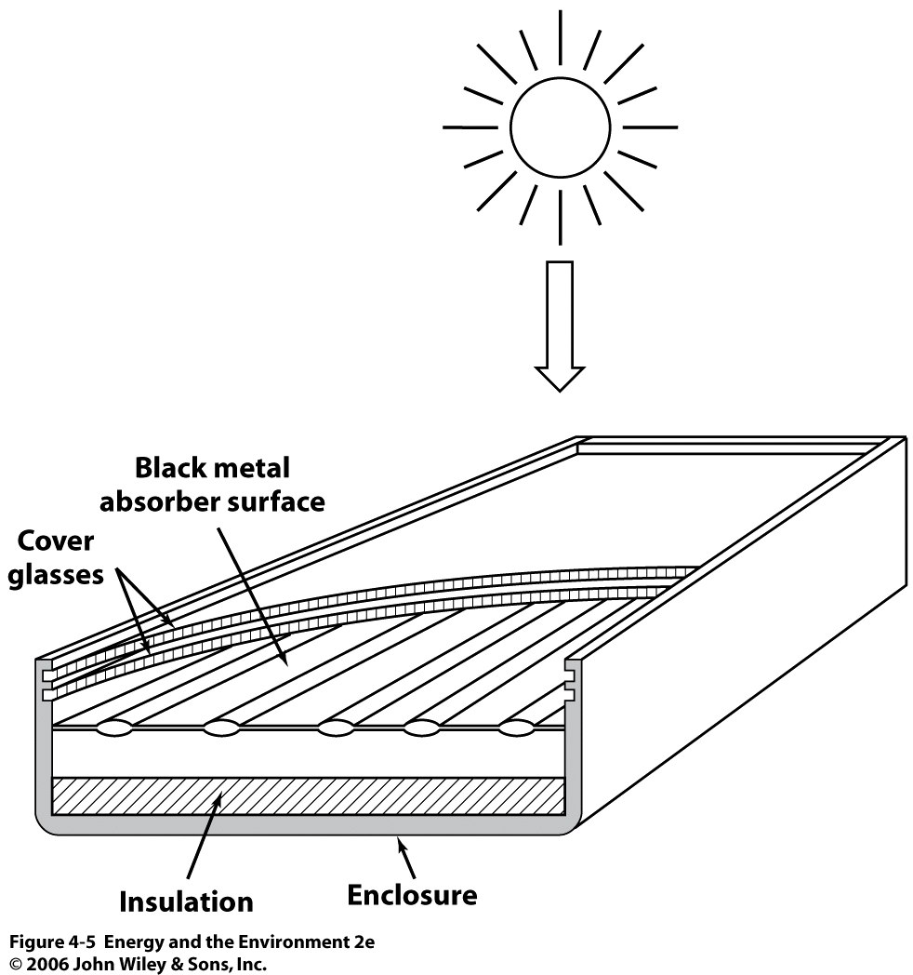
Solar Heating
Another common way to utilize the sun’s energy is to collect it for heating
In an active system, fluid is forced through a collector by an electric pump
ex. Flat-plate collector (shown on the right)
Coolant (i.e Freon) flows through tubes made of a black absorber material that absorbs a high percentage of incident sun light.

Slide 13
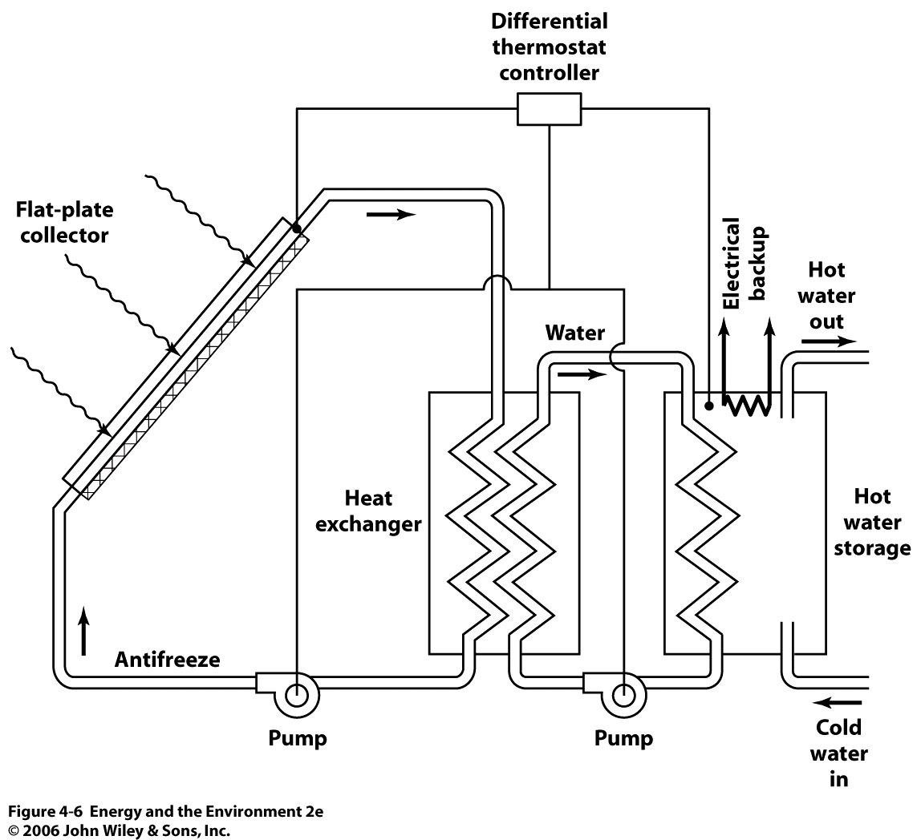

Slide 14
Solar Power Stations
An obvious application is to use solar energy to boil water in order to turn a turbine
The main problem is that the sun’s energy is diffuse. It must be precisely focused to generate enough power to boil water.
Concentrating reflectors perform this task
There are two types of proven solar power plants
Solar Power Towers
These use a large array of reflectors to concentrate light onto a central receiver which contains a working fluid that is circulated
Solar Power Systems
Uses a large array of reflectors, but concentrates light onto individual receivers

Slide 15
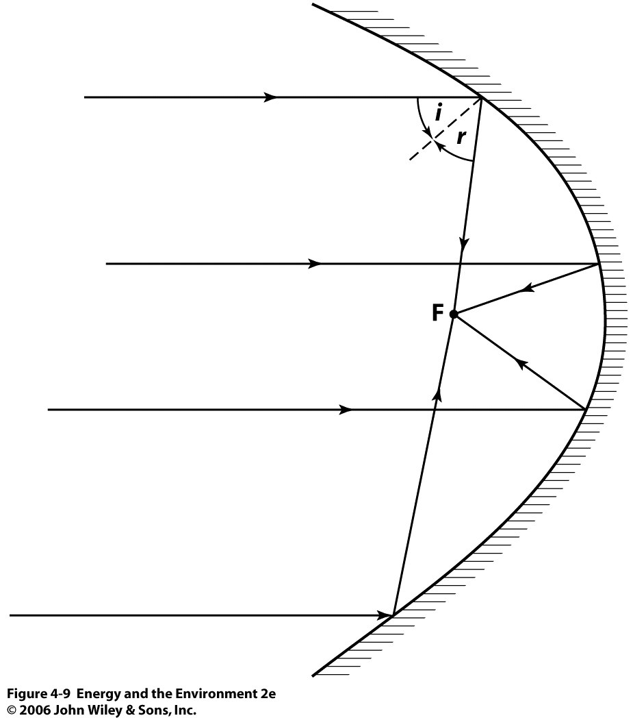
Concentrating Reflectors
Incoming sun light
The main parameter of a concentrating reflector is its concentration ratio (CR)
Ex. A reflector with a CR of 5 means that the intensity of light at the focal point is equivalent to what would be experienced if 5 suns were shining above it.
Focal point

Slide 16
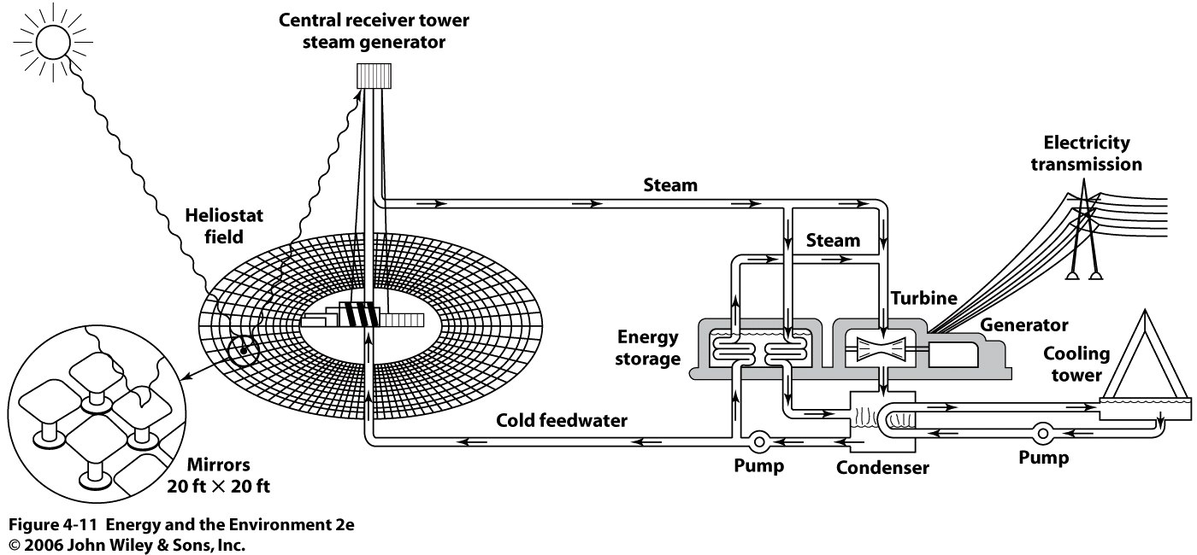
Solar Power Tower: Barstow, Ca

Slide 17
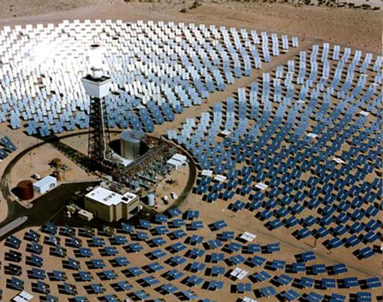

Slide 18
Photovoltaics
Another way to utilize the sun’s energy is the direct conversion of light energy to electricity. Devices that perform this action are called photovoltaics (i.e. solar cells/ solar panels)
Most photovoltaic devices contain the element silicon. Silicon classifies as a semiconductor.
Semiconductors are elements that are not good insulators, but not very good conductors either. Rather, they can be manipulated to behave a certain way.

Slide 19
Electronic Structure of Silicon
The element silicon has 14 electrons, divided across three “shells”. 10 of these electrons reside in the core (blue) of the atom (close to the nucleus). The remaining 4 electrons are further from the nucleus, and are called valence electrons (red).
The valence electrons, being furthest from the nucleus, are weakly bound. It is the valence electrons that are involved in bonding and the conversion of light to current.
•
•
•
•
•
•
•
•
14 p⁺
14 n⁰
•
Silicon (Si)
•
•
•
•
•

Slide 20
Pure Silicon
2-electron bond
In a pure silicon wafer, each of the four valence electrons of silicon is used to bond with other silicon atoms in a repeating lattice.
Thus, there are normally no free electrons to produce electricity.
If these electrons could “break free” and move about the material surface, the material would then be conductive.
Si
Si
Si
Si
Si

Slide 21
Band Structure
In 1954, Bell Labs found that light of the appropriate energy could be used to jar valence electrons loose in semiconductors.
Semiconductors possess two energy “bands”: the valence band (VB), and the conduction band (CB). These bands are separated by an energy barrier known as the band gap
Under normal conditions, the valence electrons reside in the VB
If the electrons in the VB absorb light with an energy greater than the band gap energy, the electron will be “excited” into the CB, where it is free to move about the material, or transfer into another material
When a VB electron enters the CB, an electron vacancy known as a hole is left in the VB, which is positively charged.

Slide 22
Band Structure
Energy
CB
CB
Excitation
e-
Light
Band Gap
e- e- e- e-
e- e- e- e-
e- e- e- h⁺
e- e- e- e-
VB
VB
in dark
(insulating)
in light
(conducting)

Slide 23
Example
Pure silicon has a band gap energy of 1.76 x 10⁻¹⁹ J. What is the minimum wavelength, in nm, of light that a silicon atom can absorb to excite an electron from the VB to the CB?
When the energy of the photon is exactly equal to the band gap energy, the photon will have just enough energy to excite an electron into the CB. Thus, any photon with a wavelength less than the calculated value will also work.
$$E_{photon}=E_{band gap}=\frac{hc}{λ}$$
$$1.76 x {10}^{−19} J=\frac{\left(6.626 x 10^{−34 }J•s\right)(3.0 x 10^{8}\frac{m}{s})}{λ}$$
$$λ=1.129 x 10^{−6} m=1129 nm \left(IR radiation\right)$$

Slide 24
Doping
To make a solar panel, you can not simply use pure Si. Materials with different band structures must be paired together so that a voltage is produced.
The voltage is what forces the electrons to flow in a particular direction to generate electric current
To achieve this, varieties of Si are produced by doping the Si lattace with atoms of other elements. The number of valence electrons in the dopant atom dictates how the band structure of the
There are two ways to dope a semiconductor
n-type doping (excess negative charge)
p-type doping (excess positive charge)

Slide 25
N-type Doping
To produce n-doped Si, the material is doped with Arsenic (As).
Arsenic has 5-valence electrons. When a Si atom in the lattice is replace with an As atom, an excess electron (blue) is introduced into the lattice.
Since this electron isn’t tied up in a bond, its simply free to move about the crystal. The material is “electron conducting” without light.
Si
•
Si
Ar
Si
Si

Slide 26
P-type Doping
To produce p-doped Si, the material is doped with Gallium (Ga).
Gallium has 3-valence electrons. When a Si atom in the lattice is replace with an Ga atom, the lattice becomes electron deficient, and a hole is introduced (red) into the lattice.
A neighboring electron will move to fill in the hole, producing a new hole where the electron once was. This repeats indefinitely. Thus, we say that the material is “hole conducting” without light.
Si
Si
Ga
Si
Si

Slide 27
Solar Panels: P-N Junctions
A solar panel is made by placing n-type Si in direct contact with p-type Si. The band structures are shown below.
In the n-type structure, the dopant electrons reside just below the CB. In the p-type structure, the dopant holes reside just above the VB.
Energy
CB
CB
e⁻ e⁻ e⁻e⁻ e⁻ e⁻e⁻
P-type
N-type
h⁺ h⁺ h⁺ h⁺ h⁺ h⁺
e- e- e- e-
e- e- e- e-
e- e- e- e-
e- e- e- e-
VB
VB

Slide 28
Solar Panels: P-N Junctions
Once in contact, the electrons will spontaneous diffuse from the n-type material to the p-type material to fill in the holes. This produces excess electrons in the p-type domain, and leaves excess holes in the n-type domain.
Energy
CB
CB
e⁻ e⁻ e⁻e⁻ e⁻ e⁻e⁻
P-type
N-type
h⁺ h⁺ h⁺ h⁺ h⁺ h⁺
e- e- e- e-
e- e- e- e-
e- e- e- e-
e- e- e- e-
VB
VB

Slide 29
Now that the p-type region is negatively charged, remaining electrons in the n-type region are repelled and can no longer diffuse spontaneously across the junction. Neither can holes from the p-region diffuse across to the positively charged n-region.
A “depletion zone” forms in which there are no free charge carriers.
Energy
CB
+
-
P-type
e-
h⁺
h⁺
e-
e- e- e- e-
e- e- e- e-
VB
N-type
e- e- e- e-
e- e- e- e-
Depletion Zone

Slide 30
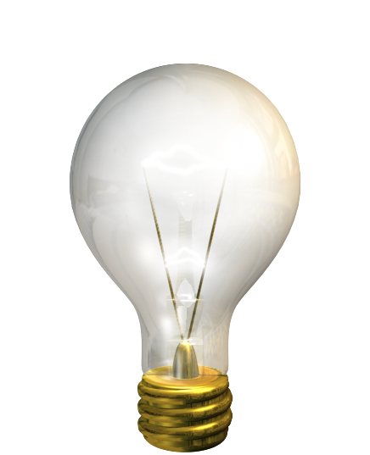
Light at the junction excites bound electrons in the n-type domain within the depletion zone.
The electric field forces the electrons away from the junction and toward the electrical contact at the surface.
They enter the p-domain through a wire, where they combine with holes. In response, the electric field forces another electron from the p-region into the n-region to maintain charge balance, and the cycle repeats.
electron

Slide 31
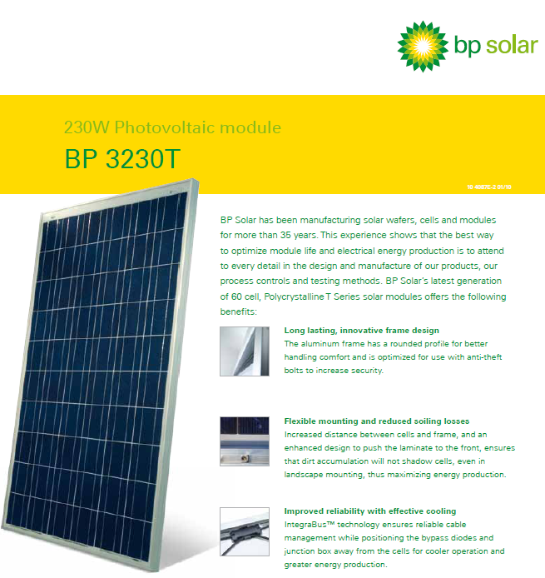

Slide 32
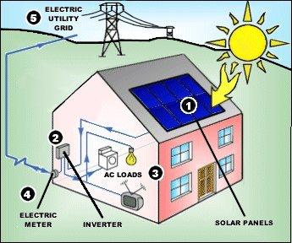
Under illumination, panels generate direct current (DC)
DC passes through an inverter which converts it to 60Hz AC
AC is used to power devices
Panel is connected to the grid. Excess power goes to the grid.

Slide 33
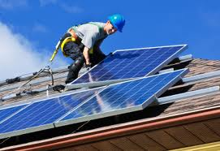

Slide 34
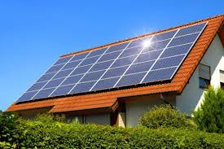
Sample Calculations for Solar Panels in SC
Let’s imagine this is your house. There are 35 BP3230T panels on your rooftop. The dimensions of each are shown below.
From the insolation chart, we see that the peak solar intensity in SC ranges from 3.88-4.43 kWh/m²
Based on the area of the panel, the total solar energy incident on each panel during 8 hours of peak sunlight is (assuming 4.1 kWh/m²):
1.667 m
(5.47 ft)
1 m
(3.28 ft)
1.667 m²
$$\frac{4.1 kWh}{m^{2}}x 1.667 m^{2}=6.83 kWh$$

Slide 35
Sample Calculations for Solar Panels in SC
These particular panels have a conversion efficiency (incident solar energy to electricity) of 13.8%.
We will also make the following assumptions:
12 hours of total sunlight
the insolation value holds for 8 hrs of peak sunlight
the total sunlight collected for the other 4 hrs of sun equals one-fourth of that collected during peak hours
total incident solar energy: [6.83 + 0.25(6.83)] = 8.53 kWh
The total energy produced by your panels per day is:
$$35 panels x \frac{8.53 kWh}{panel} x 0.138=41.2 kWh$$

Slide 36
Sample Calculations for Solar Panels in SC
The average household consumes 31.3 kWh of electricity per day. The cost per kWh in SC is $0.09.
Because the panels are hooked to the grid, you can “reverse meter”. In other words, the excess energy produced by your panels goes into the grid, and your electric meter spins backward. You receive credit for all the energy you produce.
In addition to not having an electric bill, your monthly returns would be:
$$\frac{9.9 kWh excess energy}{day} x \frac{30 day}{month} x \frac{\$ 0.09 }{kWh}=\$26. 73$$

Slide 37
Cost
The cost of the panels and installation for such a system ranges vastly from $33000 to $51,000. Lets take the median value ($42,000)
The federal government offers a tax credit for 30% of the installation. SC also offers a state tax credit of 25%. This equals:
$12,600 tax credit from U.S.
$10,500 tax credit from SC
The federal credit can roll over for 3 years, with no annual limit
The SC tax credit can roll over for 10 years, with an annual limit of $3500

Slide 38
Returns and Other Values (taken from solarestimate.org)
Average Monthly Utility Savings (assuming 3.78% annual utility inflation) | $133
25-Year Utility Savings | $39,900
Average Monthly Utility Rebate | $31.95
Appreciation in Property Value | $19,080
Normalized Power cost (per kWh) | $0.07
Greenhouse Gas Saved (25 years) | 229 tons
The number of months required to break even on investment:
$$133\left(x\right)+31.95\left(x\right)+12600+10500=42000$$
$$x=114.6 months (9.54 years)$$

