Slide 1
Lecture 4: Fossil Fuels (Ch 2)
Dr. Harris
Phys105
2/6/13

Slide 2
Intro
We will further explore the fossil fuels
History of use and resource development
Advancements
Future Projections and U.S. Resources

Slide 3
Petroleum
Included in the definition of petroleum are gasoline, kerosene, heating oil, diesel, and liquid natural gas (i.e. propane and butane)
During photosynthesis, plants convert CO₂ from the air into carbohydrates
Carbohydrate: C_{n}(H₂O)_{n}
ex. glucose C₆H₁₂O₆ --> C₆(H₂O)₆
As previously discussed, when prehistoric plants died and became buried, the conditions were anaerobic.
This condition, in conjunction with high temperatures, pressures and bacterial processes caused the displacement of oxygen from the plant sugars, leaving only hydrocarbons
Hydrocarbons: C_{n}H_{2n+2}
ex. Propane C₃H₈, Butane (C₄H₁₀), Octane (C₈H₁₈)

Slide 4
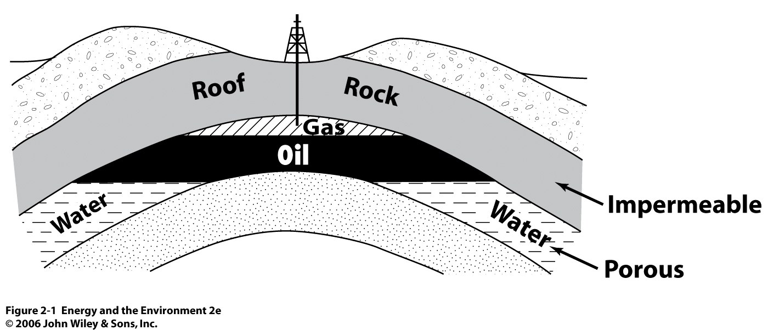
Exploration of Petroleum
Underground, oil and natural gas are found dispersed throughout porous formations.
These wells are found by monitoring shock waves from explosions or vibrating devices sent down into the Earth. When the sound waves strike an interface, they bounce back and are read by a geophone.
From this data, geologists can determine the likelihood of oil, but the only real proof is to drill. Only 1 in 9 exploratory drilling results in oil discovery.

Slide 5
History of Petroleum Production
The first US oil wells were found in Pennsylvania in 1859.
The main problem was finding containers to house the oil, as the containers were more valuable than the oil itself
Refining of this “rock oil” produced kerosine.
By 1909, wells opened in Ohio, Indiana, California and Texas. The US was producing 500,000 barrels a day (more than the rest of the world combined).
With the advent of electric lighting, a decline in the oil business was projected
However, automobiles were becoming more and more accessible, replacing horses. Demand for petroleum skyrocketed.

Slide 6
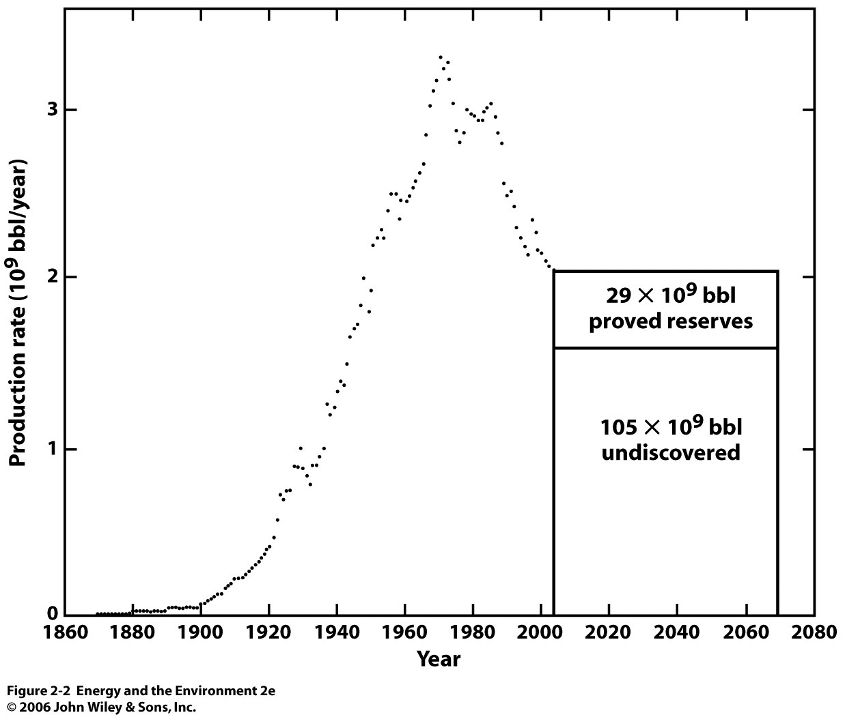
Notes:
134 x 10^9 in reserves left. US uses 6.7 x 10^9 per year. At that rate, our supply is only good for 20 years. This is why its essential for us to import as much as we do.

Slide 7
Decline in Production
The US now imports well over 50% of the oil it consumes
Drilling has drastically reduced because most of the “worthwhile” wells have been found
ex. In 2004, the US drilled 6600 wells. In 1981, there were 44,000
There will always be some oil left underground, but some of it is simply too costly to extract
In addition, the cost to explore and develop wells as also shot up drastically
ex. In 1999, $5 per barrel were spent on development and exploration. In 2004, it was $11/bbl.

Slide 8
Primary, Secondary and Tertiary Recovery
There is some optimism with regard to oil reserves. Geologists believe that after a well stops producing oil, as much as 70% of the well’s actual content is left behind in the ground
In the primary recovery, oil comes to the surface naturally, or via pumping
In secondary recovery, water is pumped into the well to force more oil upward
Tertiary (more commonly known as “enhanced”) recovery techniques are now being tested to extract this hypothetical 70%
Based on overcoming two effects: surface tension and viscosity

Slide 9
Enhanced Recovery: Overcoming Surface Tension
Surface tension describes the tendency of a surface of a liquid to resist force. This is caused by attractive forces between the molecules of a liquid.
ex. Water beads.
This can cause oil to become locked within the pores of rocks.
Surfactants can be injected into the rocks and the rock can be flooded with a viscous water solution

Slide 10
Enhanced Recovery: Overcoming Viscosity
If trapped oil is too viscous, this will also prevent flow
The viscosity of oil can be lowered by saturating it with CO₂
Steam can also be injected into the well, which heats the oil and thereby reduces its viscosity

Slide 11
Economic and Environmental Consequences of Enhanced Recovery
Enhanced recovery can cost oil companies as much as $20 per barrel of oil recovered
Additionally, the process can produce large volumes of toxic, highly salty, and sometimes radioactive water.
This can be especially harmful to drinking water
Enhance recovery is well regulated by the EPA under the Safe Drinking Water Act

Slide 12
Gas Costs In the U.S.
Despite our massive use, gasoline is cheaper in the U.S. than in any other industrialized nation. Why?
Competition in the marketplace
There is still tremendous production in the OPEC countries as well as Russia
Because so many countries rely on oil exports, competition has kept prices low
Even when OPEC tries to limit production to drive prices, it has always failed
Taxes
Tax on gasoline in the U.S. is as much as 6.5 times lower than other countries
Average gas tax in U.S. is $0.488/gal
In the U.K, gas tax is $3.43/gallon

Slide 13
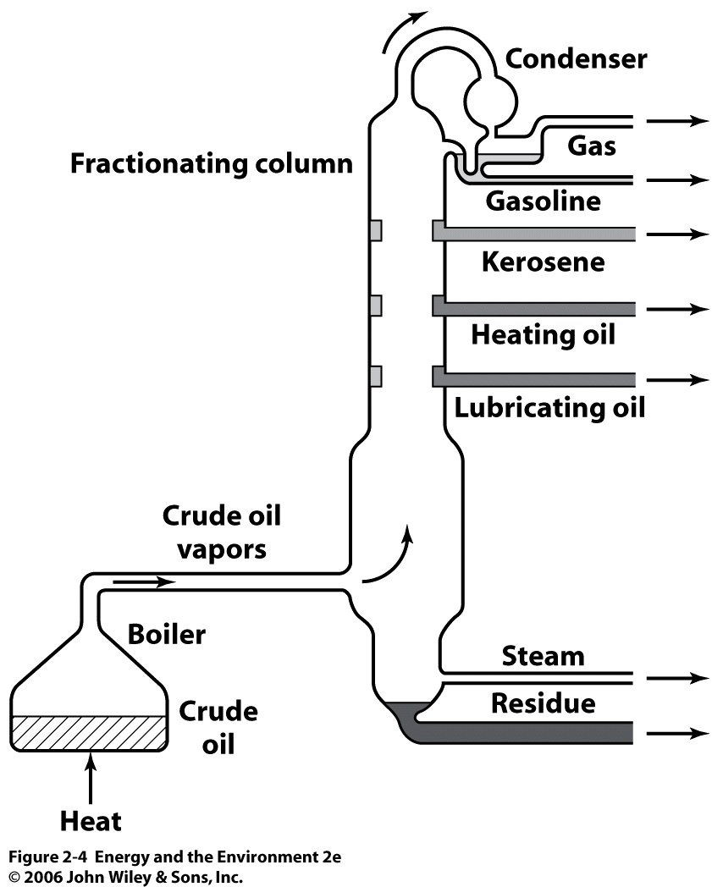
Refining
Crude petroleum taken directly from the ground is a mixture of hundreds of hydrocarbons and impurities like sulfur
Raw crude is not usable
Crude petroleum needs to be treated. The first step is a process called fractional distillation.
All of the crude is boiled. Smaller molecules boil first. As the different hydrocarbon vapors condense, they are collected at various points along the tower.
Simple hydrocarbons like methane and ethane do not condense

Slide 14
Petroleum Products
Fraction | Molecular size | Boiling Point (ºC) | Use
Gases | C₁-C₄ | -164 to 30 | Fuels
Gasoline | C₅-C₁₂ | 30-200 | Motor Fuel
Kerosine | C₁₂-C₁₆ | 175-275 | Diesel and jet fuel
Greases | C₁₆-C₂₀ | Solid | Lubricants
Paraffin | C₂₀ and up | 52-57 | Candles
Tar | Very high | No boil | Roofing, paving

Slide 15
Natural Gas
Natural gas has become a favorite fossil fuel in recent years. Many are optimistic that it can fulfill our energy needs
Natural gas is mostly methane (CH₄) with some ethane (C₂H₆)
Our natural gas use will likely increases because:
The technology for exploration and production has improved
Fossil fuels release less CO₂ into the atmosphere than coal or oil
Research has shown promise in using natural gas as motor fuel
Natural gas is cheaper than oil and coal-powered electric
Unlike electricity which is measured in kWh, natural gas use is measured by volume, typically per 1000 ft³

Slide 16
Comparing to Electric
The average cost of natural gas in the US is $10 per 1000 ft³
The amount of heat energy in 1000 ft³ of natural gas is 1.035 x 10⁶ BTU
The heat energy per kWh of electricity is 3413 BTU and the average price in SC is $0.09 per kWh
Relative costs per 10⁶ BTU:
Natural gas: $9.66
Electricity: $ 26.37
So, for home heating, ovens, dryers, and other warming devices natural gas is a better choice.
Notes:
Many have questioned if natural gas should be used for heating, with electricity used for high power devices. Compressed natural gas is also making its way into transit vehicles

Slide 17
Expanded Use
The U.S. uses about 23 trillion ft³ (tcf) of natural gas per year
Newer plants are using natural gas in the boilers rather than coal
Newer turbines are also being developed that have 45% efficiency (35% for coal power)
NG plants cost half as much as coal plants
No sulfur contamination
Our natural gas production is almost entirely domestic
The major hindrance of natural gas use is the lack of pipeline systems to bring fuel to the consumers. In many countries, the pipelines are not economically feasible and may never be built.

Slide 18
Major Natural Gas Proved Reserves
Country | Proved Reserves (tcf)
Russia | 1680
Iran | 940
Saudi Arabia | 231
U.S. | 189
Nigeria | 159
Venezuela | 148
Iraq | 110

Slide 19
New Developments
There have been some very encouraging developments in the search for natural gas
Coalbed Methane
Coal and methane were formed at the same time. Because coal is so porous, it absorbed a lot of methane. As much as 800 ft³ of methane can be stored per ton of coal
It is estimated that 700 tcf of natural gas exist in the U.S as coalbed methane
Clathrate Hydrates
Ice-like structures in which organic gases (ex. methane) are trapped in the center. These exist in enormous quantity at the bottom of the ocean
As much as 113000 tcf of methane may exist on the ocean floor

Slide 20
Coal
Following prehistoric plant death, the first stage of coal formation produces peat (decayed plant matter)
Heat and compression of peat yields different forms of coal, each one distinguished by age and carbon content.
Peat
Increasing pressure and time
Peat
Lignite
Sub-bituminous
Bituminous
Anthracite

Slide 21
Coal
Rank | Source | %Carbon | %Sulfur | BTU/lb
Anthracite | Pennsylvania | 88 | 0.9 | 13,300
Bituminous | Michigan | 50 | 1.2 | 11,780
Subbituminous | Wyoming | 46 | 0.6 | 10,750
Lignite | North Dakota | 27 | 0.6 | 6,750
Minable coal in the US is 71% bituminous and subbituminous. 28% is lignite, and 1% antracite
The older the coal, the greater the carbon content. Greater carbon content = higher thermal energy output
90% of all coal used in the US was consumed by electric utilities
Notes:
Before coal, wood was the primary energy source. Pound of wood has 8000 Btu. Wood sources became limited and too much labor was required to harvest new trees.

Slide 22
Proved Reserves
Location | Amount of proved reserve (10⁹ tons) | % of World Total | Years remaining for proved reserve for domestic use
US | 250 | 29 | 260
Russia | 230 | 17 | >500
Europe | 138 | 16 | 300
China | 115 | 13 | 70
Australia | 82 | 8.3 | 240
Africa | 55 | 5.6 | 230
The actual coal resource of the US is approximately six times the proved reserves, but it must be found.

Slide 23
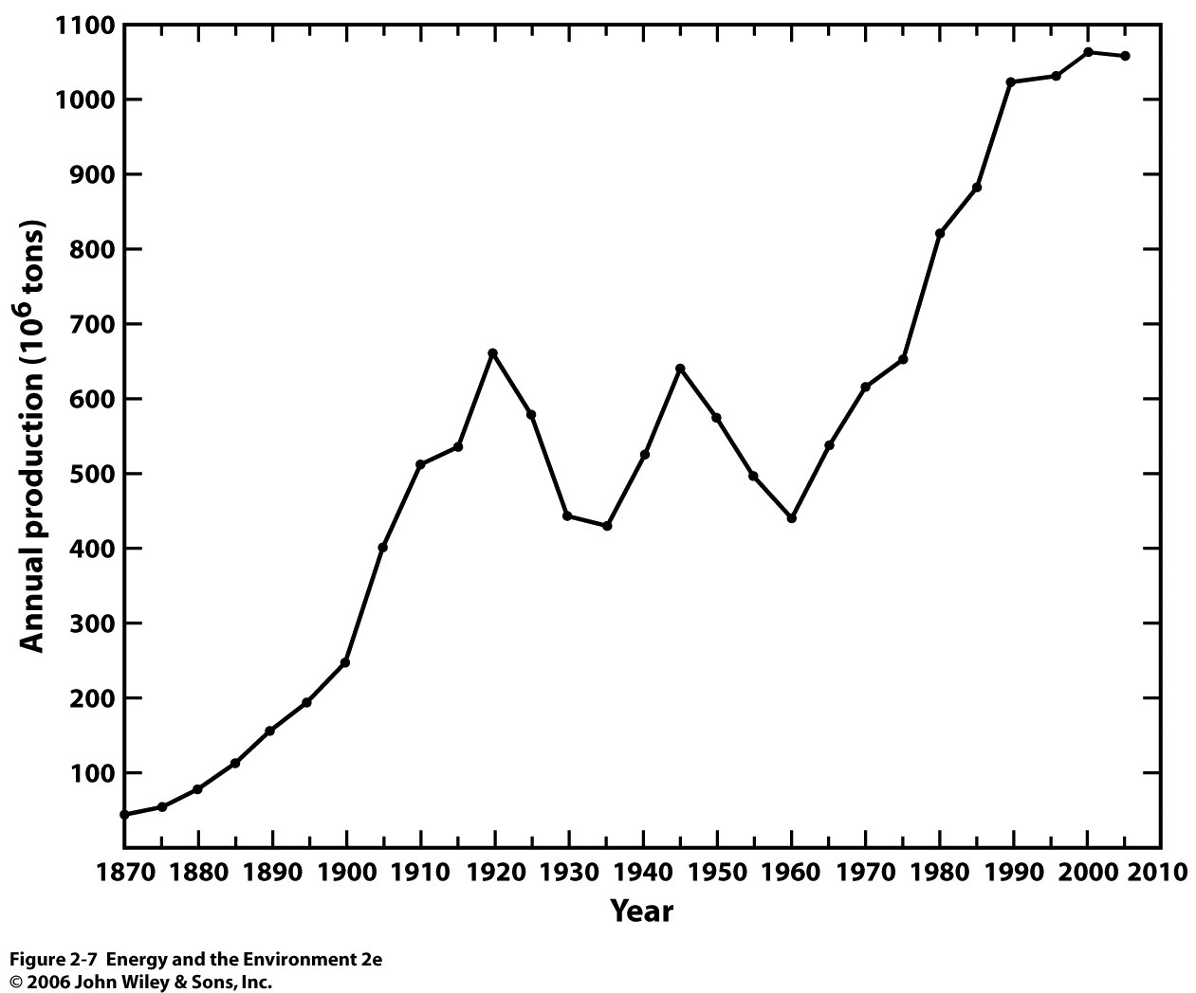
Notes:
If not for federal regulations on SO2 and environmental concerns over CO2, even more coal would be produced

Slide 24
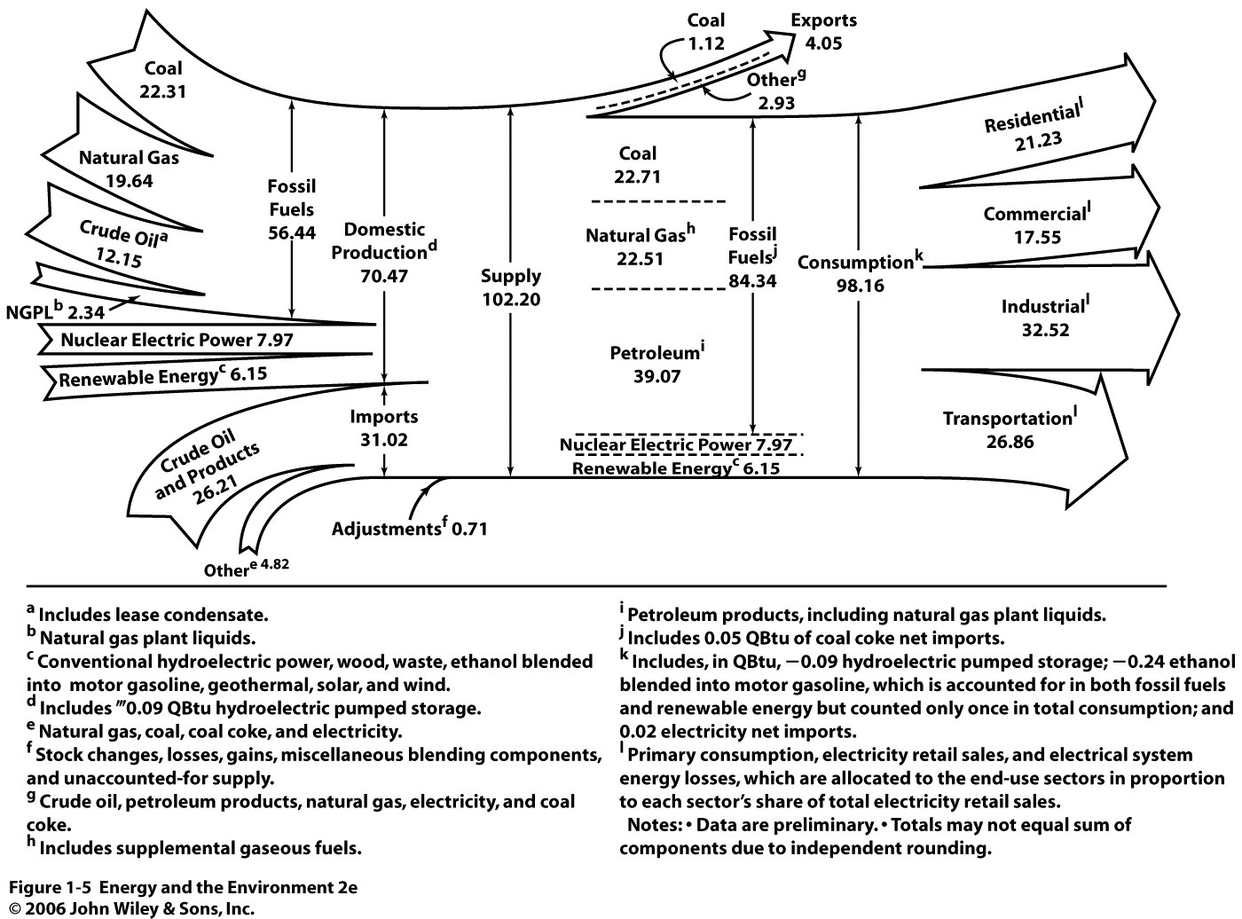
Energy Distribution in Qbtu (10¹⁴ BTU)

