Slide 1
The Promises and Problems of Nuclear Power
Dr Harris
Phys 105
Ch 6
2/25/13

Slide 2
Introduction
Nuclear power is a complex issue. It involves:
science and engineering
economics
psychology and politics
A very negative stigma is associated with nuclear power and radioactivity. These terms are often frightening and are not well understood by the public.
Due to politics, poor public perception, high start-up costs, storage issues and stringent regulations, there have been no new nuclear power plants built in the US since 1978.

Slide 3
Positives of Nuclear Power
There are many positive attributes of nuclear power that can not be overlooked. A few are listed below:
No fossil fuels are consumed
No pollutants are emitted
Uranium reactor fuel is cheap, and produces millions times more energy per unit mass than fossil fuels
Uranium can potentially provide power for thousands of years

Slide 4
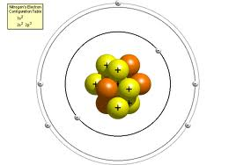
Recap
Two types of subatomic particles reside in the nucleus: protons and neutrons. We will refer to these as nucleons.
Atoms of the same element have the same number of protons. The number of protons in an element is its atomic number.
The total nucleons in an element is the mass number. Atoms of the same element with different numbers of neutrons (and thus, nucleons) are isotopes.
Particle | Relative Charge | Mass (amu)
Proton (yellow) | +1 | 1.007
Neutron (orange) | 0 | 1.008
Electron (white) | -1 | .000548

Slide 5
Neutron-to-Proton Ratio
The nuclei of most naturally occurring isotopes are very stable, despite the massive repulsive forces that exist between the protons in the nucleus.
A strong force of attraction between neutrons and protons known as the nuclear force counteracts this repulsion.
As the number of protons increases, more neutrons are required to stabilize the atom. Stable nuclei up to atomic number 20 have equal numbers of protons and neutrons.
For nuclei with atomic number above 20, the number of neutrons exceeds the protons to create a stable nucleus.

Slide 6
Radioactivity
Radioactive isotopes are unstable (high in energy). This instability is attributed to a neutron/proton ratio that is either too high or too low.
To become stable, they spontaneously release particles or electromagnetic radiation to lower their energy.
This release of energy is called radioactive decay.

Slide 7
Radioactive Decay
The three most common types of radioactive decay are alpha, beta, and gamma
Property | α | β | γ
Charge | 2+ | 1- | 0
Mass | 6.64 x 10-24 g | 9.11 x 10-28 g | 0
Radiation Type | 2 protons and 2 neutrons (${}_{2}^{4}{He}$) | High energy electron | Radiation
Penetrating Power | Low. Stopped by paper. Blocked by skin. | Moderate. Stopped by aluminum foil. (10α) | High. Can penetrate several inches of lead. (10000α)

Slide 8
Radioactive Decay
For example, the ${}_{92}^{238}U$ isotope undergoes alpha decay to decrease its n/p ratio:
The Thorium-234 isotope then undergoes beta decay which lowers the ratio even more:
In beta decay, a neutron is converted to a proton and an electron. This causes the proton count to increase:
Gamma (γ) decay usually accompanies α or β decay to release residual excess energy. γ is not shown in equations.
$${}_{92}^{238}{U→{}_{90}^{234}{Th+{}_{2}^{4}{He}}}$$
$${}_{90}^{234}{Th→{}_{91}^{234}{Pa+ {}_{−1}^{0}e}}$$
$${}_{0}^{1}{n→{}_{1}^{1}{p+{}_{−1}^{0}e}}$$

Slide 9
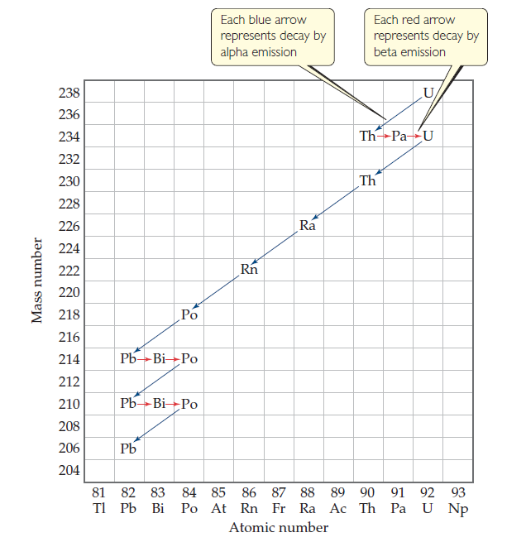
Nuclear Decay Series of ${}_{92}^{238}U$

Slide 10
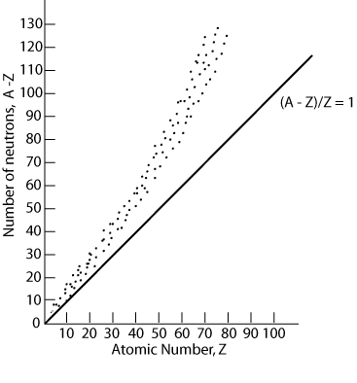
Belt of Stability
Plotting the number of neutrons in an isotope vs the number of protons for all stable isotopes, we get the graph to the right, known as the band of stability.
Nuclei outside of this band are unstable and will decay radioactively to achieve greater stability.
All elements above atomic number 83 are radioactive.

Slide 11
Dangers of Radioactive Isotopes
When radioactivity was first discovered, its harmful effects were not known
Marie Curie died of leukemia
Women who worked in factories painting radium on watch dials to make the glow in the dark developed cancer of the lips and bones from licking the paintbrushes
Why is radiation dangerous?
Radiation emitted from radioisotopes has sufficient energy to knock electrons from atoms (ionizing radiation).
The ions formed disrupt the normal workings of cells and produce abnormalities in DNA
Cancer is caused by damage to the growth regulation mechanism of cells, causing them to reproduce uncontrollably
Notes:
rapidly dividing cells more sensitive to radiation than others. bone marrow, lymph glands, embryonic cells. cancer cells are also rapidly dividing, which is why radiation therapy kills cancer cells more effectively than healthy ones

Slide 12
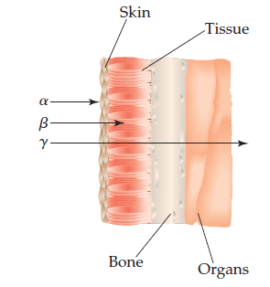
Dangers of Radioactive Isotopes
Due to its penetrating power, γ is the most dangerous radiation when the source is outside the body
However, if the source somehow enters the body, α becomes the most dangerous because it can transfer its energy into the tissue more effectively.
A substantial fraction of cancer is believed to result from the ionization of water in the body.

Slide 13
Everyday Exposure
Radiation is impossible to avoid. 82% of our exposure to ionizing radiation comes from natural sources.
66% comes from radon (Rn) gas, an α-emitter that resides in soil and rocks. It is a product formed by decay of uranium-238.
Cosmic rays from space account for 8%. This increases with altitude.
Terrestrial radiation from rocks, soil and food (i.e. carbon-14, potassium-40)
18% comes from human activity
X-rays
Consumer products
Smoking (polonium-210, an α-emitter in tobacco)

Slide 14
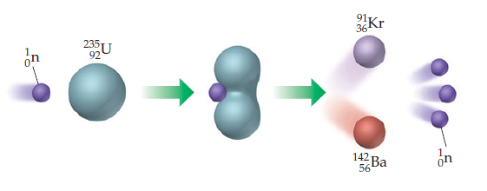
History of Nuclear Power
In 1938, researchers found that when heavy nuclei were bombarded with neutrons, they fissioned.
Nuclear power and nuclear weapons are based on the fission of ${}_{92}^{235}U$
When struck by a slow-moving neutron, uranium-235 fissions into krypton-91 and barium-142. Each of these smaller fragments then release more neutrons, which cause the fissioning of more uranium. The kinetic energy of the emitted fragments is converted to heat.

Slide 15
Mass Energy From Fission
The equation for the fission of uranium is shown below. The masses of each precursor are given in units of g/mole. Assuming 1 mol of each:
$${}_{92}^{235}{U + {}_{0}^{1}n → {}_{ 36}^{91}{Kr + {}_{56}^{142}{Ba +3 ({}_{0}^{1}{n)} }}}$$
235.0439
1.008
90.9234
3 (1.008)
141.9164
236.0519
235.8638
As you see, 0.1881 g of mass are lost during this fission. What happens to it?

Slide 16
Mass Energy From Fission
The mass is converted into thermal energy as expressed by Einstein’s equation
Plugging in the change in mass (kg) and the speed of light, the total energy emitted from the fission of a mole of uranium-235 is:
A gram of uranium-235 produces 10 millions times more energy than a gram of coal.
$$E=∆mc^{2}$$
$$E=(.001881 kg)(3.0 x 10^{8} \frac{m}{s})^{2}=1.69 x 10^{14} J$$

Slide 17
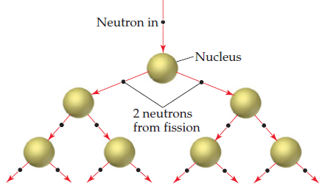
Chain Reactions
If one fission produces 3 neutrons, then 3 more fissions will proceed, which will each produce 3 more neutrons.
As you see, the energy released in a nuclear reaction can escalate quickly. If unchecked, the result is a violent explosion (i.e. Chernobyl). This is a chain reaction.

Slide 18
Critical Mass
subcritical
For a fission chain reaction to occur, a minimum mass of fissionable material is required (critical mass)
At the critical mass, the fission is sustainable and controllable. The critical mass of uranium-235 is 50 kg.
Below the critical mass (subcritical), neutrons escaped before they can cause fission.
Above the critical mass (supercritical), a nuclear explosion will occur.
supercritical

Slide 19
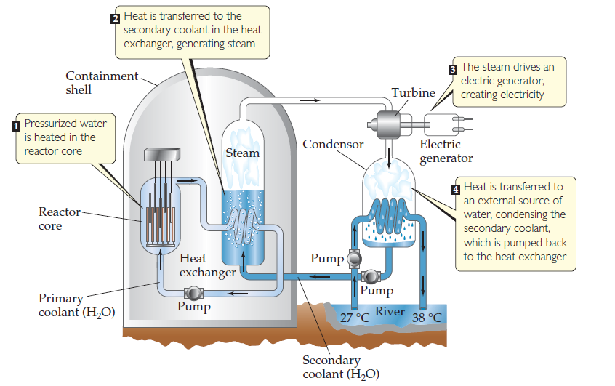
Nuclear Fission For Electric Generation
Fission can be used to generate electric power via steam generation. Shown below is a pressurized water reactor.
Notes:
containment shell shields staff from radiation. water in line is so pressurized that it cant boil.

Slide 20
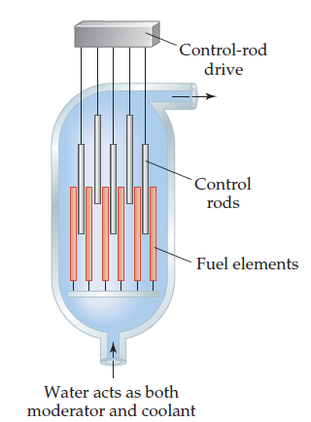
Inside the Reactor Core
The fuel elements contain pellets of uranium in the form of a uranium oxide, UO₂.
The pellets are enclosed in zirconium rods (Zr). Zr is used because neutrons are not absorbed by Zr, so they can pass through and strike other ${}_{92}^{235}U$ isotopes
The neutrons are emitted at high velocity. Fast neutrons can not be absorbed. Water is used to slow the neutrons down.
Control rods, composed of cadmium and boron, absorb neutrons to control the reaction rate and prevent overheating.

Slide 21
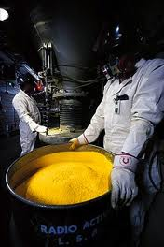
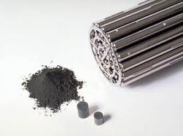
Uranium Mining
Uranium oxide pellets (UO₂)
Yellowcake (U₃O₈)
Yellowcake is mined and converted to uranium oxide.

Slide 22
Uranium Resources (U.S.)
There is estimated to be 3.75 x 10⁹ lbs of uranium ore in the US. The domestic price is $11/lb.
Assuming no reprocessing, the lifetime of uranium for U.S. energy production is 155 years for continuous operation of our 104 reactors.

Slide 23
Uranium Enrichment
Uranium exists in nature as two isotopes: ${}_{92}^{235}U$ and ${}_{92}^{238}U$.
99.3% of all uranium on Earth is uranium-238. The problem is that only uranium-235 can undergo fission.
Uranium must be enriched to accumulate a critical mass of uranium-235. The two isotopes can be separated by gas centrifuges.
For electricity generation, uranium must be enriched to 3% uranium-235.

Slide 24
Fuel Cycle
Fuel rods can be left to operate for 3 years. If the input material was 3.2% ${}_{}^{235}{UO_{2}}$, after the 3 year cycle, it would be 0.85% ${}_{}^{235}{UO_{2}}$ with some other fission products to be discussed later.
The vast majority will still be ${}_{}^{238}{UO_{2}}$.
After the 3 year period, the rods are removed. They are hot, thermally and radioactively. The rods are immersed in a cooling pool.
Other countries like France reuse the rods (reprocessing) to produce more energy. The U.S. does not out of fear that the rods could be stolen to produce weapons.

Slide 25
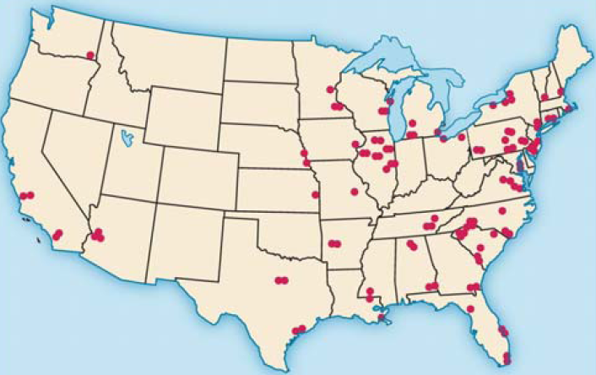
Nuclear Power Plants in Operation in the U.S.

Slide 26
Reprocessing
As discussed, ${}_{92}^{238}U$ does not fission. However, when bombarded with fast neutrons, uranium-238 can be converted to plutonium-239, which is fissionable
Since the fission of uranium-235 produces at least 2 neutrons, more plutonium-239 is produced than uranium-235 consumed. This extends the lifetime of nuclear power by thousands of years.
A breeder reactor must be used to produce plutonium-239. Breeder reactors do not use water in the core, so the neutrons are not slowed.
$${}_{92}^{238}{U+ {}_{0}^{1}{n → {}_{92}^{239}U (unstable)}}$$
${}_{92}^{239}U→ {}_{93}^{239}{Np}+ {}_{−1}^{0}e (β decay)$
${}_{93}^{239}{Np}→ {}_{94}^{239}{Pu}+ {}_{−1}^{0}e (β decay)$

Slide 27
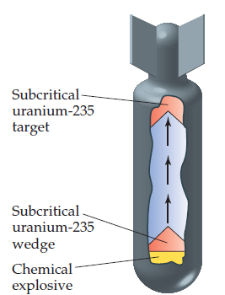
Problems with Nuclear Power: Nuclear Weaponry
Once nuclear power was established, scientists realized that building a nuclear weapon would be straight-forward as long as enough enriched uranium-235 is available.
During the 40’s, the fear was that Nazi Germany would develop a nuclear bomb.
This spurred the Manhattan Project. The U.S. wanted to build a nuclear bomb before Germany could.

Slide 28
Problems with Nuclear Power: Risk of Plant Meltdown
Let’s investigate why the nuclear power industry has not grown, despite it’s obvious promise. We should begin with the dangers of nuclear power.
Myth: The risk of explosion is the greatest problem with nuclear plants
Fact: Nuclear plants can’t blow up like nuclear bombs because of the distribution of material and insufficient enrichment of uranium-235
Human error is the biggest threat (i.e. Chernobyl and Three Mile Island)
In the two examples above, a loss of cooling water lead to overheating, which caused the core to melt.
Meltdown can result in the release of radioactive material

Slide 29
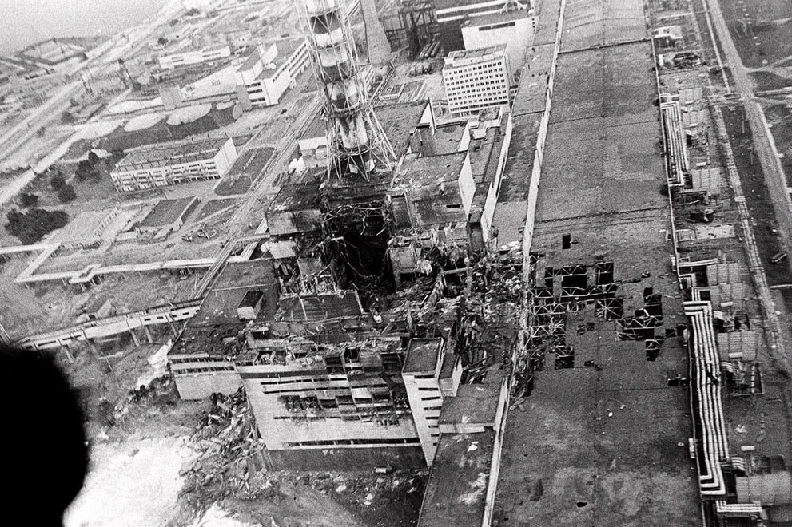

Slide 30
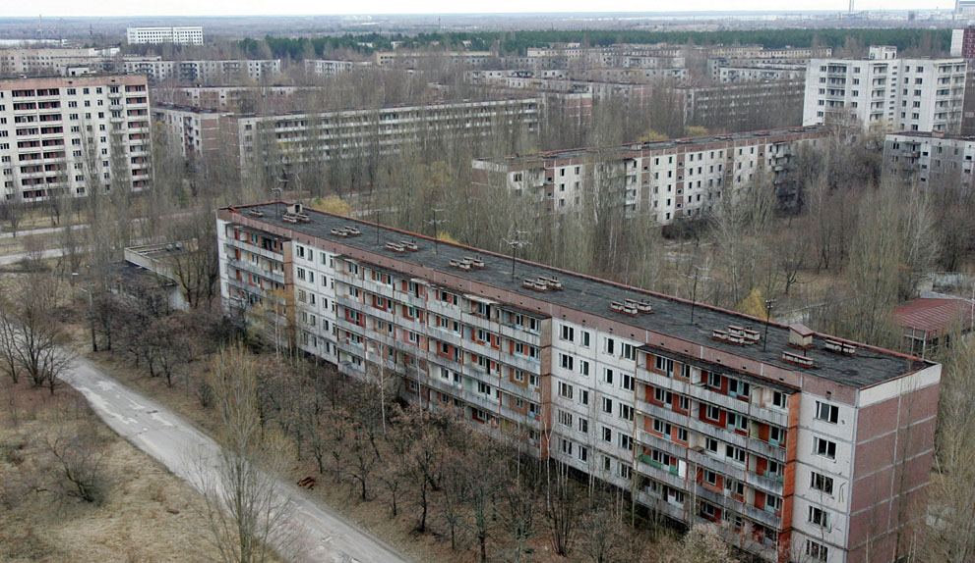

Slide 31
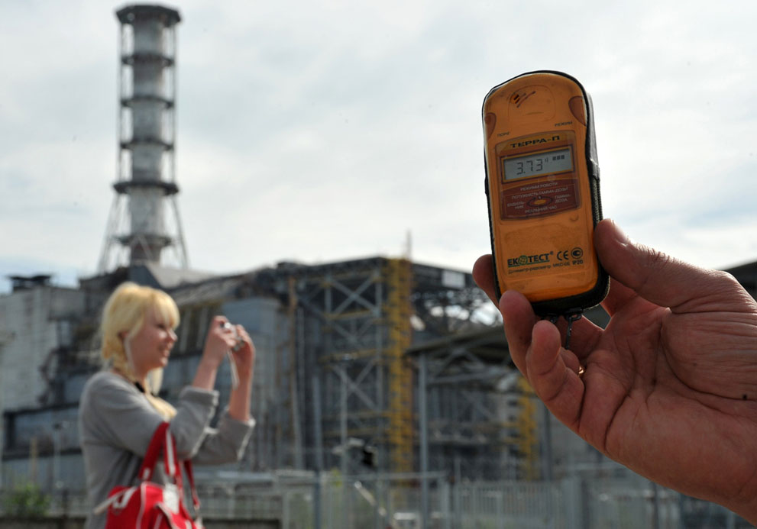

Slide 32
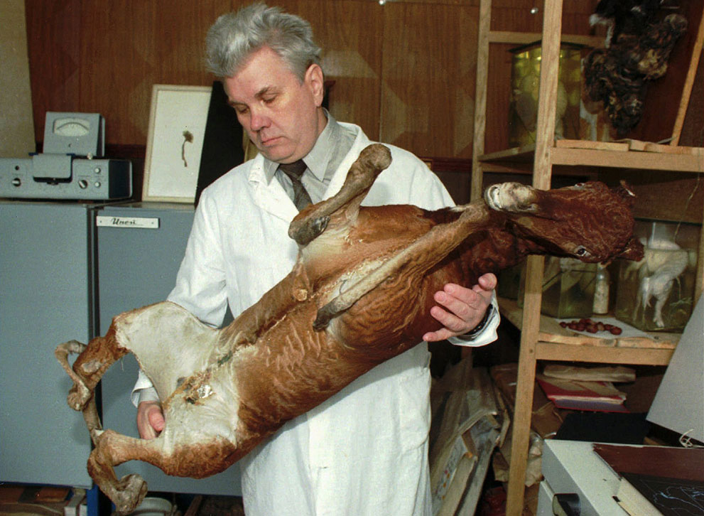

Slide 33
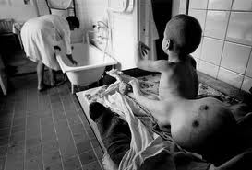

Slide 34
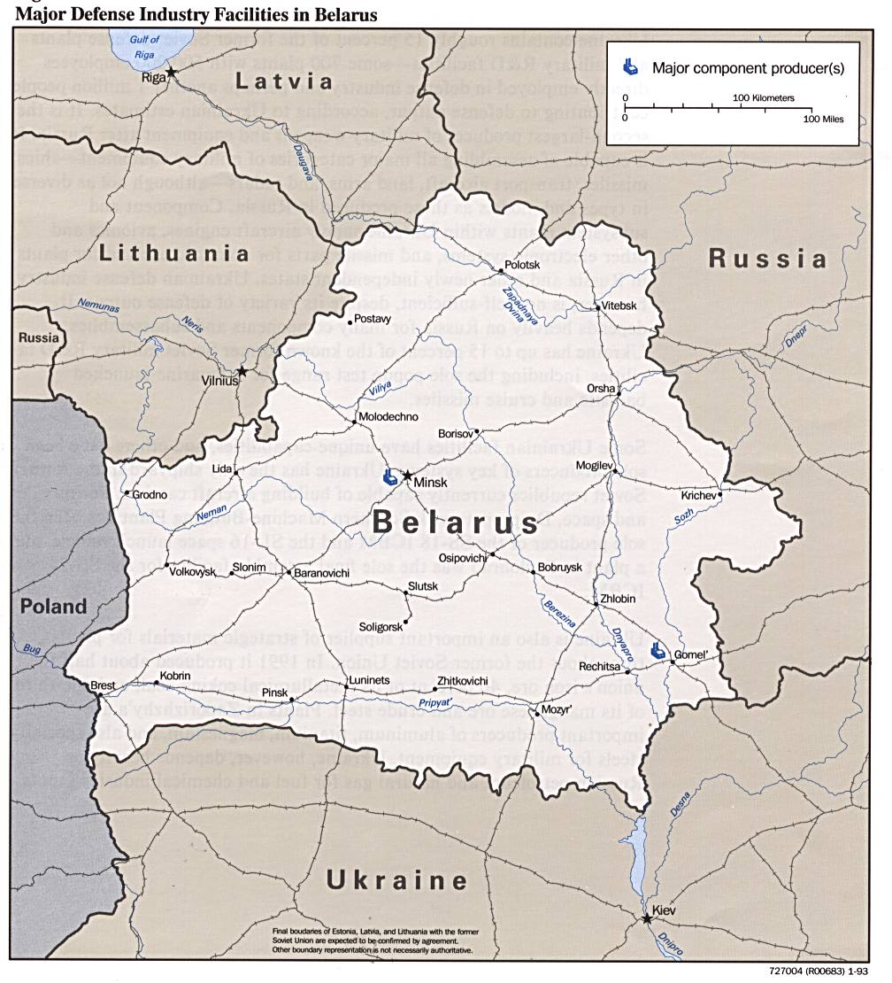
Wind Blew 70% Of The Radioactive Material Out of Ukraine and Into Belarus
On average, the incidence of all types of cancer in Belarus has increased 40% since Chernobyl.
Thyroid cancer has increased 30-fold. Leukemia rates are up 50%
In children, heart disease is up 47%, bone disorders 63%, and nervous system disorders 43%
Child deformities increased 300%

Slide 35
Problems with Nuclear Power: Dangers of Radiation
Radioactive products
Great care is taken to prevent the introduction of radioactive contaminants into the environment. However, there can be some escape of radioactive gases through microscopic cracks in cladding.
Radioactive tritium $\left({}_{1}^{3}H\right)$ is released in discharged water
Rocks left behind from uranium mining may leach into groundwater

Slide 36
Plant Decommission
Nuclear plants have a life expectancy of 30 years. After that point, neutron bombardment of plant components makes the metals brittle
The plant must be decommissioned. This may involve one of the following options
Closing the plant and leaving it under armed guard
Entombing the plant in concrete (i.e. Chernobyl)
Dismantling the plant, cutting it into pieces and storing them
The cost of decommission is $3B

Slide 37
Waste Disposal
Fission products accumulate as a reactor operates. For this reason, fuel rods must be replaced every 3 years. The rods are stored on site underwater.
Storage presents a serious problem because of the high radioactivity of the waste. It takes 20 half-lives for their radioactivity to reach low enough levels for human safety
Uranium 235 ($t_{1/2}$ = 704 million years)
Uranium 238 ($t_{1/2}$ = 4.4 billion years)
Plutonium 239 ($t_{1/2}$ =24000 years)
These half-lives are far beyond human lifetimes, so this waste will exist forever.

Slide 38
Yucca Mountain
Each year a nuclear plant produces 20-30 tons of waste.
Research has been devoted to converting the waste to synthetic rock, then placing them in resistant containers deep underground
The Yucca Mountain site in Nevada was chosen. The Department of Energy charges utility companies $1/1000 kWh to fund the $96 B project
The suitability of the site was tested for 20 years prior to approval by G.W. Bush
The capacity would be 70,000 tons of waste. Once filled, a new depository would have to be built.
Material would be buried 500 meters under the earth in tunnels, which would then be back-filled with dirt.
In 2008, the Obama administration cancelled the project. The GOP is currently fighting to overturn the decision.

Slide 39
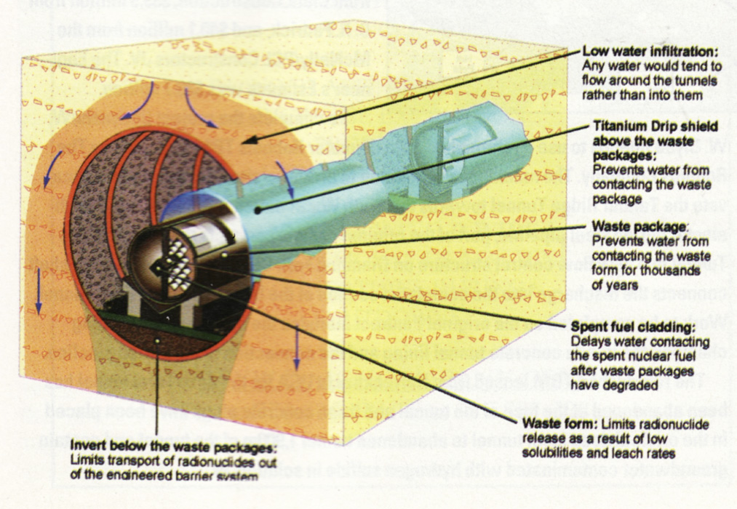

Slide 40
Cost of Nuclear Power
Accounting for startup costs, decommission costs, operation and fuel, nuclear power cost $0.051/ kWh
Coal power costs $0.037/ kWh
There are now efforts to design new reactors with less cost than 1st generation ones.
The projected cost of power generation from the newer plants is $0.04/kWh
With nuclear power, construction/operation costs dominate. With fossil fuels, the fuel itself is the important cost

