Slide 1
Heat Engines and Electric Power Transmission (Ch 3)
Phys 105
2/13/13

Slide 2
Utilizing Heat Energy
What may seem like a small unit of thermal energy, is in actuality, a seemingly large amount of mechanical energy
Ex. The amount of heat released from burning a match is approximately 1 BTU. This is the amount of energy expended by a human that lifts a 778 lb mass 1 ft off the ground (778 ft lb)
J. Dorman Steele: “ The combustion of a pound of coal, supposing it to take place in a minute, is equivalent to the work of three hundred horses”.
The possibility of easing human labor by heat sources has been the driving force behind much development of heat engines

Slide 3
Heat Engines
A heat engine is any device that takes energy from a warm source and converts a fraction of that heat to mechanical energy
ex. boiler in a coal-fired power plant
Not all of the heat energy from a heat engine can be used to perform useful work. This follows the 1st law of thermodynamics.
Power plants, automobiles, locomotives, etc. are all seen to lose waste heat to the surrounding air
The maximum theoretical efficiency of a heat engine is known as the Carnot efficiency
This value describes the percentage of energy taken from a heat source which is actually converted to useful work

Slide 4
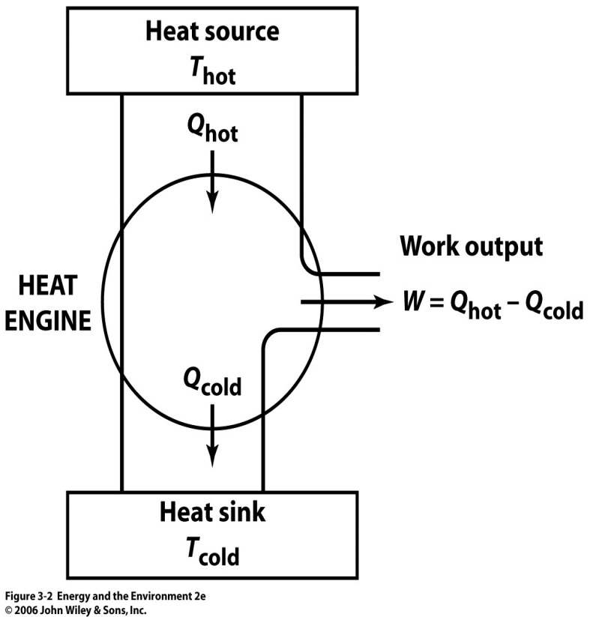
Carnot Efficiency
The Carnot efficiency (%) of a heat engine is given by:
Temperatures are in Kelvin.
The value obtained gives the maximum theoretical efficiency of the system, assuming the system to be ideal (perfect)
An ideal engine can never, ever be attained.
Reasons: Friction, limitations of insulation, heat leaks
The actual efficiency is always less than η
$$η=\left(1−\frac{T_{cold}}{T_{hot}}\right) x 100\%$$
Q is the thermal energy.

Slide 5
Example
Calculate the maximum % of thermal energy that can be used to do work for a heat engine that has steam injected to it at 1000º C and exhausted at 450º C?
$$Kelvin=Celcius+273$$
$$T_{hot }=1273^{o}K$$
$$T_{cold}=723^{o}K$$
$$η=\left(1−\frac{723}{1273}\right)x 100\% =43.2\%$$

Slide 6
Practical Heat Engines
Practical heat engines appeared wherever there was a possibility of reducing manual labor.
Heat engines have steadily improved.
The first example is the steam engine, created in 1880 with 1% efficiency
A more advanced version of the steam engine is the basis of our electric generation today.
Steam engine operation is based on the fact that water expands to about 1000 times its original volume when its converted to steam
If the steam is confined, pressure builds up and the steam tries to expand with great force. This force can be used against a piston.

Slide 7
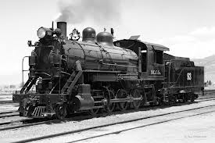
Steam engines are external combustion engines. The fuel is burned outside of the pressurized part of the engine.

Slide 8
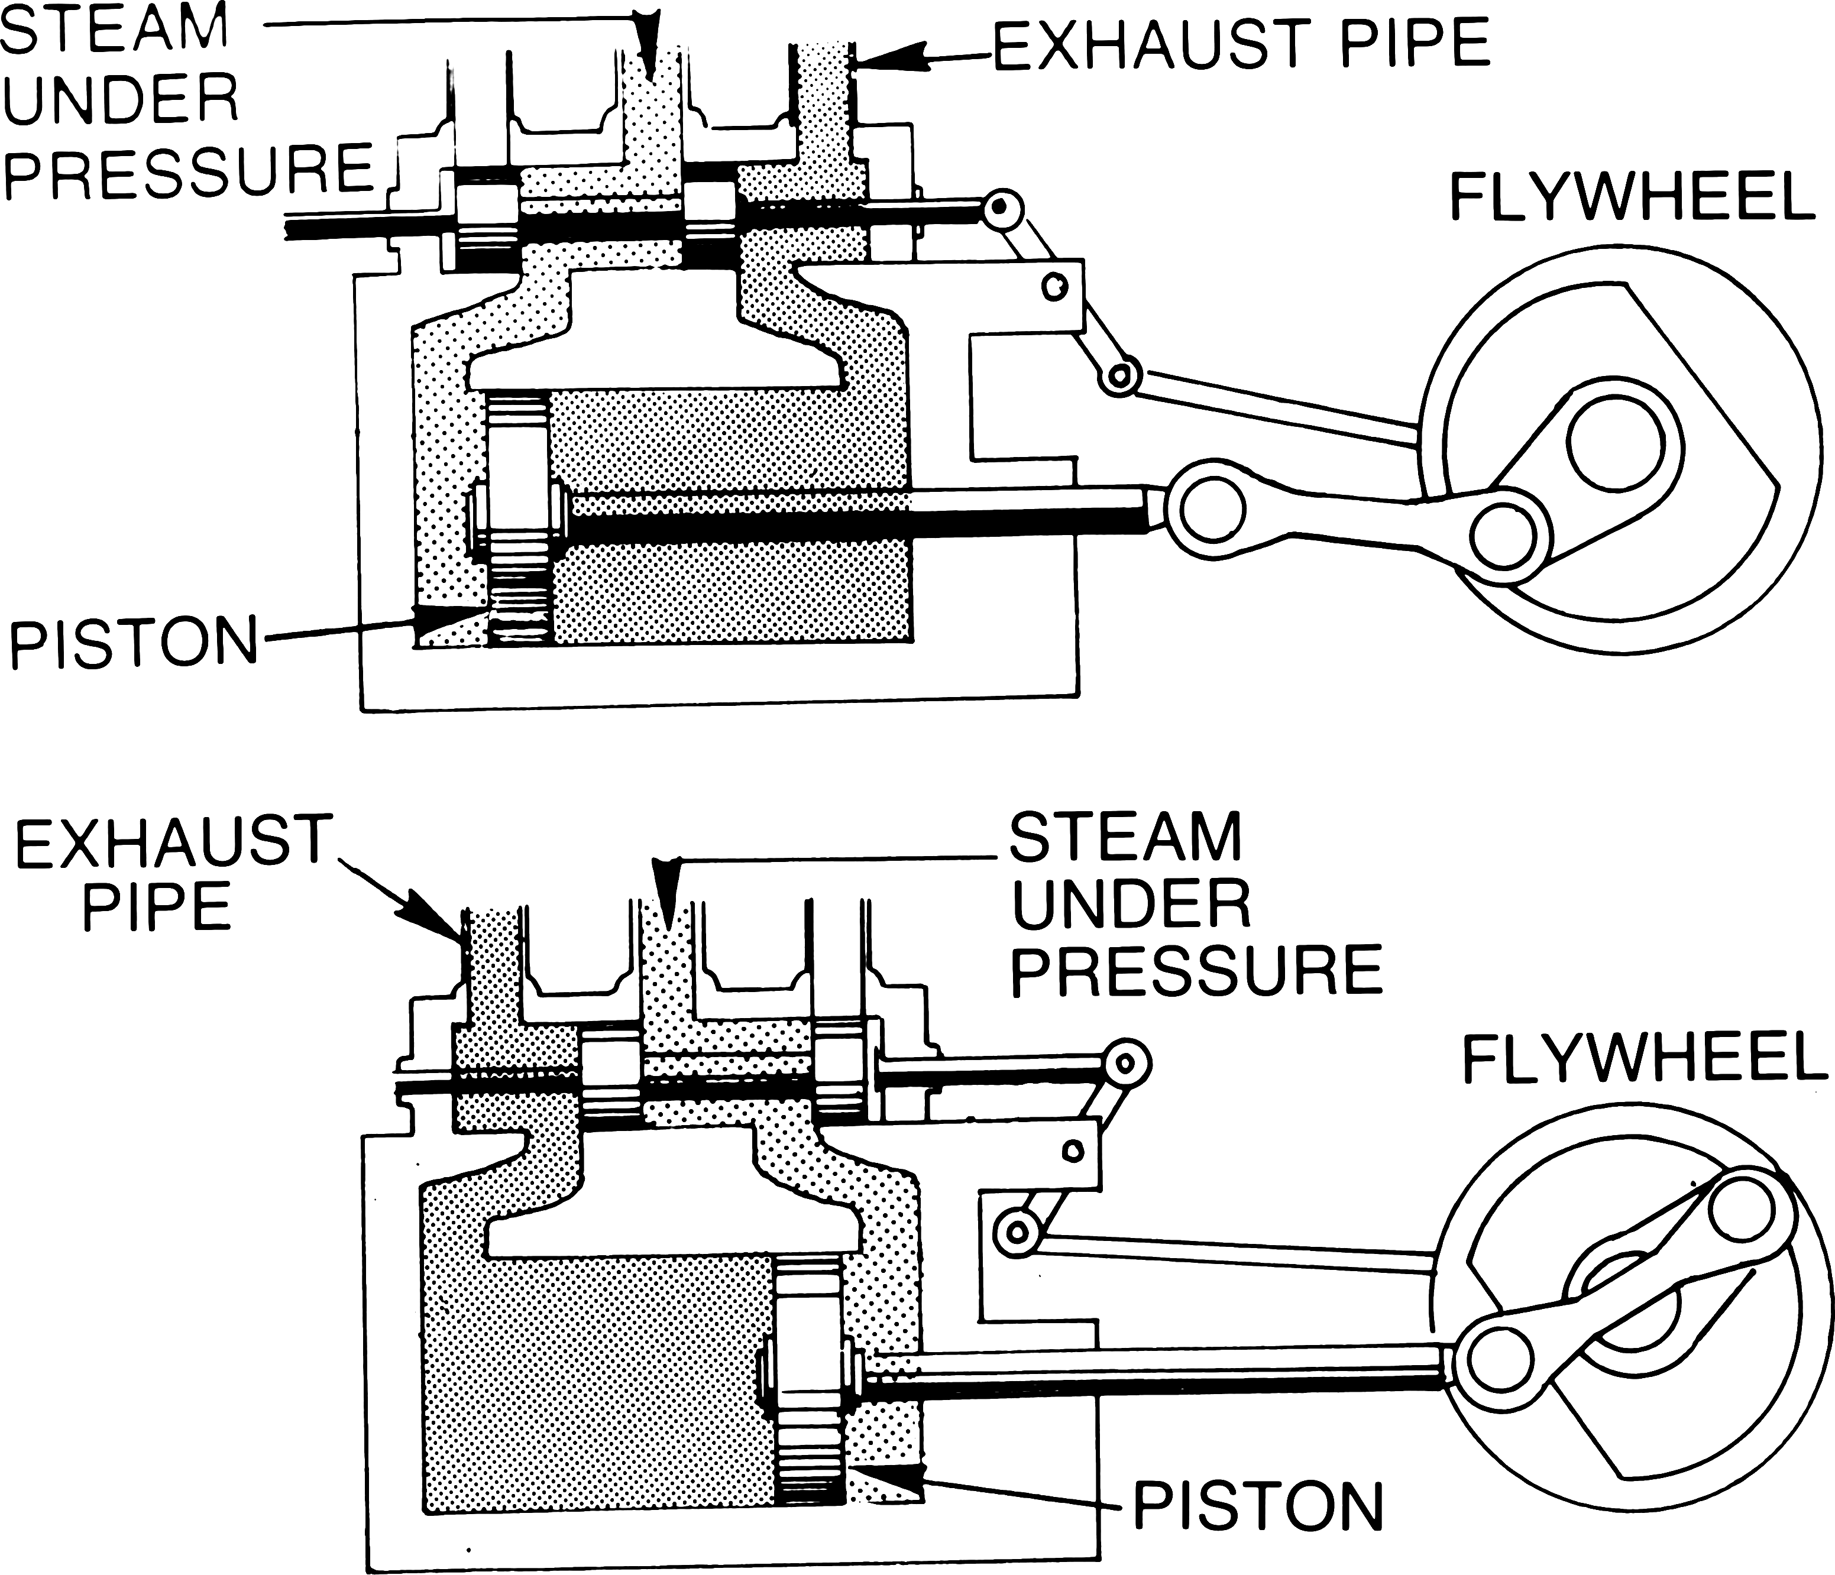

Slide 9
Gasoline Combustion Engines
Gasoline engines are internal combustion engines because fuel is burned inside the pressurized part of the engine
In these engines, gasoline is vaporized and mixed with air inside a closed chamber.
The crankshaft rotates, forcing the piston upward, which compresses the gas to high pressure
A spark plug triggers explosion of the air/gas mix, the hot gas expands against the piston, forcing it downward and continuing the rotation of the crankshaft
Exhaust valve opens to release waste gases. The piston moves back up and the cycle repeats.

Slide 10
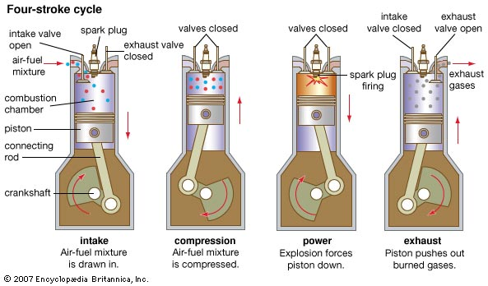

Slide 11
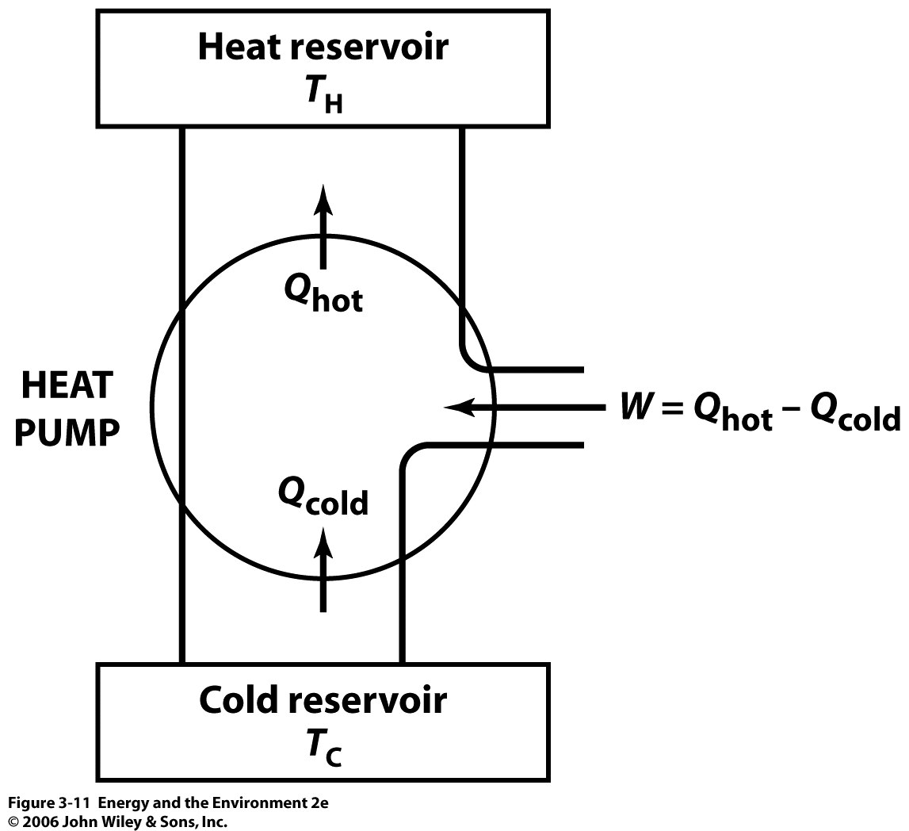
Heaters (Heat Pump) and AC
A heat pump is essentially the opposite of a heat engine. Rather than use heat to produce electrical work, heat pumps use electrical work to produce heat.
Heat is removed from a cold sink and delivered to a warmer place.
The heat energy delivered to the hot reservoir can far exceed the work input

Slide 12
Coefficient of Performance
Its clear that heat never spontaneously flows from hot to cold. Energy input is required to make this happen.
We can easily calculate the efficiency of a heat pump. This value is known as the coefficient of performance.
We define this as the ratio of the heat delivered to the work input.
For residential space, it has become very common to run a heat pump that takes heat from outside and brings it into the home
When a heat pump is run in reverse, it is known as a refrigerator or an air-conditioner
$$COP= \frac{Q_{h}}{W}=\frac{T_{h}}{T_{h}−T_{c}}$$

Slide 13
Example
Calculate the coefficient of performance for a heat pump used to maintain a house temperature of 70ºF when the outdoor temperature is 30ºF?
Convert F to K
$$Kelvin=\left(\frac{5}{9}\right)\left(F−32\right)+273$$
$$T_{H}=21+273=294 K$$
$$T_{c}=−1+273=272 K$$
For an ideal heat pump under these conditions, you could attain 13.3 units of heat for every 1 unit of work. In actuality, COP values range from 2 to 6.
$$COP= \frac{294}{294−272}= \frac{294}{22}=13.3$$

Slide 14
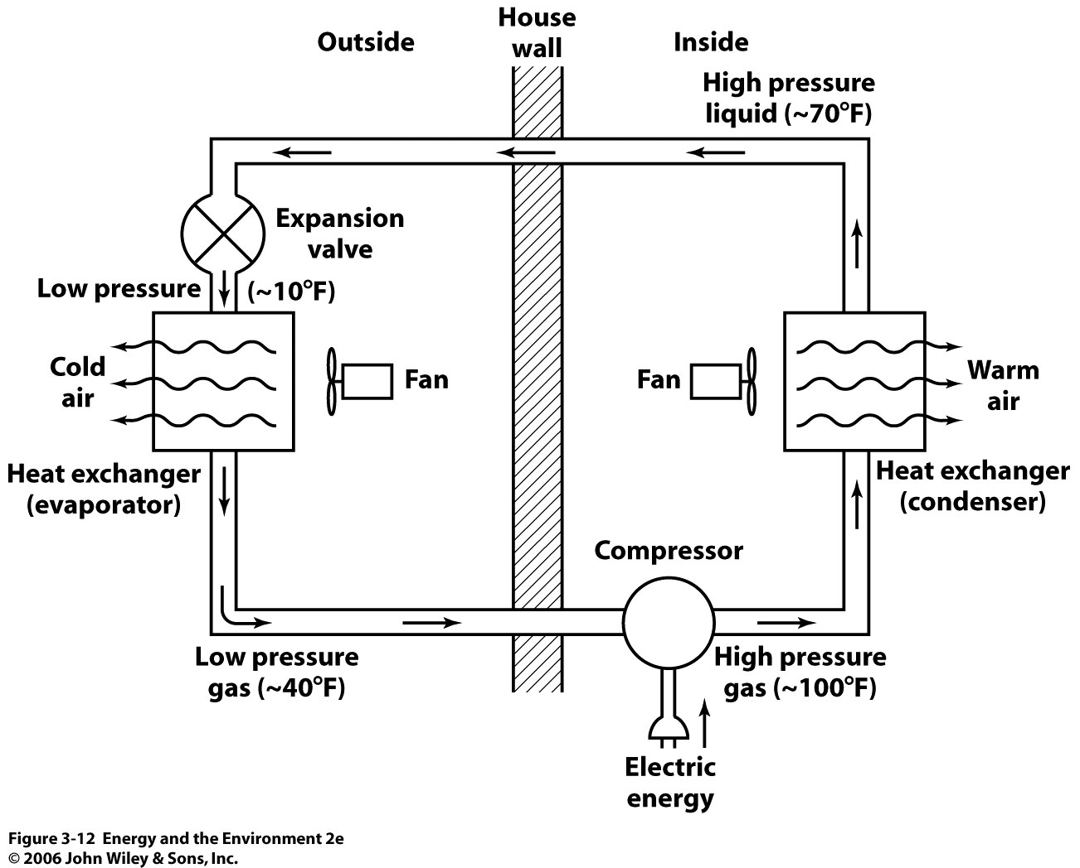
Heat Pump/AC Mechanism
Direction of Freon flow for air conditioning
Direction of Freon flow for heat pump

Slide 15
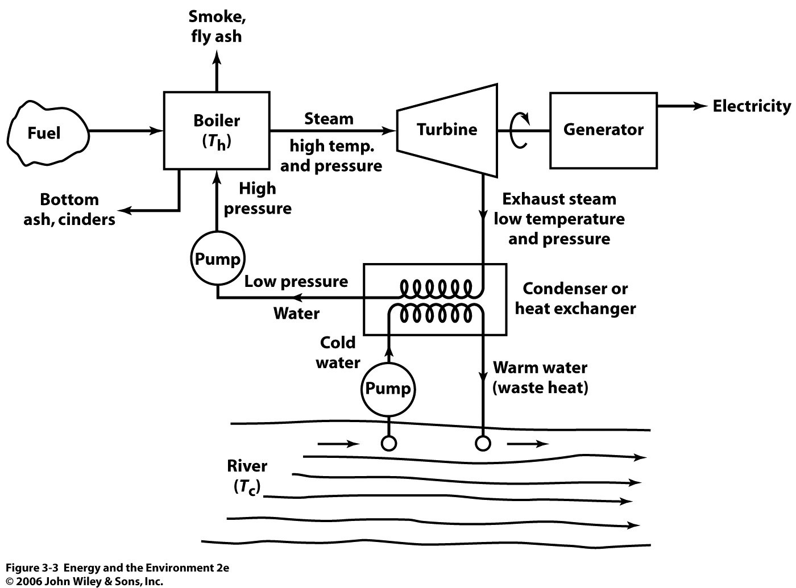
Coal-Fired Power Plants Are Essentially Massive Heat Engines

Slide 16
Example
For a coal-fired power plant, the temperature of the steam in the boiler is 552º C. The water in the cooling tower is 27ºC. Calculate the theoretical maximum efficiency of this plant.
In actuality, the efficiency of coal power is closer to 35%. This means that for every 3 units of fuel burned, 1 unit equivalent of electrical energy is produced.
$$Kelvin=Celcius+273$$
$$T_{hot}=552^{o}+273=825^{o}K$$
$$T_{cold}=27^{o}+273=300^{o}K$$
$$η=\left(1−\frac{300}{825}\right)x 100\%=64\%$$

Slide 17
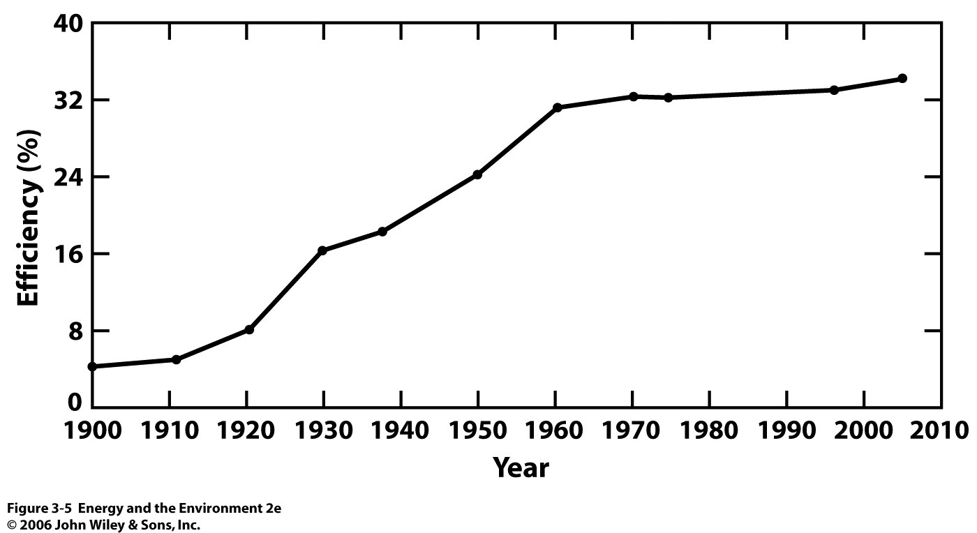
Improvements in Coal-Fired Plants

Slide 18
Utilizing Waste Heat
There is no fundamental reason why waste from a heat engine can not be used in some beneficial way
Whenever you turn on the heater in a car, waste heat from the engine is used to warm the car’s interior
Other options come to mind as well, like space heating for homes and businesses
Waste heat from power plants used for heating? Doesn’t work for large plants that are far away from the consumer
There have been recent advances in putting smaller plants near the point of use
Ex. University of Colorado Boulder

Slide 19
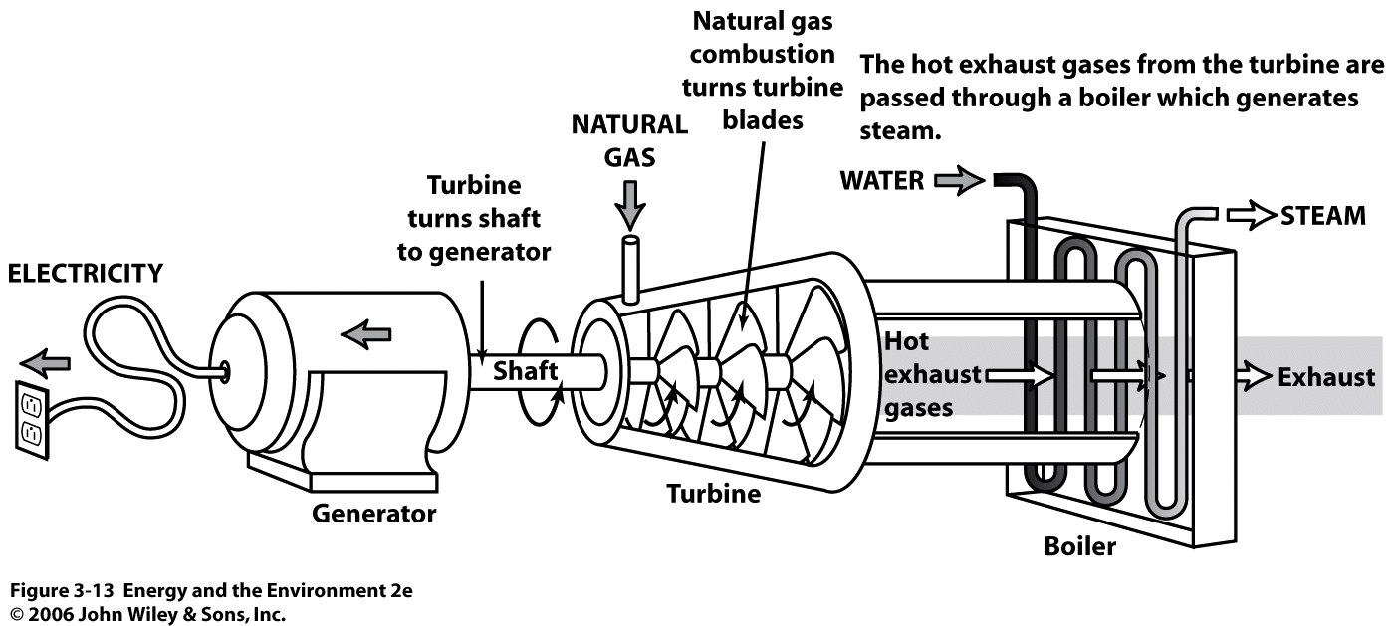
Gas Turbine
Exhaust heat pumped throughout campus for heating. Increases plant efficiency to 70%.

Slide 20
Electric Power Transmission
In order for electric energy to be useful, it must be transported to the consumer.
Thomas Edison designed the first power lines in NYC in 1882. These initially ran on direct current (DC)
As distribution networks became larger, alternating current (AC) allowed flexibility in changing the voltage of the current along different points in the system with transformers.

Slide 21
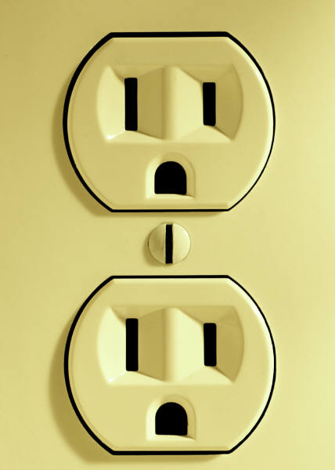
Alternating Current
current flow

Slide 22
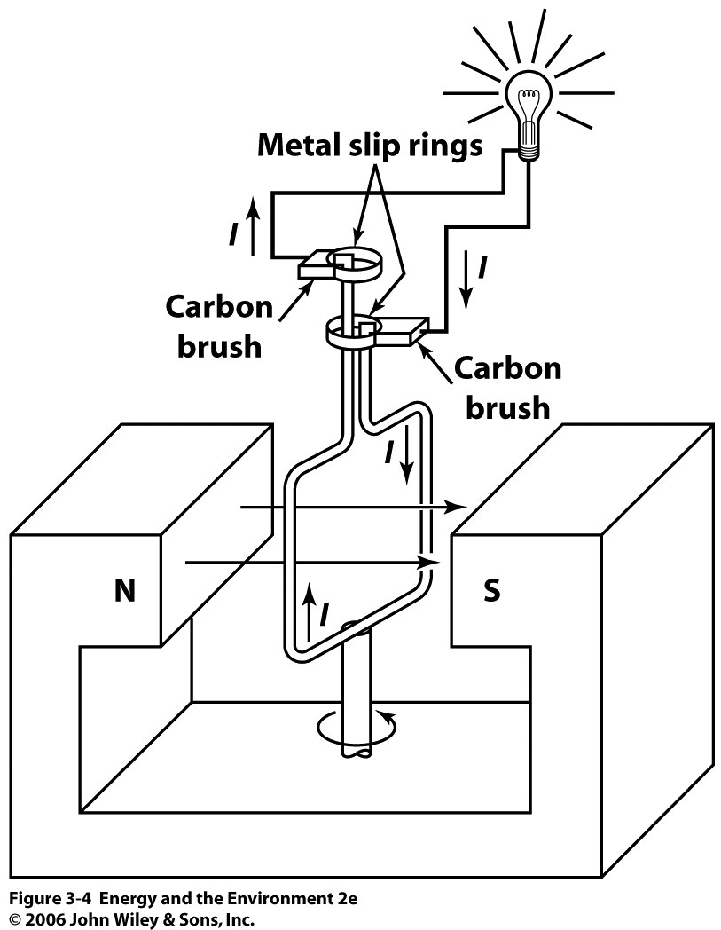
Frequency of AC Dictated By Frequency of Rotor

Slide 23
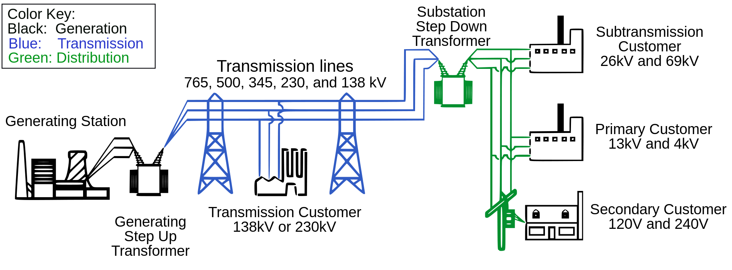
Electric Power Transmission

Slide 24
Step-Up Transformers
Voltage is stepped up by induction. In a transformer, two wires are wrapped around a solid iron core. The number of times the wire is coiled around the core alters the magnetic field, which proportionally alters the voltage.
This is done to account for the energy losses of the electrons during transmission.
Ramping up the voltage lowers the current.
20 coils
1 coil
Iron Core
10 V
100 amp
200 V
5 amp

Slide 25
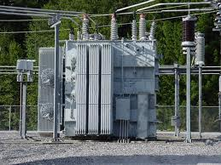

Slide 26
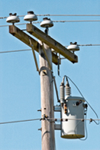
Step-Down Transformers
Step-down transformers are located at points along the transmission lines to reduce the voltage to appropriate values for use.
Residential voltage is dropped to 240V
Voltage is further divided to 120V, 60 Hz AC

Slide 27
Grid
The system of generating stations, substations and transmission lines is called the grid
Most of the electric power companies of the U.S. and Canada are integrated into a single continuous grid. The reasons are:
less cost
availability of backup power
North America has 200,000+ miles of transmission lines

