Slide 1
Ch 1. Energy Use In Industrialized Societies, Energy Basics
1/30/13

Slide 2
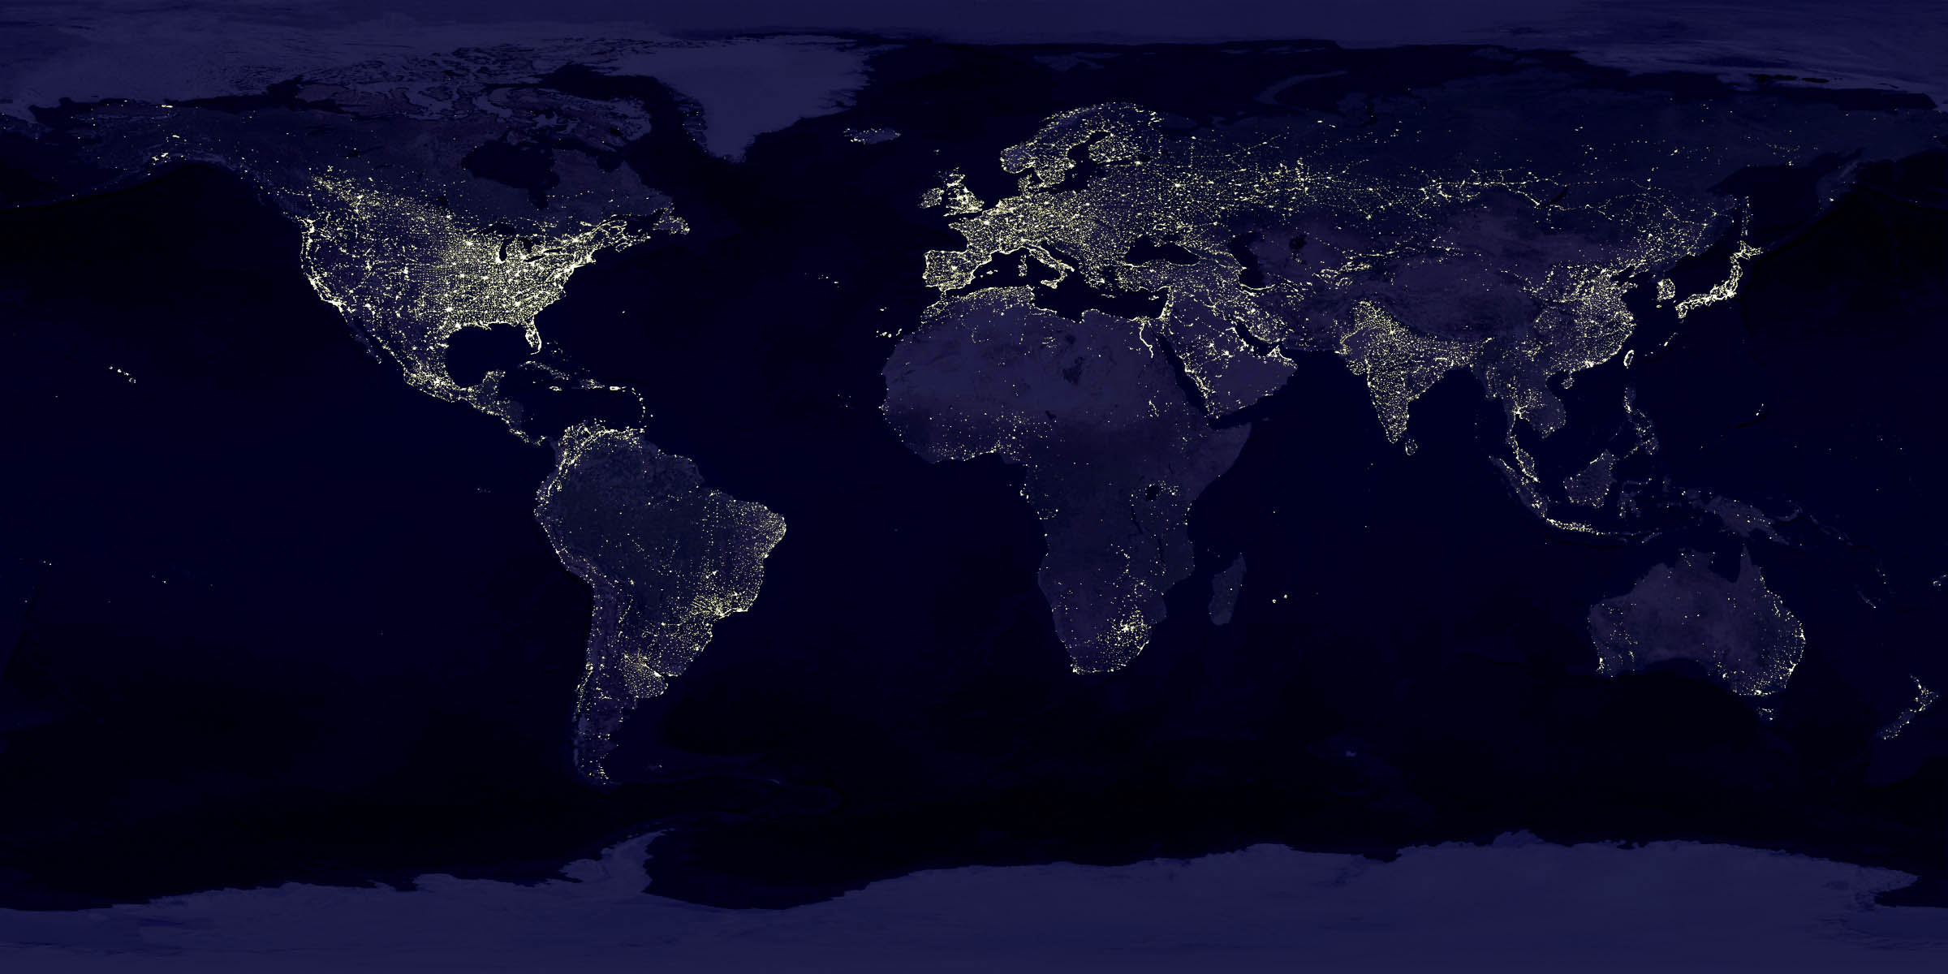

Slide 3
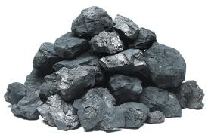
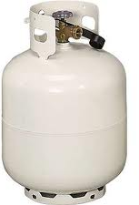
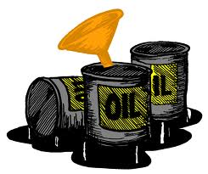
86% Of The Energy Used In the U.S. Comes From Fossil Fuels
Coal, oil, and natural gas
Fossil fuels formed from anaerobic decomposition of prehistoric plants and animals
When these thing died, they became buried under thousands of feet of dirt and rock
Immense pressure, anaerobic conditions, and bacterial processes lead to formation of the fossil fuels

Slide 4
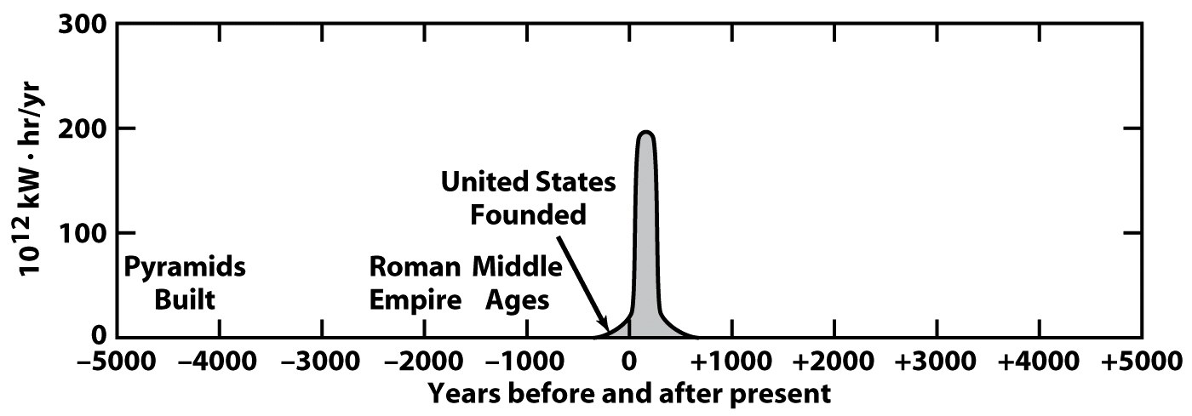
Should We Be Concerned About Our Reliance on Fossil Fuels?
Fossil fuels are limited (non-renewable resources)
We began using fossil fuels only 150 years ago, and much of the world’s supply has been consumed
Coal is abundant, but oil and natural gas will be in short supply in a matter of decades
Fuels are still being formed, but the rate is completely negligible compared to our rate of consumption

Slide 5
Total Fossil Fuel Reserves as of January 1, 2009 (billion barrels of oil equivalent)
 | Coal |  | Oil |  | Gas |  | Total Fossil
United States | 1,318 | 29% | 30 | 2% | 41 | 4% | 1,389 | 20%**
Russia | 786 | 17% | 79 | 6% | 263 | 24% | 1,128 | 16%
China | 573 | 13% | 16 | 1% | 10 | 1% | 599 | 9%
India | 238 | 5% | 5 | 1 % | 5 | 1% | 248 | 4%
Middle East | 9 | 0% | 754 | 60% | 460 | 42% | 1223 | 18%
Europe | 740 | 16% | 63 | 6% | 119 | 11% | 922 | 13%
Rest of the world | 881 | 20% | 311 | 25% | 189 | 17% | 1,381 | 20%
World | 4,545 | 100% | 1,258* | 100% | 1,087 | 100% | 6,890 | 100%

Slide 6
Energy Consumption for Selected Countries (million tons of oil equivalent)
Country | 1990 | 2000 | 2008 | Annual rise*
Canada | 248 | 301 | 330 | 1.7
United States | 1,963 | 2,309 | 2,299 | 0.9
England | 211 | 223 | 212 | 0.0
Japan | 431 | 510 | 507 | 0.9
China | 685 | 967 | 2002 | 10.1
India | 181 | 295 | 433 | 7.3
Russia | 862 | 625 | 648 | -1.3
Middle East | 255 | 399 | 613 | 7.4
World Total | 8,095 | 9,263 | 11,295 | 2.1
* Average rise since 1990. Source: BP Statistical Review of World Energy, 2009.

Slide 7
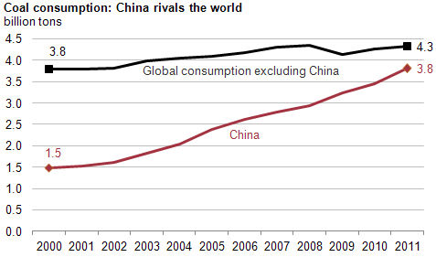
Scary Fact: China Burns As Much Coal As The Rest of The World Combined

Slide 8
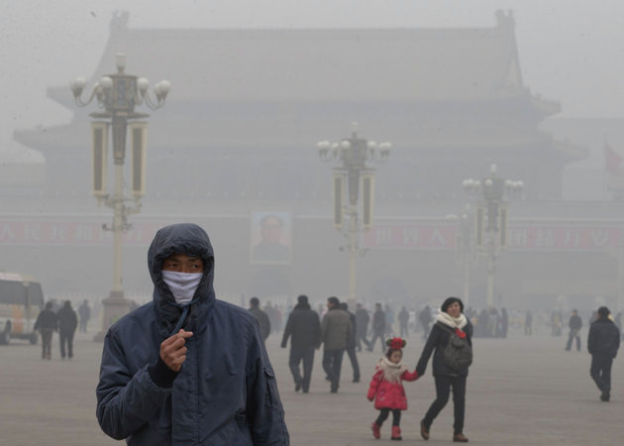

Slide 9
Population Growth

Slide 10
Another Side To The Story
Unintended environmental consequences result from the massive scale of our fossil fuel use
Gaseous pollutants are being dumped into the atmosphere, which are causing many problems (e.g. smog, acid rain, etc.)
Excessive CO₂ emissions are threatening to produce global climate changes (global warming)
Before we discuss whether or not these issues can be solved, we must first answer the following question: “Why do we use so much energy?”

Slide 11
Why Do We Use So Much Energy?
We are inefficient!!
Enormous waste, especially in the commercial sector
Transportation inefficiencies (gas-guzzling vehicles, not enough public transit, poor traffic)
Large discrepancy exists between the rate of energy usage in a given country and it’s gross domestic product (GDP) per capita
Excessive energy use is associated with a perceived standard of living
Less industrialized nations still rely on energy from muscular efforts of people and animals to do much of their work

Slide 12
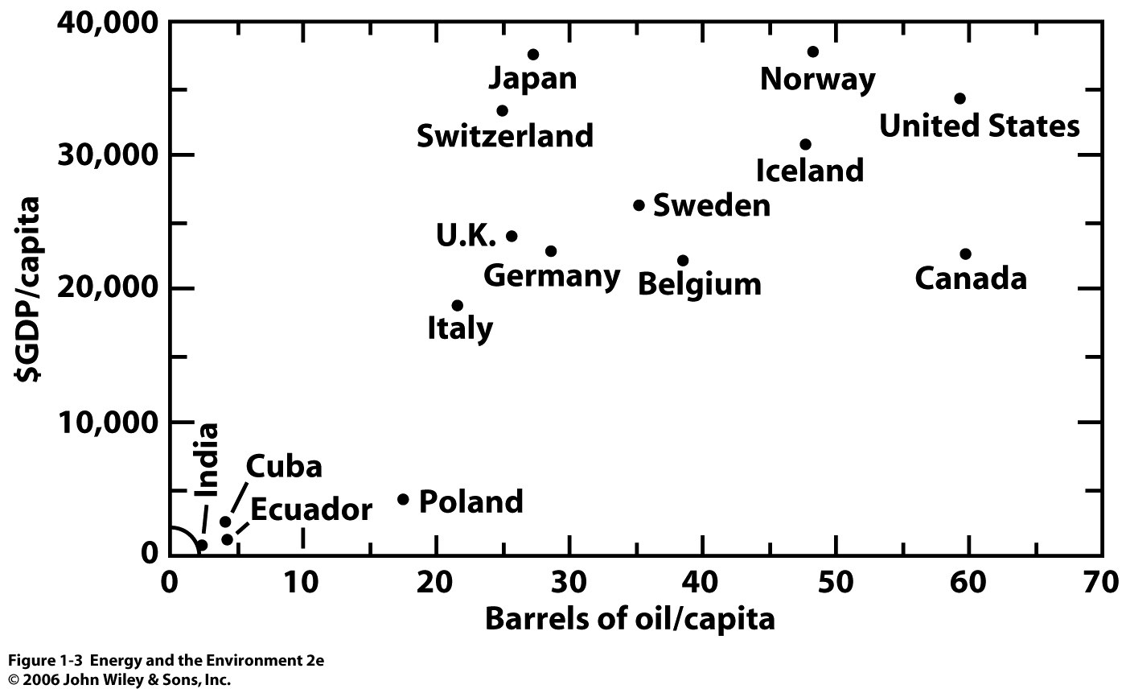
1 barrel (bbl) = 42 gallons

Slide 13
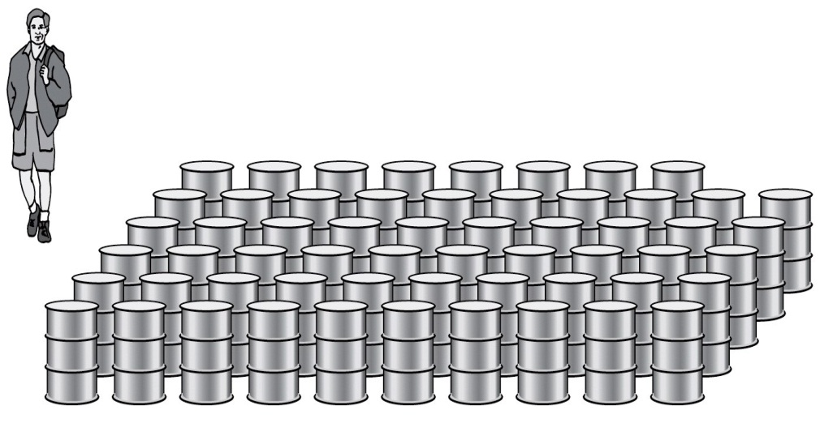
Each Person In the U.S. Consumes The Energy Equivalent of 58 Barrels of Fuel Per Year
Fifty years ago, we were using one barrel of oil for every six barrels we found.
Today, we are using four barrels of oil for every one barrel we find.
U.S. has about 5% of the World’s population, but uses 23% of the world’s oil.
The unfortunate truth is that, without easy access to fossil fuels, greater advancements would have been made in wind, solar, nuclear, hydro, etc. But, fossil fuels have provided a cheap and easy solution to our energy needs, so other avenues have been neglected.

Slide 14
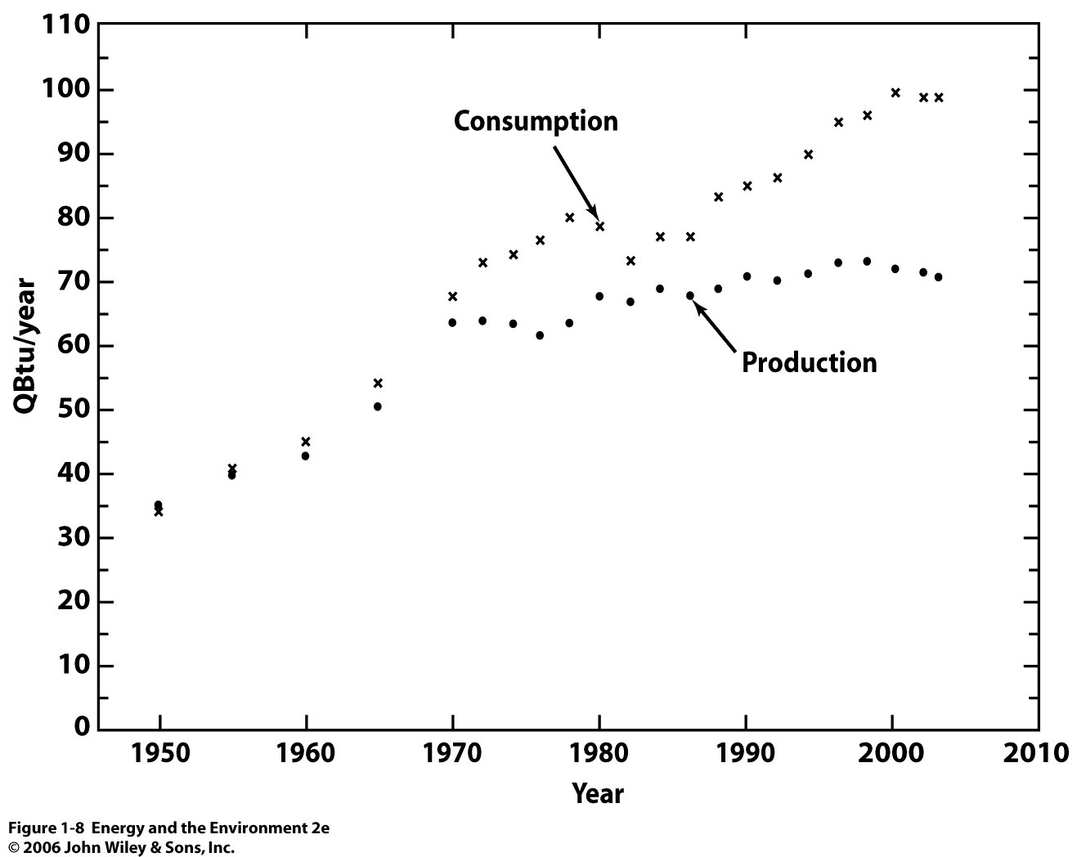
Our country is now experiencing a serious imbalance of international trade due to the cost of importing so much oil to fill the gap between our production and consumption. This leaves us vulnerable to price shocks.

Slide 15
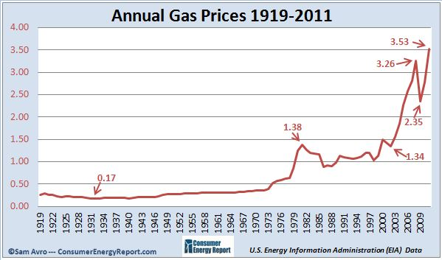
Oil Prices Over Time
US invasion of Iraq
1979 Energy Crisis: Unrest in Middle East
1973 OPEC oil embargo

Slide 16
Energy Basics
What is Energy?
Energy is defined as the capacity to perform “work”
How do we define work?
Work is defined as the product of a force times the distance over which that force is applied (F x d)
Ex. Pushing an object along a rough surface
The force can be exerted by a human, steam engine, electric motor, etc.
In SI units, force is in Newtons (N), distance is in meters. Thus, work (and therefore, energy) is expressed in Newton-meters (N•m)
We use the unit JOULE (J) to represent a Newton-meter (1 J = 1 N•m)

Slide 17
Energy Basics
In the British system of units, force is given in pounds (lbs) and distance in feet (ft), so work (and energy) is expressed in units of foot-pounds (ft•lb)
Ex. You lift a 10-lb bag of sugar 1 ft off the ground. The amount of work done (energy used) is equal to 10 ft•lb
This energy would come from food you had previously eaten
In Joules, w = 13.6 J
Based on the definition of work, if you exert force on the bag, but it does not move, no work has been done regardless of the amount of force applied.
$$w=F x d=(10 lb) x (1 ft)=10 ft•lb$$
$$1 ft•lb=1.36 J$$

Slide 18
Other Units of Energy
British Thermal Unit (BTU)
BTUs are commonly used when referring to fuel. This unit is defined as the amount of heat energy required to raise the temperature of one pound of water one degree Fahrenheit (1 BTU = 1055 J)
Calories (cal)
A calorie is the amount of energy required to raise one gram of water by one degree celcius. Calories are commonly associated with food, although a food calories are actually equal to 1000 calories (kcal). (1 cal = 4.184 J)
Electron-Volts (eV)
Typically used in measurement involving electronics and atomic nuclei. An eV is the energy required to move an electron through a potential (voltage) of 1 volt. (1 eV = 1.602 x 10⁻¹⁹ J)

Slide 19
Forms of Energy
Energy comes in many forms and can be converted from one form to another. Some examples are given:
Chemical Energy
Energy stored in chemical bonds (e.g. gasoline, coal, etc.) that can be released by chemical reaction, typically combustion (fire)
Heat Energy (thermal energy)
Heat is defined as energy flow between bodies of matter resulting from collisions of molecules or random motions of electrons. Increases in heat energy correspond to increases in temperature (heat and temperature are not the same)

Slide 20
Forms of Energy
Mass Energy
Energy and mass are interchangeable. During a fusion reaction (e.g. stars), mass is lost. This mass appears as energy according to the following:
where m is the change in mass (in kg), c is the speed of light, and E is the energy released (J). This is the basis of nuclear power.
Kinetic Energy
Energy of motion (e.g. a moving car). An object with mass m, moving at a velocity V (meters/sec) has kinetic energy:
$$E=∆mc^{2}$$
$$E_{k}= \frac{1}{2}mV^{2}$$

Slide 21
Forms of Energy
Potential Energy
Potential energy corresponds to energy that is stored as a result of the position of mass in a field.
If a mass m is held at a height h (meters) above the ground, assuming a gravitational accelearation of 9.8 m/s² (g), its potential energy is:
If the object is dropped, it loses potential energy. However, it speeds up as it falls, so its kinetic energy increases equally (conversion).
Ex. hydroelectric dam. Water is pumped uphill (potential energy). When energy is needed, the water is dropped on a turbine, which spins the blades (mechanical energy), which spins a generator and generates electricity (electrical energy).
$$E_{P}=mgh$$

Slide 22
Forms of Energy
Mechanical Energy
A form of kinetic energy, associated with the movement of mass (e.g. spinning windmill, engine pistons, fan) by transfer of another form of energy
Electrical Energy
Energy resulting from electric current, the movement of electrons through a conductive circuit. Electrical energy is a type of potential energy. For a charge q (coulombs, C) moving across a voltage V
Light/Radiation (review previous lectures)
$$E_{elec}=qV$$
$$E=hv$$

Slide 23
Power
It is often necessary to express the rate of energy usage. This is called power.
Typically, we speak in terms of energy per second. In SI units, a joule per second (J/s) is known as a watt (W).
In British units, horsepower is the unit of power (1 hp = 550 $\frac{ft•lb}{s}$)
In terms of human capacity, 1 hp is the power exerted to raise a 55 lb weight 10 ft off the ground every second.
$$Power= \frac{energy}{time}$$

Slide 24
Electricity Consumption
When you receive an electric bill, your provider bills you for every kilowatt-hour (kWh) of energy you consume
For example, a 60-W light bulb running for 1 hour uses 0.060 kWh of energy
One kWh is 3.6 x 10⁶ J
The heat energy content of coal is 6150 kWh/ton. However, the conversion of heat to electricity in a power plant is only 40% efficient, so only 2460 kWh of electricity are obtained from a ton of coal.
$$60 W x \frac{kW}{10^{3}W} x 1 hr= .060 kWh$$

Slide 25
Power Consumption of Typical Appliances
Appliance | Power (W) | Cost per hour in SC ($) | Pounds of coal burned per hour of use
Air Conditioning | 3800 | 0.34 | 3.09
Oven | 3410 | 0.31 | 2.77
Clothes Dryer | 2790 | 0.25 | 2.26
Microwave | 1450 | 0.13 | 1.17
Vacuum | 1440 | 0.13 | 1.17
Dishwasher | 1200 | 0.11 | 0.98
Hair dryer | 1000 | 0.09 | 0.81
LCD TV | 120 | 0.01 | 0.098
Fan | 88 | 0.007 | 0.072
Laptop | 50 | 0.004 | 0.041
* Average electricity price in SC: $0.09/kWh

Slide 26
Conservation of Energy
Energy comes in many forms and can be converted from one form to another
Energy is never created or destroyed, merely converted and transferred from place to place

Slide 27
Conservation of Energy, contd.
Imagine we have a perfectly insulated box. Inside that box is trapped air, a light bulb, wires and a battery
When a connection is made between the battery and bulb, chemical energy is converted to electrical energy which transmits the wiring, yielding light
Light interacts with the air, generating heat
Once the battery is dead, the amount of heat energy in the box is exactly equal to the total chemical energy that was initially in the battery
Energy is conserved!
However, the chemical energy was a useful form for generating light. The heat is not as useful

Slide 28
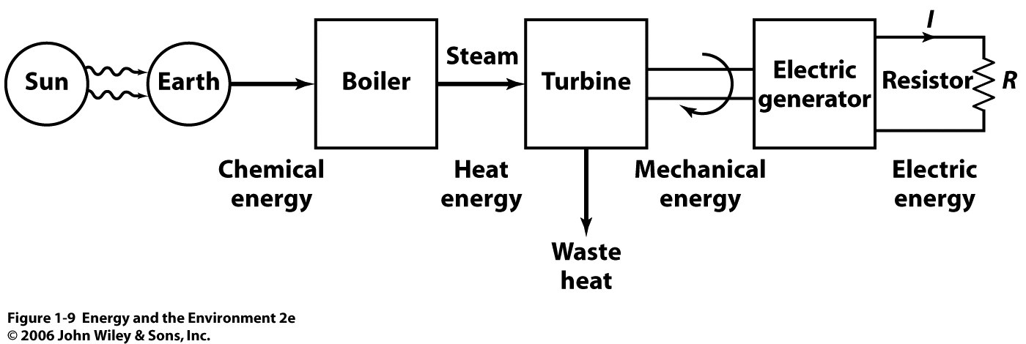
Conservation Of Energy Applied To Current Methods of Power Generation
Fusion at sun originates from mass energy (E = mc²)
Fusion produces light (E=hv) and heat
Heat and light reach Earth, captured by plants through photosynthesis
Plants store light energy as chemical energy
Plants die, become fossil fuels
Fossil fuels are burned, generating heat energy
Heat energy converted to mechanical energy by turning turbine
Mechanical energy becomes electrical energy by cranking a generator

Slide 29
Turbines
Rotation
rotor
High Pressure Steam

Slide 30
Electrical Generators
rotor: connected to turbine
Magnet
shaft
conductive coil
axis of rotation
Rotating a conductive coil through a magnetic field generates electric current (Faraday’s law)

