Slide 1
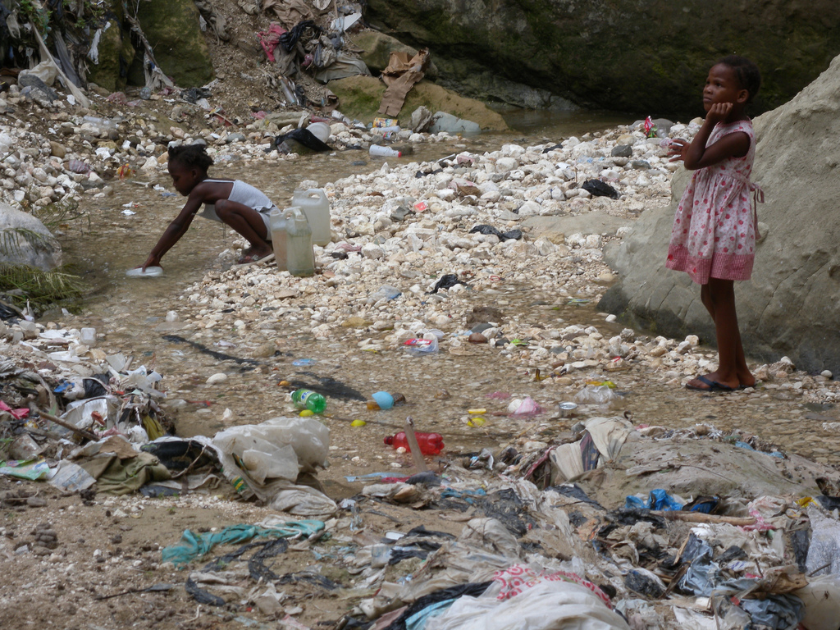
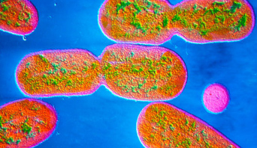
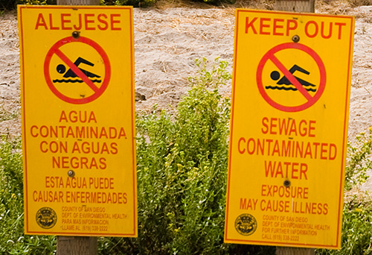
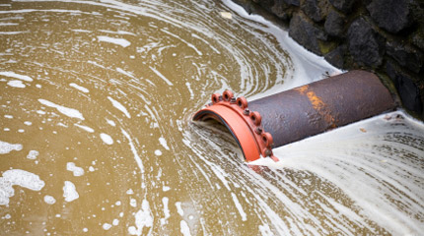
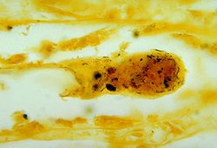
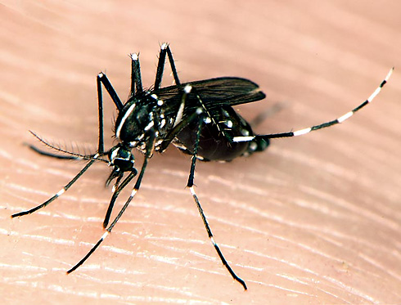
The Public Health Costs of Heavier Rainfalls
Matt Heard – Biology Department
Notes:
Thanks to Marsha for inviting me and thanks to everyone for attending. BIOL 491/492…

Slide 2
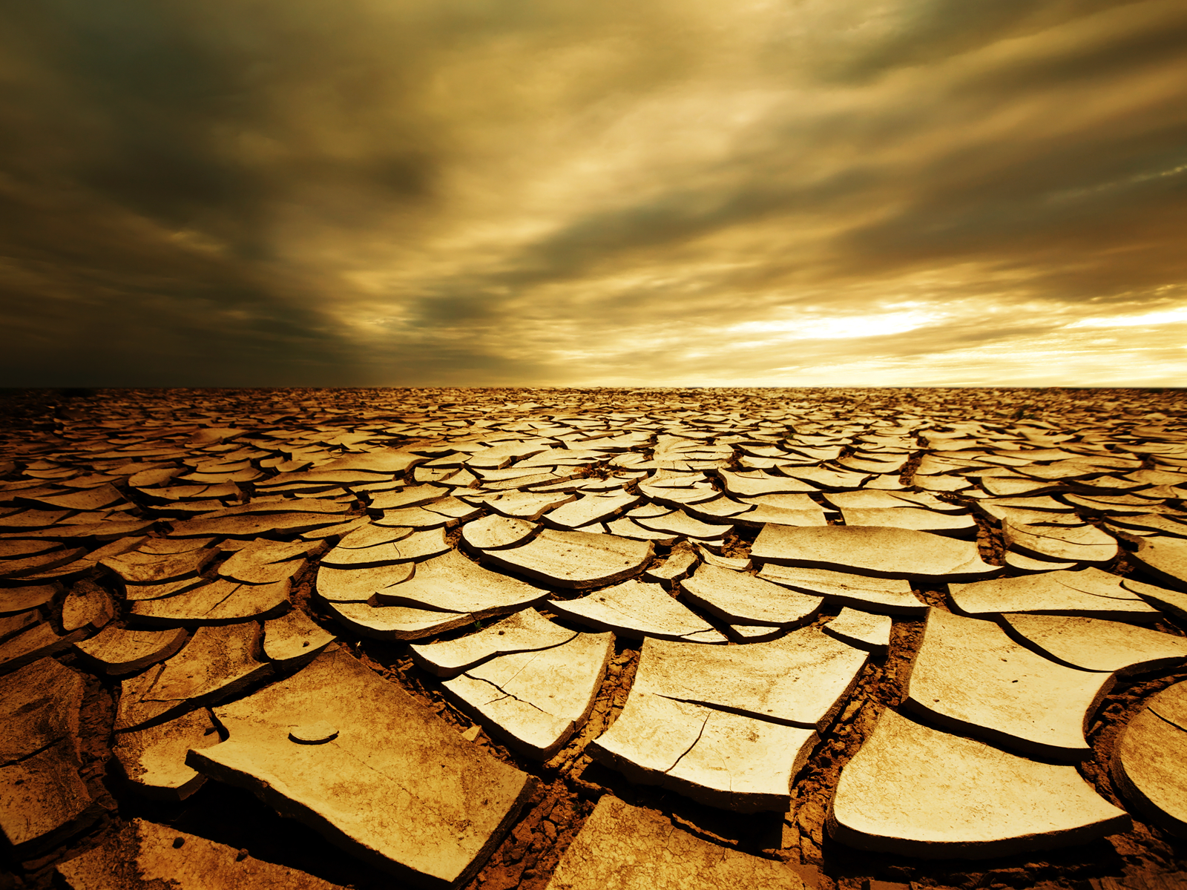
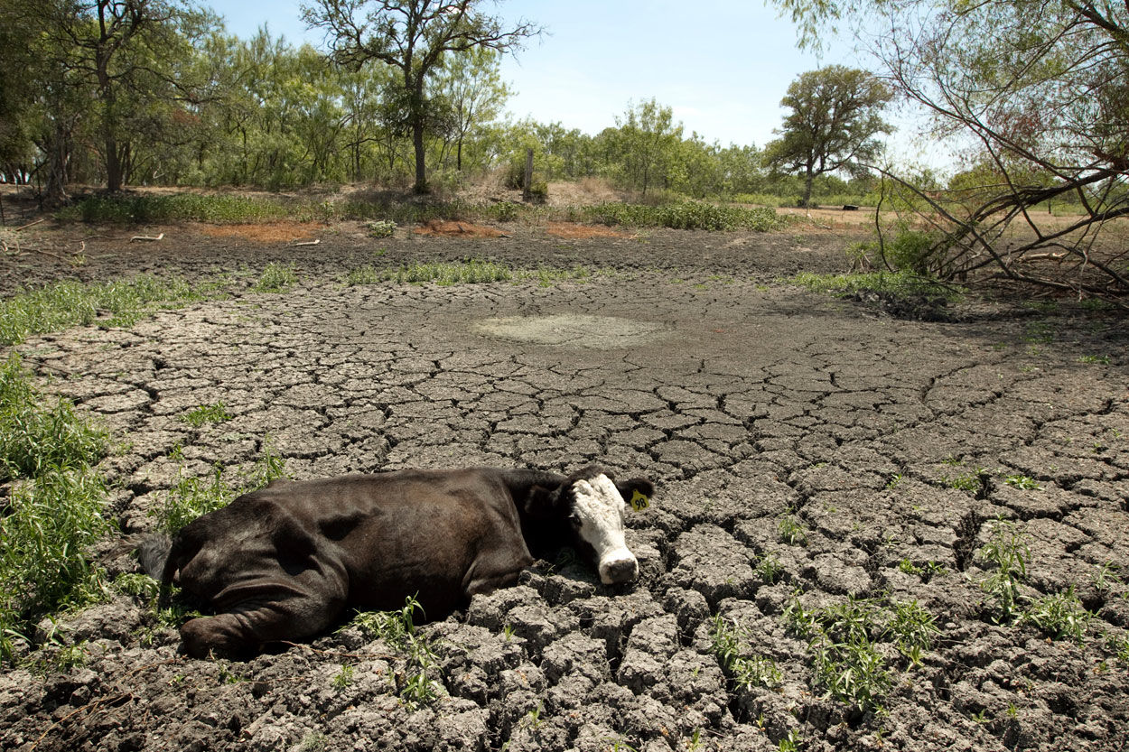
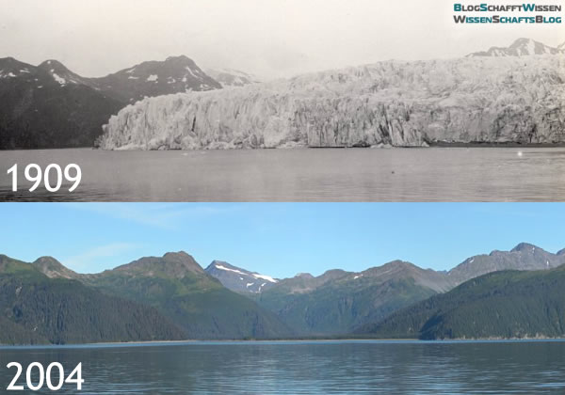
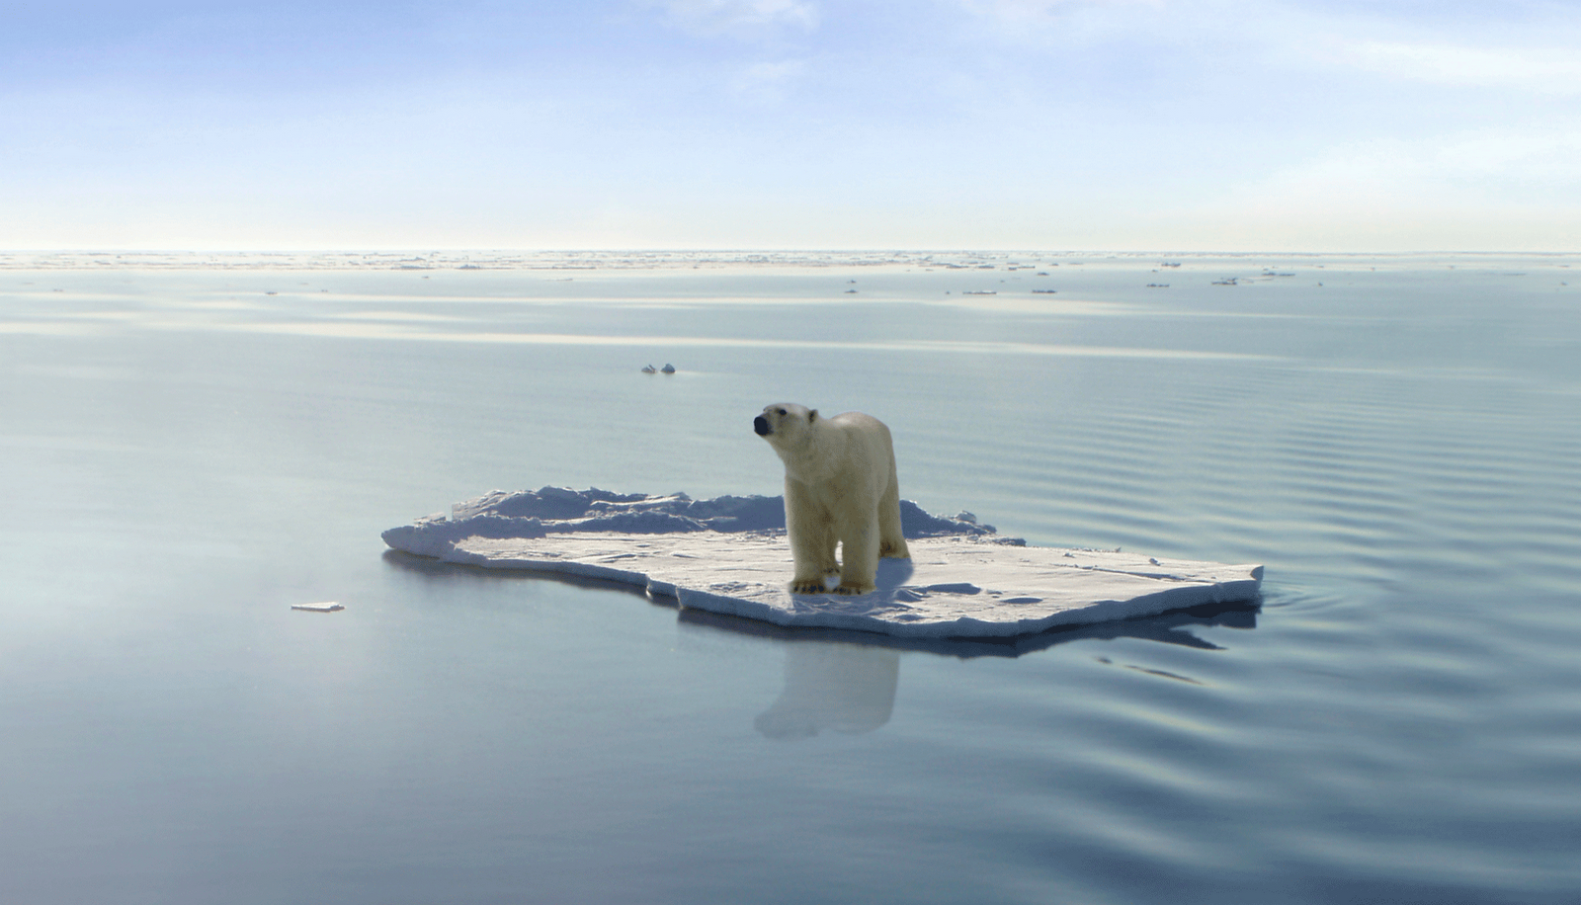
Notes:
When most of us think of climate change we think about images like this. Desertification, rising temperatures, the loss of glaciers

Slide 3
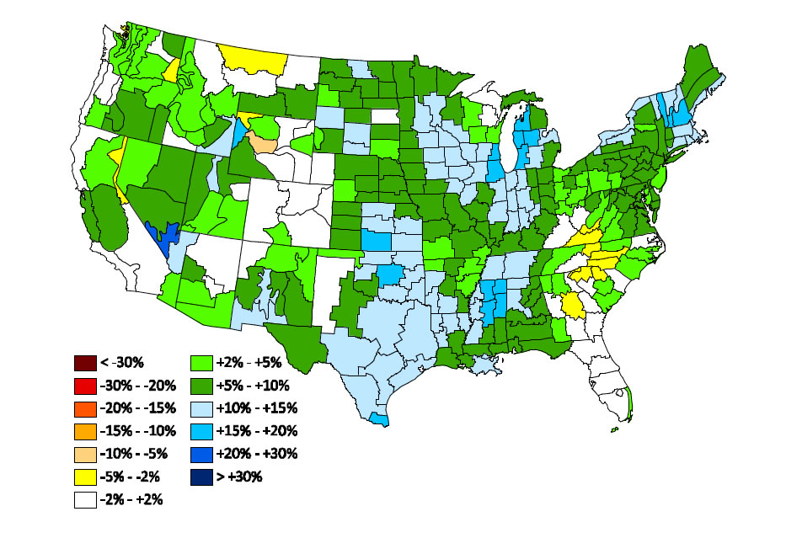
Climate Change
Temperature is increasing worldwide, but isn’t the only thing changing
Changes in US Rainfall
1911-2010

Slide 4
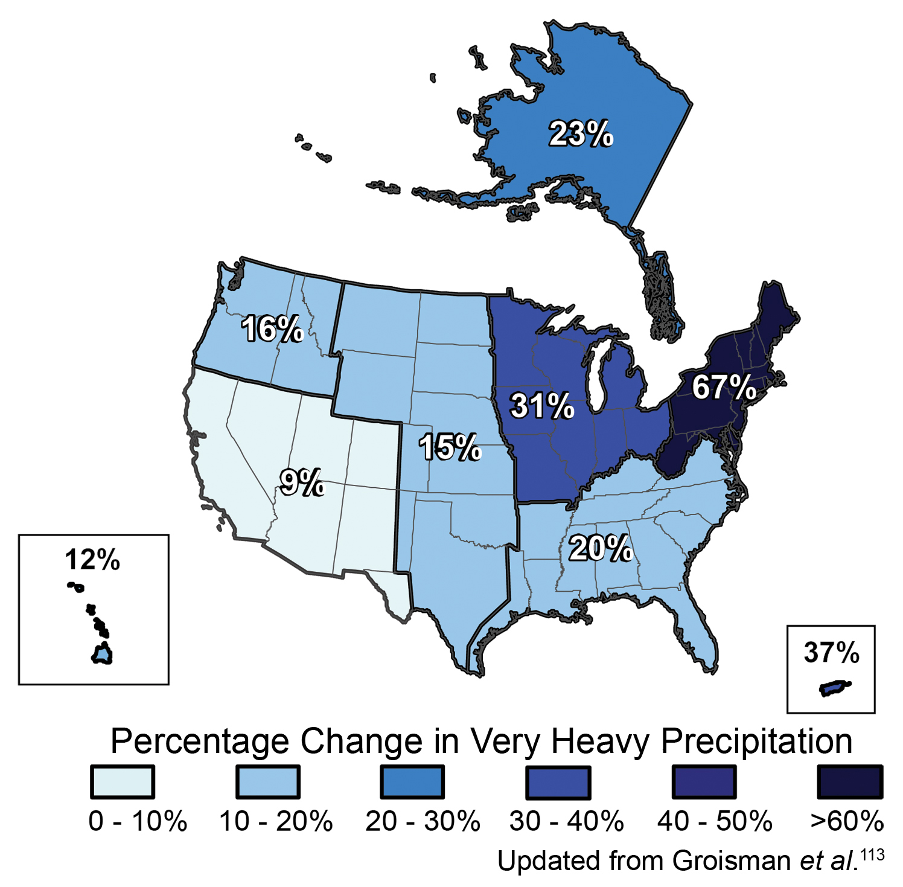
Climate Change
Rainfall isn’t just increasing on average
Intense rainfall events are increasing
1957-2008

Slide 5
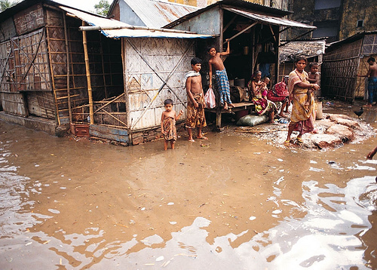
Heavy Rainfall Events
What are these events?
Occur in short time-period
Significantly exceed normal rainfall
Notes:
Cambodia

Slide 6
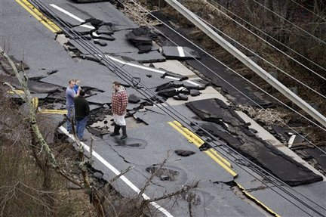
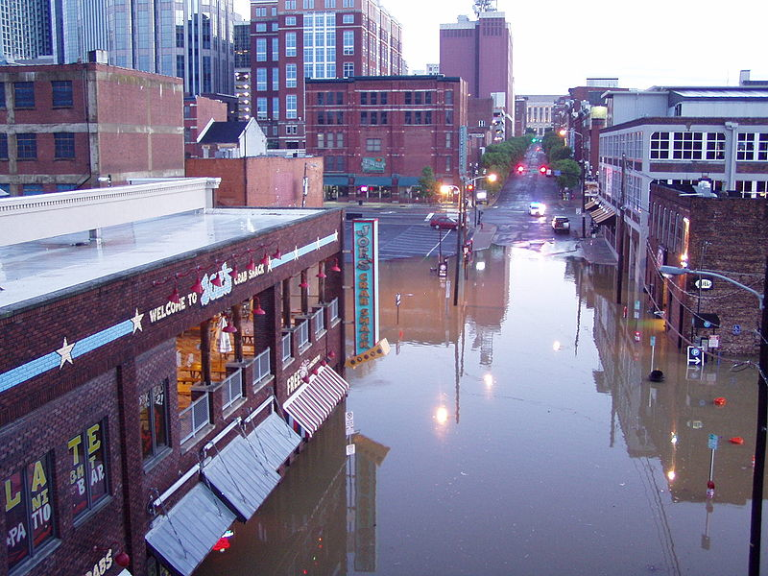
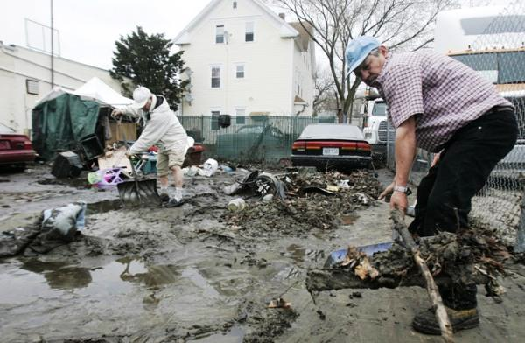
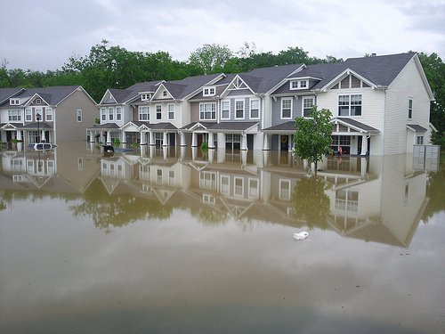
Heavy Rainfall Events
Notes:
Infrastructural and economic damage – nashville and rhode island

Slide 7
Heavy Rainfall Events
Can also increase the spread of disease
Sewage/bacteria is introduced to drinking water

Slide 8
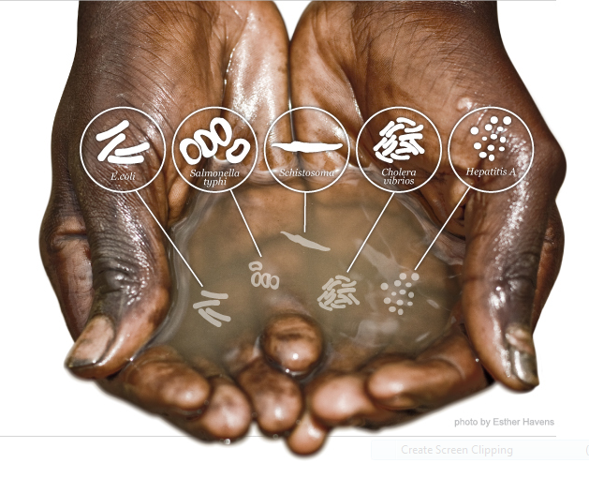
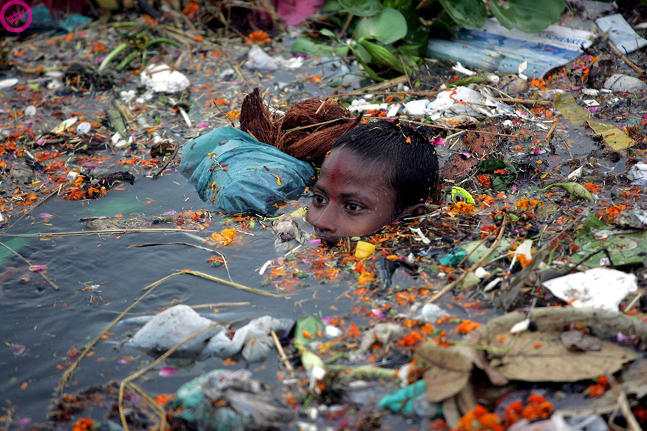
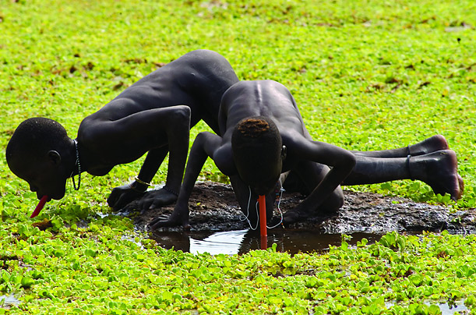
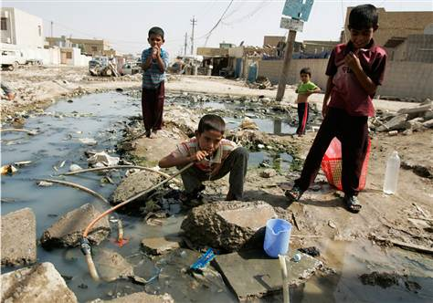
Notes:
Bacteria and viruses that pose threats to human health are often present in these kinds of water

Slide 9
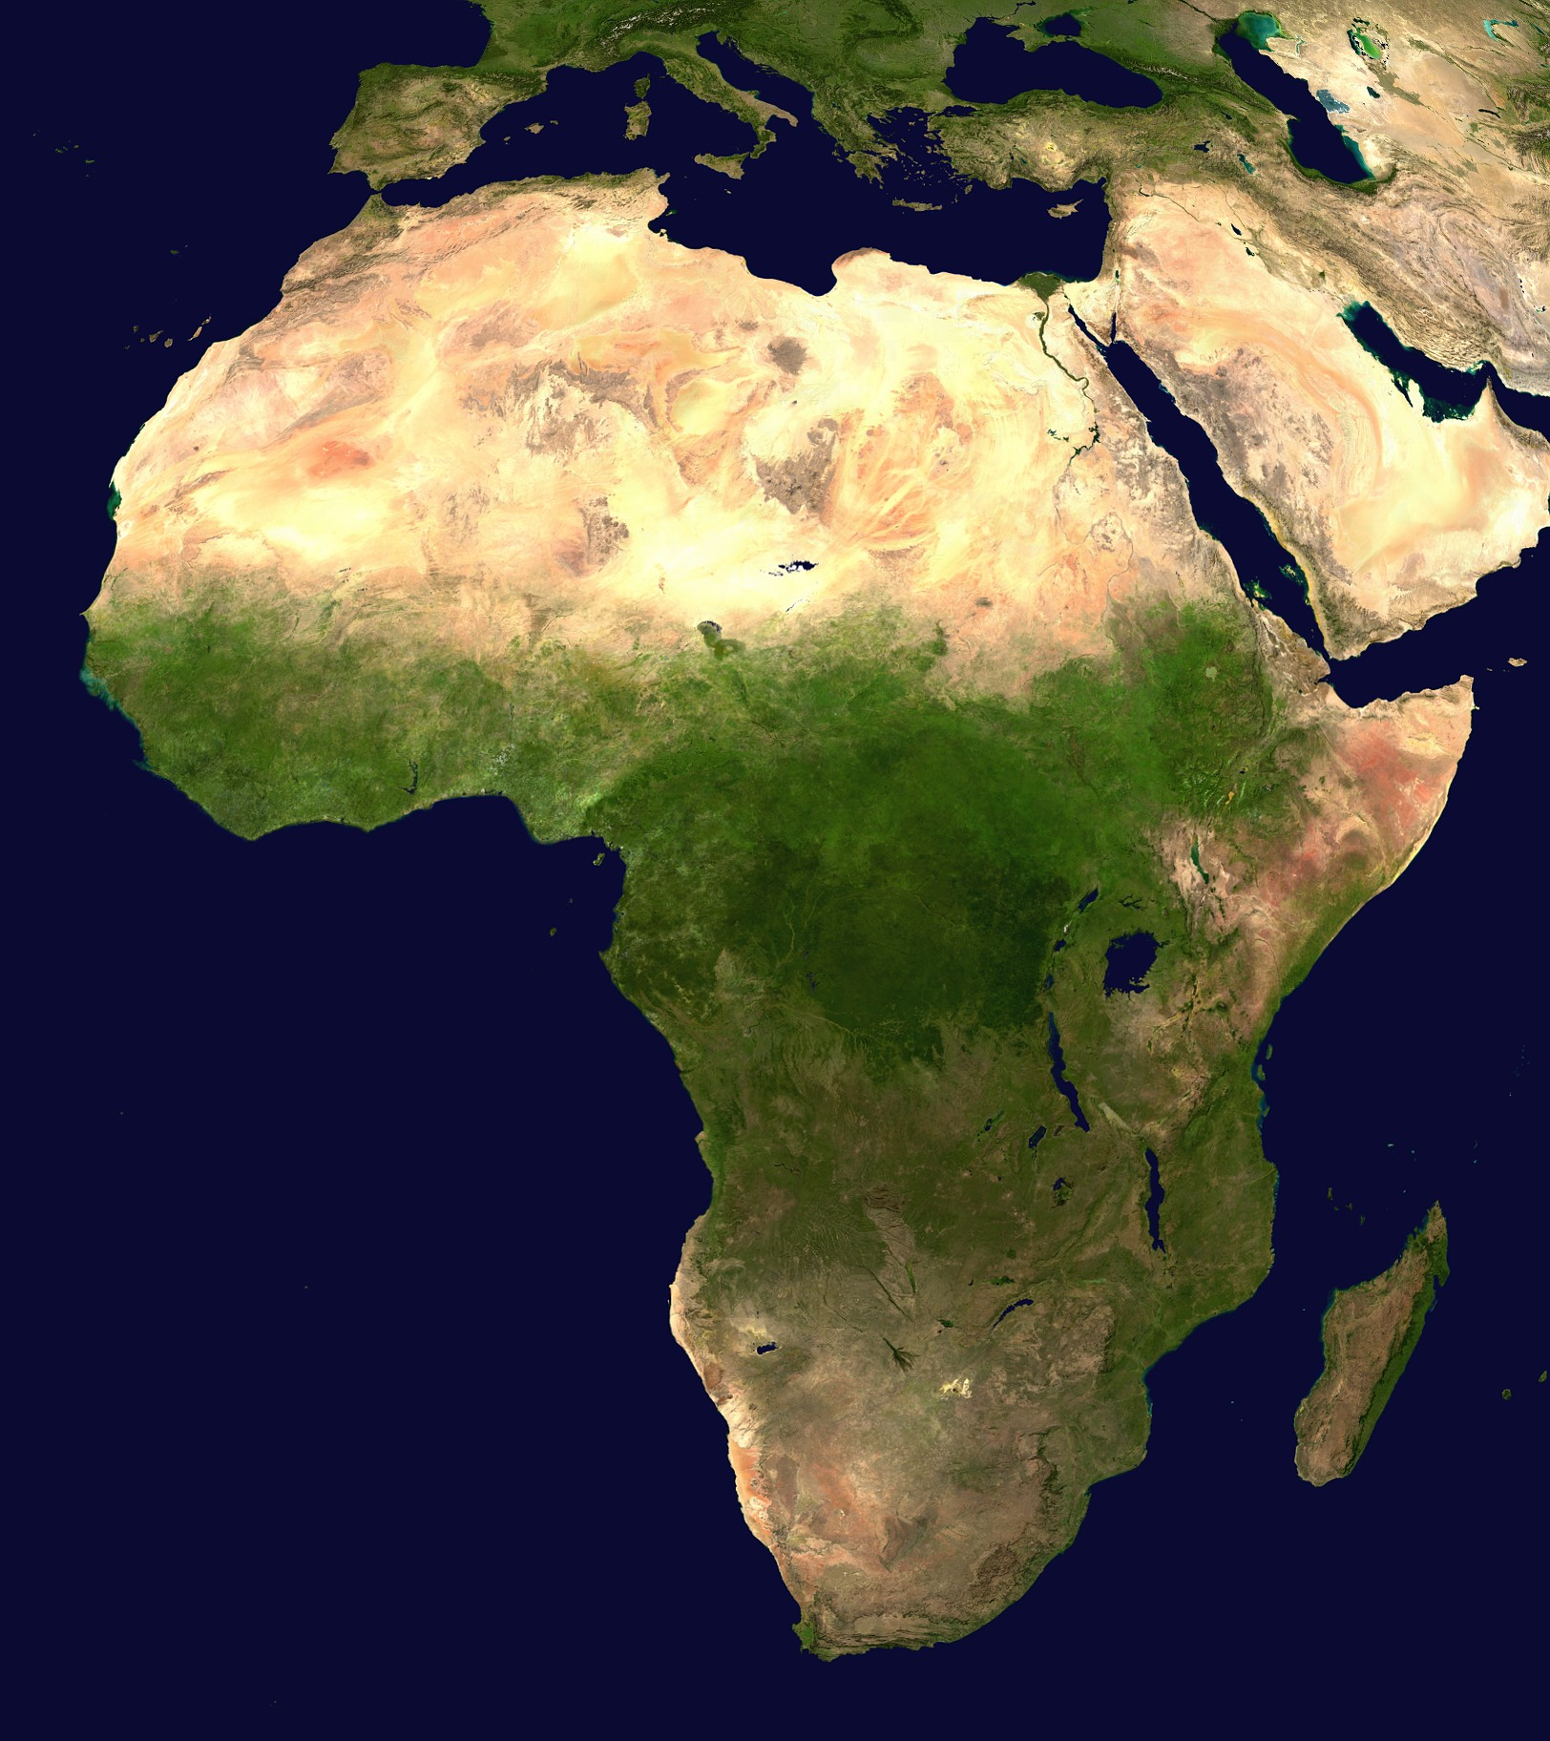
Heavy Rainfall & Disease
Outbreaks often in lesser developed nations
Common bacterial infections (e.g. diarrhea) kills >2 million per year
Expected to increase over time with climate change
African Nations
Notes:
Water-borne infectious diseases are the leading cause of death worldwie. They cause >3.4 million deaths per year

Slide 10
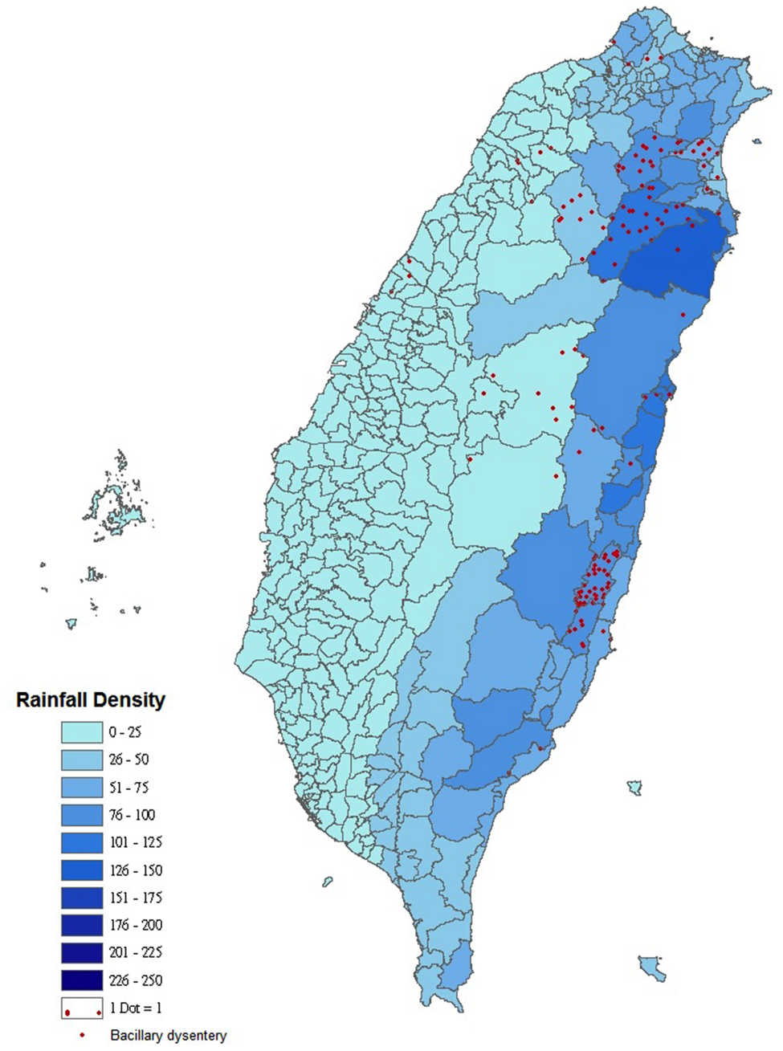
Heavy Rainfall & Disease
Bacillary Dysentery (similar to Salmonella)
Causes >1 million deaths worldwide
Outbreaks in Thailand are correlated with heavy rainfall events
Notes:
Transmission is fecal-oral; causes diarrhea gastrointestinal stress and bloody stool. Caused by Shigella bacteria, which is a genus that is gram-negative.

Slide 11
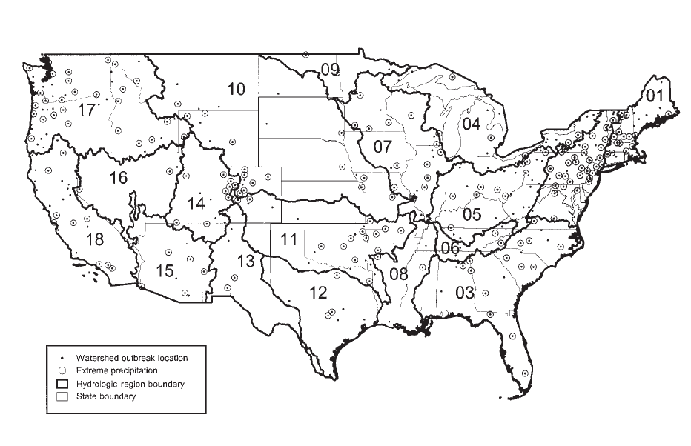
Heavy Rainfall & Disease
Notes:
From

Slide 12
Heavy Rainfall & Disease
Since 1950 there were ~600 cases of water-borne disease outbreaks in US
~70% occurred following heavy precipitation events

Slide 13
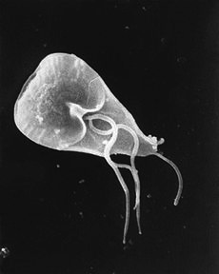
Heavy Rainfall & Disease
In 1993, in Milwaukee there was an outbreak of giardisis
Caused by protozoan Giardia lamblia
403,000 illnesses and 54 deaths occurred
Notes:
Get into the details of giardia here and how it’s passed in the manner called fecal-oral through the contamination of water pipes

Slide 14
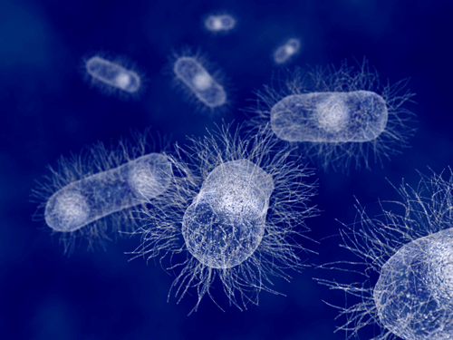
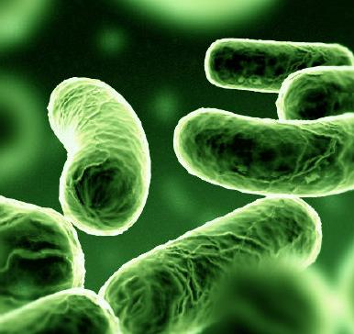
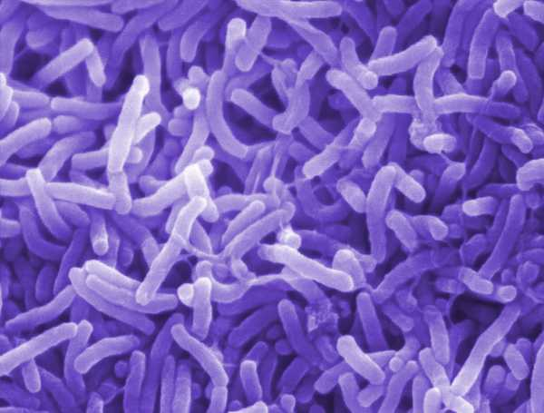
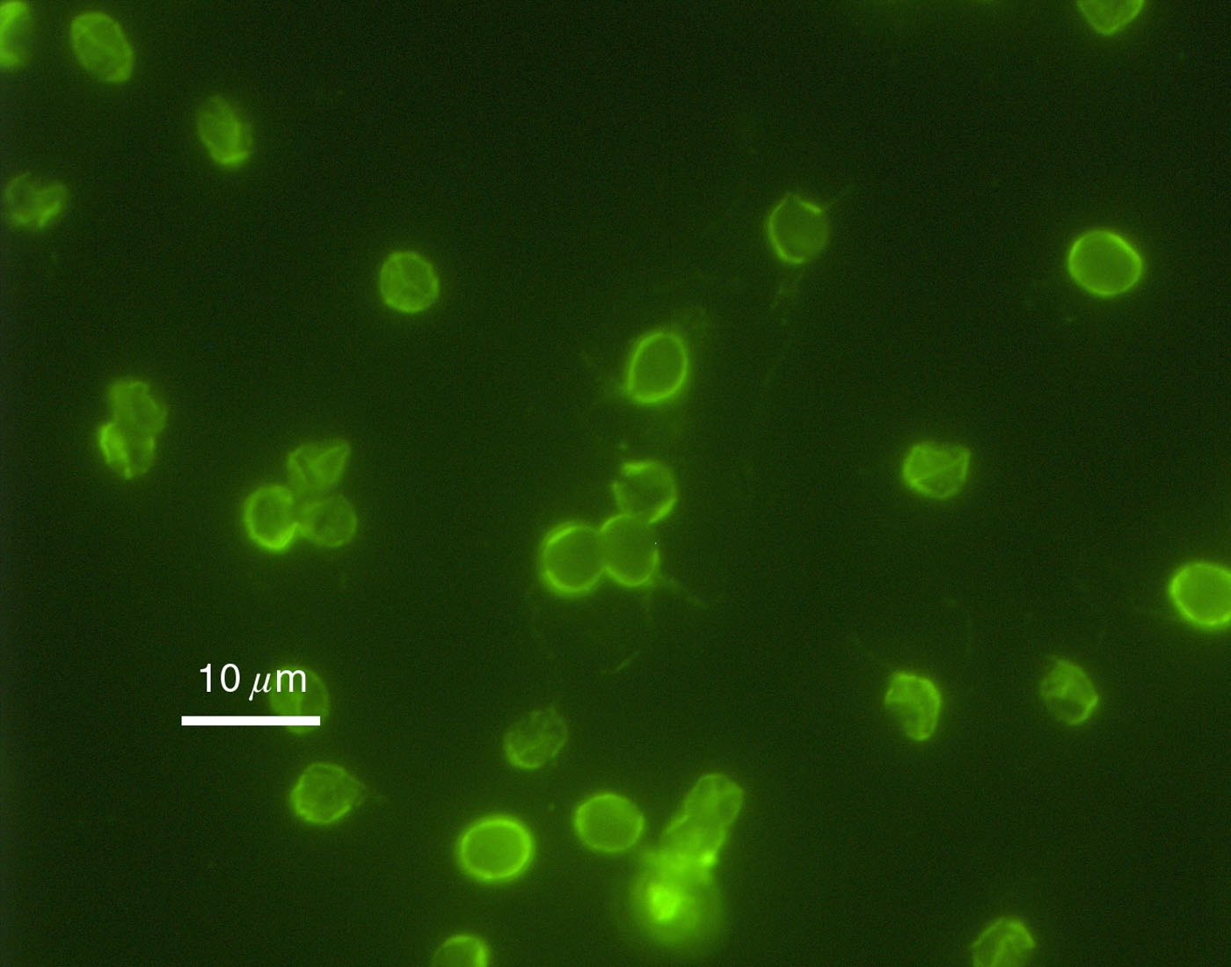
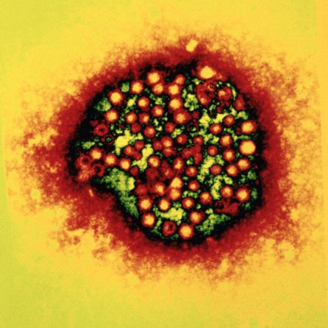
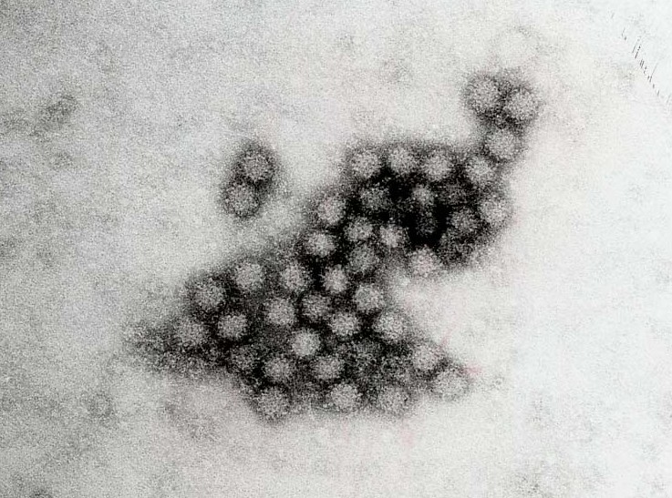
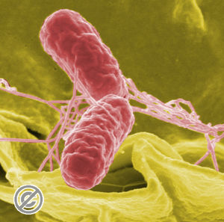
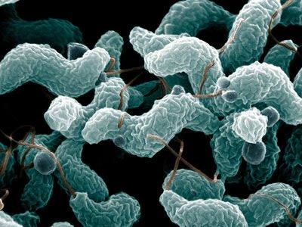
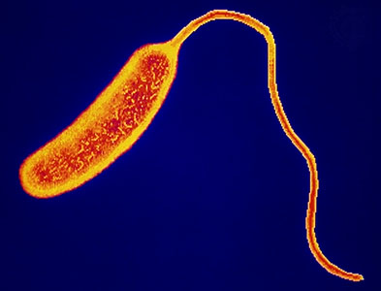
Risks in the US
Water-borne disease outbreaks from raw sewage or heavy rain are common in the US
Shigella
Cryptosporidium
Hepatitis A
Legionella
Norovirus
Salmonella
Campylobacter
Cholera
Notes:
Bacteria and viral infections, cryptosporidium,

Slide 15
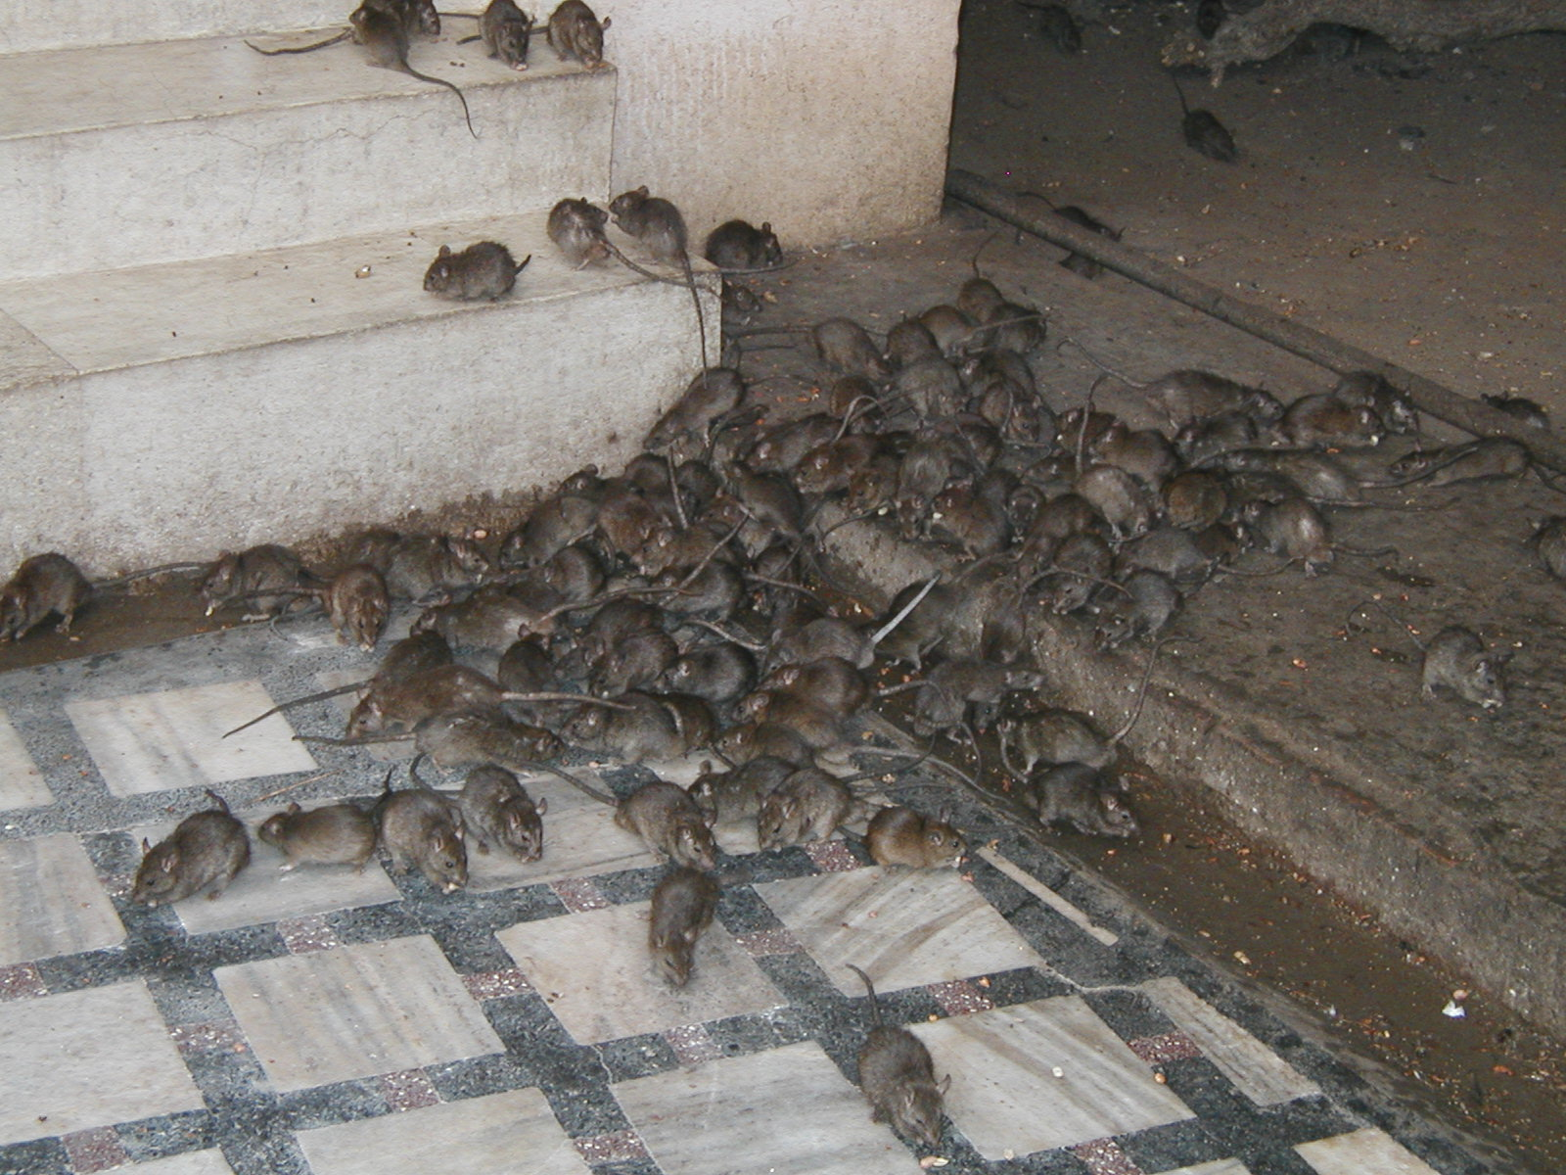
Heavy Rainfall & Disease
Another consequence is increases in standing water, which could also increase disease vectors
Rats
Rat urine often carries diseases that affect humans (e.g. Leptospirosis)
Increased flooding = potential for more contact with rat waste
Notes:
Flu-like symptoms…etc.

Slide 16
Heavy Rainfall & Disease
Another consequence is increases in standing water, which could also increase disease vectors
Asian Tiger Mosquitoes
Increased standing water = potential for more breeding
Predicted to increase risks of West Nile
Notes:
Of additional concern is puddles…

Slide 17
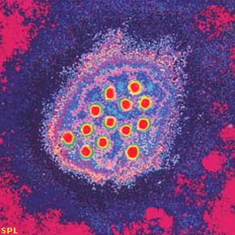
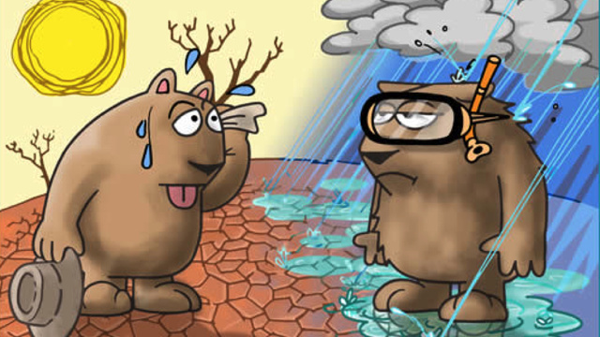
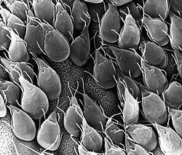
Concluding Thoughts
Perhaps this a more accurate representation?

