Slide 1
BIOFUELS (Part 2)

Slide 2
Diesel Engines
Both diesel engines and gasoline engines covert fuel into energy through a series of small explosions or combustions. The major difference between diesel and gasoline is the way these explosions happen.
In gas engines, fuel is mixed with air, compressed by pistons and ignited by sparks from spark plugs. Gas engines operate at an air-to-fuel ratio of 10:1.
In a diesel engine, the air is compressed first, and then the fuel is injected. Because air heats up when it's compressed, the fuel ignites without a spark.
Compressing air makes it concentrated. When air molecules are packed so tightly, the diesel fuel has a better chance of reacting with as many oxygen molecules as possible, improving the efficiency of the combustion. Diesel engines compress at a ratio of 20:1.

Slide 3
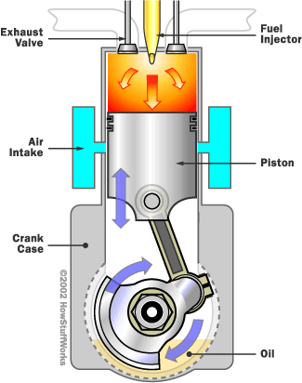
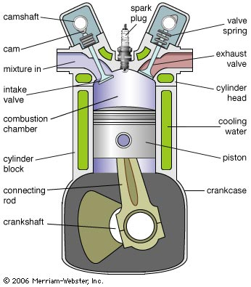
Diesel Engine
Gasoline Engine

Slide 4
About Diesel Fuel
Diesel fuel is heavier, oilier, evaporates slower, and burns at a higher temperature than gasoline.
It contains more carbon atoms in longer chains than gasoline does. It takes less refining to create diesel fuel, which is why it used to be cheaper than gasoline.
Since 2004, however, demand for diesel has risen for several reasons, including increased industrialization and construction in China.
Diesel fuel has a higher energy density than gasoline. On average, 1 gallon of diesel fuel contains approximately 1.55x10⁸ J, while 1 gallon of gasoline contains 1.32x10⁸ J.

Slide 5
Shortcomings of Diesel
During the big oil crisis in the 1970s, European car companies started advertising diesel engines for commercial use as an alternative to gasoline.
Those who tried it out were a bit disappointed -- the engines were very loud, and they would arrive home to find their cars covered from front to back in black soot
Over the past 30 to 40 years, however, vast improvements have been made on engine performance and fuel cleanliness.
Injection devices are now controlled by advanced computers that monitor fuel combustion, increase efficiency and reduce emissions.

Slide 6
Biodiesel
Biodiesel is made primarily from plant oils. Familiar crops such as soybean, rapeseed, canola, palm, cottonseed, sunflower and peanut are used to produce biodiesel. Biodiesel can even be made from recycled cooking grease.
The sources can be replenished through farming and recycling.
Biodiesel can be used in diesel engines with little or no modification needed. Although biodiesel can be used in its pure form, it is usually blended with standard diesel fuel. The most common blend is B20, or 20 percent biodiesel to 80 percent standard
Most biodiesel in the U.S. is obtained by extracting oil from soybeans.

Slide 8
Fuel Algae (Microalgae)
The newest biofuel scientists are looking beyond corn and sugar cane; they have set their sights on microscopic organisms which they hope to coax into producing fuels
Microalgae are known to naturally produce and store oils similar in content to vegetable oil.
If scientists can genetically engineer the oil-storing tendencies of algae to make them fast and more efficient, commercially viable levels of transportation fuels may result
The key challenges include:
selecting suitable algae strains
growing the algae at optimal rates
engineering the metabolic pathways that control oil production

Slide 9
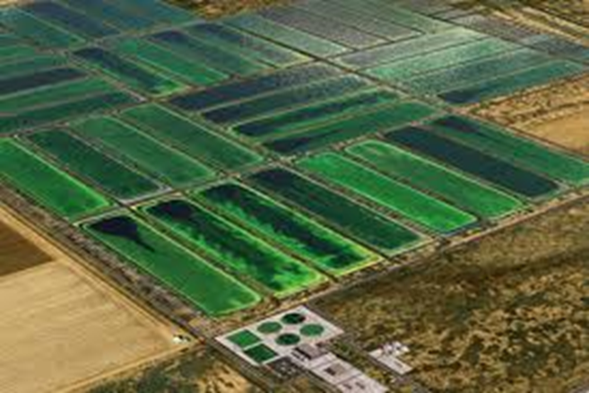

Slide 10
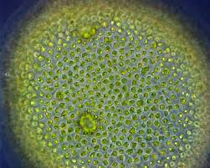
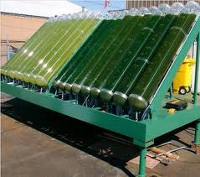
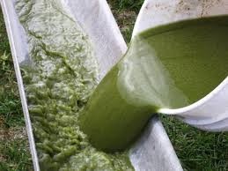

Slide 11
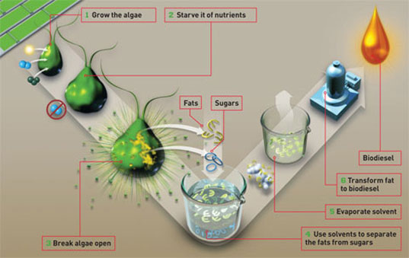

Slide 12
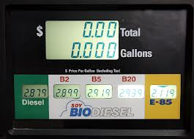
Global biodiesel production reached 3.8 million tons in 2005. Approximately 85% of biodiesel production came from the European Union.
In 2007, in the United States, average retail pricesof B2/B5 were lower than petroleum diesel by about 12 cents, and B20 blends were the same as petrodiesel.
By July 2009, the average costs of B20 was 15 cents per gallon higher than petroleum diesel

Slide 13
“Falcon 20” (Air Canada): The World’s First B100 Powered Plane

Slide 14
Municipal Solid Waste
Trash is a growing problem in the U.S., as well as the rest of the world. Landfill sites are rapidly filling and the availability of new sites is limited.
Other problems include groundwater contamination, odor, disease, and the escape of toxic gases. Everyday, 350,000 tons of trash are added to landfills in the U.S.
The majority of this waste is originated from photosynthesis:
Paper (36%)
Food Waste (11%)
Plant Waste (12%)
Wood (6%)

Slide 15
Trash-Burning Plants
In recent years, municipalities have begun burning the solid waste and using the thermal energy to generate electricity
Example: In 1961, 63% of trash was landfilled, 6% recycled, and 31% was incinerated without energy recovery
In 2001, 56% was landfilled, 29% recycled, and 15% was incinerated with energy recovery
Trash has 1/3 the energy content of coal, so it can make a reasonable contribution
Many municipalities struggle with the cost of waste-burning plants, so many of these facilities are privately owned.
There are 97 such facilities in the U.S.

Slide 17
Biogas
As previous discussed in the first lecture, microbes will ferment organic matter to ethanol under certain conditions.
Biomass can also be converted to methane gas. In the presence of water and absence of oxygen, 60-80% of the carbon in organic material is converted into methane and carbon dioxide.
Methane obtained from biomass is called biogas.

Slide 18
Biogas from Municipal Sewage
Human and animal feces can be used to generate methane.
Bacteria break down waste into sludge in a bioreactor. During the digestion of the waste, the bacteria emit methane, which is then piped into a storage container.
Such a plant exists in Boulder, Colorado. The methane is used to power a gas turbine. The plant produces 700 kW of electrical power, which sustains the sewer plants power needs.
Excess power is sold to the utility company and provides an annual revenue of $93,000. The initial cost of the plant was $2.1 M.

Slide 19
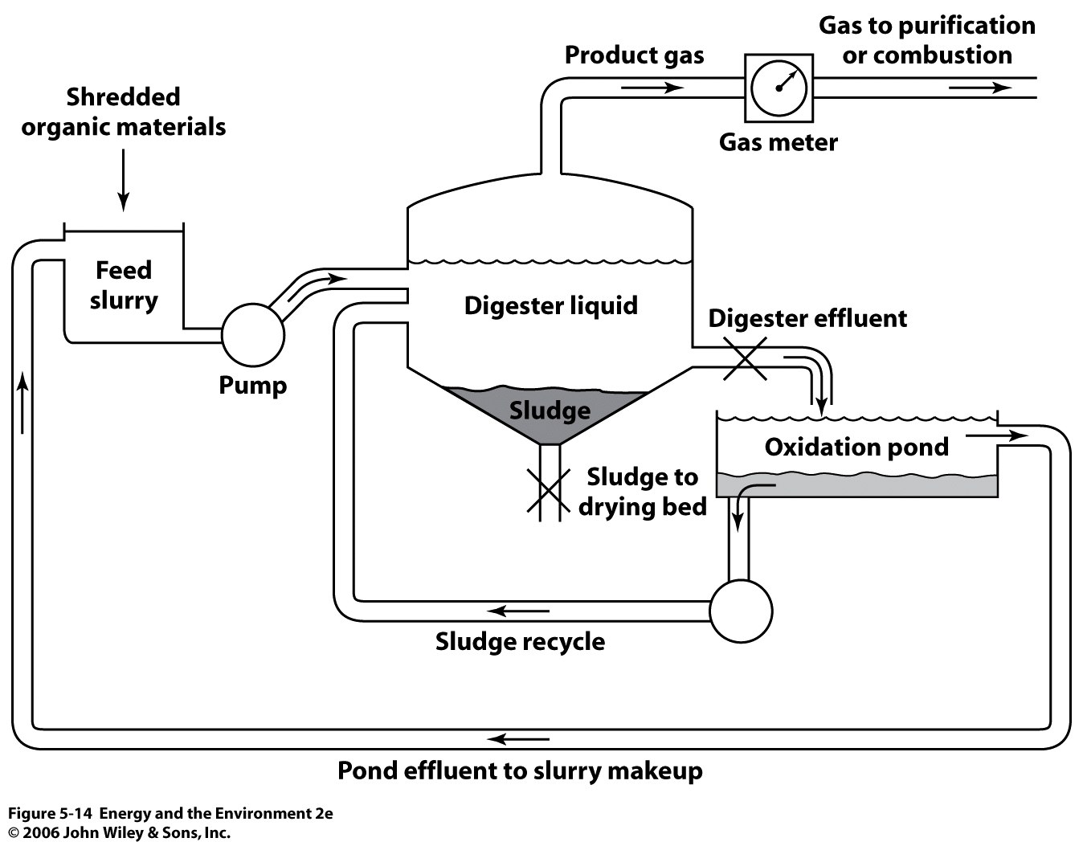

Slide 20
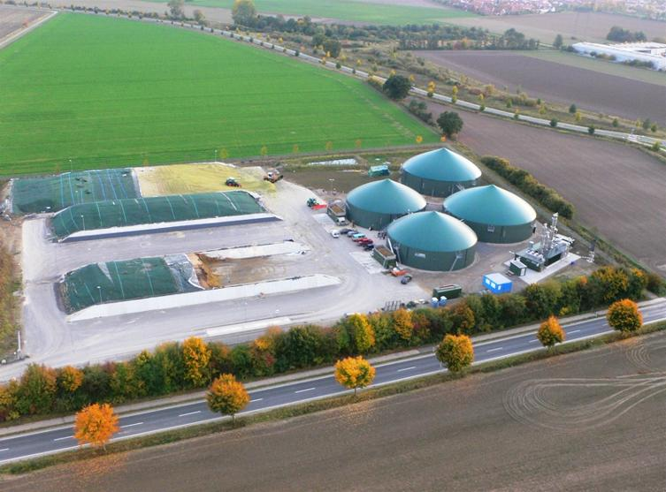

Slide 21
Biogas from Sewage
In India, individual 1m³ digesters are installed outside of homes. Waste is funneled in and converted to methane.
The methane produced provides fuel for kitchen and heating use. Each unit cost $425 USD.

Slide 22
Benefits of Biodiesel
Biodiesel is relatively environmentally friendly.
Produces 57% less greenhouse gas than petroleum diesel
It can help reduce dependency on foreign oil.
It helps to lubricate the engine itself, decreasing engine wear.
It can be used in almost any diesel with little or no engine modification.
It is safer than conventional diesel.
Biodiesel from algae has no impact on food supply, and causes no deforestation

Slide 23
Disadvantages of Biodiesel
High smog emission (NO and NO₂)
Biodiesel can absorb water.
Water causes smoke, harder starting, and reduced power.
Water causes corrosion of fuel system components
Ecosystems are destroyed to clear land for oil palm, soybean and sugar cane plantations.
Biofuels contribute to world hunger, seeing as arable land is no longer used for growing foods
In some poor countries the rising price of vegetable oil is causing problems. Some farmers are switching from producing food crops to producing biofuel crops to make more money

