Slide 1
Introduction to Gases

Slide 2
About Gases
Gases are the most understood form of matter.
Even though different gases have different chemical properties, they tend to exhibit similar physical properties
This situation arises because gas molecules expand to fill a given space, and are relatively far apart from one another. A volume of gas consists mostly of empty space. Thus, each gas atom/molecule behaves as if the others are not there.

Slide 3
Pressure
The most readily measured properties of a gas are its temperature, volume, and pressure
Pressure describes the force that a gas exerts on an area, A.
P = F/A
The image below shows gas molecules inside of a cubic container. The gas molecules strike against the walls of the container. These collisions are the source of the pressure.

Slide 4
Atmospheric Pressure
You and I are currently experiencing an attractive force that pulls us toward the center of the earth (gravity).
Gas molecules in the atmosphere also experience gravity.
Because of their small masses and thermal energies, gas molecules can somewhat counteract gravity, which is why gases don’t just sit on the surface
Nonetheless, gravity causes the gases in the atmosphere to “press down” on the surface. This is atmospheric pressure.

Slide 5
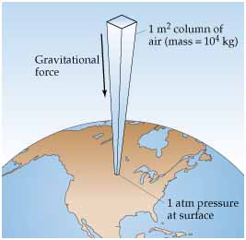
Atmospheric Pressure
The mass of a 1m² column of air extending through the entire atmosphere would be approximately 10⁴ kg.
The force exerted on the surface would be:
F= ma = (10⁴kg)(9.8 ms⁻²) = 10⁵ N
Then, P = F/A = 10⁵ N/m² = 10⁵ Pa
SI unit of pressure is the Pascal (Pa). Related units of pressure are given on the next slide.

Slide 6
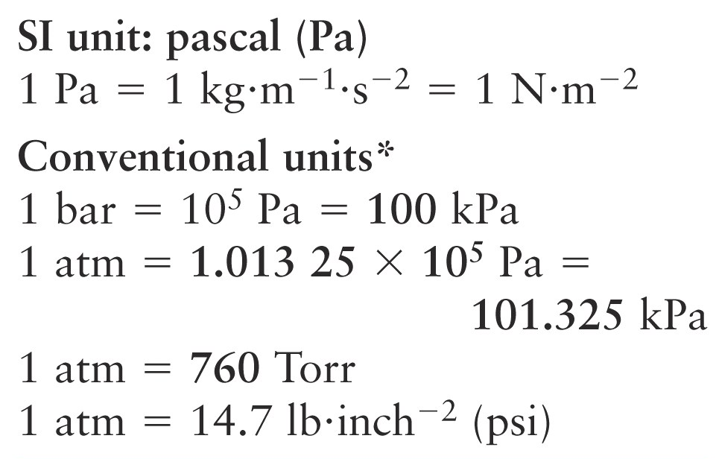
Units of Pressure
The most commonly used unit is the atmosphere, which describes the pressure exerted by air on the surface at sea level

Slide 7
The Ideal Gas Law
The ideal gas law is an equation that is used to describe the behavior of a gas in terms of common parameters pressure, volume, moles and temperature.
Here, the value R is known as the universal gas constant.
For P in atmospheres and V in liters, and T in Kelvin, the term R has a value of 0.0821 $\frac{L atm}{mol K}$
PV = nRT

Slide 8
Ideal Gases
Any gas that follows the ideal gas law is considered an ideal (perfect) gas.
One mole of an ideal gas at 0 ºC and 1 atmosphere of pressure occupies 22.4 L of space. The value of R is based on these values of n, T, P, and V.
The ideal gas law is valid only at low pressures
The conditions listed above (0 ºC, 1 atm) are referred to as standard temperature and pressure (STP)

Slide 9
Example
The pressure in a 10.0 L gas cylinder containing N₂(g) is 4.15 atmospheres at 20.0 ºC. How many moles of N₂(g) are there in the cylinder?
*When dealing with ideal gas law questions, follow these steps:
1) Determine what it is you are solving for.
2) List the given information. Pay attention to the units of each parameter. Convert as needed, and MAKE SURE THAT THE TEMPERATURE IS IN KELVIN !
3) Rearrange the ideal gas law equation accordingly to solve for the desired parameter.

Slide 10
Example, continued.
The pressure in a 10.0 L gas cylinder containing N₂(g) is 4.15 atmospheres at 20.0 ºC. How many moles of N₂(g) are there in the cylinder?
PV = nRT
We are solving for moles.
V = 10.0 L
P = 4.15 atm.
T = 20. 0 ºC 293 ºK
R = .0821 L•atm•mol⁻¹• K⁻¹
Rearrange the equation to solve for n.
$$n=\frac{PV}{RT}=\frac{(4.15 atm)(10.0 L)}{(.0821 L∙atm∙mol^{−1} K^{−1})(293 K)}$$
= 1.72 moles N₂(g)

Slide 11
Example 3
PV = nRT
2KClO₃(s) → 2KCl(s) + 3O₂(g)
In the reaction above, 1.34 g of potassium chlorate is heated inside a container to yield oxygen gas and potassium chloride. The oxygen gas occupies 250 mL at 20.0 ºC. What will the pressure of the gas be, in atmospheres?
Use STOICHIOMETRY to find the moles (n) of the gas.
We are solving for pressure in atm.
V = .250 L
T = 20 ºC → 293 ºK
n = ?
R = 0.821 L•atm•mol⁻¹• K⁻¹

Slide 12
2KClO₃(s) → 2KCl(s) + 3O₂(g)
1.34 g
.0109 mol
$$.0109 mol KClO_{3} x \frac{3 mol O_{2}(g)}{2 mol KClO_{3}}=.0164 mol O_{2}(g)$$
$$P=\frac{nRT}{V}=\frac{(.0164 mol)(0821 L∙atm∙mol^{−1} K^{−1})(293 K)}{(.250 L)}=1.57 atm$$

