Slide 1
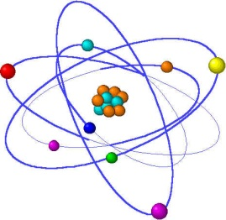
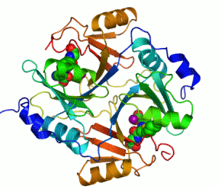
Lecture 6
Protein Structure and Properties

Slide 2

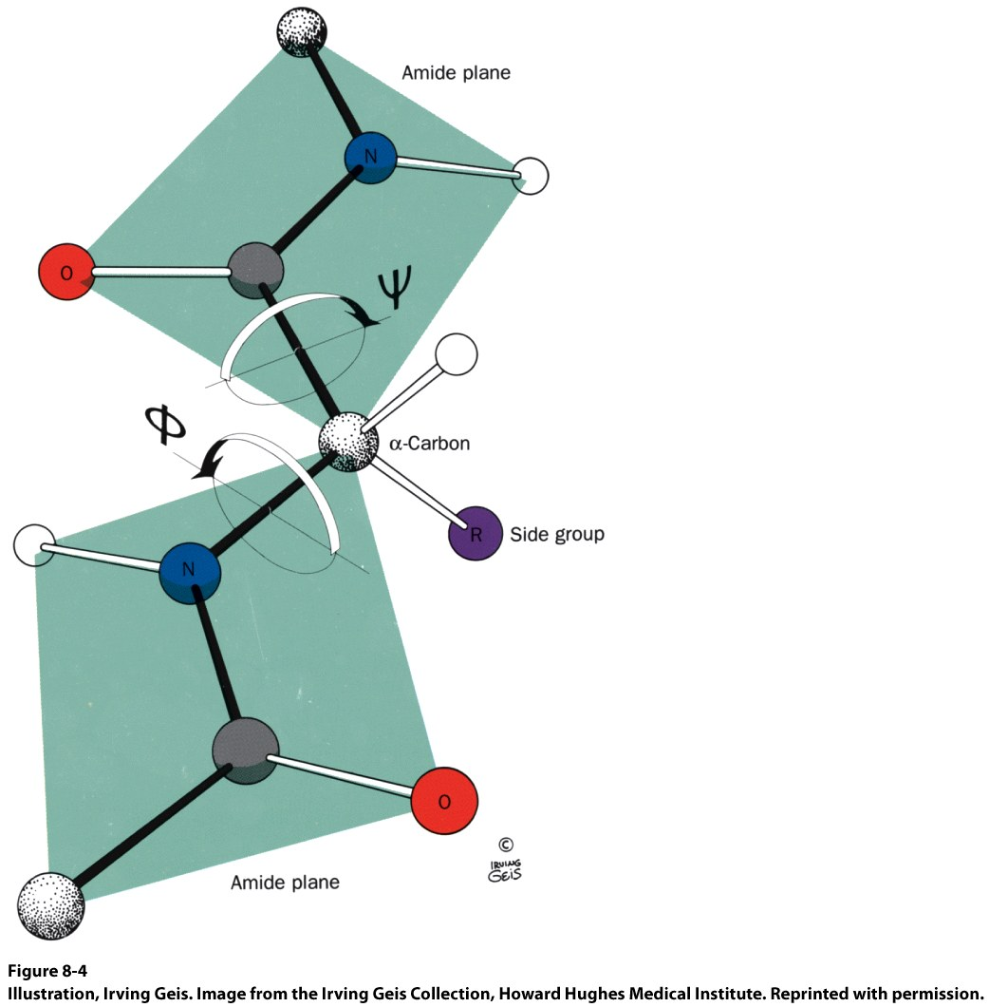
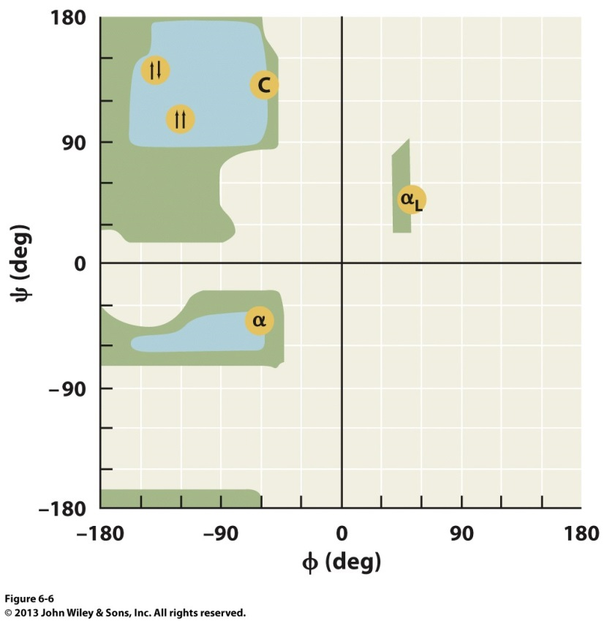
Torsion Angles
When both peptide bonds are in trans conformation:
Φ = -180
Ψ = 180

Slide 3
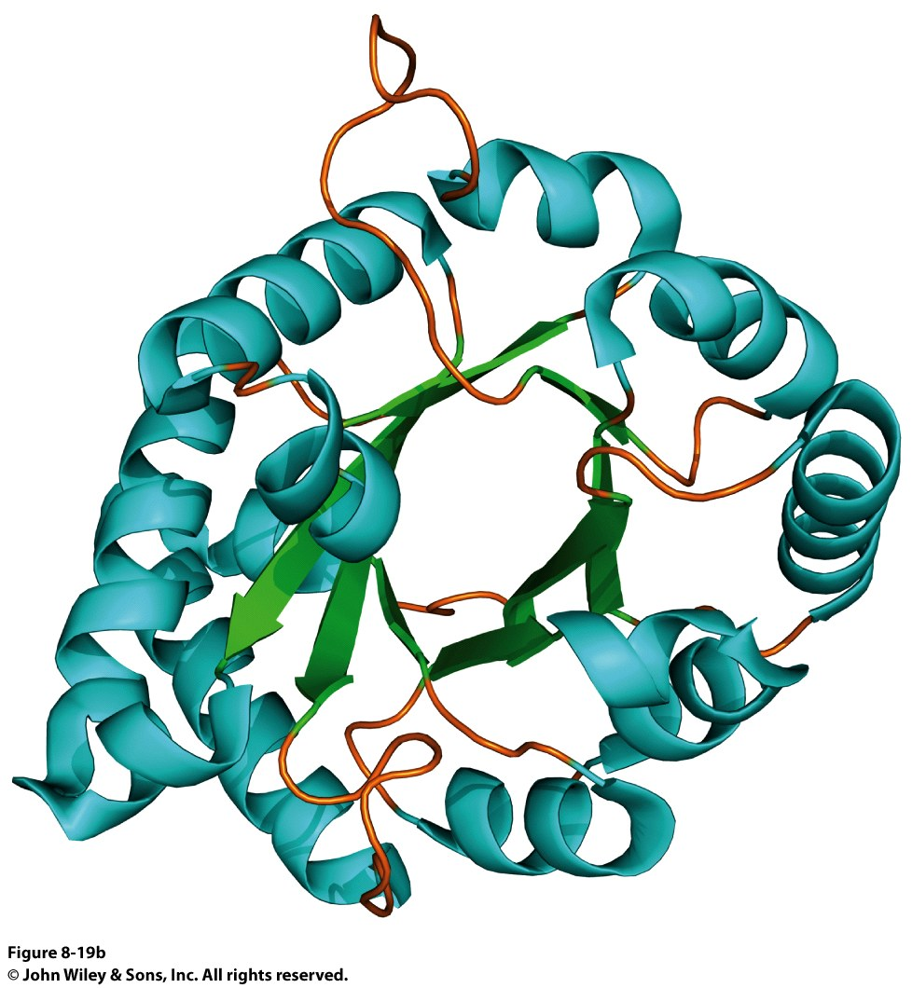
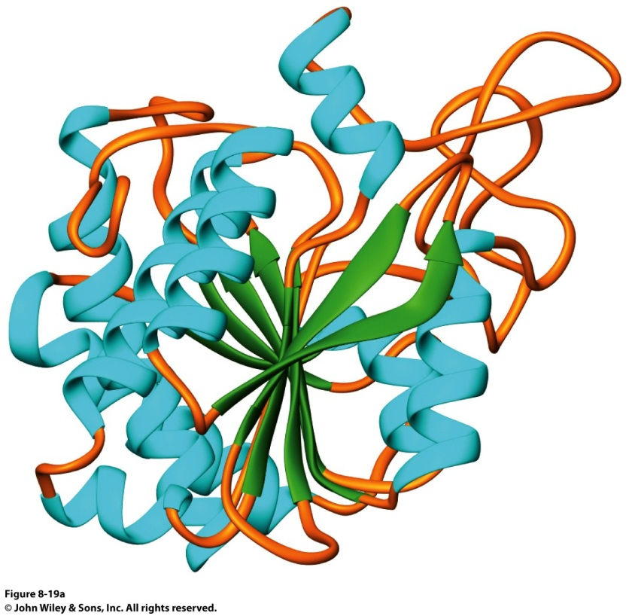
Globular Proteins
Exist as compact, roughly spherical molecules
Highly Solvated

Slide 4
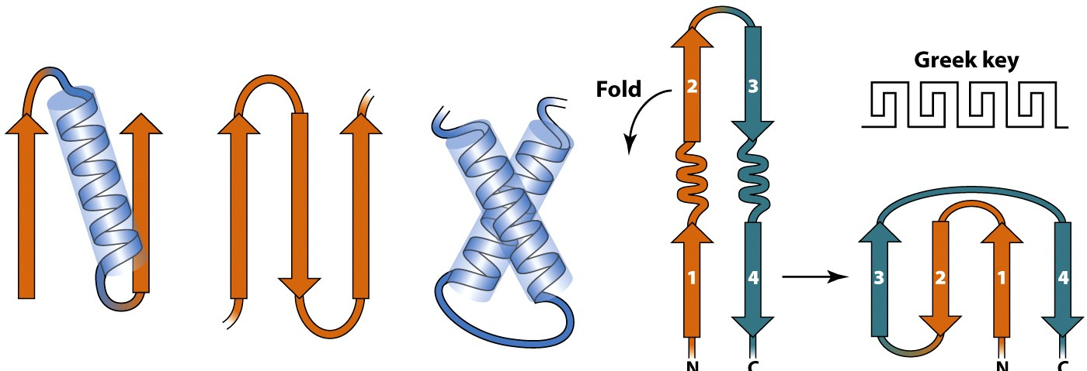
Superseconday Structure
Some common groupings of Secondary Structural Motifs
αα
Helix-turn-helix
βαβ
β hairpin
Greek Key

Slide 5
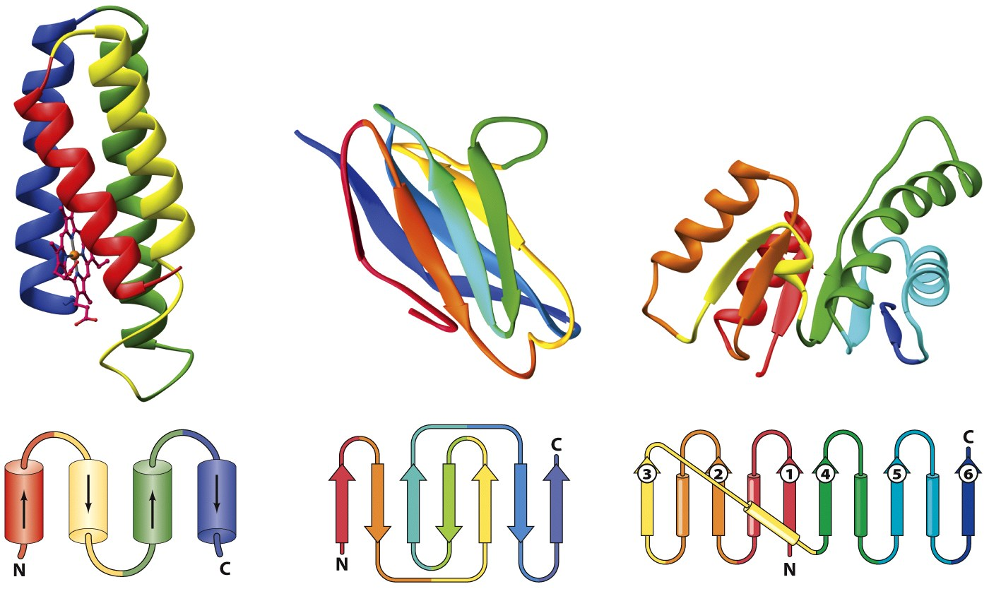
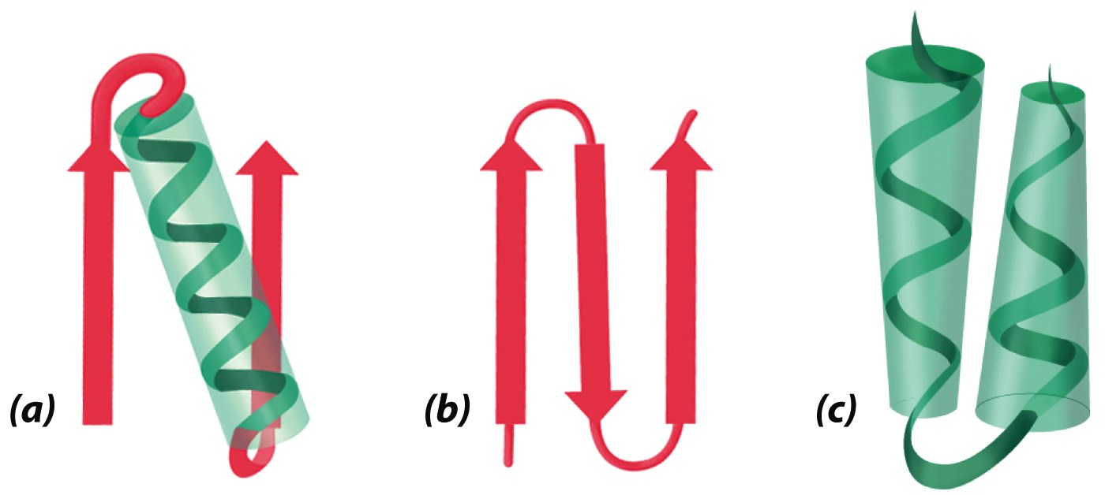
Superseconday Structure
Find the Common Structural Motifs
αα
Helix-turn-helix
βαβ
β hairpin

Slide 6
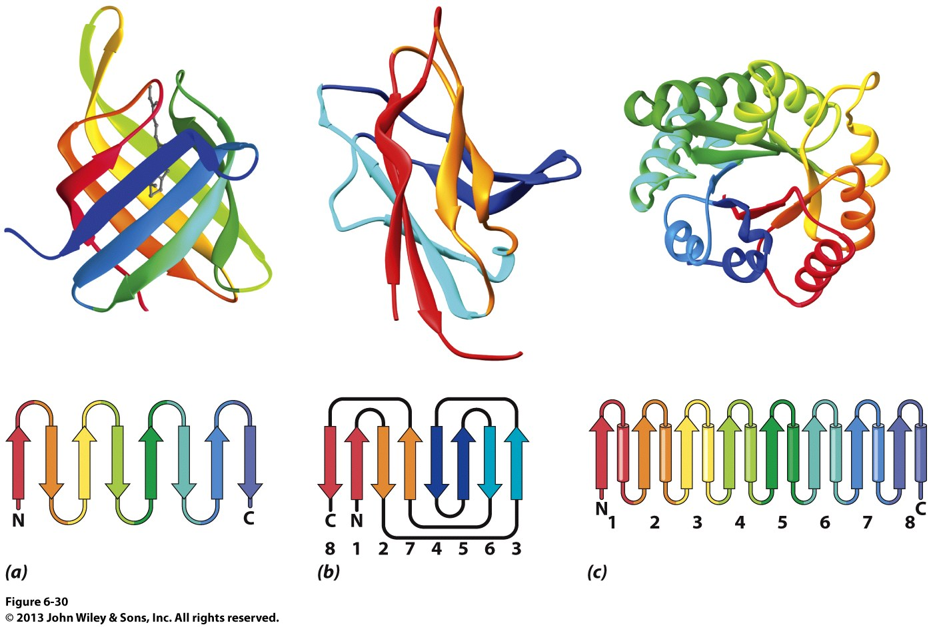
Common Tertiary Structures
β Barrels

Slide 7
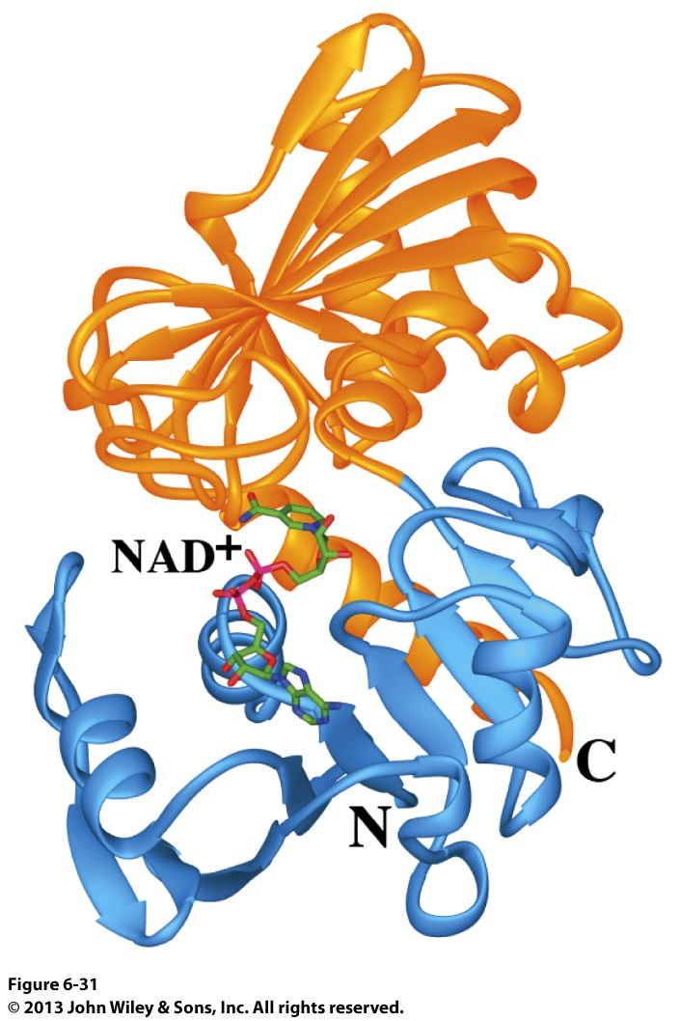
Common Tertiary Structures
Multi-domain Proteins

Slide 8
Protein Stability
Calculations show that proteins are NOT very stable molecules
Net stabilization of ~0.4 kJ mol⁻¹ for each amino acid
Electrostatic
Hydrogen Bonding
Hydrophobic
Covalent (disulfide)
The cumulative stabilizing energy of each of these forces can be in the thousands of kJ mol⁻¹

Slide 9
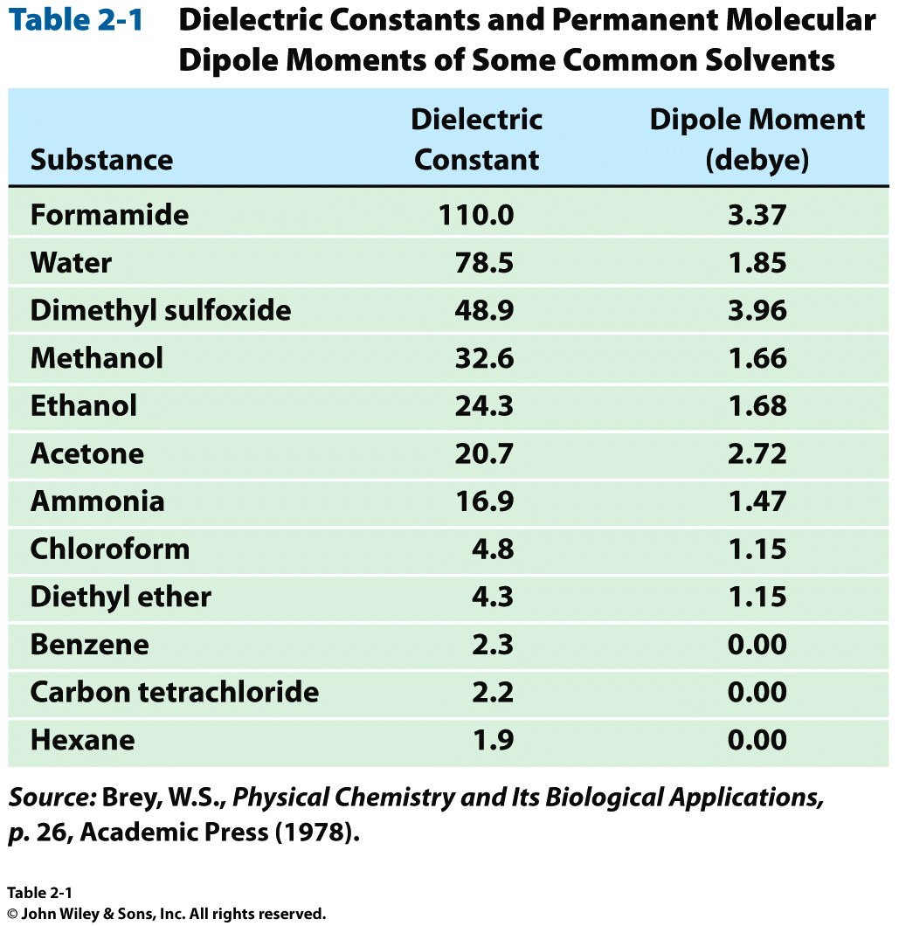
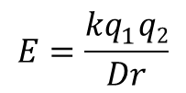
Protein Stability – Electrostatics
$$E=\frac{kq_{1}^{}q2}{Dr}$$
Protein cores are approximated to have a dielectric constant of 4
What residues have a potential for ionic interactions?

Slide 10
Protein Stability – Hydrogen Bonds
Proteins maximize H-bonding by selecting a local H-bond network
Side Chain – Backbone H-bonds are clustered @ Helix termini
H – bonding position | Type of 2˚ Structure | Percentage of H bonds
n→n-4 | α helix | ~25%
n→n-3 | 3₁₀ helix and turns | ~25%
 | β sheets | ~25%

Slide 11
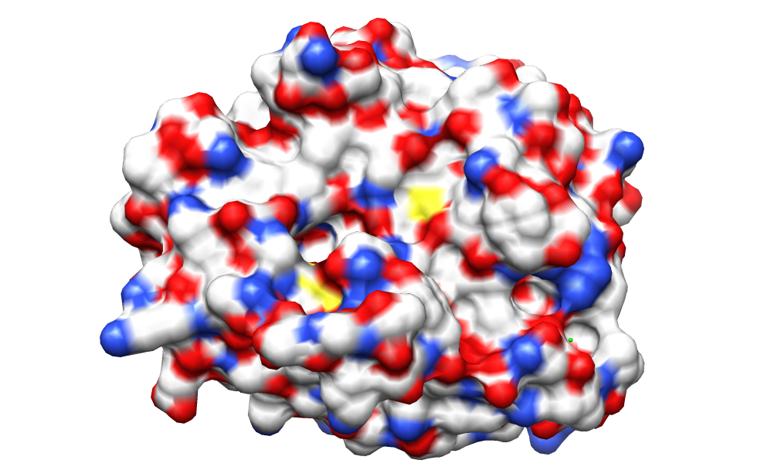
Protein Stability – dipoles
Which amino acids can be involved in dipole-dipole interactions?
What else is an important dipole interaction?
δ⁺
δ⁻
δ⁺
δ⁻

Slide 12
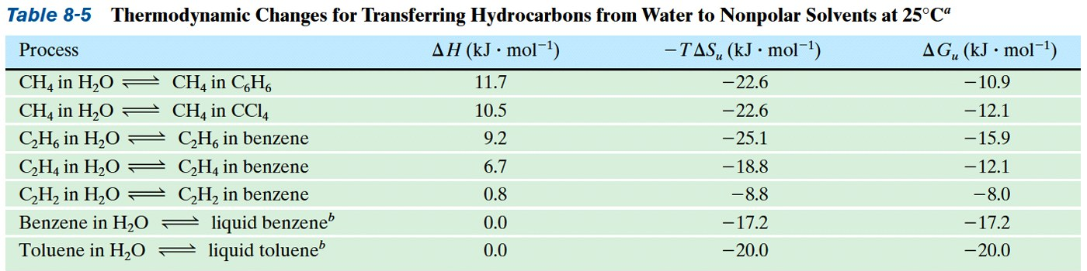
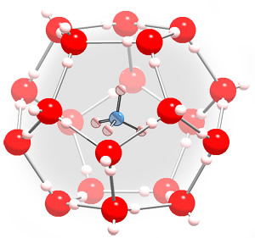
Protein Stability – The Hydrophobic Effect

Slide 13
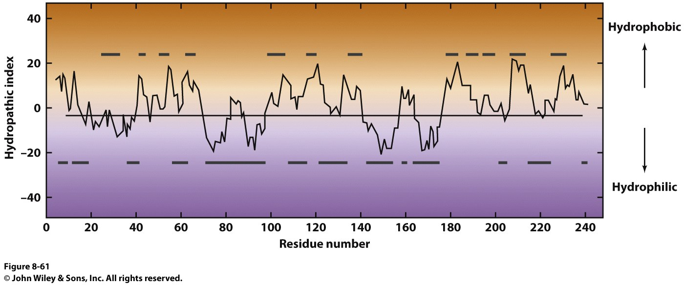
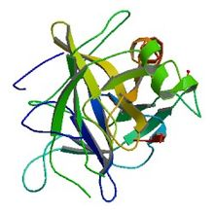
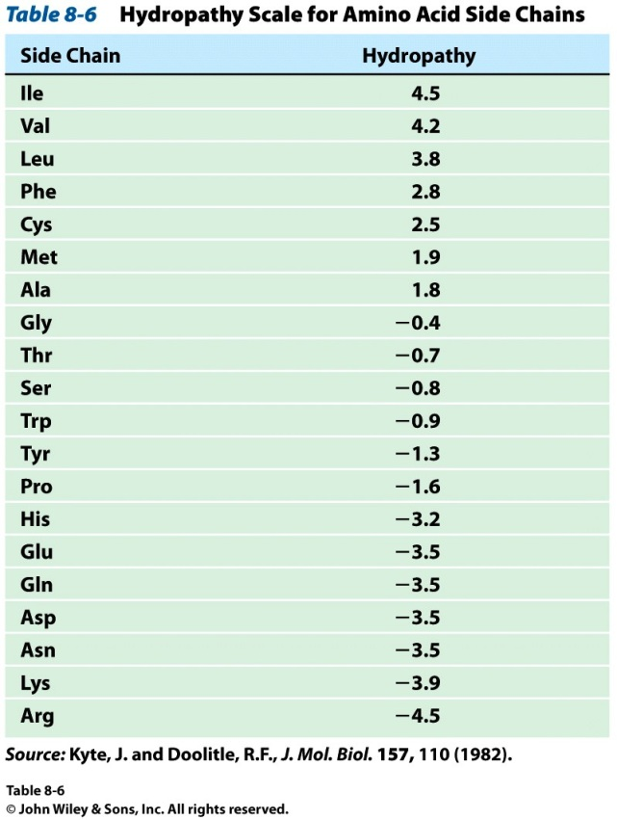
Protein Stability – Hydrophobicity
This scale takes the cumulative hydropathy for 9 consecutive amino acids

Slide 14
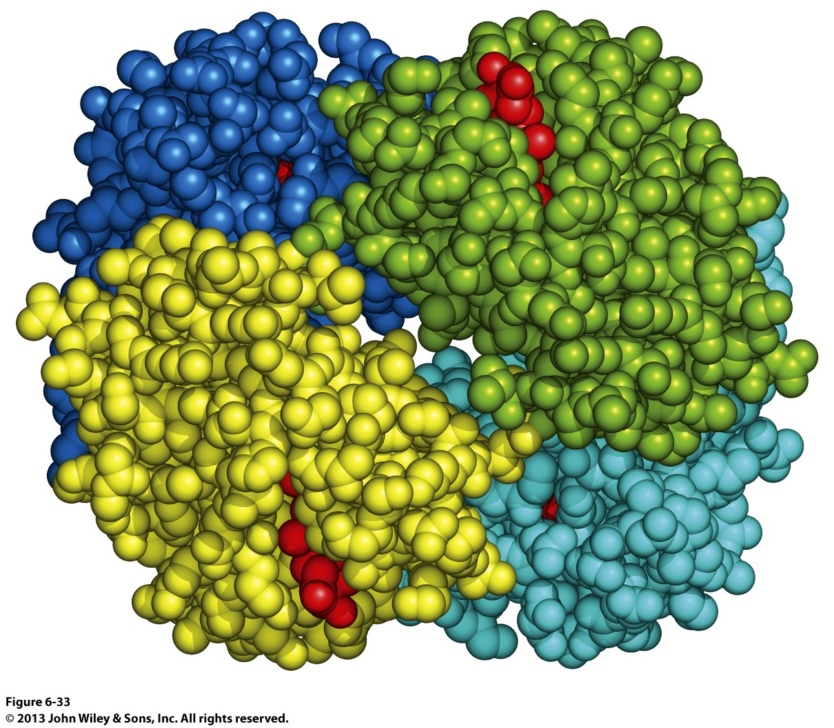
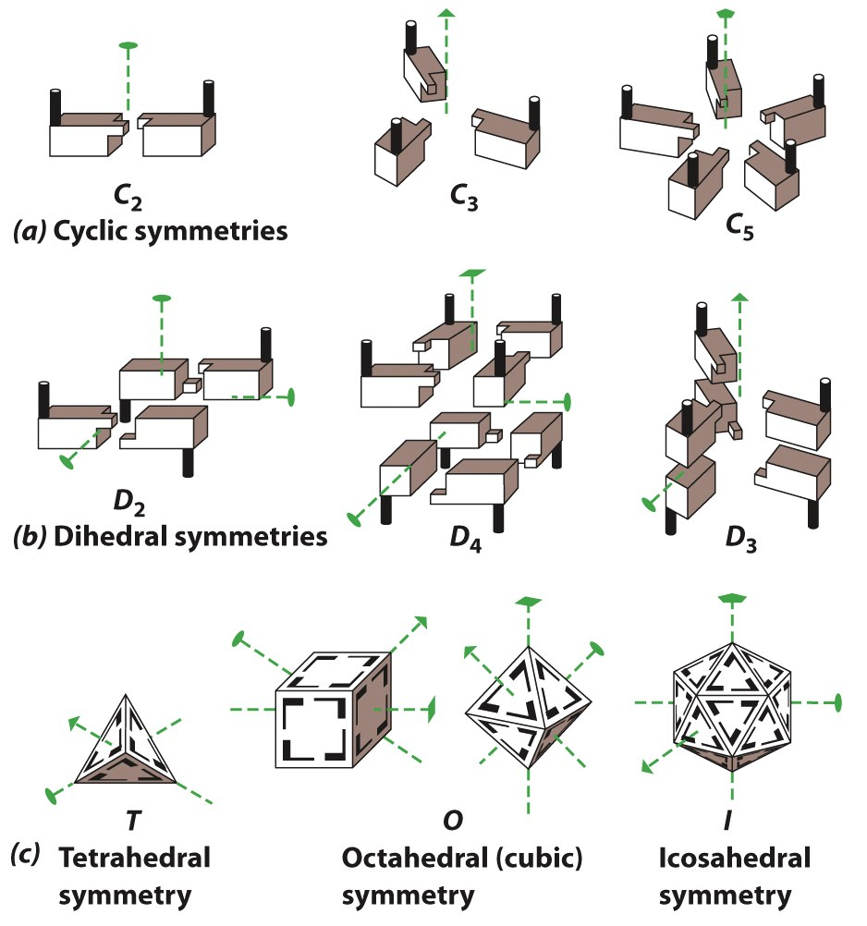
Quaternary Structure and Symmetry

Slide 15
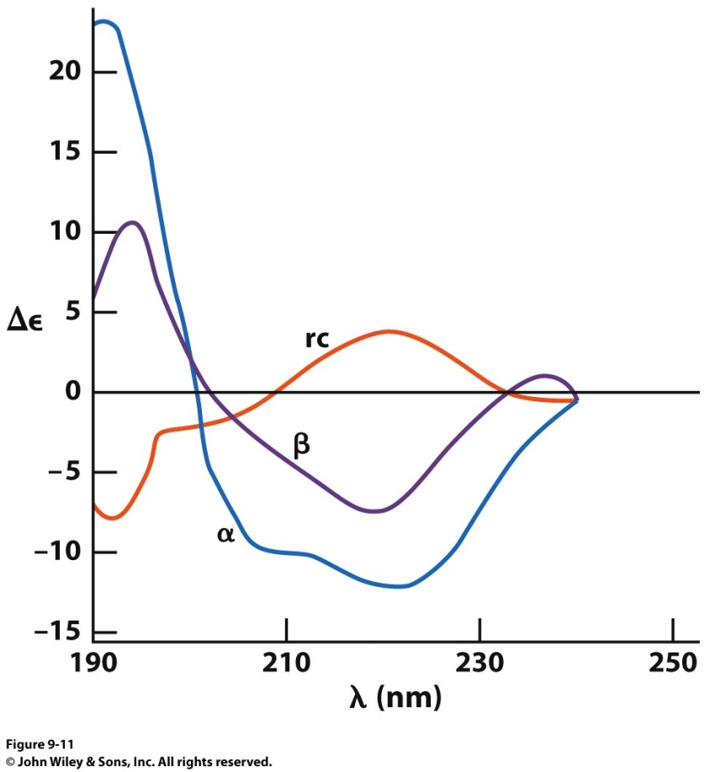
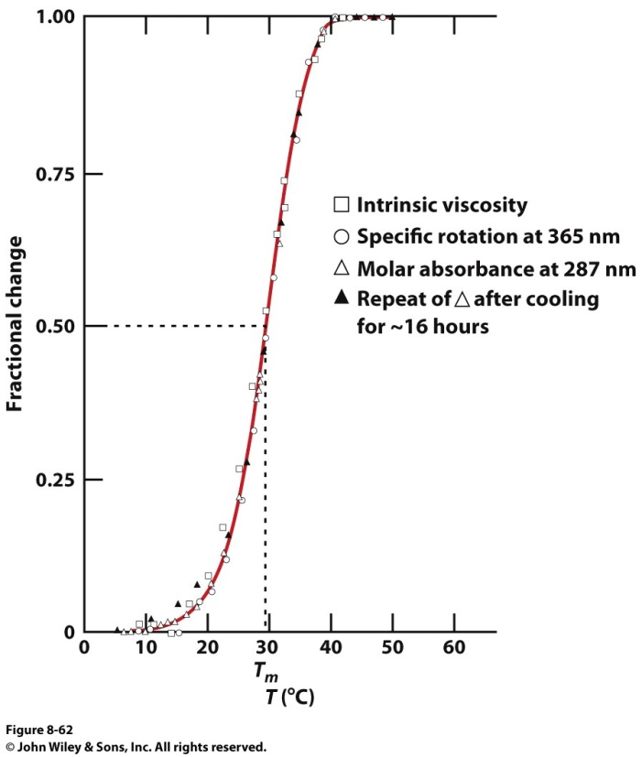
Measuring Protein Stability
Heat
Circular Dichroism Spectroscopy
Absorbance of circularly polarized light is dependent on the chirality of the sample
Abs_{CW} - Abs_{CCW}
How could we denature a protein without heating it up?

Slide 16
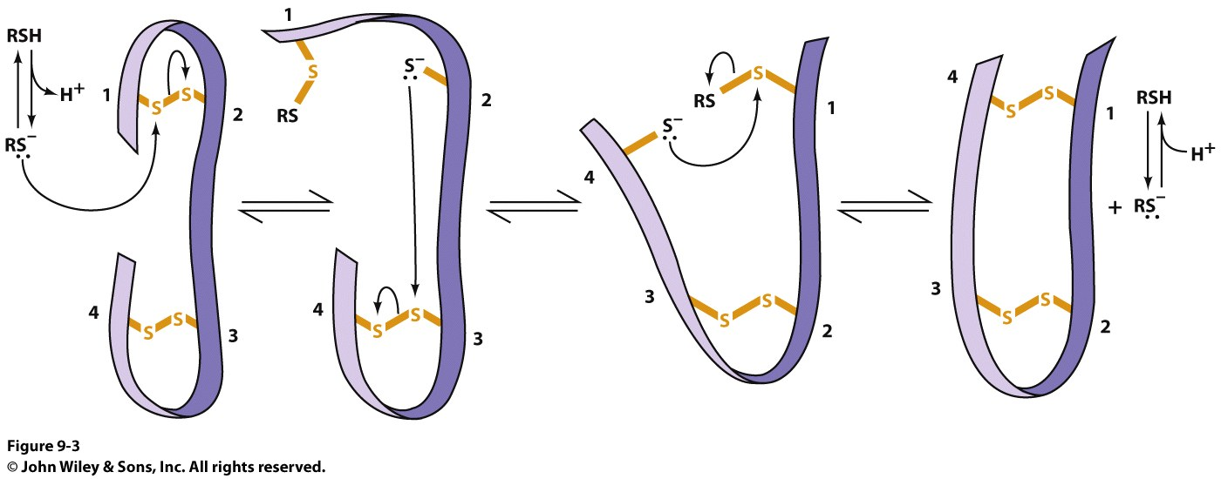
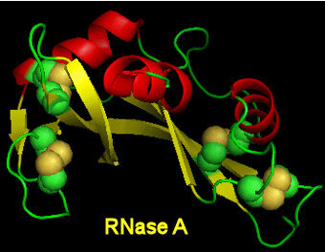
Protein Folding
If the wrong disulfide is formed, what happens to the protein?
How can we completely reverse RNase A folding?
Odds of finding the correct cysteine?
Plausible mechanism of a Protein Disulfide Isomerase

Slide 17
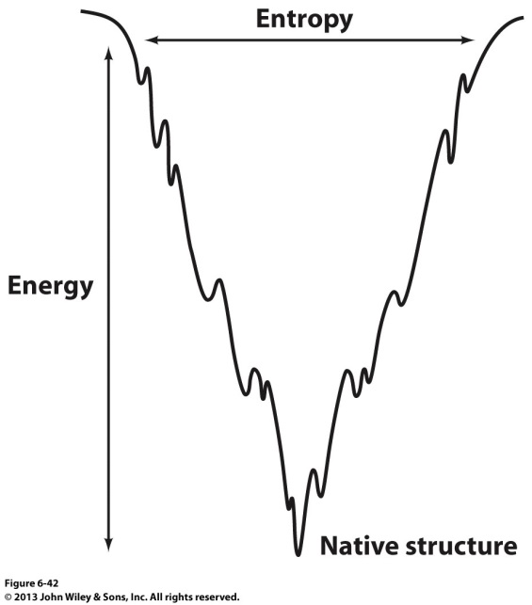
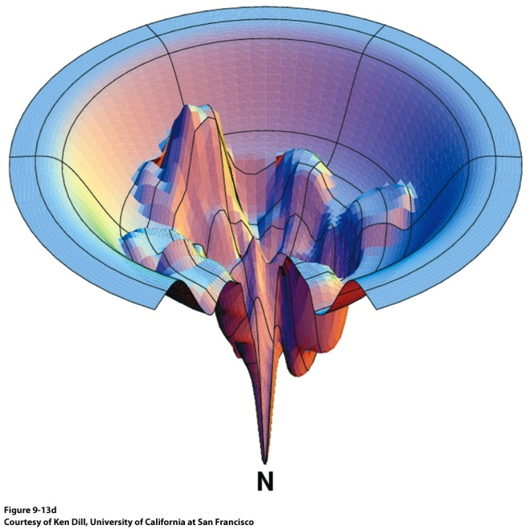
Protein Folding – Energy Landscapes
Native conformation
Local Energy minimum = Wrong Structure

Slide 18
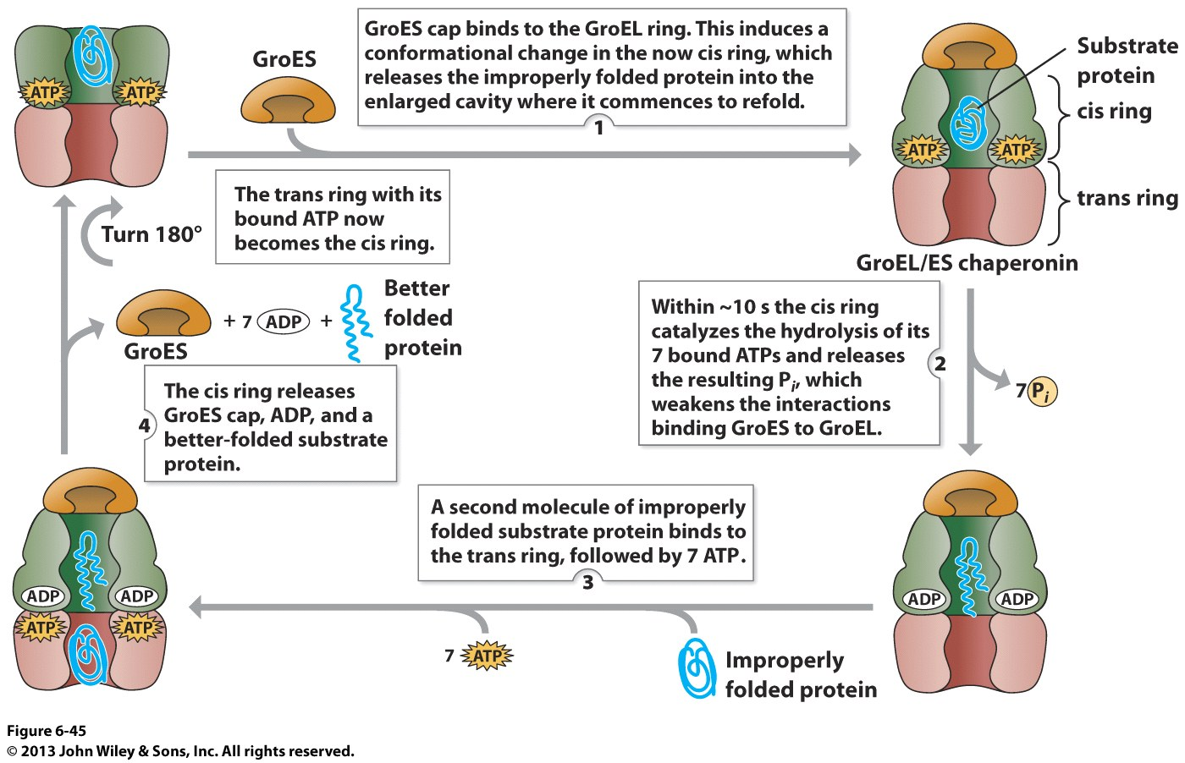
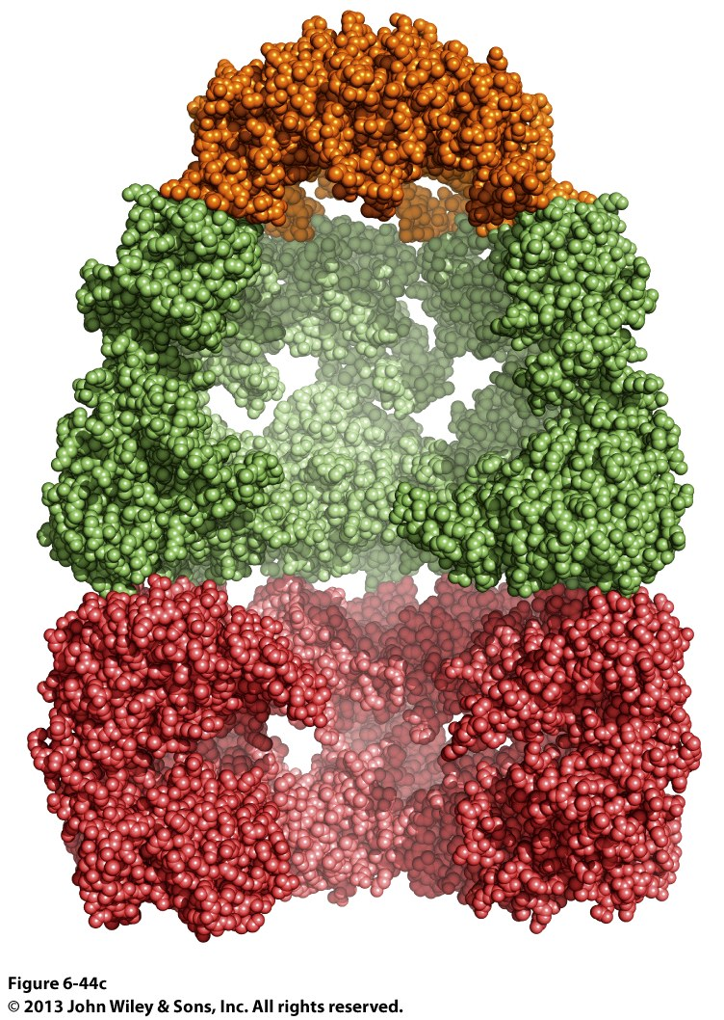
Overcoming the Local Energy Minima
Molecular Chaperones → bind to unfolded proteins and prevent non-native conformations

Slide 19
How well do you understand protein structure?

Slide 20
Which of the following statements about the peptide bond is true?
It is a phosphoamide bond.
It is a double bond.
Atoms of the peptide bond are located in a single plane.
The peptide bond is charged.
Notes:
C

Slide 21


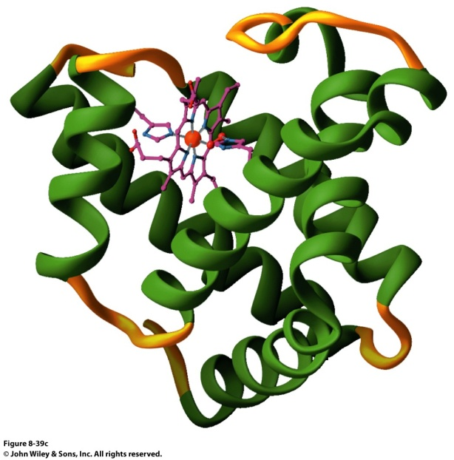
Which of the following statements is FALSE with respect to the ribbon diagrams shown below ?
1
2
3
Protein 2 contains parallel β-sheet strands.
Protein 3 contains a prosthetic group.
The secondary structure of protein 3 is all α-helix.
These proteins have both secondary and tertiary structure.

Slide 22
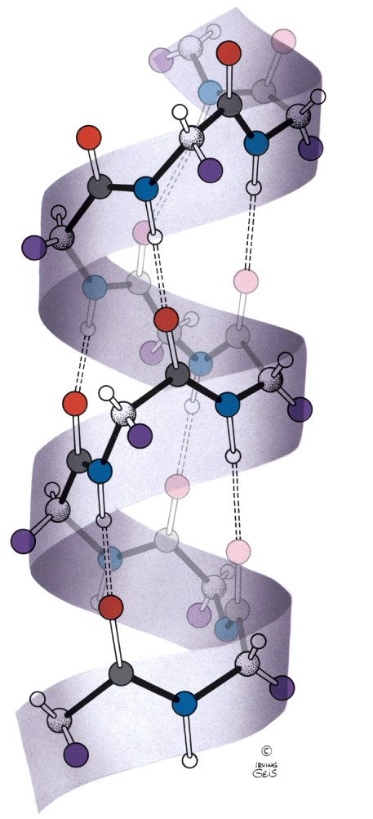
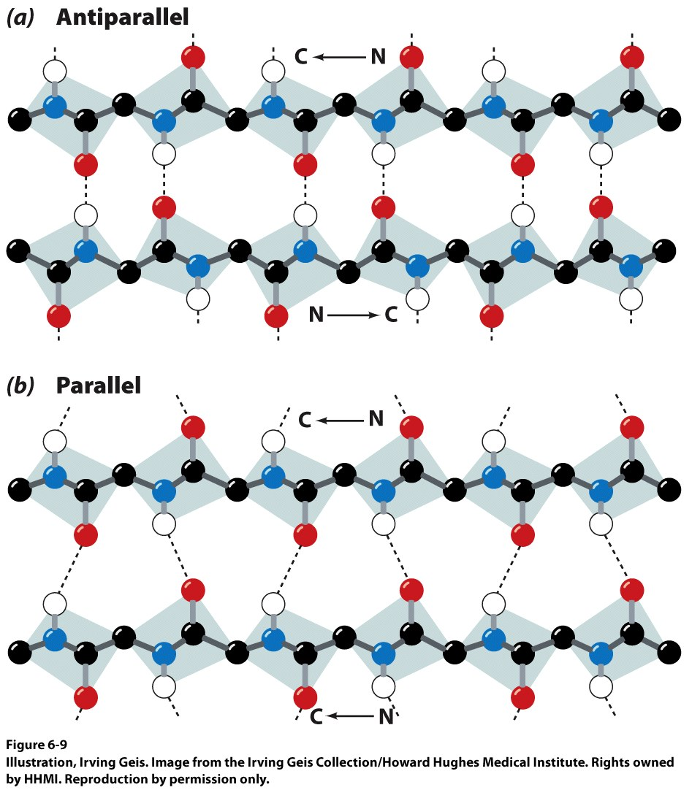
α-helix and β-sheet secondary structure is located mainly in the interior of folded proteins, whereas irregular loops occur on the outside. Why?
Notes:
22
The H bonding requirements of the polypeptide backbone in irregular loops are not fully satisfied, and so these structures interact with water at the surface

Slide 23
Which of the following series of amino acids is MOST likely to be at the surface of a water-soluble globular protein?
……..met-phe-pro-ile-leu……..
……..tyr-phe-gly-asn-leu……...
……..glu-asn-ser-thr-arg………
……..val-ala-val-glu-val………
……..met-cys-pro-ala-tyr……...
Notes:
23
C

Slide 24
Which of the following amino acid residues form hydrogen bonds with Ala residues located in an α-helix?
Residues in a neighbouring α-helix.
Residues located within the same α -helix.
None, because Ala is unable to form hydrogen bonds.
Notes:
B

Slide 25
The following sequence of amino acids is very unlikely to fold into a stable α-helix. Why?
Asp-Glu-Ser-Asp-Glu-Glu-Arg-Val-Asp-Ala-Glu-Asp
Would a β-sheet be more likely? Why?
Notes:
25
Show structure first, then given the options to choose from.
C

Slide 26
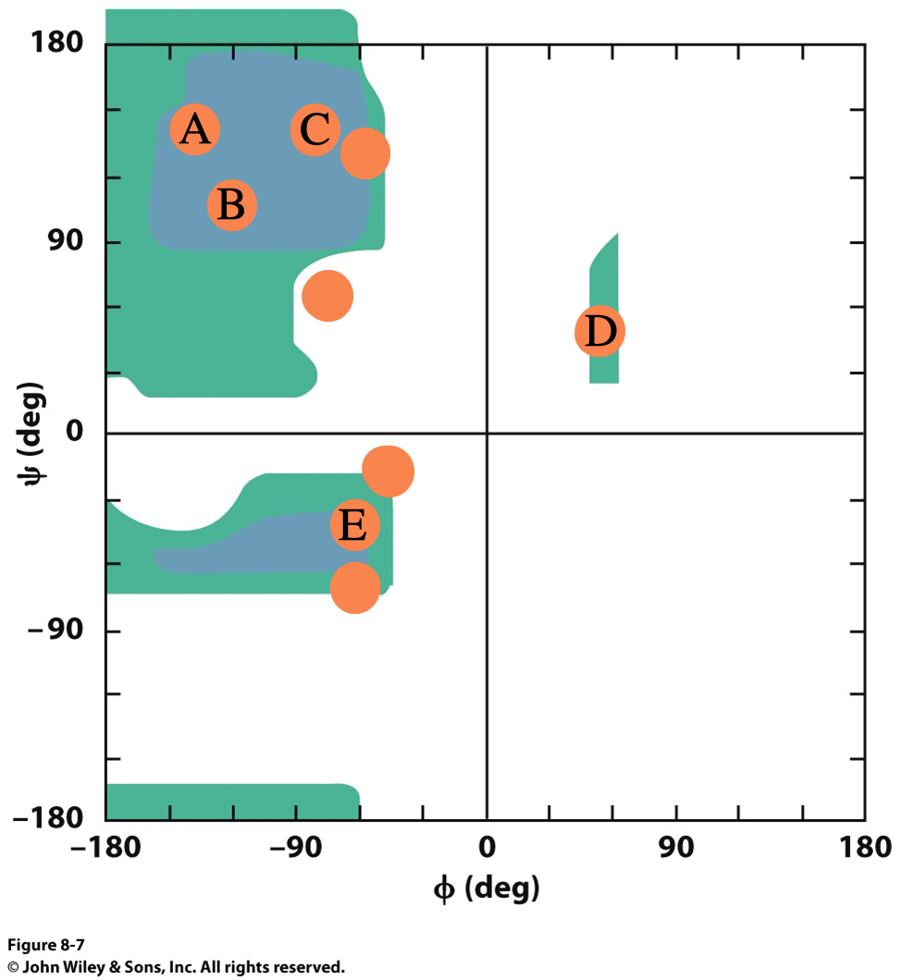
What Secondary Structures correspond with each label?
Notes:
A=antiparallel
B = parallel

Slide 27
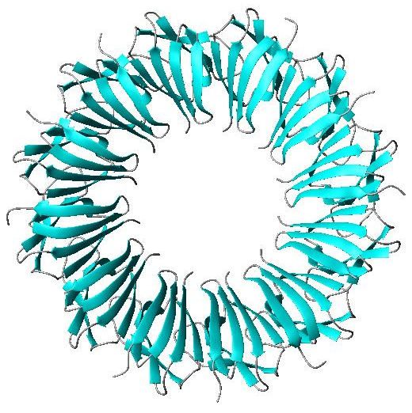
What is the symmetry of the structure shown?
C₂
C₃
C₆
C₁₂
Notes:
D

