Slide 1
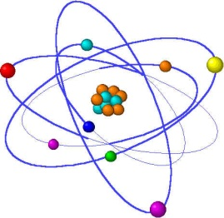
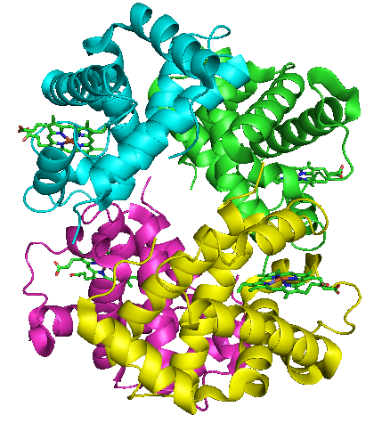
Lecture 11
Protein Function and Allostery: the case of Oxygen Transport and Storage

Slide 2
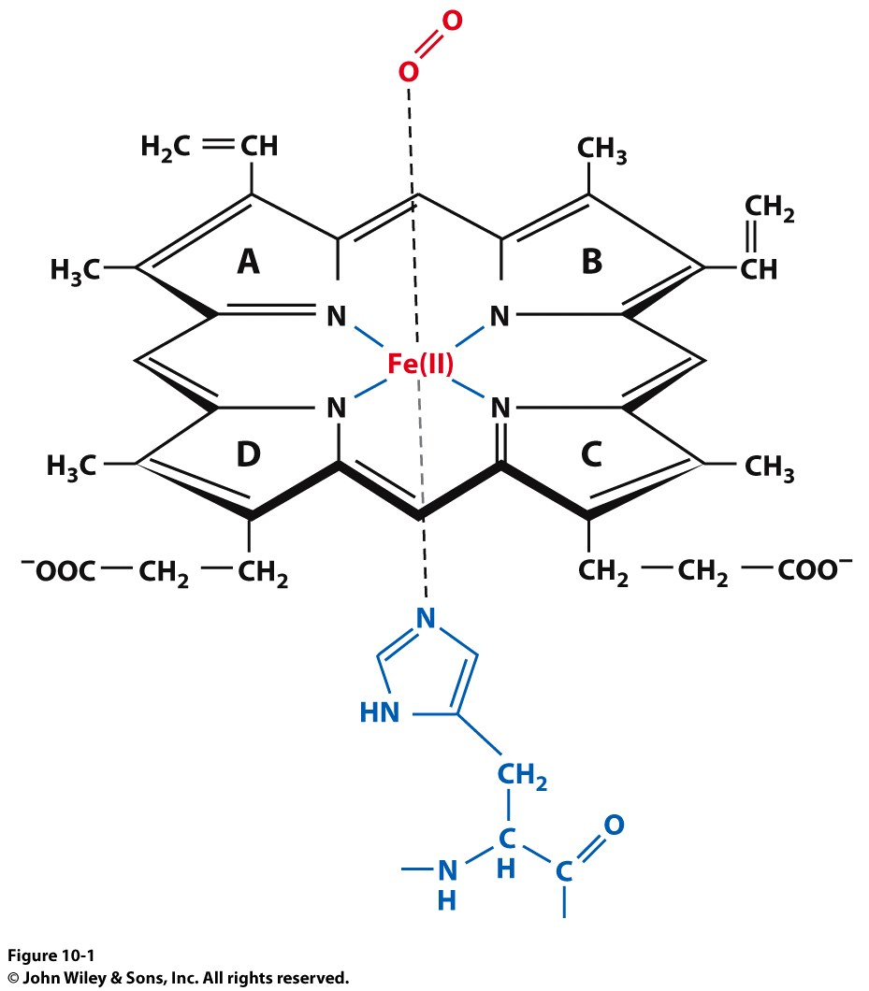
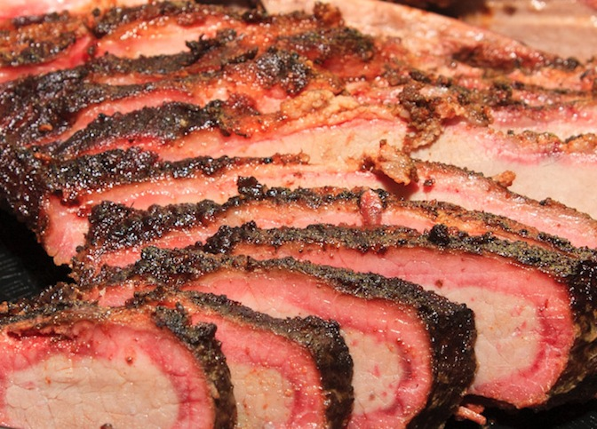
Oxygen Storage and Transport
Iron is always in the Fe²⁺ oxidation state. Oxidation to Fe³⁺ results in abolished O₂ binding
Meat Colors correspond to Myoglobin State:
Uncooked = Ferrous/O₂ bound
Well done (brown) = Ferric (deoxy)
Pink = CO bound

Slide 3
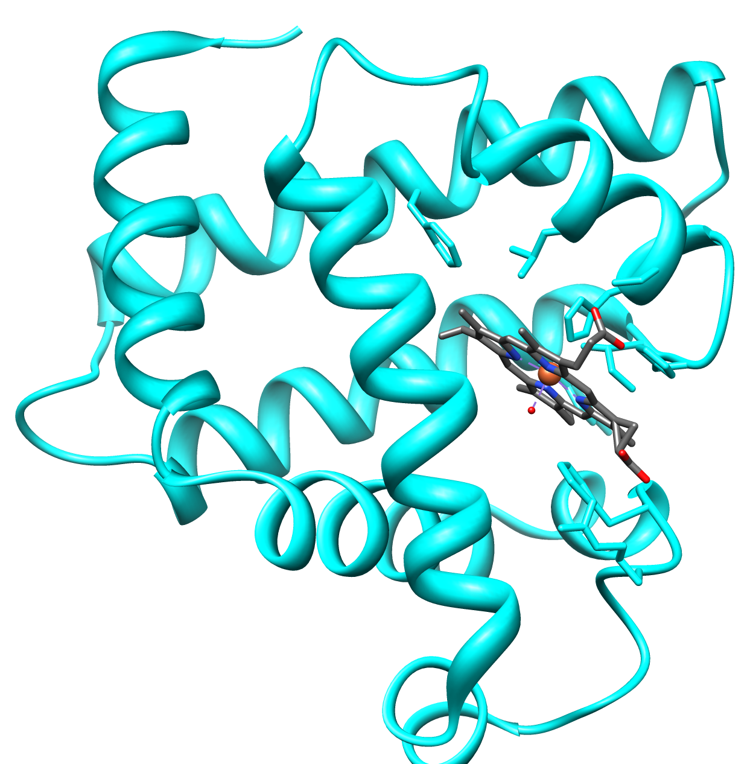
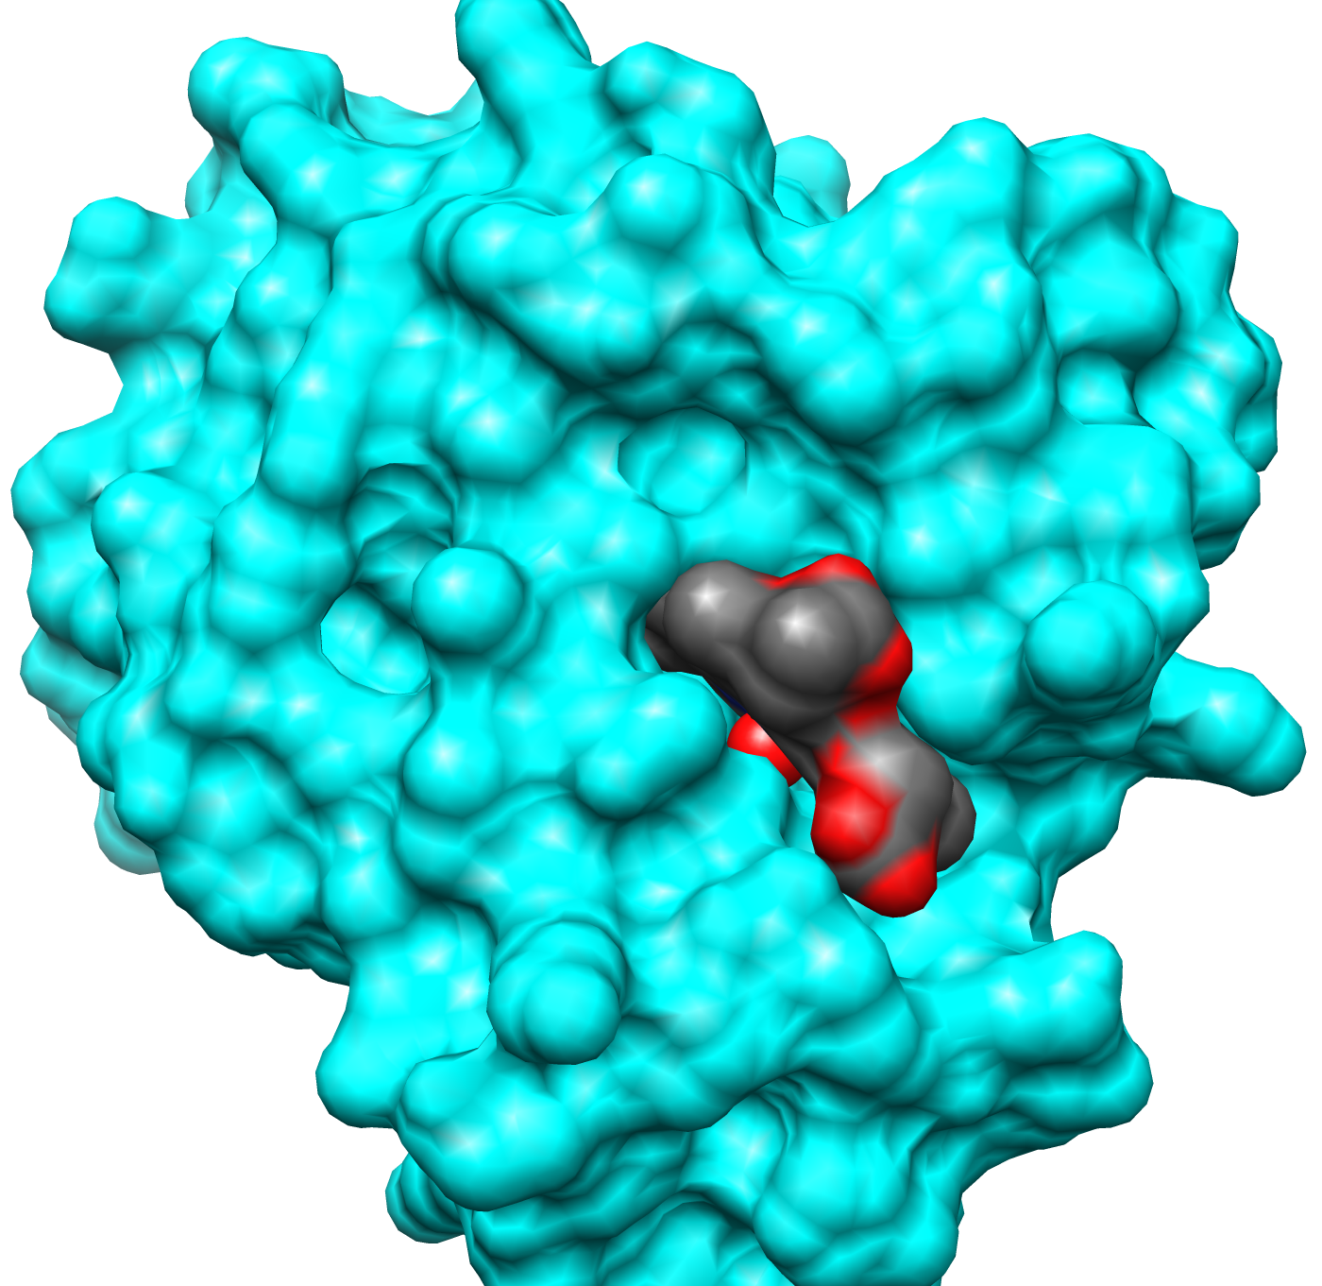
Myoglobin
Myoglobin and hemoglobin both contain a Protoporphrin IX

Slide 4
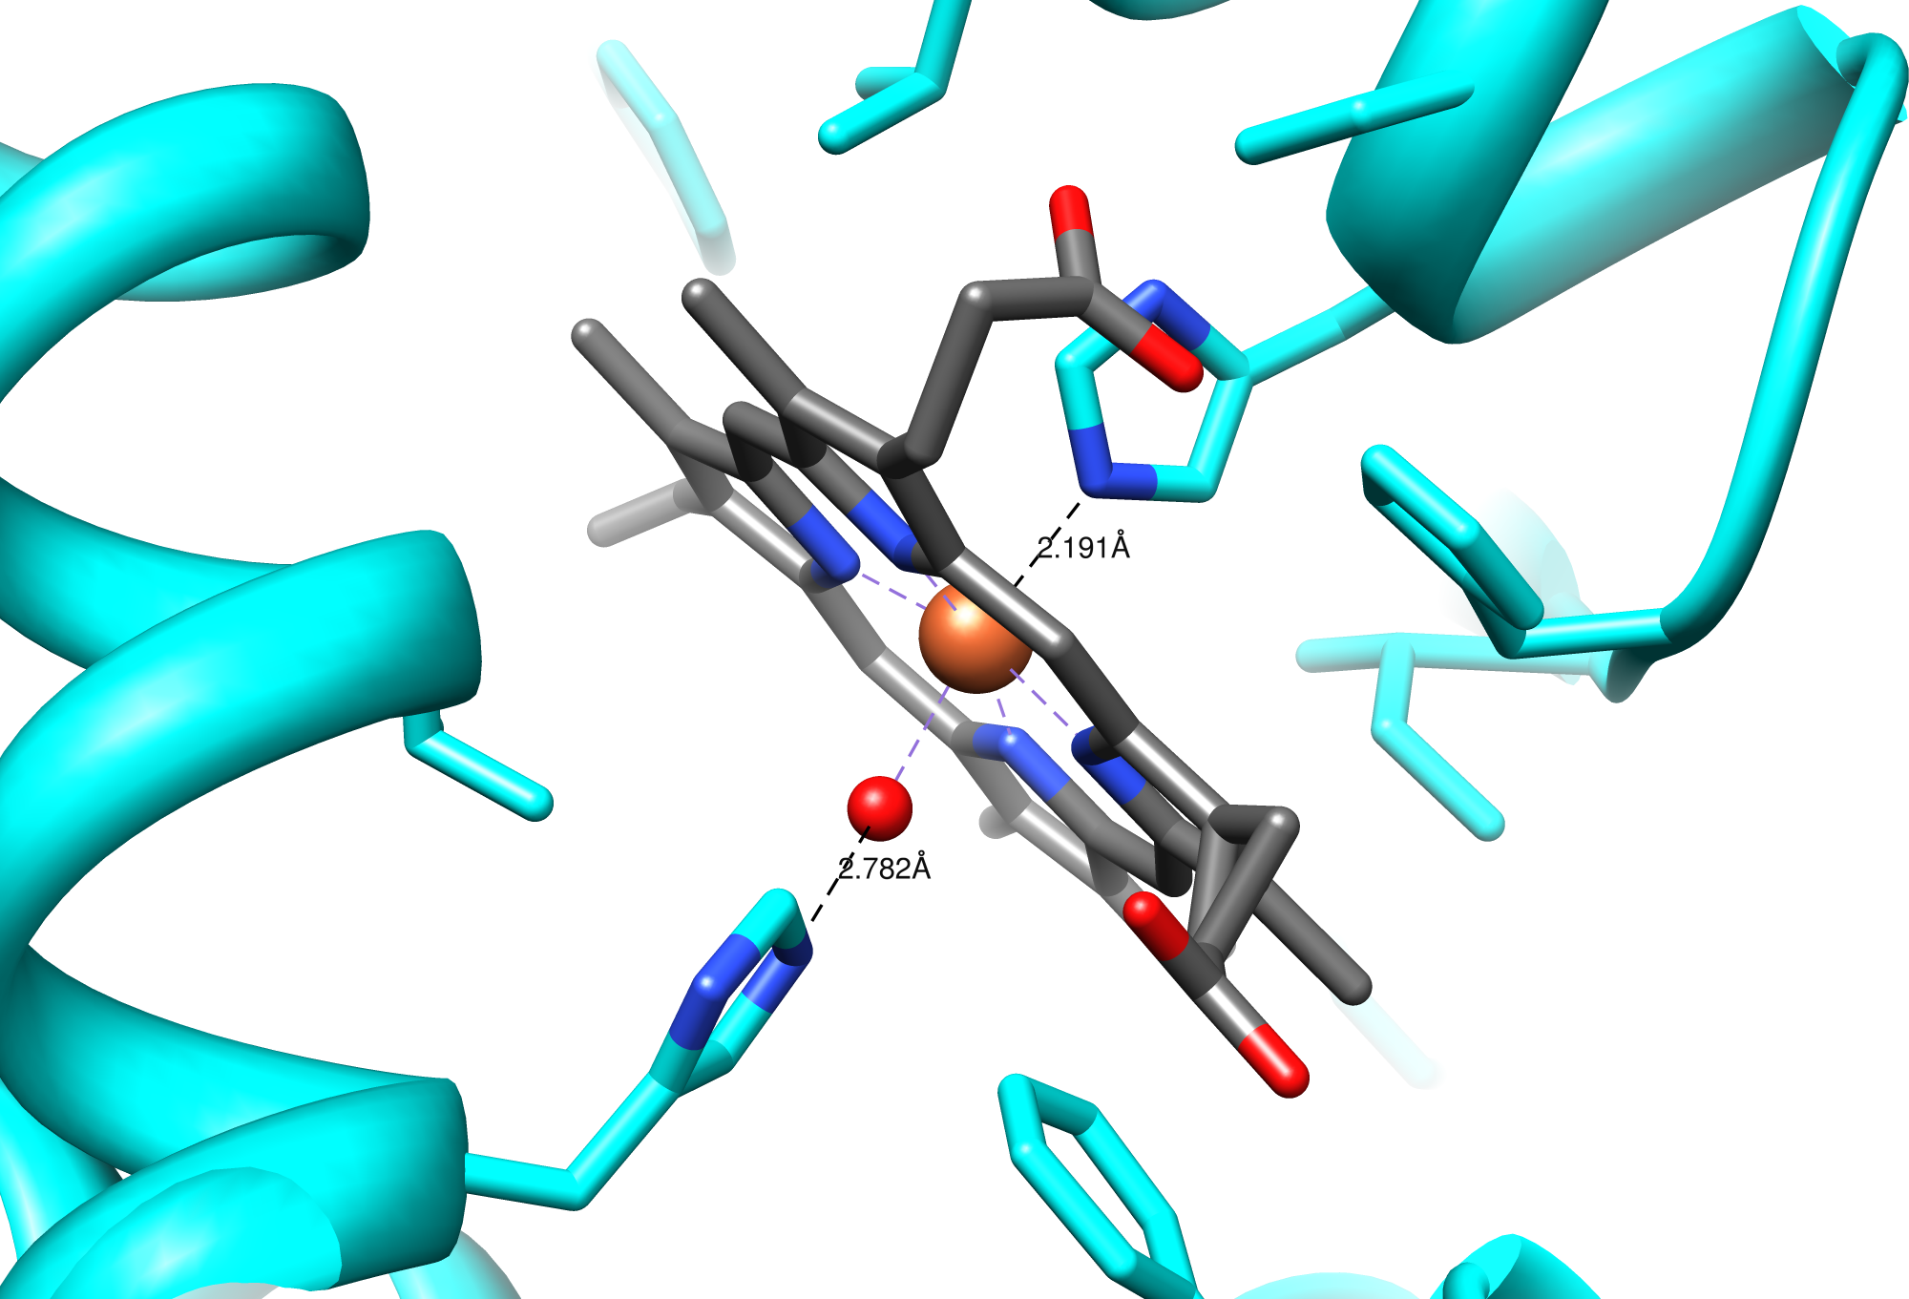
Myoglobin Heme Site

Slide 5
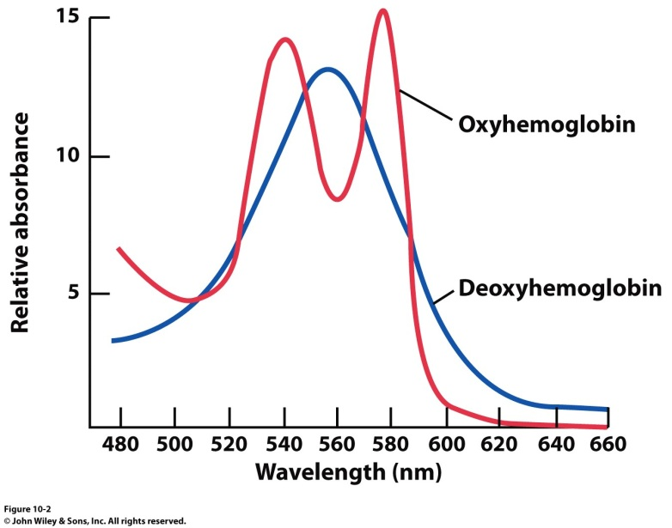
Modeling the Binding Curve
Iron is always in the Fe²⁺ oxidation state. Oxidation to Fe³⁺ results in abolished O₂ binding
O₂ bound
deoxy
Proximal Histidine
Spectroscopic handle that allows us to monitor O₂ binding.

Slide 6
Oxygen Binding
Tight Binding
O₂ bound
Intermediate
Affinity
% Abs
deoxy
Low Affinity
Spectroscopic handle that allows us to monitor O₂ binding.
[O₂]

Slide 7
Modeling the Binding Curve
$$K= \frac{\left[MbO2\right]}{\left[Mb\right][O2]}$$
Mb + O₂ MbO₂
Fractional Saturation (Y)
The fraction of binding sites that are occupied with a ligand (O₂).
$$Y_{O2}=\frac{[Sites occupied]}{[Total sites]}=\frac{[MbO2]}{\left[Mb\right]+[MbO2]}$$

Slide 8
Modeling the Binding Curve
$$K= \frac{\left[MbO2\right]}{\left[Mb\right][O2]}$$
Mb + O₂ MbO₂
p₅₀ = 2.8 torr under biological conditions. What pressure of oxygen is needed for Mb to be:
25% saturated
75% saturated
$$Y_{O2}=\frac{[O2]}{K^{−1}+\left[O2\right]}=\frac{pO2}{p50+pO2}$$

Slide 9
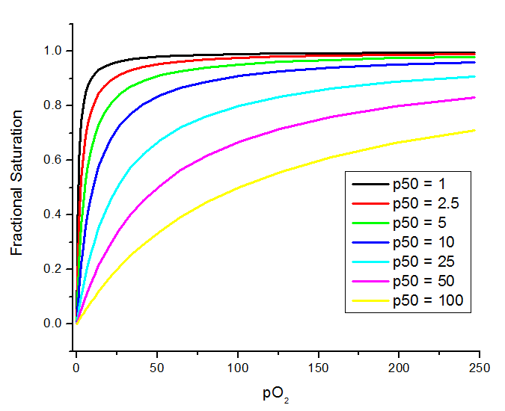
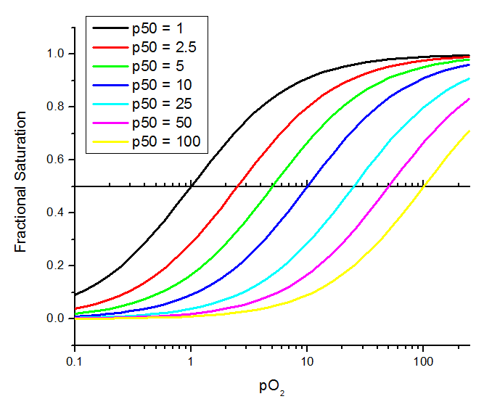
Modeling the Binding Curve
$$Y_{O2}=\frac{pO2}{p50+pO2}$$
By definition, Kd (p₅₀ in this case) is concentration with 50% saturation

Slide 10
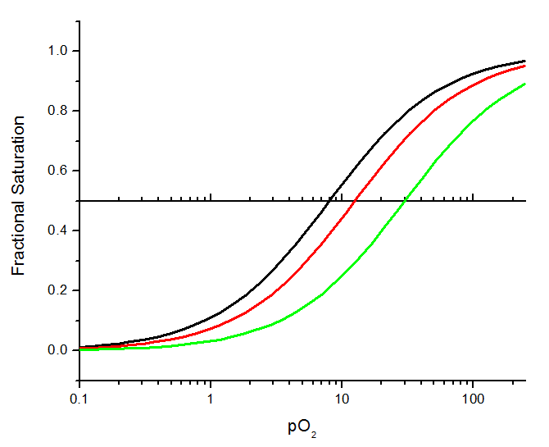
Modeling the Binding Curve
$$Y_{O2}=\frac{pO2}{p50+pO2}$$
What is the K_{D}?

Slide 11
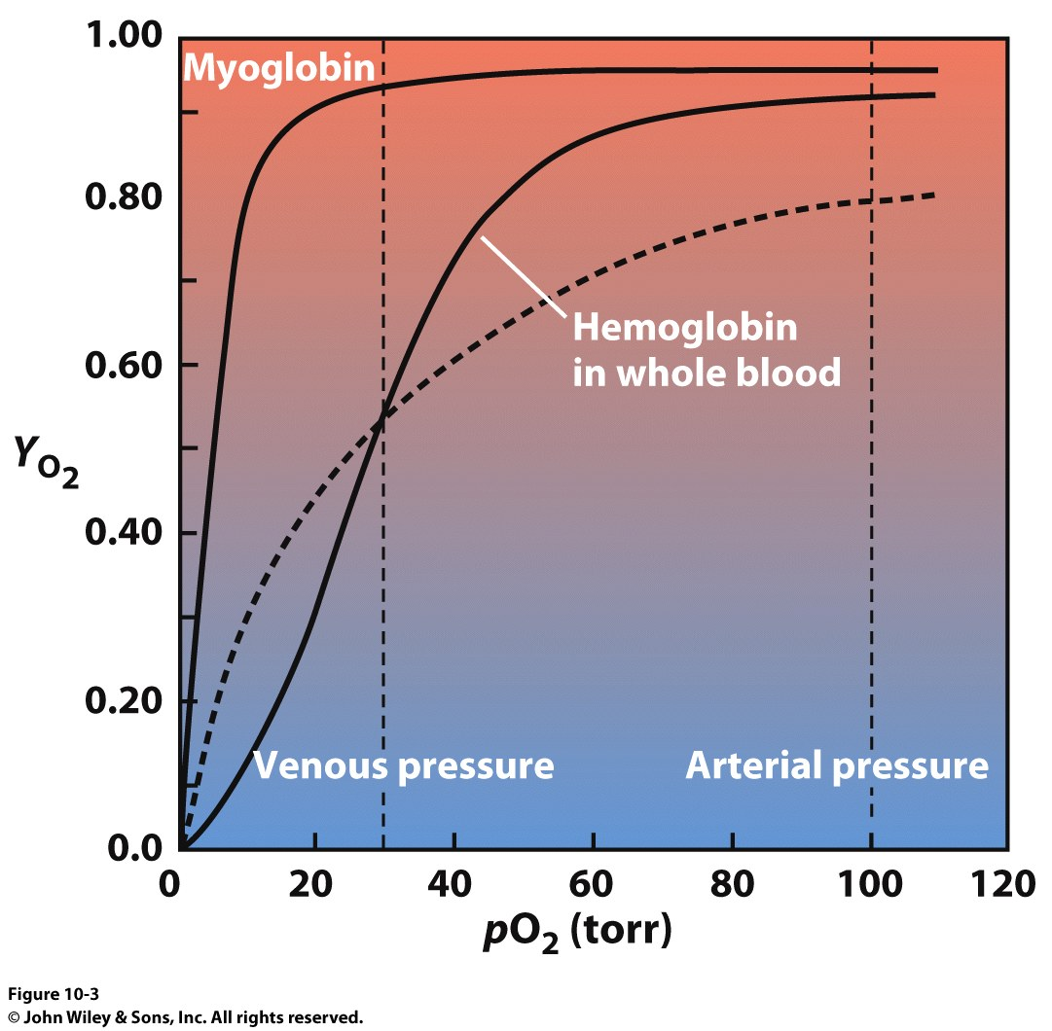
Modeling the Binding Curve
$$KD=\frac{\left[Mb][O2\right]}{\left[MbO2\right]}$$
MbO₂ Mb + O₂
$$Y_{O2}=\frac{pO2}{KD+pO2}$$
Artery
Hemoglobin
90% O₂ loaded
Myoglobin
Hemoglobin
50% O₂ loaded
Vein

Slide 12
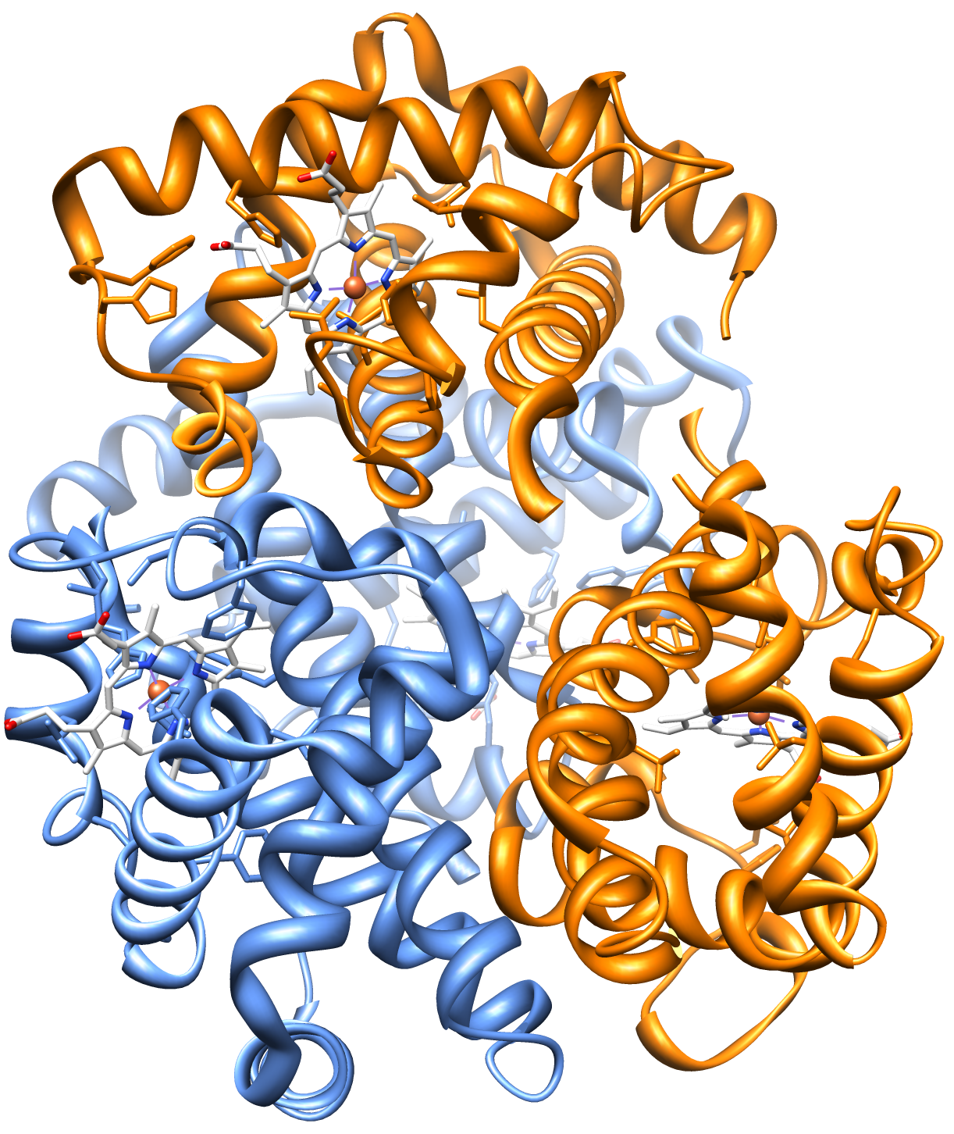
Understanding the Hb curve
% Abs
Intermediate Affinity
for O₂.
[O₂]
Very low affinity for O₂

Slide 13
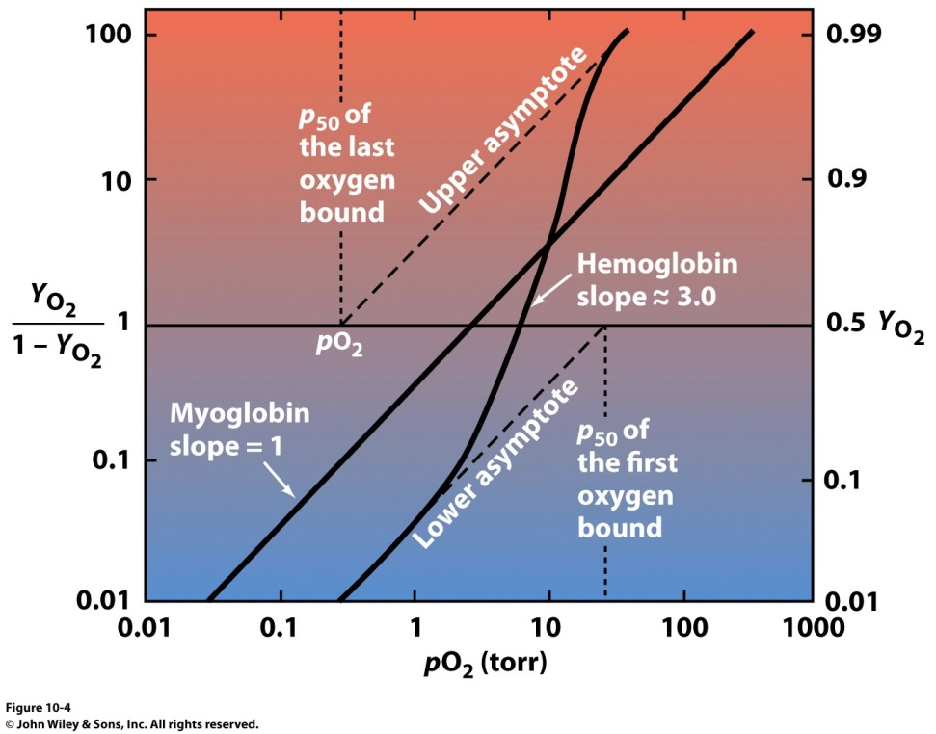
Modeling the Binding Curve
n = Hill coefficient
n > 1 → positive cooperativity
n = 1 → no cooperativity
n < 1 → negative cooperativity
Hb + nO₂ Hb(O₂)_{n}
$$K= \frac{\left[Hb\left(O2\right)n\right]}{\left[Hb\right]\left[O2\right]n}$$
Hill Equation
Linear form of Hill Equation
$$Y_{O2}=\frac{\left(pO2\right)n}{p50n+\left(pO2\right)n}$$
Rearranges to
$\log\left(\frac{Y_{O2}}{1−Y_{O2}}\right)=n log\left(pO2\right)$ - $n log\left(p50\right)$
K⁻¹
So binding of one O₂ influences the affinity of the subsequent O₂ binding events
log
Allosteric communication between subunits
log

Slide 14
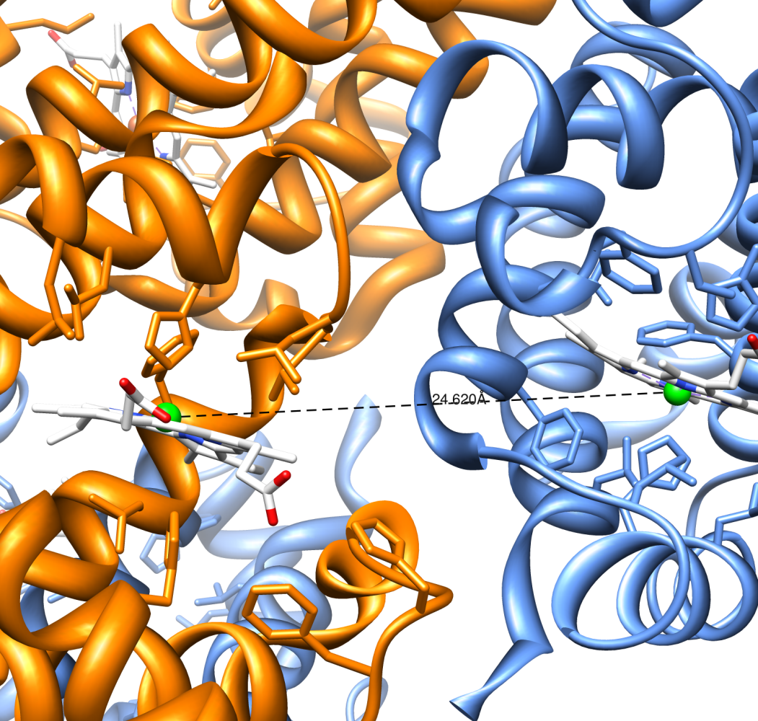
Structural Justification of Allostery

Slide 15
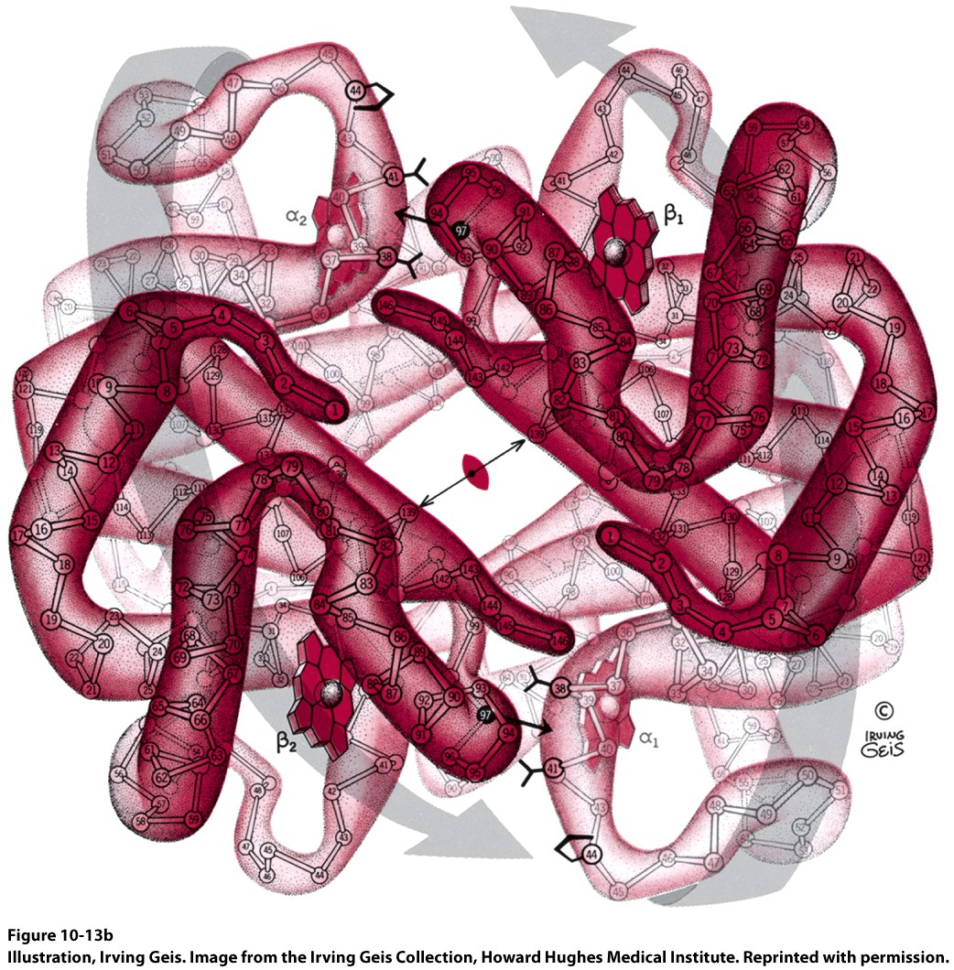
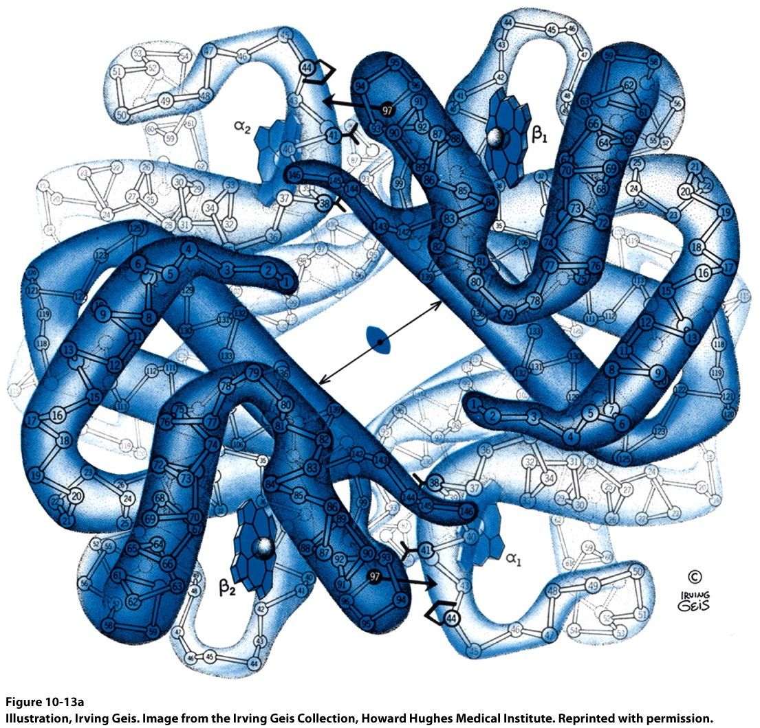
Structural Justification of Allostery
Oxygen binding to one subunit induces a large structural change
β−subunit
α−subunit
Deoxy form
Oxy form

Slide 16
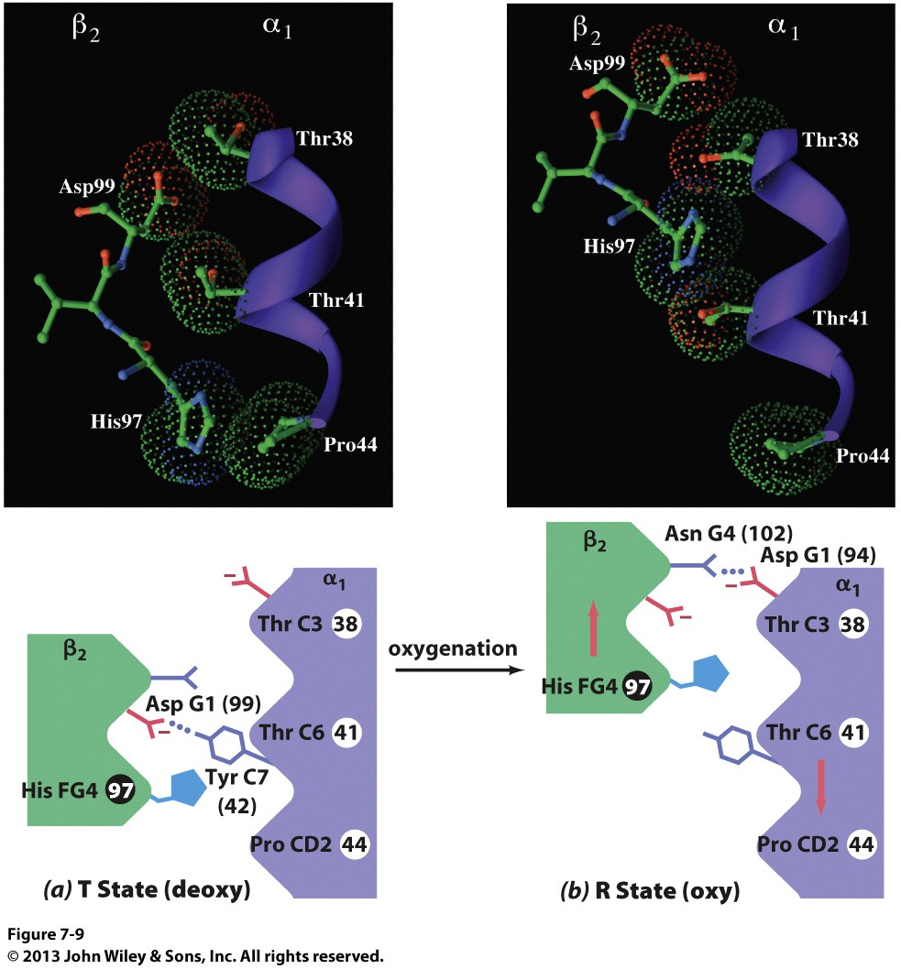
Structural Justification of Allostery

Slide 17
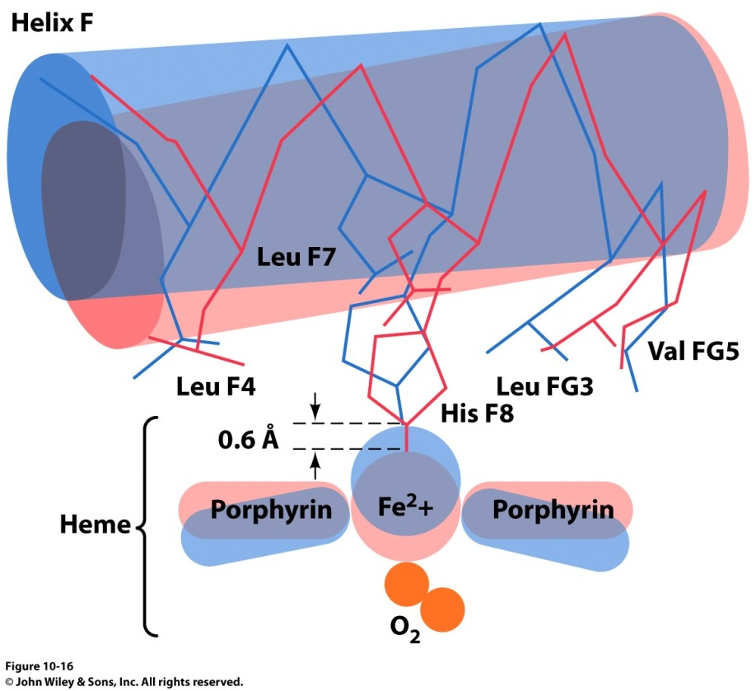
Structural Justification of Allostery
Structural change is triggered by O₂ binding induced adjustment of Fe²⁺ position
R-State
T-State

Slide 18
Structural Justification of Allostery
High Affinity Binding
Low Affinity Binding
Allosteric
Communication

Slide 19
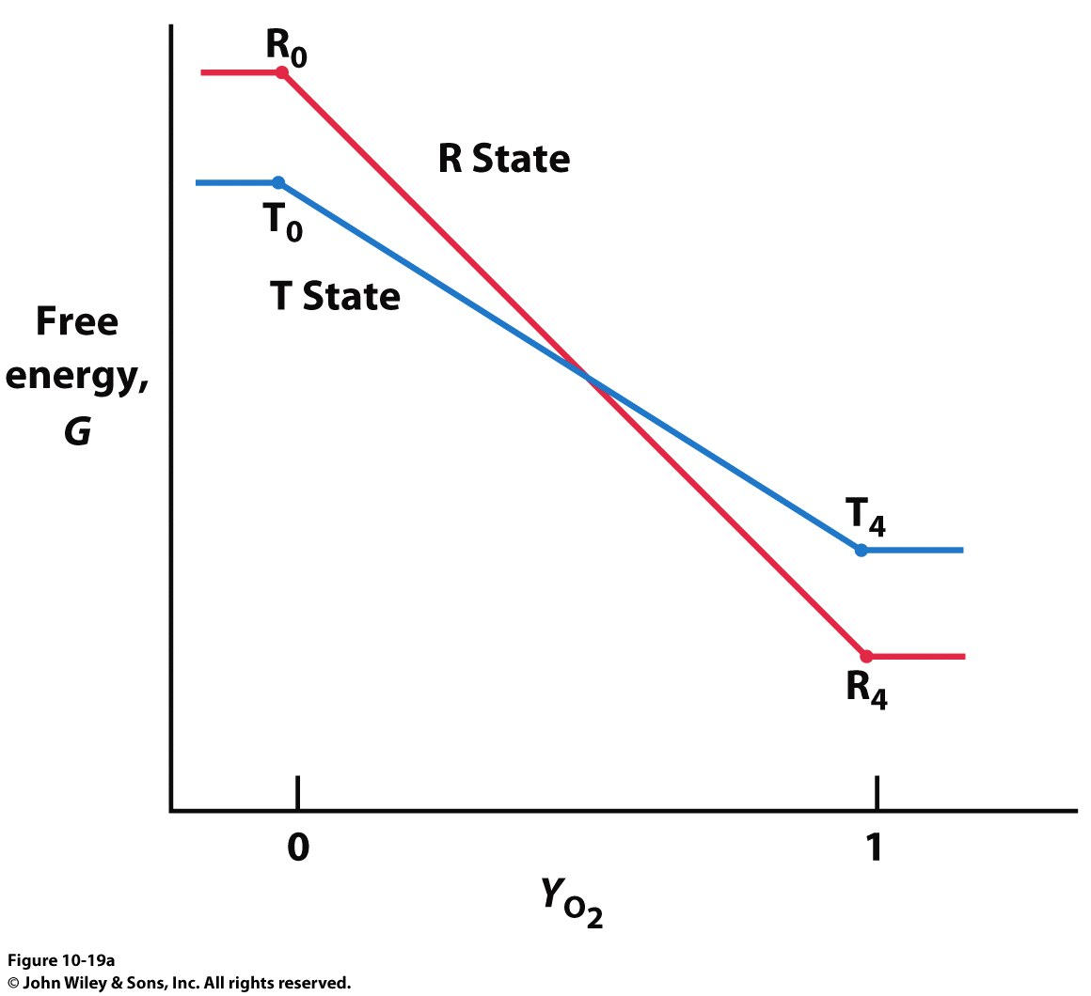
Structural Justification of Allostery

Slide 20
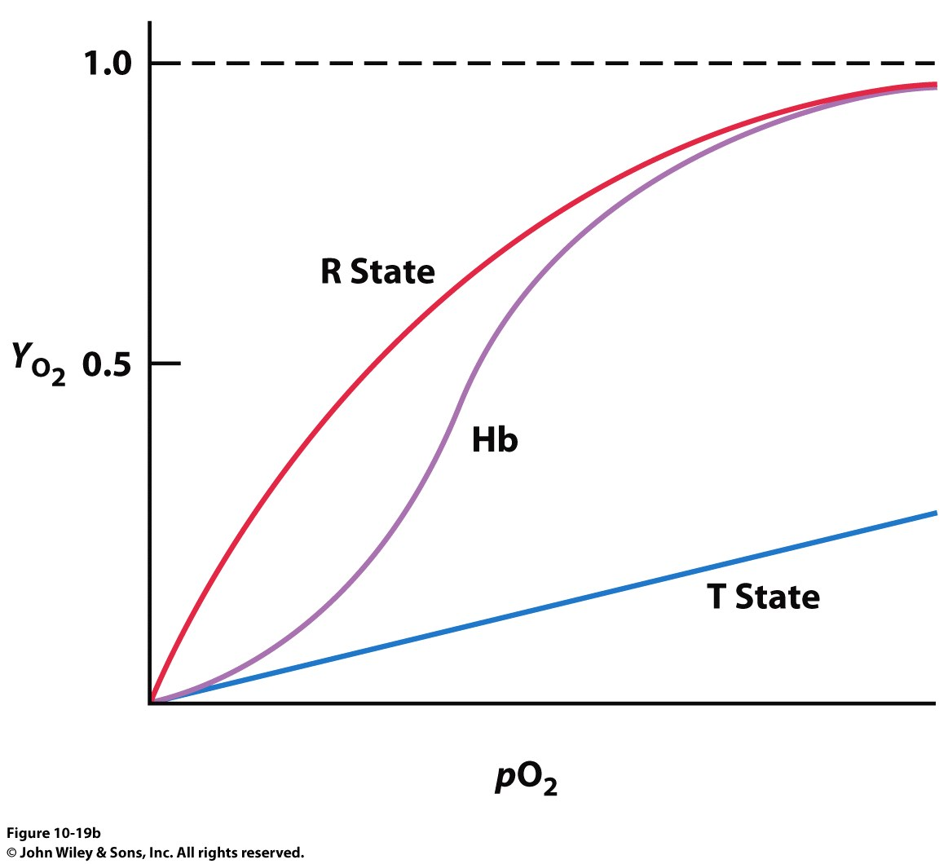
Structural Justification of Allostery

Slide 21
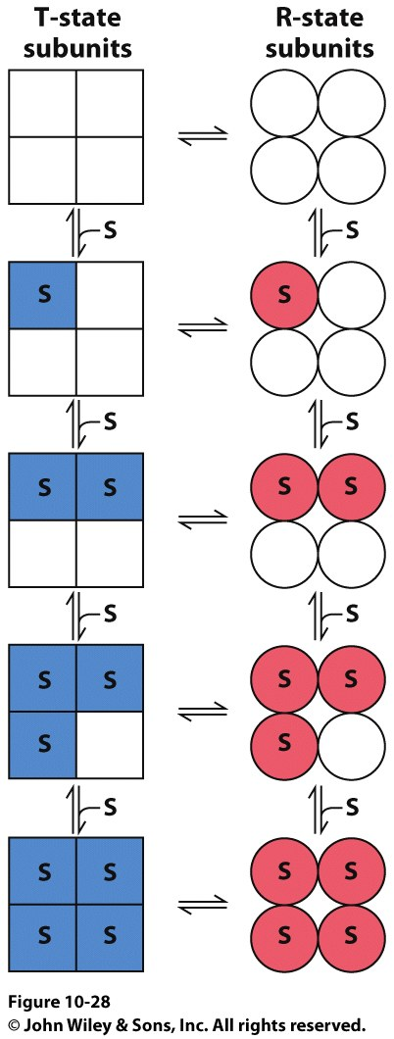
Models for Allostery in Hemoglobin
The Symmetry (Concerted) Model
Developed by Monod, Wyman and Changeaux (MWC Model)
Allosteric protein is an oligomer of subunits (protomers)
Each subunit can exist in two conformations
Only structural change can influence affinity
Symmetry of the molecule MUST be conserved

Slide 22
Models for Allostery in Hemoglobin
The Sequential (Induced Fit) Model
Developed by Koshland, Nemethy and Filmer (KNF Model)
Each subunit can exist in multiple conformations
Binding event triggers a conformation change to only that subunit
Conformational changes will be induced upon neighboring subunits
Symmetry of the molecule is not necessarily conserved
Allosteric
Communication

Slide 23
Models for Allostery in Hemoglobin
The Sequential (Induced Fit) Model
Developed by Koshland, Nemethy and Filmer (KNF Model)
Each subunit can exist in multiple conformations
Binding event triggers a conformation change to only that subunit
Conformational changes will be induced upon neighboring subunits
Symmetry of the molecule is not necessarily conserved

Slide 24
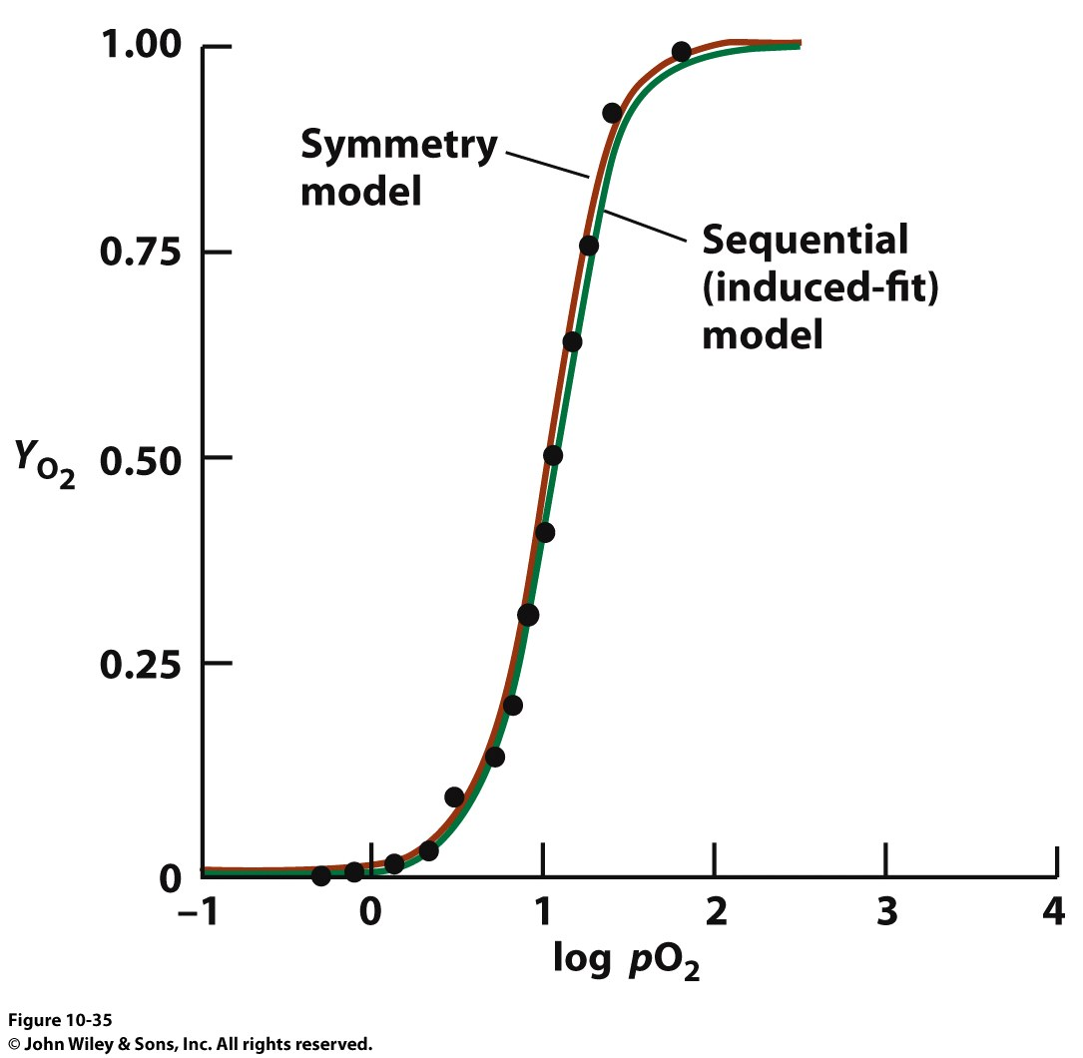
Models for Allostery in Hemoglobin

Slide 25
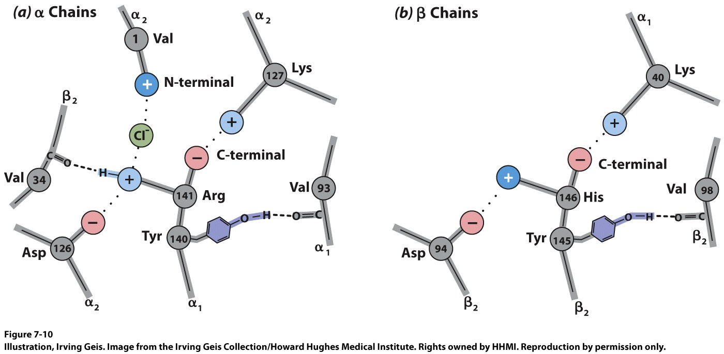
Ion pairing influences pKa values
T-State: Protonated side chains are involved in ion pairs → Higher pKa (so less deprotonated)
R-State: Ion pairs broken! pKa values decreased → net deprotonation
This suggests that O₂ binding will be pH sensitive!

Slide 26
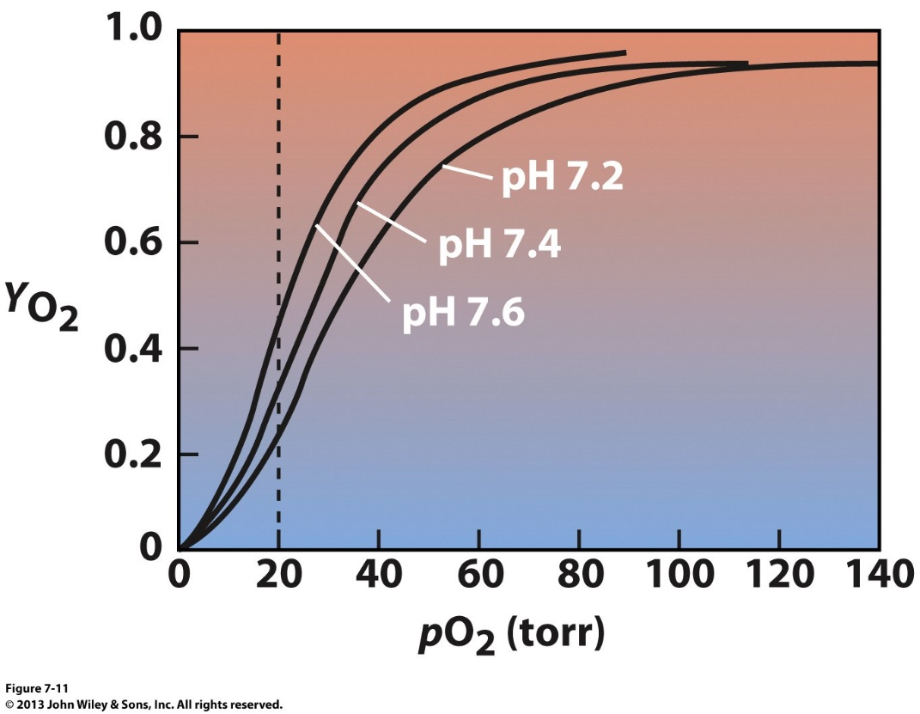
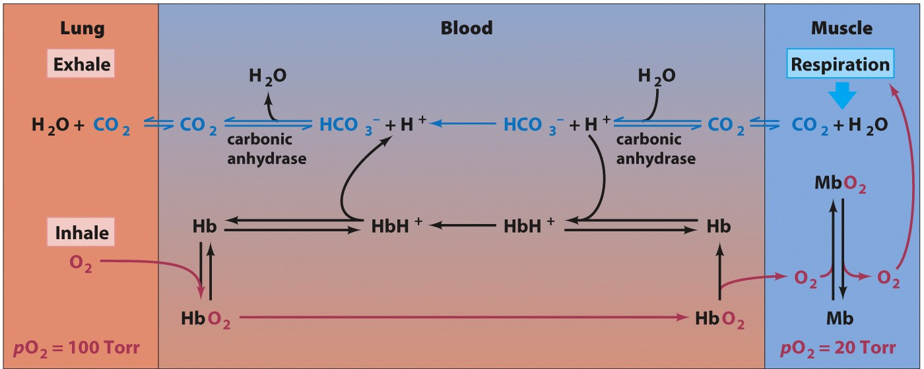
Modifying the Affinity: Bohr Effect
Hb + nO₂ Hb(O₂)_{n} + H⁺

Slide 27
Modifying the Affinity: Bohr Effect
Hb + nO₂ Hb(O₂)_{n} + xH+
Bicarbonate is the transportable form of CO₂
Carbonic Anhydrase
CO₂ + H₂0 HCO₃⁻ + H⁺
Artery
Production of CO₂ during metabolism in ultimately generate H⁺ in the capillaries.
This promotes release of O₂ from Hb(O₂)_{n}
Why is this important for highly active muscle tissue?
Hemoglobin
90% O₂ loaded
CO₂ produced
Hemoglobin
50% O₂ loaded
Vein

Slide 28
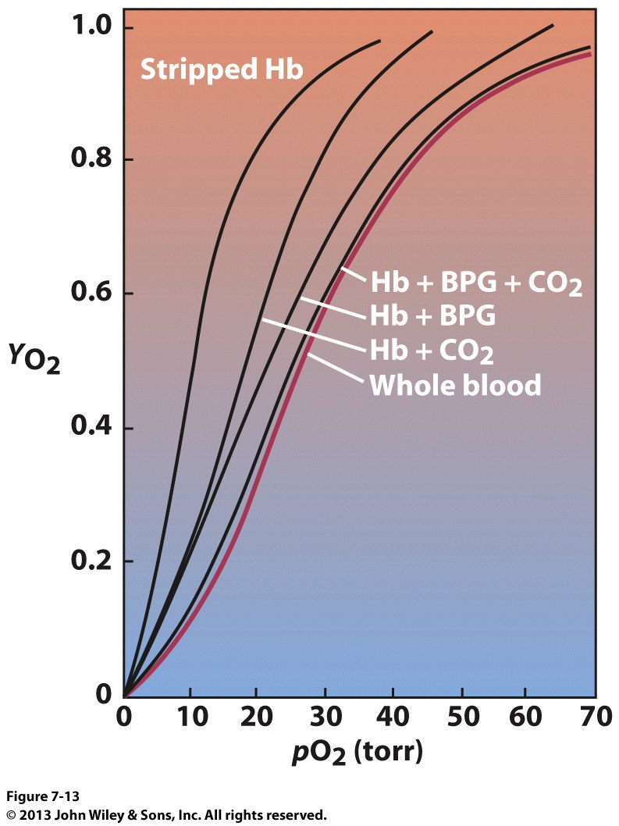
Modelling the Affinity in the Blood
Reference Form
Arterial pressure = 100 torr
Veinous pressure = 30 torr
Observed in blood
CO₂ → reacts with N-term to form carbamates (preferentially reacts with T state)
BPG (2,3-bisphosphoglycerate) → stabilizes T state

Slide 29
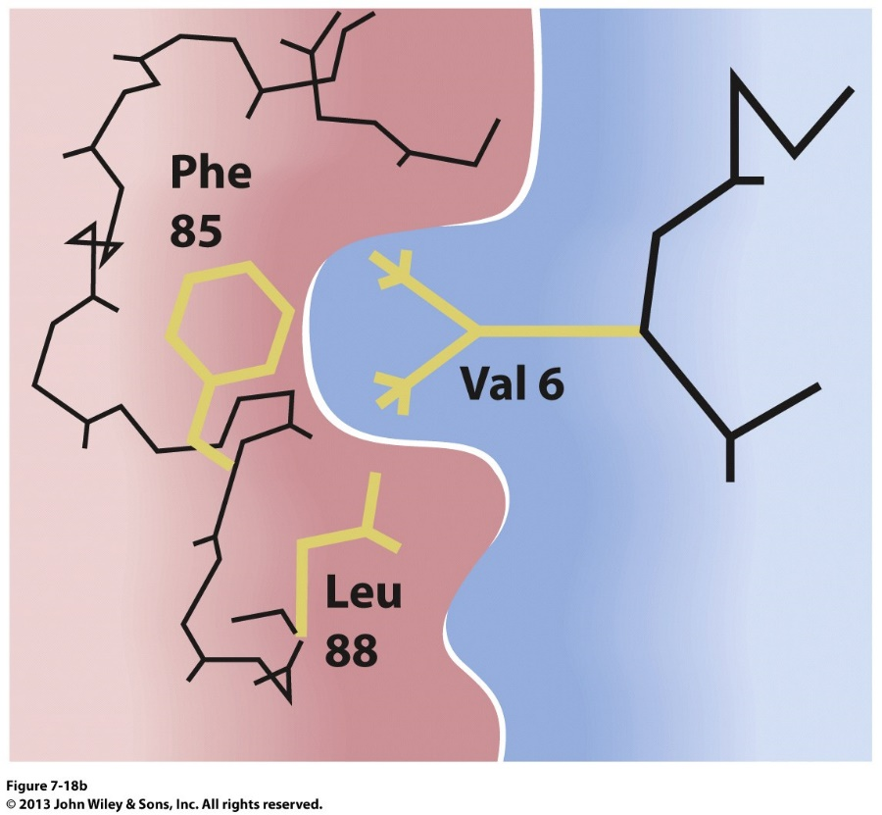
Hemoglobin and Sickle Cell Anemia

Slide 30
Self Check
If curve 3 represents the binding behavior of normal Hb in the presence of 5 mM BPG, which curve represents the binding behavior of Hb at 8 mM BPG?
100
1
2
3
4
None of the above
1
2
3
4
% saturation
0
pp oxygen (Torr)

Slide 31
Self Check
Which of the following statements about the oxygen binding site in myoglobin is FALSE?
Oxygen binds to myoglobin by forming an H bond with the distal histidine.
The heme prosthetic group is held in the heme binding pocket via hydrophobic interactions.
The proximal histidine partially blocks the oxygen binding site, forcing oxygen to bind at an angle.
The distal histidine helps to define the geometry of the oxygen binding site.

Slide 32
Self Check
Which of the following lines represents the binding of oxygen to Hb at pH 7.8 if the red line represents the binding of oxygen to Hb at pH 7.2?
100
The red line
The green line
The blue line
The dotted line
% saturation
0
pp oxygen (Torr)

Slide 33
Self Check
Which of the following is true regarding the ability of Hb to bind oxygen?
CO₂ promotes the release of oxygen
Salt bridges stabilize the deoxy form of Hb.
H⁺ and BPG stabilize the deoxy form of Hb.
B and C are true.
All the above are true.

Slide 34
Self Check
True or False?
Heme is a polypeptide group.
The proximal histidine interacts with O₂.
Myoglobin has quaternary structure.

