Slide 1
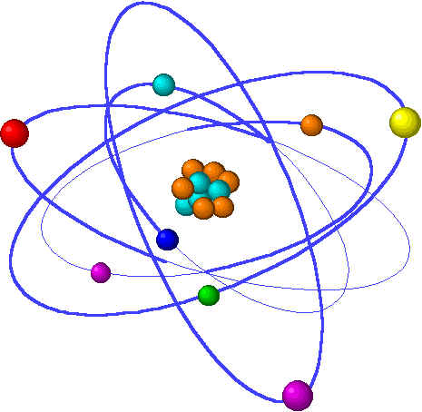
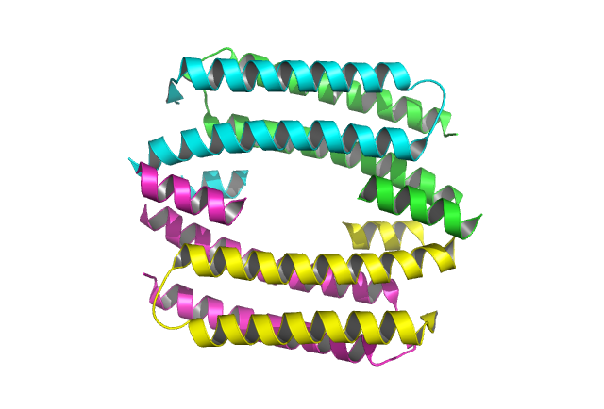
CONTROL OF COPPER RESISTANCE AND INORGANIC SULFUR METABOLISM BY PARALOGOUS REGULATORS IN STAPHYLOCOCCUS AUREUS
Nicholas E. Grossoehme

Slide 2
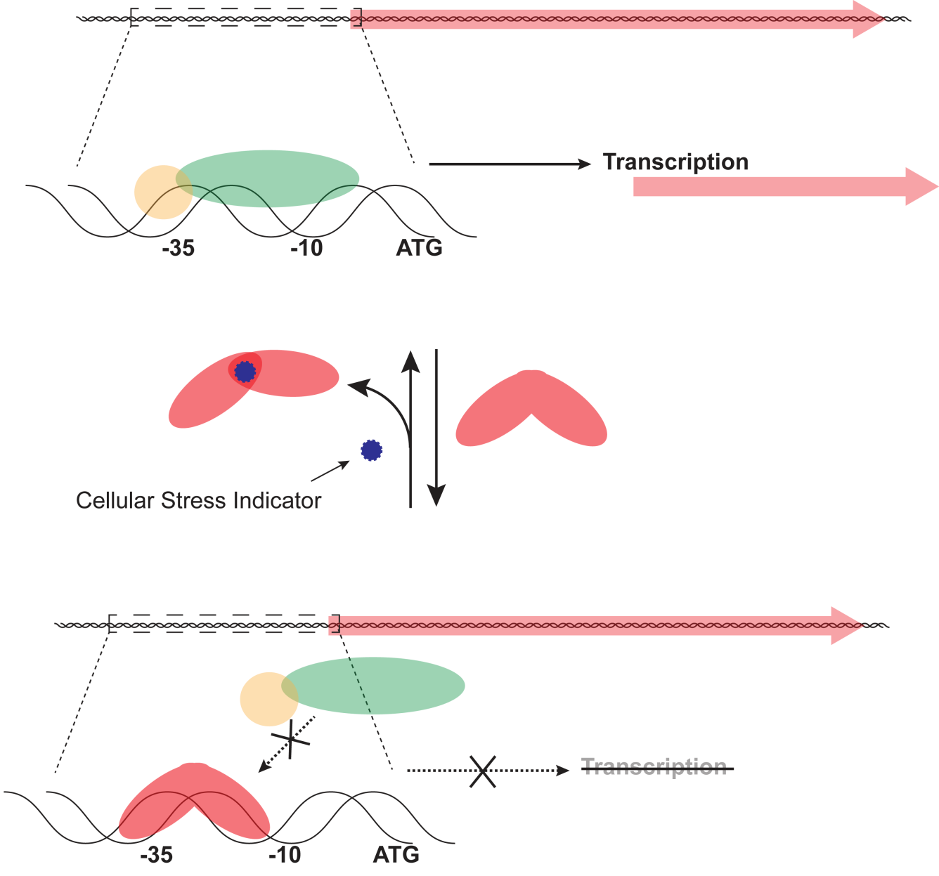
Transcriptional Repressors

Slide 3
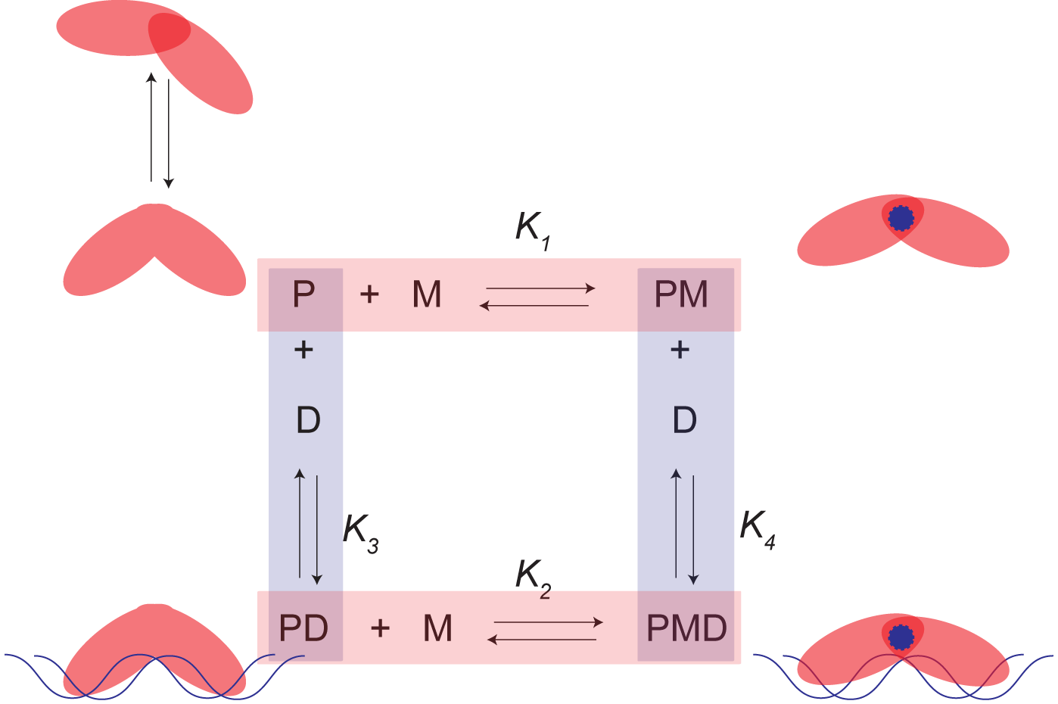
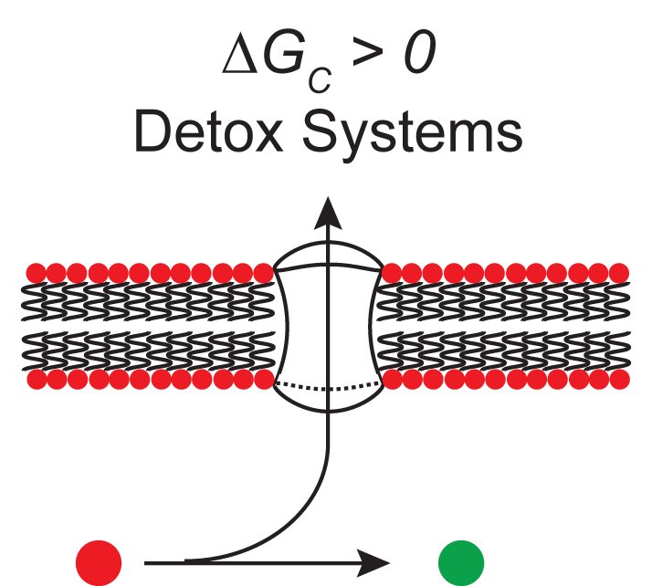
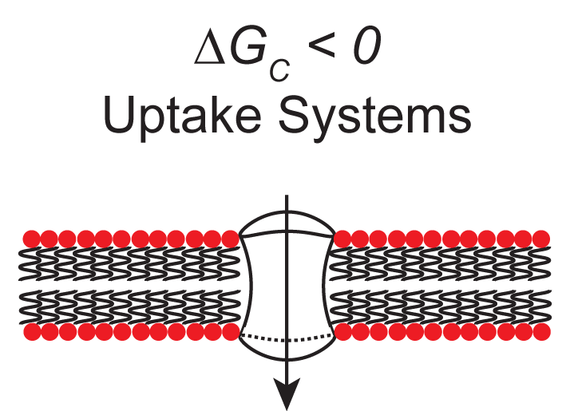
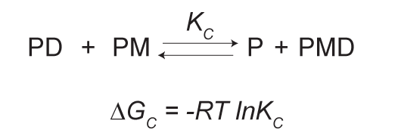
Allosteric Model of Transcriptional Control
Apoprotein is in a dynamic equilibrium between two binding conformations
Effector molecule stabilizes one conformation
DNA stabilizes one conformation
Ternary complex may or may not be stable

Slide 4
Allosteric Model of Transcriptional Control
Apoprotein is in a dynamic equilibrium between two binding conformations
Effector molecule stabilizes one conformation
DNA stabilizes one conformation
Ternary complex may or may not be stable
Determine as many equilibrium constants as possible
Investigate DNA binding modes and specificity
Determine induction molecule and mechanism
(Metal) coordination information

Slide 5
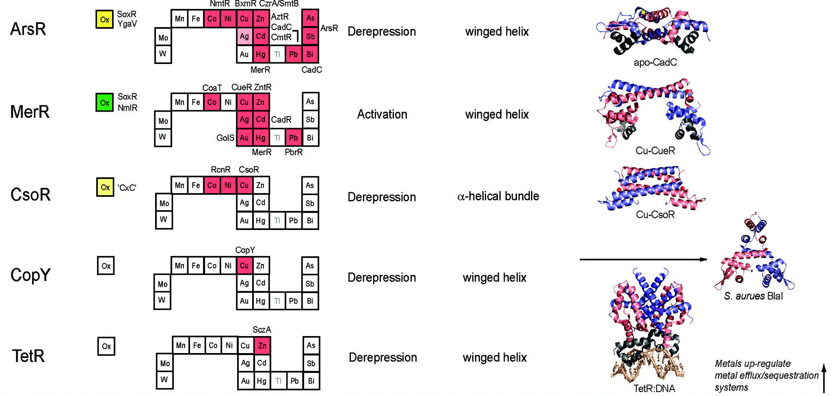
Metal regulatory protein families demonstrate adaptive evolution
Ma, Z., Jacobsen, F. E., and Giedroc, D. P. (2009) Chem Rev 109, 4644-4681

Slide 6
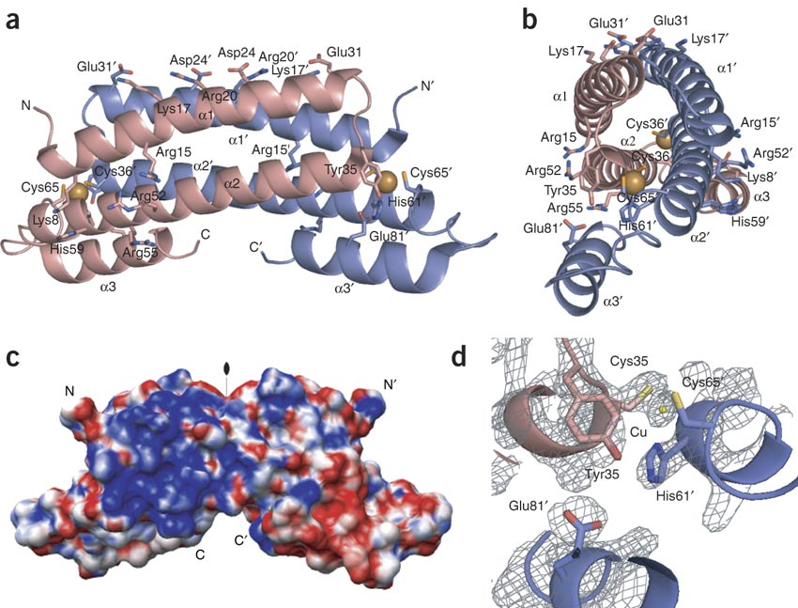
CsoR Family of Transcription Regulators
M. tuberculosis CsoR is the founding member of a new class of metal sensing transcriptional regulators
Liu, T., Ramesh, A., Ma, Z., Ward, S. K., Zhang, L., George, G. N., Talaat, A. M., Sacchettini, J. C., and Giedroc, D. P. (2007) Nat Chem Biol 3, 60-68

Slide 7
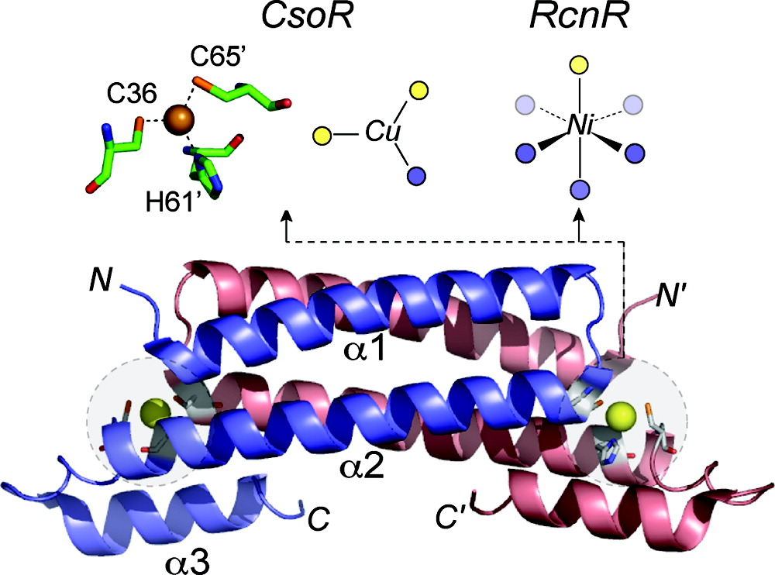
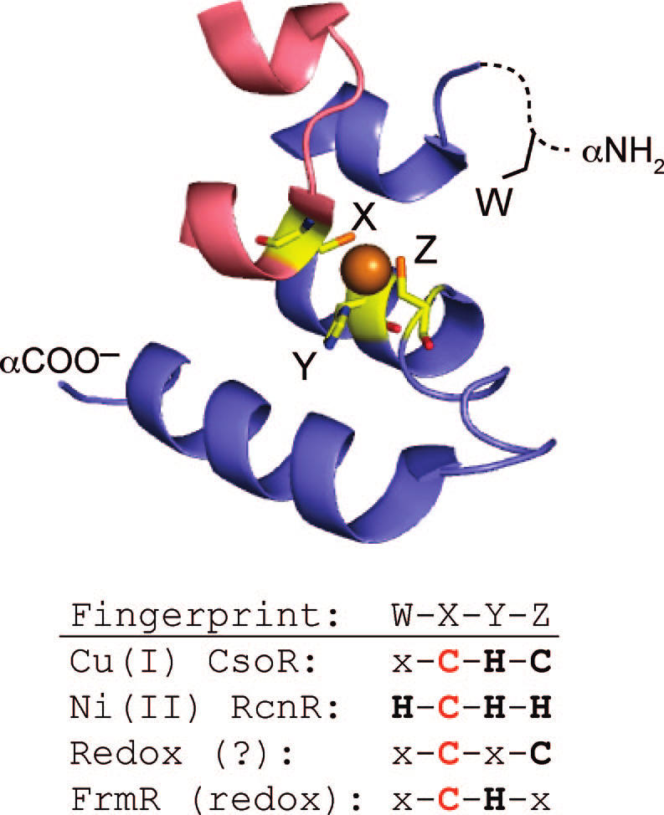
CsoR Family – Expanded Sensitivity
Allosteric inducer of CsoR family members can be predicted based on a 4 residue signature WXYZ
Ma, Z., Jacobsen, F. E., and Giedroc, D. P. (2009) Chem Rev 109, 4644-4681

Slide 8
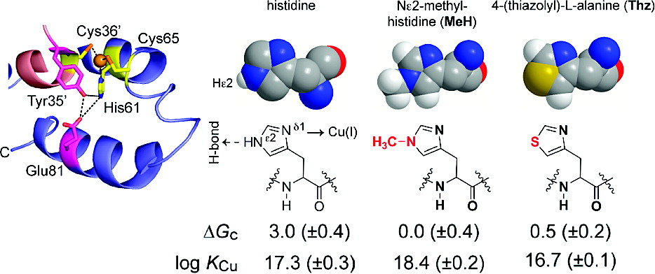
CsoR Family – mechanism of allosteric control
Removing H-bonding potential of the ε-N in the Cu-coordinating Histidine removes destroys allosteric communication.
) Ma, Z., Cowart, D. M., Ward, B. P., Arnold, R. J., DiMarchi, R. D., Zhang, L., George, G.
N., Scott, R. A., and Giedroc, D. P. (2009) J Am Chem Soc 131, 18044-18045

Slide 9
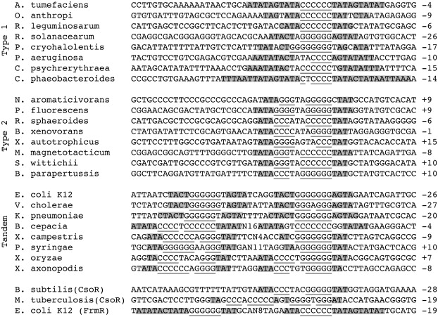
CsoR regulators selectively binds to DNA with a GC-tract
Three types of specific binding motifs have been found for CsoR family members.
All contain a core of GC base pairs.
Iwig, J. S., Leitch, S., Herbst, R. W., Maroney, M. J., and Chivers, P. T. (2008) J Am Chem Soc 130, 7592-7606

Slide 10
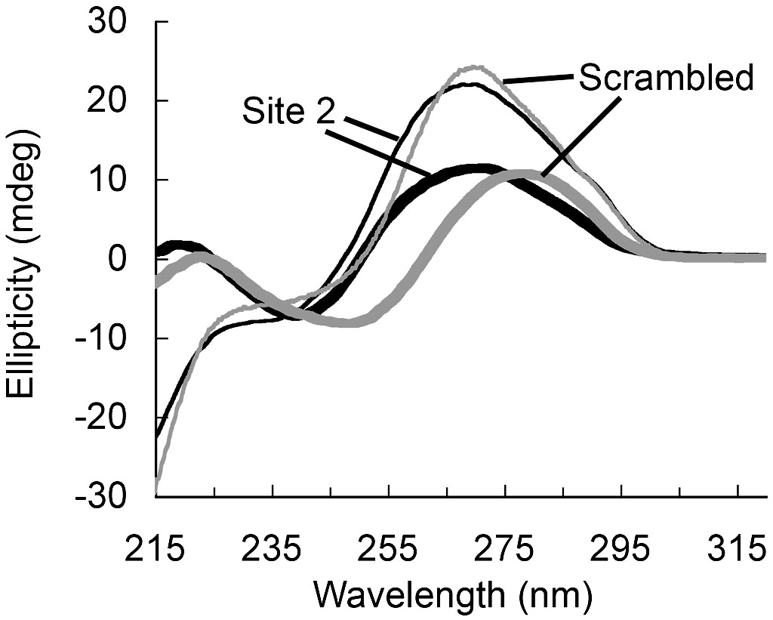
CsoR regulators selectively binds to DNA with a GC-tract
GC-tracts promote A-form DNA resulting in A-B DNA helical junctions
A-form DNA is characterized by a transition from (+) → (-) helicity at 250 nm and more intense maximum ~270
RncR binding region possess A-form DNA characteristics
Iwig, J. S., Leitch, S., Herbst, R. W., Maroney, M. J., and Chivers, P. T. (2008) J Am Chem Soc 130, 7592-7606

Slide 11
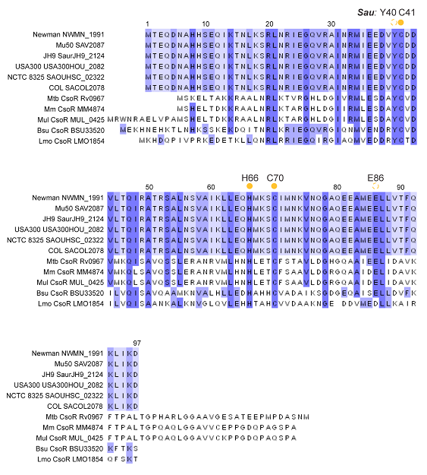
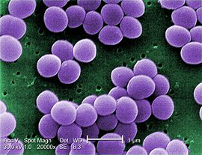
S. aureus encodes a putative CsoR
Staphylococcus aureus is an opportunistic gram positive human pathogen
Associate with a wide range of hospital and community-acquired diseases
Increasing prevalence of methicillin resistance in low incidence areas

Slide 12
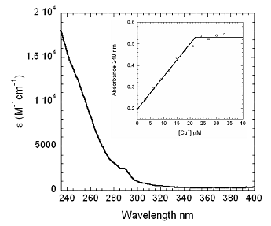
CsoR binds stoichiometric Cu(I)
Sau CsoR bind one copper ion per monomer
Conditions:
20 μM CsoR monomer
10 mM HEPES, 0.2 M NaCl, pH 7.0

Slide 13
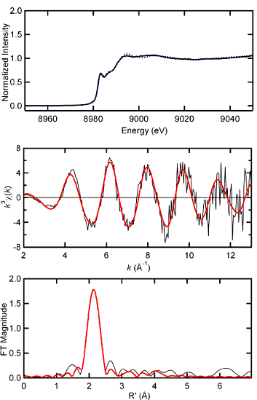
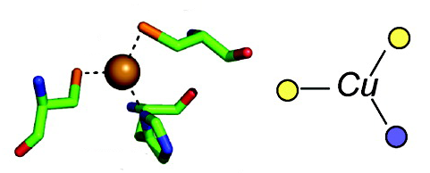
CsoR binds Cu(I) with trigonal S₂N geometry
8980 eV K-edge is consistent with a three coordinate Cu(I) 1s →4p transition
Shell | R_{as} | σ_{as}²
 | (Å) | (Å²)
Cu-S₂ | 2.20 | 0.0028
Cu-N₁ | 2.01 | 0.0016
Cu-C₁ | [2.99] | [0.0032]
Cu-C₁ | [3.04] | [0.0033]
Cu-N₁ | [4.17] | [0.0020]
Cu-C₁ | [4.22] | [0.0020]

Slide 14
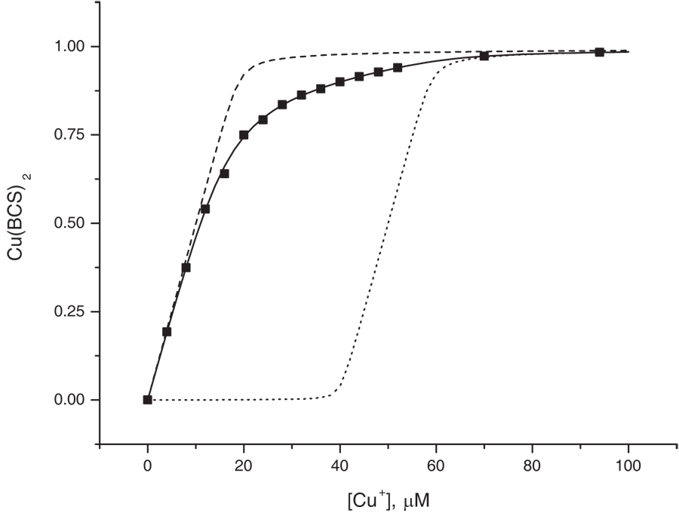
Assessing the Cu(I) – CsoR binding constant
K_{protein} << β_{BCS}
K_{protein} >> β_{BCS}
K_{protein} ≈ β_{BCS}

Slide 15
Assessing the Cu(I) – CsoR binding constant
CsoR | log K_{Cu} | reference
Wild-type Sau | 18.1 ±0.5 | this work
C41A Sau | 15.3 ±0.3 | this work
H66A Sau | 14.5 ±0.1 | this work
Wild-type Mtb | 18.0 ±0.2 | (1)
H61A Mtb | 14.7 ±0.4 | (1)
Wild-type Bsu | ≥19.0 | (2)
(1) Ma, Z., Cowart, D. M., Ward, B. P., Arnold, R. J., DiMarchi, R. D., Zhang, L., George, G.
N., Scott, R. A., and Giedroc, D. P. (2009) J Am Chem Soc 131, 18044-18045
(2) Ma, Z., Cowart, D. M., Scott, R. A., and Giedroc, D. P. (2009) Biochemistry 48, 3325-3334

Slide 16
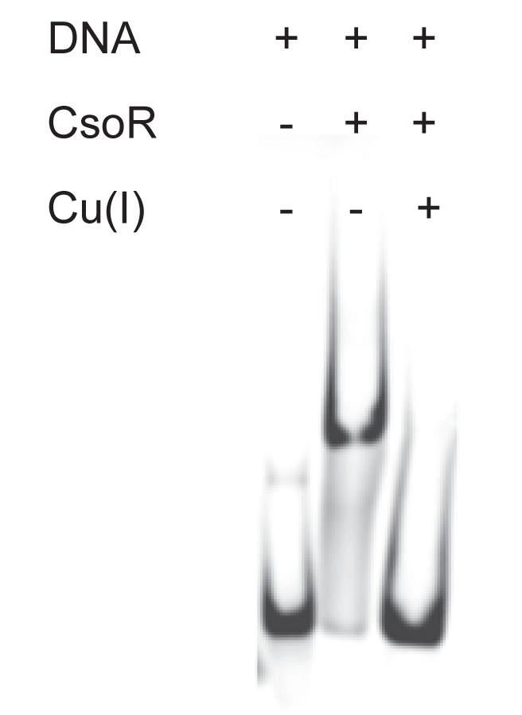
CsoR binds to copA promoter region
Conditions:
0.5 μM DNA
5 μM CsoR monomer
Preloaded Cu(I) (stiochiometric)
10 mM HEPES, 0.2 M NaCl, pH 7.0
6% polyacrylamide gel in TBE

Slide 17
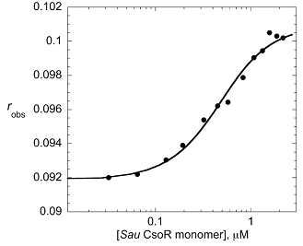
CsoR binds to copA promoter region
Conditions:
10 nM DNA
20 mM HEPES, 0.2 M NaCl, pH 7.0
K_{tet} = 3 x 10⁷ M⁻¹

Slide 18
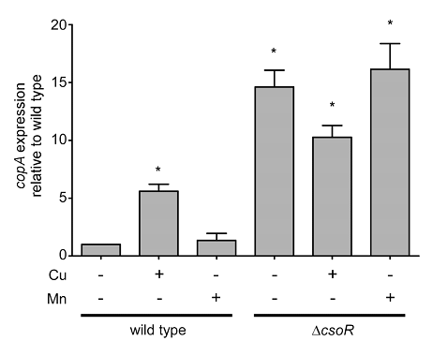
CsoR is the biological regulator of copA
copA levels are increase ~6x when 1 mM CuCl₂ is added to the media.
copA is constitutively on in a ΔcsoR mutant and is unresponsive to metals

Slide 19
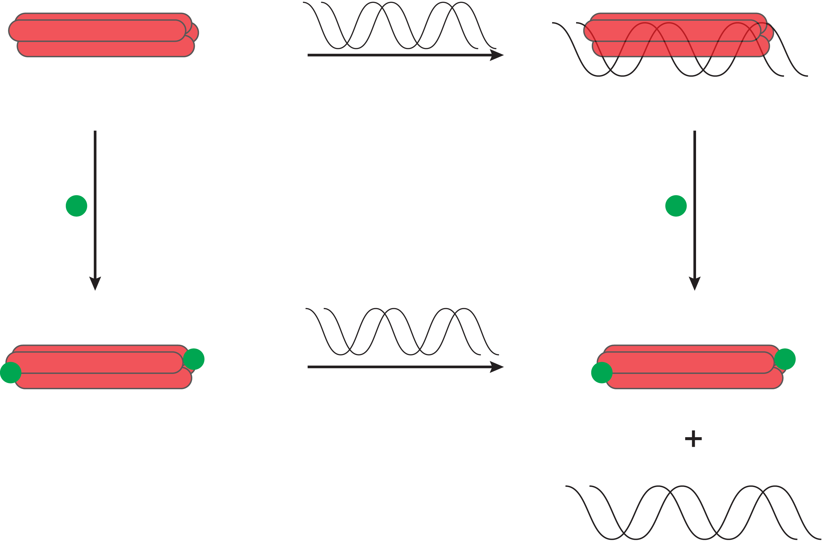
CsoR is a Cu(I) sensitive repressor of copA
K_{tet} = 3 x 10⁷ M⁻¹
K = 1.26 x 10¹⁸ M⁻¹

Slide 20
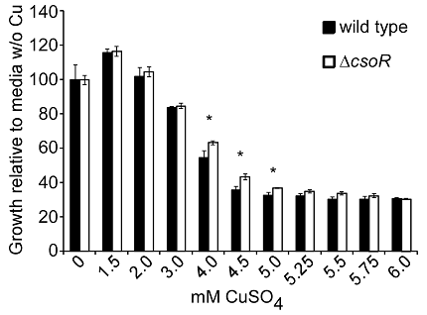
ΔcsoR confers modest copper tolerance
Deleting csoR
Detoxification system always on
Confers some tolerance to S. aureus

Slide 21
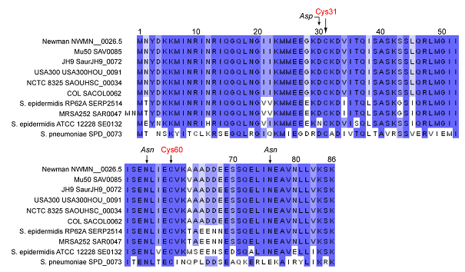
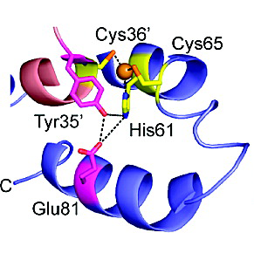
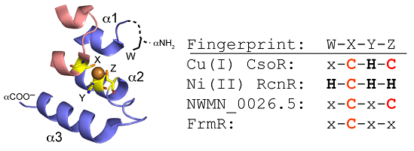
All strains of S. aureus contains a second CsoR
As compared to CsoR
35% Identical
60% Similar

Slide 22
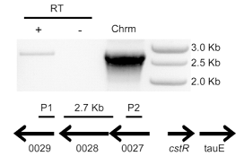
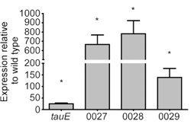
NWMN_0026.5 regulates 0026 → 0029
Δ0026.5
0027 → 0029 constitutes a polycistronic operon in S. aureus under the control of NWMN_0026.5
Amplified cDNA template prepared from Δ0026.5

Slide 23
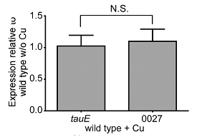
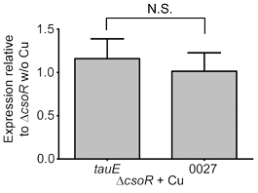
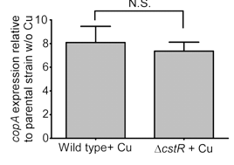
The cstR operon is unresponsive to copper
No measurable change in the mRNA levels of tauE when under copper stress
copA mRNA (regulated by the copper sensing CsoR) is not effected by ΔcstR

Slide 24
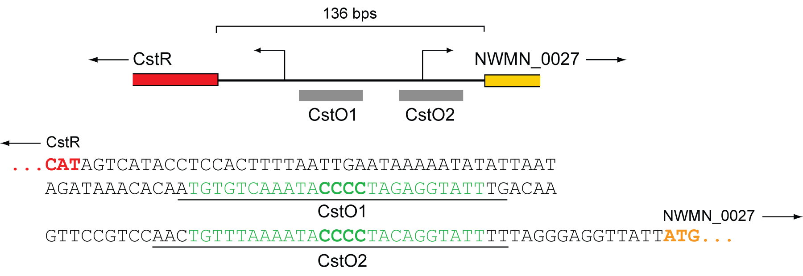
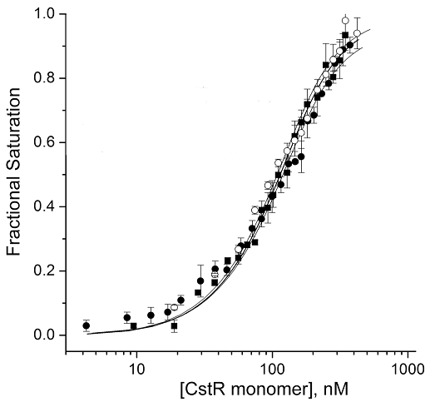
The intergenic region contains two CsoR binding candidates
Conditions:
10 nM dsDNA
20 mM HEPES, 0.2 M NaCl, pH 7.0

Slide 25
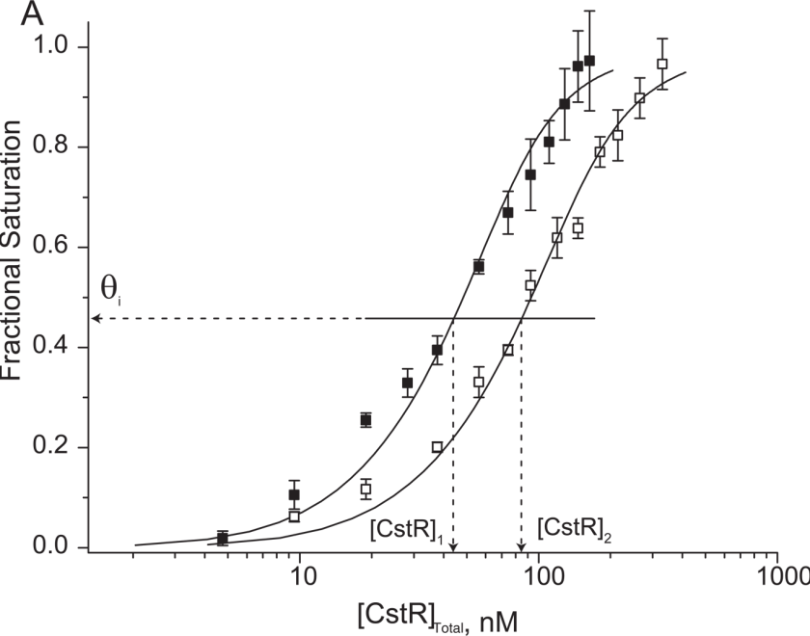
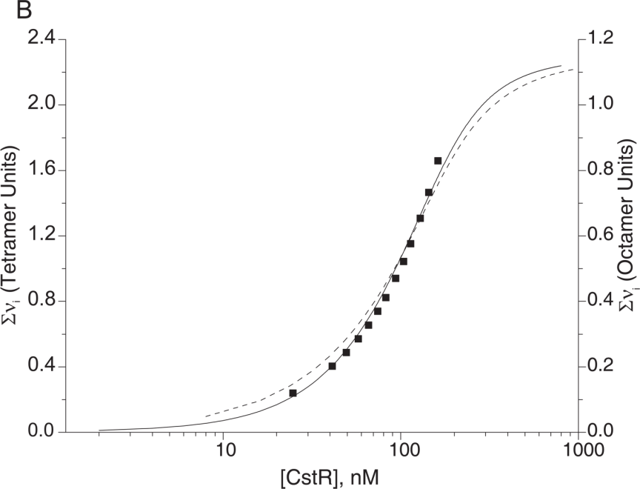
Two CstR tetramers bind to CstO1
Model-independent analysis of CstR binding to CstO1 demonstrates that two CsoR tetramers interact the 28 bp dsDNA sequence
Number of ligands (CstR) bound to macromoluecule (DNA)

Slide 26
The intergenic region contains two CsoR binding candidates
DNA | r_{o} | r_{complex} | K₁ (x 10⁷ M⁻¹) | K₂ (x 10⁷ M⁻¹) | K_{tet} (x 10⁷ M⁻¹)
OP1 | 0.129 | 0.226 | 0.7 (±0.3) | 55 (±5) | 27 (±5)
OP2 | 0.142 | 0.221 | 2.4 (±0.1) | 18 (±9) | 10 (±9)
OP1_5GC | 0.112 | 0.148 | 3 (±1) | 13 (±4) | 8 (±4)

Slide 27
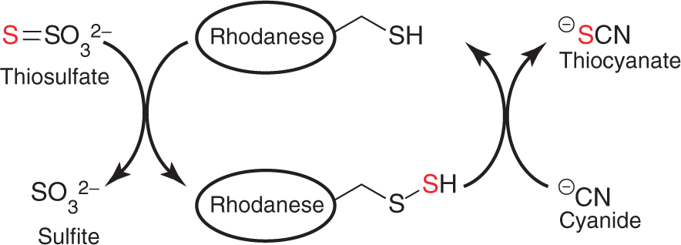
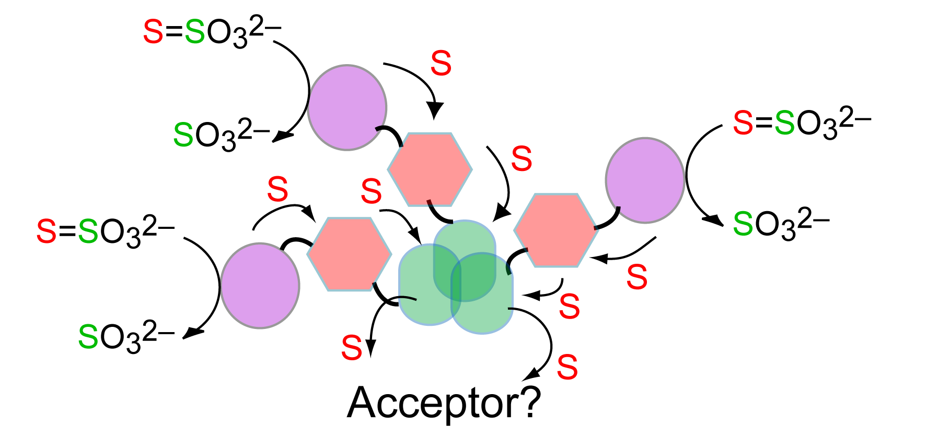
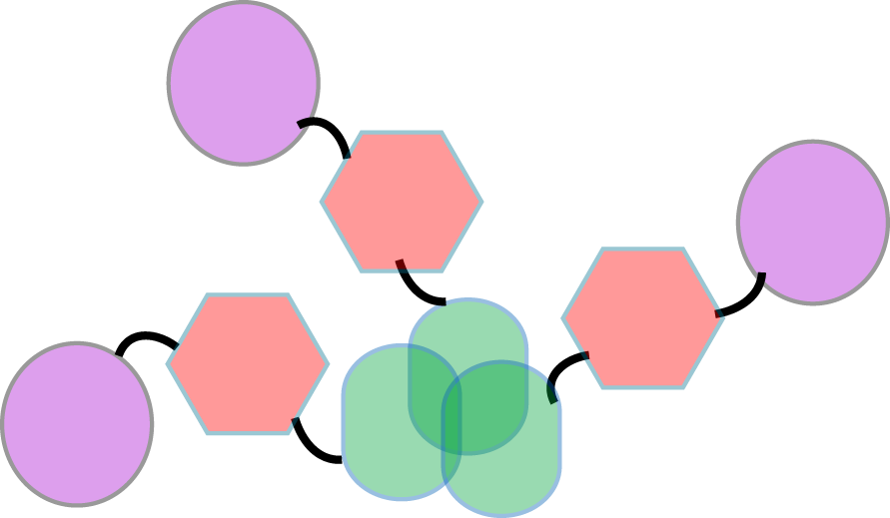
NWMN_0026.5 genetic neighborhood
Lacks metallo-responsive signature
Sulfite Export
TauE
SO₃²⁻ is toxic to S. aureus
Rhodanese
TusA
DsrE
Sulfur Transfer

Slide 28
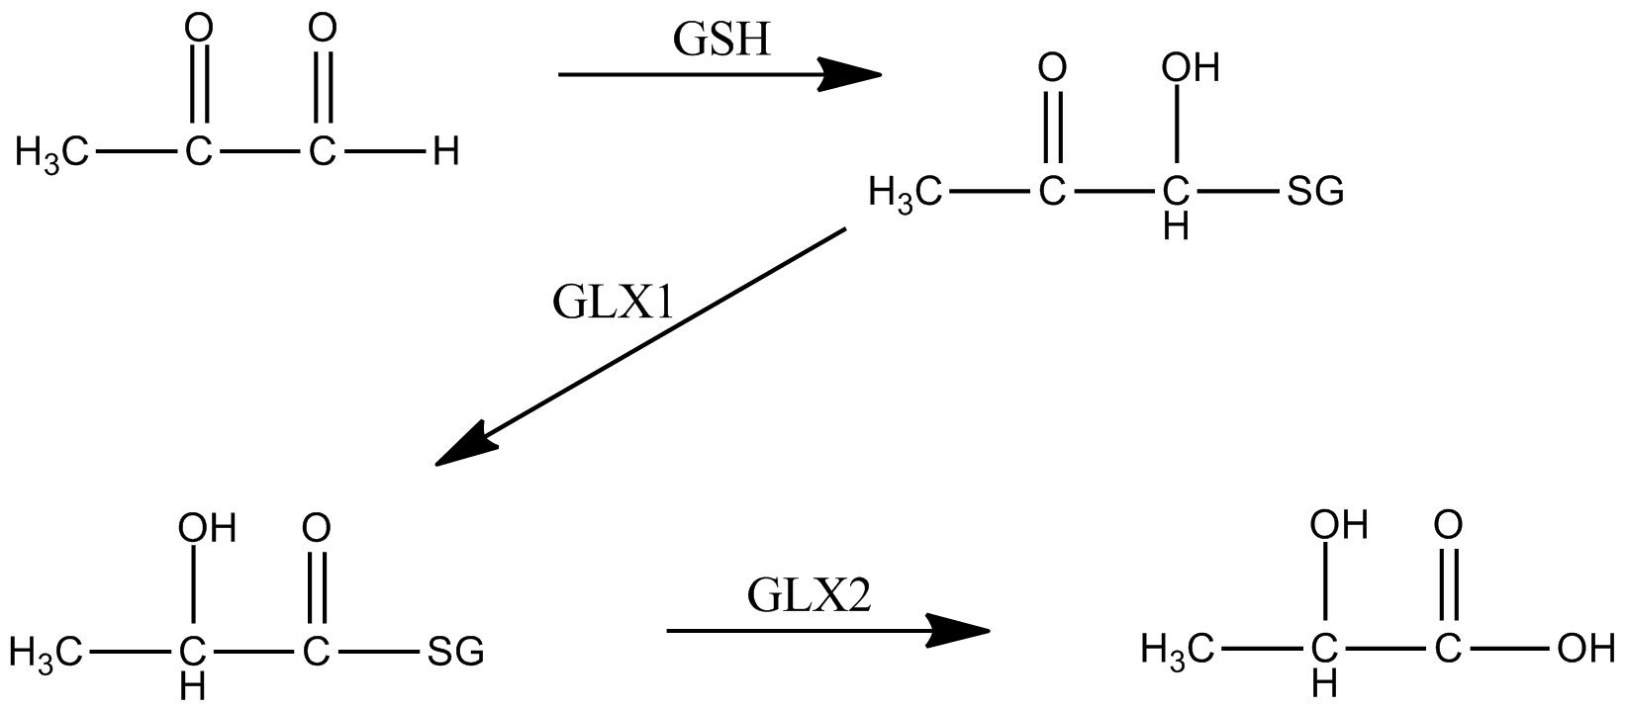
NWMN_0026.5 genetic neighborhood
Sulfite Export
TauE
SO₃²⁻ is toxic to S. aureus
Rhodanese
TusA
DsrE
Sulfur Transfer
GloB
Rhodanese
Glyoxylase II
Involved in detoxificaion of several cytotoxic 2-oxo-aldehydes
Traditionally mechanism uses of glutathione

Slide 29
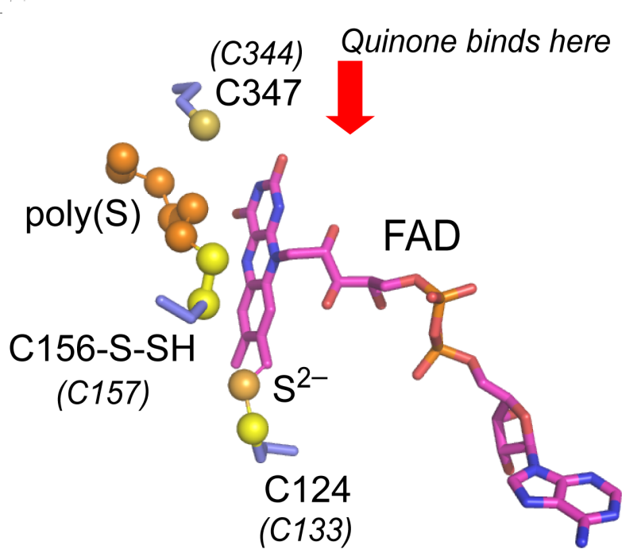
NWMN_0026.5 genetic neighborhood
CsoR-like Sulfur Tranfer Regulator
Sulfite Export
TauE
CstR
CstA
CstB
CstC
SO₃²⁻ is toxic to S. aureus
Predicted quinone-binding FAD-containing enzyme
Q_{ox} + S²⁻ → S˚ + Q_{red} ?
Rhodanese
TusA
DsrE
Sulfur Transfer
GloB
Rhodanese
Glyoxylase

Slide 30
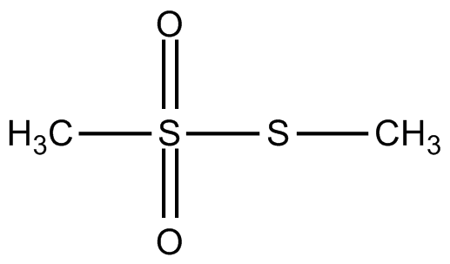
Reaction with sulfite results in a cysteine modification
Protein | reactant | M_{r} observed (D) | assignment | Expected modification | M_{r} expected^{b} (D)
CstR | No addition | 9640.7 | – | – | 9641.2
 | Na₂S₂O₃ | 9640 | n.r.^{c} | –SH (x2) | 9673.2 (9705.2)
 | Na₂S | 9640 | n.r. | –SH (x2) | 9673.2 (9705.2)
 | Na₂SO₃ | 19280 19312 19344 | CstR₂^{S–S} CstR₂^{S–S–S} ^{d}CstR₂^{(S–S–S)2} | CstR₂^{S–S} CstR₂^{S–S–S} ^{d}CstR₂^{(S–S–S)2} | 19280.4 19312.4 19344.4
 | MMTS^{e} | 9732 | –SCH₃ x2 | –SCH₃ (x2) | 9733.2

Slide 31
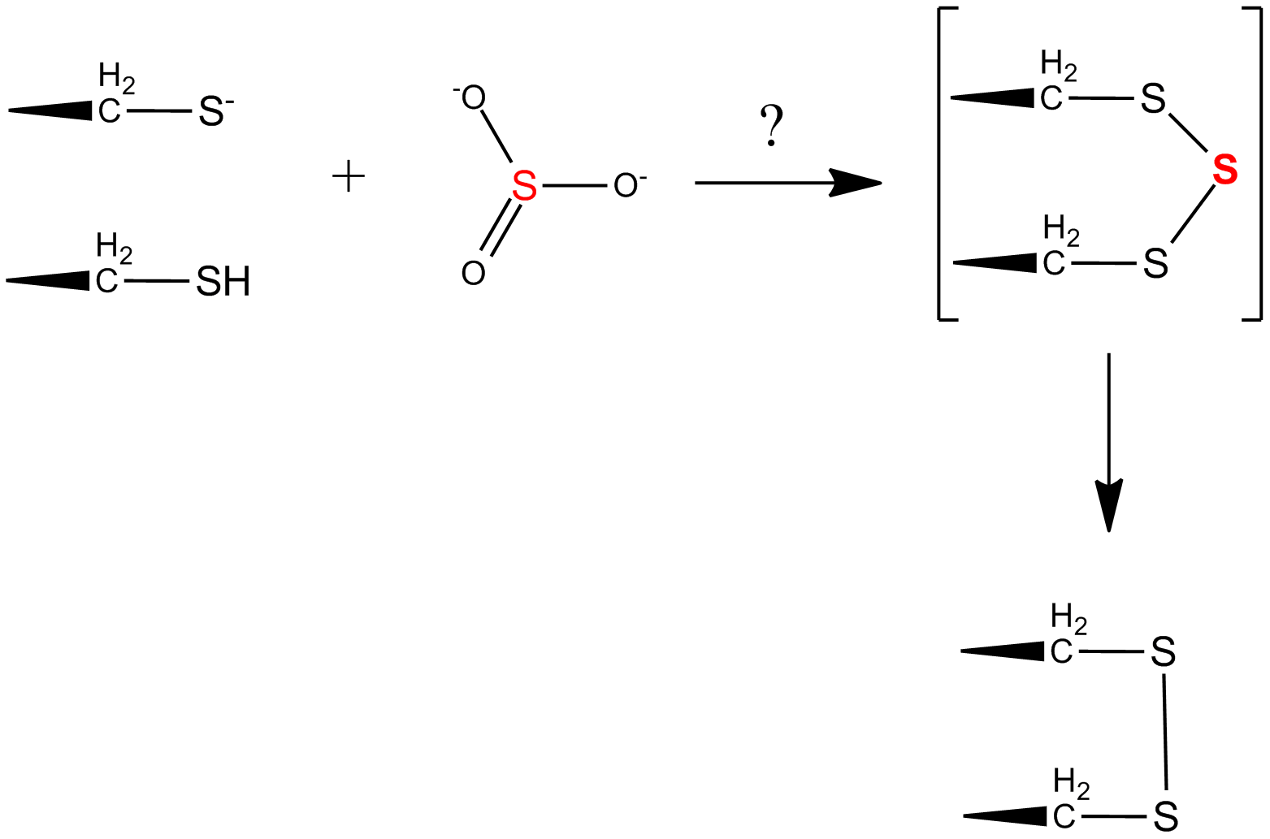
Reaction with sulfite results in a cysteine modification
Protein | reactant | M_{r} observed (D) | assignment | Expected modification | M_{r} expected^{b} (D)
CstR | No addition | 9640.7 | – | – | 9641.2
 | Na₂S₂O₃ | 9640 | n.r.^{c} | –SH (x2) | 9673.2 (9705.2)
 | Na₂S | 9640 | n.r. | –SH (x2) | 9673.2 (9705.2)
 | Na₂SO₃ | 19280 19312 19344 | CstR₂^{S–S} CstR₂^{S–S–S} ^{d}CstR₂^{(S–S–S)2} | CstR₂^{S–S} CstR₂^{S–S–S} ^{d}CstR₂^{(S–S–S)2} | 19280.4 19312.4 19344.4
 | MMTS^{e} | 9732 | –SCH₃ x2 | –SCH₃ (x2) | 9733.2

Slide 32
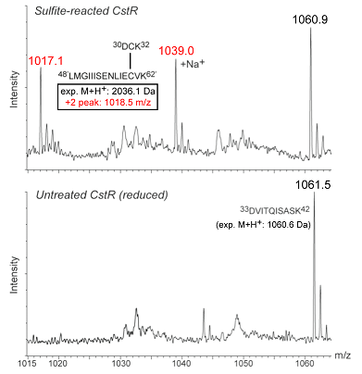
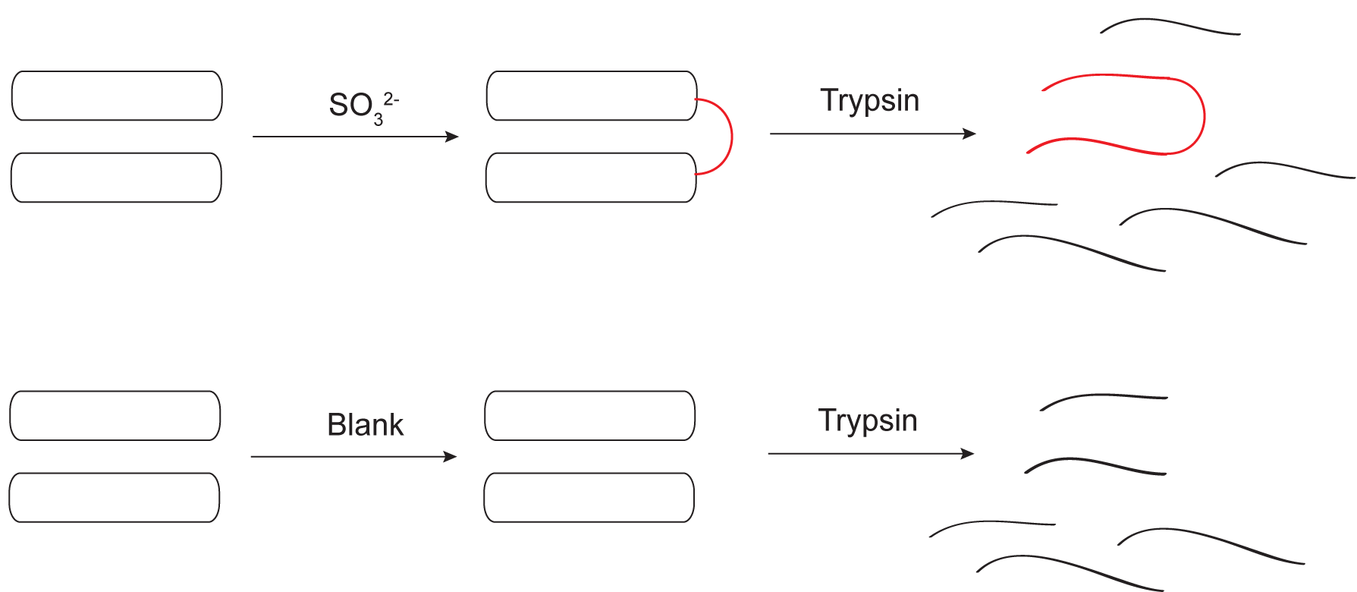
Reaction with sulfite results in a cysteine modification

Slide 33
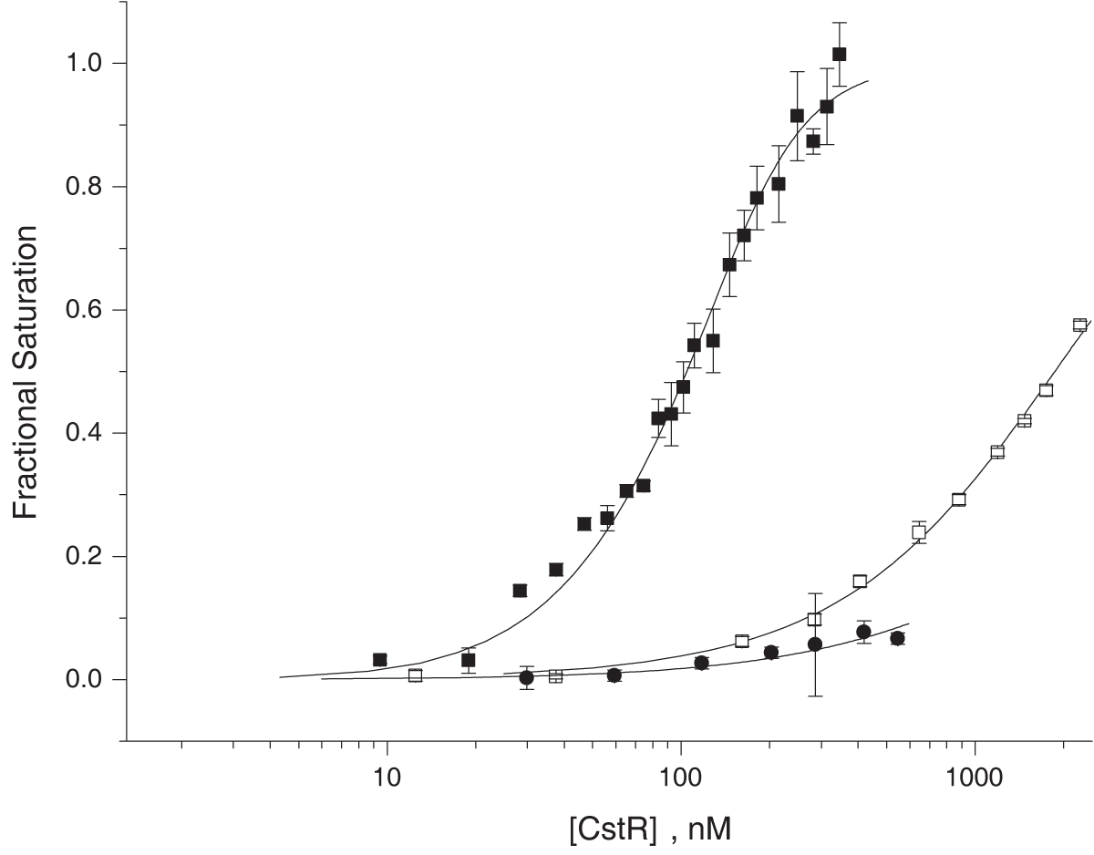
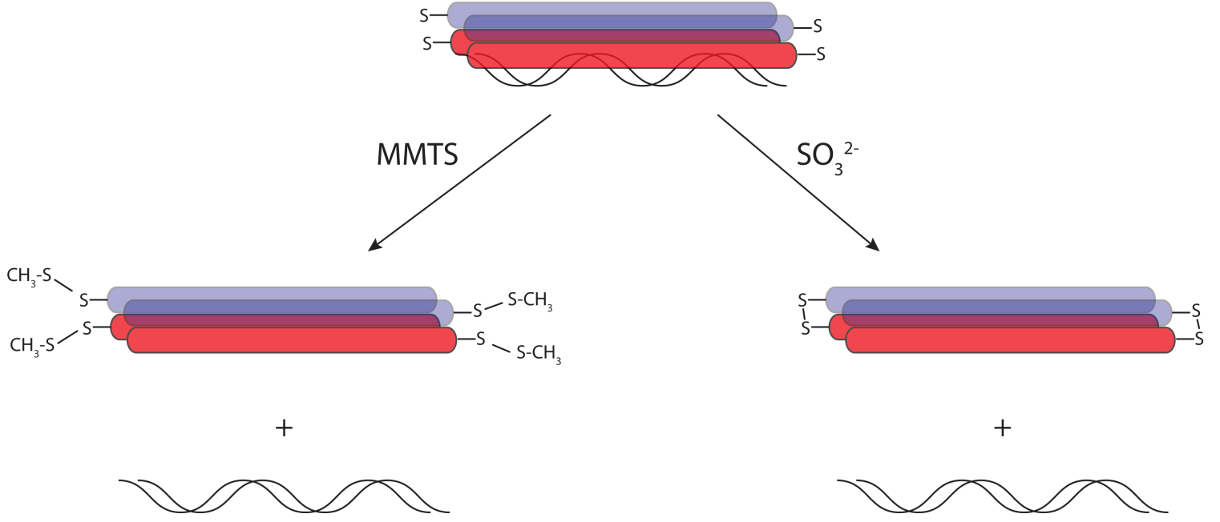
Modified CstR is DNA-binding incompetent
Untreated
Modifying the cysteine residues on CstR by methylpersulfide formation or oxidation results in dramatically reduced DNA binding affinity
Sulfite Treated
MMTS Treated

Slide 34
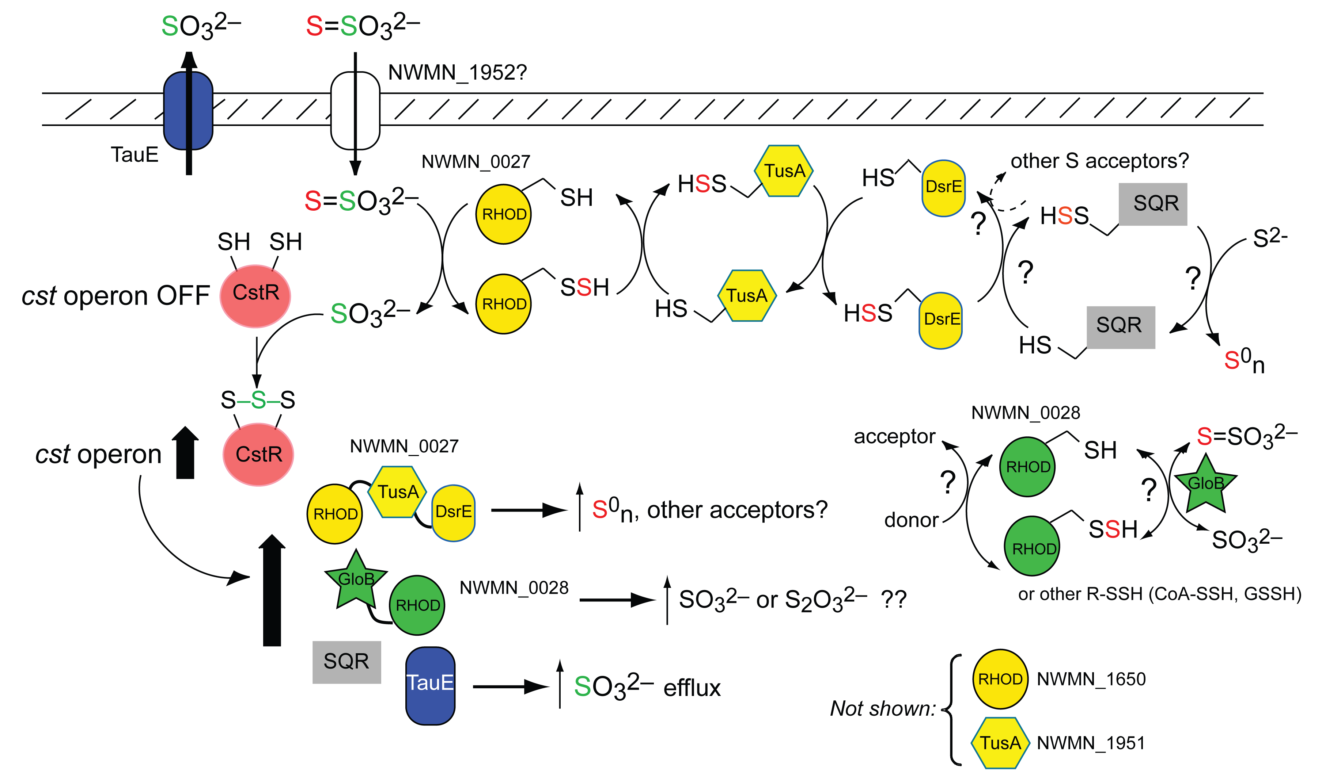
Biological Implications

Slide 35
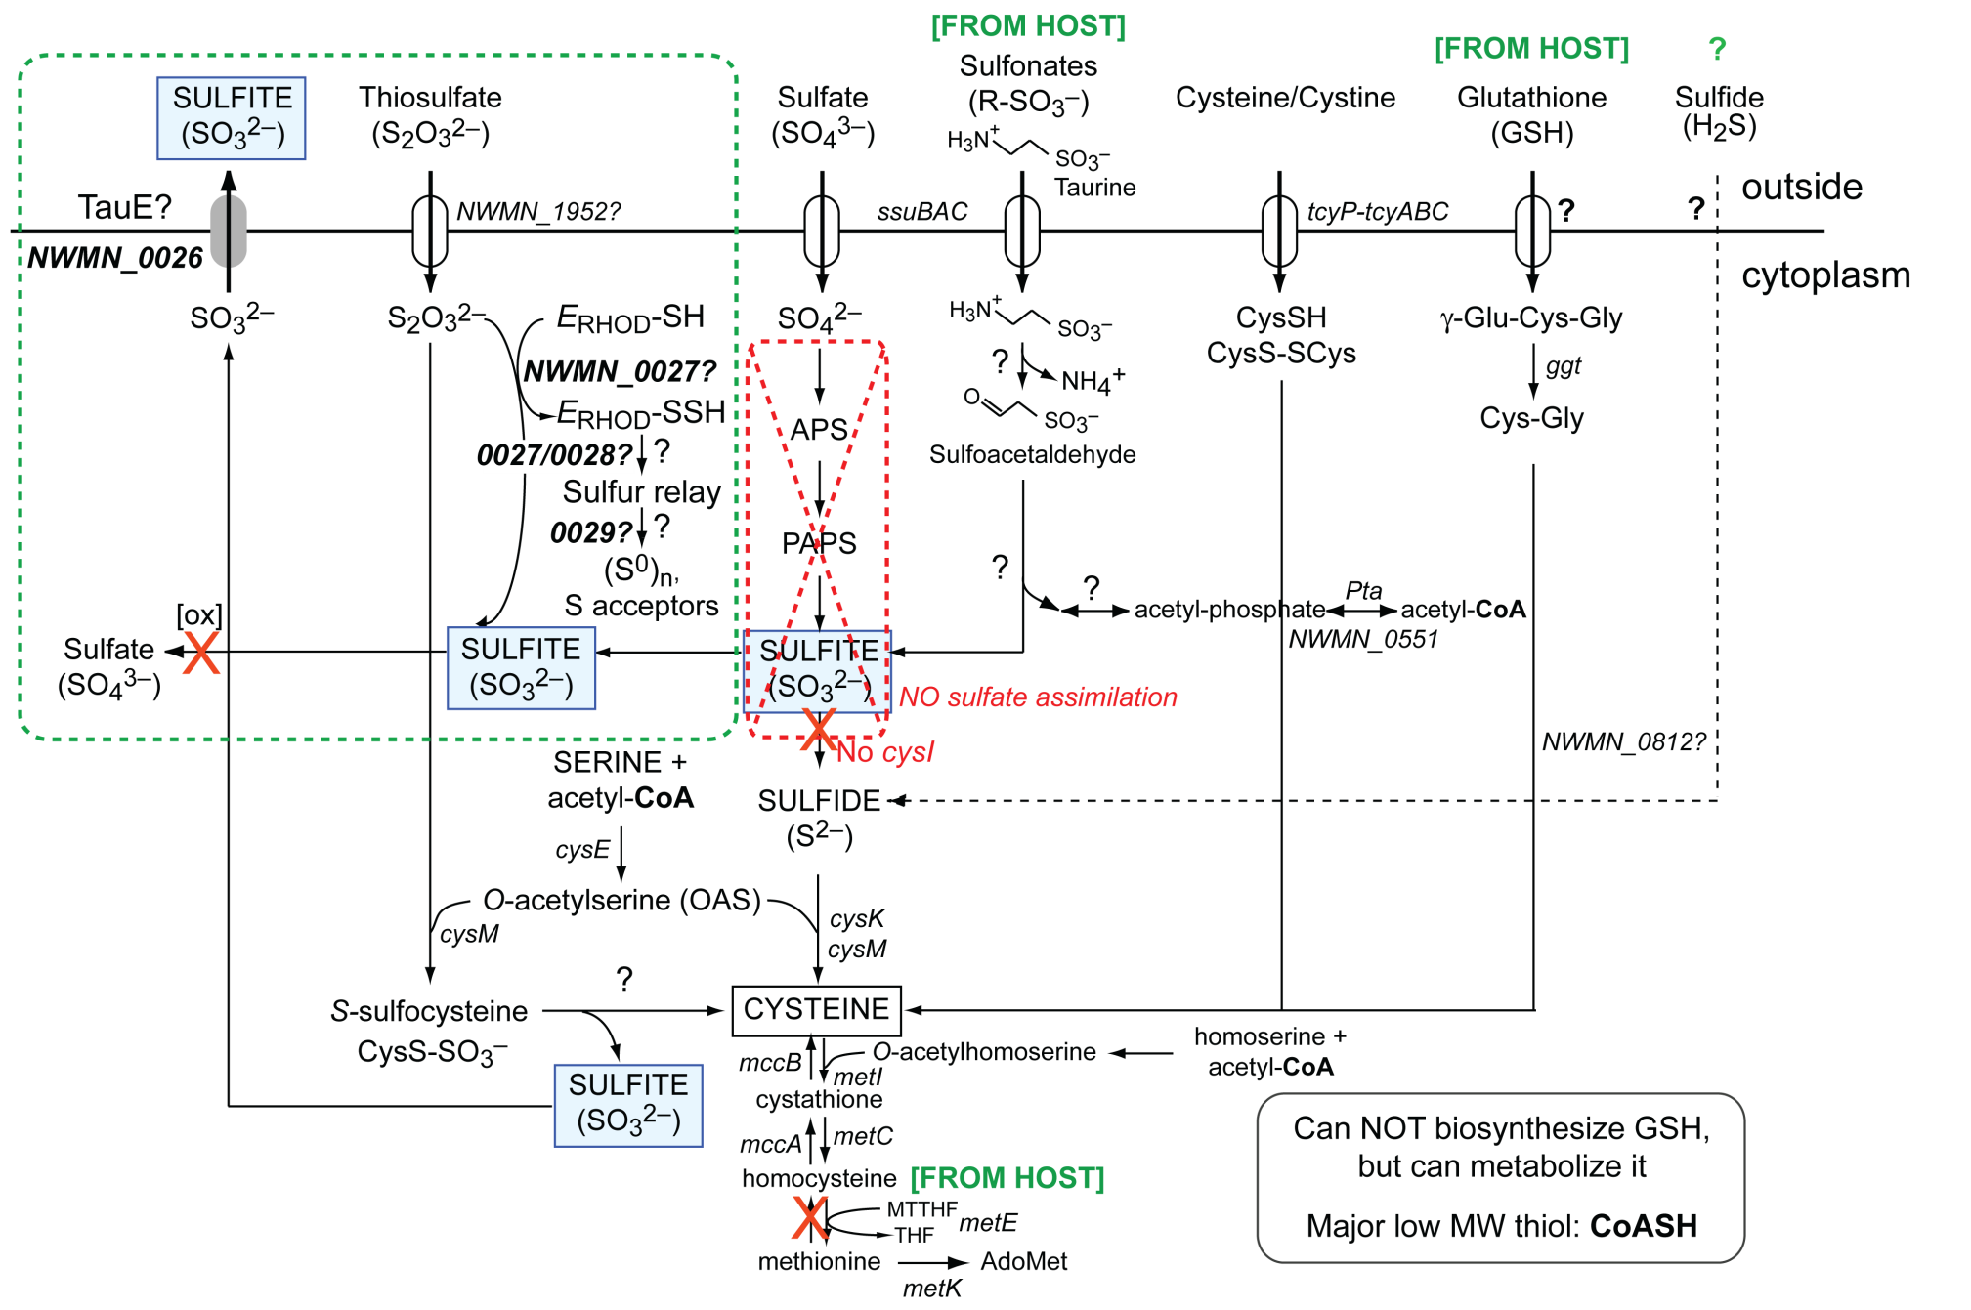
S. aureus sulfur assimilation pathways

Slide 36
Acknowledgements
Indiana University
David Giedroc
Zhen Ma
Justin Leubke
Vanderbilt
Eric Skaar
Thomas Kehl-Fie
Keith Adams
University of Georgia
Robert Scott
Darin Cowart

