Slide 1
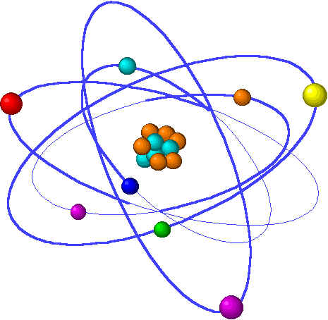
Lecture 17
DNA Replication – Process
Chapter 30.1-30.4

Slide 2
DNA Replication
Forms of DNA Helices
Replication of parent DNA can theoretically generate 3 possible conformations of daughter DNA
Template DNA (parent DNA)
S Phase
S Phase
M Phase
M Phase

Slide 3
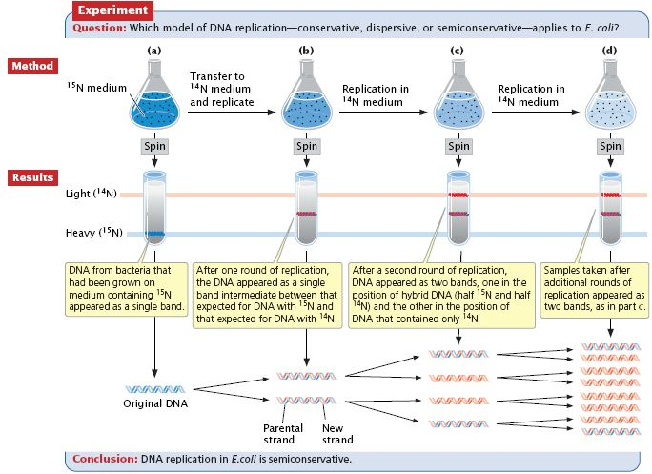
DNA Replication
Forms of DNA Helices
In 1958, Meselson and Stahl designed an experiment to determine how DNA replication worked…
http://palyapbio.edu.glogster.com/meselsonstahlcc

Slide 4
DNA Replication
Forms of DNA Helices
So, shortly after Watson and Crick determined the structure of DNA (with err, “borrowed” data from Rosalind Franklin), Meselson and Stahl determined that DNA replication was semi-conservative.
Side note: People knew about the results of their experiments for months. Finally a colleague had to lock them in a room with cots and typewriters in order to get them to write the paper detailing their results. And you thought you procrastinated on lab reports!
But what does this mode of replication imply?
There must be a template strand
Did one parent DNA strand serve as a template or both?
Did DNA replication occur in both directions of the chromosome?
How was the DNA opened for replication?
What was responsible for the replication reaction?

Slide 5
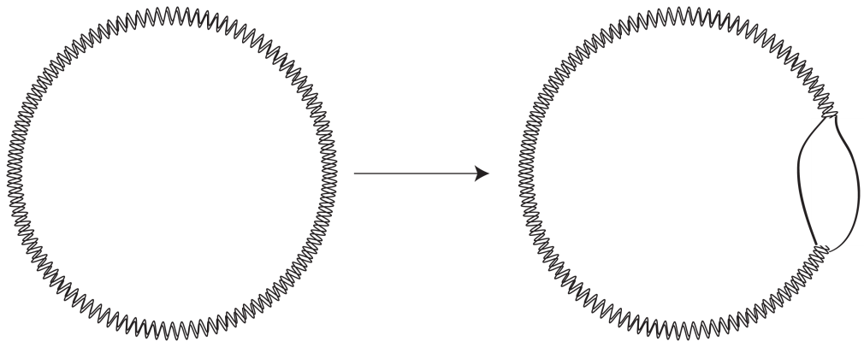
DNA Replication
Forms of DNA Helices
How do bacteria go about replicating DNA?
Linearize DNA for replication?
Keep DNA circular?
The experiment:
Grow cells in ³H-thymidine enhanced media

Slide 6
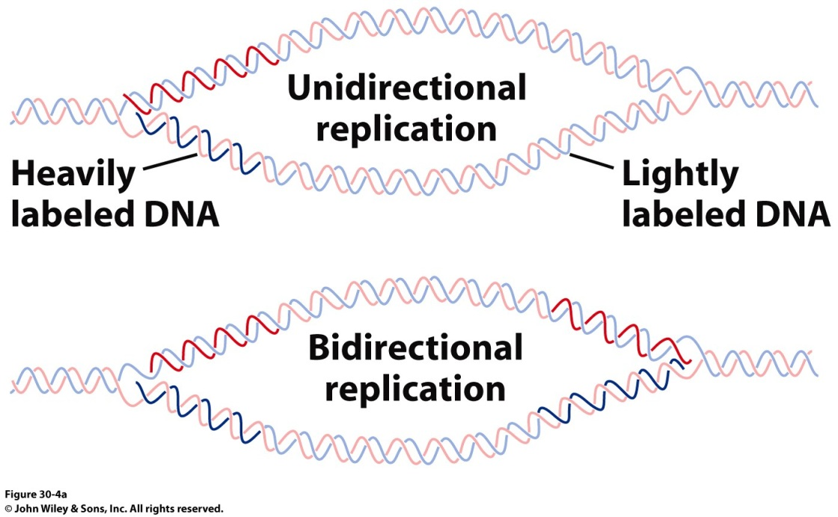
DNA Replication
Forms of DNA Helices
Where does replication start and is it uni- or bidirectional?
Heavy staining on both sides of the replication eye indicates that replication is almost always bidirectional in bacteria.
Bacterial replication also starts at the same spot indicating a single origin of replication

Slide 7
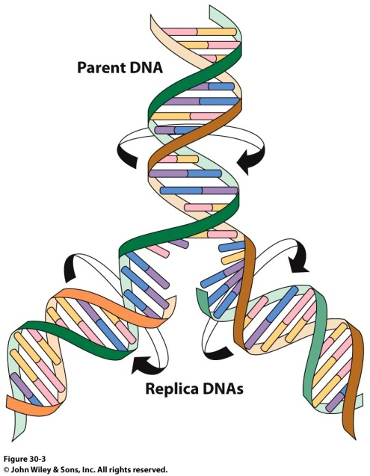
Dealing with DNA Superstructure
Forms of DNA Helices
Parent DNA must be unwound at the replication fork
For this to occur at biological rates (1000 nt per second for E. coli), genomic DNA must twist at a rate of 100 rps.
What enzyme is capable of modifying DNA topology?
Topoisomerase (DNA Gyrase)
E. coli’s genome is circular, so this is not possible!

Slide 8
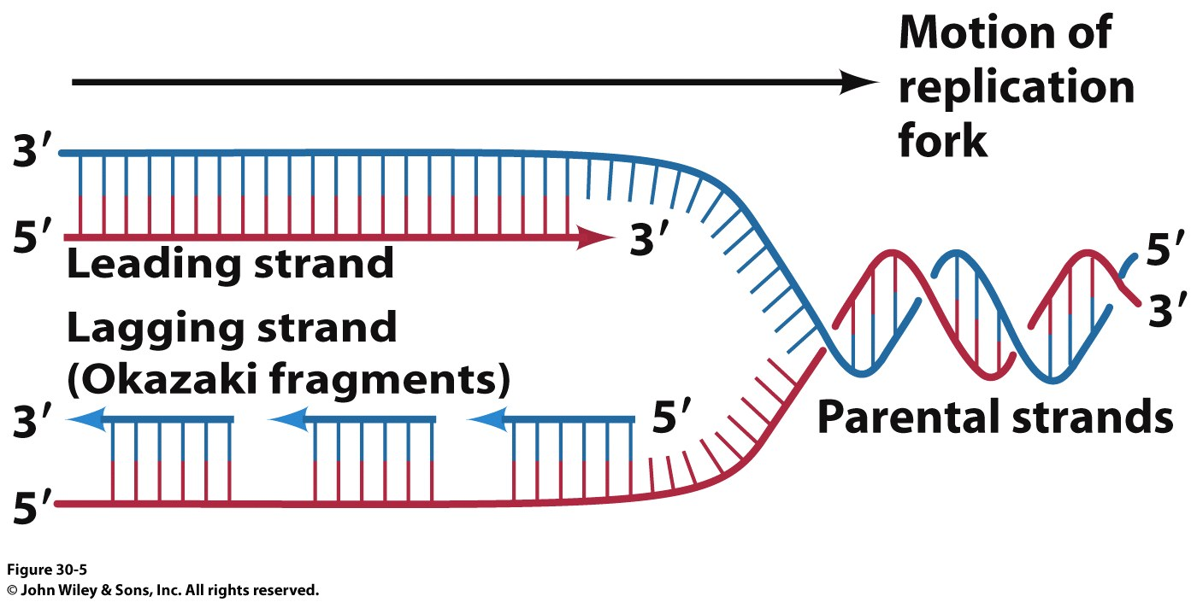
Semi-discontinuous Replication
Forms of DNA Helices
DNA’s 2 strands are replicated at the same time
DNA Polymerase synthesize DNA in the
5’ → 3’ direction
5’
3’
5’
So how does the other strand elongate?
The ‘Lagging Strand’ is synthesized as small fragments (1000 – 2000 nuclotides in bacteria or 100-200 nt in eukaryotes) called Okazaki fragments.
Okazaki fragments are combined by a DNA Ligase after the RNA primers are cut out by the 5’-3’ exonuclease activity of DNA PolI

Slide 9
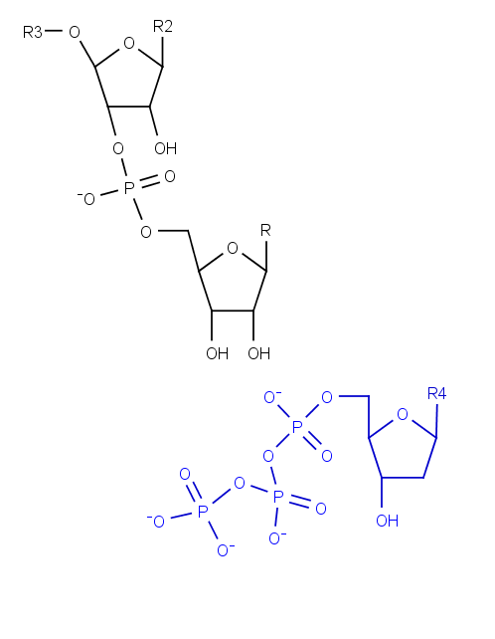
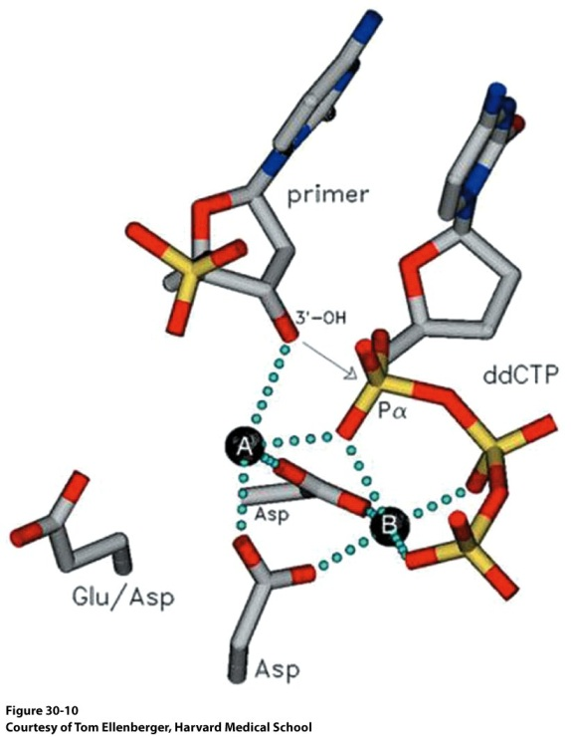
DNA Replication
Forms of DNA Helices
How will a dNTP be added to the existing chain?
How might the reaction be activated?

Slide 10
Requirement for priming
Forms of DNA Helices
This model of DNA replication requires a 3’ OH for strand elongation
5’
3’
5’
Analysis of Okazaki fragments indicated that the 5’ end was always composed of RNA 1→60 nucleotides in length
These will have to be replaced at some point
Nucleophile

Slide 11
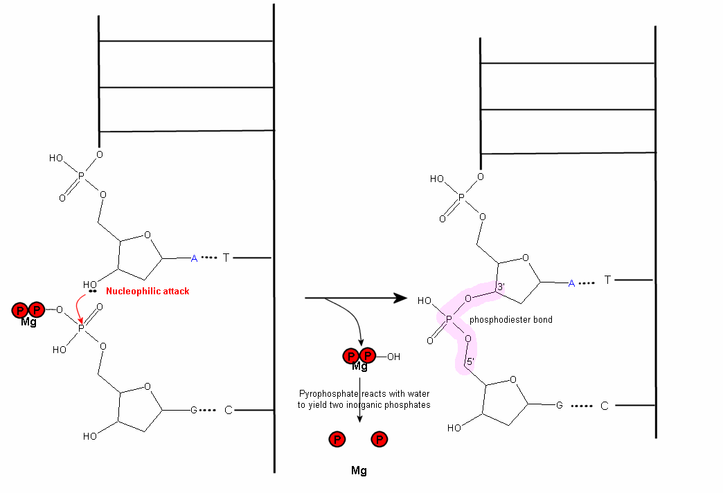
Polymerization Reaction
Forms of DNA Helices
http://wiki.cstl.semo.edu/agathman/GetFile.aspx?File=DNA%20polymerase/nucleophilic.gif

Slide 12
Enzyme Requirements for Replication
Forms of DNA Helices
DNA Polymerase
Catalyze the DNA chain elongation using the ‘parent’ strand as a template
RNA Primer Synthesis
RNA Polymerase
460 kDa (E. coli)
catalyzes primer synthesis for leading strand only
Primase
60 kDa
Responsible for priming Okazaki fragment
Works synergistically with RNA Polymerase to prime leading strand
Topoisomerase (Gyrase)
Unwind supercoiled template DNA
Energy dependent process
Ligase
Join Okazaki fragments

Slide 13
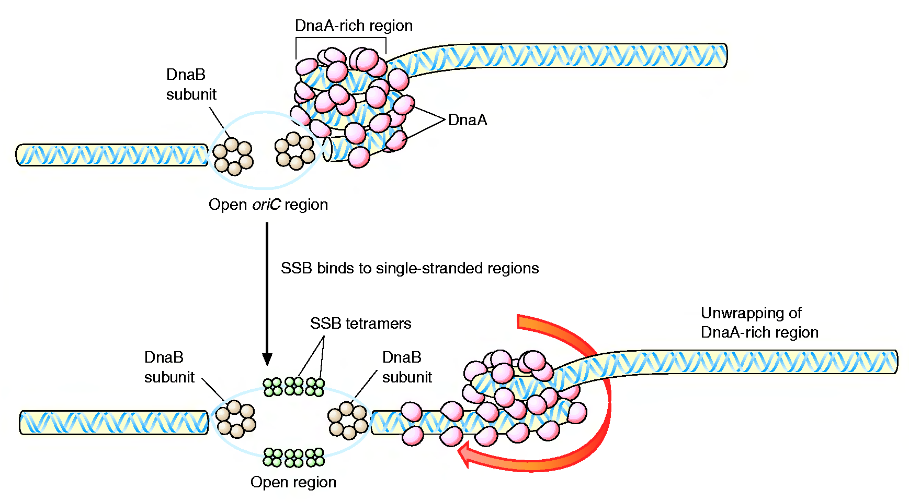
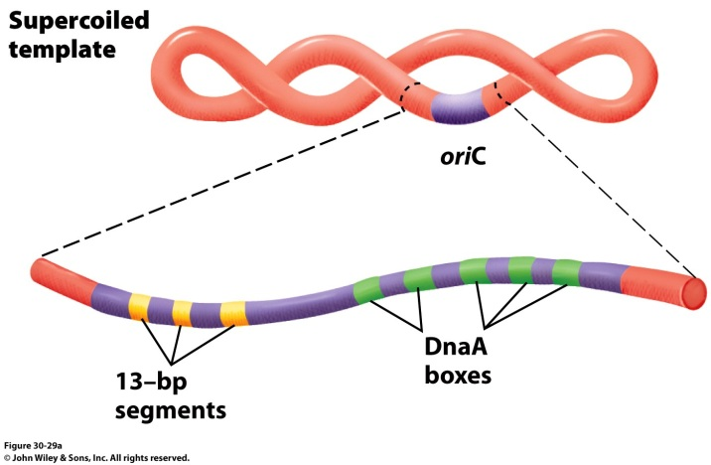
Formation of the Replication Fork
Forms of DNA Helices
4 DnaA proteins bind to the oriC region (recognizes 9 nucleotide segments)
Additional DnaA monomers bind forming a histone like complex of tightly wound DNA
Localized melting of a 13bp repeats
DnaB (6 subunit helicase) binds and unwinds the DNA
Topoisomerase functions downstream to relieve stress
Single Strand DNA binding proteins prevent the ssDNA from reannealing

Slide 14
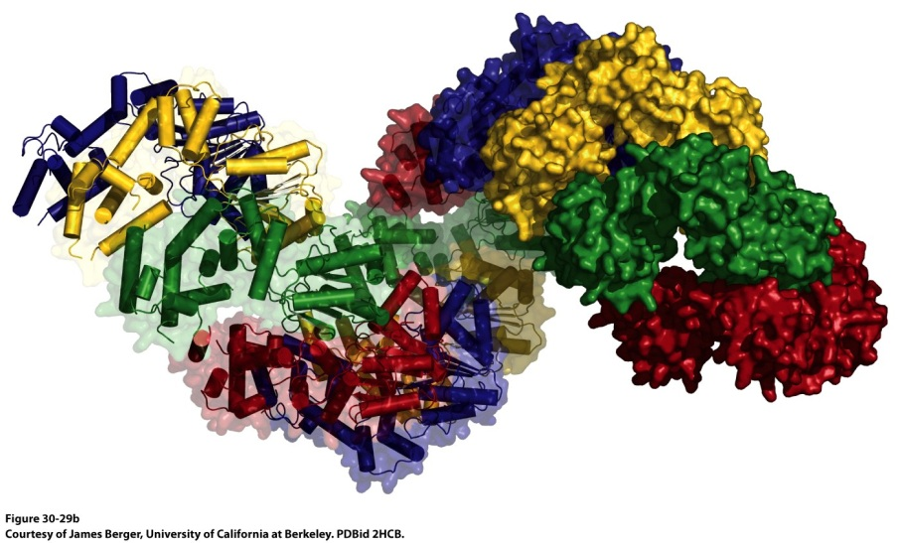
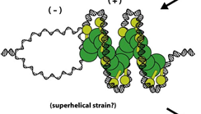
Formation of the Replication Fork
Forms of DNA Helices
178 Å
DnaA helical filament – 8 monomers per turn
ATP-bound DnaA molecules sit on 3 of the 5 DnaA boxes of the origin.
They recruit additional DnaA molecules to occupy the remaining boxes
This introduces positive supercoiling into the DNA, causing the DNA to unwind (It is negatively supercoiled, right? Topoisomerase says “Oh, yeah.”)
The ATPase domain of DnaA may actively unwind DNA as a function of ATP hydrolysis
4) The oriC-DnaA complex recruits DnaB-DnaC hexamers to actively separate the DNA helix (DnaB is a helicase, DnaC is a loading protein that places DnaB onto the strand)

Slide 15
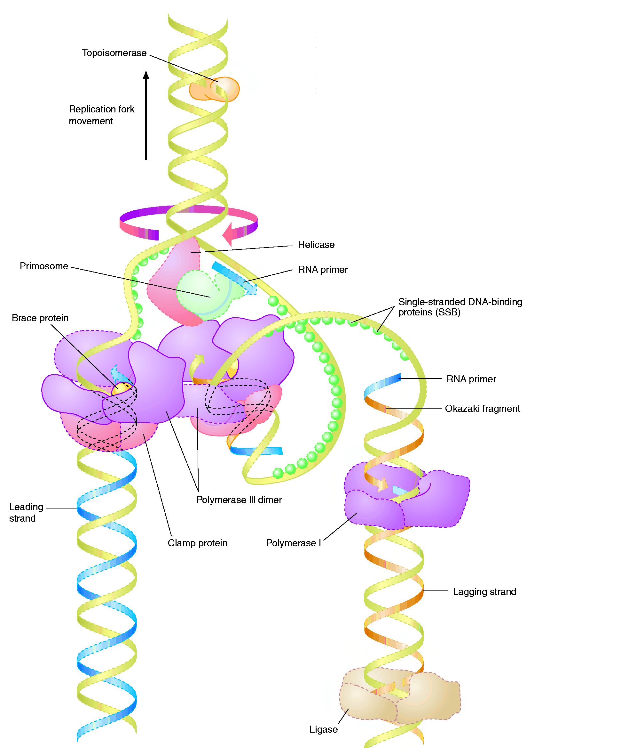
The Big Picture (in E.coli)
Forms of DNA Helices
Topoisomerase: relieves topological strain
Helicase - unwinds dsDNA at replication fork
SSB: keeps ssDNA from reannealing
Primase: synthesizes RNA primers for lagging strand
Pol III elongates lagging strand until strained. It then releases the template and rebinds at a new primed location.
DNA Polymerase III : elongate primed DNA from 5’→3’
3’→5’ exonuclease activity limits errors
Pol I: closes any gaps in lagging strand and replaces RNA primer
Ligase: seals off backbone nicks

Slide 16
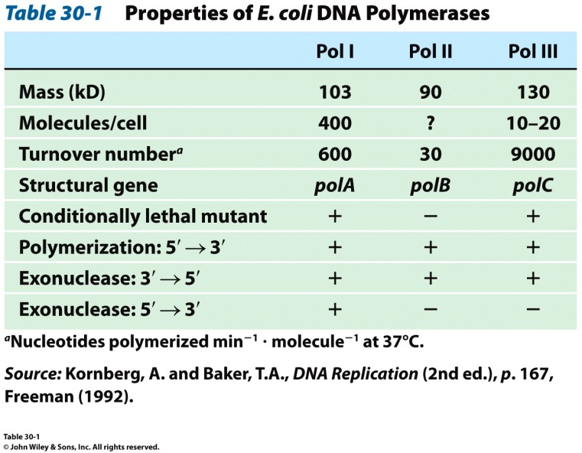
What do we need in a DNA Polymerase?
Forms of DNA Helices
Template DNA binding site
Single Strand or Double Strand?
Remember DnaA/DnaB/DnaC?
Room for growing dsDNA
dNTP binding site
Mechanism to differentiate between the 4 possible dNTPs
Self Correcting?
Viral Polymerase vs. Human Polymerase

Slide 17
DNA Polymerase Structures
Forms of DNA Helices
Arthur Kornberg discovered the first DNA polymerase isolated from Escherichia coli in 1956
This was called DNA Polymerase I (DNA PolI)
The structure of this enzyme was solved by Tom Steitz in 1987 (at least part of it was…)
PDB ID Code: 1DPI
The structure of the Thermus aquaticus DNA PolI was also discovered by Steitz in 1996
PDB ID Code: 1TAQ
For today’s lectures, we’ll use the following structures:
1QSS: ddGTP-trapped Closed Ternary Complex of the Large Fragment of DNA PolI from T. aquaticus
1KLN: DNA PolI Klenow Fragment Mutant/DNA Complex

Slide 18
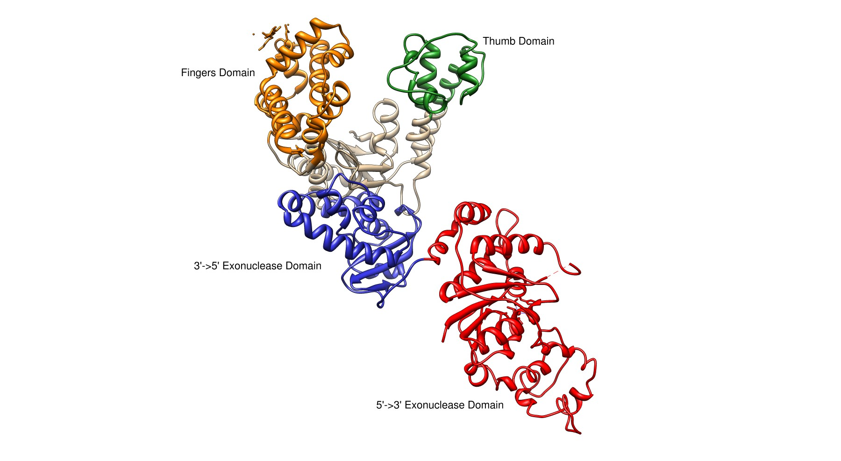
E. coli DNA Polymerase I
Forms of DNA Helices
Pol I
3’→ 5’ and 5’ → 3’ exonuclease activity
Small N-terminal domain contains the 5’→3’ exonuclease activity
Completely independent from active site or 3’ → 5 site
Thumb
Guides newly formed DNA
Responsible for processivity
Fingers
Contains dNTP binding site
Close in on dNTP/Growing Strand once successful Watson-Crick base pairing made
Palm Domain
~22 Å x 30 Å
Ideal shape to bind B-DNA
Lined with basic amino acids

Slide 19
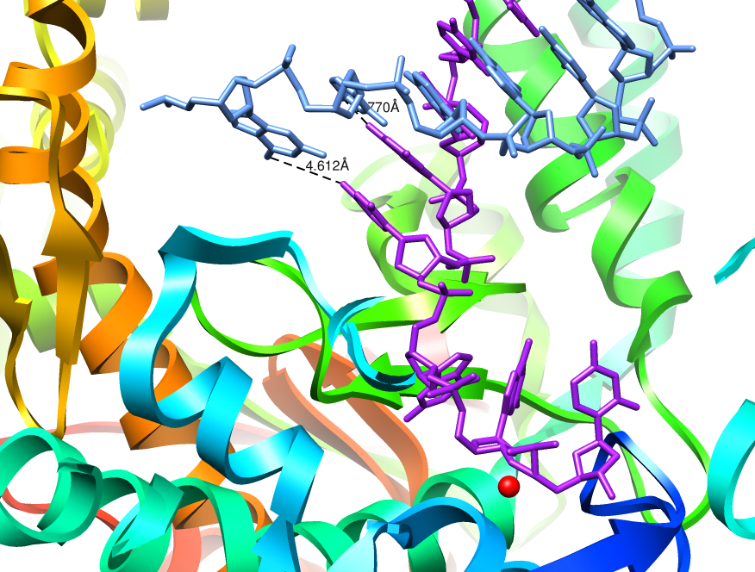
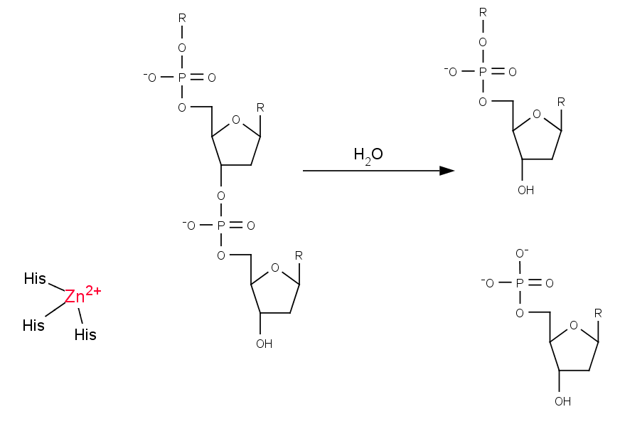
3’ → 5’ Exonuclease
Forms of DNA Helices
The structure of E. coli Pol I has been solved with DNA bound in the 3’→5’ exonuclease active site
Growing strand peels away from active site
The base pair closest to the polymerization active site is significantly weakened
Exonuclease site (Zn²⁺ activated mechanism)
Which bond will be cleaved?
NEED 3’-hydroxyl for elongation

Slide 20
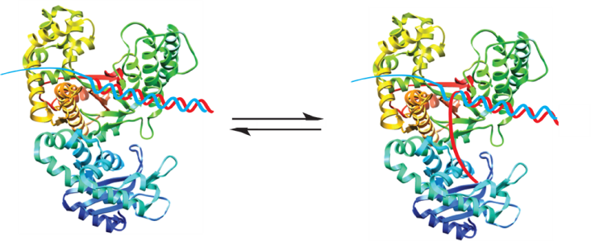
Model for Proofreading in DNA Polymerases
Forms of DNA Helices
dNTPs are in rapid equilibrium at active site
When reaction occurs, proper base pair will form a strong tight bonding pair
When an error occurs, the base pair is not as tight, resulting in increased favorability for the growing chain to be positioned at the 3’→5’ exonuclease site
A-form DNA of DNA @ polymerization active site makes this process easier (less tightly wrapped and less stable helix)

Slide 21
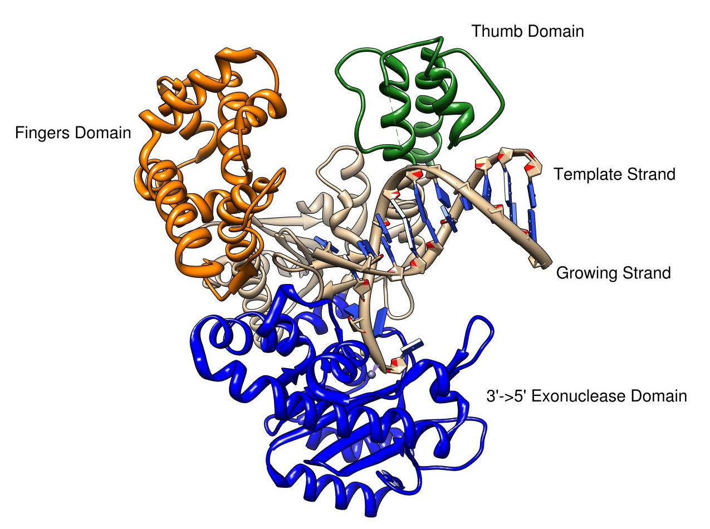
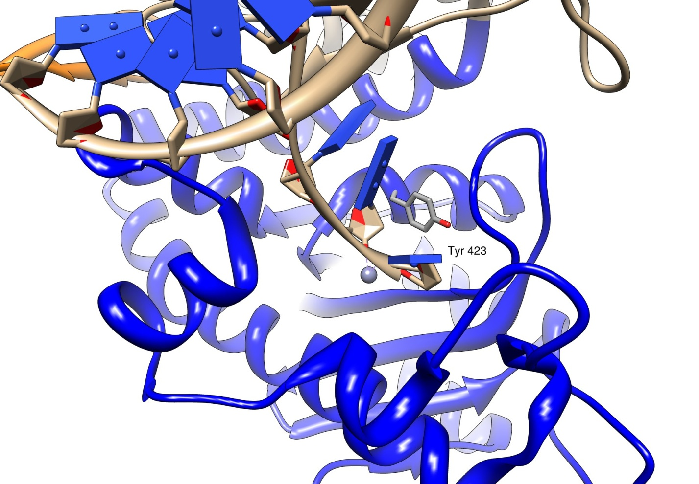
3’->5’ Exonuclease Mechanism
Forms of DNA Helices
The structure of E. coli Pol I has been solved with DNA bound in the 3’→5’ exonuclease site
Growing strand peels away from active site
Tyr 423 activates a water molecule which then serves as a nucleophile to begin the cleavage of the base from the strand

Slide 22
3’->5’ Exonuclease Mechanism
Forms of DNA Helices
Tyr 423 activates a water molecule which then serves as a nucleophile to begin the cleavage of the base from the strand
Freemont et al. (1988). Cocrystal structure of an editing complex of Klenow fragment with DNA. PNAS 85: 8924-8928.

Slide 23
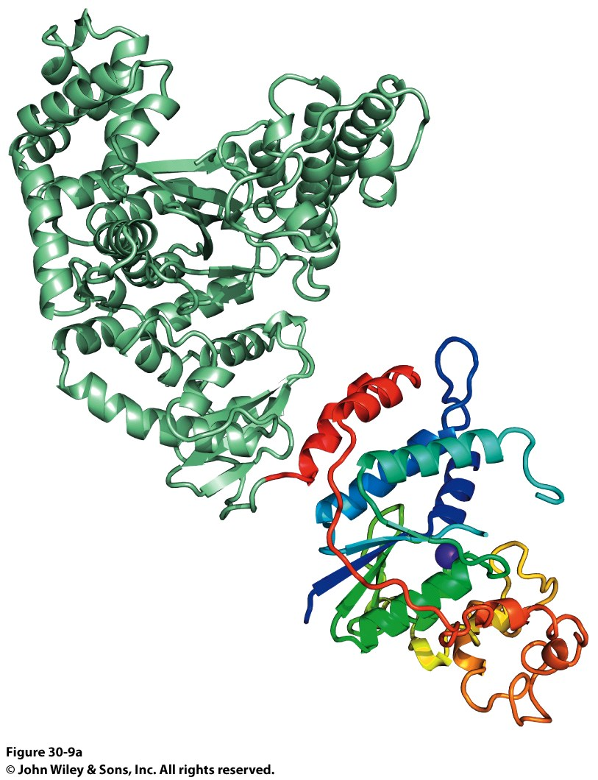
Taq DNA Polymerase
Forms of DNA Helices
Two domains were identified:
Polymerase Domain
Exonuclease Domain
N-terminal domain contains 5’ → 3’ exonuclease
C-terminal domain contains polymerase activity

Slide 24
Taq DNA Polymerase
Forms of DNA Helices
Notice the same Finger and Thumb domains as E. coli DNA PolI
Same function, same domains
Evidence of evolutionary conservation of function
No 3’->5’ exonuclease domain though…

Slide 25
E. coli and Taq DNA Polymerase Superposition
Forms of DNA Helices
Notice the same Finger and Thumb domains as E. coli DNA PolI
Same function, same domains
Evidence of evolutionary conservation of function
No 3’->5’ exonuclease domain though…

Slide 26
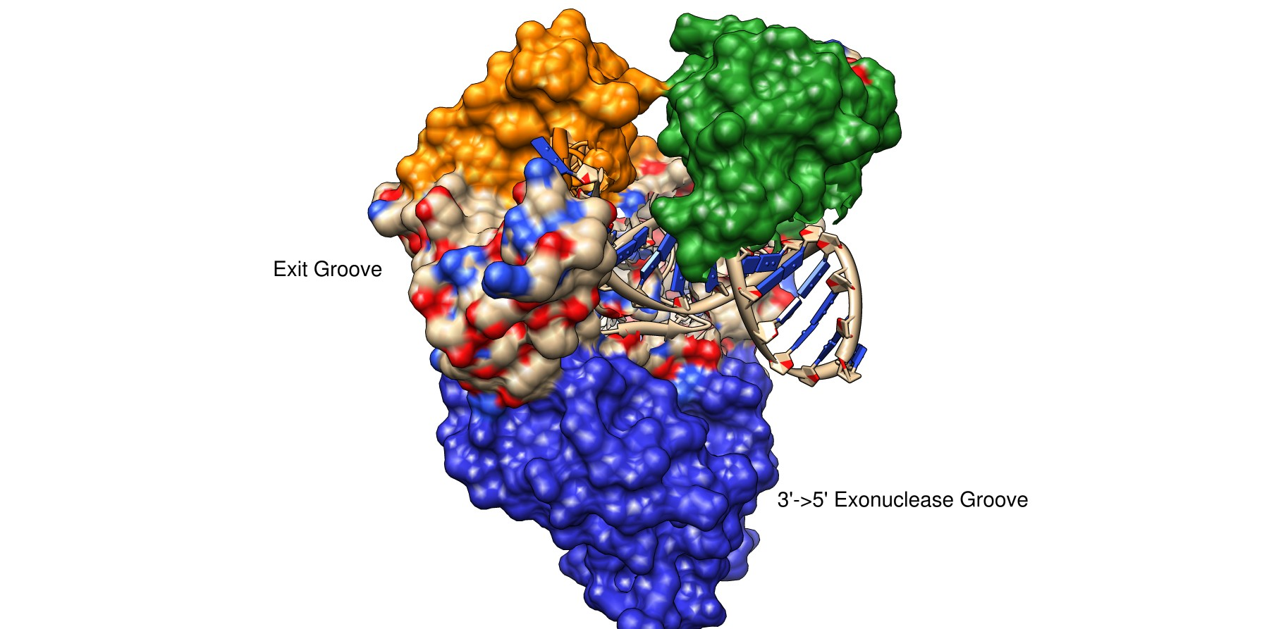
Taq DNA Polymerase
Forms of DNA Helices

Slide 27
Taq DNA Polymerase
Forms of DNA Helices

Slide 28
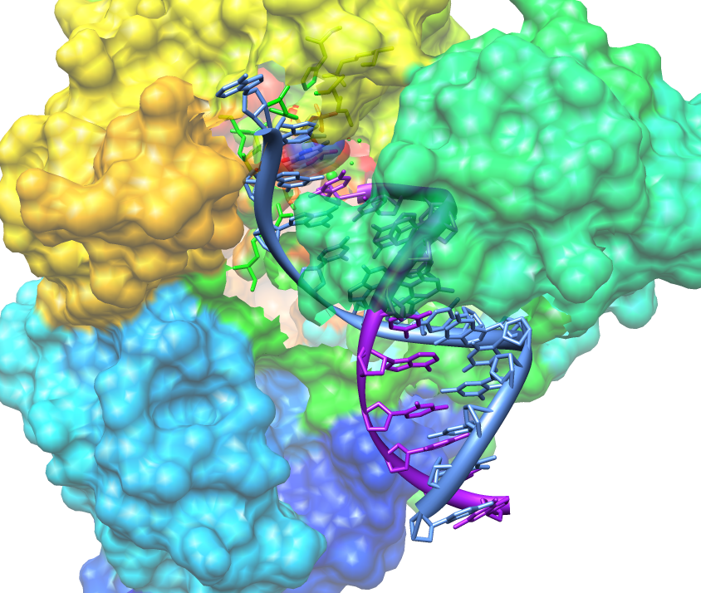
Taq DNA Polymerase
Forms of DNA Helices
Initial inspection of the groove between the thumb and fingers suggests the DNA would follow this cleft. This is NOT the case!
Active Site
Projected path of ssDNA template
5’
Template
Growing Strand
Thumb folds down over elongating dsDNA preventing it from escaping

Slide 29
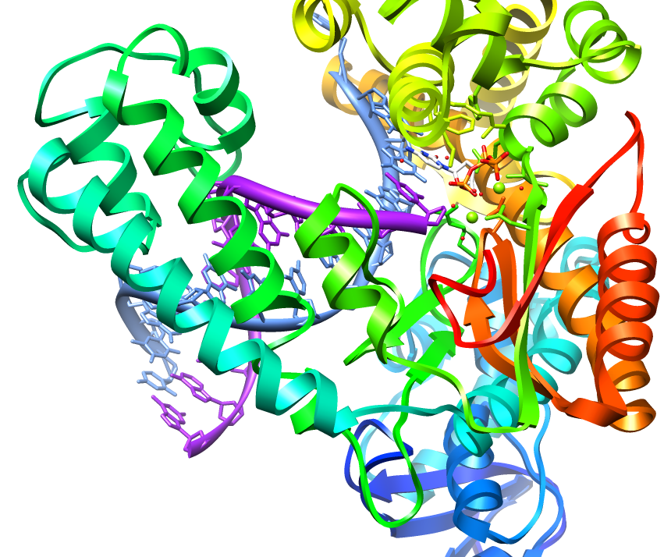
Taq DNA Polymerase
Forms of DNA Helices
dNTP Binding Site – allows for rapid sampling of the dNTPs
Projected path of ssDNA template
Thumb
Knuckles?

Slide 30
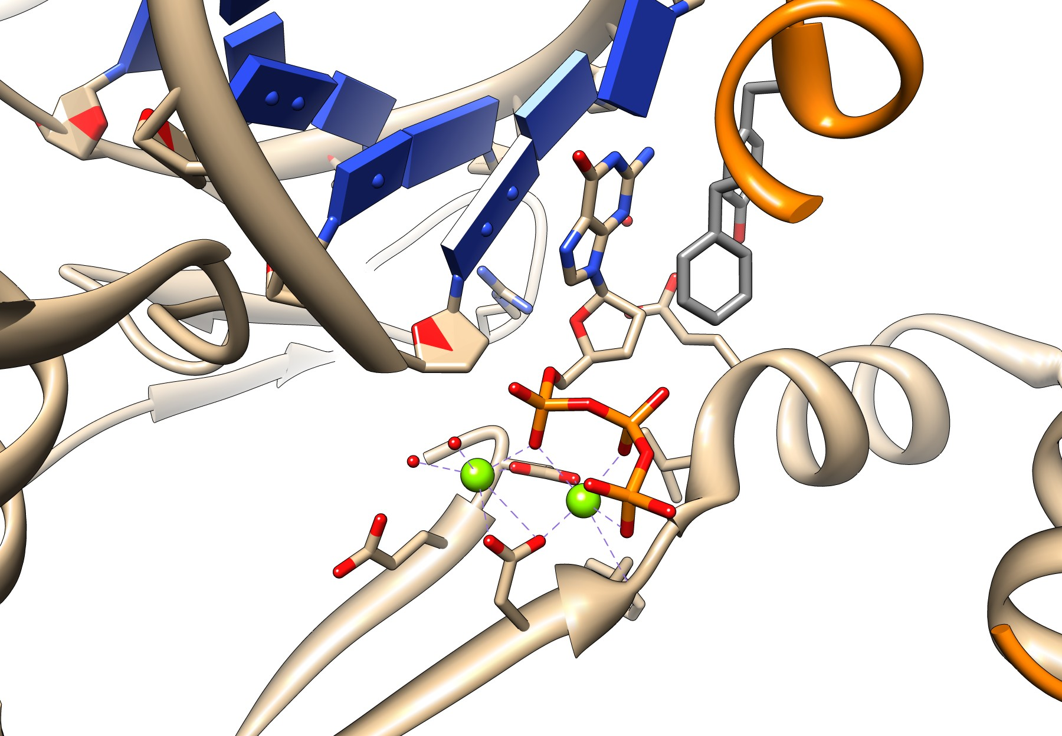
Taq DNA Polymerase
Forms of DNA Helices

Slide 31
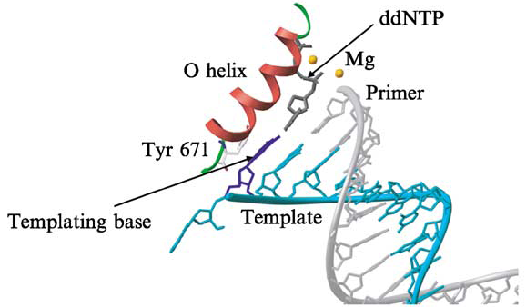
The Role of the O Helix in the Finger Domain
Forms of DNA Helices
O-Helix
Rothwell and Waksman. (2005) Structure and Mechanism of DNA Polymerases. Adv. Protein Chemiistry 71: 401-440.

Slide 32
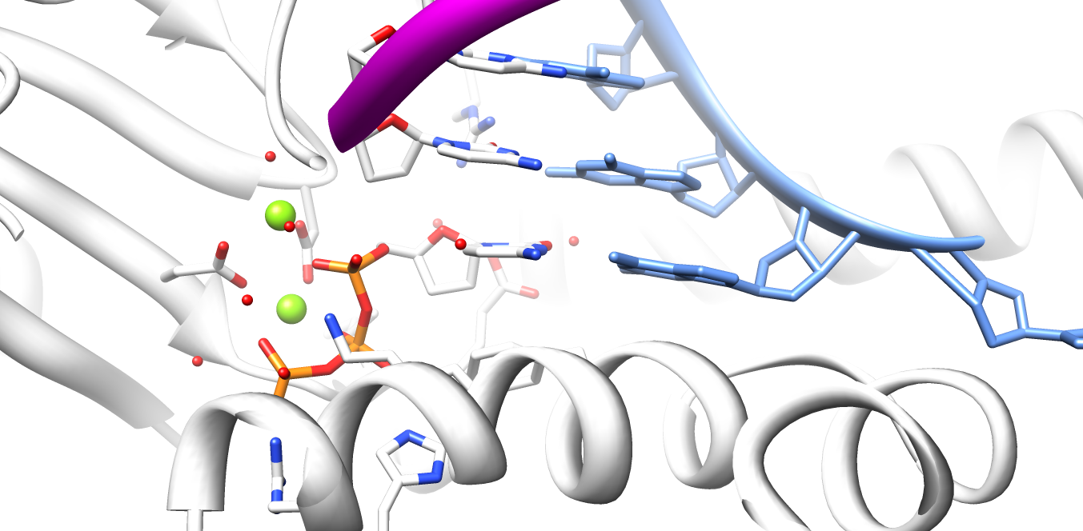
Taq DNA Polymerase
Forms of DNA Helices
DNA polymerases apparently select incoming dNTP based on SHAPE of Watson-Crick base pair (Purine-Pyrimidine)
Only one combination will provide most favorable pair
Growing Strand
Template
Mg situated for activation of 3’OH
5’ end of growing strand is 2’-3’-dideoxy CTP
Watson-Crick Base Pair between Template and incoming dNTP at active

Slide 33
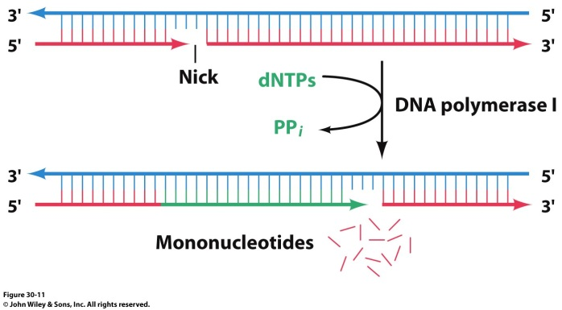
Taq DNA Polymerase Exonuclease
Forms of DNA Helices
Pol I from Thermus aquaticus lacks 3’→5’ exonuclease activity
What does this mean for fidelity?
N-terminal domain contains 5’ → 3’ exonuclease
Taq polymerase can translate a single nick in DNA by a mechanism that involves both the polymerase active site and the 5’→3’ exonuclease active site

Slide 34
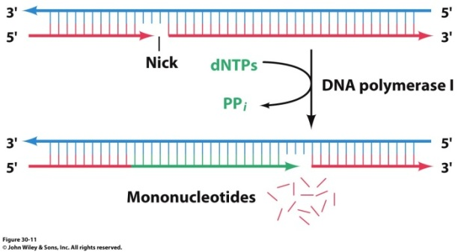
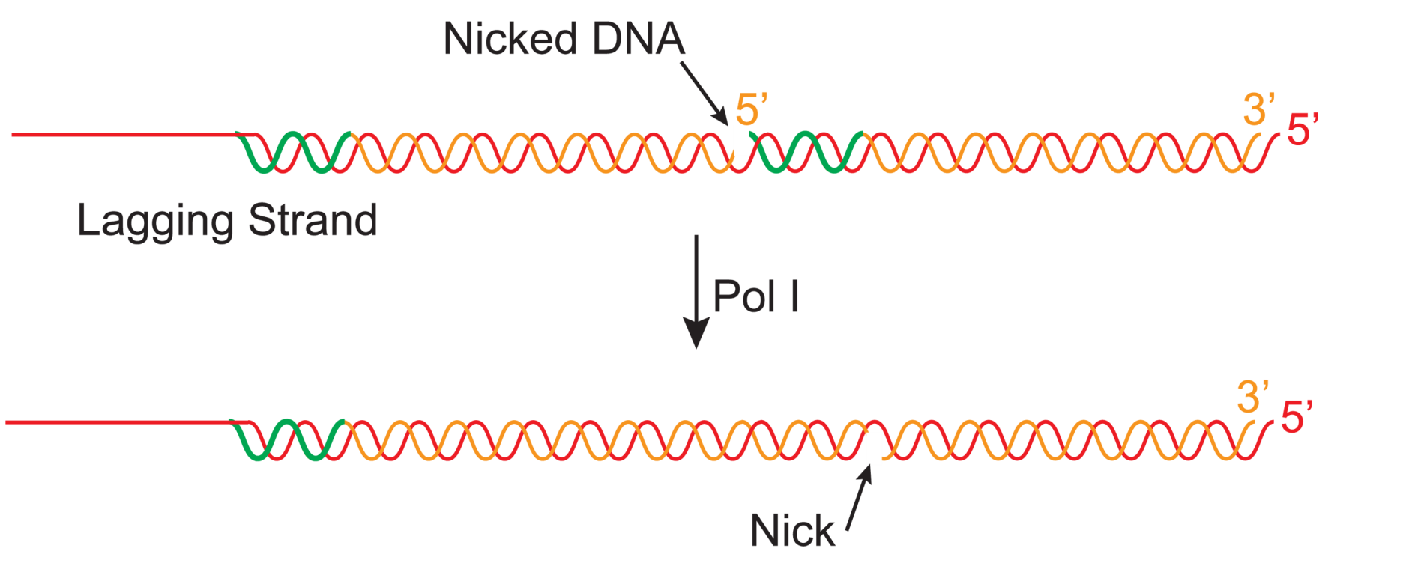
Taq DNA Polymerase Exonuclease
Forms of DNA Helices
What process in DNA replication requires a 5’→ 3’ exonuclease process?
Need to remove RNA primers from lagging strand!

