Slide 1


WEEK SEVEN: ACADEMIC SUCCESS

Slide 2

DISCUSSION
STUDY SKILLS INVENTORY
pg. 60

Slide 3
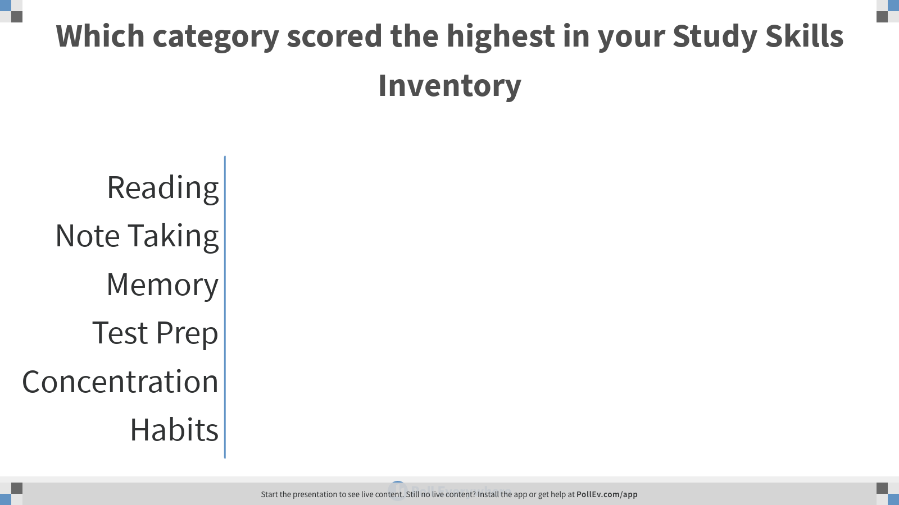
Notes:
Poll Title: Which category scored the highest in your Study Skills Inventory
https://www.polleverywhere.com/multiple_choice_polls/eHHciHnwV1mRIhxg865vT

Slide 4
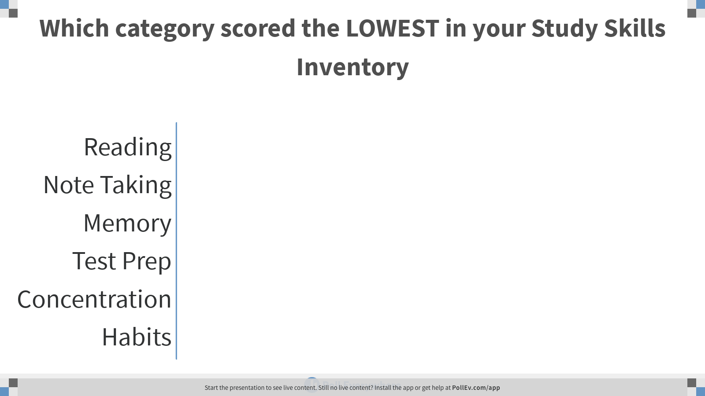
Notes:
Poll Title: Which category scored the LOWEST in your Study Skills Inventory
https://www.polleverywhere.com/multiple_choice_polls/LCiYs88I5Fu8Mfh9mfhiw

Slide 5
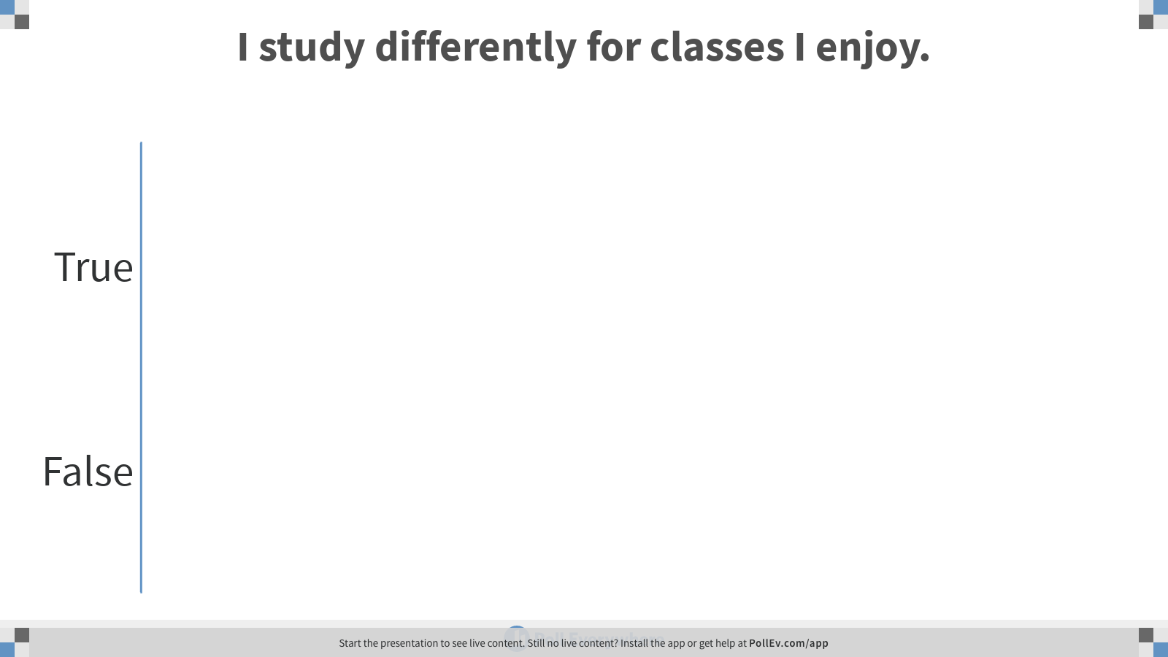
Notes:
Poll Title: I study differently for classes I enjoy.
https://www.polleverywhere.com/multiple_choice_polls/aNCcUfI4tj1N5IlPVpxxe

Slide 6
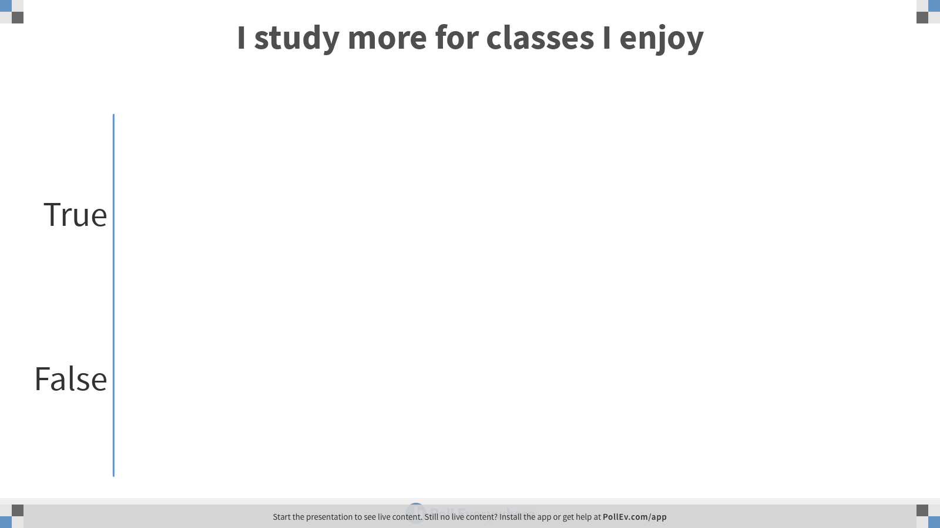
Notes:
Poll Title: I study more for classes I enjoy
https://www.polleverywhere.com/multiple_choice_polls/gg4SVmuJ1rW5aSenOYFaK

Slide 7
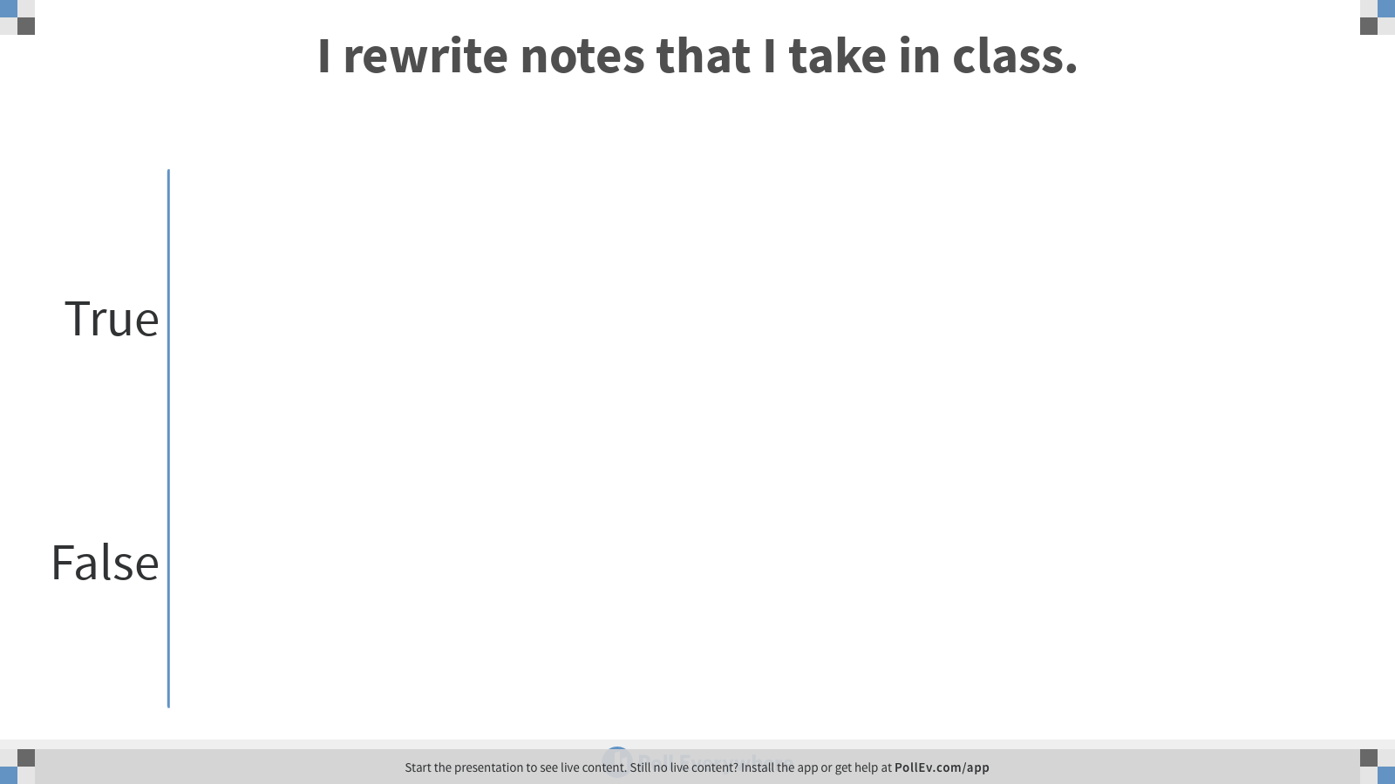
Notes:
Poll Title: I rewrite notes that I take in class.
https://www.polleverywhere.com/multiple_choice_polls/l4yX8lWhL4PDItvXgEc5F

Slide 8
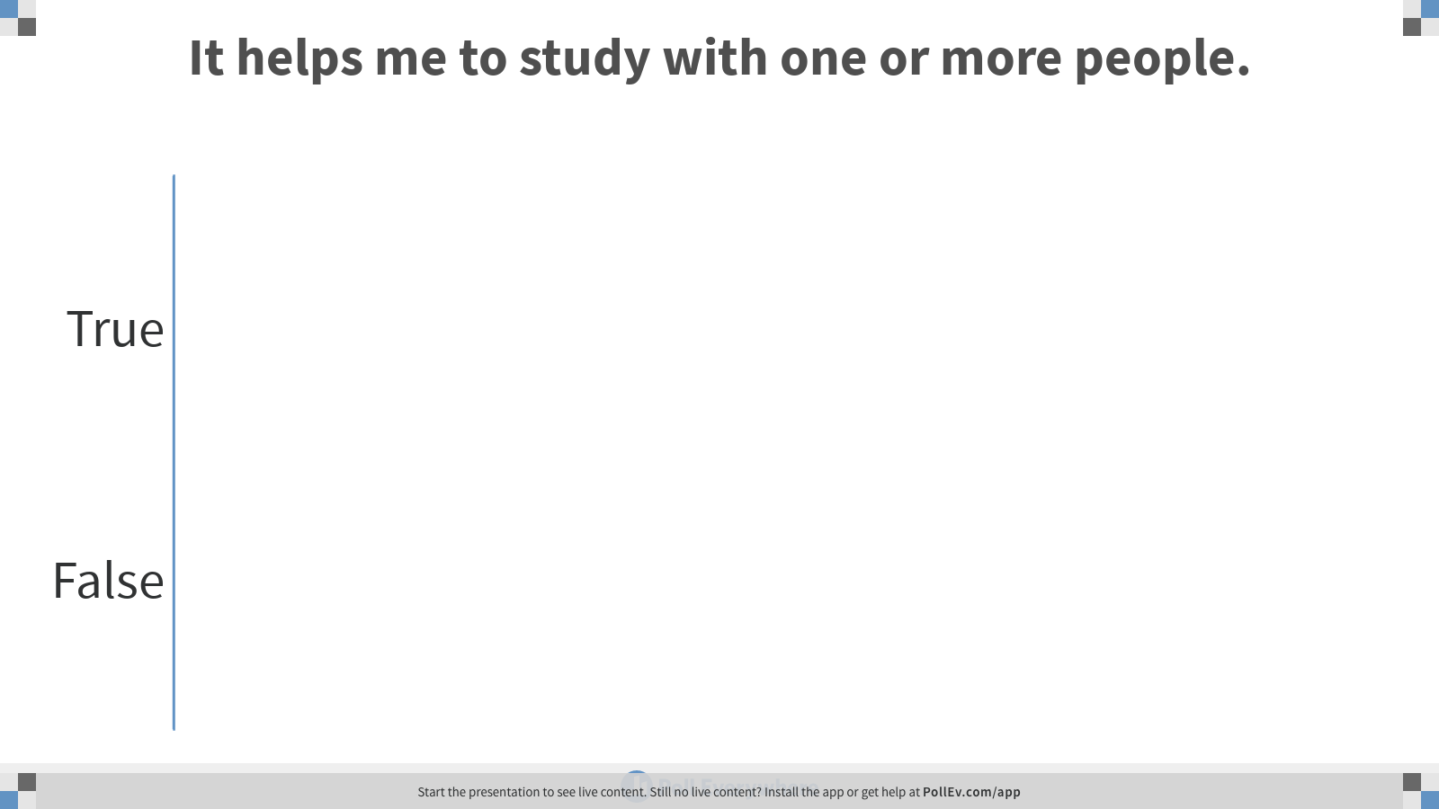
Notes:
Poll Title: It helps me to study with one or more people.
https://www.polleverywhere.com/multiple_choice_polls/VUFhA6XZjZu0DkxVUKu0F

Slide 9
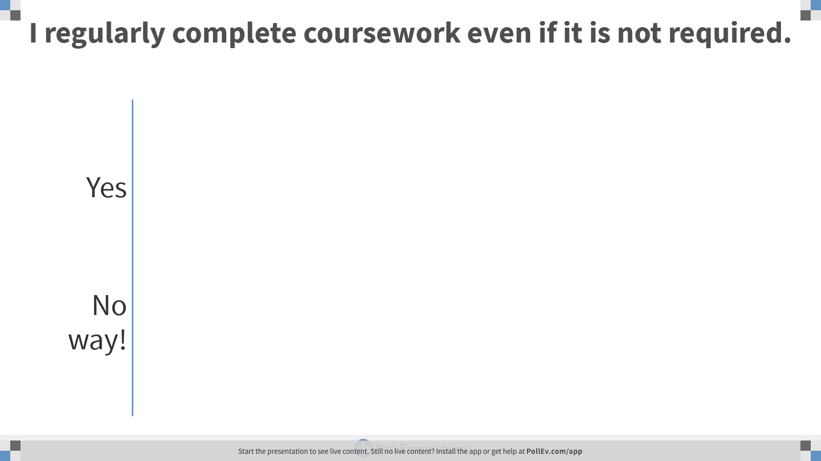
Notes:
Poll Title: I regularly complete coursework even if it is not required.
https://www.polleverywhere.com/multiple_choice_polls/idjTBTY2t2siJWIRy00Wc

Slide 10
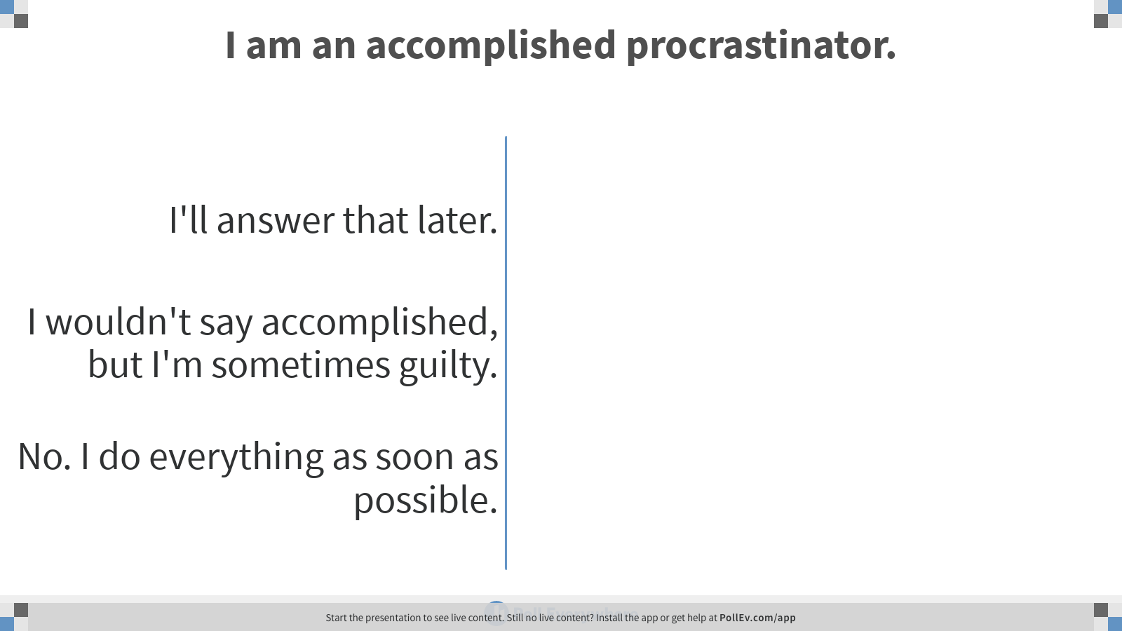
Notes:
Poll Title: I am an accomplished procrastinator.
https://www.polleverywhere.com/multiple_choice_polls/nMxEq2iqIHBpQOY6NBSv2

Slide 11
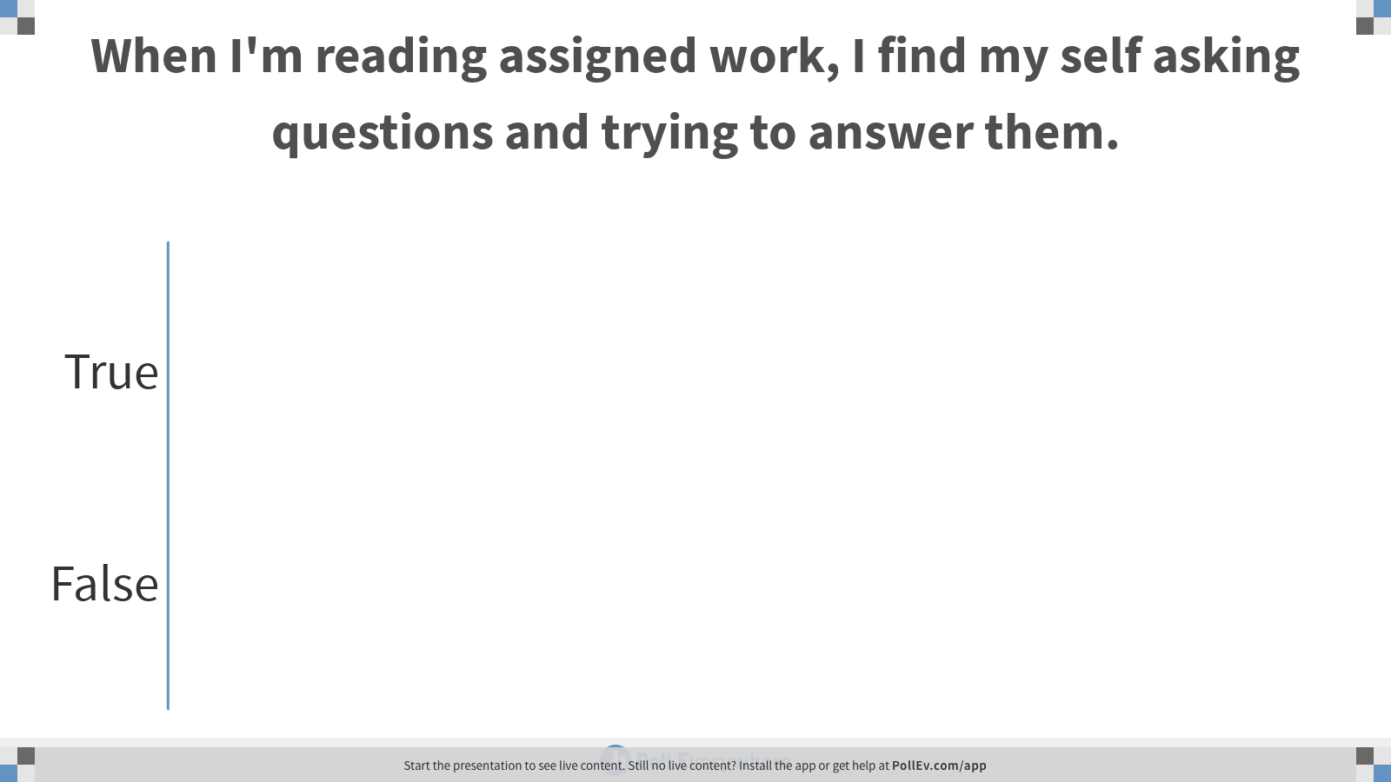
Notes:
Poll Title: When I'm reading assigned work, I find my self asking questions and trying to answer them.
https://www.polleverywhere.com/multiple_choice_polls/BfYxwVSYQ0irvnzzntwoC

Slide 12
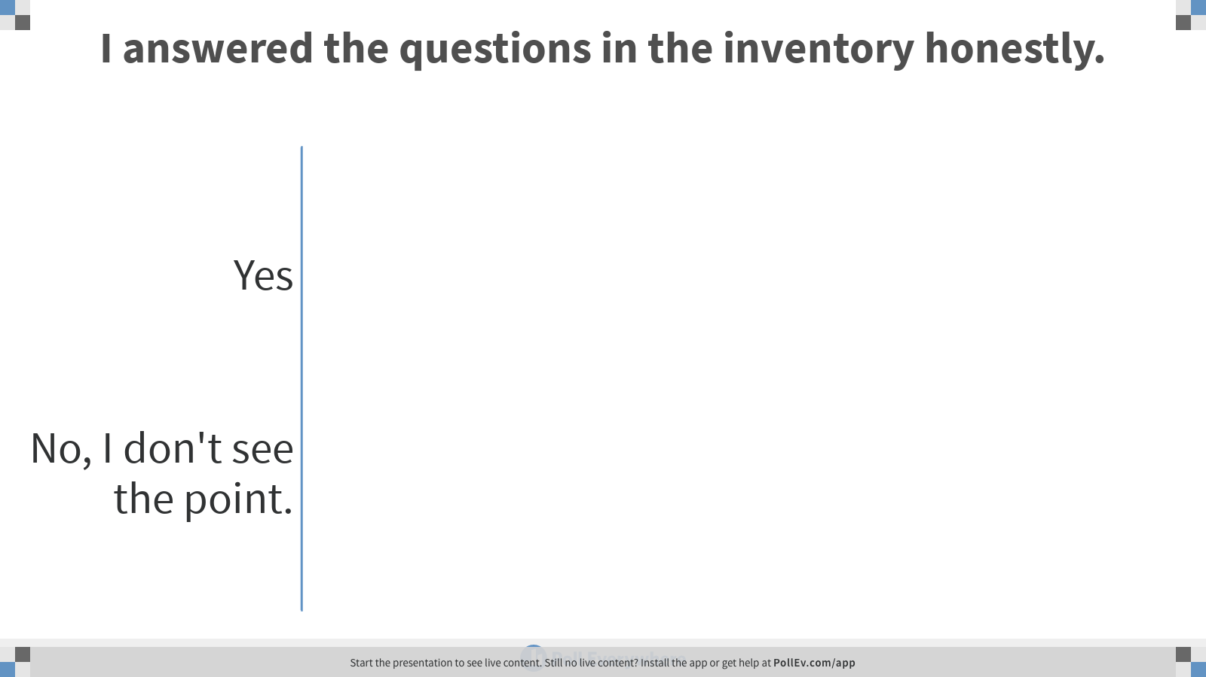
Notes:
Poll Title: I answered the questions in the inventory honestly.
https://www.polleverywhere.com/multiple_choice_polls/rezCA8ZT4v8uiDjo62Srb

Slide 13
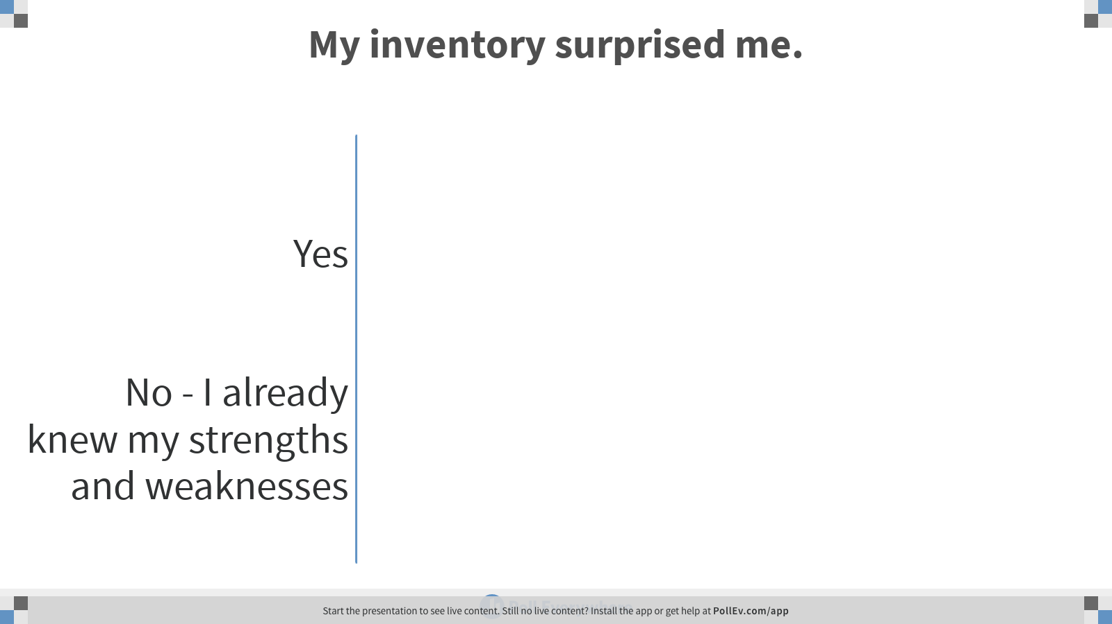
Notes:
Poll Title: My inventory surprised me.
https://www.polleverywhere.com/multiple_choice_polls/HDbmrXombG0U5deDiOcKE

Slide 14
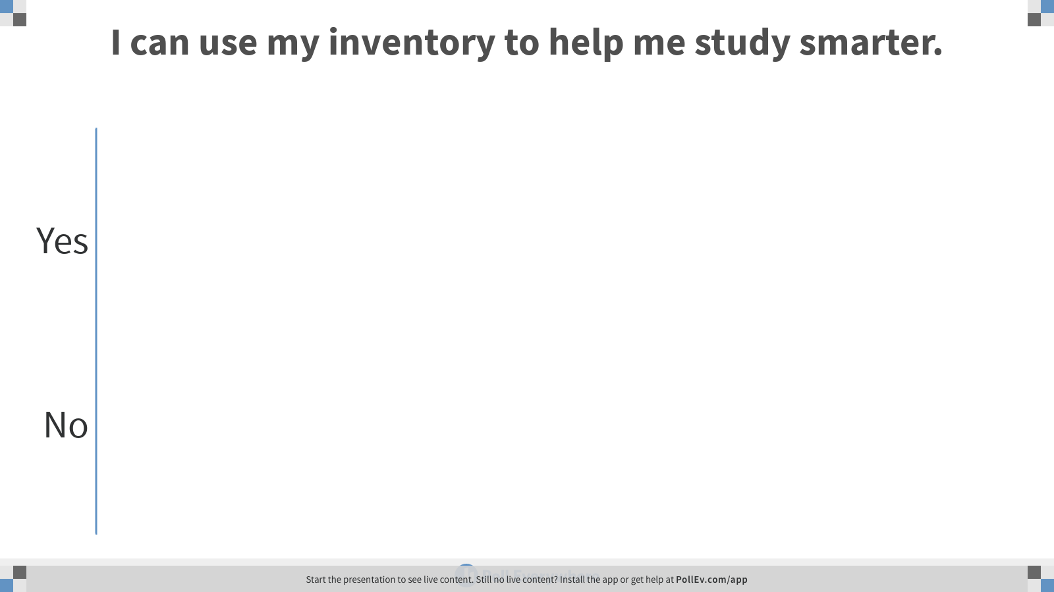
Notes:
Poll Title: I can use my inventory to help me study smarter.
https://www.polleverywhere.com/multiple_choice_polls/deW0hqWXTe4THxeHMLSzx

Slide 15
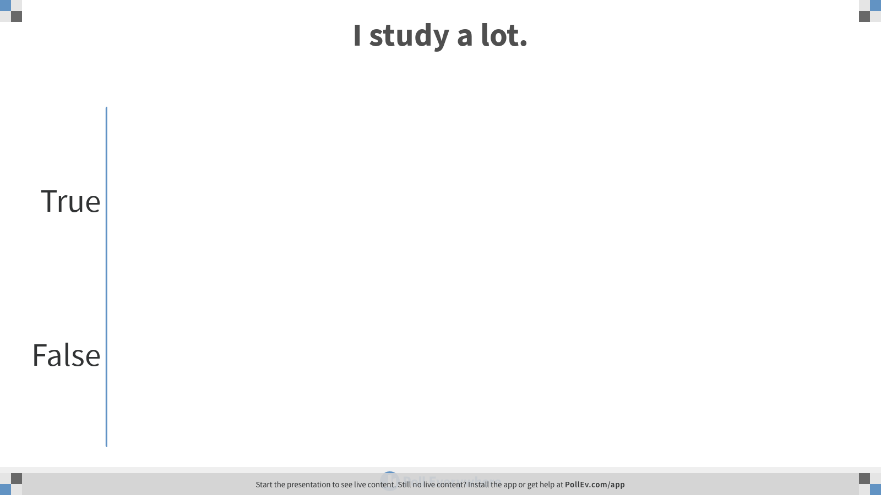
Notes:
Poll Title: I study a lot.
https://www.polleverywhere.com/multiple_choice_polls/Zz3Dk2c2zrqouu1kRuuCH

Slide 16
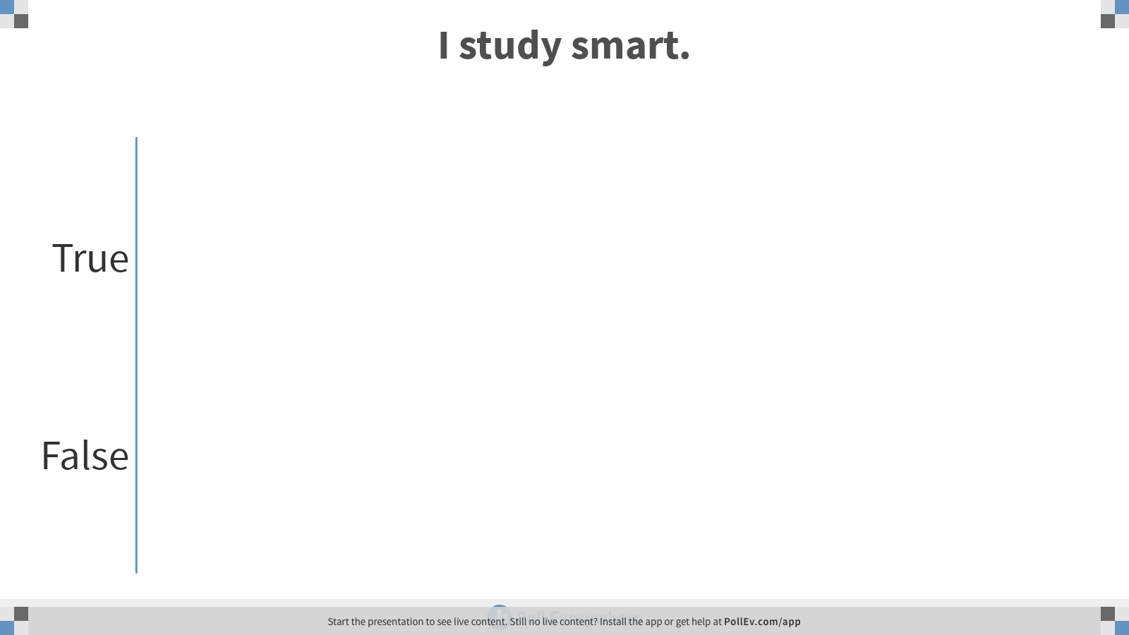
Notes:
Poll Title: I study smart.
https://www.polleverywhere.com/multiple_choice_polls/zTeBThKhGflkimiOhQ2nn

Slide 17
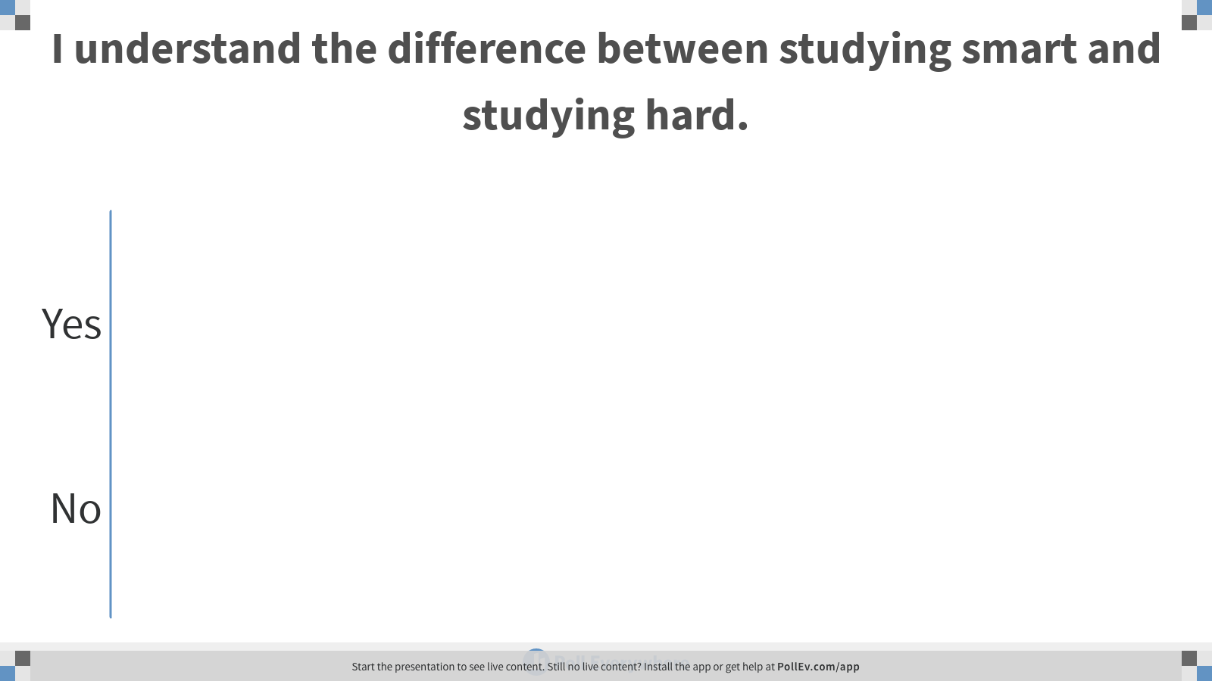
Notes:
Poll Title: I understand the difference between studying smart and studying hard.
https://www.polleverywhere.com/multiple_choice_polls/zDfSy8e9HJTUxBXoh9fi1

Slide 18


Slide 19


Slide 20

SEEI ACTIVITY
ACADEMIC SUCCESS

Slide 21

POLL EVERYWHERE
ACTIVITY
ACADEMIC SUCCESS

Slide 22
POLL EVERYWHERE
INSTRUCTIONS
Text ___________ to _____________
Answer the prompts by texting in your responses

Slide 23

STUDY APPS
ACTIVITY
ACADEMIC SUCCESS

Slide 24

QUIZLET
ACTIVITY
ACADEMIC SUCCESS

Slide 25
ACADEMIC SUCCESS

Slide 26

DISCUSSION
ACADEMIC RESOURCES
pg. 64

Slide 27
ACADEMIC SUCCESS CENTER
DINKINS HALL, ROOM 106
ATTEND A TUTTEE SEMINAR
WINTHROP.EDU/SUCCESS

Slide 28
BUSINESS RESOURCE ROOM
THURMOND HALL, ROOM 107

Slide 29
HOUSE CALLS
TUTORING
CALL 803.323.1422

Slide 30
INTERNATIONAL STUDENT TUTOR
DINKINS HALL, ROOM 219

Slide 31
MATH TUTORIAL CENTER
BANCROFT HALL, ROOM 271

Slide 32
WRITING CENTER
BANCROFT HALL, ROOM 242
SCHEDULE APPOINTMENT AT
WINTHROP.MYWCONLINE.COM

Slide 33


ASSIGNMENTS
DUE NEXT WEEK

Slide 34
INTERIM GRADES POSTED
Monday, OCTOBER 7th
WINGSPAN.WINTHROP.EDU

Slide 35
INTERIM GRADES
• Login to Wingspan
and print interim grades
• Bring printed interim grades next week to ACAD

Slide 36
• Watch the State Scholarship video from Financial Aid
https://www.youtube.com/watch?v=d7hdJBELxZc
• Complete the Financial Aid Video Guide (pg. 70) as you watch the video

Slide 37


ANNOUNCEMENTS
& UPCOMING EVENTS

