Slide 1


WEEK SIX: TIME MANAGEMENT

Slide 2
How many hours are
in a given week?

Slide 3
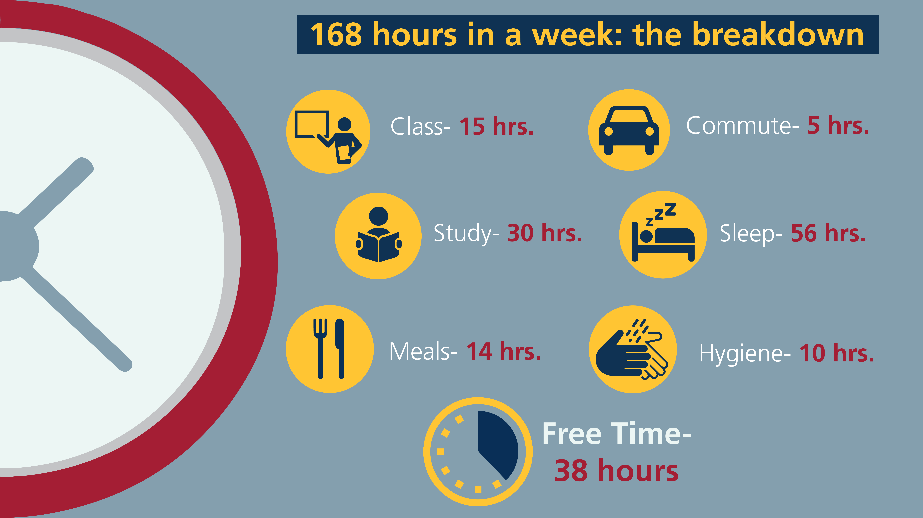

pg. 55

Slide 4
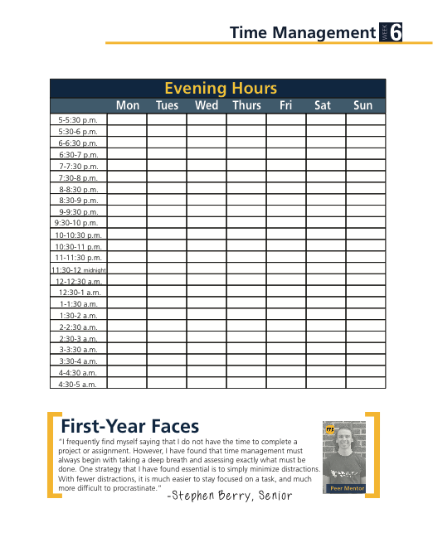

Slide 5

TIME INVENTORY
WHERE DOES MY TIME GO?
pg. 54

Slide 6
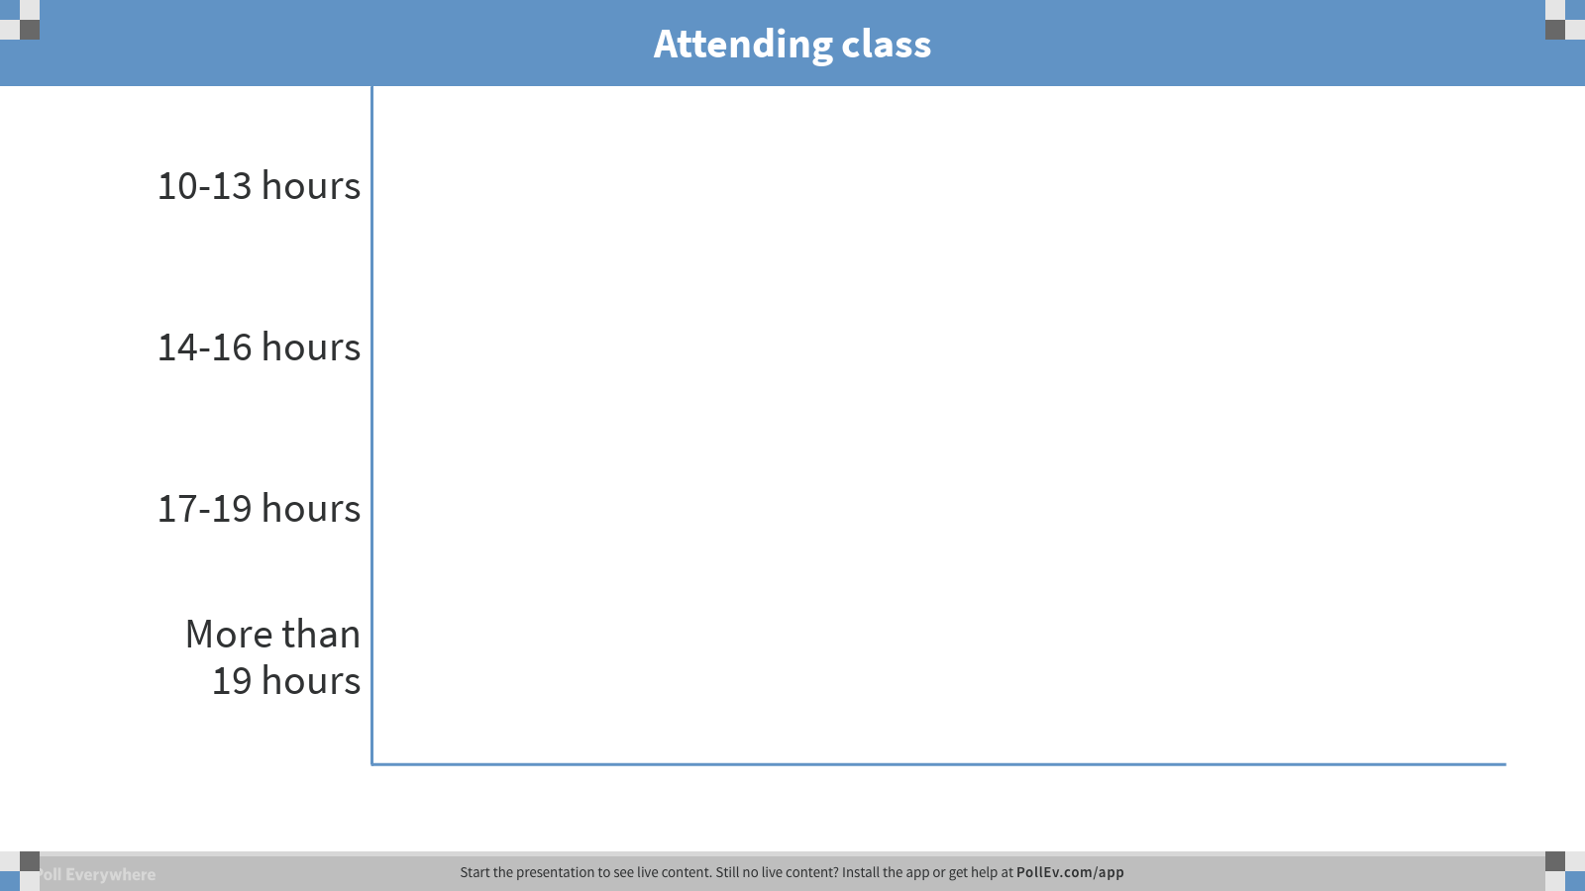
Notes:
Poll Title: Attending class
https://www.polleverywhere.com/multiple_choice_polls/RcAfC7p70iZBOxh

Slide 7
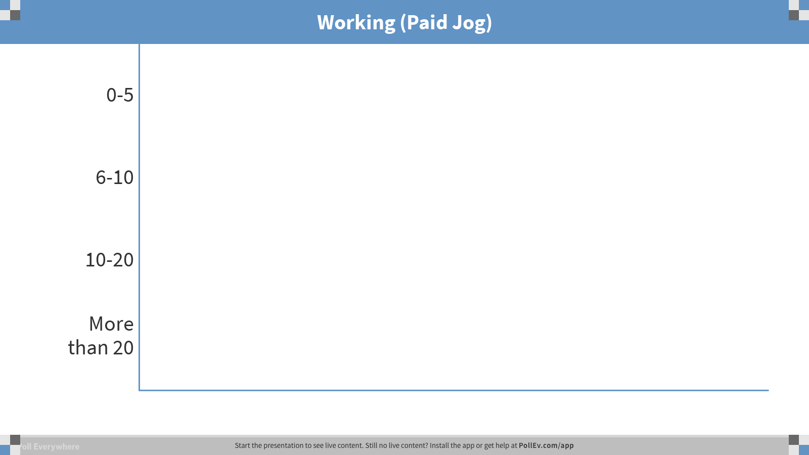
Notes:
Poll Title: Working (Paid Jog)
https://www.polleverywhere.com/multiple_choice_polls/Ic6u4d34tjoOaYX

Slide 8
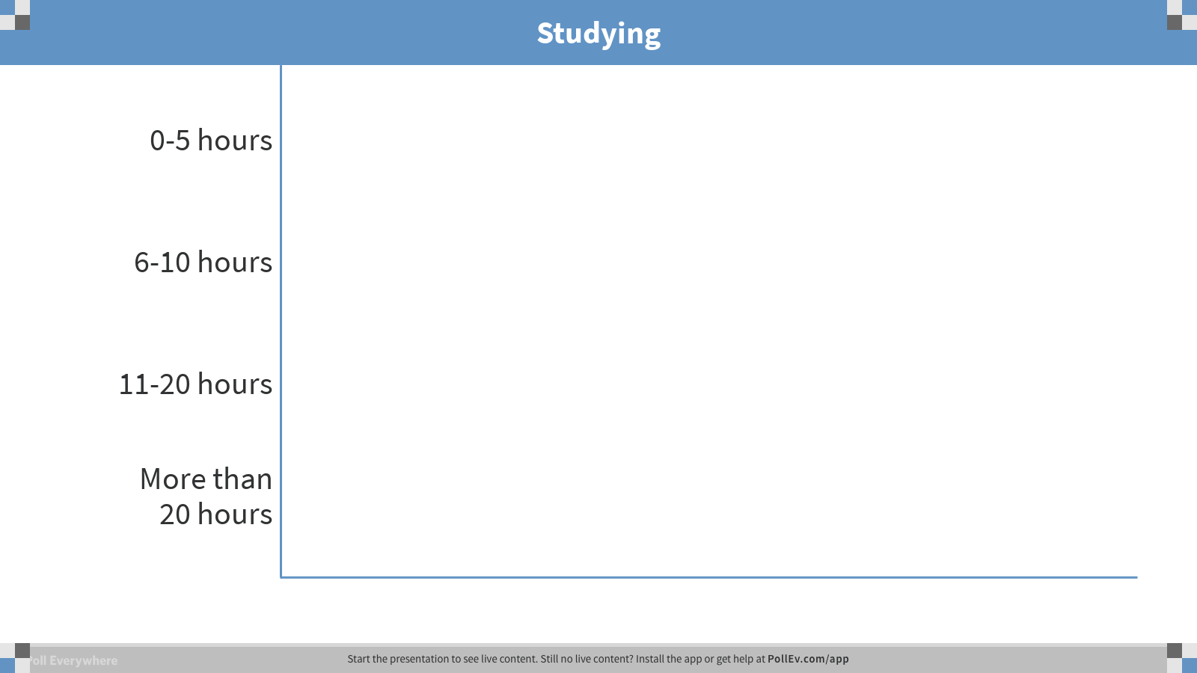
Notes:
Poll Title: Studying
https://www.polleverywhere.com/multiple_choice_polls/6TlbhDXukXnQQN2

Slide 9
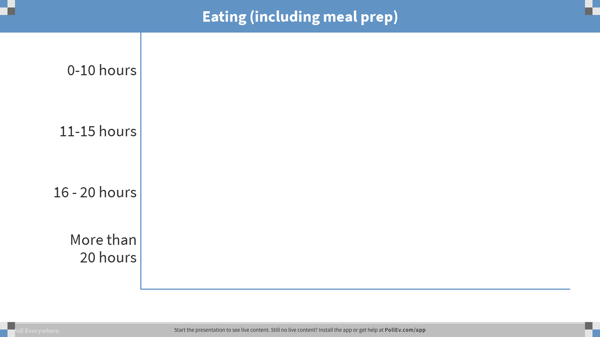
Notes:
Poll Title: Eating (including meal prep)
https://www.polleverywhere.com/multiple_choice_polls/6jNwB64Ordv5qUe

Slide 10
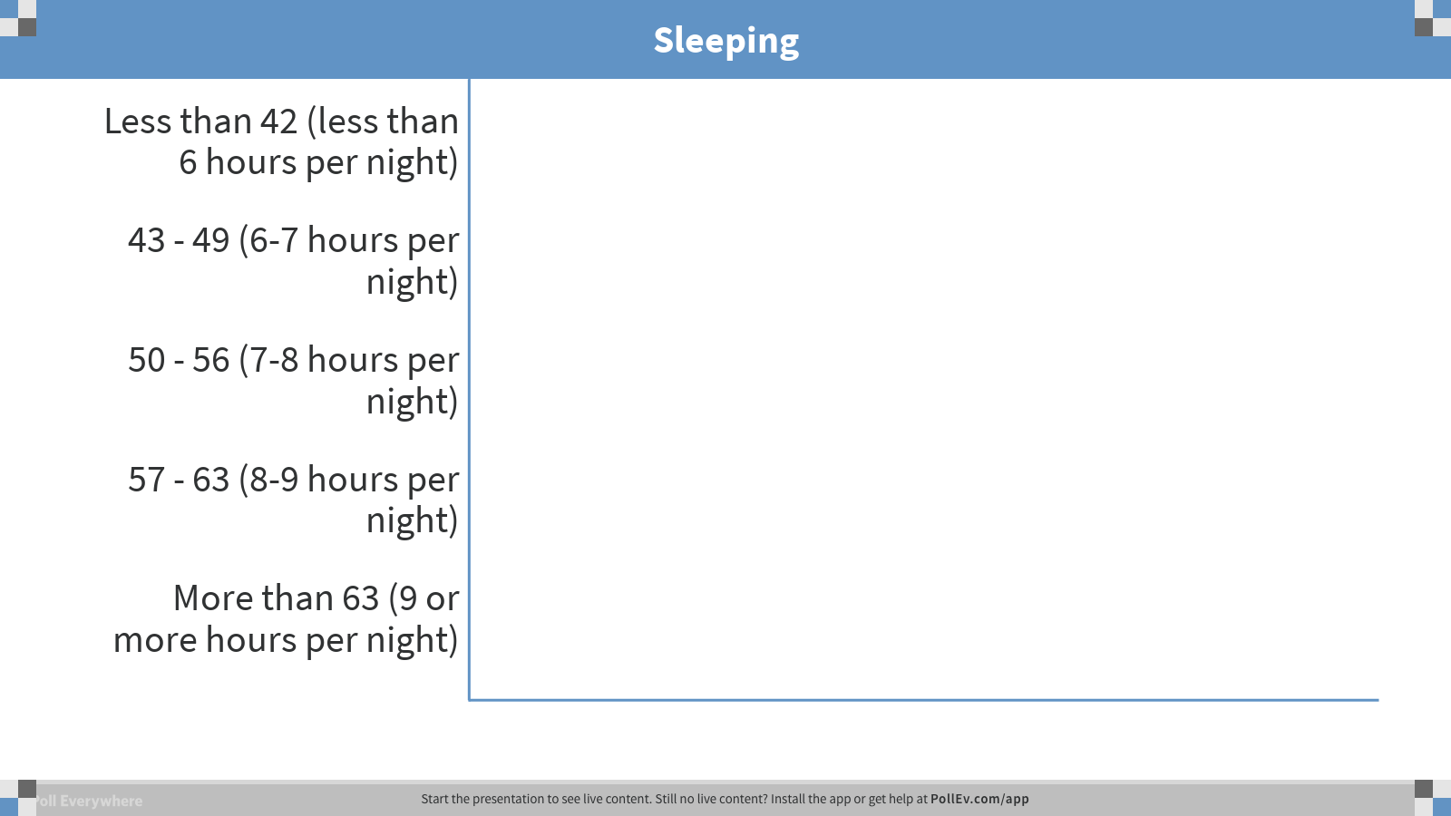
Notes:
Poll Title: Sleeping
https://www.polleverywhere.com/multiple_choice_polls/6AnkkaVHiGC7JnX

Slide 11
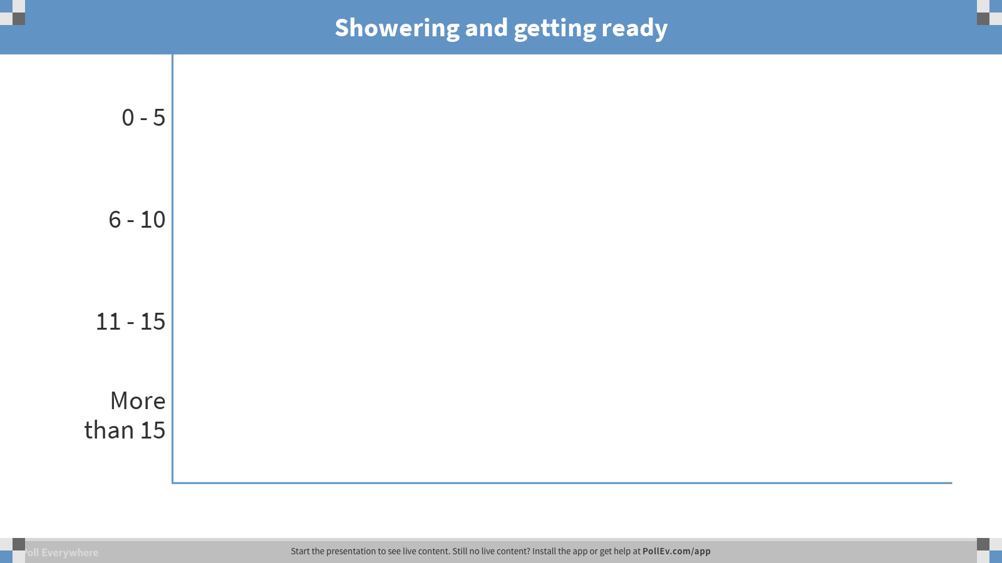
Notes:
Poll Title: Showering and getting ready
https://www.polleverywhere.com/multiple_choice_polls/ZRcs2EDkqU0ad2g

Slide 12
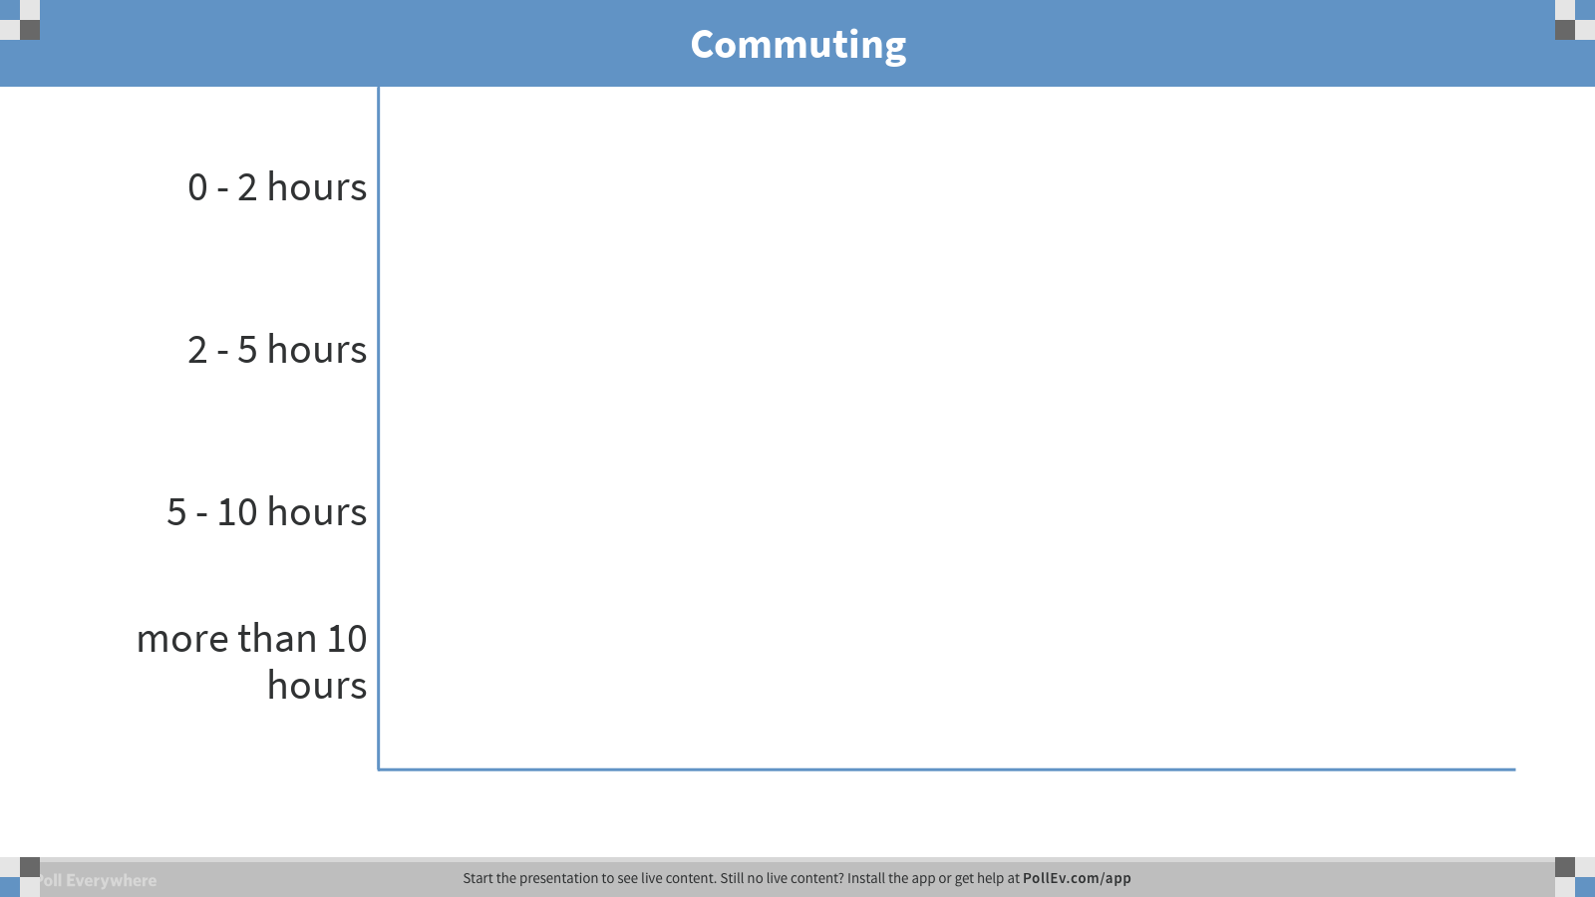
Notes:
Poll Title: Commuting
https://www.polleverywhere.com/multiple_choice_polls/GUjuSFj9OcQytpl

Slide 13
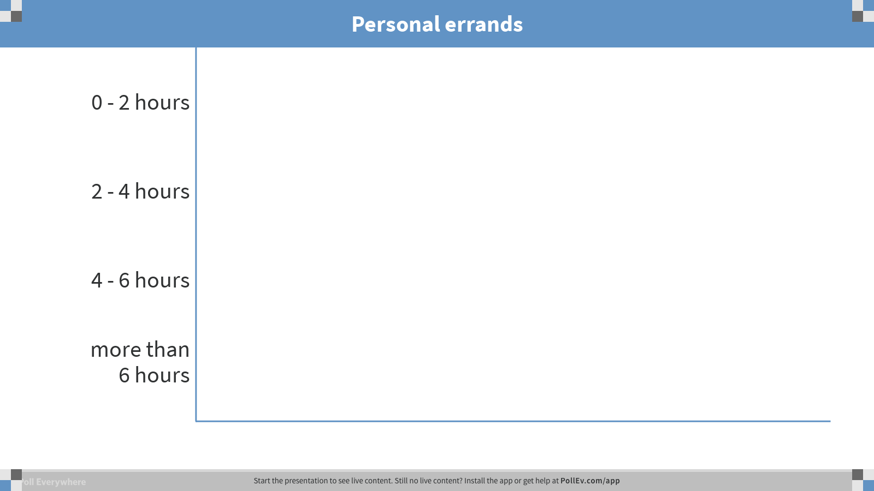
Notes:
Poll Title: Personal errands
https://www.polleverywhere.com/multiple_choice_polls/szLP8C4iD3YD5me

Slide 14
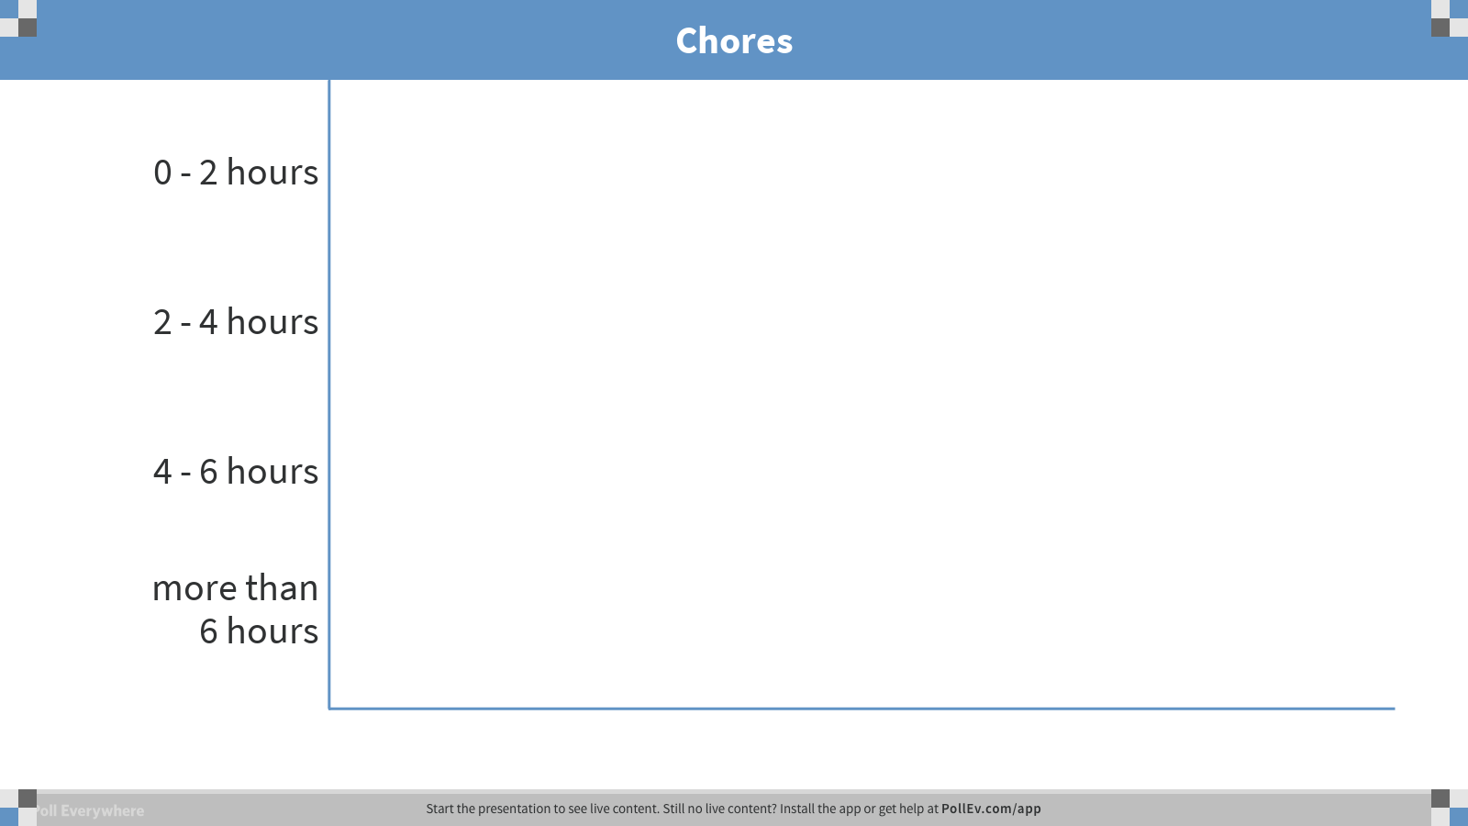
Notes:
Poll Title: Chores
https://www.polleverywhere.com/multiple_choice_polls/6XvseWFQjSDzCAF

Slide 15
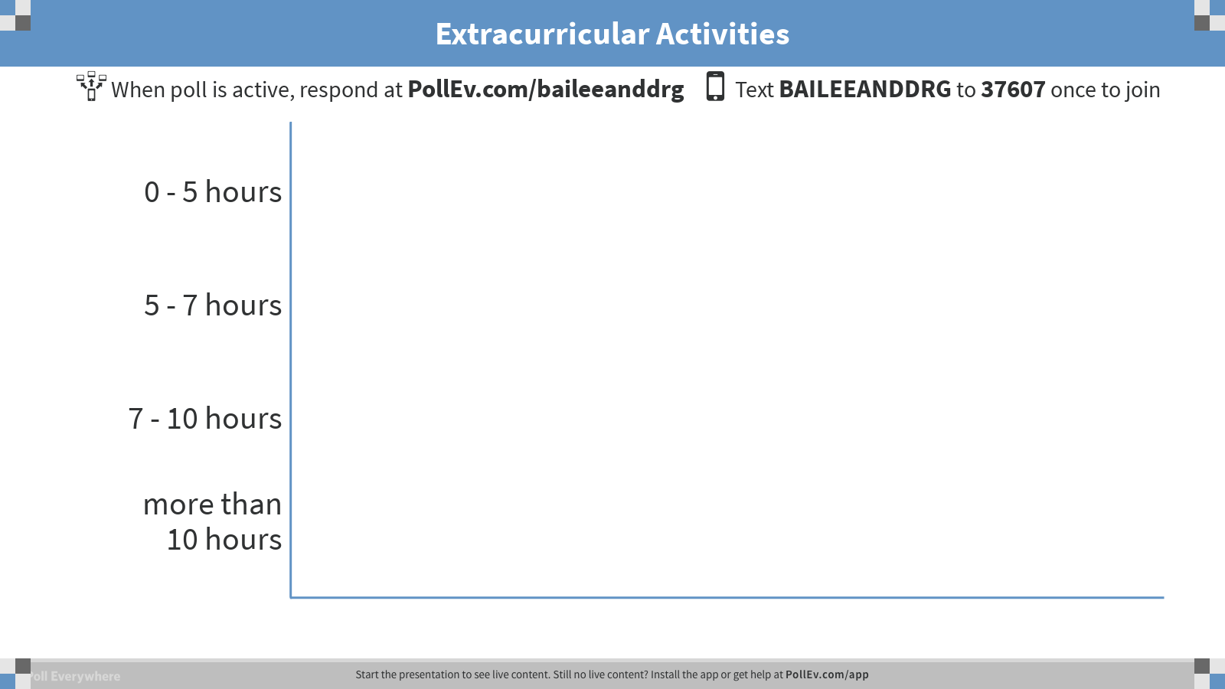
Notes:
Poll Title: Extracurricular Activities
https://www.polleverywhere.com/multiple_choice_polls/I8l7ALvUOOlEEmJ

Slide 16
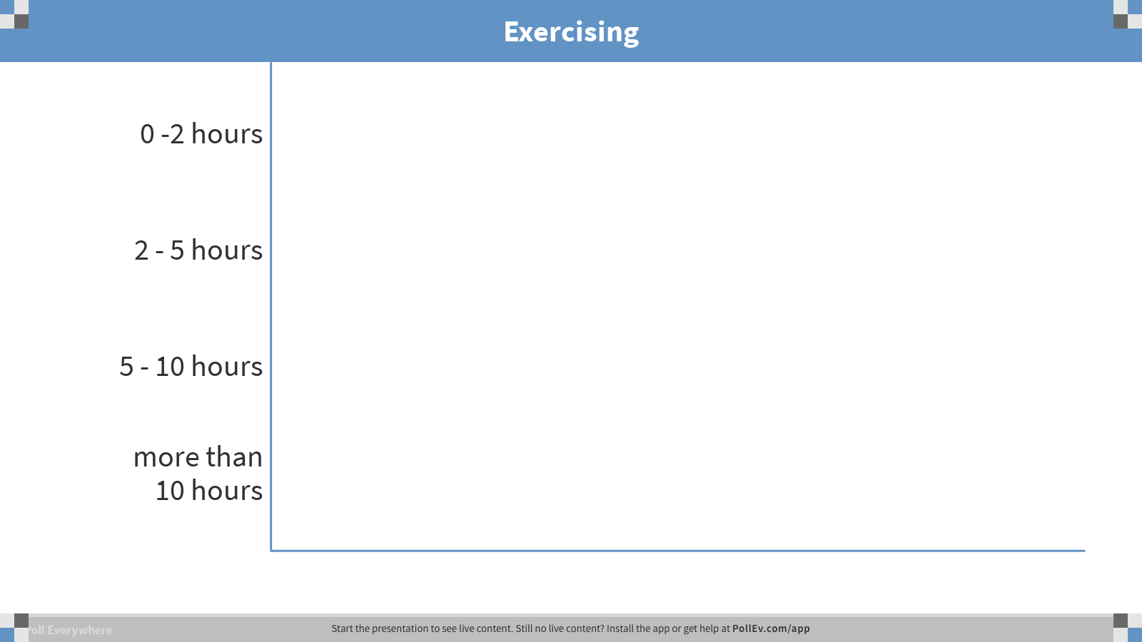
Notes:
Poll Title: Exercising
https://www.polleverywhere.com/multiple_choice_polls/rbtx3s5VF1BCrNU

Slide 17
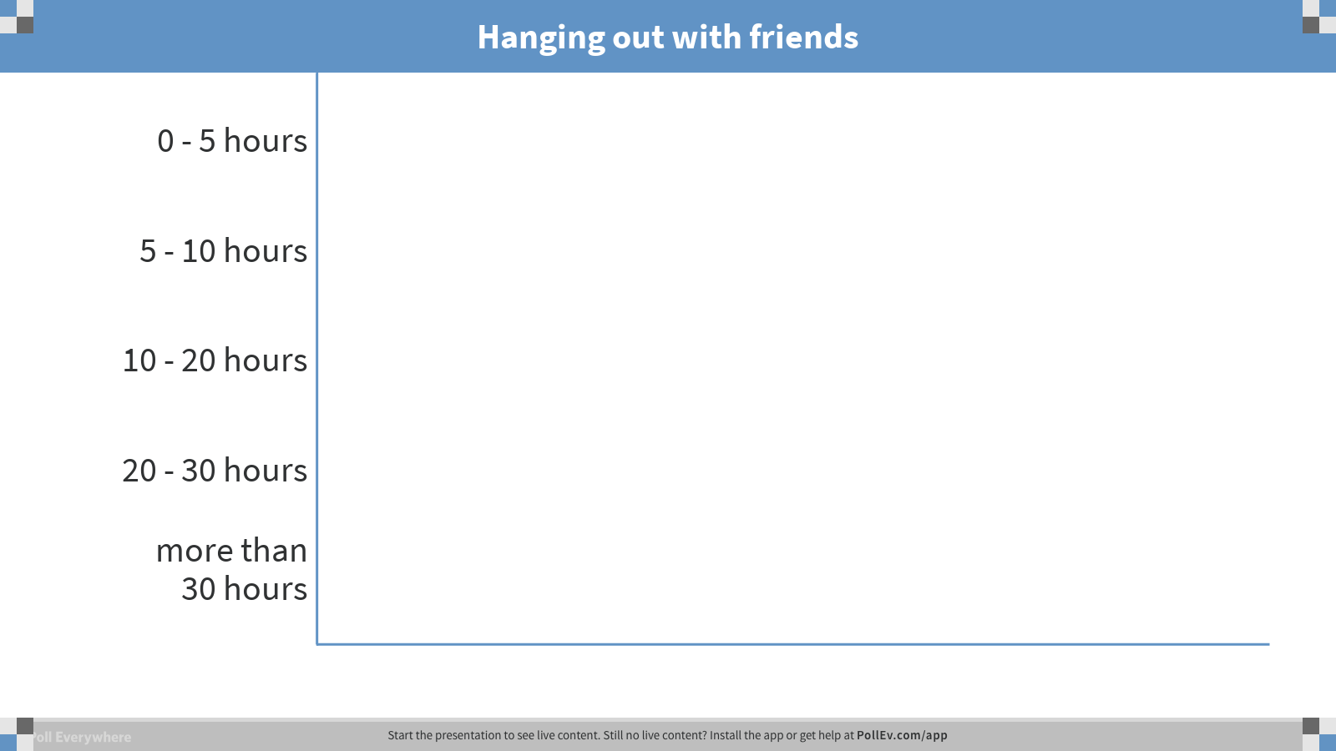
Notes:
Poll Title: Hanging out with friends
https://www.polleverywhere.com/multiple_choice_polls/JshTMs2nBXxTWrc

Slide 18
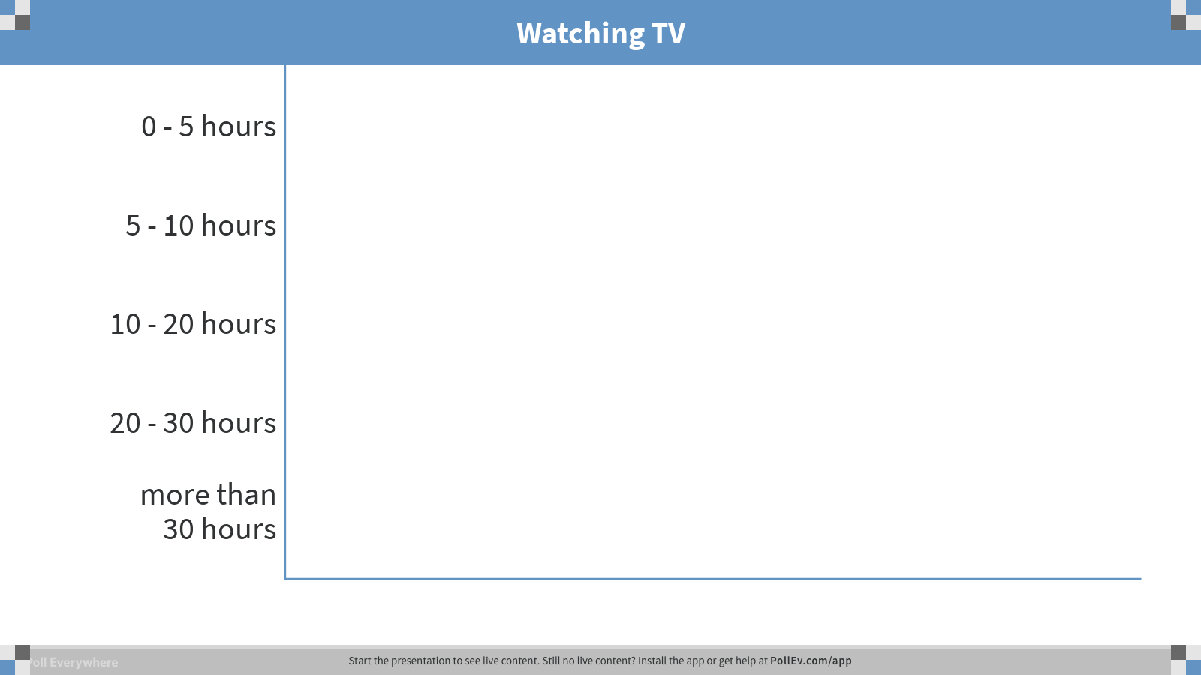
Notes:
Poll Title: Watching TV
https://www.polleverywhere.com/multiple_choice_polls/VRdJK7DvJPcAmaR

Slide 19
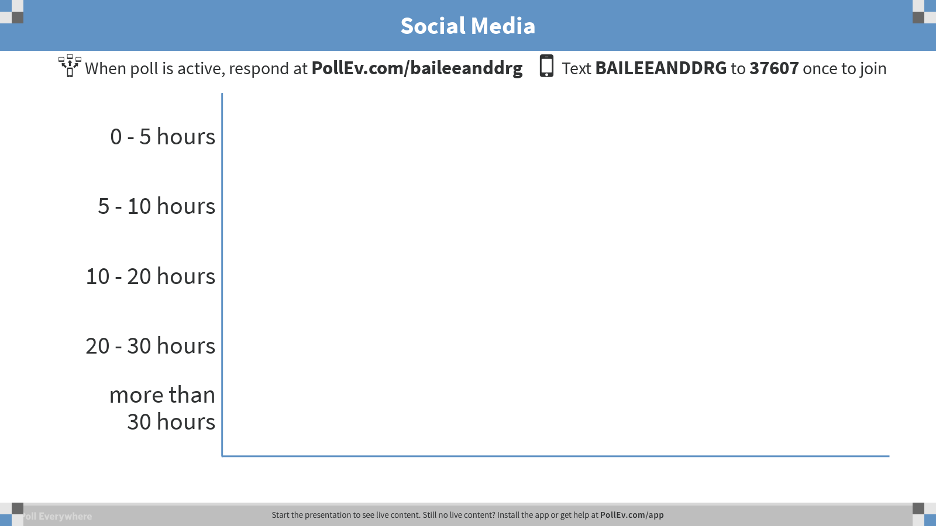
Notes:
Poll Title: Social Media
https://www.polleverywhere.com/multiple_choice_polls/57TnIMVlYNSCdVm

Slide 20

Notes:
Poll Title: Any additional activities
https://www.polleverywhere.com/multiple_choice_polls/Si24fGDhJLeRgOF

Slide 21
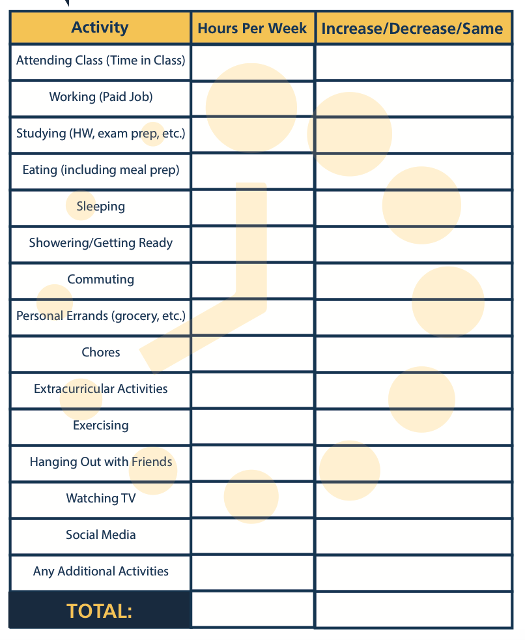
DISCUSSION
Time Management Inventory
pg. 54

Slide 22
IMPROVING TIME
MANAGEMENT
KEY STRATEGIES TO IMPLEMENT

Slide 23



Slide 24

TOP 10 TIPS ACTIVITY
DISCUSS WITH PEERS
pg. 51

Slide 25
pg. 51

Slide 26


ASSIGNMENTS
DUE NEXT WEEK

Slide 27
• Study Skills Inventory (pg.58-60)
• Motivation Inventory (pg. 62)
• Student Organization Reflection
(pg. 36)
• Making Connections: Peer Mentor One-on-One (pg. 24)

Slide 28

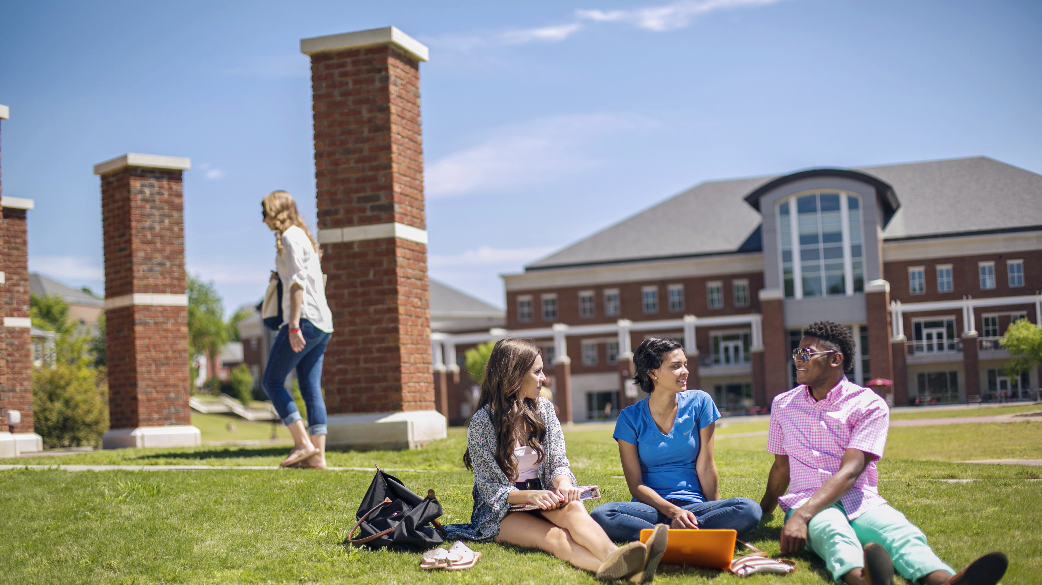
ANNOUNCEMENTS
& UPCOMING EVENTS

