Slide 1
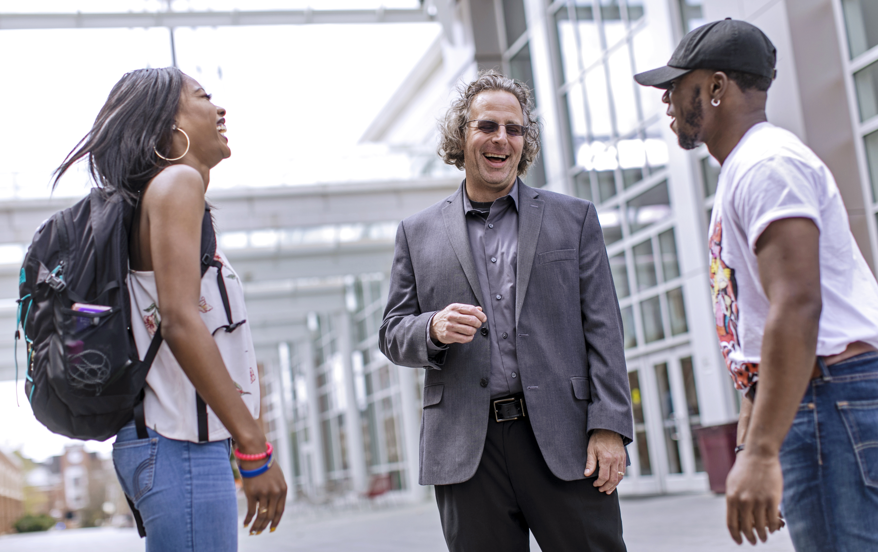

WEEK ELEVEN: CORE VALUES

Slide 2
Do you know your
core values?

Slide 3

CORE VALUES
ACTIVITY
pg. 80

Slide 4
CORE VALUES ACTIVITY
RULES FOR ACTIVITY:
Take this activity seriously as it will define core values for you
Refrain from talking during specific times
There will be time at the end of the activity for personal and professional reflection

Slide 5
4 PEOPLE
that are the most important to you;
family, friends, mentors, professors, etc.

Slide 6
4 POSSESSIONS
material items/personal possessions that you value the most (List only one item per bullet)

Slide 7
4 GOALS
important goals that you have set for your future
(Can be immediate or long-term; however you define this)

Slide 8
4 EXPERIENCES
things you always want to remember– either good or tough experiences, anything that you have learned from

Slide 9
4 VALUES
qualities or beliefs that are important to you– either a current quality you have to exude or something you hope
to strive for

Slide 10
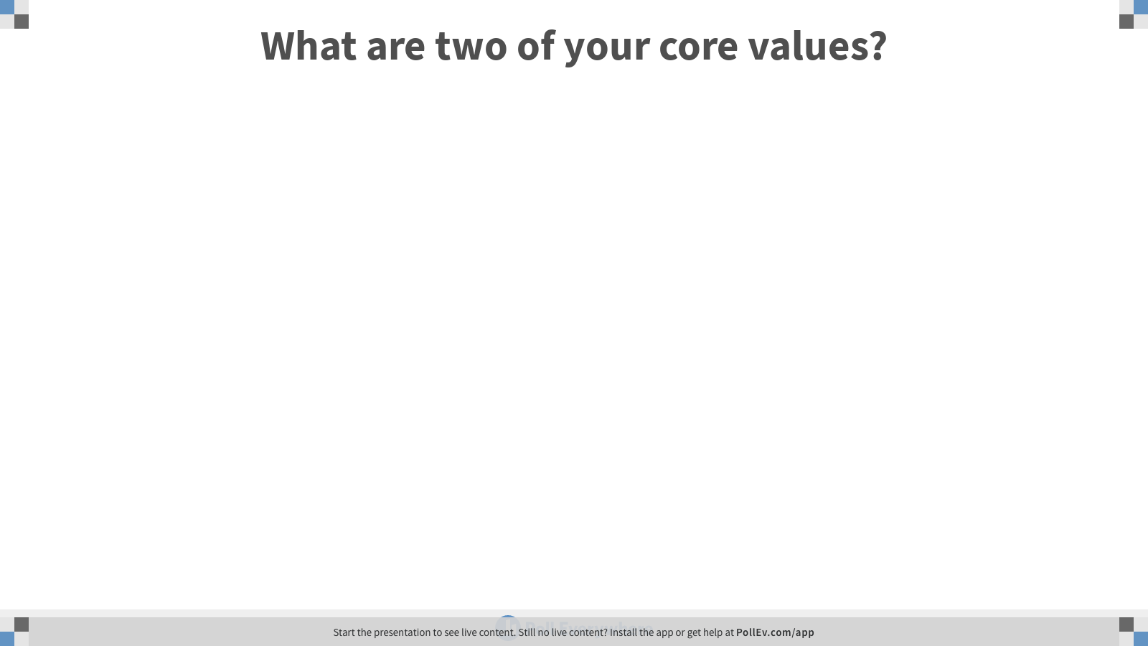
Notes:
Poll Title: What are two of your core values?
https://www.polleverywhere.com/free_text_polls/Hqr4Zo9pdYX4IOOLz5YbB

Slide 11
Why are these things most important to me?

Slide 12
CORE VALUES DISCUSSION
WHY? DIG DEEPER
What values are you left with?
Did you find this exercise easy? Hard? Why?
What did you learn about yourself from this activity?
What pressures (in college and beyond might you experience that would force you to make challenging decisions with regards to your values?

Slide 13
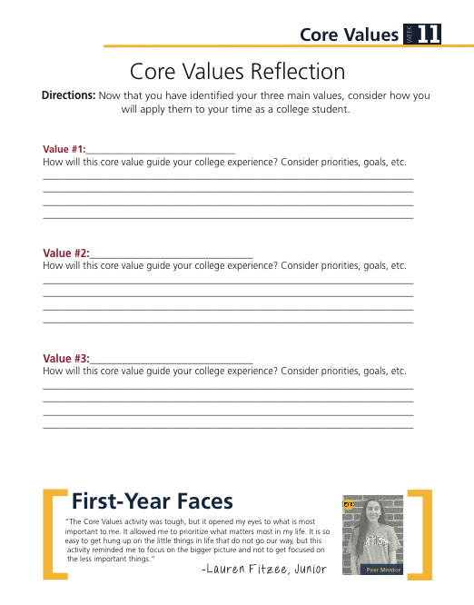
CORE VALUES
REFLECTION
ACTIVITY
pg. 81

Slide 14


ASSIGNMENTS
DUE NEXT WEEK

Slide 15
  Making Connections – Faculty planner pg. 24
  Printed Degree Checklist
  Complete O*NET Assessment (planner pg. 83)
    Directions in Dropbox
    EMAIL results to Yourself!

Slide 16
EARLY REGISTRATION OPEN
NOVEMBER 6TH

Slide 17

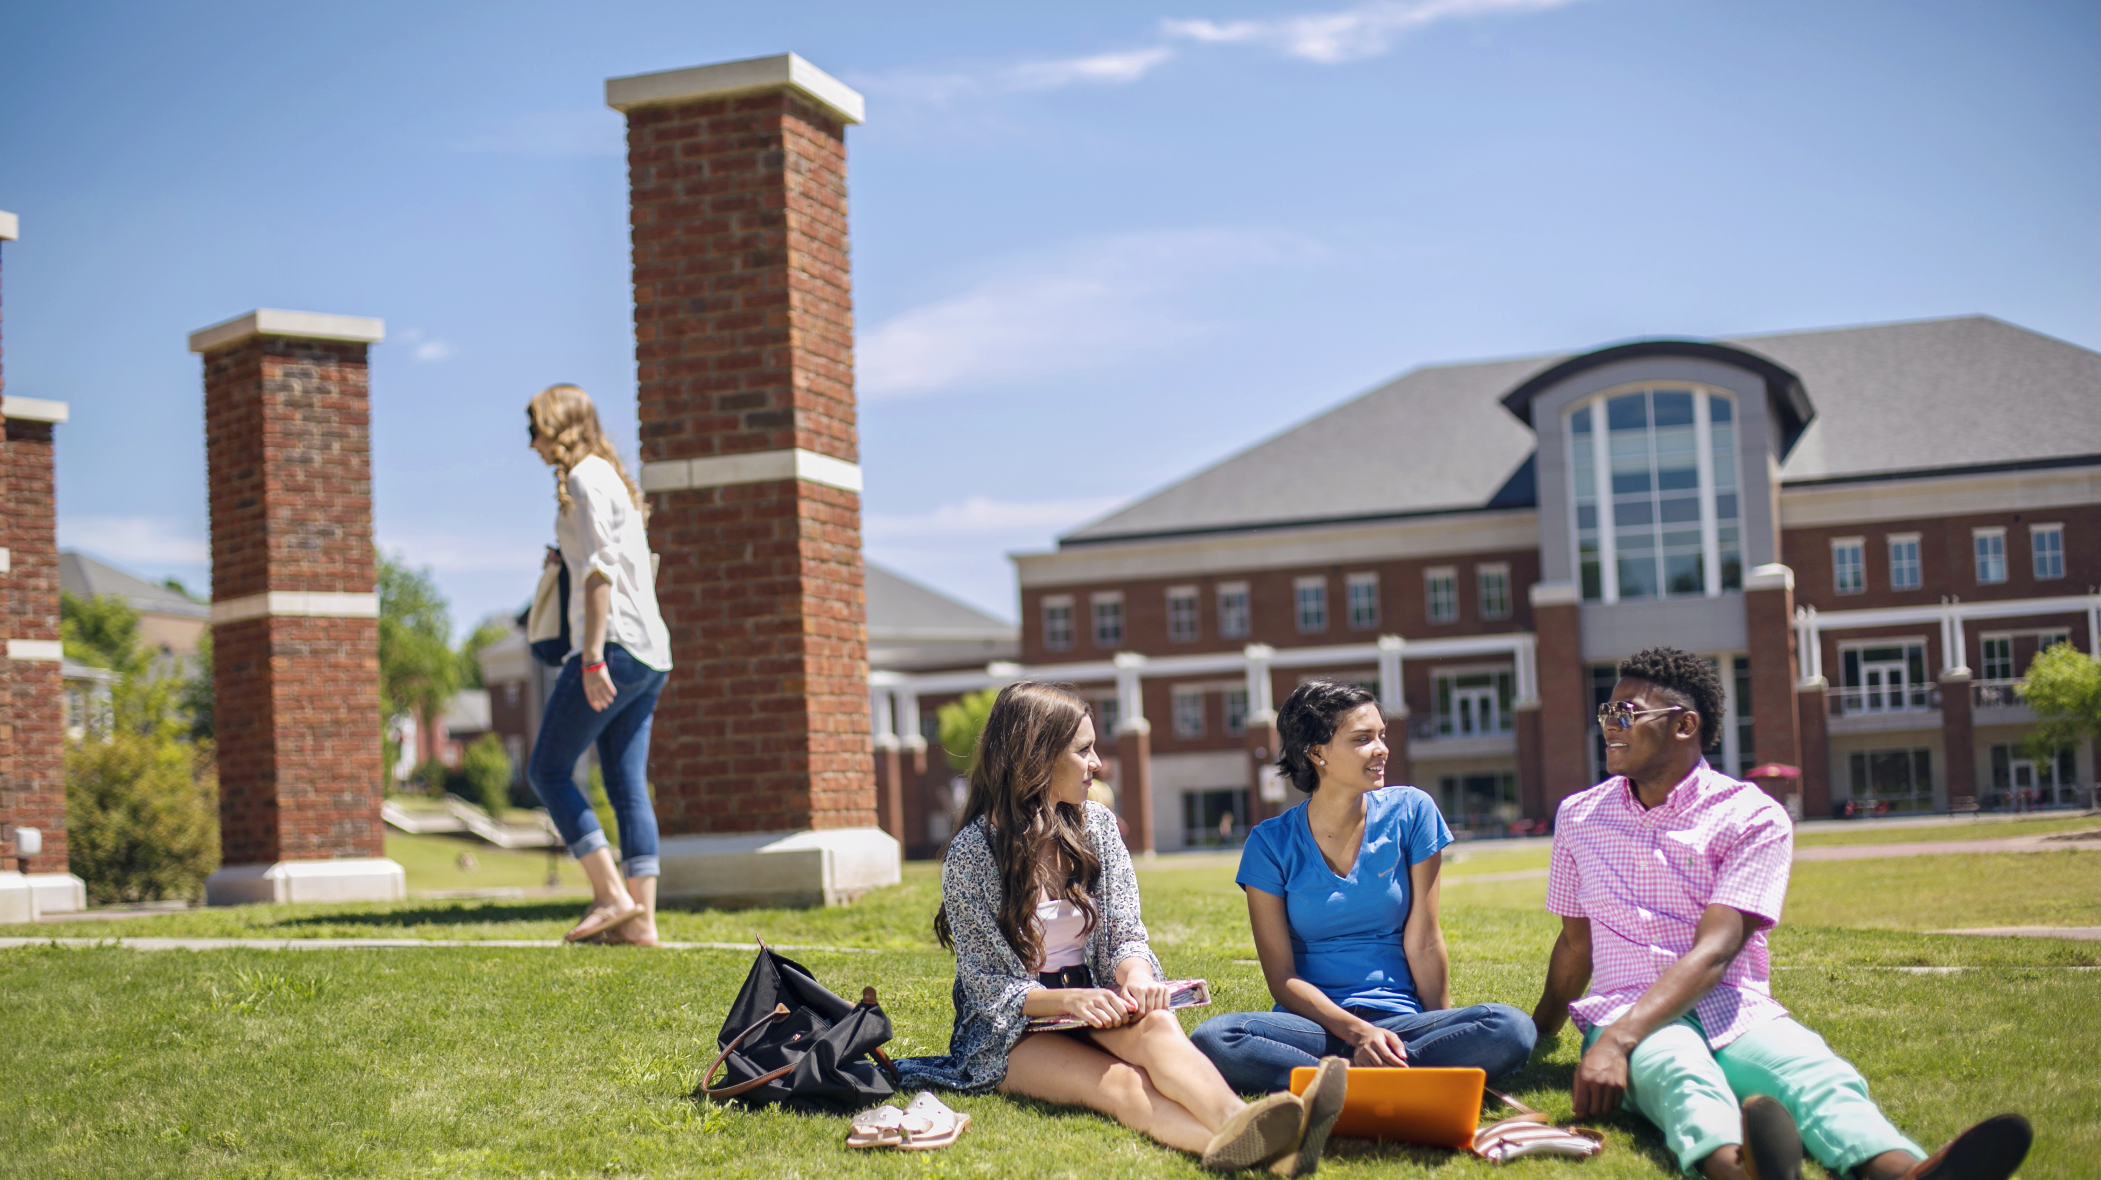
ANNOUNCEMENTS
& UPCOMING EVENTS

Slide 18


Slide 19

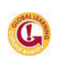
DIGS Lobby
TUES., November 12
11 am

