Slide 1
The Atmosphere
Structure and composition
Solar radiation budget
Greenhouse warming

Slide 2
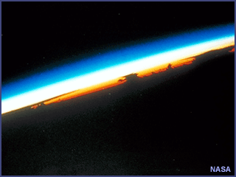
The Atmosphere
The thin envelope of air that surrounds our planet is a mixture of gases, each with its own physical properties.
http://www.ucar.edu/learn/1_1_1.htm

Slide 3
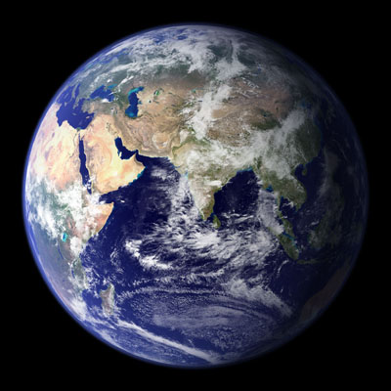
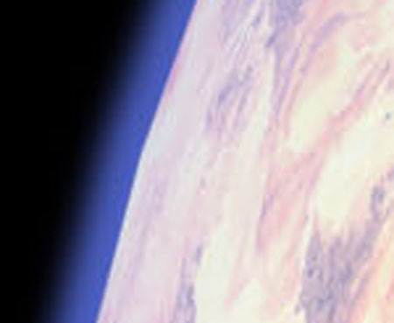
Images copyright NASA

Slide 4
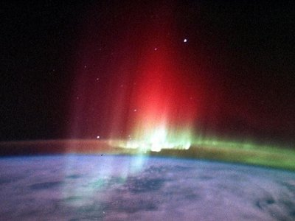
Aurora Borealis from Space
Caused by interaction of high energy particles from Sun with outer atmosphere.
http://www.doc.mmu.ac.uk/aric/eae/english.html

Slide 5
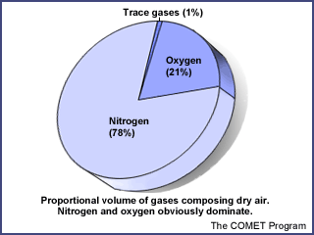
Composition of Dry Air
The atmosphere contains primarily N₂ and O₂
(78%+21%=99% of total)
The most abundant “trace gases” is the noble gas argon (Ar). Of the other gases, two of the most important are:
CO₂ (carbon dioxide) – the main “greenhouse gas” responsible for keeping the surface of the Earth warm, also essential for photosynthesis and thus vital for life
O₃ (ozone) – found primarily in the upper atmosphere, absorbs wavelengths of UV radiation that would be dangerous to surface life. When found at low altitude, it is a major pollutant.
http://www.ucar.edu/learn/1_1_1.htm

Slide 6
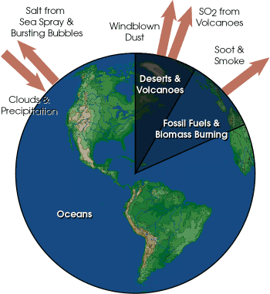
Other Components of the Atmosphere
Water Vapor
Concentrations vary from trace amounts to about 4% in very humid environments (e.g., over the oceans)
Aerosols
Tiny particles suspended in the air. Tend to cool Earth by reflecting sunlight back to space. Also very important in precipitation.
http://earthobservatory.nasa.gov/

Slide 7
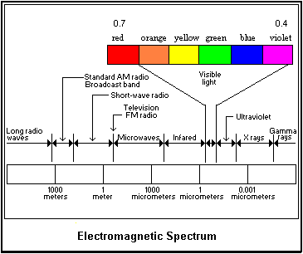
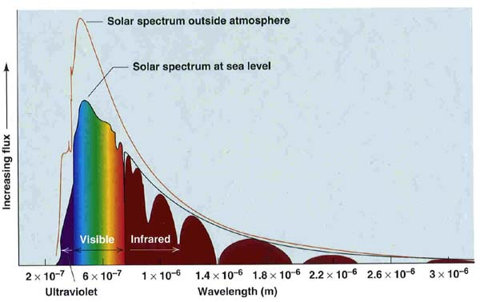
Solar Radiation
Almost all energy in the atmosphere ultimately comes from solar radiation.
http://physics.uwstout.edu/wx/Notes/ch2notes.htm
http://paos.colorado.edu/~toohey/study.html

Slide 8
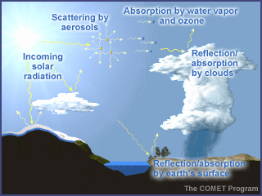
Solar Radiation
The “solar budget” sums up the fate of various portions of the incoming solar radiation
Solar radiation can be: reflected, scattered, and/or absorbed by the atmosphere and/or surface of the Earth.
http://www.ucar.edu/learn/1_1_1.htm

Slide 9
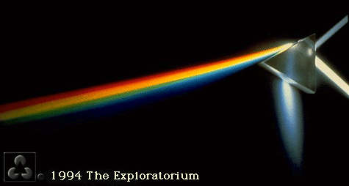
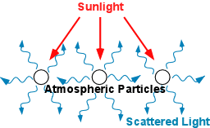
refraction
Radiation Scattering
Light refracts through gases and reflects off aerosols in the atmosphere.
The net result is that the light is scattered in all directions. This is why the daytime sky appears to be uniformly lit.
http://ww2010.atmos.uiuc.edu/(Gh)

Slide 10
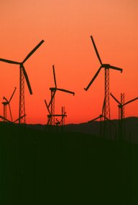
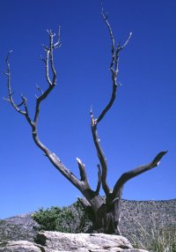
Atmospheric Scattering
Sunset - Longer Wavelengths
Noon - Shorter Wavelengths
Shorter wavelengths of light (e.g., blue) refract more than longer wavelengths (e.g., red), and are therefore more easily scattered. The thicker the atmosphere through which the light passes, the less blue (and the more red) the sky will appear.
http://www.doc.mmu.ac.uk/aric/eae/english.html

Slide 11
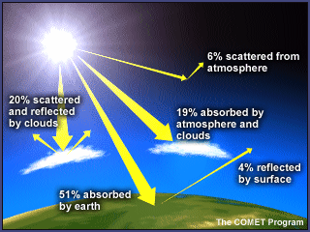
Average Solar Radiation Budget
70% absorbed
19% by atmosphere and clouds
51% by surface
30% reflected or scattered back to space
20% from clouds
6% from atmosphere
4% from surface
http://www.ucar.edu/learn/1_1_1.htm

Slide 12
http://www.ucar.edu/learn/1_1_1.htm
Radiation that is absorbed by the atmosphere or surface of the Earth heats those bodies.
The absorbed radiation energizes a number of natural process. Radiation absorbed by water molecules can cause a phase change (e.g., solid ice to liquid water or liquid water to water vapor).
Most of the large amount of radiation absorbed by the surface of the Earth is re-radiated to the lowest level of the atmosphere, heating it. This warm air expands, causing it to be buoyant, and thus rise into the atmosphere.
A tiny percentage of the solar budget is absorbed by photosynthetic plants, which use it to make organic fuel (sugar).

Slide 13
Average Solar Radiation Budget
70% absorbed
19% by atmosphere and clouds
51% by surface
30% reflected or scattered back to space
20% from clouds
6% from atmosphere
4% from surface
The solar budget differs from place to place on the Earth, e.g., the shiny white ice surfaces at high latitudes are much more reflective than dark green rainforests at the equator.
It also changes with climate. During ice ages, more land is covered with reflective ice, so less radiation is absorbed overall. A good volcanic eruption will put lots of aerosols in the atmosphere, increase scattering by the atmosphere.
http://www.ucar.edu/learn/1_1_1.htm

Slide 14
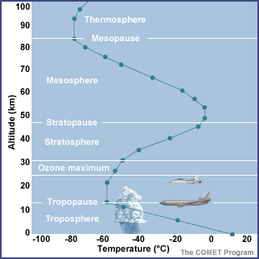
Temperature Structure of the Atmosphere
Thermosphere – temperature increases because of interaction with high energy radiation.
Mesosphere – temperature decreases with increasing altitude
Stratosphere – temperature increases due to activity in the ozone layer
Troposphere – temperature decreases with elevation above the heat source (the Earth’s surface)
http://www.ucar.edu/learn/1_1_1.htm

Slide 15
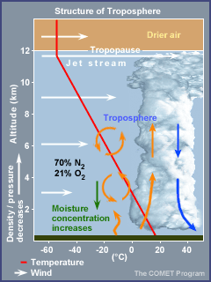
Troposphere - the highly variable lowest layer of the atmosphere.
Extends from Earth surface to approximately 12 km elevation
Pressure ranges from 1 atm to 0.2 atm.
Temperature averages 15ºC (59ºF) near surface, -57ºC (-71ºF) at top.
Average temperature decrease is called the environmental lapse rate
Wind speed increases with height up to jet stream.
Moisture concentration decreases with height
http://www.ucar.edu/learn/1_1_1.htm

Slide 16
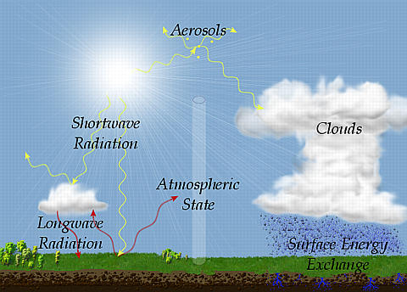
Greenhouse Warming
As the heated atmosphere and surface cool, they release energy as radiation back into the atmosphere. However, it is not the same wavelength energy as the original solar radiation.
http://www.arm.gov/docs/data.html

Slide 17
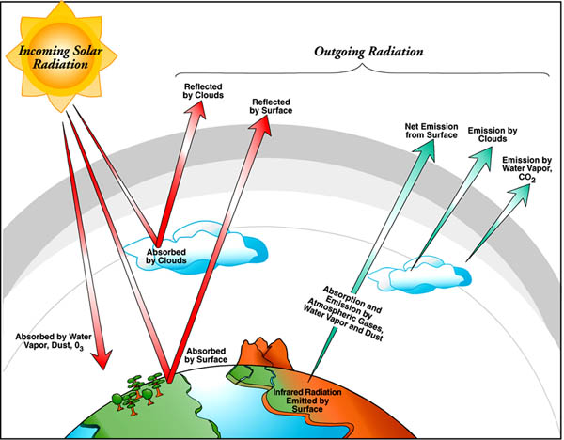
Greenhouse Warming
The Earth re-radiates energy as a “black-body” – an object that emits radiation at a wavelength dependant on its temperature. The Earth radiates in the infrared spectrum – a much longer wavelength than incoming solar radiation.
http://www.arm.gov/docs/data.html

Slide 18
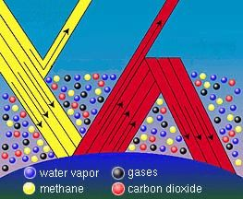
Greenhouse Warming
Several gases in the Earth’s atmosphere (particularly water, methane, and carbon dioxide) are relatively transparent to short wavelength radiation (e.g., incoming sunlight), but will readily absorb longer wavelengths (e.g., the infrared radiation emitted from Earth).
This re-absorption and re-radiation prevents energy from escaping back to space, and thus keeps the atmosphere and surface of the Earth warmer than it would be otherwise.
http://www.cmdl.noaa.gov/info/ipcc.html

Slide 19
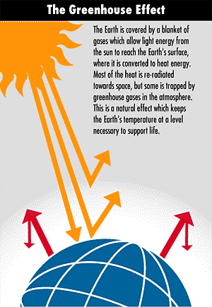
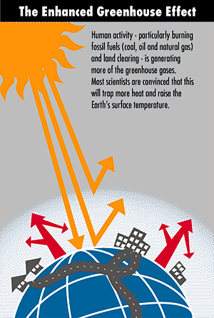
http://www.greenhouse.gov.au/

Slide 20
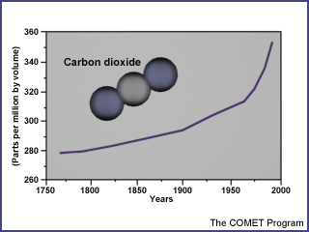
Greenhouse Warming
There are many greenhouse gasses, including the very important trace gas carbon dioxide.
O
C
O
http://www.ucar.edu/learn/1_1_1.htm

Slide 21
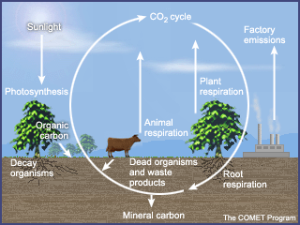
The Carbon Cycle
The amount of CO₂ in the atmosphere is controlled by a complex set of interacting biological and environmental processes.
Plants (and other photosynthetic organisms) remove CO₂ from the air and use it to produce biochemical energy (carbohydrates, e.g., C_{n}H_{2n}O₂). When these primary producers or their consumers use the biochemical energy, it is released back into the atmosphere as CO₂.
http://www.ucar.edu/learn/1_1_1.htm

Slide 22
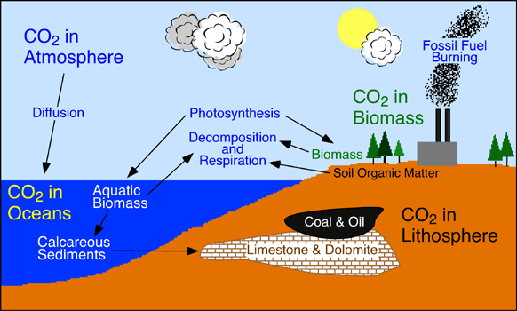
The Carbon Cycle
Some organic matter is semi-permanently removed by being buried and converted into fossil fuels (hydrocarbons, e.g., methane - CH₄). When those fuels are burned, the CO₂ is re-released into the atmosphere.
CO₂ is absorbed by processes other than photosynthesis (e.g., limestone formation CaCO₃). Some of these processes are very poorly understood, especially on the global scale.
http://www.geog.ouc.bc.ca/physgeog/contents/9r.html

Slide 23
Major Stores of Carbon on Earth
Store Metric Tons (x10⁹)
Sediments and Sedimentary Rocks ~100,000,000
Ocean ~39,000
Fossil Fuel Deposits 4,000
Soil Organic Matter ~1,550
Terrestrial Plants ~600
Atmosphere (1700) 578
Atmosphere (1999) 766
http://www.geog.ouc.bc.ca/physgeog/contents/9r.html

Slide 24
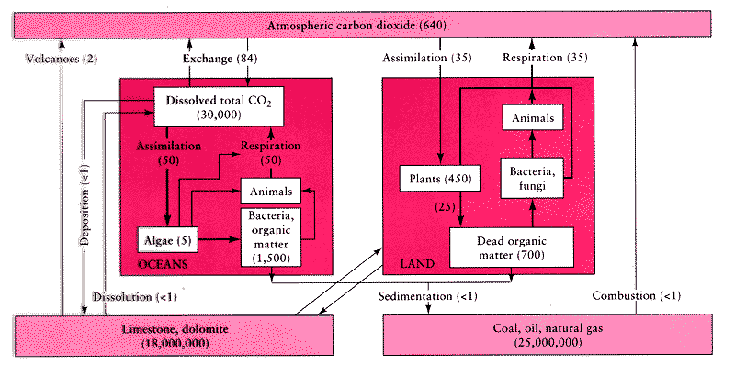
Tracking the interactions between all of the various groups of sources and sinks or CO₂ is quite complex. A linear change in one set of processes may cause an exponential change elsewhere!
http://essp.csumb.edu/esse/climate/climatefigures/Ccycle.html

Slide 25
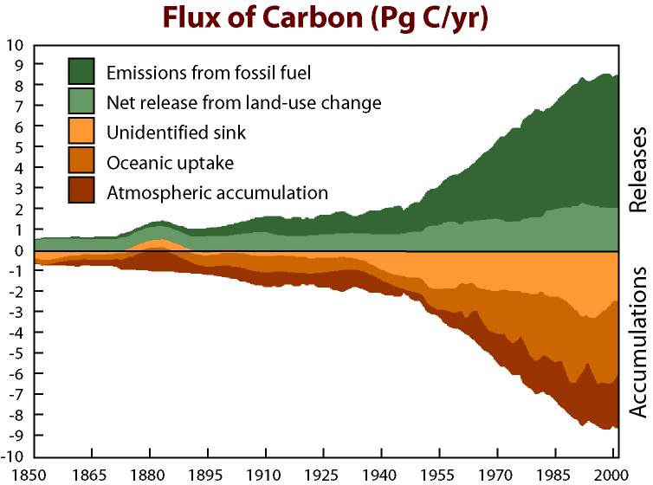
Thought to be due to a combination of factors including unexpectedly high uptake in intact tropical rainforests.
http://www.blog.thesietch.org/2007/06/24/exactly-where-does-all-that-co2-go-scientists-close-in-on-missing-carbon-sink/

Slide 26
Non-atmospheric CO₂ does not lead to warming!
Adds to atmospheric CO₂:
Respiration + Fossil Fuel Emission + Land Use Change
Takes away atmospheric CO₂:
Photosynthesis + Ocean Uptake + Land Uptake + Missing Uptake
http://www.whrc.org/science/carbon/carbon.htm

Slide 27
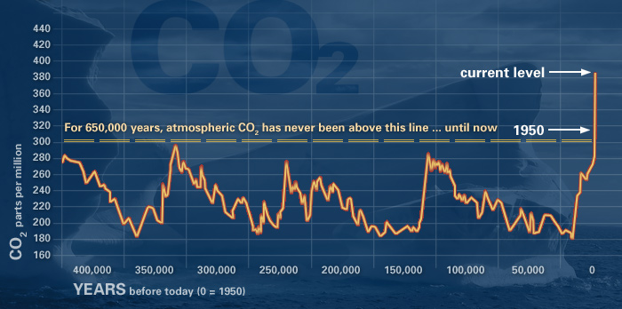
The rate of carbon dioxide accumulation in the atmosphere has risen at a rather alarming rate when viewed against the historical trend of the past half million years.
http://climate.nasa.gov/evidence

Slide 28
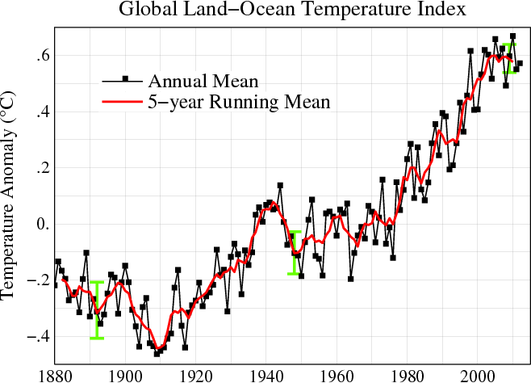
This rise in atmospheric carbon dioxide correlates with global temperature anomalies and global climate anomalies.
http://data.giss.nasa.gov/

