Slide 1
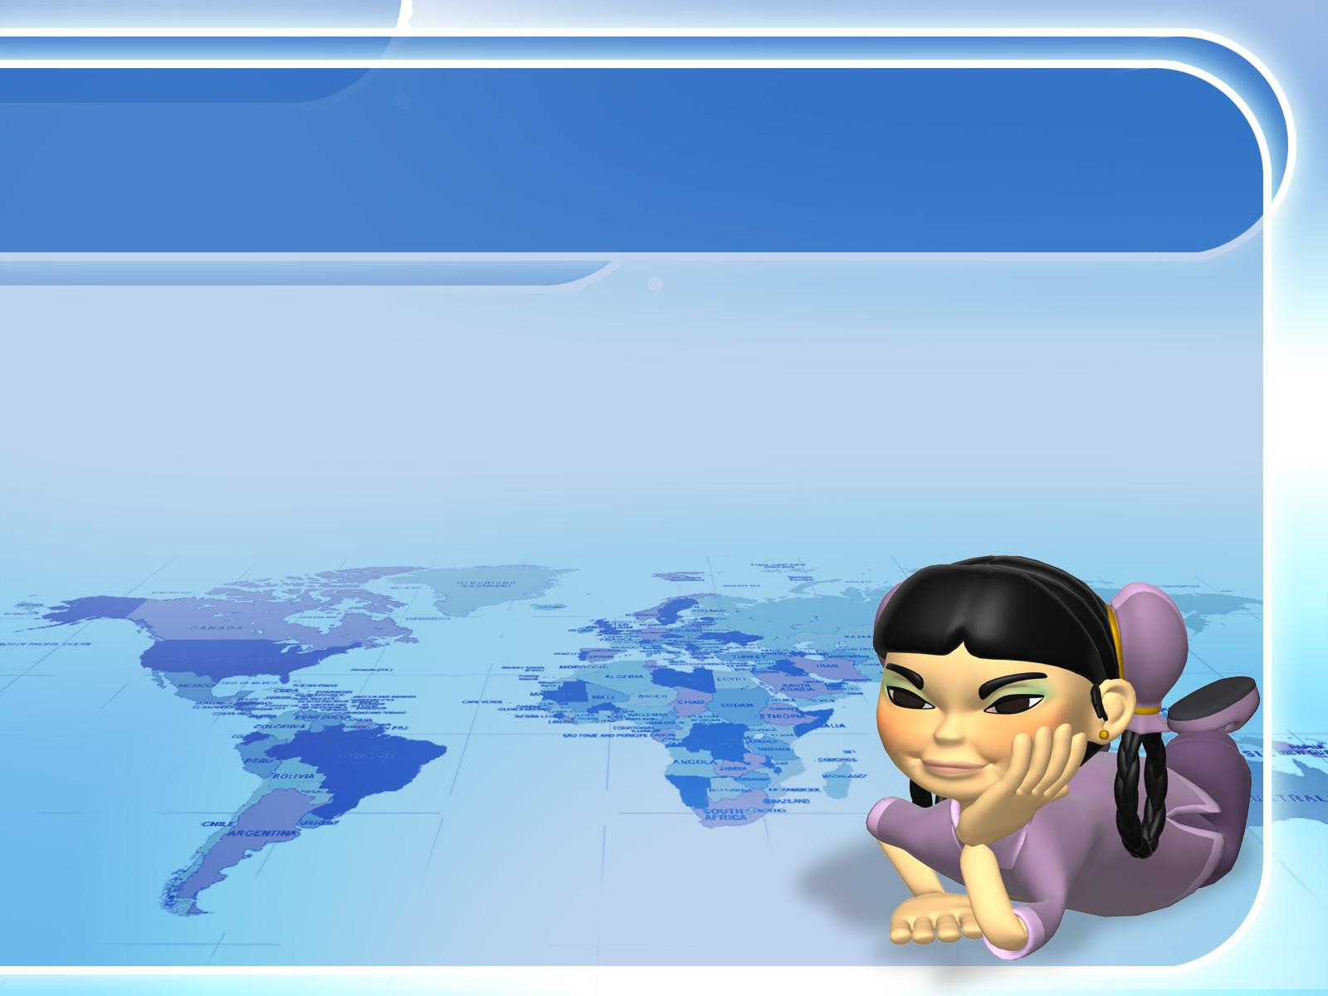
Plate Tectonics II: How it works

