Slide 1
Life: Diversity and Fossils
Taphonomy
Refractory versus volatile remains
Destruction
Modes of preservation
Diversity

Slide 2
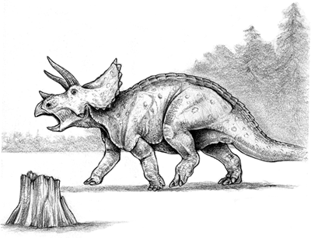
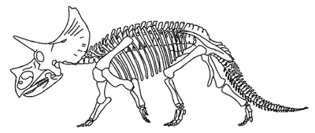
Taphonomy - the study of the post-mortem history of organic matter.
Building blocks of organic remains
Post-mortem history
Modes of preservation

Slide 3
Chemical Composition of the Human Body
PRIMARY ELEMENTS
H 63.0%
O 25.5%
C 9.5%
SECONDARY ELEMENTS
Ca 0.31%
P 0.22%
K 0.06%
S 0.05%
Na 0.03%
Cl 0.03%
Mg 0.01%
TRACE ELEMENTS (<0.01%)
Cr
Co
Cu
F
I
Fe
Mn
Mo
Se
Si
Sn
Zn
(Frieden 1972)

Slide 4
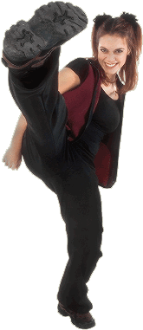
Chemical Composition of the Human Body
PRIMARY ELEMENTS
H 63.0%
O 25.5%
C 9.5%
carbohydrates
C_{n}H_{2n}O_{n}
SECONDARY ELEMENTS
Ca 0.31%
P 0.22%
K 0.06%
S 0.05%
Na 0.03%
Cl 0.03%
Mg 0.01%
amino acids
C₆H₁₄N₂O₂ (lysine)
TRACE ELEMENTS (<0.01%)
Cr
Co
Cu
F
I
Fe
Mn
Mo
Se
Si
Sn
Zn
Heme a
C₄₉H₅₆O₆N₄Fe
(Frieden 1972)

Slide 5
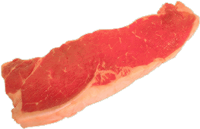
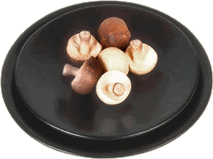
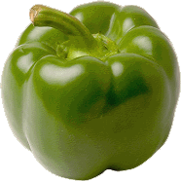
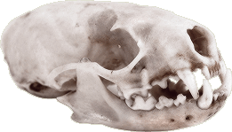
Soft Parts and Hard Parts
Volatile (“soft”)- easily and quickly digested
e.g, sugars, starches, fats, simple proteins
Refractory (“hard”)- tough to break down
e.g., biominerals, wood

Slide 6
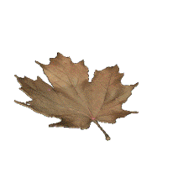
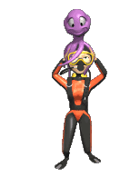
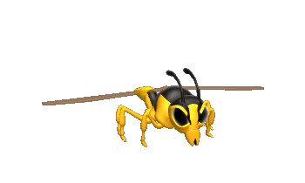
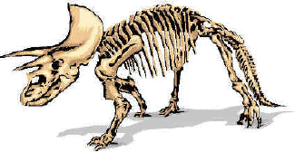
Common Refractory Biomolecules
Sporopollenin
oxidative polymer of carotenoid or carotenoid esters
dinoflagellates, acritarchs, plant spores and pollen
Cellulose
polysaccharide carbohydrate
plant cell walls
Lignin
polyaromatic
woody plants
Melanin
polyaromatic
cephalopod ink, fungi pigment
Chitin
polysaccharide carbohydrate
arthropod cuticle, fungi hyphae
Collagen
protein polymer
chordate bone and skin, graptolite periderm
(Allison and Briggs 1991)

Slide 7
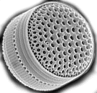
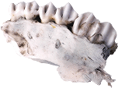
Common Biominerals
Aragonite
CaCO₃
scleractinian corals, some mollusks, some algae
Calcite
CaCO₃
rugose and tabulate corals, some brachiopods, bryozoans, some mollusks, echinoderms, calcareous nannofossils
Carbonates
Opalline Silica
SiO₂*(H₂O)
silicoflagellates, diatoms, radiolarians, some sponges
Apatite
Ca₅(PO₄)₃(OH, F)
Chordates, conodonts, some brachiopods
(Allison and Briggs 1991)

Slide 8
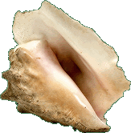
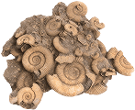
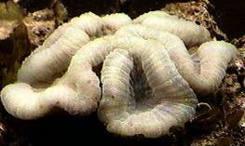
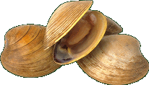
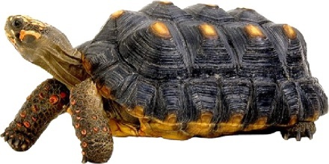
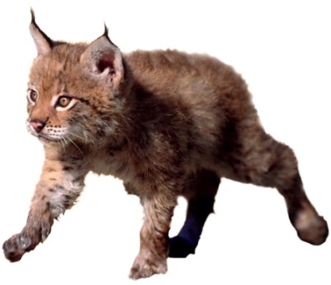
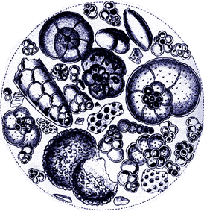
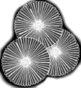
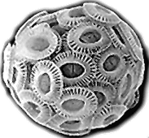
Cellulose and Lignin
Apatite and Collagen
Organisms with readily identifiable hard parts have good fossil records, e.g.
Clams, snails, and other creatures with shells
Corals and other organisms that make rocky skeletons
Animals with bones
Plants with wood
Plant spores and pollen
Many microscopic organisms with hard parts
Calcite and Aragonite
Calcite and Aragonite
Sporopollenin
Calcite, Aragonite, Silica, Sporopollenin, and others
microfossils

Slide 9
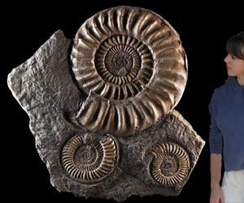
Post-Mortem Destruction
The fossil record is biased specifically against organisms without hard parts. Preservation of these animals requires some kind of special conditions. The more robust remains are also more likely to be preserved than delicate bits.
In a typical shallow water marine environment, approximately 40% of bottom-dwelling species have hard parts. Almost all of those species have fossil records.
Of the remaining 60% of species, almost none are found as fossils.

Slide 10
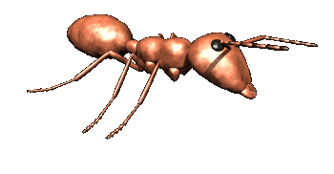
Post-Mortem Destruction
Remains left on the surface tend to degrade much more quickly than interred remains due to physical, chemical, and biological processes
scavenging, decay, recycling, accidental destruction
Preservation of fossil remains depends on relatively rapid and permanent burial.

Slide 11
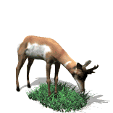
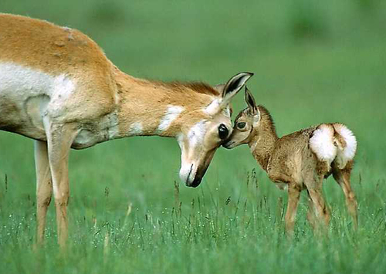
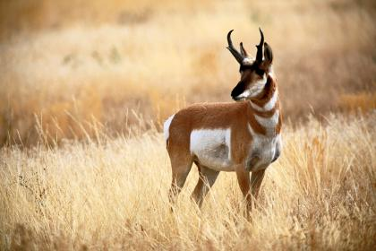
Post-mortem Decay
http://lauri.vox.com/library/posts/tags/dog/
A lot of energy goes into building and maintaining a living organism.
http://saltlakecity.about.com/

Slide 12
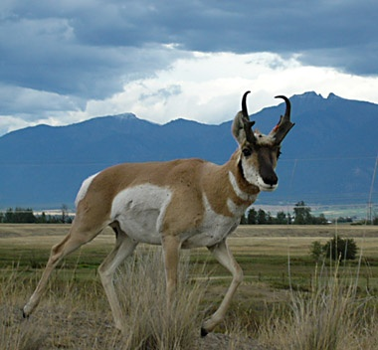
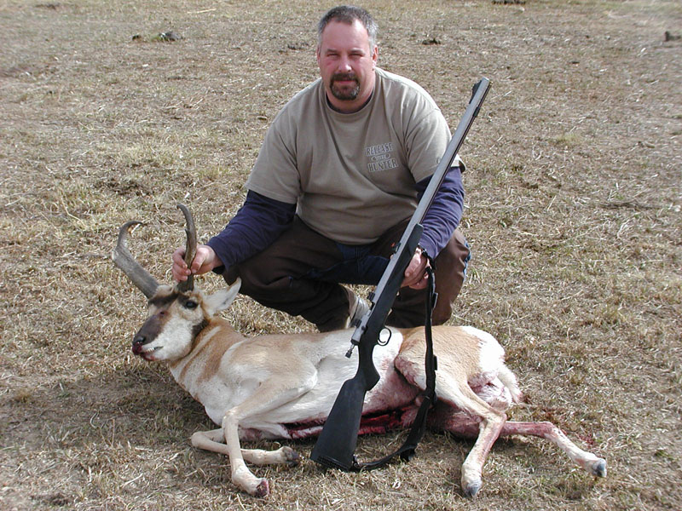
Post-mortem Decay
As long as an organism is alive, it expends energy and resources to maintain its body. While disease can cause some deterioration, most carcasses are relatively whole before death.
How an organism dies is important in determining whether or not it will be fossilized.
http://www.wildlifemanagementpro.com/2007/12/05/wyoming-offers-great-pronghorn-hunting-on-public-land/
http://www.outdoorsunlimited.net/

Slide 13
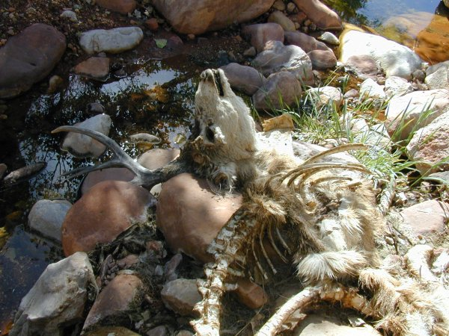
Post-mortem Decay
Predators and scavengers will strip even the hardiest carcasses, removing some parts and scattering others.
http://www.kaibab.org/

Slide 14
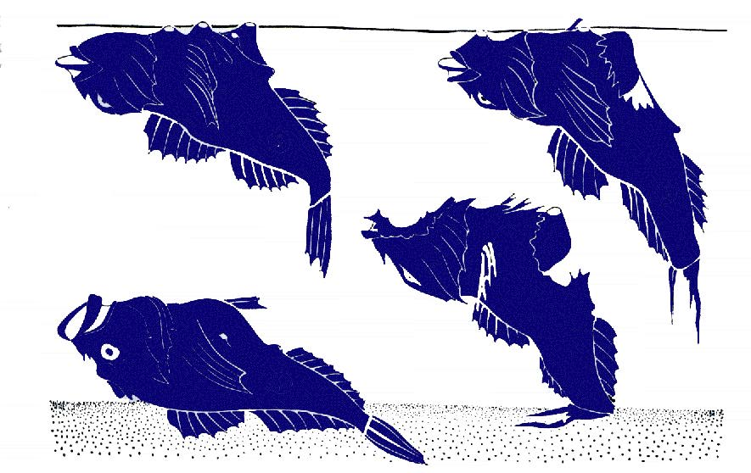
Post-Mortem Decay
C
B
A
D
Schaefer, W. 1972. Ecology and palaeoecology of marine environments. University of Chicago Press.
A
carcass sinks
Bloat and Float
B
carcass fills with decay gas, and floats
C
decay continues, with pieces detaching
D
gas escapes, allowing carcass to sink

Slide 15
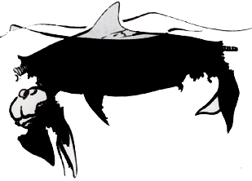
Post-Mortem Decay
Bloat and Float
Schaefer, W. 1972. Ecology and palaeoecology of marine environments. University of Chicago Press..
Large carcasses (especially of well-constructed animals like dolphins) can float for weeks or months before sinking
Different parts fall off at different times, spreading the remains over a wide area.

Slide 16
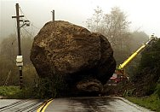
Post-Mortem Destruction
Organisms that lived (and died) in environments in which they were not likely to be buried before complete disintegration don’t have good fossil records.
(AP Photo/Damian Dovarganes)
Burial requires relatively high sedimentation rates (at least periodically), and so fossils are most likely found in environments in which sediment is being accumulated.
Since marine environments are more likely to accumulate sediment than terrestrial environments, the fossil record of ocean life is much better than that of land organisms.

Slide 17
Modes of Preservation
Organism remains are frequently altered in one way or another before, during, and after burial.
Both chemical and physical alterations are common, and the resulting fossil is frequently not composed of the same material as the original remain.

Slide 18
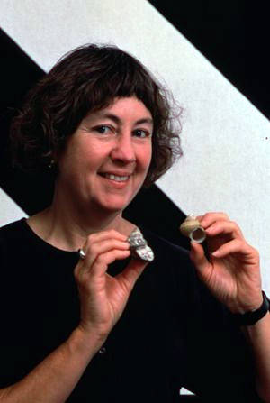
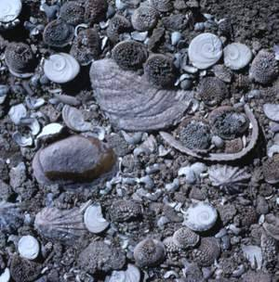
Unaltered Remain
Some fossils are essentially unaltered organic material. Such preservation is exceedingly rare for soft parts, but more common for hard parts.
http://www.calacademy.org/

Slide 19
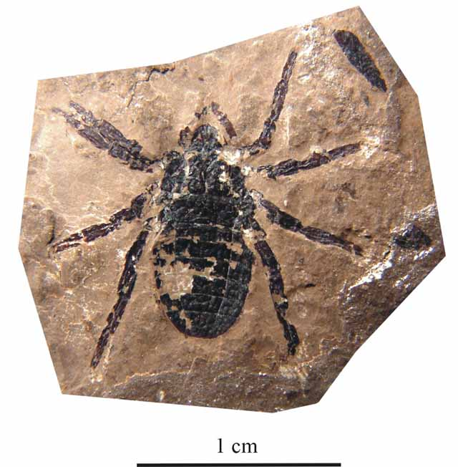
Distillation
Alteration of organic molecules leaving behind a carbon film. Can result in very fine scale preservation of soft parts.
300-million-year-old arachnid with what look like silk-spinning structures
http://researchnews.osu.edu/archive/silkspin.htm

Slide 20
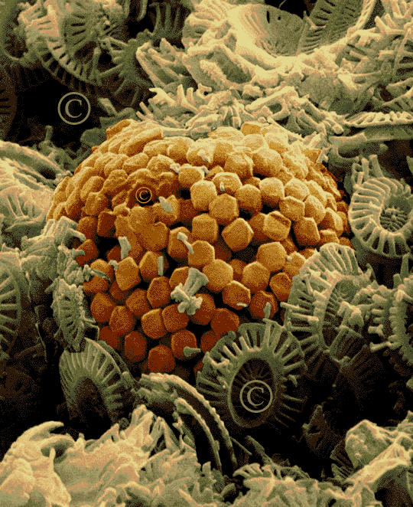
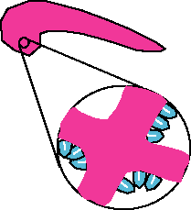
Permineralization
Void spaces in remain fill with mineral crystals. The mineralogy of infill may or may not be the same as that of the remain.
http://www.ldeo.columbia.edu/

Slide 21
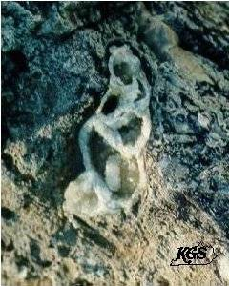
Recrystalization
The biominerals (plus any permineralized crystals) re-crystallize, maintaining the same bulk chemical composition of the original. This process usually destroys fine scale features.
http://www.uky.edu/

Slide 22
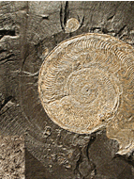
Replacement
The remain is replaced by a mineral. The process can preserve very fine detail (especially in pyritization and phosphatization), or can obliterate details.
http://geodecor.com

Slide 23
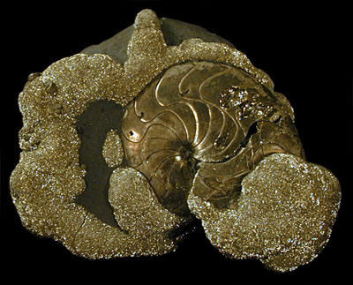
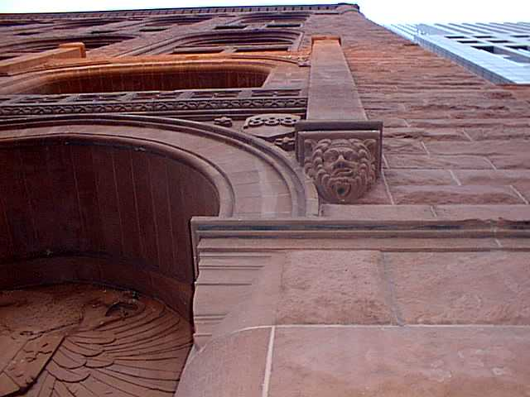
Common Replacement and Permineralization Minerals
Pyrite (FeS)
Common in stinky, reducing environments
Hematite (Fe₂O₃)
With limonite, the main kind of “rust.”
http://www.nysm.nysed.gov/
http://www.ndc.edu/

Slide 24
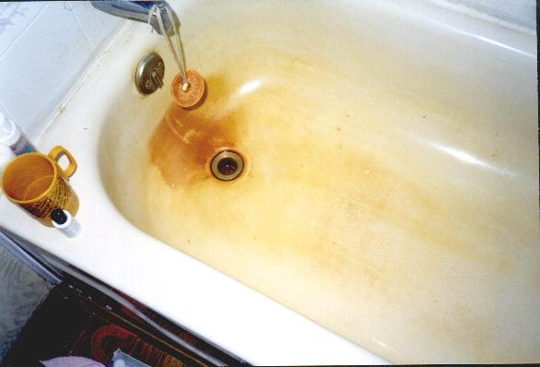
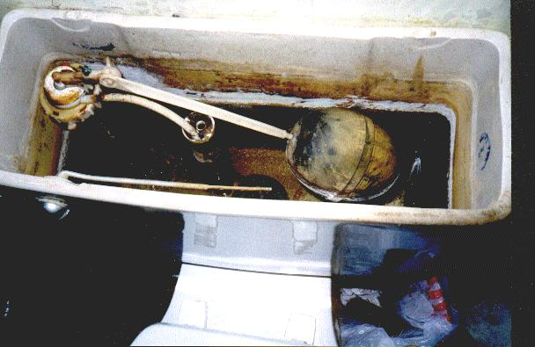
Common Replacement and Permineralization Minerals
Iron oxide precipitation
Manganese oxide precipitation
http://www.scalefighter.com/

Slide 25
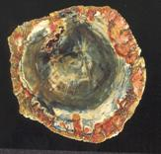
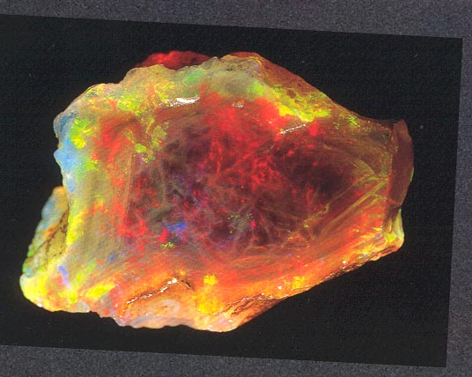
Common Replacement and Permineralization Minerals
Opalline silica (SiO₂•H₂O) and chert (SiO₂)
Commonly precipitated where concentration of silica ions (derived from unstable silicates) is high (e.g., volcanic regions).
http://www.ncsec.org/

Slide 26
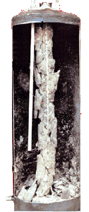
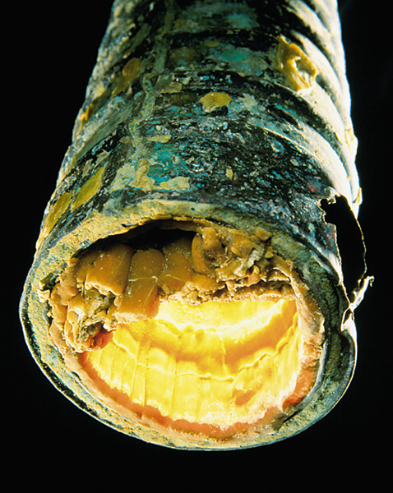
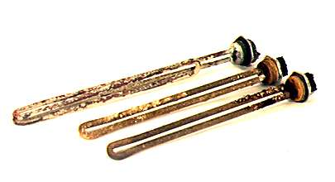
Common Replacement and Permineralization Minerals
Lime Scale
Calcite (CaCO₃) precipitation
“scale” build-up in water heaters and pipes
http://www.scalefighter.com/
http://cwx.prenhall.com/

Slide 27
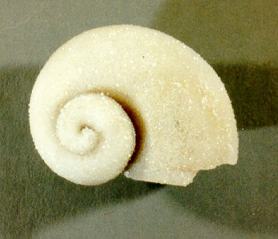
Casts and Molds
Molds form when a buried remain dissolves after (or during) lithification, leaving impressions of the remain and containing a void space. A cast is a secondary infilling of a mold.
http://www.uky.edu/

Slide 28
Diversity - measure of the number of taxa in a community or other group or area.
Diversity is a somewhat slippery concept for several reasons, including:
Many taxa are “over-split” or “over-lumped”
Characterizing a complete community is very difficult
Scale differences are very problematic
Marine species known from the continental seas of the British Isles
http://www.marlin.ac.uk/learningzone/
Most studies of diversity concentrate on a single taxon (e.g., birds) or a small number of ecologically related taxa (e.g., marine benthic organisms) in a single ecosystem (e.g., the Gulf Coast of the U.S. and Mexico)

Slide 29
South Carolina Terrestrial Vertebrates
Taxa Genera Diversity
Amphibians 23 13%
frogs/toads 7
salamanders 16
Reptiles 41 22%
turtles 19
snakes 26
lizards 5
alligators 1
Birds 76 41%
Mammals 45 24%
Total: 185
http://www.snakesandfrogs.com/scra/

Slide 30
Taxa SC Div. Global Div.
Amphibians 13% 19%
Reptiles 22% 28%
Birds 41% 35%
Mammals 24% 18%
Modern global tetrapod diversity = 25,654
http://users.tamuk.edu/kfjab02/Biology/Vertebrate%20Zoology/b3405_ch01.htm
http://www.snakesandfrogs.com/scra/

Slide 31
Diversity tends to decrease with increasing environmental stress (more stressful environment = lower diversity), e.g.,:
Environmental variability
Higher latitudes (toward poles)
Increasing altitude
Rocky Intertidal Zone
http://home.earthlink.net/~huskertomkat/zone.html

Slide 32
Environmental variability is found at all scales from tiny to global.
High Intertidal Zone
Gooseneck Barnacles
Acorn Barnacles
Limpets
Mussels
Perwinkles
Snails
Brown Algae
Mid Intertidal Zone
Purple Sea Urchin
Red Sea Urchin
Ochre Sea Star
Anemone
Crabs
Chitons
Tunicate
Sea Lettuce
Algae
Sub-tidal Zone
Brittle Star
Bat Star
Green Anemone
Aggregating Anemone
Sea Hares
Nudibranch
Chitons
Black Eyed Goby
Kelp Fish
Sponges
Red Algae
Gooseneck Barnacles
Acorn Barnacles
Keyhole Limpet
Mussel
Periwinkles
Snails
White Cap Limpet
Keyhole Limpet
Periwinkles
Snails
Purple Sea Urchin
Red Sea Urchin
Ochre Sea Star
Rocky Intertidal Zone
http://home.earthlink.net/~huskertomkat/zone.html

Slide 33
Global Bivalve Diversity
In general, diversity is highest at the equators and lowest at the poles.
Hallam, A. 1994. An outline of Phanerozoic biogeography. Oxford Univ. Press.

Slide 34
Pole
high latitude
low diversity
Total Bird Species
marine
terrestrial
low latitude
high diversity
Equator
Cowan, R. 1995. History of Life. Blackwell Sci. Press.

Slide 35
Jack Sepkoski’s Three Evolutionary Faunas
Mass Extinctions
O
D
P/
Tr
Tr
K/
T
600
400
Number of Families (Marine)
Modern Fauna
200
Paleozoic Fauna
Cambrian Fauna
C
O
S
D
C
P
Tr
J
K
T
Paleozoic
Mesozoic
Cenozoic

Slide 36
Cambrian Fauna
Paleozoic Fauna
Modern Fauna
http://www.micro.utexas.edu/courses/levin/bio304/

Slide 37
Group I: The “Cambrian” Fauna
Tons of trilobites
Extinct – end of Permian
Many monoplacophorans
Almost went extinct at end of Permian
Lots of inarticulate brachiopods
Huge diversity loss at end of Cambrian
http://www.mcz.harvard.edu/Departments/InvertPaleo/Trenton/

Slide 38
Group II: The “Paleozoic” Fauna
Almost went extinct at end of Permian
Almost went extinct at end of Permian
crinoids
Extinct – end of Permian
articulate brachiopods
rugose corals
starfish
Extinct – end of Permian
Slammed by two mass extinctions
tabulate corals
cephalopods
stenolaemate bryozoans

Slide 39
Group III: The “Modern” Fauna
malacostracans
bivalves
scleractinian coral
echinoids
chondrichtys
osteichthys
gastropods

