Slide 1
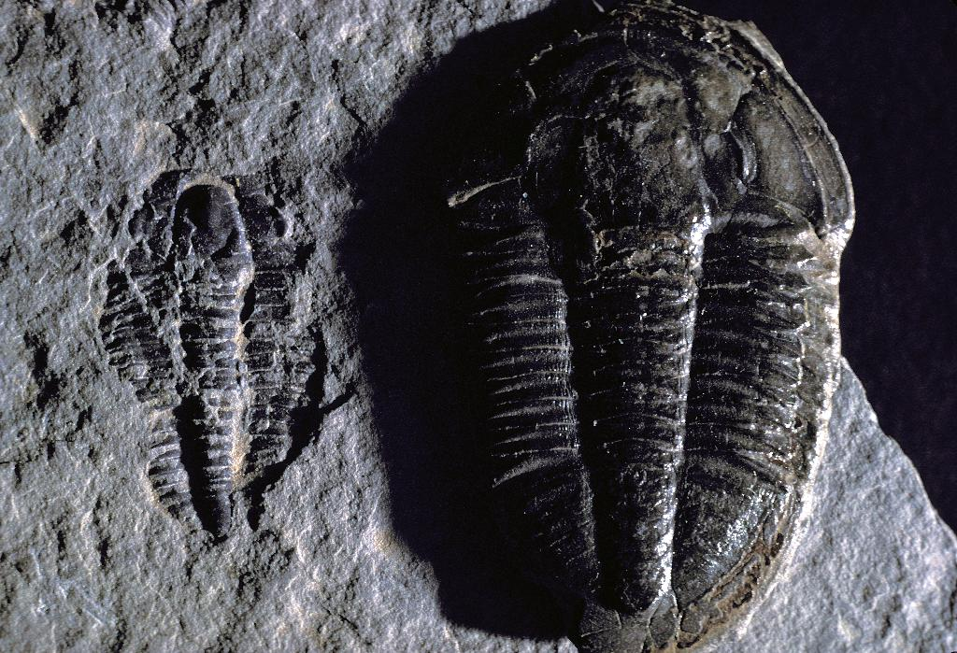
Historical Geology
Geol 211
Introduction and ground rules
Historical sciences
The Earth

Slide 2



Ground Rules
No food in Sims 202 at any time. Drinks are fine.

Slide 3

Ground Rules
If you have a question or comment, speak up!

Slide 4

Ground Rules
Attendance is mandatory and necessary.
Please be on time (in your seat, ready to go)!

Slide 5

Ground Rules
Office hours are for students - take advantage of them!

Slide 6
Ground Rules
During lecture please refrain from other conversations.

Slide 7
Ground Rules
When it is time for discussion, discuss!

Slide 8

Ground Rules
Please turn off cell phones and other electronic devices. If your cell phone goes off, you will be asked to leave.

Slide 9

Ground Rules
If you fall asleep, we’ll be sure to wake you up…

Slide 10
Ground Rules
Please review the Winthrop University student conduct code.

Slide 11
Ground Rules
No late work will be accepted. Plan ahead!

Slide 12
Grades
Quizzes (4) 5% 20 %
Exams (4) 20% 80 %
Total: 100 %
Scale
A
90
B+
87
B
80
C+
77
C
70
D
60
F

Slide 13
Quizzes
We will have a total of 4 scheduled quizzes. Quiz format will vary.

Slide 14
Exams
There are 4 scheduled exams, including a comprehensive final exam. The final exam will only be given during the scheduled time, so plan accordingly!

Slide 15


Academic Integrity
Cheating will not be tolerated. Cheating includes, but is not limited to:
  Plagiarism
  Using unauthorized material (including material on electronic devices) on quizzes and exams
  Copying someone else’s work

Slide 16
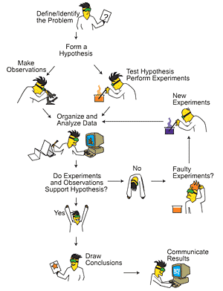
Historical Sciences
The “scientific method” requires the scientist to formulate hypotheses to explain natural phenomena. These hypotheses are then tested using experimentation.
“Experimentation” in historical sciences is a little different than in lab sciences because the data used for testing the hypotheses already exists.
http://scifiles.larc.nasa.gov/text/kids/Research_Rack/tools/scientific_method.html

Slide 17
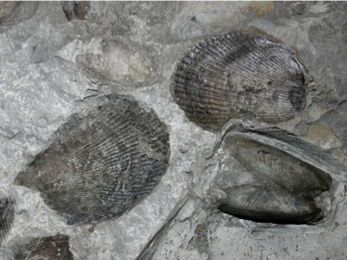
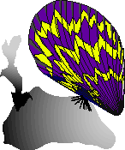
Testing for Cope’s Law in Ambonychia from the Ordovician of Ohio
Ambonychia was a bivalve that lived ~440,000,000 years ago in what is now the U.S. Midwest. Its fossils are abundant in rocks of the Cincinnatian Series exposed in Ohio, Kentucky and Indiana.
Ambonycia
It had been reported that the body size within the taxon increased through the time it lived during the Ordovician – an evolutionary pattern named “Cope’s Law.”
http://cincyevolution.com/invertpaleo/Bivalvia.html

Slide 18
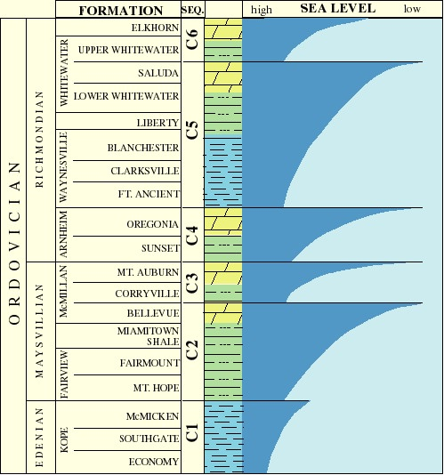

First Hypothesis – Cope’s Law
Cope’s Law

Slide 19

Initial Data
shell length

Slide 20
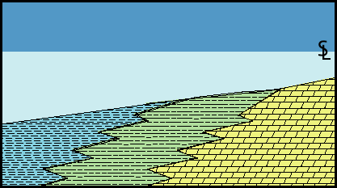
New Idea – Large Ambonychia lived in shallow water, small Ambonychia lived in deep water

Slide 21
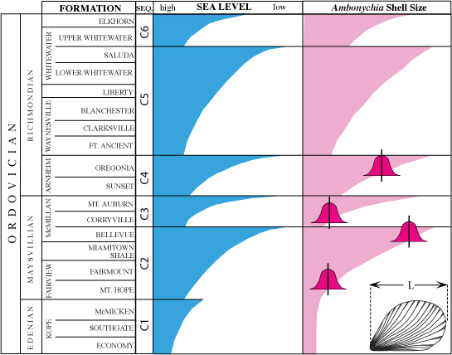
New Hypothesis

Slide 22
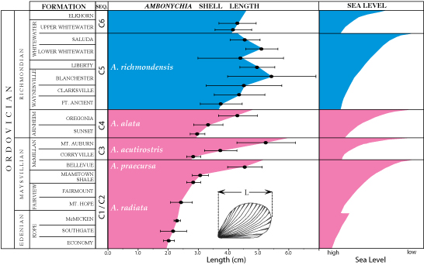
Results

Slide 23
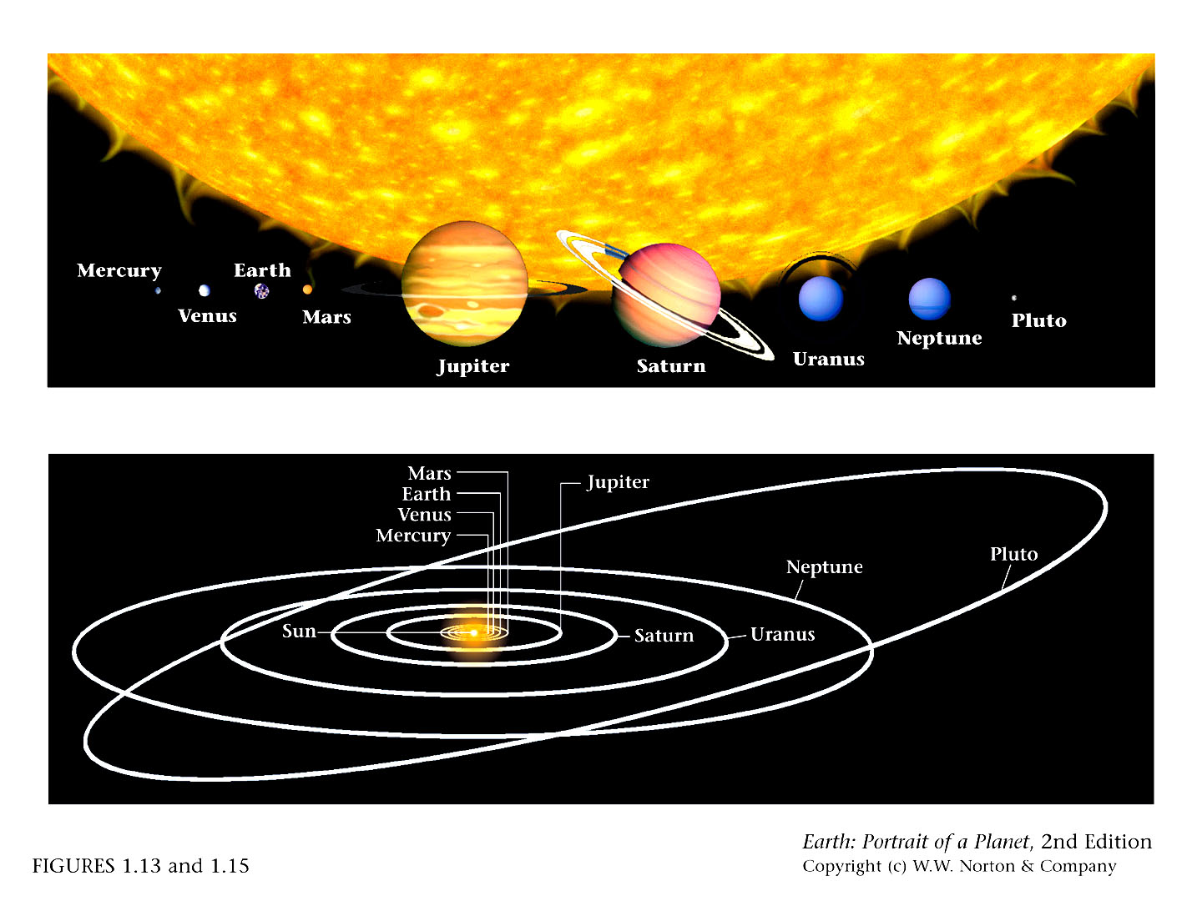
01_13and15.jpg
You are here

Slide 24
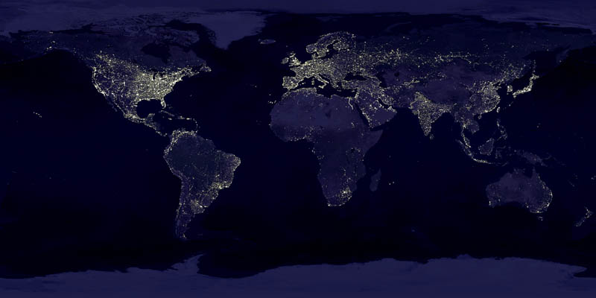

Earth

Slide 25
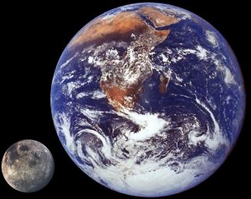

The Earth has an unusually large satellite – the Moon. The Moon is similar in size to the larger satellites of the gas giants like Jupiter.
Earth’s Moon is in revolution-rotation synch with the Earth. It rotates on its axis once for every revolution around the Earth – i.e., the same side of the Moon always faces the Earth.
http://www.freemars.org/jeff/planets/Luna/Luna.htm

Slide 26



Images copyright NASA

Slide 27
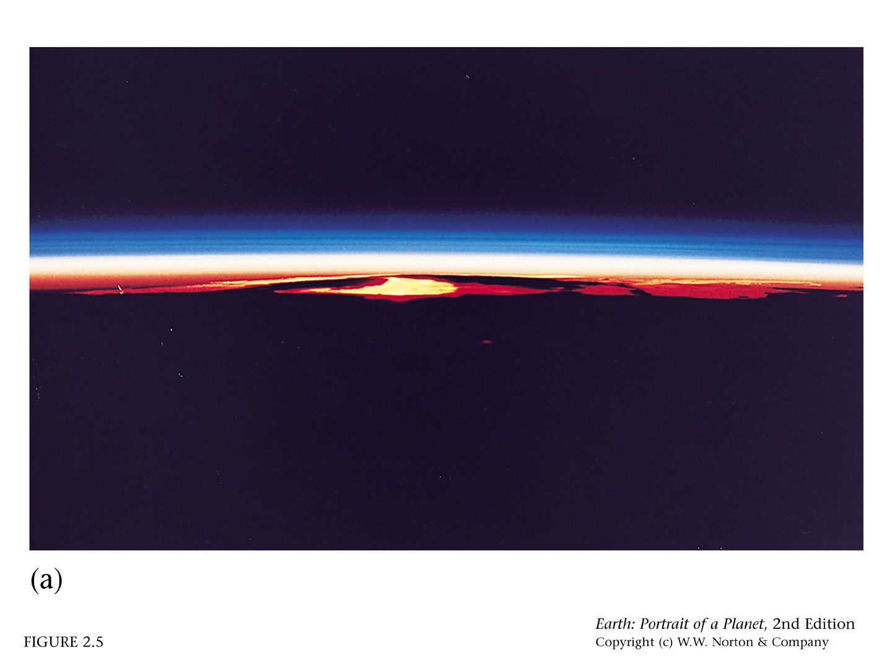
02_05a.jpg
space
The Earth is covered by an atmosphere, a thin layer of gas above the surface. The atmosphere is the most dynamic of Earth’s layers, especially at low altitude.

Slide 28
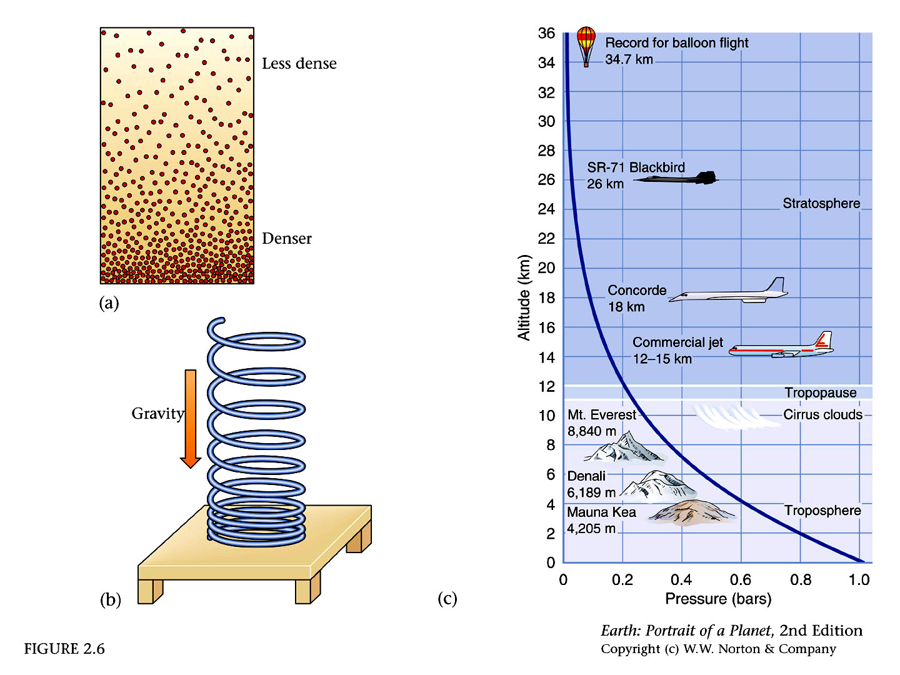

Slide 29
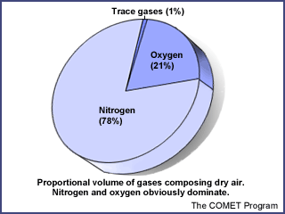

Composition of Dry Air
The atmosphere contains primarily N₂ and O₂
(78%+21%=99% of total)
The most abundant “trace gases” is the noble gas argon (Ar). Of the other gases, two of the most important are:
CO₂ (carbon dioxide) – the main “greenhouse gas” responsible for keeping the surface of the Earth warm, also essential for photosynthesis and thus vital for life
O₃ (ozone) – found primarily in the upper atmosphere, absorbs wavelengths of UV radiation that would be dangerous to surface life. When found at low altitude, it is a major pollutant.
http://www.ucar.edu/learn/1_1_1.htm

Slide 30
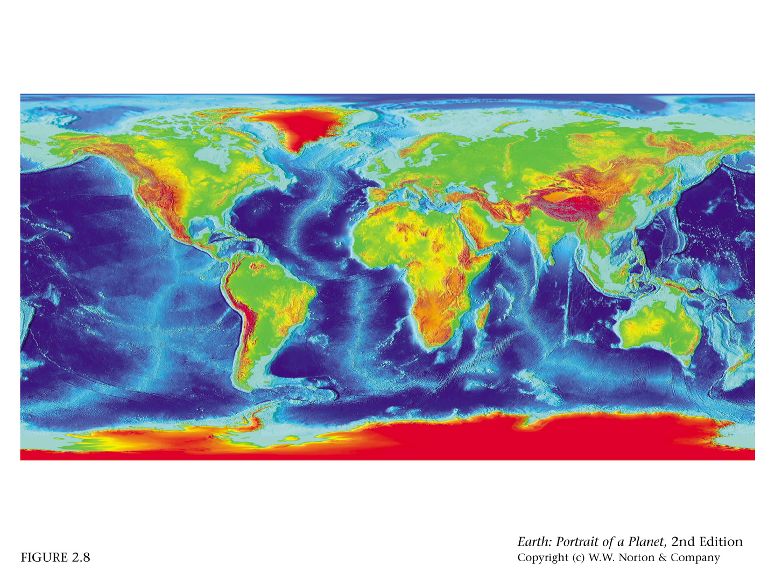
The surface of the Earth is either exposed directly to the atmosphere (i.e., land), or covered with water (primarily ocean).

Slide 31
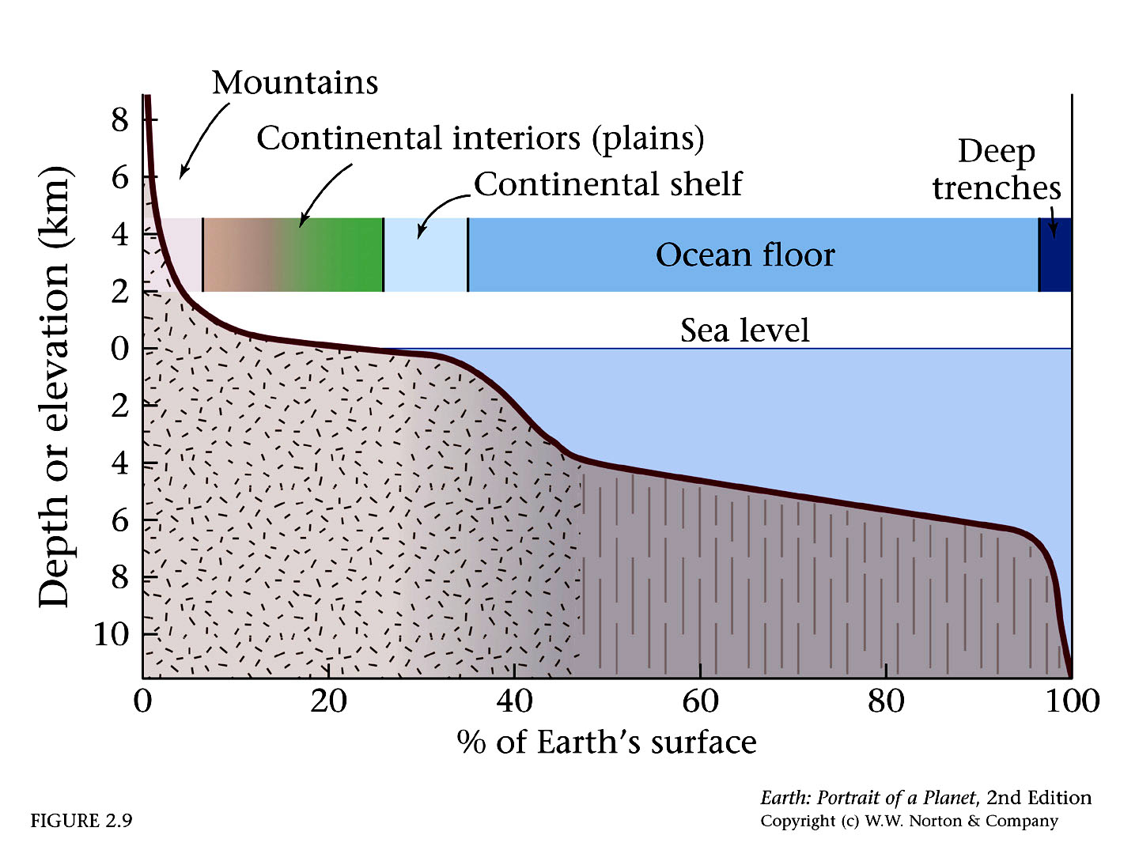
In terms of surface area, oceans cover ~70% of the Earth’s surface. The “average” elevation on Earth is well below sea level.
Highest Elevation: 8,850 m (above sea level)
Lowest Elevation: 10,924 m (below sea level)
-3,600 m
-11,800 ft
50%

Slide 32
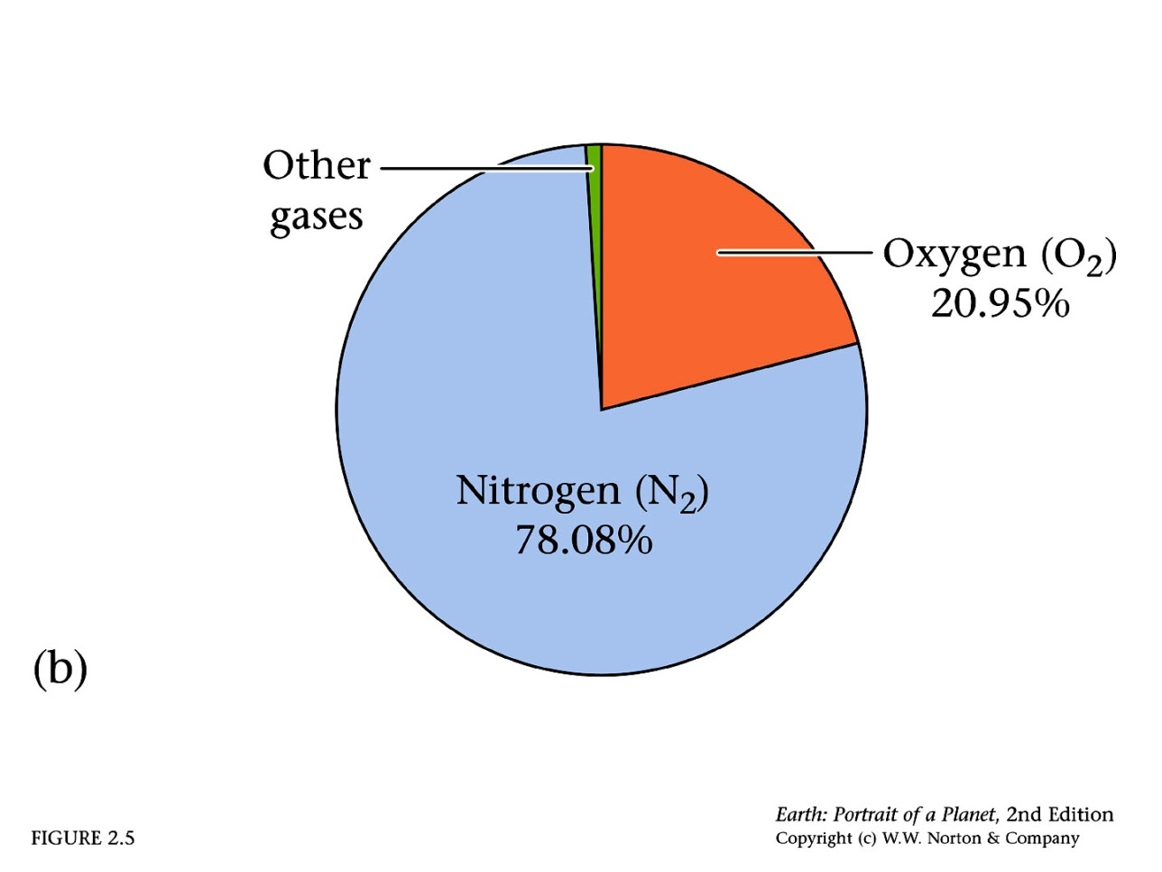
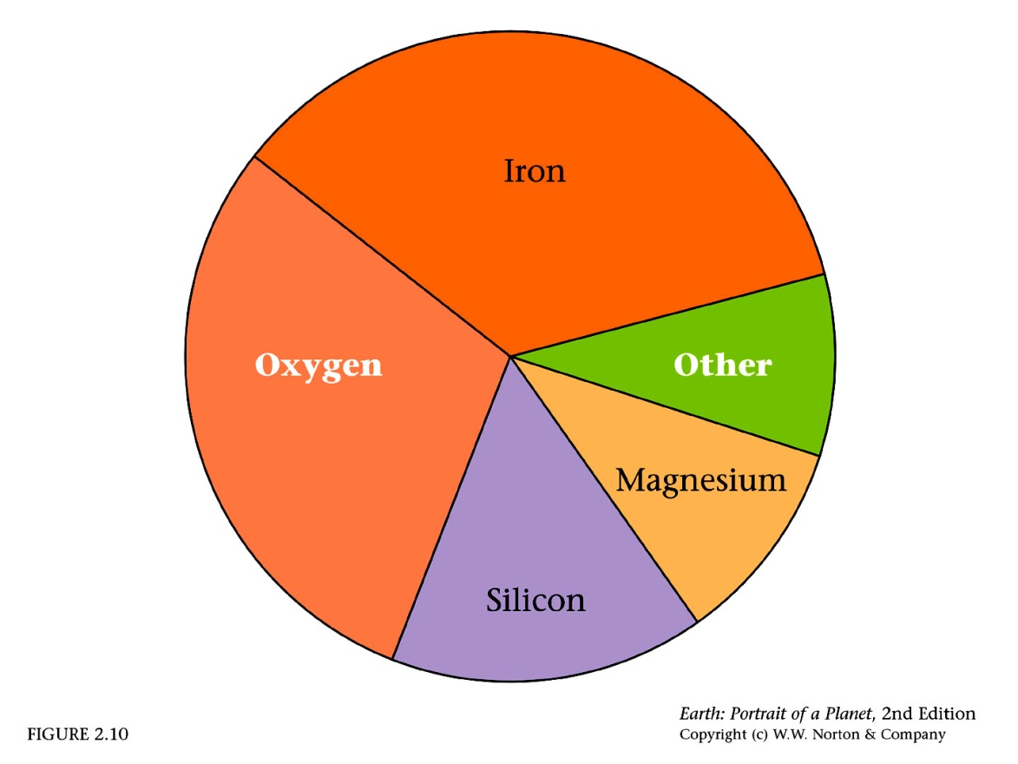
The Earth is a chemically interesting place. There are a huge variety of environments both on the surface and within the bulk of the Earth in which chemicals interact to form different solid, liquid and gaseous substances.
Bulk Composition of the Earth
Bulk Composition of Earth’s Atmosphere

Slide 33
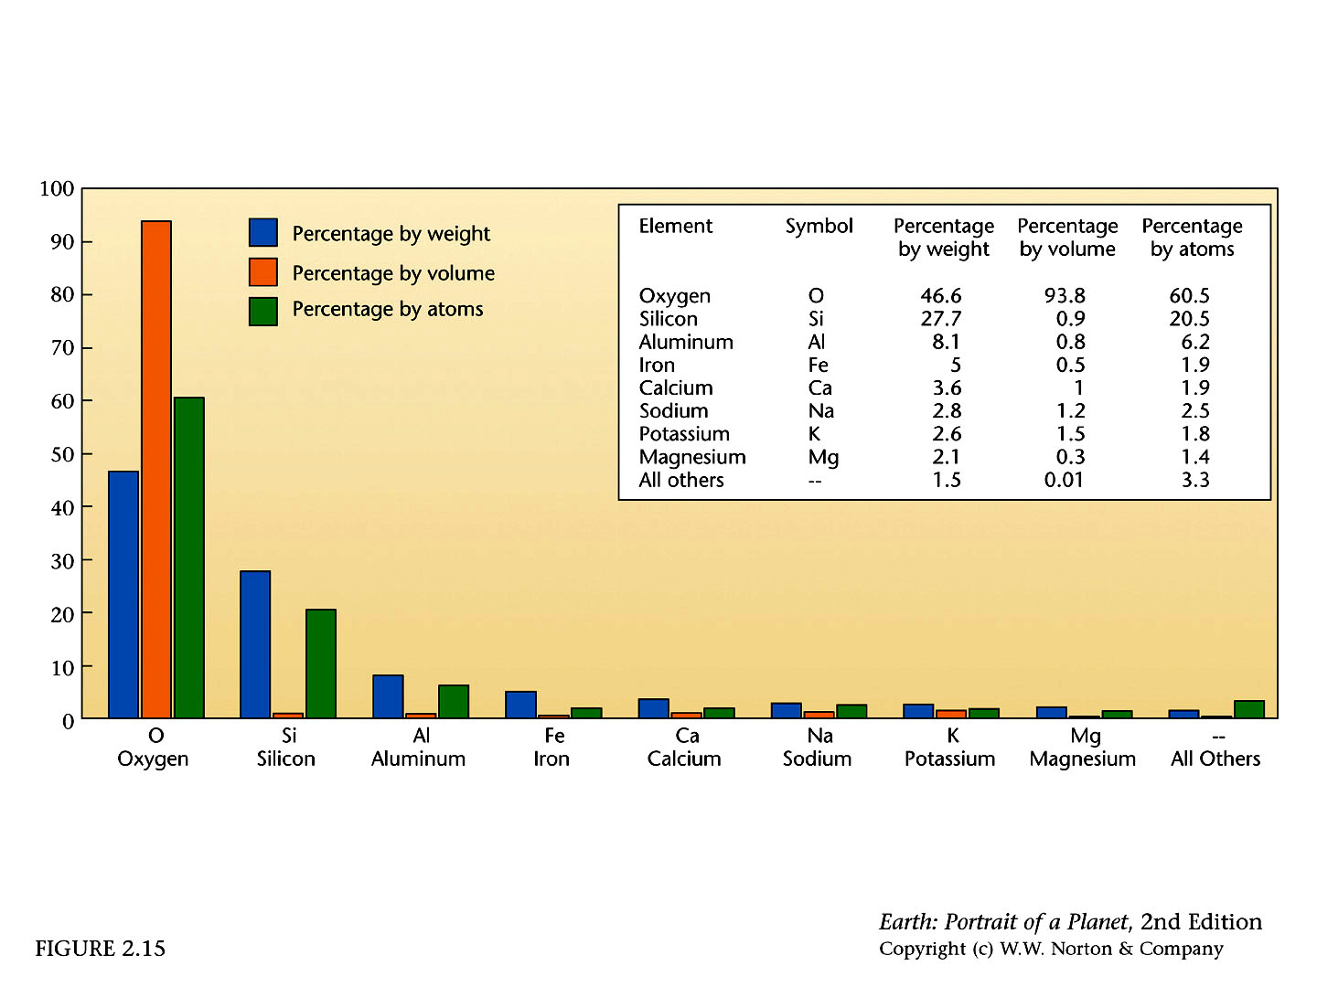
The Earth is primarily composed of minerals. In the outermost layer, the most abundant of these “major rock-forming” minerals contain the two most abundant elements on in that layer – silicon and oxygen.

Slide 34


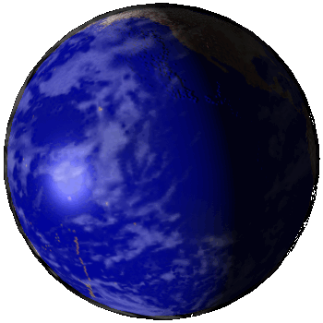
Studying the interior of the Earth is not easy. All materials on the Earth’s surface formed within the top 100 km of the Earth.
The radius of the Earth is 6,370 km, meaning we have no physical samples whatsoever from approximately 6,270 km thickness of our home planet!

Slide 35


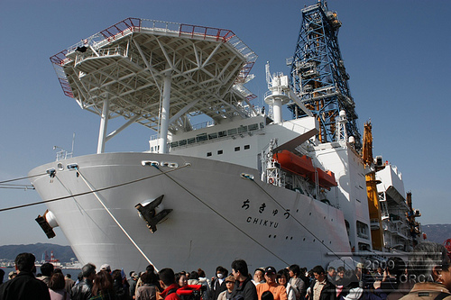
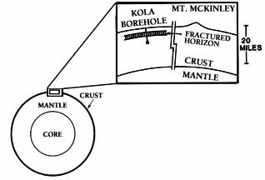
Project Mohole
1958 - 1966
Kola Borehole
1970 - present
An attempt to retrieve a sample of material from the earth's mantle by drilling a hole through the earth's crust to the Mohorovicic Discontinuity.
Integrated Ocean Drilling Project
http://www.iodp.org/
International effort to drill to mantle where it is thinnest – near mid-ocean ridges.
Funded by the Office of Naval Research, National Science Foundation (NSF), and National Research Council (NRC)
Chikyu – aka “Godzilla Maru”
After an initial season of data collection in 2005, Chikyu was damaged by a storm. It is back in action after extensive repairs, Chikyu is now involved in a wide variety of oceanographic projects
Drilled less than a kilometer of oceanic crust under 11,000 feet of ocean before U.S. Congress nixed funding.
Russian drilling project
now at ~40,000 ft
http://www.nas.edu/history/mohole/
http://www.gi.alaska.edu/ScienceForum/ASF7/725.html/

Slide 36
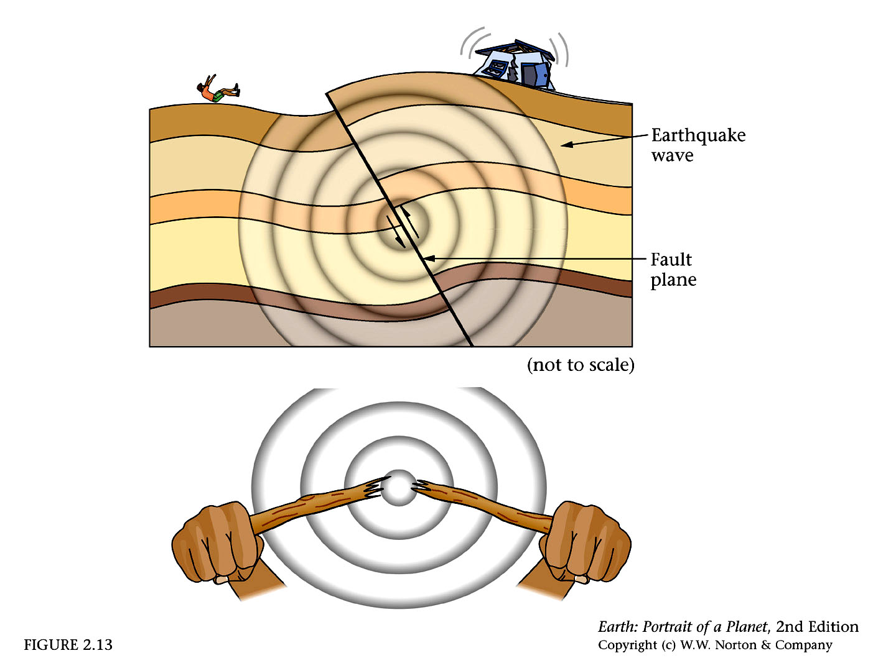
Most of our data about the structure of the Earth’s interior comes from observations of seismic waves (energy waves caused by earthquakes that move through the Earth).

Slide 37
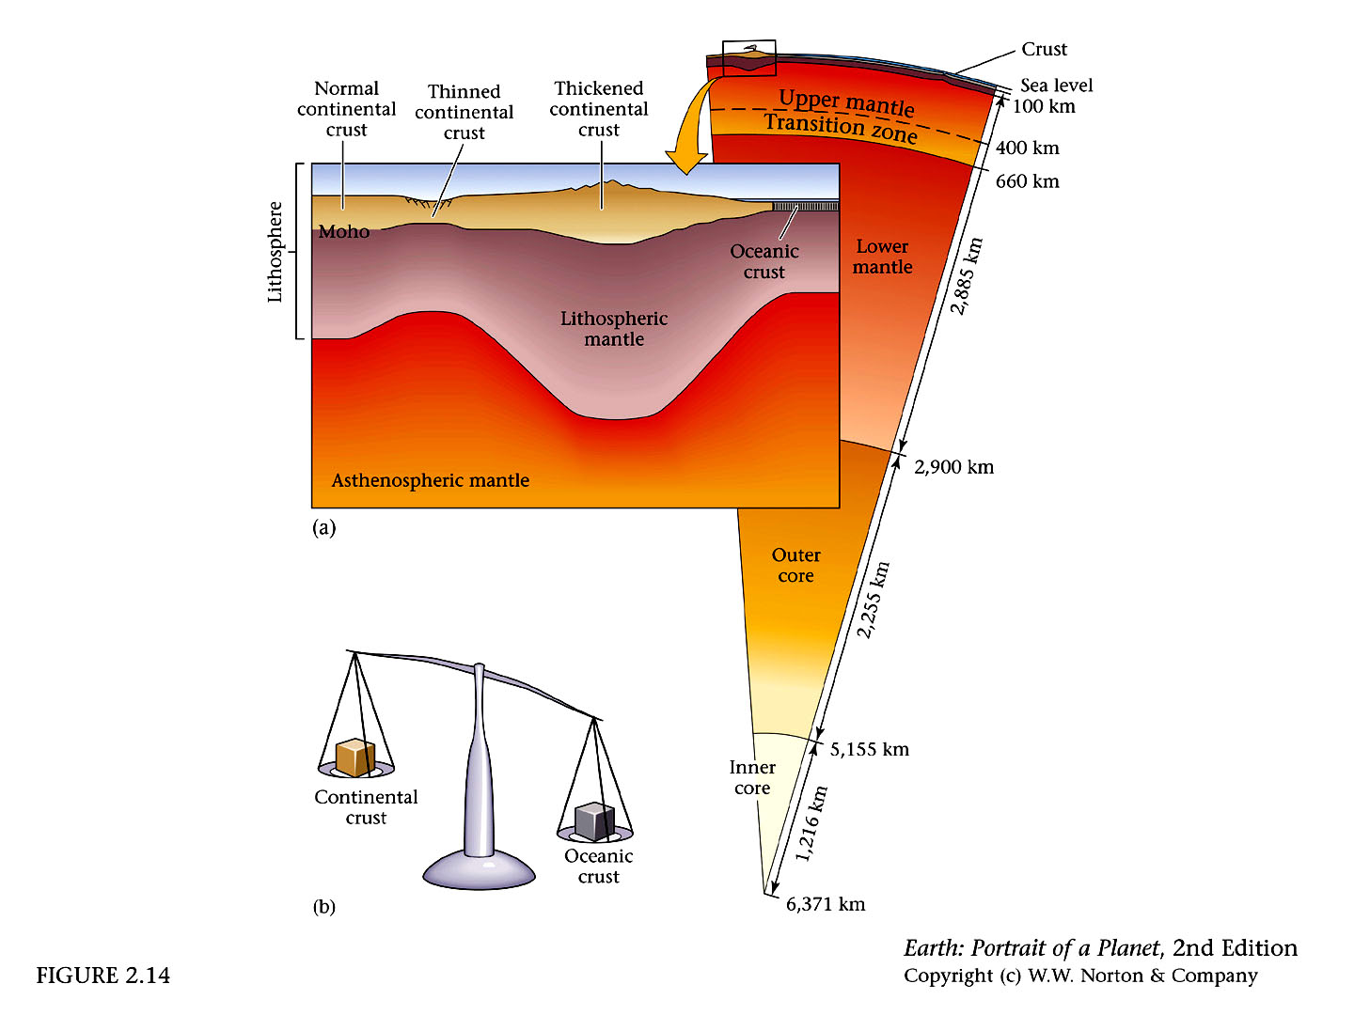
discontinuities
Each discontinuity marks the boundary between two layers with different physiochemical conditions.

Slide 38
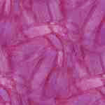
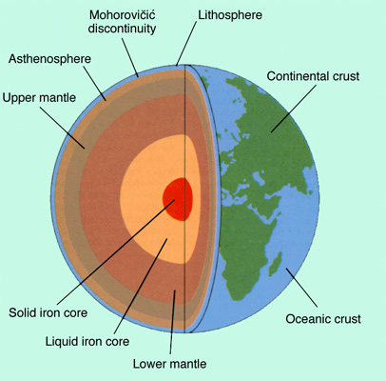
Moho Discontinuity
Thickness
(km)
Density
(g/cm³)
Typical
Rocks
Crust 30 2.2 2.9
silica rocks
andesite, basalt at base
Upper Mantle 720 3.4
Lower Mantle 2,171 4.4
peridodite, eclogite, olivine, spinel, garnet, pryoxene
http://www.glossary.oilfield.slb.com
magnesium and silicon oxides
Outer Core 2,259 9.9
Inner Core 1,221 12.8
Center 13.1
iron+oxygen, sulfur, nickel alloy (liquid)
zone including uppermost mantle and lowermost crust is called the aethenosphere
iron+oxygen, sulfur, nickel alloy (solid)
http://pubs.usgs.gov/gip/interior/

