Slide 1
Relative Age Dating
Uniformitarianism
Principles of correlation
Original horizontality
Superposition
Inclusion
Cross-cutting relationships
Biostratigraphy

Slide 2
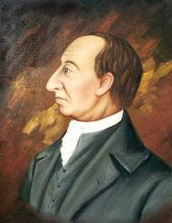
James Hutton, Scottish Geologist
Royal Society of Edinburgh meetings - 1785
Formations of rocks and soils on the Earth’s surface formed over long periods of time via processes observable on the modern Earth
http://de.wikipedia.org/wiki/James_Hutton
This worldview became known as the Principle of Uniformitarianism, and specifically rejected supernatural causation to explain natural processes and formations.
Coal gas first used for illumination; Louis XVI of France signs to a law that a handkerchief must be square; British government establishes a permanent land force in the Eastern Caribbean, based in Barbados; The North Carolina General Assembly incorporates Lincolnton, North Carolina (named for American General Benjamin Lincoln) as the new county seat for Lincoln County. (http://en.wikipedia.org/wiki/1785)

Slide 3
Principle of Uniformitarianism
Hutton’s work did not gain much acceptance for a long time – probably because the writing was dry. Later, Charles Lyell published a three volume set of books about interpreting geologic history.
Unlike Hutton’s indigestible prose, Lyell’s books became required reading for the “natural philosophers” of the day.
Charles Darwin brought the first volume with him to South America on the Beagle, and arranged to have the second and third volumes sent when they were published
http://en.wikipedia.org/wiki/Image:HMSBeagle.jpeg

Slide 4
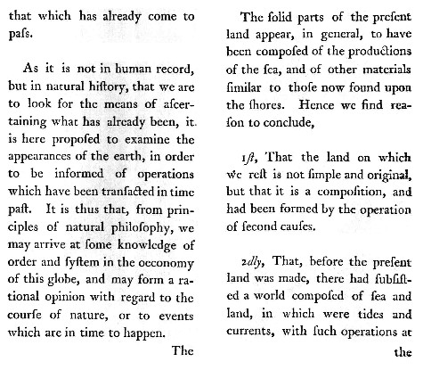
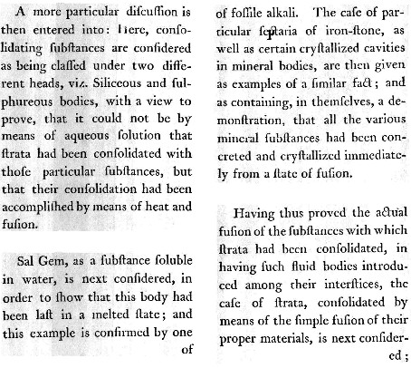
Hutton, James, 1788. Theory of the Earth; or an Investigation of the Laws observable in the Composition, Dissolution, and Restoration of Land upon the Globe. Transactions of the Royal Society of Edinburgh, vol. I, Part II, pp.209-304, plates I and II.
As it is not in the human record, but in natural history, that we are to look for the means of ascertaining what has already been, it is here proposed to examine the appearances of the earth, in order to be informed of operations which have been transacted in time past. It is thus that, from principles of natural philosophy, we may arrive at some knowledge of order and system in the economy of this globe, and may form a rational opinion with regard to the course of nature or to events which in time to happen.
http://www.uwmc.uwc.edu/geography/hutton/hutton.htm

Slide 5
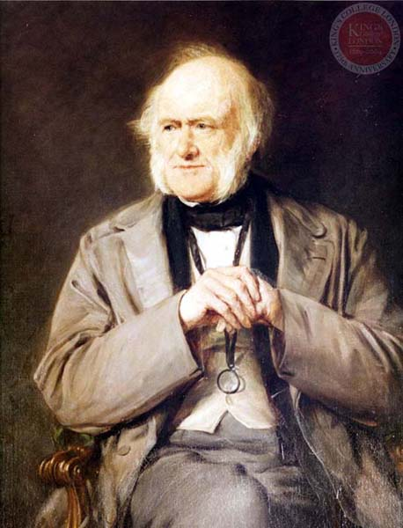
Charles Lyell
Principles of Geology
Geology is the science which investigates the successive changes that have taken place in the organic and inorganic kingdoms of nature; it enquires into the causes of these changes, and the influence which they have exerted in modifying the surface and external structure of our planet.
By these researches in the state of the earth and its inhabitants at former periods, we acquire a more perfect knowledge of its present condition, and more comprehensive views concerning the laws now governing its animate and inanimate productions.
Lyell, Charles, 1830. Principles of Geology. [Fascimile 1990, University of Chicago Press.]
http://www.kcl.ac.uk/depsta/iss/archives//london/going09a.htm

Slide 6
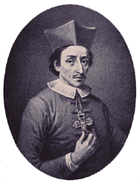
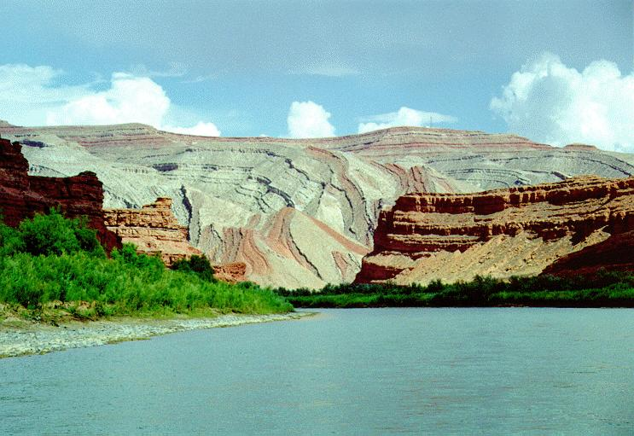
Nicholas Steno (1638-1686)
Formulated logical principles for determining the relative ages of rocks
http://www.rjsmith.com/san_juan_river.html
http://www.ucmp.berkeley.edu/history/steno.html

Slide 7
Principle of Original Horizontality
Sedimentary rocks were deposited in primarily horizontal beds
deposited last - youngest
gravity
deposited first - oldest
Principle of Superposition
In an undisturbed sedimentary sequence, the oldest rocks are on the bottom of the stack

Slide 8
Youngest
gravity
Oldest
Principle of Superposition
In an undisturbed sedimentary sequence, the oldest rocks are on the bottom of the stack

Slide 9
Principle of Inclusion
When clasts of one rock are found in another, the rock from which the clasts were derived is the older rock, since it must have already existed in order to be included in the new rock
igneous intrusion
Inclusions - pieces of older rock incorporated into younger rock

Slide 10
Principle of Inclusion
When clasts of one rock are found in another, the rock from which the clasts were derived is the older rock, since it must have already existed in order to be included in the new rock
Inclusions - pieces of older rock (clasts) incorporated into younger rock

Slide 11
(a scene from Jurassic Park)
Principle of Cross-Cutting Relationships

Slide 12
Principle of Cross-Cutting Relationships
Older features are cut or crossed by younger features.

Slide 13
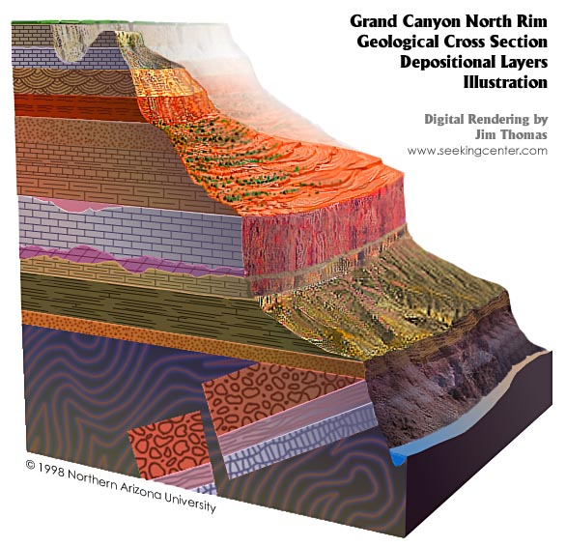
Contact – surface separating two formations
Hermit Shale
Supai Group
Redwall Limestone
Formation – bodies of rock with recognizable characteristic that are thick enough to map
Muav Limestone
Bright Angel Shale
Tapeats Sandstone

Slide 14
Reconstructing Geologic History
The geologic history of an area can be divided into times during which:
Rock is being formed or altered
Rock is being eroded
Periods of rock formation leave positive evidence of what geologic processes were in effect at the time of formation.
Periods of rock erosion leave unconformities.

Slide 15
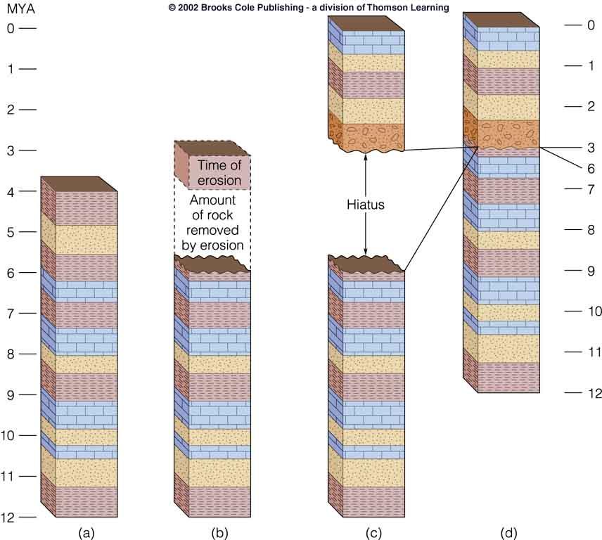
Unconformities

Slide 16
Reconstructing Geologic History
Unconformities represent missing time in the geological sequence, either due to no rock being formed or rock being removed.
There are three kinds of unconformities:
disconformity – unconformity between parallel strata. Represents a time of non-deposition or erosion without deformation of strata.
angular unconformity – unconformity between non-parallel strata. Strata were deformed as well as eroded (not necessarily at the same time)
nonconformity – unconformity representing erosion of a non-sedimentary rock

Slide 17
Reconstructing Geologic History
disconformity unconformity between parallel strata.
nonconformity unconformity between non-sedimentary and sedimentary rocks
angular unconformity unconformity between non-parallel strata

Slide 18
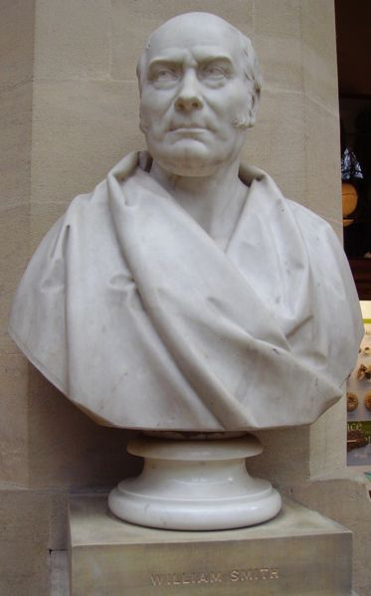
William “Strata” Smith
1769-1839
A trained surveyor with an avid interest in fossils, Smith suffered from rare condition for naturalist of his time - lowly birth. He worked in both the coal industry and supervised the digging of the Somerset Canal in England, but still spent time in debtors’ prison.
Smith formulated the Principle of Faunal Succession, which he then used to draft the first modern geologic map, which serves as a model to the present day.
http://en.wikipedia.org/wiki/Image:William_Smith.JPG

Slide 19
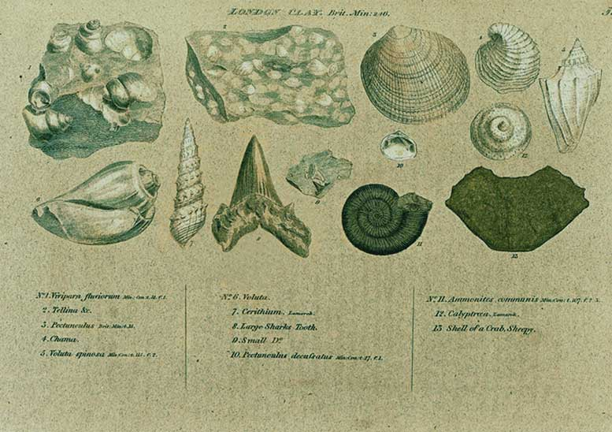
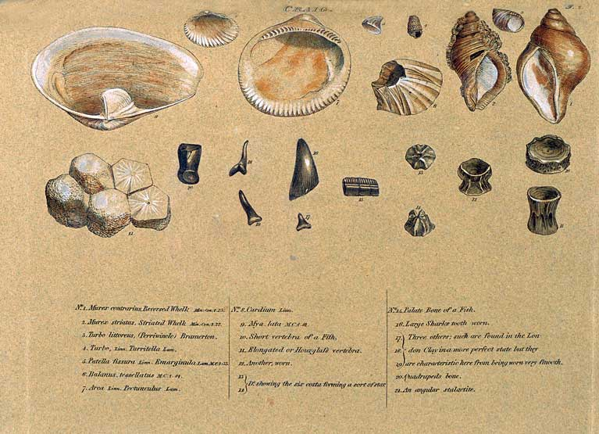
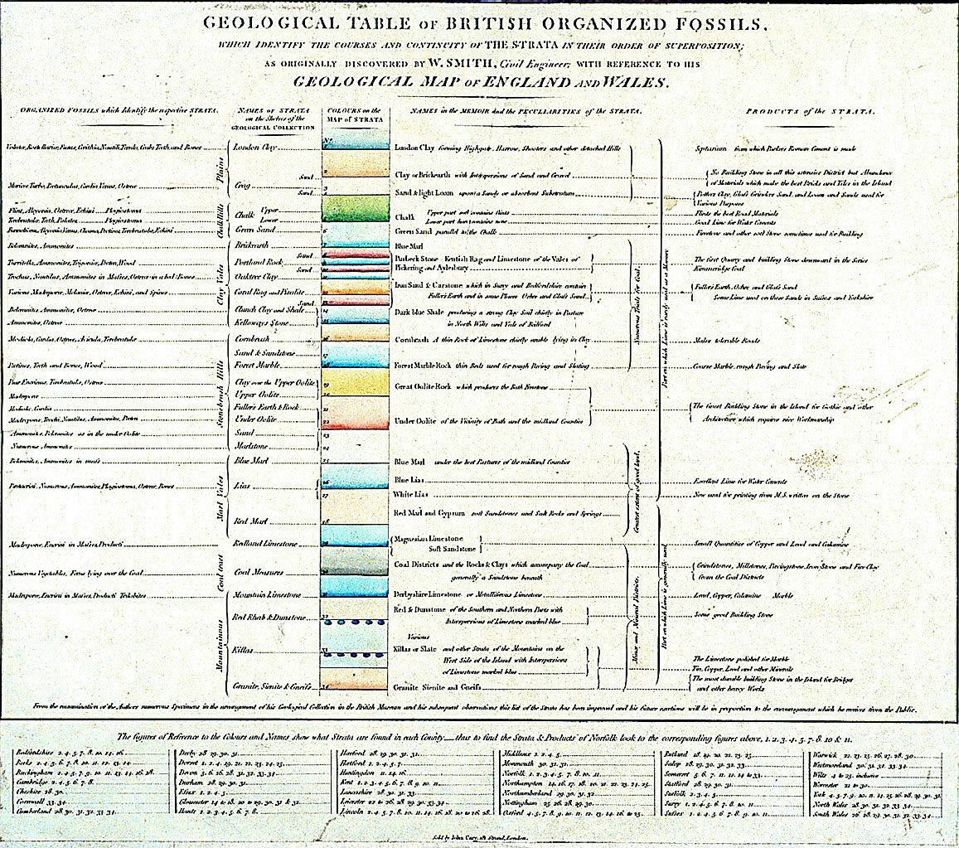
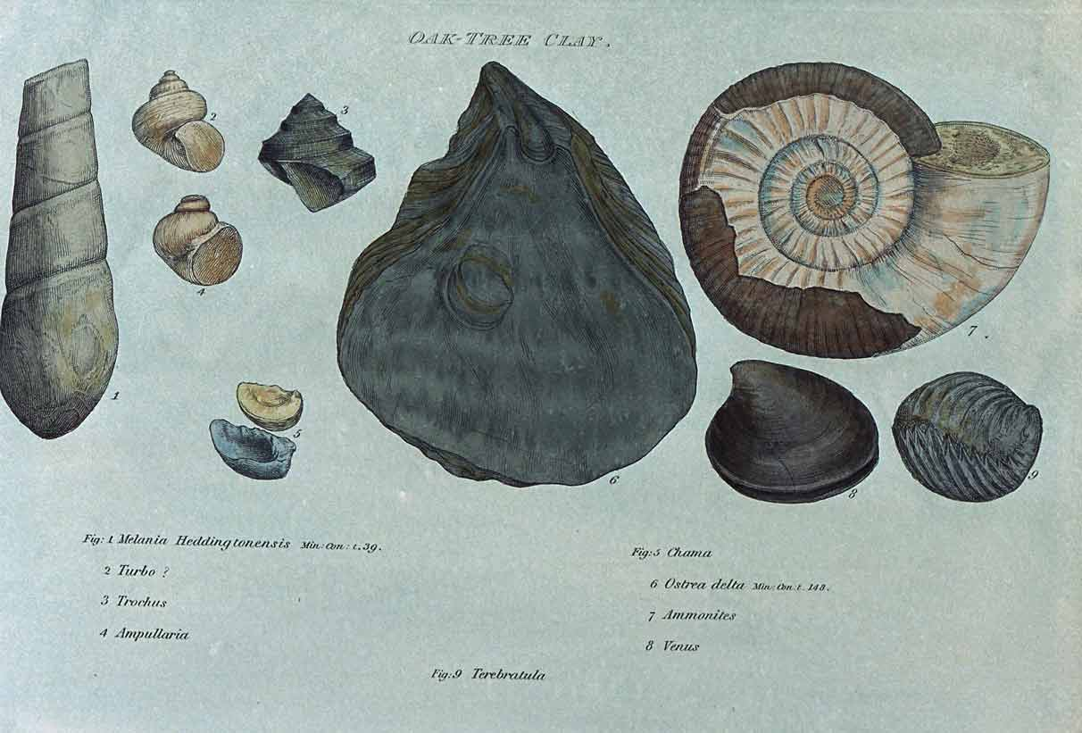
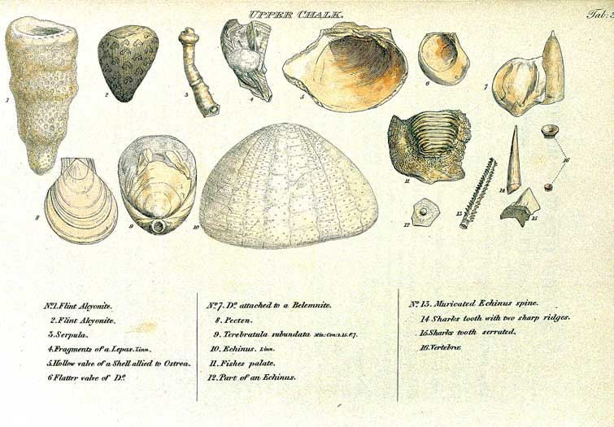
London Clay
Craig
London Clay
Craig
Upper Chalk
Oak Tree Clay
Oak Tree Clay
Upper Chalk
http://www.unh.edu/esci/wmsmith.html

Slide 20
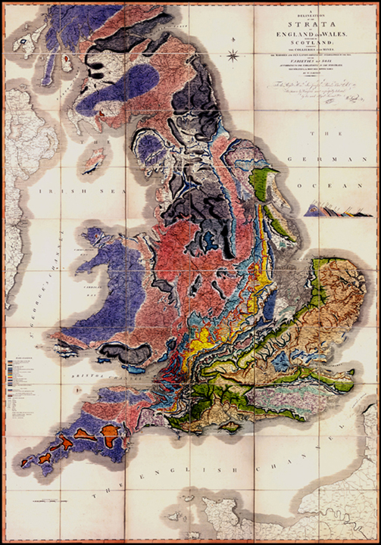
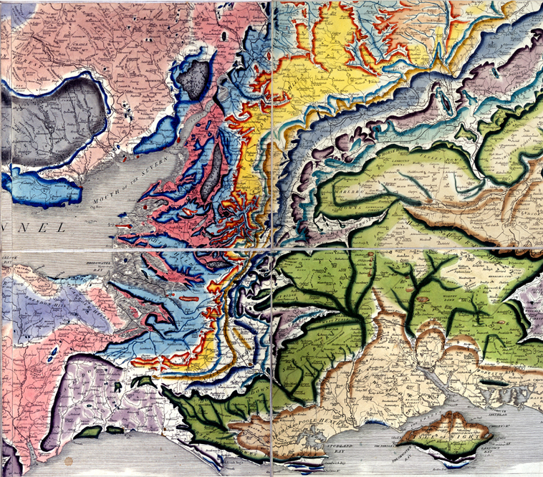
William Smith’s geologic map of England, Wales ,and Scotland.
6x9 ft
http://www.unh.edu/esci/wmsmith.html

Slide 21
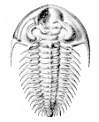
Biostratigraphy
More Recent
X
Extinction - last appearance of species in fossil record
Time
Fossil A
O
Origination - evolution of species
More Ancient

Slide 22
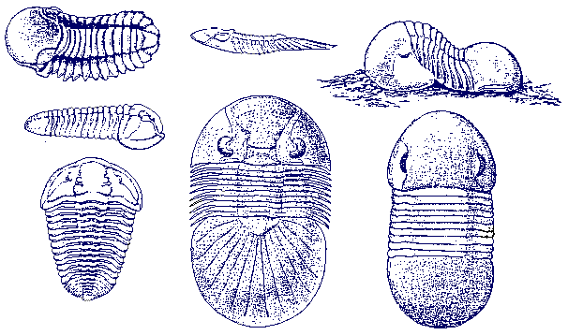
Biostratigraphy
A
B
Time
C
A
B
C
Overlap zone

Slide 23
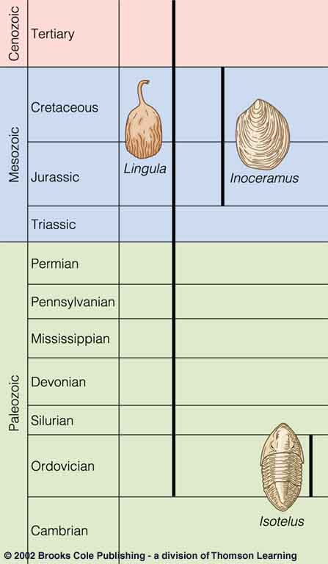
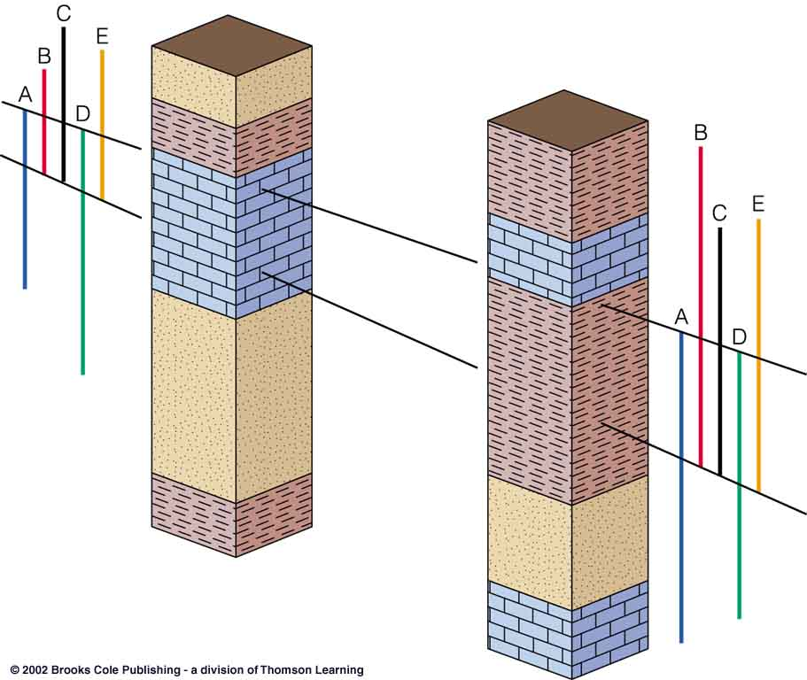
Biostratigraphy

Slide 24
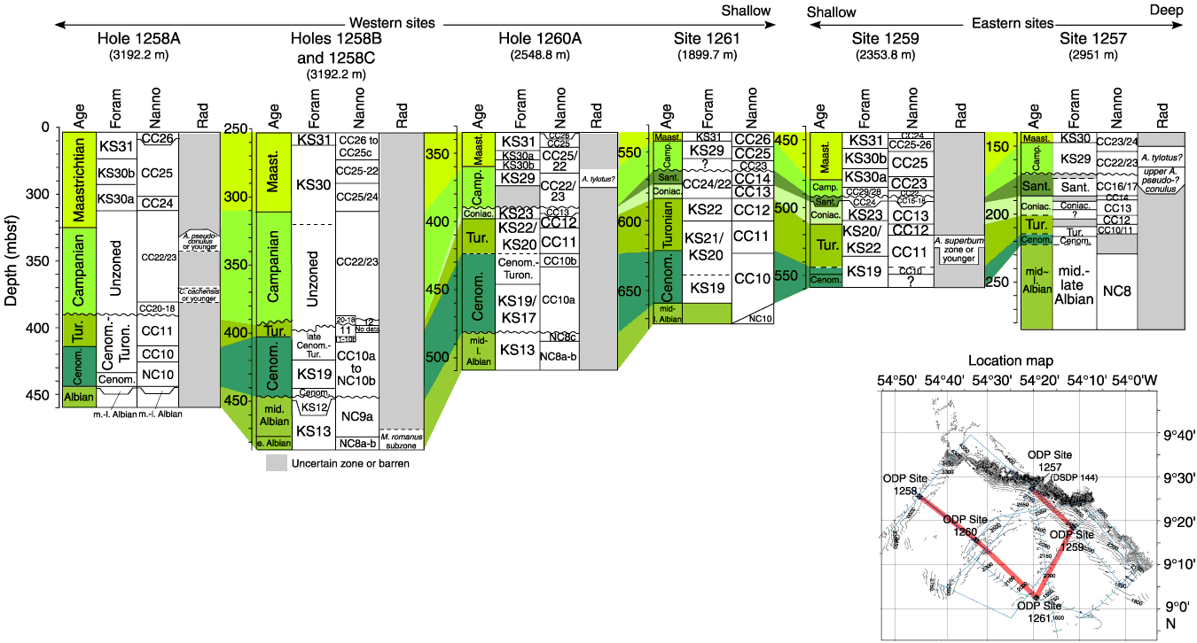
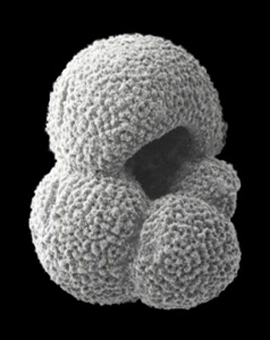
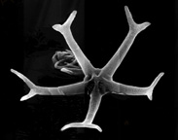
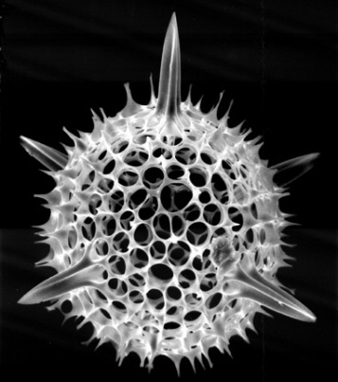
http://www-odp.tamu.edu/
Biostratigraphy for several wells off the coast of Suriname, South America.
Correlation based on foraminifera, calcareous nannofossils and radiolarians.

Slide 25
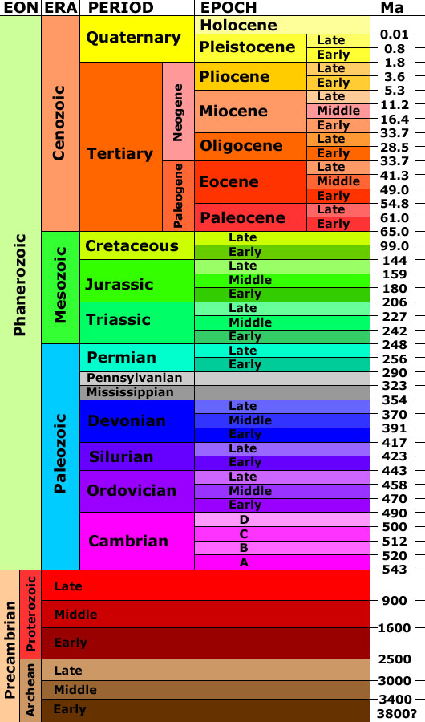
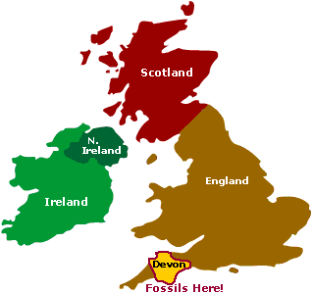
Geologic Time Scale
Devonian
http://3dparks.wr.usgs.gov/coloradoplateau/images/timescale.jpg
http://pubs.usgs.gov/gip/geotime/

Slide 26
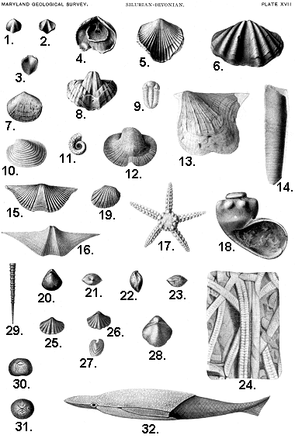
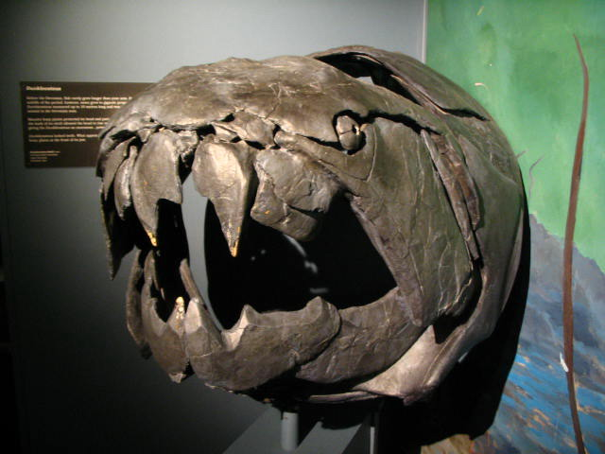
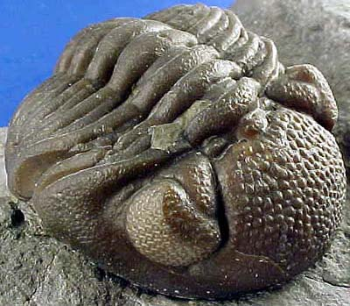
http://thunderlizard.gn.apc.org/image_devonian.html
Devonian Life
http://www.mgs.md.gov/esic/brochures/fossils/devofos.html
http://paleoprep.com/
http://www.globaltrekkers.ca/wp-photo.php?id=152

Slide 27
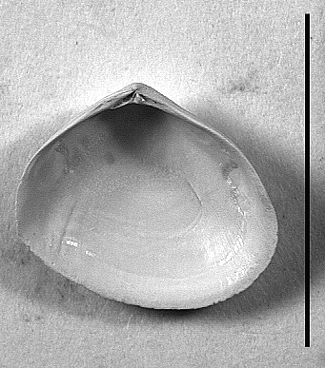
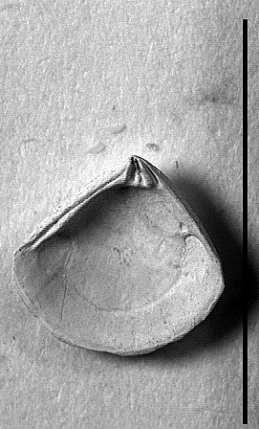
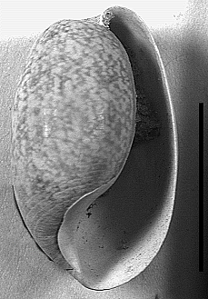
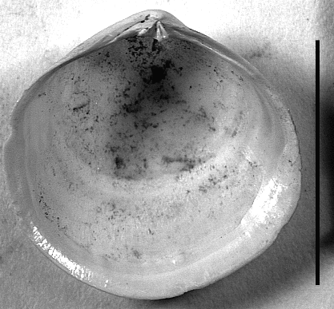
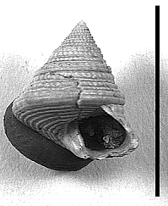
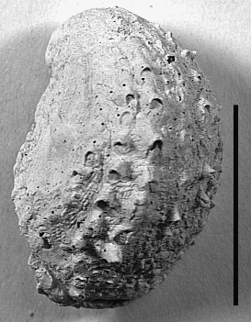
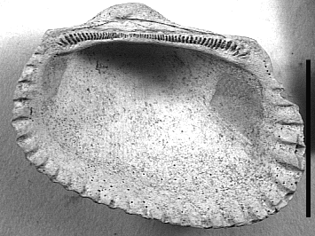
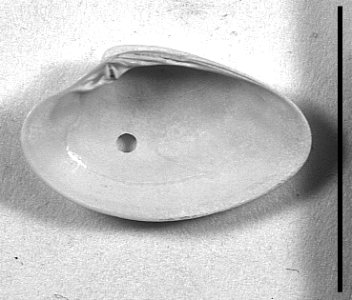
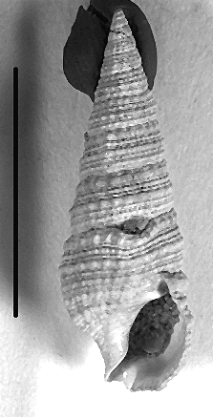
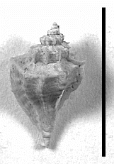
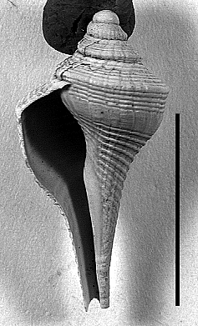
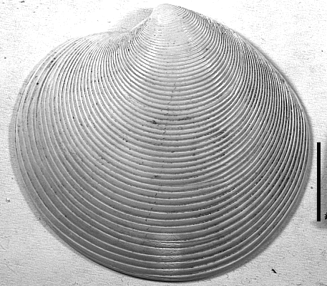
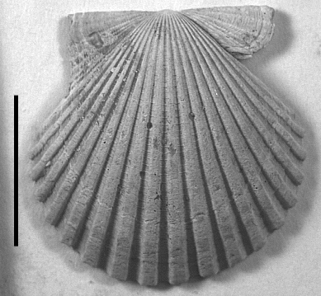
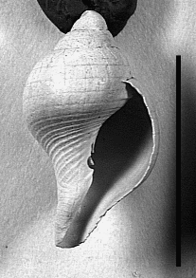
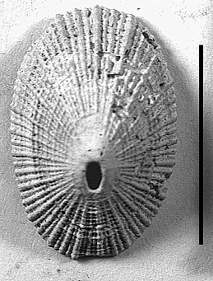
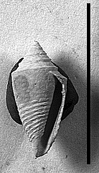
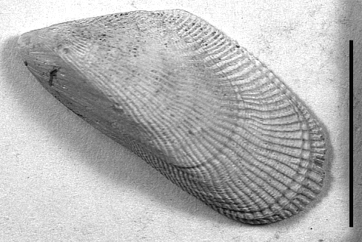
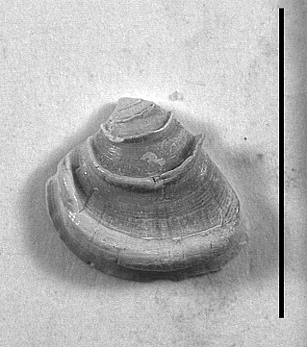
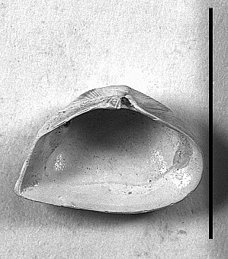
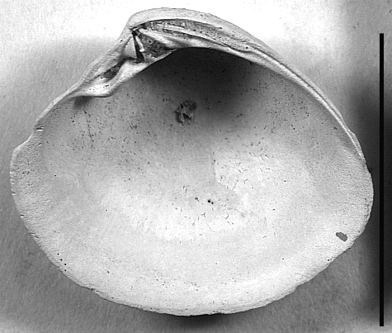
Pleistocene
Molluscan Assemblage

Slide 28
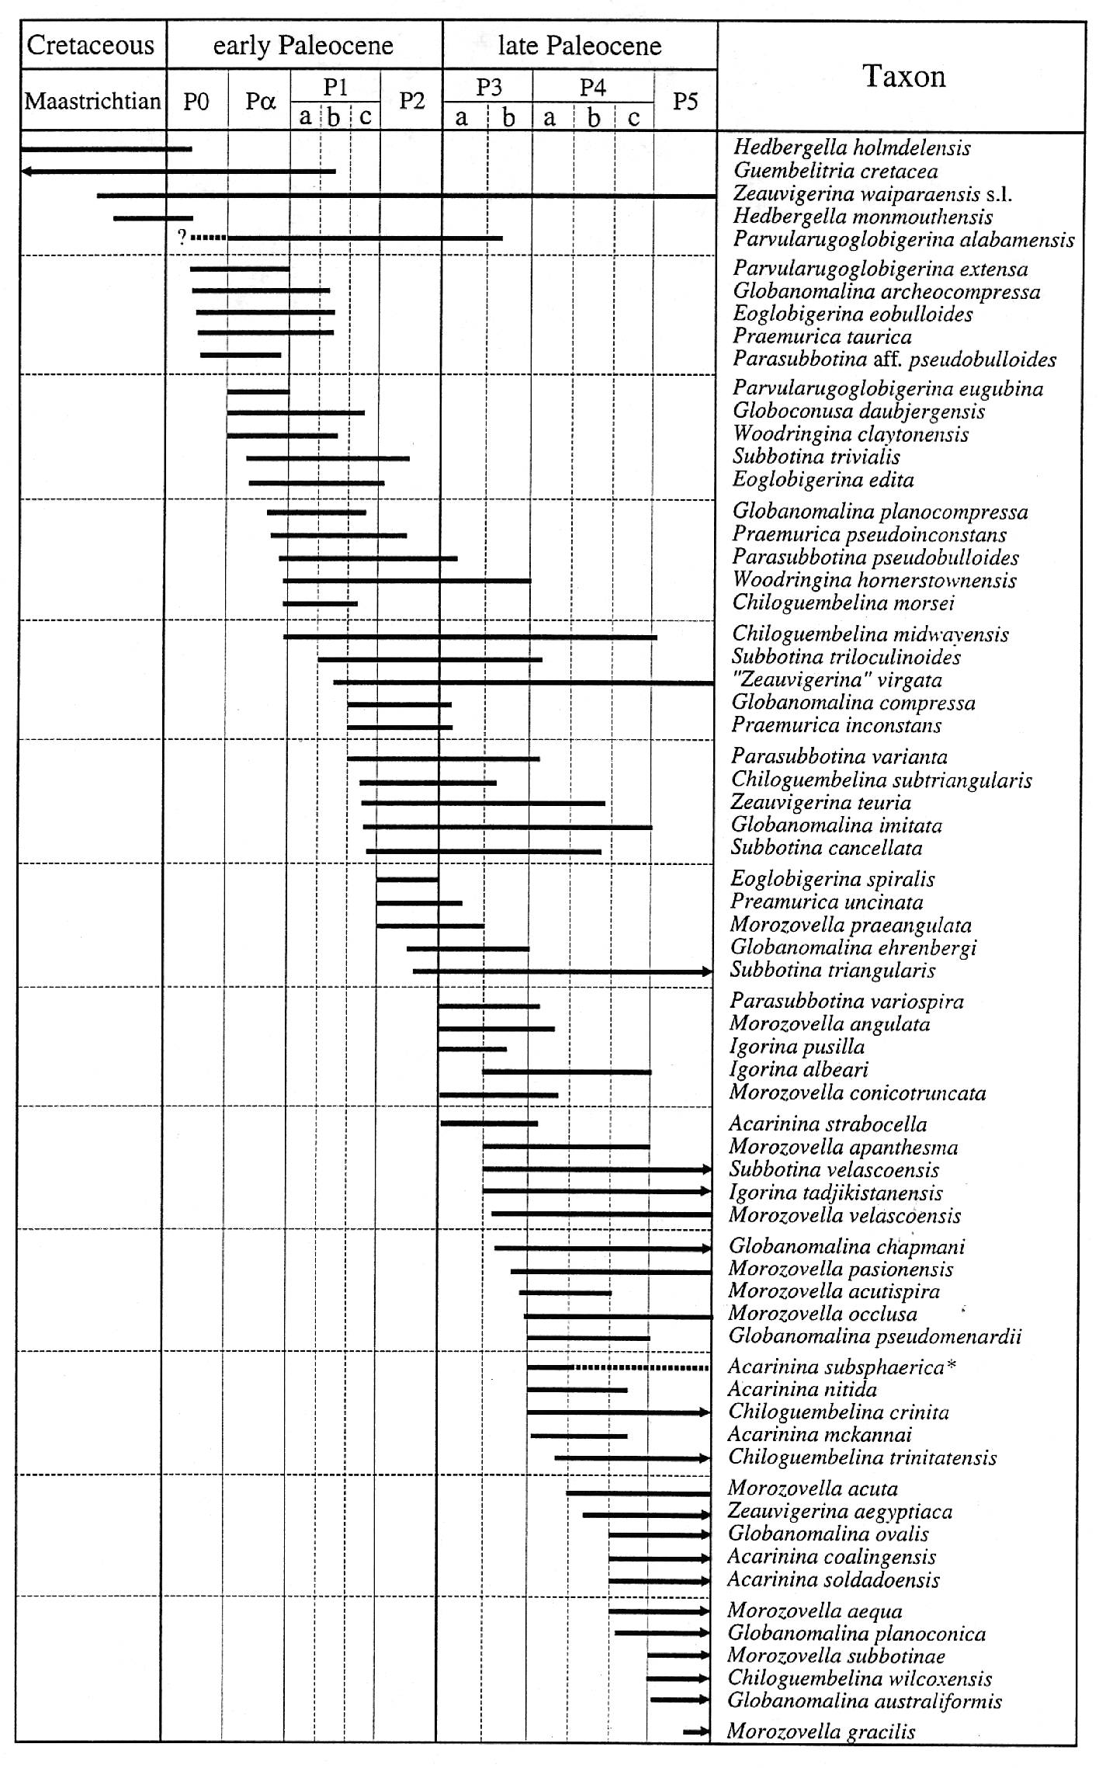
Foraminifera
http://services.chronos.org/foramatlas/pages/rcfo.htm
http://www.ucmp.berkeley.edu/people/klf/MicroGallery.htm

Slide 29
The Geologic Time Scale subdivides the history of the Earth based on biostratigraphy and other dating techniques into:
4 Eons (Hadean, Archean, Proterozoic, Phanerozoic), each of which contains
Eras (e.g., Paleozoic, Mesozoic, Cenozoic) which are further subdivided into
Periods (e.g., Triassic, Jurassic and Cretaceous), Epochs and smaller time divisions
Geologic Time Scale
http://3dparks.wr.usgs.gov/coloradoplateau/images/timescale.jpg

Slide 30
Most people think of time in terms of blocks of seconds, minutes, years, etc. Geologists also use a concept called “rock time” which is time designations assigned to physical rock bodies.
“Time”-Time
“Rock”-Time
Eon
Era
Period
Epoch
Eonothem
Erathem
System
Stage
Geologic Time Scale
A sedimentary rock deposited during the Devonian Period would be a member of the Devonian System.
http://3dparks.wr.usgs.gov/coloradoplateau/images/timescale.jpg

