Slide 1
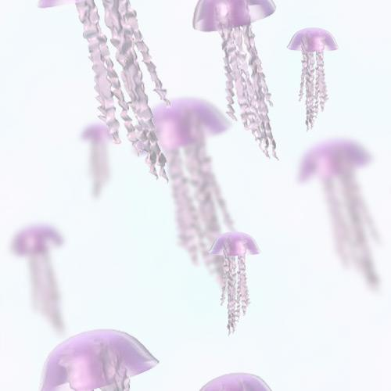
Cambrian Earth History

