Slide 1
Energy Mechanics
Exam dates:
Sept. 16
Oct. 21
Dec. 2
HW1 posted due on Tueday, Sept. 9

Slide 2
Worked example: unit conversion
World energy consumption is about 500Quad/yr. Human population is about 6.5billion. What is the average per capita rate of energy consumption, in units of food calories (=kilocalories=kcal) per day?

Slide 3
Worked example: unit conversion
If humans eat an average of 2500 food calories (kcal) per day, how many quads of food are consumed by humanity in one year?

Slide 4
Worked example: unit conversion
Again with the 2500kcal/day: Convert this rate of energy usage into Watts=Joules/second.

Slide 5
Introduction of Energy Mechanics
The term “physics” is derived from the Greek word physike, meaning science or knowledge of nature.
Physics is the branch of science concerned with the nature and properties of matter and energy.

Slide 6
Forms of Energy (1 of 3)
Energy is the capacity to do work.
One of the basic types of energy is associated with the motion of the object is the kinetic energy.
Examples of kinetic energy include a moving car or a rotating turbine.
The energy associated with an object’s position is gravitational potential energy.
Kinetic and potential energy can be classified as forms of mechanical energy.

Slide 7
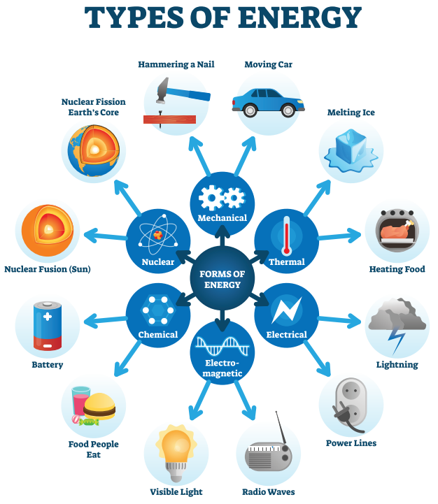
Forms of Energy
Forms of energy.
Notes:
Figure 2.1 Forms of energy.

Slide 8
Forms of Energy
Chemical energy: Fossil fuels, as well as food, are sources of stored chemical potential energy.
Nuclear energy: The energy found within the atomic nucleus is nuclear energy.
Thermal energy: A hot object possesses thermal energy (a function of its mass and temperature).
Electrical energy: Electrical energy is produced at an electrical power plant.
Electromagnetic or light energy: Electromagnetic energy is also called radiant and covers everything from radio waves to infrared radiation to visible light to X-rays.

Slide 9
Forms of Energy
Sources of chemical energy.
Wood: A readily accessible source of chemical energy is wood.
Coal: Coal is the most fundamental type of chemical energy.
Gasoline: The gasoline in cars is a source of chemical energy as well.
Electrolysis: Electrolysis is the process of breaking down an electrolyte using electricity to create various compounds.

Slide 10
Energy Conversion Processes
Electrical energy is not a primary energy source but is the result of a conversion process that began with chemical, nuclear, or solar energy sources.
The thermal energy released by burning coal in a boiler turns water into steam, which drives a turbine connected to a generator to produce electrical energy.
The wind’s kinetic energy is converted into the kinetic energy of the shaft and then into electrical energy through a generator.

Slide 11
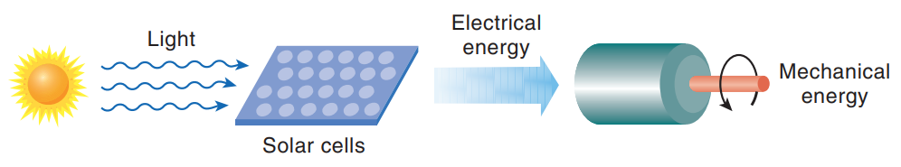
Energy Conversion Processes
Illustration of conversions between different forms of energy. Here, solar energy is converted into electrical energy by a solar cell, which is used to run a motor.
Notes:
Figure 2.3 Illustration of conversions between different forms of energy. Here, solar energy is converted into electrical energy by a solar cell, which is used to run a motor.

Slide 12
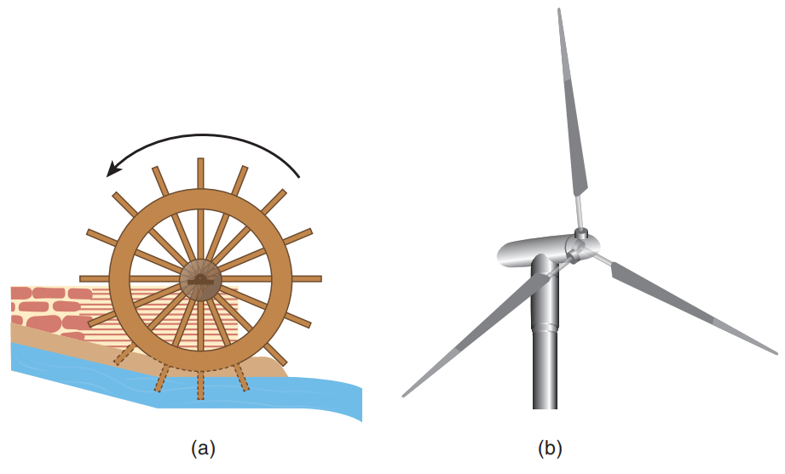
Energy Conversion Processes
Two examples illustrating the conversion of kinetic energy (KE) of water or air into the motion of a waterwheel or a blade, which can be used to grind grain or generate electricity, respectively. (a) An undershot waterwheel. (b) A horizontal-axis, three-bladed, wind-powered generator.
Notes:
Figure 2.4 Two examples illustrating the conversion of kinetic energy (KE) of water or air into the motion of a waterwheel or a blade, which can be used to grind grain or generate electricity, respectively. (a) An undershot waterwheel. (b) A horizontal-axis, three-bladed, wind-powered generator.

Slide 13
Knowledge Check 2
What are the examples associated with the kinetic energy of the motion of an object?

Slide 14
Knowledge Check 2: Answer
What are the examples associated with the kinetic energy of the motion of an object?
Answer: Examples of kinetic energy objects include a moving stream of water, a bug flying through the air, a spinning flywheel, and the wind.

Slide 15
Motion
The objective of this section is to be familiar with motion and its causes. Along with a brief discussion of the Special Topic “Newton’s Laws of Motion.”
The speed of an object is equal to the distance it has traveled divided by the time taken to travel that distance.
Commonly used units for speed are meters per second (m/s), kilometers per hour (km/h), feet per second (ft/s), and miles per hour (mph).
Velocity is displacement (change in position) divided by travel time.
Acceleration is the change in velocity divided by the time elapsed during that change.

Slide 16
Newton’s Law of Motion

Slide 17
Speed, Velocity, and Acceleration (1 of 3)
Speed is equal to the ratio of distance traveled to the time taken to travel that distance.
Velocity provides additional information about the motion of an object, namely its direction.

Slide 18
Speed, Velocity, and Acceleration (2 of 3)
Average velocity is precisely defined as displacement (change in position) divided by the time of travel.
The change in velocity in a certain amount of time is acceleration.
Acceleration is the rate of change in an object’s speed, direction, or both.
If an object’s velocity changes at a constant rate, its acceleration is constant.

Slide 19
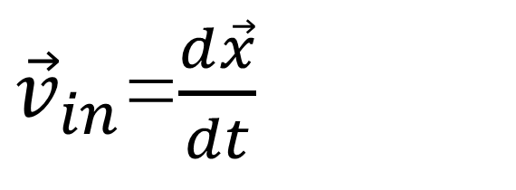
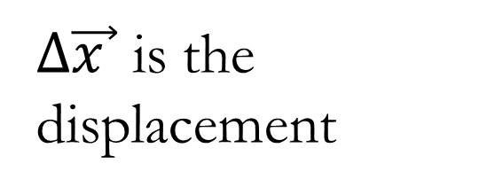
Velocity
$∆\vec{x }$ is the displacement
${\vec{v}}_{in}$=$\frac{d\vec{x}}{dt}$
Instantaneous Velocity

Slide 20
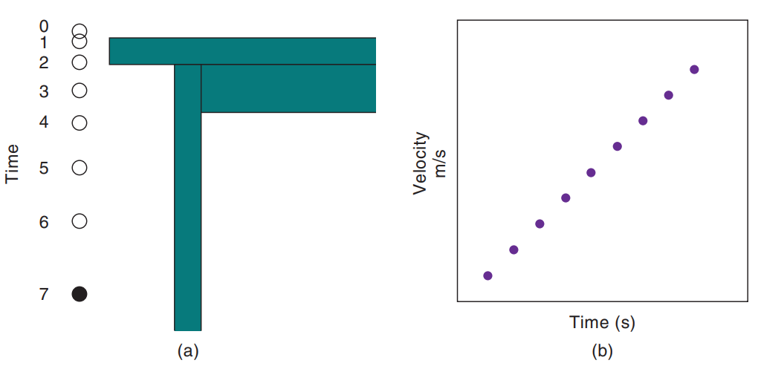
Speed, Velocity, and Acceleration (3 of 3)
A freely falling object. (a) Positions of a ball at equally spaced time intervals after being dropped from a tabletop. (b) Graph of the ball’s velocity versus time. Even though the velocity is changing, the rate of change of velocity (the acceleration) remains constant. (Air resistance is assumed to be zero.)
Notes:
Figure 2.12 A freely falling object. (a) Positions of a ball at equally spaced time intervals after being dropped from a tabletop. (b) Graph of the ball’s velocity versus time. Even though the velocity is changing, the rate of change of velocity (the acceleration) remains constant. (Air resistance is assumed to be zero.)

Slide 21
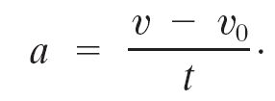
Acceleration, Equations of Motion
Average velocity

Slide 22
Motion
Humans can sense acceleration, but not necessarily speed.
A force causes the velocity of an object to change (i.e., for the object to accelerate).
A force can be defined as the interaction of an object with other objects in its environment, usually a push or a pull.
The net force is the (vector) sum of all the forces acting on the object.

Slide 23
Newton’s Second Law of Motion
Newton’s second law of motion states that the acceleration (a) of an object is directly proportional to the net force acting on it and inversely proportional to the object’s mass (m).
Acceleration only occurs if a net force acts on the object, that is if the sum of all the forces acting on an object is unbalanced or nonzero.
One of the most common forces in nature is the force of friction, which always opposes motion.

Slide 24
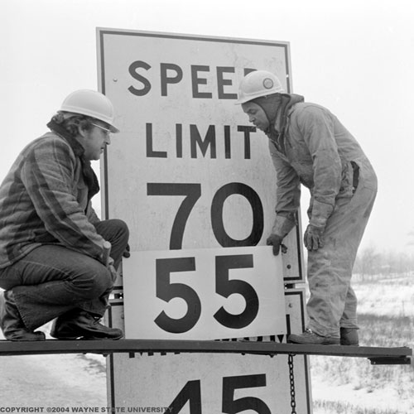
Questions
NEWTON #2
If, while traveling due north on an interstate highway, your speed changed from 50 miles per hour to 55 miles per hour in five seconds, you could say (correctly)
the acceleration of the car is one mile per hour per second.
the velocity of the car is five miles per hour.
the acceleration of the car is -25 miles per hour per second.
the speed is unchanged.
there is no net force on the car.

Slide 25

Questions
Equal net forces are applied to a Cadillac and a Volkswagen Beetle. We would expect the Volkswagen to experience the larger acceleration because
it is less expensive.
German engineers design more efficient cars.
it has less mass.
it has smaller wheels.
it has more weight.

Slide 26
Questions
A 1000-kilogram car undergoes an acceleration of 0.4 meters per second per second. According to Newton’s second law of motion, we would say
the net force on the car is 400 N.
the kinetic energy of the car is constant.
there is no work done on the car.
the reaction force is 1000 kilograms.
the net force on the car is 2500 N.

Slide 27
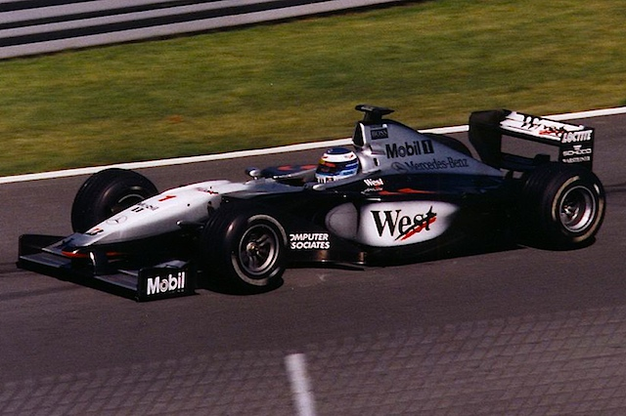
Worked example: acceleration
A McLaren Formula 1 racer accelerates “from 0 to 60” [60mph=27m/s] in 3.1s.
What is its acceleration in m/s²? In gees [1 gee =9.8m/s²]?
If the car is 1290kg, what is the average net force on it?
What force must you exert on your 165lb, 75kg professor to get him to go from 0 to 60 in 3.1s? Would dropping him out the window do it?

Slide 28
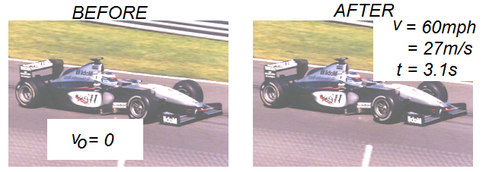

Worked example
Start by drawing a diagram and labeling it with EVERYTHING.
b) $F=ma=1290kg\left(\frac{8.7m}{s2}\right)=11,223 N$
The only difference for your prof is his mass, so
which happens to be 0.89x his weight. So, yes, dropping him out the window will make him go “from 0 to 60” in under 3.1s, UNLESS....
air resistance is significant, or
he hits the ground first. (Ouch!)

Slide 29
Worked example: Newton’s 1st
You exert a 40N force on a 2kg box, which experiences 15N of friction. What is its acceleration if there are no other forces affecting its motion?

Slide 30
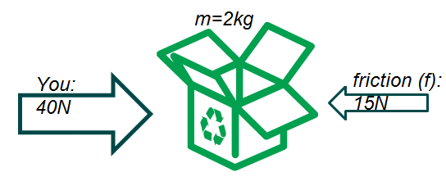
Worked example: Newton’s 1st
Draw a figure. Label it with all the knowns and unknowns.

Slide 31
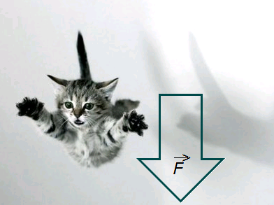
Worked example: freefall
In freefall, one accelerates at a constant a=-g=-9.8m/s/s downward. Show that one’s weight is equal to W=mg.
.

Slide 32
Problem
A baseball is seen to pass upward by a window 23 m above the street with a vertical speed of 14 m/s. If the ball was thrown from the street, (a) what was its initial speed, (b) what altitude does it reach, (c) when was it thrown?

Slide 33
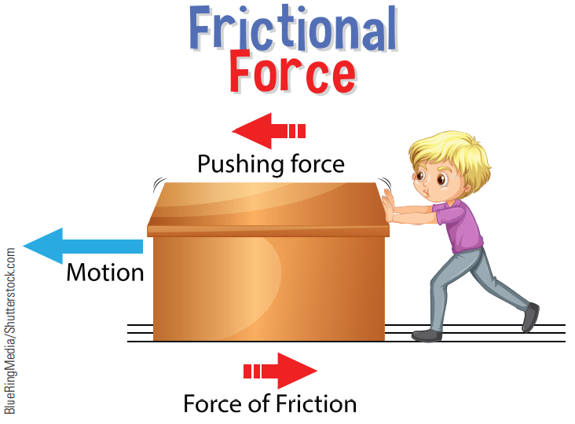
Newton’s Second Law of Motion (2 of 3)
Friction enters into almost every situation in the real world. To accelerate the object, the force of the person’s push must exceed the force of friction.
Notes:
Figure 2.6 Friction enters into almost every situation in the real world. To accelerate the object, the force of the person’s push must exceed the force of friction.

Slide 34
Newton’s Second Law of Motion (3 of 3)
Driving in a city with stop-and-go traffic, people burn more fuel than they do while driving at comparable distances in the country.
We burn more because, in the city, we accelerate from rest, which requires a net force acting on the car.
One of the reasons for the greater use of gasoline per person in the United States than in other countries is that fuel prices are comparatively low.

Slide 35
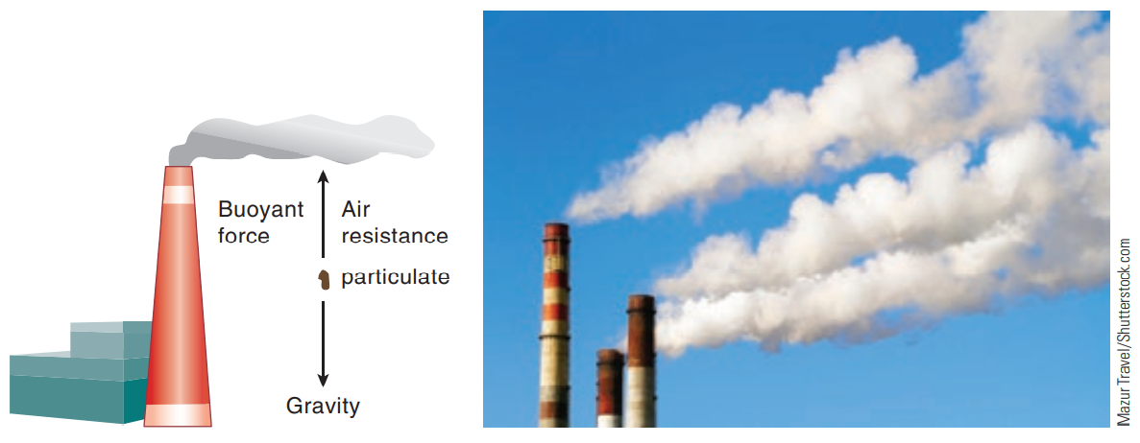
Self-Assessment 1
Explain the process happening in the diagram.
Very small particles (particulates or sulfates) emitted from the tall smokestacks of industrial smelters and electric power plants can experience net vertical forces of zero. They thus remain aloft a long time and can contribute to pollution hundreds of kilometers downwind.

Slide 36
Self-Assessment 1: Answer
As an example of Newton’s laws of motion, consider the following: One of the environmental problems associated with burning fossil fuels is the emission of particulates from the stack. These particles (from about one millionth to a hundred millionth of a meter in size) have been known to travel many hundreds of kilometers before landing, depending on wind velocity
Mazur Travel/Shutterstock.com
Very small particles (particulates or sulfates) emitted from the tall smokestacks of industrial smelters and electric power plants can experience net vertical forces of zero. They thus remain aloft a long time and can contribute to pollution hundreds of kilometers downwind.

Slide 37
Force and Newton’s Laws of Motion (1 of 3)
Newton’s First Law:
The part of mechanics that deals with the causes of motion is called dynamics, and it is based on three laws called Newton’s laws of motion.
The first law of Newton’s laws of motion says that “A body continues in a state of rest, or motion with a constant velocity (i.e., with a constant speed in a straight line), unless compelled to change by an unbalanced (net) outside force.”
It is also called the law of inertia.
Inertia is the tendency of all objects to resist changes in their motion.

Slide 38
Force and Newton’s Laws of Motion (2 of 3)
Newton’s Second Law:
The second law of motion quantifies this relationship between net force and acceleration.
The second law of Newton’s laws of motion says, “The acceleration of an object is directly proportional to the net force acting upon it and inversely proportional to its mass. The direction of the acceleration will be the same as the net force.”
A force can cause deceleration as well as acceleration.

Slide 39
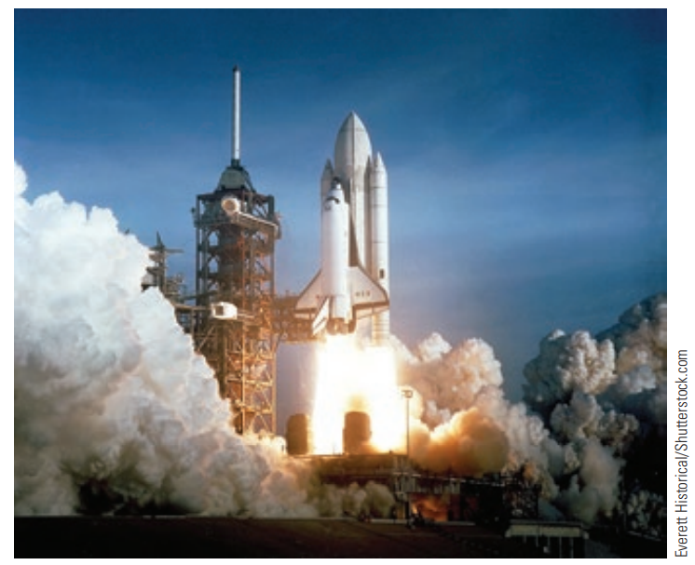
Force and Newton’s Laws of Motion (3 of 3)
Newton’s Third Law:
Newton’s third law says, “For every action force, there is an equal and opposite reaction force.”
The action and reaction forces always act on different objects.
In the acceleration of a space shuttle into outer space, the rockets force the gas out of the ship (action force); the reaction force is the force of the exiting gas on the rocket, thus propelling the ship forward.
Everett Historical/Shutterstock.com
The reaction force of the exiting gases on the rocket accelerates it.

Slide 40
Knowledge Check 3
What is an example of Newton's first law of motion in everyday life?

Slide 41
Knowledge Check 3: Answer
What is an example of Newton's first law of motion in everyday life?
When an accident occurs or the car is suddenly braked, the body tends to continue its inertia and move forward, which is likely to be fatal. To prevent such accidents, seat belts are used to prevent your body from moving forward in its inertia and avoid danger.

Slide 42
Weight versus Mass
Weight is a force and a measure of the force of gravity on an object.
Mass is an intrinsic property of a substance.
Mass is a measure of the “inertia” of an object; it never changes.
An object’s weight depends on its position in a gravitational field.
On the moon, the weight of an object is one-sixth of what it is on earth, but its mass is the same.

