Slide 1
Energy Sources: their uses and effect on the Environment
PHYS305

Slide 2
Syllabus
Class will meet in SIMS 205 once to twice a week
Office Hours: T 1-2 and W 1-2, or by appointment
Cell phones, tablets, and computers are not allowed in class

Slide 3
Attendance:
Although roll is not formally taken in class, I strongly recommend regular attendance. The course has a significant component of interactive learning, and the activities done in class reinforce the material discussed. If there is a reason that you must miss class, please talk with me to make arrangements to cover the material. The attendance policy described in the Winthrop University undergraduate catalog will be followed.

Slide 4
Class
This class is an independent study, which means I will post the slides before the class meetings, you will read the slides and I will answer questions in class

Slide 5
Homework
Homework problems are due on the dates indicated on the class calendar. Your work is due on time, with the exception of reasonable documented excuses. Late work will be docked 50% of face value and 100% after solutions have been posted. For any questions regarding assignment or any topics covered in class, you are encouraged to come for help during office hours. If you cannot make office hours, please email me, and I can meet you any time that works for you.

Slide 6
No use of generative AI tools permitted:
In this course every element of the class assignments must be fully prepared by the student. The use of any generative AI tools for any part of your work will be treated as plagiarism. If you have questions, please contact me.

Slide 7
Course Communication
Be sure to check your Winthrop email account daily, as I may send out course related announcements that will come *only* to Winthrop email addresses.
If you email me, please be sure to use your Winthrop email account I will respond to email within 24 hours except from Saturday morning through Sunday afternoon when my response may be slower.

Slide 8
Exam Policy:
There are three in class exams that are 75 minutes’ duration. All relevant equations and physical constants will be provided. If you are going to miss a test, you must notify me in advance (preferably one week) so alternate arrangements can be made. If you miss a test and your absence is not excused, a grade of zero points must be assessed for that particular piece of work. You must take all in-class exams in order to pass the course.
Grading:
Homework 10%
Three in Class exams 30% each

Slide 9
Syllabus change policy:
I will make changes to this syllabus as deemed necessary for the progression of the course

Slide 10
Introduction to energy, energy production, impact of energy use on the environment
Chapter 1

Slide 11
Icebreaker: Introduction to Energy
What do you think about when you hear: “Energy use”.
Describe the importance of energy conservation.

Slide 12
Energy, Introduction
Energy is the major building of a modern society
It is needed to create goods and provide services
Economic development needs an adequate and reliable supply of energy.
Energy pervades all sectors of Society: economics, labor, environment and international relations.

Slide 13
Energy, Introduction
Energy is found in many forms, and we will in this class identify and study how they can be used.
It can be in the form of wind, flowing water, stored in matter such as fossil fuels, oil, coal, and natural gas.
Energy can be best described in terms of what we can do with it. We cannot see energy , we can only see its effects

Slide 14
Energy, Introduction
We cannot make energy, we can only use it
We cannot destroy energy, only waste it (i.e. use it inefficiently).
Energy is a conserved quantity, that is , the total amount of energy in the universe is constant.
Energy is not created or destroyed but converted from one form to another.

Slide 15
Energy as a field of Physics, Science
Physics= The User’s Guide to the universe
♦ Quantitative
♦ Observation-based
Observation disagrees with theory?
♦ Throw out the theory.
Physicists focus first on the essentials (blowing off the details for now).
Physicists focus on context, the big picture.

Slide 16
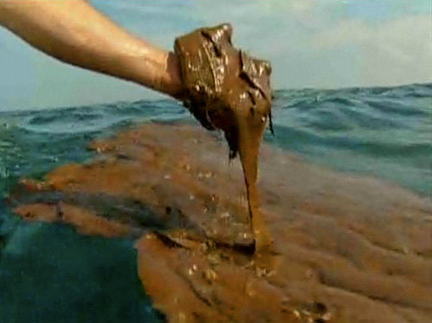
The Importance of Context
Proper units help keep things in context.
2010 BP oil spill:
Up to 4.9 million barrels of oil. Is that a lot?
0.03 Quads vs 100 Quads/yr US use.
(Quad = quadrillion BTUs =10¹⁵ BTU = 1,000,000,000,000,000 BTU)
equivalent to 2.5 of total US energy use
Image: http://www.burdr.com/2010/05/deepwater-horizon-oil-spill-on-60-minutes

Slide 17
Fuel energy content
Food 2 kWh/kg
Wood 5
Coal 7
Anthracite 10
Petroleum 12
Methane (Natl. gas) 15
Hydrogen 40
Uranium fission 2×10⁷
Hydrogen fusion 15×10⁷
Solar, wind infinite

Slide 18
Chapter Objectives
By the end of this chapter, you should be able to:
Explain the basic concept of energy.
Describe the conservation of energy and technical, lifestyle changes.
Explain the uses of energy and major factors affecting the environment.
Use diagrams to illustrate energy consumption in the world.
List the different types of energy resources.
Discuss the scope of energy in the future.

Slide 19
Energy: An Introduction

Slide 20
Energy (1 of 2)
According to the ex Director-General of the International Renewable Energy Agency (IRENA), “Energy is fundamental to our civilization and to the prosperity of nations. Its production, distribution, and utilization are deeply embedded in the fabric of our economies and central to the relations between states.”
Energy provide services from your morning latte to emergency medical care.
Energy pervades all sectors of society—economics, labor, environment, and international relations.
Using energy resources has made our efforts more productive.

Slide 21
Energy (2 of 2)
About 80% of the world’s energy comes from fossil fuels, about 30% from oil, 25% from coal, and 25% from natural gas.
Countries such as Morocco, Japan, Lebanon, and Luxembourg import more than 90% of their energy resources.
Energy is a basic concept in all science and engineering disciplines.
Sustained energy growth in this century presents an opportunity to transform lives and economies and improve the quality of everyone’s lives through the expanded use of renewable energy sources.
Renewable energy sources, such as water, wind, solar, and biomass are important especially right now with the climate change.

Slide 22
Knowledge Check 1
What provides 80% of the world's energy today? And what is the main energy supply for our world?

Slide 23
Knowledge Check 1: Answer
What provides 80% of the world's energy today? And what is the main energy supply for our world?
Answer: About 80% of the world’s energy comes from fossil fuels, about 30% from oil, 25% from coal, and 25% from natural gas. Globally we get the largest amount of our energy from oil, followed by coal, gas, then hydroelectric power.

Slide 24
Energy Conservation

Slide 25
Energy Conservation (1 of 2)
The total energy consumed in any activity can be thought of as consisting of two factors:
  The efficiency of the activity and the length/amount of the activity that input provides
Efforts of energy conservation usually concentrate on either changes to technology or lifestyle.
  Technical change: This change consists of using fuel more efficiently to perform the same task.
  Lifestyle change: This change means consciously using less fuel by such behaviors as turning down the thermostat or driving fewer miles.

Slide 26
Energy Conservation (2 of 2)
The maximum possible success of technical fixes for energy conservation is limited by the laws of physics.
Conservation measures can be readily practiced by each individual with the incentive of saving money and energy.
Turning down the thermostat leads to lower household energy bills.
Walking or biking short distances, rather than driving, lowers spending on gasoline.

Slide 27
Discussion Activity 1
Discuss five ways to conserve energy.

Slide 28
Discussion Activity 1 Debrief
Discuss the five ways to conserve energy.
Get a smart thermostat.
Reduce the uses of electric appliances.
Replace the traditional light bulbs with LEDs.
Use natural lights.
Insulate home properly.

Slide 29
Energy Use and the Environment

Slide 30
Energy Use and the Environment (1 of 4)
The use of our energy resources is one of the major factors affecting the environment.
The degradation of the environment and impacts to human health inspired the first Earth Day, on April 22, 1970.
The United States has made significant progress in reducing pollution in the years since the establishment of the Environmental Protection Agency (EPA).Now….
Air pollution has declined nationally by two-thirds since 1970.
New cars emitted about 1% of the pollution per mile in the 1970s.

Slide 31
Energy Use and the Environment (2 of 4)
Observed increases in greenhouse gas concentrations are caused by human activities, primarily the burning of fossil fuels.
Use of fossil fuels, since the beginning of the industrial age, has increased the carbon dioxide concentration in the atmosphere by 50% and has increased the earth’s temperature by more than 1°C.
Achieving the goal of net-zero emissions by 2050 has put renewable energy sources at the forefront of energy policy, research, and investment. Except that…..
The technological advances of the past two decades have led to falling costs, causing renewable energy sources to grow faster than fossil fuel energy sources. But…..

Slide 32
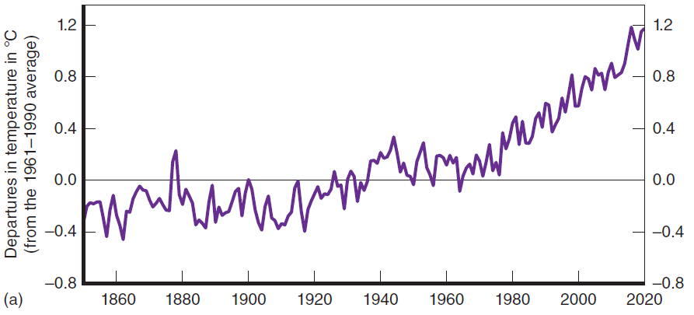
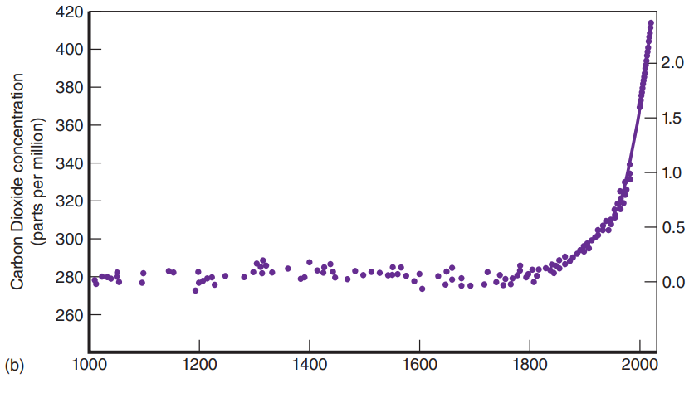
Energy Use and the Environment (3 of 4)
(a) The global mean temperature anomaly compared to the pre-industrial average (1850–1900). From 1900 to 2020, the global temperature is 1.27 °C (2.29 °F) warmer (source: http://berkeleyearth.org/).
(b) Global average concentrations of carbon dioxide and methane (greenhouse gases) in the atmosphere over the past 1,000 years (source: NOAA).
Notes:
Figure 1.1 (a) The global mean temperature anomaly compared to the pre-industrial average (1850–1900). From 1900 to 2020, the global temperature is 1.27 °C (2.29 °F) warmer (source: http://berkeleyearth.org/). (b) Global average concentrations of carbon dioxide and methane (greenhouse gases) in the atmosphere over the past 1,000 years (source: NOAA).

Slide 33
Energy Use and the Environment (4 of 4)
The extraction and use of fossil fuels for energy production have caused widespread air pollution, environmental damage, and climate change.
The World Health Organization estimates that 7 million people die every year from exposure to polluted air, causing diseases including stroke, heart disease, lung cancer, chronic obstructive pulmonary diseases, and respiratory infections, including pneumonia.
These impacts, and others, have led governments, businesses, and the public to recognize the need to find better options for global energy production.

Slide 34
Knowledge Check 2
What is the role of the Environmental Protection Agency (EPA).

Slide 35
Knowledge Check 2: Answer
What is the role of the Environmental Protection Agency (EPA).
The Environmental Protection Agency protects people and the environment from significant health risks, sponsors and conducts research, and develops and enforces environmental regulations. EPA works to insure that Americans have clean air, land and water.

Slide 36
Energy Use Patterns

Slide 37
Energy Use Patterns (1 of 7)
Until the 1980s, energy consumption in the world—especially the United States—had been increasing annually at a rapid rate.
Between 1850 and 2000, the use of commercial fuels increased by a factor of 100.
In the late 1940s and 1950s, post-WWII, energy use grew an average of 2.9% each year in the United States.
In 1983, the United States used 11% less energy than it did in 1979, even with an increase in population.

Slide 38
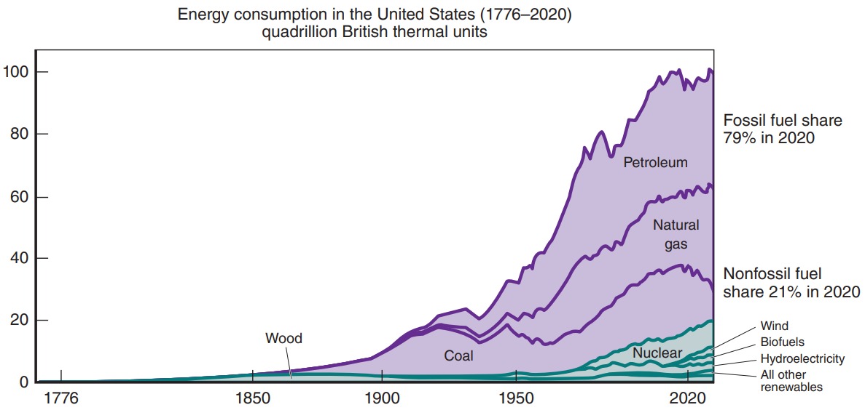
Energy Use Patterns (2 of 7)
Energy consumption in the United States over the past 200 years by fuel use. A quadrillion Btu (or Quad) is 1015 Btu. (Source: United States Energy Information Administration, USEIA)
Notes:
Figure 1.5 Energy consumption in the United States over the past 200 years by fuel use. A quadrillion Btu (or Quad) is 1015 Btu. (Source: United States Energy Information Administration, USEIA)

Slide 39
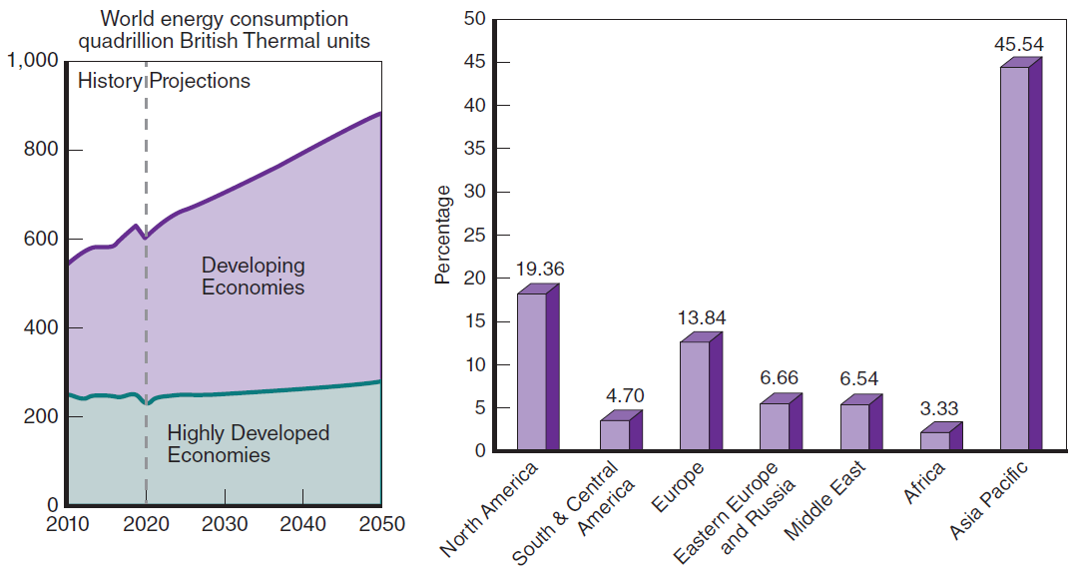
Energy Use Patterns (3 of 7)
Energy consumption in industrialized countries remain the same.
In the developing economies will grow by 2.5% per year
(a) World energy consumption, 1970–2050, for highly developed and developing economies.
(b) Regional shares of total final consumption for 2020. (Source: United States Energy Information Administration, USEIA.)
Notes:
Figure 1.6 (a) World energy consumption, 1970–2050, for highly developed and developing economies. (b) Regional shares of total final consumption for 2020. (Source: United States Energy Information Administration, USEIA.)

Slide 40
Energy Use Patterns (4 of 7)
The fuel mix has changed over the years.
A shift to nonrenewable resources began in the eighteenth century, as increasingly industrialized societies started to burn fossil fuels to make steam for steam engines (invented in 1763) and to smelt iron.
More than three-quarters of the United States’ energy comes from fossil fuels, and more than 80% globally.
The first modern oil well was drilled in Pennsylvania in 1859, and oil found increased use after the invention of the internal combustion engine in the 1870s.

Slide 41
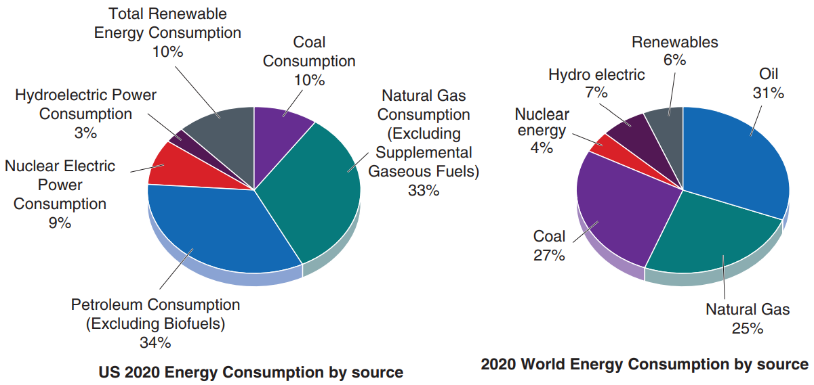
Energy Use Patterns (5 of 7)
Energy consumption by source for the world and for the United States. (Source: USEIA)
Notes:
Figure 1.8 Energy consumption by source for the world and for the United States. (Source: USEIA)

Slide 42
Energy Use Patterns (6 of 7)
The downward trend in production continued for three decades until U.S. crude oil production began to increase in 2010.
From 1995 through 2010, imports exceeded production, but in 2020, the United States exported more oil than it imported.
The end uses of energy are traditionally broken down into four sectors: transportation, industrial, residential (single and multifamily dwellings), and commercial (offices, stores, schools, etc.).

Slide 43
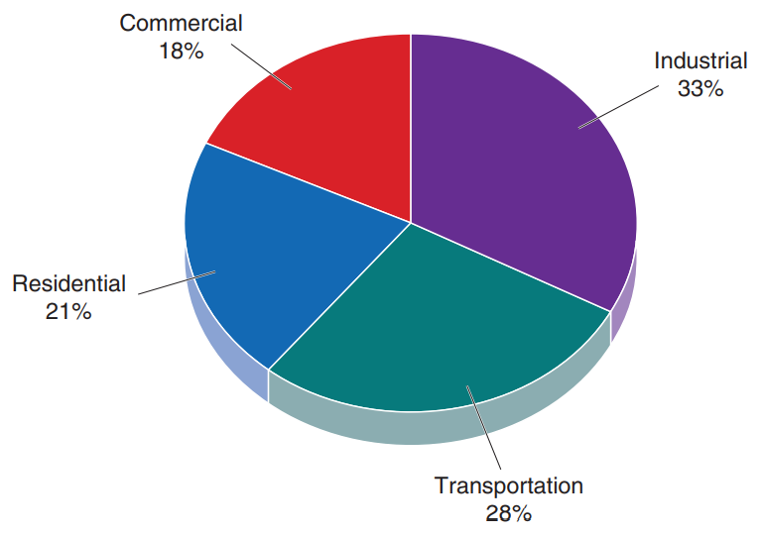
Energy Use Patterns (7 of 7)
U.S. end uses of energy by sector: 2020. (Source: USEIA)
Notes:
Figure 1.11 U.S. end uses of energy by sector: 2020. (Source: USEIA)

Slide 44
Energy Resources

Slide 45
Energy Resources (1 of 3)
Estimates of fossil fuel resources are easiest for coal because coal deposits occur in extensive seams over a large area and often crop out on the earth’s surface.
Estimates of petroleum and natural gas resources are more difficult because deposits are not uniformly distributed.
Estimates of U.S. and world fossil fuel resources that can be recovered profitably with present technology. These resources are called reserves.
Reserves are not a static quantity—they grow every year through discovery and improved methods of economically extracting the particular resource.

Slide 46
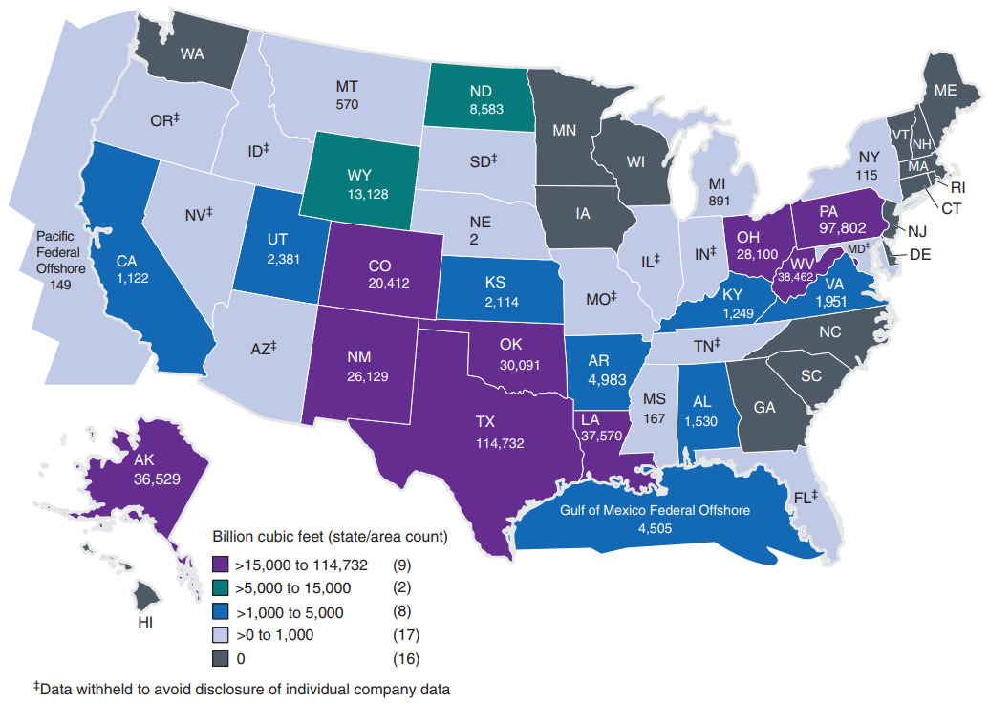
Energy Resources (2 of 3)
Map of natural gas reserves in the United States. (Source: USEIA)
Notes:
Figure 1.12 Map of natural gas reserves in the United States. (Source: USEIA)

Slide 47
Energy Resources (3 of 3)
Each type of energy resource is measured in units appropriate to its physical form:
  Tons of coal
  Barrels (bbl) of oil (where 1 barrel is equal to 42 U.S. gallons)
  Trillion cubic feet (tcf) of natural gas
  The speed of the wind (m/s)
  Total sunlight striking the earth’s surface each second (W/m²).

Slide 48
Discussion Activity 2
Discuss the importance of energy resources in day to day life.

Slide 49
Discussion Activity 2 Debrief
Discuss the importance of energy resources in day to day life.
Energy powers electronic devices, communications, medical devices, industrial devices, transportations, and many more. For the developed and developing nations the need for reliable energy is more fundamental. The growth of energy is directly proportional to prosperity and well-being across the globe. The examples include working from home on your laptop or computer, running appliances and cooking, watching television, and washing clothes etc.

Slide 50
Energy in the Future

Slide 51
Energy in the Future (1 of 2)
Introduction of electricity in the twentieth century was one of key developments in world energy use.
Electricity is efficient, flexible, and quiet.
The introduction of electricity transformed energy systems from those in which fossil fuel energy was used directly to a system in which fossil fuels are used to generate electricity for distributed use.
Oil supply and demand created power differentials between exporters and importers, generating the need for energy security.

Slide 52
Energy in the Future (2 of 2)
Highly developed economies like those in United States, Europe, Japan, and other parts of the wealthy world, are focusing on reducing the greenhouse gas emissions that result from their energy-intensive economies.
Growing economies and industrializing countries must follow a cleaner path than the United States.
The energy sector is the source of around three-quarters of greenhouse gas emissions.
To avoid the worst impacts of climate change, we must completely transform of how we produce, transport, and consume energy.

Slide 53
Discussion Activity 3
Discuss different types of energies to be used in the future.

Slide 54
Discussion Activity 3 Debrief
Discuss different types of energies to be used in the future.
Solar energy: Solar energy is the heat and radiant light from the Sun that is collected using the technologies to generate electricity.
Wind energy: Wind is used to generate electric energy by means of various wind turbines.
Biomass energy: It can be generated by once-living or living organisms.

Slide 55
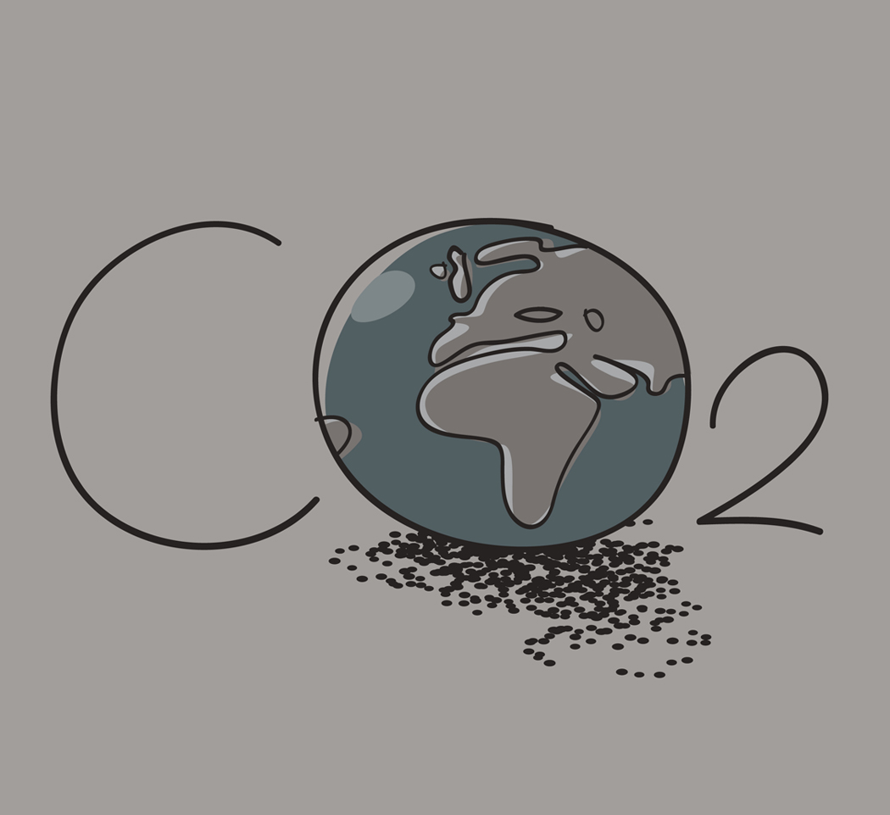
Study questions
A study of carbon dioxide content in the atmosphere and global temperatures shows
a) A modest correlation between the two.
b) A very strong correlation going back to about 1000AD.
c) A very strong correlation going back about 160,000 years.
d) A very strong correlation that breaks down over the last hundred years or so.

Slide 56
Study questions
An increase in CO₂ in the atmosphere since the Industrial Revolution
a) Has not been observed yet.
b) Has been claimed by some but the evidence for an actual increase is controversial.
c) Has been definitively observed to be smaller than increases between the Ice Ages.
d) Has pushed CO₂ level in the atmosphere above its previous values during or between the Ice Ages.

Slide 57

Study questions
How many of the following statements about atmospheric methane levels are true?
I. Methane is not a “greenhouse” gas.
II. Changes in methane levels over the last 100 years are correlated to changes in CO₂ levels.
III. The data shows that methane levels have already contributed to global warming.
a) II only
b) II and III only
c) I and III only
d) All of the above.

Slide 58
What have we learned?
US 5% of the world’s population; 20% of energy use.
US = 100Q, stable. World: 500Q & increasing.
Cow toots (methane) and doots are evil.
Canada & Mexico are our main energy suppliers.
Hubbert curve predicts future history
There may be syllabus quiz Friday!!

