Slide 2
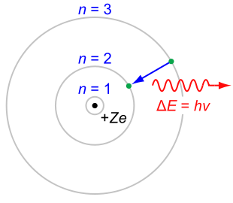
Chapter 4-class 1:The Bohr Model of the atom
Some people say, "How can you live without knowing?" I do not know what they mean. I always live without knowing. That is easy. How you get to know is what I want to know.
- Richard Feynman

Slide 3
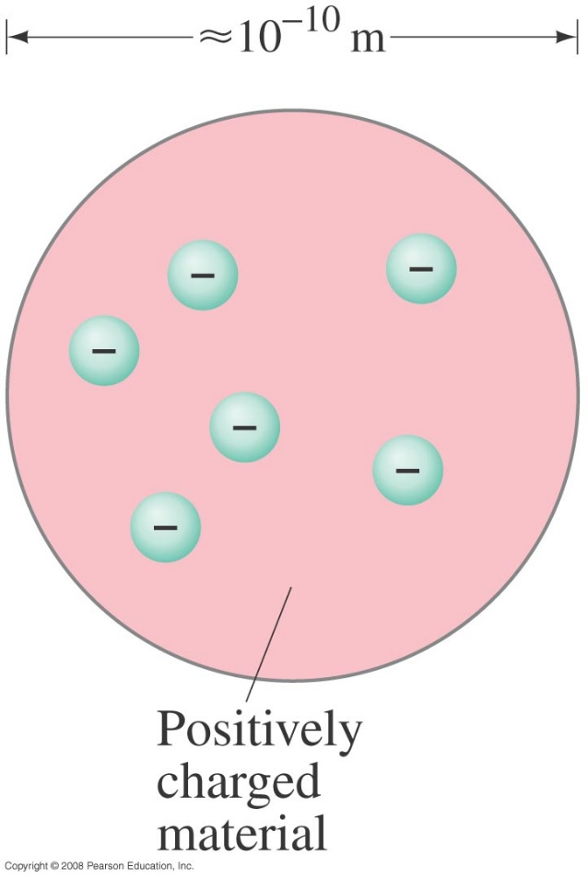
Early Models of the Atom
It was known that atoms were electrically neutral, but that they could become charged, implying that there were positive and negative charges and that some of them could be removed.
One popular atomic model was the “plum-pudding” model:
This is the first model of the atom in 1890
Notes:
Figure 37-16. Plum-pudding model of the atom.

Slide 4
Early Models of the Atom
This model had the atom consisting of a bulk positive charge, with negative electrons buried throughout.
Rutherford did an experiment that showed that the positively charged nucleus must be extremely small compared to the rest of the atom. He scattered alpha particles – helium nuclei – from a metal foil and observed the scattering angle. He found that some of the angles were far larger than the plum-pudding model would allow.

Slide 5
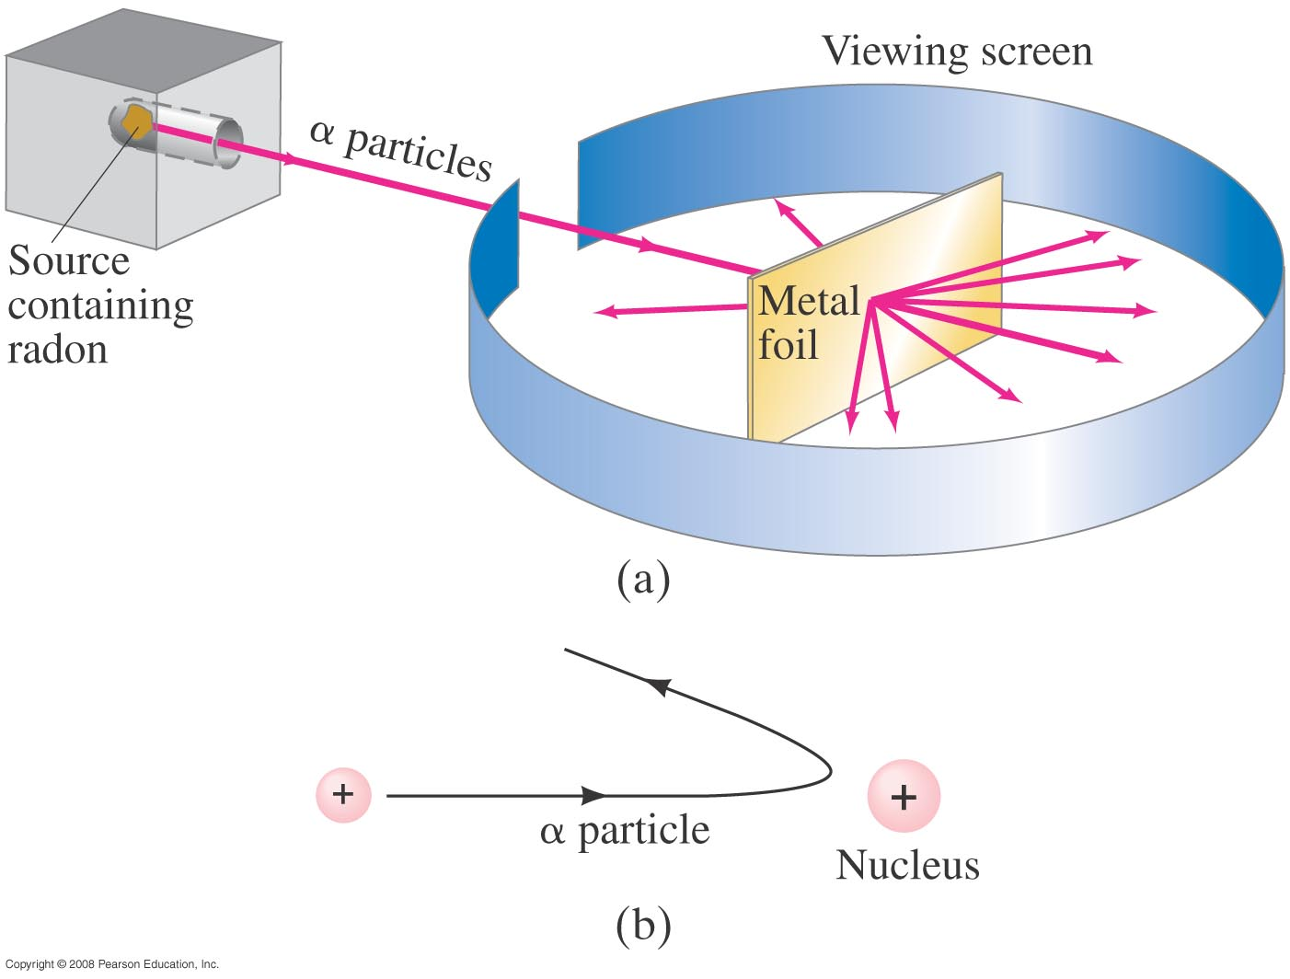
Early Models of the Atom
The only way to account for the large angles was to assume that all the positive charge was contained within a tiny volume – now we know
that the radius of the nucleus is 1/10,000 that of the atom.
α particles emitted by radon are deflected by a metallic foil, and few particles rebound
Notes:
Figure 37-17. (a) Experimental setup for Rutherford’s experiment: particles emitted by radon are deflected by a thin metallic foil and a few rebound backward; (b) backward rebound of particles explained as the repulsion from a heavy positively charged nucleus.

Slide 6
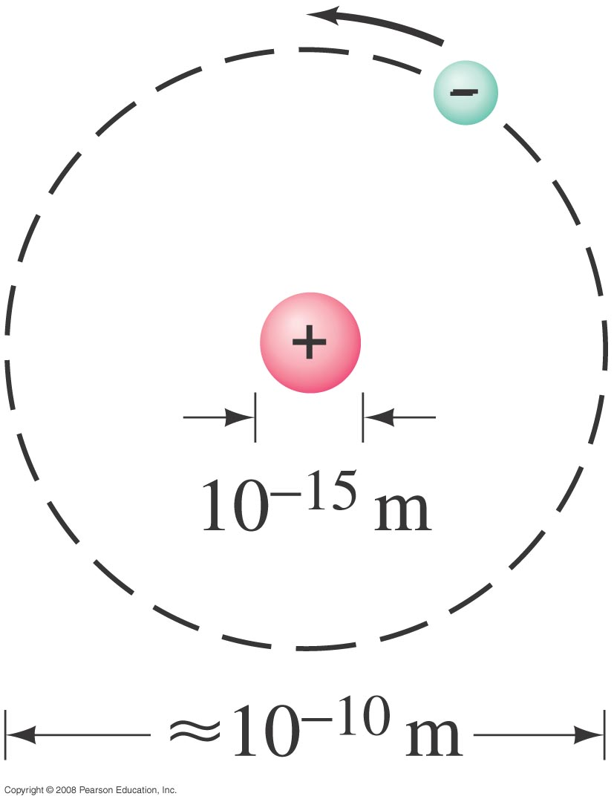
Early Models of the Atom
Therefore, Rutherford’s model of the atom is mostly empty space:
He hypothesized that the atom consists of a tiny massive nucleus with electrons orbiting about it, if not orbiting they fall into the nucleus.
Notes:
Figure 37-18. Rutherford’s model of the atom, in which electrons orbit a tiny positive nucleus (not to scale). The atom is visualized as mostly empty space.

Slide 7
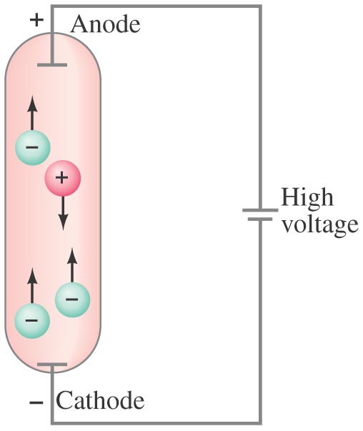
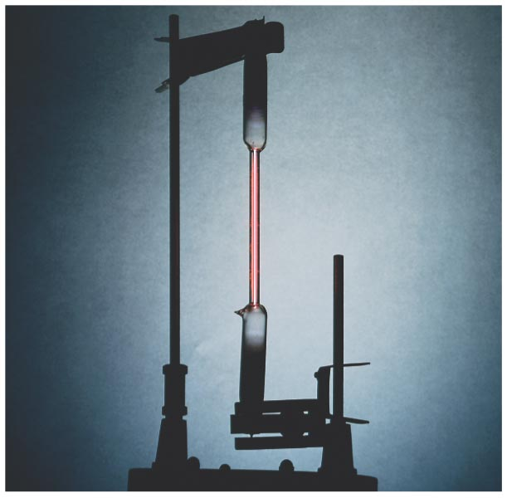
Atomic Spectra: Key to the Structure of the Atom
A very thin gas heated in a discharge tube emits light only at characteristic frequencies.
Rarefied gases emit light
Radiations are due to atoms or molecules.
This was observed in the late 19th century.
Discharge tube with gas at low pressure
Atoms will move and emit light at certain wavelengths (or frequencies) that consist of the atomic spectrum
Notes:
Figure 37-19. Gas-discharge tube: (a) diagram; (b) photo of an actual discharge tube for hydrogen.

Slide 8

Atomic Spectra: Key to the Structure of the Atom
An atomic spectrum is a line spectrum – only certain frequencies appear, it is discrete not continuous when analyzed through a spectrometer. If white light passes through such a gas, it absorbs at those same frequencies. (this is light emitted by individual atoms)- but this conflicts with Rutherford model
Hydrogen gives off 4 energies (or wavelengths)
This is the atom model
(a) Emission of Hydrogen
(b) Emission of Helium
(c) Solar absorption spectrum
Notes:
Figure 37-20. Emission spectra of the gases (a) atomic hydrogen, (b) helium, and (c) the solar absorption spectrum.

Slide 9
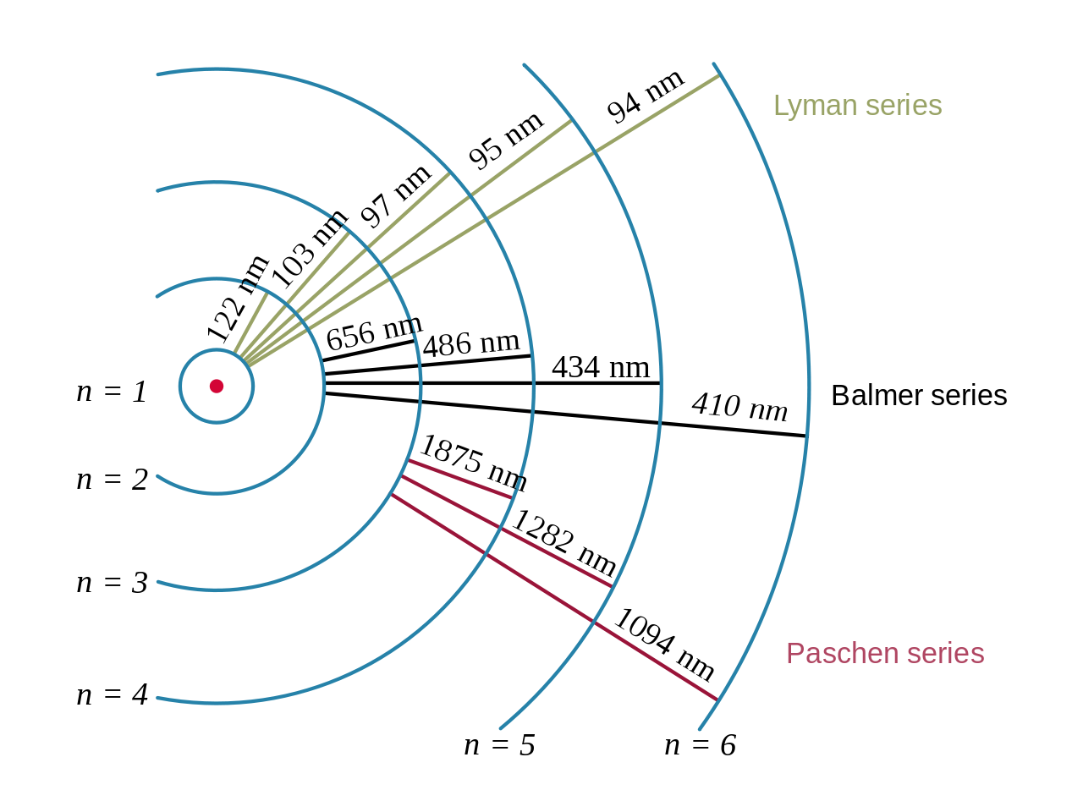
Atomic Spectra: Key to the Structure of the Atom
Each energy state, or orbit, is designated by an integer, n as shown in the figure.
Spectral emission occurs when an electron transitions, or jumps, from a higher energy state to a lower energy state.
The energy of an emitted photon corresponds to the energy difference between the two states.
Because the energy of each state is fixed, the energy difference between them is fixed, and the transition will always produce a photon with the same energy.
The spectral lines are grouped into series,
lines are named sequentially starting from the longest wavelength/lowest frequency of the series

Slide 10
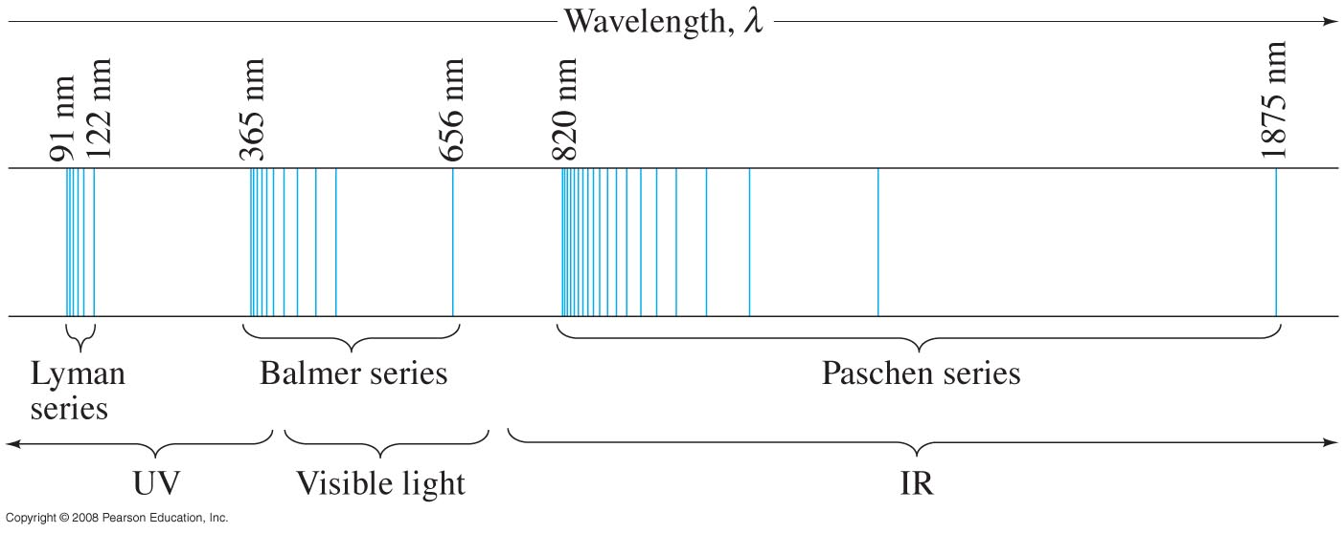
Atomic Spectra: Key to the Structure of the Atom
A portion of the complete spectrum of hydrogen is shown here. The lines cannot be explained by the Rutherford theory.
The spacing between the lines decreases in a regular way.
The line spectra is a key to the structure of the atom.
Notes:
Figure 37-22. Line spectrum of atomic hydrogen. Each series fits the formula 1/λ = R(1/n’² – 1/n²) where n’ = 1 for the Lyman series, n’ = 2 for the Balmer series, n’ = 3 for the Paschen series, and so on; n can take on all integer values from n = n’ + 1 up to infinity. The only lines in the visible region of the electromagnetic spectrum are part of the Balmer series.

Slide 11
Summary of important Ideas
Electrons in atoms are found at specific energy levels
Different set of energy levels for different atoms
One photon emitted per electron jump down between energy levels. Photon color (wavelength) determined by energy difference.
4) If electron not bound to an atom: Cannot have any energy.
(For instance free electrons in the Photoelectric effect.)
Hydrogen
Lithium
Electron energy levels in 2 different atoms: Energy Levels have different spacing (explains unique colors for each type of atom.
Atoms with more than one electron … lower levels filled.
Energy
(not to scale)
Notes:
Note increase in energy is increase in PE! (or energy INPUT into atom).

Slide 12
Now we know about the energy levels in atoms. But how can we calculate/predict them?
→ Need a model
Step 1: Make precise, quantitative observations!
Step 2: Be creative & come up with a model.
Step 3: Put your model to the test.

Slide 13
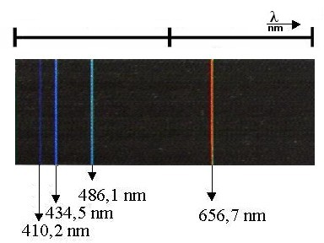
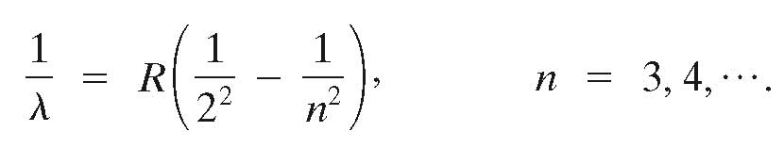

Balmer series:
A closer look at the spectrum of hydrogen
410.3
434.0
486.1
656.3 nm
Balmer (1885) noticed wavelengths followed a progression
where n = 3,4,5, 6, ….
or
R is the Rydberg constant
As n gets larger, what happens to wavelengths of emitted light?
  → λ gets smaller and smaller, but it approaches a limit.

Slide 14

Balmer series:
A closer look at the spectrum of hydrogen
410.3
434.0
486.1
656.3 nm
Balmer (1885) noticed wavelengths followed a progression
So this gets smaller
where n = 3,4,5,6, ….
Balmer correctly predicted yet undiscovered spectral lines.
gets smaller as n increases
gets larger as n increases,
but no larger than 1/4
λ gets smaller and smaller, but it approaches a limit

Slide 15

The Balmer series
Example 1: Wavelength of a Balmer line.
Determine the wavelength of light emitted when a hydrogen atom makes a transition from the n = 6 to the n = 2 energy level according to the Bohr model.
Notes:
Solution: Using equation 37-15 we find λ = 4.10 x 10-7 nm (violet).

Slide 16
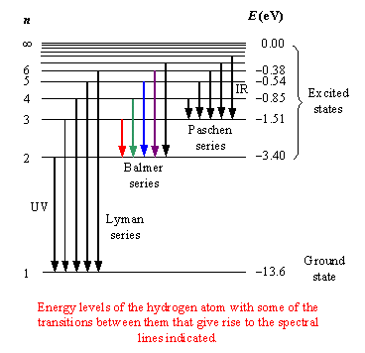
Hydrogen atom – Rydberg formula
Does generalizing Balmer’s formula work?
Yes! → It correctly predicts additional lines in HYDROGEN.
Rydberg’s general formula
Hydrogen energy levels
Experiments showed later that there was similar lines in IR and UV regions and explain the transition in hydrogen with the wavelength equation
Predicts λ of n→m transition:
n
(n>m)
m
(m=1,2,3..)
m=1, n=2

Slide 17
Hydrogen atom – Lyman Series
Rydberg’s formula
Hydrogen energy levels
0eV
Predicts λ of n→m transition:
Can Rydberg’s formula
tell us what ground state energy is?
n
(n>m)
m
(m=1,2,3..)
-?? eV
m=1

Slide 18
Balmer-Rydberg formula
Hydrogen energy levels
0eV
Look at energy for a transition
between n=infinity and m=1
Yes the Rydberg formula can and this is how we calculate the energy level
0eV
0
-?? eV

Slide 19
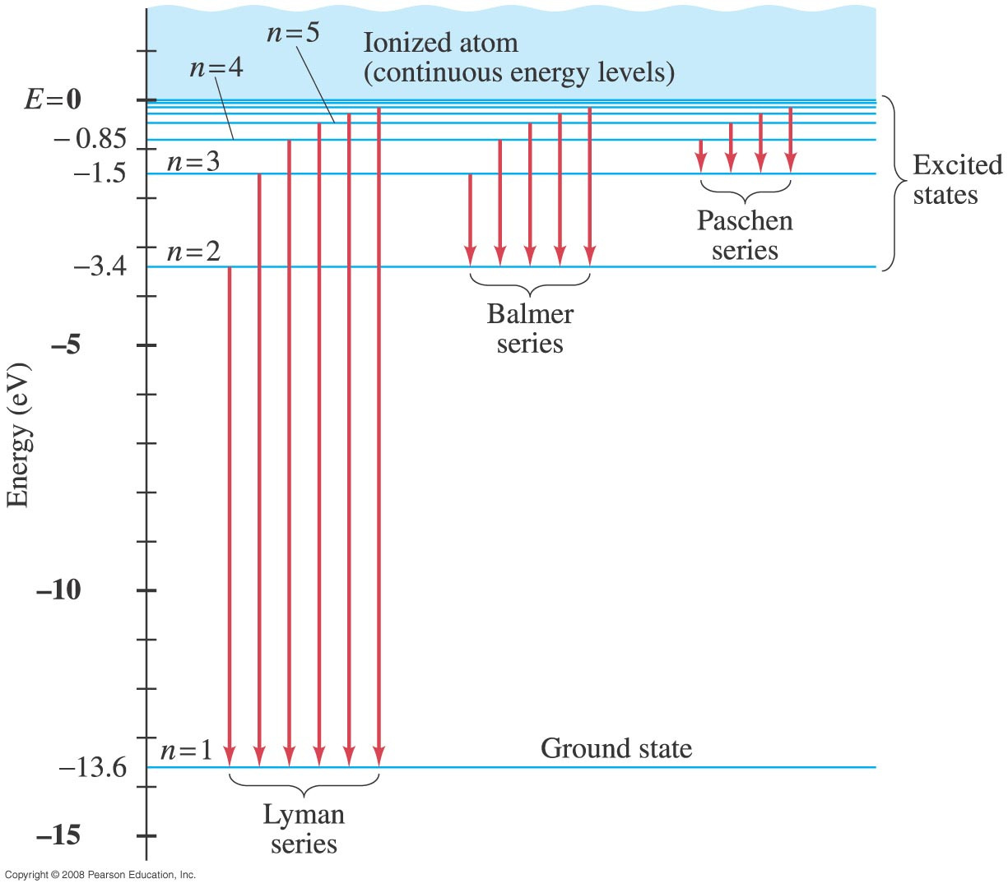
Lyman Series
Example 2: Wavelength of a Lyman line.
Use this figure to determine the wavelength of the first Lyman line, the transition from n = 2 to n = 1. In what region of the electromagnetic spectrum does this lie?
Notes:
Solution: The energy is the difference between the two levels, 10.2 eV. Then λ = hc/E = 1.22 x 10-7 m. This is an ultraviolet photon.

Slide 20
The Balmer/Rydberg formula is a mathematical representation of an empirical observation.
It doesn’t explain anything, really.
How can we calculate the energy levels in the hydrogen atom?
→ A semi-classical explanation of the
atomic spectra (Bohr model)

Slide 21
Bohr Model
Bohr studied in Rutherford’s laboratory for several months in 1912, and was convinced that the Rutherford’s planetary model of atom had validity
Bohr thought: Everybody’s using Planck’s constant these days to talk about energy and frequencies. Why not use it inside the atoms themselves, since they interact with quantized light energy?
The Bohr model has some problems, but it's still useful.
Why doesn’t the electron fall into the nucleus?
  According to classical physics, It should!
  According to Bohr, It just doesn’t.
  Modern QM give a satisfying answer , but this is for another class…
Original paper: Niels Bohr: On the Constitution of Atoms and Molecules, Philosophical Magazine, Series 6, Volume 26, p. 1-25, July 1913.)

Slide 22
Bohr's approach:
#1: Treat the classical mechanics case (electron spinning around a proton):
- Newton's laws assumed to be valid
- Coulomb forces provide centripetal acceleration.
#2: Bohr's hypothesis (Bohr had no proof for this; he just assumed it – leads to correct results!):
- The angular momentum of the electrons is quantized in multiples of ћ. (L=nћ)
- The lowest angular momentum is ћ.
ћ = ^{h}/_{2π}

Slide 23
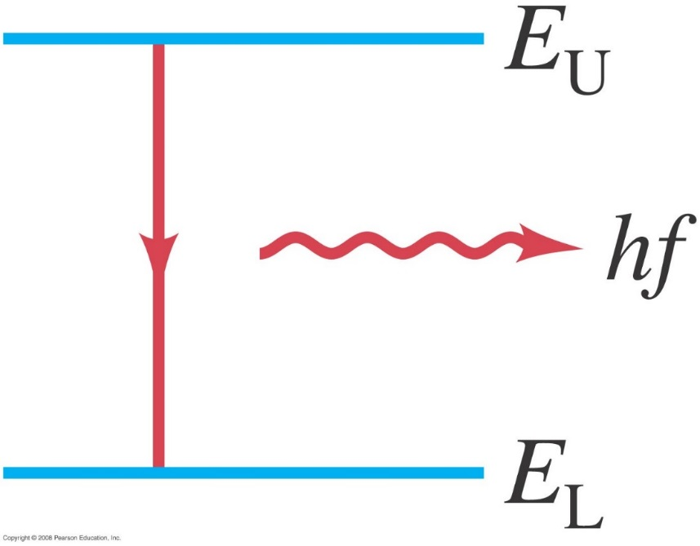
The Bohr Model
Bohr argued that the electrons in an atom lose energy and do it in quantum jumps.
He postulated that the electrons move about the nucleus in circular orbits, but only certain orbits are allowed
He also postulated that an electron in each orbit would have a definite energy.
Bohr proposed that the possible energy states for atomic electrons were quantized – only certain values were possible. Then the atom spectrum could be explained as transitions from one level to another.
hf= E_{U}-E_{L}
An atom emits a photon (energy = hf) when its energy
changes from upper energy level E_{U} to a lower energy E_{L}

Slide 24
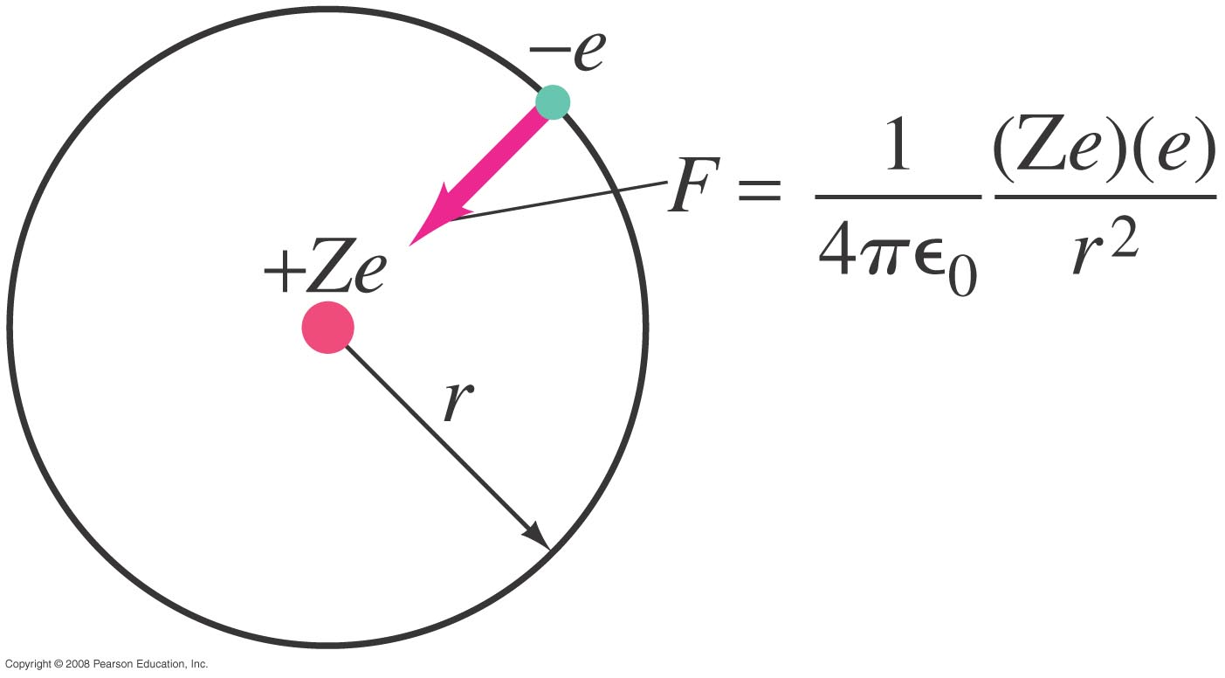
The Bohr Model
Electric force (Coulomb’s law) keeps the negative electron in orbit around the positively charged nucleus.
An electron is held in orbit by the Coulomb force:
Z is the atomic number in the periodic table of elements
Notes:
Figure 37-24. Electric force (Coulomb’s law) keeps the negative electron in orbit around the positively charged nucleus.

Slide 25
Bohr Model. # 1: Classical mechanics
F=k e²/r²
The centripetal acceleration
a = v² / r is provided by the coulomb force
F = k·e²/r² ( electrostatic force) with z=1
v
k is the Coulomb constant=8.99 10⁻⁹ Nm²/c²
Newton's second law → mv²/r = k·e²/r²
or: mv² = k·e²/r
The electron's kinetic energy is KE = ½ m v²
The electron's potential energy is PE = - ke²/r
→ E= KE + PE = -½ ke²/r = ½ PE
+
→E
Therefore: If we know r, we know E and v, etc…

Slide 26
Bohr Model. #2: Quantized angular momentum
F=k e²/r²
Bohr assumed that the angular momentum of the electron could only have the quantized values of:
L= nћ
And therefore: mvr = nћ, (n=1,2,3…)
or: v = nћ/(mr)
v
Substituting this into mv² = k·e²/r leads to:
, r_{B}: Bohr radius
E_{n} is also called ionization energy
, E_{R}: Rydberg
Energy

Slide 27
Bohr Model. Results
, r_{B}: Bohr radius
, E_{R}: Rydberg
Energy
The Bohr model not only predicts a reasonable atomic radius r_{B}, but it also predicts the energy levels in hydrogen to 4 digits accuracy!
Possible photon energies:
(n > m)
→ The Bohr model 'explains' the Rydberg formula!!

Slide 28
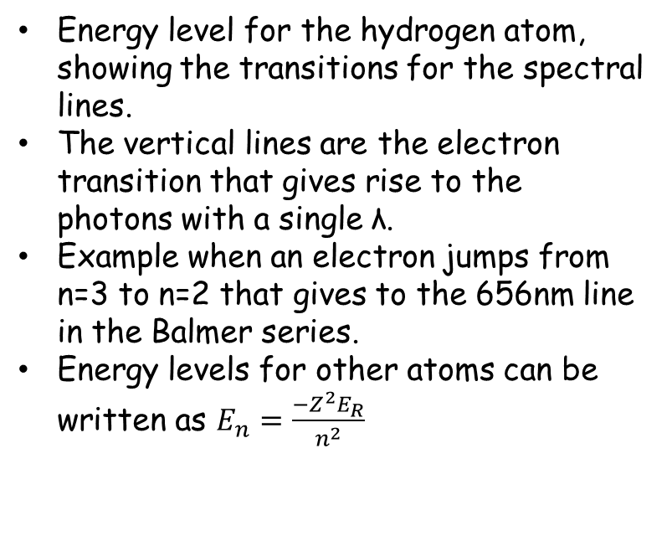
The Bohr Model
Bohr found that the angular momentum was quantized: L=nћ
The lowest energy level is called the ground state; the others are excited states.
Energy level for the hydrogen atom, showing the transitions for the spectral lines.
The vertical lines are the electron transition that gives rise to the photons with a single λ.
Example when an electron jumps from n=3 to n=2 that gives to the 656nm line in the Balmer series.
Energy levels for other atoms can be written as $E_{n}=\frac{−Z^{2}E_{R}}{n^{2}}$
Notes:
Energy-level diagram for the hydrogen atom, showing the transitions for the spectral lines of the Lyman, Balmer, and Paschen series (Fig. 37–22). Each vertical arrow represents an atomic transition that gives rise to the photons of one spectral line (a single wavelength or frequency).

Slide 29
Only discrete energy levels possible.
Electrons hop down towards lowest level, giving off photons
during the jumps. Atoms are stable in lowest level.
0
distance from proton
potential
energy
Bohr couldn't explain why the angular momentum is quantized but his model lead to the Rydberg-Balmer formula, which matched to the experimental observations very well!
He also predicted the atomic radii reasonably well and was able to calculate the Rydberg constant.
Notes:
L = I ω= mr^2 w = mr^2 v/r = mvr

Slide 30
Which of the following principles of classical physics is violated in the Bohr model?
Opposite charges attract with a force inversely proportional to the square of the distance between them.
The force on an object is equal to its mass times its acceleration.
Accelerating charges radiate energy.
Particles always have a well-defined position and momentum.
All of the above.
Note that both A & B are used in derivation of Bohr model.
Notes:
SKIP but leave in notes

Slide 31
The Bohr Model
Example 3: Absorption wavelength.
Use this figure to determine the maximum wavelength that hydrogen in its ground state can absorb. What would be the next smaller wavelength that would work?
Notes:
Solution: The maximum wavelength corresponds to the minimum energy, which from the ground state would be to the first excited state. We already found this wavelength in Example 37-13; it is 122 nm. The next smaller wavelength would be for the difference between the ground state and the second excited state, an energy difference of 12.1 eV. This gives a wavelength of 103 nm.

Slide 32
The Bohr Model
Example 4: He⁺ ionization energy.
(a) Use the Bohr model to determine the ionization energy of the He⁺ ion, which has a single electron. (b) Also calculate the maximum wavelength a photon can have to cause ionization.
Notes:
Solution: a. The energy is Z², or 4, times the ionization energy of hydrogen: -54.4 eV.
b. This is the minimum energy, and therefore the maximum wavelength that a photon could have to cause ionization (in an unexcited atom); it gives λ = 22.8 nm.

