Slide 1
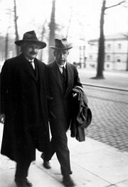
Properties of Matter Waves-
Chapter 3-Class 5
Schrodinger equation
The Bohr Model
Some people say, "How can you live without knowing?" I do not know what they mean. I always live without knowing. That is easy. How you get to know is what I want to know.
- Richard Feynman

Slide 2
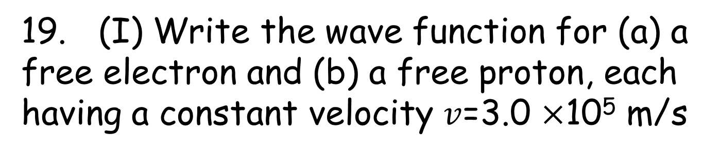
Problem
19. (I) Write the wave function for (a) a free electron and (b) a free proton, each having a constant velocity $v$=3.0 $×$10⁵ m/s

Slide 3
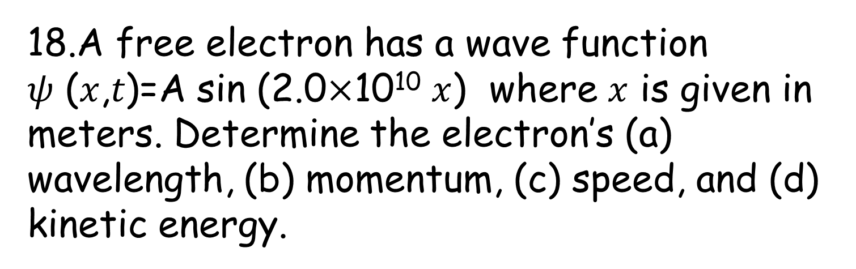
Problem
A free electron has a wave function
𝜓 (𝑥,𝑡)=A sin (2.0$×$10¹⁰ $x$) where $x$ is given in meters. Determine the electron’s (a) wavelength, (b) momentum, (c) speed, and (d) kinetic energy.

Slide 4
Particle in a box
In quantum mechanics, the particle in a box model (also known as the infinite potential well or the infinite square well) describes a particle free to move in a small space surrounded by impenetrable barriers.
In classical systems, for example, a particle trapped inside a large box can move at any speed within the box and it is no more likely to be found at one position than another.
However, when the well becomes very narrow (on the scale of a few nanometers), quantum effects become important. The particle may only occupy certain positive energy levels. Likewise, it can never have zero energy, meaning that the particle can never "sit still". Additionally, it is more likely to be found at certain positions than at others, depending on its energy level. The particle may never be detected at certain positions, known as spatial nodes.

Slide 5
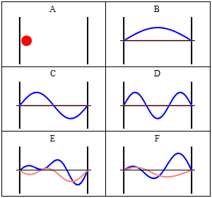
Particle in a box
The animation here shows a particle moving in a box
Because it acts as a wave, when meeting an obstacle, the wave will be reflected.
Yu will have something similar to a standing wave, when a wave and its reflection interfere.

Slide 6
Example of Square well ( quantum well)
Quantum wells are formed in semiconductors by having a material, like gallium arsenide, sandwiched between two layers of a material with a wider bandgap, like aluminum arsenide. (Other example: layer of indium gallium nitride sandwiched between two layers of gallium nitride.) These structures can be grown by molecular beam epitaxy or chemical vapor deposition with control of the layer thickness down to monolayers.
Thin metal films can also support quantum well states, in particular, metallic thin overlayers grown in metal and semiconductor surfaces. The electron (or hole) is confined by the vacuum-metal interface in one side, and in general, by an absolute gap with semiconductor substrates, or by a projected band gap with metal substrates.

Slide 7
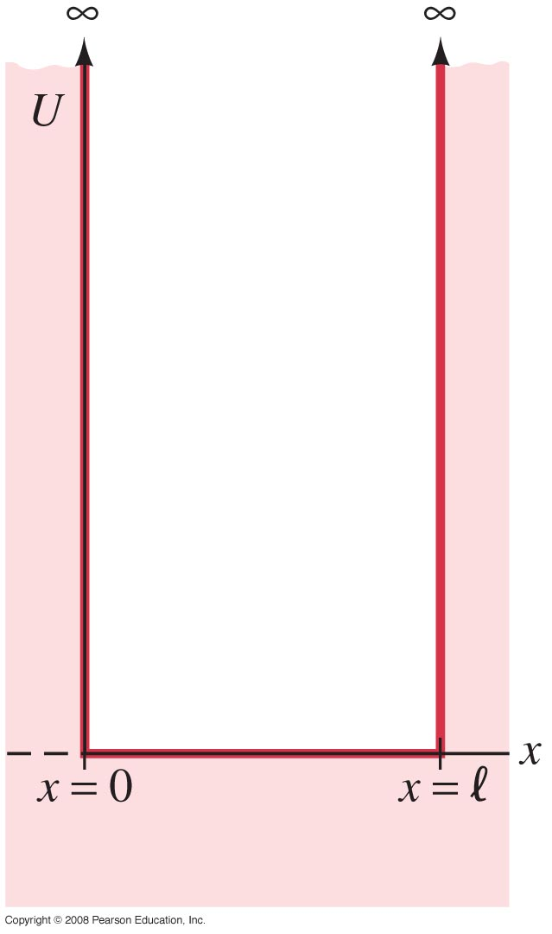
Particle in an Infinitely Deep Square
Well Potential (a Rigid Box)
One of the few geometries where the Schrödinger equation can be solved exactly is the infinitely deep square well. As is shown, this potential is zero from the origin to a distance , and is infinite elsewhere.
We assume that a particle is trapped in the box(an approximation to an electron in a metal).
The collisions with the wall are perfectly elastic. The potential energy for this situation know as an infinitely deep square well potential or rigid box is shown here.
V(x)=∞
V(x)=0
V(x)=∞
Notes:
Figure 38-7. A plot of potential energy U vs. x for an infinitely deep square well potential.

Slide 8
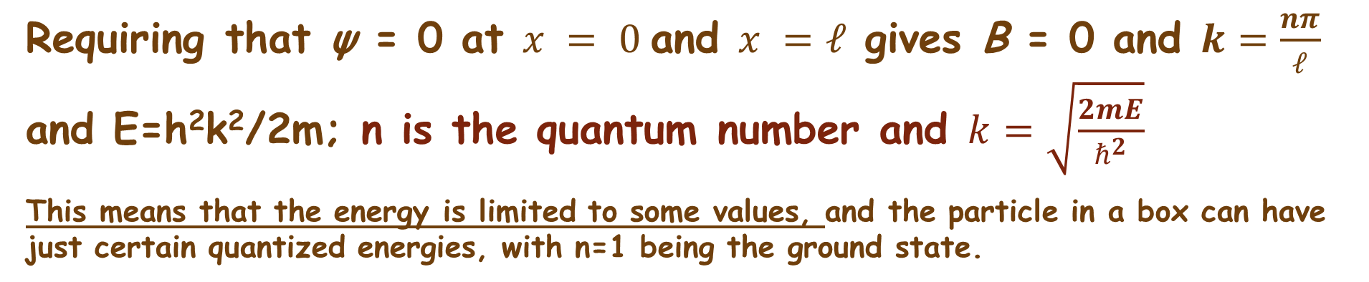
Particle in an Infinitely Deep Square
Well Potential (a Rigid Box)
The solution for the region between the walls is that of a free particle:
A and B are determined from the boundary conditions.
Requiring that ψ = 0 at $x = 0$and $x =ℓ$gives B = 0 and $k=\frac{nπ}{ℓ}$ and E=h²k²/2m; n is the quantum number and $k=\sqrt{\frac{2mE}{ℏ^{2}}}$
This means that the energy is limited to some values, and the particle in a box can have just certain quantized energies, with n=1 being the ground state.

Slide 9
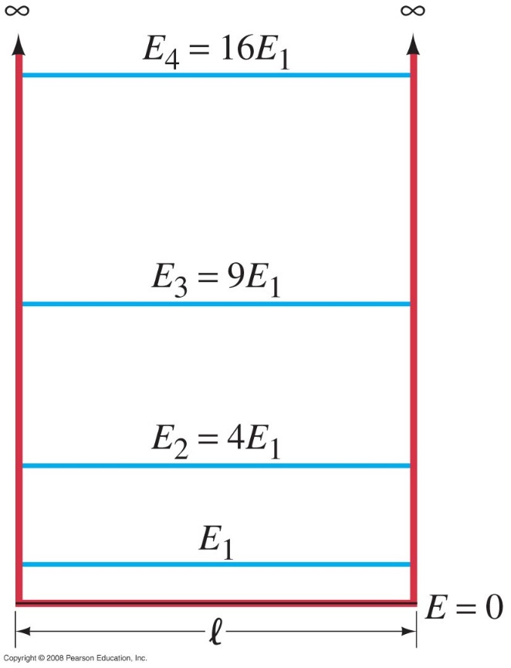
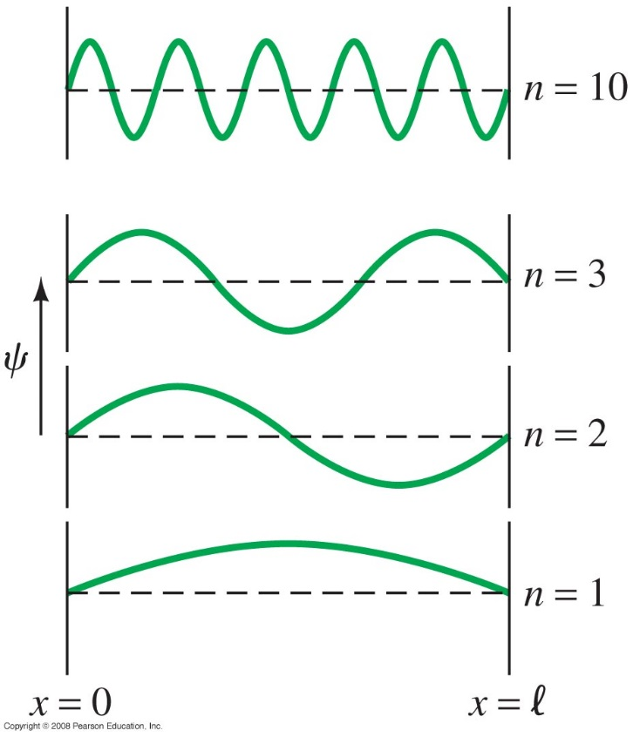
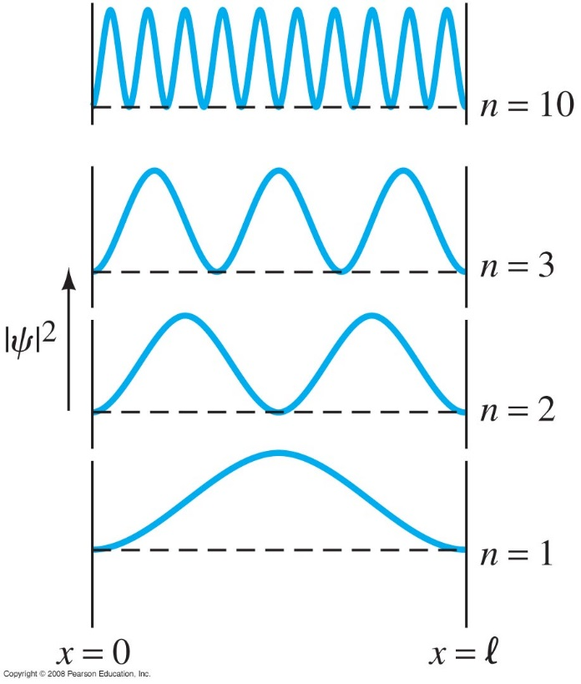
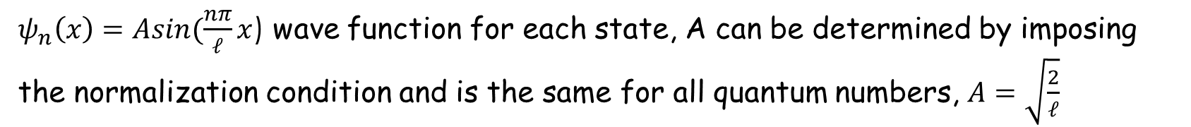
Particle in an Infinitely Deep Square
Well Potential (a Rigid Box)
These plots show the energy levels, wave function, and probability distribution for several values of n.
$ψ_{n}\left(x\right)=Asin(\frac{nπ}{𝓁}x$) wave function for each state, A can be determined by imposing the normalization condition and is the same for all quantum numbers, $A=\sqrt{\frac{2}{ℓ}}$
ψ
ψ²
E₁ can never be zero, because the particle can never be at rest.
Particle is most likely to be found inn some places than in others.
For n=1,the electron can be found near the center of the box.
Notes:
Figure 38-8. Possible energy levels for a particle in a box with perfectly rigid walls (infinite square well potential).
Figure 38-9. Wave functions corresponding to the quantum number n being 1, 2, 3 and 10 for a particle confined to a rigid box.
Figure 38-10. The probability distribution for a particle in a rigid box for the states with n = 1, 2, 3, and 10.

Slide 10
Particle in an Infinitely Deep Square
Well Potential (a Rigid Box)
Example 1: Electron in an infinite potential well.
(a) Calculate the three lowest energy levels for an electron trapped in an infinitely deep square well potential of width = 1.00 x 10⁻¹⁰ m (about the diameter of a hydrogen atom in its ground state). (b) If a photon were emitted when the electron jumps from the n = 2 state to the n = 1 state, what would its wavelength be?
Notes:
Solution: a. For n = 1 (ground state), the energy is 37.7.eV; higher levels are n² times the ground level. So for n = 2, E = 151 eV; for n = 3, E = 339 eV.
b. The energy difference is 113 eV, so the wavelength is hc/E = 1.10 x 10⁻⁸ m (remember to convert E to joules!).

Slide 11
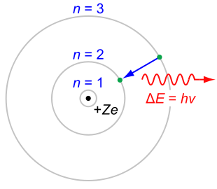
Chapter 4-class 1:The Bohr Model of the atom
Some people say, "How can you live without knowing?" I do not know what they mean. I always live without knowing. That is easy. How you get to know is what I want to know.
- Richard Feynman

Slide 12
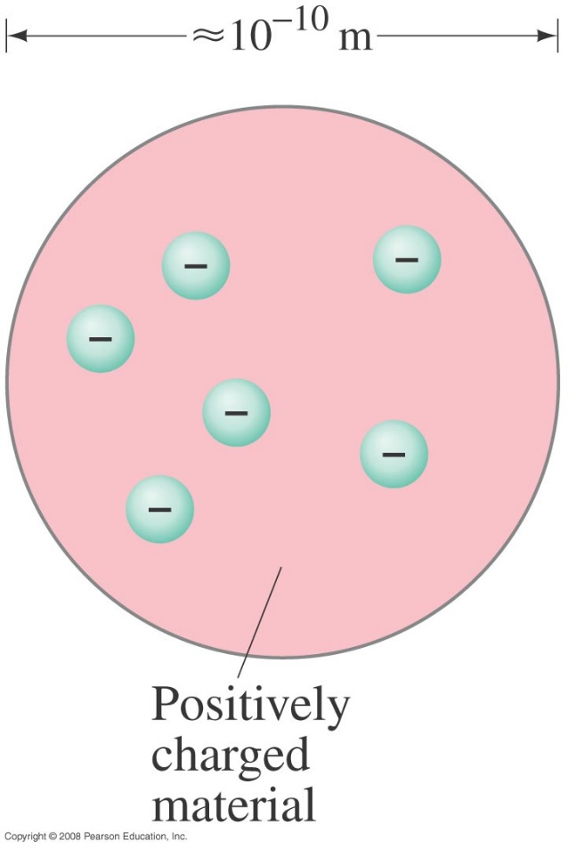
Early Models of the Atom
It was known that atoms were electrically neutral, but that they could become charged, implying that there were positive and negative charges and that some of them could be removed.
One popular atomic model was the “plum-pudding” model:
This is the first model of the atom in 1890
Notes:
Figure 37-16. Plum-pudding model of the atom.

Slide 13
Early Models of the Atom
This model had the atom consisting of a bulk positive charge, with negative electrons buried throughout.
Rutherford did an experiment that showed that the positively charged nucleus must be extremely small compared to the rest of the atom. He scattered alpha particles – helium nuclei – from a metal foil and observed the scattering angle. He found that some of the angles were far larger than the plum-pudding model would allow.

Slide 14
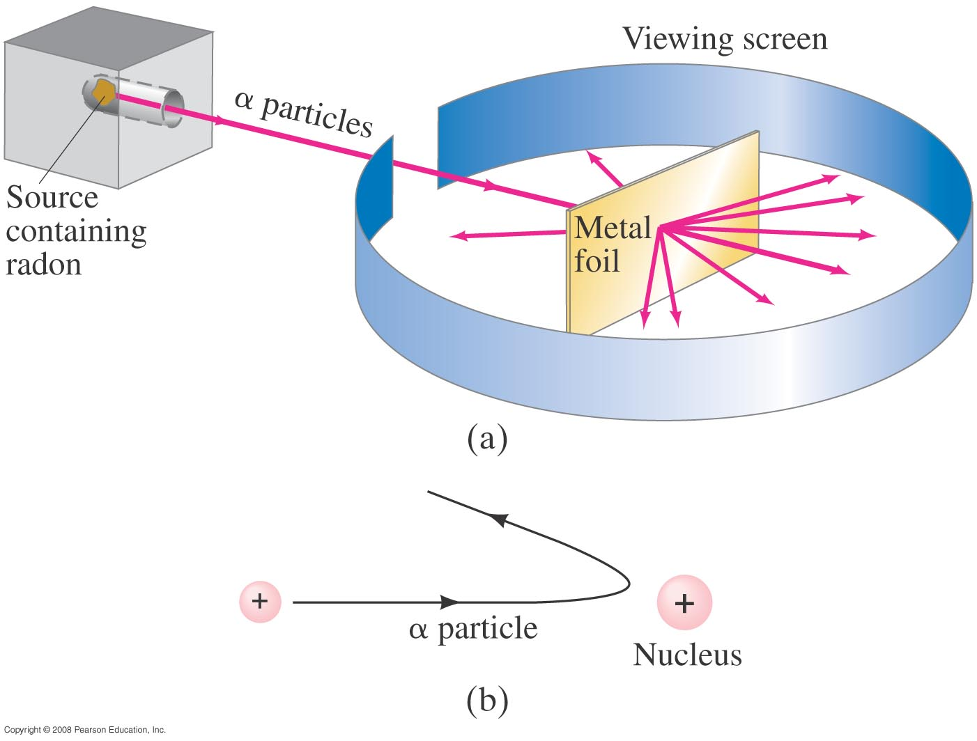
Early Models of the Atom
The only way to account for the large angles was to assume that all the positive charge was contained within a tiny volume – now we know
that the radius of the nucleus is 1/10,000 that of the atom.
α particles emitted by radon are deflected by a metallic foil, and few particles rebound
Notes:
Figure 37-17. (a) Experimental setup for Rutherford’s experiment: particles emitted by radon are deflected by a thin metallic foil and a few rebound backward; (b) backward rebound of particles explained as the repulsion from a heavy positively charged nucleus.

Slide 15
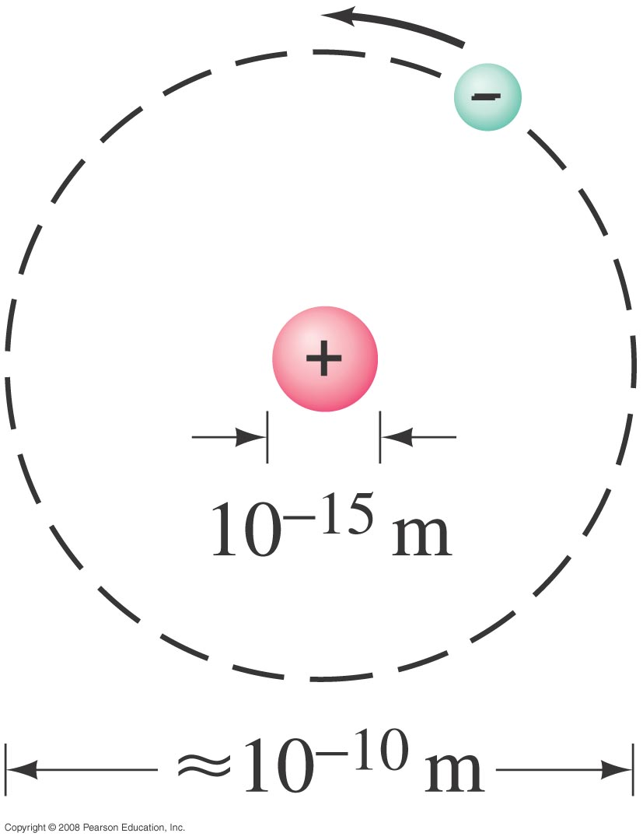
Early Models of the Atom
Therefore, Rutherford’s model of the atom is mostly empty space:
He hypothesized that the atom consists of a tiny massive nucleus with electrons orbiting about it, if not orbiting they fall into the nucleus.
Notes:
Figure 37-18. Rutherford’s model of the atom, in which electrons orbit a tiny positive nucleus (not to scale). The atom is visualized as mostly empty space.

Slide 16
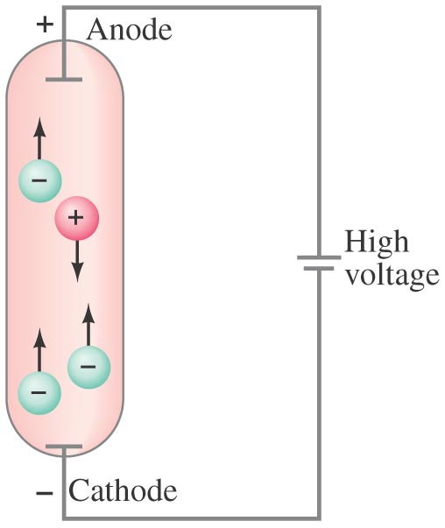
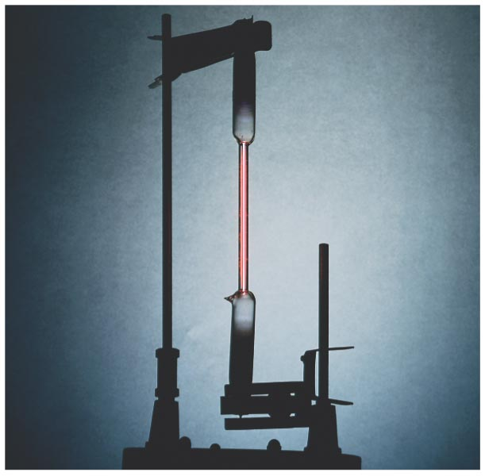
Atomic Spectra: Key to the Structure of the Atom
A very thin gas heated in a discharge tube emits light only at characteristic frequencies.
Rarefied gases emit light
Radiations are due to atoms or molecules.
This was observed in the late 19th century.
Discharge tube with gas at low pressure
Notes:
Figure 37-19. Gas-discharge tube: (a) diagram; (b) photo of an actual discharge tube for hydrogen.

Slide 17

Atomic Spectra: Key to the Structure of the Atom
An atomic spectrum is a line spectrum – only certain frequencies appear, it is discrete not continuous when analyzed through a spectrometer. If white light passes through such a gas, it absorbs at those same frequencies. (this is light emitted by individual atoms)- but this conflicts with Rutherford model
Hydrogen gives off 4 energies (or wavelengths)
This is the atom model
(a) Emission of Hydrogen
(b) Emission of Helium
(c) Solar absorption spectrum
Notes:
Figure 37-20. Emission spectra of the gases (a) atomic hydrogen, (b) helium, and (c) the solar absorption spectrum.

Slide 18
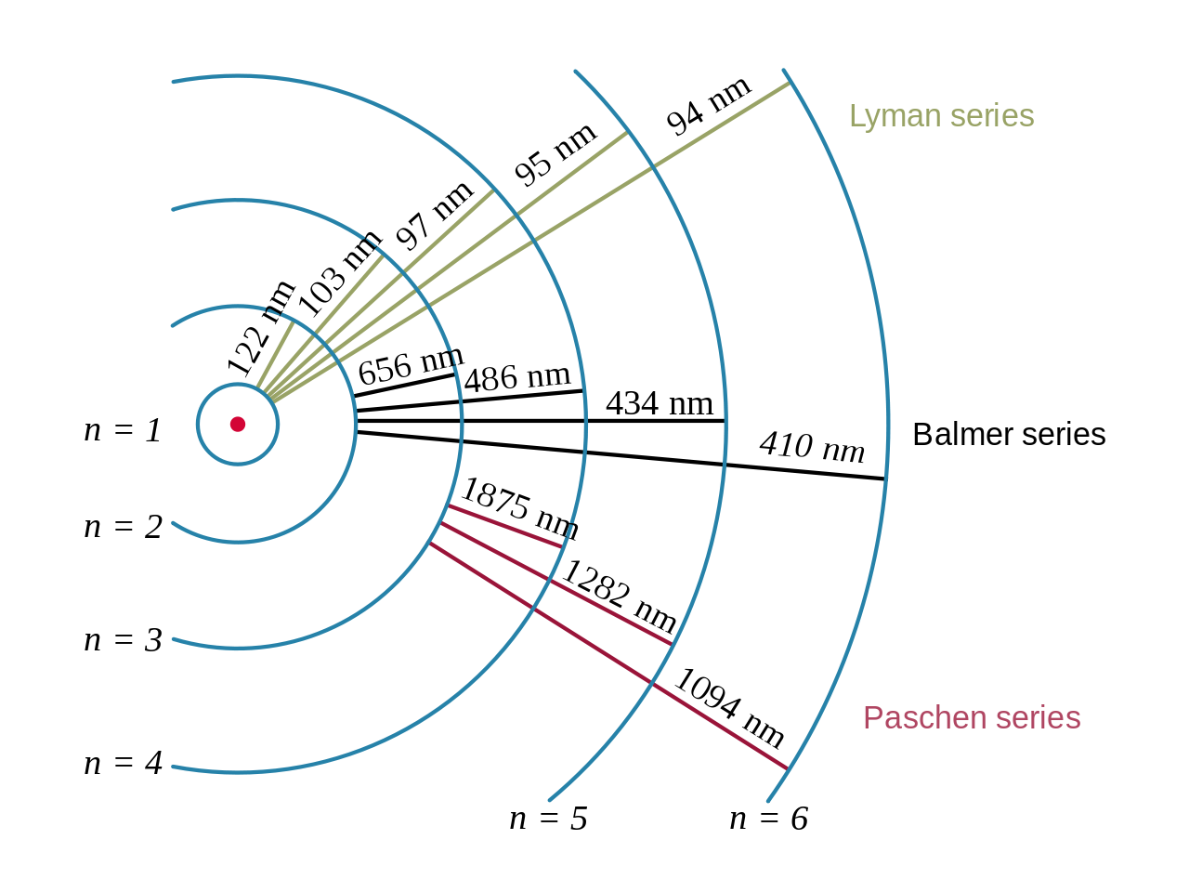
Atomic Spectra: Key to the Structure of the Atom
Each energy state, or orbit, is designated by an integer, n as shown in the figure.
Spectral emission occurs when an electron transitions, or jumps, from a higher energy state to a lower energy state.
The energy of an emitted photon corresponds to the energy difference between the two states.
Because the energy of each state is fixed, the energy difference between them is fixed, and the transition will always produce a photon with the same energy.
The spectral lines are grouped into series,
lines are named sequentially starting from the longest wavelength/lowest frequency of the series

Slide 19
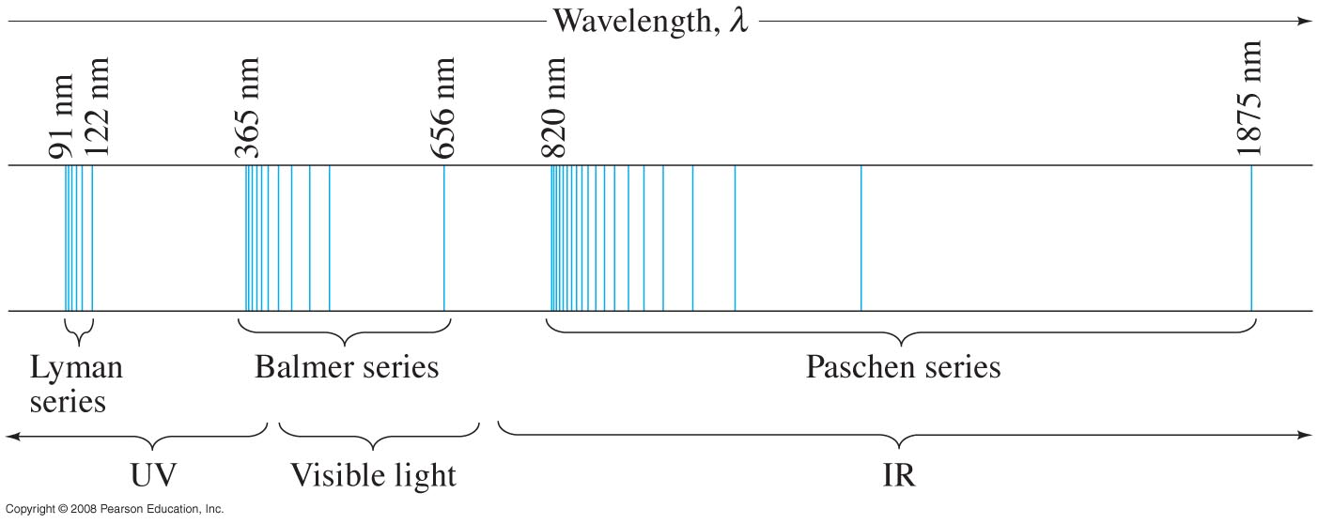
Atomic Spectra: Key to the Structure of the Atom
A portion of the complete spectrum of hydrogen is shown here. The lines cannot be explained by the Rutherford theory.
The spacing between the lines decreases in a regular way.
The line spectra is a key to the structure of the atom.
Notes:
Figure 37-22. Line spectrum of atomic hydrogen. Each series fits the formula 1/λ = R(1/n’² – 1/n²) where n’ = 1 for the Lyman series, n’ = 2 for the Balmer series, n’ = 3 for the Paschen series, and so on; n can take on all integer values from n = n’ + 1 up to infinity. The only lines in the visible region of the electromagnetic spectrum are part of the Balmer series.

Slide 20
Summary of important Ideas
Electrons in atoms are found at specific energy levels
Different set of energy levels for different atoms
One photon emitted per electron jump down between energy levels. Photon color (wavelength) determined by energy difference.
4) If electron not bound to an atom: Cannot have any energy.
(For instance free electrons in the Photoelectric effect.)
Hydrogen
Lithium
Electron energy levels in 2 different atoms: Energy Levels have different spacing (explains unique colors for each type of atom.
Atoms with more than one electron … lower levels filled.
Energy
(not to scale)
Notes:
Note increase in energy is increase in PE! (or energy INPUT into atom).

Slide 21
Now we know about the energy levels in atoms. But how can we calculate/predict them?
→ Need a model
Step 1: Make precise, quantitative observations!
Step 2: Be creative & come up with a model.
Step 3: Put your model to the test.

Slide 22
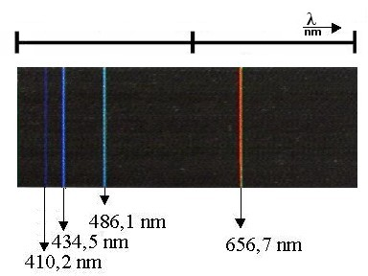
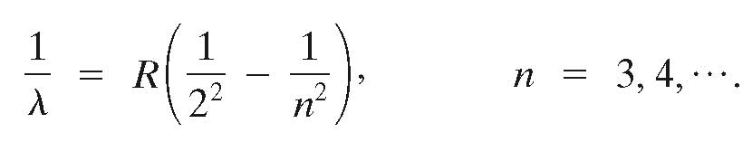

Balmer series:
A closer look at the spectrum of hydrogen
410.3
434.0
486.1
656.3 nm
Balmer (1885) noticed wavelengths followed a progression
where n = 3,4,5, 6, ….
or
R is the Rydberg constant
As n gets larger, what happens to wavelengths of emitted light?
  → λ gets smaller and smaller, but it approaches a limit.

Slide 23

Balmer series:
A closer look at the spectrum of hydrogen
410.3
434.0
486.1
656.3 nm
Balmer (1885) noticed wavelengths followed a progression
So this gets smaller
where n = 3,4,5,6, ….
Balmer correctly predicted yet undiscovered spectral lines.
gets smaller as n increases
gets larger as n increases,
but no larger than 1/4
λ gets smaller and smaller, but it approaches a limit

Slide 24

The Balmer series
Example 37-14: Wavelength of a Balmer line.
Determine the wavelength of light emitted when a hydrogen atom makes a transition from the n = 6 to the n = 2 energy level according to the Bohr model.
Notes:
Solution: Using equation 37-15 we find λ = 4.10 x 10-7 nm (violet).

