Slide 1
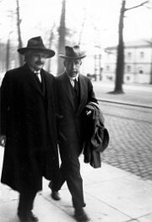
Properties of Matter Waves-
Chapter 3-Class 4
Schrodinger equation
The Bohr Model
Quantum Mechanics is the greatest
intellectual accomplishment of human race.
- Carl Wieman, Nobel Laureate in Physics 2001
HW3 posted and it is due on Friday, Nov. 10

Slide 2
The Schrödinger Equation in one Dimension
The wave equation governing the motion of electrons and other particles with mass, which is analogous to the classical wave equation was found by Schrödinger late in 1925 and is now known as the Schrödinger equation.
Like the classical wave equation, the Schrödinger equation relates the time and space derivatives of the wave function.
We can’t derive the Schrödinger equation just as we can’t derive Newton’s laws of motion. Its validity, like that of any fundamental equation, lies in its agreement with experiment.
Schrödinger’s equation is perfectly satisfactory when applied to the equally extensive range of nonrelativistic problems in atomic, molecular, and solid state physics.

Slide 3
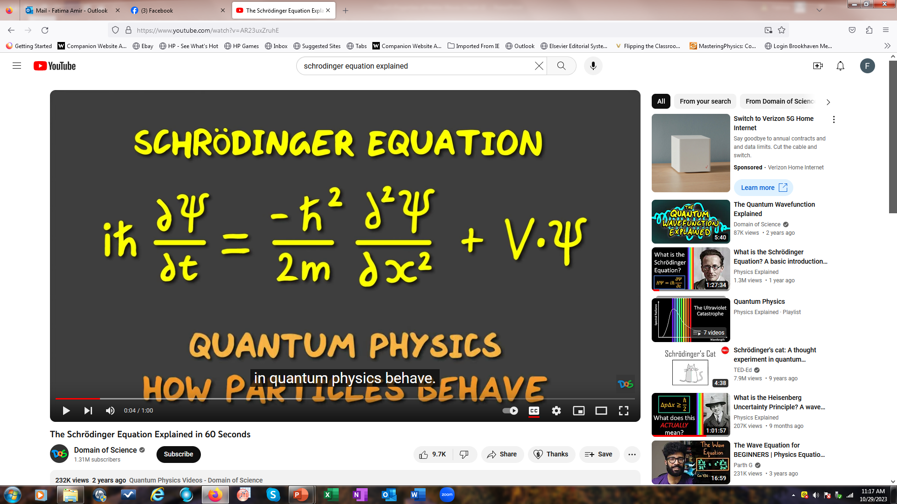
The Schrödinger Equation
https://www.youtube.com/watch?v=AR23uxZruhE

Slide 4
Time independent Schrodinger Equation
Time independent Schrodinger can be written for a wave function a free particle as
This can be written by using conservation of energy
for a free particle, V is the potential energy, E is the total Energy

Slide 5
The Schrödinger Equation in one Dimension
The Schrödinger equation for a particle of mass m in one dimension has the form (time dependent)
V is the potential energy,
Schrödinger equation is based on the energy approach
The time dependent equation in 3D can be written as x, y, z or ψ(r,θ,Ф)
When we used Newton’s laws: we have used conservation of energy and no external force acting on a system.
Here we consider a particle moving in the x –axis with no force acting on it.

Slide 6
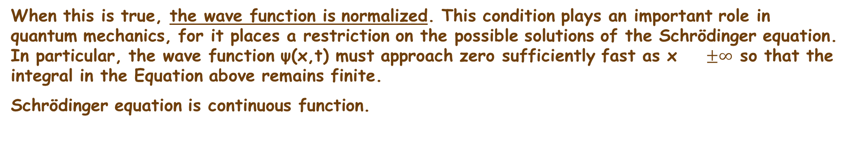
The Schrödinger Equation in One Dimension
Since the solution to the Schrödinger equation is supposed to represent a single particle, the total probability (sum of all probabilities) of finding that particle anywhere in space should be equal to 1 (or 100%):
Sum of all probabilities
When this is true, the wave function is normalized. This condition plays an important role in quantum mechanics, for it places a restriction on the possible solutions of the Schrödinger equation. In particular, the wave function ψ(x,t) must approach zero sufficiently fast as x $±∞$ so that the integral in the Equation above remains finite.
Schrödinger equation is continuous function.

Slide 7

Separation of Time and Space dependencies of Schrödinger Equation
Schrödinger’s first application of his wave equation was to problems such as the hydrogen atom (Bohr’s work) and the simple harmonic oscillator (Planck’s work), in which he showed that the energy quantization in those systems can be explained naturally in terms of standing waves.
The separation of Time and Space is accomplished by first assuming that the wave function can be written as a product of two functions, one of x and one of t, as
we find that the Schrödinger equation can be separated – its time- and space-dependent parts can be solved for separately.

Slide 8
Time-Dependent Schrödinger
Equation
The time dependence can be found easily; by Substituting ψ(x,t) into the general, time-dependent Schrödinger equation
This function has an absolute value of 1; it does not affect the probability density in space and the equation becomes after some Algebra
“ this is called time independent Schrodinger equation”

Slide 9
What are these waves?
EM Waves (light/photons)
Amplitude = electric field
tells you the probability of detecting a photon.
Maxwell’s Equations:
Solutions are sine/cosine waves:
Matter Waves (electrons/etc)
Amplitude = matter field
tells you the probability of detecting a particle.
Schrödinger Equation:
Solutions are complex sine/cosine waves:

Slide 10
Nanotechnology: how small does a wire have to be
before the movement of electrons starts to depend on the size
and shape due to quantum effects?
How to start?
Need to look at
a. size of wire compared to size of atom
b. size of wire compared to size of electron wave function
c. Energy level spacing compared to thermal energy, kT.
d. Energy level spacing compared to some other quantity
(what?)
e. something else (what?)

Slide 11
Nanotechnology: how small does a wire have to be
before movement of electrons starts to depend on size
and shape due to quantum effects?
How to start?
Need to look at
c. Energy level spacing compared to thermal energy, kT.
Almost always focus on energies in QM.
Electrons, atoms, etc. hopping around with random energy kT.
kT >> than spacing, spacing irrelevant. Smaller, spacing big deal.
So need to calculate energy levels.
pit depth compared
to kT?

Slide 12
Where does the electron want to be?
⇒ potential energy vs position, V(x) & boundary conditions.
Electron wants to be at position where
  a. V(x) is largest
  b. V(x) is lowest
  c. Kin. Energy > V(x)
  d. Kin. E. < V(x)
  e. where elec. wants to be does not depend on V(x)
Notes:
CONSIDER TAKING OUT>>>>
⇒Will grade a few more questions and harder questions.
Nanotechnology: how small does an object have to be
before movement of electrons starts to depend on size and shape due to quantum effects?

Slide 13
Electron wants to be at position where
a. V(x) is largest
b. V(x) is lowest
c. Kin. Energy > V(x)
d. Kin. E. < V(x)
e. where elec. wants to be does not depend on V(x)
V(x)
electrons always want to go to position
of lowest potential energy, just like
ball going downhill.
x
c. and d. not right, because actual value of V(x) is
arbitrary, so you can choose it bigger or smaller than KE.
Only thing that matters is how it changes.

Slide 14
0
L
Solving Schrod. equ.
Before tackling wire, understand simplest case.
electron in free space, no electric fields or gravity around.
1. Where does it want to be?
2. What is V(x)?
3. What are boundary conditions on ψ(x)?
no preference- all x the same.
constant.
none, could be anywhere.
smart choice
constant, V(x) =0!

Slide 15
what does this equation describe?
a. nothing physical, just math exercise.
b. only an electron in free space along the x axis with no electric fields around.
c. an electron flying along the x axis between two metal plates with a voltage between them as in photoelectric effect.
d. an electron in an enormously long wire not hooked to any voltages.
e. more than one of the above
ans e. -- both b and d are correct. No electric field or voltage
means potential energy constant in space and time, V=0.

Slide 16
A solution to this diff. eq. is
a. A cos(kx)
b. A e^{-kx}
c. B sin (kx)
d. b. and c.
e. a. and c.
ans. e. Both a. and c. are solutions. Check a., plug in.
solution if

Slide 17
Problem
16. (II) Show that the superposition principle holds for the time-dependent Schrödinger equation. That is, show that if 𝜓₁(𝑥,𝑡) and 𝜓₂(𝑥,𝑡) are solutions, then A𝜓₁(𝑥,𝑡) +B 𝜓₂(𝑥,𝑡) is also a solution where A and B are arbitrary constants.

Slide 18
Free Particles; Plane Waves and Wave Packets
Free particle: no force, so V = 0. The Schrödinger equation becomes the equation for a simple harmonic oscillator,
with solutions:
where
Since V= 0,

Slide 19
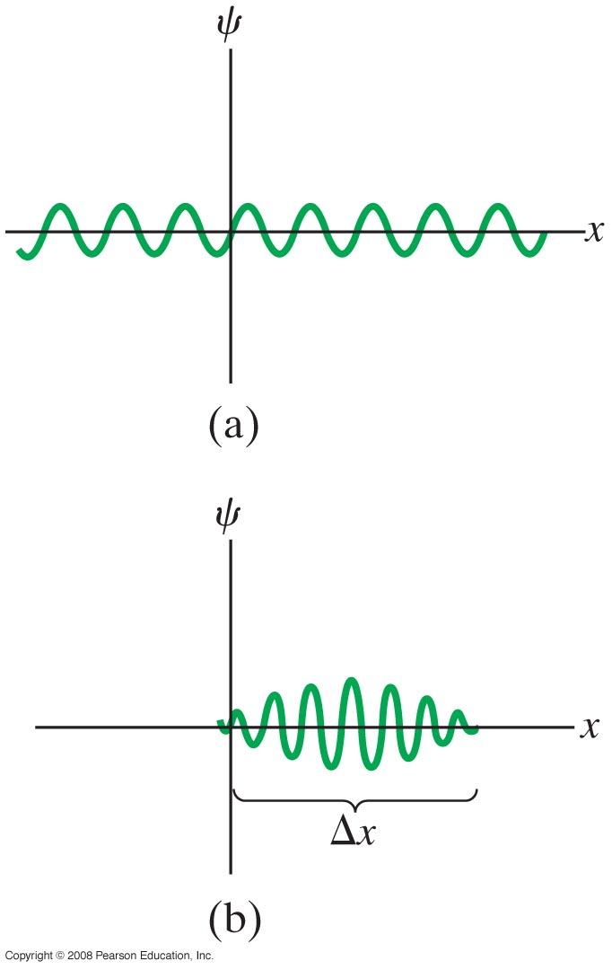
Free Particles; Plane Waves and Wave Packets
The solution for a free particle is a plane wave, as shown in part (a) of the figure; (The sin wave extend indefinitely in the +x and –x directions)
more realistic is a wave packet, as shown in part (b). The wave packet has both a range of momenta and a finite uncertainty in width.( the particle is most likely to be found within a region of space)
Notes:
Figure 38-6. (a) A plane wave describing a free particle. (b) A wave packet of “width” Δx.

Slide 20
Free Particles; Plane Waves and Wave Packets
Example 38-4: Free electron.
An electron with energy E = 6.3 eV is in free space (where V = 0).
Find (a) the wavelength λ (in nm) and
(b) the wave function for the electron (assuming B = 0).
Notes:
Solution: a. From 38-11a, and 38-11b, λ = 0.49 nm.
b. k = 1.28 x 10¹⁰ m⁻¹, so ψ = A sin [(1.28 x 10¹⁰ m⁻¹)x].

