Slide 1
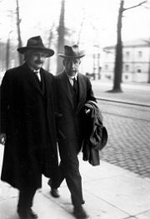
Properties of Matter Waves-
Chapter 3-Class3
“The most incomprehensible thing about the world is that it is comprehensible.”
– Albert Einstein

Slide 2
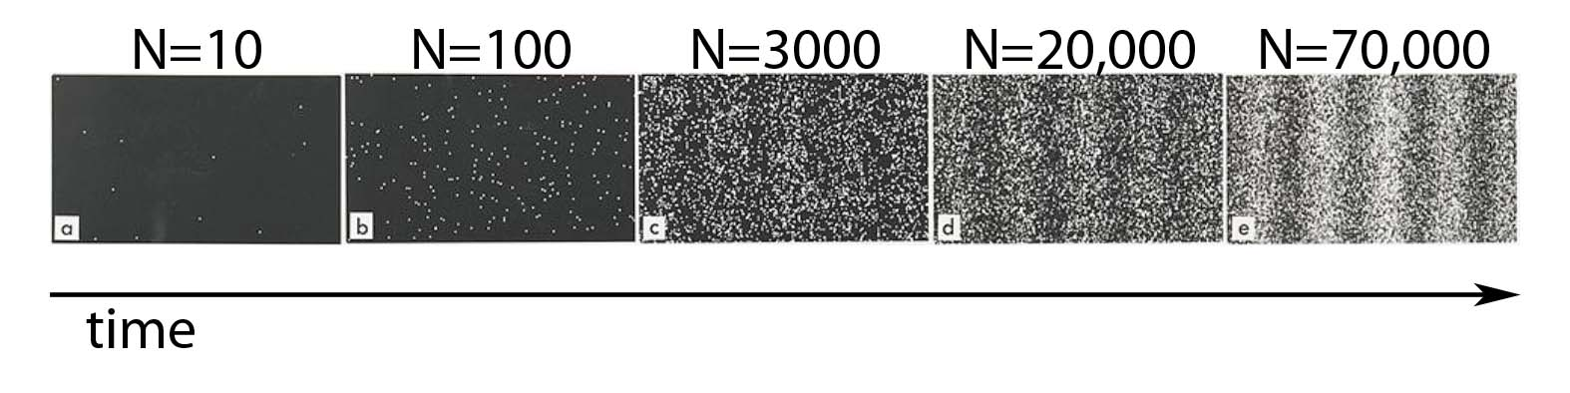
The Probabilistic Interpretation of the Wave Function
We cannot predict or even follow the path of one single electron
precisely through space and time
Pass a beam of electrons through a double-slit apparatus.
Individual electrons are detected as points on the scintillator.
Over time, a fringe pattern of dark and light bands appears.

Slide 3
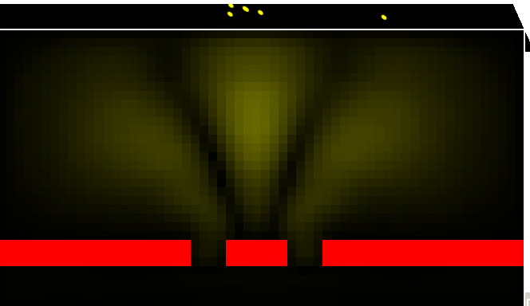
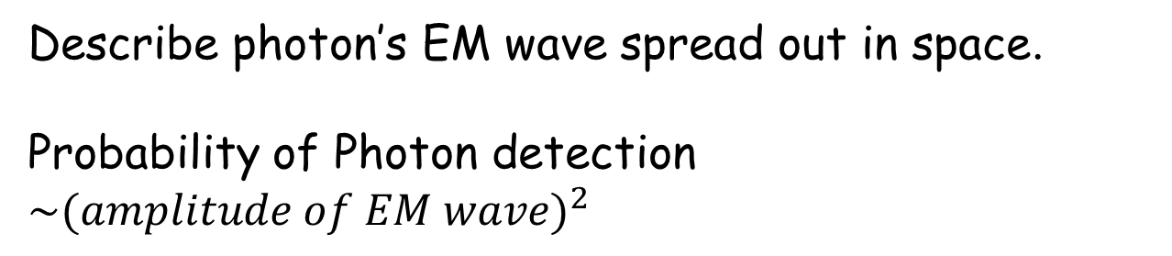
Light (photons) Waves
High Amplitude
Screen
Low Amplitude
Describe photon’s EM wave spread out in space.
Probability of Photon detection $\sim {(amplitude of EM wave)}^{2}$

Slide 4
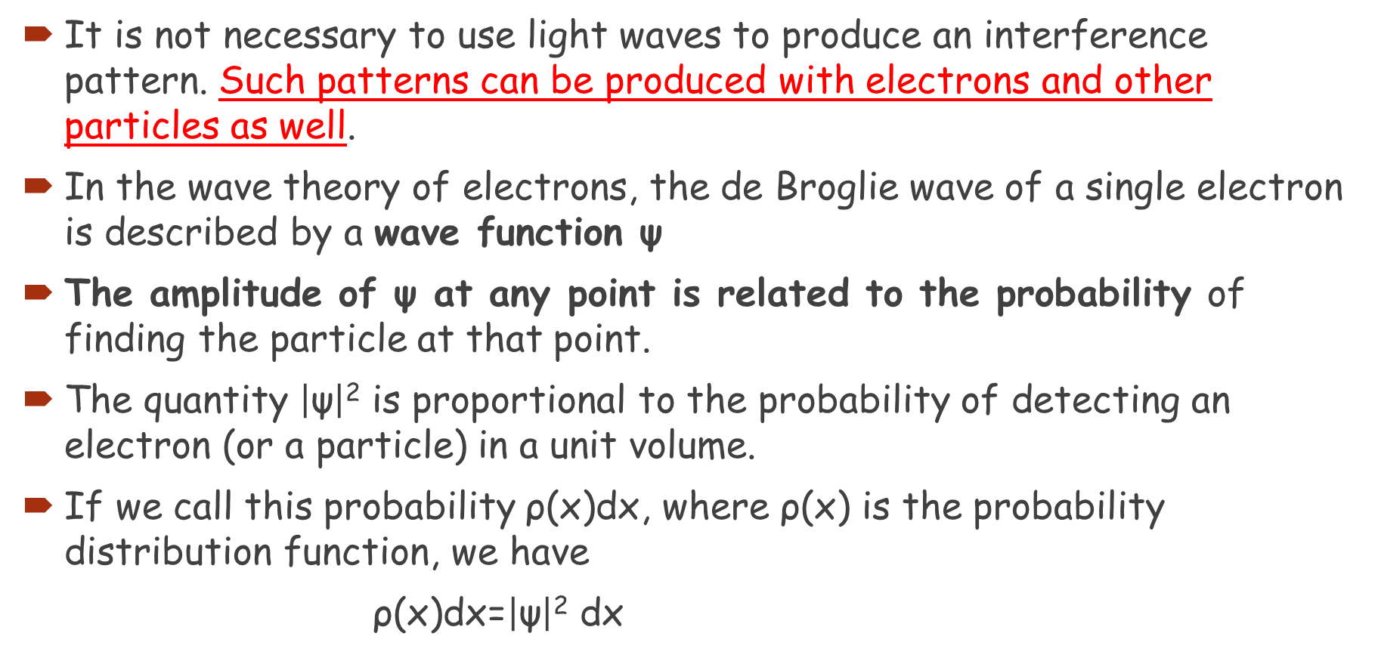
It is not necessary to use light waves to produce an interference pattern. Such patterns can be produced with electrons and other particles as well.
In the wave theory of electrons, the de Broglie wave of a single electron is described by a wave function ψ
The amplitude of ψ at any point is related to the probability of finding the particle at that point.
The quantity $\left|\text{ψ}\right|$² is proportional to the probability of detecting an electron (or a particle) in a unit volume.
If we call this probability ρ(x)dx, where ρ(x) is the probability distribution function, we have
ρ(x)dx=$\left|\text{ψ}\right|$² dx

Slide 5
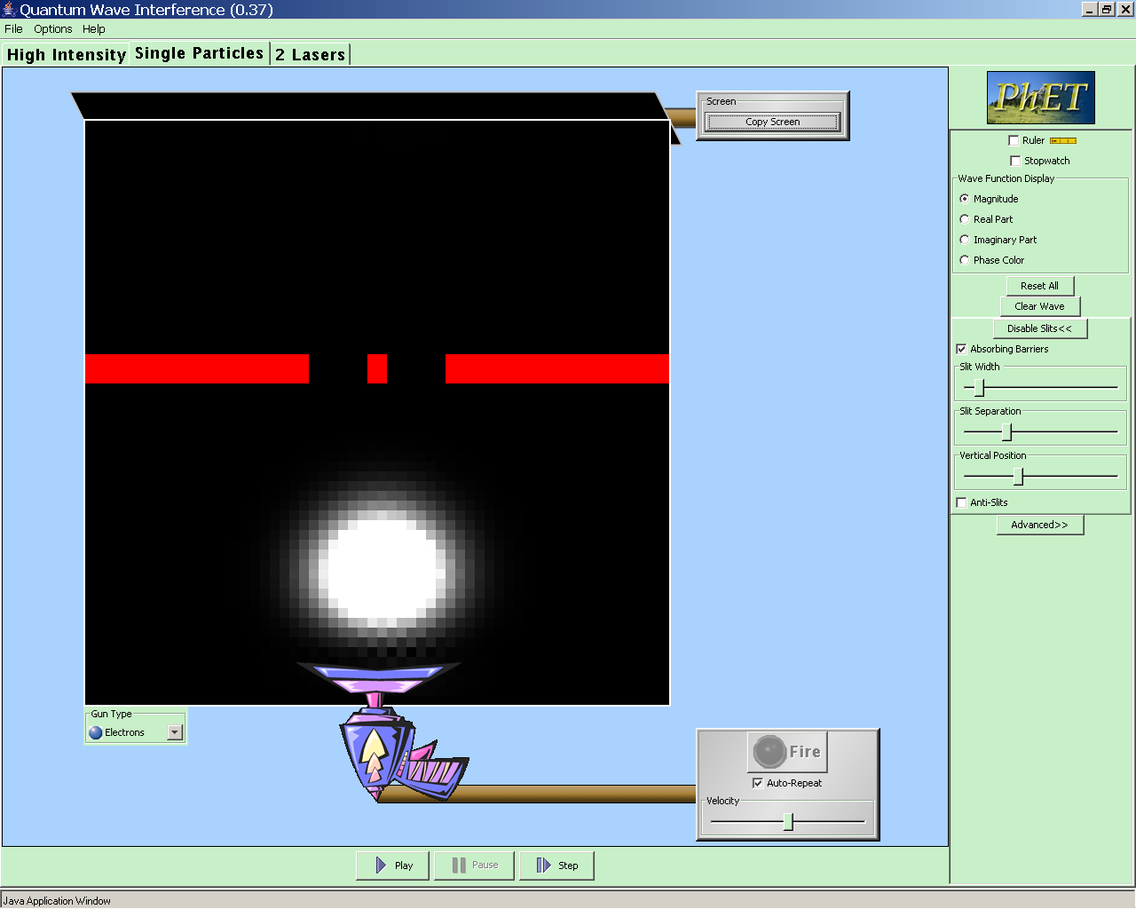
Follow same prescription for matter waves (electrons):
  Describe massive particles with wave functions:
  ψ is a complex function,
  Interpret (wave amplitude)² as a probability :
  Ψ* is the complex conjugate of ψ
Electron double slit experiment.
Display=Magnitude of wave function
Large Magnitude (|Ψ|)=
probability of detecting electron here is high
Small Magnitude (|Ψ|)=
probability of detecting electron here is low

Slide 6
Matter Waves
Describe a particle with a wave function.
Wave does not describe the path of the particle.
Wave function contains information about the probability to find a particle at x, y, z & t.
In general (in 3D):
-L
L
x
Simplified:
&

Slide 7
Matter Waves
-L
Wave function
L
x
Probability Density
-L
L
x
Probability of finding particle
in the interval dx is

Slide 8

The Uncertainty Principle
https://www.youtube.com/watch?v=m7gXgHgQGhw

Slide 9
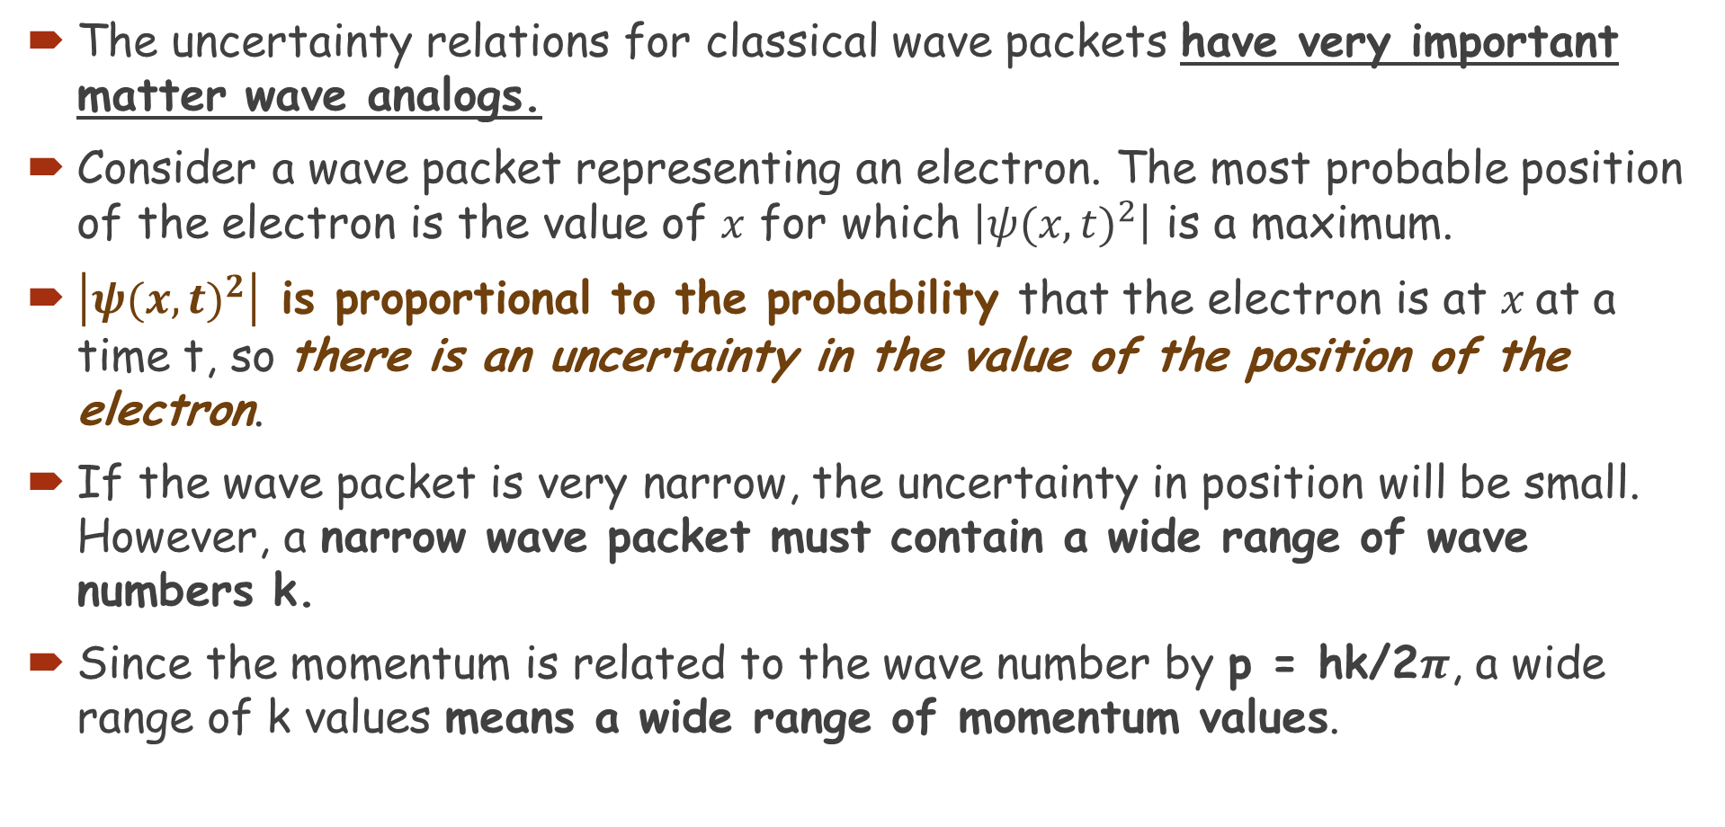
The Uncertainty Principle
The uncertainty relations for classical wave packets have very important matter wave analogs.
Consider a wave packet representing an electron. The most probable position of the electron is the value of $x$ for which $\left|{ψ(x,t)}^{2}\right|$ is a maximum.
$\left|{ψ(x,t)}^{2}\right|$ is proportional to the probability that the electron is at $x$at a time t, so there is an uncertainty in the value of the position of the electron.
If the wave packet is very narrow, the uncertainty in position will be small. However, a narrow wave packet must contain a wide range of wave numbers k.
Since the momentum is related to the wave number by p = hk/2$π$, a wide range of k values means a wide range of momentum values.

Slide 10
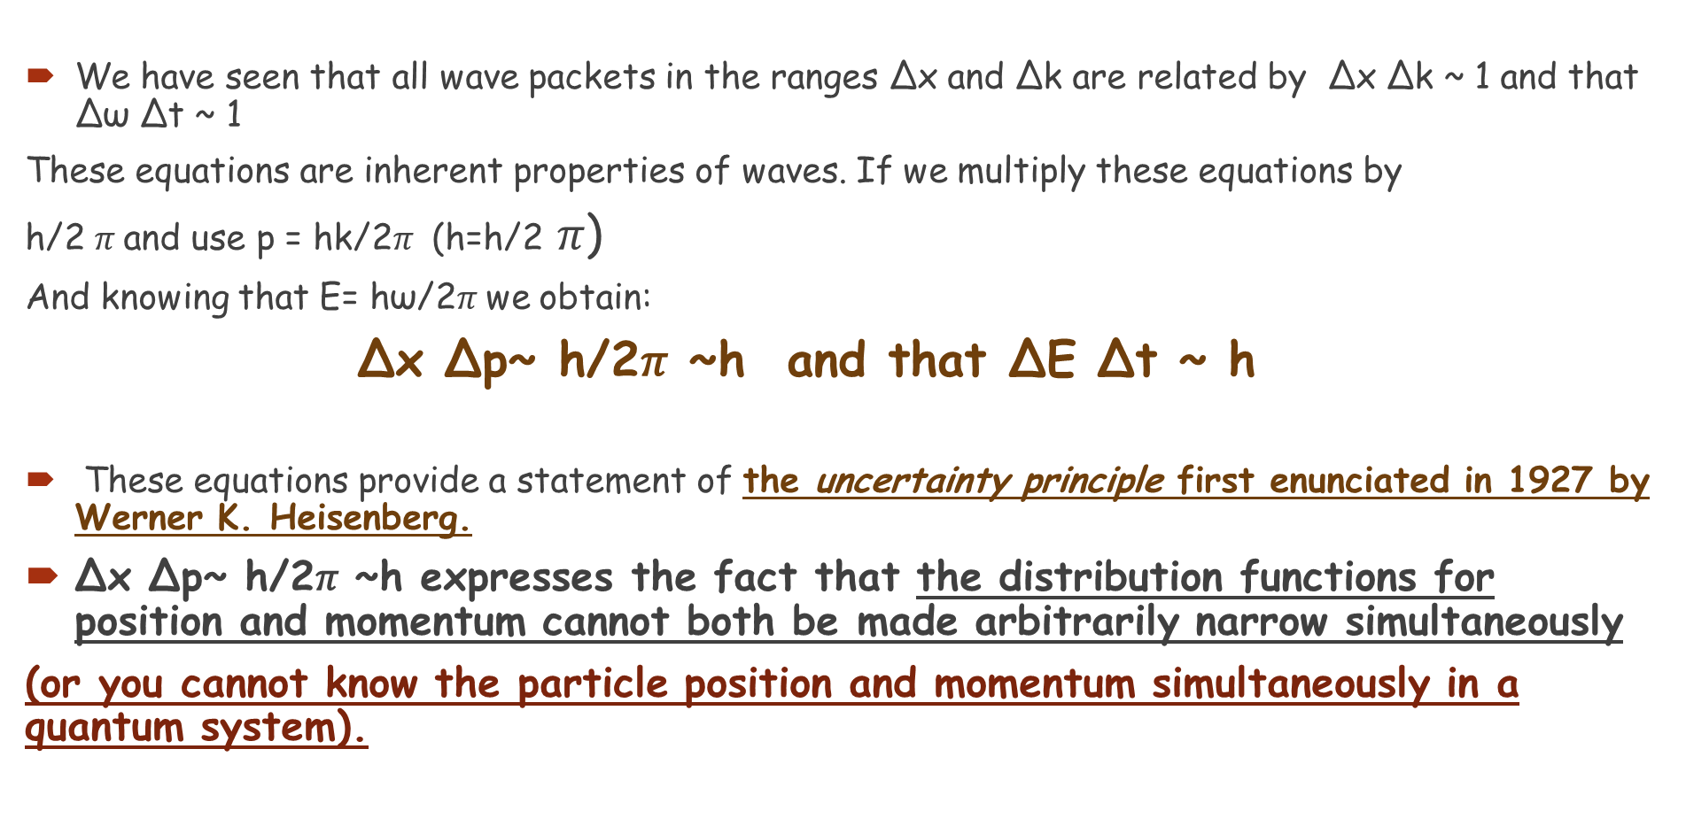
The Uncertainty Principle
We have seen that all wave packets in the ranges Δx and Δk are related by Δx Δk ~ 1 and that Δω Δt ~ 1
These equations are inherent properties of waves. If we multiply these equations by
h/2 $π$and use p = hk/2$π$ (h=h/2 𝜋)
And knowing that E= hω/2$π$we obtain:
Δx Δp~ h/2𝜋 ~h and that ΔE Δt ~ h
These equations provide a statement of the uncertainty principle first enunciated in 1927 by Werner K. Heisenberg.
Δx Δp~ h/2𝜋 ~h expresses the fact that the distribution functions for position and momentum cannot both be made arbitrarily narrow simultaneously
(or you cannot know the particle position and momentum simultaneously in a quantum system).

Slide 11
The Uncertainty Principle
Of course, because of inaccurate measurements, the product of Δx and Δp can be, and usually is, much larger than h
The lower limit is not due to any technical problem in the design of measuring equipment that might be solved at some later time; it is instead due to the wave and particle nature of both matter and light.

Slide 12

The Uncertainty Principle
This Heisenberg uncertainty principle:
tells us that the position and momentum cannot simultaneously be measured with precision, and be known at the same time.

Slide 13

The Uncertainty Principle
This relation can also be written as a relation between the uncertainty in time and the uncertainty in energy:
This says that if an energy state only lasts for a limited time, its energy will be uncertain. It also says that conservation of energy can be violated if the time is short enough.

Slide 14
The Uncertainty Principle
Example 1: Position uncertainty of an electron.
An electron moves in a straight line with a constant speed v = 1.10 x 10⁶ m/s, which has been measured to a precision of 0.10%. What is the maximum precision with which its position could be simultaneously measured?
Notes:
Solution: Using p = mv and ΔxΔp ≈ ħ, we find Δx ≈ 1.1 x 10⁻⁷ m – about 1000 times the size of an atom.

Slide 15
The Uncertainty Principle
Example 2: Position uncertainty of a baseball.
What is the uncertainty in position, imposed by the uncertainty principle, on a 150-g baseball thrown at (93 ± 2) mph = (42 ± 1) m/s?
Notes:
Solution: Using p = mv and ΔxΔp ≈ ħ, we find Δx ≈ 7 x 10⁻³⁴ m – far too small to be measured.

Slide 16
The Uncertainty Principle
Example 3: J/ψ lifetime calculated.
The J/ψ meson, discovered in 1974, was measured to have an average mass of 3100 MeV/c² (note the use of energy units since E = mc²) and an intrinsic width of 63 keV/c². By this we mean that the masses of different J/ψ mesons were actually measured to be slightly different from one another. This mass “width” is related to the very short lifetime of the J/ψ before it decays into other particles. Estimate its lifetime using the uncertainty principle.
Notes:
Solution: Using ΔEΔτ ≈ ħ, we find Δτ ≈ 1.0 x 10⁻²⁰ s (this is why lifetimes of very short-lived particles are measured using the width rather than directly!)

Slide 17
Philosophic Implications; Probability versus Determinism
The world of Newtonian mechanics is a deterministic one. If you know the forces on an object and its initial velocity, you can predict where it will go.
Quantum mechanics is very different – you can predict what masses of electrons will do, but have no idea what any individual one will do.

Slide 18
Problem
8. A 12-g bullet leaves a rifle horizontally at a speed of 180m/s (a) What is the wavelength of this bullet? (b) If the position of the bullet is known to a precision of 0.65 cm (radius of the barrel), what is the minimum uncertainty in its vertical momentum?

Slide 19
Problem
9. An electron and a 140-g baseball are each traveling 95m/s measured to a precision of 0.085%. Calculate and compare the uncertainty in position of each.

Slide 20
Problem
10. What is the uncertainty in the mass of a muon (m=105.7MeV/c²) specified in eV/c² given its lifetime of 2.20μs?

