Slide 1
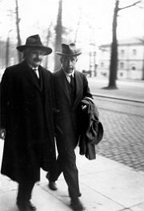
Properties of Matter Waves-
Chapter 3-Class2
“The most incomprehensible thing about the world is that it is comprehensible.”
– Albert Einstein

Slide 2
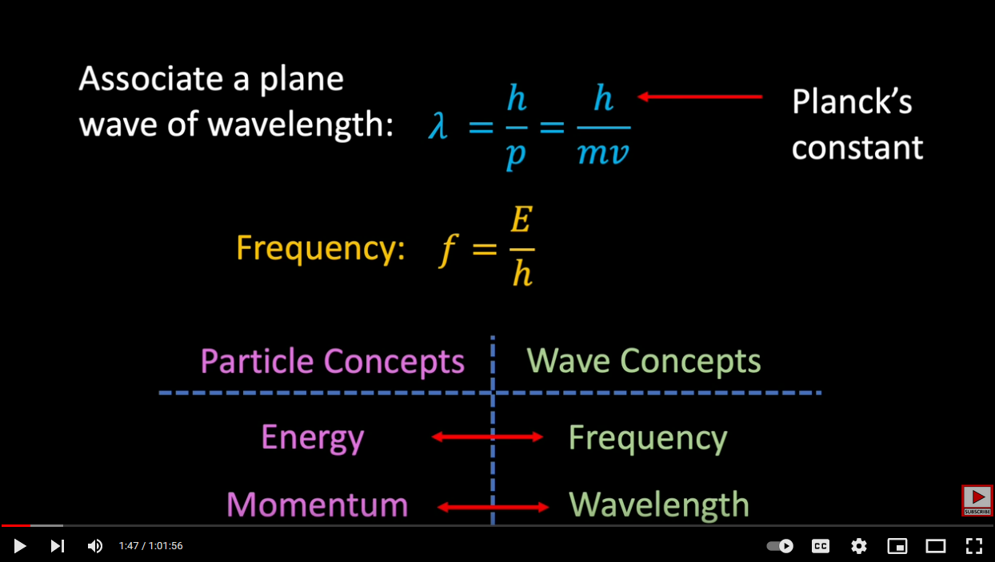
Wave Packet
https://www.youtube.com/watch?v=FRP4AqZR3UU

Slide 3
Wave Packets
Vibrations on a string: Classical wave equation (ocean wave, sound wave)
y
x
Among the solutions of the classical
Wave equation is the harmonic wave of amplitude y₀
and frequency f, and period T
v=speed of wave
Solutions: y(x,t)
Magnitude is spatial:
= Vertical displacement of String

Slide 4
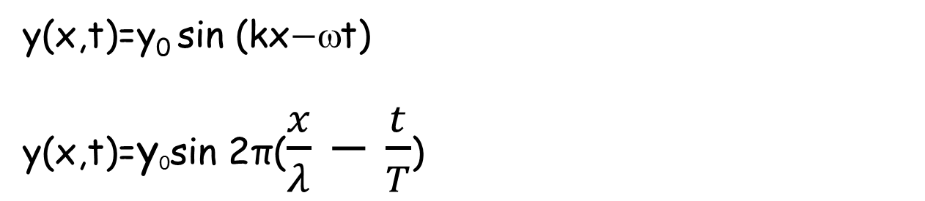
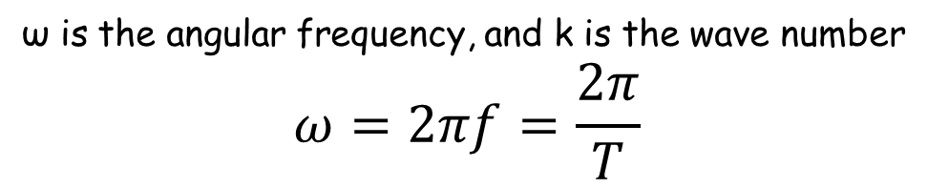
ν = speed of wave
What are the solutions of the wave equation?
y(x,t)=y₀ sin (kx$−$ωt)
y(x,t)=y₀sin 2π($\frac{x}{λ}$ $−$ $\frac{t}{T}$)
k, ω, λ are constant
ω is the angular frequency, and k is the wave number
$$ω=2πf=\frac{2π}{T}$$
v_{p} is also called wave or phase velocity

Slide 5

Wave Packets
A familiar wave phenomenon that cannot be described by a single harmonic wave is a pulse, such as the flip of one end of a long string (Figure), a sudden noise, or the brief opening of a shutter in front of a light source.
The main characteristic of a pulse is localization in time and space.
A single harmonic wave is not localized in either time or space. The description of a pulse can be obtained by the superposition of a group of harmonic waves of different frequencies and wavelengths. Such a group is called a wave packet.
Wave groups are particularly important because a wave description of a particle must include the important property of localization.
(a) Wave pulse moving along a string.
(b)A wave packet formed by the superposition of harmonic waves.

Slide 6
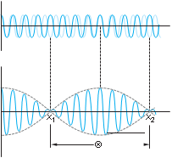

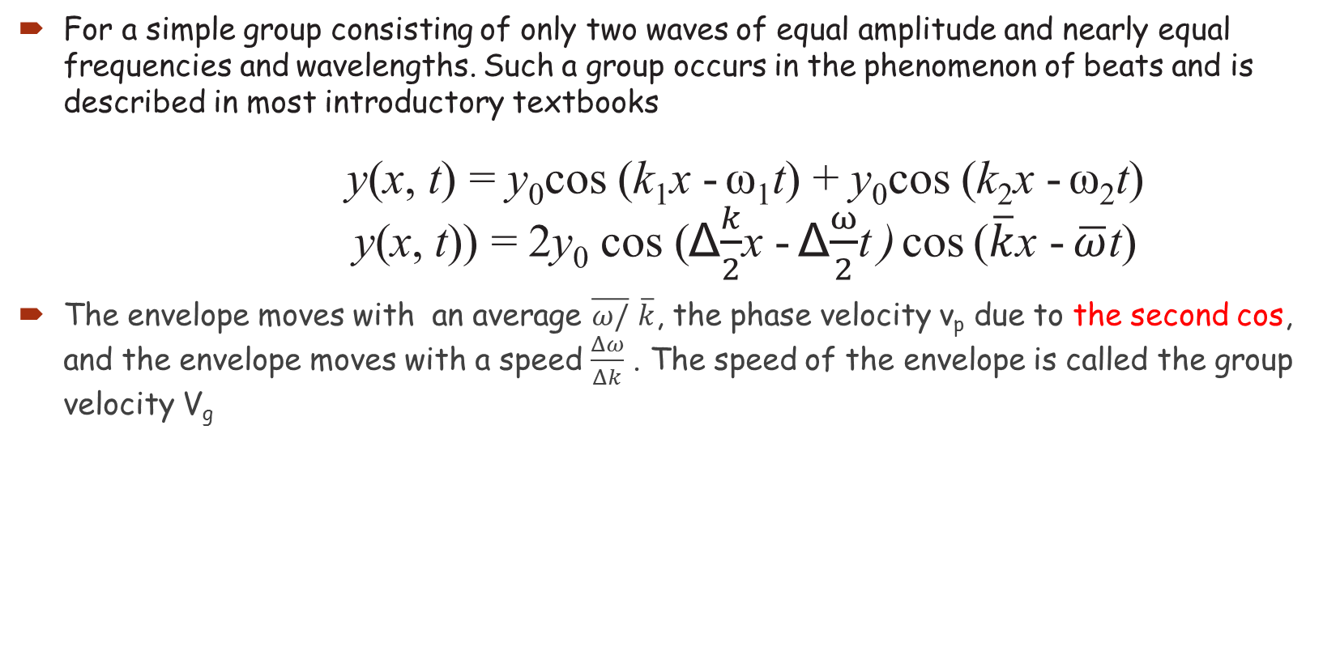
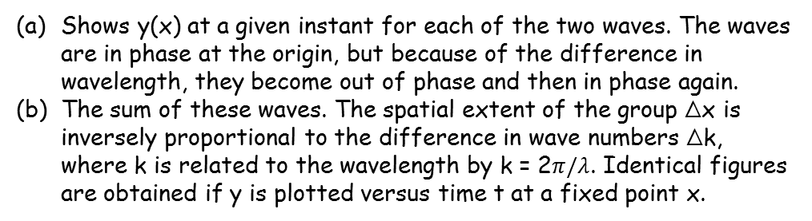
Wave Packets
For a simple group consisting of only two waves of equal amplitude and nearly equal frequencies and wavelengths. Such a group occurs in the phenomenon of beats and is described in most introductory textbooks
y(x, t) = y₀cos (k₁x - ω₁t) + y₀cos (k₂x - ω₂t)
y(x, t)) = 2y₀ cos (Δ$\frac{k}{2}$x - Δ$\frac{ω}{2}$t ) cos ($\overline{k}$x - $\overline{ω}$t)
The envelope moves with an average $\overline{ω/}$ $\overline{k}$, the phase velocity v_{p} due to the second cos, and the envelope moves with a speed $\frac{Δω}{Δk}$ . The speed of the envelope is called the group velocity V_{g}
(a)
Envelope of the two waves moving with v_{g}
Shows y(x) at a given instant for each of the two waves. The waves are in phase at the origin, but because of the difference in wavelength, they become out of phase and then in phase again.
The sum of these waves. The spatial extent of the group Δx is inversely proportional to the difference in wave numbers Δk, where k is related to the wavelength by k = 2$π/λ$. Identical figures are obtained if y is plotted versus time t at a fixed point x.
(b)
Δx
moving with v_{p}

Slide 7

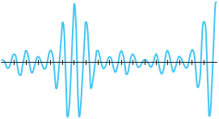




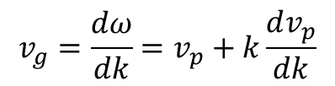





Wave packets
For several waves with different λ
20 $π$
$$π$$
The phase velocity of one harmonic wave
(a)
$$v_{p}=\frac{ω}{k}$$
$$π$$
y
The group velocity of the group packet
$$π$$
$$π$$
$$v_{g}=\frac{dω}{dk}=v_{p}+k\frac{dv_{p}}{dk}$$
(c)
$$π$$
x(units of 1/12)
(b)
$$y=\sum_{i}{y_{i}}$$
Graph of the amplitude
$$Δx=1/12$$
4π

Slide 8
Wave packets
If the phase velocity is the same for all frequencies and wavelengths, then dv_{p}/ dk = 0, and the group velocity is the same as the phase velocity.
A medium for which the phase velocity is the same for all frequencies is said to be nondispersive. Examples are waves on a perfectly flexible string, sound waves in air, and electromagnetic waves in a vacuum.
An important characteristic of a nondispersive medium is that, since all the harmonic waves making up a packet move with the same speed, the packet maintains its shape as it moves; thus, it does not change its shape in time.
if the phase velocity is different for different frequencies, the shape of the pulse will change as it travels. In that case the group velocity and phase velocity are not the same. Such a medium is called a dispersive medium; examples are water waves, waves on a wire that is not perfectly flexible, light waves in a medium such as glass or water in which the index of refraction has a slight dependence on frequency, and electron waves.

Slide 9
Classical Uncertainty Relations
Notice that the width of the group waves Δx of the superposition y(x, t₀) in Figure b is just a bit larger than 1/ 12. Similarly, the graph of the amplitude of these waves versus k has width Δk = 4π, which is a bit more than 12 (Figure c), so we see that
            Δk Δx ~ 1 and Δω Δt ~ 1 (Classical uncertainty)
The range of wavelengths or frequencies of the harmonic waves needed to form a wave packet depends on the extent in space and duration in time of the pulse.
In general, if the extent in space Δx is to be small, the range Δk of wave numbers must be large. Similarly, if the duration in time Δt is small, the range of frequencies Δω must be large.

Slide 10
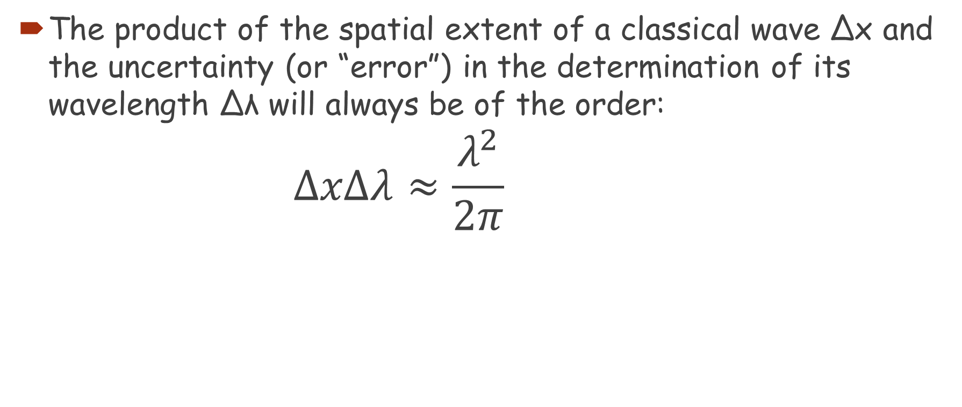
Classical Uncertainty Relations
The product of the spatial extent of a classical wave Δx and the uncertainty (or “error”) in the determination of its wavelength Δλ will always be of the order:
        $$ΔxΔλ≈\frac{λ^{2}}{2π}$$

Slide 11
Classical Uncertainty Relations
Problem 1: Δλ for Ocean Waves:
Standing in the middle of a 20-m-long pier, you notice that at any given instant there are 15 wave crests between the two ends of the pier. Estimate the minimum uncertainty in the wavelength that could be computed from this information.

Slide 12
Classical Uncertainty Relations
Problem 2: Frequency Control
The frequency of the alternating voltage produced at electric generating stations is carefully maintained at 60.00 Hz. The frequency is monitored on a digital frequency meter in the control room. For how long must the frequency be measured and how often can the display be updated if the reading is to be accurate to within 0.01 Hz?

Slide 13
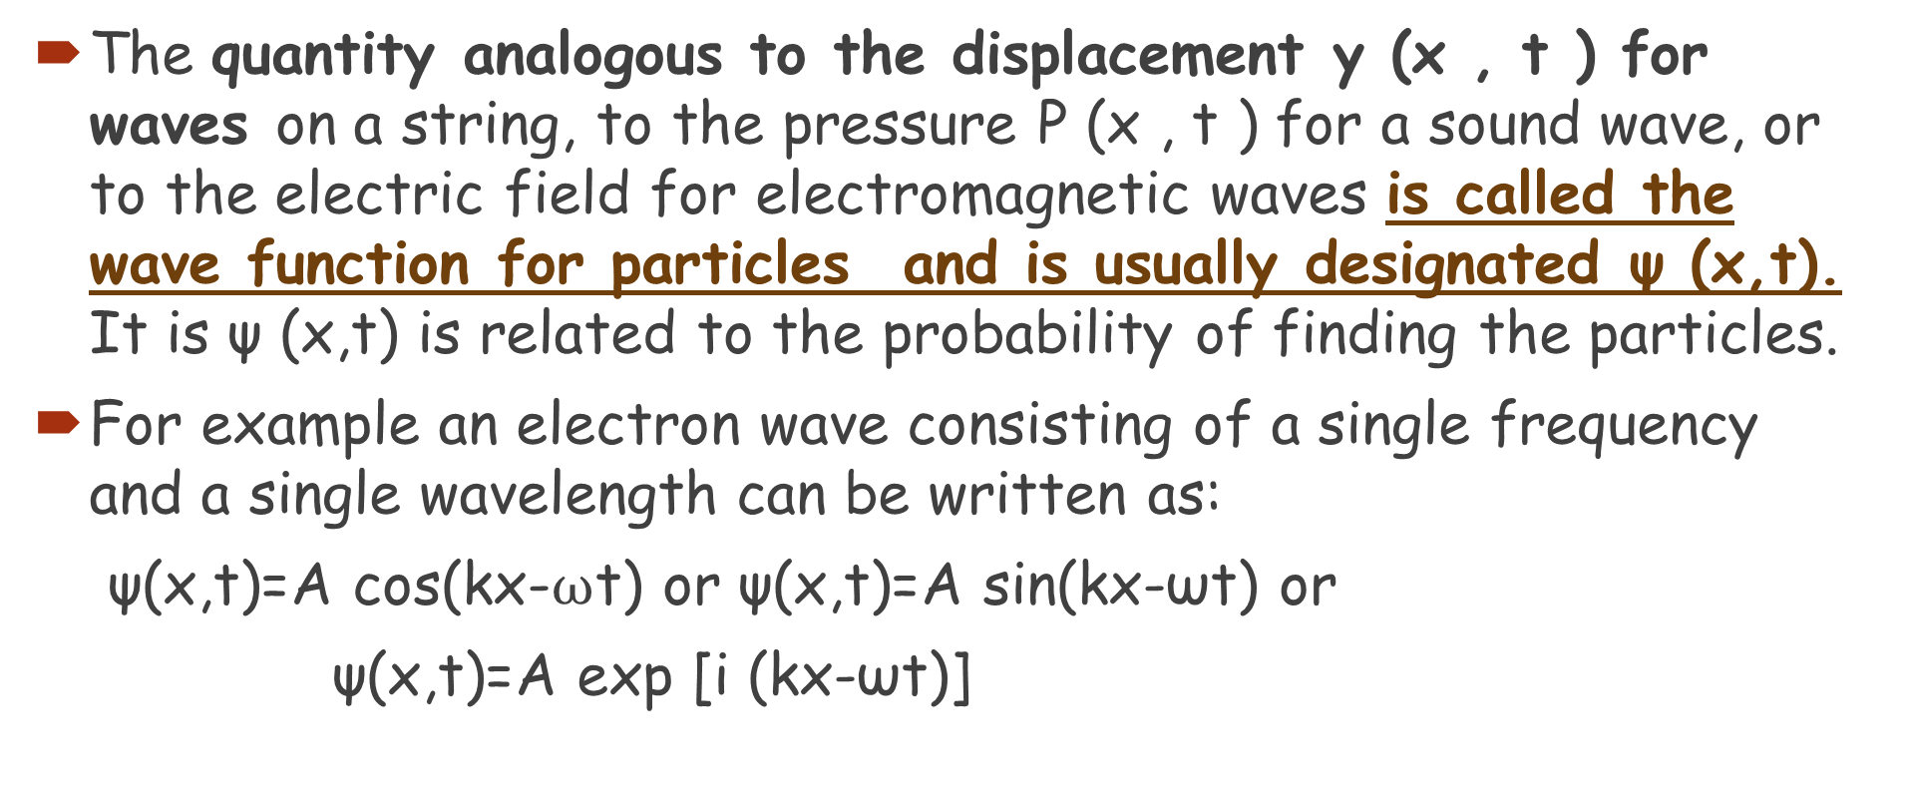
Particle Waves Packets
The quantity analogous to the displacement y (x , t ) for waves on a string, to the pressure P (x , t ) for a sound wave, or to the electric field for electromagnetic waves is called the wave function for particles and is usually designated ψ (x,t). It is ψ (x,t) is related to the probability of finding the particles.
For example an electron wave consisting of a single frequency and a single wavelength can be written as:
ψ(x,t)=A cos(kx-$ω$t) or ψ(x,t)=A sin(kx-ωt) or
ψ(x,t)=A exp [i (kx-ωt)]

Slide 14
Particle Waves Packets
The phase velocity for the wave v_{p} = fλ= (E/h) (h/p)=E/p
using the non-relativistic energy equation:
E= P²/2m and v_{p}= v/2 , v is the velocity of an electron with momentum p.
The phase velocity is not equal to the particle velocity.
A wave of a single frequency and wavelength is not localized but is spread throughout space, which makes it difficult to see how the particle and wave properties of the electron could be related.

Slide 15
Particle Waves Packets
Thus, for the electron to have the particle property of being localized, the matter waves of the electron must also be limited in spatial extent—i.e., realistically, ψ (x,t) must be a wave packet containing many more than one wave number k and frequency ω.
It is the wave packet ψ (x,t) that we expect to move at a group velocity equal to the particle velocity.
The wave packet ψ (x,t) moves with the velocity of the electron
v_{g}=v

Slide 16
Quantum Mechanics – A New Theory
Quantum mechanics incorporates wave-particle duality, and successfully explains energy states in complex atoms and molecules, the relative brightness of spectral lines, and many other phenomena.
It is widely accepted as being the fundamental theory underlying all physical processes.
Quantum mechanics is essential to understanding atoms and molecules, but can also have effects on larger scales.

Slide 17
The Wave Function and Its Interpretation; the Double-Slit Experiment
An electromagnetic wave has oscillating electric and magnetic fields. What is oscillating in a matter wave?
This role is played by the wave function, Ψ. The square of the wave function at any point is proportional to the number of electrons expected to be found there.
For a single electron, the wave function is the probability of finding the electron at that point.

Slide 18
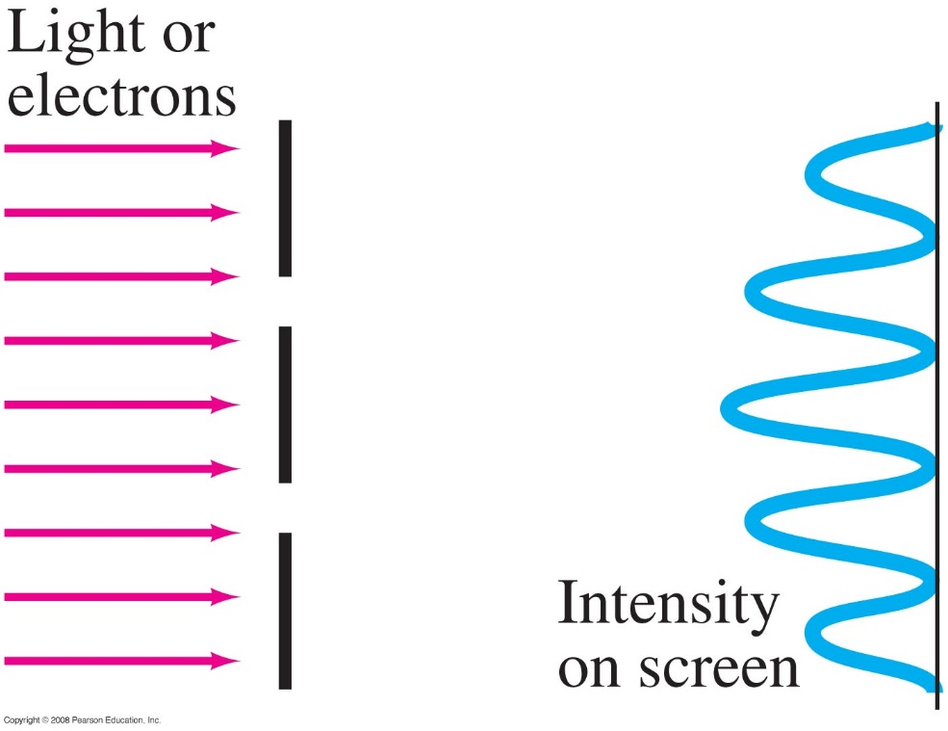
The Wave Function and Its Interpretation; the Double-Slit Experiment
For example: the interference pattern is observed after many electrons have gone through the slits. If we send the electrons through one at a time, we cannot predict the path any single electron will take, but we can predict the overall distribution.
Notes:
Figure 38-3. Parallel beam, of light or electrons, falls on two slits whose sizes are comparable to the wavelength. An interference pattern is observed.

Slide 19
The Probabilistic Interpretation of the Wave Function
(a)
(b)
If the film were to be observed at various stages, such as after being struck by 28 electrons, then after about 1000 electrons, and again after about 10,000 electrons, the patterns of individually exposed grains would be similar to those shown in (a), (b), and (c) except that the exposed dots would be smaller than the dots drawn here.
(d) The photo is an actual two-slit electron interference pattern in which
the film was exposed to millions of electrons.
(c)
(d)
The interaction of light with the detector or scintillator is a quantum phenomenon.

