Slide 1
Quantization of light, charge and energy
Chapter 2-Class5
Light carries energy :sun
How does light travel and in what form this energy is carried?
Energy can be carried by particles and waves: So does light travel as a stream of particles or as waves?

Slide 2

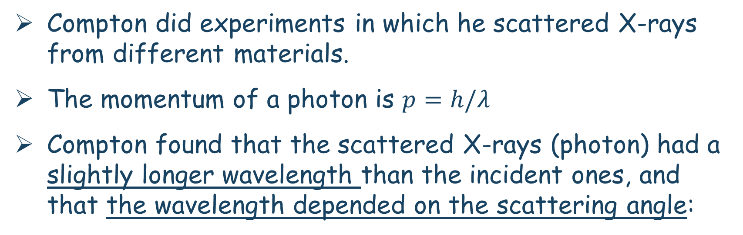
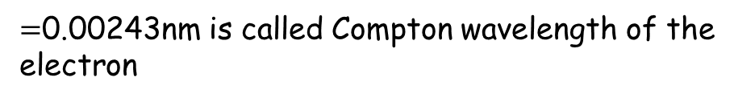
Compton Effect
Compton did experiments in which he scattered X-rays from different materials.
The momentum of a photon is $p=h/λ$
Compton found that the scattered X-rays (photon) had a slightly longer wavelength than the incident ones, and that the wavelength depended on the scattering angle:
$=$0.00243nm is called Compton wavelength of the
electron

Slide 3
Compton Effect: Example
Example: X-ray scattering.
X-rays of wavelength 0.140 nm are scattered from a very thin slice of carbon. What will be the wavelengths of X-rays scattered at (a) 0°, (b) 90°, and (c) 180°?
Notes:
Solution: Use the Compton scattering equation.
0.140 nm (no change)
0.142 nm
0.145 nm (the maximum)

Slide 4
Compton effect problem
Problem :In a particular Compton scattering experiment it is found that the incident wavelength λ is shifted by 1.5 percent when the scattering angle Φ = 120°. (a) What is the value of λ? (b) What will be the wavelength λ’ of the shifted photon when the scattering angle is 75°?

Slide 5
Compton effect problem
31. In the Compton effect, determine the ratio (∆λ/λ ) of the maximum change ∆λ in a photon’s wavelength to the photon’s initial wavelength λ if the photon is (a) a visible-light photon with λ=550nm (b) an X-ray photon with λ=0.10nm.

Slide 6
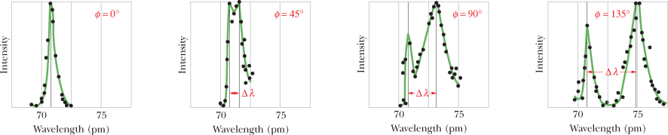

Compton Shift
Figure below shows results from Compton experiments. Although there is only a single wavelength of Molybdenum (λ = 0.740nm) in the incident x-ray beam, we see that the scattered x rays contain a range of wavelengths with two prominent intensity peaks. One peak is centered about the incident wavelength λ, the other about a wavelength λ ′ that is longer than λ by an amount Δλ, which is called the Compton shift. The value of the Compton shift varies with the angle at which the scattered x rays are detected and is greater for a greater angle.

Slide 7
Photon Interactions; Pair Production
Photons passing through matter can undergo the following interactions:
  Photoelectric effect: photon is completely absorbed, electron is ejected.
  Photon may be totally absorbed by electron, but not have enough energy to eject it; the electron moves into an excited state.
  The photon can scatter from an atom and lose some energy.
  The photon can produce an electron–positron pair.

Slide 8
Pair Production
In August 1932, Anderson recorded the historic photograph of a positively charged electron (now known as a positron) passing through the lead plate in the cloud chamber. It was definitely a positively charged particle, and it was traveling upwards.
His discovery get Anderson a Nobel Prize in Physics in 1936, at the age of 31—the youngest person to be so honored.
Anderson was studying the effects of Cosmic rays, when he noticed something behaving like an electron but of positive charge.
The positively charged electron was termed the Positron.
High energy photons are constantly creating positron all around us through pair-production.

Slide 9
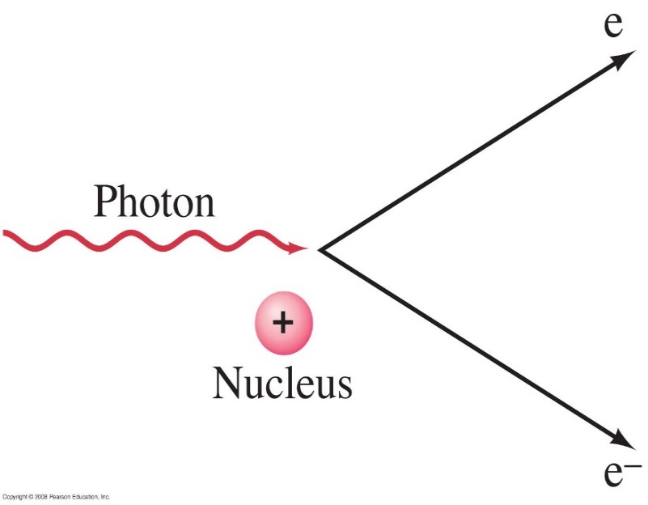
Pair Production
In pair production, energy, electric charge, and momentum must all be conserved.
Energy will be conserved through the mass and kinetic energy of the electron and positron; their opposite charges conserve charge; and the interaction must take place in the electromagnetic field of a nucleus, which can contribute momentum:
E=K+mc²
In pair production of an electron-positron, the photon create matter: mass is created from pure Energy (Einstein equation E=mc²)
The photon does not slow down and travels at cf which is < loss of energy.
Notes:
Figure 37-9. Pair production: a photon disappears and produces an electron and a positron.

Slide 10
Pair Production
An electron by itself cannot be created since the charge would not be conserved (e-, p+)
If the electron collides with a positron, they annihilate: energy and mass appears as EM energy of photons and the positron does not last too long because of that.
The positron is antimatter.
Positron life is short and its end is dramatic
It quickly finds an electron-any will do, and after a brief quantum dance, they annihilate together: erased, their entire energy suddenly transformed to two photons.
The process is called pair annihilation.

Slide 11
Pair Production
Example 1: Pair production.
(a) What is the minimum energy of a photon that can produce an electron–positron pair? (b) What is this photon’s wavelength?
Notes:
Solution: a. The photon must have energy equal to twice the electron mass, or 1.02 MeV.
b. λ = hc/E = 1.2 x 10⁻¹² m. This is a gamma-ray photon.

Slide 12

Complementarity
Sometimes photons behave like waves, and sometimes like particles, but never both at the same time.
According to Bohr, particle or wave are just classical concepts, used to describe the different behaviors of quanta under different circumstances.
Neither concept by itself can completely describe the behavior of quantum systems.
Contraria
sunt
Complementa
Latin for:
opposites
are
complements

Slide 13
Complementarity
Depending on the context, complementarity can refer to:
The mental picture we have of a physical system.
(particle vs. wave )
What an experiment can reveal.
(which-path vs. interference)
What quantum mechanics allows us to know.
(position vs. momentum)

Slide 14
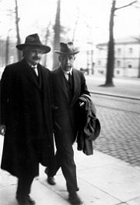
Properties of Matter Waves-
Chapter 3-Class1
“The most incomprehensible thing about the world is that it is comprehensible.”
– Albert Einstein

Slide 15
Chapter 3: Properties of Matter Waves
We have phenomena such as interference that show that light is a wave, and phenomena such as the photoelectric effect and the Compton effect that show that it is a particle.
Which is it?
we must accept the dual wave–particle nature of light.

Slide 16
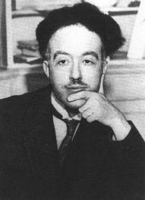
Matter Waves
As a doctoral student (1923), Louis de Broglie proposed in his dissertation, that dual behavior of light was also characteristic of matter, in particular electrons.
That is : electrons might also behave like waves.
  Light, often thought of as a wave, had been shown to have particle-like properties.
  For photons, we know how to relate momentum to wavelength:
From the photoelectric effect:
From special relativity:
Combined:

Slide 17
Matter Waves
De Broglie described it with these words:
After the end of World War 1, I gave a great deal of thought to the theory of quanta and to the wave-particle dualism. It was then that I had a sudden inspiration. Einstein’s wave-particle dualism was an absolutely general phenomenon extending to all physical nature.
Since the visible universe consists entirely of matter and radiation, de Broglie’s
hypothesis is a fundamental statement about the grand symmetry of nature. (There is currently strong observational evidence that ordinary matter makes up only about 4 percent of the visible universe. About 22 percent is some unknown form of invisible “dark matter,” and approximately 74 percent consists of some sort of equally mysterious “dark energy”)

Slide 18
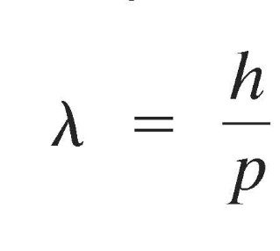
Properties of Matter Waves
Just as light sometimes behaves like a particle, matter sometimes behaves like a wave.
The wavelength of the matter proposed by Louis de Broglie (Nobel price 1929) is
.
This wavelength is extraordinarily small. And was confirmed even for relativistic speeds by experiments such crystal diffraction.

Slide 19
Davisson-Germer Experiment
In a brief note in the August 14, 1925, issue of the journal (Naturwissenschaften), Walter Elsasser, at the time a student of J. Franck’s (of the Franck-Hertz experiment), proposed that the wave effects of low-velocity electrons might be detected by scattering them from single crystals.
The first such measurements of the wavelengths of electrons were made in 1927 by C. J. Davisson and L. H. Germer, who were studying electron reflection from a nickel target at Bell Telephone Laboratories, unaware of either Elsasser’s suggestion or De Broglie’s work.
After heating their target to remove an oxide coating that had accumulated during an accidental break in their vacuum system, they found that the scattered electron intensity as a function of the scattering angle showed maxima and minima. The surface atoms of their nickel target had, in the process of cooling, formed relatively large single crystals, and they were observing electron diffraction (wave nature of the electron).
Recognizing the importance of their accidental discovery, they then prepared a target consisting of a single crystal of nickel and extensively investigated the scattering of electrons from it.

Slide 20
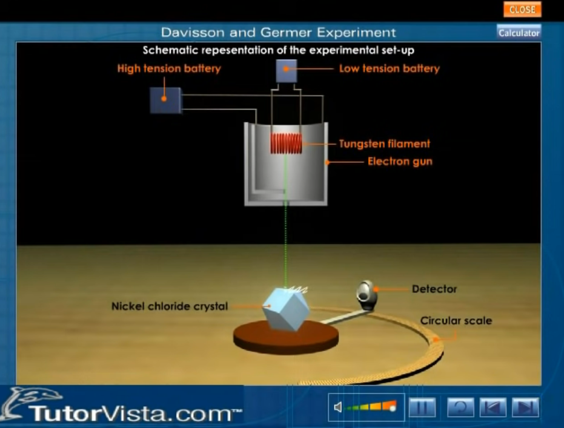
Davisson-Germer Experiment
https://www.youtube.com/watch?v=Ho7K27B_Uu8

Slide 21
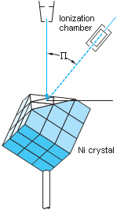
Davisson-Germer Experiment
Electron gun
φ=0º
φ
φ=50º
Detector angle
φ=90º
Scattered intensity vs. detector angle for 54-eV electrons.
Polar plot of the data. The intensity at each angle is indicated by the
distance of the point from the origin. Scattering angle φ is plotted clockwise starting at the vertical axes.
(b) The same data plotted on a Cartesian graph.
The intensity scales are arbitrary but the same on both graphs. In each plot there is maximum intensity at φ = 50°, as predicted for Bragg scattering of waves having wavelength λ=h/p.
The Davisson- Germer experiment.
Low-energy electrons scattered at angle φ from
a nickel crystal are detected in an ionization chamber. The kinetic energy of the electrons could be varied by changing the accelerating voltage on the electron gun

Slide 22
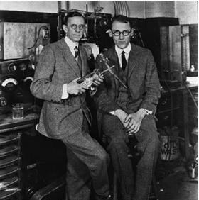
Davisson-Germer Experiment
Incident beam
ϕ = 2α
Intense reflected beam
α
D
α
Scattering of electrons by a crystal.
Electron waves are strongly scattered if the Bragg condition nλ = 2d sinθ is met. This is equivalent to the condition
nλ = D sin φ
α
d
θ
θ

Slide 23
Wave Nature of Matter
Example 2: Wavelength of a ball.
Calculate the de Broglie wavelength of a 0.20-kg ball moving with a speed of 15 m/s.
Notes:
Solution: λ = h/p = 2.2 x 10⁻³⁴ m.

Slide 24
Wave Nature of Matter
Example 3: Wavelength of an electron.
Determine the wavelength of an electron that has been accelerated through a potential difference of 100 V.
Notes:
Solution: The kinetic energy of the electron is classical. Its speed is found from conservation of energy: ½ mv² = eV, so v = 5.9 x 10⁶ m/s. The wavelength is then h/p = 1.2 x 10⁻¹⁰ m; roughly the size of an atom.

Slide 25
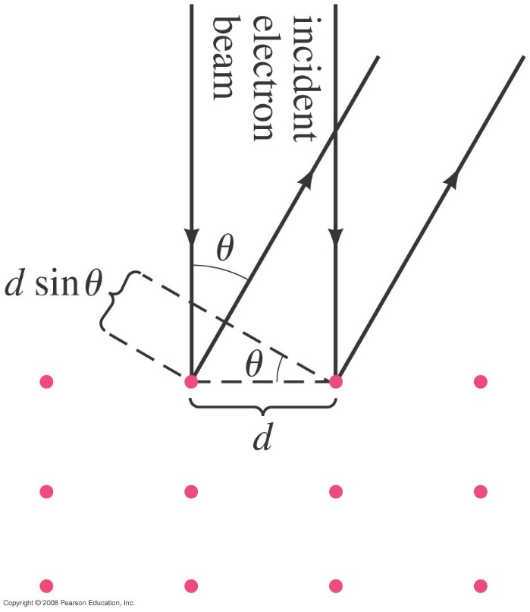
Wave Nature of Matter
Example 4: Electron diffraction.
The wave nature of electrons is manifested in experiments where an electron beam interacts with the atoms on the surface of a solid. By studying the angular distribution of the diffracted electrons, one can indirectly measure the geometrical arrangement of atoms. Assume that the electrons strike perpendicular to the surface of a solid, and that their energy is low, K = 100 eV, so that they interact only with the surface layer of atoms. If the smallest angle at which a diffraction maximum occurs is at 24°, what is the separation d between the atoms on the surface?
Notes:
Figure 37-12. Example 37–12. The red dots represent atoms in an orderly array in a solid.
Solution: The smallest angle will occur when d sin θ = λ. The electrons are not relativistic, so the wavelength can be found from the kinetic energy: λ = 0.123 nm. Then the spacing is λ/sin θ = 0.30 nm.

Slide 26
De Broglie Wavelength of a Slow Electron
Example5:
Compute the de Broglie wavelength of an electron whose kinetic energy is 10 eV.

Slide 27
Matter Waves
The wave nature of matter becomes more important for very light particles such as the electron.
Electron wavelengths can easily be on the order of 10⁻¹⁰ m; electrons can be diffracted by crystals just as X-rays can.

Slide 28
Real world Examples: Electron Microscopes
The wavelength of electrons will vary with energy, but is still quite short. This makes electrons useful for imaging – remember that the smallest object that can be resolved is about one wavelength. Electrons used in electron microscopes have wavelengths of about 0.004 nm.

Slide 29
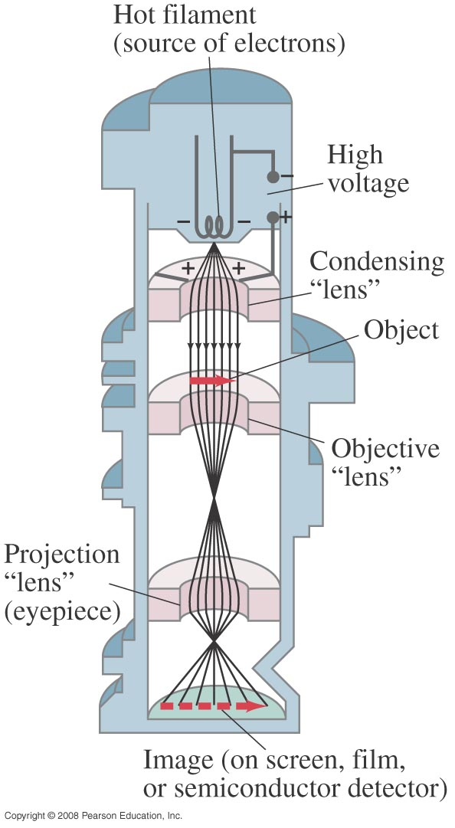
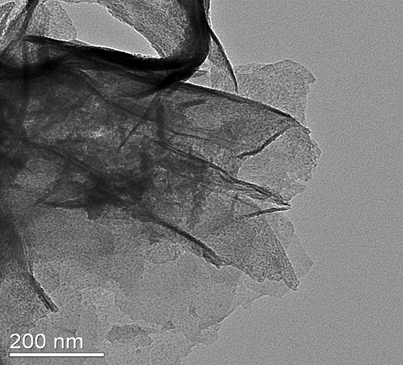
Transmission Electron Microscopes
Transmission electron microscope – the electrons are focused by magnetic coils.
Transmission electron microscopes produce 2 D images.
Current are produced by current carrying coils
Electrons are accelerated by voltages of about 10⁵ V, and have a wavelength of 0.004nm.
Magnetic fields
Notes:
Figure 37-13. Transmission electron microscope. The magnetic field coils are designed to be “magnetic lenses,” which bend the electron paths and bring them to a focus, as shown.

Slide 30
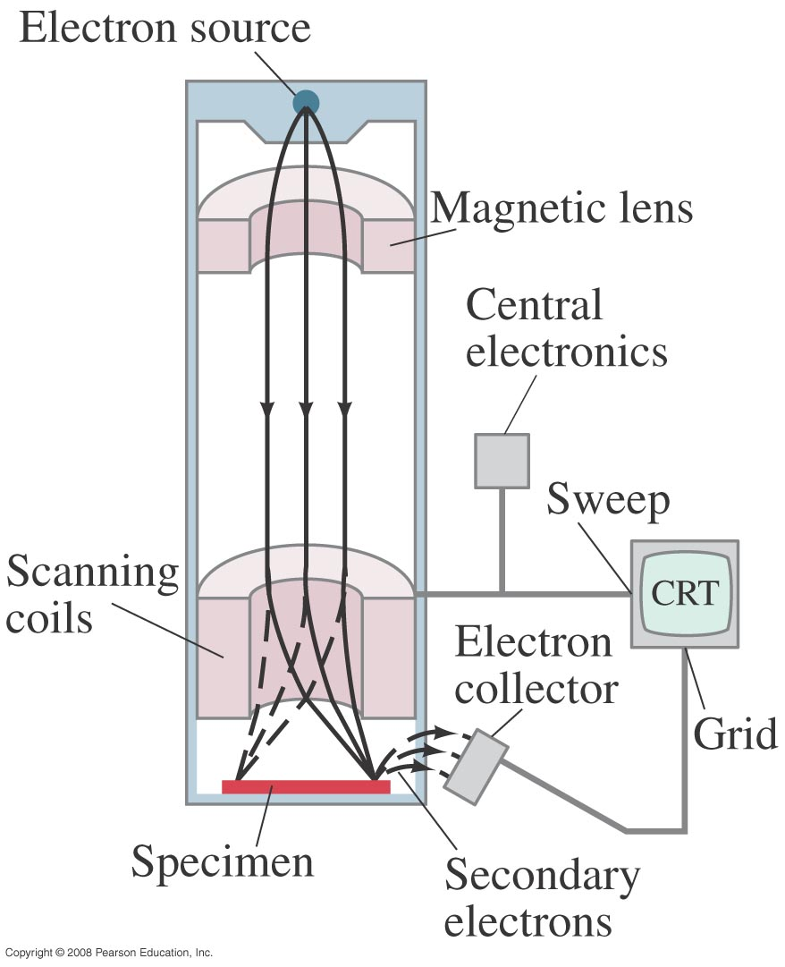
Scanning Electron Microscopes
Scanning electron microscope – the electron beam is scanned back and forth across the object to be imaged.
Scanning electron microscope produce 3D images
Electron are accelerated by voltages of 10⁵V.
The resolution is on the order of the wavelength (0.1-0.5nm).
Notes:
Figure 37-14. Scanning electron microscope. Scanning coils move an electron beam back and forth across the specimen. Secondary electrons produced when the beam strikes the specimen are collected and modulate the intensity of the beam in the CRT to produce a picture.

Slide 31
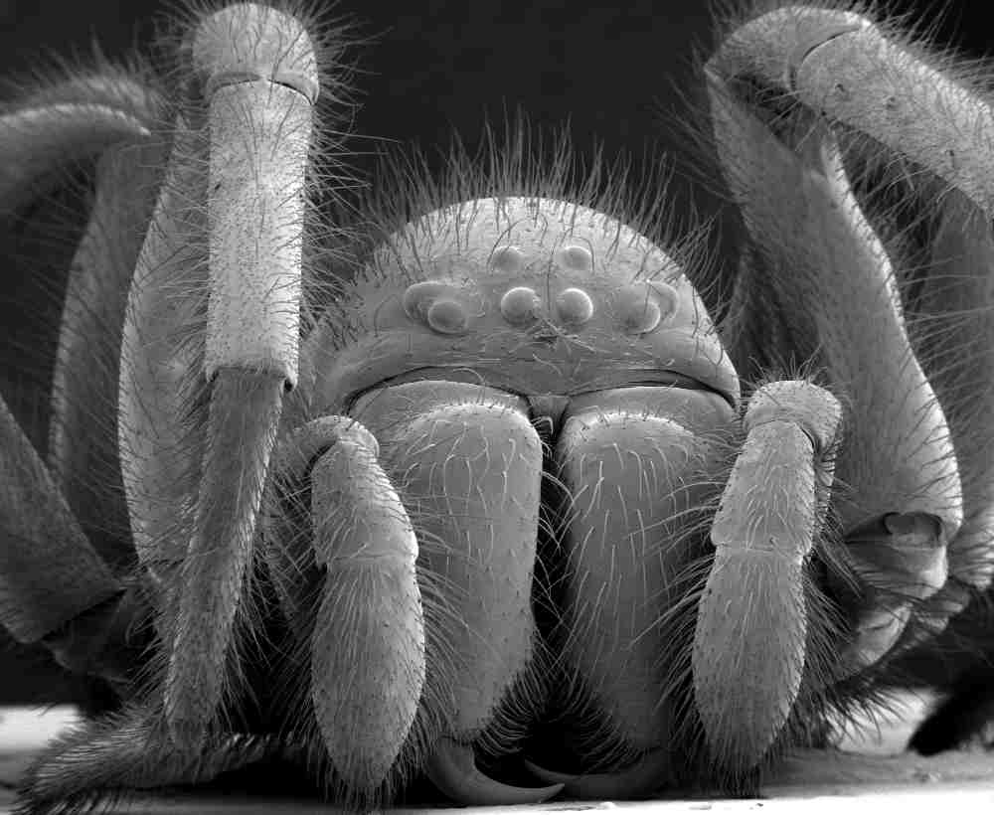
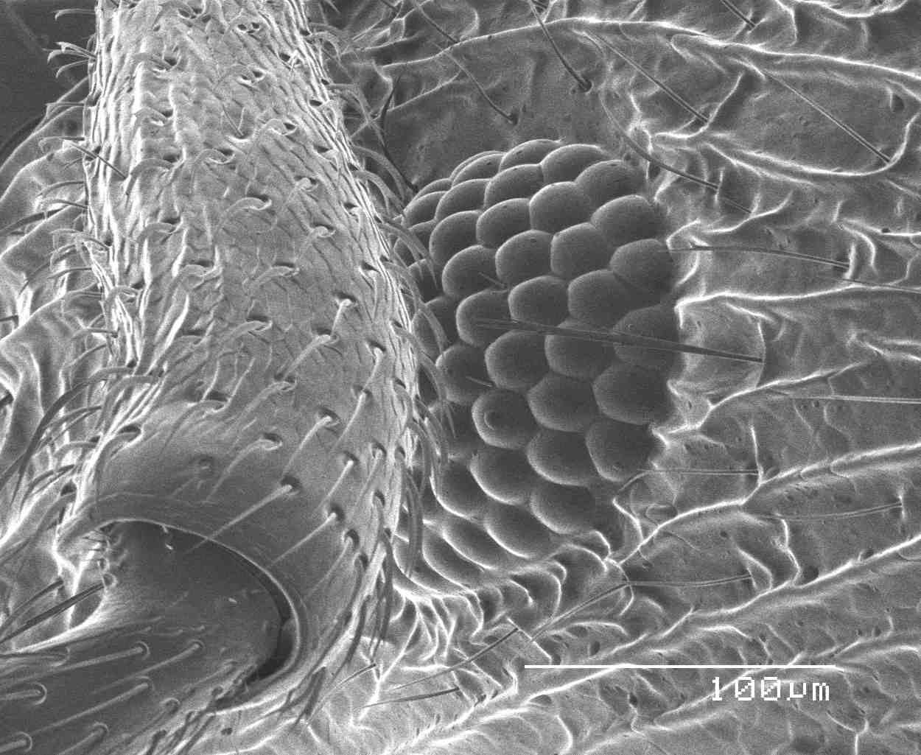
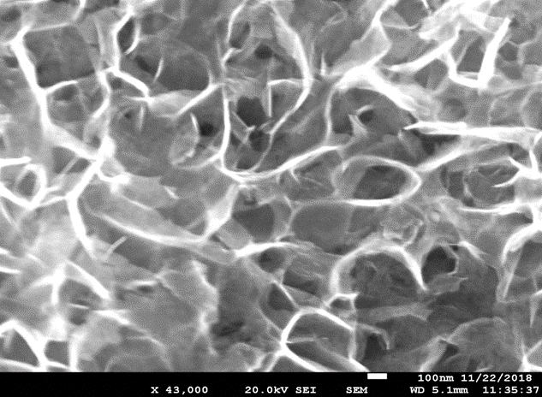
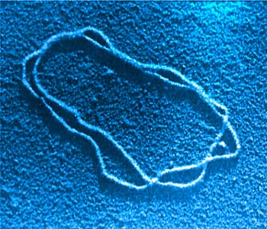
Electron Microscopy
Use electron waves just like light waves:
Ant’s Eye
Tiny Spider
Ni₃(HITP)₂ Nanosheets
DNA Molecule

Slide 32
Diffraction of Other Particles
The wave properties of neutral atoms and molecules were first demonstrated by O. Stern and I. Estermann in 1930 with beams of helium atoms and hydrogen molecules diffracted from a lithium fluoride crystal. Since the particles are neutral, there is no possibility of accelerating them with electrostatic potentials.
The energy of the molecules was that of their average thermal motion, about 0.03 eV, which implies a de Broglie wavelength of about 0.10 nm for these molecules.
Because of their low energy, the scattering occurs just from the array of atoms on the surface of the crystal, in contrast to Davisson and Germer’s experiment

Slide 33
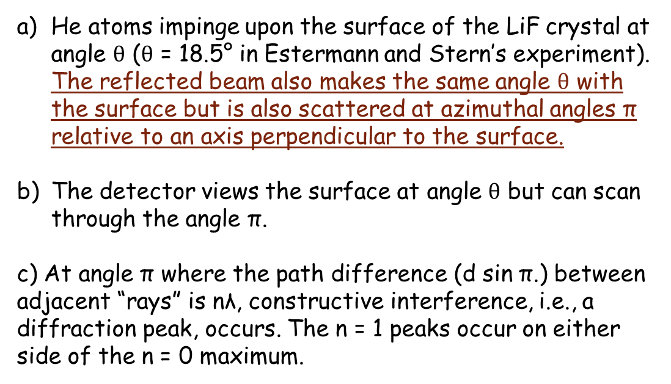




Diffraction of Other Particles
He atoms impinge upon the surface of the LiF crystal at angle $θ$ ($θ$ = 18.5° in Estermann and Stern’s experiment). The reflected beam also makes the same angle $θ$ with the surface but is also scattered at azimuthal angles π relative to an axis perpendicular to the surface.
The detector views the surface at angle $θ$ but can scan through the angle π.
c) At angle π where the path difference (d sin π.) between adjacent “rays” is nλ, constructive interference, i.e., a diffraction peak, occurs. The n = 1 peaks occur on either side of the n = 0 maximum.
$$θ$$
$$θ$$
$$θ$$
$$θ$$

Slide 34
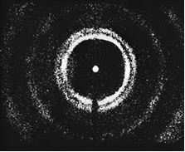
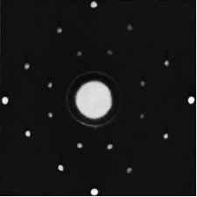
Diffraction of Other Particles
Neutron Laue pattern of NaCl. Compare this with the x-ray Laue pattern [Courtesy of E. O. Wollan and C. G. Shull.]
Diffraction pattern produced by 0.0568-eV neutrons (de Broglie wavelength of 0.120 nm) and a target of polycrystalline copper. Note the similarity in the patterns produced by x rays, electrons, and neutrons. [Courtesy of C. G. Shull.]

Slide 35
Problems
41. What is the wavelength of a neutron traveling at 8.5X10⁴m/s
42. Through how many volts of potential difference must an electron be accelerated to achieve a wavelength of 0.21 nm?
44. The speed of an electron in a particle accelerator is 0.98c. Find its de Broglie wavelength. (Use relativistic momentum.)

Slide 36
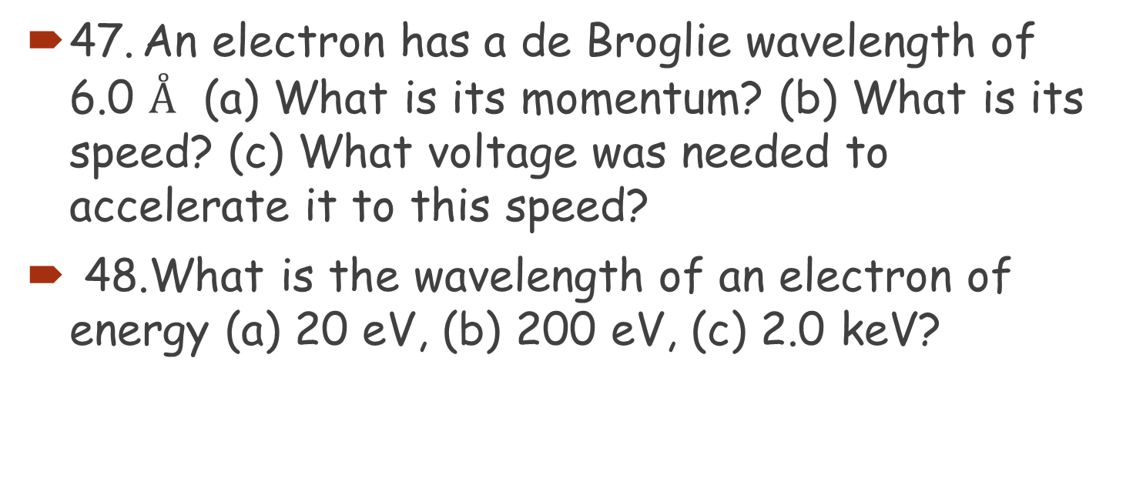
Problems
47. An electron has a de Broglie wavelength of 6.0 $Å$ (a) What is its momentum? (b) What is its speed? (c) What voltage was needed to accelerate it to this speed?
48.What is the wavelength of an electron of energy (a) 20 eV, (b) 200 eV, (c) 2.0 keV?

Slide 37
Electron Microscope- Problems
*52. What voltage is needed to produce electron wavelengths of 0.28 nm? (Assume that the electrons are nonrelativistic.)
*53. Electrons are accelerated by 3450 V in an electron microscope. Estimate the maximum possible resolution of the microscope.

