Slide 1
Quantization of light, charge and energy Chapter 2-Class5
Light carries energy :sun
How does light travel and in what form this energy is carried?
Energy can be carried by particles and waves: So does light travel as a stream of particles or as waves?

Slide 2
Mosley Law
https://www.youtube.com/watch?v=SGBt7uTR0D4

Slide 3
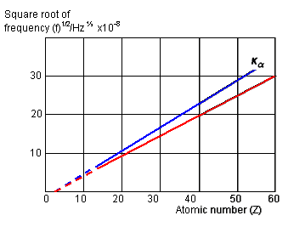
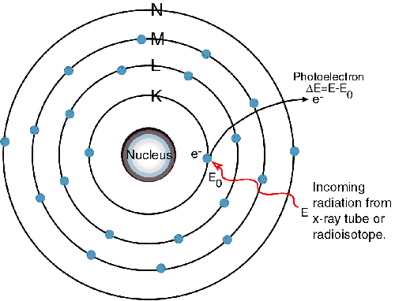
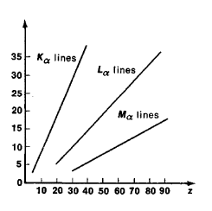
Moseley’s Law
Electrons falling to the lowest level (or K-shell) in the atom from other excited levels give out X-rays in a series of wavelengths like an optical spectrum. This is known as the K-series, and individual lines are denoted by K_{α}, K_{β} and so on. Electron transitions ending on the second level are known as the L-series. Changed the periodic table
In 1914 Moseley proposed a law showing how the X-ray frequency can be related to the proton (atomic) number Z of the target material. If f is the X-ray frequency, then:
X ray frequency (f) = k(Z- b)²
b = 1, for K series and b = 7.4 for L series

Slide 4
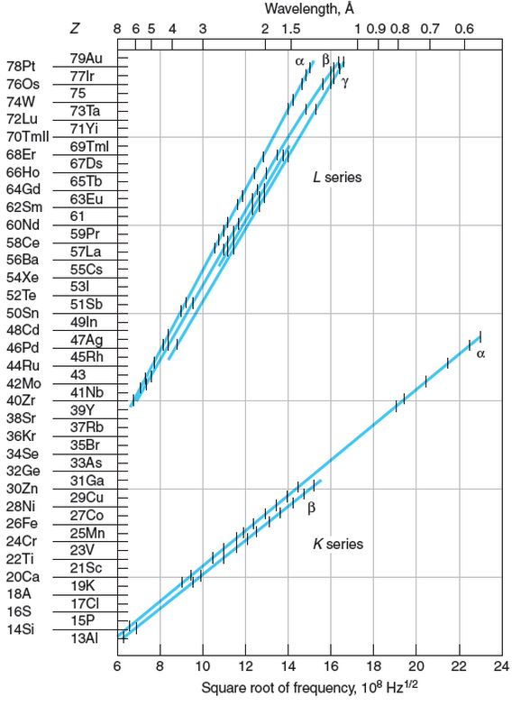
Moseley’s Plots
X ray frequency: f = k(Z- b)²
$$f\left(k_{α}\right)=3.29×{10}^{15}×\frac{3}{4}{(z−b)}^{2}$$
$$f\left(L_{α}\right)=3.29×{10}^{15}×\frac{5}{36}{(z−b)}^{2}$$
Pb1. The wavelength of the K_{α} x-ray line for an element is measured to be 0.794 Å. What is the element?
The element is ⁴²Mo from the graph

Slide 5
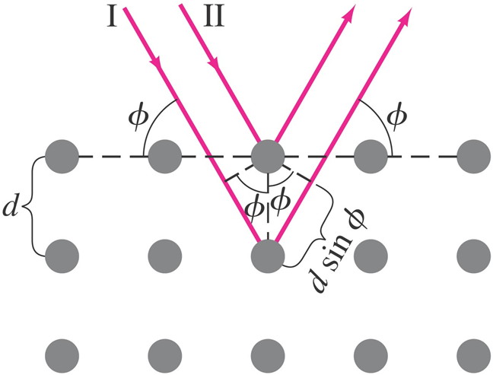
Problem
49. X-rays of wavelength 0.138 nm fall on a crystal whose atoms, lying in planes, are spaced 0.285 nm apart. At what angle Φ (relative to the surface, Fig. on the right) must the X-rays be directed if the first diffraction maximum is to be observed?

Slide 6
Problem
50. (II) First-order Bragg diffraction is observed at 26.8° relative to the crystal surface, with spacing between atoms of 0.24 nm. (a) At what angle will second order be observed? (b) What is the wavelength of the X-rays?

Slide 7
Compton effect
https://www.youtube.com/watch?v=rGy7nsC8O_Y

Slide 8
Compton effect
The Compton effect (also called Compton scattering) is the result of a high-energy photon (x-rays) colliding with a target, which releases loosely bound electrons from the outer shell of the atom or molecule.
The effect was first demonstrated in 1923 by Arthur Holly Compton (for which he received a 1927 Nobel Prize in Physics). Compton's graduate student, Y.H. Woo, later verified the effect.

Slide 9
Compton Effect
Compton pointed out that if the scattering process were considered a “collision” between a photon of energy hf₁ and an electron, the recoiling electron would absorb part of the incident photon’s energy.
The energy hf₂ of the scattered photon would be less than the incident one and thus of lower frequency f₂ .
Compton applied the laws of conservation of momentum and energy in their relativistic form to the collision of a photon with an isolated electron to obtain the change in the wavelength λ of the photon as a function of the scattering angle Φ.

Slide 10
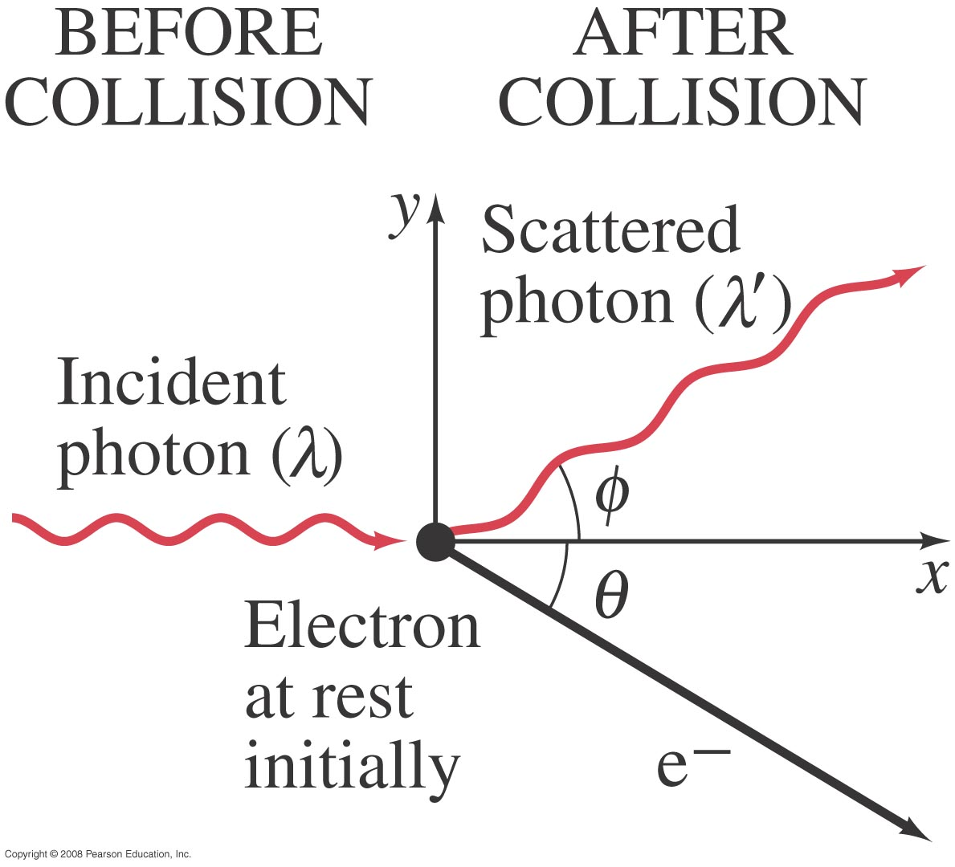
Compton Effect
This is another effect that is correctly predicted by the photon (Particle) model and not by the wave model.
A single photon of wavelength λ strikes an electron in some material, knocking it out of its atom. The scattered photon has less energy (some energy is given to the electron) and hence has a longer wavelength λ’
Notes:
The Compton effect. A single photon of wavelength λ strikes an electron in some material, knocking it out of its atom. The scattered photon has less energy (some energy is given to the electron) and hence has a longer wavelength λ’.

Slide 11
Compton Effect
Compton did experiments in which he scattered X-rays from different materials.
The momentum of a photon is $p=h/λ$
Compton found that the scattered X-rays (photon) had a slightly longer wavelength than the incident ones, and that the wavelength depended on the scattering angle:
$=$0.00243nm is called Compton wavelength of the
electron

Slide 12
Compton Effect: Example
Example: X-ray scattering.
X-rays of wavelength 0.140 nm are scattered from a very thin slice of carbon. What will be the wavelengths of X-rays scattered at (a) 0°, (b) 90°, and (c) 180°?
Notes:
Solution: Use the Compton scattering equation.
0.140 nm (no change)
0.142 nm
0.145 nm (the maximum)

Slide 13
Compton effect problem
Problem :In a particular Compton scattering experiment it is found that the incident wavelength λ is shifted by 1.5 percent when the scattering angle Φ = 120°. (a) What is the value of λ? (b) What will be the wavelength λ’ of the shifted photon when the scattering angle is 75°?

Slide 14
Compton effect problem
31. In the Compton effect, determine the ratio (∆λ/λ ) of the maximum change ∆λ in a photon’s wavelength to the photon’s initial wavelength λ if the photon is (a) a visible-light photon with λ=550nm (b) an X-ray photon with λ=0.10nm.

Slide 15
Compton Shift
Figure below shows results from Compton experiments. Although there is only a single wavelength of Molybdenum (λ = 0.740nm) in the incident x-ray beam, we see that the scattered x rays contain a range of wavelengths with two prominent intensity peaks. One peak is centered about the incident wavelength λ, the other about a wavelength λ ′ that is longer than λ by an amount Δλ, which is called the Compton shift. The value of the Compton shift varies with the angle at which the scattered x rays are detected and is greater for a greater angle.

Slide 16
Photon Interactions; Pair Production
Photons passing through matter can undergo the following interactions:
Photoelectric effect: photon is completely absorbed, electron is ejected.
Photon may be totally absorbed by electron, but not have enough energy to eject it; the electron moves into an excited state.
The photon can scatter from an atom and lose some energy.
The photon can produce an electron–positron pair.

Slide 17
Pair Production
In August 1932, Anderson recorded the historic photograph of a positively charged electron (now known as a positron) passing through the lead plate in the cloud chamber. It was definitely a positively charged particle, and it was traveling upwards.
His discovery get Anderson a Nobel Prize in Physics in 1936, at the age of 31—the youngest person to be so honored.
Anderson was studying the effects of Cosmic rays, when he noticed something behaving like an electron but of positive charge.
The positively charged electron was termed the Positron.
High energy photons are constantly creating positron all around us through pair-production.

Slide 18
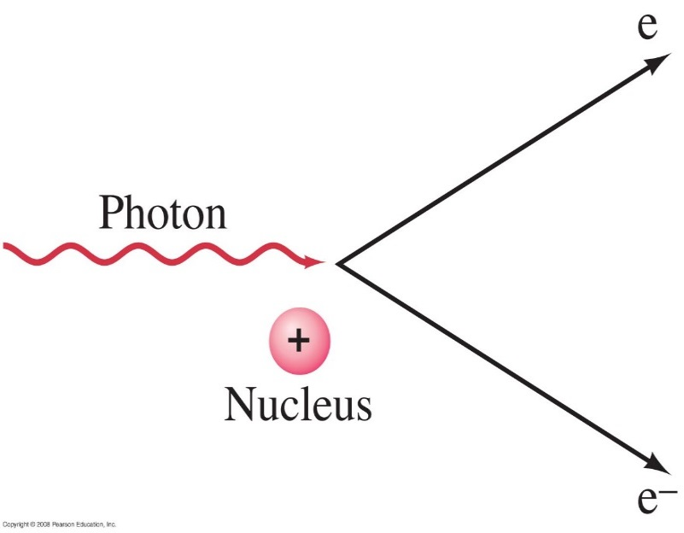
Pair Production
In pair production, energy, electric charge, and momentum must all be conserved.
Energy will be conserved through the mass and kinetic energy of the electron and positron; their opposite charges conserve charge; and the interaction must take place in the electromagnetic field of a nucleus, which can contribute momentum:
E=K+mc²
In pair production of an electron-positron, the photon create matter: mass is created from pure Energy (Einstein equation E=mc²)
The photon does not slow down and travels at cf which is < loss of energy.
Notes:
Figure 37-9. Pair production: a photon disappears and produces an electron and a positron.

Slide 19
Pair Production
An electron by itself cannot be created since the charge would not be conserved (e-, p+)
If the electron collides with a positron, they annihilate: energy and mass appears as EM energy of photons and the positron does not last too long because of that.
The positron is antimatter.
Positron life is short and its end is dramatic
It quickly finds an electron-any will do, and after a brief quantum dance, they annihilate together: erased, their entire energy suddenly transformed to two photons.
The process is called pair annihilation.

Slide 20
Pair Production
Example 1: Pair production.
(a) What is the minimum energy of a photon that can produce an electron–positron pair? (b) What is this photon’s wavelength?
Notes:
Solution: a. The photon must have energy equal to twice the electron mass, or 1.02 MeV.
b. λ = hc/E = 1.2 x 10⁻¹² m. This is a gamma-ray photon.

Slide 21
Complementarity
Sometimes photons behave like waves, and sometimes like particles, but never both at the same time.
According to Bohr, particle or wave are just classical concepts, used to describe the different behaviors of quanta under different circumstances.
Neither concept by itself can completely describe the behavior of quantum systems.
Contraria
sunt
Complementa
Latin for:
opposites
are
complements

Slide 22
Complementarity
Depending on the context, complementarity can refer to:
The mental picture we have of a physical system.
(particle vs. wave )
What an experiment can reveal.
(which-path vs. interference)
What quantum mechanics allows us to know.
(position vs. momentum)

